Slide 1

StarDICE status overview
LSST-France
LPSC June 08th 2023

Slide 2
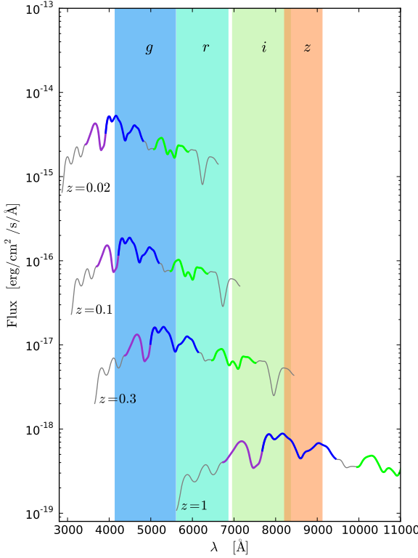
Providing flux references for Supernovae distances
Apparent flux of supernovae at different redshifts gives a noisy (~7%) measurement of distance -> Hubble diaggram
VRO will provide thousands of SNe to beat this noise
All SNe at a given redshift share one noise in common : The error on the survey passbands
Large survey needs exquisite calibration references (standard stars)
The goal of StarDICE is to provide such standards

Slide 3
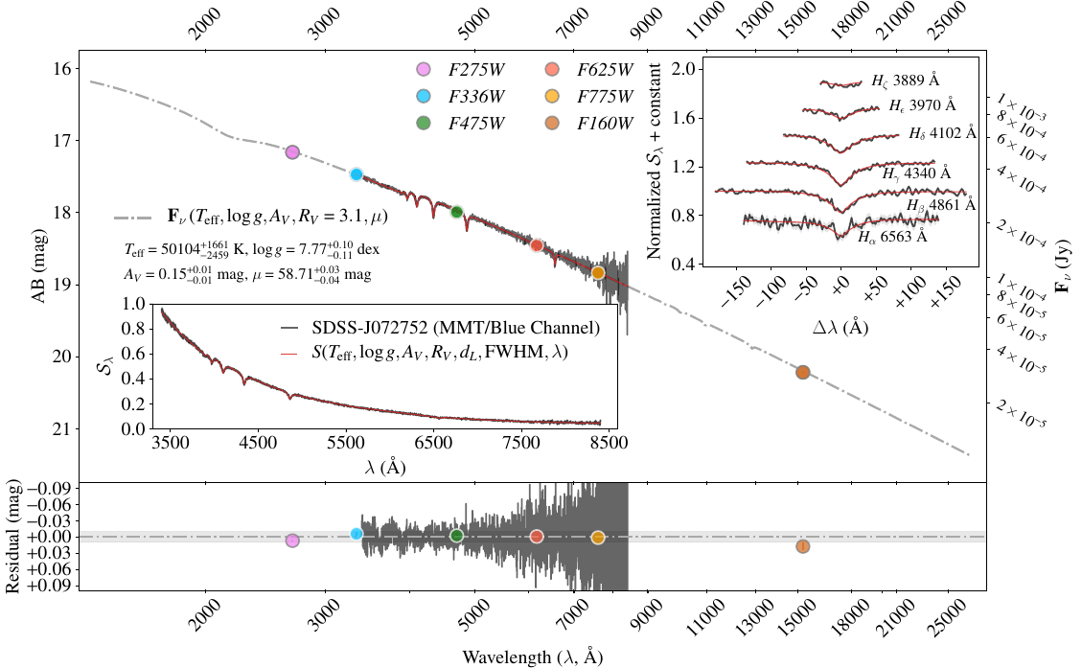
The only practical references to date are pure hydrogen WD
Numerical model of the radiative transfer in the hydrogen atmosphere
Model parameters infered from measurement of H profile in high-resolution spectrosopy
Largest implementation to date : The cosmic flux standards program (Narayan et al. 2022)
The proposal of the StarDICE experiment is to build an instrumental check of this model

Slide 4
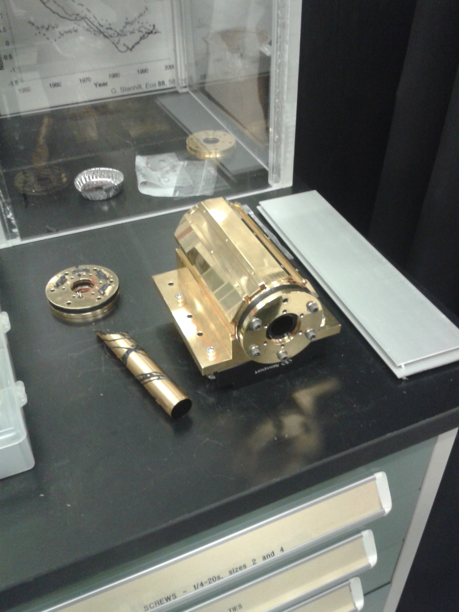
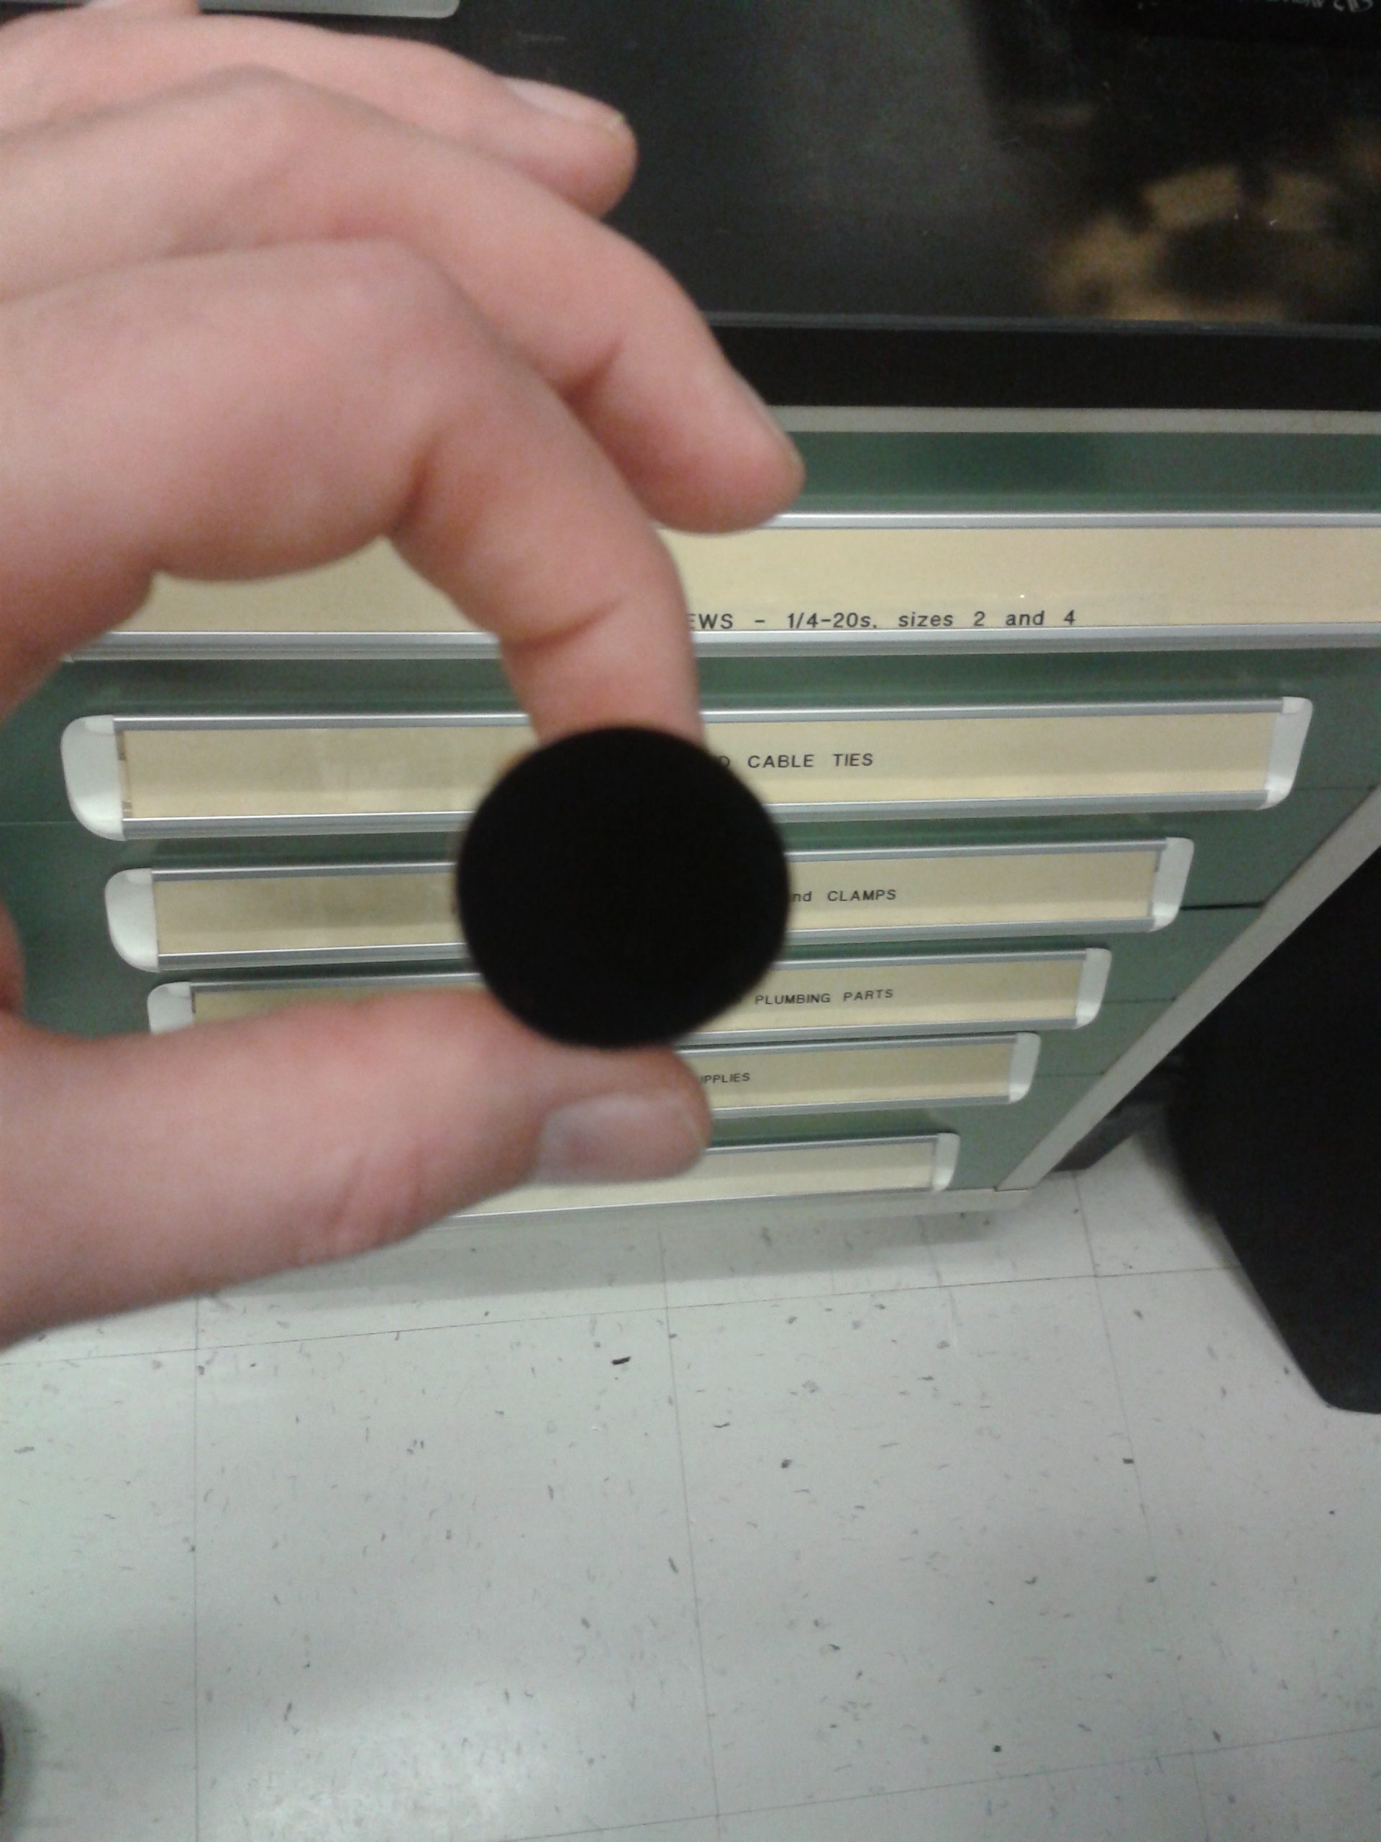
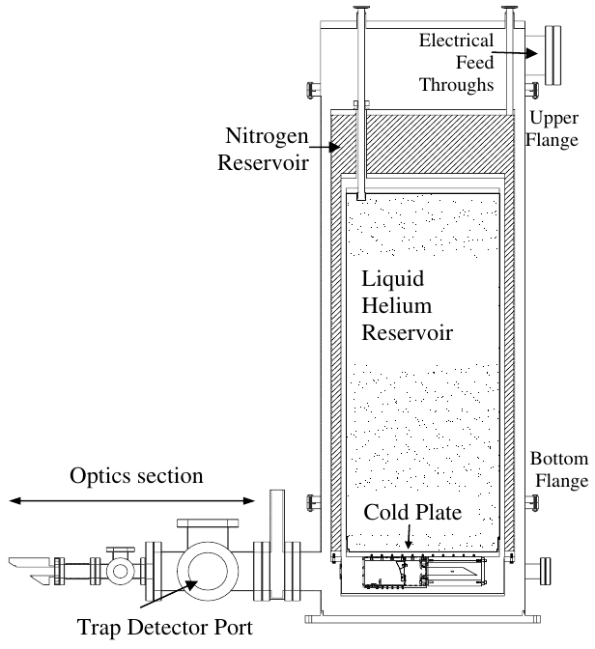
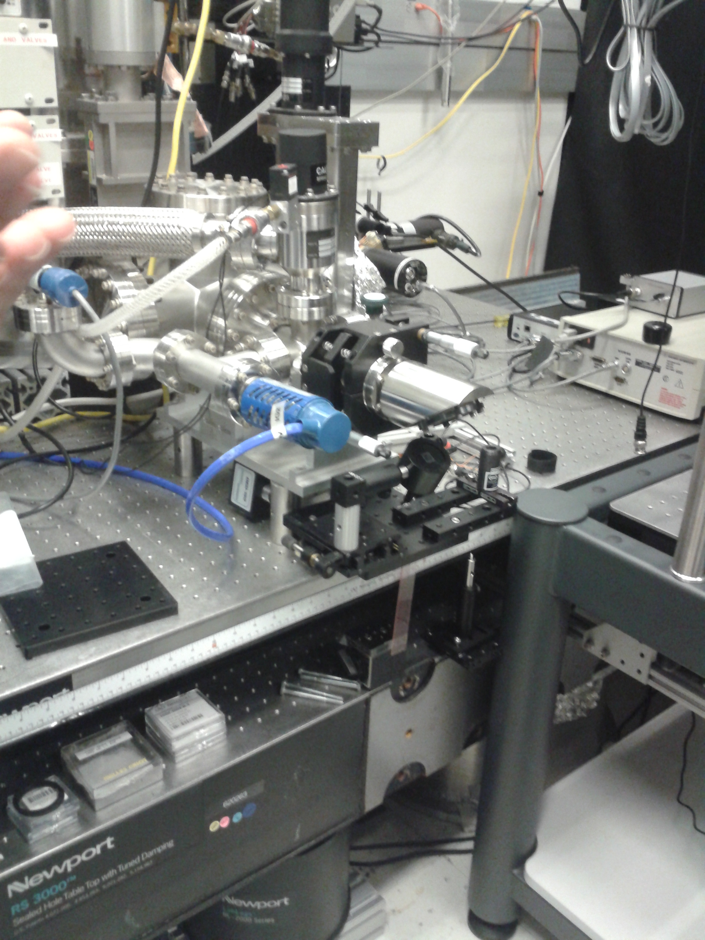
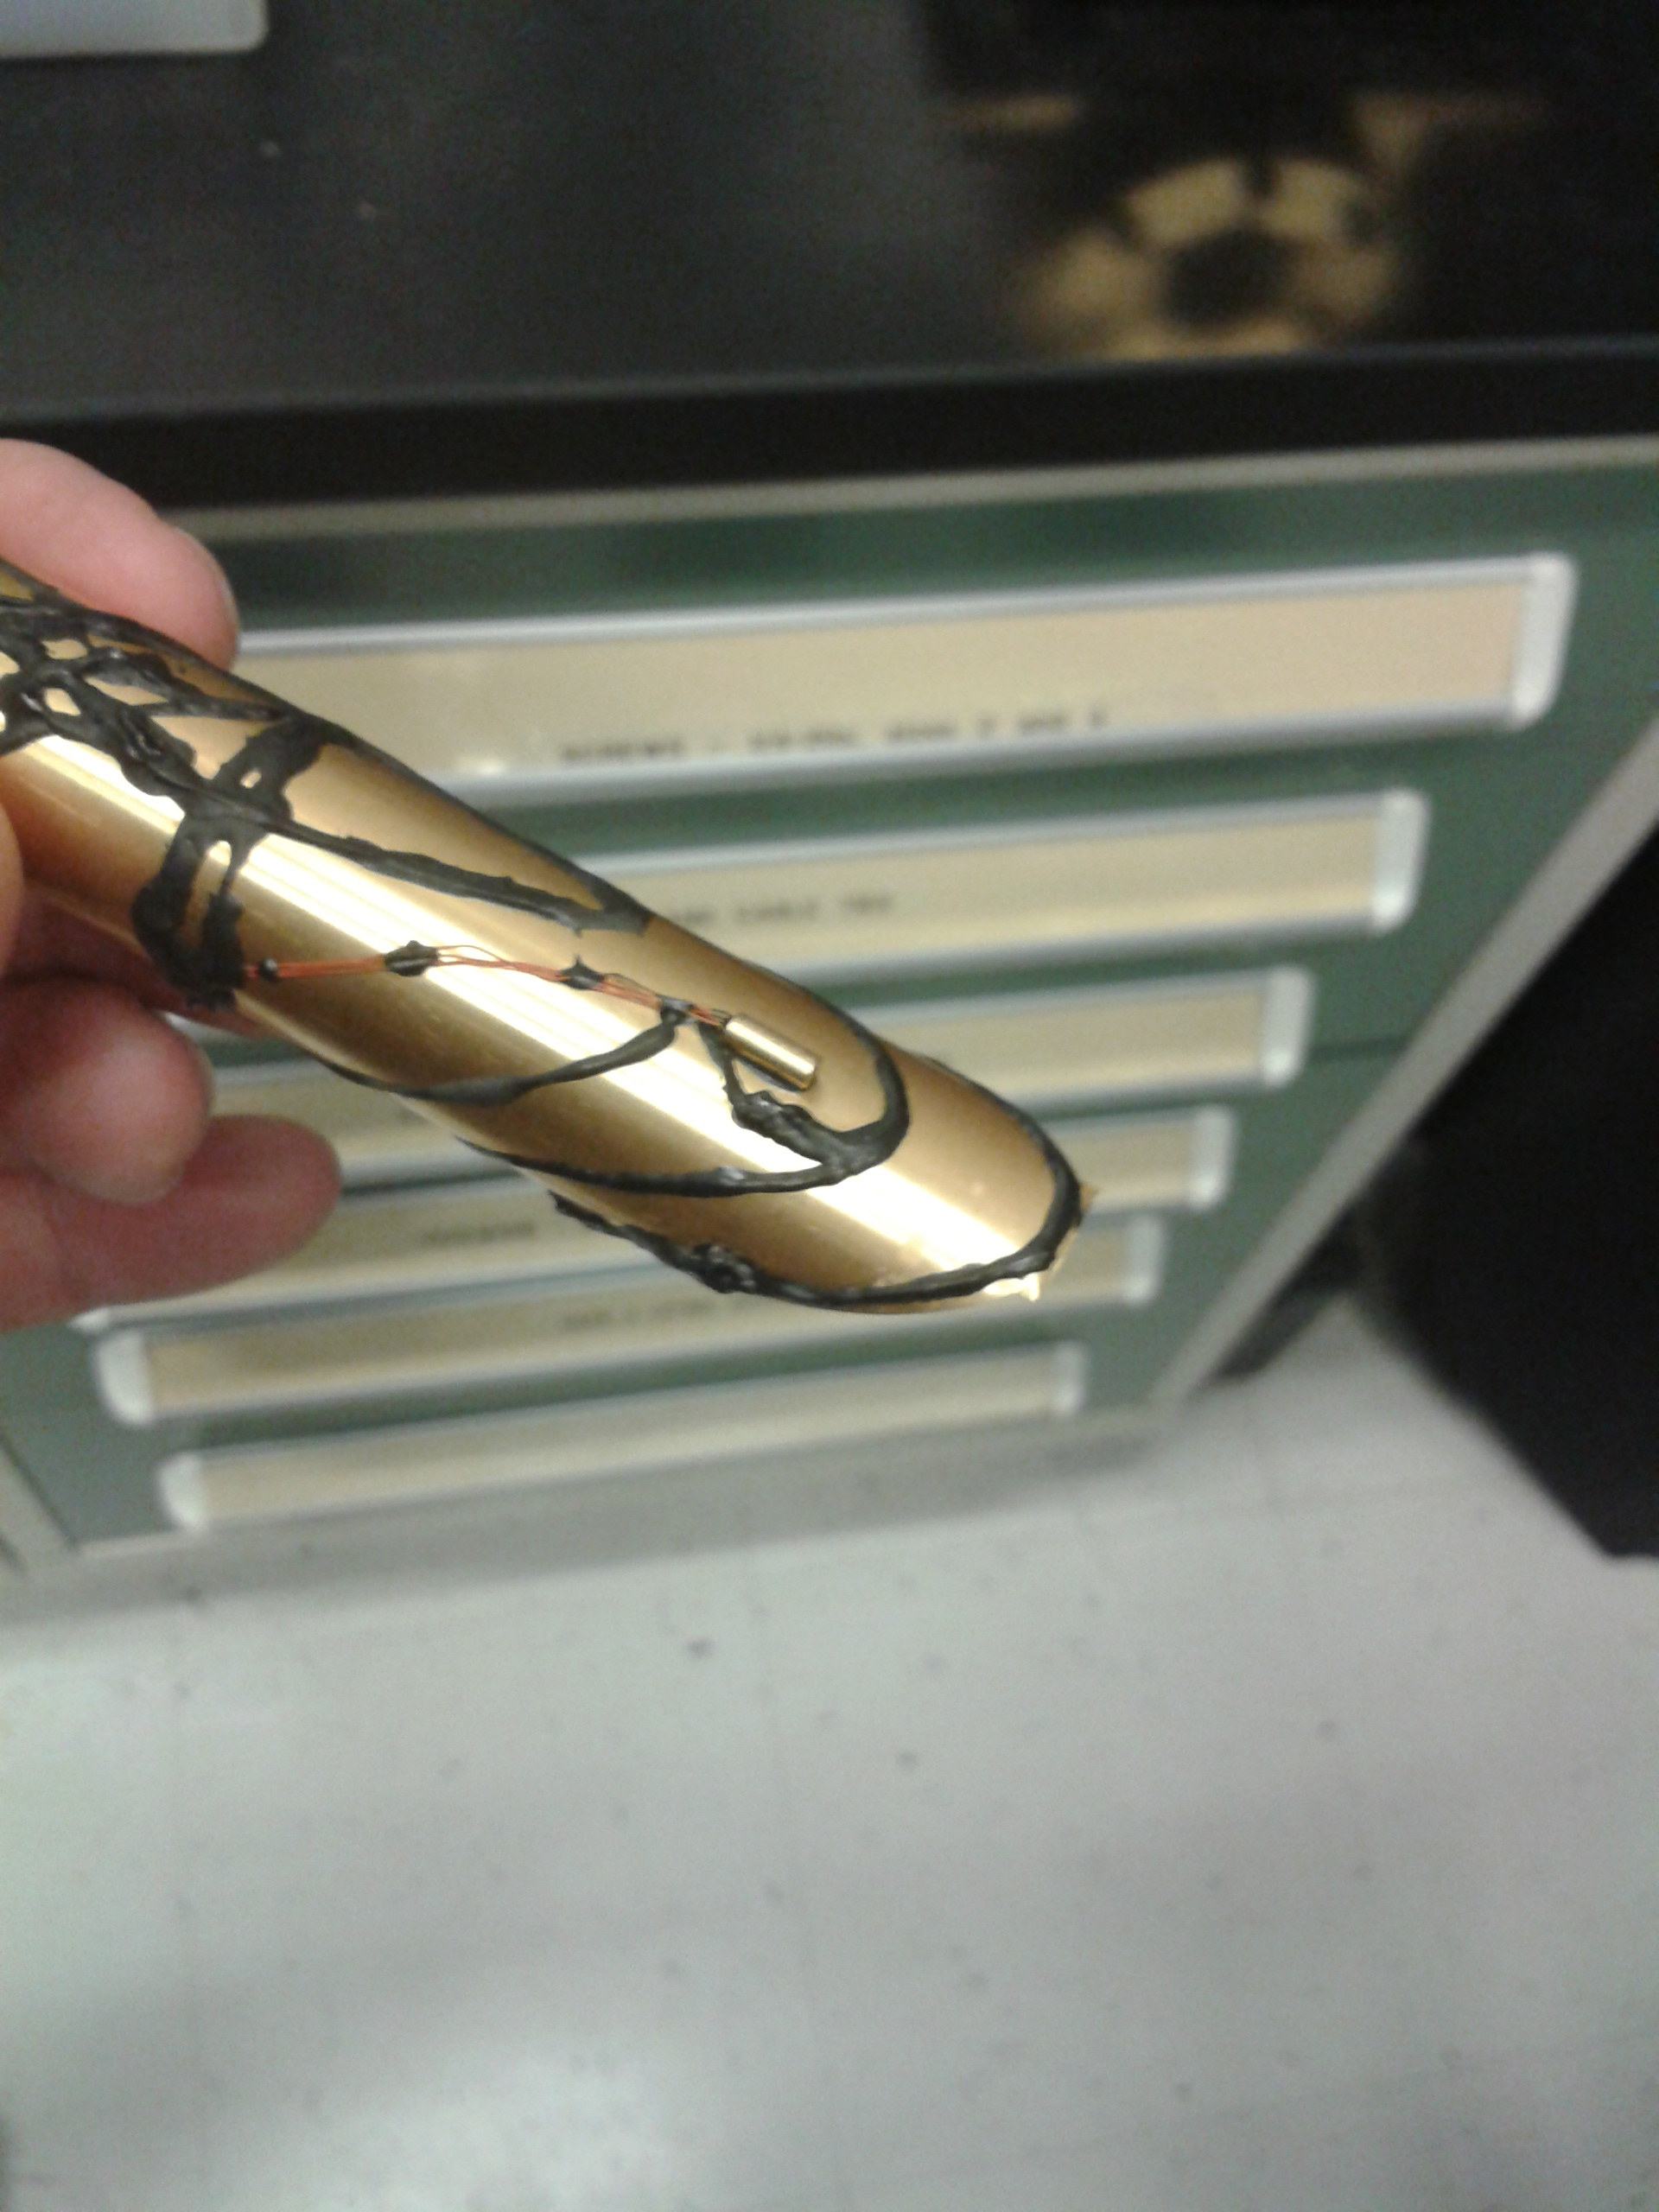
The alternative standard
POWR: the Primary Optical Watt Radiometer
(Brown et al. 2006, Houston et al. 2006)
high-accuracy electrical substitution cryogenic radiometer
Cryogenic shelter
Black absorbing cavity
Germanium resistance thermometer
Claimed accuracy at the 10⁻⁴ level

Slide 5
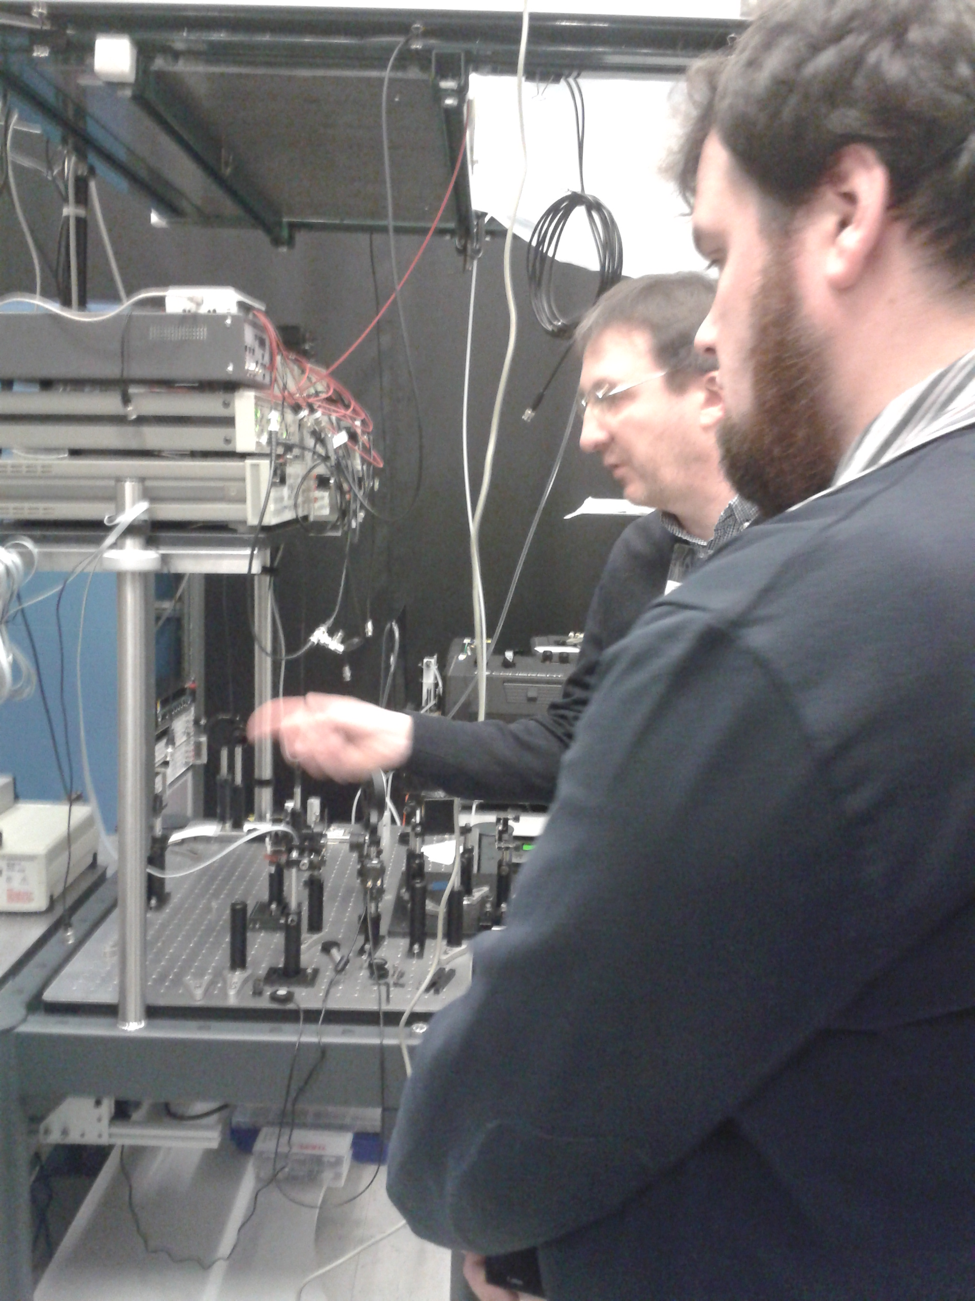
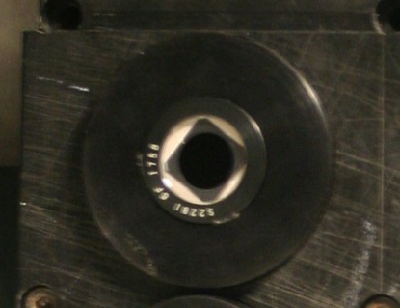
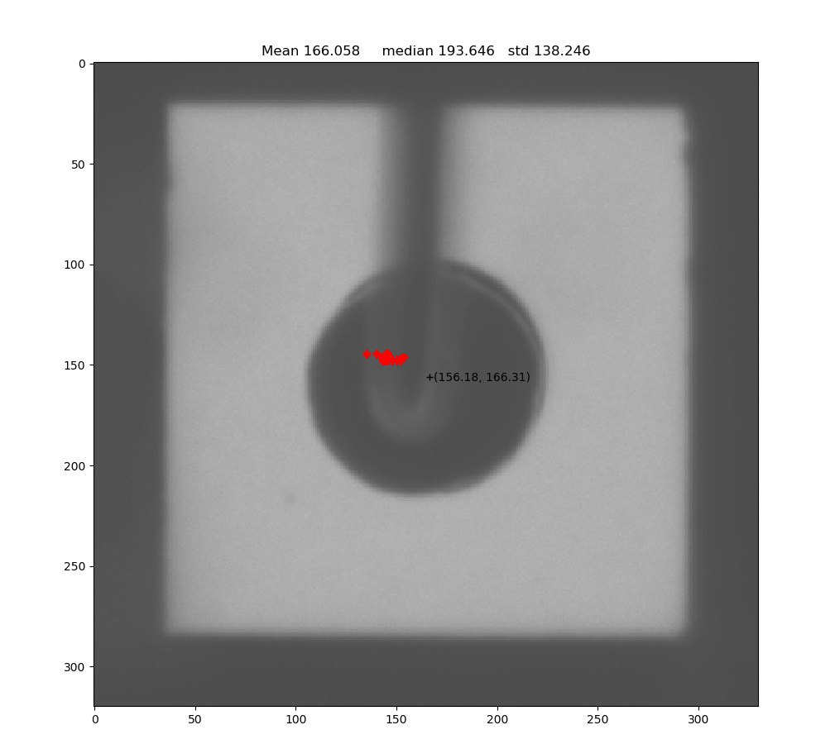
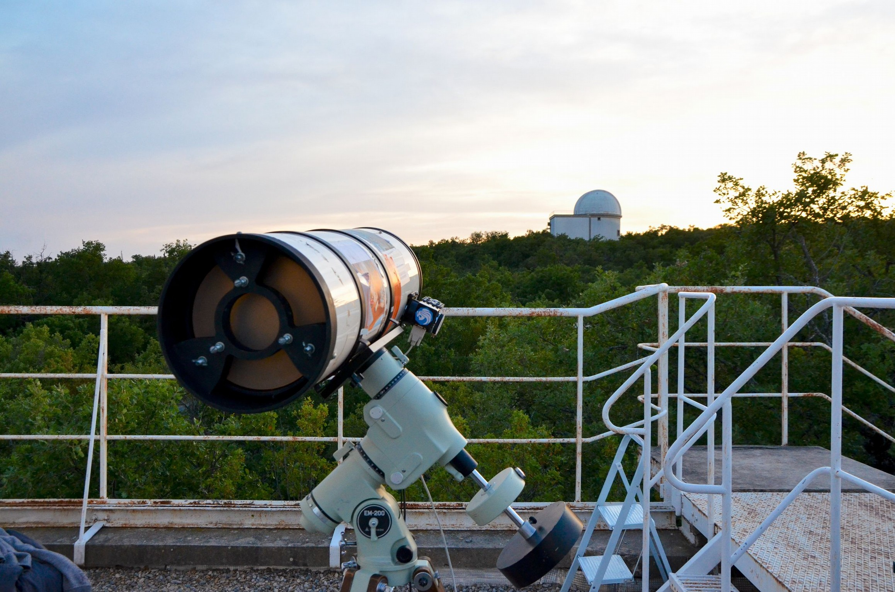
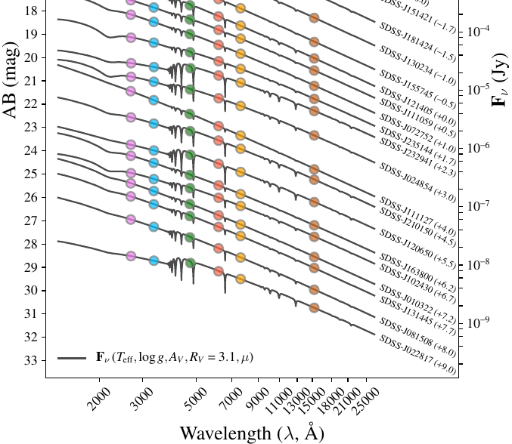
The original concept proposal for a path finder (2016-2019)
NIST POWR
10⁻³W
10⁻⁶W
NIST SCF
NIST Photodiodes
Narrow spectrum LEDs
with temperature monitoring
Small aperture telescope
250 μm
10⁻¹⁷ W/cm²/nm
Spectrophotometric
standard stars
10⁻¹⁹W/cm²/nm

Slide 6
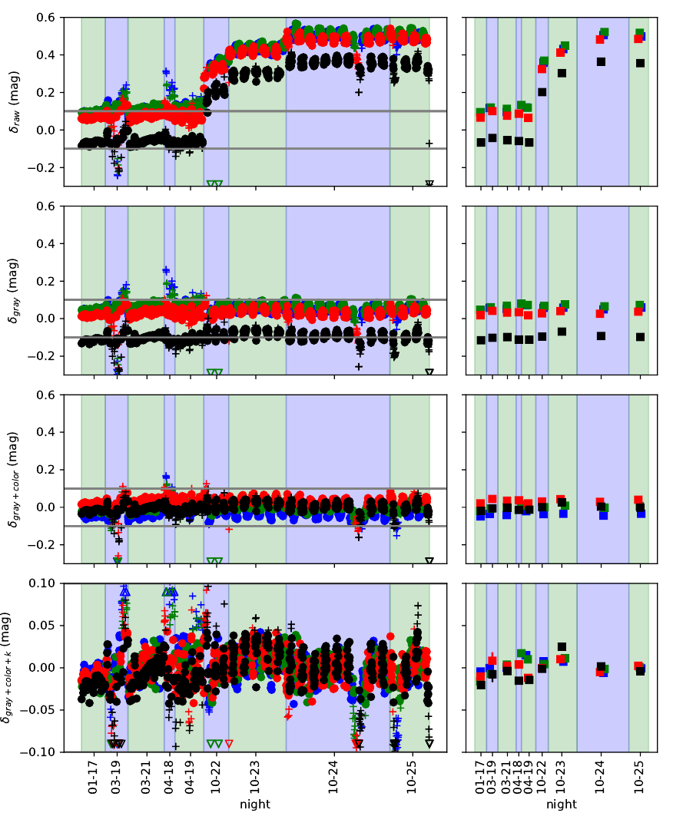
Conclusion from F. Hazenberg thesis (2019)
  Optically perfect : Full pupil and point like which makes the result absolutely Independent of any optics model
  Fast : full telescope calibration in 20min
  Stable : consistent results over 6 monthes at the % level
  Lessons learned for the upgrade:
  Current T monitoring accurate at .5%: new T proxy
  One step missing in the transfer: Calibration transfer bench
  Transfer hindered by clouds: IR instrument
  Estimated number of nights 200-400: Robotic Telescope
  Accurate determination of mirror reflectivity: Collaboration with CBP
  LEDs spectra at nominal (extremely low) flux not acquired: Spectrograph

Slide 7
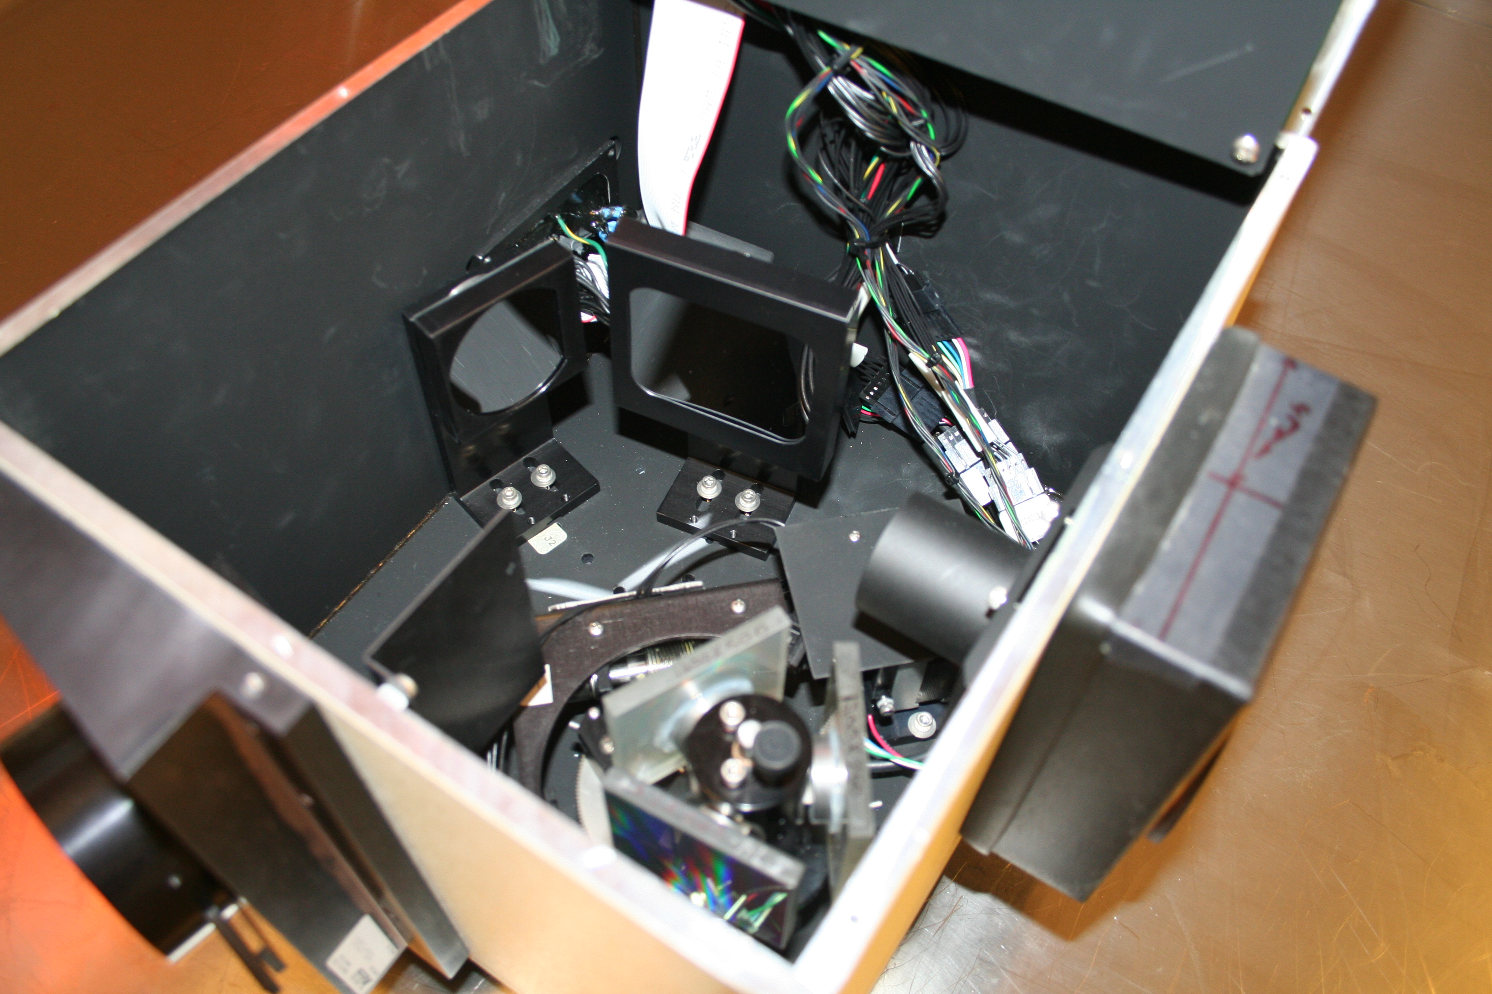
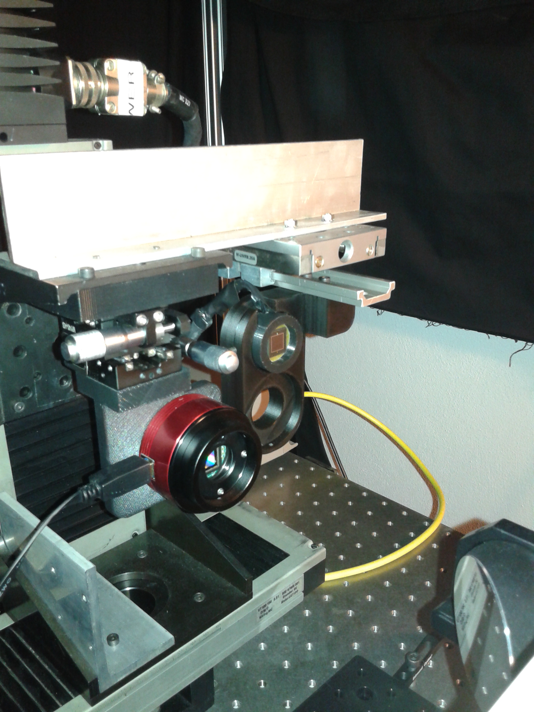
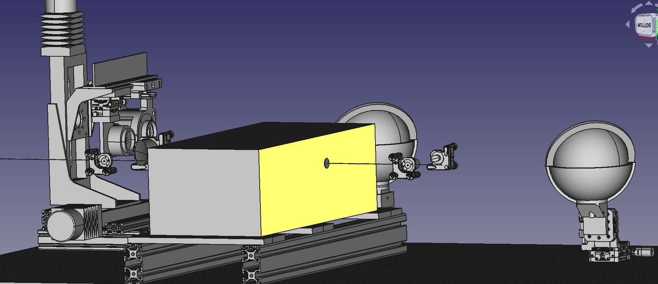
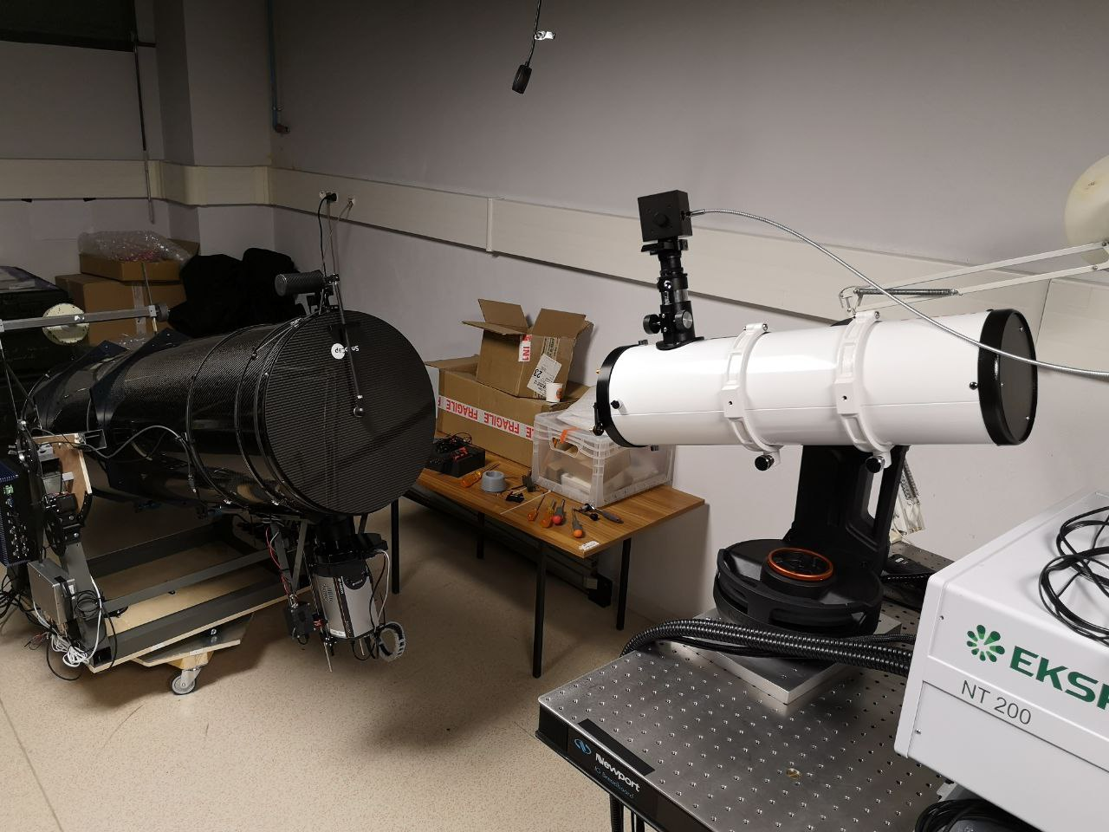
The revised StarDICE metrology chain
NIST POWR
10⁻³W
NIST SCF
10⁻⁶W
NIST Photodiodes
StarDICE transfer bench
CCD Camera and
Calibration spectrograph
10⁻¹³ W/cm²/nm
Small aperture telescope
+ 200 nights automated
+ passband measurement
+ Atmospheric monitoring
Narrow spectrum LEDs
with forward voltage monitoring
10⁻¹⁷ W/cm²/nm
250 μm
Spectrophotometric
standard stars
10⁻¹⁹W/cm²/nm

Slide 8
StarDICE Milestones
Sept. 2019: F. Hazenberg PhD thesis. The complete experiment is designed and requires ~200 - 400 nights
2020 Sept. 25 : MOU with OHP to host the experiment in one of its jumelé coupola, parallel work starts on the building, mount, optical instrument, calibration bench and artificial star.
2022 Mar. : CBP measurement of the optical instrument complete
2022 Nov. 11 : Acceptance of the StarDICE bench demonstration paper
2023 Mar. : Robotic telescope complete with optical and IR instrument
2023 Mai 28 : OHP review grants green light for remote operations

Slide 9
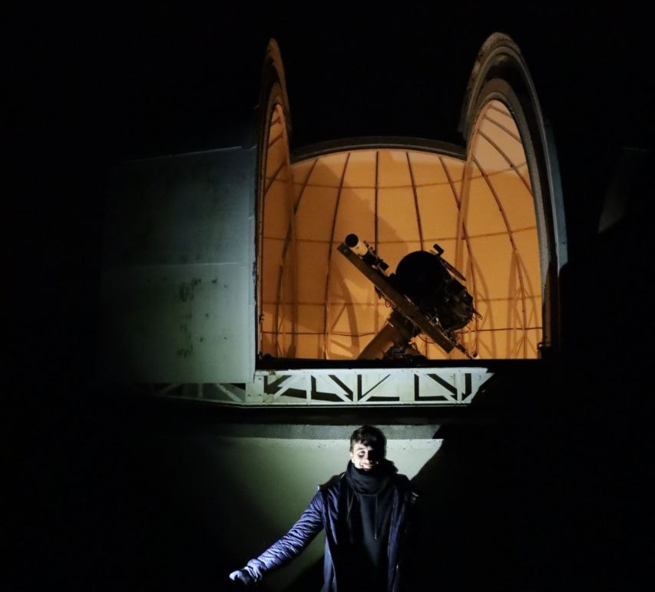

Slide 10
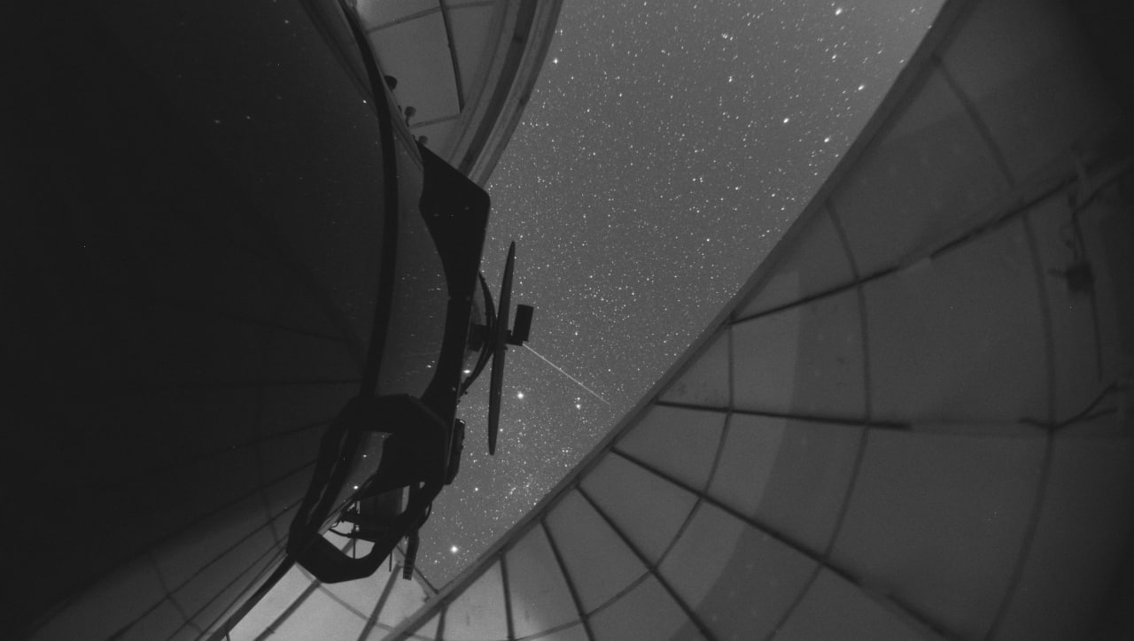
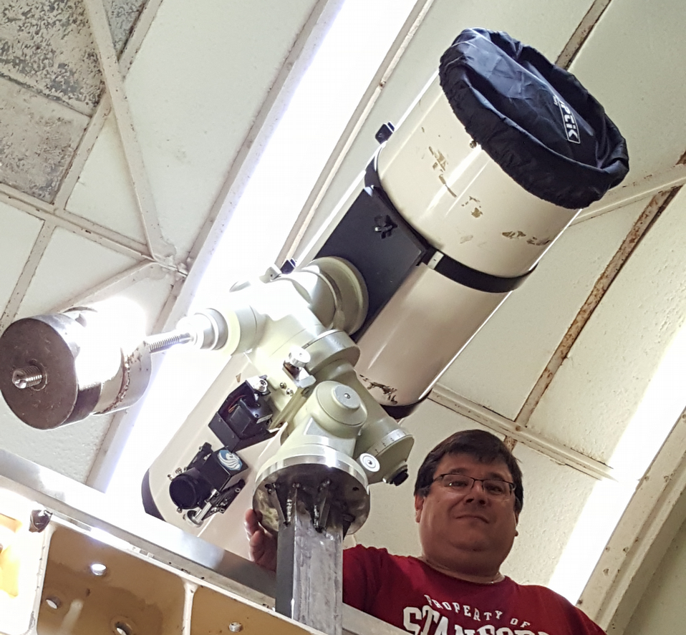
From then to now
CPPM : O. Angelini, S. Beurthey, S. Deguero, F. Feinstein
LPNHE : P. Antilogus, Ph. Bailly, E. Barrelet, M. Betoule, S. Bongard, J. Coridian, M. Dellhot, P. Ghislain, A. Guyonnet, F. Hazenberg, C. Juramy, H. Lebbolo, L. Le Guillou, E. Pierre, N. Regnault, Ph. Repain, M. Roynel, K. Schahmaneche, E. Sepulveda, T. Souverin
LUPM : J. Cohen-Tanugi, Eric Nuss, B. Plez, Kélian Summer
IJCLab : J. Neveu, S. Dagoret-Campagne, M. Moniez
OHP : Pierre-Eric Blanc, Auguste Le Van Suu, Jean-Paul Payan, Jean Claude Brunel, François Dolon, Marc Ferrari

Slide 11
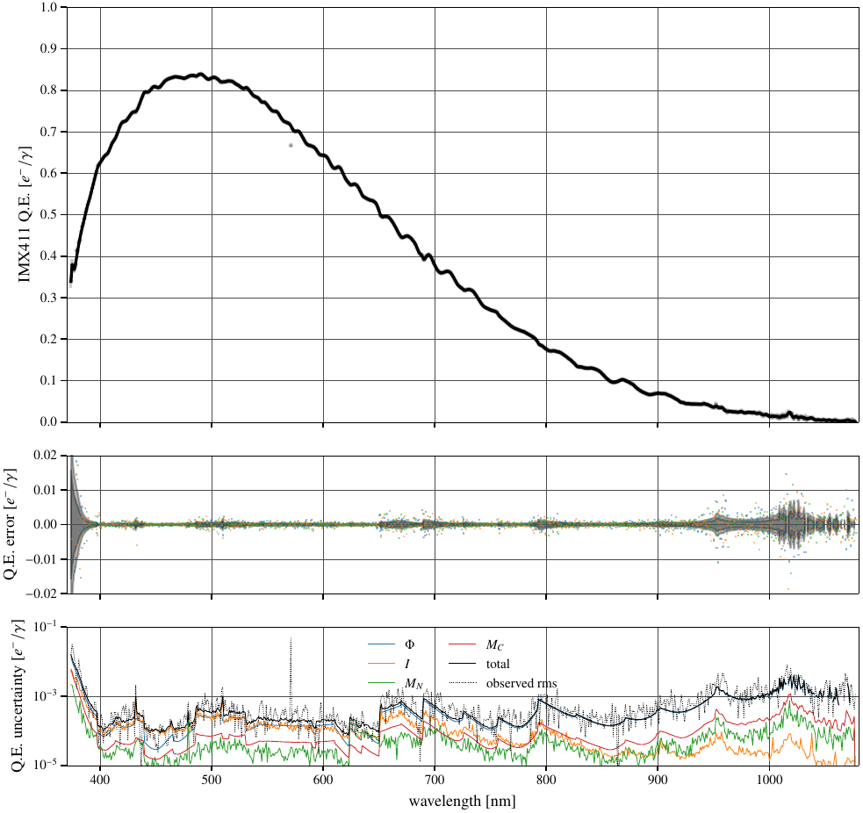
Calibration bench
The game is to calibrate a CCD sensor relative to the NIST Photodiodes at 10⁻³ over the range 400-1000 nm
Already validated performance on v2 are sufficient for the validation survey
A&A 2022_44973
Work on v3 has started
  Optimization of photodiode reading
  Optimization of photocurrent extraction
  Rework of the mechanical components
  New CCD camera

Slide 12
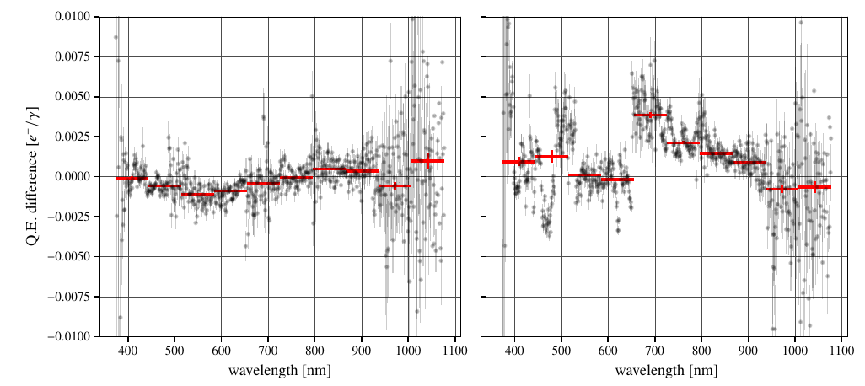
Calibration bench systematic
Main identified systematics is the linearity
But at a non-critical level for the survey validation
Still a bit more work to have a fully calibrated artificial star

Slide 13
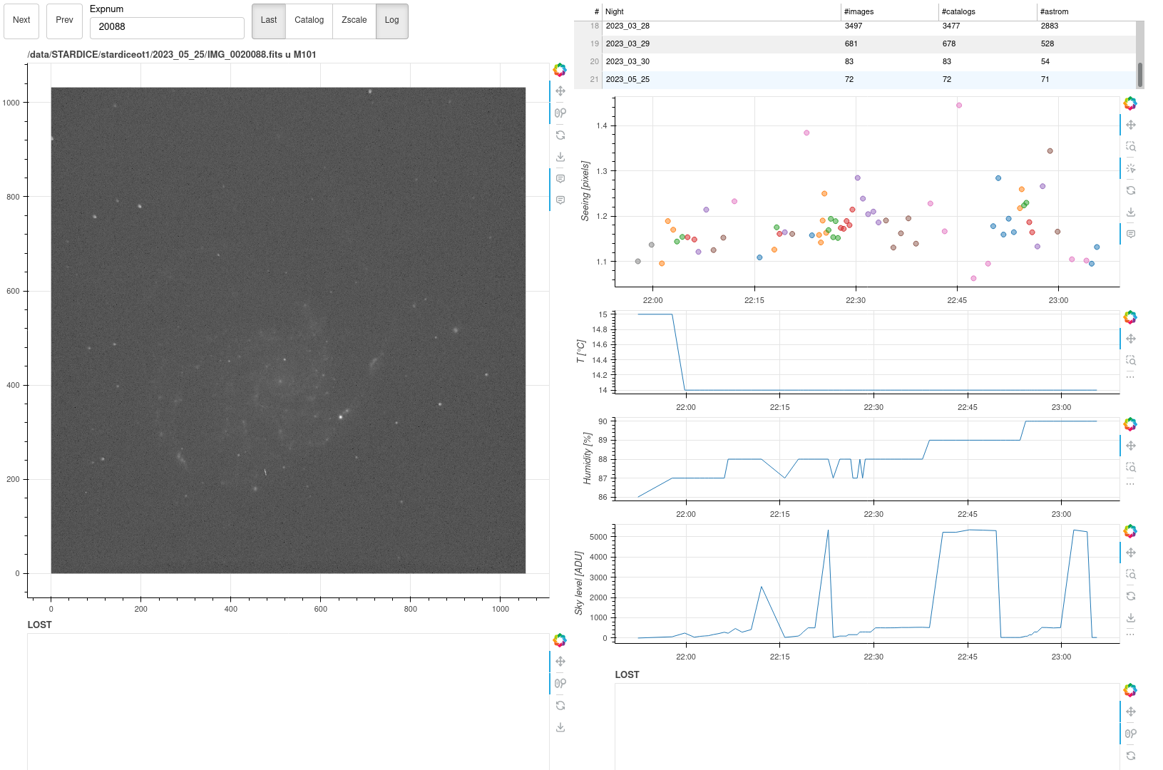
Robotic instrument is ready
Screenshot from the remote control
6 good nights accumulated
Start a 20 night validation survey as soon as weather (and network) cooperate.
See Jeremy’s talk for details on the transmission measurement of the optical instrument
And Thierry’s talk for a first evaluation of the performances of the optical instrument

Slide 14
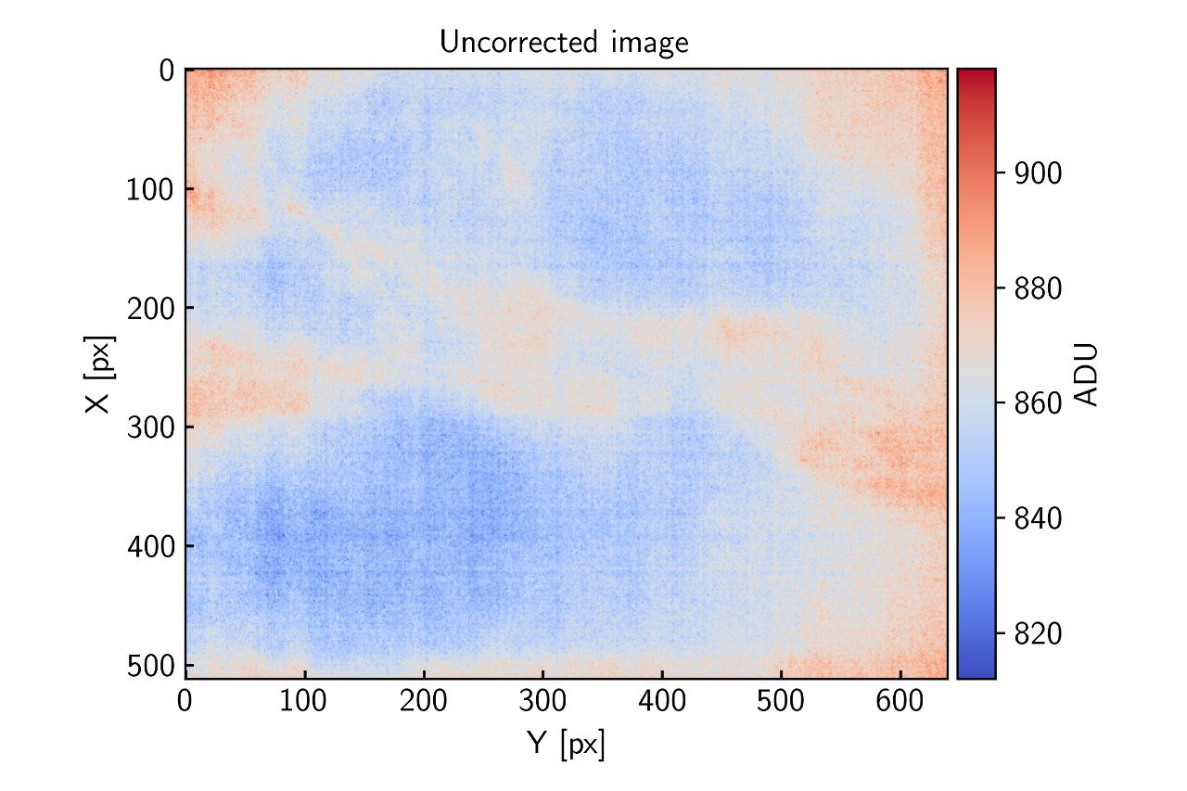
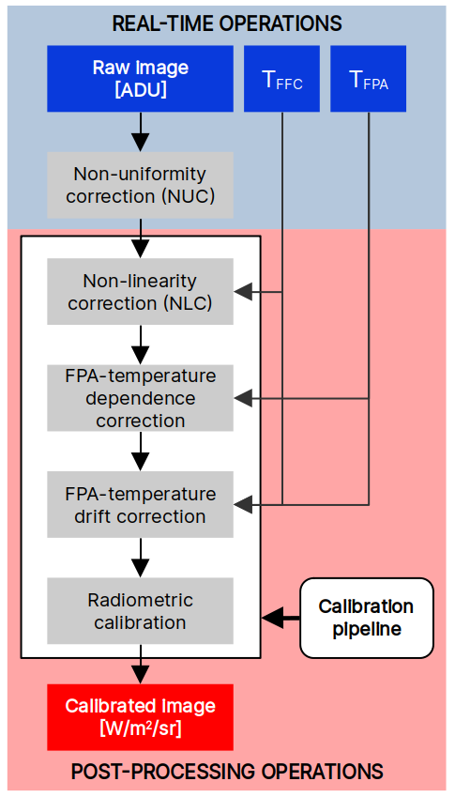
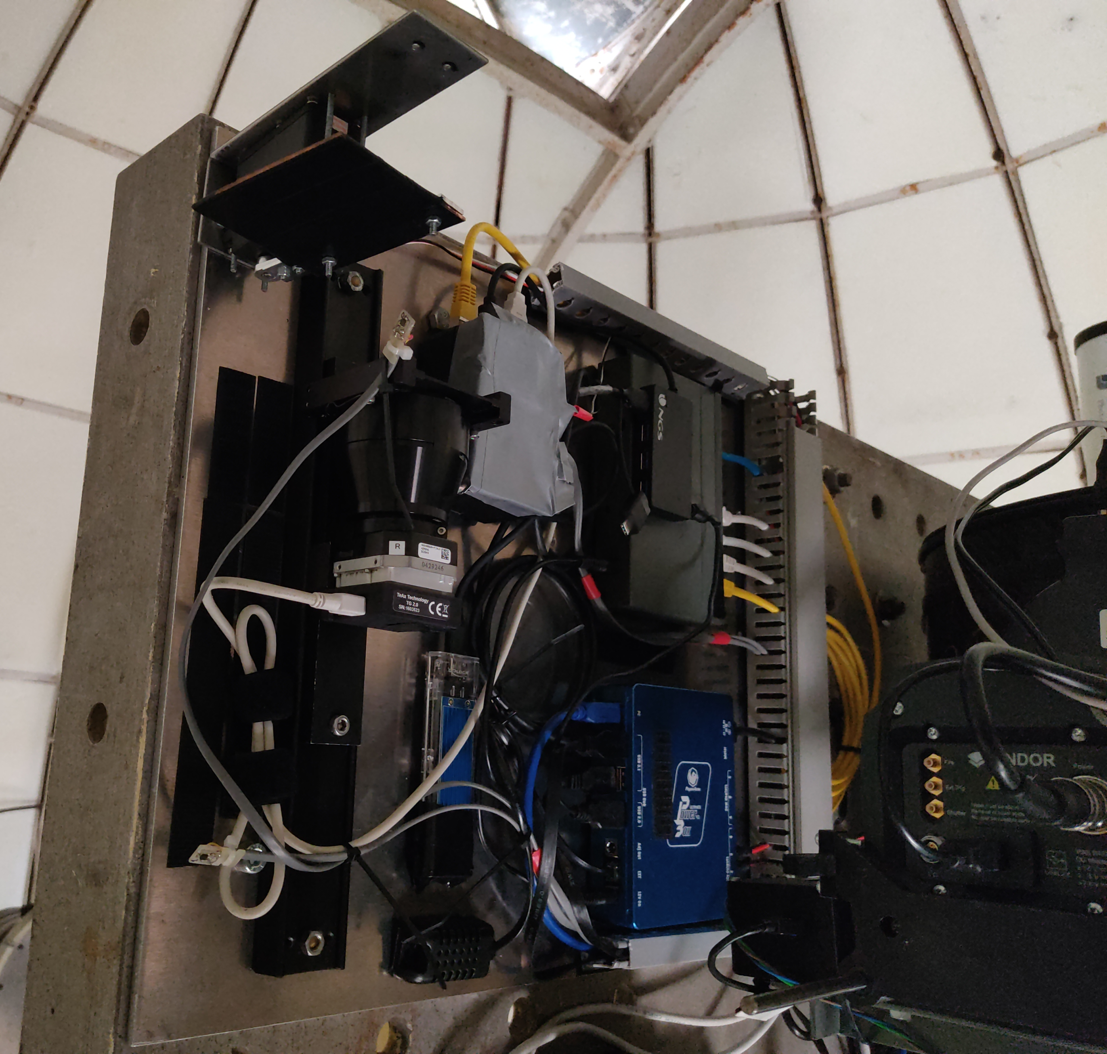
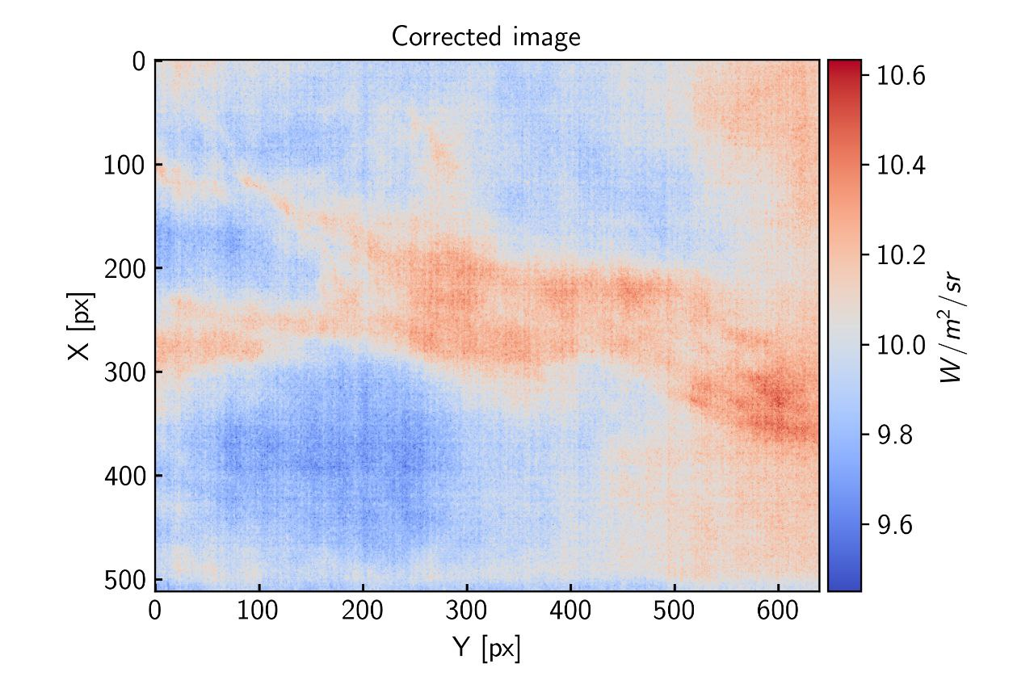
Installation of the IR instrument at OHP
Telescope pointing upward
Kélian SOMMER

Slide 15
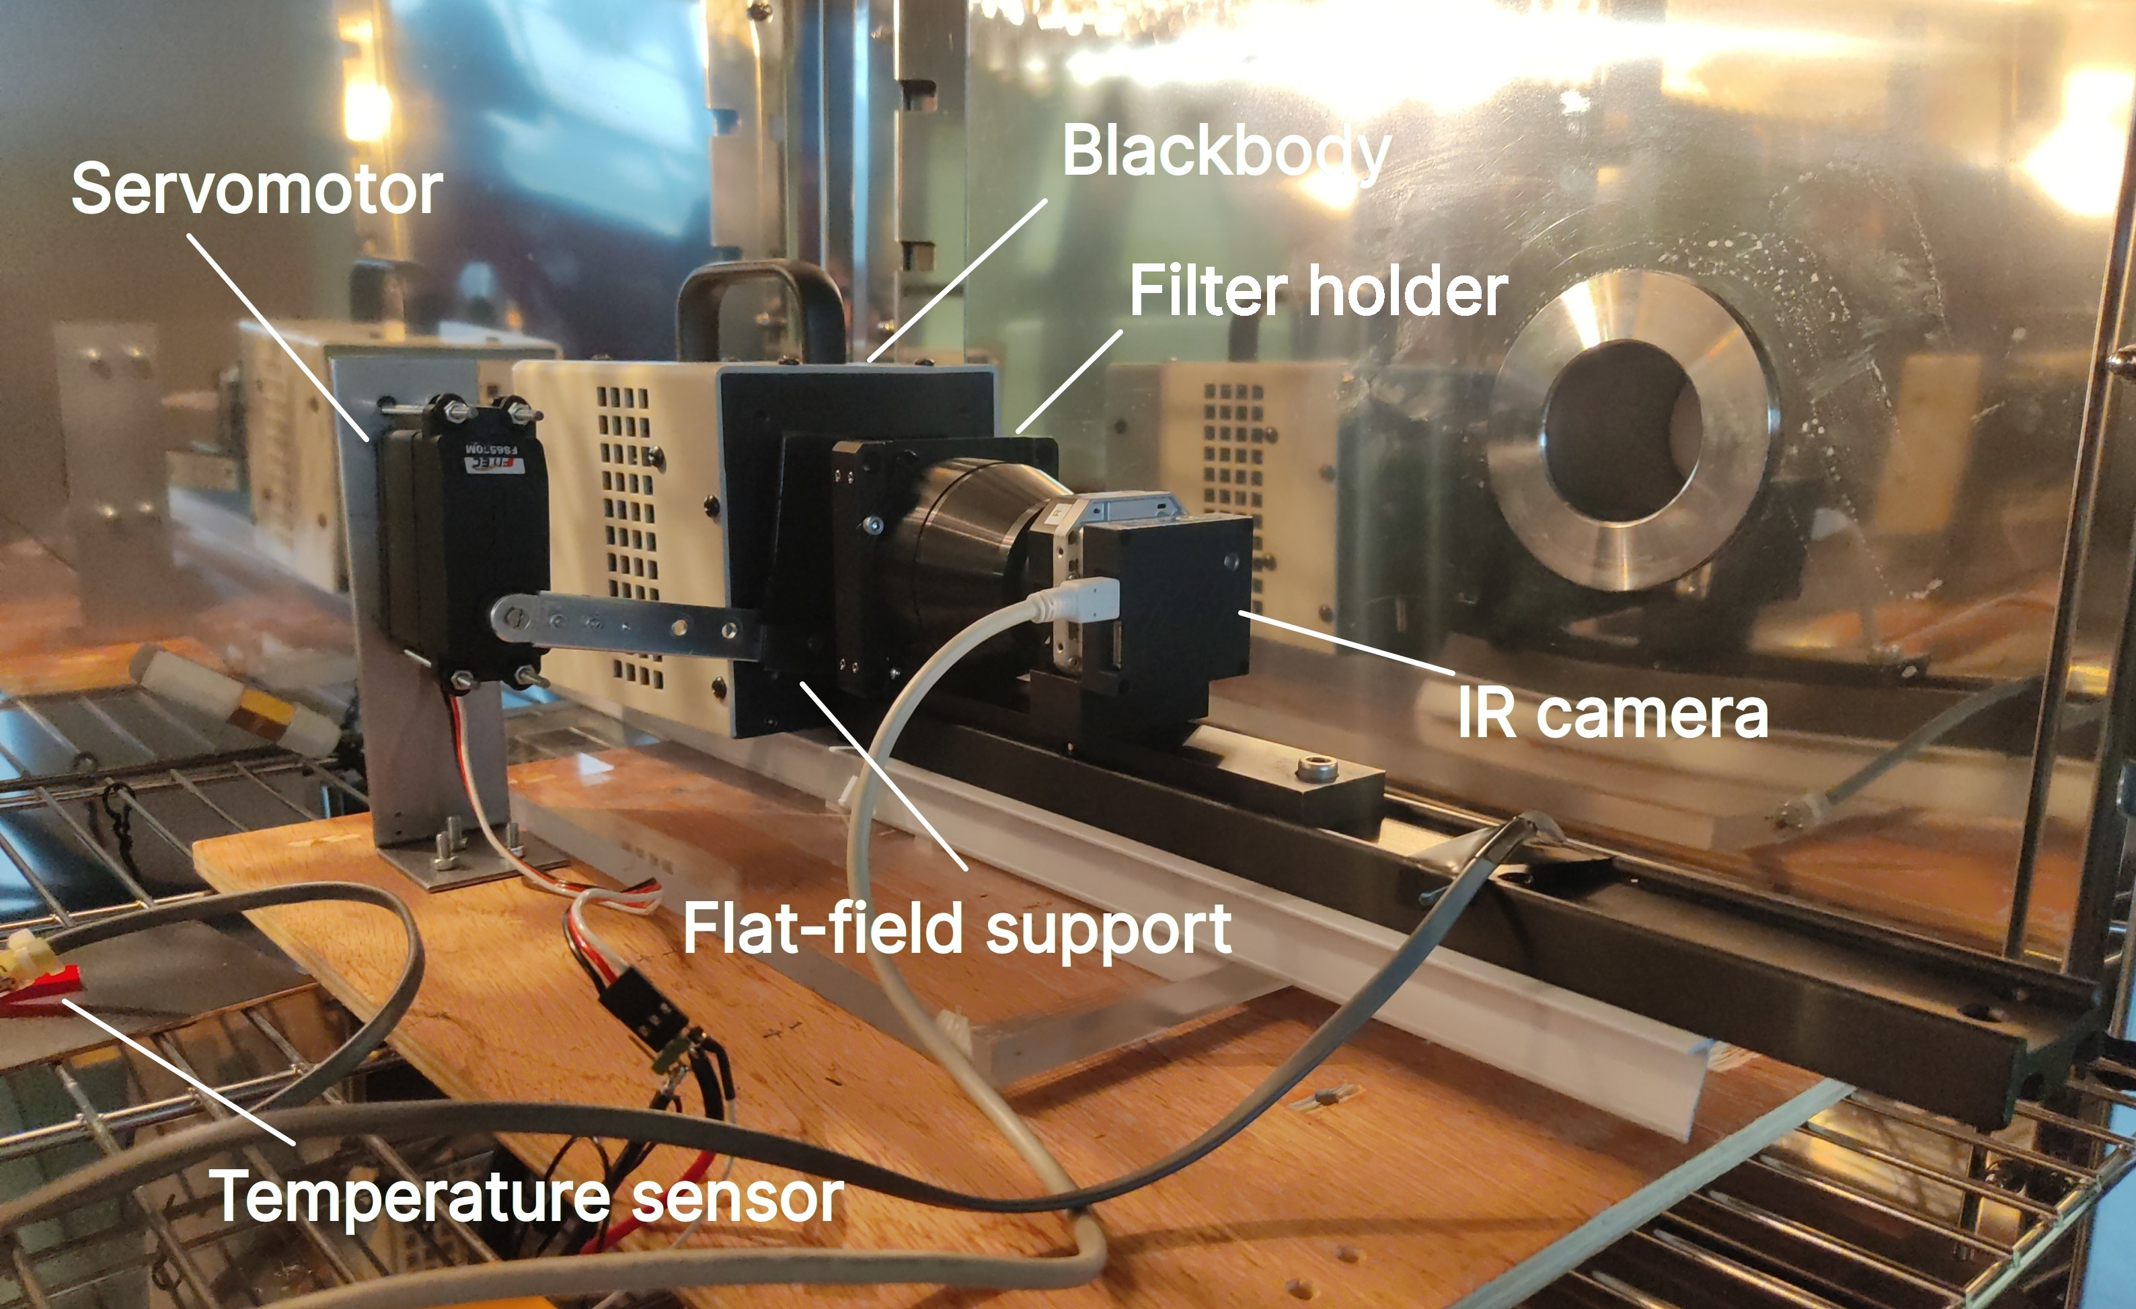
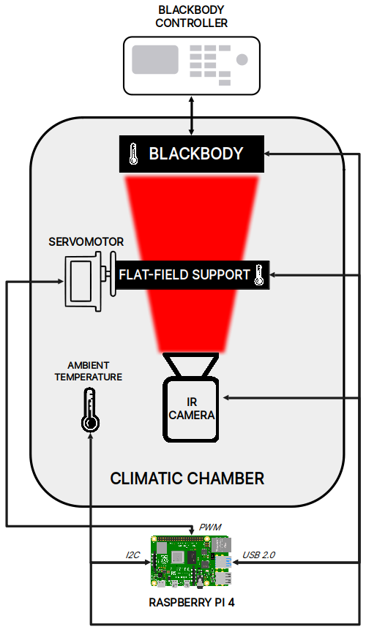
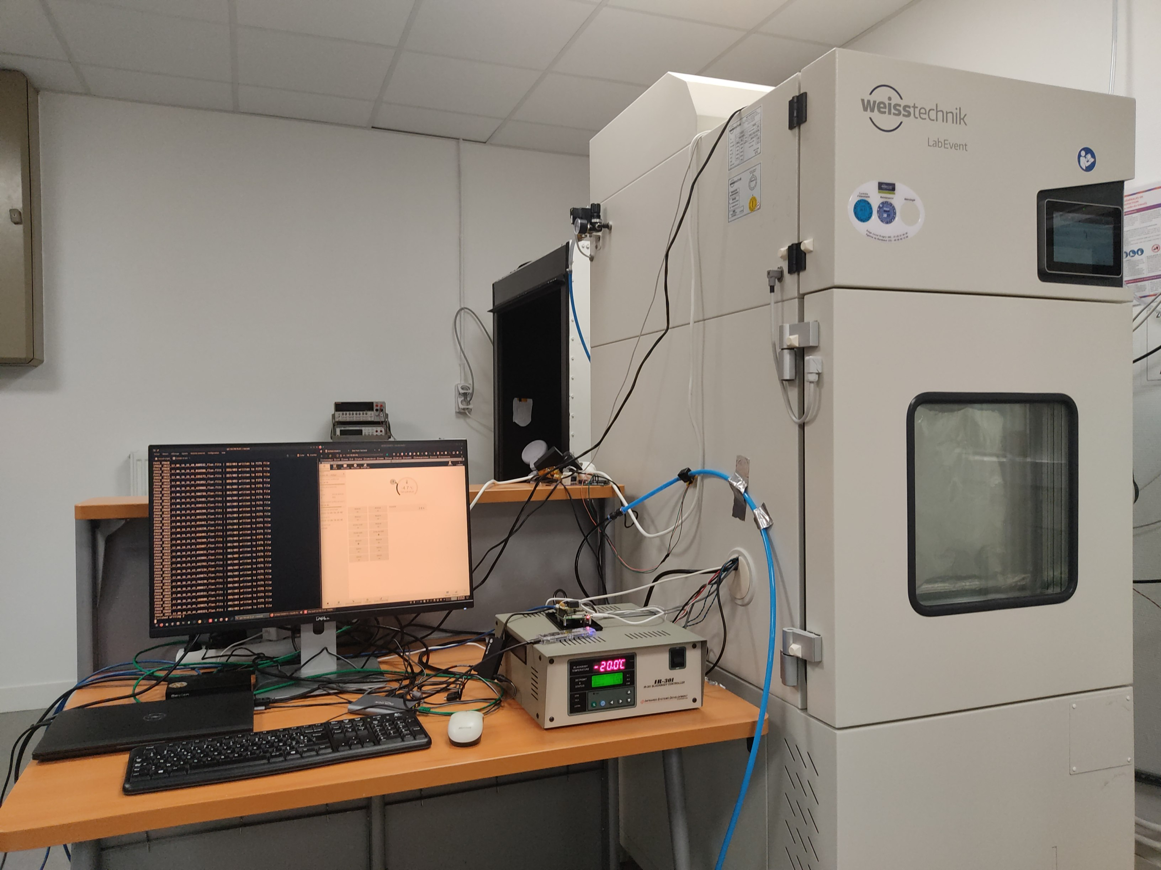
Calibration of the bolometer array (1/2)
December 2022 : calibration data acquisition at IJCLab in ATLAS climatic chamber with S. Dagoret-Campagne and M. Moniez
Goal : imaging a low-temperature/radiance blackbody at different camera operating temperatures
→ correct for various camera defects (non-linearity response, sensor temperature drift...)
Kélian SOMMER

Slide 16
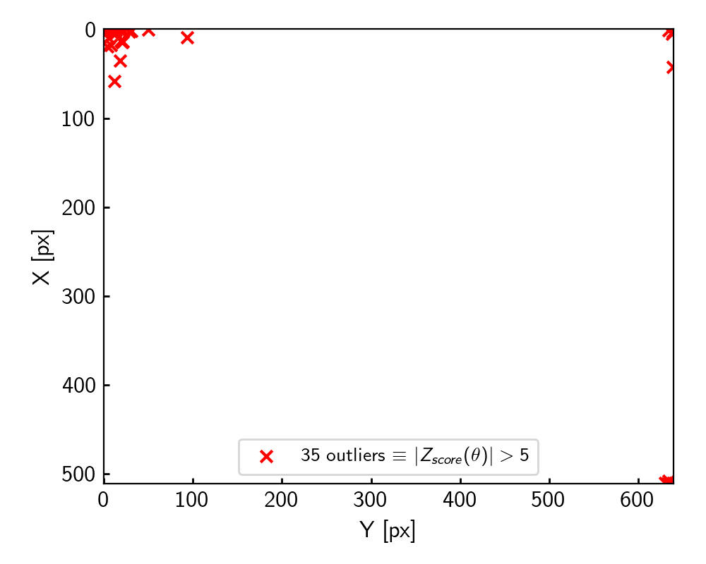
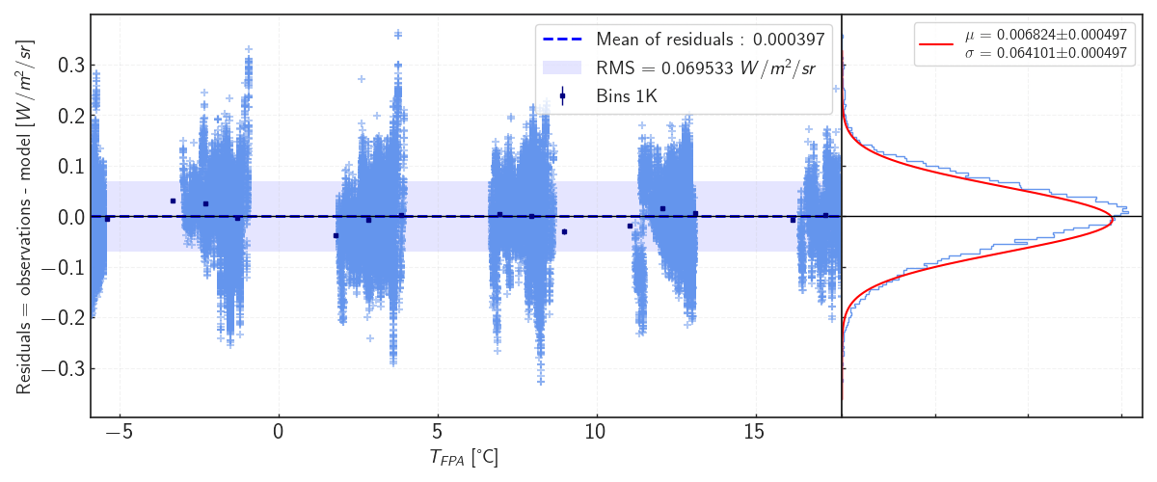
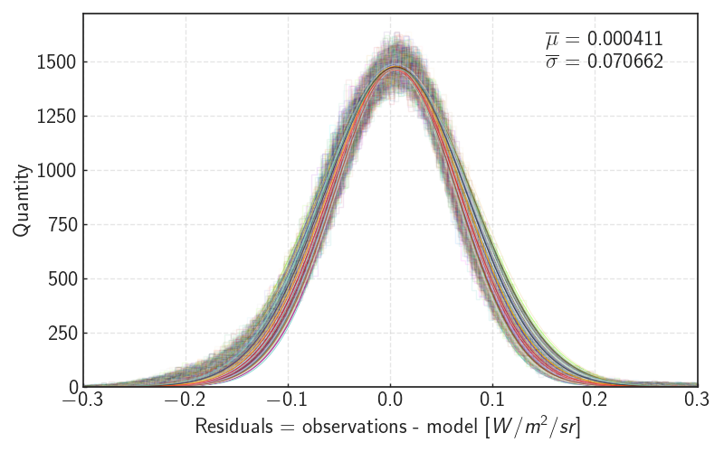
Calibration of the bolometer array (2/2)
Preliminary average uncertainty per pixel :
+- 0.07 (stat.) W/m²/sr
+- 0.04 (syst. of calibration experiment) W/m²/sr
~ 0.011 % pixel outliers at > 5-sigma
PRELIMINARY
1000 random pixels
PRELIMINARY
Residuals for the central pixel of the focal plane array between the corrected images and the scene radiance model. Temperature gaps are due to environmental conditions in the climatic chamber. [K. Sommer et al., in prep]
Kélian SOMMER

Slide 17

First light at OHP

Slide 18
Conclusion
StarDICE robotic installation is up and running
Up for a 20-night validation survey allowing to build the data analysis chain for the spectrophotometric and IR instruments
Optimizing the observation strategy to learn the best way to beat the atmospheric noise
On the hardware side, the focus is switching toward the finalisation of the calibrated artificial star

