Slide 1
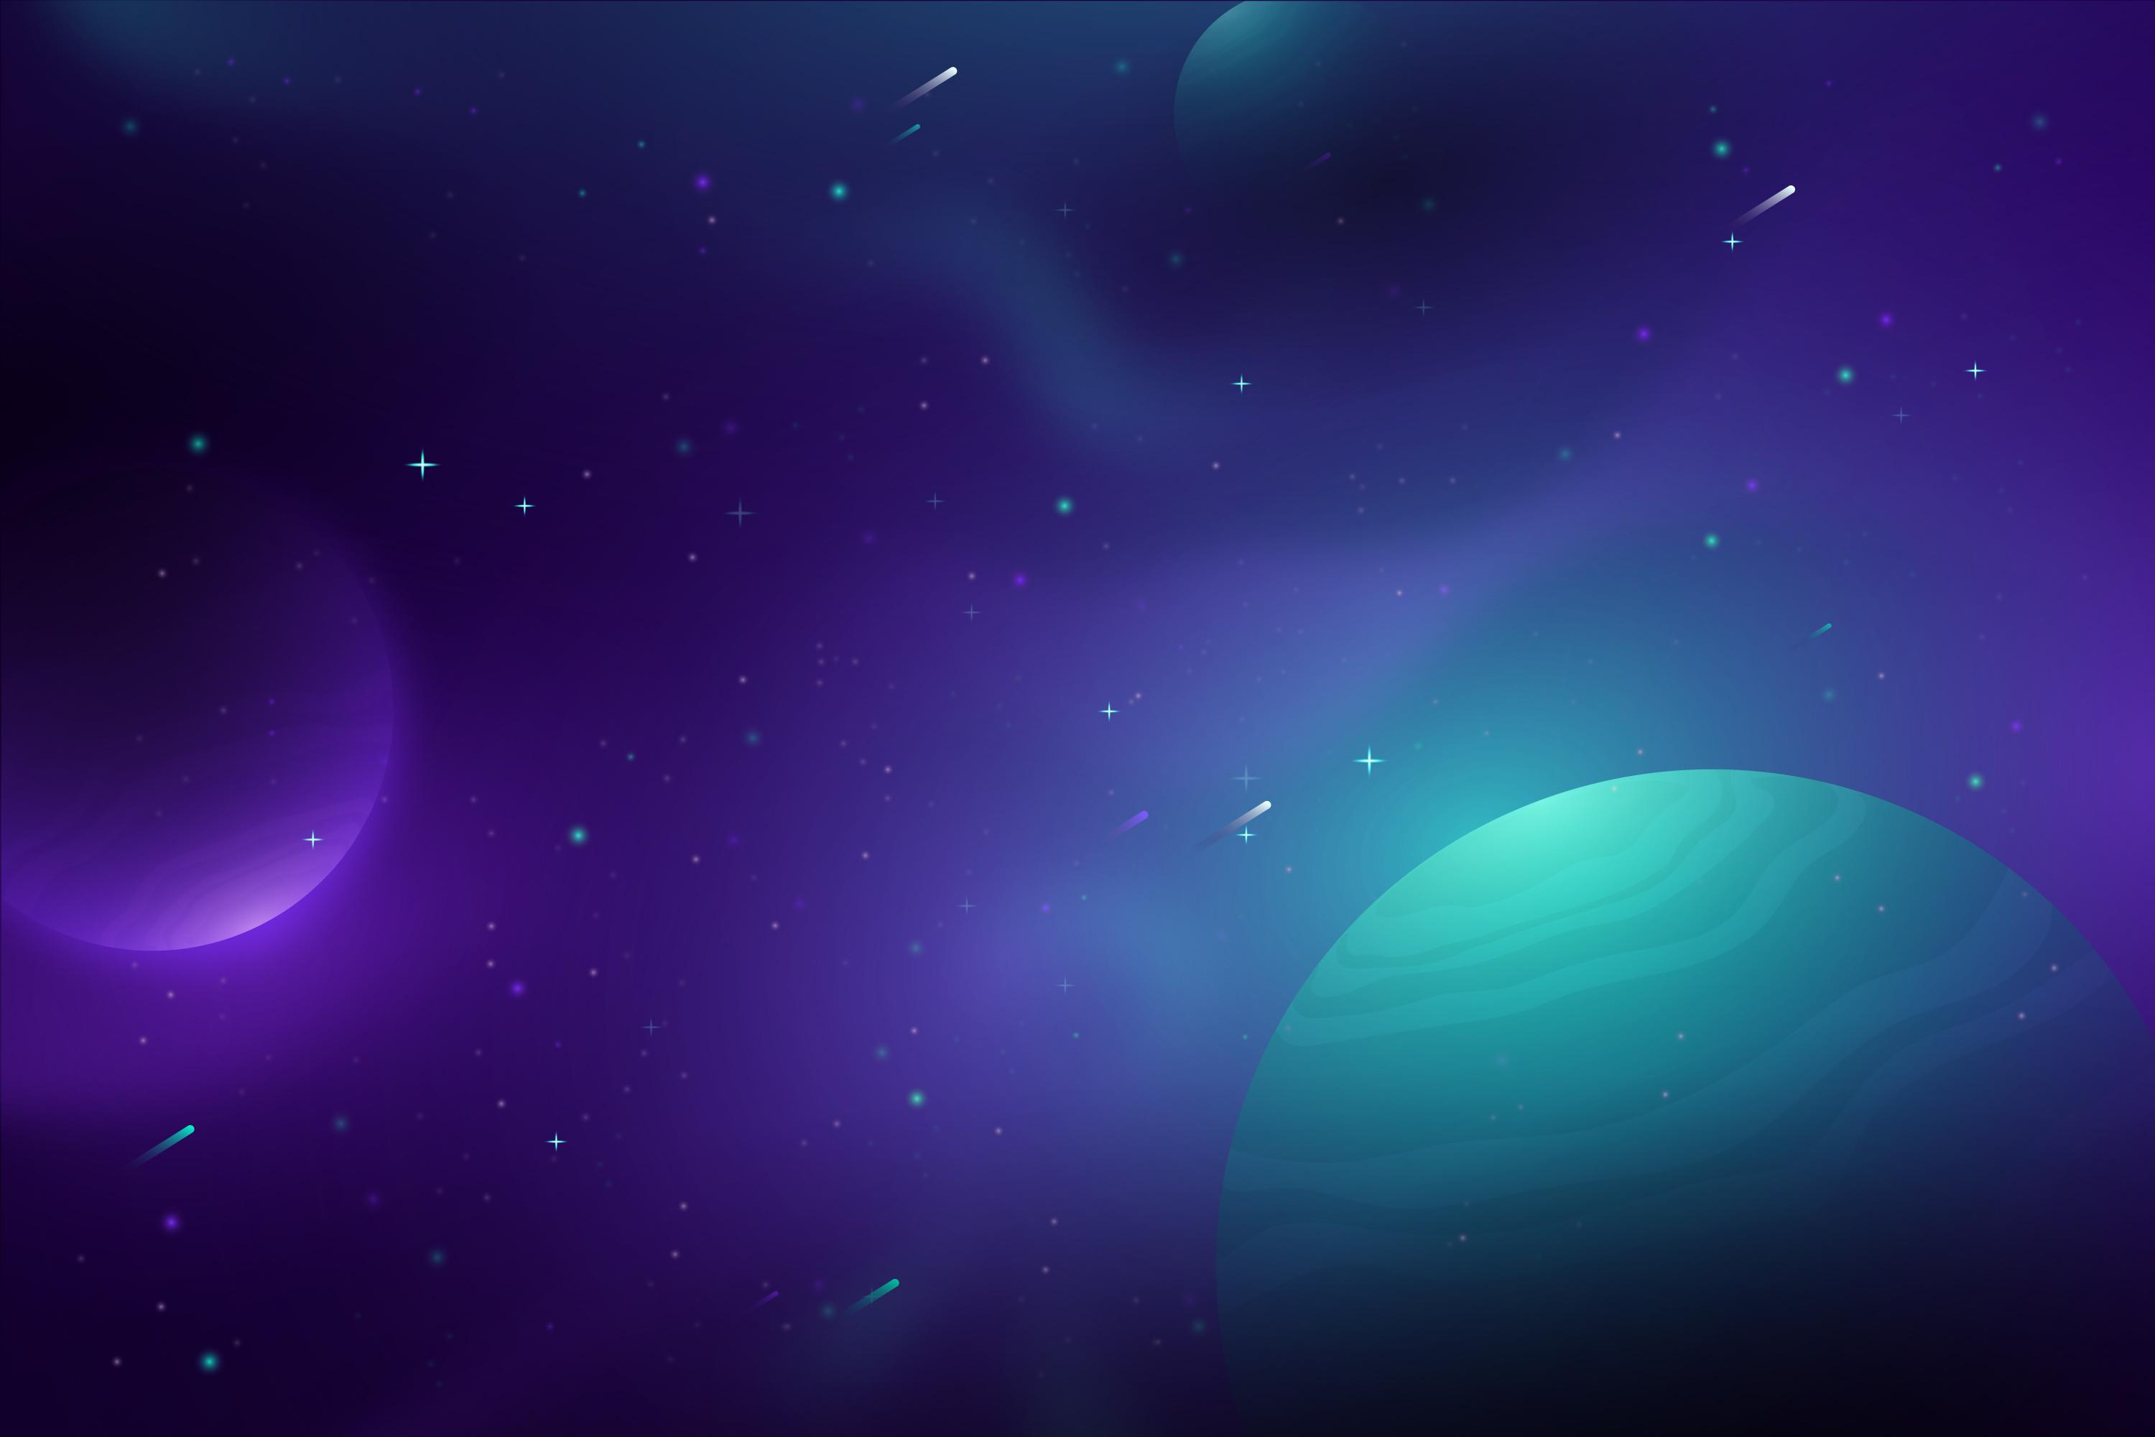






Performance of AMICO on cosmoDC2 simulation
Nathan AMOUROUX
Supervised by Thibault Guillemin (LAPP)
In collaboration with Matteo Matturi (Heidelberg)
DC2 DESC projects : AMICO validation project & galaxy cluster algorithm comparison project
LSST France meeting
Grenoble
June 8, 2023

Slide 2
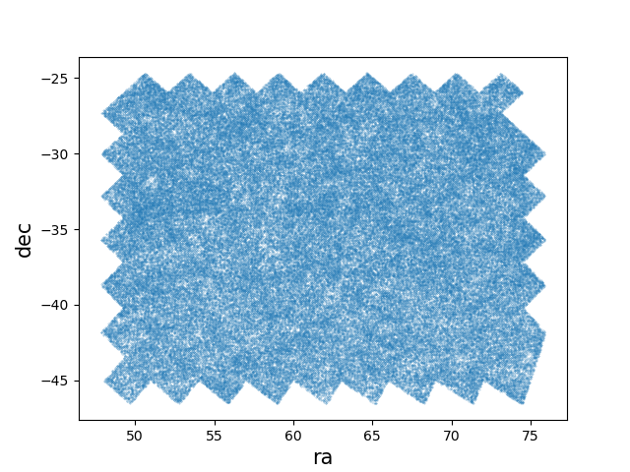

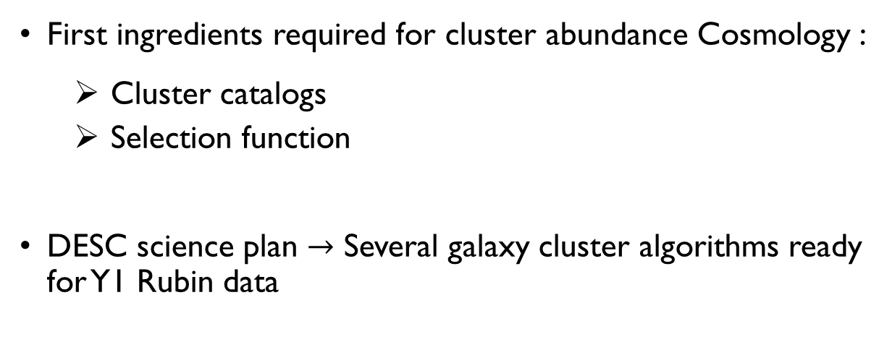
DESC science requirements
cosmoDC2 sky map
First ingredients required for cluster abundance Cosmology :
  Cluster catalogs
  Selection function
DESC science plan $→$ Several galaxy cluster algorithms ready for Y1 Rubin data
Nathan Amouroux

Slide 3
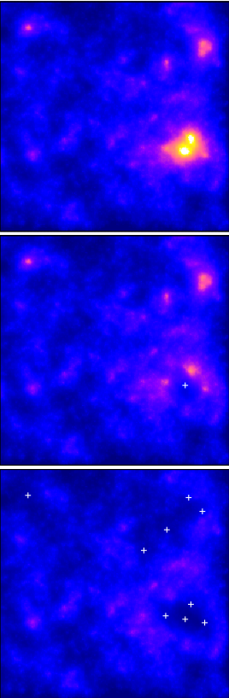
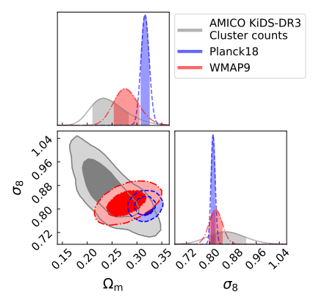
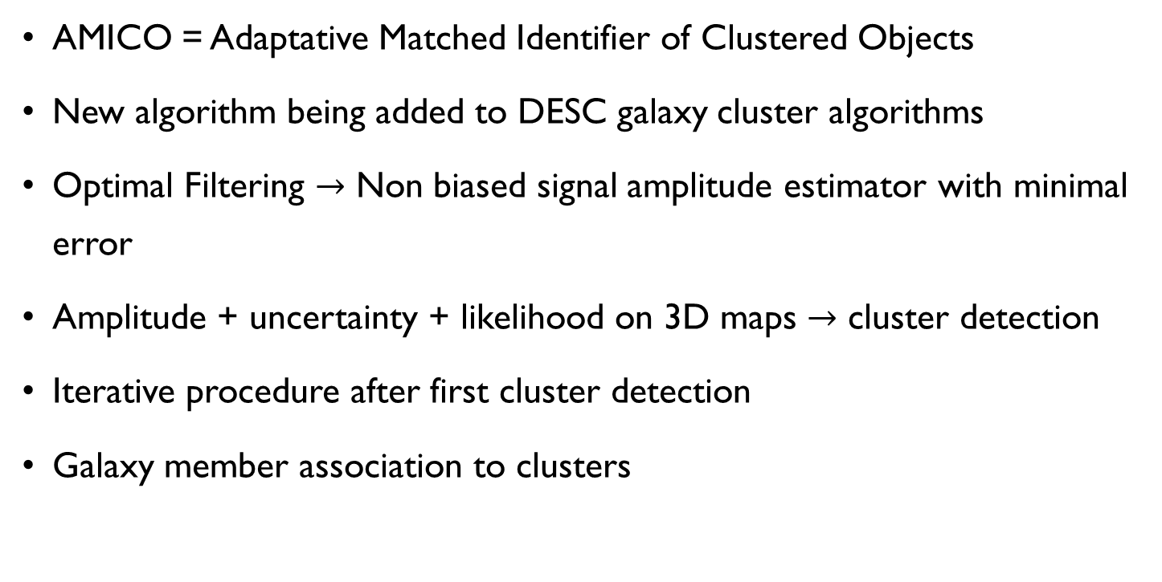
AMICO algorithm
AMICO = Adaptative Matched Identifier of Clustered Objects
New algorithm being added to DESC galaxy cluster algorithms
Optimal Filtering $→$ Non biased signal amplitude estimator with minimal error
Amplitude + uncertainty + likelihood on 3D maps $→$ cluster detection
Iterative procedure after first cluster detection
Galaxy member association to clusters
1x1 deg2 Amplitude map
arXiv:1705.03029v2
KiDS constraints with AMICO
Nathan Amouroux

Slide 4
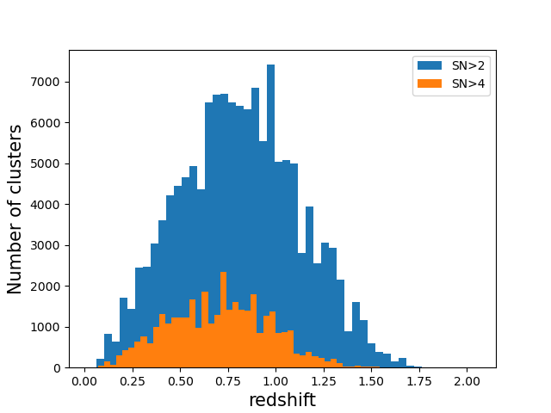
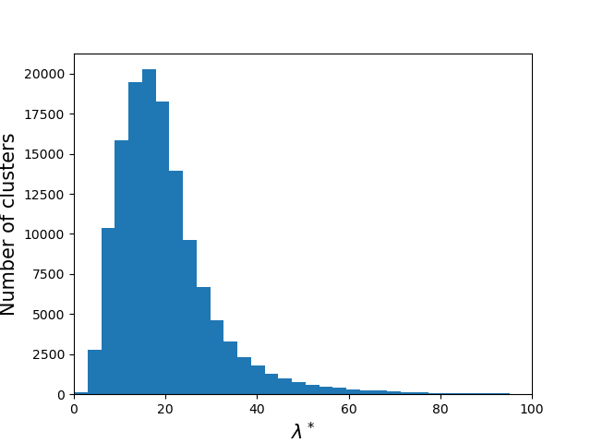
AMICO on cosmoDC2 catalogs
This work : AMICO run on i-band with magi < 25.3
AMICO gives two tables :
  Cluster table → redshift, position, richness, …
  Galaxy member table → associated cluster id + membership probability, magnitudes, field probability
Nathan Amouroux

Slide 5
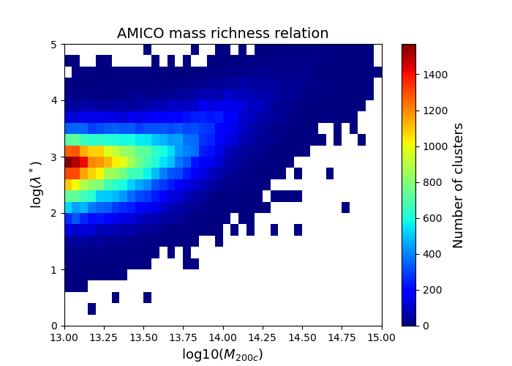
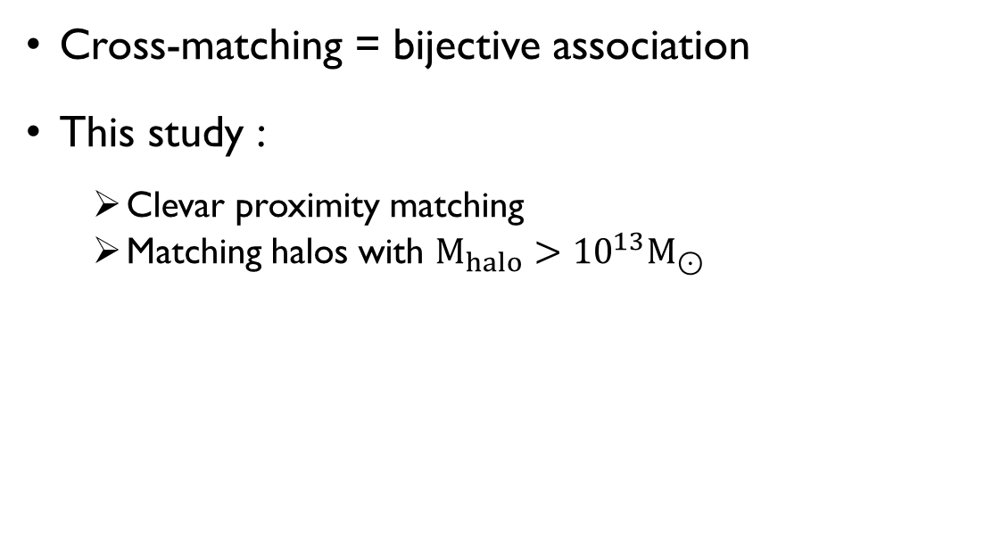
Matching procedure
Cross-matching = bijective association
This study :
  Clevar proximity matching
  Matching halos with $M_{halo}>{10}^{13}M_{⊙}$
 | Nall | Ncross | Nexcl
AMICO | 135 916 | 110 954 (82%) | 24 962 (18%)
M200c ≃ 1014 ➡ λ* ≃ 35
Nathan Amouroux

Slide 6
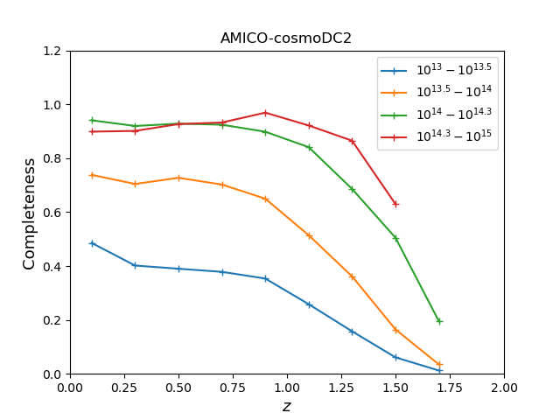
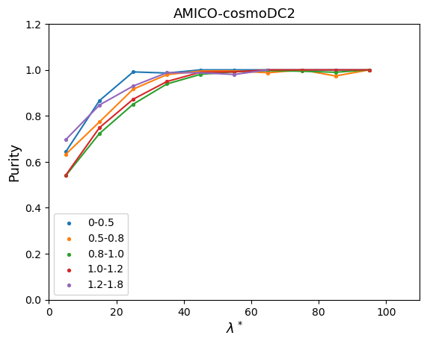
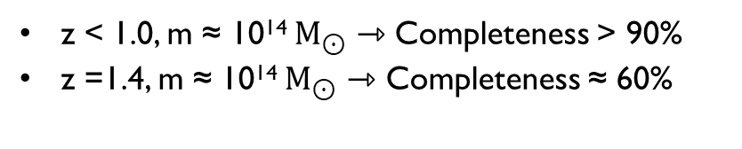
Completeness and purity
Completeness(m,z) = Ncross matched clusters/Nhalos (m,z)
Purity (m,z) = Ncross matched halos/Nclusters(m,z)
z < 1.0, m ≈ 1014 $M_{⊙}$ ⇾ Completeness > 90%
z =1.4, m ≈ 1014 $M_{⊙}$ ⇾ Completeness ≈ 60%
λ* > 30 ⇾ Purity > 90%
Nathan Amouroux

Slide 7
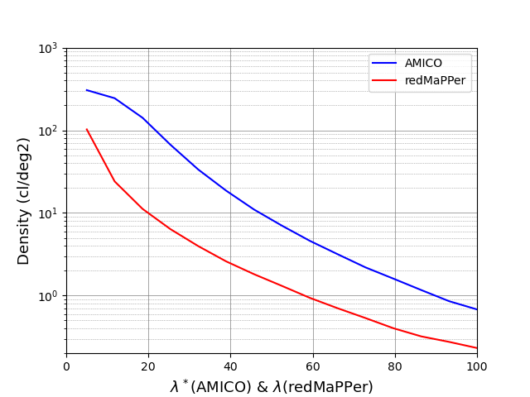
Comparison to redMaPPer
Before cuts : N_clustersAMICO ≃ 136000, λAMICO> 0
N_clustersRedMapper ≃ 46000, λRedMapper > 5
We want to define relevant cuts to get similar densities
Richness definitions are not the same
After cuts matching results
(z ∊ [0, 1.15], λRM ≥ 14 & λAMICO ≥ 38)
 | Nall | Ncross | Nexcl
AMICO | 8219 | 4749 (57%) | 3470 (43%)
redMaPPer | 7892 | 4749 (60%) | 3143 (40%)
Nathan Amouroux

Slide 8
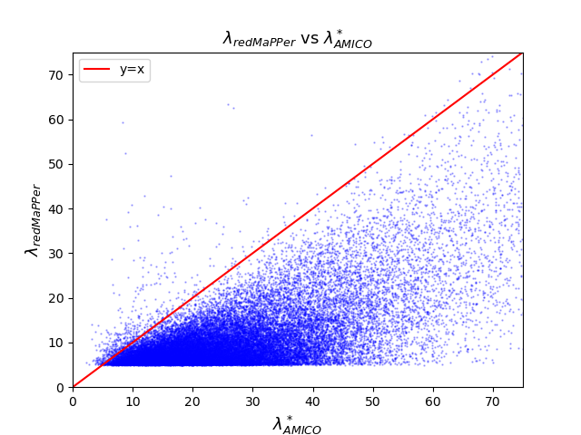
Richness correlation
Higher richness values for AMICO
Large AMICO dispersion at given value (λRedMapper = 20 →λ*AMICO~ [25, 50])
Next slides clusters are from those cuts
Nathan Amouroux

Slide 9
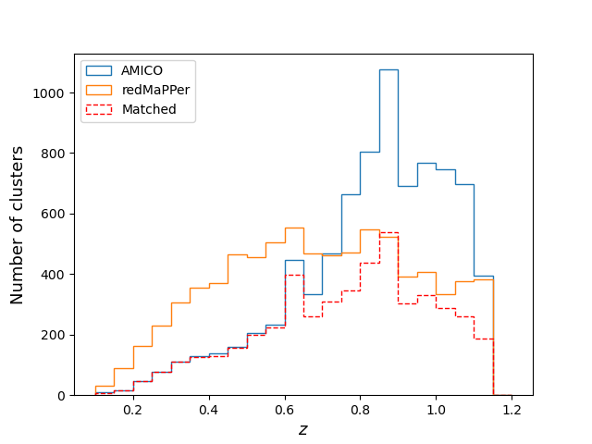
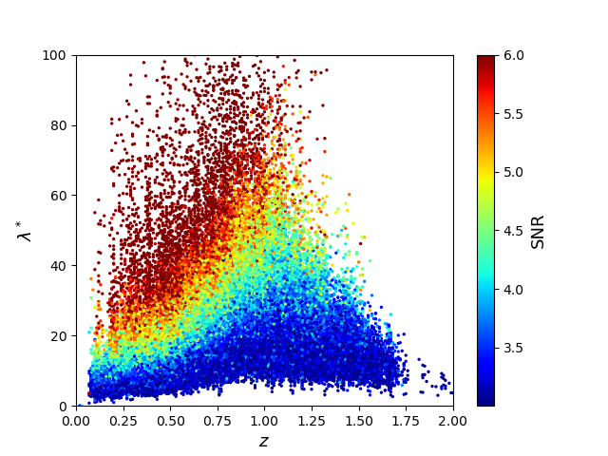
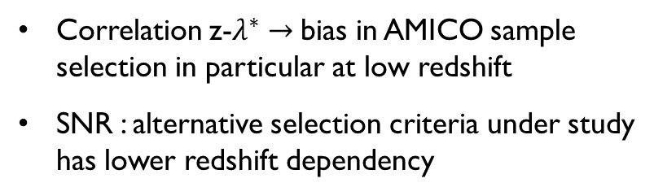
Redshift distributions
High richness samples have significantly different distributions
Correlation z-$λ^{∗}→$bias in AMICO sample selection in particular at low redshift
SNR : alternative selection criteria under study has lower redshift dependency
Nathan Amouroux

Slide 10
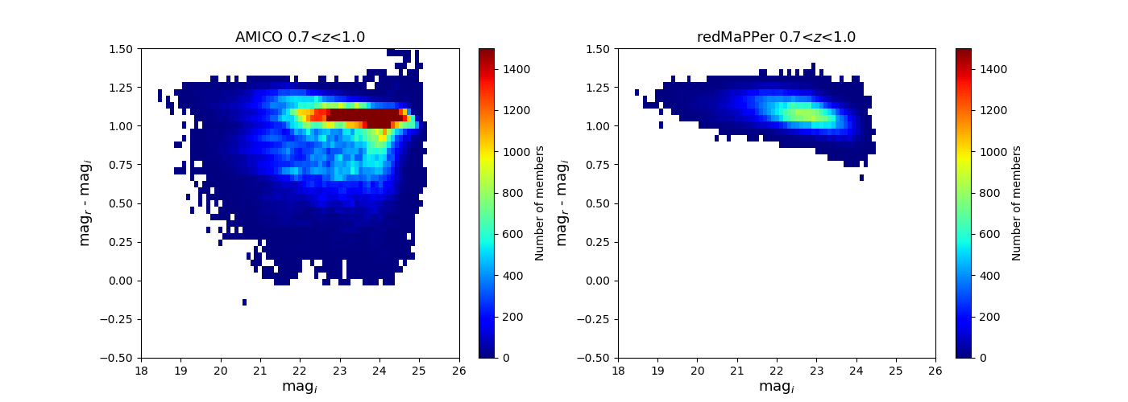
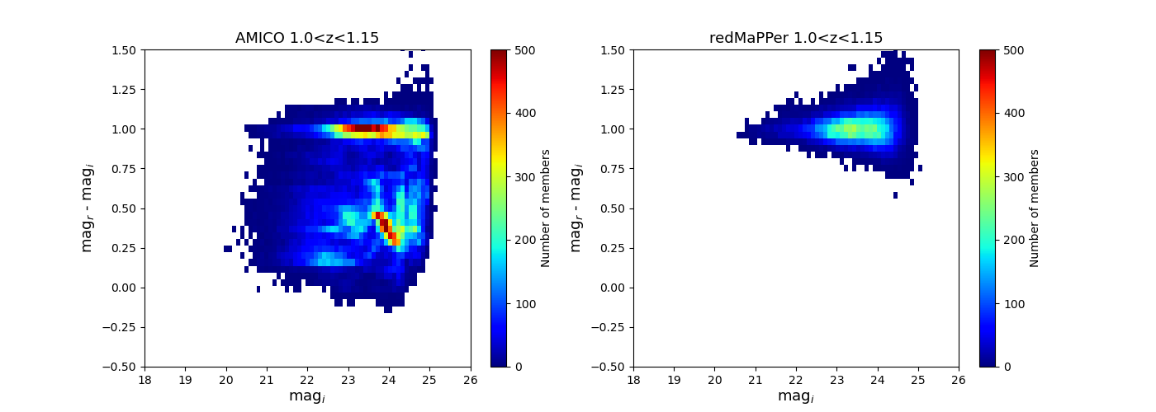
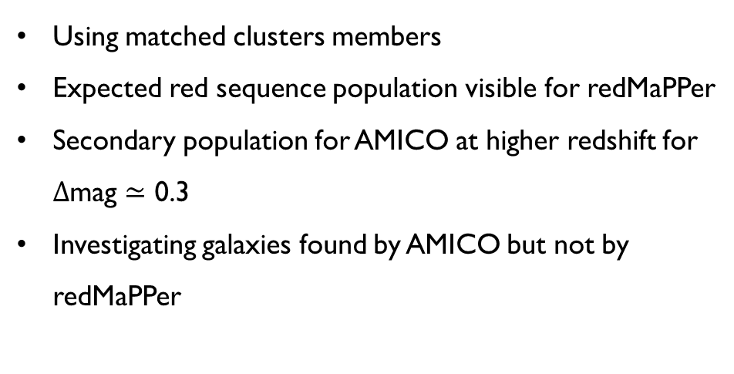
Colors of member galaxies
Using matched clusters members
Expected red sequence population visible for redMaPPer
Secondary population for AMICO at higher redshift for $Δ$mag $≃$ 0.3
Investigating galaxies found by AMICO but not by redMaPPer
Nathan Amouroux

Slide 11
Conclusion
AMICO run on cosmoDC2 catalog soon avaible in DESC
First algorithm performances estimated
First AMICO-redMaPPer comparison, focused on high richness clusters
NEW : AMICO just run on DC2 data
Nathan Amouroux

