Slide 1

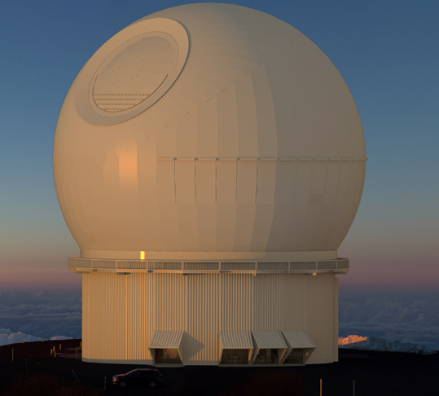
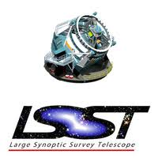
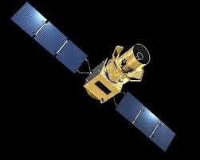
The path of cosmology
in the decade
Ch. Yèche (CEA-Saclay Irfu)
DESI
Euclid
SPEC-S5
MSE
WST
LiteBIRD
Journée de la SFP, Division Champ & Particules
LPNHE Jussieu – July 10, 2023

Slide 2
Outlines
History and Basics of Cosmology
CMB and H₀ controversy
BAO and Dark Energy
Inflation
Neutrino Masses

Slide 3
History and Basics of Cosmology
3

Slide 4
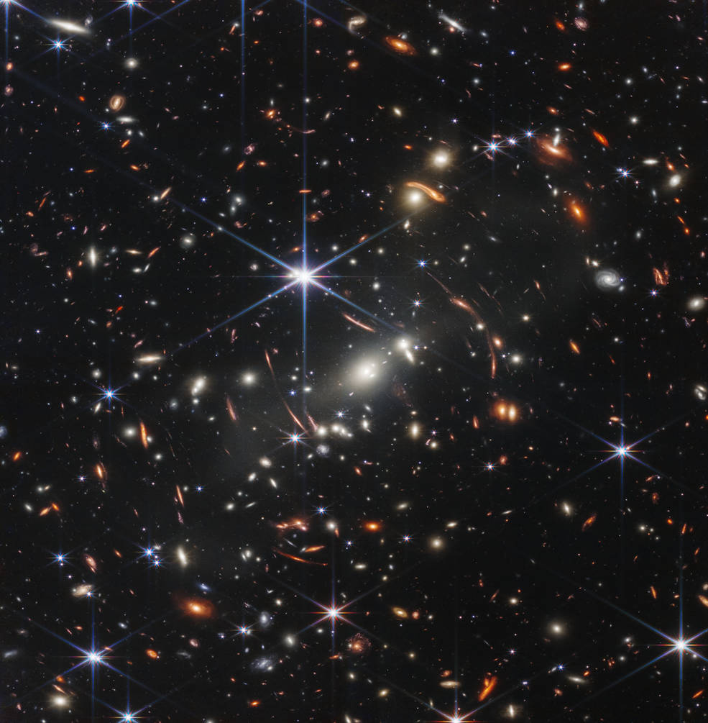
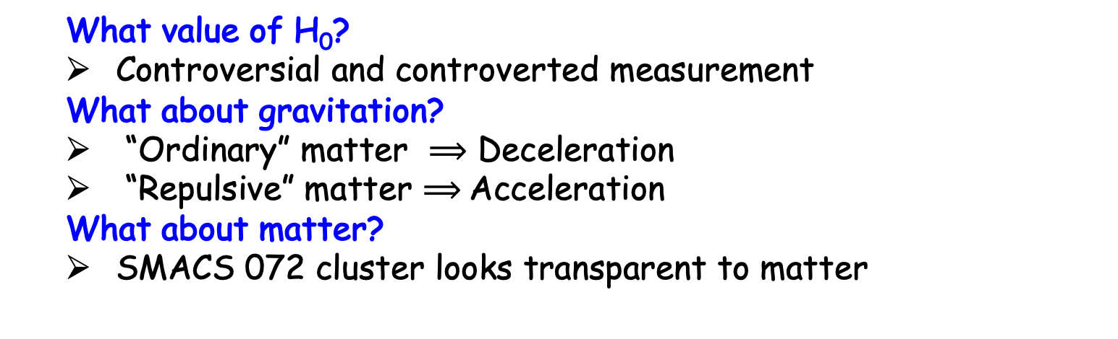
1929 - Expanding Universe
Hubble’s law: V=H₀d
Discovery by Lemaitre and Hubble
Measurement of the velocity V of galaxies with their redshift (z)
  z=(λ-λ₀)/λ₀
Illustration with the SMACS 0723 galaxy cluster (8.10¹³m⊙ R_{vir}=2.4Mpc) observed by JWST
JWST
0.7Mpc at z=0.39
  What value of H₀?
  Controversial and controverted measurement
  What about gravitation?
  “Ordinary” matter $⟹$ Deceleration
  “Repulsive” matter $⟹$Acceleration
  What about matter?
  SMACS 072 cluster looks transparent to matter
4

Slide 5
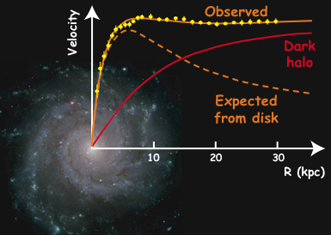
1970 - Dark Matter
Newton Law
Constant rotation curve
Halo of
Dark Matter
Milky Way:
M_{halo}~ 10 x M_{visible}
Galactic rotation curves
Final proof by measuring the velocity of stars within galaxies
Work of Vera Rubin and Kent Ford in the 70’

Slide 6
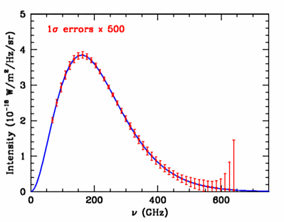
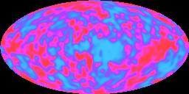
1964 - CMB discovery
COBE-FIRAS
COBE-DMR
380 000 years: Recombination: Universe becomes transparent.
1964: Discovered ”by chance” by Penzias and Wilson
(uniform radio “noise” at 7.5 cm ⟶ 2.7 K)
1989-1992: Satellite COBE
  Perfect black body with a temperature T=2.725K !
  Extremely small anisotropies of 1/10000 degrees….

Slide 7
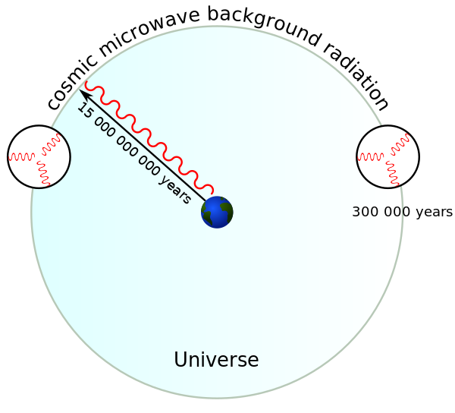
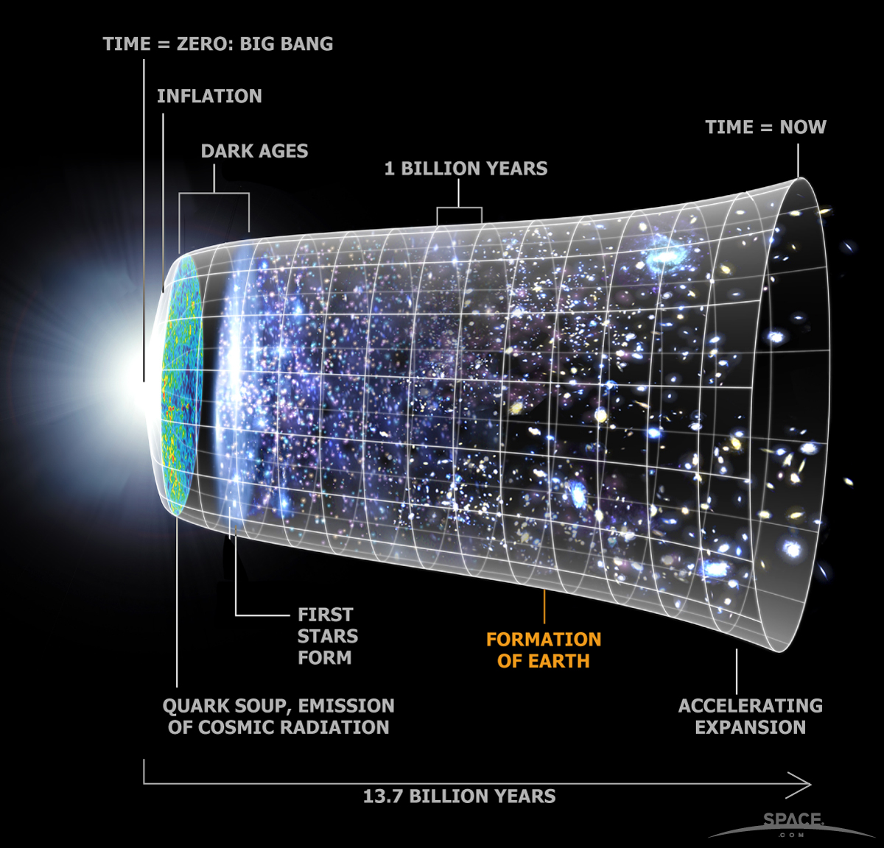
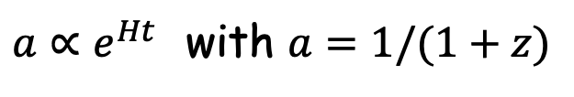
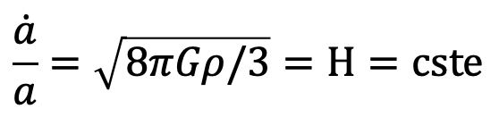
1979 - Inflation
Horizon problem
Two photons in opposite direction cannot communicates between them.
Temperature of CMB almost identical in all the directions.
A simple solution: very fast inflation of the Universe (A. Guth 1979)
Deep field
observed by HST
Inflation framework
Density energy stay almost constant
Typically, the Universe expanded by a factor of about e⁶⁰ at 10⁻³⁶s (after GUT)
$$\frac{\dot{a}}{a}=\sqrt{8πGρ/3}=H=cste$$
$a∝e^{Ht }$ with $a=1/(1+z)$
7

Slide 8
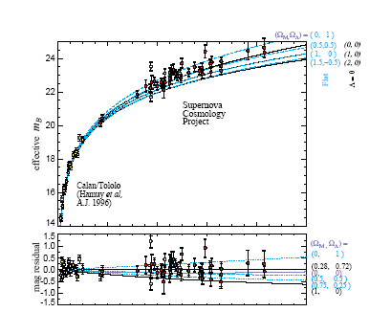
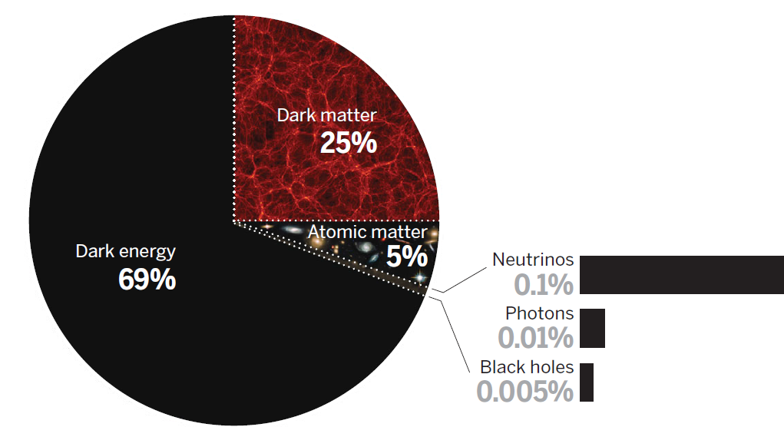
1998 - Dark energy
Acceleration of Universe expansion
In 1998 revolution of cosmology with standard candles, SNIa
  SNIa were dimmer (~0.2 mag), ~10% further away than expected with Ω_{m} =1 (only ‘ordinary’ matter)
Perlmutter,
et al. (1998)
0.0
Redshit
1.0
Content of the Universe
2/3 of Dark Energy repulsive for gravitation
1/3 of “classical” matter
CMB
8
Notes:
8

Slide 9
CMB
-
H₀ controversy
9

Slide 10
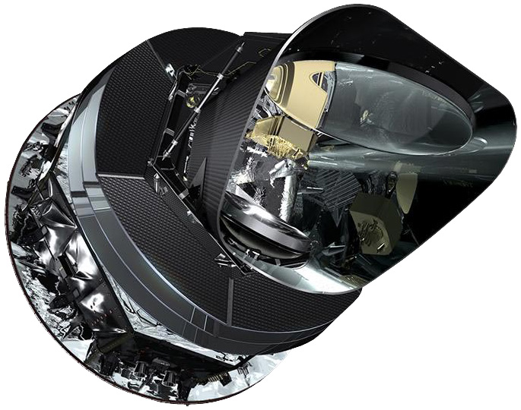
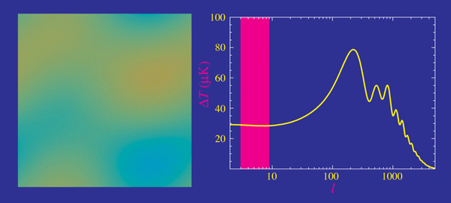
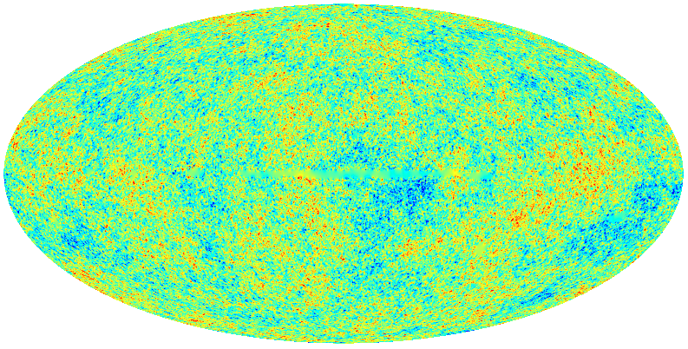
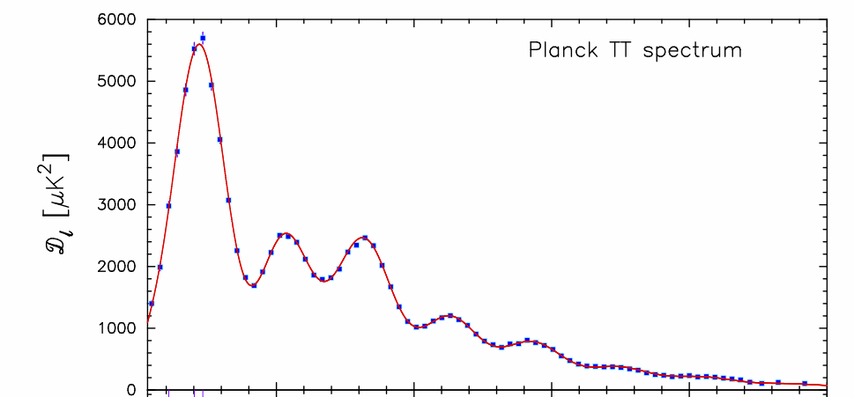
What do we learn with these maps?
Planck Satellite (2009)
1st peak
Position: curvature and Dark Energy
Amplitude: baryonic matter
Temperature fluctuations
CMB anisotropies
Angular size of the fluctuations
Conversion : angle θ→multipôle l = 180^{O}/θ
Ratio 1st peak/3rd peak
Dark Matter/baryon
0 500 1000 1500 2000 2500
Large scales
Small scales

Slide 11
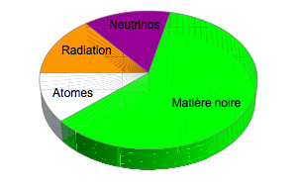
Universe content seen by Planck
  Starting from power spectrum (acoustic oscillations), we derive the content of the Universe, 380 000 years ago.
Light particles relativistic (neutrinos)
Radiation (photons)
Dark Matter
(SUSY, axions..)
Atoms
(ordinary matter, hydrogen, helium)

Slide 12
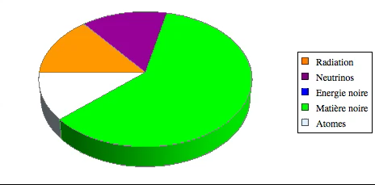
From CMB to today
From Friedmann equation, we can predict the evolution of Universe components
CMB provides a prediction for H₀ that can be compared to H₀ locally measured by supernovae
Dark
Energy
Atoms
(gas, stars, planets)
Dark Matter

Slide 13
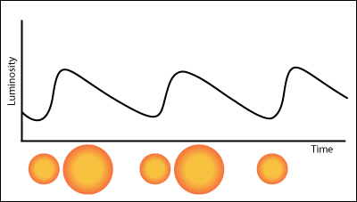
Local measurement of H₀
Distance ladder
  Parallaxes
  Cepheids
  SN-Ia
Comparison to CMB
  Indirect measurement of H₀ through the evolution of the Univers assuming ΛCDM since CMB (z=1100)
5σ tension
CMB: H₀ = 67.7 ± 0.4
SNIa: H₀ = 73.0 ± 1.0
  L_{obs}∝ L₀/R²
  Period of cepheid → L₀
SN-Ia with cepheids
in their host galaxy
Distant SN-Ia providing the H₀ measurement
Local cepheids
calibrated by their parallax
Riess et al., 2022
13

Slide 14
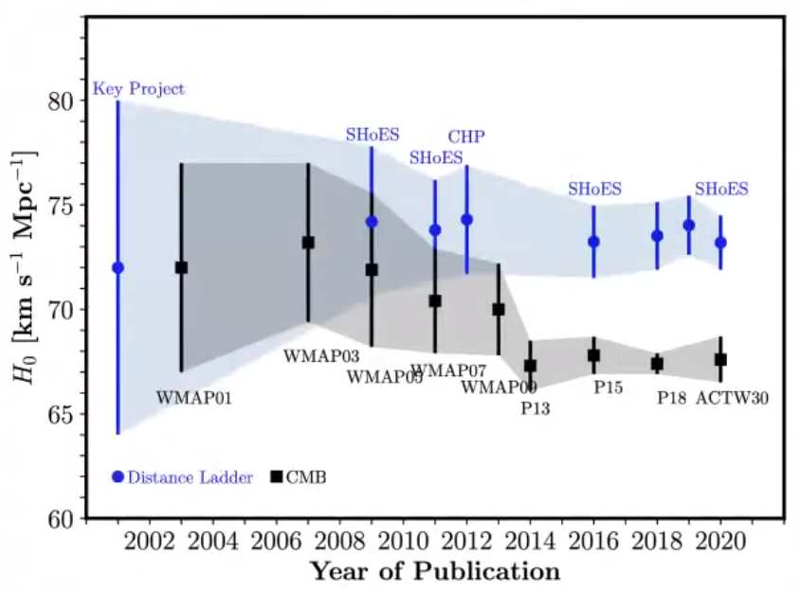
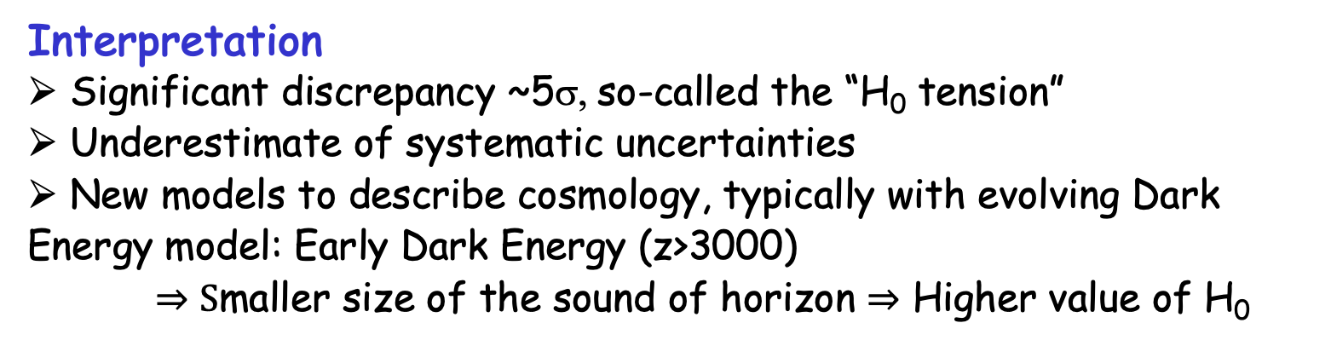
Comparison CMB/Distance ladder
Interpretation
Significant discrepancy ~5σ, so-called the “H₀ tension”
Underestimate of systematic uncertainties
New models to describe cosmology, typically with evolving Dark Energy model: Early Dark Energy (z>3000)
    $⇒S$maller size of the sound of horizon $⇒$ Higher value of H₀
14

Slide 15
Dark Energy
-
BAO
15

Slide 16
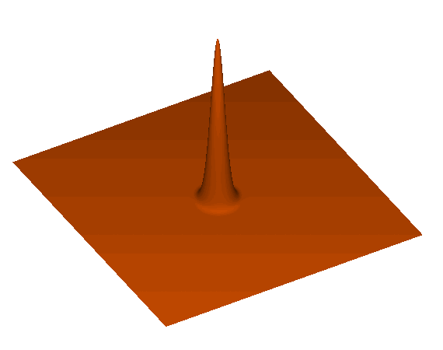
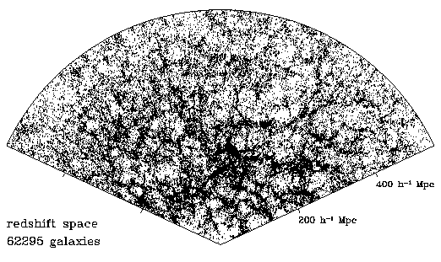
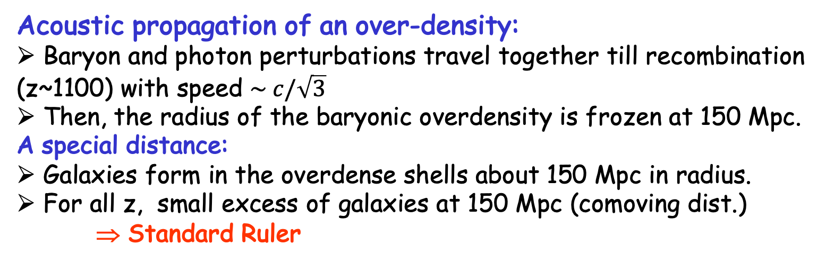
Baryonic Acoustic Oscillations
Acoustic propagation of an over-density:
Baryon and photon perturbations travel together till recombination (z~1100) with speed $\sim c/\sqrt{3}$
Then, the radius of the baryonic overdensity is frozen at 150 Mpc.
A special distance:
Galaxies form in the overdense shells about 150 Mpc in radius.
For all z, small excess of galaxies at 150 Mpc (comoving dist.)
⇒ Standard Ruler
16

Slide 17
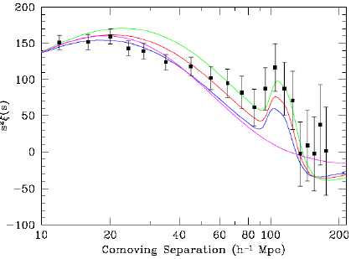
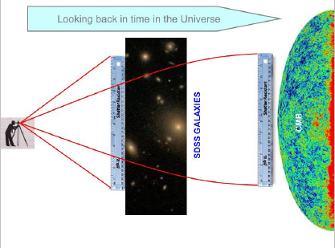
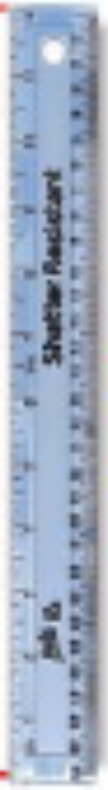
2005 - Observation of BAO
First observation:
In 2005: First observations of baryonic oscillations by 2 teams (2dFGRS and SDSS)
SDSS observe a peak at ~150 Mpc
SDSS: ~50 000 LRGs <z> ~ 0.35
SDSS
Standard Ruler
D. Eisenstein et al.,
ApJ, 633, 560 (2005)
A 3D measurements:
Position of acoustic peak
Transverse direction:
Δθ = r_{s}/(1+z)/D_{A}(z)
⇒ Sensitive to angular distance D_{A}(z)
Radial direction (along the line of sight)
Δz = r_{s}⋅H(z)/c
⇒ Sensitive to Hubble parameter H(z).
Δθ
Δz
17

Slide 18
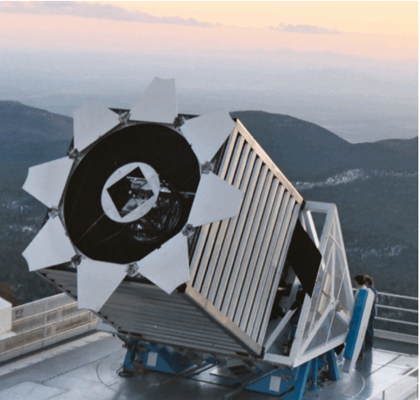
SDSS: 2009-2019
Sloan Telescope
D:2m, FoV~7deg²
BOSS (2009→2014)
1.2 millions of Luminous Red Galaxies (LRG)
  - 0.15<z<0.7
170 000 quasars
- z>2.1, HI absorption)
eBOSS (2014→2019)
Redshift of LRG extended to 0.8
Emission Line Galaxies (ELG): star forming galaxies, z~0.85
Quasars direct tracers
  - 0.9<z<2.2
18

Slide 19
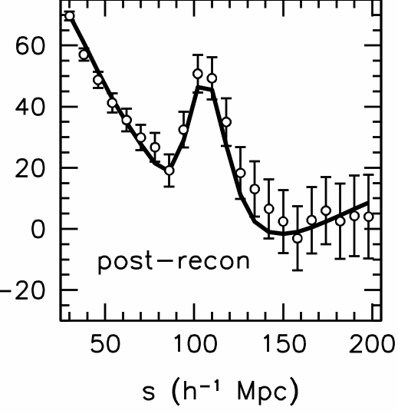
BAO with galaxies and quasars
Confirmation with BOSS in 2012
  Redshift range 0.15<z<0.7
  BOSS-only 8-σ observation of BAO
Even better with eBOSS in 2O20
  Redshift range 0.15<z<2.5
BOSS
~ 1M Luminous
Red Galaxies
Agreement with Planck
  BAO scales consistent with Planck
  Consistency of cosmological measurements

Slide 20
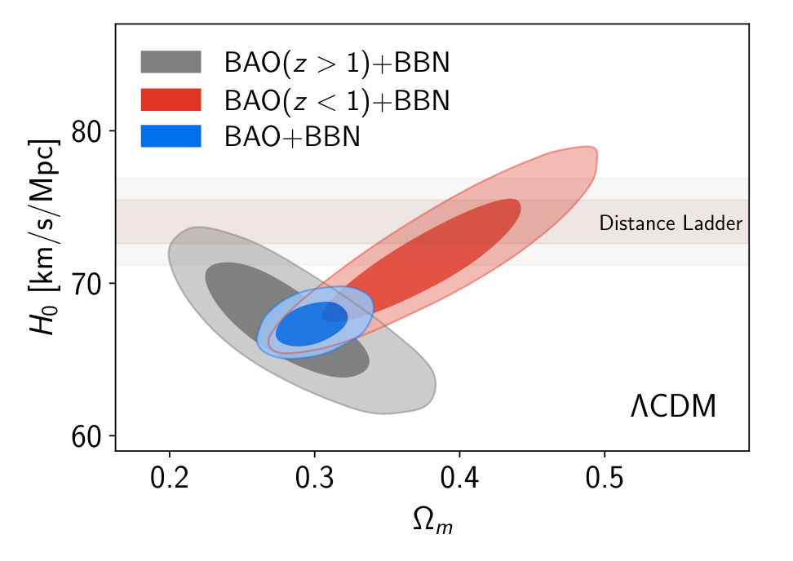
H0 controversy - Dark Energy
With BAO and Big Bang Nucleosynthesis (BBN)
  Observation of Dark Energy (Ω_{Λ}~0.7)
  Confirmation of Planck value for H₀
20

Slide 21
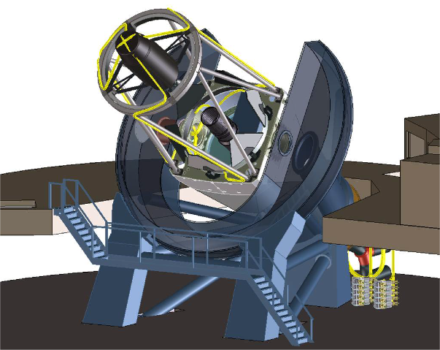
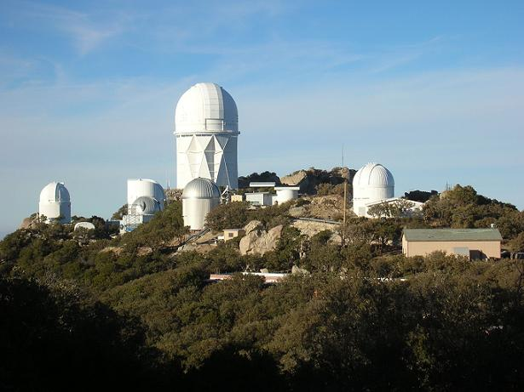
DESI 2021-2026
5000 fiber positioner
New corrector
~ 7 deg²
Scientific Project
1/3 of the sky
3D survey for 0<z<4
International collaboration
74 institutions (46 non-US)
Mayall
4-m
Télescope
Mayall
Telescope
10 spectrographs
Instrument
4-m telescope at Kitt Peak (Arizona)
Wide FoV (~ 8 deg²)
Robotic positioner with 5000 fibers
10 spectrographs x 3 bands (blue, visible, red-NIR) ➝360-1020 nm
21

Slide 22
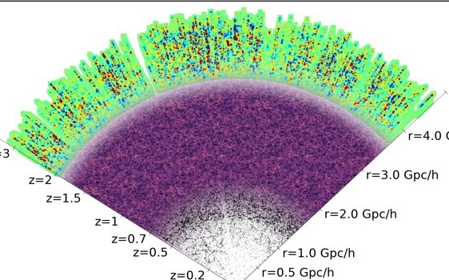
DESI tracers of the Matter
Five target classes
~40 million redshifts
in 5 years over 14000 deg²
3 million QSOs
  Ly-α z > 2.1
  Tracers 0.9 < z < 2.1
4
12 Gyr
16 million ELGs
0.6 < z < 1.6
2
10 Gyr
Redshift
8 million LRGs
  0.4 < z < 1.0
1
8 Gyr
Lookback time
0.7
13.5 million
Brightest galaxies
  0.0 < z < 0.4
0.2
2 Gyr
22
Notes:
22

Slide 23
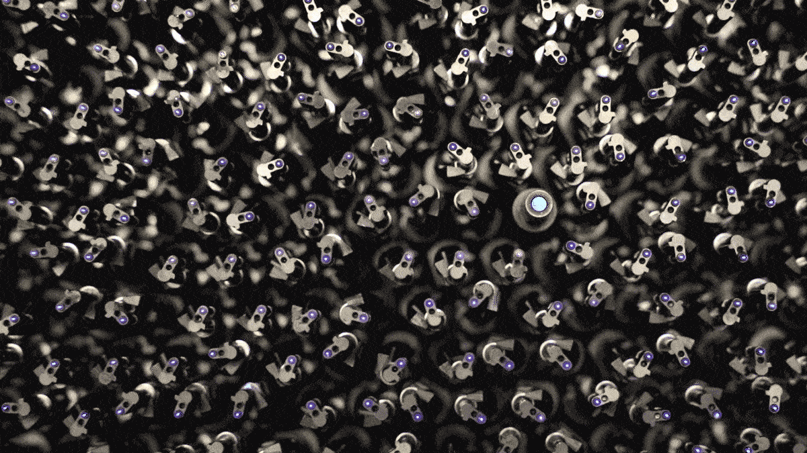
Status of DESI
First two
months of DESI
Corrector
Very efficient instrument with 5000 robotic fiber positioners and 10 spectrographs built in France
May 2021: Science Survey started!
~55% of the survey already covered
23
Notes:
23

Slide 24
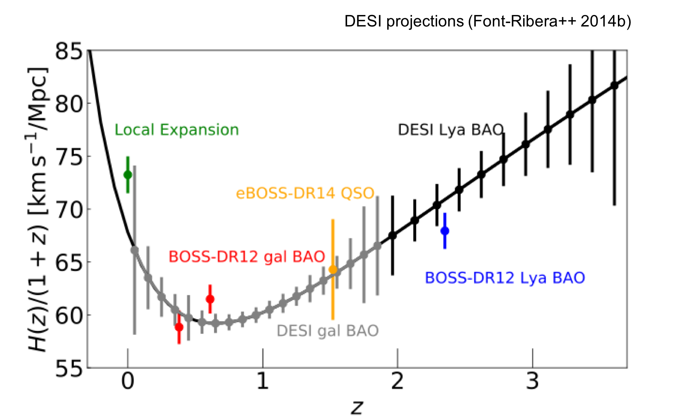
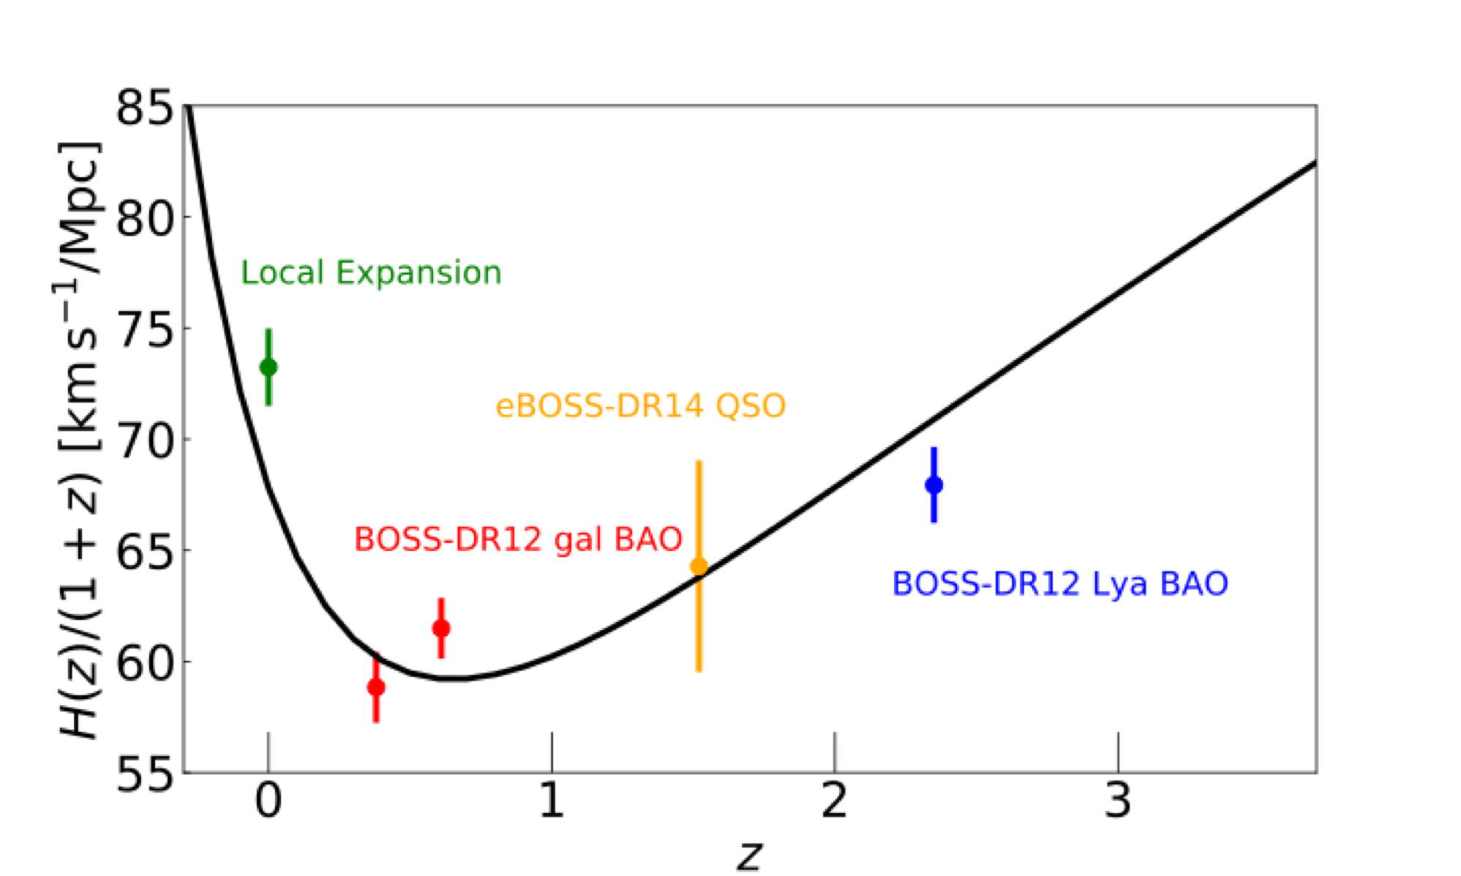
Science with DESI
BAO
Improvements compared to SDSS
  BAO: 1 order of magnitude better σ(α) ~ 0.1%
24

Slide 25
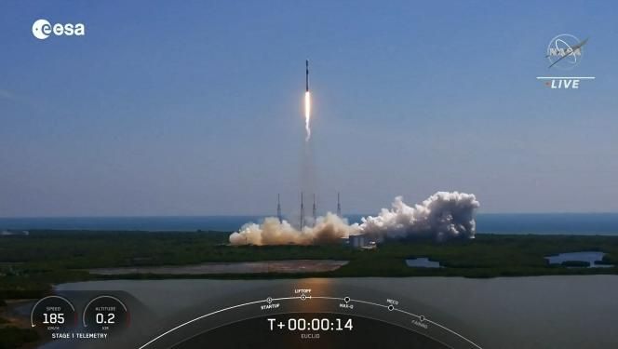
Euclid 2023-2029
Instrument
ESA Satellite launched on July 1st to L2
6 year program
14 countries + 1100 members
1.2m telescope with 0.5 deg² FoV
Two instruments (VIS, NISP)
Slitless NIR spectrograph (1 blue and 3 red grisms) ➝1000-2000 nm
Mayall
4-m
Télescope
Scientific Project
15000 deg² survey for 0.9<z<1.85
50M galaxy spectra with R~250
Redshift determined with Hα line
Weak lensing (WL), not covered in this talk
25

Slide 26
Euclid performances in BAO
Improvements with Euclid
  For BAO in the 1<z<1.6 region
  (but the gain is cosmic variance limited)
  Higher in redshift, up to z~1.8 even z~2.0 (region not covered by DESI)
  More galaxies (>50M galaxies to compare to ~40M for DESI)
  Very efficient for other science not covered in this talk:
    Redshift Space Distortion
    Weak Lensing
    Cross-correlation (RSDxWL)
0.1
BOSS (2009-2014)
eBOSS (2014-2019)
DESI (2021+)
Euclid (2023+)
Sensitivity on BAO scale
0.01
0
1
2
3
Redshift z
26

Slide 27
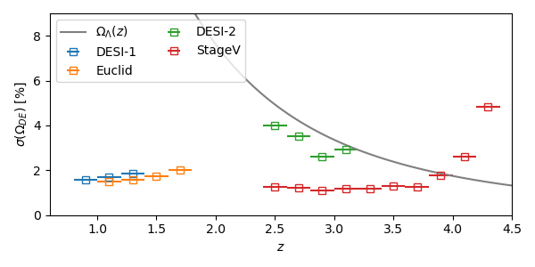
Future Spectroscopic Surveys
SPEC-S5/MSE/WST in a nutshell
Many projects with comparable sensitivity and topics by 2035
~10k to 20 k fiber positionners
Diameter: 6.5 to 11m
Main goal: distant Universe with tracers for 2<z<4.5
ΛCDM prediction
of Dark Energy
SPEC-S5
MSE
WST
DESI/Euclid
SPEC-S5
27

Slide 28
Inflation
1) CMB polarization
2) Non-gaussianities
28

Slide 29
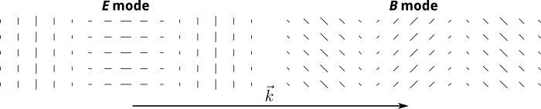
Inflation and CMB polarization
Deep field
observed by HST
Wave vector k
Observation of B modes
CMB is polarized (Thomson scattering over free electrons)
E modes: parallel or perpendicular to k
B modes: rotated by 45º with respect to k
Prediction of inflation: in addition, production of B-mode with GW at angular scales of a degree or larger.
Amplitude of the B modes depends on the inflation models
Ratio r: amplitude of tensor / amplitude of scalar
29

Slide 30
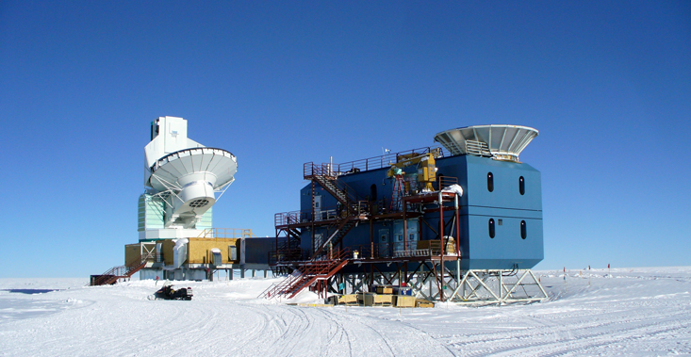
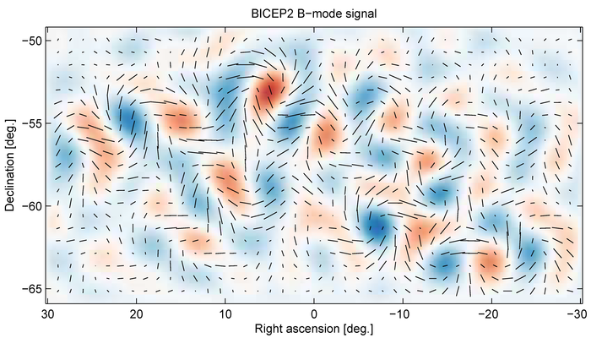
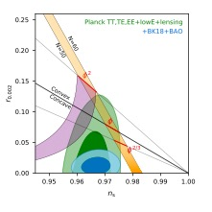


Current status on r
BICEP2 = South pole
ground experiment
Constraints on inflation
  r<0.1 with Planck
  Constraint three time better with BICEP2
  Sensitivity at the order of σ_{r}~0.01
  Many models still possible
  Slow roll models with V’’(Φ)<0 are favored
  σ_{r}~0.003 expected by ~2028
r
$${Spectral index: n}_{s}$$
$$n_{s}=dP_{CMB}(k)/dln(k)$$
30

Slide 31
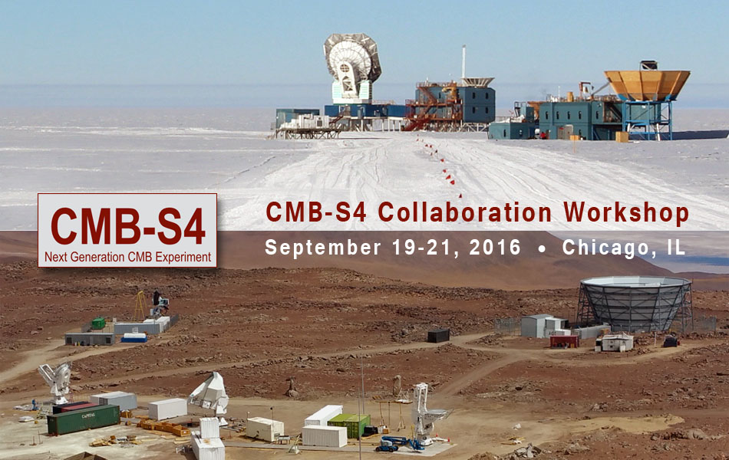
Future CMB programs
Complementary approach
Deep field
observed by HST
Satellite Mission: LiteBird (2029)
  Project selected by JAXA
  International collaboration
  Low resolution ~5’
  15 frequencies
  80 bolometers
Ground Mission: CMB-S4 (~2030)
  High resolution ~1’
  Only a few frequencies
  ~500 000 bolometers
  Combine several sites (SP, Atacama)
  Adiabatic evolution from existing programs (ACTPol, BICEP/Keck, Simons Obs…)
31

Slide 32
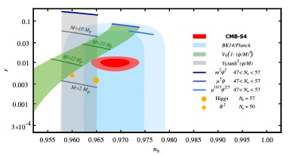
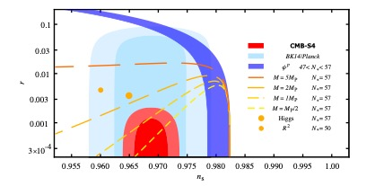


Forecasts on r
Measurement
Deep field
observed by HST
r
LiteBIRD or CMB-S4 have both sensitivity at the order of σ_{r}~0.001
Winning bet
if 0.003<r<0.01
In addition, LiteBIRD measures τ (see later for neutrino masses)
$$n_{s}$$
Limit
r
$$n_{s}$$
32

Slide 33
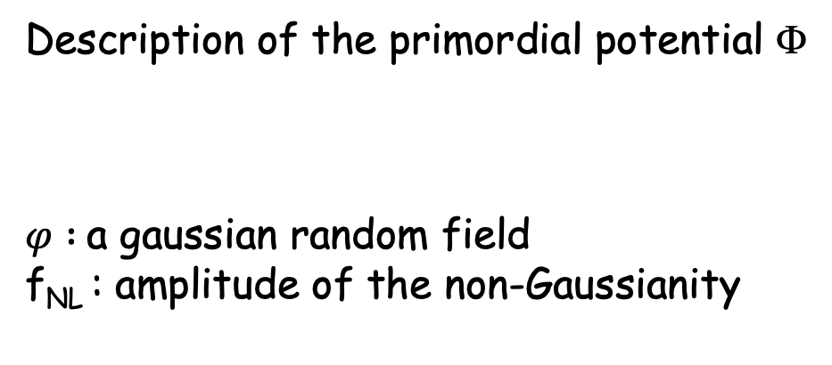

Inflation and non-gaussianity
Description of the primordial potential Φ
$φ :$a gaussian random field
f_{NL} : amplitude of the non-Gaussianity
$$Φ=φ+f_{NL}.(φ^{2}−<φ^{2}>)$$
Primordial non-gaussianities: a test of inflation
  Inflation also provides an explanation for the origin of the primordial perturbations
  Primordial fluctuations distributed almost Gaussian with the simplest slow-roll models f_{NL} ~ O(10⁻³)
  Alternative inflation models (multi-fields) predict f_{NL} > 1
  3D galaxy surveys with a large volume can achieve σ(f_{NL})~1
DESI
33

Slide 34

Ground: Forecast for f_{NL}
SPEC-S5/MSE
Quasars
alone
A picture of primordial Universe
  CMB is cosmic variance limited : σ(f_{NL})~5
  f_{NL} : the SPEC-S5/MSE quasars alone are as good as all DESI tracers combined or CMB.
  All tracers combined: total accuracy σ(f_{NL})~1.8
34

Slide 35
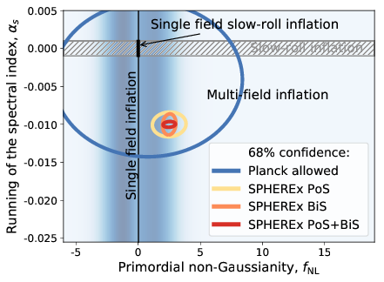

Satellite project for f_{NL}
SPHEREx
  NASA Medium-class mission – Launch in ~2025 – 2 years
  All sky survey with a small mirror (20cm) in NIR
  Redshift expected for ~400M galaxies (low resolution in z)
  Very aggressive sensitivity, σ(f_{NL})<1
  Discriminate multi- and single-field inflation models
$$a_{s}=d(n_{s})/dln(k)$$
35

Slide 36
Neutrino masses with multi-probes
36

Slide 37
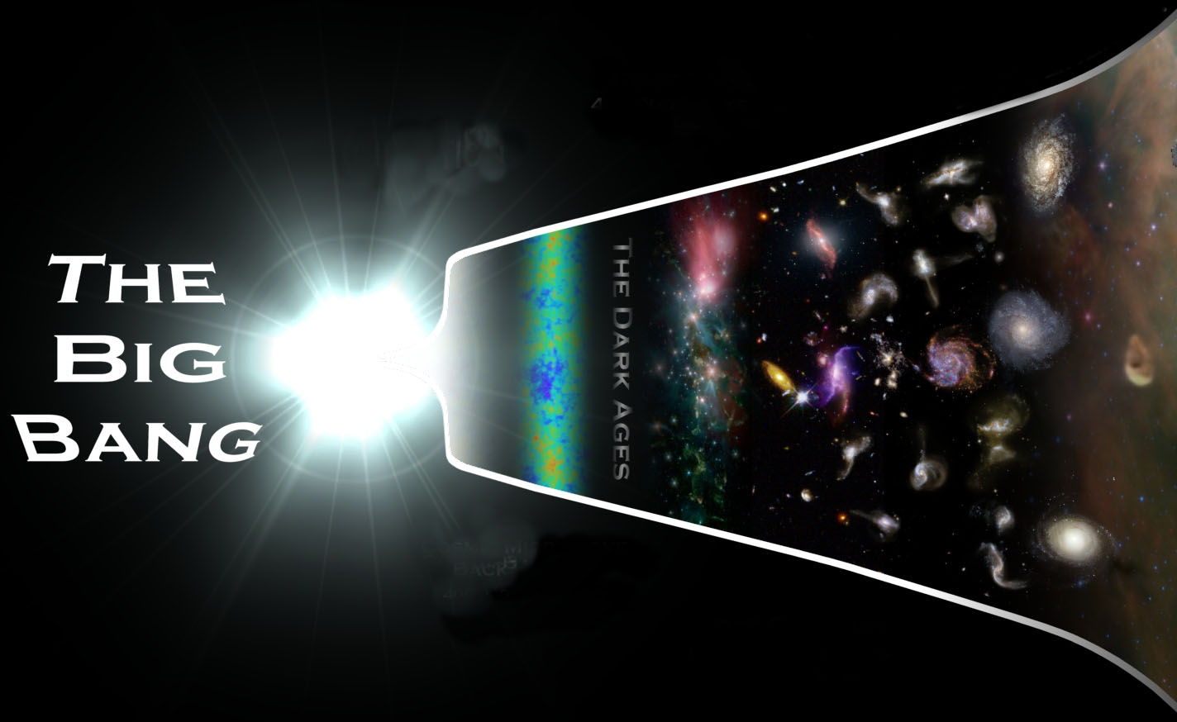
Cosmic neutrino background
At early times (T_{ν} ≫ m_{ν}), neutrinos contribute as radiation
At late times (T_{ν} ≪ m_{ν}), neutrinos contribute as matter
Non-relativistic transition
At recombination
m_{ν} < 0.6 eV (Σm_{ν} <1.7) : relativistic
m_{ν} > 0.6 eV (Σm_{ν} >1.7) : matter-like
Relativistic ν’s
Non-relativistic ν’s
Radiation
Matter
Dark energy
Cosmic Microwave
Background
Cosmic Microwave
Background
Cosmic Microwave
Background
N. Palanque-Delabrouille — Dec. 2, 2016
37
Large Scale structures
Large Scale structures
Large Scale structures
37
37
37
37

Slide 38


Free-streaming
Suppression of the small scales
ΛCDM massless neutrinos
ΛCDM massive neutrinos
38

Slide 39

Current limits on Σm_{ν}
Planck 2018
Palanque-Delabrouille , Yèche et al. (2019)
  With Planck 2018 alone:
    Σm_{ν} < 0.3 eV @95%CL
Ly-α combined with Planck 2018
  Σm_{ν} <0.10 eV @95%CL
BAO combined with Planck 2018
  Σm_{ν} <0.11 eV @95%CL
39

Slide 40

Neutrino Masses and Hierarchy
Δm² > 0
Δm² < 0
Σm > 60 meV
Σm > 100 meV
An answer to mass hierarchy with cosmological neutrinos
  Particles Physics: atmospheric and solar oscillations
  No constraint on absolute masses
  2 possible schemes: normal vs inverted hierarchy
  With σ(Σm_{ν})~20/12 meV, we measure the mass of the neutrinos with a precision better than 3σ/5σ
  With σ(Σm_{ν})~8 meV, we may have a decision at 5σ on mass hierarchy
40

Slide 41
DESI and Euclid forecast for Σm_{ν}
DESI
Euclid
DESI and Euclid combined with Planck give σ(m_{ν})~20 meV
41

Slide 42


Large Synoptic Survey Telescope
Rubin/LSST in a nutshell
  Site: Cerro Pachon in Chile.
  8.4 m (~6.5m) telescope with
  3.5 deg. FoV
  A 3.2-gigapixel digital camera
  15s exposure every 20s.
  Six filters ➝ 330-1080 nm
  Infrastructure almost completed
  Camera completed (important
  French participation)
  Science survey starts in 2025
Program for cosmology:
  Supernovae
  BAO with photo-z
  Weak lensing (3x2pt analyses)
42

Slide 43




Free-streaming and lensing
Gravitational weak lensing
JWST
CMB
early ISW
Lensing
Gravitational lensing of CMB
43

Slide 44

CMB-S4 and LSST forecast for Σm_{ν}
LiteBird
arXiv:1803.07561, S. Mishra-Sharma et al.
Degeneracy with other cosmological parameters (Ω_{k},w₀,w_{a},…)
Strong degeneracy between τ and m_{ν} for CMB lensing
Need a measurement of τ with CMB polarization (LiteBird)
LSST+S4+LiteBird gives σ(m_{ν})~14 meV
44

Slide 45
MSE :Forecast for Σm_{ν}
SPEC/S5/MSE
A most precise measurement of neutrino mass
  With CMB(S4+LiteBird), accuracy on neutrino masses σ(Σm_{ν})~8 meV
  Measure the neutrino masses and test the mass hierarchy
  Neutrino mass hierarchy at 5σ as precise as DUNE (ν beams)
45

Slide 46
Summary
46

Slide 47
Timeline of the projects in Cosmology
Euclid
LiteBIRD
DESI
SPEC-S5
MSE
WST
Ground: CMB-S4
2021 2023 2025 2029 2035/2040
French community involved in all the future cosmological projects
Dark Energy – Dark Matter -2025
  With BAO (DESI, Euclid) and LSST (BAO-2D & WL)
Inflation - Neutrinos – 2028-2032
  First constraints with 3D survey with DESI and Euclid
  With CMB (LiteBIRD,S4) and later SPEC-S5 (or similar)
DESI
47

Slide 48
Additional
Slides
48

Slide 49



H0licow – lensed quasars
4 images
of the same
quasars
Deep field
observed by HST
The lens:
a galaxy
Principles
Study of the time-delay for each image
Several lensed quasars
Quasar variability makes time delays measurable
Time delays: ~10 days
49

Slide 50

H0licow – lensed quasars
4 images
of the same
quasars
Deep field
observed by HST
The lens:
a galaxy
Principles
Study of the time-delay for each image
Several lensed quasars
Main uncertainty: quantification of the mass profile around the lensing galaxy
5.3σ
50

Slide 51


H0 and Gravitational Waves?
Principles
Binary neutron star merger
Measurement of distance with the GW
Measurement of the redshift with the optical counterpart (host galaxy)
Deep field
observed by HST
Prospects
Measurement at 10% with one BNS
~10 BNS merger expected by year
In O3, since April only 2-3 BNS alerts
Expect a few % of accuracy within a few years
H₀ = 70⁺¹²₋₈
51

Slide 52

Matter power spectrum
Analogy with sound: higher at certain frequencies
Real space ⟹ k-space (Mpc⁻¹)
Observation of “total” power spectrum with different tracers of the matter
Chabanier, et al. (2019)
Large scales
Small scales
k_{eq}
52

Slide 53

Impact on matter power spectrum
Impact in CMB-alone only for non-relativist neutrinos ⇒ ~1-2 eV limit
Free-streaming:
  Wash out the fluctuations
  Suppression of small scales in P(k)
Suppression factor ⟺ Σm_{ν}
⟺ f_{ν} = Ω_{ν}/Ω_{m}
Three probes directly sensitive to free-steaming
  Galaxy Power spectrum
  Weak lensing
  Ly-a absorption along the line of sight
CMB- lensing is similarly affected by free-steaming
z=4
0.5 eV
z=0
P(k) massive / P(k) massless
8f_{ν}
CMB
1.0 eV
Galaxy LSS
WL
1D Ly-α
Wavenumber k (h.Mpc⁻¹)
Large scales
Small scales
53

