Slide 1
First OSSR Open Collaboration Meeting
Kay GRAF
ECAP, Erlangen Centre for Astroparticle Physics, Friedrich-Alexander-Universität Erlangen-Nürnberg

Slide 2
Introduction

Slide 3
Introduction
Aim of the meeting
  First meeting of OSSR community after the end of the ESCAPE project
  Shape the future organization and set-up of the
  Open Software and Service Repository
    Discussion on organisation
    Establish bodies and roadmaps
  Onboarding of new software
  Three main areas of collaboration:
    Policy & Strategy
    Onboarding
    Technical Developments
Open meeting in an Open Collaboration
Round table of introductions and expectations

Slide 4
Future of ESCAPE
ESCAPE transforms into the ESCAPE Open Collaboration
  Partners use reasonable endeavours to achieve the objectives
  Work will be managed workplan and current organisational structure
  Partner contribute the time and effort necessary to complete the work
Work Plan (currently) with 12 points
  Common infrastructure, repository and catalogue for software, VRE, collaborative operations, citizen science, advanced technologies, HPC community, virtual software institute, career development, science projects, European Strategy for Data
Strive to include new partners
(e.g. for onboarding following “train the trainers”)

Slide 5
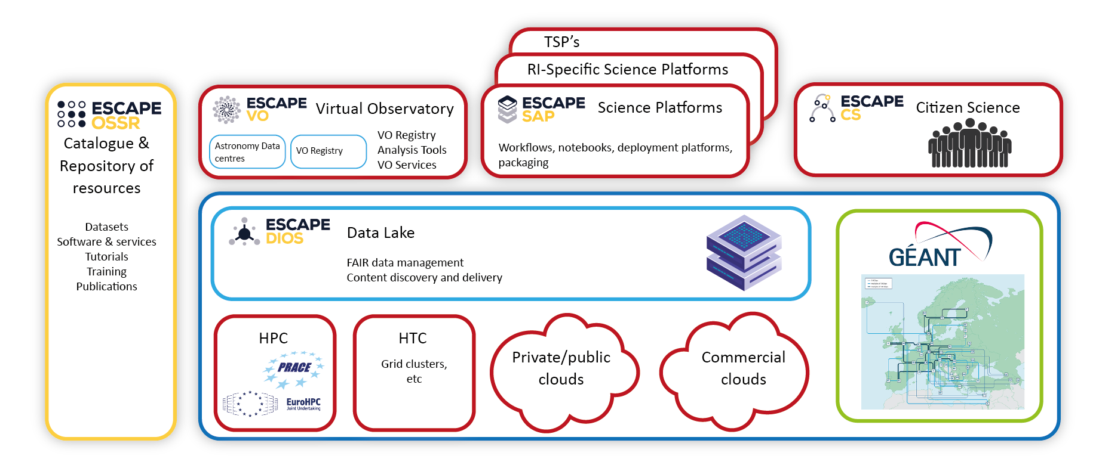
Current ESCAPE EOSC cell
Notes:
Data Lake:
Build a scalable, federated, data infrastructure as the basis of open science for the ESFRI projects within ESCAPE. Enable connection to compute and storage resources.
Software Repository:
Repository of "scientific software" as a major component of the “data” to be curated in EOSC. Implementation of a community-based approach for the continuous development of shared software and for training of researchers and data scientists.
Virtual Observatory:
Extend the VO FAIR standards, methods and to a broader scientific context; prepare the VO to interface the large data volumes of next facilities.
Science Platforms:
Flexible science platforms to enable the open data analysis tailored by and for each facility as well as a global one for transversal workflows.
Citizen Science:
Open gateway for citizen science on ESCAPE data archives and ESFRI community

Slide 6
ESCAPE EOSC cell evolve to
G. Lamanna,
ESCAPE to the Future
Notes:
Data Lake:
Build a scalable, federated, data infrastructure as the basis of open science for the ESFRI projects within ESCAPE. Enable connection to compute and storage resources.
Software Repository:
Repository of "scientific software" as a major component of the “data” to be curated in EOSC. Implementation of a community-based approach for the continuous development of shared software and for training of researchers and data scientists.
Virtual Observatory:
Extend the VO FAIR standards, methods and to a broader scientific context; prepare the VO to interface the large data volumes of next facilities.
Science Platforms:
Flexible science platforms to enable the open data analysis tailored by and for each facility as well as a global one for transversal workflows.
Citizen Science:
Open gateway for citizen science on ESCAPE data archives and ESFRI community

Slide 7
Introduction
Proposal: Organise meeting and bodies along the lines of
  Policy & Strategy
  Onboarding
  Technical Developments
  (can be adopted later on, but needed a start to organise today’s
  meeting and next activities)

Slide 8
Introduction
Round table of introductions and expectations
  Name
  Institute / project affiliation
  Interest in OSSR
  Possible contributions in the future, past contributions
  Expectation for this meeting

Slide 9
Policy Part

Slide 10
Timeline of this morning
Reporting; 45 min
  KG: Research Software Activities – Landscape
  DMA Activities
Coffee break; 20 min
Future Options and Roadmap; 30 min
  moderation: KG, support: Jutta Schnabel
Future organization of Policy Group; 30 min
  Organizing group, meetings & communication infrastructure
  Open meeting for innovation
  Publications

Slide 11
Landscaping

Slide 12
Landscaping
Research software is a necessary ingredient to science on par with data
  more and more acknowledged by national and international science organisation and recognised by funding
  Many bottom up and top down initiatives and projects focused on
In the following an incomplete landscape of research software (primarily in astro/particle physics)
  Projects and Institutes
  Groups and initiatives
  Archives and Repositories
Where do we position OSSR in this landscape?

Slide 13

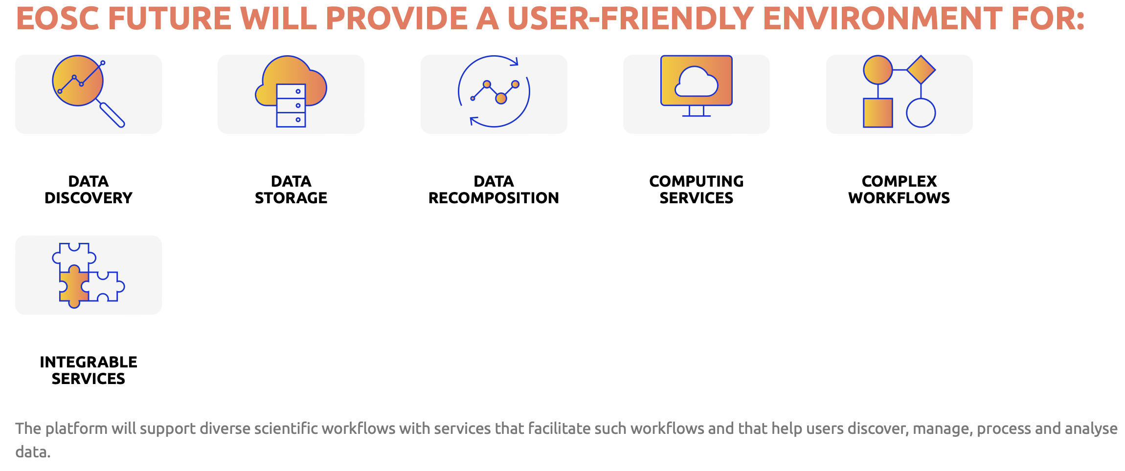
Projects and Institutes - International
EOSC Future (primarily via Test Science Projects) https://eoscfuture.eu

Slide 14

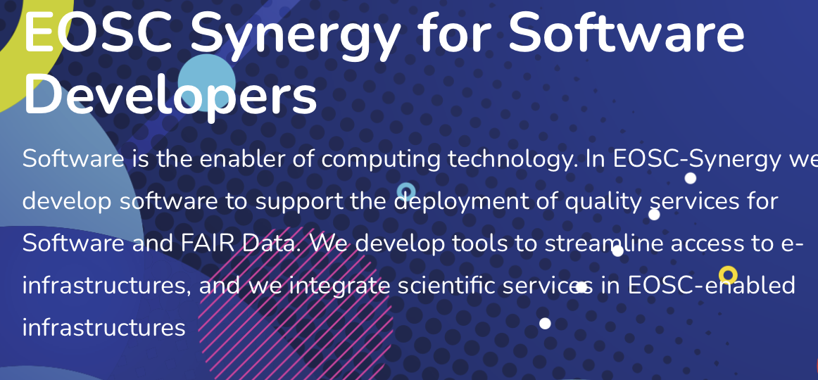
Projects and Institutes - International
EOSC Synergy (finished 2022)
https://www.eosc-synergy.eu

Slide 15


Projects and Institutes - International
ESFRI Thematic Cluster Projects –
most going to Open Collaborations after finishing
https://science-clusters.eu (coming soon)
Common answer to call
HORIZON-INFRA-2023-EOSC-01-02
handed in 03/2023
  Expected Outcomes from call:
    A framework of community curation for quality of software and code across the different disciplines.
    Infrastructure, tools and services to develop, describe with proper metadata, version, archive, share and reuse research software.
    The notion of software quality is defined.
    Baseline quality indicators along the notion of “minimum quality” are defined.
    The quality of research software is improved.
    Software is developed in a sustainable way and its reuse is maximised.

Slide 16





ESFRI Thematic Cluster Projects
EOSC-Life: biology and medicine
  Services: https://www.eosc-life.eu/services/
ENVRI-FAIR: environmental science
  Hub: https://envri.eu/envri-hub/
ESCAPE: astronomy- and accelerator-based particle physics
  Services: https://projectescape.eu/services
SSHOC: social sciences and humanities
  Marketplace: https://marketplace.sshopencloud.eu/
PaNOSC: Photon and Neutron science
  Services: https://www.panosc.eu/services/

Slide 17

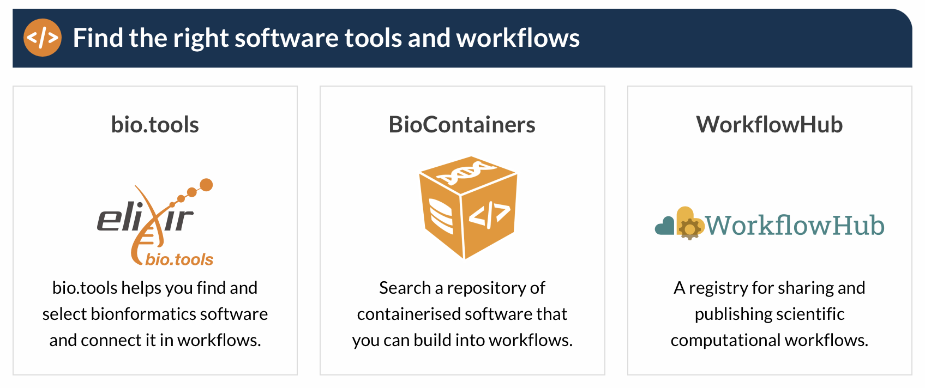
Thematic Cluster Projects
ELIXIR: life science organisations
https://elixir-europe.org
  Best Practices in software developments:
  https://elixir-europe.org/platforms/tools/software-best-practices
  Portals: https://elixir-europe.org/what-we-offer/portals

Slide 18

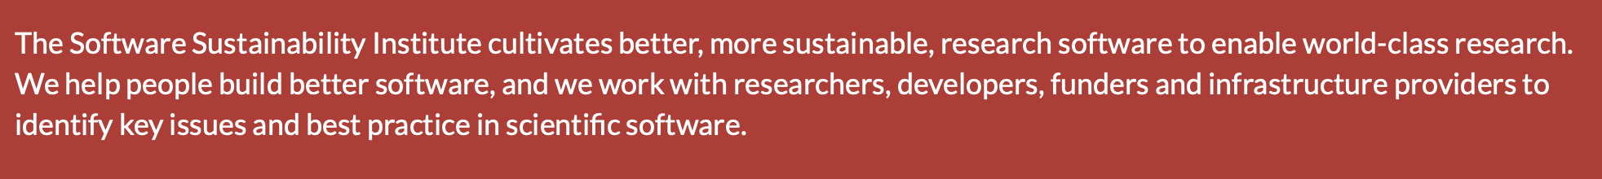
Projects and Institutes - International
Software Sustainability Institute
https://www.software.ac.uk
Programmes and Events
  Fellowship Programme
  Research Software Healthcheck
  Carpentry Programmes
  Research Software Engineers
  Collaborations Workshops
  Research Software Camps
  Past events
  Code of Conduct
  Open Call for Projects

Slide 19


Projects and Institutes - (Inter)national
Netherlands eSiencecenter
https://www.esciencecenter.nl
What we do
  How can we help you?
  Calls for proposals
  Projects
  Training & Workshops
  Events
  Communities
  Fellowship Programme
  Software Management Plans

Slide 20
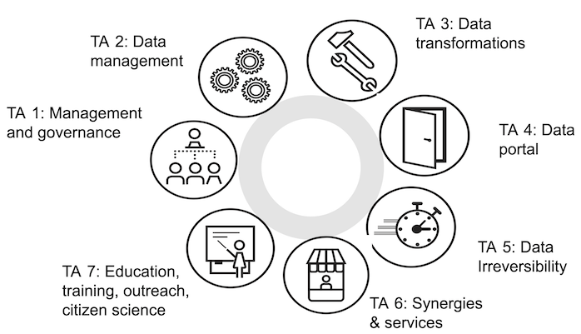
Projects and Institutes - National
focusing on Germany for today
German NFDI initiative (national research data infrastructure)
https://www.nfdi.de
  Related projects:
    PUNCH4NFDI: particles physics,
    astrophysics, nuclear and hadron physics
    https://www.punch4nfdi.de
    DAPHNE4NFDI: photons and neutron
    sources and experiments
    https://www.daphne4nfdi.de
DMA – see additional presentation
DLR Institute for Software Technology
https://dlr.de/sc/en/
  DLR Software Engineering Guidelines
PUNCH4NFDI Task Areas:

Slide 21



Landscaping - Groups
Research Data Alliance
https://rd-alliance.org
“The Research Data Alliance (RDA) builds the social and technical bridges to enable the open sharing and re-use of data.”
  Groups: https://www.rd-alliance.org/groups/
  FAIR for Research Software (FAIR4RS) WG
    FAIR Principles for Research Software (FAIR4RS Principles)
Force11
https://force11.org
“FORCE11 is a community of scholars, librarians, archivists, publishers and research funders that has arisen organically to help facilitate the change toward improved knowledge creation and sharing. Individually and collectively, we aim to bring about a change in modern scholarly communications through the effective use of information technology.”
Research Software Alliance
https://www.researchsoft.org
“Our vision: Research software and those who develop and maintain it are recognised and valued as fundamental and vital to research worldwide”
  Funders Workshop The Future of Research Software (with eScienceCentre) → Amsterdam Declaration
  https://future-of-research-software.org/draft-amsterdam-declaration-on-funding-research-software-sustainability/
  (7 principles and 10 recommendations for software sustainability)

Slide 22

Landscaping - Groups
EOSC Association Task Forces
https://eosc.eu/news/eosc-association-task-forces-community-agenda
  AG Implementation of EOSC
    TF PID Policy and Implementation
    TF Researcher Engagement and Adoption
    TF Rules of Participation Compliance Monitoring
  AG Metadata and Data Quality
    TF FAIR Metrics and Data Quality
    TF Semantic Interoperability
  AG Research Careers and Curricula
    TF Data Stewardship Curricula and Career Paths
    TF Research Careers, Recognition, and Credit
    TF Upskilling Countries to Engage in EOSC
  AG Sustaining EOSC
    TF Defining Funding Models for EOSC
    TF Long-Term Data Preservation
  AG Technical Challenges on EOSC
    TF AAI Architecture
    TF Infrastructure for Quality Research Software
    TF Technical Interoperability of Data and Services

Slide 23

Landscaping - Groups
HEP Software Foundation
https://hepsoftwarefoundation.org
“The HEP Software Foundation (HSF) facilitates coordination and common efforts in high energy physics (HEP) software and computing internationally.”
  8 Working Groups
  Activities:
  “We organise many activities, from our working groups, to organising events, to supporting projects as HSF projects, and helping communication within the community through our discussion forumsand technical notes.
  The HSF can also write letters of collaboration and cooperation to project proposals.”

Slide 24
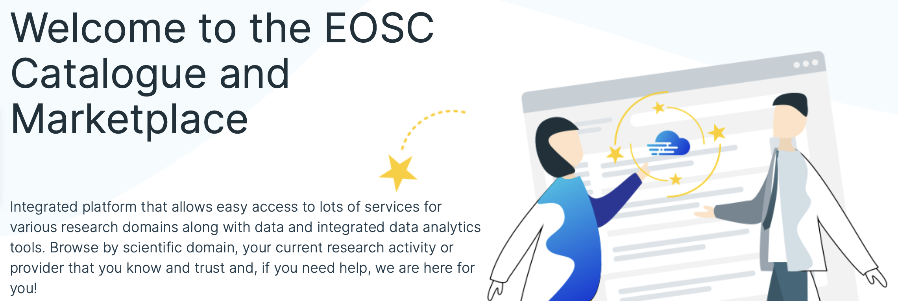
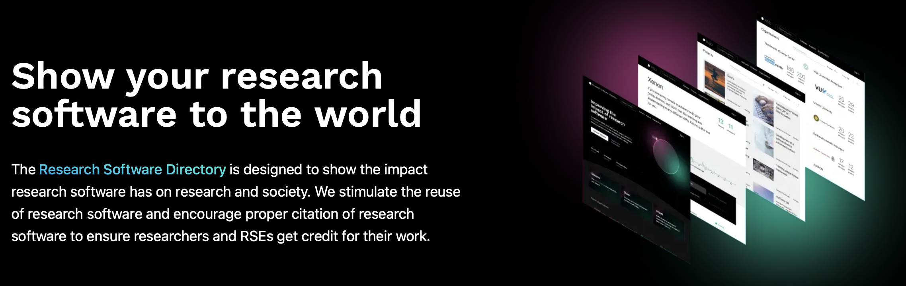
Landscaping – Software Repositories
EOSC Marketplace
(all EOSC related services)
https://marketplace.eosc-portal.eu
Research Software Directory (eScienceCentre)
https://research-software-directory.org (also https://helmholtz.software)

Slide 25
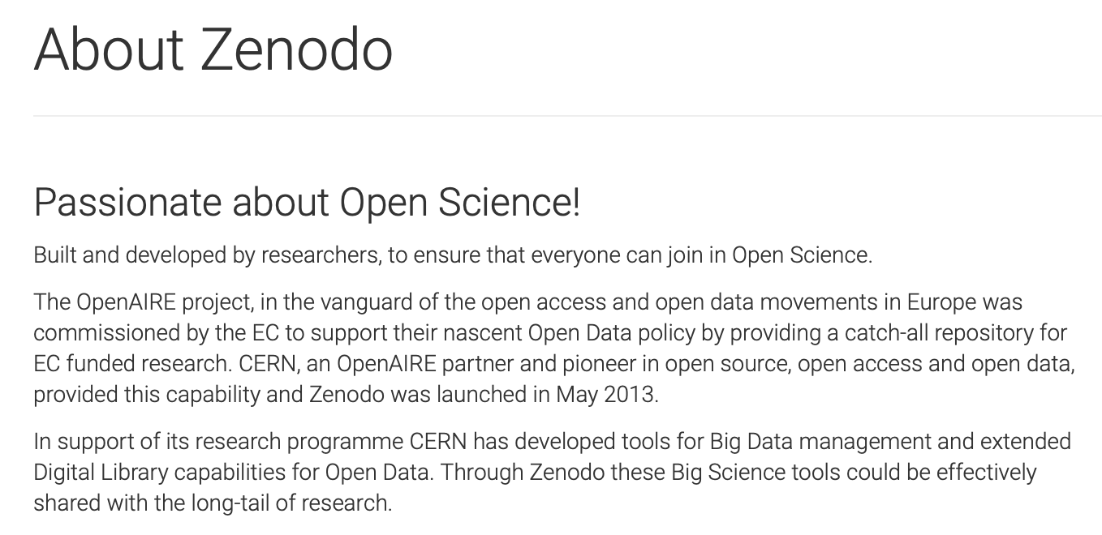

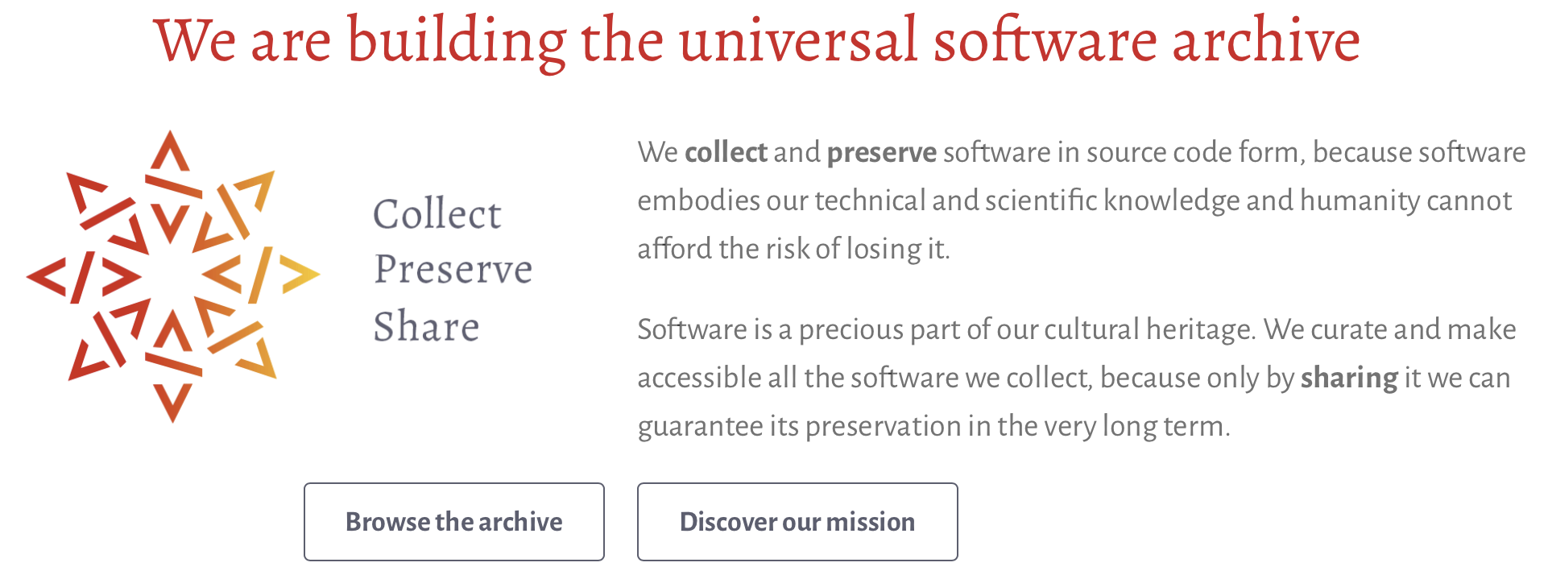
Landscaping – Archives
  Zenodo
  https://zenodo.org
  Software Heritage
  https://www.softwareheritage.org

Slide 26
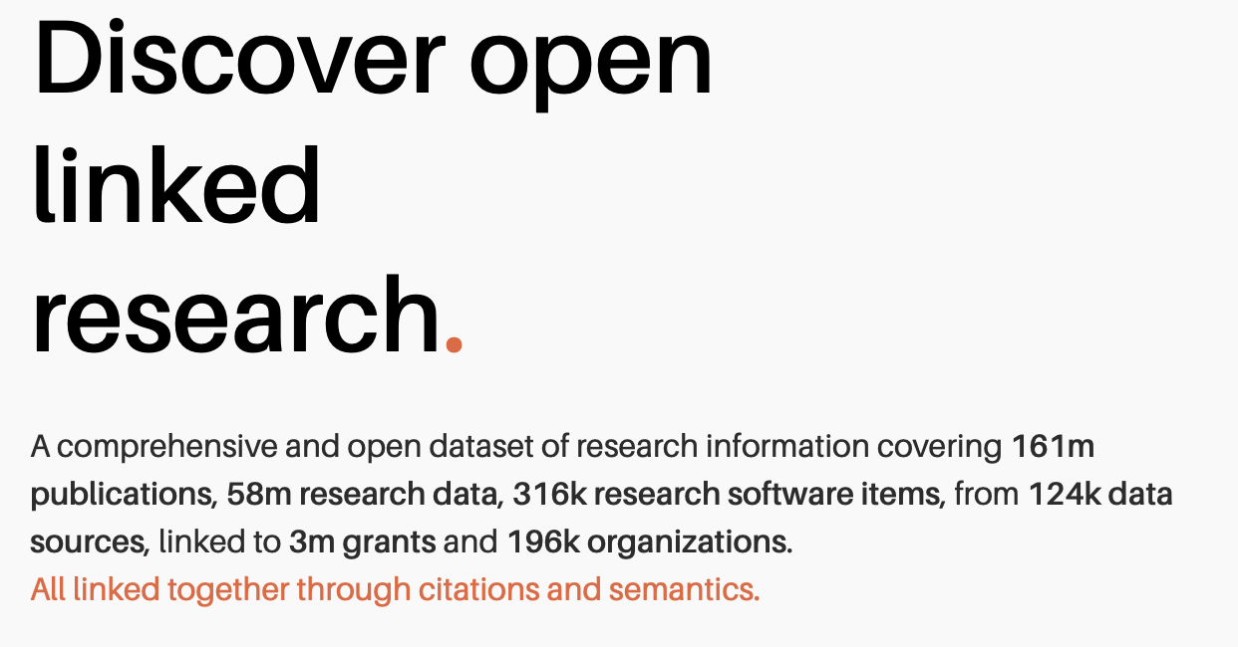
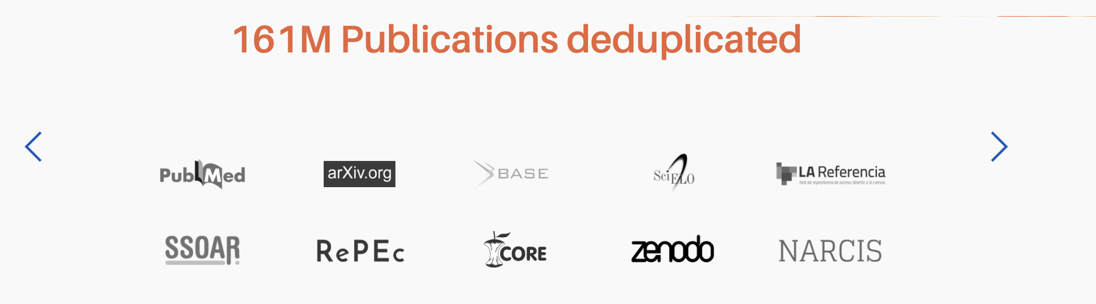
Landscape - Aggregators
openAire
https://explore.openaire.eu

Slide 27
Future Options and Roadmap
Future organization

Slide 28
OSSR
Goals & Mission statement from OSSR final workshop
  Continue to maintain the OSSR
  Collect software to provide additional visibility and citeability;
  strengthen software competence with quality in focus
  Use of OSSR as forum to foster publication
  Offer standards for new communities to join
Publications
  Open Source and Service Repository Policy https://doi.org/10.5281/zenodo.6757112
    The OSSR mission
    Guidelines and rules of participation to the ESCAPE OSSR
    Onboard Process incl. checklist
    Metadata definition
  Technical Paper draft published https://open-research-europe.ec.europa.eu/articles/3-46/v1
  ESCAPE General Paper – to be written until Summer

Slide 29
Future Options and Roadmap – Points of Discussion with Proposals
Positioning of OSSR
  ESCAPE Open Collaboration (members)
  Depth of work/involvement
Organisation
  3 Bodies: Policy & Strategy / Onboarding / Technical Developments
  Proposal: charge policy group with the formulation of an MoU
Communication Channels
  Meeting framework
  Chat channel
  Mailing List
  Development Platform
Topics / Subgroups(?) for Policy
  Organisation
  Best Practices
  Innovative Approaches
  Software Quality
  Software Efficiency

Slide 30
Organizing group, meetings & communication infrastructure

Slide 31
Organisation of Group with Proposals
Meetings
  General Meeting every 3 Months with organisatorial, onboarding, technical part – one focus/highlight
  Monthly meetings of subgroups
Group Composition
  (preliminary) WG-lead + co-lead
  members

