Slide 1
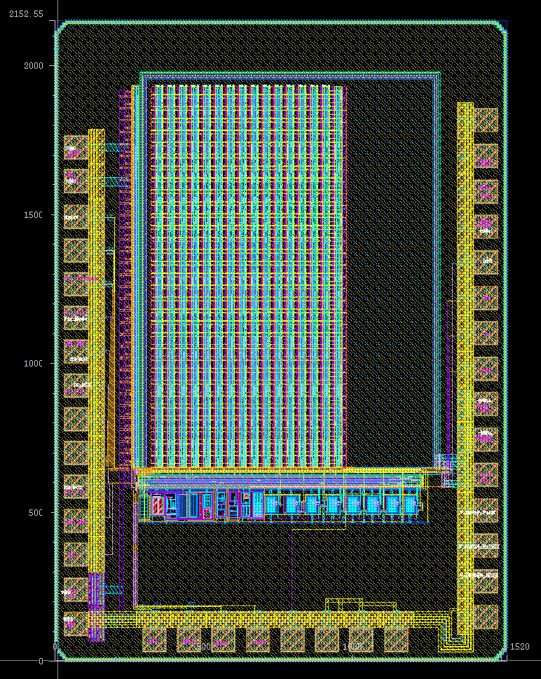
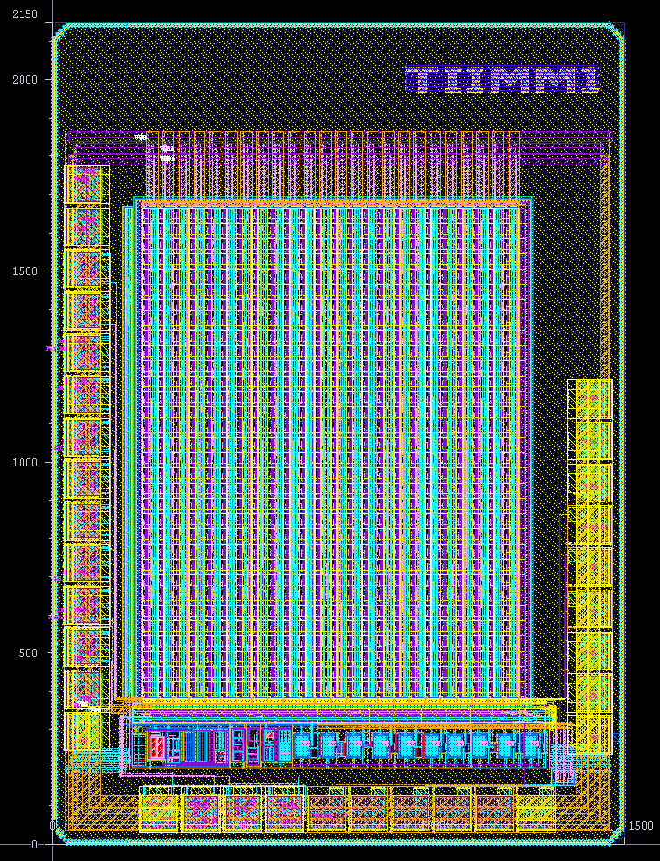
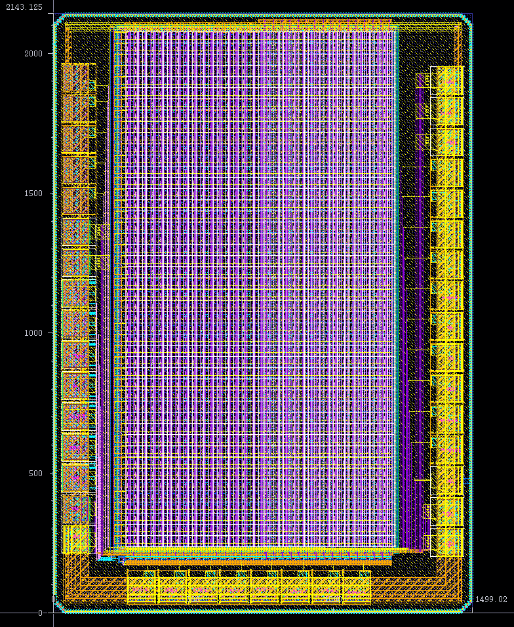
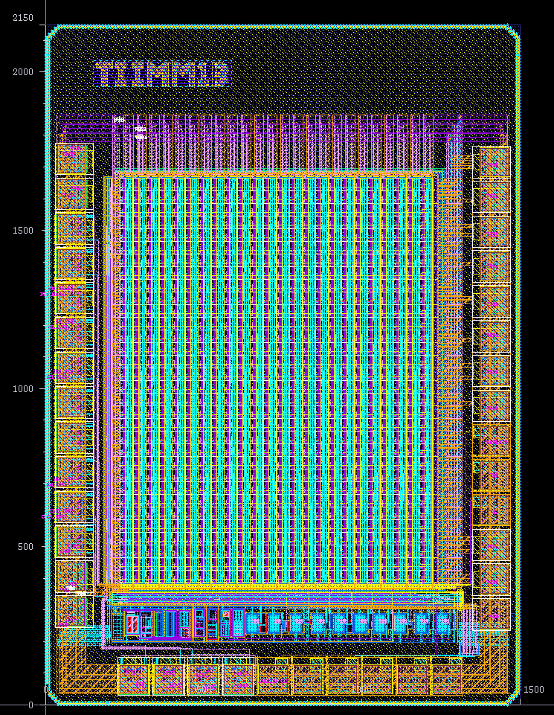

TIIMM Sensor’s overview
CMOS Monolithic Active Pixel Sensor
design in TowerJazz 180 nm process
For position and energy measurements
  - First submission: preliminary prototype (TIIMM0) submitted in March 2020.
  - Second submission: TIIMM0/TIIMM1/TIIMM1A/TIIMM1B prototypes received in August 2022
7 sensing layer variants
Thickness | Process
25 μm Epi High Res. | Standar | Non-uniform N- layer Uniform N- layer + Extra Deep
50 μm Epi High Res. | Non-uniform N- layer Uniform N- layer + Extra Deep P
100 μm Epi High Res. | Non-uniform N- layer Uniform N- layer + Extra Deep P
TIIMM0 (second submission)
Chip area: 2.2 mm * 1.5 mm
Matrix: 32 (rows) * 16 (col)
Pixel pitch: 40 μm×40 μm
Corrected from the first
submission
TIIMM1 sensor
Chip area: 2.2 mm * 1.5 mm
Matrix: 32 (rows) * 24 (col)
Pixel pitch: 41.2 μm×40 μm
TIIMM1A sensor
Chip area: 2.2 mm * 1.5 mm
Matrix: 46 (rows) * 32 (col)
New front end
Analog part study only
TIIMM1B sensor
Chip area: 2.2 mm * 1.5 mm
Matrix: 32 (rows) * 24 (col)
Pixel pitch: 41.2 μm×40 μm
New front-end
New front-end enhanced

Slide 2
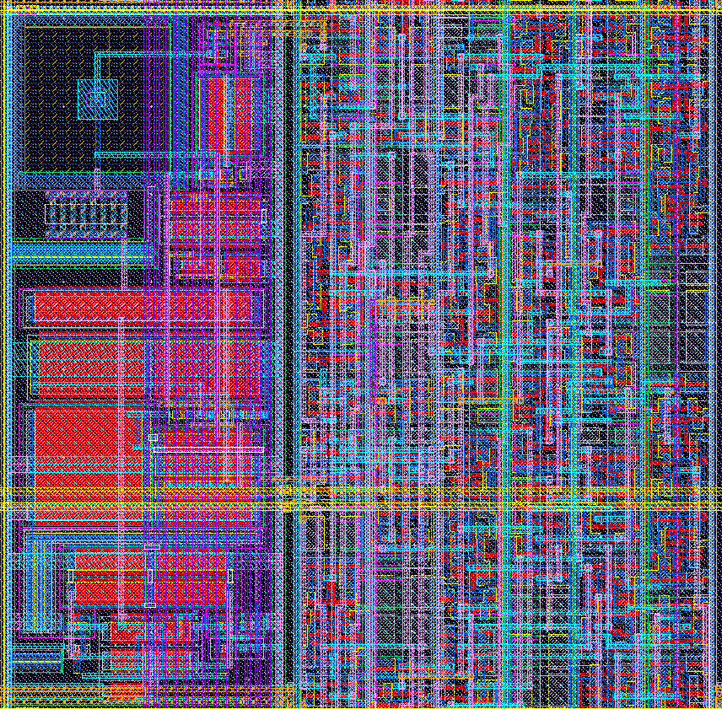
TIIMM1B: Single pixel Analog Front-end
Pixel pitch: 40 μm × 41.2 μm
ToT (6 bits)
AC coupling
C_{f} = 3.75fF， C_{d} = 2fF
Gain=29mV/ke-, ENC: 102 e-（extracted sim）
Threshold=1000e-

Slide 3
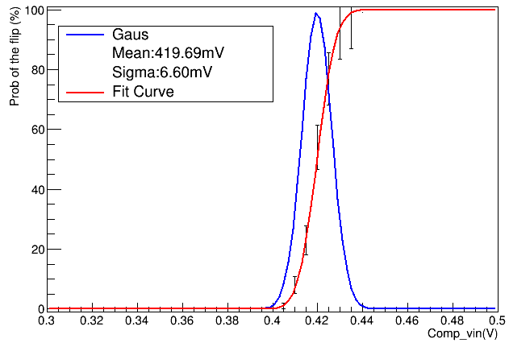
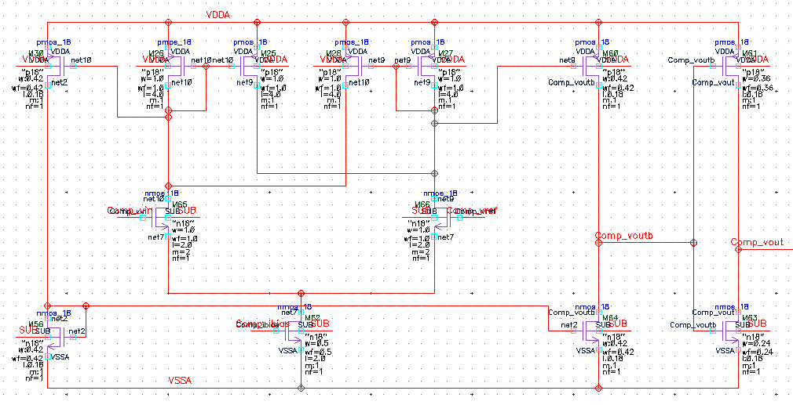
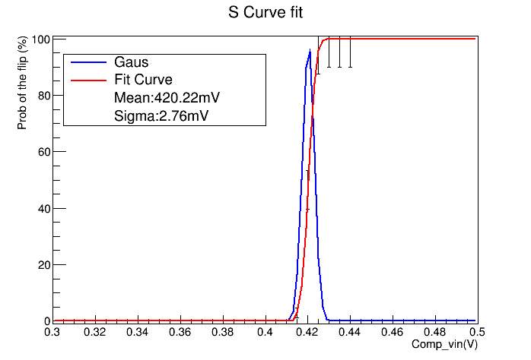
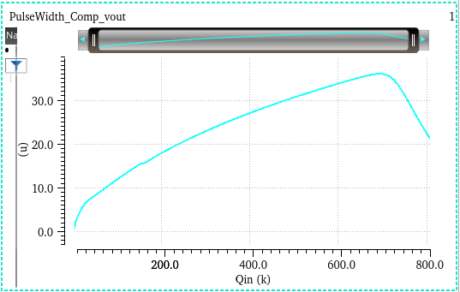
TIIMM1B (Transistor level - simulations only)
TIIMM1 comparator offset
TIIMM1 comparator
TIIMM1B comparator offset
TIIMM1B comparator
 | TIIMM1 | TIIMM1B
Range of TOT | Maximum at 250ke⁻ | Maximum at 700ke⁻
Comparator input offset | 6.6 mV | 2.7 mV
TOT(µS)
TIIMM1 vs TIIMM1B
Amplifier structure optimized
for larger input dynamic range
New Comparator structure with
less intrinsic input offset
Qin (ke⁻)

Slide 4
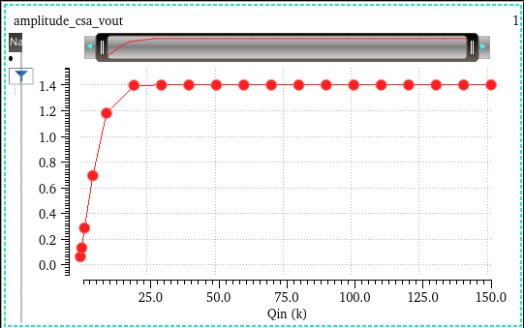
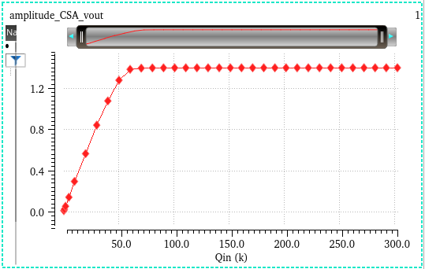
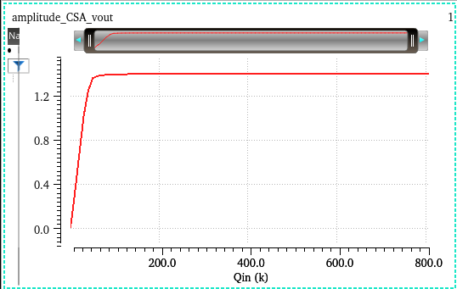
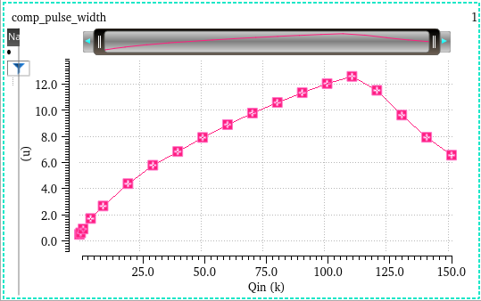
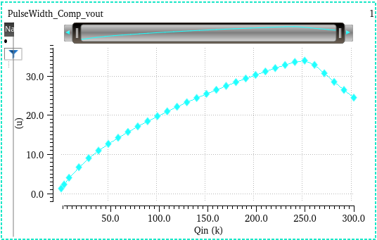
La comparaison (Réglages typiques)
Amplitude of the csa_vout (V)
Amplitude du CSA vs Qin (500 e⁻~150 ke⁻)
Amplitude of the csa_vout (V)
Amplitude du CSA vs Qin (0,7Ke ⁻~ 300 ke⁻)
Amplitude of the csa_vout (V)
Amplitude du CSA vs Qin
(1Ke ⁻~ 800 ke⁻)
Qin (ke⁻)
Qin (ke⁻)
Qin (ke⁻)
Pulse width of the comparator (µS)
Pulse width of the comparator (µS)
Pulse width of the comparator (µS)
Largeur de signal du comparateur vs Qin (500 e⁻ ~150 ke⁻)
Largeur de signal du comparateur vs Qin (0,7k e⁻ ~300 ke⁻)
Largeur de signal du comparateur vs Qin (1k e⁻ ~800 ke⁻)
Qin (ke⁻)
Qin (ke⁻)
Qin (ke⁻)
TIIMM0
TIIMM1.
TIIMM1B
La partie ~ linéaire du ToT est de 500e- à ~110 ke⁻.
La partie ~ linéaire du ToT est de 700e- à ~ 250 ke⁻.
La partie ~ linéaire du ToT est de 1Ke- à ~ 700 ke⁻.
4

Slide 5
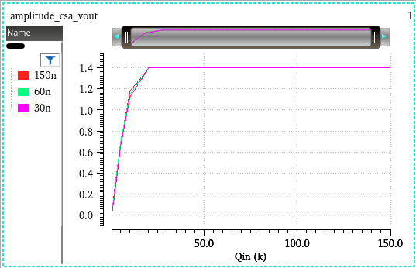
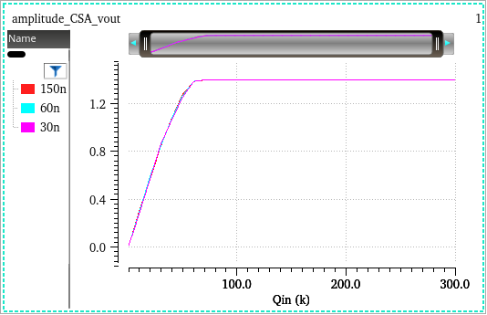
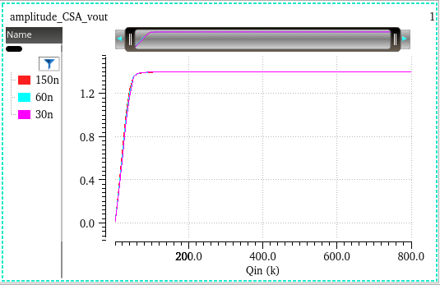
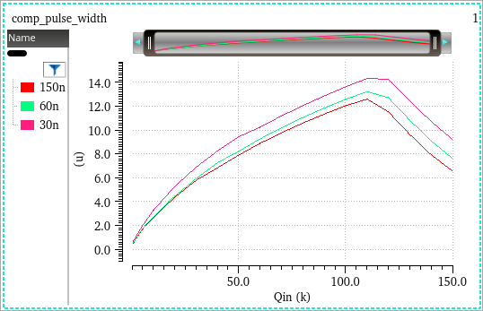
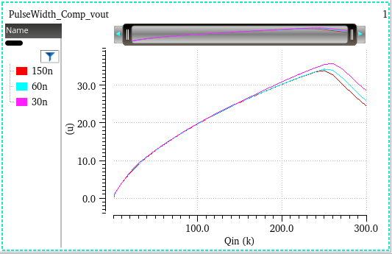
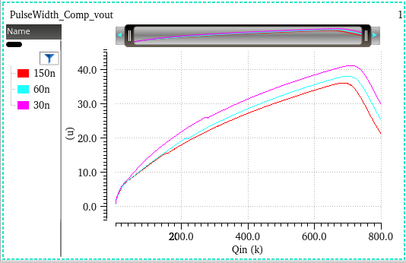
Avec 3 courants de bias (ampli) différents : 30nA, 60nA et 150nA
Amplitude of the csa_vout (V)
Amplitude of the csa_vout (V)
Amplitude du CSA vs Qin
(1Ke ⁻~ 800 ke⁻)
Amplitude of the csa_vout (V)
Amplitude du CSA vs Qin
(500 e⁻~150 ke⁻)
Amplitude du CSA vs Qin
(0,7Ke ⁻~ 300 ke⁻)
Qin (ke⁻)
Qin (ke⁻)
Qin (ke⁻)
Pulse width of the comparator (µS)
Pulse width of the comparator (µS)
Pulse width of the comparator (µS)
Largeur de signal du comparateur vs Qin (500 e⁻ ~150 ke⁻)
Largeur de signal du comparateur vs Qin (0,7k e⁻ ~300 ke⁻)
Largeur de signal du comparateur vs Qin (1k e⁻ ~800 ke⁻)
Qin (ke⁻)
Qin (ke⁻)
Qin (ke⁻)
TIIMM0
TIIMM1.
TIIMM1B
La partie linéaire reste sensiblement la même.
La partie linéaire reste sensiblement la même.
La partie linéaire reste sensiblement la même.
5

Slide 6
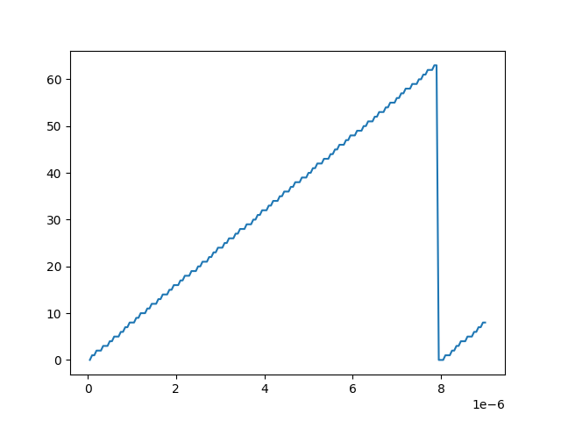
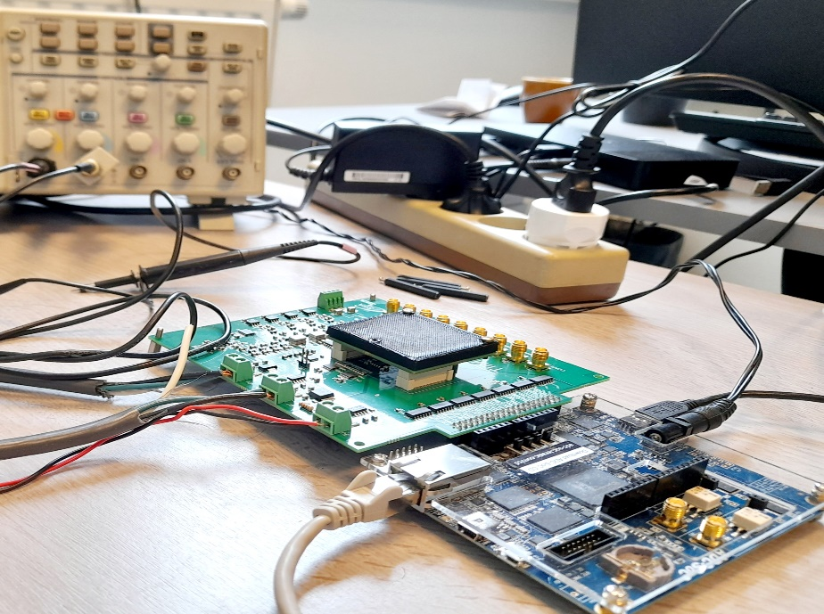
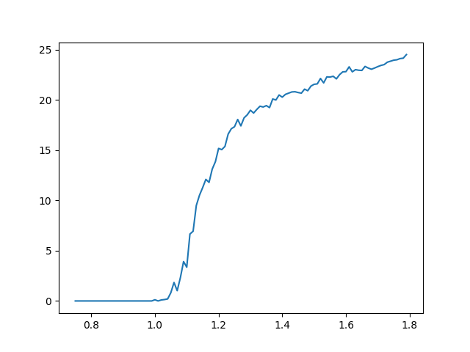
TIIMM1B – First Functional test results (single pixel)
TIIMM1B Sensor covered
Digital part
Full chain
TOT: Time Over Threshold
TOT: Time Over Threshold
TOT counts
TOT counts
Setup:
ADC – SOC (FPGA: Cyclone V with ARM- A9 running Linux)
Automatic controlled Pulses generator
Sensor prototype wire bonded on custom board
monitoring ADC, biasing DACs, analog outputs readout
Full control acquisition system
Pulse width (s)
Input amplitude (V)
External digital pulse generator (hits emulator)
TOT counting is correct (6bits)
Internal analog injection pulse
(using parasitic capacitor)
The full chain working

Slide 7
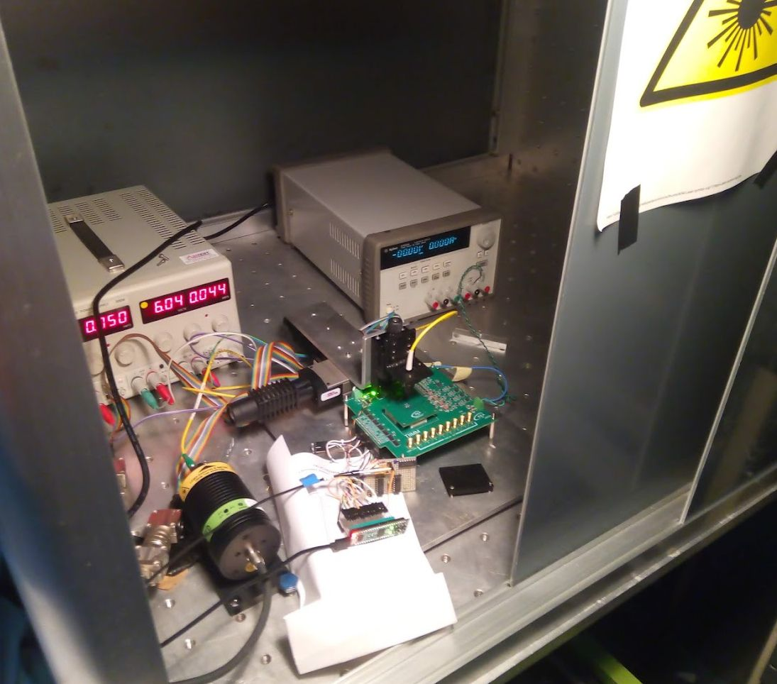
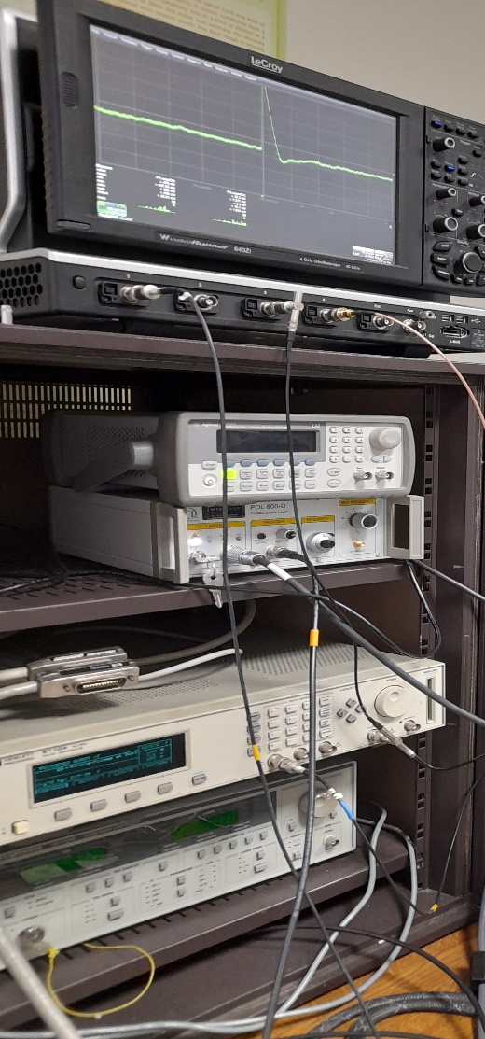
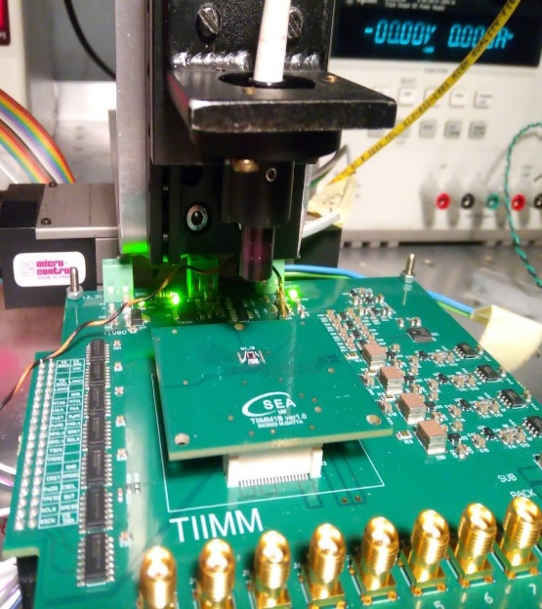
TIIMM1B – First Laser tests
Single pixel CSA output signal
with 2 laser pulses
TIIMM1B sensor
We can move the laser spot in
x/y direction with 1μm step precision
We are able to inject charge in a single pixel
Positioning and number of laser pulses are remotely controlled
8 analog outputs to perform
different measurements with
the oscilloscope
Pulsed Diode LASER
(Model LDH-P-C-N-1060)
Selectable repetition frequencies: 3.25 KHz to 80 MHz
Wavelength (average): 1061 nm
Peak power (intensity): from 18 mW to 400 mW
FWHM (time-width): 88 ps to 500 ps
Pulse generator
(Model HP 811A)
Width: 5 ns ; Period: 10 ns
Amp: 2 V
Leading-edge: 2ns ; Trailing-edge: 2ns

Slide 8
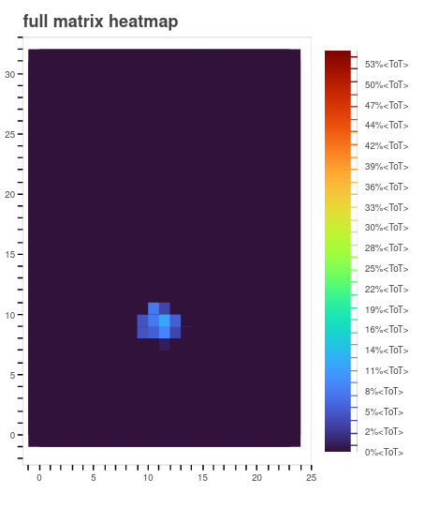
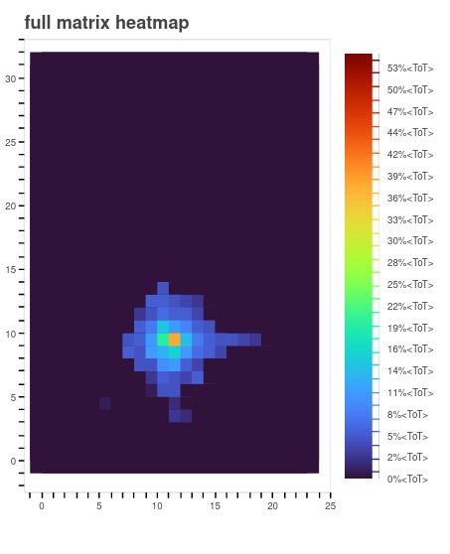
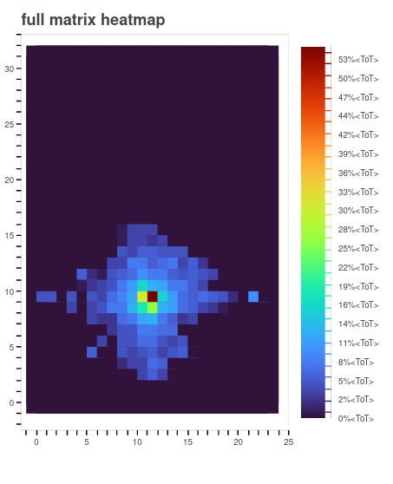
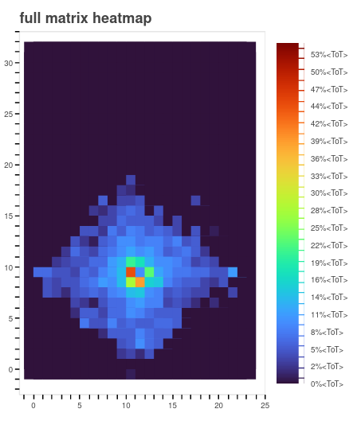
TIIMM1B – First Laser tests - Full matrix heat map
880 ke⁻
660 ke⁻
440 ke⁻
220 ke⁻
0 ke⁻
180 Laser pulses
5 Laser pulses
50 Laser pulses
130 Laser pulses
180 Laser pulses
Pixel number
130 Laser pulses
Pixel number

Slide 9
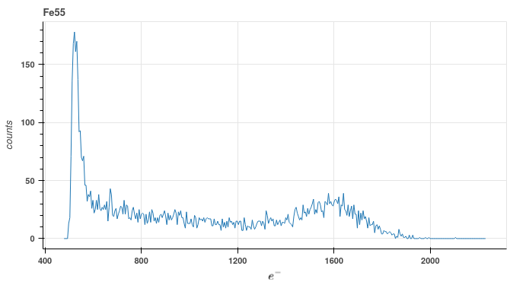
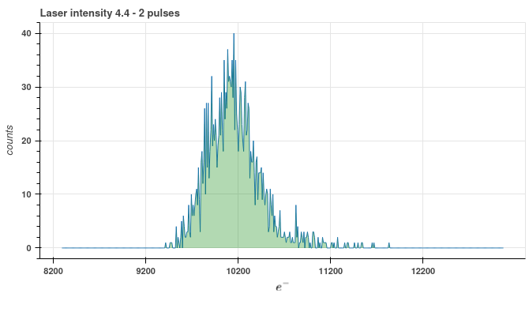
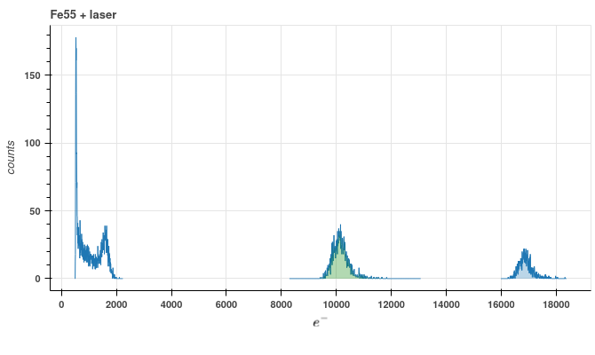
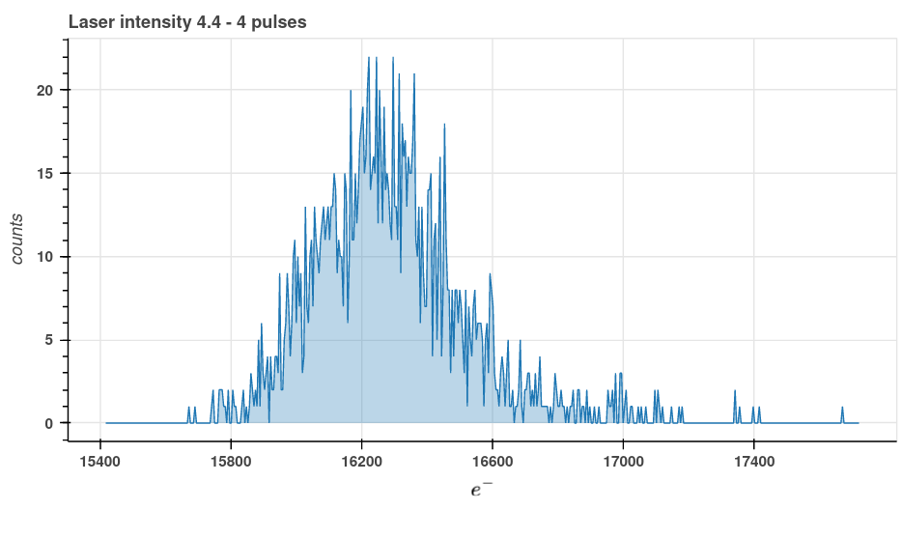
TIIMM1B – CSA output preliminary tests with Fe55 source - Calibration
Histogram of the output voltage
of the CSA (single pixel) with a Fe55 source only
Histogram of the output voltage
of the CSA with 2 laser pulses
(single pixel)
Histogram of the output voltage of the CSA with 4 laser pulses (single pixel)
Superposition of 3 histograms
Noise
Fe55
2 laser pulses
4 laser pulses
9

Slide 10
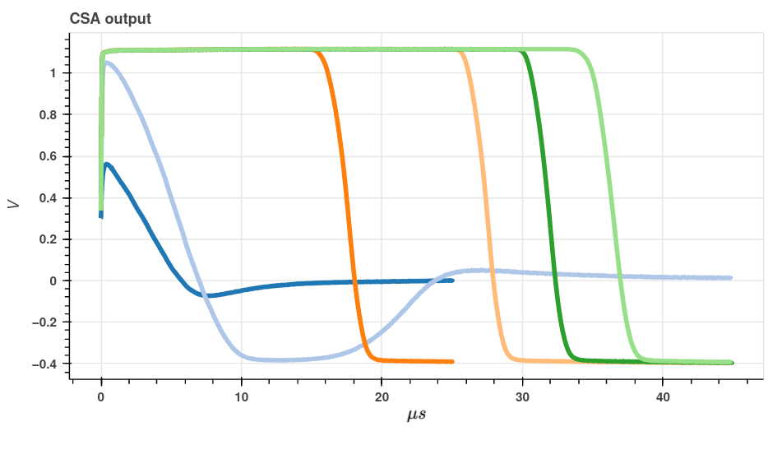
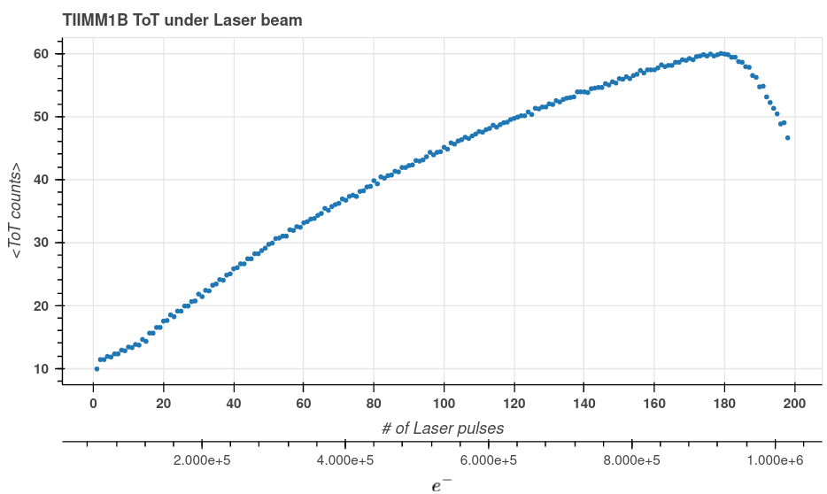
TIIMM1B – First Laser tests Energy loss measurement
(single pixel TOT)
TOT(µS)
Simulation
Charge Sensitive Amplifier output voltage (oscilloscope)
880 ke⁻
Qin (ke⁻)
24 ke⁻
635 ke⁻
490 ke⁻
240 ke⁻
9,8 ke⁻
Measurements
Range of measured charges on single pixel: ⁓ [500e⁻ , 900Ke⁻]

Slide 11
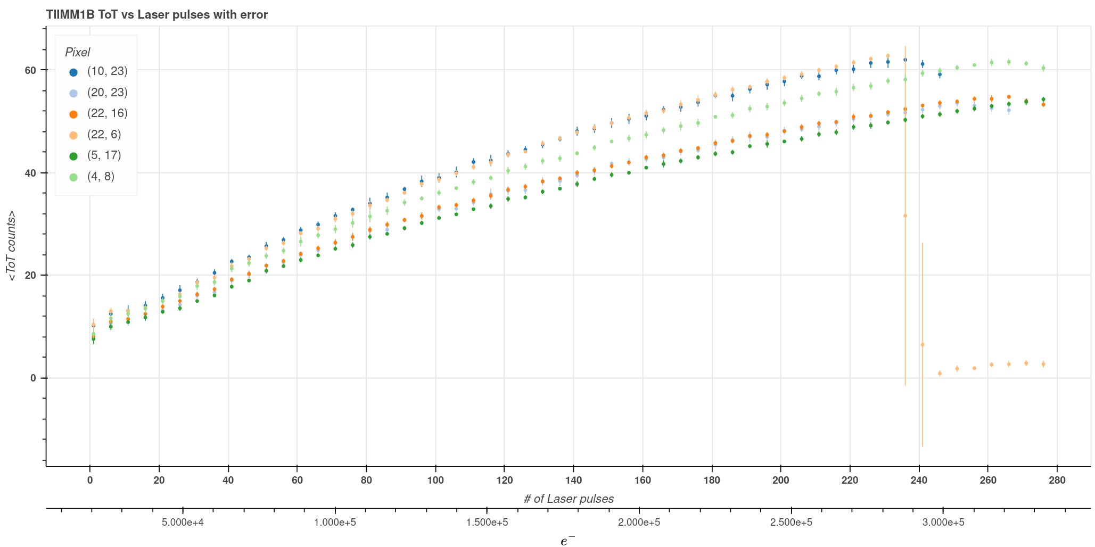
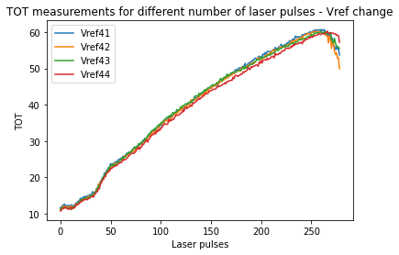
TIIMM1B – First Laser tests Energy loss measurement
(single pixel TOT)

Slide 12




Merci de votre attention

