Slide 1
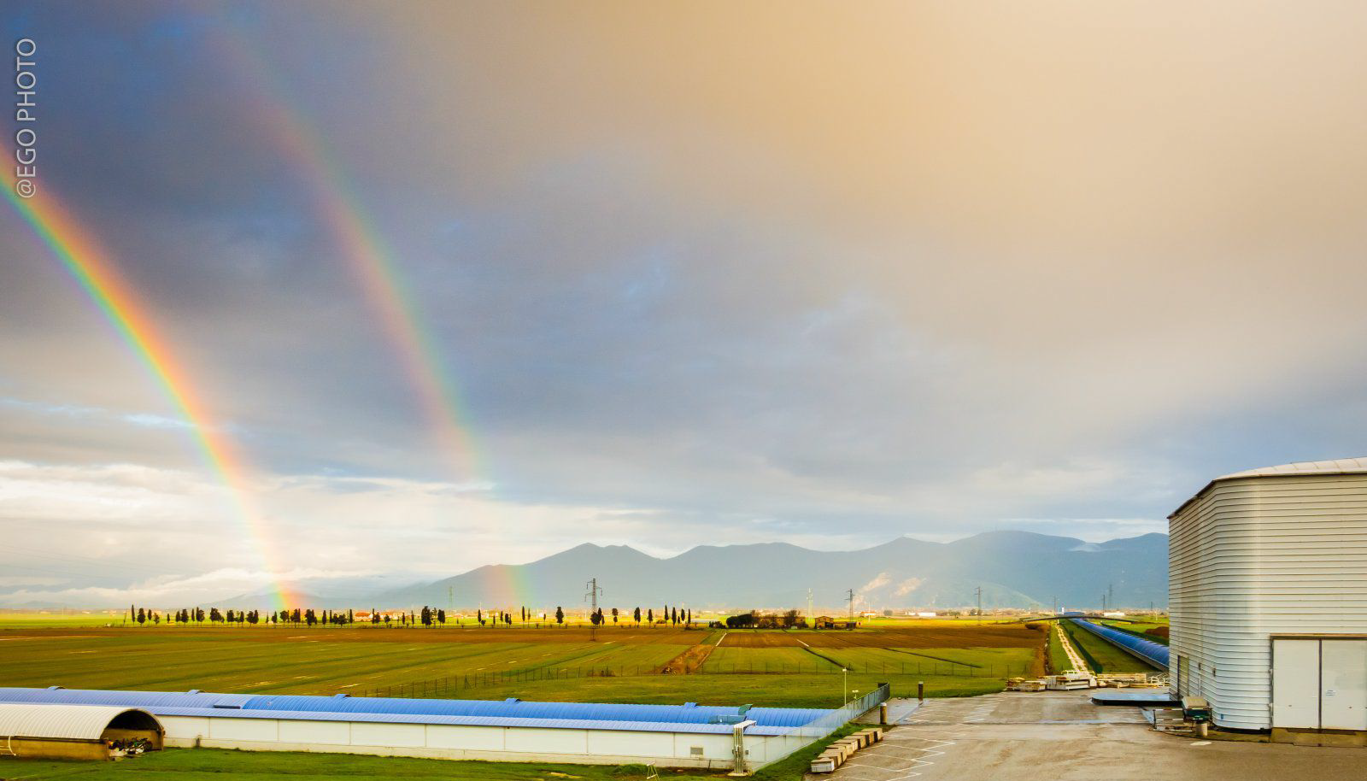
Environmental science
@EGO-Virgo
Irene Fiori and Maria Concetta Tringali
European Gravitational Observatory
Stavros Katsanevas Symposium
1st June 2023, Université Paris Cité - France

Slide 2
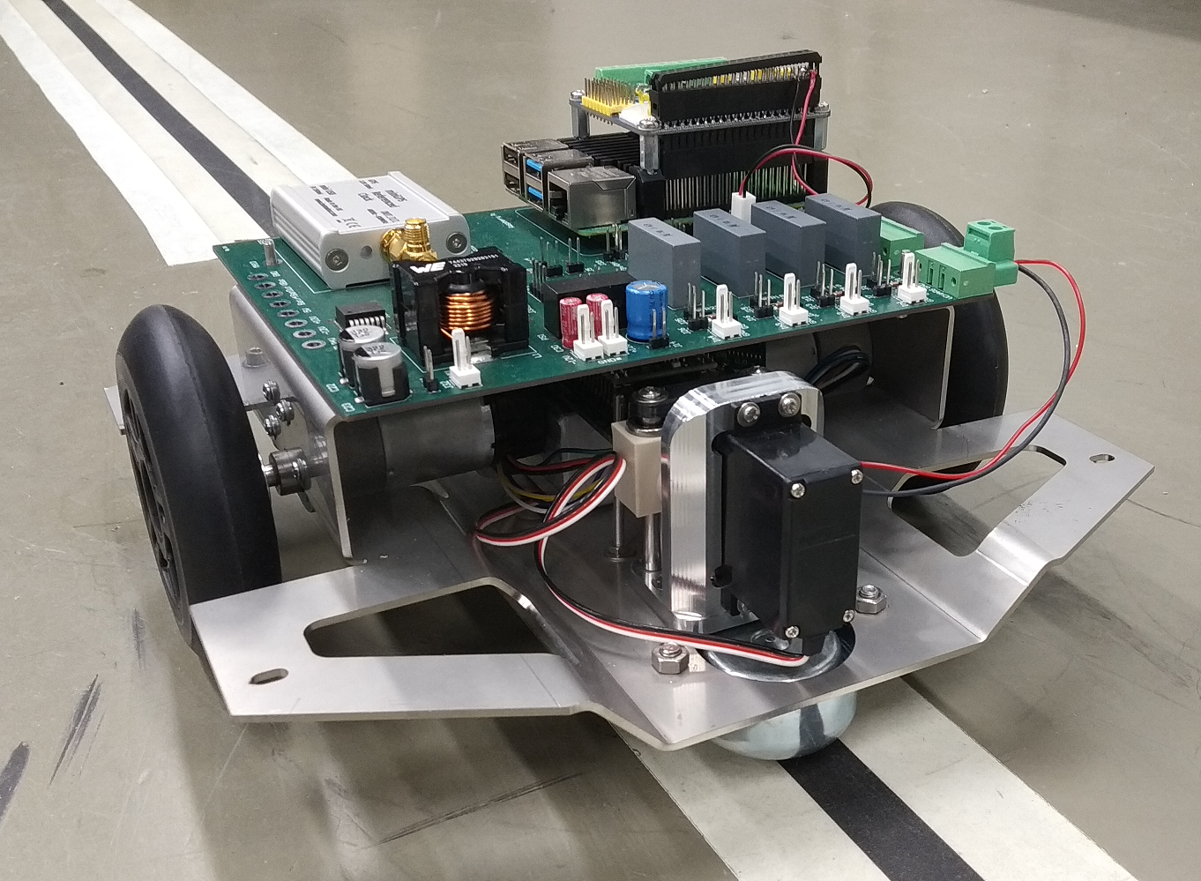
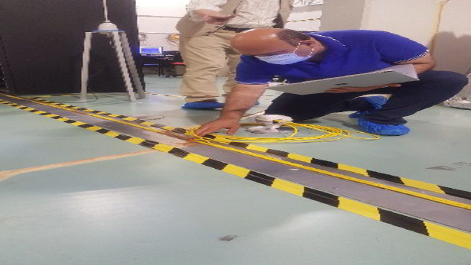
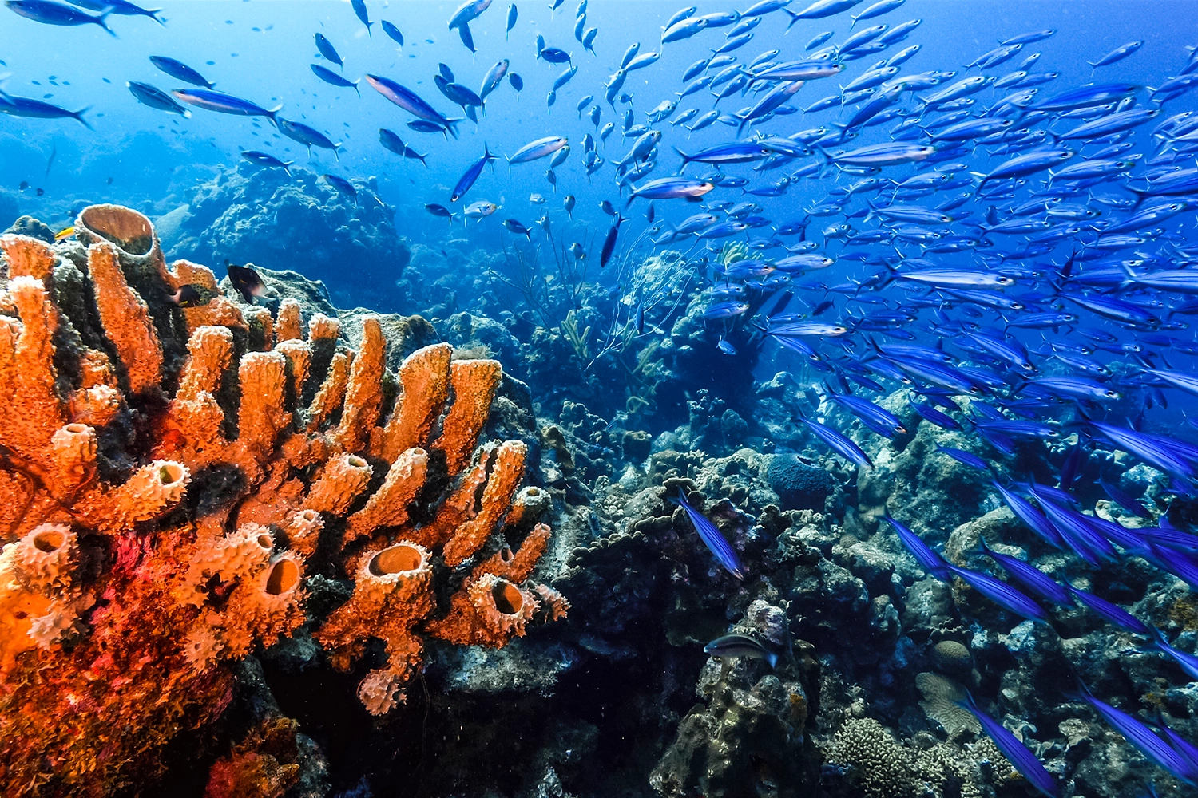
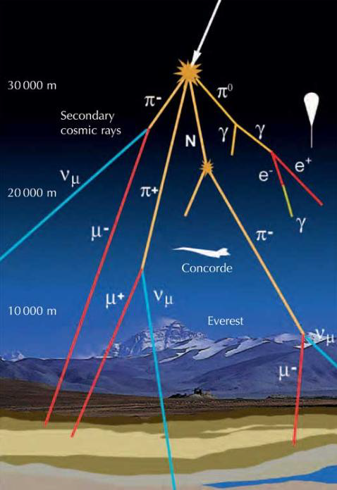
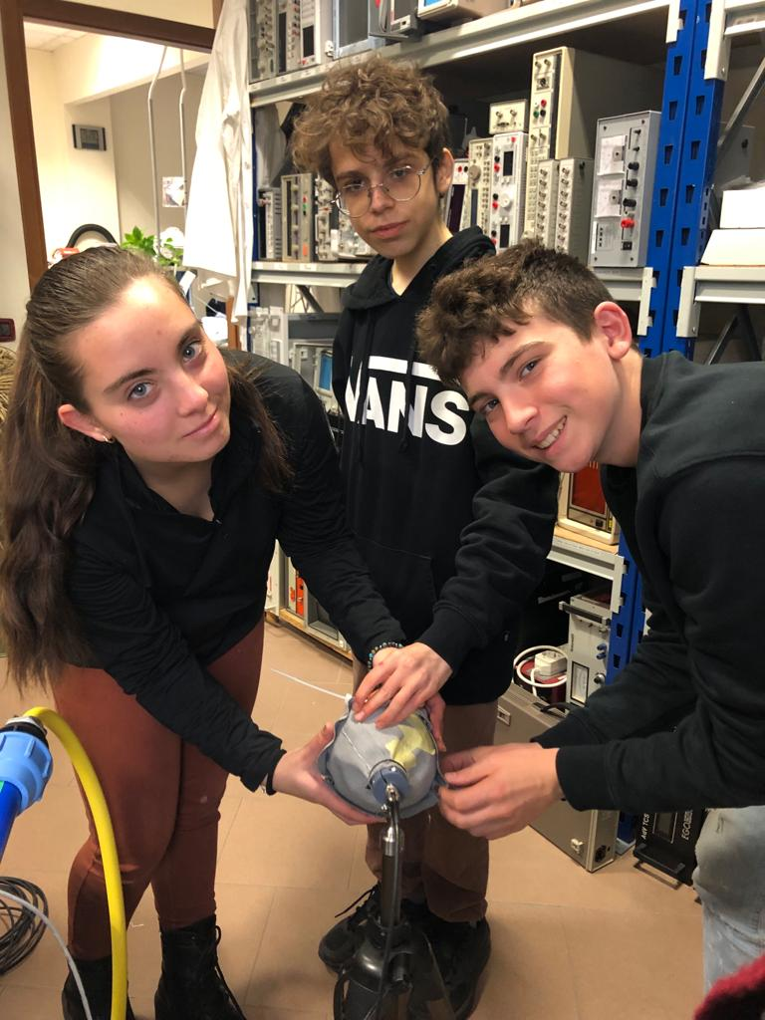
Synergy
Robotized sensors
>>>>
Noise cancellation
GW site monitoring
Lunar GW detectors
Environmental data sharing >>>
Marine-ecosystems
Biodiversity
Coastal erosion
Climate change
Big data analysis
Fiber sensors
>>>>
GW site monitoring
Geoscience
Lunar GW detectors
Bridges with
Scientific
communities
Industry
Society
Arts
Students
Cosmic rays
>>>>
GW detectors monitoring
Muon imaging
Meteorology

Slide 3
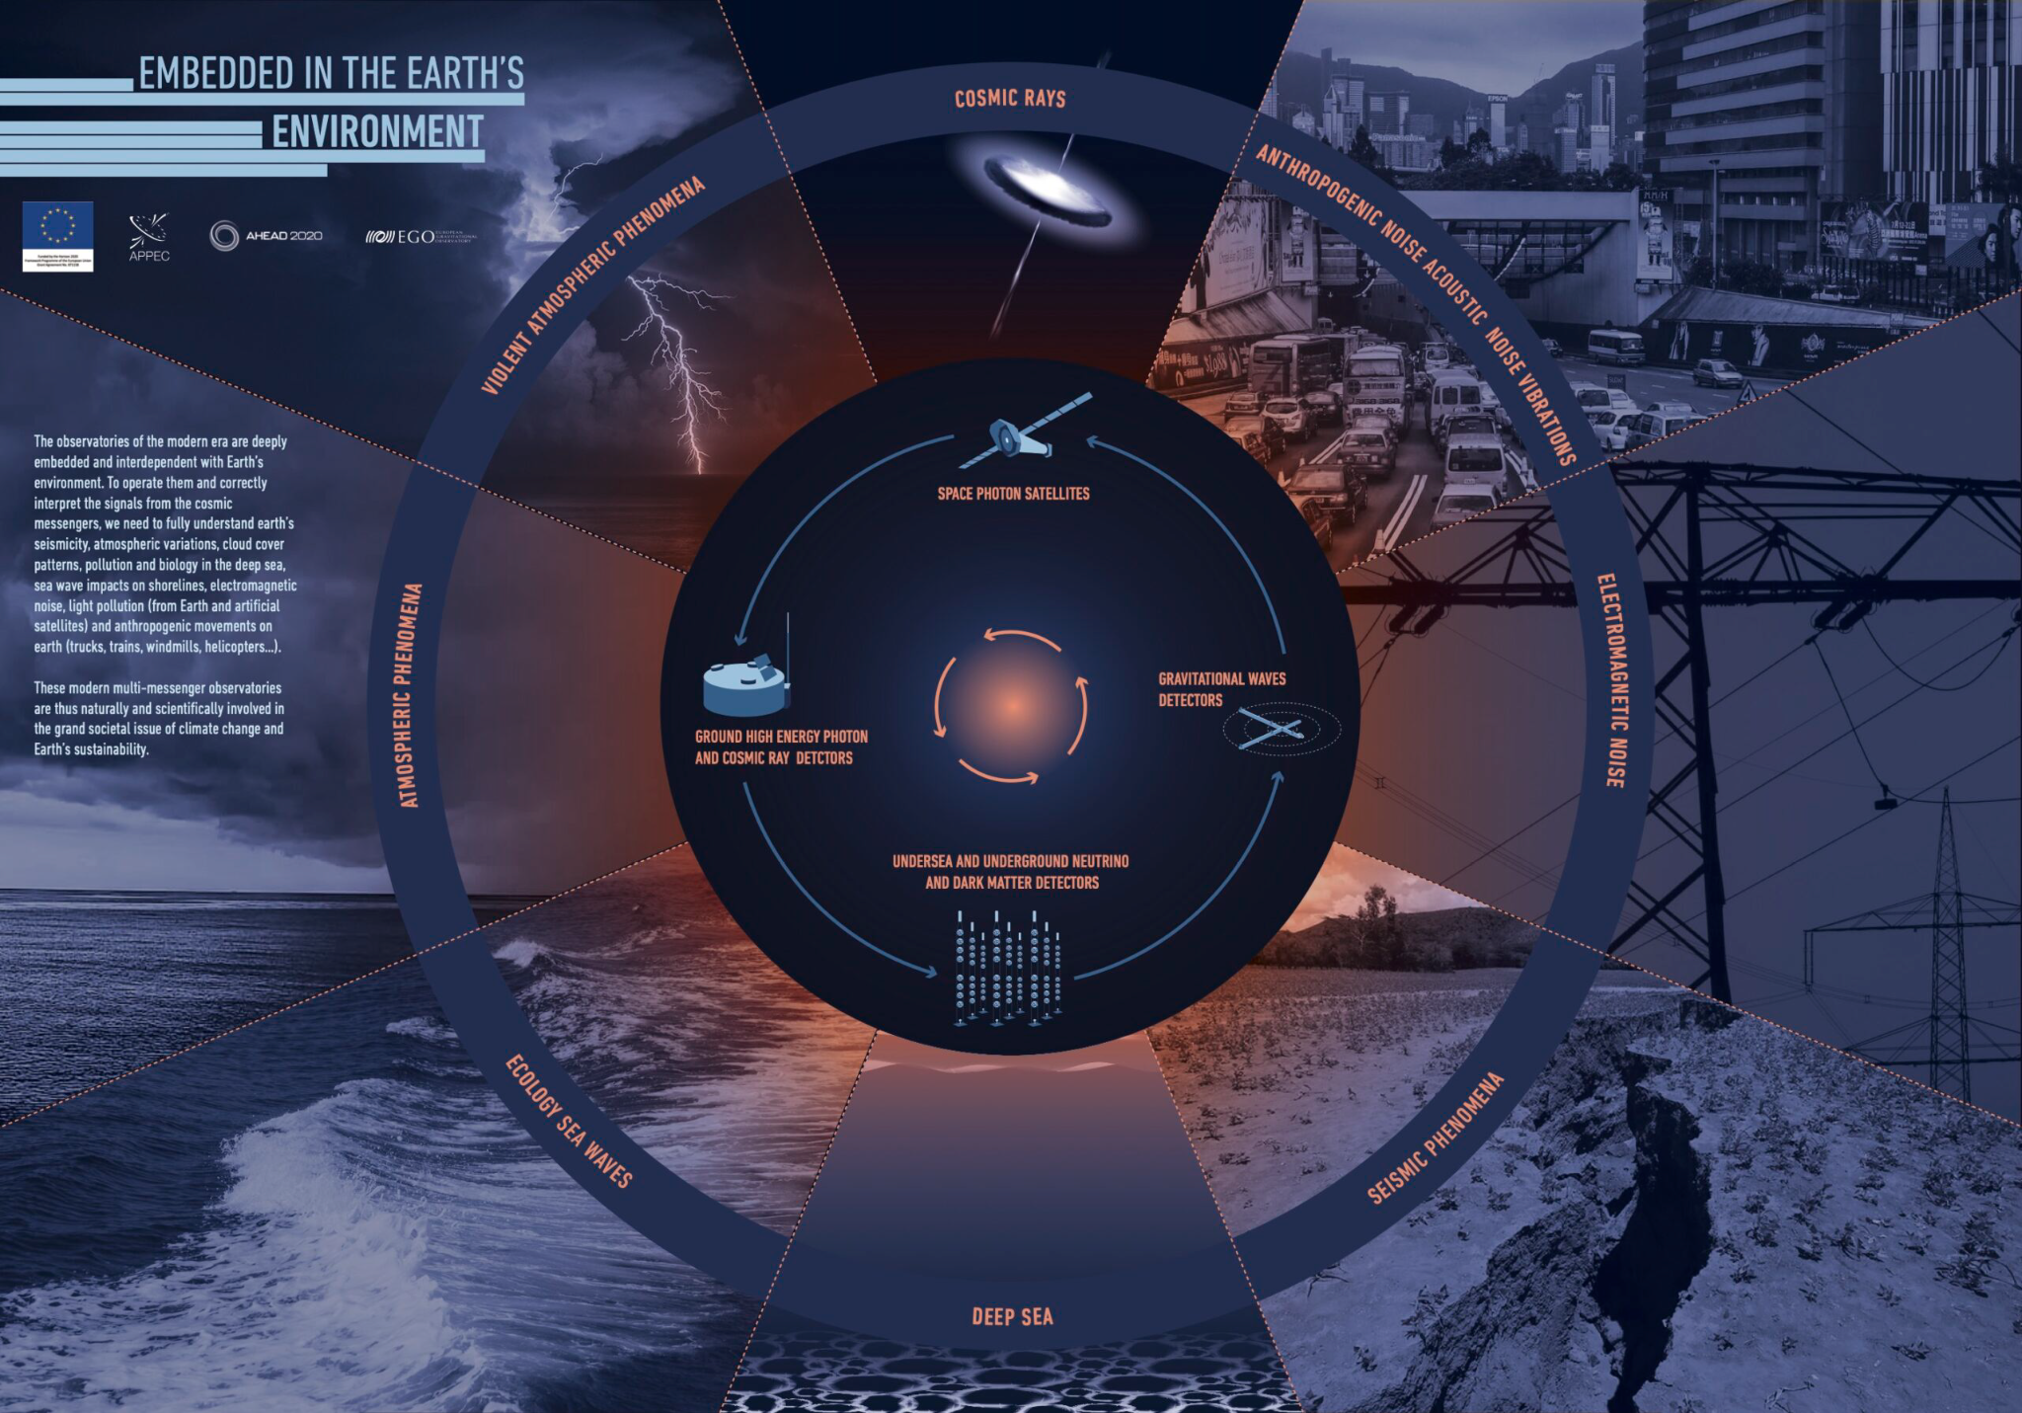
https://www.ego-gw.it/posters-multimessenger-astrophysics/

Slide 4
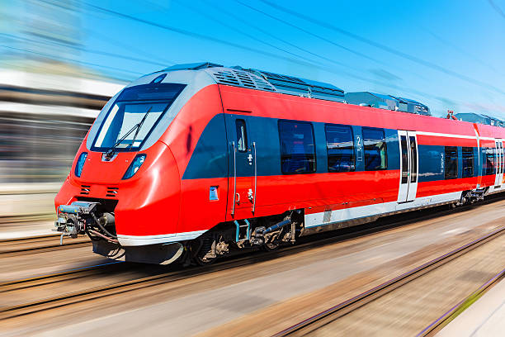
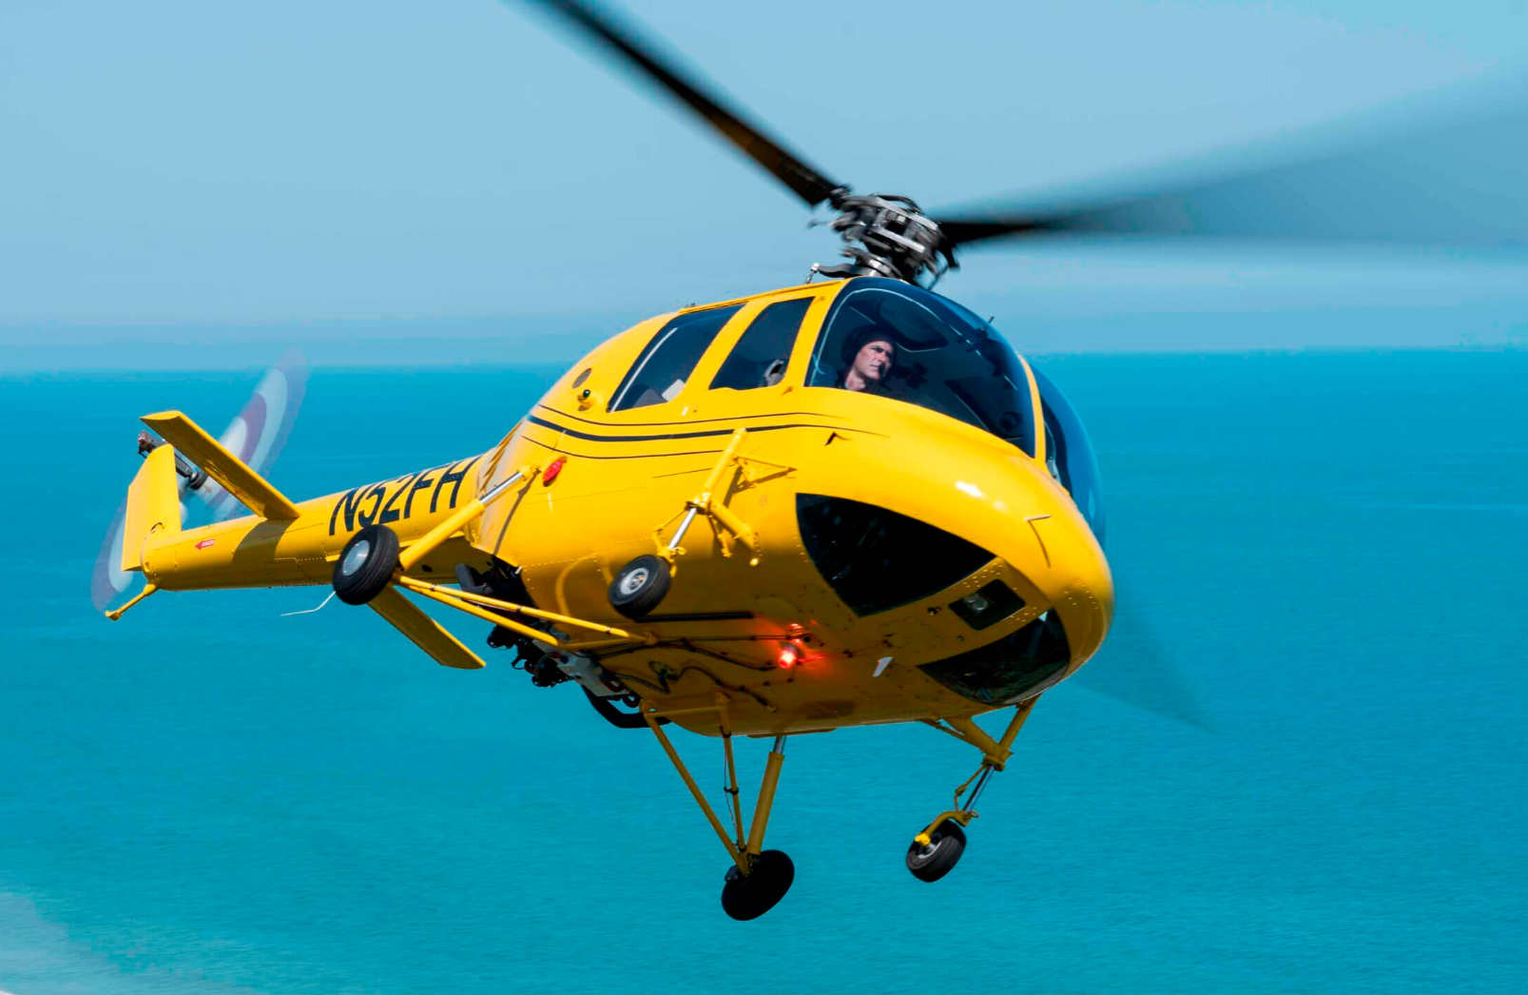
Virgo into the environment
Virgo, embedded in the Earth’s environment
Wind
Sea
waves

Slide 5
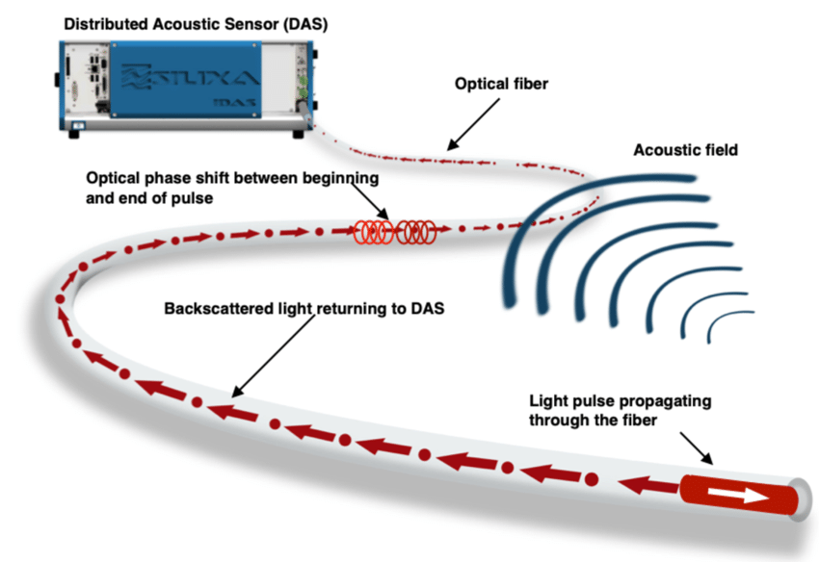
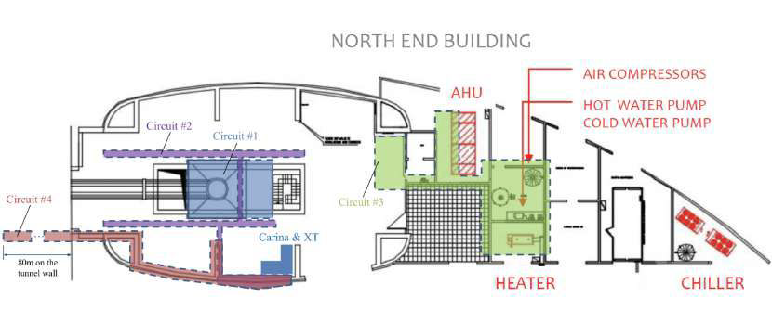
Optical fibers monitoring site noise
DAS measures strain modulations in FO cables based on the inherent backscatter
Distributed Acoustic Sensing technique with optical fibers by SILIXA company: engineered Constellation™ fibers (very good SNR performance)
1.5 km of fiber deployed at Virgo North End building and N arm tunnel
Extensive monitoring of site infrastructure noise (vibrations and sounds)
Localization of sources
Wind action of building walls
Test for future applications: monitoring of remote GW sites (e.g. Einstein Telescope), Fiber GW detector on the Moon.

Slide 6
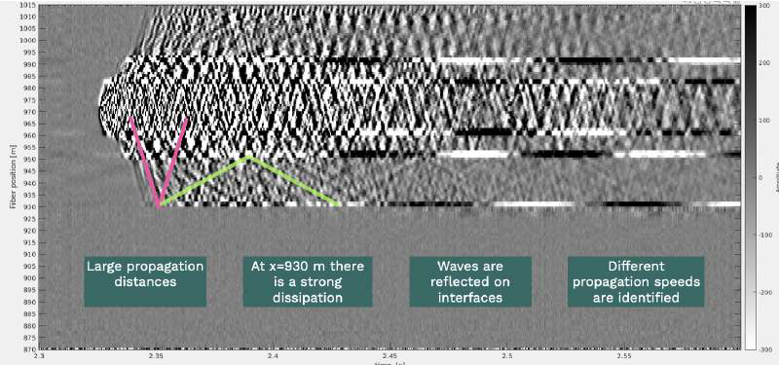
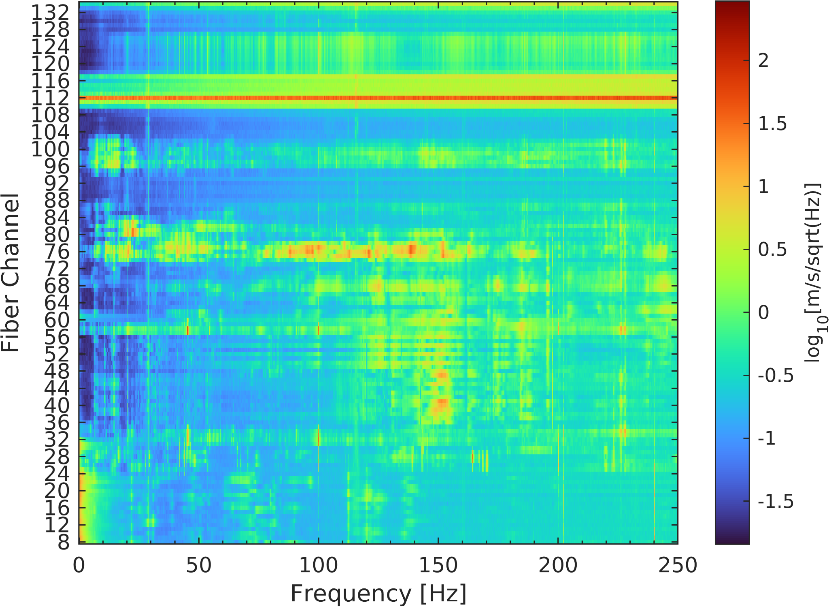
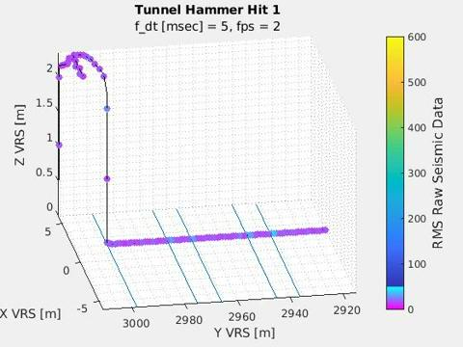
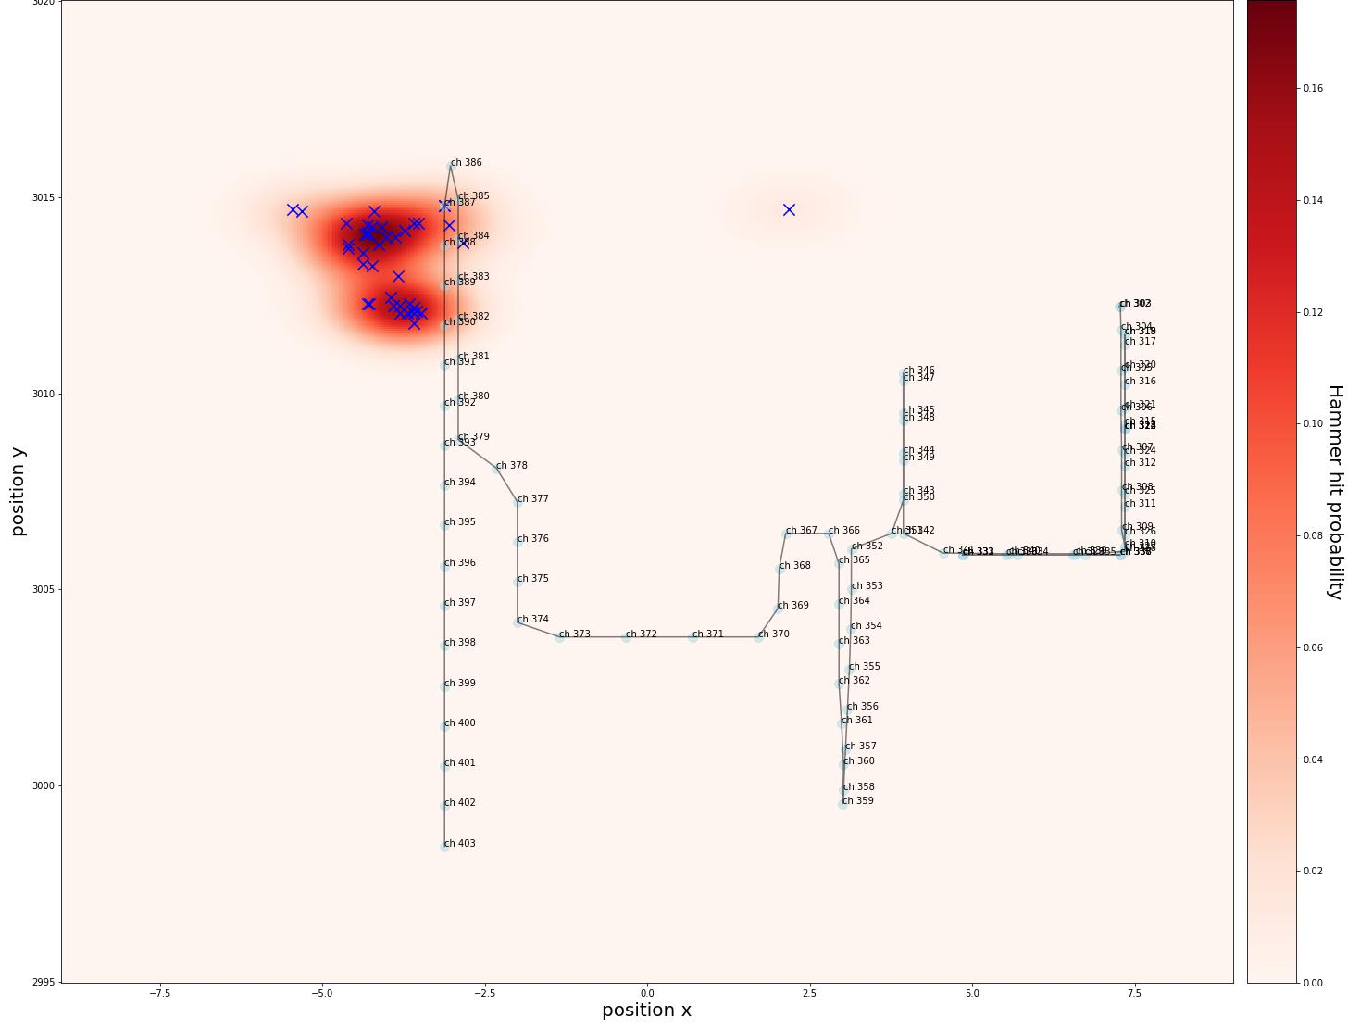
Optical fibers monitoring site noise
Seismic wave propagation at interfaces
Credits:
Stamatios Gkaitatzis – Università di Pisa
Paul Boniol – Université Paris Cité
Miquel Santasusana – Universitat Politècnica de Catalunya
Pierpaolo Marchesini - SILIXA
M.C. Tringali - EGO
Sources localization
SAT racks
Vac racks
Tower base

Slide 7
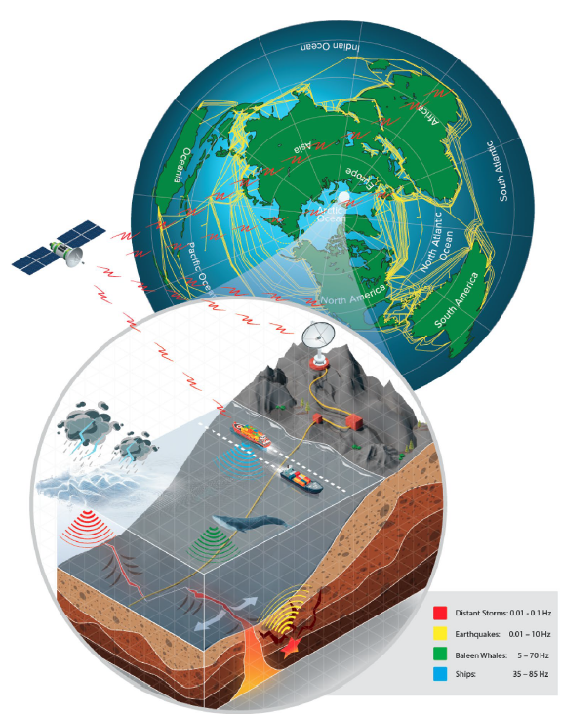
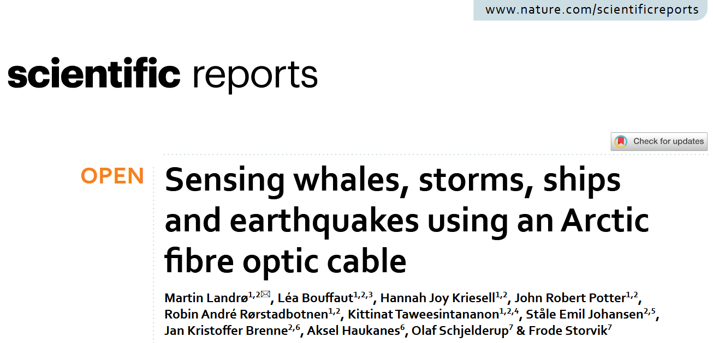
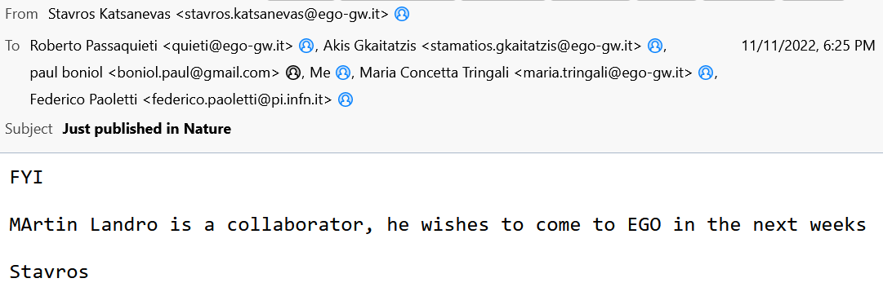

Slide 8
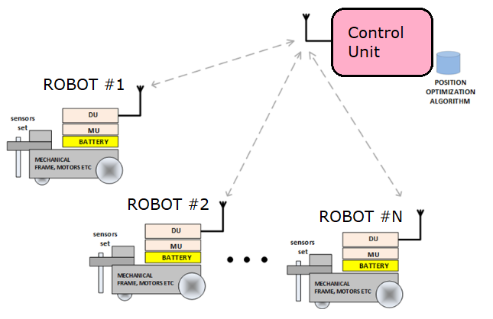
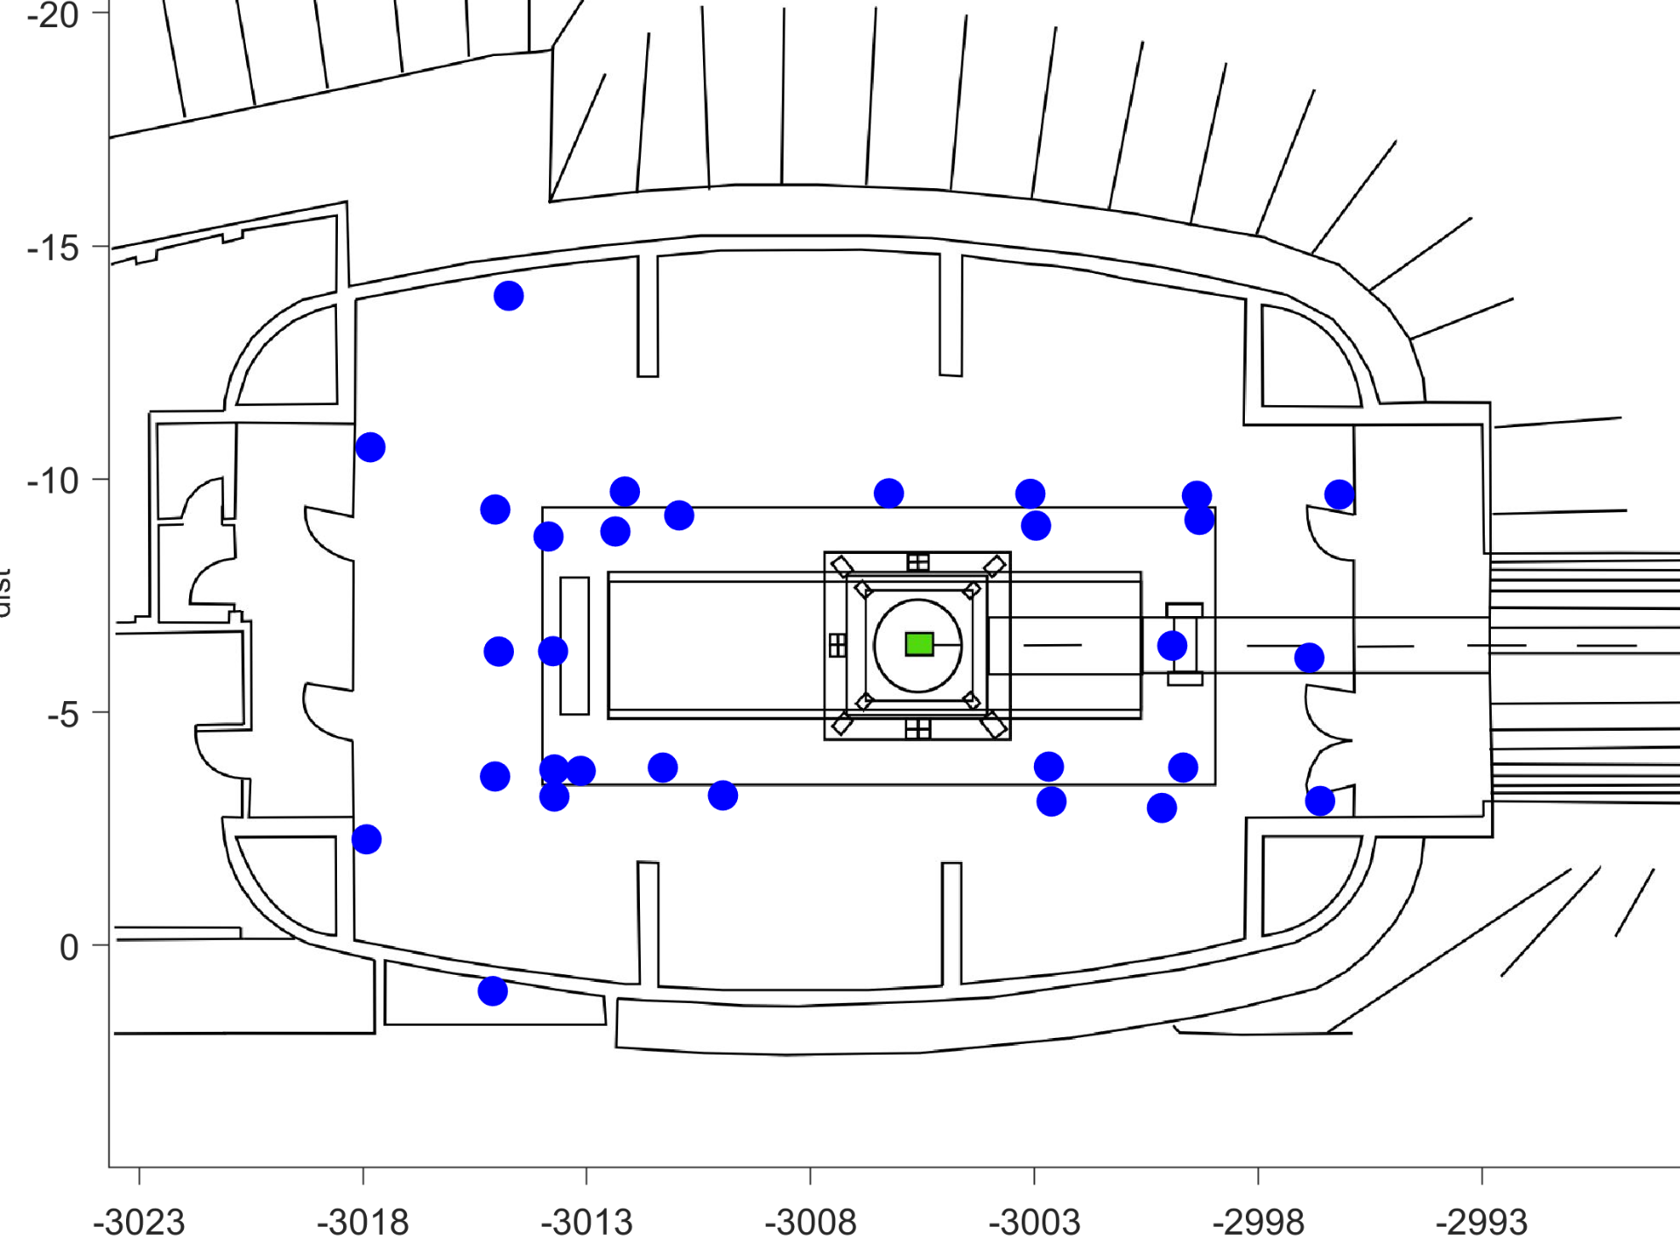
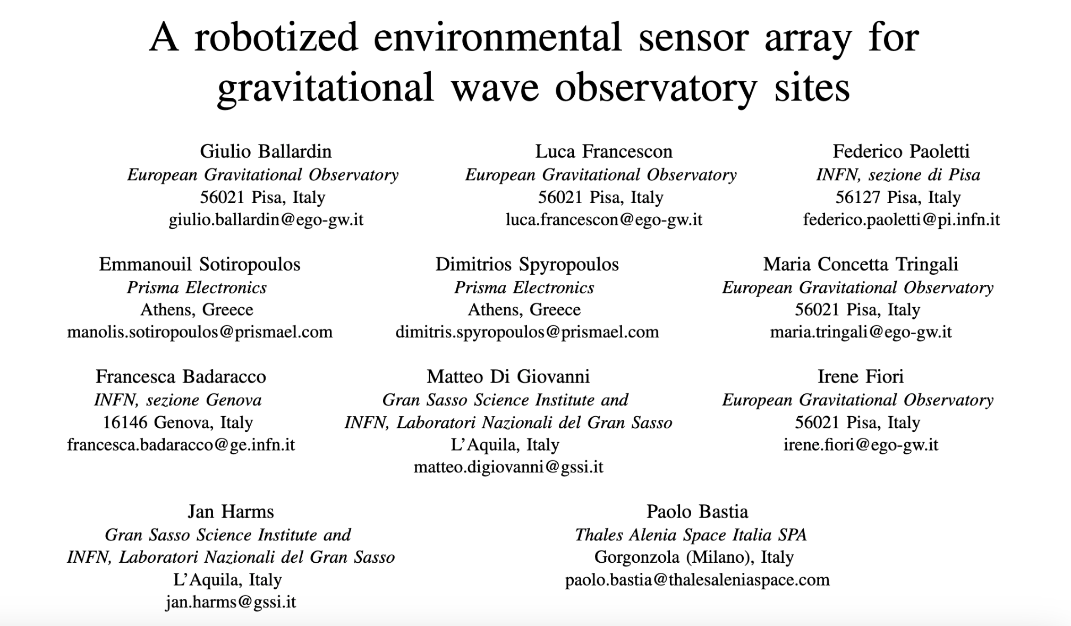
Robotized seismic sensors
An array of smart multi-sensors driven by an optimization algorithm to perform a specific task
Part of AHEAD2020 - WP15.5
EGO and GSSI - “proof of principle” - 3 robots set and optimization algorithm
Virgo:
cancellation of Newtonian Noise
Future:
remote GW sites mapping noise sources
GW detector on the Moon
Multidisciplinary:
Geophysical surveys

Slide 9
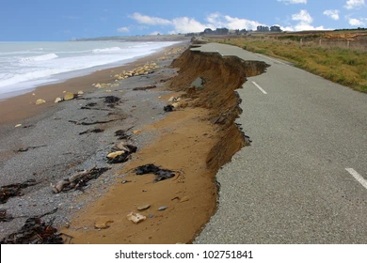
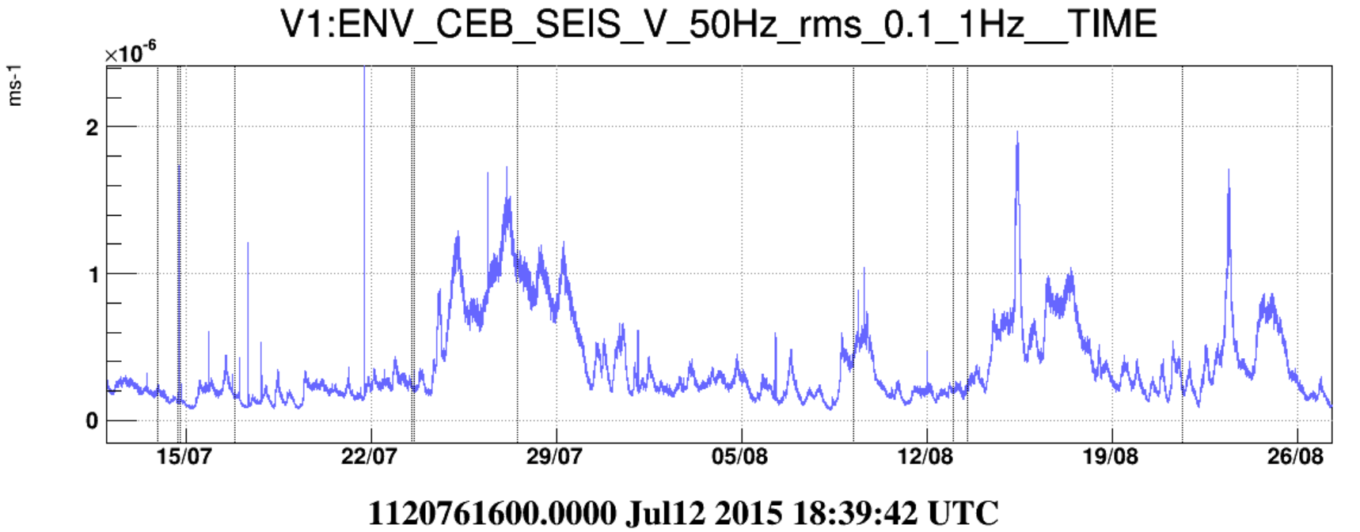
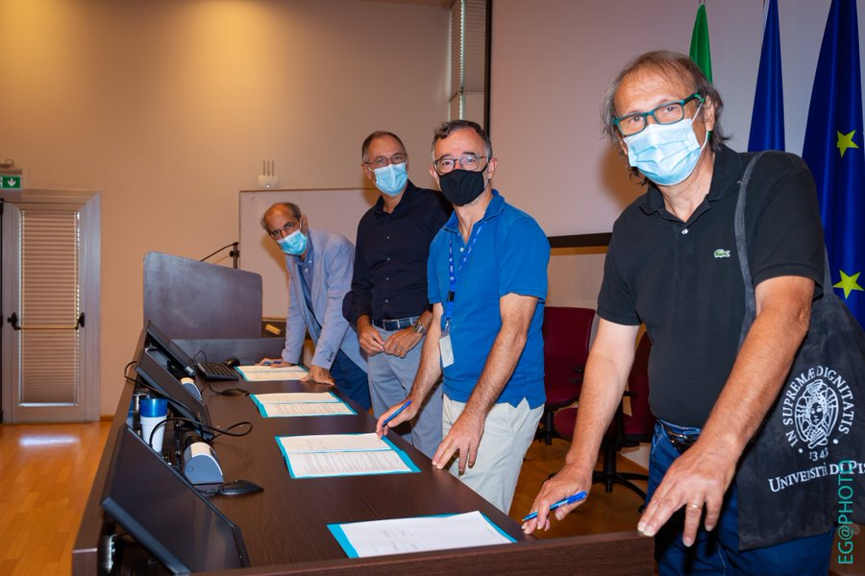
Marine ecosystems
Sea activity recorded a Virgo
Virgo data archive contains 20 years of environmental data, with information on Sea activity, and more
Climate change studies
Marine life and biodiversity
Coastal erosion
2021 - Agreement with University of Pisa - sharing of Virgo seismic sensors data.

Slide 10
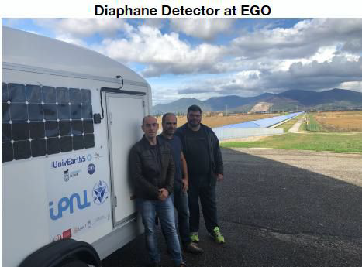
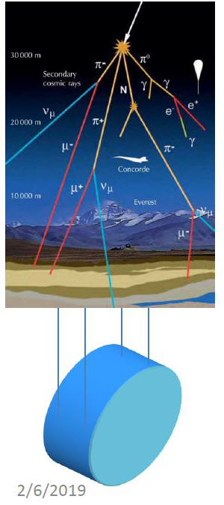
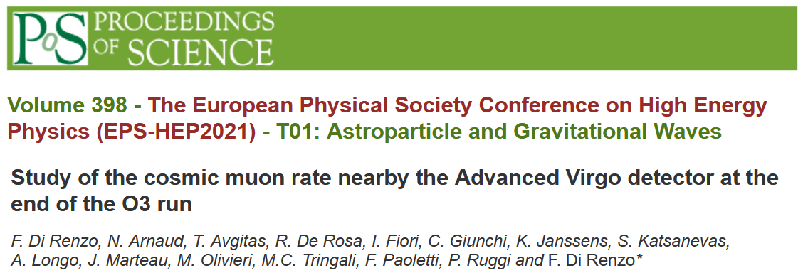
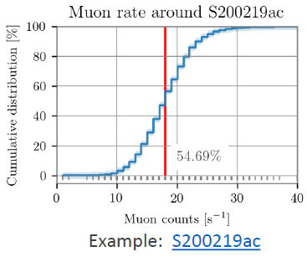
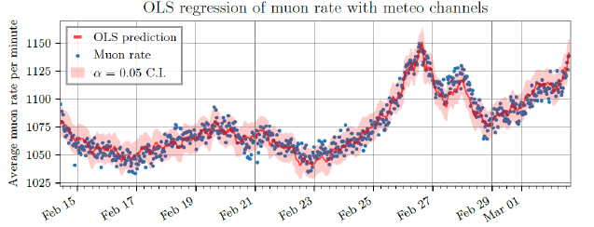
Cosmic rays
Cosmic rays interacting with Virgo mirrors can mimic GW events.
Muon detector from Jacques Marteau and his team (IP2I laboratory) at EGO during Virgo O3 run
Muons rate correlation with
GW events
Atmospheric parameters (P, T, Hu)
μ+
F. Di Renzo et al. https://pos.sissa.it/398/059
F.Acernese et al. The Virgo O3 run and the impact of the environment

Slide 11
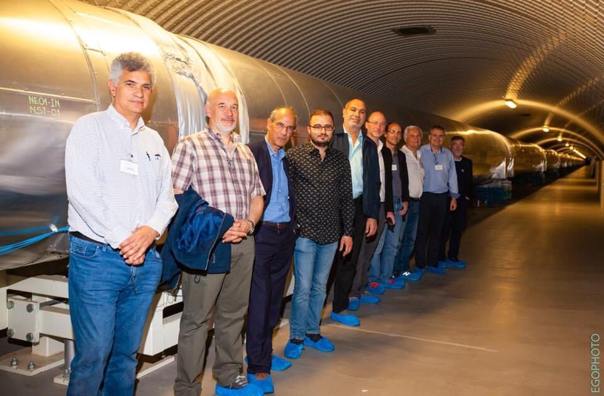
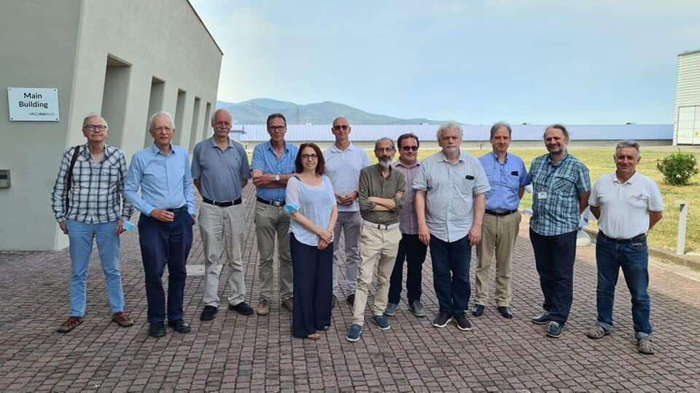
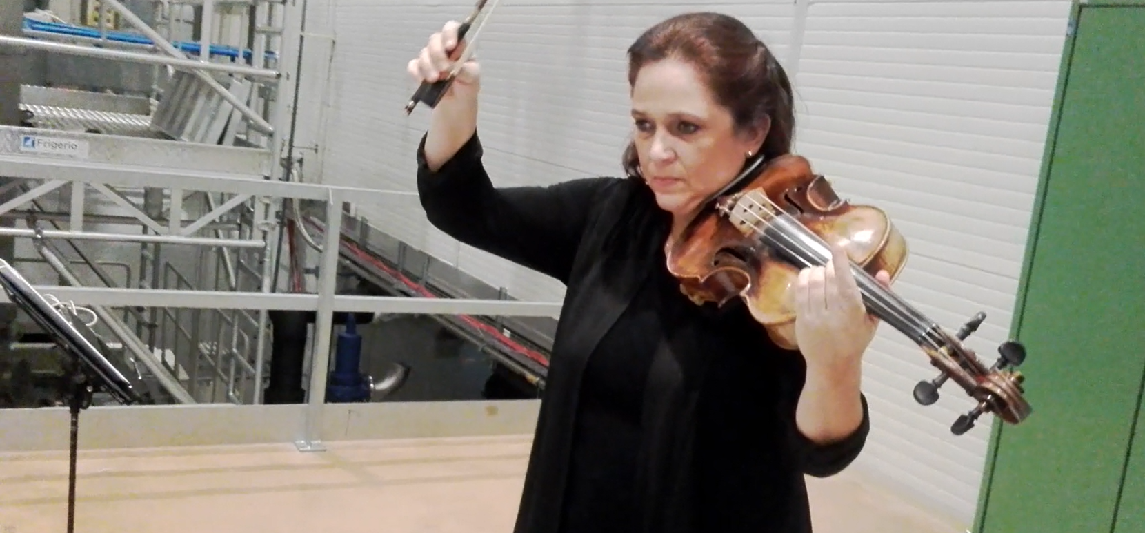
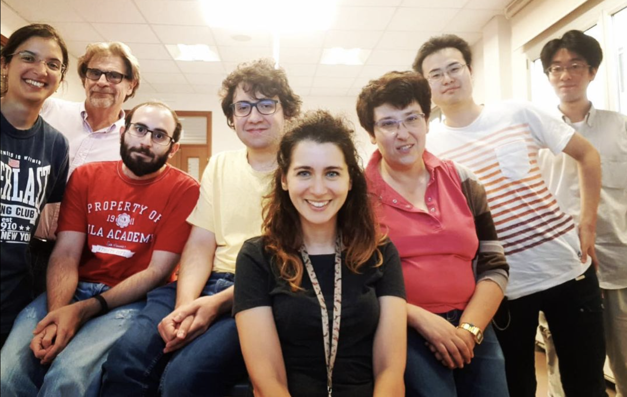
Building bridges
EGO, Virgo
GW community
Scientific communities
Industry
Arts
Society
Young researchers
The rhythm of space

Slide 12
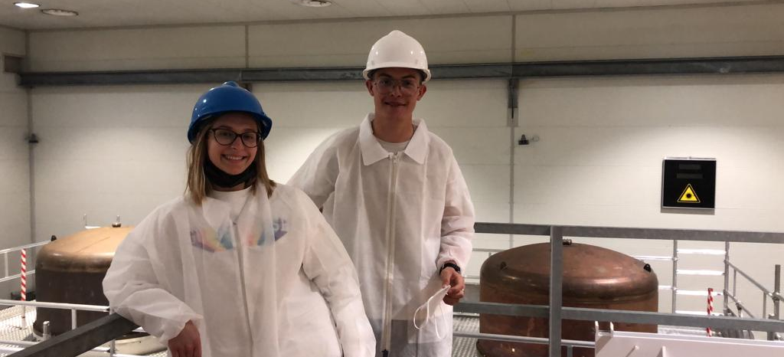
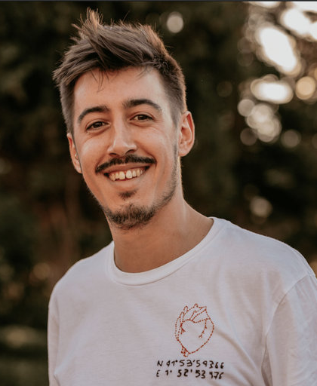
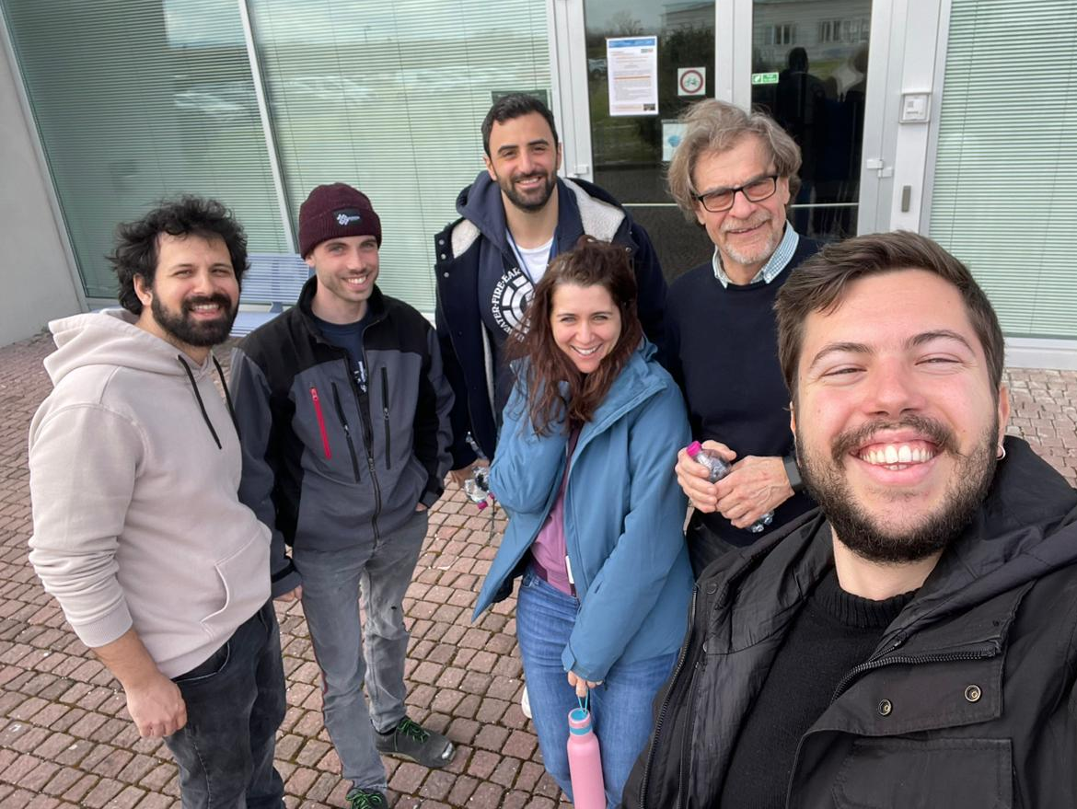
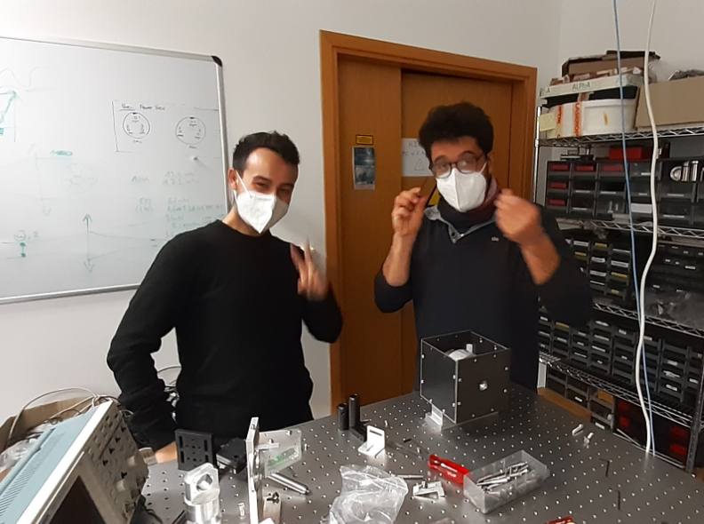
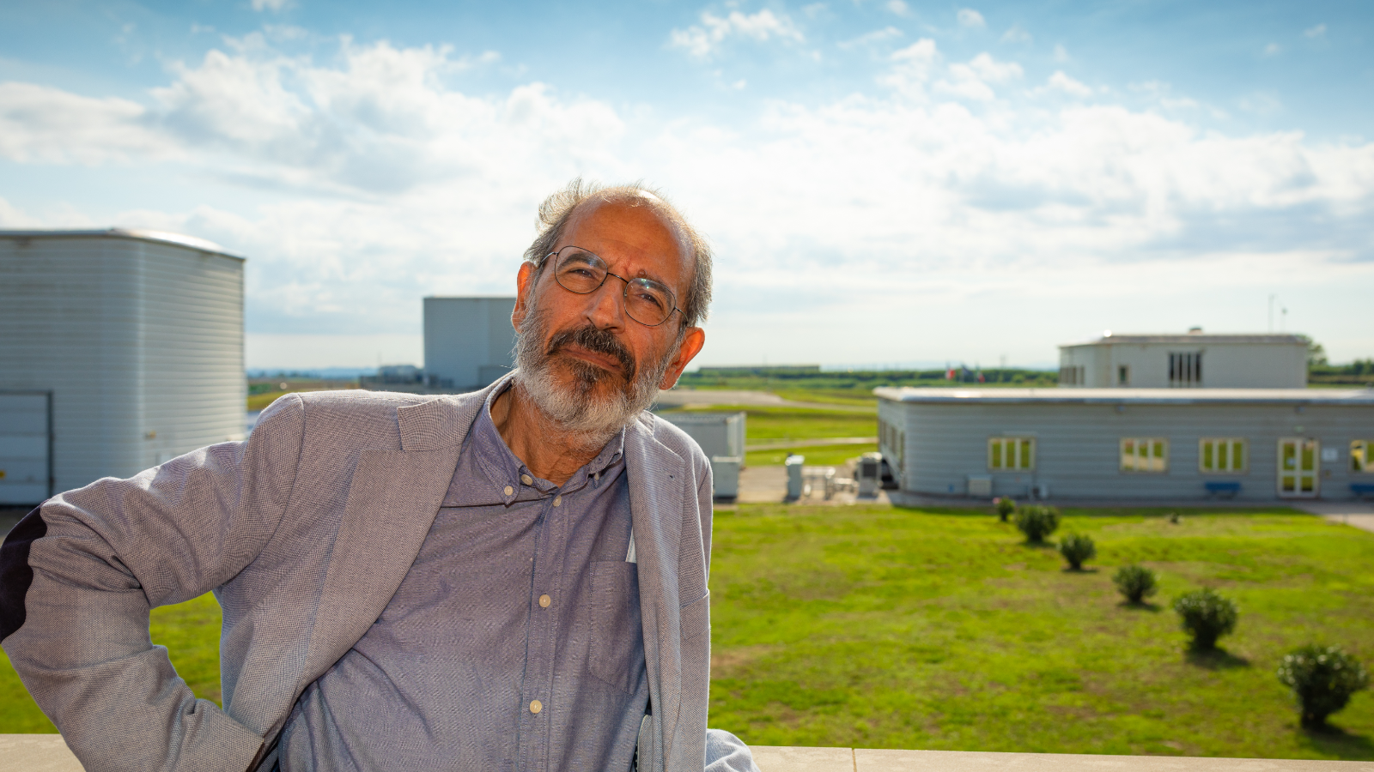
Thank you!

