Slide 1
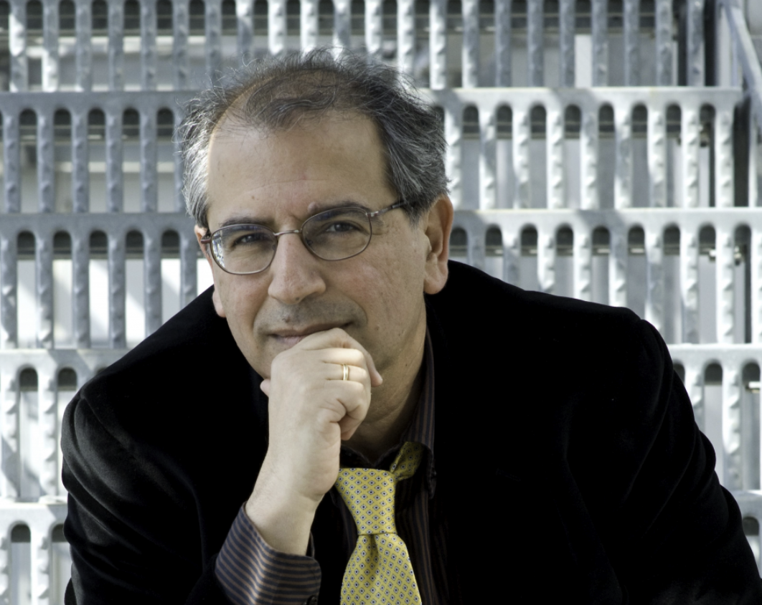
Stavros Katsanevas
Lyon
1996-2003

Slide 2
November 27th will be always a sad day for many of us and in particular for all Lyon physicists.
-Lyon was the place where Stavros’s ideas and enthusiasm found a fertile environment.
-Lyon was also the first and also the last French University to benefit of this remarkable man
1996 Stavros was invited by J-E Augustin (IPNL’s director at that time) as a visitor professor.
1996 Stavros was recruited as a full professor in Lyon University where he conducted
important work on SUSY & neutrino but also EW physics (W)
He quickly took over as DELPHI team leader and later on OPERA team leader in Lyon
2002 Stavros joined the IN2P3 directorate
2003 left Lyon University for Paris VII University

Slide 3
Stavros and SUSY
Stavros was one of the most active physicists in SUSY research between 1996 and 2000
SUSYGEN generator was used by the 4 experiments looking for supersymmetrical particles at LEP. (with P. Morawitz and then with N. Godhbane)
Became a pilar of the SUSY GDR headed by P. Binetruy
Organized the first GDR meeting in Lyon
Supervised researches on charginos, squarks and gluinos: N. Ghodbane & P. Verdier
Created a SUSY community in Lyon including experimental and theoretical physicists (I.L , M. Kibler, F. Gieres, R. Barbier...) but also outside Lyon (LAPP, LPTH,LAL… )
SUSY GDR meetings were often the occasion for passionate discussions in a very friendly environment.
Invited brilliant physicists working on SUSY to Lyon
S. Pokorski, J. Rosiek, G. Kane, M. Carena, C. Wagner….

Slide 4
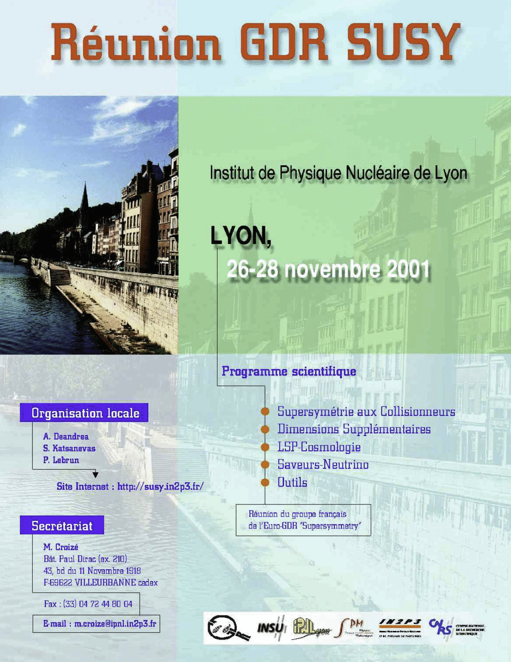

Slide 5
Stavros and neutrino
Stavros was neutrino fervent before to come to Lyon (Nestor project)
After LEP2 and the venue to Y. Declais to Lyon the neutrino became the hottest topic on Stavros’s list of interests.
Several beam-based neutrino projects were discussed: Monolith, OPERA….
Opera group was created in 1997 (L. Chaussard , Y. Declais, S. Katsaneva, I. Laktineh)
Stavros then replaced Y. Declais as the team leader.
Supervised many preparatory studies for OPERA to be accepted
The group was joined after by D. Autiero and later on by J. Marteau
Stavros supervised two PhD students
F. Gharbi and C. Heritier
Stavros initiated a new photodetection development in Lyon to read out scintillators
(MAPMT)
Stavros was the first to lead the OPERA DAQ system
Many researchers from Russia, Bulgaria, Sweden and China came to Lyon to work with Stavros
When Stavros accepted the Deputy Scientific Director position we were happy for him but we also were aware of the big loss that his departure represented for Lyon and at the same time the extraordinary asset for the French physics
Stavros continued to follow and support the neutrino activities in Lyon longtime after his departure.
He always cared about his fellows

Slide 6
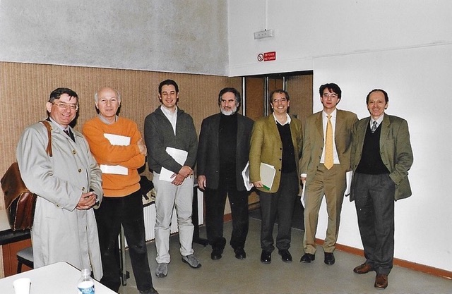
Stavros the teacher
Stavros was really appreciated by the students
Always available for them
He attracted brilliant PhD students
Although he dealt with his PhD students as real collaborators he looked after them as a father.
P. Verdier PhD thesis defense jury

Slide 7
Personal memories of Stavros
When I think about Stavros, a few pictures come to me
Passionate physicist
Creative spirit
Open-minded
Friendly
Soft and well-mannered
Universal
And above all, he had no hatred in his heart always forgiving those who mistreated him
Stavros was an exceptional human being
One does not meet so many like Stavros in a man life

Slide 8
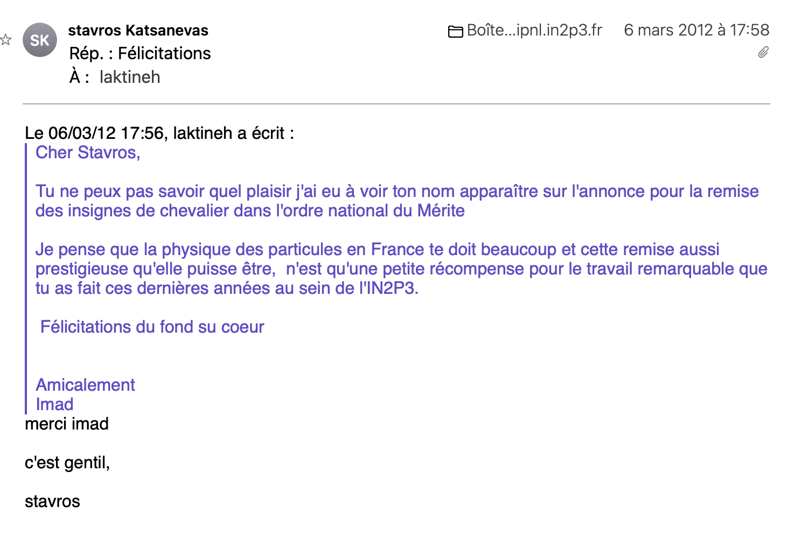

Slide 9
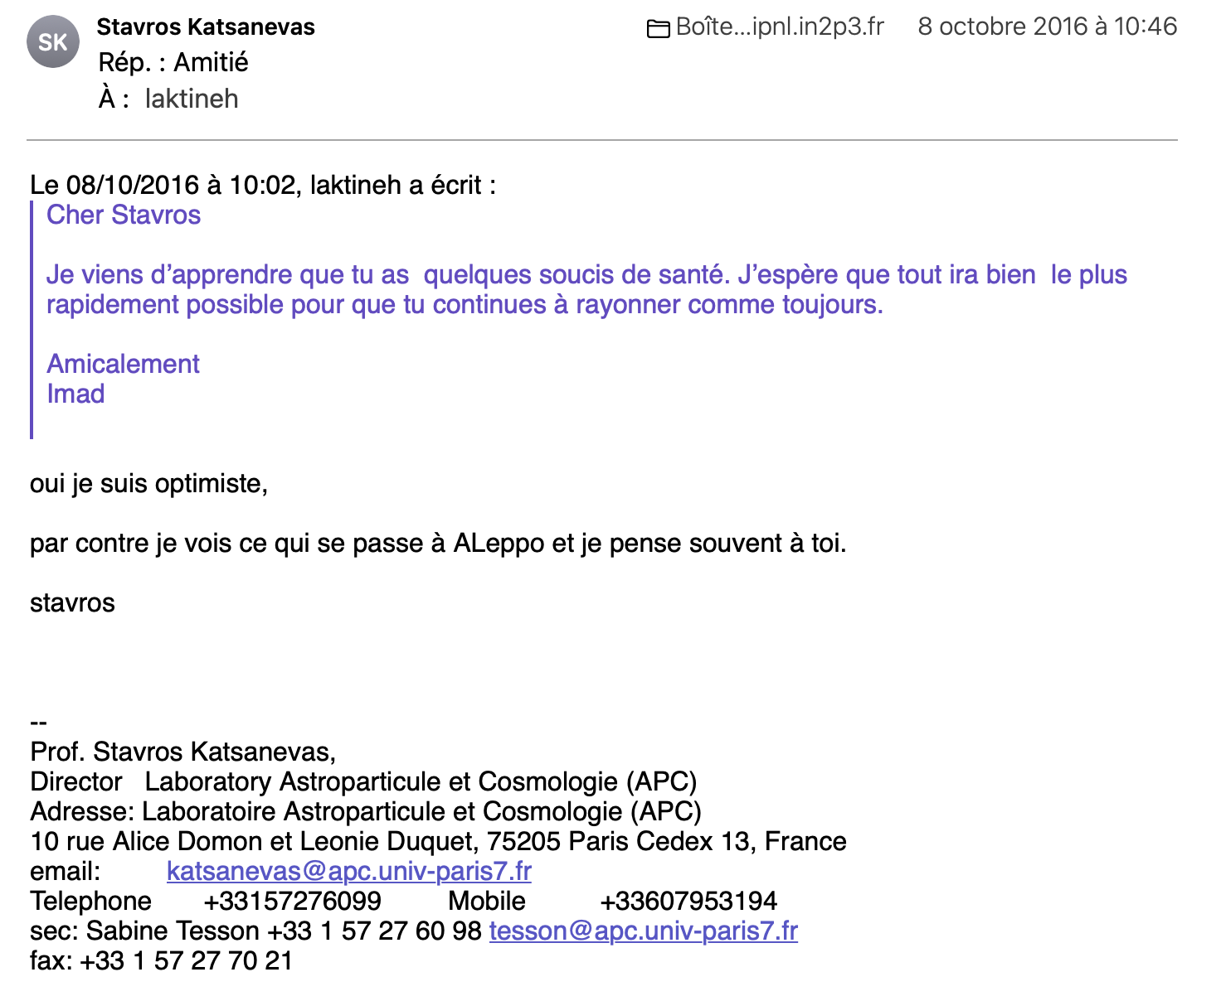

Slide 10
Yannis Karyotakis wrote:
“Je suis certain que Stavros le long du Styx est en train d’expliquer à Charon l’importance de la découverte des ondes gravitationnelles. ”
I would say he is probably sitting now with Aphrodite and Apollo trying to convince them of the beauty of the physics of the two infinities and I am sure they will soon join his team

Slide 11
Dear Stavros
For all what you did for the physics and in particular for the physics in Lyon
For all what you did for many of us and me in particular
I want to say thank you.
You will always be remembered with love, respect and admiration.
Ευχαριστώ φίλε

