Slide 1
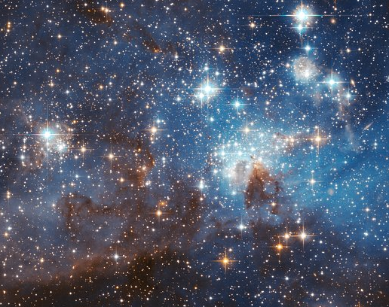
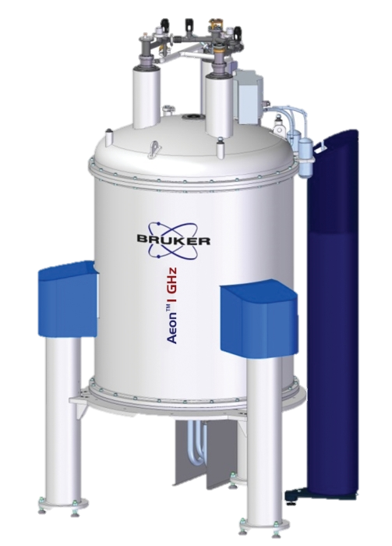

Results and prospects at the Cosmic Axion Spin Precession Experiments
Hendrik Bekker
for the CASPEr collaboration

Slide 2
Contents
Dark matter
Searches employing magnetic resonance
Hyperpolarized samples
Spectral signatures
Networks of sensors

Slide 3
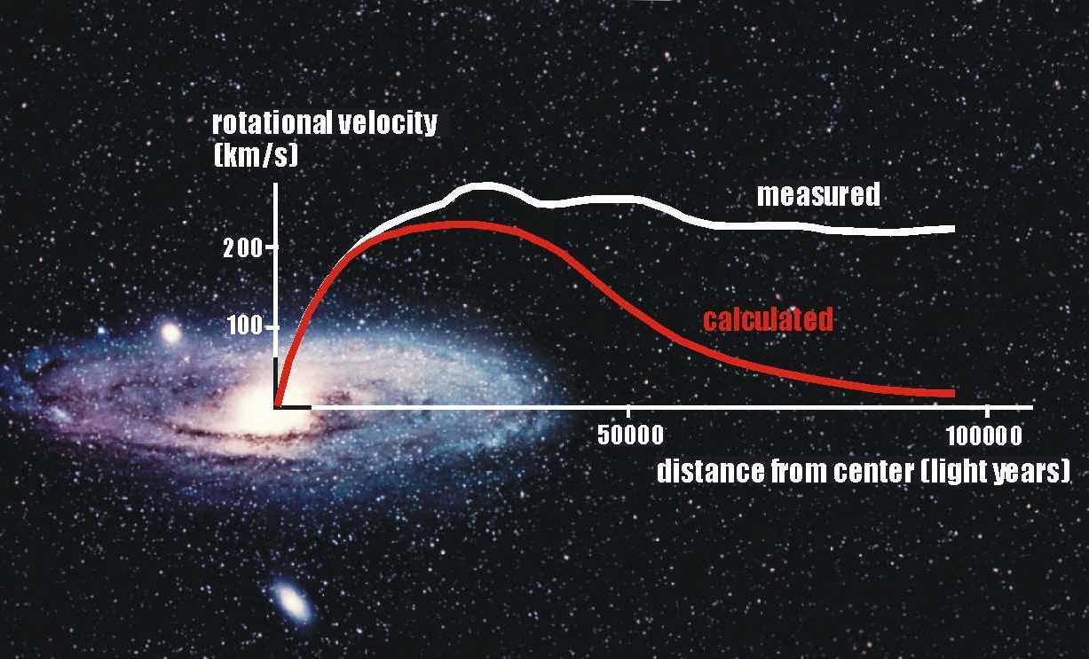
Dark matter, astronomical evidence

Slide 4
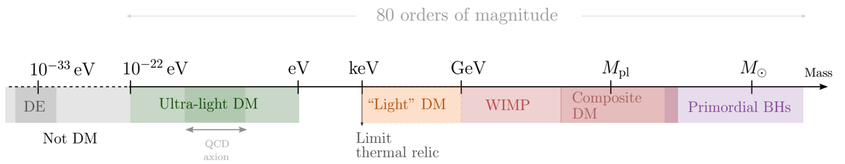
Dark matter, sought after particles
Number density > 10⁶
Number density < 10⁻³⁰
wave-like behavior
particle-like behavior
bosonic
Ferreira, Elisa G. M. “Ultra-Light Dark Matter.” The Astronomy and Astrophysics Review 29, no. 1 (September 9, 2021): 7.

Slide 5
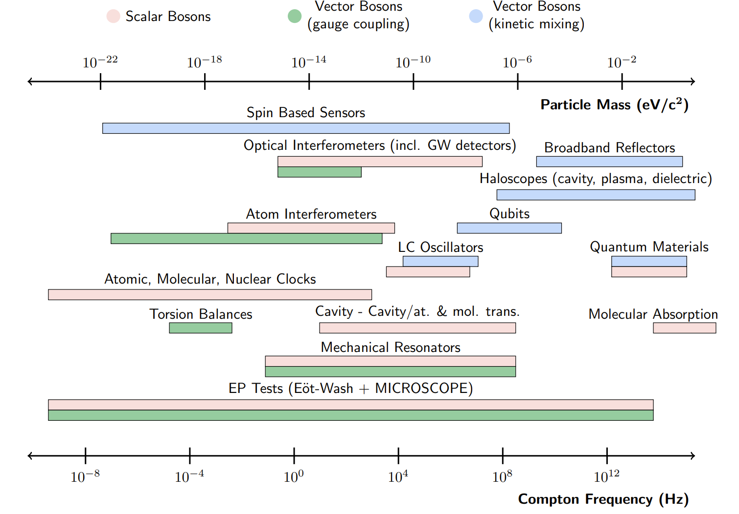
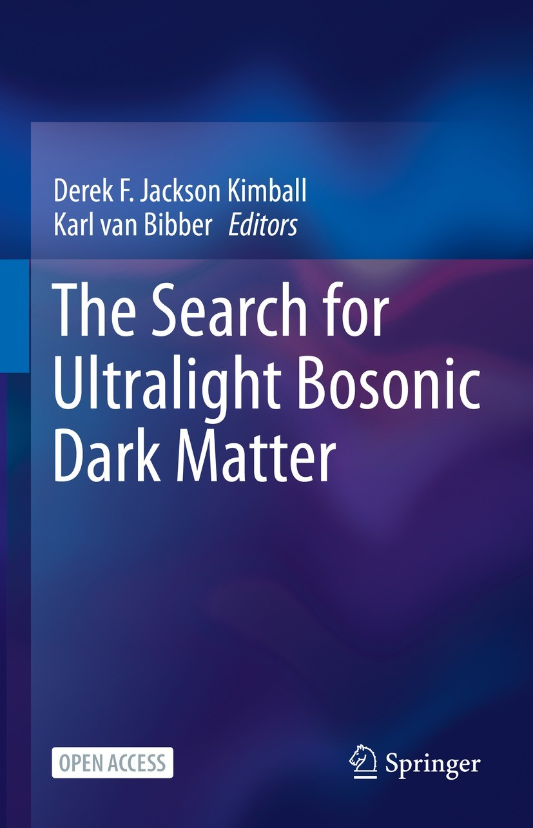
Dark matter, ultralight bosonic
Snowmass 2021 White Paper New Horizons: Scalar and Vector Ultralight Dark Matter, https://arxiv.org/pdf/2203.14915.pdf

Slide 6
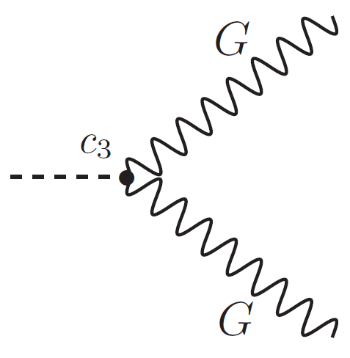
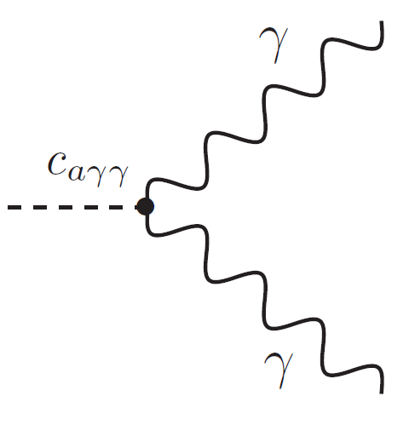
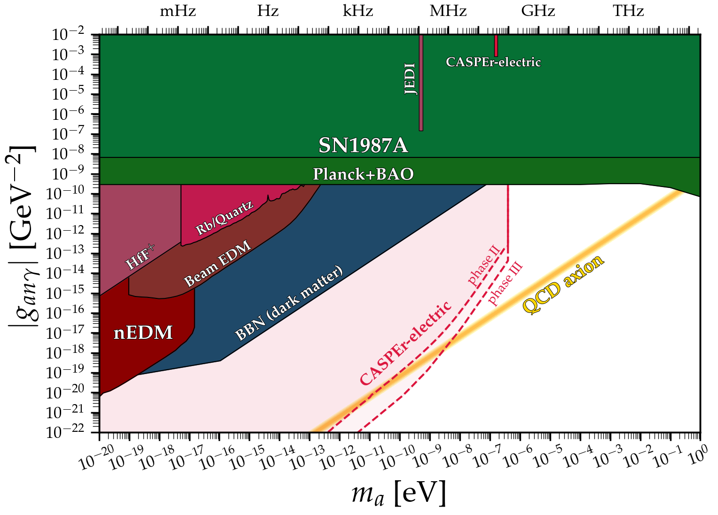
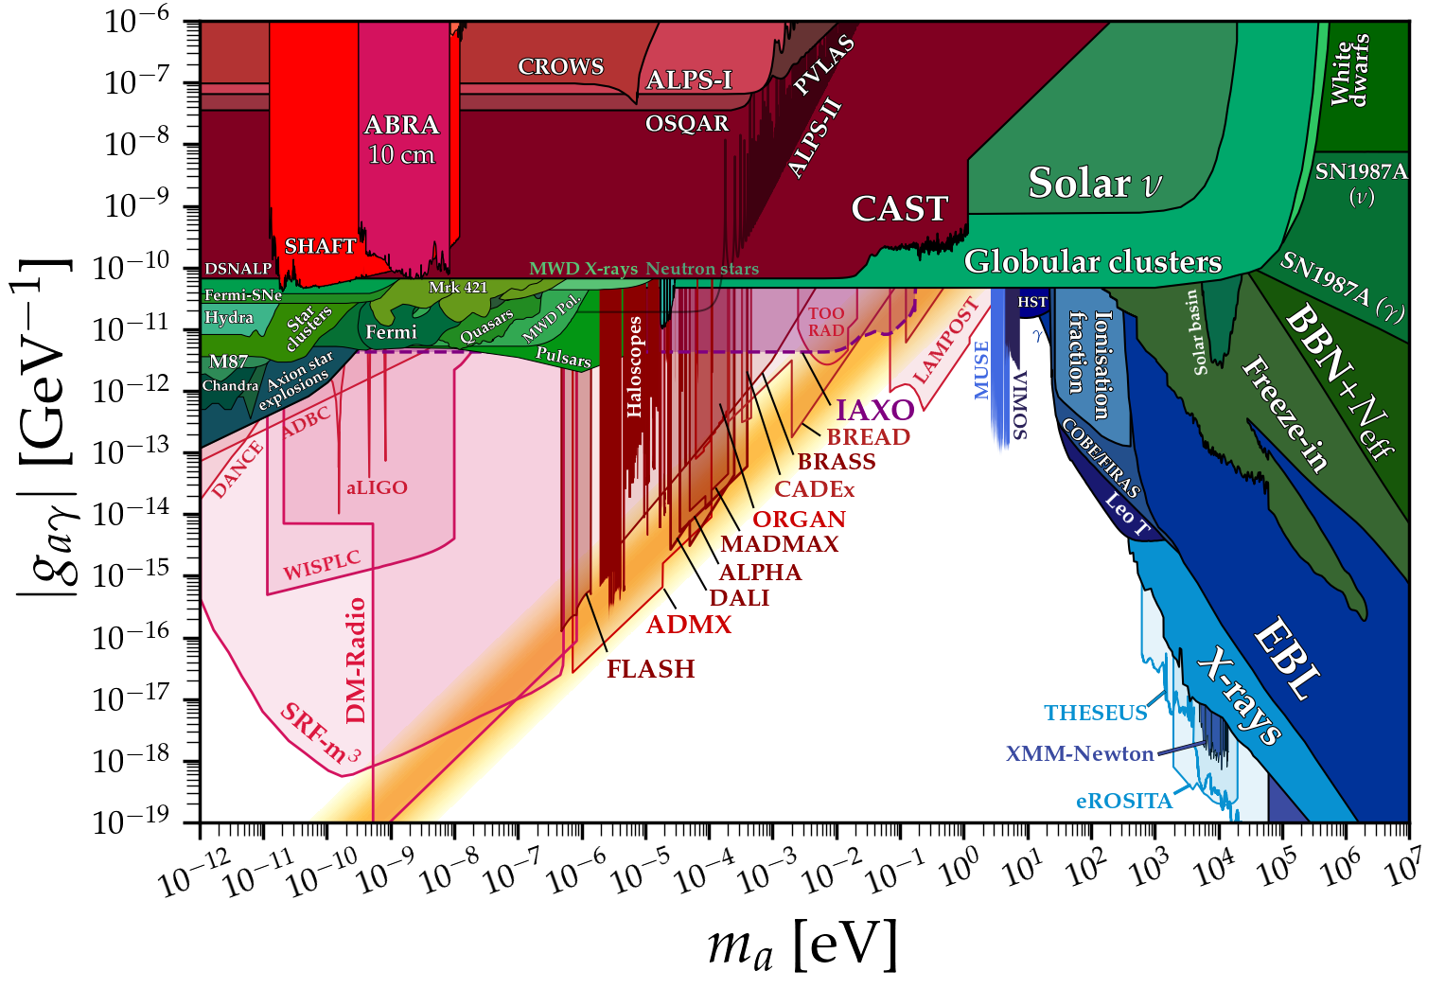
Dark matter, couplings to normal matter
axion-gluon coupling
induces an electric dipole moment
axion-photon coupling
(inverse) Primakoff effect
https://github.com/cajohare/AxionLimits

Slide 7
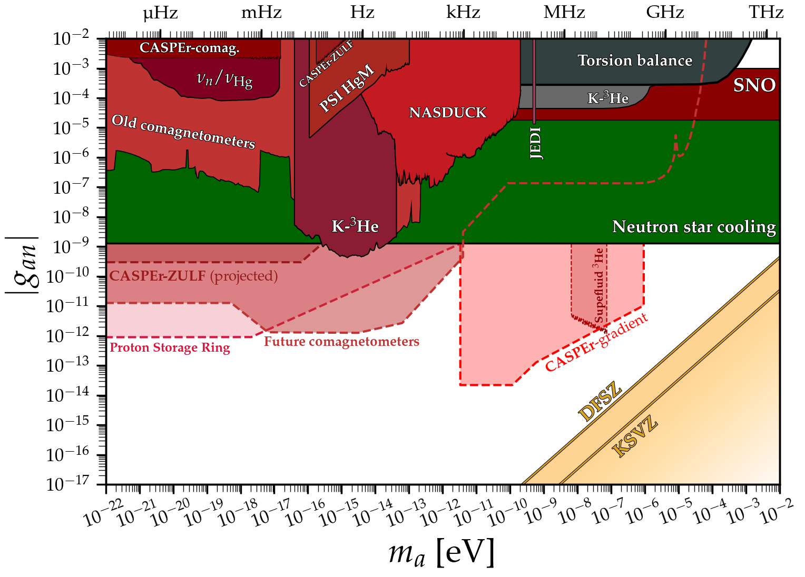
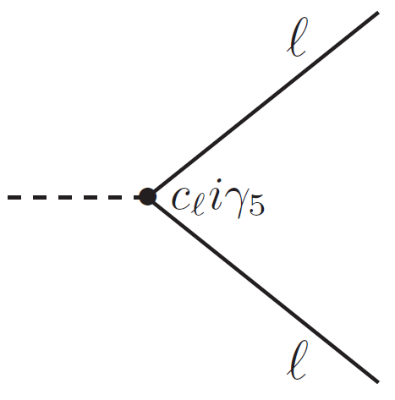
Dark matter, couplings to normal matter
axion-fermion coupling
https://github.com/cajohare/AxionLimits

Slide 8
Spin-based magnetometry

Slide 9



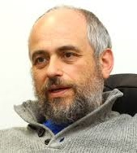
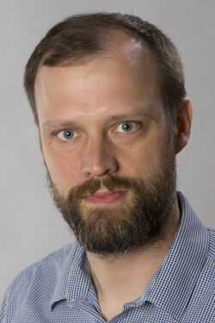









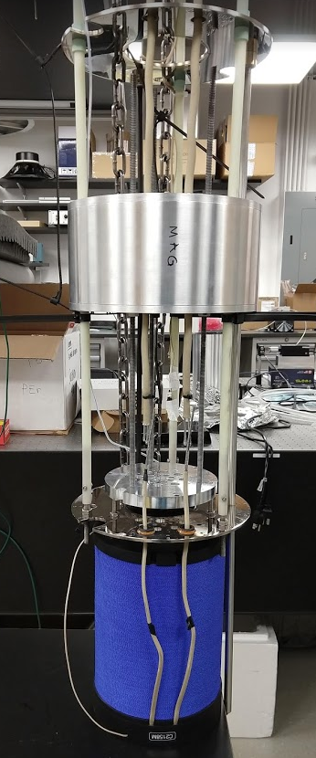
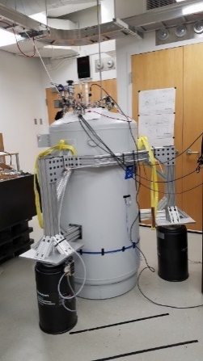
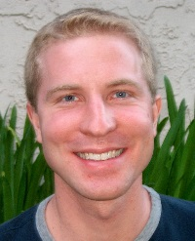
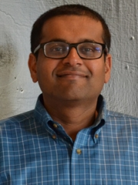
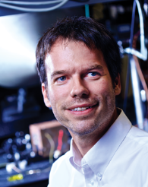
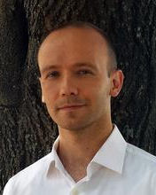
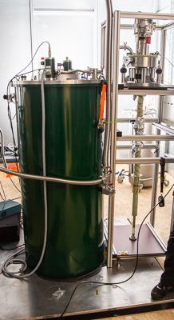
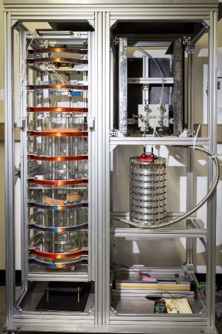
The Cosmic Axion Spin Precession Experiment program
Deniz Aybas
Alex Wilzewski
Janos Adam
Sasha Gramolin
Dorian Johnson
Annalies Kleyheeg
John Blanchard
Antoine Garcon
Gary Centers
Nataniel Figueroa
Marina Gil Sendra
Yuzhe Zhang
Arian Dogan
Julian Walter
Olympia Maliaka
Ophir Rumi
Jiaxuan Xu
Pengyu Zhou
Teng Wu
Alfredo Ferella
Matthew Lawson
Dmitry Budker Arne Wickenbrock
Boston University:
CASPEr-electric using spins in solids
Helmholtz institute Mainz:
CASPEr-gradient using hyperpolarized liquids
Peter Graham Surjeet Rajendran Derek Kimball Alex Sushkov

Slide 10



Cosmic Axion Spin Precession Experiment
CASPEr-electric (gluon) CASPEr-gradient (fermion)
Nuclear magnetic resonance
pseudo-magnetic field
$$B_{ALP}∝g_{aNN}v_{a} \sqrt{2ρ_{DM}}\sin\left(ω_{a}t\right)$$
coupling constant
oscillating at ALP Compton frequency
ALP velocity
D. Budker et al., Phys. Rev. X 4, 021030 (2014)

Slide 11
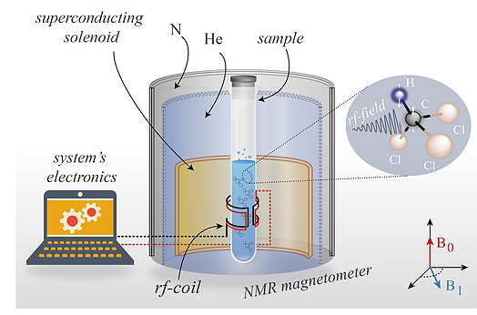
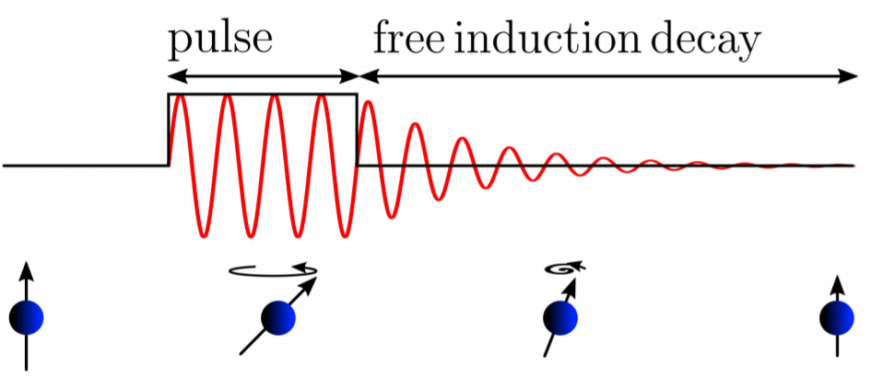
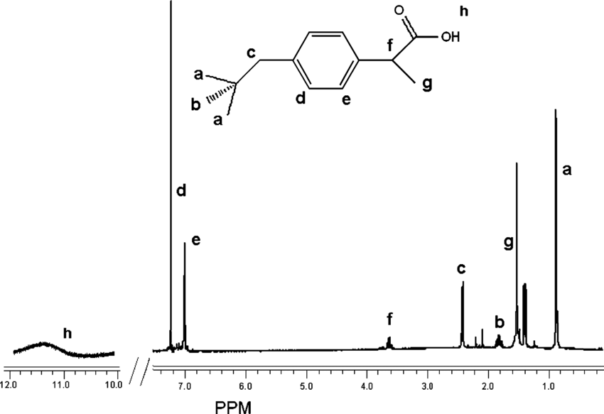

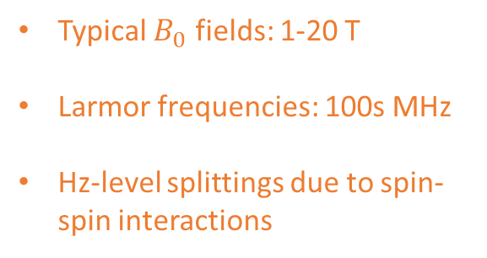


Nuclear magnetic resonance (NMR) spectroscopy
external pulse free induction decay (FID)
Field in pick-up coil, i.e., signal
$$B_{0}$$
Sample magnetization vector
$$B_{1}\sin\left(ω_{0}t\right)$$
NMR H-spectrum
of ibuprofen (advil)
Typical $B_{0}$ fields: 1-20 T
Larmor frequencies: 100s MHz
Hz-level splittings due to spin-spin interactions
www.quantumufabc.org/labs
CASPEr is similar to NMR
Mizrahi, Boaz, and Abraham J. Domb. "Anhydride prodrug of ibuprofen and acrylic polymers." Aaps Pharmscitech 10.2 (2009): 453-458.
D. Budker et al., Phys. Rev. X 4, 021030 (2014)

Slide 12
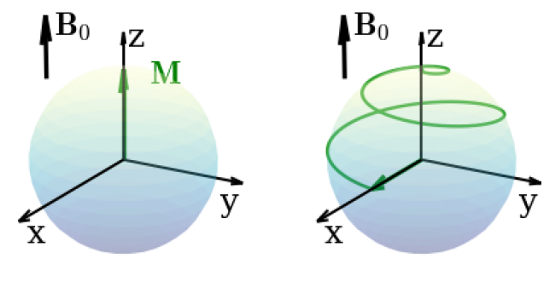
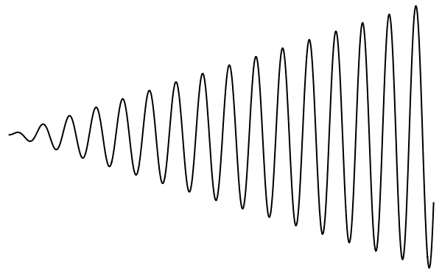
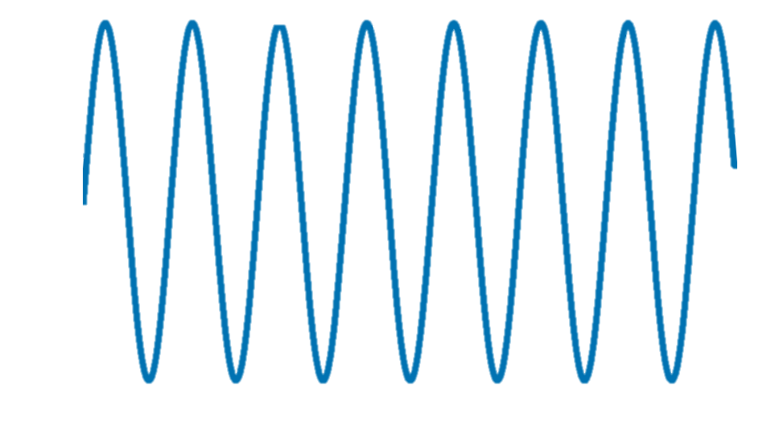
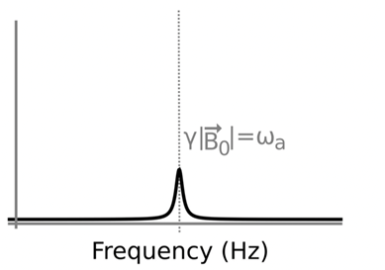
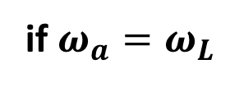

ALP-search method 1: direct drive
if $ω_{a}=ω_{L}$
Transverse magnetization
$$B_{0}$$
ALP field
time
tipping angle:
$$θ=γB_{1}τ$$
www.quantumufabc.org/labs
CASPEr is similar to NMR

Slide 13
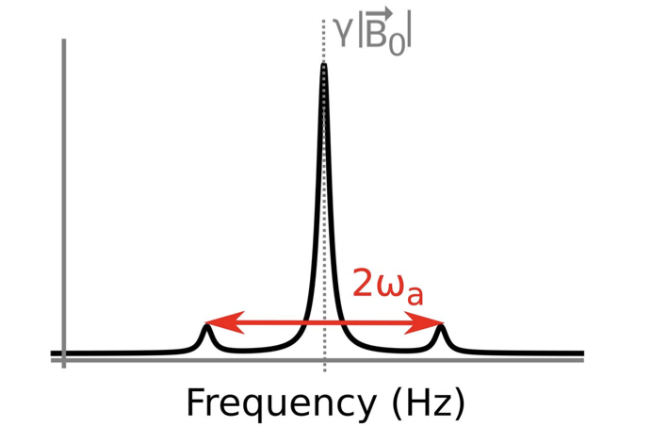



ALP-search method 2: sidebands
$|−1/2>$
$$ω=γ B_{0}$$
$$B_{0}$$
ALP field
$|+1/2>$
www.quantumufabc.org/labs
CASPEr is similar to NMR

Slide 14
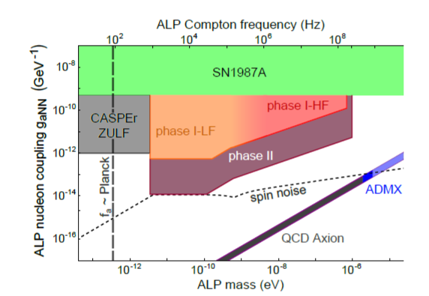
CASPEr-gradient principle and goals
$$B_{0}$$
www.quantumufabc.org/labs
CASPEr is similar to NMR
D. F. Jackson Kimball et al., Overview of the Cosmic Axion Spin Precession Experiment (CASPEr), in Microwave Cavities and Detectors for Axion Research, edited by G. Carosi and G. Rybka (Springer International Publishing, Cham, 2020), pp. 105–121

Slide 15
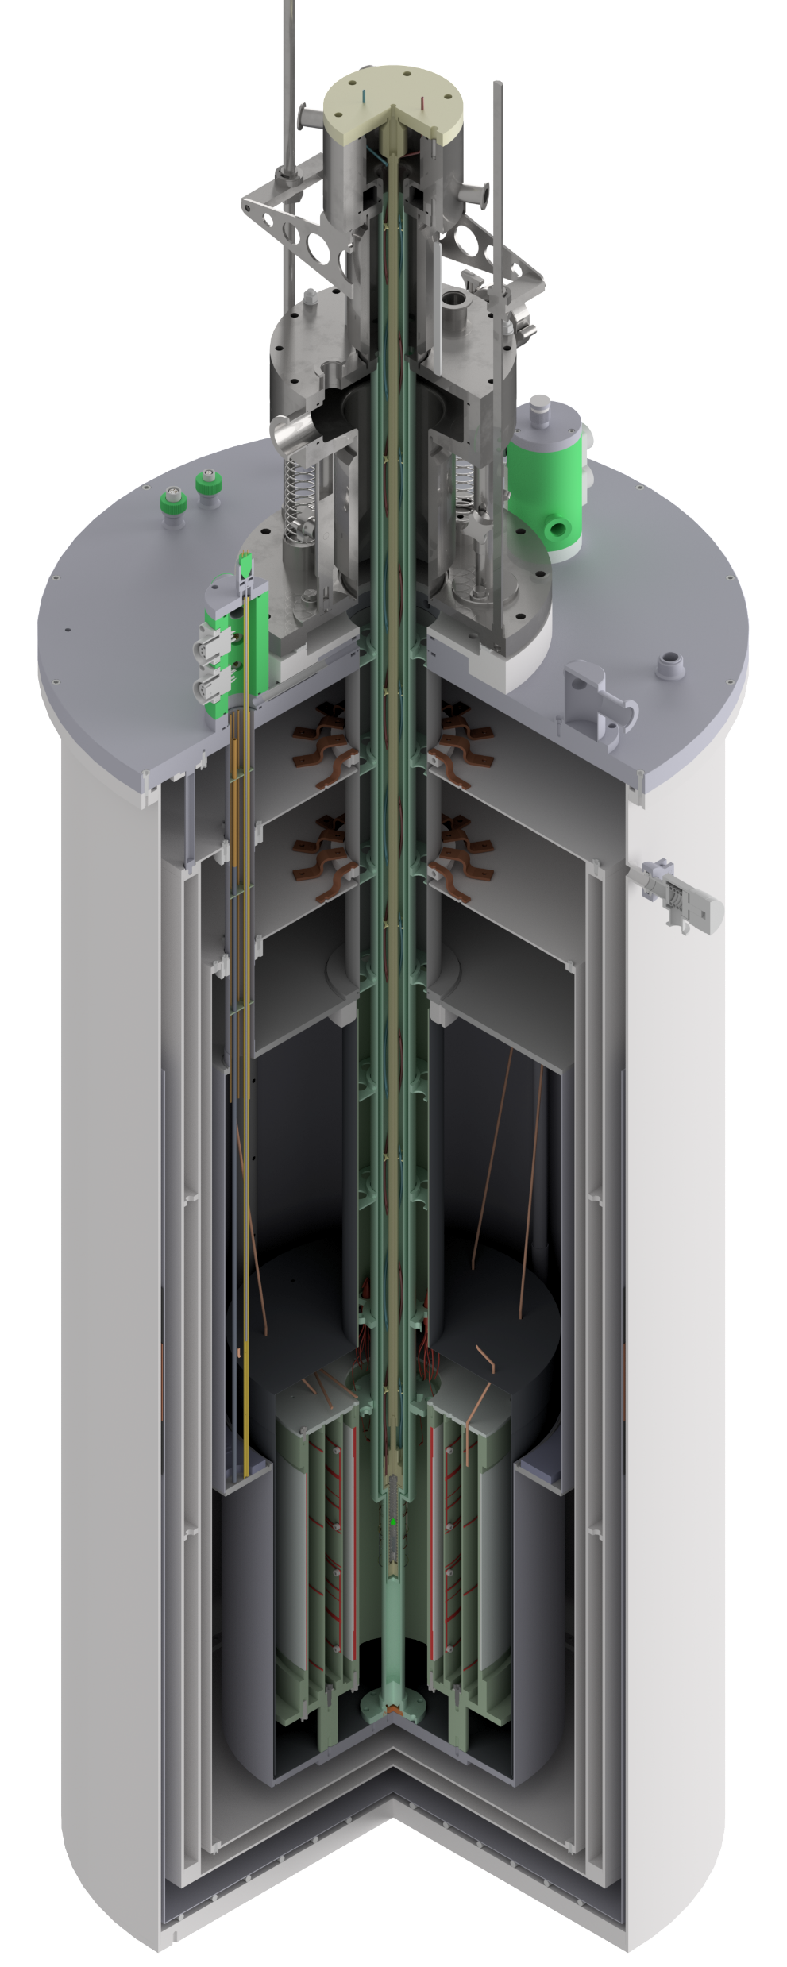
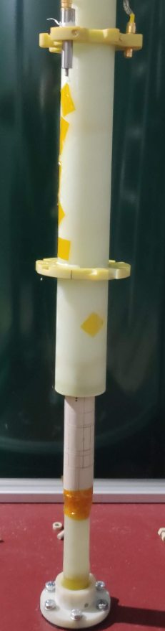
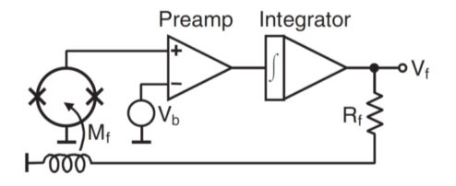
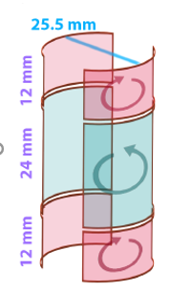
CASPEr-gradient low field setup, 1 kHz – 4 MHz
0.1 T (1 kG) superconducting B₀ coil
wet bore
actively shielded
superconducting shield
placed in Faraday room
SQUIDs
variable temperature insert
Flux-locked loop
gradiometer
Scheme of SQUID https://commons.wikimedia.org/wiki/File:SQUID_IV.jpg

Slide 16
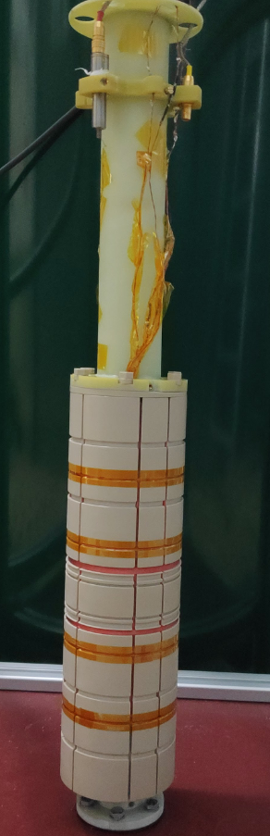
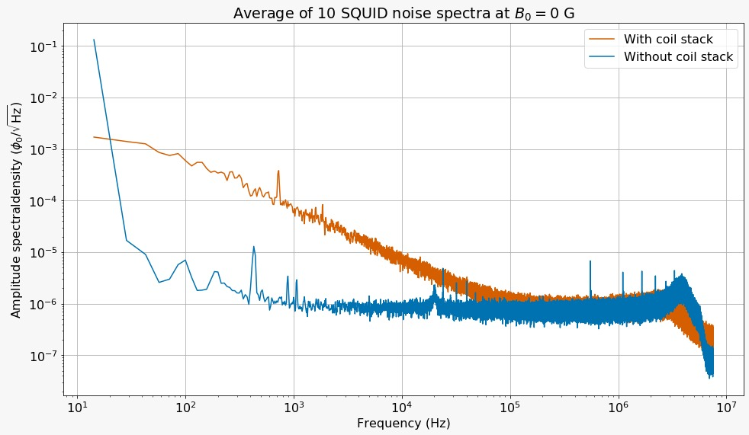
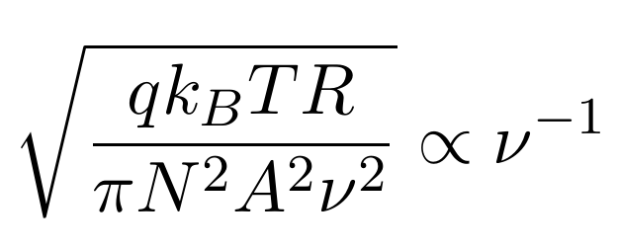
Eliminating noise
Gradiometer coil
Nb shield in cryostat
Only use Nb coils
Setup in Faraday room
Electronics in room battery powered
Introduces
Johnson noise!
q (geometric) filling factor
k_B Boltzmann constant
T temperature of the copper coil

Slide 17
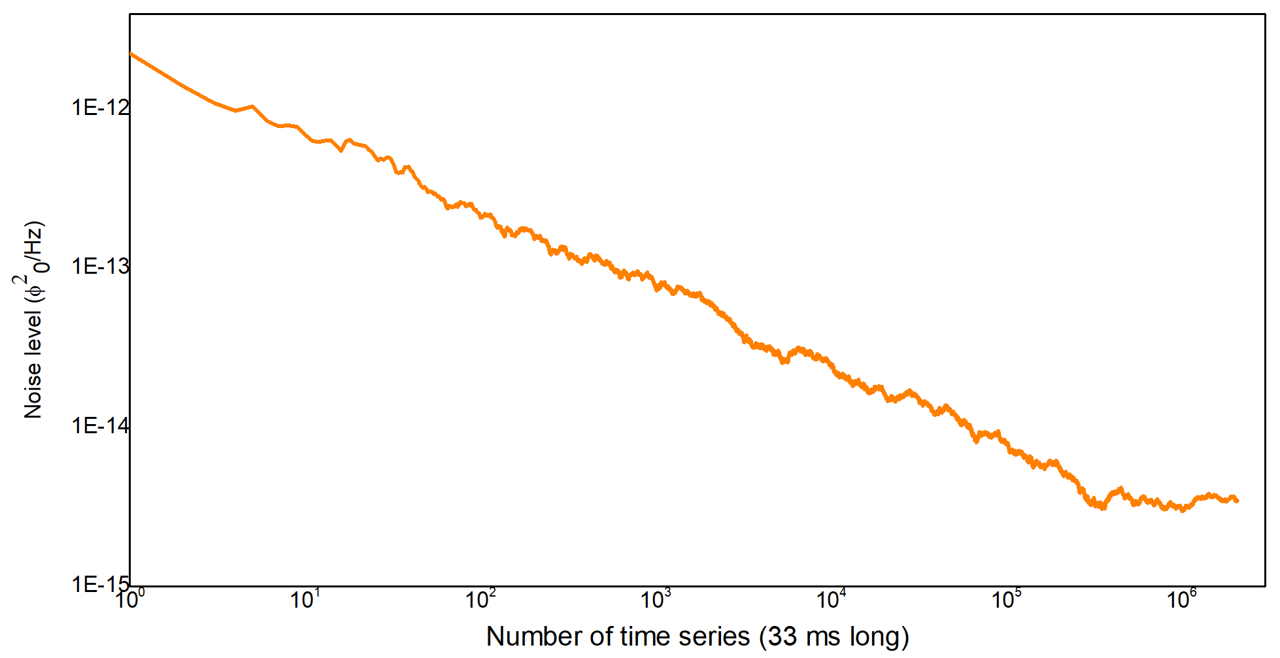
Sensitivity over time
Noise power ~ T^{1/2}

Slide 18
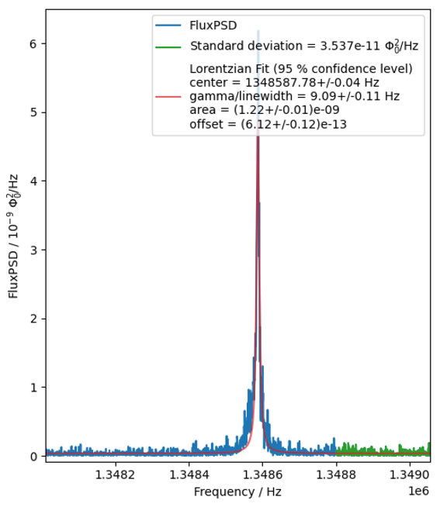
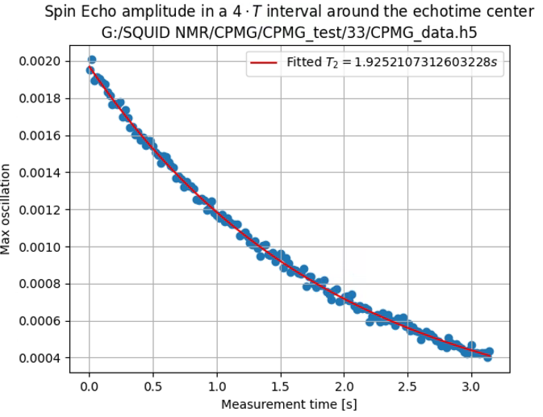
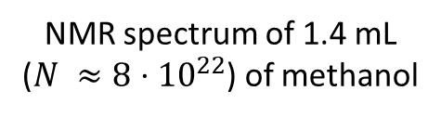
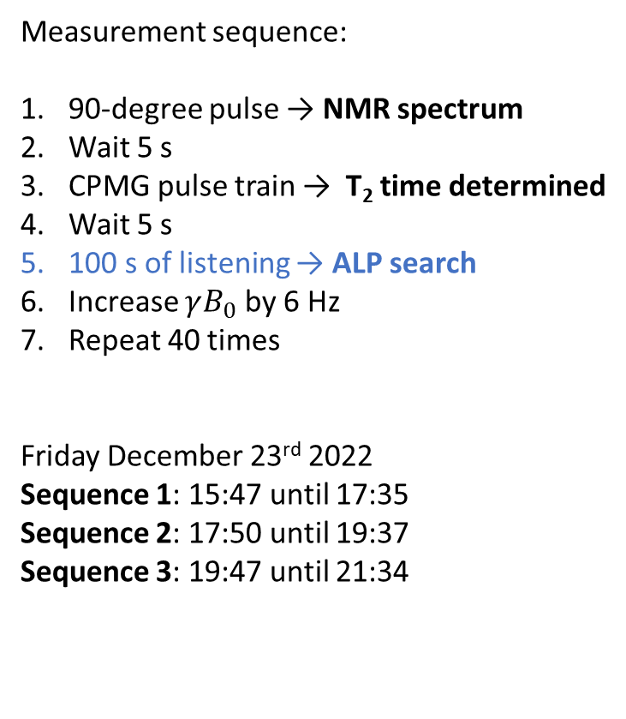
Anatomy of a dark matter search
NMR spectrum of 1.4 mL ($N ≈8⋅{10}^{22}$) of methanol
Measurement sequence:
90-degree pulse → NMR spectrum
Wait 5 s
CPMG pulse train → T₂ time determined
Wait 5 s
100 s of listening → ALP search
Increase $γB_{0}$ by 6 Hz
Repeat 40 times
Friday December 23rd 2022
Sequence 1: 15:47 until 17:35
Sequence 2: 17:50 until 19:37
Sequence 3: 19:47 until 21:34
Influence of T₂ and T₂* in our sensitivity investigated, manuscript in preparation

Slide 19
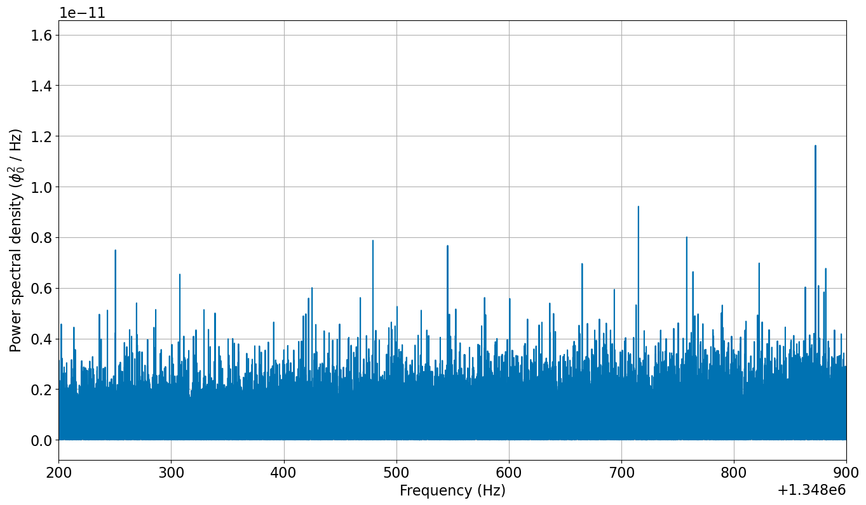
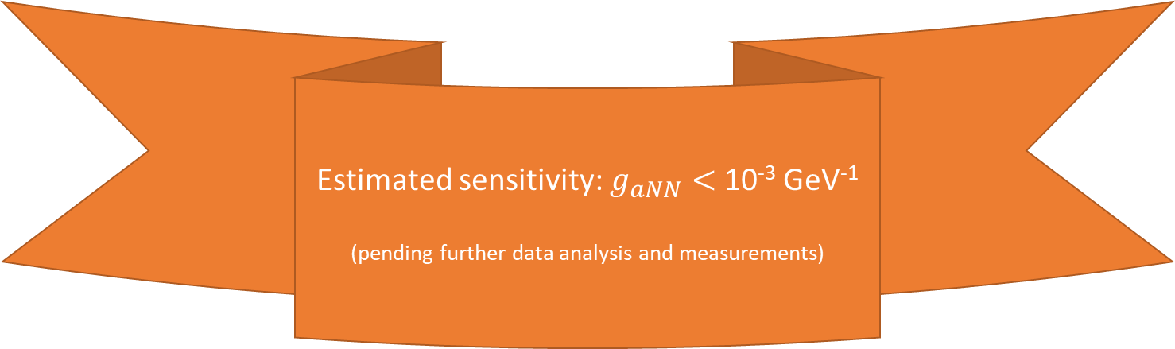
Typical spectrum when not pulsing
Axion?
Line shape should match expectation
  Matched filter
Should appear in each spectrum
Daily/annual modulation expected
Estimated sensitivity: $g_{aNN}<$ 10⁻³ GeV⁻¹
(pending further data analysis and measurements)

Slide 20

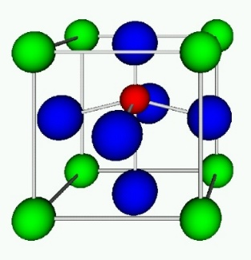
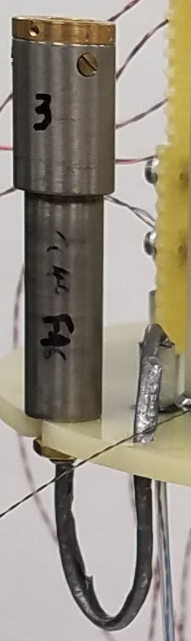
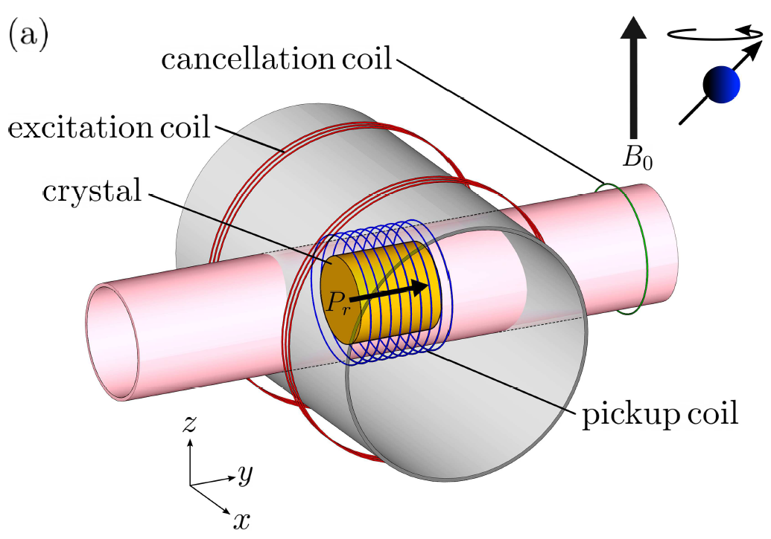






CASPEr-electric, probing gluon coupling using solid state NMR
sample:
sensor:
NMR calibration:
liquid helium bath cryostat with 9T magnet
²⁰⁷Pb nuclear spins in ferroelectrically-polarized PMN-PT
SQUID or low-noise RF amplifier
(depending on frequency)
crossed excitation and pickup coils
first-generation proof-of-principle CASPEr-e search based on nuclear magnetic resonance
D. Aybas et al., Phys. Rev. Lett. 126, 160505 (2021)

Slide 21






CASPEr-electric, first scientific run
histogram after optimal (matched) filtering
injected ALP dark matter signal:
3.35σ candidate threshold
amplifier noise floor:
first CASPEr-e limits on nucleon EDM and gradient interactions of axion-like dark matter
95% exclusion
preliminary
D. Aybas et al., Phys. Rev. Lett. 126, 160505 (2021)
D. Aybas et al., Phys. Rev. Lett. 126, 160505 (2021)

Slide 22







CASPEr-gradient high field, up to 600 MHz
14.1 T warm bore magnet
delivery Fall 2022
2 variable temperature inserts (VTIs)
design based on e.g. ANSYS simulations
sample at 160 to 300 K
pickup coil
tunable capacitors
amplifier at 20 K

Slide 23
Sideband measurements

Slide 24




Sample (hyper)polarization, the road to increased sensitivity
Thermal polarization
$$P∝{T B}_{0}≈{10}^{−7}$$
Does not require sample preparation
Current work
Hyperpolarized xenon-129
$P ≈0.7$
Liquid at 160 K
Long relaxation time $T_{1}≈1000$s
$T_{1}>$ hours when frozen
Future
Sample polarization:
$$P=\frac{N_{+}−N_{−}}{N_{+}+N_{−}}$$
Hyperpolarized protons
$P ≈0.1$
Wide variety of molecules
Short relaxation time $T_{1}<1$ s
Future

Slide 25


Hyperpolarization of xenon-129
Spin exchange optical pumping cell
Xe, N₂, and He mixed with Rb vapor
  Control pressure and flow rate
Interaction region for 795 nm laser light at D1 line
  Polarize Rb atoms
Spin exchange between Rb and ¹²⁹Xe
  Transfer polarization to ¹²⁹Xe
Imai et al, “Continuous Flow Production of Concentrated Hyperpolarized Xenon Gas from a Dilute Xenon Gas Mixture by Buffer Gas Condensation.” Scientific Reports 7, no. 1 (2017): 7352
Kavtanyuk et al, “Production of Hyperpolarized ¹²⁹Xe Using Spin Exchange Optical Pumping.” Journal of the Korean Phys. Soc. 73, no. 10 (2018): 1458–65
Hersman et al, “Large Production System for Hyperpolarized 129Xe for Human Lung Imaging Studies.” Academic Radiology 15, no. 6 (2008): 683–92

Slide 26

Hyperpolarization of xenon-129
SEOP cell
Xe, N₂, and He mixed with Rb vapor
Interaction region for 795 nm laser light at D1 line
Spin exchange between Rb and ¹²⁹Xe
Light absorption of Rb D2 at various vapor densities
Signal
Frequency
Measurements by Gary Centers and Arian Dogan
9

Slide 27


Hyperpolarization of xenon-129
SEOP cell
Xe, N₂, and He mixed with Rb vapor
Interaction region for 795 nm laser light at D1 line
Spin exchange between Rb and ¹²⁹Xe
Polarization
200 W optical power at laser output
Laser diode current (A)
Measurements by Gary Centers and Arian Dogan
10

Slide 28


Hyperpolarization of xenon-129
SEOP cell
Xe, N₂, and He mixed with Rb vapor
Interaction region for 795 nm laser light at D1 line
Spin exchange between Rb and ¹²⁹Xe
NMR diagnostic
Polarization, $P=$ 11(3) % achieved, further optimization underway
CW-NMR: scan of leading B-field
Scan time
Measurements by Gary Centers and Arian Dogan
11

Slide 29

Hyperpolarization of xenon-129
SEOP cell
Xe, N₂, and He mixed with Rb vapor
Interaction region for 795 nm laser light at D1 line
Spin exchange between Rb and ¹²⁹Xe
NMR diagnostic
Polarization, $P=$ 11(3) % achieved, further optimization underway
Cryoseparator
Freeze out Xe
Store until needed
Conserve polarization in 0.2 T field ($T_{1}>1$h)
Measurements by Gary Centers and Arian Dogan
12

Slide 30





Hyperpolarization of protons
Parahydrogen induced polarization (PHIP)
Four spin states of molecular hydrogen:
Signal amplification by reversible exchange (SABRE)
Parahydrogen
NMR silent
Easy to produce
Long storage times (weeks)
In cooperation with
dr. Danila Barskiy at HIM
https://blog.zulf.eu/BP5.php
https://www.sigmaaldrich.com/DE/de/technical-documents/technical-article/research-and-disease-areas/metabolism-research/phip-sabre

Slide 31



SABRE testing underway
Sample:
800 mmol target (benzylamine)
20 mmol catalyst
15.6 mol solvent (dichloromethane)
Largest polarization at
17.3 mT = 173 G
$γB_{0}=737$ kHz
Figure courtesy of Erik Vandyke and Danila Barsky

Slide 32

Maxwell-Boltzmann distributed
not clumped
$$B_{ALP}∝g_{aNN}v_{a} \sqrt{2ρ_{DM}}\sin\left(ω_{a}t\right)$$
Coherence limited to 10⁶ oscillations
directionality

Slide 33

https://bigthink.com/starts-with-a-bang/earth-move-universe/

Slide 34




Line shape modulations due to Earth’s motion
Monte Carlo simulation and analytic solution in agreement
CASPEr Mainz B₀
Earth velocity
V. Gramolin et al., Spectral Signatures of Axionlike Dark Matter, Phys. Rev. D 105, 035029 (2022).

Slide 35



D. Aybas et al., Quant. Sci. Tech. 6, 034007 (2021)
CASPEr-electric, towards the QCD-axion
D. Aybas et al., Phys. Rev. Lett. 126, 160505 (2021)
our present limits
other experimental constraints
our sensitivity with current setup
QCD axion band
our sensitivity with upgraded setup: 80 cm sample, 100 mK
spin projection noise quantum sensitivity limit
ongoing work:
1) sweep the full frequency range → current results at 40 MHz, we are sweeping down to kHz
2) increase sample size → currently
3) improve material → currently ferroelectric PMN-PT
non-centrosymmetric ionic crystals
4) improve sensor → currently RF amp/SQUID
collaboration with SLAC to couple RQUs
5) increase spin polarization (quantum state control) → currently
optical control of spin thermalization
optical spin hyperpolarization

Slide 36

Zero to ultralow field (ZULF) NMR
Teng Wu et al, PRL 122, no. 19 (2019): 191302
Antione Garcon et al, Science Advances, Vol 5, Issue 10, (2019)

Slide 37

Zero to ultralow field (ZULF) NMR
Teng Wu et al, PRL 122, no. 19 (2019): 191302
Antione Garcon et al, Science Advances, Vol 5, Issue 10, (2019)

Slide 38

Global Network of Optical Magnetometers for Exotic physics searches
(GNOME)
Mainz SERF (Quspin) ⁸⁷Rb
Krakow SERF (Quspin) ⁸⁷Rb
Moxa rf-driven ¹³³Cs
Stuttgart rf-driven ⁸⁵Rb
Belgrade rf-driven ¹³³Cs
Beersheba
Beijing NMOR ¹³³Cs
Daejeon NMOR ¹³³Cs
Hefei SERF Rb/K
Canberra SERF ⁸⁷Rb
Oberlin SERF K/Rb
Lewisburg SERF ⁸⁷Rb
Berkeley 1 NMOR ¹³³Cs
Berkeley 2 NMOR ¹³³Cs
Hayward SERF (Quspin) ⁸⁷Rb
Los Angeles rf-driven ⁸⁵Rb
budker.uni-mainz.de/gnome/

Slide 39


Global Network of Optical Magnetometers for Exotic physics searches
(GNOME)
topological defects, boson stars, …

Slide 40



Afach, S., et al. “Characterization of the Global Network of Optical Magnetometers to Search for Exotic Physics (GNOME).” Physics of the Dark Universe 22 (December 1, 2018): 162–80
GNOME equipment
Several types of magnetometer based on nuclear spins
  spin-exchange-relaxation-free (SERF)
  radio-frequency-driven optical
  Frequency/amplitude-modulated nonlinear magneto-optical rotation
GPS receiver for time-tagging
Sensors to reject non-DM signals
  Accelerometers
  Gyroscopes
  Unshielded magnetometers
https://twinleaf.com/gnome/

Slide 41







Conclusions and outlook
CASPEr principle proven for mass range ≈ 10⁻²² to 10⁻⁶ eV
CASPEr-gradient low field apparatus taking data
High field apparatus under construction
Gradient line shape fundamentally different to scalar one
Orders of magnitude higher sensitivity accessible with hyperpolarized samples
Exploit power of networks of sensors

Slide 42




Zero to ultralow field (ZULF) NMR
$\frac{Δν_{1}}{Δν_{2}}$ is insensitive to $ΔB$
$$ω_{L}=ω_{a}±ω_{Earth}$$
140.6 Hz ~ 10⁻⁵ Hz
resolution = 10⁻⁷ Hz
Teng Wu et al, PRL 122, no. 19 (2019): 191302
Antione Garcon et al, Science Advances, Vol 5, Issue 10, (2019)

