Slide 1
Contribution to ITS3 design proposal from IPHC

Slide 2
Introduction
4 main axes
Digital flow
Pixel readout and pixel array
Power and rails simulations
Analogue Front-End optimisations
Resources
Mainly in the digital with strong backend background
3 FTP: X. Fang, F. Morel, and A. Himmi, G. Bertolone and J. Soudier for 1 ETP
Expertise in analogue front end
1 FTP: A. Dorokhov
Also C. Lemoine with Walter’s thesis

Slide 3
Digital flow
Digital flow is not unique, the choices can have a strong impact on the design
Verification capabilities
Design duration
Hardware limitation (CPU, RAM)
Stitched sensor is very demanding on the capabilities of the tools
Need to elaborate a strategy on the flow
We can help with our experience on previous design
To select and configure most effective verifications

Slide 4
Pixel matrix and readout 1/2
Experience on column readout
MIMOSIS chips
MOSS
Better to assemble the pixel matrix with Innovus
Best control of the digital (reduce respin)
Can merge Digital pixel and Column readout
Can make analysis at early stage with the Blackbox flow
IR drop, Crosstalk, Timing, Congestion
Respin of the matrix
22.5 / 25 µm
Analog FE
Digital
Pixel
Column
Readout
Digital
Pixel
Analog FE
Collection
Diode
Collection
Diode
Analog FE
Analog FE
Digital
Pixel
Digital
Pixel
17 / 18 µm
Collection
Diode
Collection
Diode

Slide 5
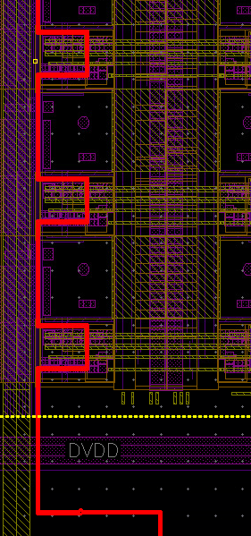
Pixel matrix and readout 2/2
Even if the digital tools are used, the same quality can be achieved
Complex and controlled routing is possible
Xiaochao and Frederic are former analogue designers
Current activities:
Column readout study has started (Xiaochao)
Preliminary results: width of 16 µm is achievable with 4 routing metal layers with standard width and spacing
Flip-flop as memory has not been started (Frederic)
Further implication on the pixel matrix readout?

Slide 6
Power and rails simulations
Power and rails simulations are crucial with ER2
Need to start as soon as possible
Will help sizing power rails
Embedded regulators
We have started to study power rails on chip with embedded regulators
OBELIX for BELLEII experiment

Slide 7
Analogue Front-End optimisations
Andrei's expertise is well established
Andrei and Walter are a good duo

