Slide 1



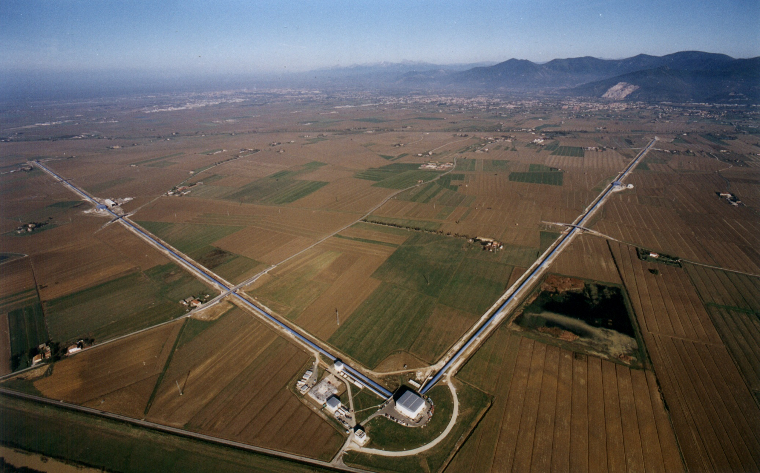

LIGO, Virgo … en route vers O4
Patrice Hello
IJCLAB, Orsay
CNRS/IN2P3 et Université de Paris-Saclay
LPNHE
Paris 6/03/2023

Slide 2
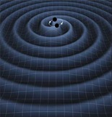
Gravitational Waves
Einstein field equations
Linearization
+
Propagation equation (far from sources)
Properties:
Propagation at speed of light.
Transverse and traceless.
Two independant polarizations h₊ and h_{x}
Quadrupolar emission at lowest order.

Slide 3
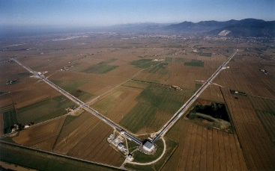
Gravitational Waves
Gravitational wave = perturbation of spacetime metric
Modifies distances between 2 test masses.
GW
Geodetic equation in weak field approximation
A
B
L
Variation distance between A and B
But (very) weak effect
r > 100 Mpc

Slide 4
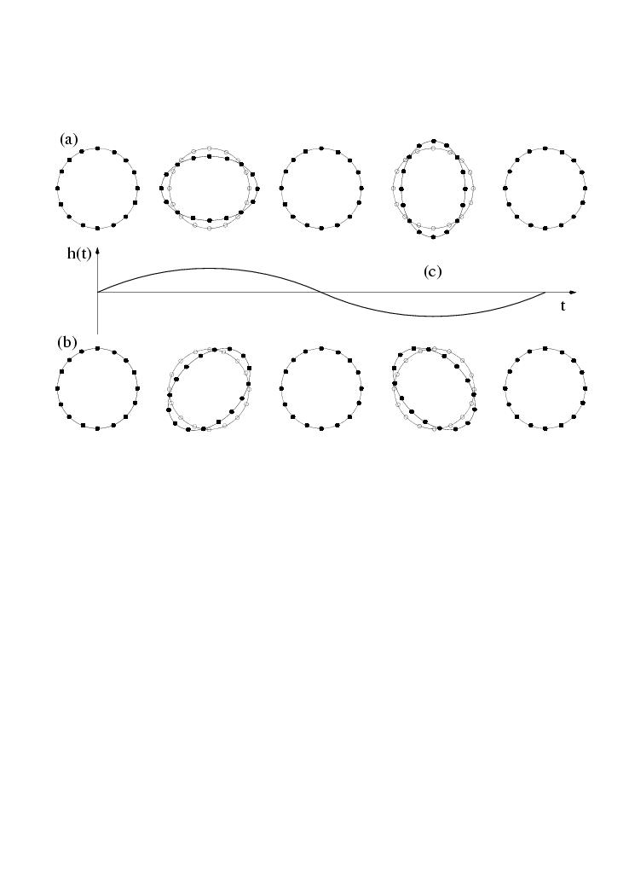


Gravitational Waves
Incident GW on a circle of test masses
Effect of h₊
Effect of h_{x}
One GW period

Slide 5
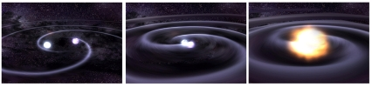
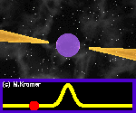
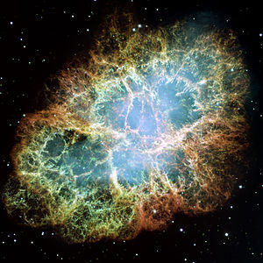
Astrophysical sources
« High frequency » sources (bandwidth of LIGO/Virgo)
Transient sources
Supernovae (gravitational collapse)
Compact Binary Coalescences (CBC)
black holes (BH) and/or neutron stars (NS)
=> BBH, BNS or NS-BH.
…
Quasi continuous sources
Isolated Neutron Stars, Pulsars
Stochastic backgrounds (cosmological or astrophysical origin)
…

Slide 6
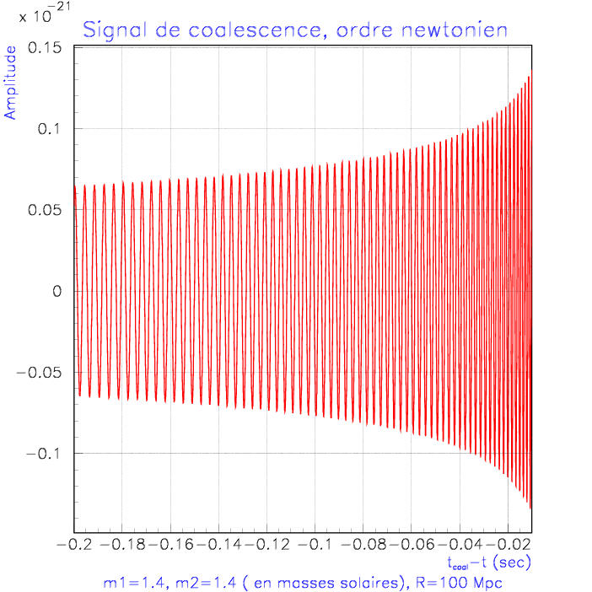
Astrophysical sources
BNS GW signal
SN GW signal
V. Morozova et al., Astrophys.J. 861 (2018) no.1, 10.
(last milliseconds before merging)
(core collapse to a NS)
A « chirp »!

Slide 7
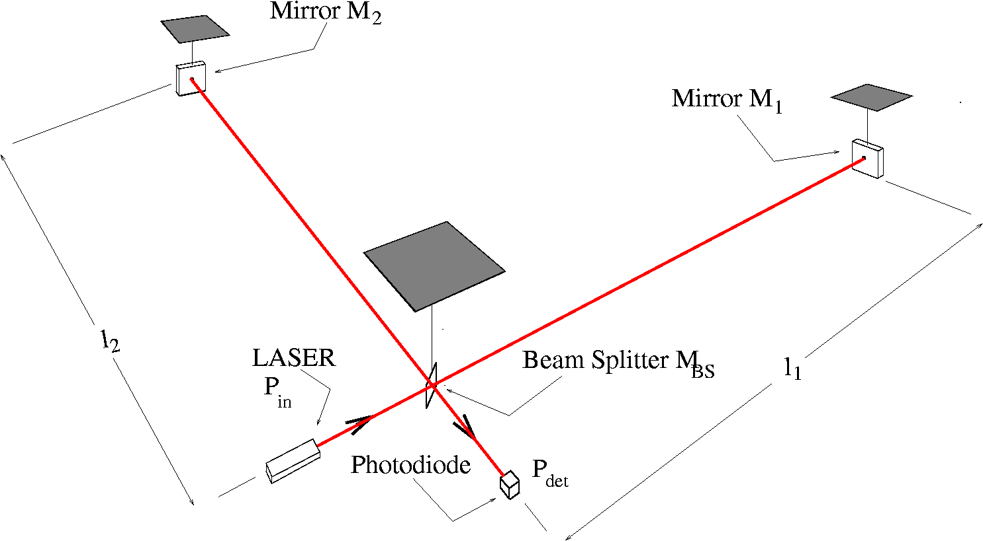
Detectors
Principle:
Suspended mirrors
⬄ test-masses
Signal on photodiode is proportional to h(t) !

Slide 8
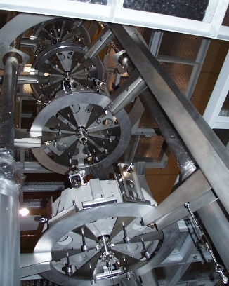
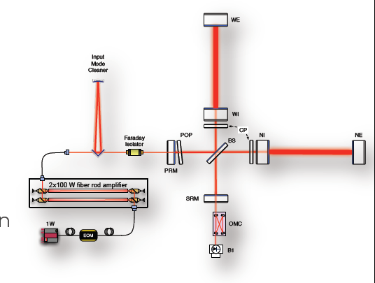
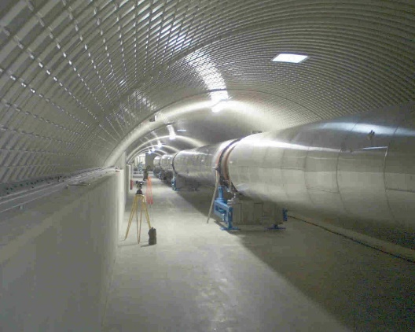
Detectors
Kilometric arms
Cavities in interferometer arms (finesse ~450)
Large mirrors
Suspended mirrors (seismic isolation)
Ultra stable laser source
Power recycling
Signal recycling
Under ultra-vacuum
h(t)
CALIB
DAQ

Slide 9

Detectors Network
GEO600
Virgo
LIGO
KAGRA
LIGO-India
AIGO ?

Slide 10
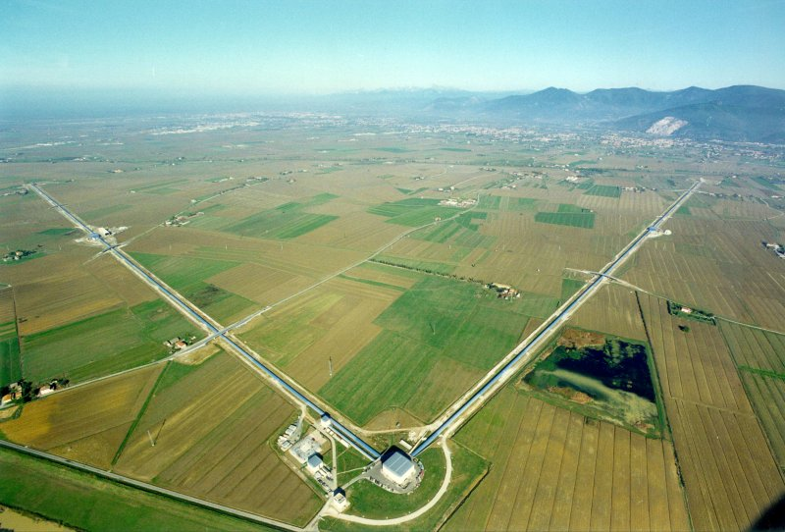
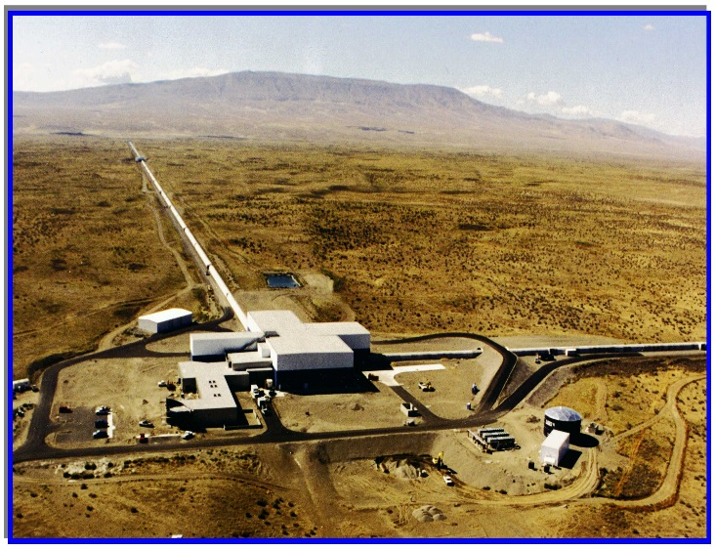
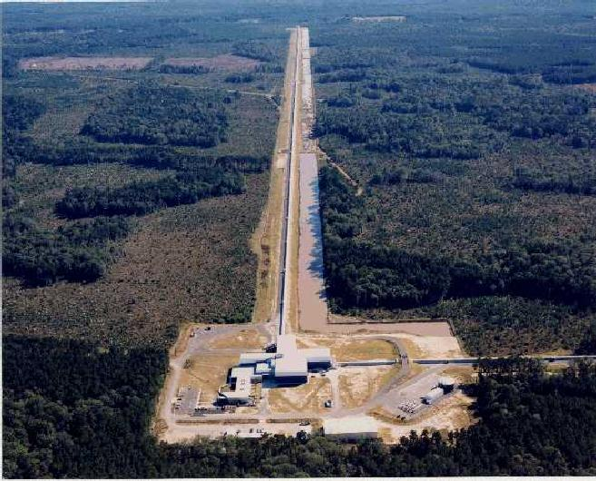
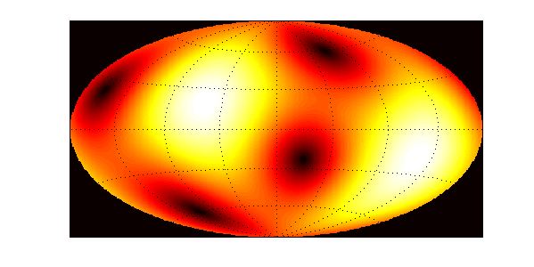
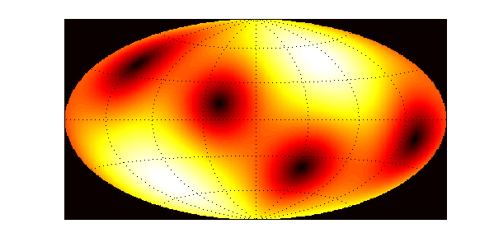
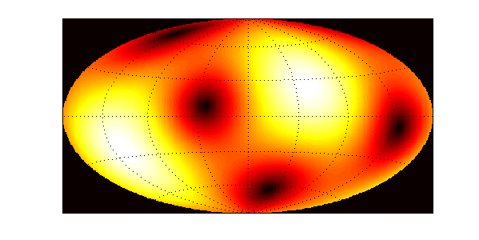
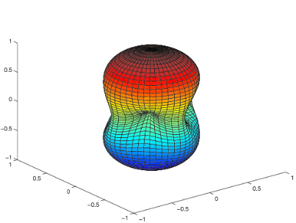
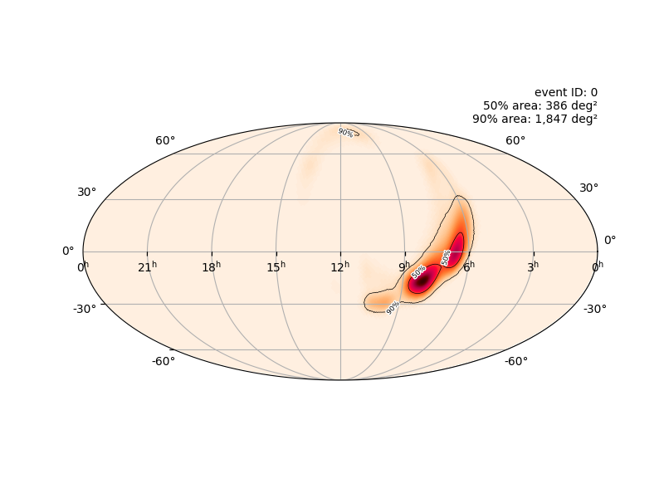
LIGO-Virgo Network
Virgo (V1)
LIGO-Hanford (H1)
LIGO-Livingston (L1)
The LIGO-VIRGO Network :
Beam patterns
Antenna pattern=>not directionnal detectors
Reconstruction of source position by triangulation (poor accuracy)
Times of flight:
HL ~ 10 msec.,
VL ~ 26 msec. and VH ~ 27 msec.

Slide 11
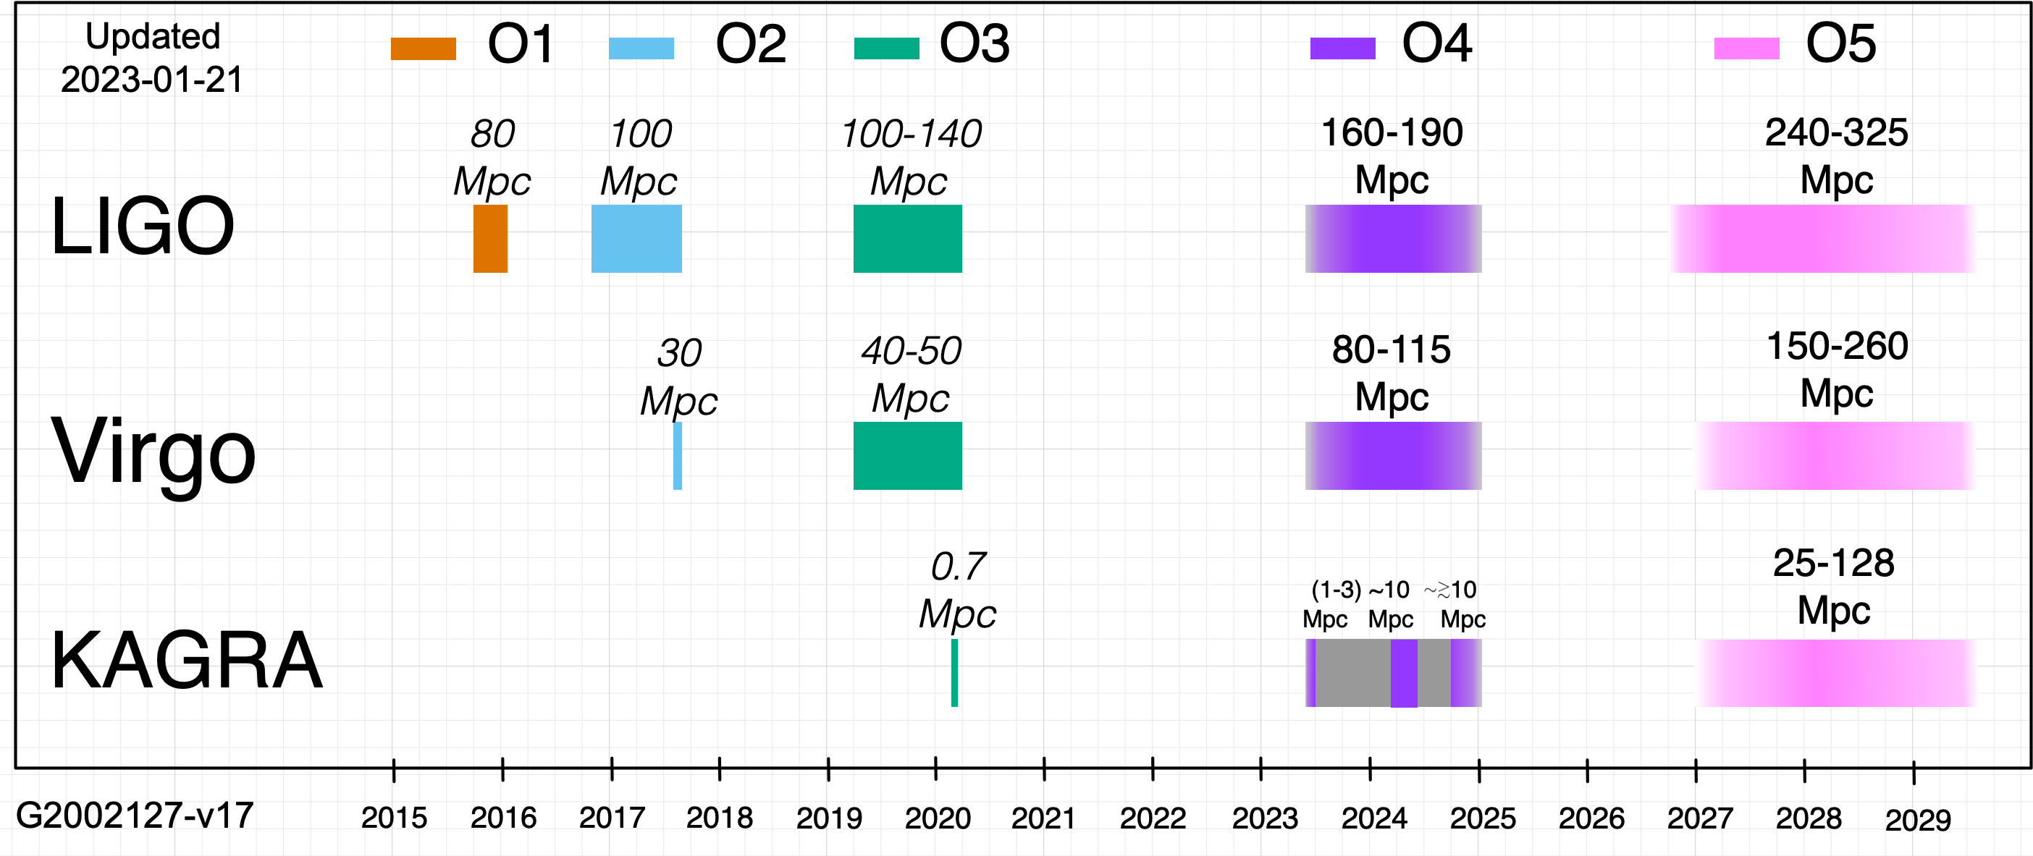
LIGO-Virgo runs
Sensitivity measured by the BNS « horizon »,
i.e. the distance at which we detect a 1.4 M +1.4 M BNS with a SNR = 8 (averaged over all angles) .
We are here

Slide 12
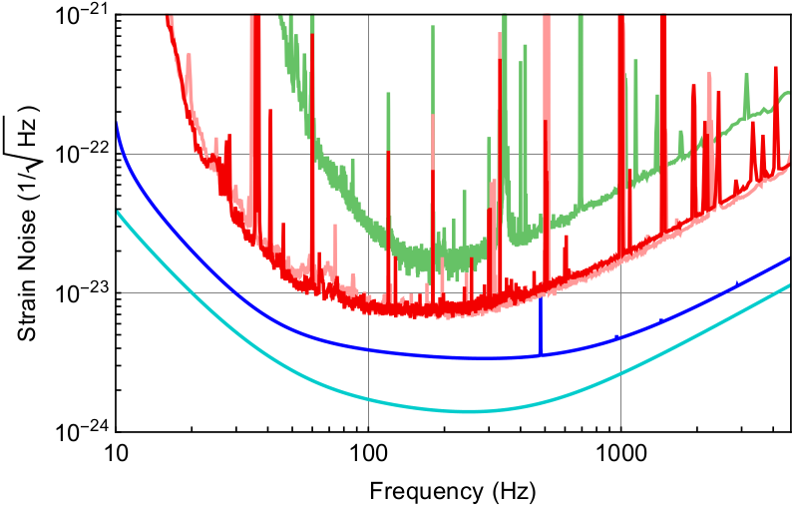
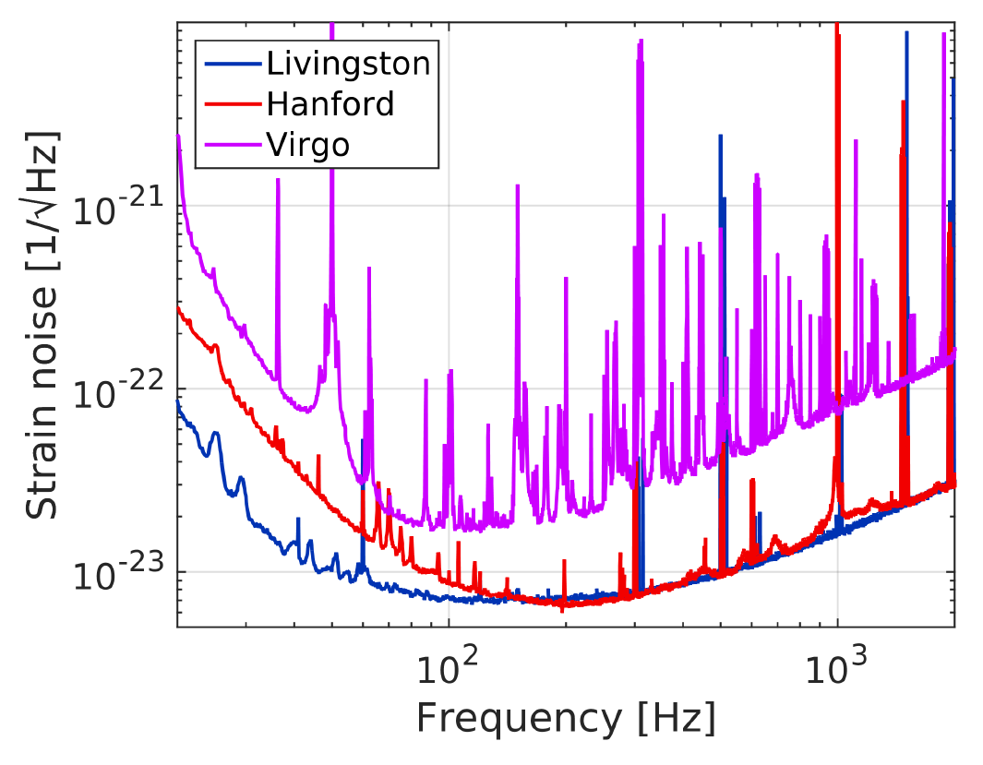
LIGO-Virgo runs
O1 : sensibilités de H1 et L1
O2 : sensibilités de H1, L1 et V1
2010
2015
O3 : sensibilités de H1, L1 et V1

Slide 13
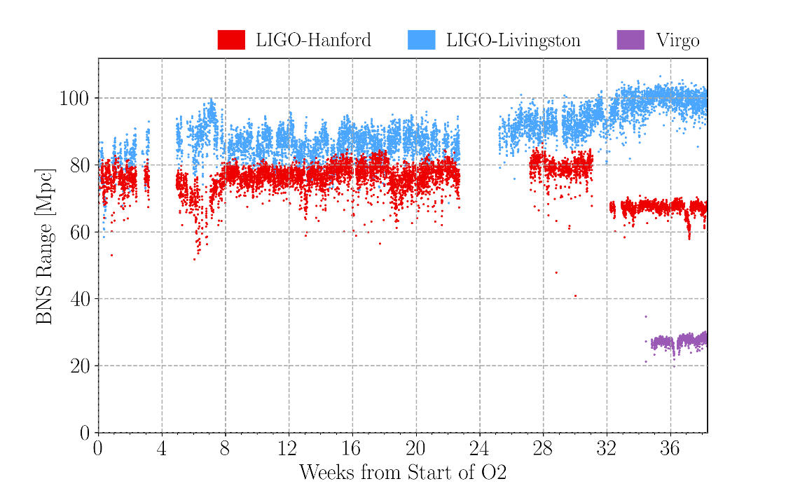
LIGO-Virgo runs
O2
O3

Slide 14
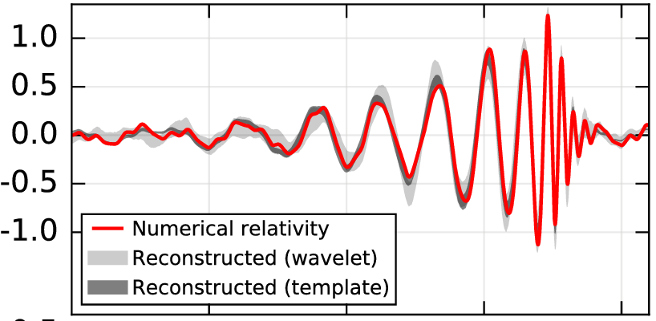
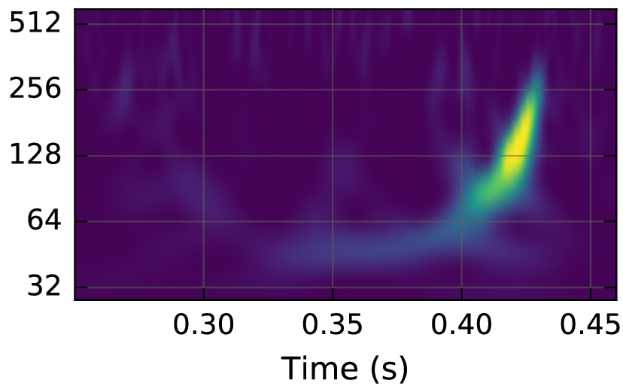
LIGO-Virgo data
What are calibrated data made of?
Fundamental Noises :
Shot Noise / Quantum Noise
Thermal noise
Seismic noise
Excess noises :
(Technical or environmental origins)
Saturations
Scattered light
« Bip » glitches
Storms
Planes
Astrophysical
signal
(sometimes)
h (x10⁻²¹)
Frequency (Hz)
(GW150914 in H1)

Slide 15
LIGO-Virgo data
What are calibrated data made of?
Fundamental noise
Excess noise (glitch)
Coalescing BNS
(GW170817 in L1)

Slide 16
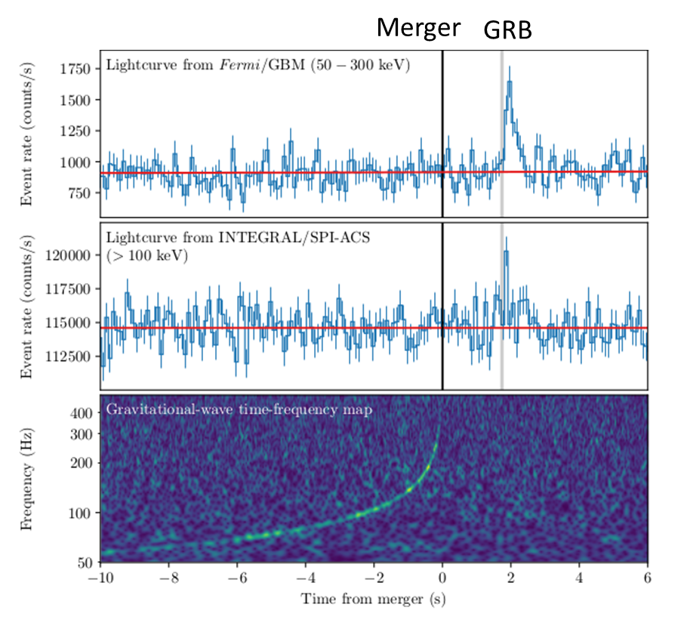
LIGO-Virgo O1+02 runs recap
10 BBH
1 BNS
(GW170817)
O1
+ GRB
+ KILONOVA

Slide 17
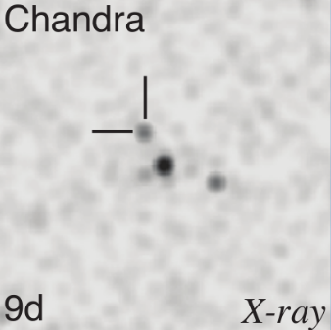

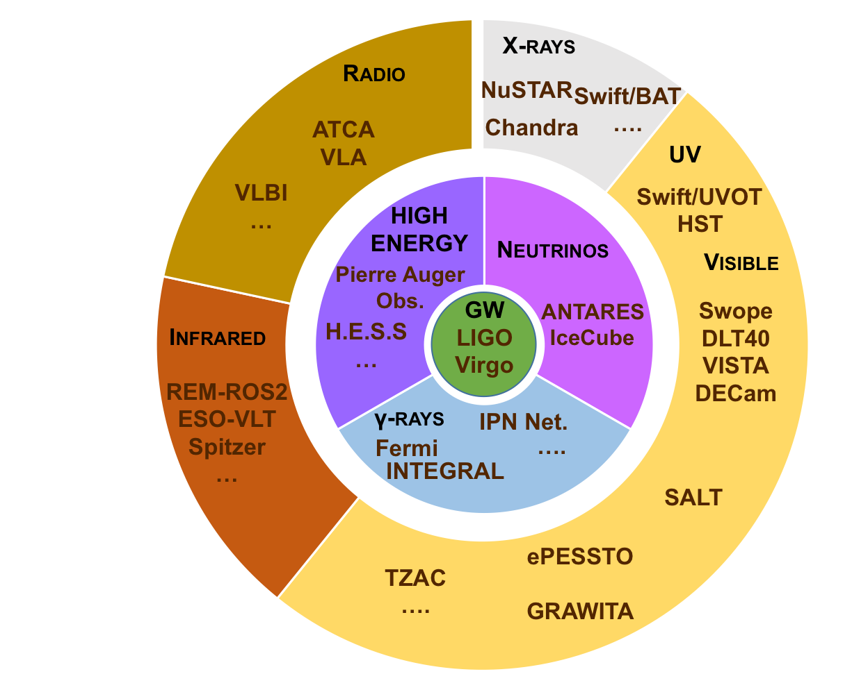
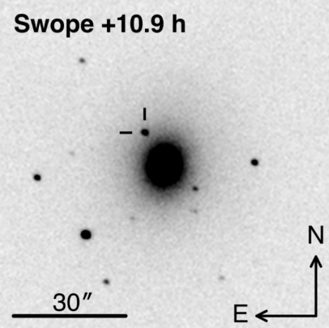
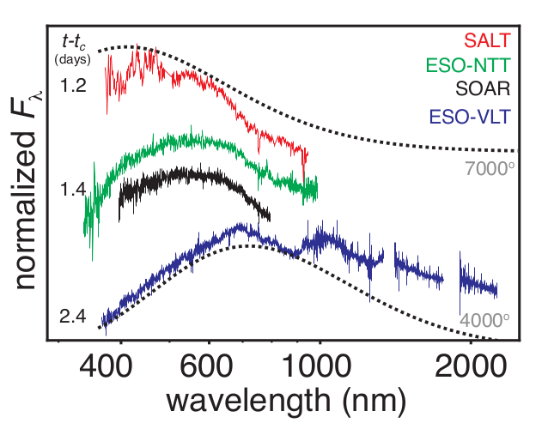
GW170817 recap (an extraordinary event!)
17/08/2017
12:41:04
GW170817
+2 s
GRB170817A
+5h
Localisation with GW
Distance 40 Mpc
« Multi-messenger observations of a binary neutron star merger », Abbott et al., ApJ, 2017
+11h
Discovery of kilonova
AT2017gfo by Swope
Find host galaxy : NGC4993
Start Campaign on AT2017gfo
+1.2j
First spectra of the kilonova
+9j
Discovery of an X-ray counterpart
+16j
First radio signal found with VLA

Slide 18
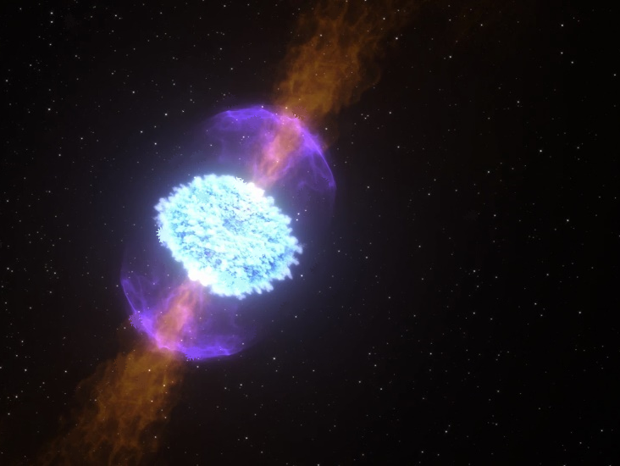
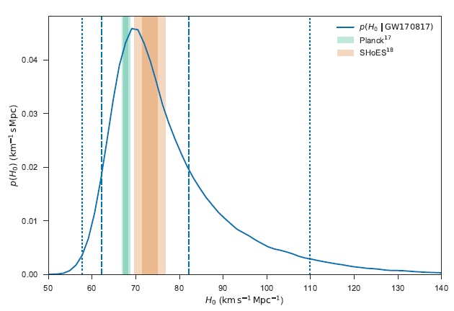
GW170817 recap (an extraordinary event!)
Confirmation of BNS systems as progenitors of GRB
First confirmed observation of the kilonova phenomenon
No clue about the final object (NS or BH?)
kilonova predicted by Li&Paczynski (1998) and Metzger et al. (2010).
Rapid captures of neutrons (r process) => heavy elements nucleosynthesis.
Emission (heating) due to ejecta radioactivity, cooling by expansion in the ISM.
Fast transition from blue (hot) to red (cool).
First constraints on NS equation of state.
Fundamental physics tests (GW celerity, GR tests, graviton mass, EP, Lorentz invariance…)
Cosmology (H0 measurement)
…

Slide 19
LIGO-Virgo 03 run (April 2019-March 2020)
Dramatic increase in number of events
79 new events
1 BNS
2 (+1?) NSBH
76 (-1?) BBH
New !

Slide 20
LIGO-Virgo 03 remarkable events
GW190425: another BNS (but with unexpected masses!)
Distance ~160 Mpc + very poor localization
No counterpart observation.
No evidence for tidal effects.
BH not ruled out…

Slide 21


LIGO-Virgo 03 remarkable events
2 (+1?) NSBH
GW200105, GW200115 and GW190814?
290 Mpc
270 Mpc
GW190814
Again no counterpart detection.
GW20015: 600 deg². GW200105: 7200 deg².

Slide 22
LIGO-Virgo 03 remarkable events
GW190412 : unequal masses BBH
8 + 30 solar masses @ 740Mpc
first observation of multipole moment (l=3) beyond quadrupole (l=2)
(as predicted by GR)
+ indication of weak precession
GR (again) confirmed by this system

Slide 23
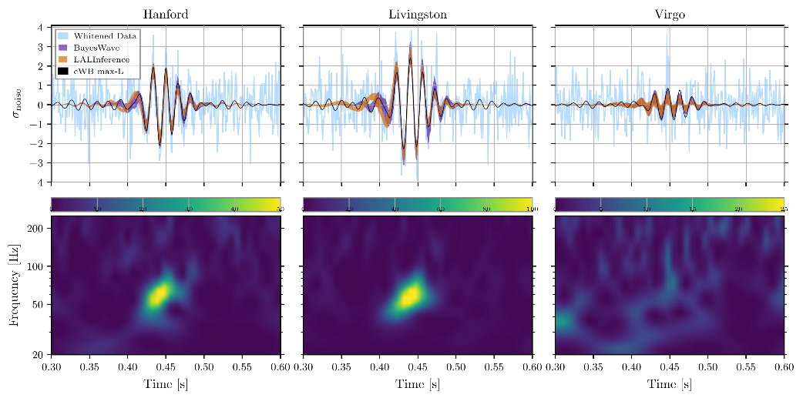
LIGO-Virgo 03 remarkable events
GW190521 : very massive BBH (85+66 solar masses)
Primary BH in pair-instability mass gap.
Final object is an IMBH (142 solar masses)
Evidence for large spins and orbital precession
PI Mass Gap
Also the shortest signal ever detected!

Slide 24
LIGO-Virgo observations implications
Fundamental physics/Tests General Relativity
Speed of GWs
Strong constraints on theories of modified gravity.
Polarizations of GWs (tensor vs. Scalar-tensor, or vector-tensor …)
PN expansion.
High order modes beyond quadrupolar.
Test of EP (via the Shapiro effect).
Test of Lorentz Invariance.
Mass of graviton.
No deviation / GR

Slide 25
LIGO-Virgo observations implications
Cosmology
Binary mergers => standard sirens measure of distances !
Host galaxy => measure of redshift ie speed
Independant Measure of Hubble constant
Primordial Universe (phase transitions)
Limits on GW stochastic backgrounds (e.g. cosmic strings)
(+ astrophysical backgrounds)
BBH+NSBH+BNS

Slide 26
LIGO-Virgo observations implications
Hubble constant measurement
Hubble tension and GW170817.
More GW events may allow to see clearer!
A few tens of events => < 1% accuracy

Slide 27
LIGO-Virgo observations implications
Astrophysics
Physics of compact objects BH and NS
Formation of BH and NS
Formation of BBH and BNS
(measure of masses and spins, measure of excentricities of binary systems…)
EOS of NS
(measures of masses and radii, direct constraints on EOS, indirect via spin-down limits))
Cf. GW170817.
Measure of rates
- BBH, BNS, supernovae => stellar evolution.
Physics of GRB
Central engine ?
Late evolution (kilonova etc)

Slide 28
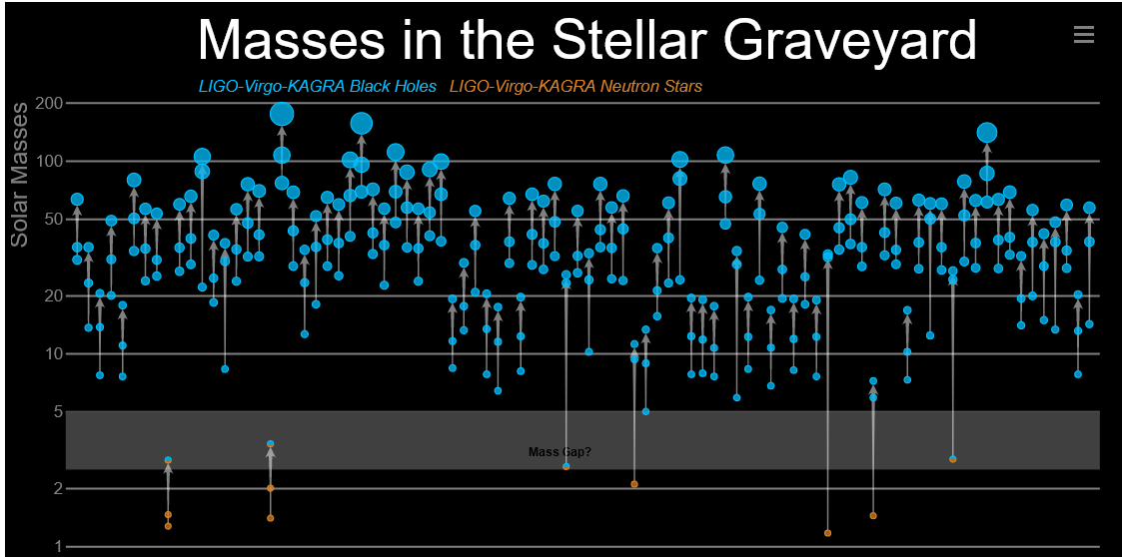
LIGO-Virgo observations implications
(include « marginal events », cf. GWTC-3)

Slide 29
LIGO-Virgo next run: O4
Virgo upgrades I

Slide 30
LIGO-Virgo next run: O4
Virgo upgrades II
+ LIGO upgrades: fequency dependant squeezing, new mirrors, laser power increase…

Slide 31

LIGO-Virgo next run: O4
What to expect during O4?
~ 1 candidate (online alert) / day (mostly BBHs)
O(100) more BBHs
O(10) more BNS and NSBH. Not too far if we are lucky!
Other events?
Next Galactic Supernova?
(GW+photons+neutrinos !!!)

Slide 32
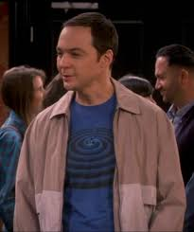
Merci de votre attention !

