Slide 1
GATE status and future perspectives
On behalf of the collaboration

Slide 2
Release 9.3 – March 2023
New ”digitizer” refactorisation (see Olga presentation)
Consolidation of 9.2
With Geant4 11.1
Gate is only evaluated with this Geant4 version
May work with previous, but no guarantee (and not maintained)
Automated compilation check on Linux + OSX
15+ benchmarks
Docker + VirtualMachine
https://github.com/OpenGATE/Gate

Slide 3
Release 10.beta02 – March 2023
Macro files are replaced by Python scripts
Geant4 multithreading
Simplified installation (one line)
Numerous enhancements (speed, IA integration, digitizer, etc)
With Geant4 11.1
Gate is only evaluated with this Geant4 version
May work with previous, but no guarantee (and not maintained)
+100 tests !
https://github.com/OpenGATE/opengate

Slide 4
Still … we keep
Open-source, open-mind
OpenGate community
Collaborative work
Research oriented in Medical Physics (imaging, dosimetry, etc)
Current GATE serie 9.3 (c++) will be continued
Future GATE serie 10.0 (python/c++) is still a beginning project
Transition period: two versions

Slide 5
Yesterday … GATE Hackathon !
Around 20 participants
https://shorturl.at/bfoY5
Lot of feedback !
e.g. PET Vision volume (Groningen)
e.g. JPET volumes (Jakub)
e.g. RBE / TEPC / MKM / Nanox bio actors
e.g. Optical simulation : started
Struggling for installing the developers version

Slide 6
DEMO
Installation

Slide 8
Installation
Simple pip install
Take care of architectures (linux, osx, win*) and python version
Install lot of packages: G4, ITK, QT, UPROOT, etc
Download Geant4 data and tests data
Two commands : opengate_info and opengate_tests
*soon

Slide 9
Status
Still not equivalent to current GATE. Estimate : 70%
Available (among others):
Time slicing, basics volumes, voxelized volumes, boolean volumes, repeaters
All G4 physics lists, production cuts, users limits, spliting/Russian Roulette (partial)
Generic source, voxelized source, beta+ source (!), confine, motion source, GAN source, TPS source
DoseActor, PhaseSpaceActor (root), Adder, Readout (digitizer), AcceptanceAngle, LET …
Not yet implemented (among others):
STL volume
Optical, Polarization, DNA, back to back gamma source, Y90 source
TLE, FFD
Coincidences sorter
Estimation: last 5% will be very hard
Warning : “it is hard to make prediction, especially about the future” ;)

Slide 10
New features (not in 9.x serie)
Boolean volumes
TAC source
beta+ sources
Acceptance Angle
ARF with NN
GAN sources (conditional, spect, pet, voxelized)
Gamma ion source (soon)
Some (almost) ready-to-use models :
SPECT: GE NM 670, Siemens Intevo Bold, soon = Spectrum Veriton
PET: Vereos Philips, soon = Vision Siemens

Slide 11
Documentation
https://opengate-python.readthedocs.io/
User guide: 60%
Developer guide : 1% ;)
Easy to contribute : edit online, PR on github

Slide 12
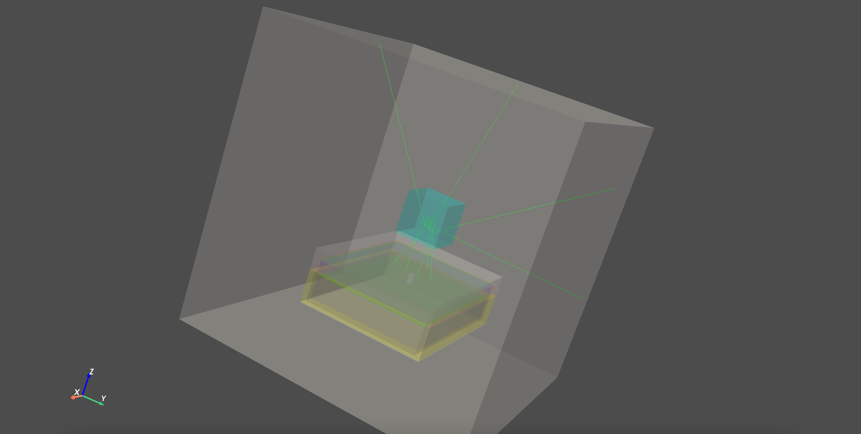
Visualisation
QT
Works on some machines, not all, only when compiled
Don’t work via “pip install”
We don’t know why, working on it.
VRML
Available “post-mortem”
Need pyvista
GDML
Available “post-mortem”
No particle trajectory
Need pyg4ometry

Slide 13
Short focus on “digitizers”
hc = sim.add_actor("DigitizerHitsCollectionActor", "Hits")
hc.mother = [ crystal1.name, crystal2.name ]
hc.output = ”output.root"
hc.attributes = [
"PostPosition",
"TotalEnergyDeposit",
"PreStepUniqueVolumeID",
"GlobalTime"]
sc = sim.add_actor("DigitizerAdderActor", "Singles")
sc.input_digi_collection = "Hits"
sc.policy = "EnergyWeightedCentroidPosition"
sc.output = hc.output
bc1 = sim.add_actor("DigitizerBlurringActor", "Singles_1")
bc1.output = ""
bc1.input_digi_collection = "Singles"
bc1.blur_attribute = "GlobalTime"
bc1.blur_method = "Gaussian"
bc1.blur_fwhm = 100 * ns
bc2 = sim.add_actor("DigitizerBlurringActor", "Singles_2")
bc2.output = hc.output
bc2.input_digi_collection = bc1.name
bc2.blur_attribute = "TotalEnergyDeposit"
bc2.blur_method = "InverseSquare"
bc2.blur_resolution = 0.18
bc2.blur_reference_value = 511 * keV

Slide 14
Short focus on “GAN phase-space”
gsource = sim.add_source("GANSource", "gaga")
gsource.particle = "gamma"
gsource.mother = "my_plane"
gsource.activity = 10 * MBq
gsource.pth_filename = "test.pth"
gsource.position_keys = [
"PrePosition_X",
"PrePosition_Y",
"PrePosition_Z"]
gsource.direction_keys = [
"PreDirection_X",
"PreDirection_Y",
"PreDirection_Z"]
gsource.energy_key = "KineticEnergy”
gsource.weight_key = None
gsource.time_key = "TimeFromBeginOfEvent"
gsource.relative_timing = True
gsource.energy_min_threshold = 10 * keV
gsource.skip_policy = "ZeroEnergy"
gsource.batch_size = 5e4
gsource.verbose_generator = True

Slide 15
Under the hoods
Folder g4_bindings Geant4 binding from C++ to Python
(expose functions, classes) ; pybind11
Folder opengate_lib Core classes (running): source, scorers etc
Folder opengate User UI (initialisation)
C++

Slide 16
Principle
User commands are in python
Mostly managed at the python level
Check required or invalid parameters
Build intermediate stuff (images, etc)
Once user ask to start
Create a new process (optional)
Initialize G4 engine with user information (volumes, sources, actors, physics)
Run G4 : in the compiled cpp library
During run : actors and source cpp side
Once terminated, copy back output to main process + python
Output
User can get output and start analysis

Slide 17
pybind11
Some Geant4 classes & methods are exposed : available from python
Not all, only if required (can be extended)
Object destruction policy C++ vs Python
If, C++ pointer, need to keep a point in Python side
Not possible to create or start 2 G4 simulation in the same script
Managed with external process
Image management via ITK:
Accessible via both C++ and Py sides
If transfer: need to copy !
Warning for actors and scorers
Need to comply to multithread (need lock on shared variables)
Need to comply to multi-run and timed simulation

Slide 18
How to add an actor ?
Cpp side : almost the same than with legacy Gate
Warning for actors and scorers
Need to comply to multithread (need lock on shared variables)
Need to comply to multi-run and timed simulation

Slide 19
Perspectives
Code restructuration
User limits
User info (parameters)
Python import module
Windows
Visualisation QT (?)
Coincidences sorter (goal: < 1year from now)
Consolidation

Slide 20
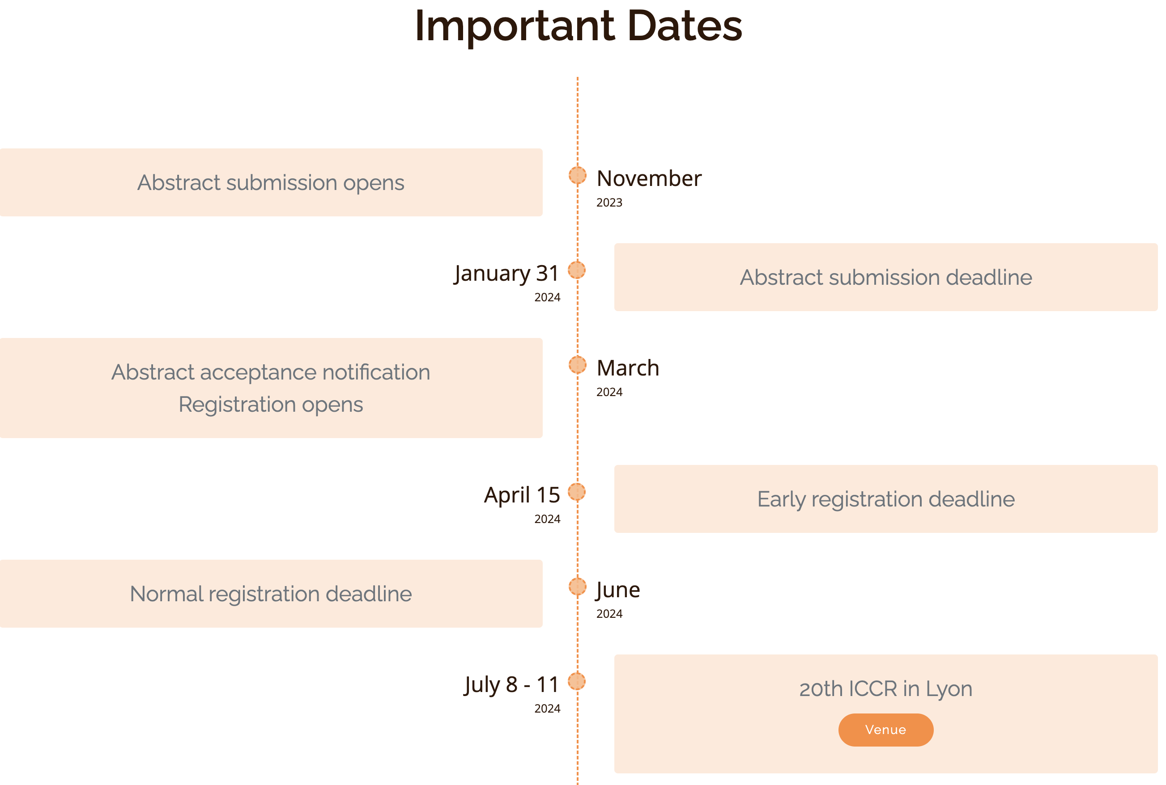
XXth International Conference of the use of Computer in Radiation Therapy

Slide 21
Conclusion – questions ?

