Slide 1
Intra- and inter-field imaging of proton therapy with the PETITION PET detector
Keegan McNamara :: Paul Scherrer Institute
24.4.2023

Slide 2
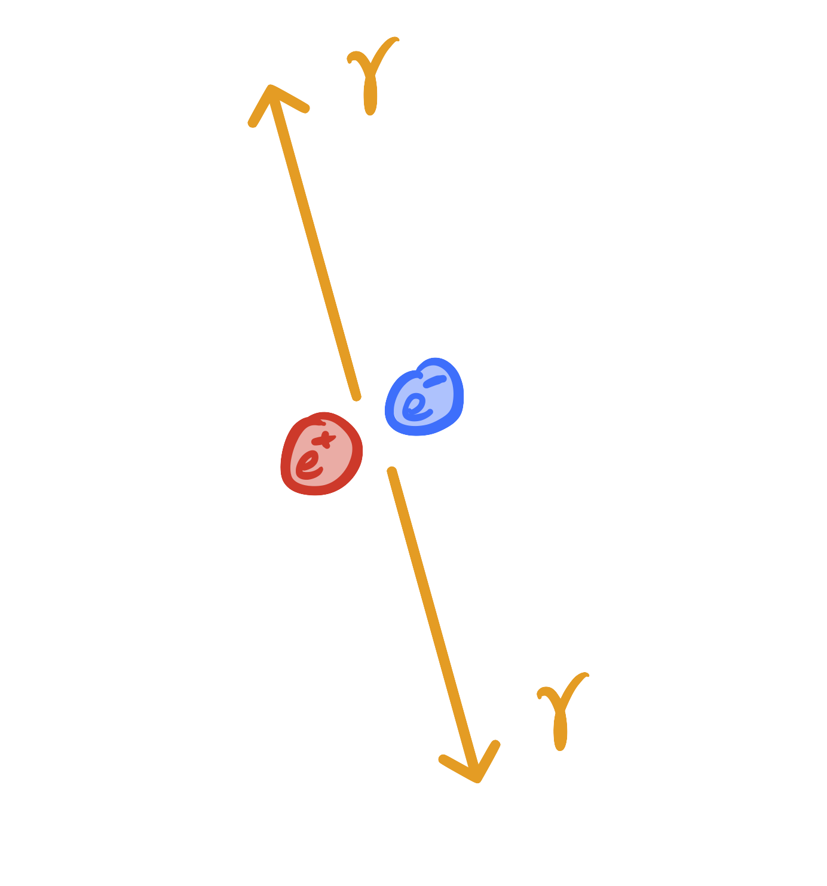
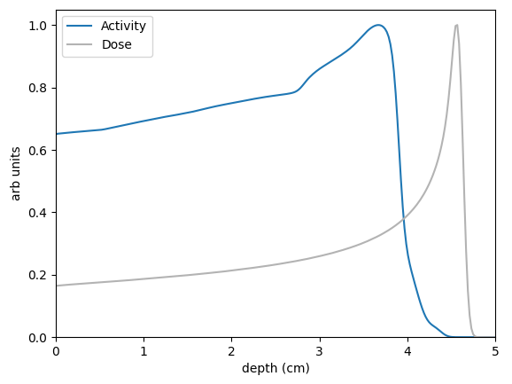
PET for range verification
Proton therapy gives highly conformal dose distributions and spares healthy tissue
Range uncertainties can lead to over/under dosage of tissue
Positron emitting isotopes can be used for in-vivo validation

Slide 3
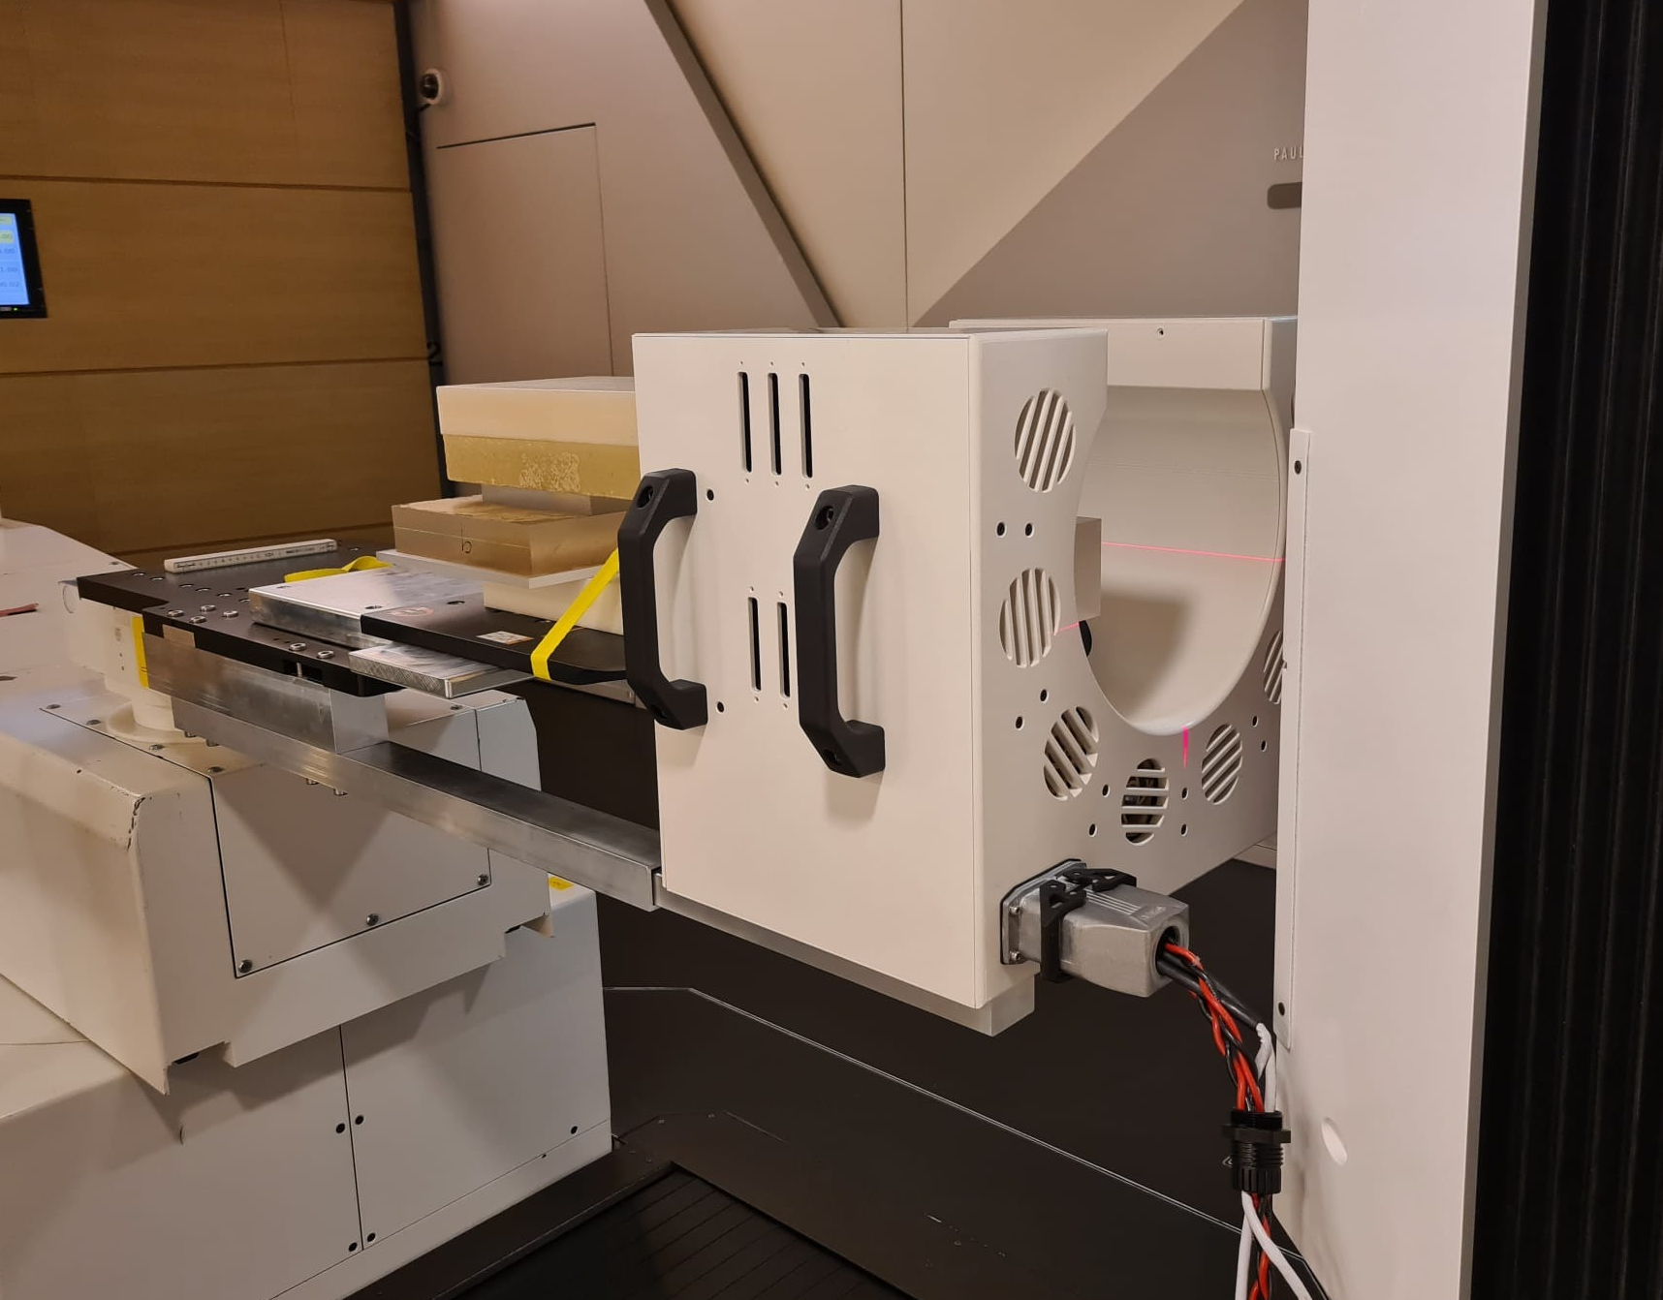
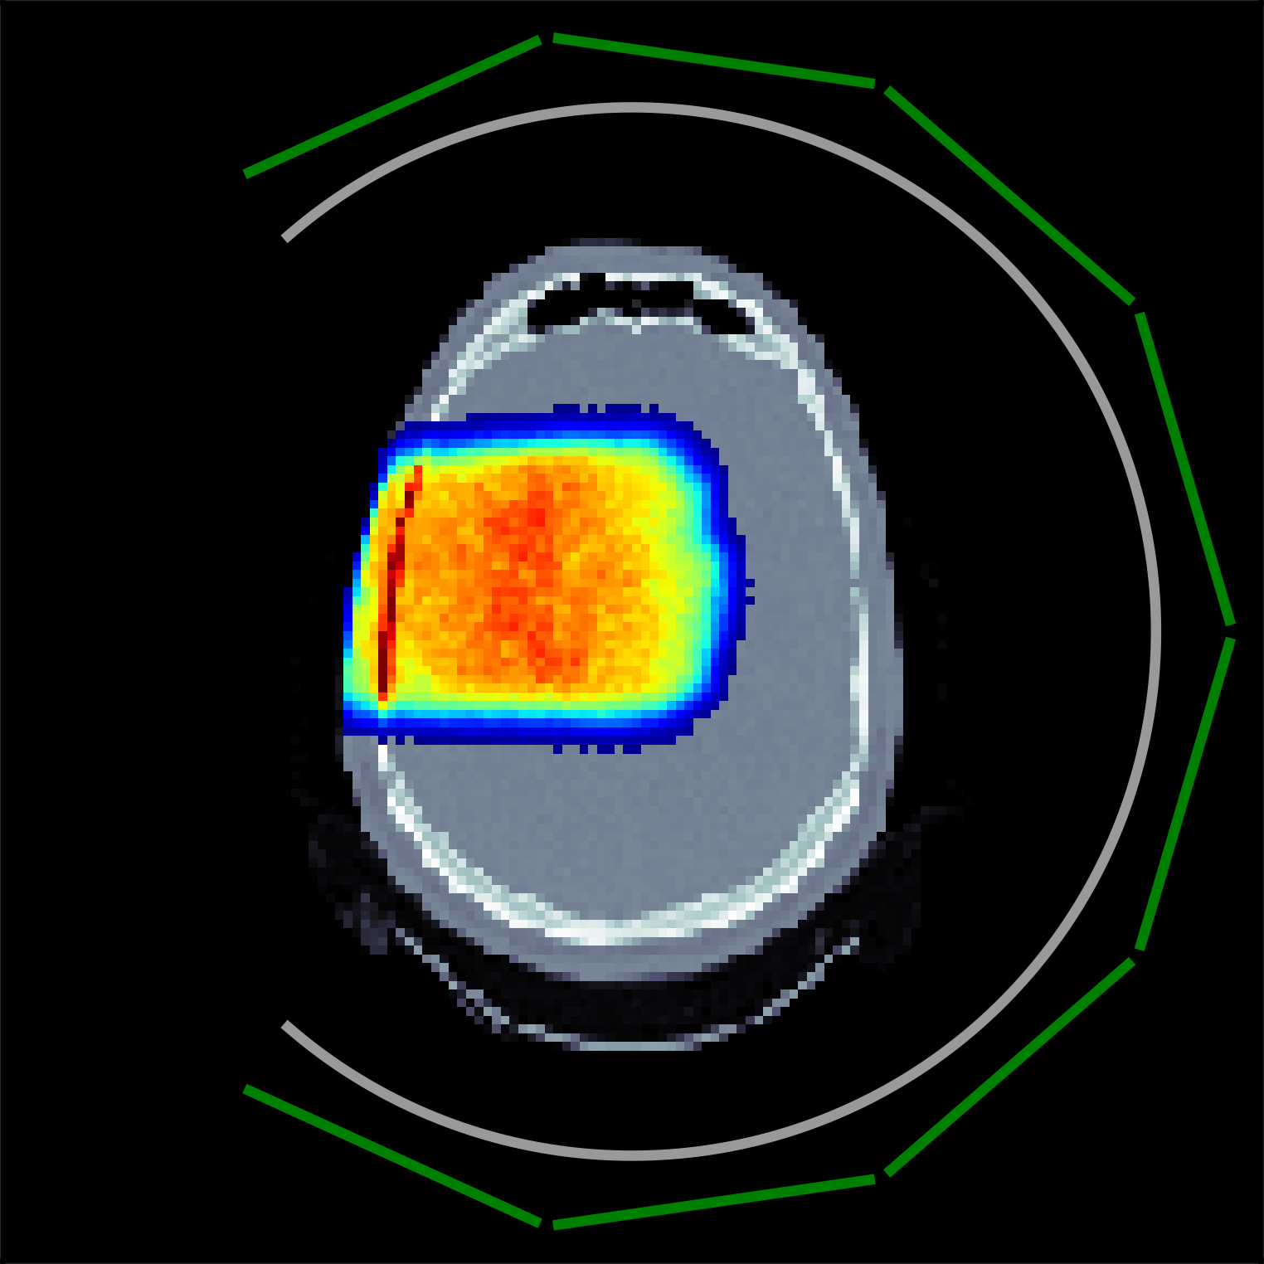
PETITION PET detector
PET for InTensive care and Innovative iON therapy
Open-ring PET detector for in-beam imaging in Gantry 2 at PSI
Current design fixed to 90˚ increments
Full clinical implementation would require PET scanner to rotate with Gantry nozzle

Slide 4
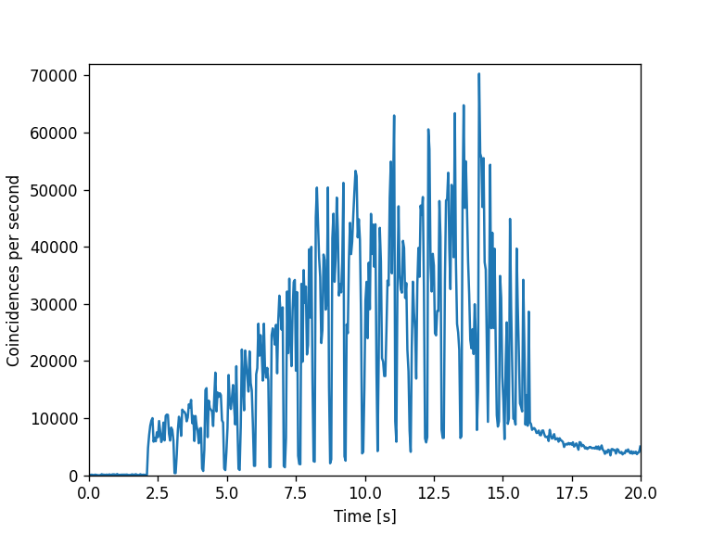
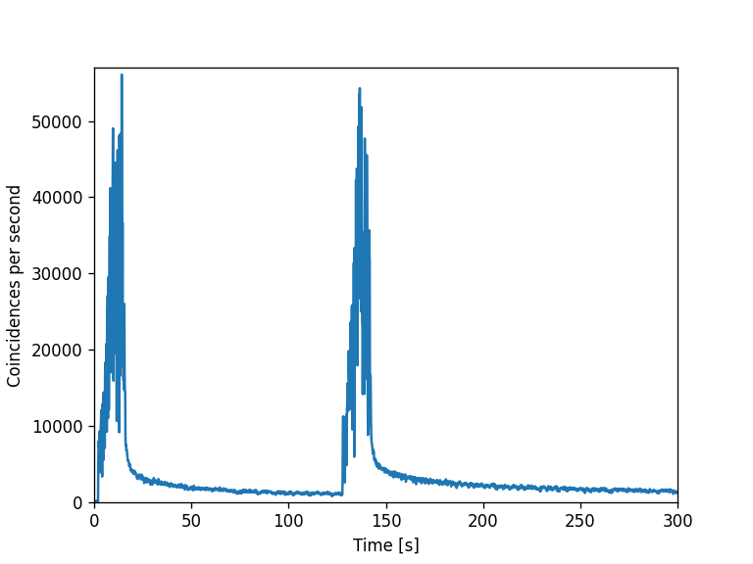
Basic imaging protocol
During treatment ¹²N (t_{1/2} = 11ms) is formed
Spot delivery time 5-100 ms
Energy layer change time 100ms
Post field irradiation imaging ¹⁵O, ¹¹C, ³⁸K, etc.
Couch and Gantry movements take >30s between fields
Notes:
Coincidences label

Slide 5
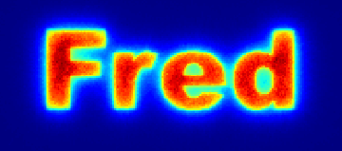
Simulation workflow
*Keegan McNamara et al 2022 Phys. Med. Biol. 67 244001
TPS
(FIonA)
Dose & activity calculation
(FRED)*
Isotope decay & imaging
(GATE)
Image reconstruction
(SIONARA)

Slide 6
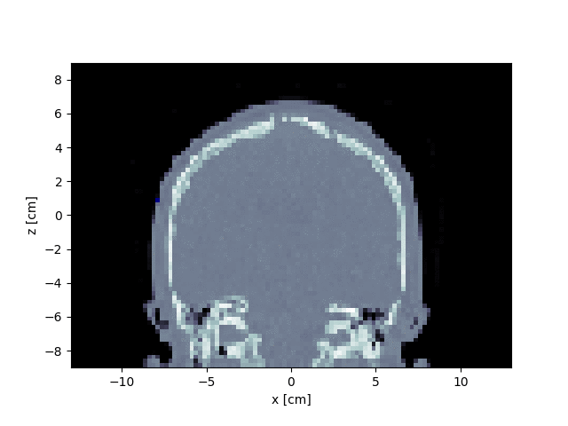
Energy layer imaging
Pauses between each energy layer allow for imaging
Ideally: ~100 ms energy switching time enough to image ¹²N (t_{1/2} = 11 ms)
Scanner saturation
Dead time of crystals
Low SNR
Build up of longer lived isotopes

Slide 7
Inter-field imaging
Time between fields ~60 seconds, allowing for direct imaging of each field
Following final field longer imaging time is feasible

Slide 8
Inter- and post field imaging
Opening of scanner leads to loss of counts and spatial resolution
Normalised root mean square error (NRMSE)
NRMSE=2.70 NRMSE=1.97 NRMSE=2.88

Slide 9
Inter-field imaging with rotations
In a clinical setting, scanner must be manoeuvrable to next field delivery position
Why not acquire during this period?

Slide 10
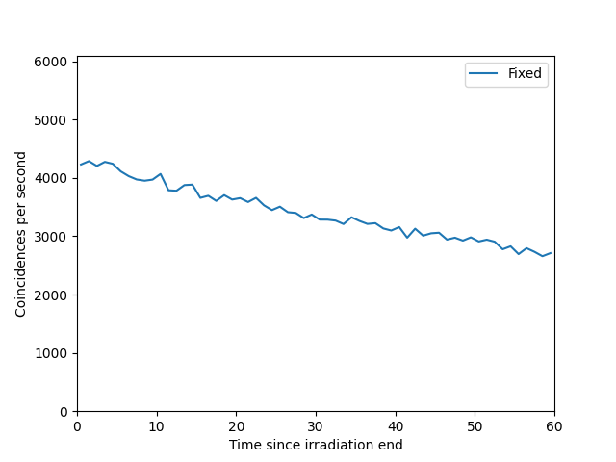
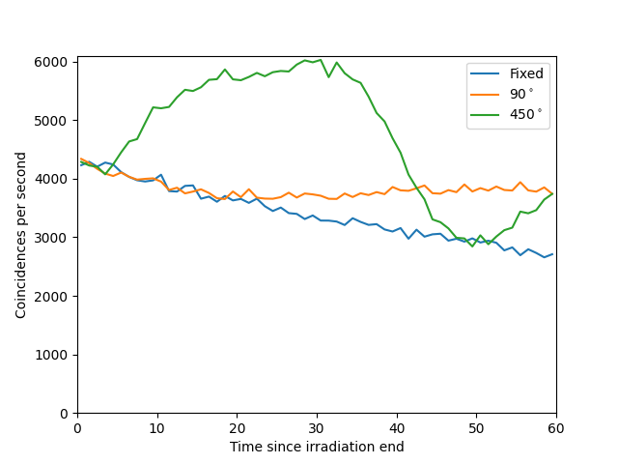
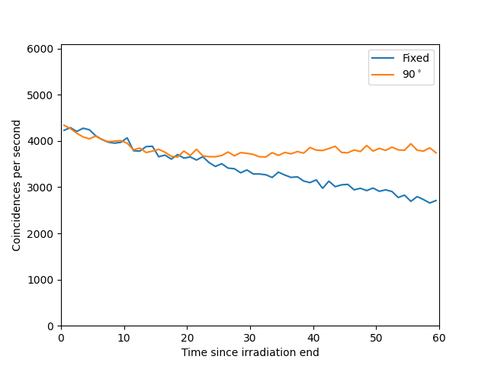
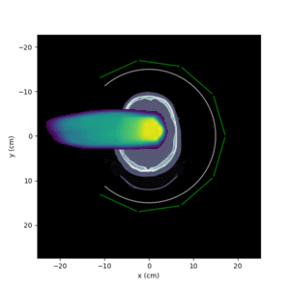
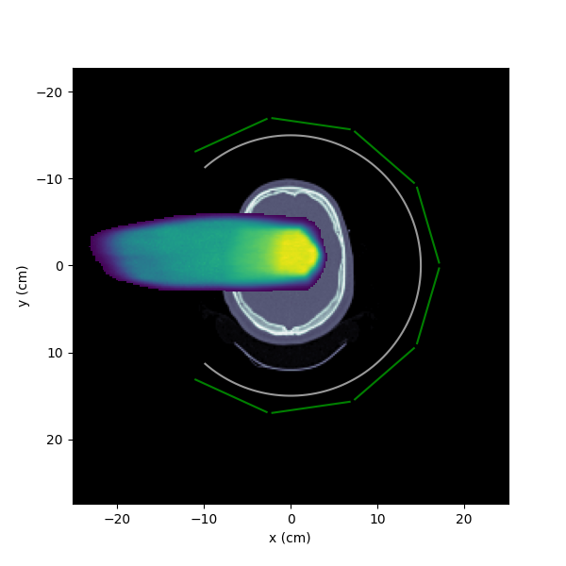
Inter-field imaging with rotations
Moves opening (low sensitivity) away, giving higher count rate
Boost spatial resolution in different regions
Notes:
204’300 fixed, 229’500 rotating 90˚, 281’200 rotating 450˚

Slide 11
Inter-field imaging with rotations
Symmetric ION therapy Accelerated Reconstruction Algorithms (SIONARA)
Reconstruction of PET images aquired at different angles is memory intensive
System matrix required for every position
Instead one matrix can generate many others!
Publication in preparation

Slide 12
Inter- and post field imaging
With 90˚ rotation to next imaging position, spatial resolution is partially recovered
NRMSE=1.40 NRMSE=1.15 NRMSE=1.02

Slide 13
Inter- and post field imaging, rotating scanner
With 450˚ rotation to next imaging position, spatial resolution is fully recovered
NRMSE=1.32 NRMSE=0.99 NRMSE=0.91

Slide 14
Summary
In-beam imaging provides verification possibility during delivery of first field
Fixed position inter-field imaging poses challenges due to poor image quality
Rotating scanner between fields drastically improves verification capabilities
Outlook
Incorporating BEV range analysis
And…

Slide 15
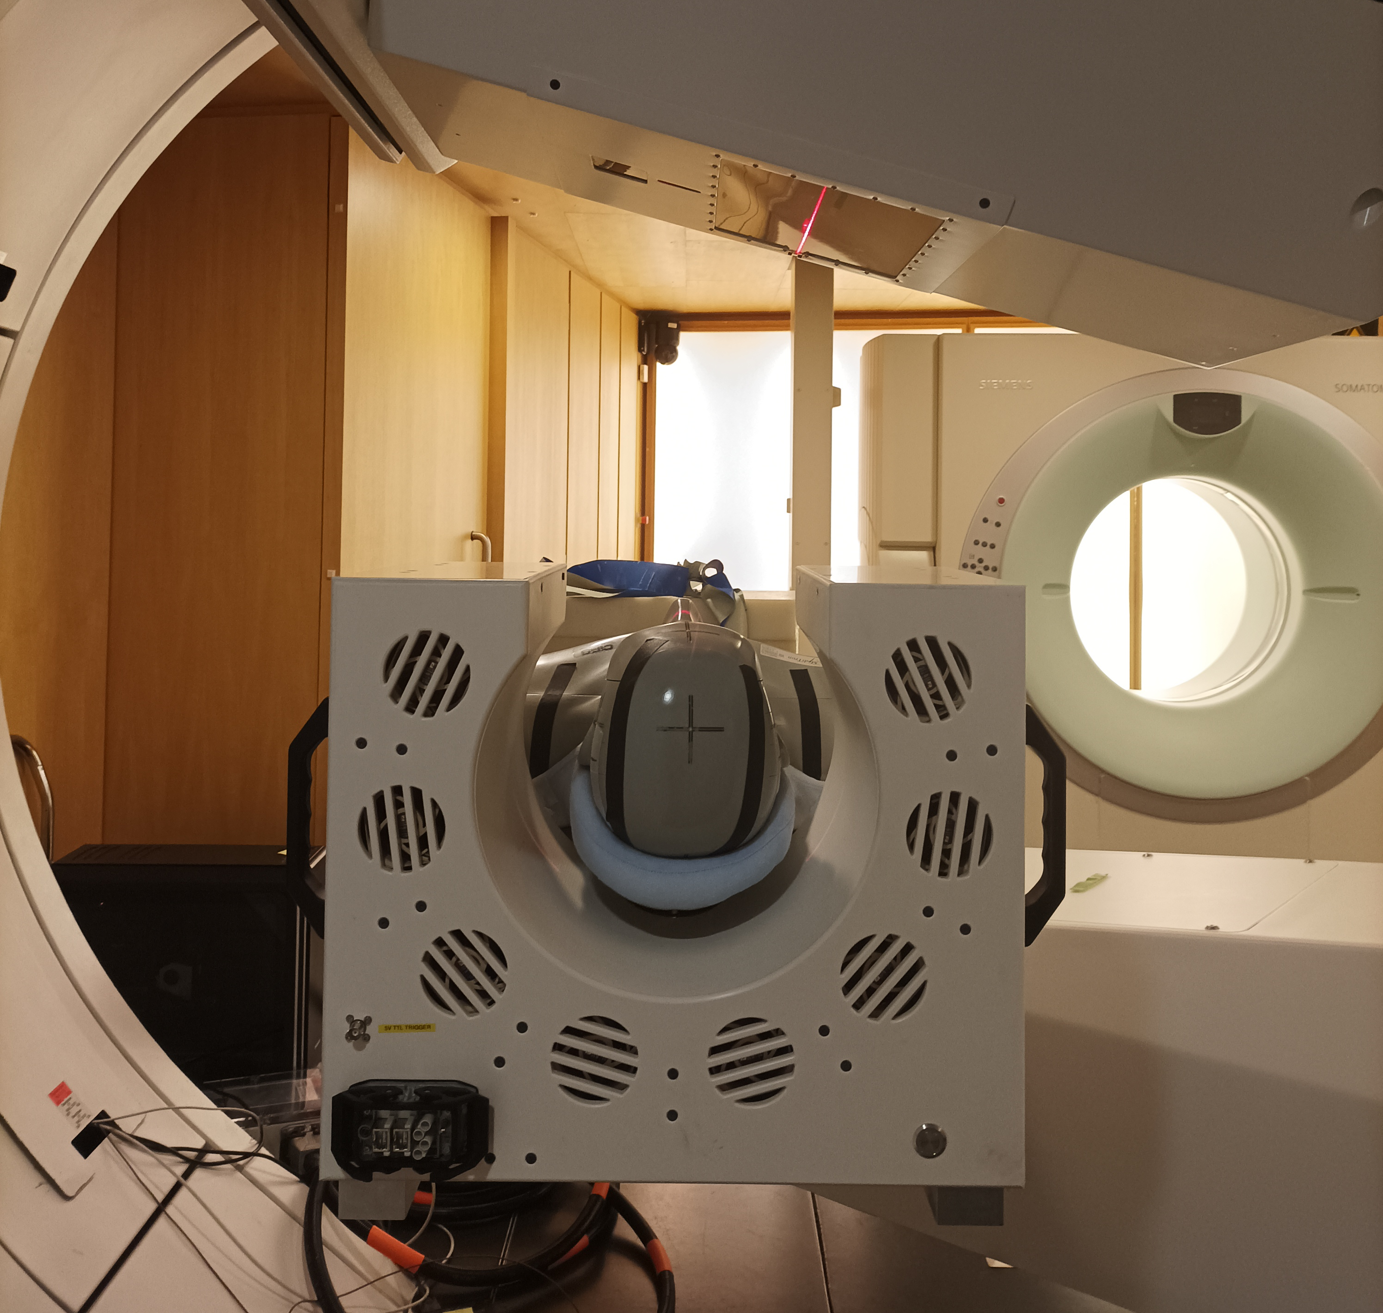
Early measurements
Comparison to simulations upcoming!

Slide 16
Wir schaffen Wissen – heute für morgen
Acknowledgements
Shubhangi Makkar
Christian Ritzer
Cristian Fuentes
Judith Flock
Marina Beguin
Daniel Lempen
Martina Bochsler
Anne-Sophie Bogaert
Jan Hrbacek
Prof. Damien Weber
Prof. Günther Dissertori
Carla Winterhalter
Prof. Tony Lomax

Slide 17
Other views

Slide 18
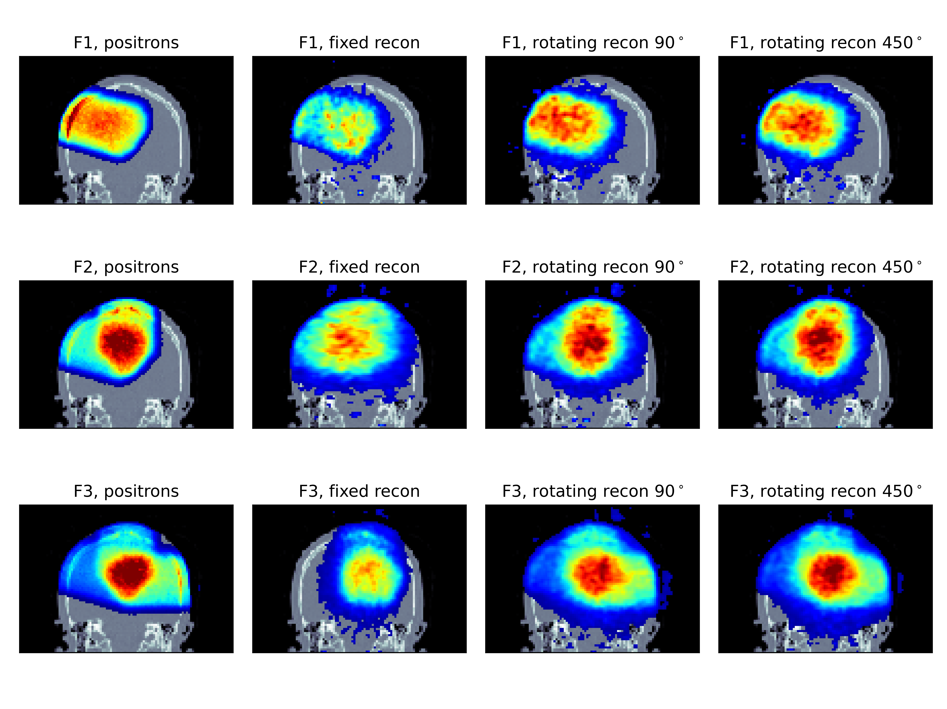
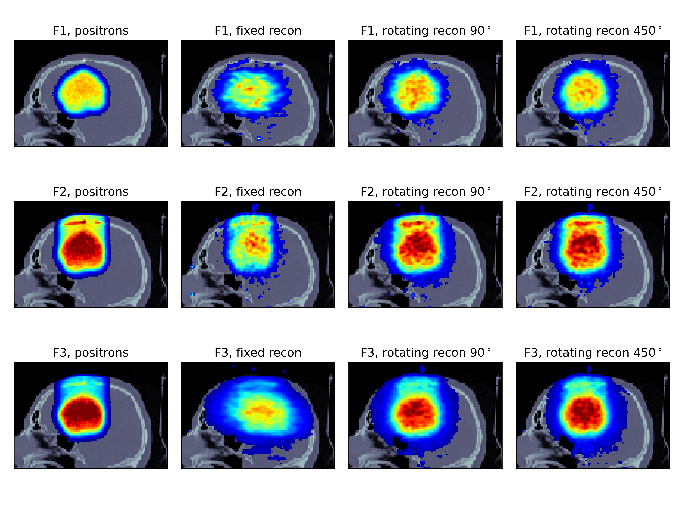
Other views

Slide 20
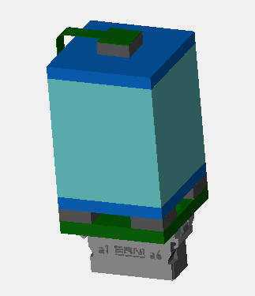
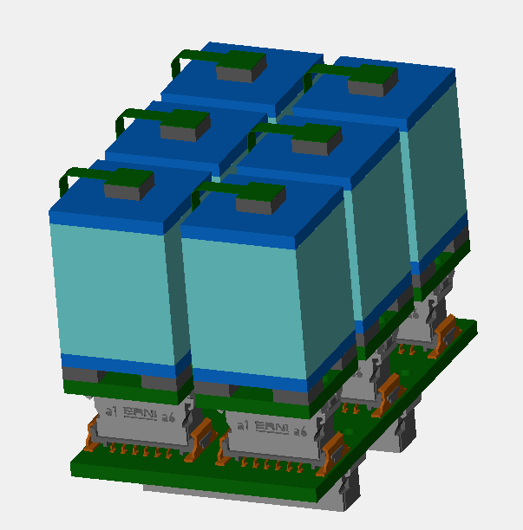
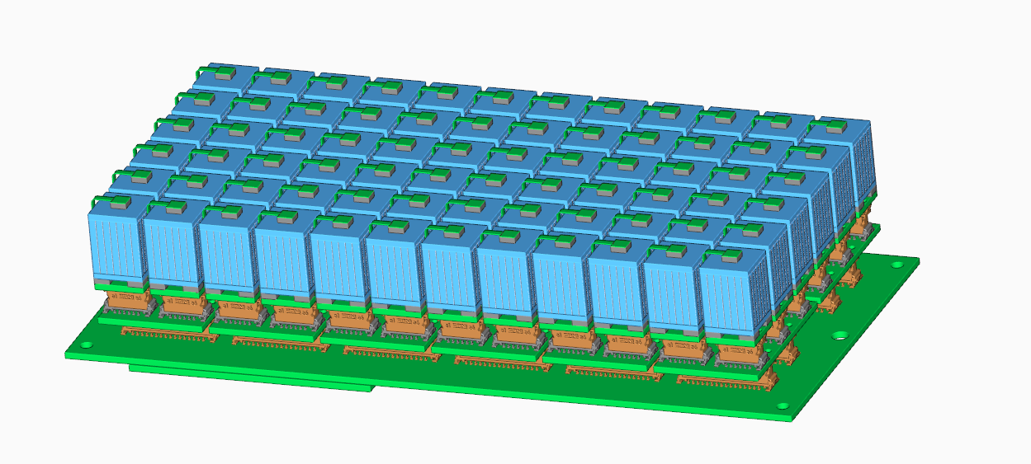
Scanner properties
SiPM Board
x 6
2.74x2.74x15 mm³ LYSO crystals
Energy resolution: 12% (FWHM)
Timing resolution: 500ps (FWHM)
Spatial resolution: 1.8-2.7 mm
ASIC Board
x 12
Main Board
Images courtesy Cristian Fuentes
Notes:
If theres time

