Slide 1
Virgo LIGO et KAGRA
Matteo Barsuglia
CNRS
Laboratoire Astroparticule et Cosmologie

Slide 2
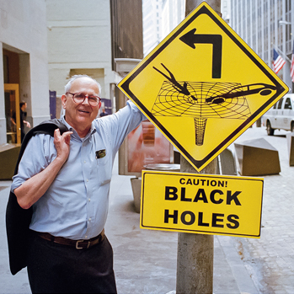
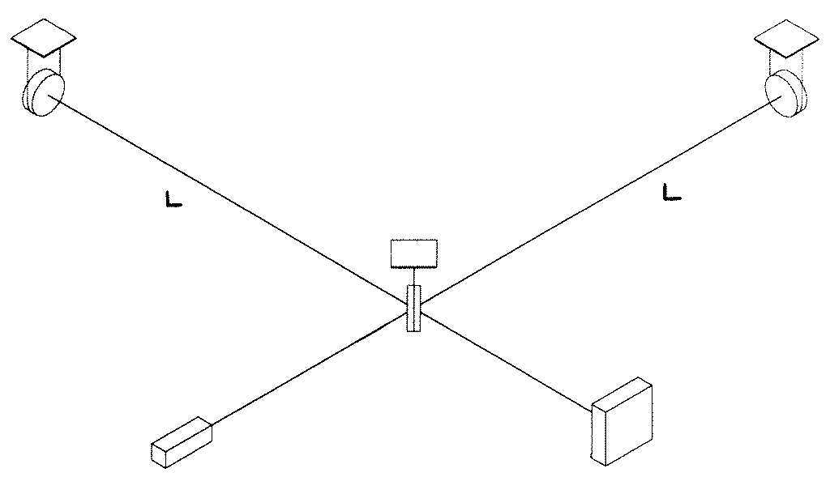
Interferometric detectors: The early years
Gertsenshtein and V. I. Pustovoit (1962), Pirani (1962)
Weber and Forward, experiment in Malibù
First prototype: E. Moss, L. R. Miller, and R. L. Forward (1971)
~ 10⁻¹⁴ mHz^{-1/2}
R. Weiss (1972) – realistic study of the noises
Joseph H.Taylor Jr
Source: www.NSF.gov
Notes:
Une détection indirecte

Slide 3
Virgo proposal - 1989
VIRGO must be considered both as an experiment and as a step towards a future observatory. The immediate goal of the VIRGO experiment is to realize, or to participate in, the first detection of gravitational radiation, but it also has the long term goal of being one component of the gravitational wave detectors network which will involve other detectors in other countries, and provide data of astrophysical interest. These goals imply a collaboration with the other groups having similar projects, without excluding some competition.
The group leaders from Italy, France, Germany, Scotland, and the USA have agreed to exchange all information and to collaborate on all the aspects of the construction of large interferometers in order to generate the international effort required by the birth of gravitational astronomy.
A BRILLET & A GIAZOTTO
Virgo approval by CNRS in 1993 and INFN in 1994
Virgo commissioning starts in 2001
Virgo starts scientific data taking in 2007
Virgo first detection in 2017

Slide 4
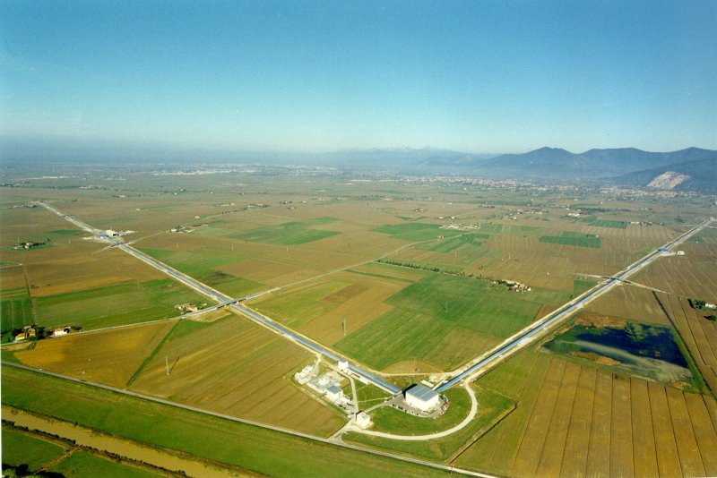
Virgo and EGO
Virgo Scientific Collaboration
827 members, 555 authors, 140 institutions from 15 countries
37 Groups
9 countries represented in the Virgo executive committee
EGO
Consortium France-Italy-The Netherlands
IR* (ex TGIR)

Slide 5
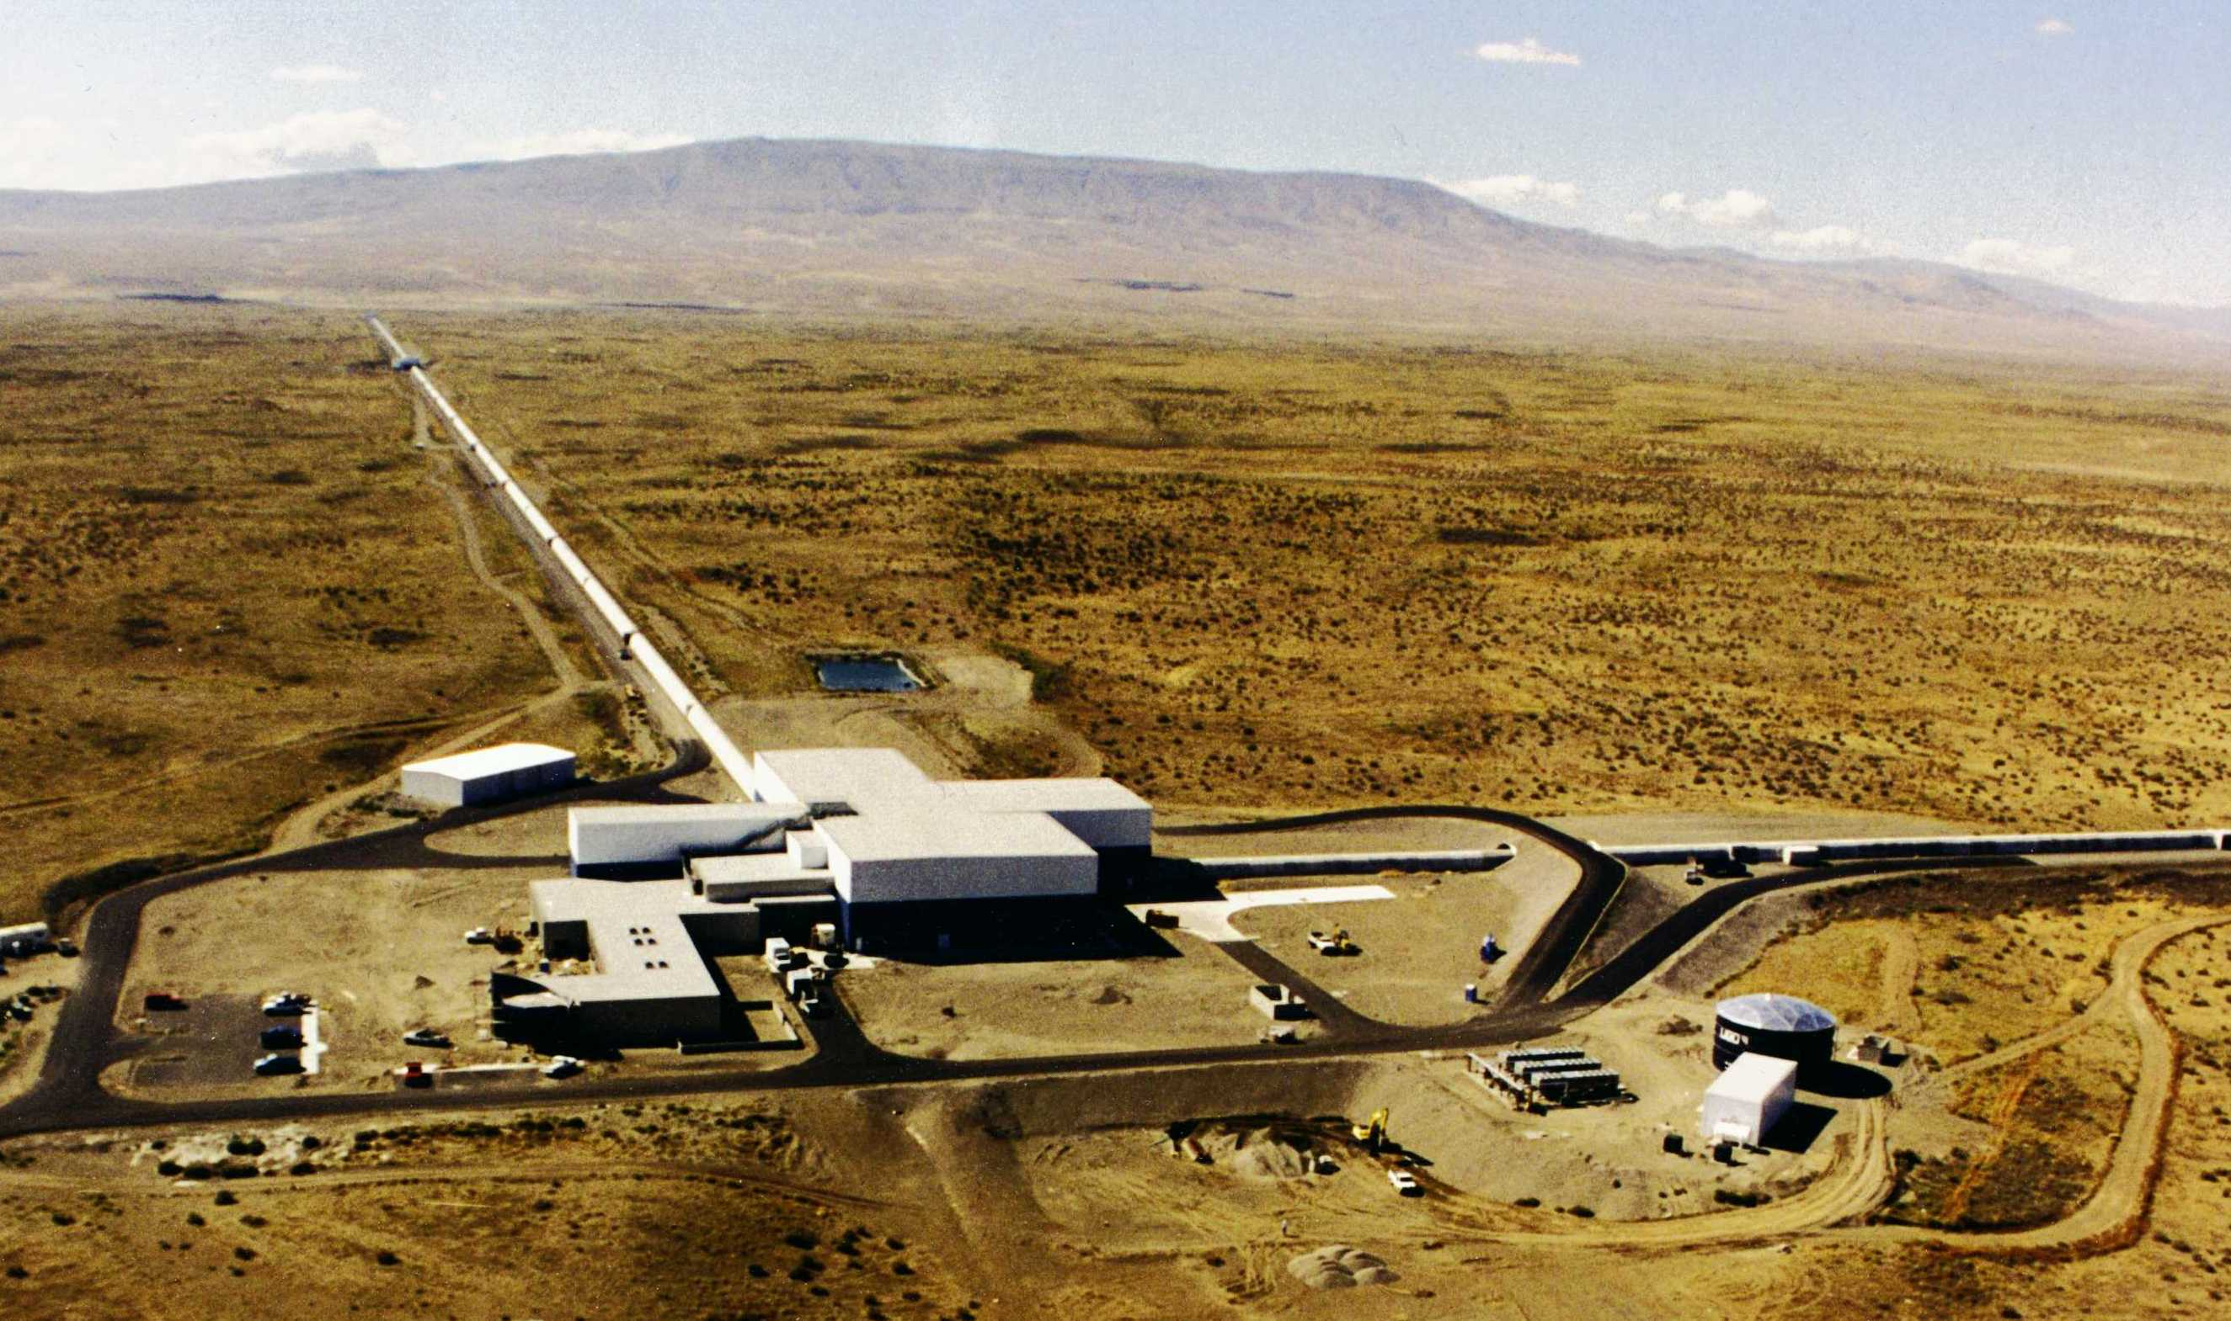
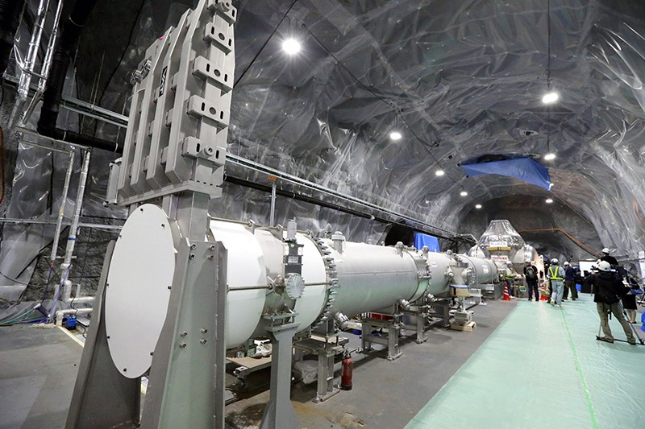
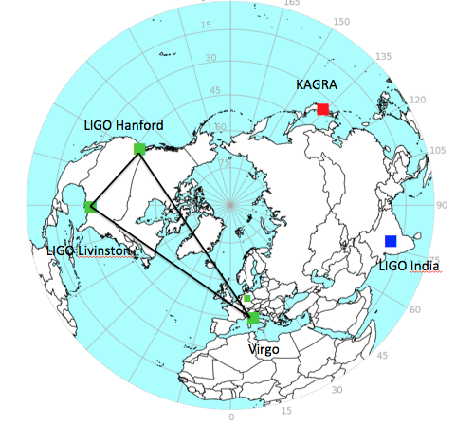
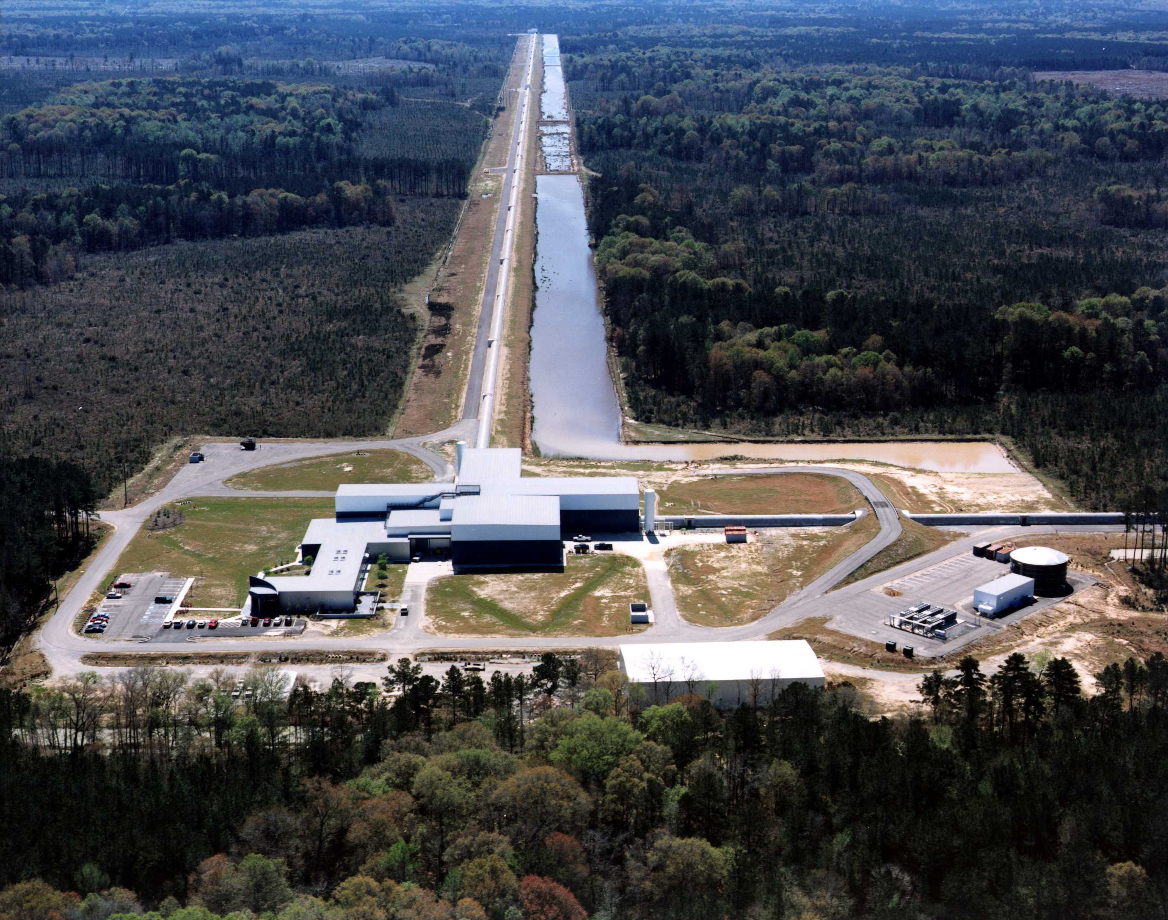
The LIGO-Virgo-KAGRA (LVK) network
LIGO Hanford
KAGRA
LIGO Livingston
Virgo

Slide 6
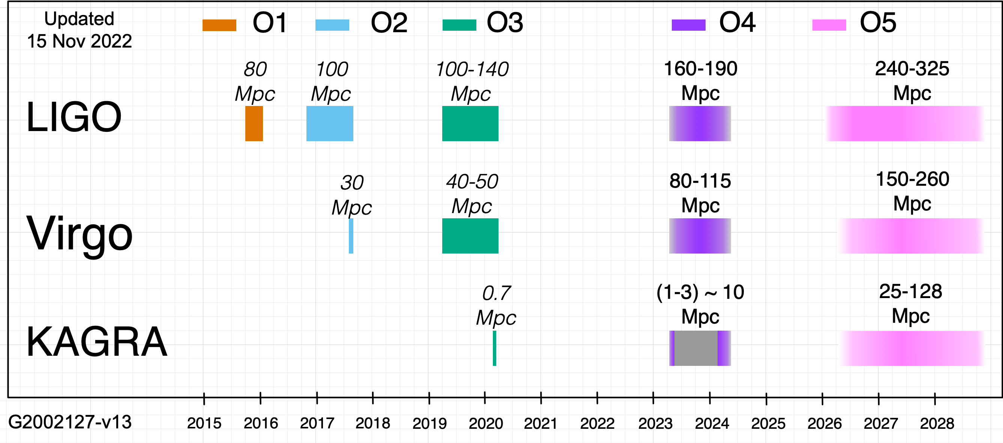
The LIGO-Virgo-KAGRA data takings
Advanced Virgo (AdV)
AdV+ phase 1
AdV+ phase 2

Slide 7
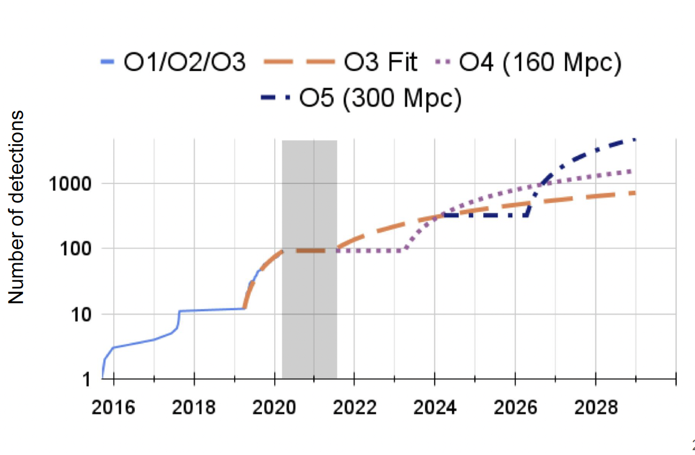
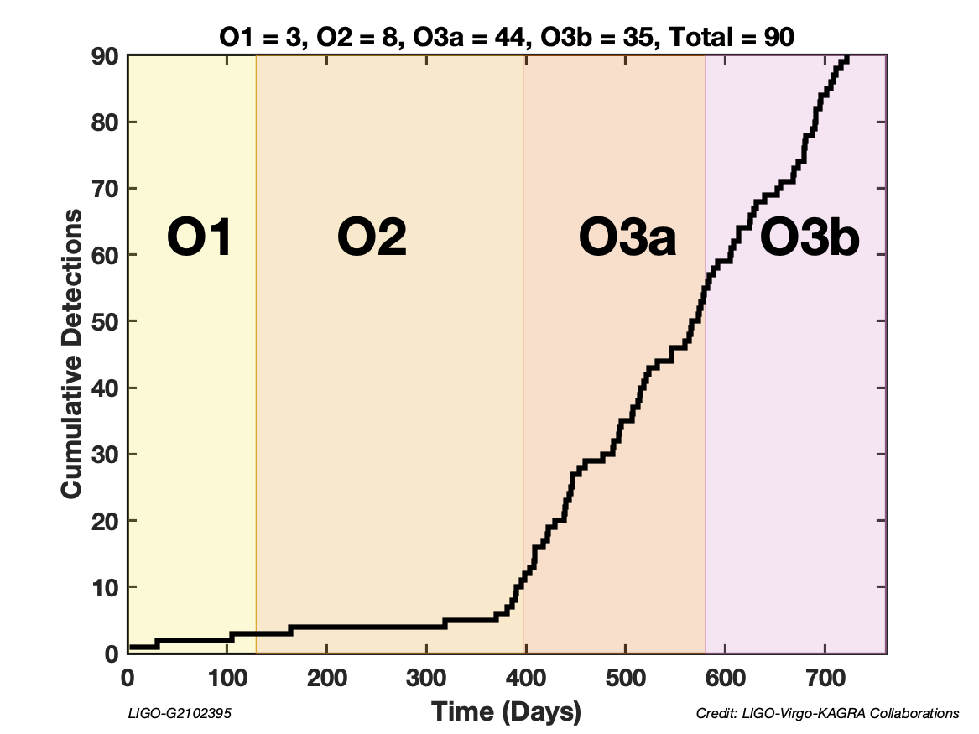
Alternate observing periods with upgrades
Credit: P.Brady
Credit:P.Brady

Slide 8
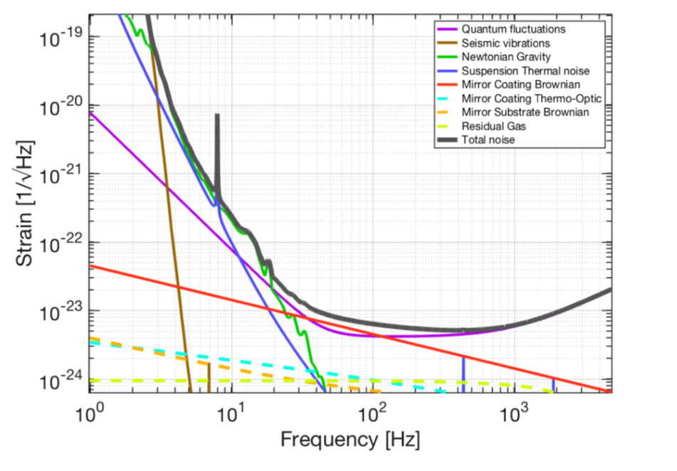
Interferometric gravitational-wave detectors: main noise sources
Read-out noises
Displacement noises
Fundamental noises
Technical noises
Environmental noises

Slide 9
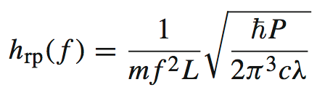
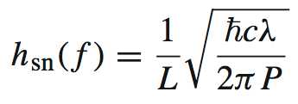
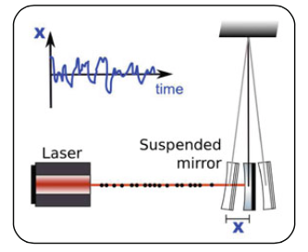
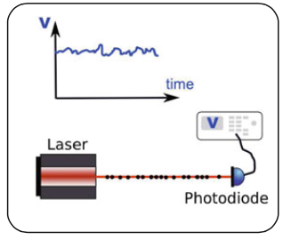
Quantum noise
Radiation pressure noise
Shot noise
Poissonian statistics on the photon arrival time
Fluctuation in the momentum transferred to the mirror

Slide 10
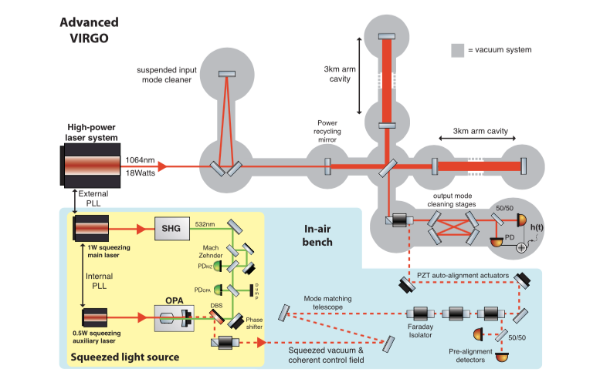
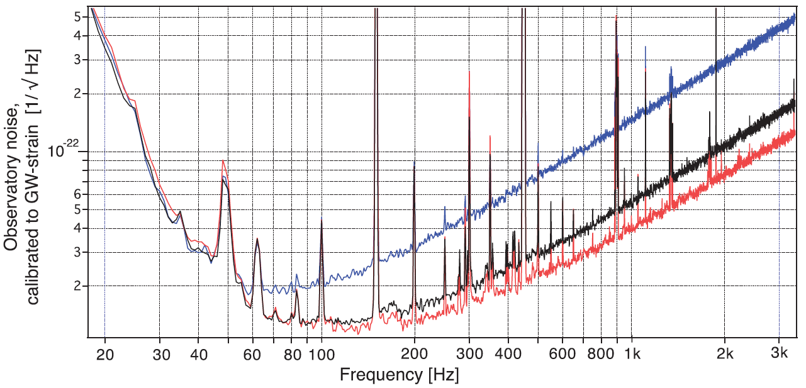
Squeezing
Squeezed vacuum injected

Slide 11
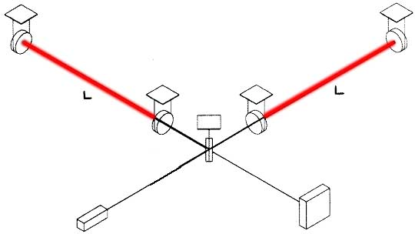
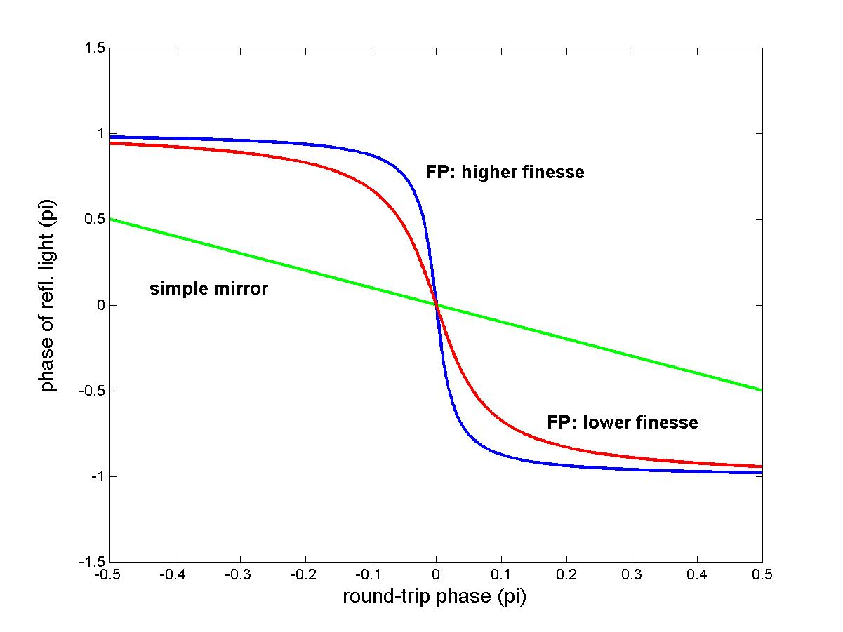
Increasing the signal: Fabry-Perot cavities
Fabry-Perot cavities: amplify the length-to-phase transduction
Drawback: works only at resonance

Slide 12
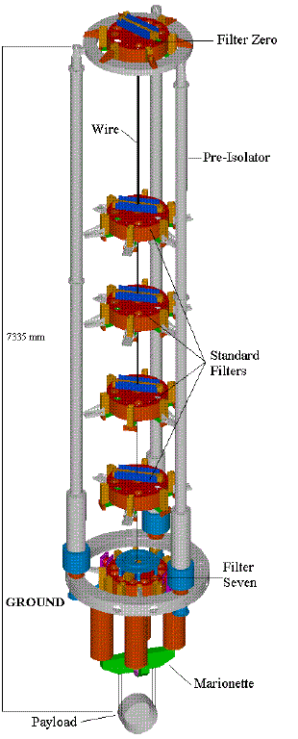
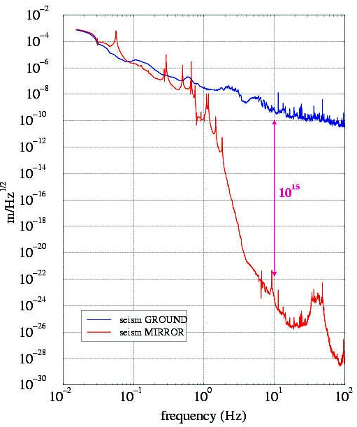
The seismic noise and the suspensions
14
10
Virgo superattenuator transfer function

Slide 13
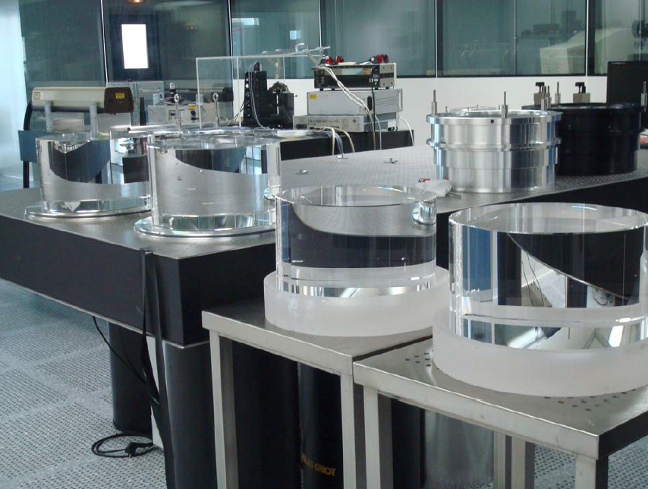
Thermal noise

Slide 14
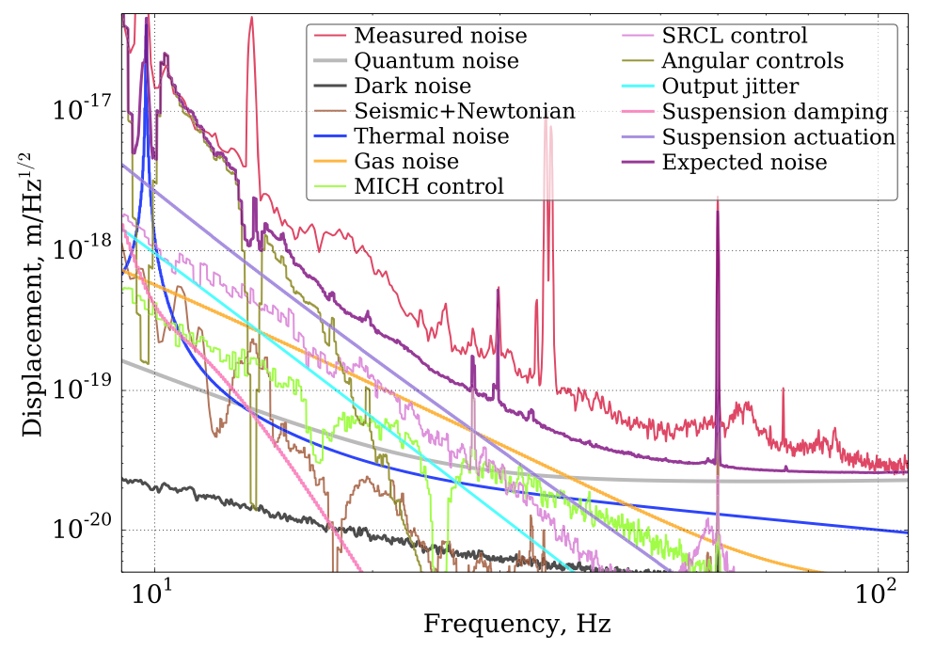
A real sensitivity curve
Sensitivity of the Advanced LIGO detectors at the beginning of gravitational wave astronomy
D. V. Martynov et al. Phys. Rev. D 93, 112004 – (2016)

Slide 15
The next data takings
Advanced Virgo (AdV)
AdV+ phase 1
AdV+ phase 2

Slide 16
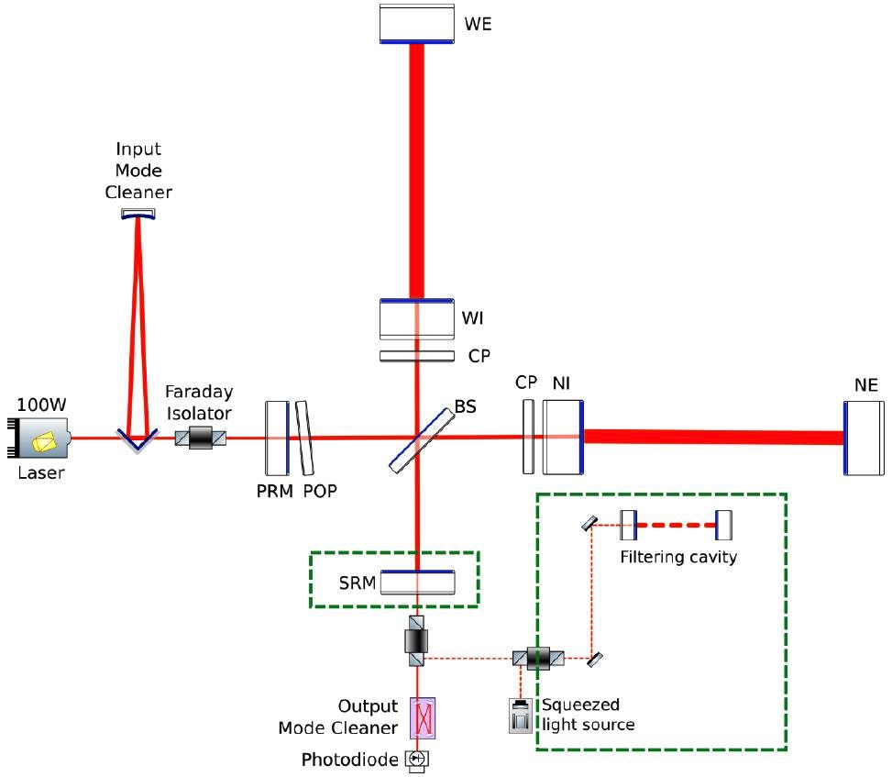
Advanced Virgo + (phase 1)
Laser power increase
Signal recycling
Squeezing

Slide 17
The period 2030-2035
2G
2G+
Reaching the limit of 2G
Virgo_nEXT
Advanced Virgo and Advanced LIGO
Advanced Virgo+
and Advanced LIGO +

Slide 18
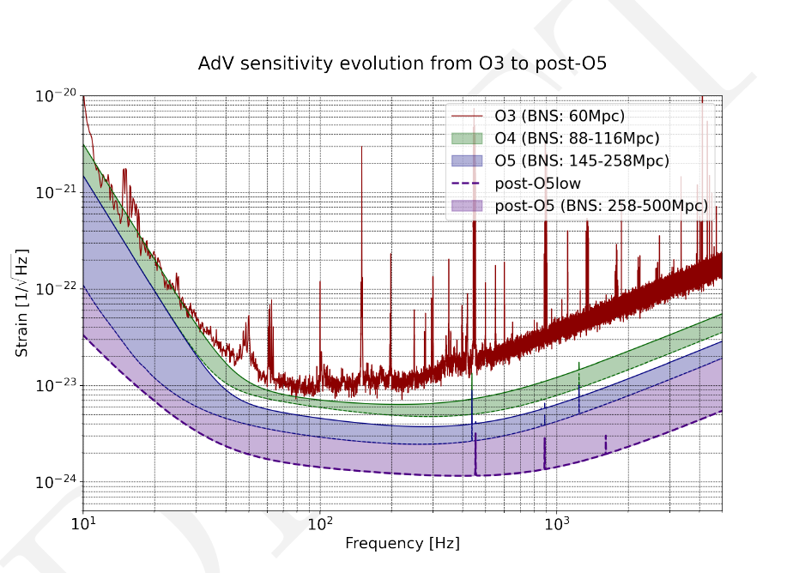
The period 2030-2035
New Virgo/LIGO upgrades under study
Work in progress
Testbench for 3G detectors
Technologies
  Better coatings
  Higher laser powers
  Higher squeezing level
  Reduce technical noises at low frequency
  Reduce Newtonian noise

Slide 19
The “big picture”
2G
2G+
Reaching the limit of 2G
Virgo_nEXT
Advanced Virgo and Advanced LIGO
Advanced Virgo+
and Advanced LIGO +

