Slide 1
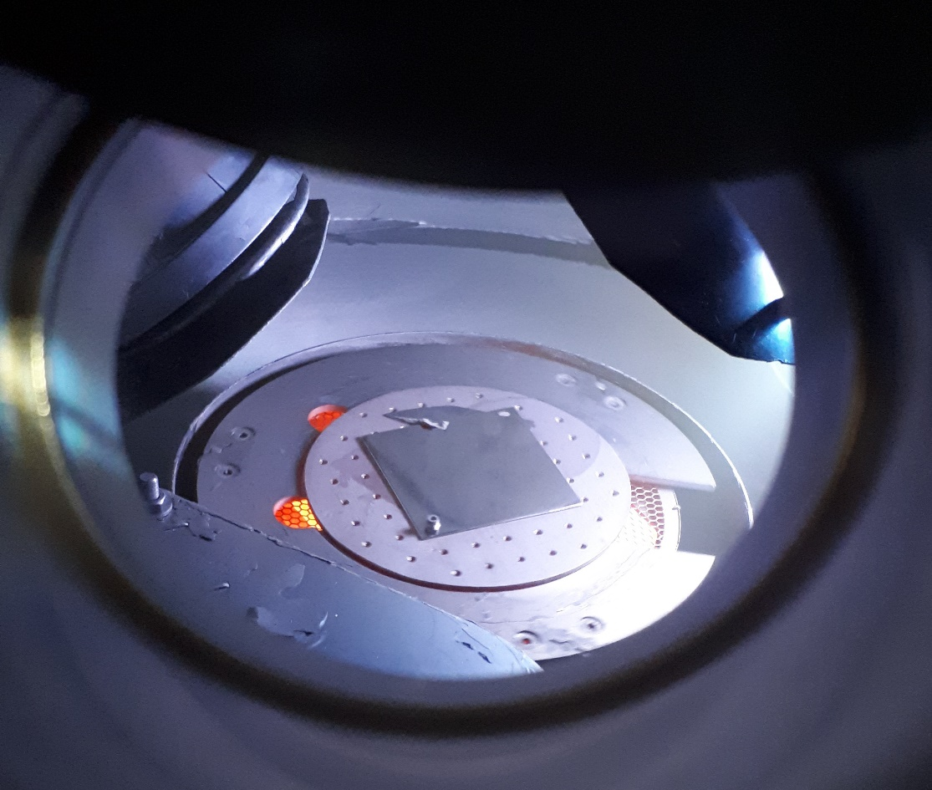
Material Characterisation and Test Capabilities at STFC
Anthony Gleeson
AMICI - iFAST WP13 Workshop, IJCLab Orsay, 22-23 June 2023

Slide 2
Who are STFC?
The Science & Technology Facilities Council (STFC) is one of the research bodies which make up UK Research and Innovation (UKRI)
STFC provides the ‘Big Science’ infrastructure which is uneconomic for individual academic or industrial parties to establish and operate
Our facilities across the UK and overseas support fundamental research in astronomy, physics, computation and space science
We use our facilities, technology and skills to the benefit of academia, society and industry
We are the perfect neutral space where academia, industry partners and the national laboratories can collaborate.

Slide 3
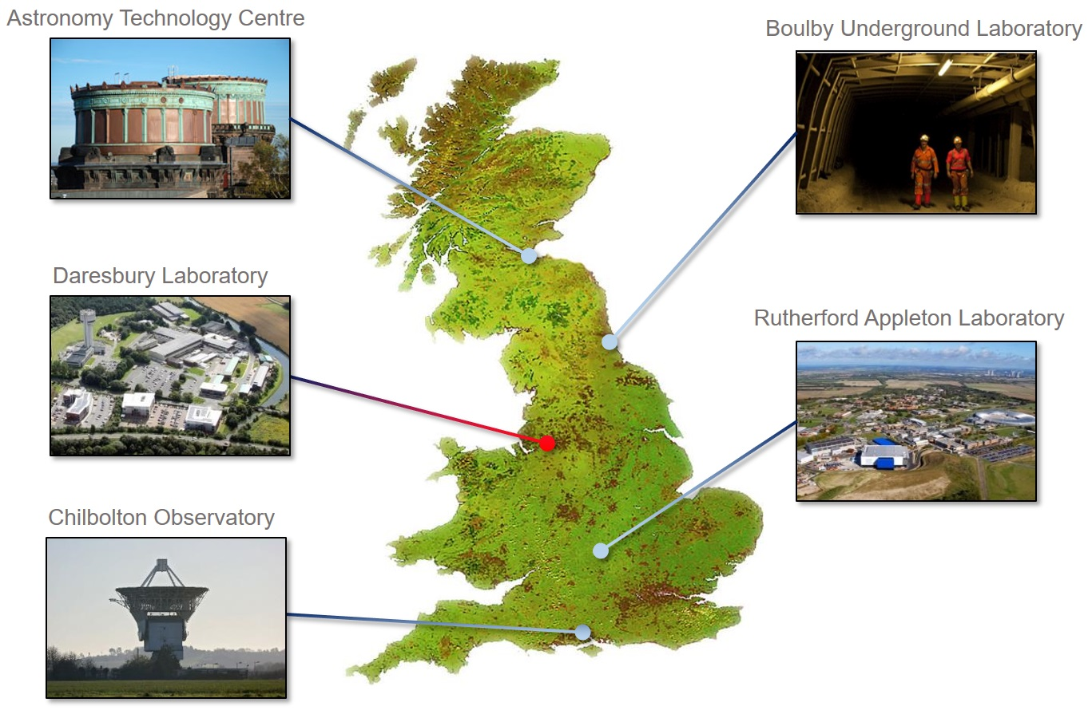
Who are STFC?
The Science & Technology Facilities Council (STFC) is one of the research bodies which make up UK Research and Innovation (UKRI)
STFC provides the ‘Big Science’ infrastructure which is uneconomic for individual academic or industrial parties to establish and operate
Our facilities across the UK and overseas support fundamental research in astronomy, physics, computation and space science
We use our facilities, technology and skills to the benefit of academia, society and industry
We are the perfect neutral space where academia, industry partners and the national laboratories can collaborate.

Slide 4
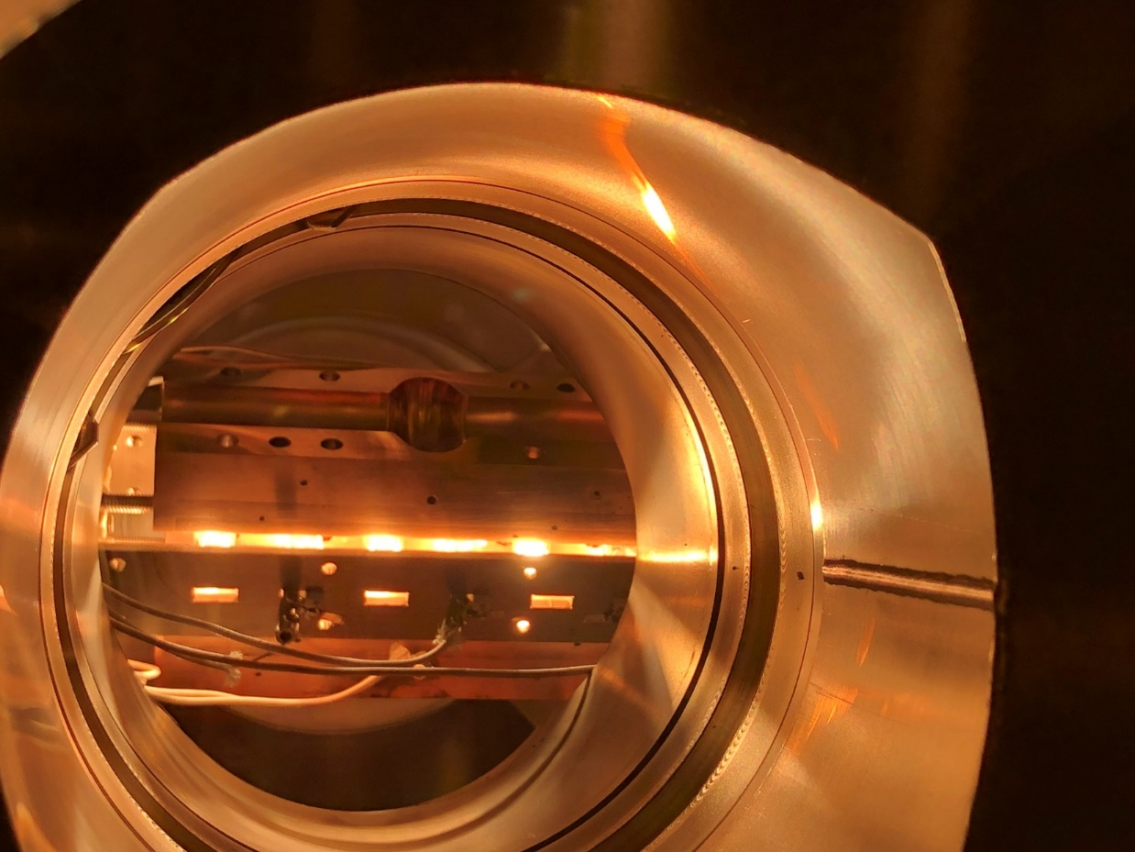
VISTA Lab
The Vacuum Interfaces and Surface Technologies for Accelerators (VISTA) laboratory is the main hub for both vacuum science and surface science R&D within the UK accelerator community.
Recent work programmes have been centred around activities such as NEG and novel coating developments for DLS-II and PETRA-IV; secondary electron suppression schemes for CERN; superconducting thin film development for iFAST; CsTe photocathode development for UK-XFEL.

Slide 5
Material & Surface Analysis
The VISTA laboratory's suite of instruments cover specialisms such as vacuum system analysis, vacuum metrology and gauge calibration, and XHV processing for large vessels.
PVD, CVD and ALD deposition development for complex freeform and long structures.
The laboratory is equipped with full surface analysis capabilities including:
RBS
NRA
MEIS
LEIS
AES
XPS
SIMS
SEM
TEM
…

Slide 6
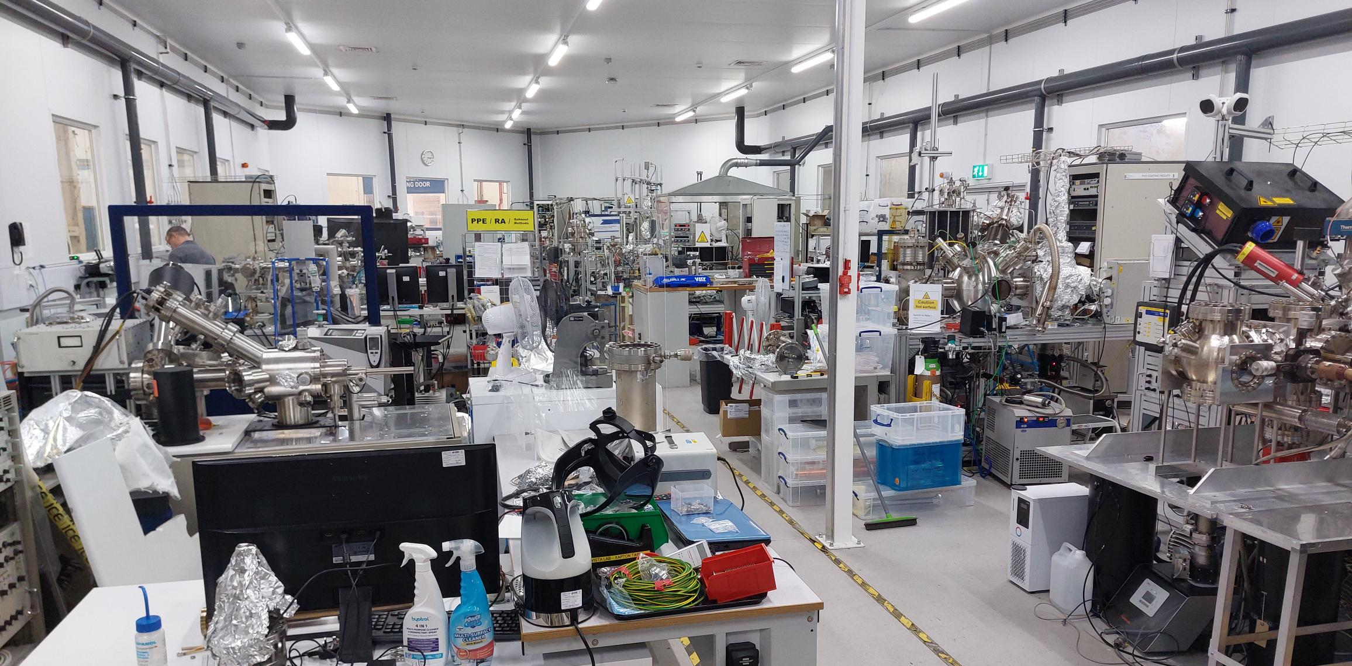
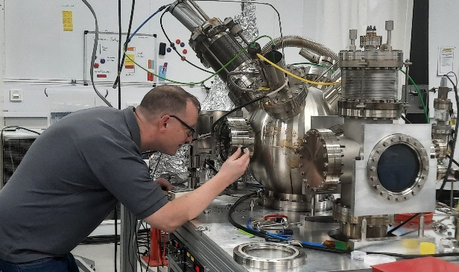
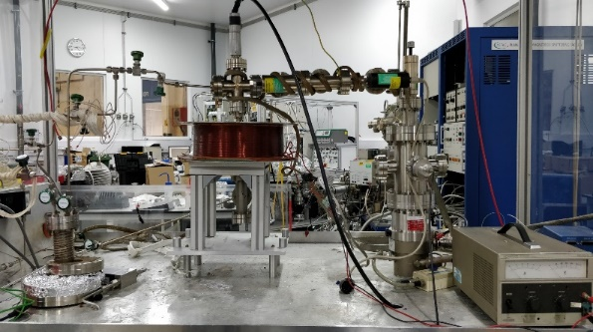
VISTA Coatings / Deposition
Commercial partnerships and contracts include: vacuum pump, vessel and component manufacturers, photonics, medical & dentistry, hydrogen storage development.

Slide 7
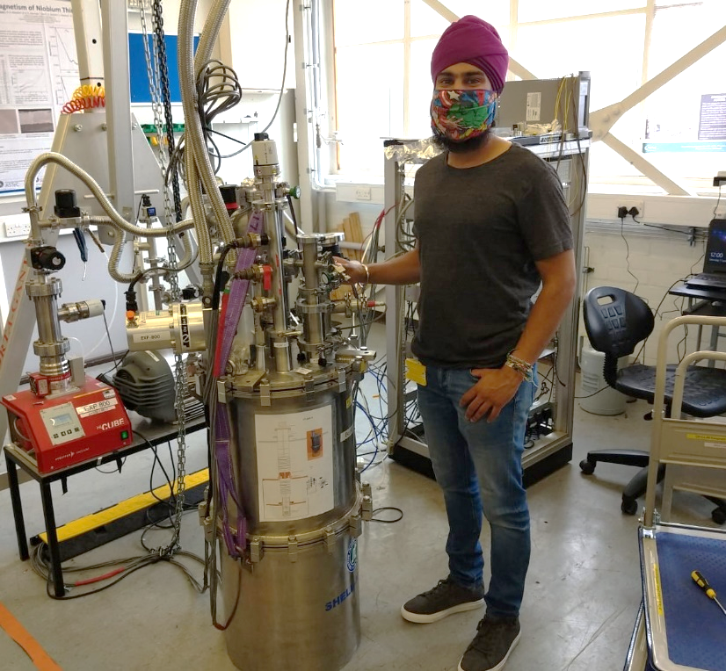
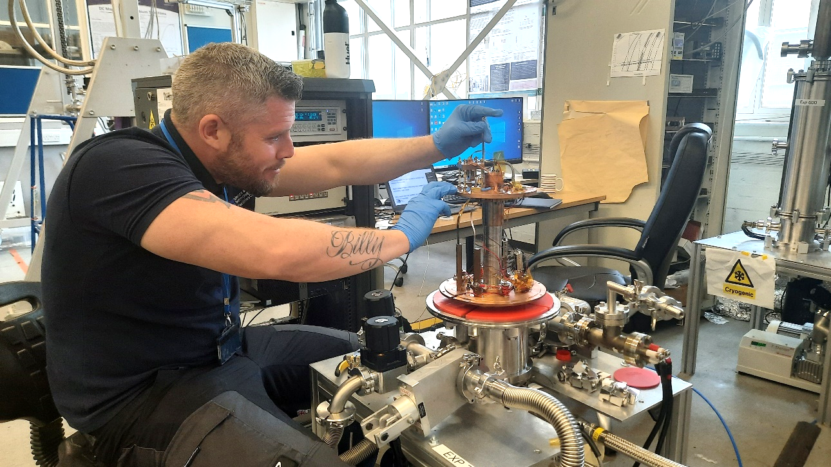
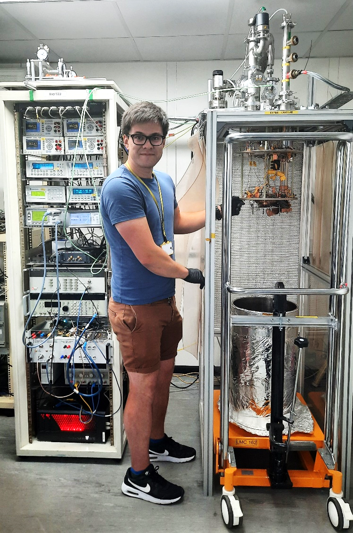
Cryogenic Test Lab
RRR and T_{c} measurements
Magnetic field penetration facility for planar TF samples which replicates conditions similar to ones in an RF cavity
RF cavity and cryostat for measurement of superconducting coatings at 7.8 GHz using a closed-cycle refrigerator

Slide 8
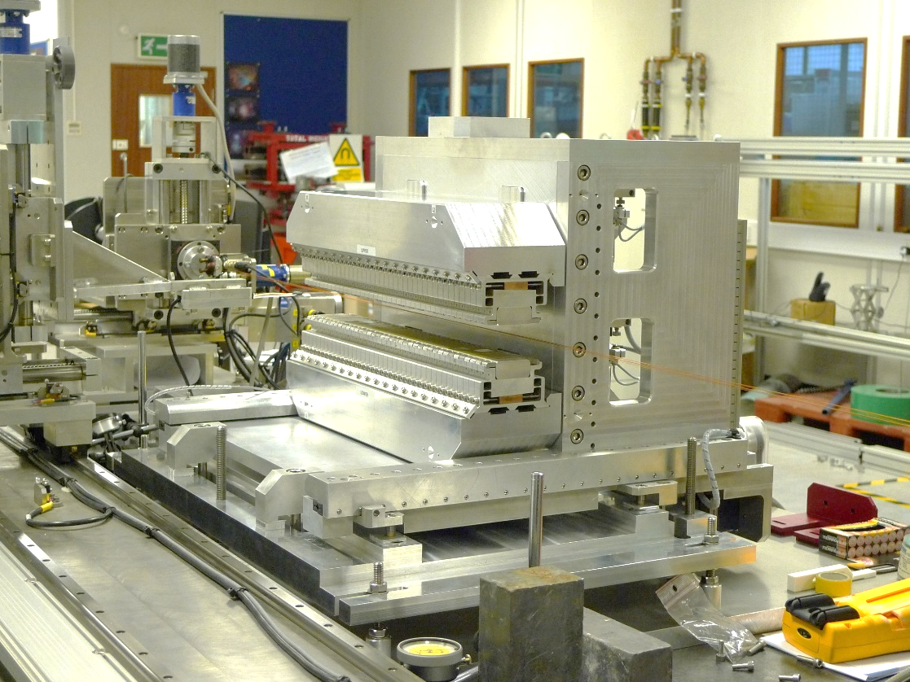
Magnet Test Lab
Hall probe mapping:
5m long bench
3-axis movement
1µm resolution
Variety of probes for different applications
Fiducialisation of magnet centres
Wire measurement:
Stretched wire (field integrals)
Pulsed wire (fast undulator measurements)
Rotating coil (accurate harmonics)
Hall probe calibration:
Reference dipole magnet
NMR reference probe
Commercial partnerships and contracts include: normal & superconducting magnet manufacturers, electronics, battery development

Slide 9
Thank you. Questions?
Anthony Gleeson
Anthony.Gleeson@stfc.ac.uk
📱07590 450 356

