Slide 1
Test and Material Characterisation for superconducting magnets at CEA/Irfu Mechanical Laboratory
I.Fast – WP13
Workshop on Platforms for characterisation, treatments and test of materials
22/06/2023
PERRAUD Simon
Many thanks to C. Mayri, R. Vallcorba, G. Campagna, E. Fernandez-Mora, C. Genot, G. Lenoir, Y. Peron, H. Reymond, E. Rochepault, F. Stacchi and C. Wei
CEA Paris-Saclay/DRF/IRFU/DACM/LEAS

Slide 2
Introduction : A lot of challenges for future accelerator magnets development
Strong magnetic field ➔ High stress induced by Lorentz forces
Cryogenic environment ➔ Different working temperature from 1.9 K to 77 K
Multi-scale composition ➔ From filament to magnet
HTS tapes ➔ Anisotropic behavior
Nb₃Sn brittleness ➔ Performance sensitive to stress
Magnet complexity ➔ Composite with materials interactions
And more…
Necessity to investigate in detail all of those aspects…

Slide 3
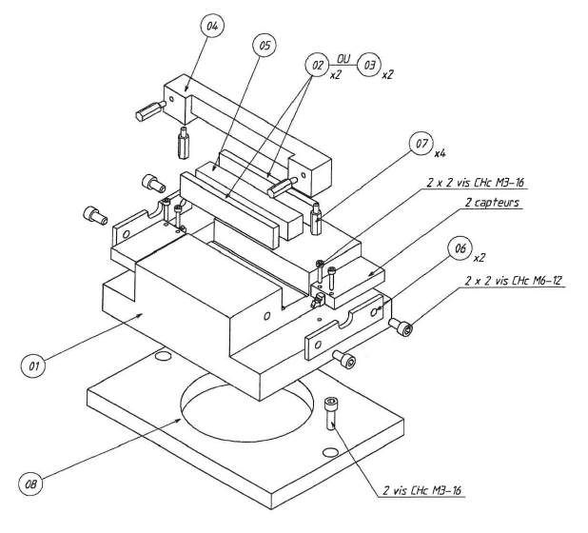
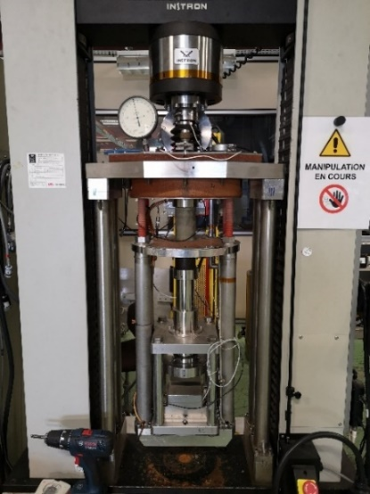
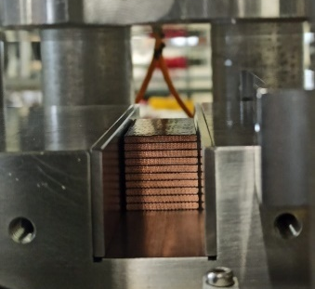
10-stacks compression test
Goal : Characterize the mechanical behavior of a coil with representative samples made of 10 layers of Rutherford cables
Context : Upgraded setup in the framework of Nb₃Sn CERN-CEA collaboration
Nb₃Sn impregnated samples, compressed with loading cycles by a pushing bar under the 150 kN press at room temperature (RT), 77K and 4.2K.
Displacement measured by two extensometers at the extremity of the pushin bars
10stacks samples of FRESCA2 cables
Exploded view of the setup
150 kN press configuration for compression tests at RT, 77 K and 4.2 K (with cryostat)

Slide 4
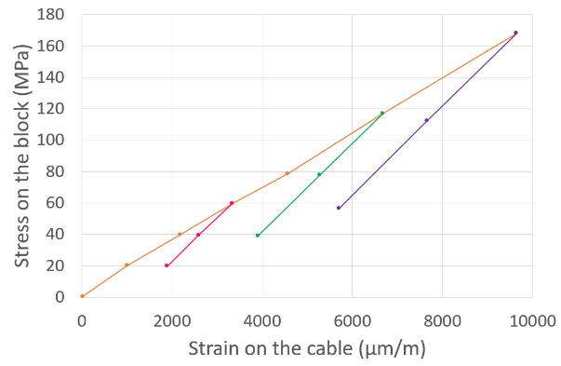
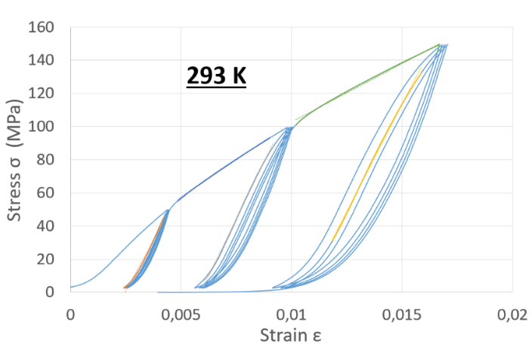
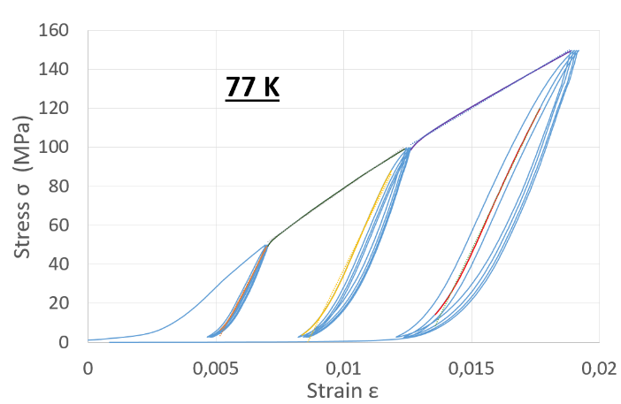
10-stacks compression test
Results : Non-linear behavior characterized by stress-strain curve for differents temperatures
➔ Behavior law implementation in FEA models for correlation studies and better predictions for future magnet design
➔ Comparison with real magnet tests and measurements
Next steps : Mechanical characterization of R2D2 Nb₃Sn cables, metallographic studies…
Non-linear behavior law extracted from 10-stacks measurement and implemented in FEA model
Example of stress-strain behavior on a Nb3Sn 10-stacks at RT and 77 K

Slide 5
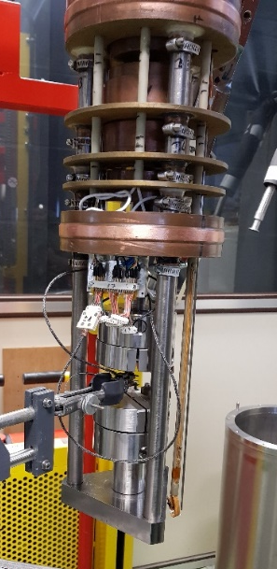
Tensile test on Nb₃Sn strand
Courtesy of G. Lenoir
Goal : Characterize the mechanical behavior of a strand for correlation with multi-scale FEA model
Context : Developpement in the framework of ANR Cocascope. Re-launched with Nb₃Sn CERN-CEA collaboration
Nb₃Sn strand tested in the 150kN press with the 10kN force cell, at RT and 77K
SCUTT method developped at CEA to limit transverse forces during a tensile test
Displacement measured by an extensometer glued to the strand
Break !
σapplied
Extensometer
10 kN press configuration for tensile test at RT / 77 K / 4.2 K (with cryostat)
Extensometer installation on a strand

Slide 6
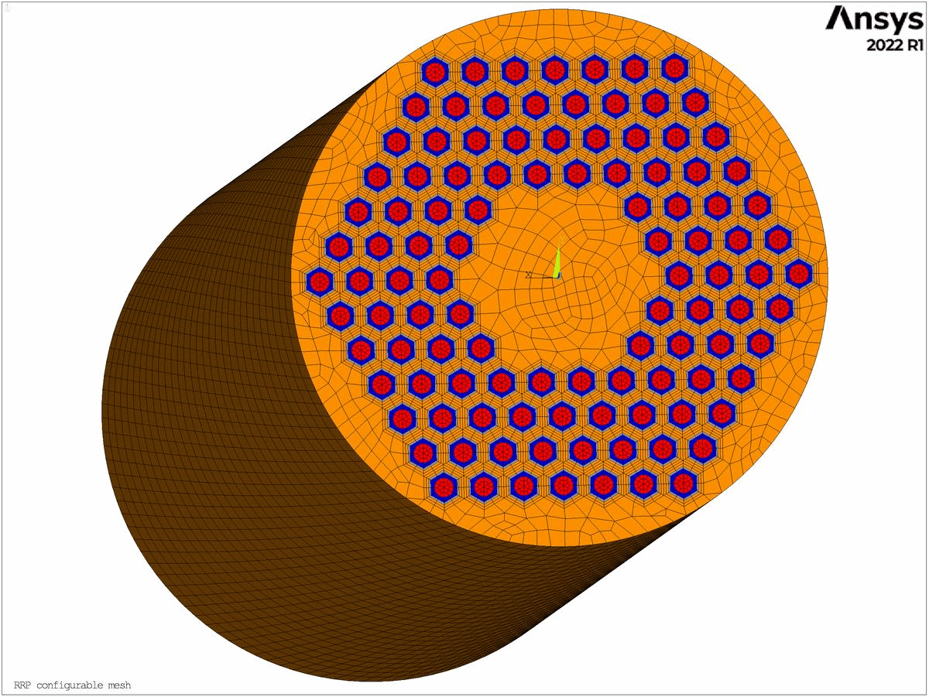
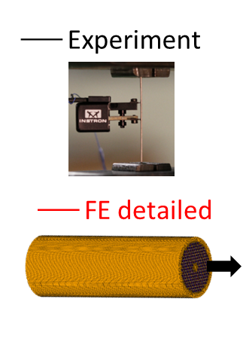
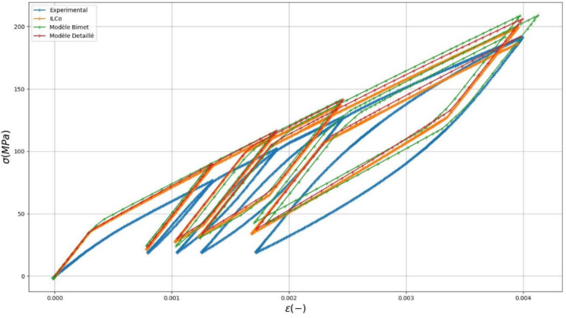
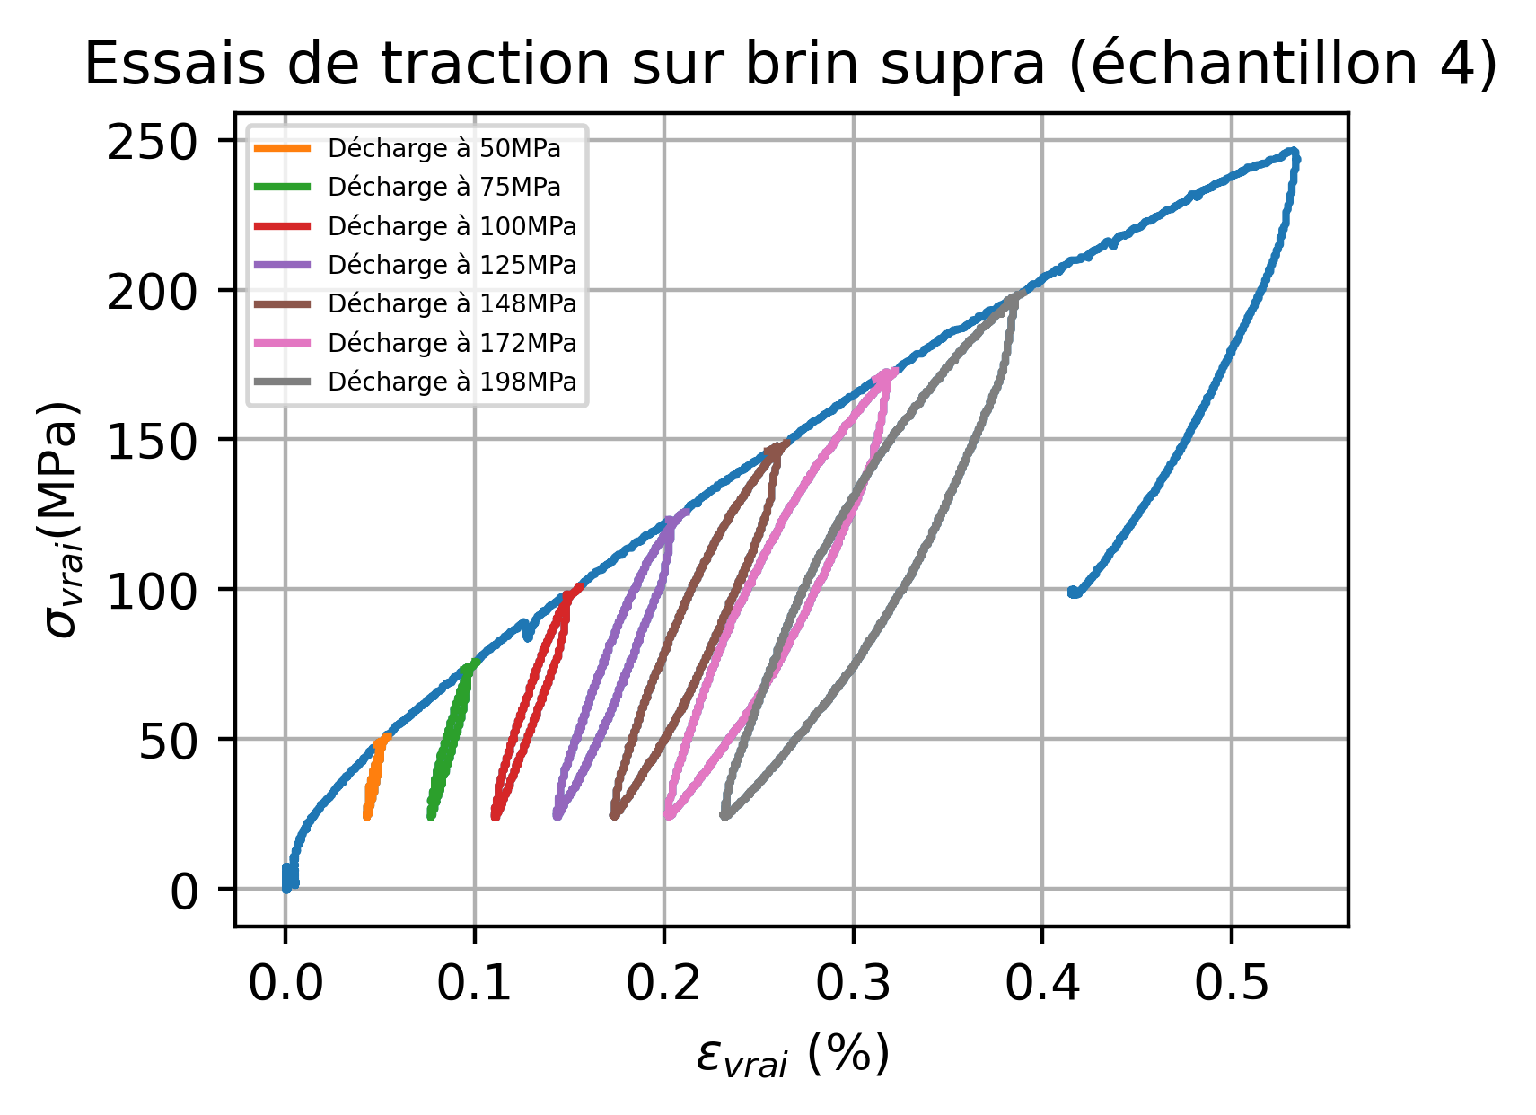
Tensile test on Nb₃Sn strand
Courtesy of G. Lenoir
Results : Non-linear behavior characterized at differents temperatures (RT and 77 K)
➔ Comparison with multi-scale FEA model from Cocascope project
Next steps : Test campaigns on differents strand geometries, tests at 4.2 K…
Example of Nb₃Sn strand geometry generated with ANSYS
Experiment and FEA model comparison for a Nb3Sn strand under tensile test at RT
Exemple of stress-strain curve obtained for a Nb3Sn strand under tensile test at 77 K

Slide 7
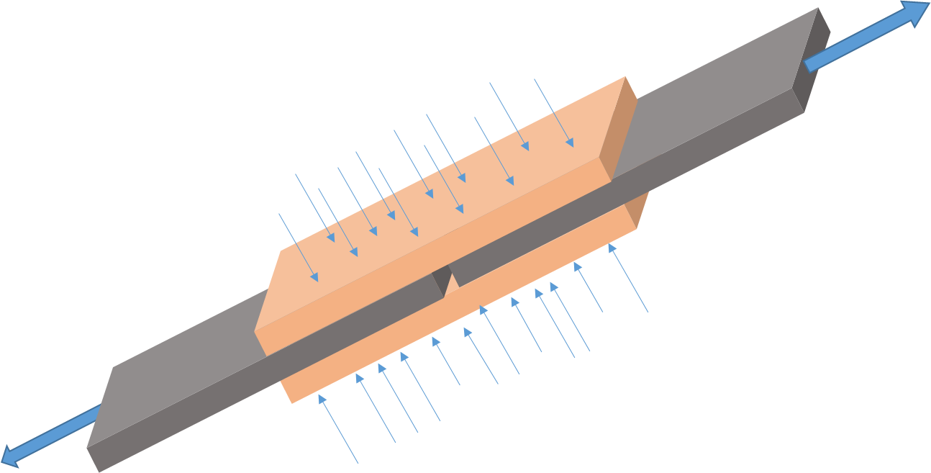
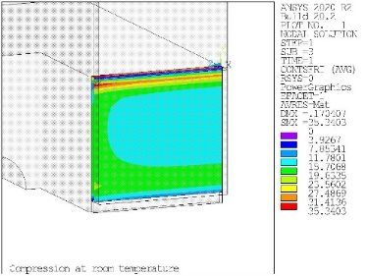
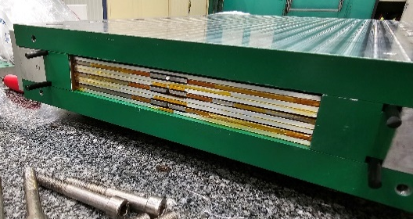
Behavior study of metal-resin interface
Courtesy of G. Campagna
Goal : Study the behavior at the interface between metal parts and impregnated glass fiber under shear stress
Tensile force
Context : G. Campagna thesis preparation in the framework of Nb₃Sn CERN-CEA collaboration
Derivate form of « double lap shear test » with additional pressure applied lateraly on the sample
Stainless steel and titanium samples with differents surface roughness (smooth, after machining, after sandblast…) impregnated with fiberglass and CTD101K resin
Tests planned in 150kN press at RT and 77 K with strain gages, extensometers, temperature sensors and acoustic sensors
Fiberglass impregnated
Metal
Sample compression during test
Drawing of principle
➔ Activities on-going with FEA model development and sample fabrication

Slide 8
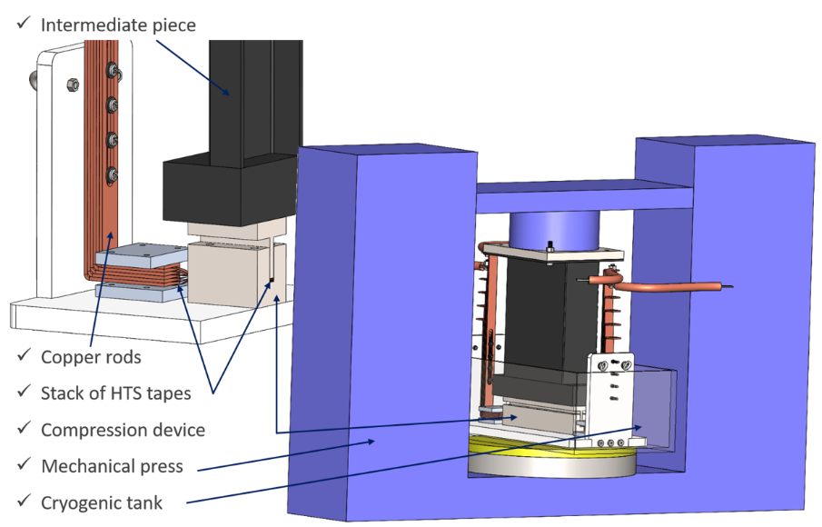
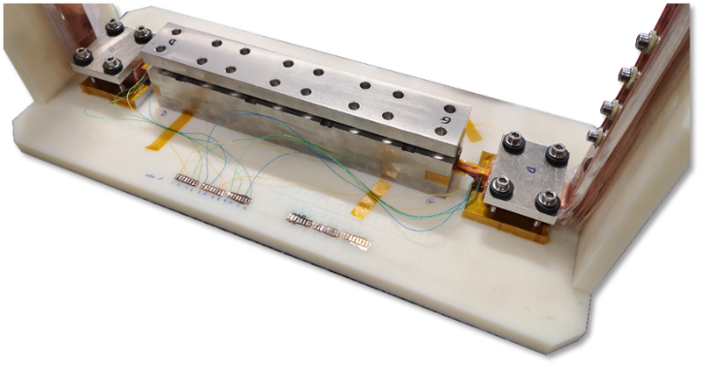
Contact resistance under compression
Courtesy of C. Genot
Goal : Measure the contact resistance on HTS tapes under variable compressive load
Context : HTS developement at CEA by C. Genot during his PhD thesis
Stress applied up to 100MPa on a stack of HTS REBCO tapes with the 300kN press at 77K with samples immersed inside a box filled with liquid nitrogen
HTS tapes connected to a current supply, with resistance calculated through voltage taps measurement positionned all along the straight sections
Photo of the setup
CAD setup for the 300kN press configuration

Slide 9
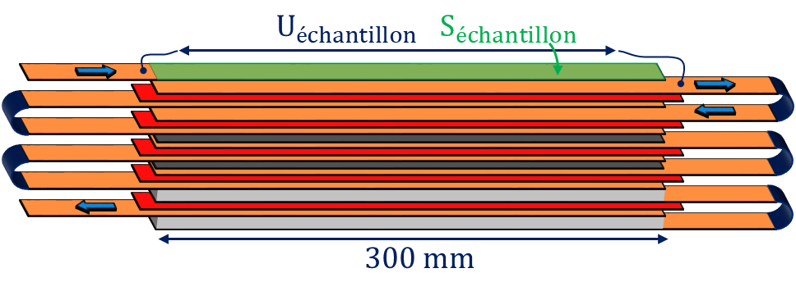
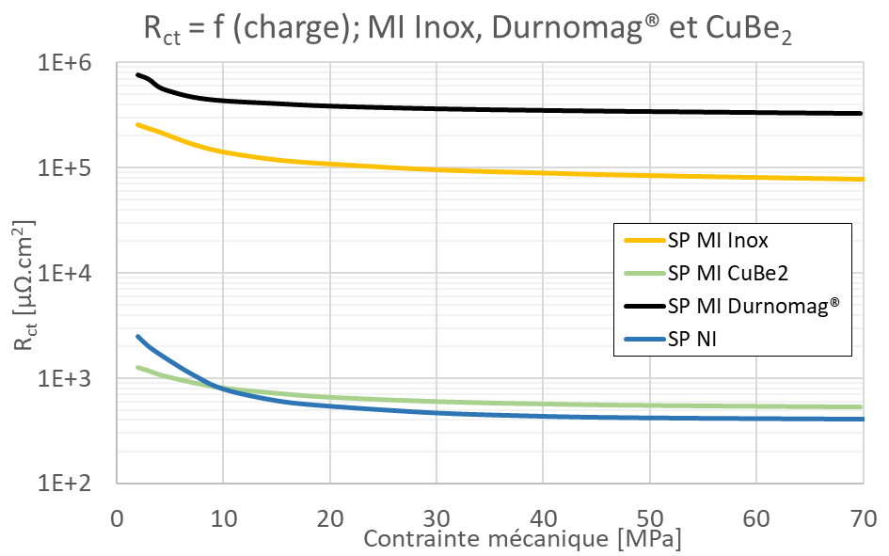
Contact resistance under compression
Courtesy of C. Genot
Results : Comparison of contact resistance results for differents HTS tape manufacturer, insulations configurations…
➔ Implementation of contact resistance values inside quench models (Critical parameter to master, particularly in MI configuration
Next steps : New test campaigns on larger tapes, with different insulation configurations…
HTS sample representation
HTS
Stainless steel
HTS
Photo of an HTS sample, made with confocal microscopy
Example of contact resistance measurement evolution depending on the stress applied, for differents stacking configurations

Slide 10
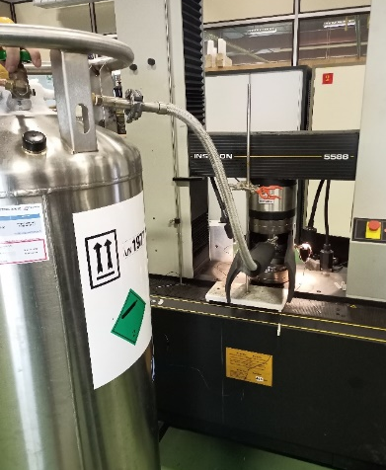
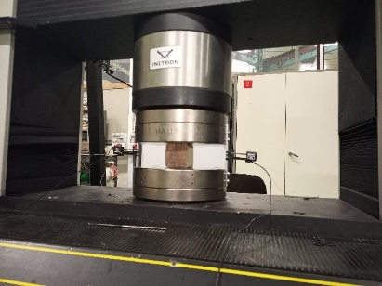
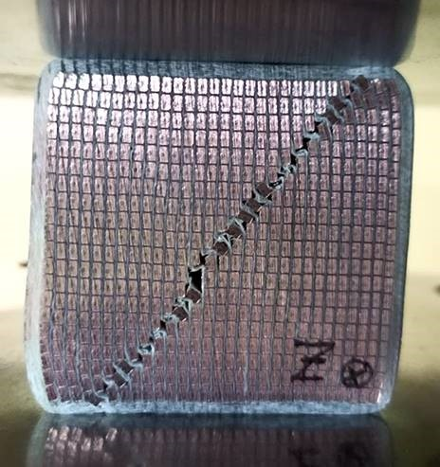
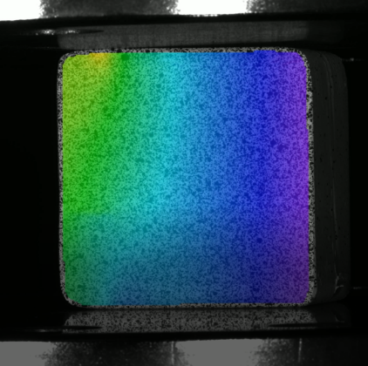
Mechanical characterization of NbTi WiC
Courtesy of H. Reymond
Goal : Study the mechanical behavior of a Wire-in-channel (WiC) NbTi coil representative sample under compression
Context : Design of SuperFRS NbTi dipoles and future similar magnets for GSI
Samples made of WiC NbTi conductor extracted from unused coils and characterized in compression up to failure in the 300kN press, at RT and 77 K
➔ FEA model of the cable rebuild from a photo and compared to the experimental results achieved by an external DIC company
Next steps : New representative samples to test and correlate with FEA model, home-made DIC measurement…
Setup of the compression test
Cooldown of the sample at 77 K in 300kN press
Example of sample compressed up to failure
Example of DIC results obtained

Slide 11
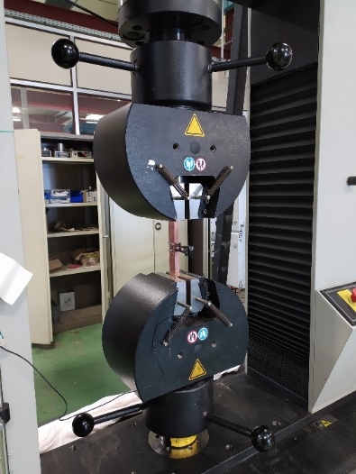
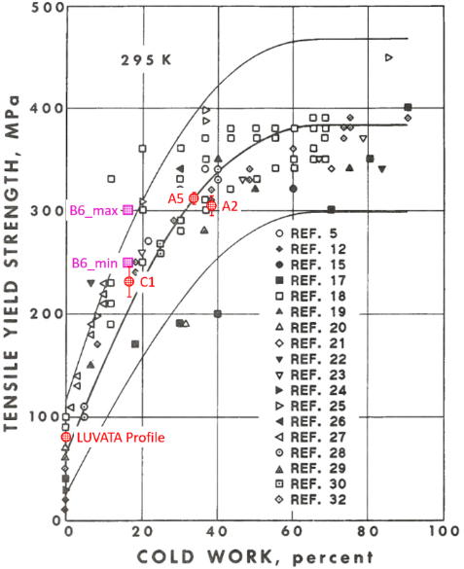
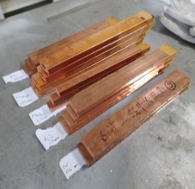
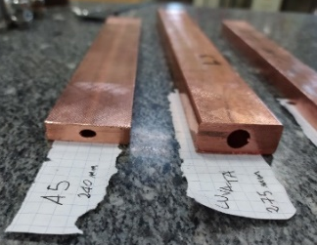
Tensile test on CICC copper jackets
Courtesy of F. Stacchi
Goal : Characterize the tensile yield strength of Cable-In-Conduit Conductor (CICC) copper jackets after differents cold work
Context : Design study of a NbTi dipole detector for Madmax project (Max Planck Institute)
Several copper jackets cold worked at different percentages, from 0 to 38%
Tensile test done in the 300 kN press with jaws and at RT. Displacement measured by one extensometer
➔ Tensile yield strength determine by standard ISO 6892 definition
Next steps : Characterization of other geometries and configurations for futures developements...
Setup of the experiment with the 300 kN press
CICC copper jackets (left) and cable (top)
Tensile yield strength results compared to NIST database

Slide 12
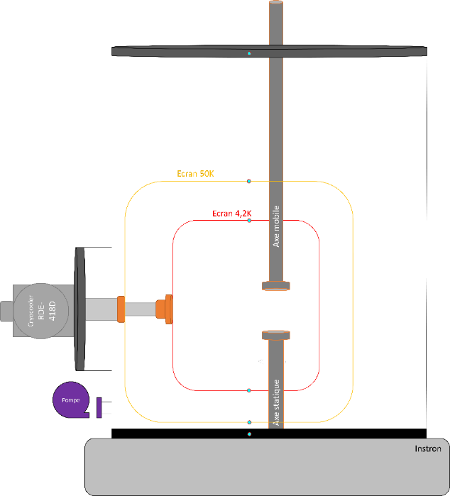
Variable low temperature test bench
Courtesy of C. Mayri and S. Roux
Goal : Mechanical measurements at variable cryogenic temperature up to 4.2K
Context : Infrastructure investment from ANR PACIFICS
Specific interest from academies and industries for Nb3Sn and HTS developement with intermediate temperature characterization, like liquid hydrogen (20K).
Cryostat to be installed on the actual 300kN press, with a cooldown managed by cryocoolers
Designed for tensile and compression tests at stable temperature, from 4.2K to 150K or more (in discussion)
CAO preliminary design
➔ Preliminary studies ongoing
Drawing of principle

Slide 13
Perspectives and conclusions
Larges spectrum of forces, dimensions and temperatures testable at the CEA/Irfu Mechanical Laboratory
Developement on more and more superconducting magnet projects, with specifities on each
Implementation of new tests capabilities and methods of measurement to respond to the need
Interest to share knowledges, experiences and capabilities between laboratories and industrials
Collaboration with a Paris-Saclay academic laboratory for a shared test facility able to characterize materials at high temperature with in-situ measurement systems

Slide 14
Any questions ?

