Slide 1
ALSYMEX Mechanical Engineering Complex Systems

Slide 2
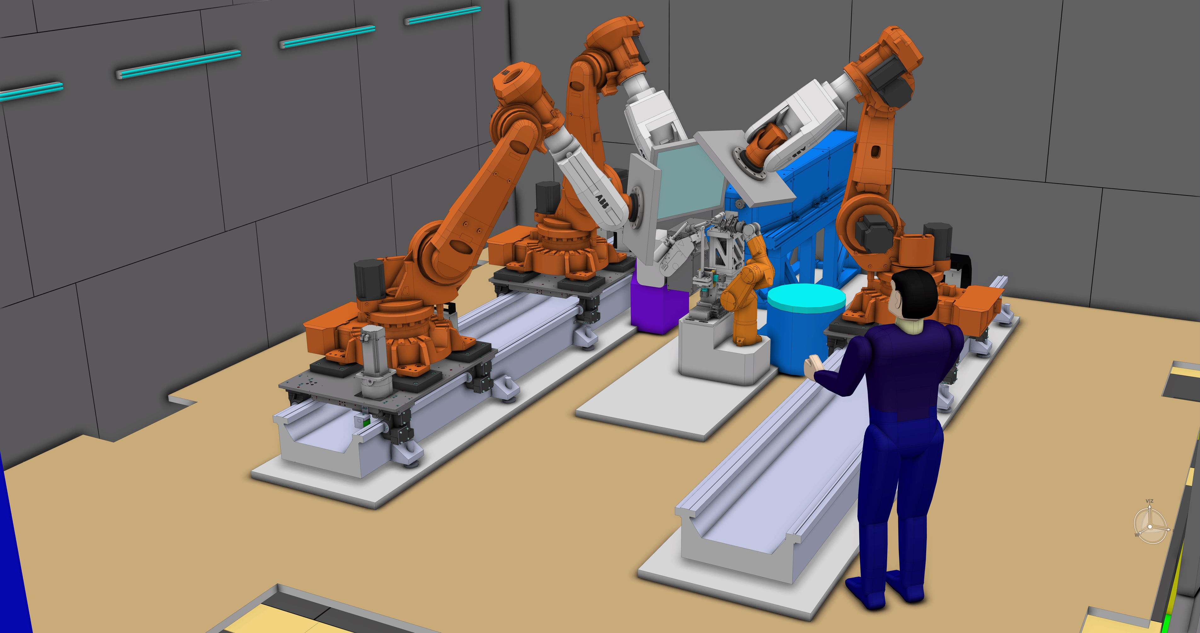
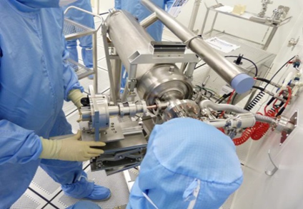
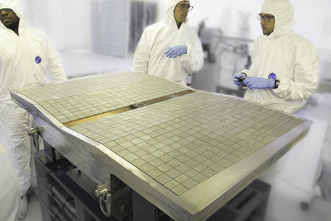
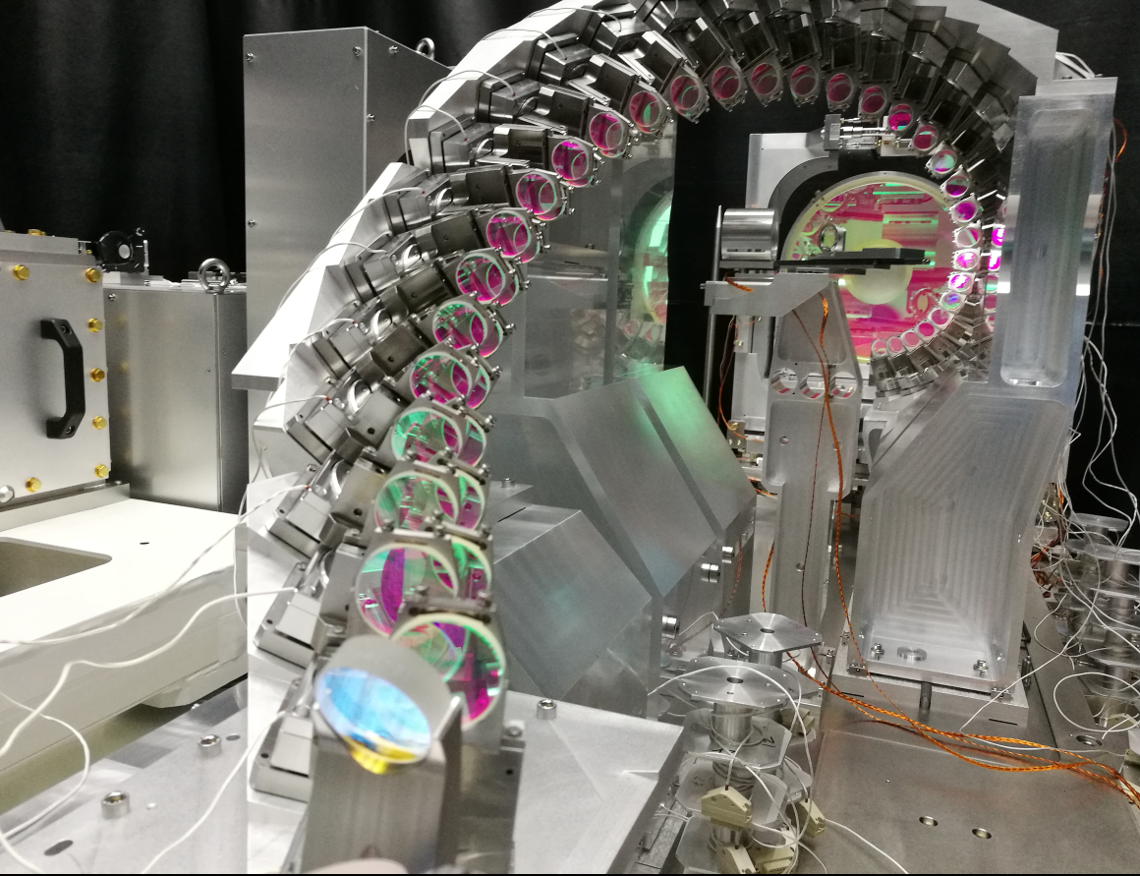
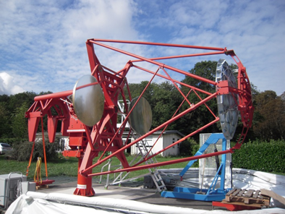
Assembly of the XFEL cryomodules
ITER first wall panel
CTA proto: mirrors & mechanical structures
ELI-NP Gamma beam source laser-electron interaction chamber

Slide 3
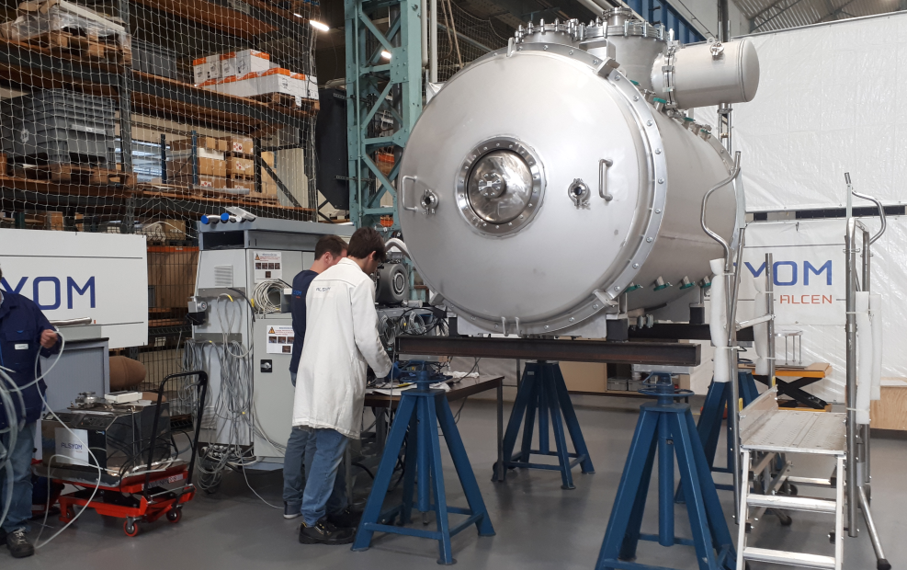
VACUUM: PARTICLE ACCELERATOR
ESS Spoke cryomodule vacuum vessel
Assembly of the XFEL cryomodules

Slide 4
DEVELOPMENT & OPPORTUNITY
UHV, Ultra Clean, Cryo
Stainless Steel, Titanium Alloys, Aluminum, …
Size & Geometries
Production Process: Machining, Welding, Assembly, Tests
Consistent & Stable Performance
Energy Saving
Data

Slide 5
CONTACT
JOEL VANDEN BOSCH
AUTOMATION and ROBOTICS Business Development
jvandenbosch@alsymex-alcen.com
+33 (0)7 63 13 05 90
https://www.alsymex-alcen.com/

