Slide 1
Eurolabs WP3 - presentation MACHAFILM lab
Yasmine Kalboussi, Claire Antoine, Stephane Berry, Thomas Proslier.
Ingénieurs Chercheurs – DRF/IRFU/DACM/LIDC2

Slide 2
DEPOSITION
CHARARACTERIZATION

Slide 3
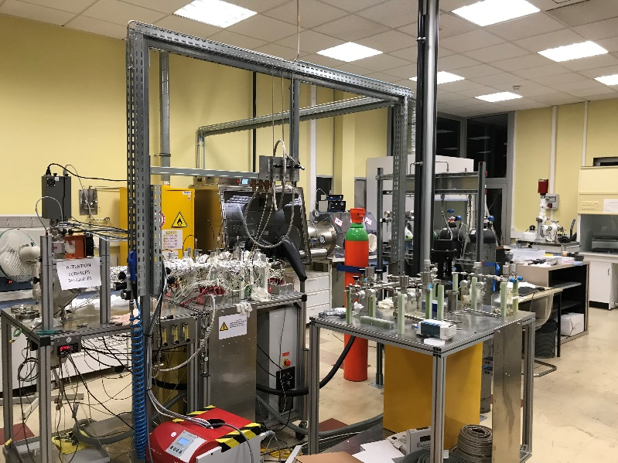
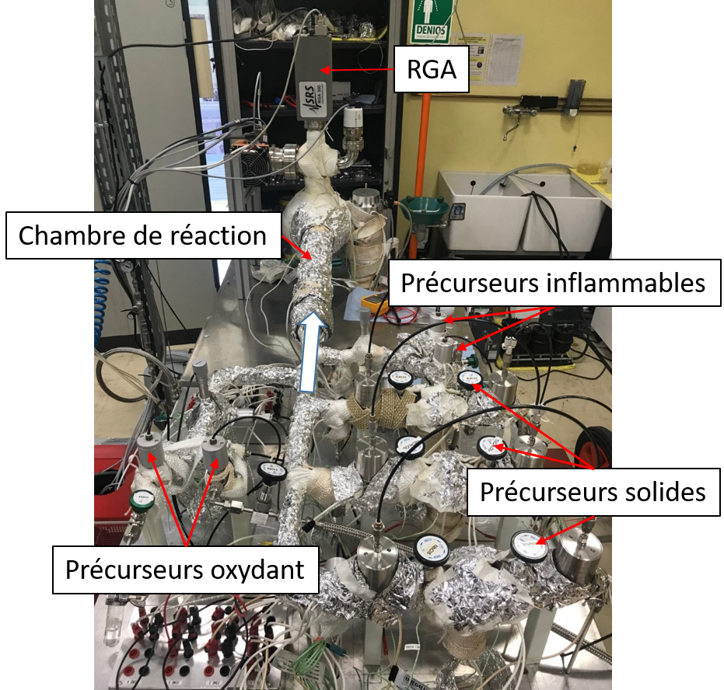
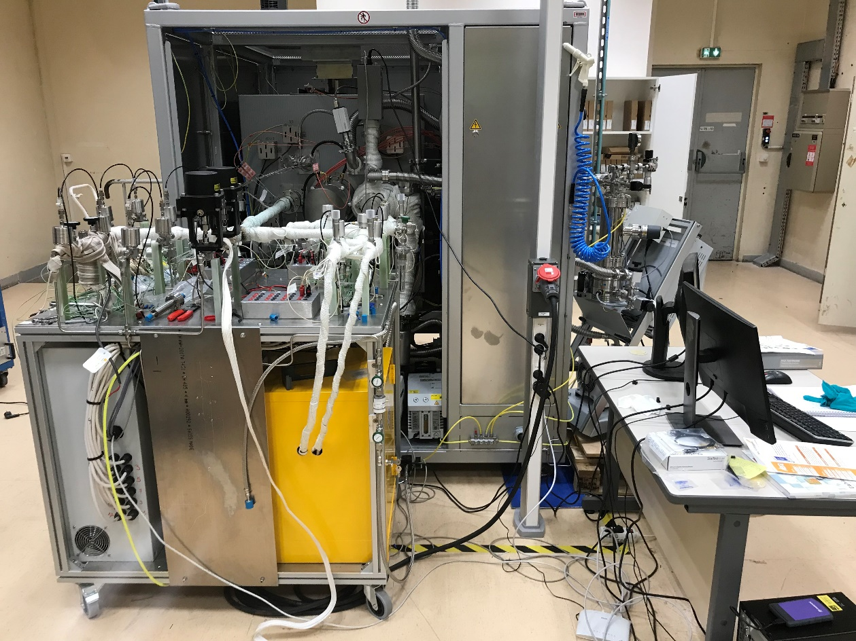
CEA – MACHAFILM: Atomic Layer Deposition
Research scale
Development scale
      Chamber/reactor ØxL: 5x50 cm.
      Temperature: 30-450°C
      7 precursor lines:
      3 solids, 2 liquids, 2 gases.
      Chamber adaptation possible (cavités, QPR)
      In situ: RGA, QCM.
      High vacuum oven ØxL: 50x110 cm.
      Temperature: 30-450°C
      8 precursor lines :
      4 solids, 2 liquids, 2 gases.
      Chamber adaptation (cavités, QPR).
      In situ: RGA.
Two ALD reactors:
  Research scale: small sample, test new chemistries and thin film deposition processes.
  Development scale: ALD on large objects.
  Futur HIPIMS (High Impulse magnetron sputtering) deposition system on samples and large objects.
    Research topics:
      Corrosion, Supraconductors (cavité, QuBits), multipacting (coupleurs, cavités…), filtration.
      Materials: nitrides, oxides, some metals.
Other: glove box under N₂, Sorbonne, 4 points measurement at RT, optical microscope, 3 zones tubular oven under gas (Ar, N₂, O₂, N₂-H₂) up to 1100°C.

Slide 4
DEPOSITION
CHARARACTERIZATION

Slide 5
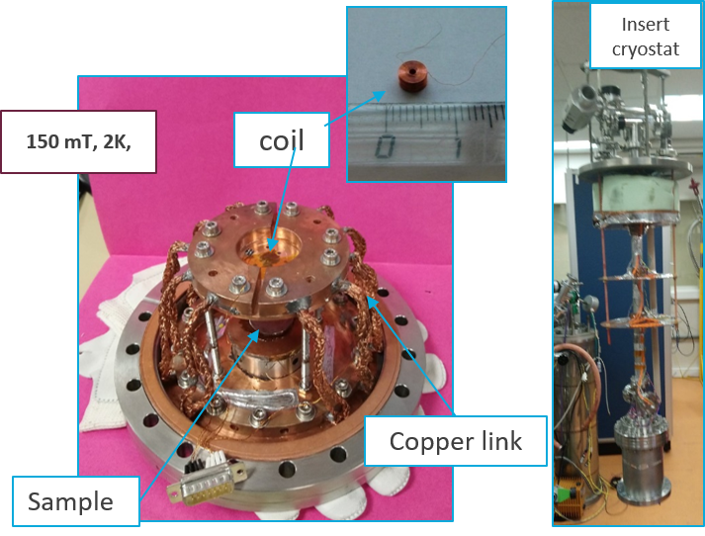
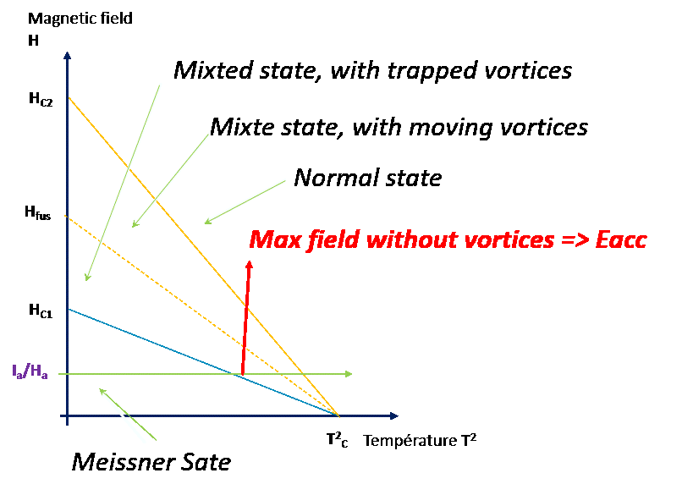
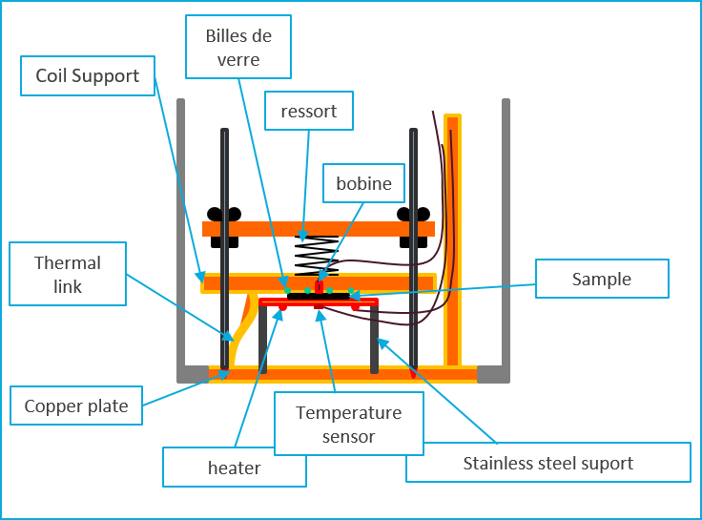
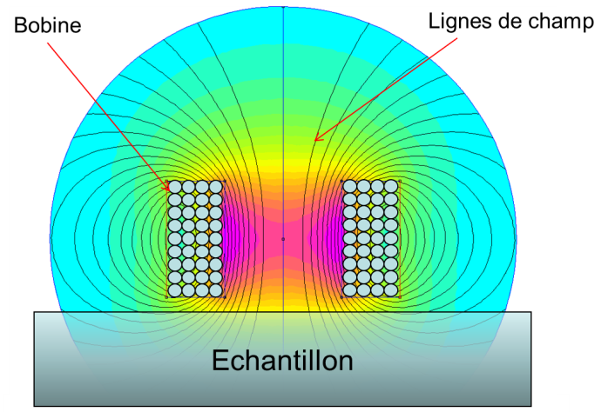
Magnetometry
Probe the magnetic field response of superconductors:
Measure of the superheating critical field: vortex penetration threshold
System features:
- Temperature: 4,2 K to 300 K
Sample size max: 5 cm diameter, thick ~ 1 cm
Max field: up to 120 mT

Slide 6
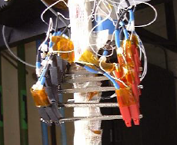


RRR : trivial but effective “purity” measurement
  Resistivity measurement between 4,2 K and 295 K for Nb, Cu, Al, Ti…..:
  Resistivity is proportional to impurity content if:
      Sample is well recrystallized
      Surface/volume is low
      When T→ 0
  Below RRR ~800: mostly sensitive to light impurities => thermal conductivity estimation
  Measurement of Tc for superconductors
V
I
ρ_{T} ~ ρ_{imp} + ρ_{latt}+ ρ_{s} + ρ_{ph} (T)
impurities
surfaces
phonons
lattice defects
RRR = ρ_{295K}/ρ_{0K} ~ R_{295K}/R_{0K}

Slide 7
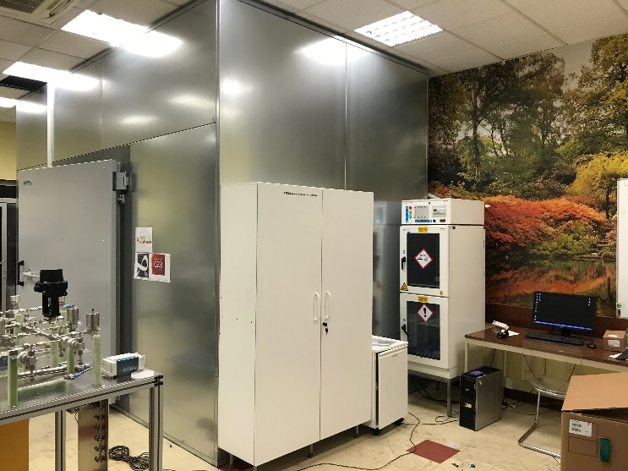
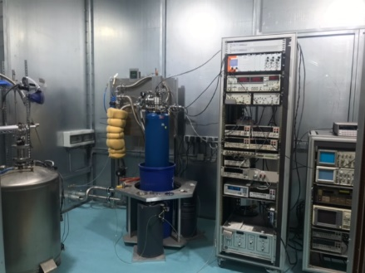
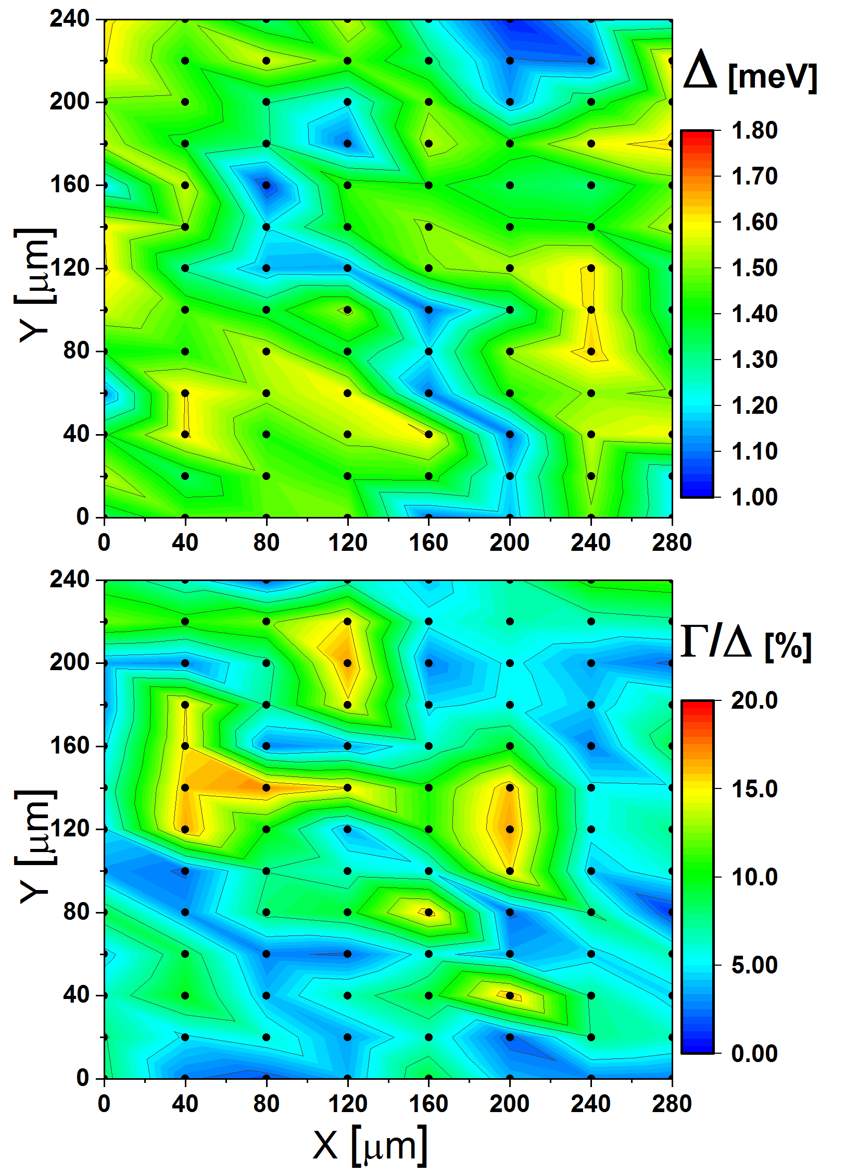
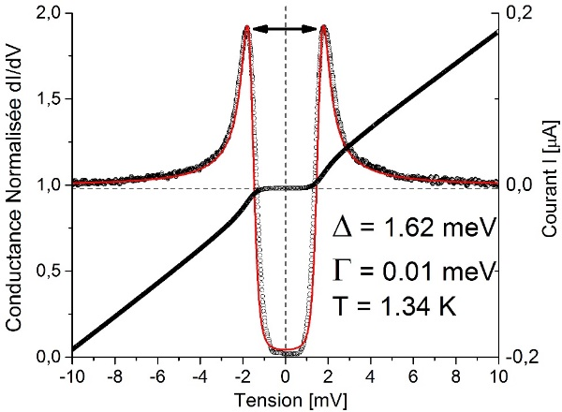
Tunneling spectroscopy
Mapping on a Nb sample
Measurement of surface electronic properties
Superconductors – measure of fundamental quantities : Δ, Tc, Hc
Temp: 1,4 – 300 K.
mapping: lateral size from 10 µm to 1 mm.
For materials under « real » conditions (air exposed native oxide)
Correlation spectroscopie – device performances.
Sample size : ~ 10x10x4 mm
Applications:
Fundamental studies of exotic superconductors
Accélérators: superconducting cavities
Qubits: dissipation phenomenom (TLS, inelastic scattering)
    Research topics:
      Superconducting resonnators (Qubits, cavities), thin superconducting films (ALD…)
Tunneling spectrum on Nb samples
2Δ

Slide 8
Collaborations
Thin film deposition:
Superconducting thin films for cavities:
Collaborations European network:
ARIES, IFAST: CEA, CERN, HZB, STFC, INFN.
Collaboration USA:
Jlab.
Collaboration France:
Région: Sésame AXESRF (CNRS/IJCLab-CEA)
P2IO: CATTISA (CNRS/IJCLab-CEA)
Multipacting – tuning surface SEY:
Collaboration ONERA.
anticorrosions and diffusion barriers:
Collaboration CEA/DES (anticorrosion filters)
Collaboration CEA/IRAMIS (nanotube growth)
Characterization - electronic properties
Superconducting resonnators (films and bulk supraconductors):
Collaborations European network :
IFAST: CEA, CERN, STFC, INFN.
Collaboration USA:
Jlab, Illinois Institut of Technology.
Collaboration France:
Région: Sésame AXESRF (CNRS/IJCLab-CEA)
Quantum bits(thin supraconducting films - surface dissipation) :
Collaboration CEA/IRAMIS/SPEC.
Collaboration USA:
Rigetti, Fermilab, Illinois Institut of Technology.
Ultra-thin supraconducting films and exotic superconductors (fondamentale/détecteurs):
Collaboration USA:
Illinois Institut of Technology.

