Slide 1
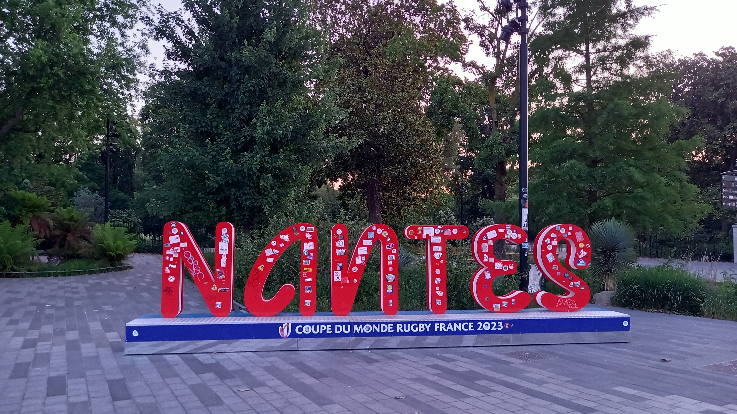
Liquid Xenon Electromagnetic Calorimeters of MEG and Pioneer
Satoshi MIHARA
KEK, Japan

Slide 2
LXe Calorimetry
Intermediate Energy 10-100MeV photon and electron
No (extremely) special care of radioactivity from ingredient material
Detectors
  MEG Liquid Xenon Detector, PMT R&D and SiPM, more details in MEG presentation by Lukas
    Why no segmentation?
    Why LXe? = Why not crystal?
    Why PMT readout on all surface (later SiPM on the front )?
  Pioneer Liquid Xenon Detector, electron measurement, more details in Pioneer presentation by Chloé
    Lessons from MEG LXe detector
    Why LXe? = Why not crystal?
    Electron energy loss at the entrance window material
    Technology improvement
      We need further R&D and proof of principle though

Slide 3
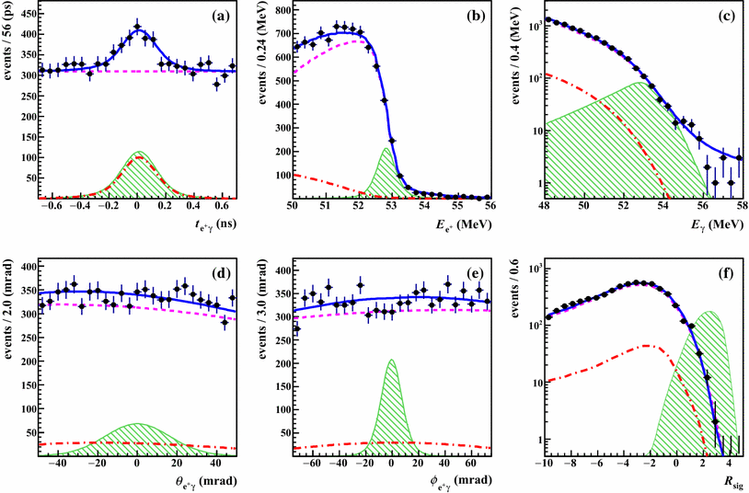
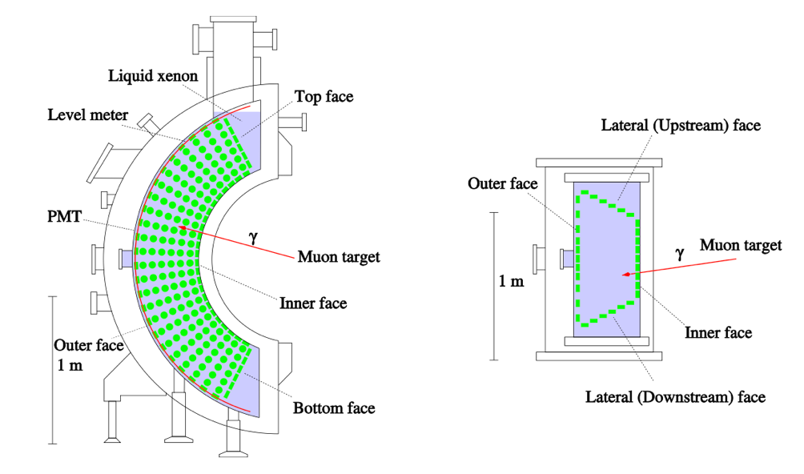
MEG & MEG II
γ
52.8MeV
μ
180º
e
Detection of 52.8MeV gamma-ray with (sufficiently) good, energy, position, time resolutions
Pile-up detection in time and space
https://doi.org/10.1140/epjc/s10052-016-4271-x

Slide 4
Why no segmentation?
Sufficient depth (> 15 X₀ ) necessary to contain most of deposit energy
Better for rate capability if segmented
No segmentation
12bit x 1024 x 900 inputs
<<
Segmentation
12bit x 1024 x ~10 inputs

Slide 5
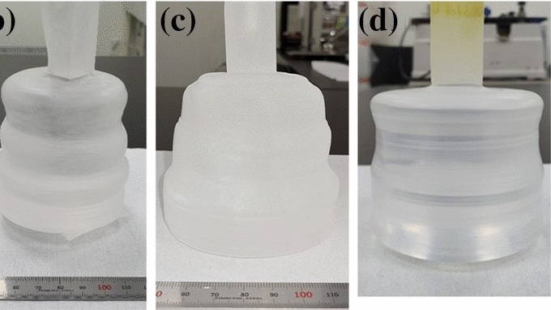
Crystal Uniformity
The best uniform and large enough scintillation crystal is NaI
  Largest size ever build?
  To cover 1m x 1m x 15 X₀ depth, we need segmentation anyway.
Segmentation provides nonuniformity
  Reflection at the boundary
  Energy loss in boundary material…
COSINE-200 NaI(Tl)
https://doi.org/10.1140/epjc/s10052-020-8386-8

Slide 6
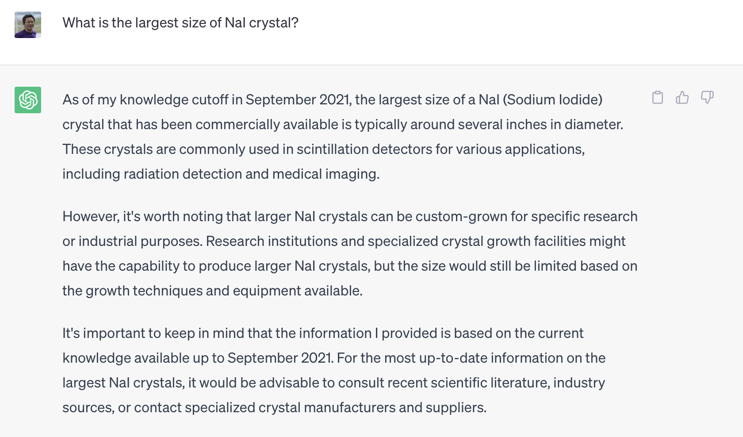
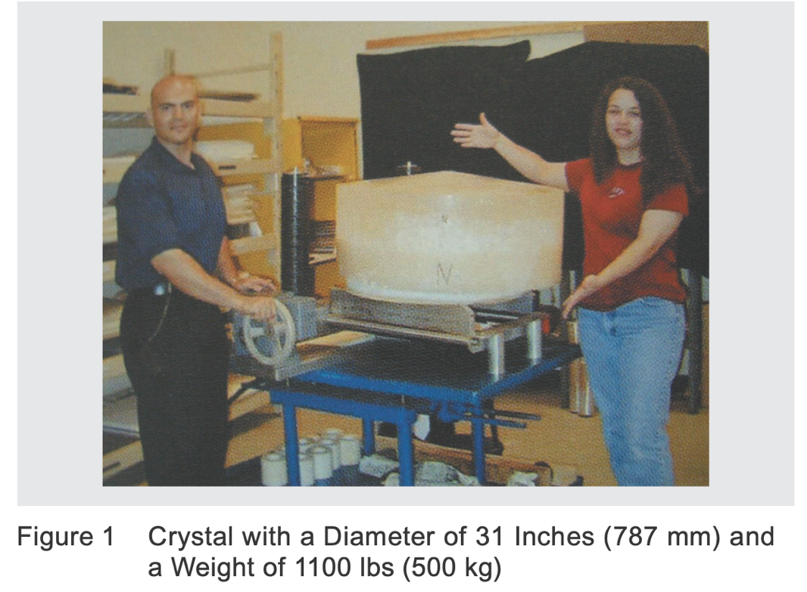
Horiba technical report
https://www.horiba.com/uploads/media/RE09-18-098_03.pdf

Slide 7
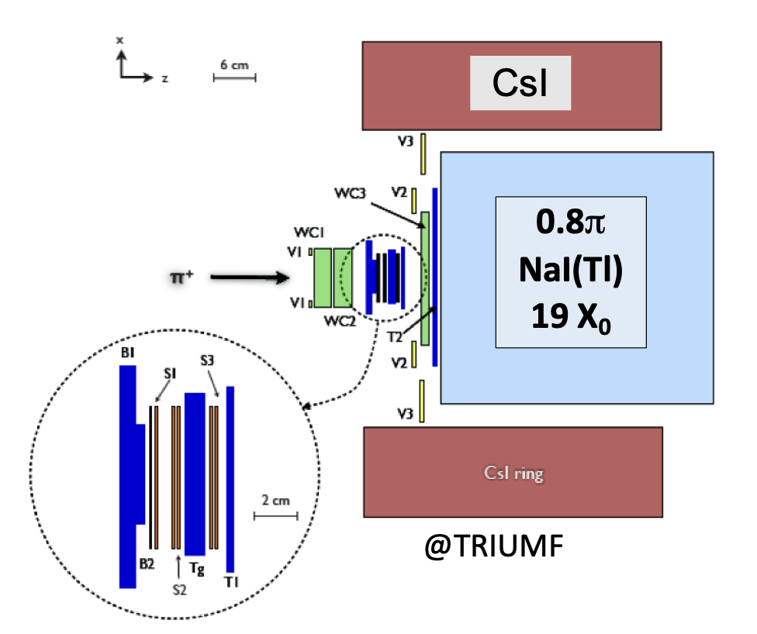
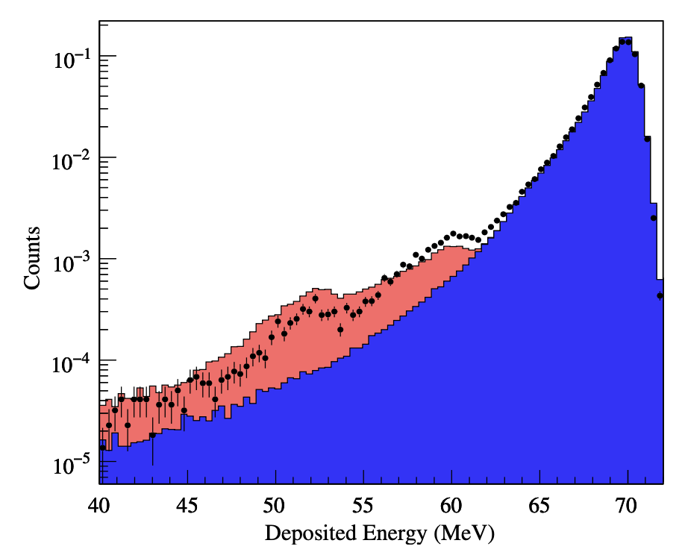
NaI(Tl) Detector
PIENU detector to measure π→eν
48cm diam. x 48 cm depth
19 X₀
~2.2% in FWHM
→ LXe Calorimeter for MEG

Slide 8
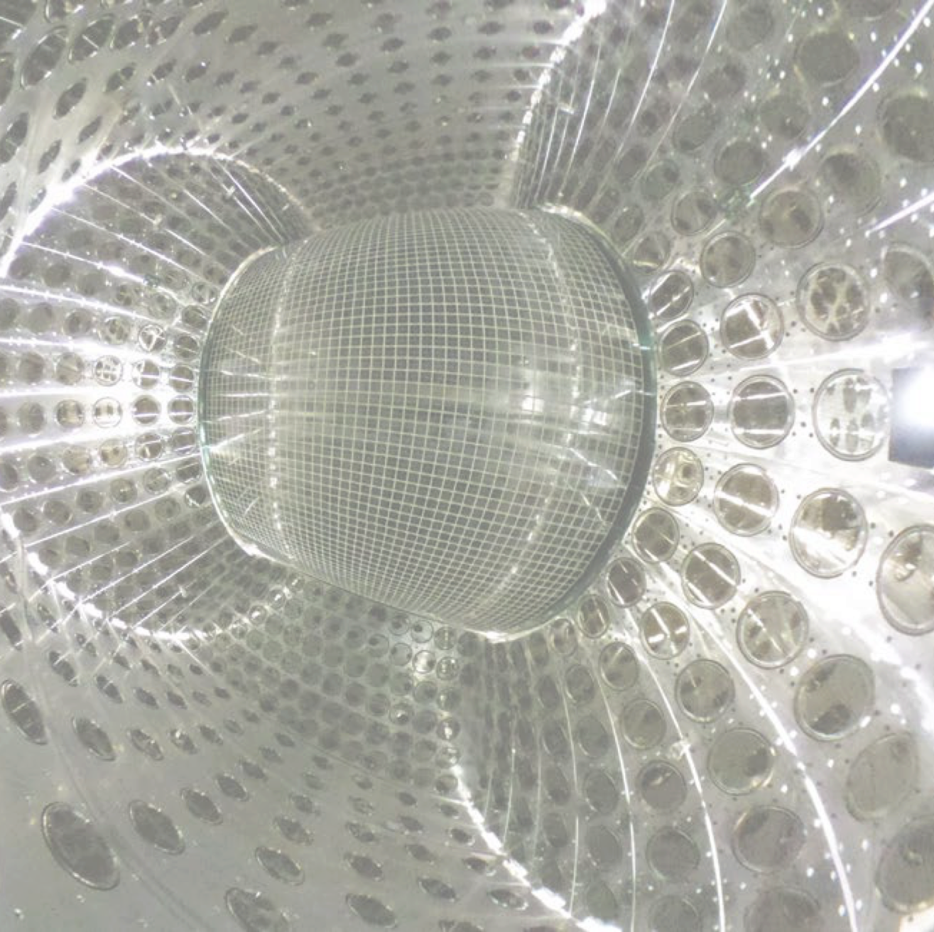
MEG LXe Detector R&D Issues
Photosensor
  Radioactivity control for the purpose of very low energy measurement (WIMP DM)
Impurity removal
Pulse-tube refrigerator optimized to liquefy and cool xenon
Front window with a thin steel sheet backed up by an aluminum honeycomb sandwiched in carbon fiber plates
Xenon storage
  High pressure tanks
  Low pressure – liquid phase tank

Slide 9
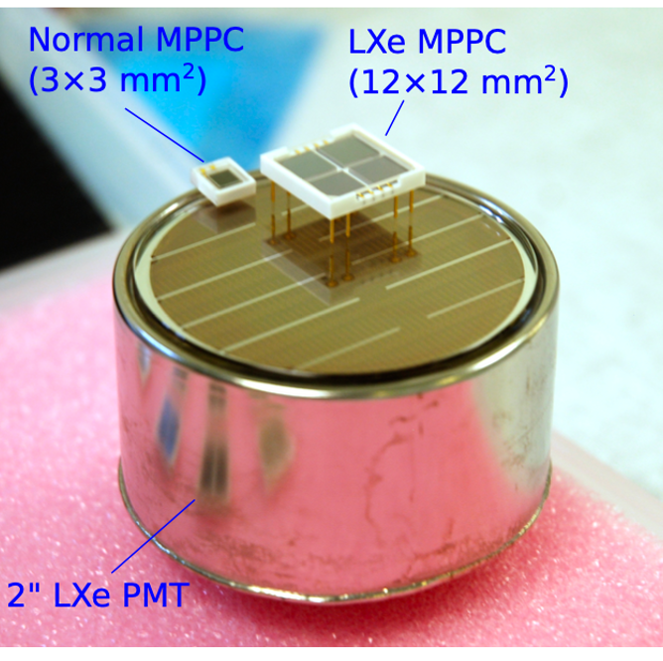
LXe Calorimetry Ingredient Technology
Normal
(3 x
Photosensor R&D
  High QE (PDE), less material, low heat dissipation
  Low heat dissipation ↔ rate capability (PMT)
SiPM?
  Much less material budget than that of PMT
    PMT dynodes made of steel
  Tremendous efforts by MEG II and Hamamatsu
  PDE for UV light and radiation hardness
  Details in MEG II presentation by Lukas

Slide 10
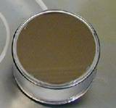
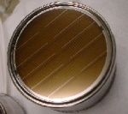
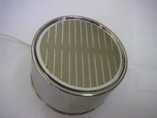
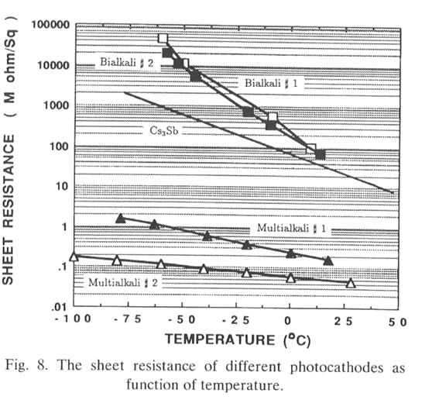
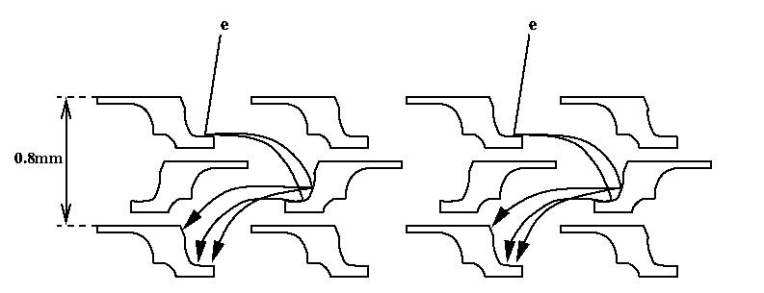
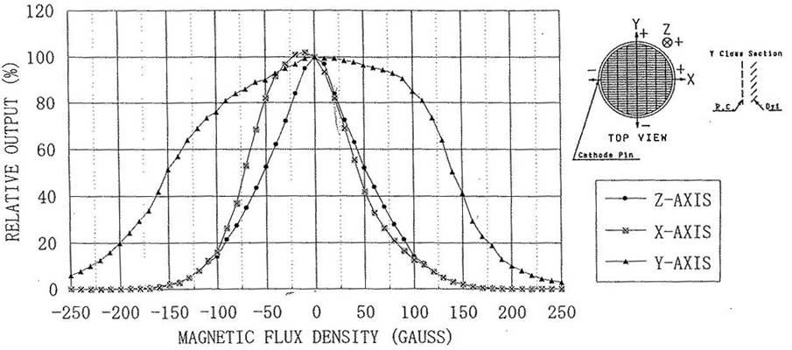
MEG PMT R&D
1st generation R6041Q | 2nd generation R9288TB | 3rd generation R9869
228 in the LP (2003 CEX and TERAS) 127 in the LP (2004 CEX) | 111 In the LP (2004 CEX) | Used in the final detector
Rb-Sc-Sb Mn layer to keep surface resistance at low temp. | K-Sc-Sb Al strip to fit with the dynode pattern to keep surface resistance at low temp. | K-Sc-Sb Al strip density is doubled. 4% loss of the effective area.
1st compact version QE~4-6% Under high rate background, PMT output reduced by 10 -20% with a time constant of order of 10min. | Higher QE ~12-14% Good performance in high rate BG Still slight reduction of output in very high BG | Higher QE~12-14% Much better performance in very high BG

Slide 11
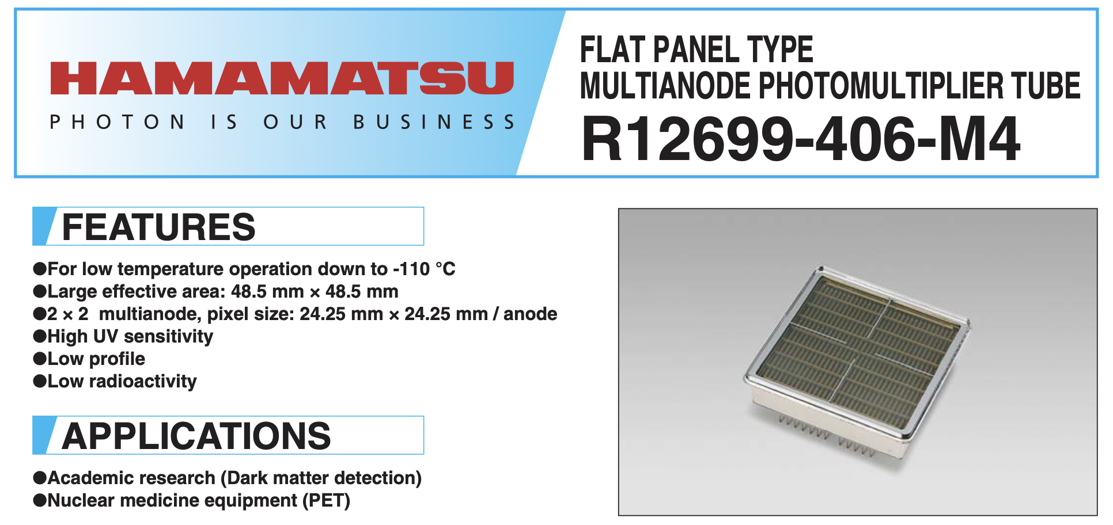
4th Generation (not used in MEG but you can buy from Hamamatsu)

Slide 12
MEG LXe detector
Lessons from NA48 Kr calorimeter (cryostat design), BINP LKr calorimeter (LXe handling) …
  Prof. Doke of Waseda U experience
No segmentation, scintillation photon readout by photosensors immersed in LXe
Impurity removal technologies
  Wash the detector with LXe !

Slide 13
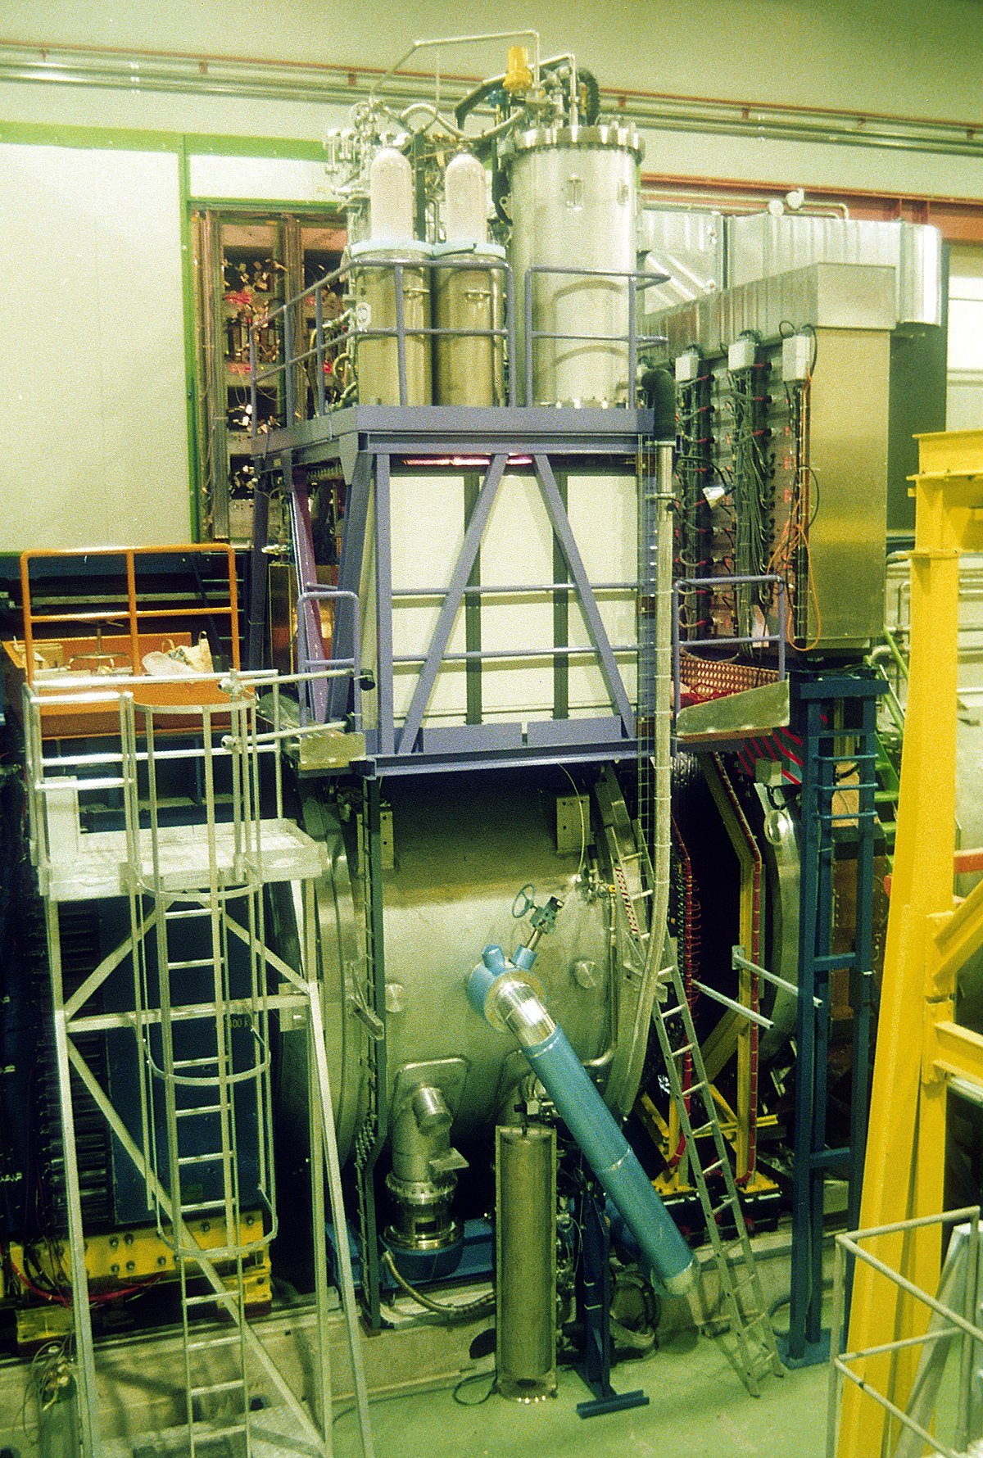
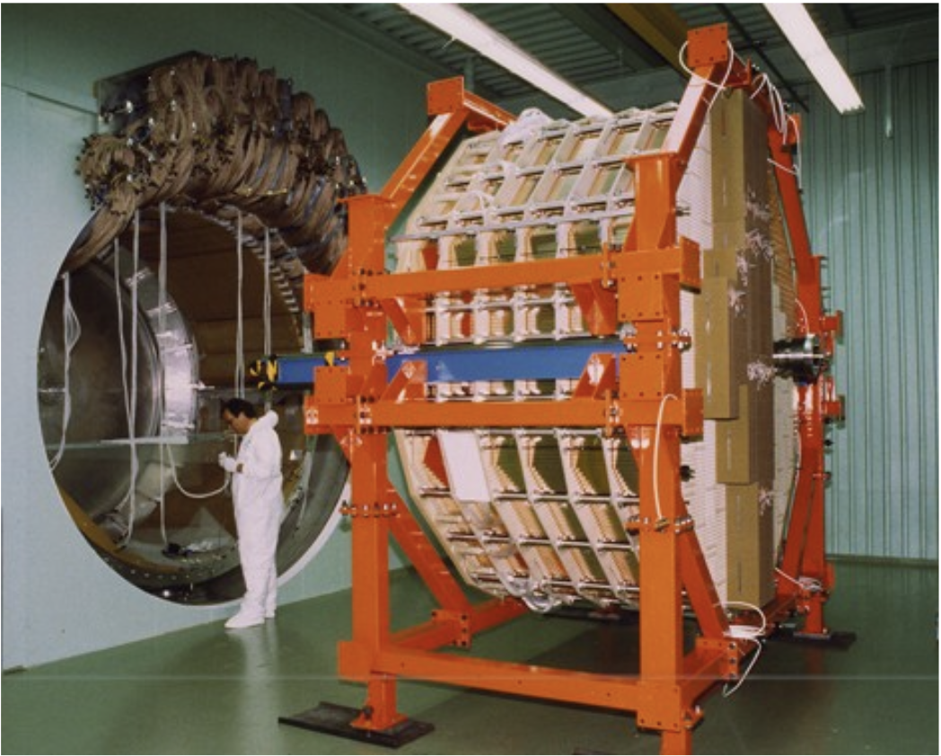
NA48 Kr Calorimeter
M. Jeitler
RECFA meeting

Slide 14
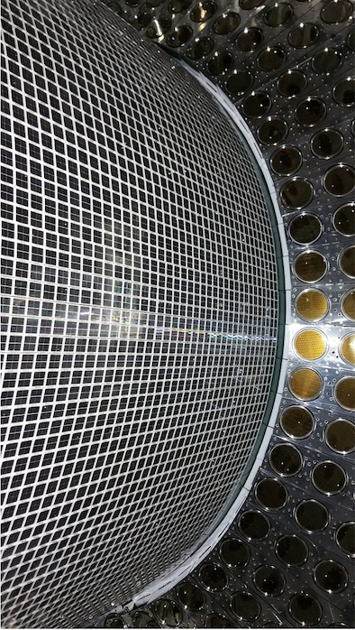
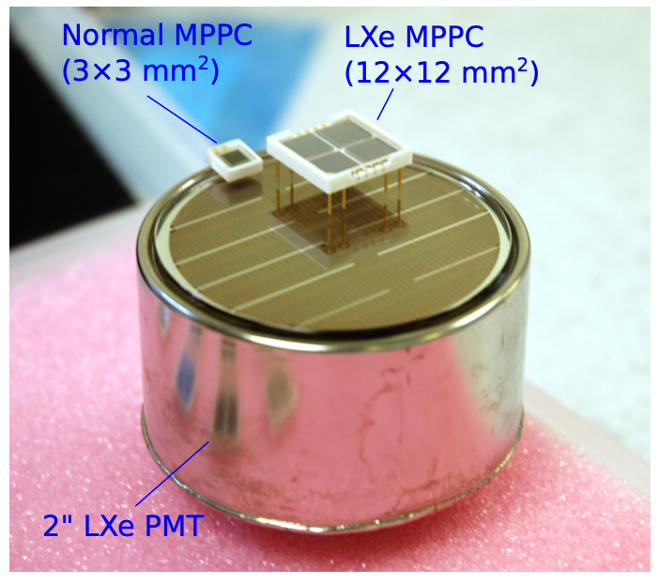
SiPM for MEG II
Details in MEG presentation by Lukas

Slide 15
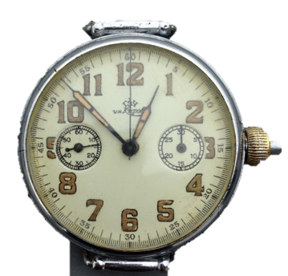
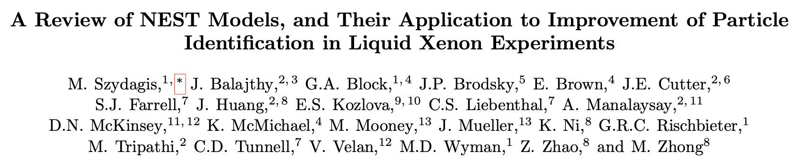
Time flies …
Very precise understanding of microscopic interactions in liquid xenon and scintillation/ionization yield, NEST model
New technologies developed after MEG LXe detector was built
  Cooling, heat exchanger, purification system. Details are in this meeting
  … and a thin Be window for low temperature use and/or a thin window with 3D printing/superplastic forming
    Active target to measure electron tracks right before they enter the calorimeter
arXiv:2211.10726v2

Slide 16

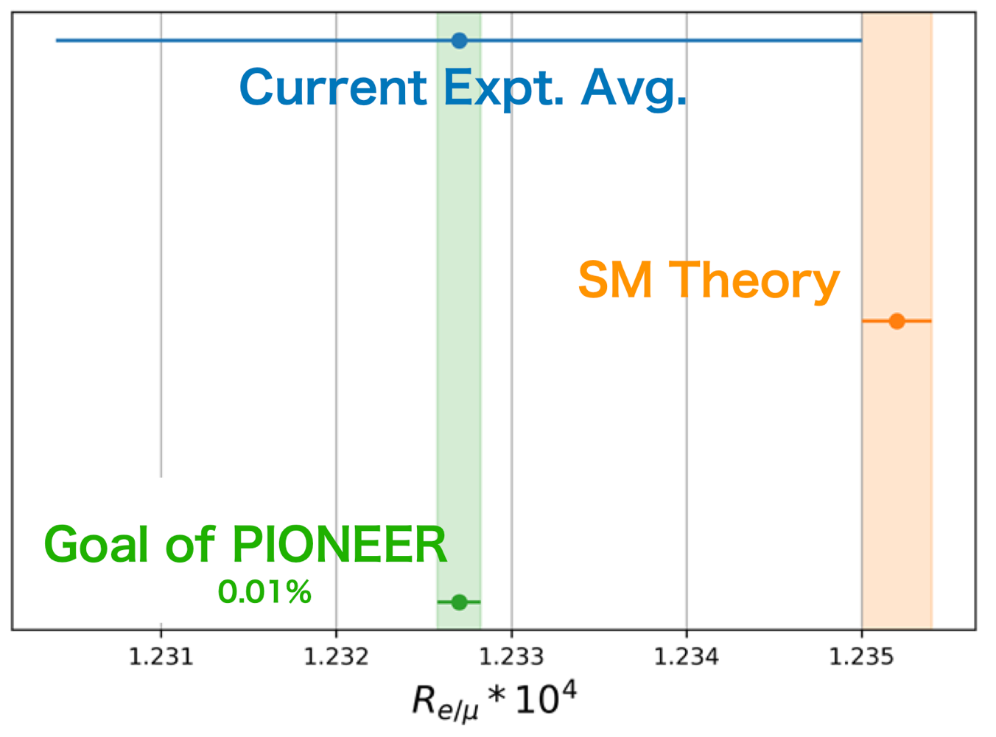
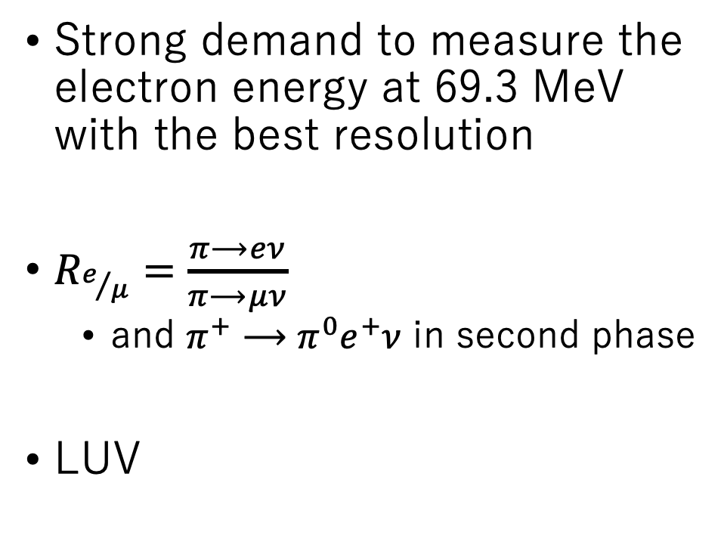
PIONEER
Strong demand to measure the electron energy at 69.3 MeV with the best resolution
$R_{e/μ}=\frac{π⟶eν}{π⟶μν}$
  and $π^{+}⟶π^{0}e^{+}ν$ in second phase
LUV

Slide 17

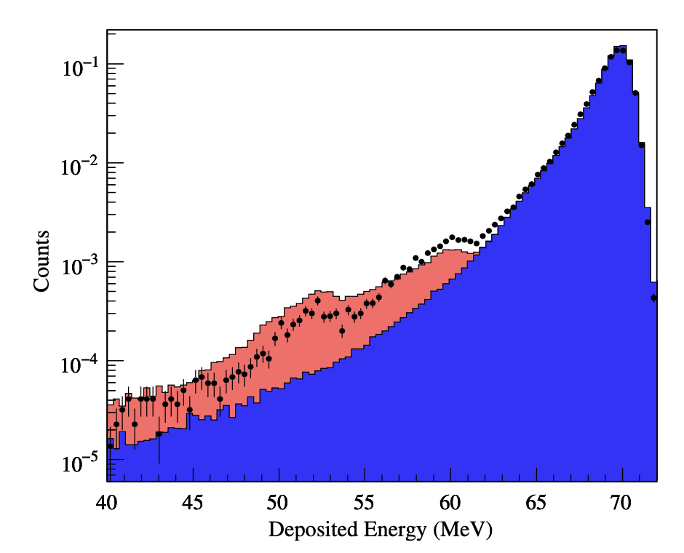
PIONEER electron measurement
Photonuclear reactions in NaI detector

Slide 18
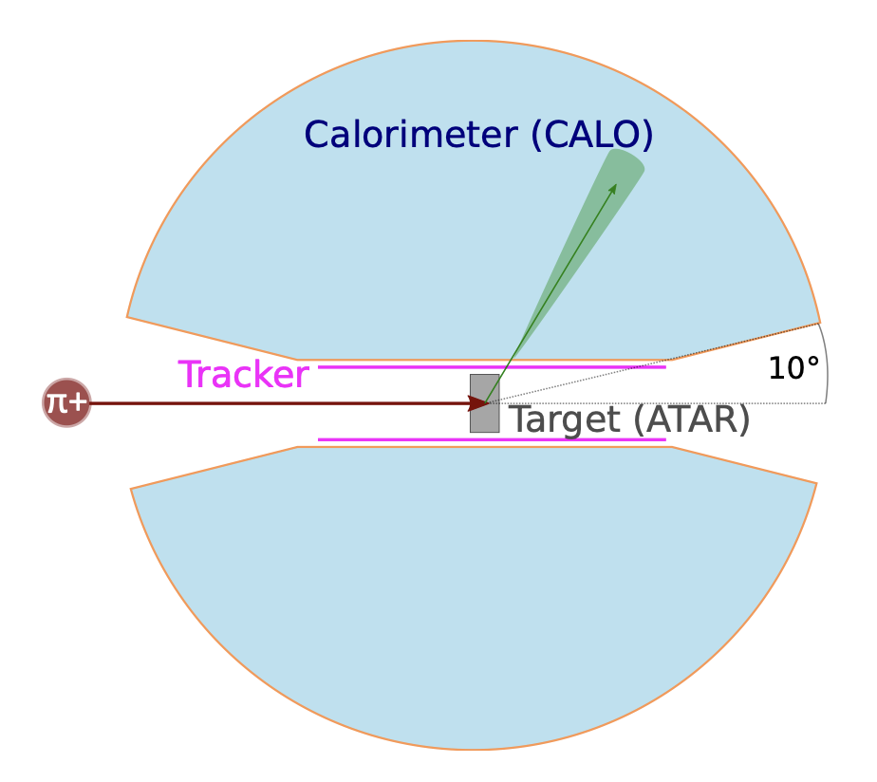
PIONEER Calorimeter Detector Concept
Deep enough (25 X₀) to fully contain energy
Large coverage (3π) surrounding the target
Active target & tracker right in front of the calorimeter
Segmentation ?
LYSO + CsI option is also studied
25X₀

Slide 19
Photosensors on the inner surface ?
Reflective material coatings on the inner surface
Or
Installation of SiPMs on the inner surface
Electron
ATAR and tracker
(not in scale)
3π coverage
25 X₀
PMTs on the outer surface

Slide 20
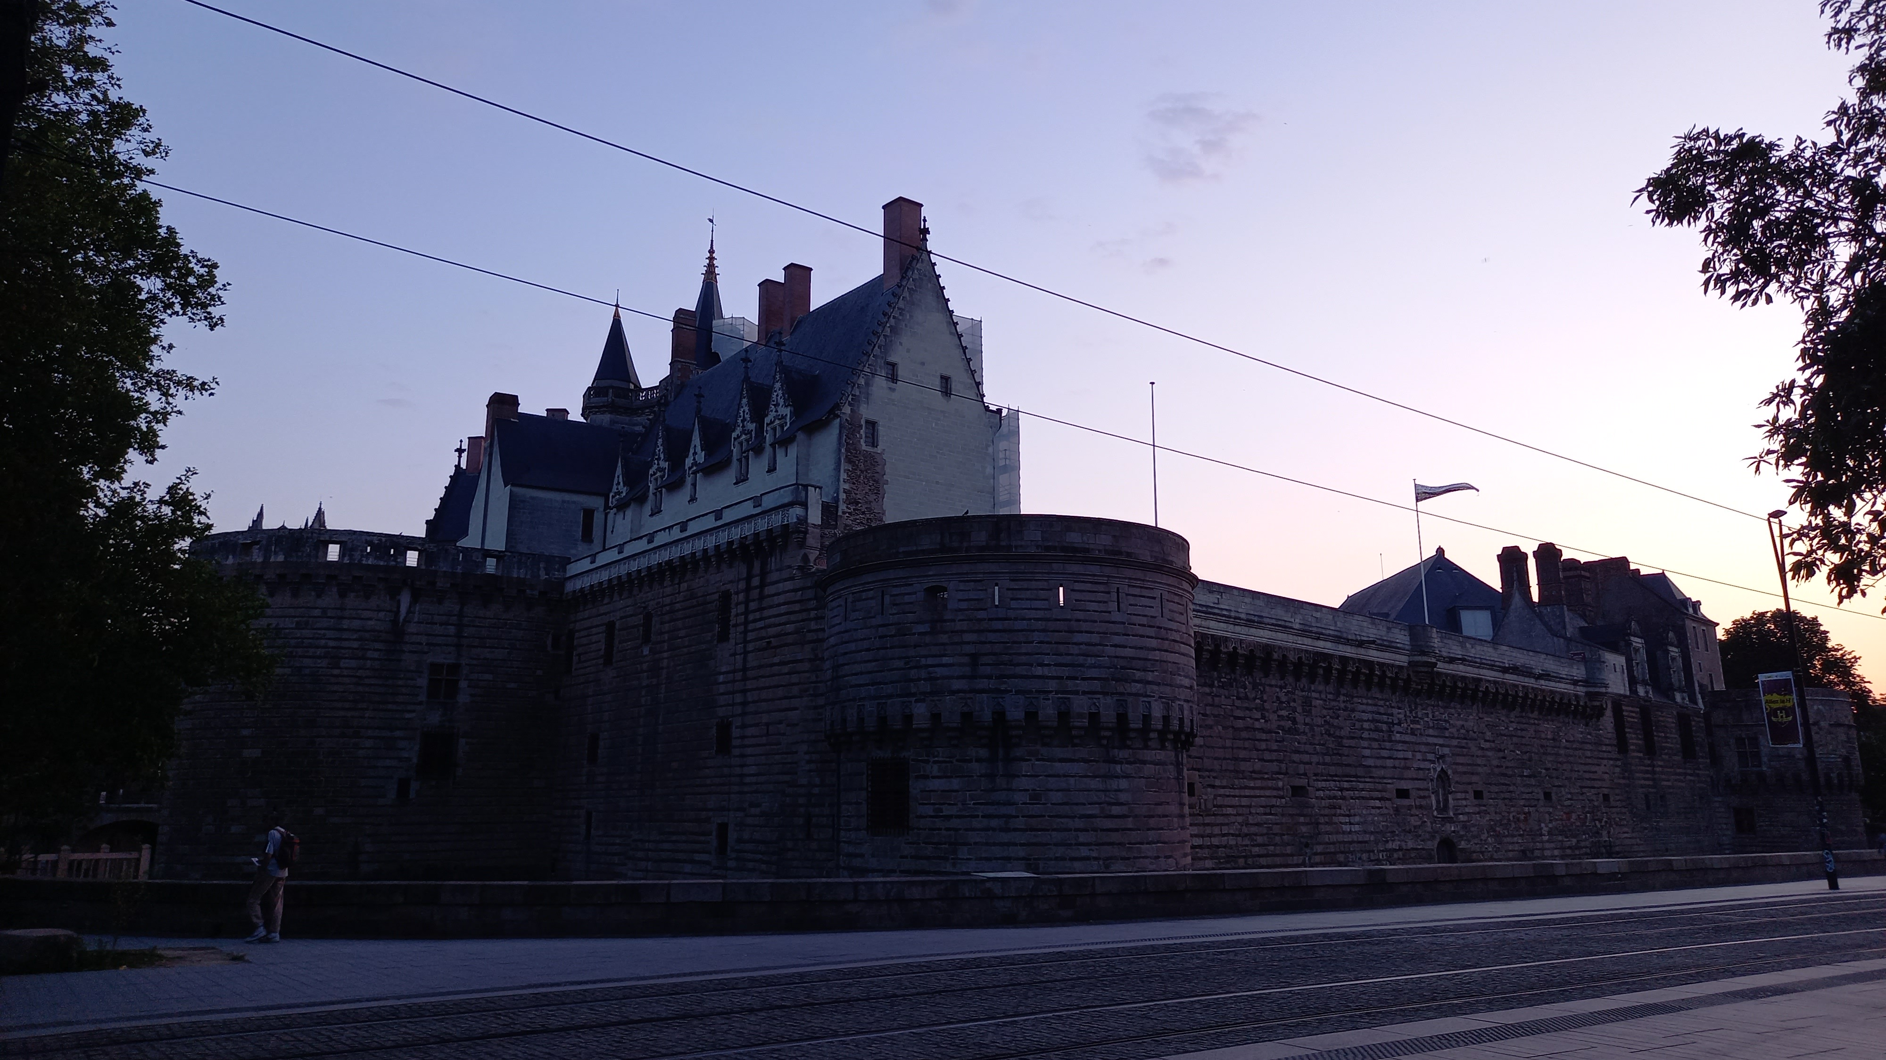
Summary
Successful operation of LXe in MEG and MEG II
  Thanks to many people in this room for your supports/suggestions/advices
Application of LXe calorimetry to measuring electrons ~70MeV
  Most of technologies developed in MEG can be applied with modern upgrade
  Window (and photosensors on it if necessary) is a key (my personal view)
  More precise understanding of the tail component

