Slide 1
The CMS team at IPHC - Strasbourg
Top LHC France – May 2023

Slide 2
Welcome from the Director Sandrine Courtin

Slide 3
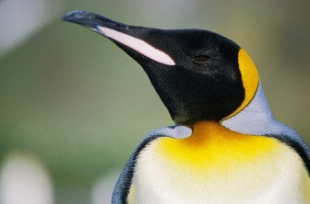
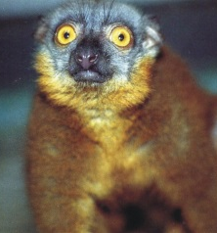
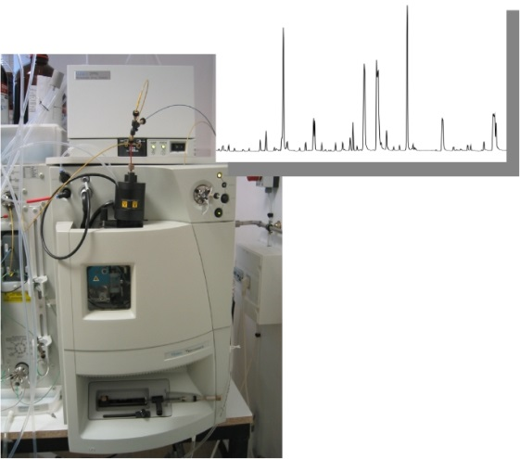
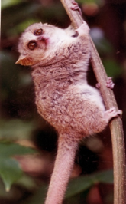
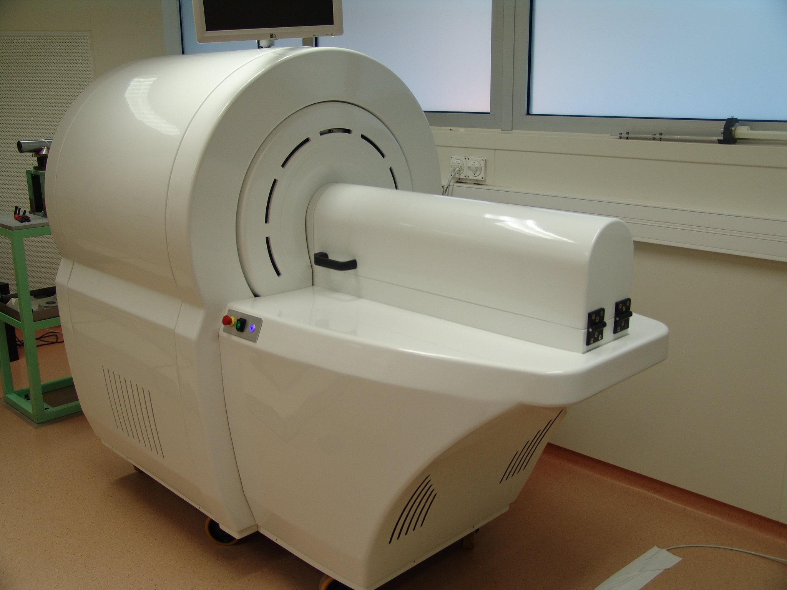
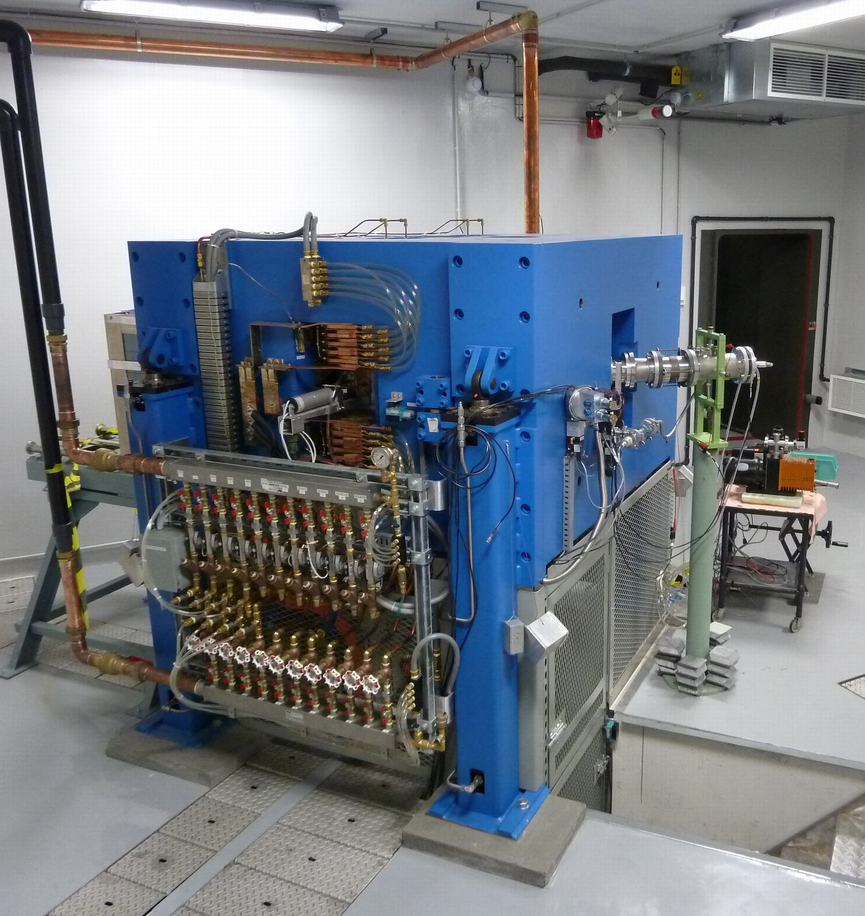
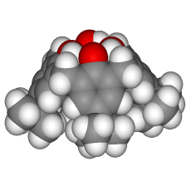
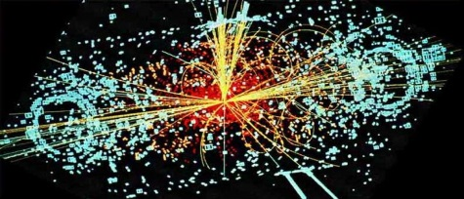
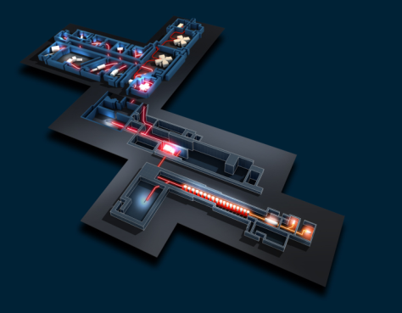
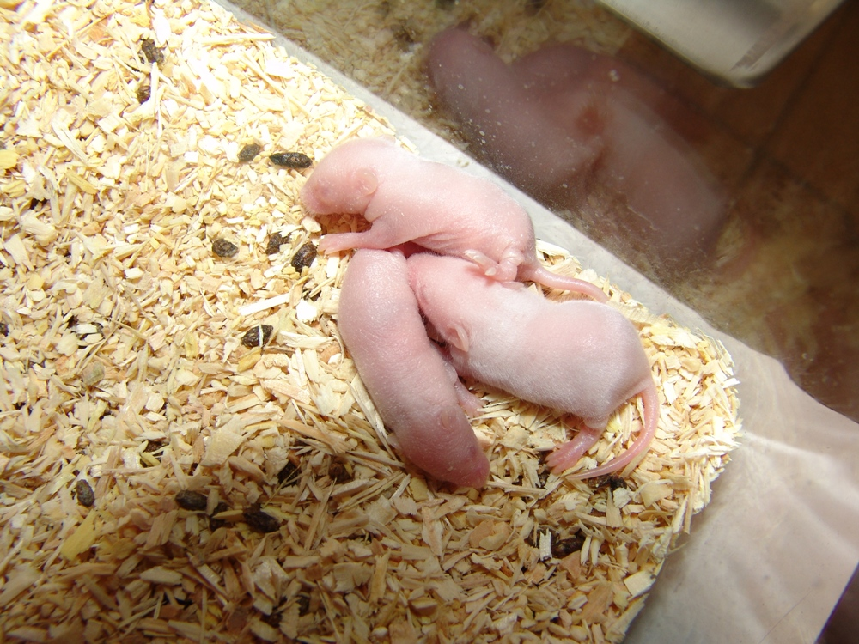
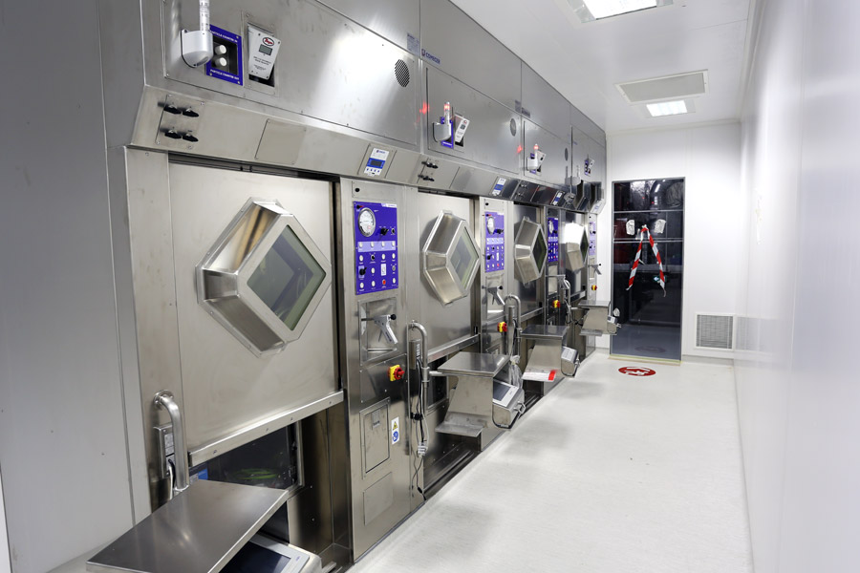
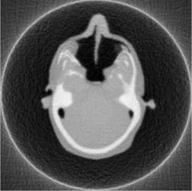
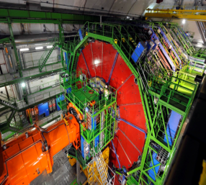
The Institut Pluridisciplinaire Hubert Curien (IPHC)
Comes from the fusion of 3 laboratories in 2006,
Attached to the CNRS (in2p3) and the University of Strasbourg.
Department of Ecology, Physiology and Ethology
Réponse de l’animal aux changements environnementaux
Les animaux comme indicateurs de changements de climats
Mécanismes d’adaptation animale
Department of Analitical Sciences
Department of Radiobiology, Hadron therapy, and Nuclear Imaging
Spectro de masse BioOrganique
Chimie Analytique
Reconnaissance moléculaire et processus de séparation
Ingénierie moléculaire et analyse
Department of Subatomic Researches
From Nucleus to Stars : exotic structures, fusion, nucleosynthesis, super-heavy
From Big-Bang to particles : ALICE, BELLE II, CMS, PICSEL (CMOS)
Energy, environment and dosimetry : nuclear data for reactors, radiochemistry, dosimetry.
Theory : low and high energy, phenomenology.
Master 2 : in subatomic physics : ~20 students per year.
BIOLOGIE
Cyclotron
CHIMIE
PHYSIQUE / BIOLOGIE / CHIMIE / MEDECINE
PHYSIQUE
Head of Department : Jeremy Andrea

Slide 4
IPHC buildings

Slide 5
IPHC in numbers (2022)
406 members
258 permanents
138 Engineers and technicians,
59 full time researchers (CNRS),
61 junior and senior professors (University)
148 non-permanents
106 PhD students
25 Engineers and technicians,
17 postdocs.
More than 200 internships per year.
DRS is about half of the IPHC
Strong technical services :
Mechanical workshop and design office,
Computing, with a grid T2/T3,
Electronic services : software/firmware.
Micro-Electronic, Micro-technic with strong expertise in tracking sensors (monolithic),
Cyclotron and test beam experiments.

Slide 6
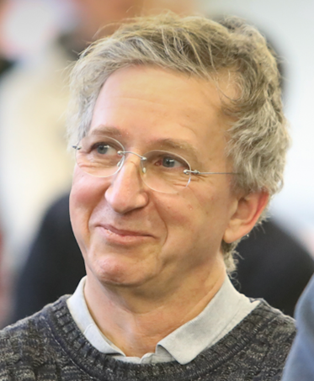
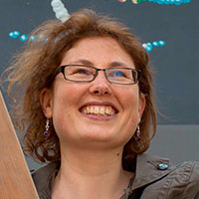
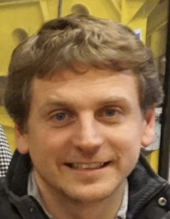
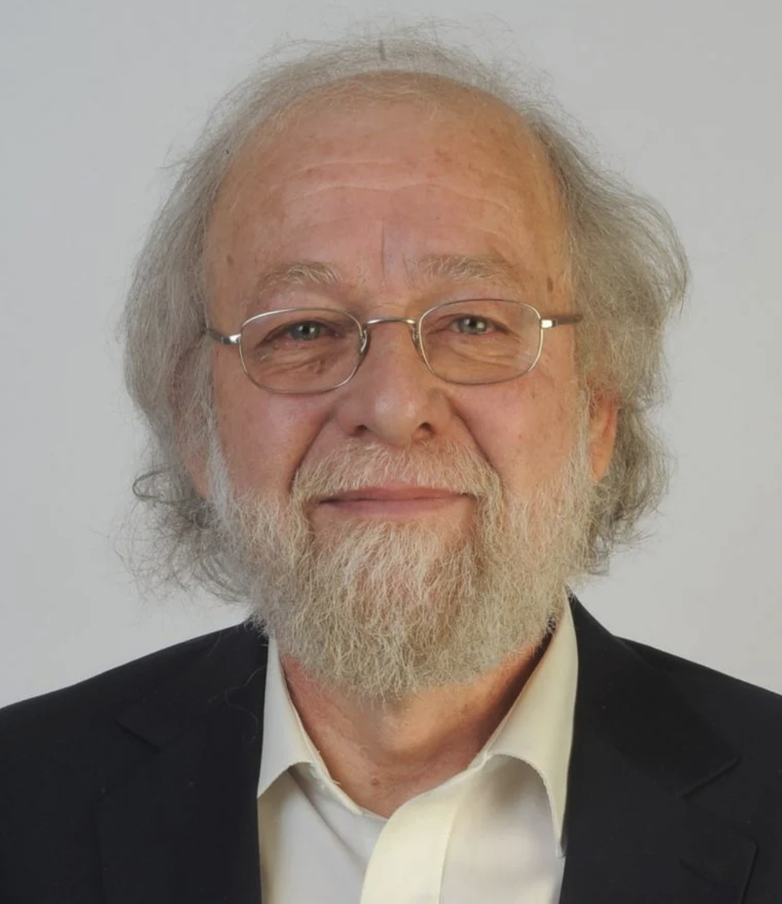
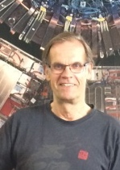
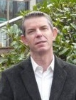
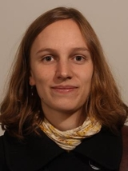
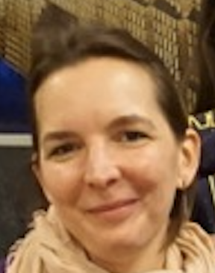
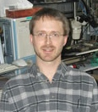
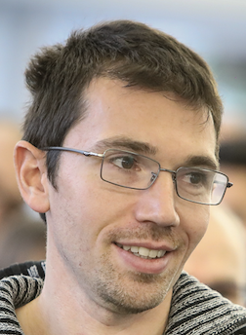
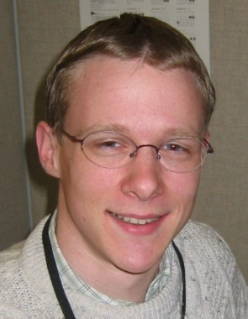
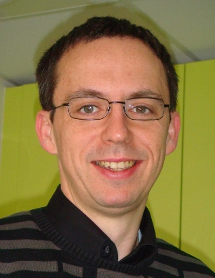
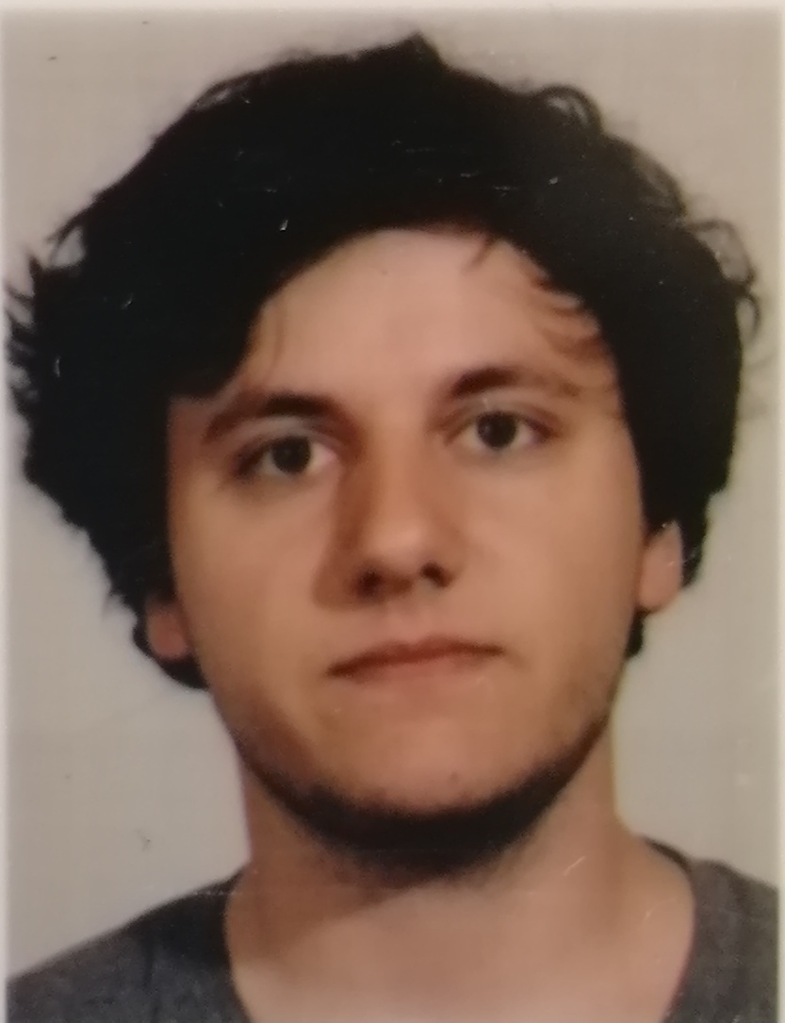
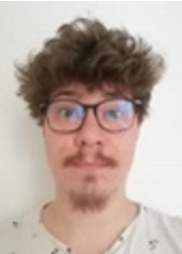
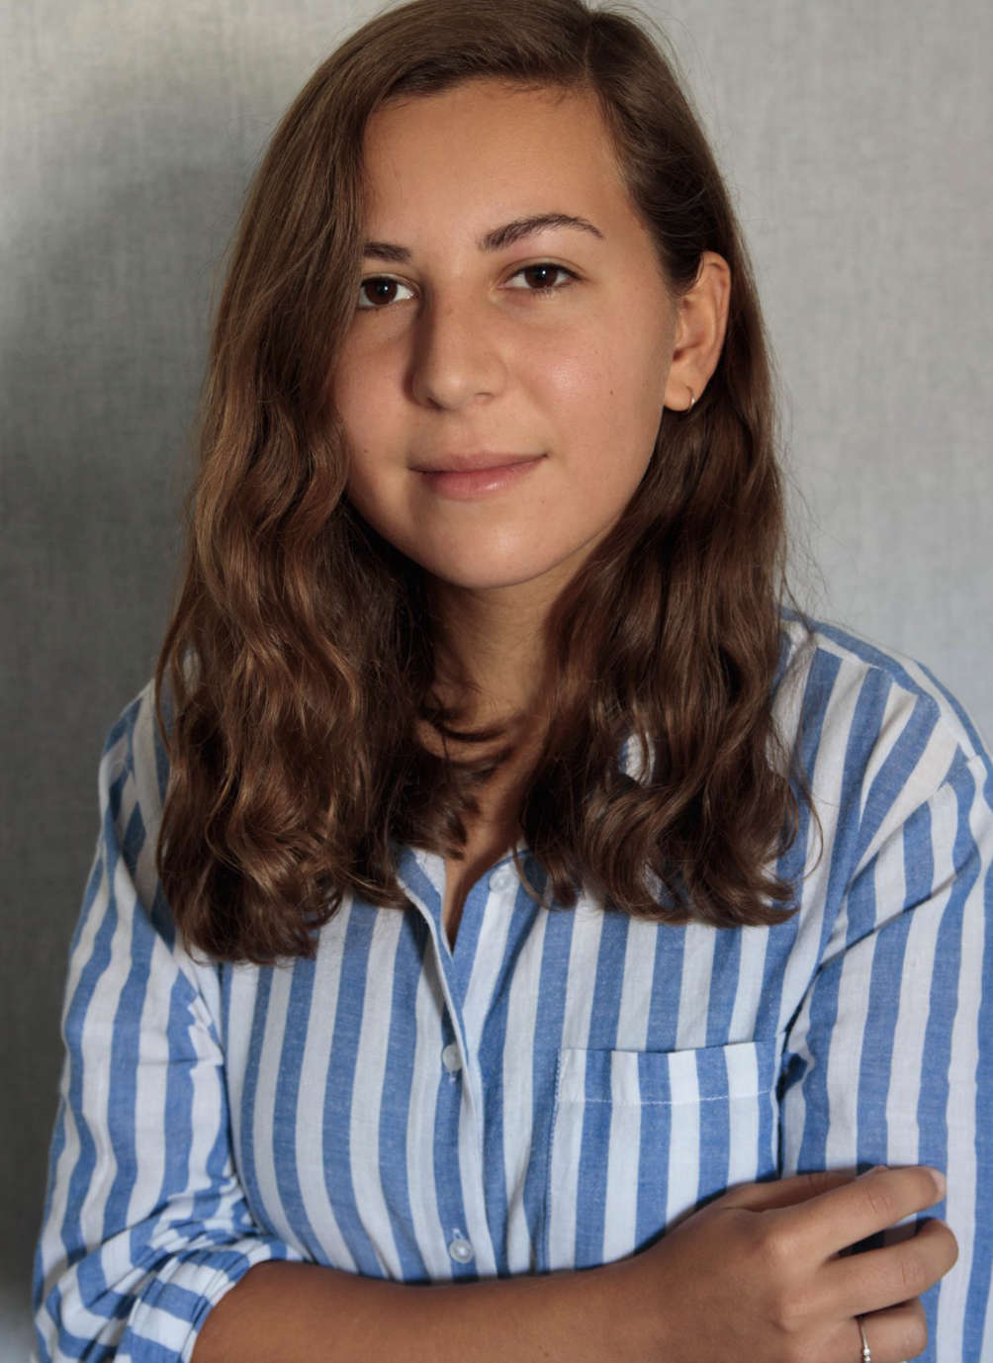
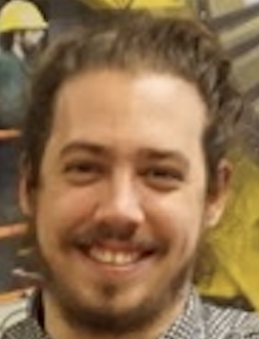
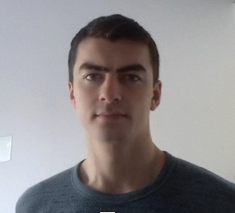
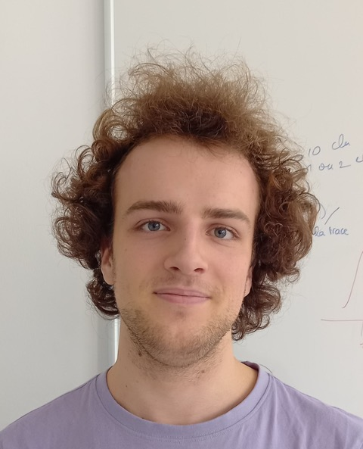
CMS team at IPHC : physicists
(DR)
(PR)
Daniel Bloch
Caroline Collard
Jeremy Andrea
Jean-Marie Brom
(Emérite)
Ulrich Goerlach
UDS *
Jean-Charles Fontaine
UHA
(CR)
Group Leader
(MCF)
Saskia Falke
Anne-Catherine Le Bihan (HDR)
Pierre
Van Hove
Eric Chabert UDS
Jean-Laurent Agram, UHA
Eric Conte
UHA (phéno)
Doctorants
Master 2
Gael Coulon
Dylan Apparu
→2023
Mario Sessini
→2023
Raphaël
Haeberle
→2024
Océan Poncet
→ 2025
Paul Vaucelle
→ 2025

Slide 7
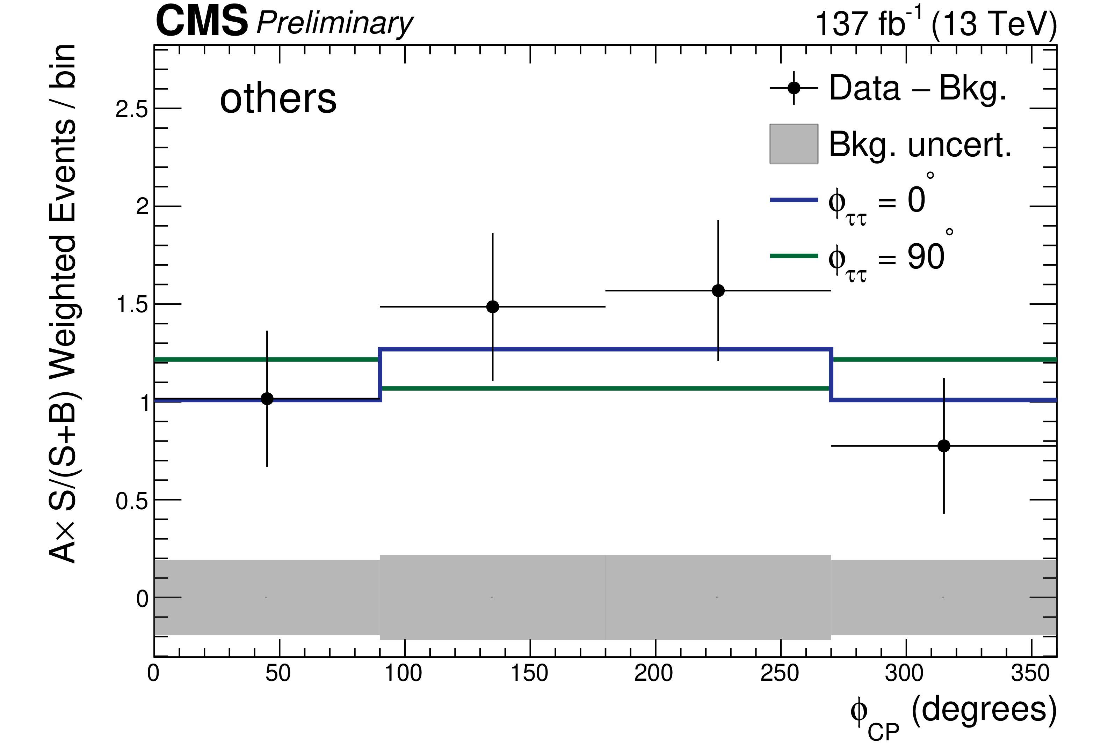
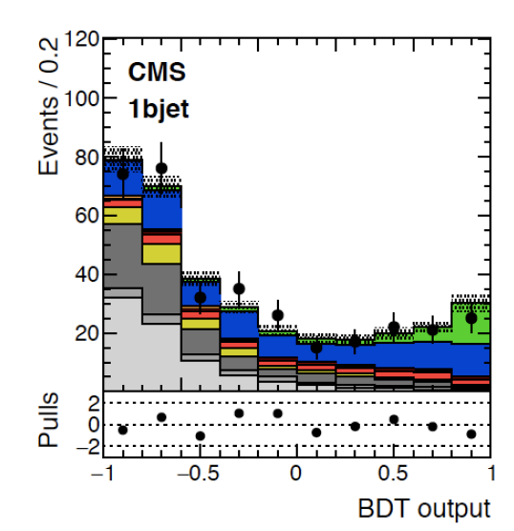
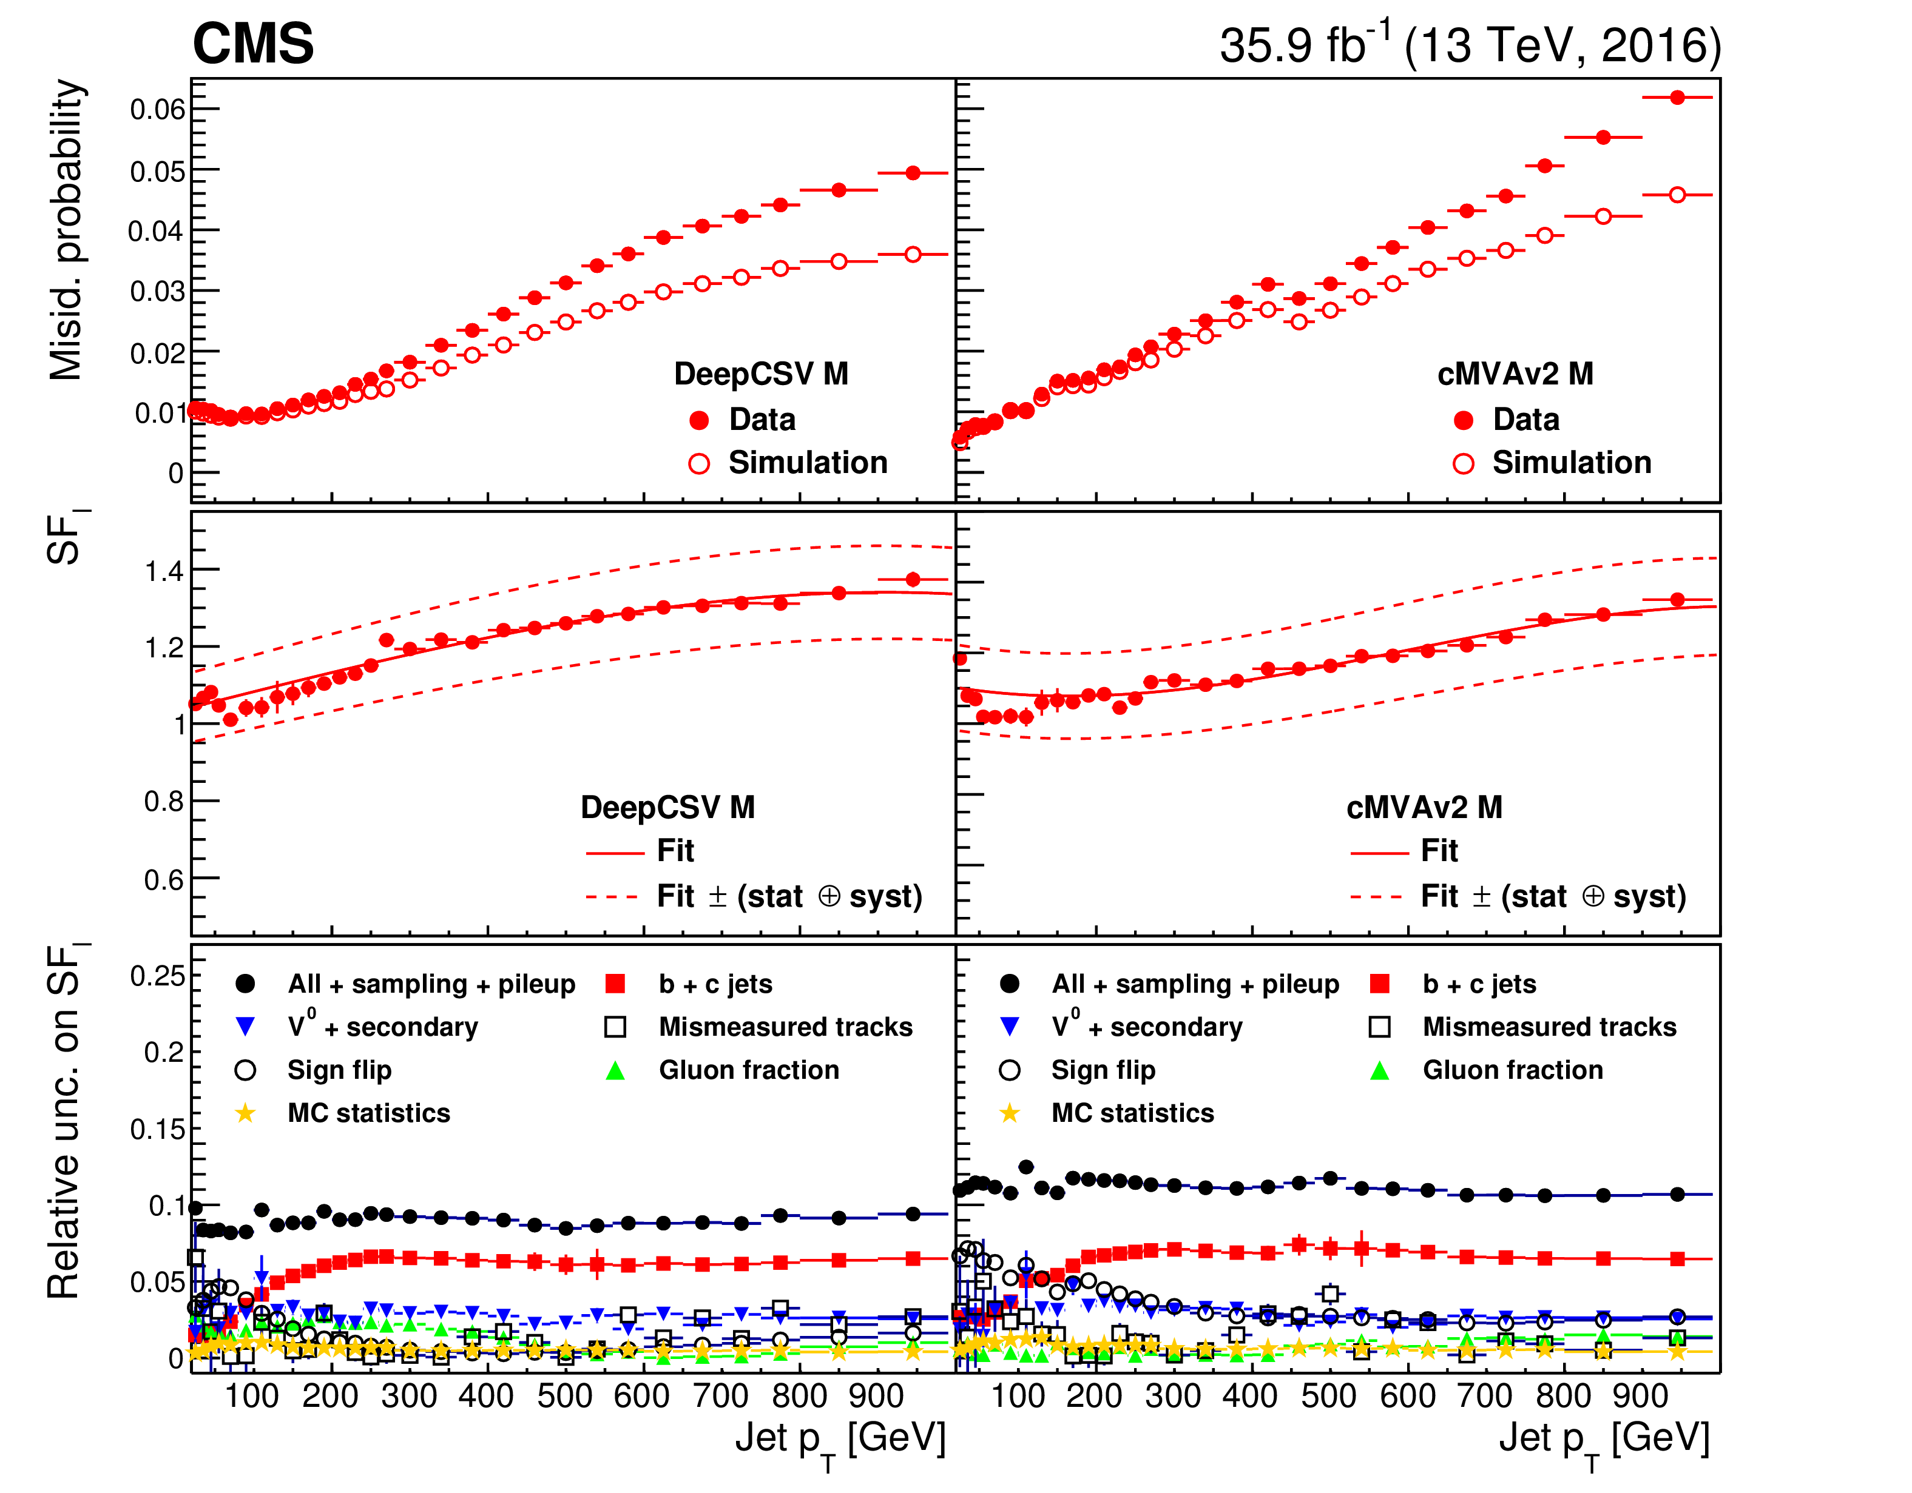
Contributions to physics and other POGs
Participations to POG highly connected with tracker and tracking performance :
b-tagging (2 convenorships),
and 𝛕-ID (1 convenorship).
Contributions to physics analyses where tracker/tracking, b-tagging and 𝛕-ID have key roles.
Top-quark physics : cross sections, properties, (rare) single top,
Higgs properties measurements : ttH, tHq, CP violation,
Searches for new physics : EFT in the top sector, susy stops, mono-tops, displaced vertices, Heavy Stable Charge Particles etc…
Also prospective of tau-Id and b-tagging performances for HL-LHC.
Higgs CP
tZq
Mistag rates
Placeholder pour une plot b-tag
And several contribution to tracker operation and upgrade

Slide 8
Organisationnal matters

Slide 9
Lunches and coffee breaks
Lunches at Tuesday and Wednesday : should not be late .
Need of green tickets (1 per lunch), ask Jeremy.
Coffee breaks in front of the Amphi.

Slide 10
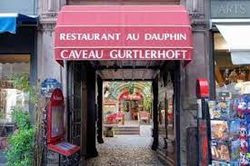
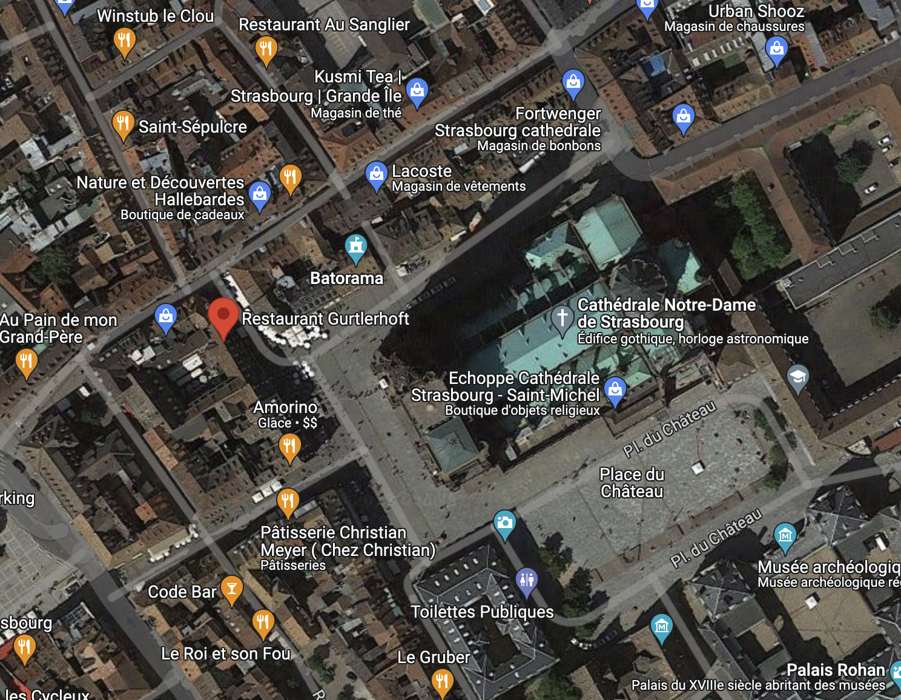
Diner
Gurtlerhoft 13 place de la Cathédrale, 6700 Strasbourg
Located in front of the Cathedral.
Reservation made at 20h00.
From the lab :
Bus G “Argo”, direction and stop “Gare Centrale”,
Either walk from train station (15’)
Or take Tram A, direction “Illkirch”, stops Langstross Grand rue, then 5’ walking.

Slide 11
Have a good workshop !

