Slide 1
LSST CCD Readout Chain
Claire Juramy
August 2020

Slide 2
CCD readout chain: e2v CCD
e2v CCD
Passive flex cable
Current source
ASPIC
Amplifier
ADC
ITL CCD
Active flex cable
Current source
ASPIC
Amplifier
ADC

Slide 3
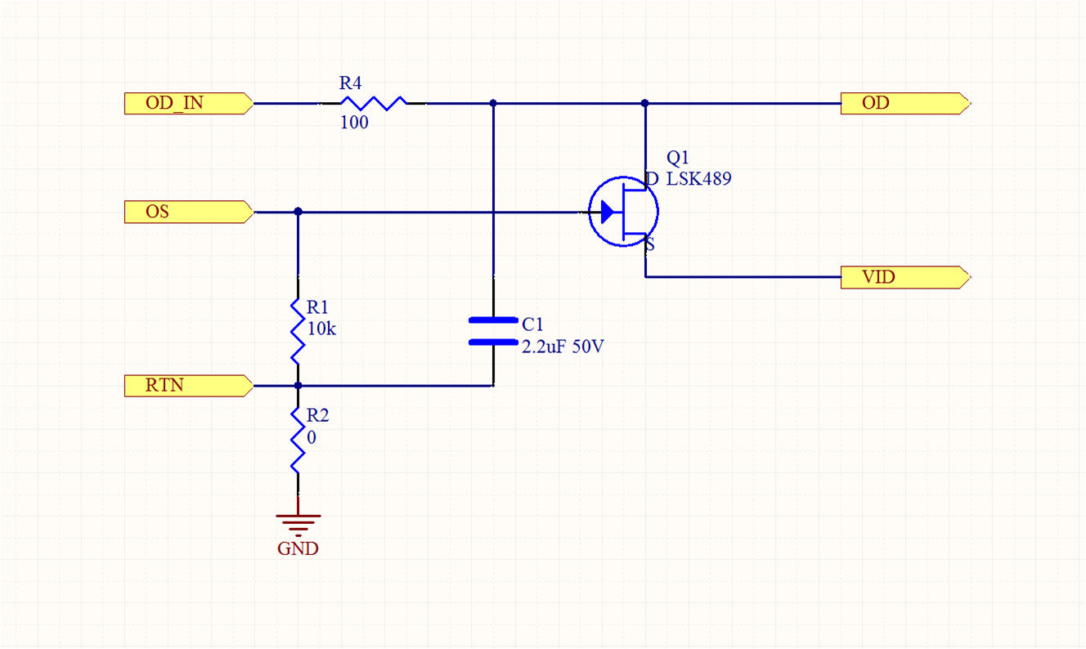
CCD readout chain: ITL CCD and active flex
e2v CCD
Passive flex cable
Current source
ASPIC
Amplifier
ADC
ITL CCD
Active flex cable
Current source
ASPIC
Amplifier
ADC

Slide 4
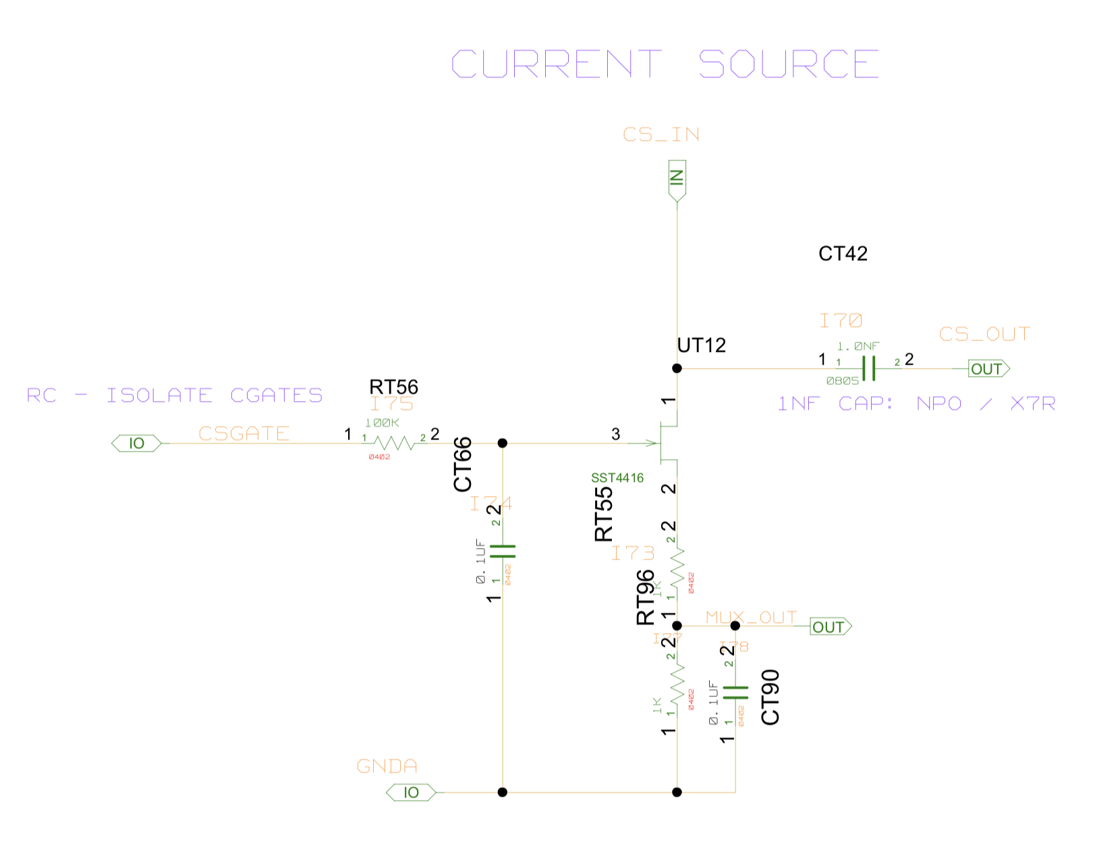
CCD readout chain: current source and capacitor
e2v CCD
Passive flex cable
Current source
ASPIC
Amplifier
ADC
ITL CCD
Active flex cable
Current source
ASPIC
Amplifier
ADC
From CCD
To ASPIC
Serial capacitor for AC coupling
CS gate current setting

Slide 5
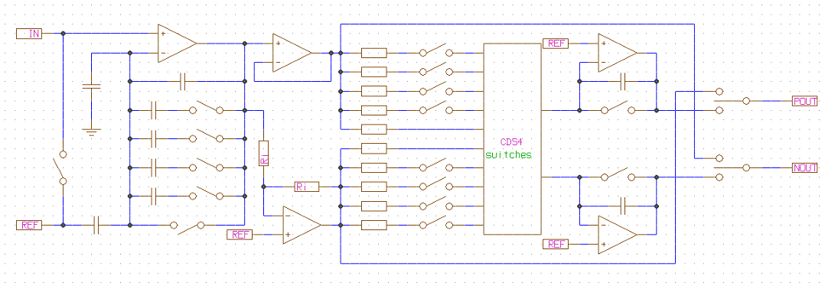
CCD readout chain: ASPIC
e2v CCD
Passive flex cable
Current source
ASPIC
Amplifier
ADC
ITL CCD
Active flex cable
Current source
ASPIC
Amplifier
ADC
ASPIC clamp clock:
DC restore on input
+ reset first-stage amplifier
ASPIC reset clock

Slide 6
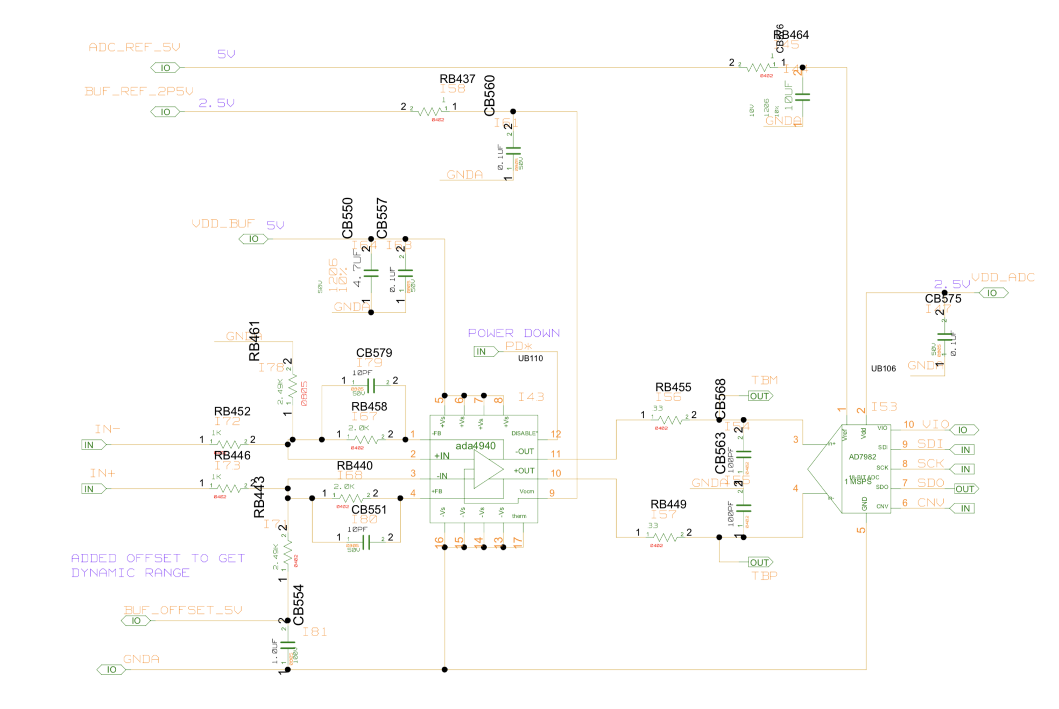
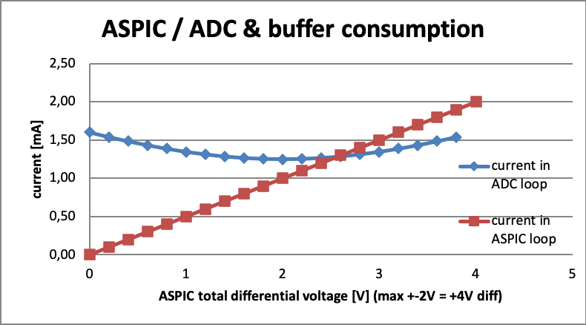
CCD readout chain: amplifier and ADC
e2v CCD
Passive flex cable
Current source
ASPIC
Amplifier
ADC
ITL CCD
Active flex cable
Current source
ASPIC
Amplifier
ADC

