Slide 1
Sensor Anomalies Overview
Claire Juramy
presenting work from the Sensor Anomalies Working Group
DESC – August 2022

Slide 2
Sensor anomalies
Goal: from a numerical value per pixel, to how many photons were captured in each pixel
Source for each Instrument Signature Removal (ISR) step
Impact on processing
Some anomalies have been fixed during optimization phase, need metrics
Latest developments in the Working Group (and in the Camera Verification Testing meeting) – but not an exhaustive list
Full focal plane, large set of data: start seeing anomalies that appear on small fractions of sensors

Slide 3
Sensor and electronics effects
Intrinsic sensor effects:
Defects: bright, dark
Quantum Efficiency, fringes
Static effects: tree rings, edges, midline
Dynamic effect: brighter-fatter
Sensor management effects:
Clocking scheme: bias stability, bias shape
Charge Transfer Efficiency: traps, pinch
Full well
Glows
CCD output stage: gain stability, noise
Readout speed
Clock-induced: tearing
Persistence
Readout electronics:
Gain stability
Linearity
Bias shift
Crosstalk, memory
Acquisition :
ADU favoritism
DAQ scrambling

Slide 4
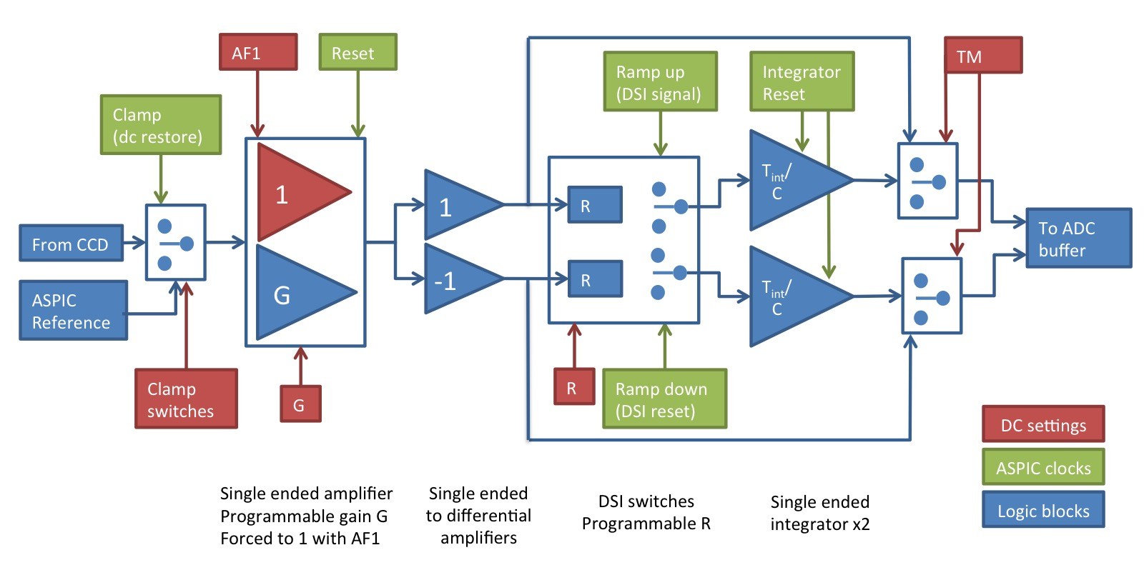
Electronic readout chain
ITL CCDs: second output stage on flex cables
Dedicated readout integrated circuit: ASPIC, 8 channels/chip
Two stages: gain (1.6) and Dual-Slope Integrator (RC, integration time)
External buffer amplifier + 18-bit ADC

Slide 5
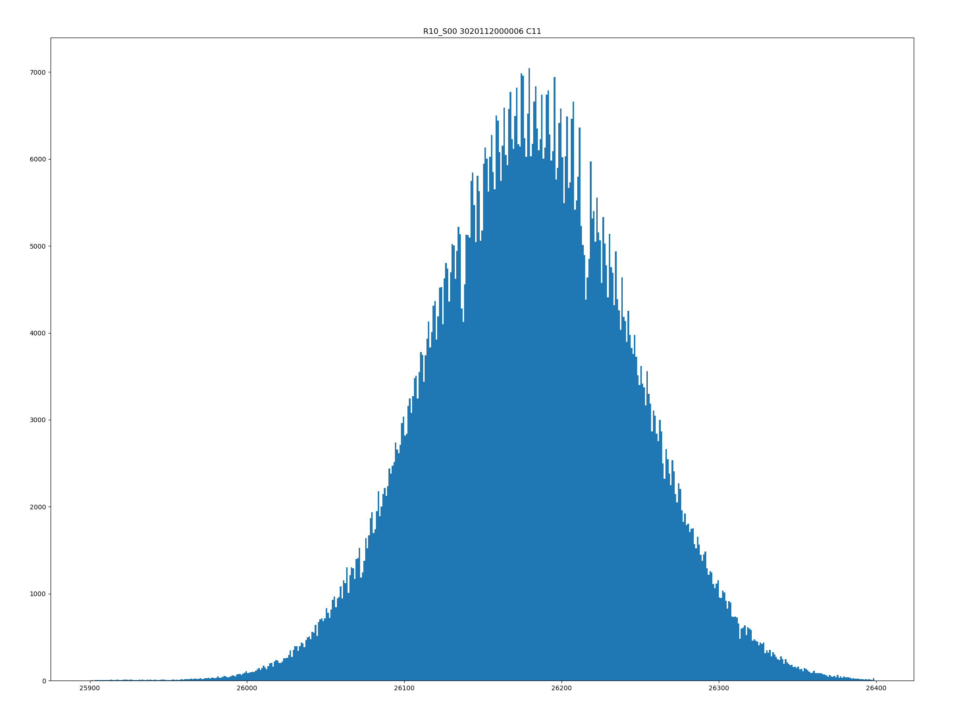
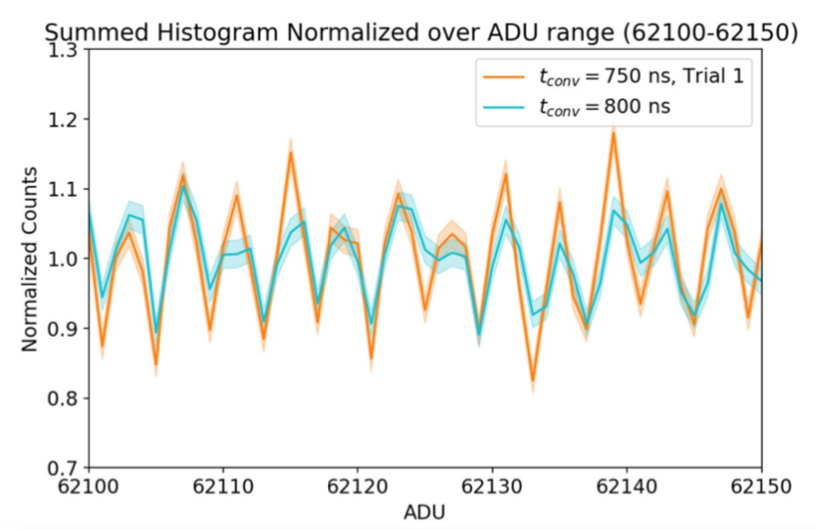
Analog-to-Digital Converters
ADC distribution study: Adrian Shestakov CVT page
ADC favoritism: Zoe Smith CVT slides (DNL, testing conversion times)

Slide 6
Analog-to-Digital Converters
Signal-dependent noise from ADC: Andy Rasmussen CVT slides
Narrow ADC codes model: Pierre Astier CVT slides – does not expect that DNL correction would be required for science products

Slide 7
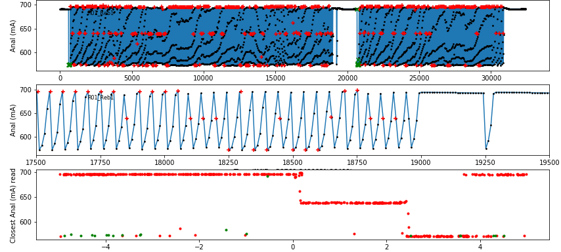
Electronic gain variations
Fine reconstruction of monitoring values
Current consumption increased in ASPIC -> temperature increased -> gain changed (RC increased)
Need to clamp (reset capacitors on first stage of ASPIC) regularly

Slide 8
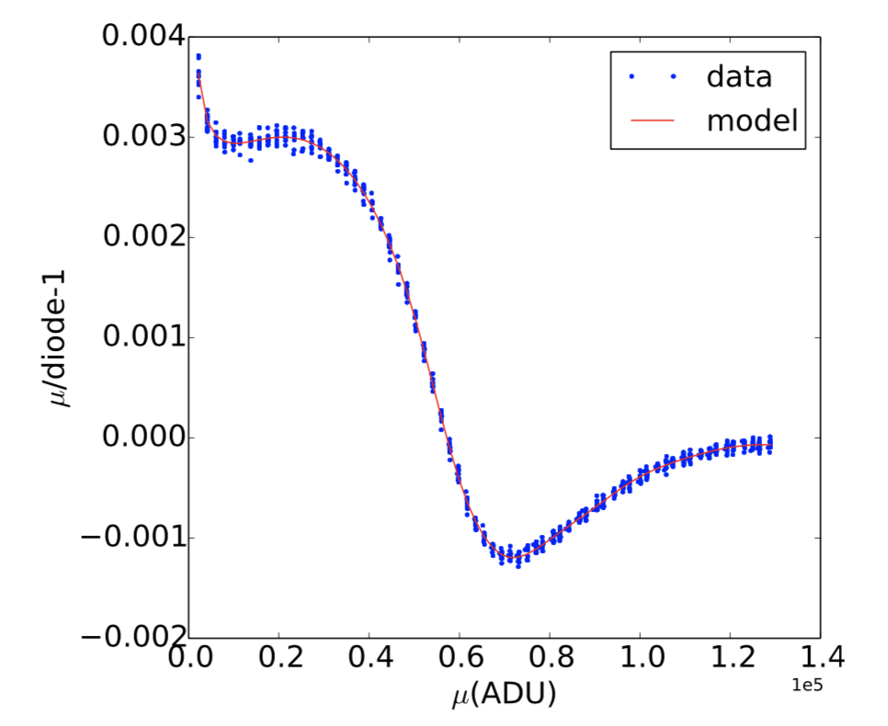
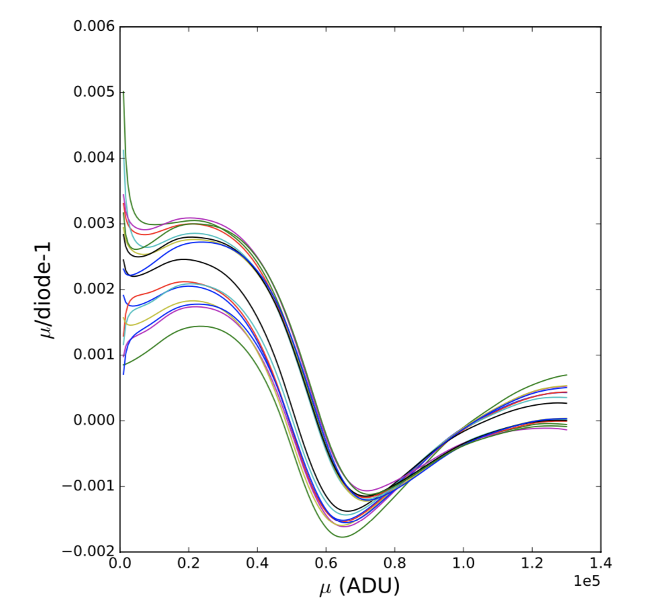
Linearity
Correction in EOtest: Jim Chiang CVT slides
Evaluating the DM linearizer and proposing a new method: Craig Lage slides
Known non-linearity structure from ASPIC: need fine sampling mid-range

Slide 9
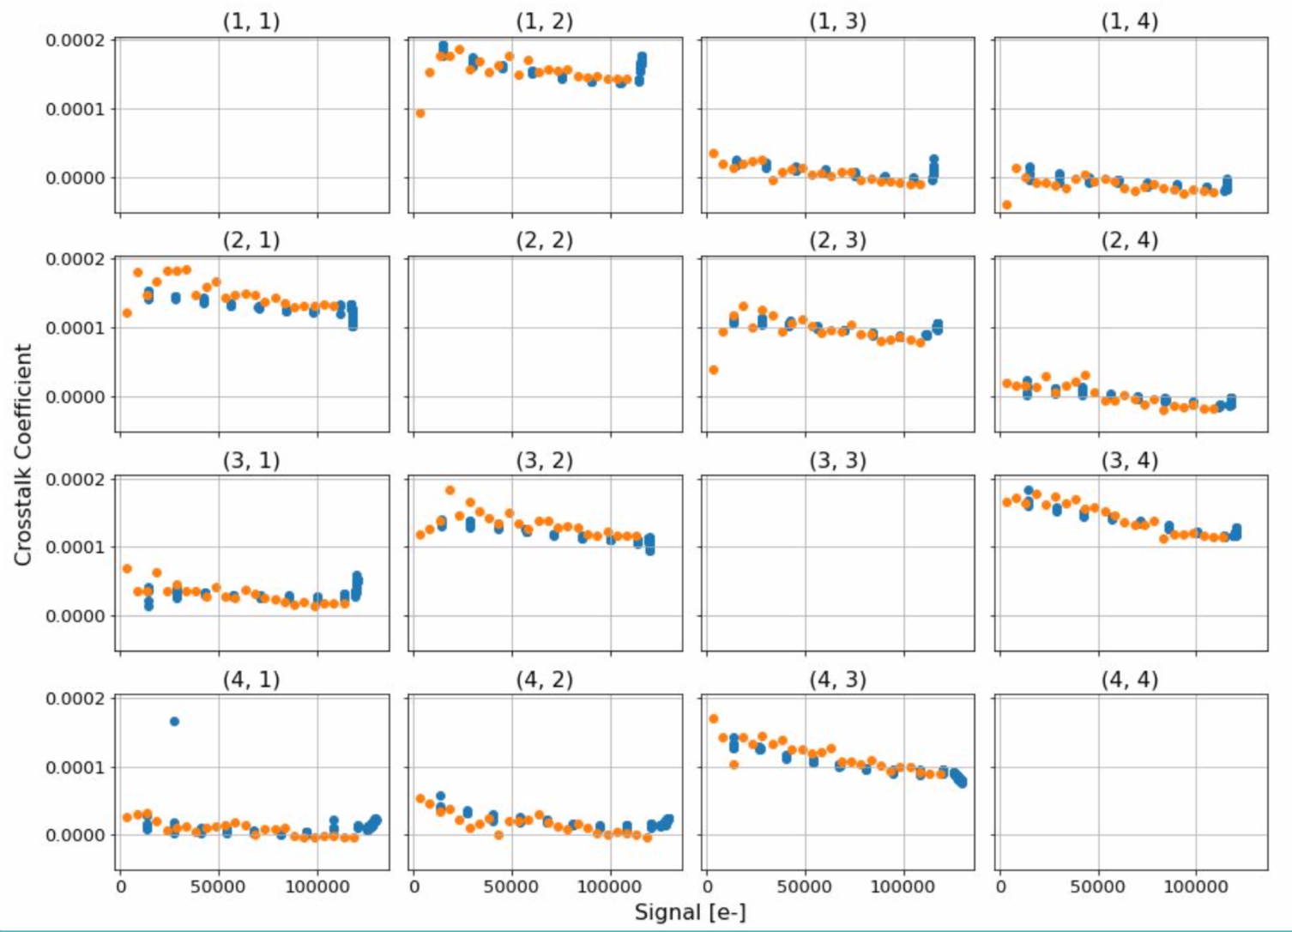
Crosstalk non-linearity
Crosstalk data on full focal plane: combined analysis by Andrew Bradshaw and Adam Snyder

Slide 10
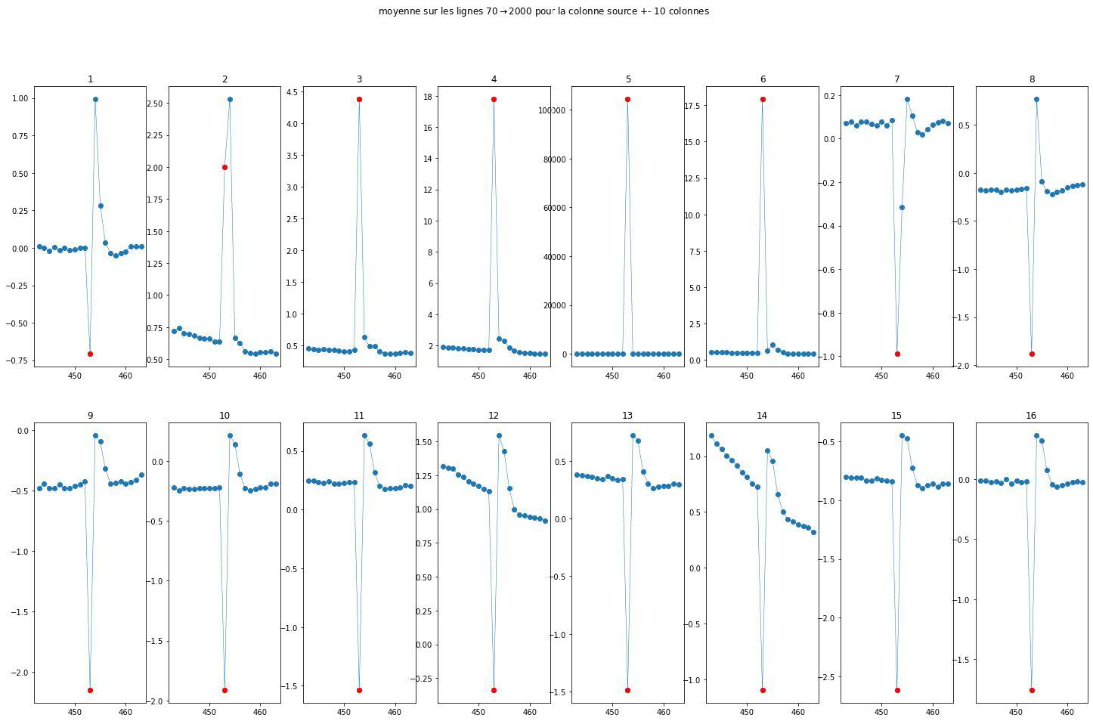
Crosstalk and delayed signal
After a bright pixel: delayed signal in the next pixels in all channels of the sensor (Bruno Longo slides from bright columns)

Slide 11
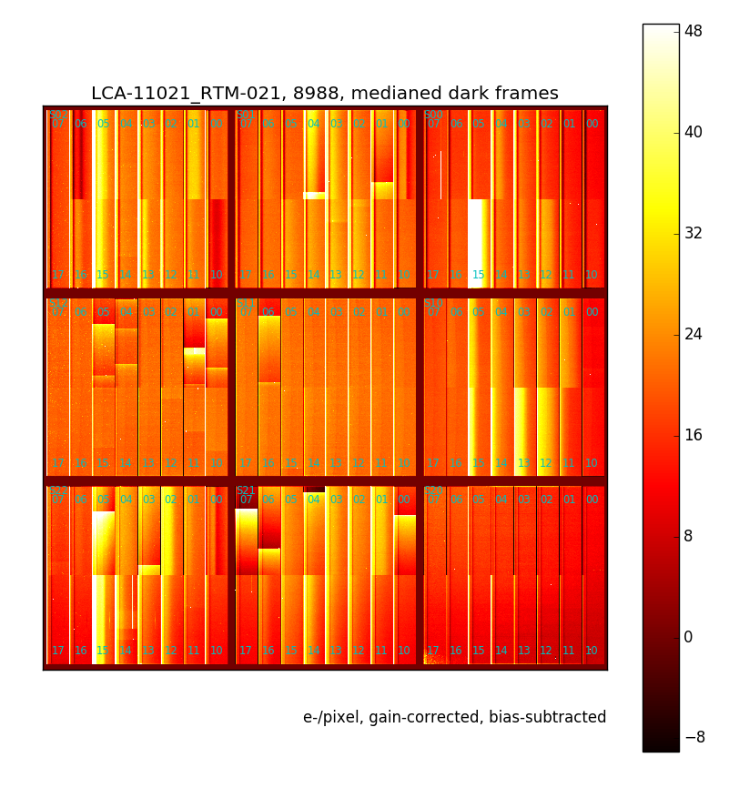
Bias shift
Seen from bright defects
Very long relaxing time
Threshold ~ 190 kADU (raw)
Adjustement to ASPIC gain + RC + integration time
Detected again in run 5: Duncan Wood slides

Slide 12
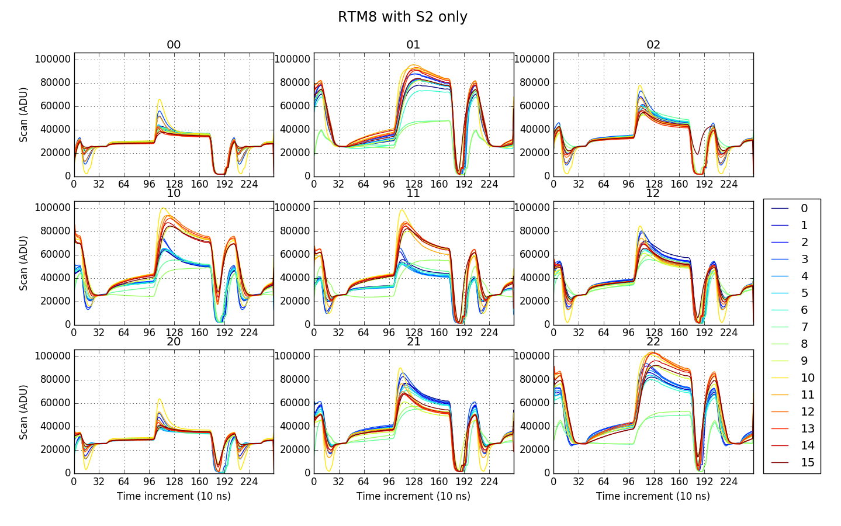
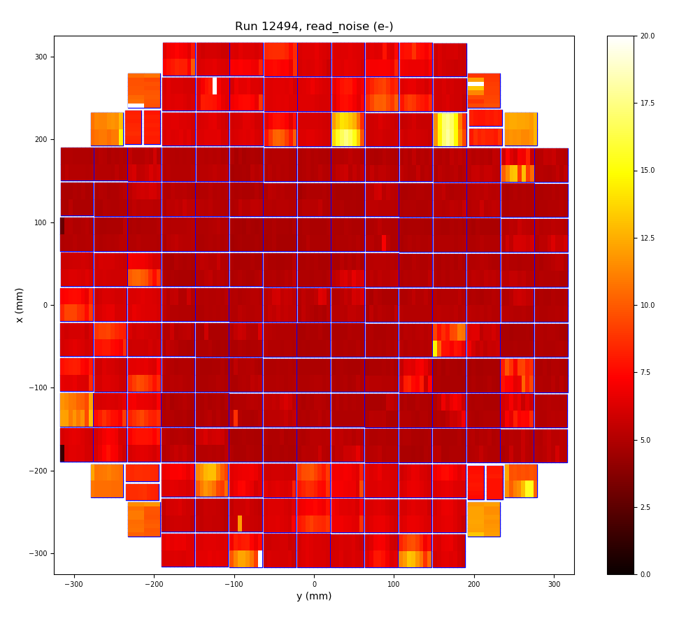
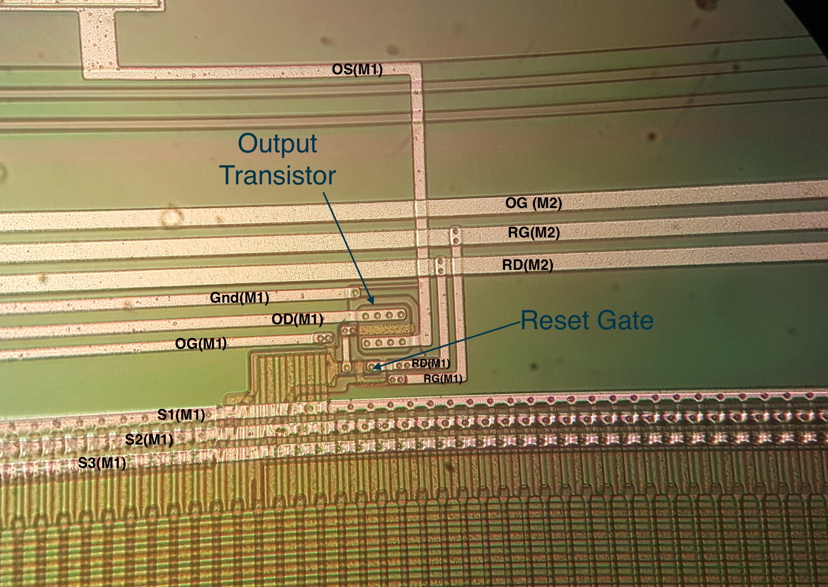
Clock injection in ITL rafts
Individual clock injections: S1 > S2 > S3
Affects bias level: combination of clock injections
Injects noise

Slide 13
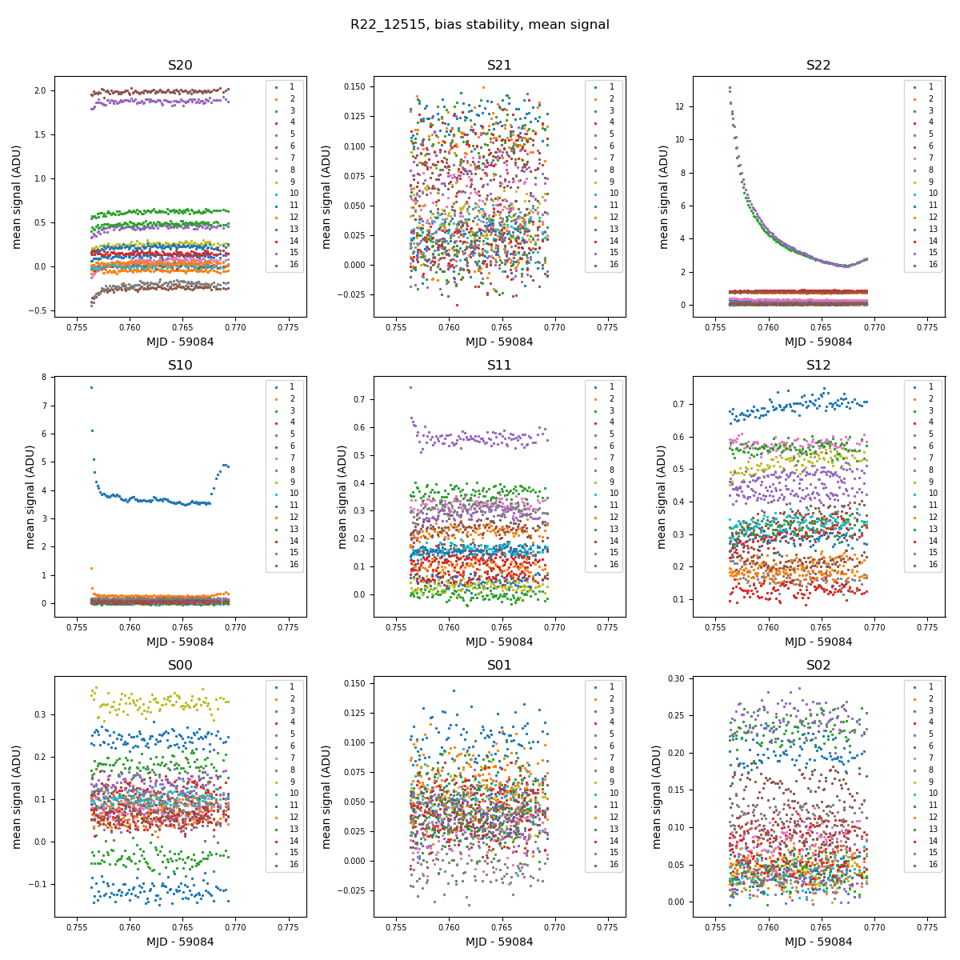
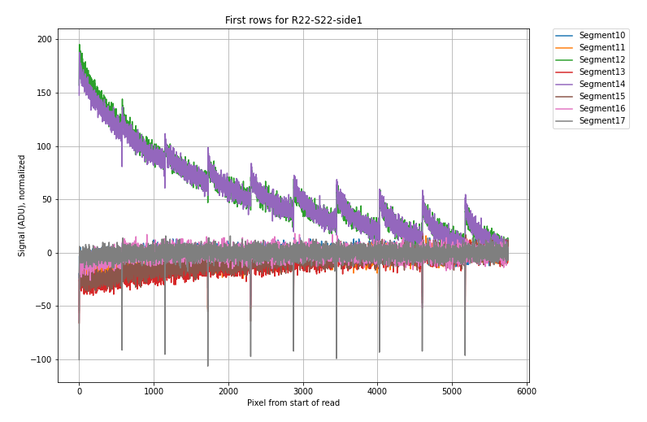
Bias stability and bias drift
Bias 2D structure: all sensors
Bias drift: specific to some e2v sensors: time-dependent structure
Stability: dependent on how the sensors are run between frames

Slide 14
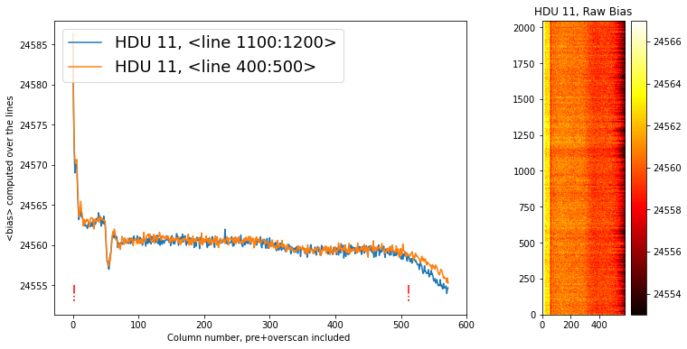
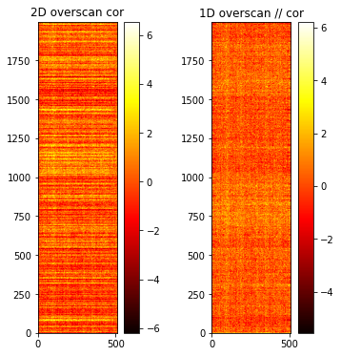
Bias structure
Bias correction: many contributions, no single solution:
PCA correction (Thibault Guillemin CVT slides )
Using the serial overscan
Pierre Antilogus ITL and e2v studies

Slide 15
Parallel transfer efficiency
Parallel clocks in e2v: 4 phases, crossing
Delay rise / fall, propagation of clock wavefront over sensor area
Traps: pocket pumping?
No overlap in parallel clocks
1 µs overlaps

Slide 16
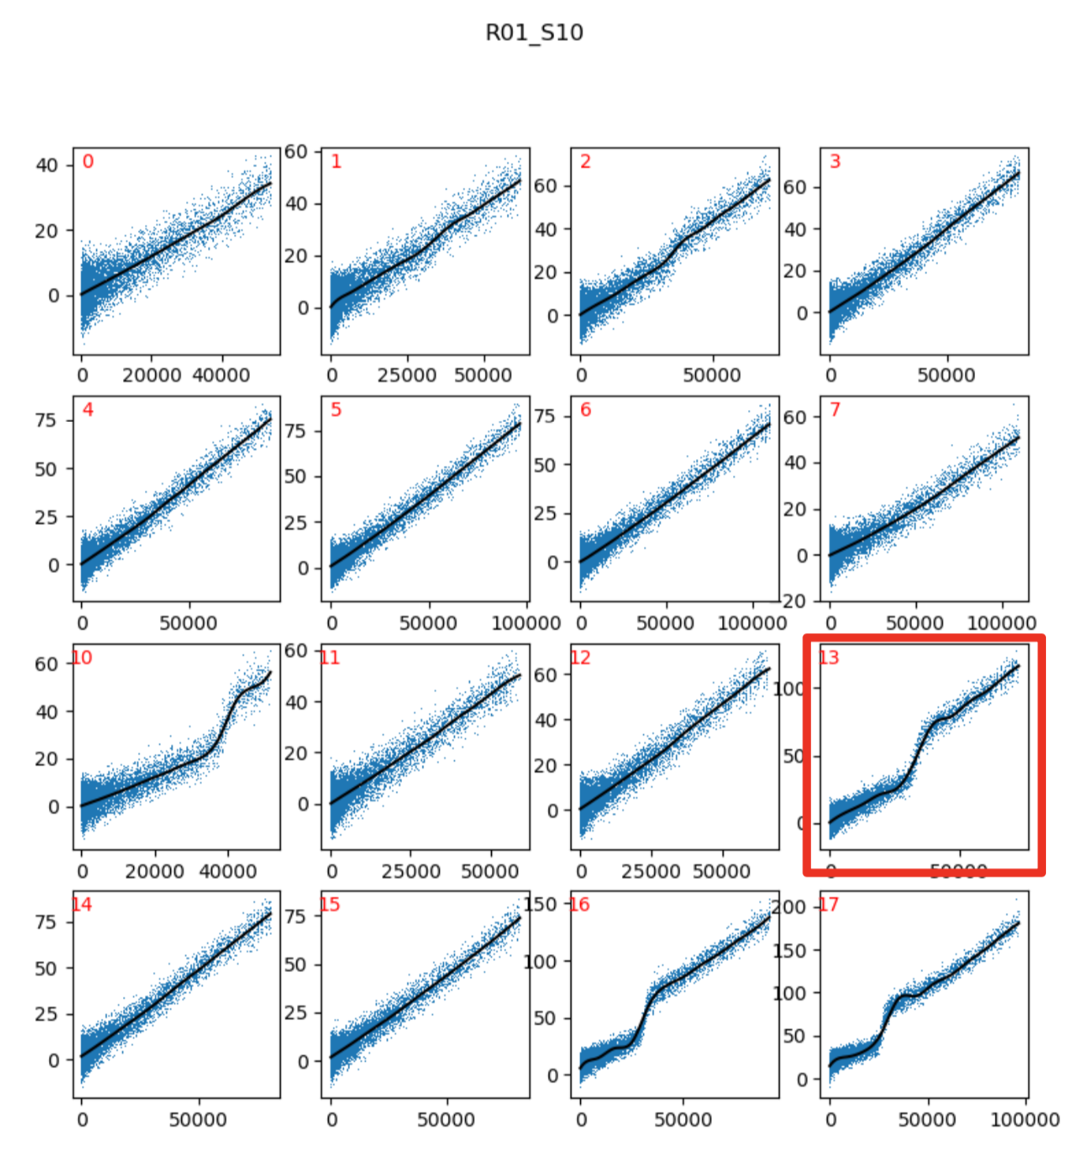
Serial charge transfer efficiency
Traps: fixed amount, present at low flux
Threshold: ‘pinching’ effect
Voltage range + timing
P. Astier

Slide 17
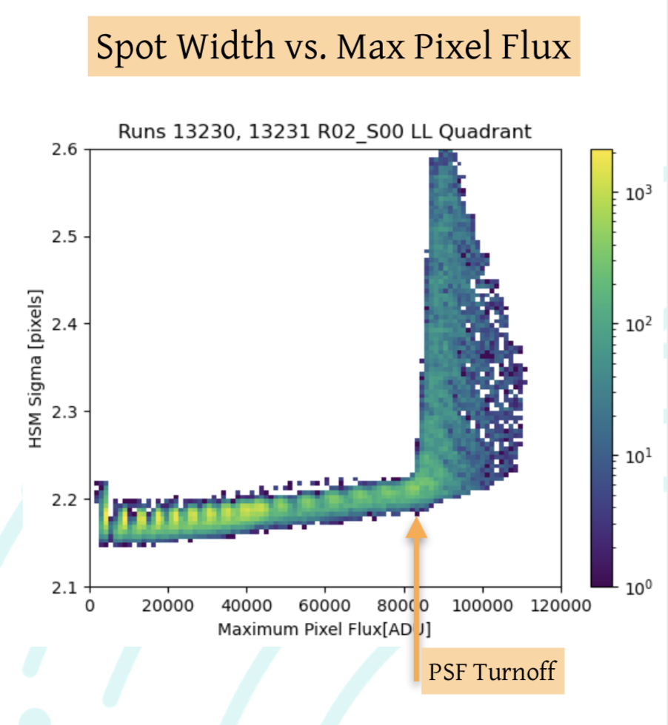
Full well and Photon Transfer Curve
Full well definitions:
Intuitive
Loss of meaning: PTC turn-off
‘PSF full well’ (Aaron CVT recap slides)
Dip in the PTC: ‘pinching’ effect in parallel transfer, voltage range + timing (see also Andy Rasmussen slides)

Slide 18
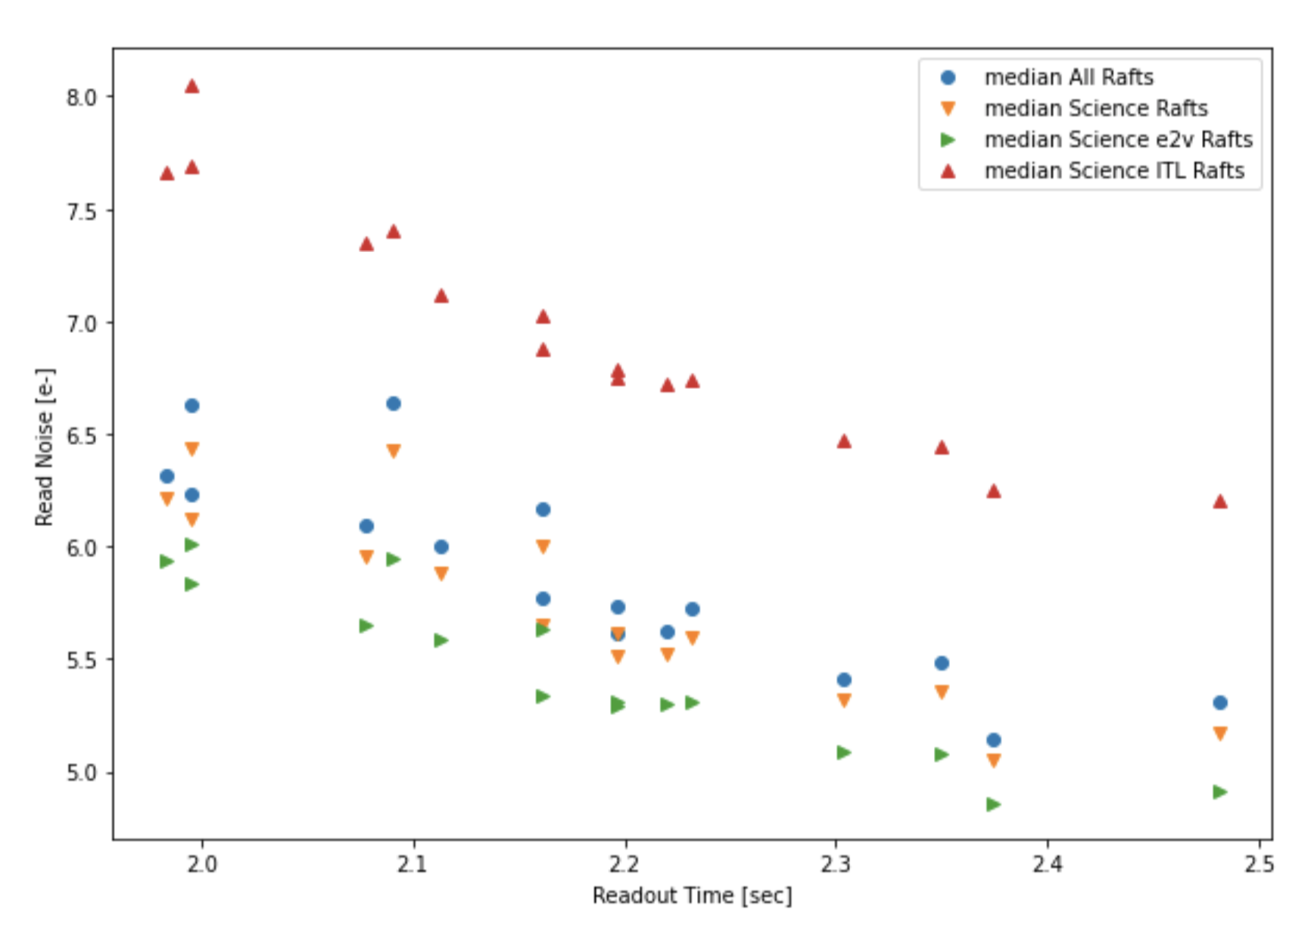
Readout speed
Slower readout in latest focal plane run (Aaron Roodman slides)

Slide 19
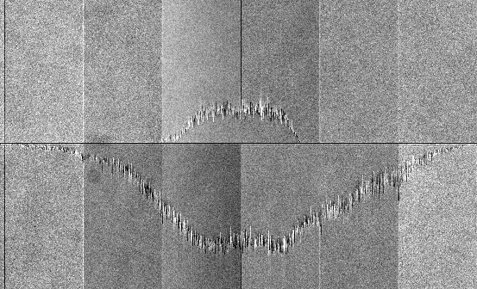
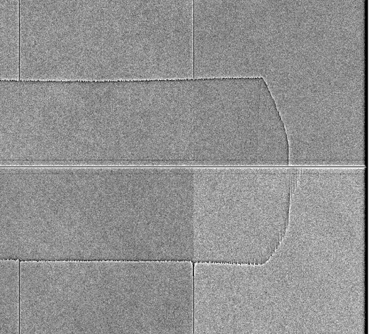
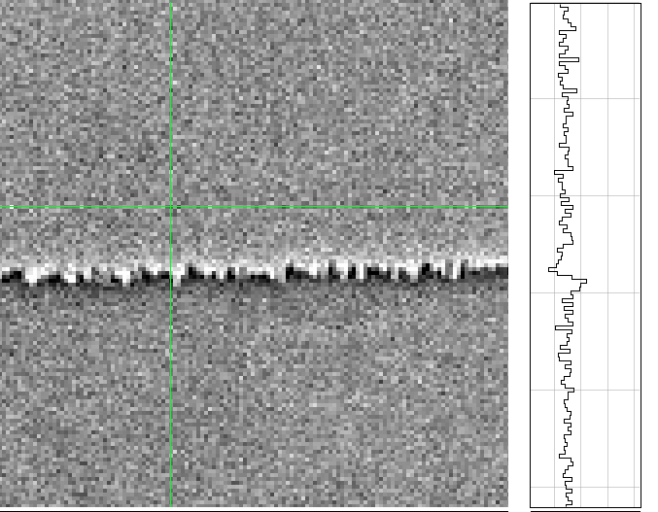
Original tearing patterns
Skyline pattern: observed at high deltaP (> 9.5V), builds up from middle of sensor
Thin tearing: excess of charges comes before deficit in readout: not an issue with parallel transfer
Divisadero
19

Slide 20
Testing on full focal plane
Bipolar mode: variety of structures depending on working conditions and sensor
Without inversion (< -7V), same conditions as unipolar mode
Metrics: at segment edges

Slide 21
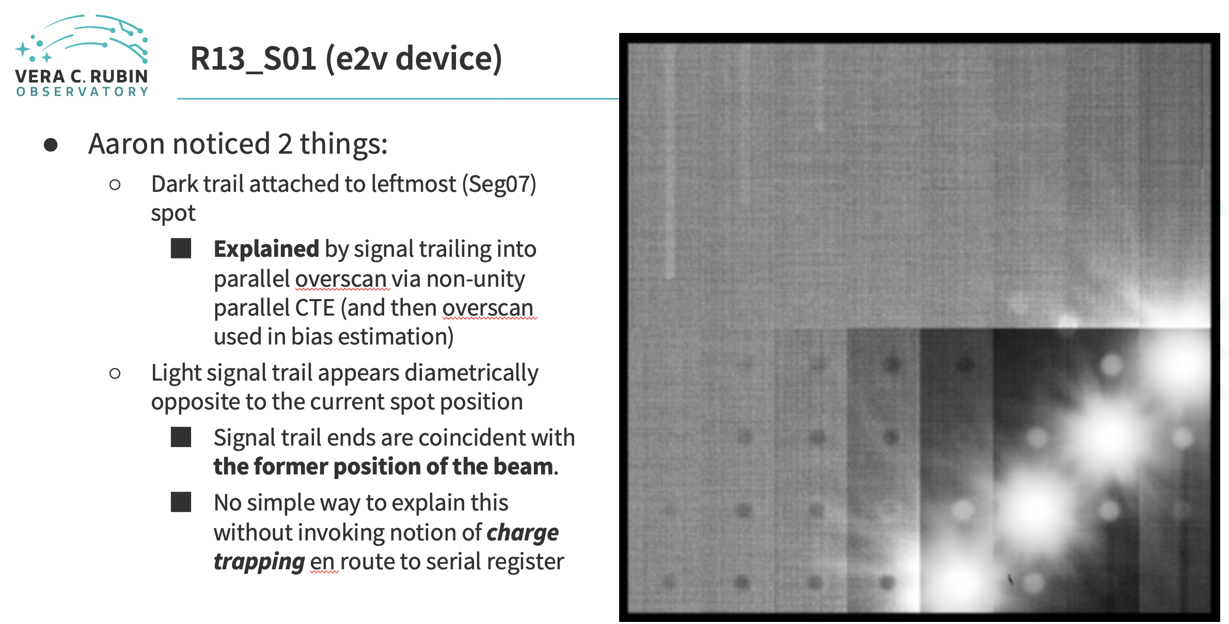
Persistence
Andy Rasmussen CVT slides

Slide 22
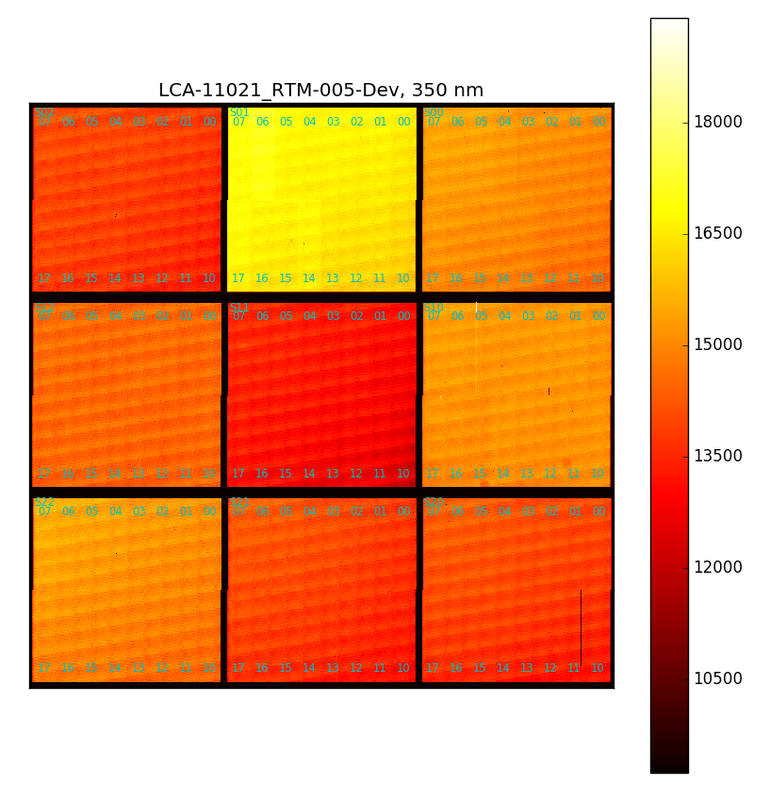
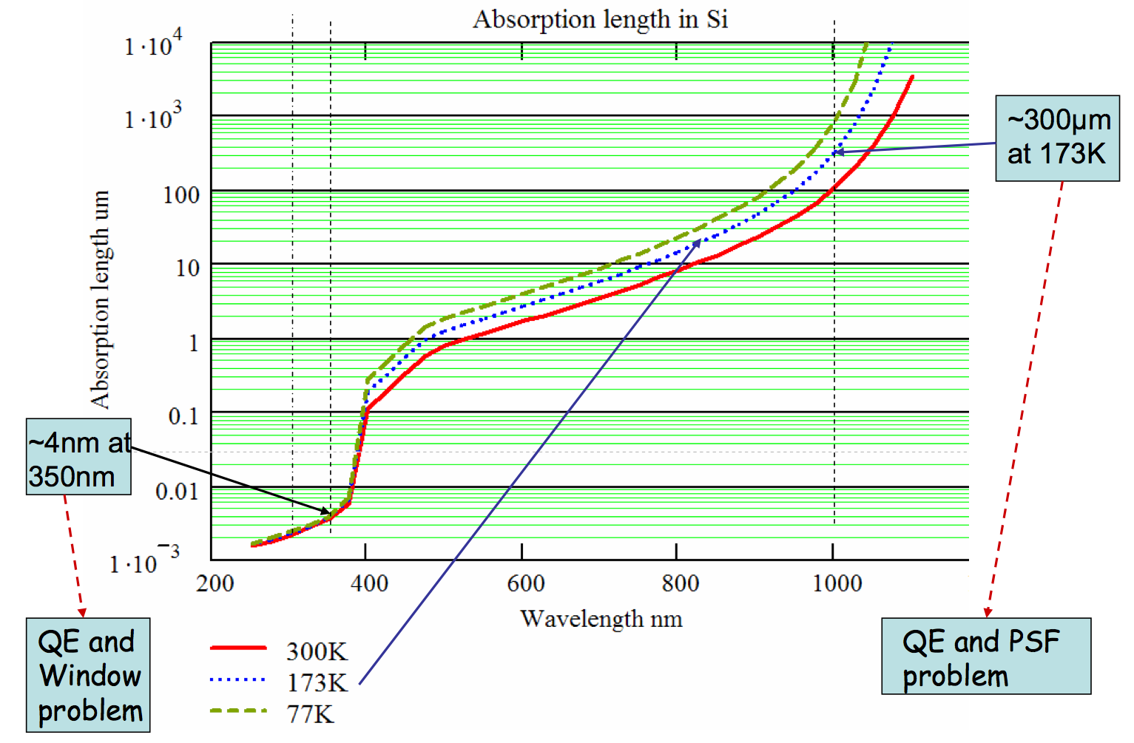
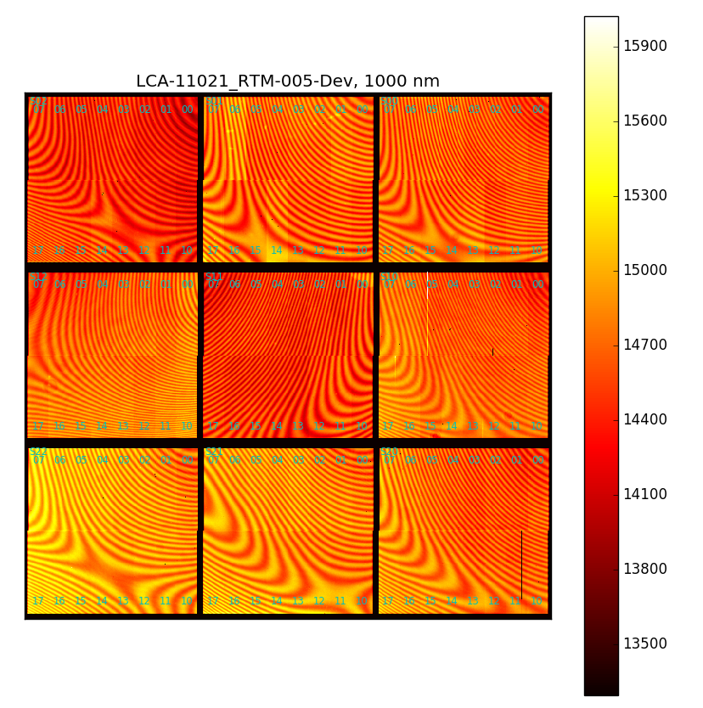
Quantum efficiency
Scan over wavelength range (not absolutely calibrated)
Depth of photon conversion (from the back)

Slide 23
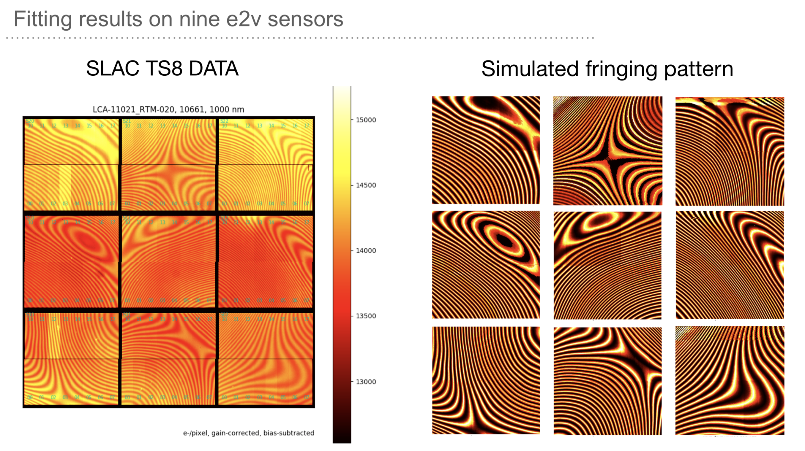
Fringing
Model and fit, for various sensors + conditions: Zhiyuan Guo slides
Amplitude depends on focal ratio

Slide 24
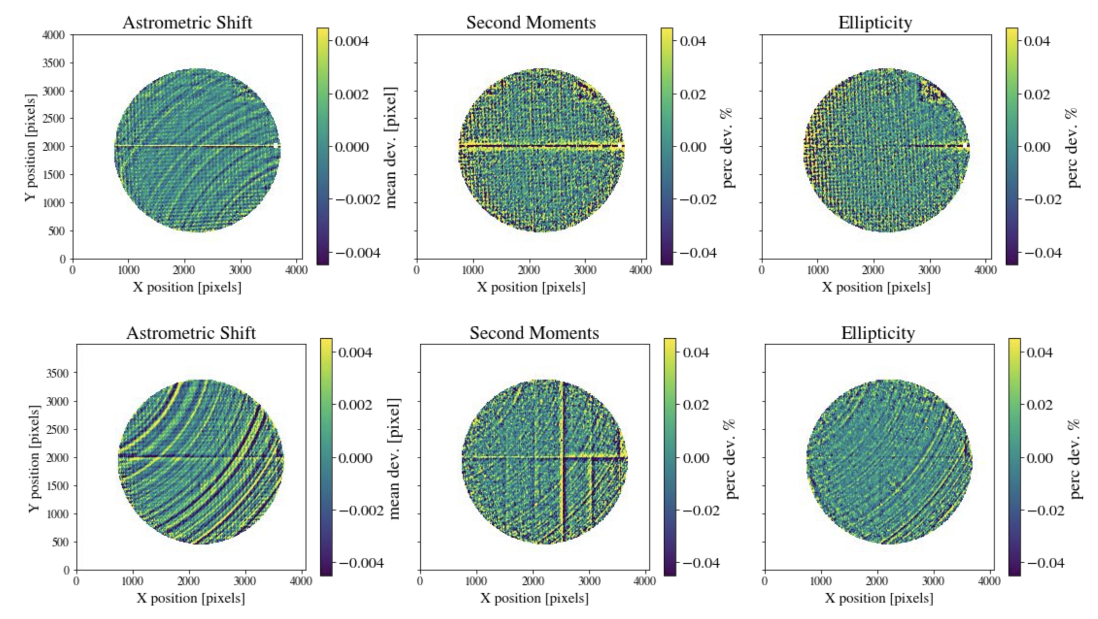
Tree rings
Several studies, with 9-raft data: Johny Esteves slides

Slide 25
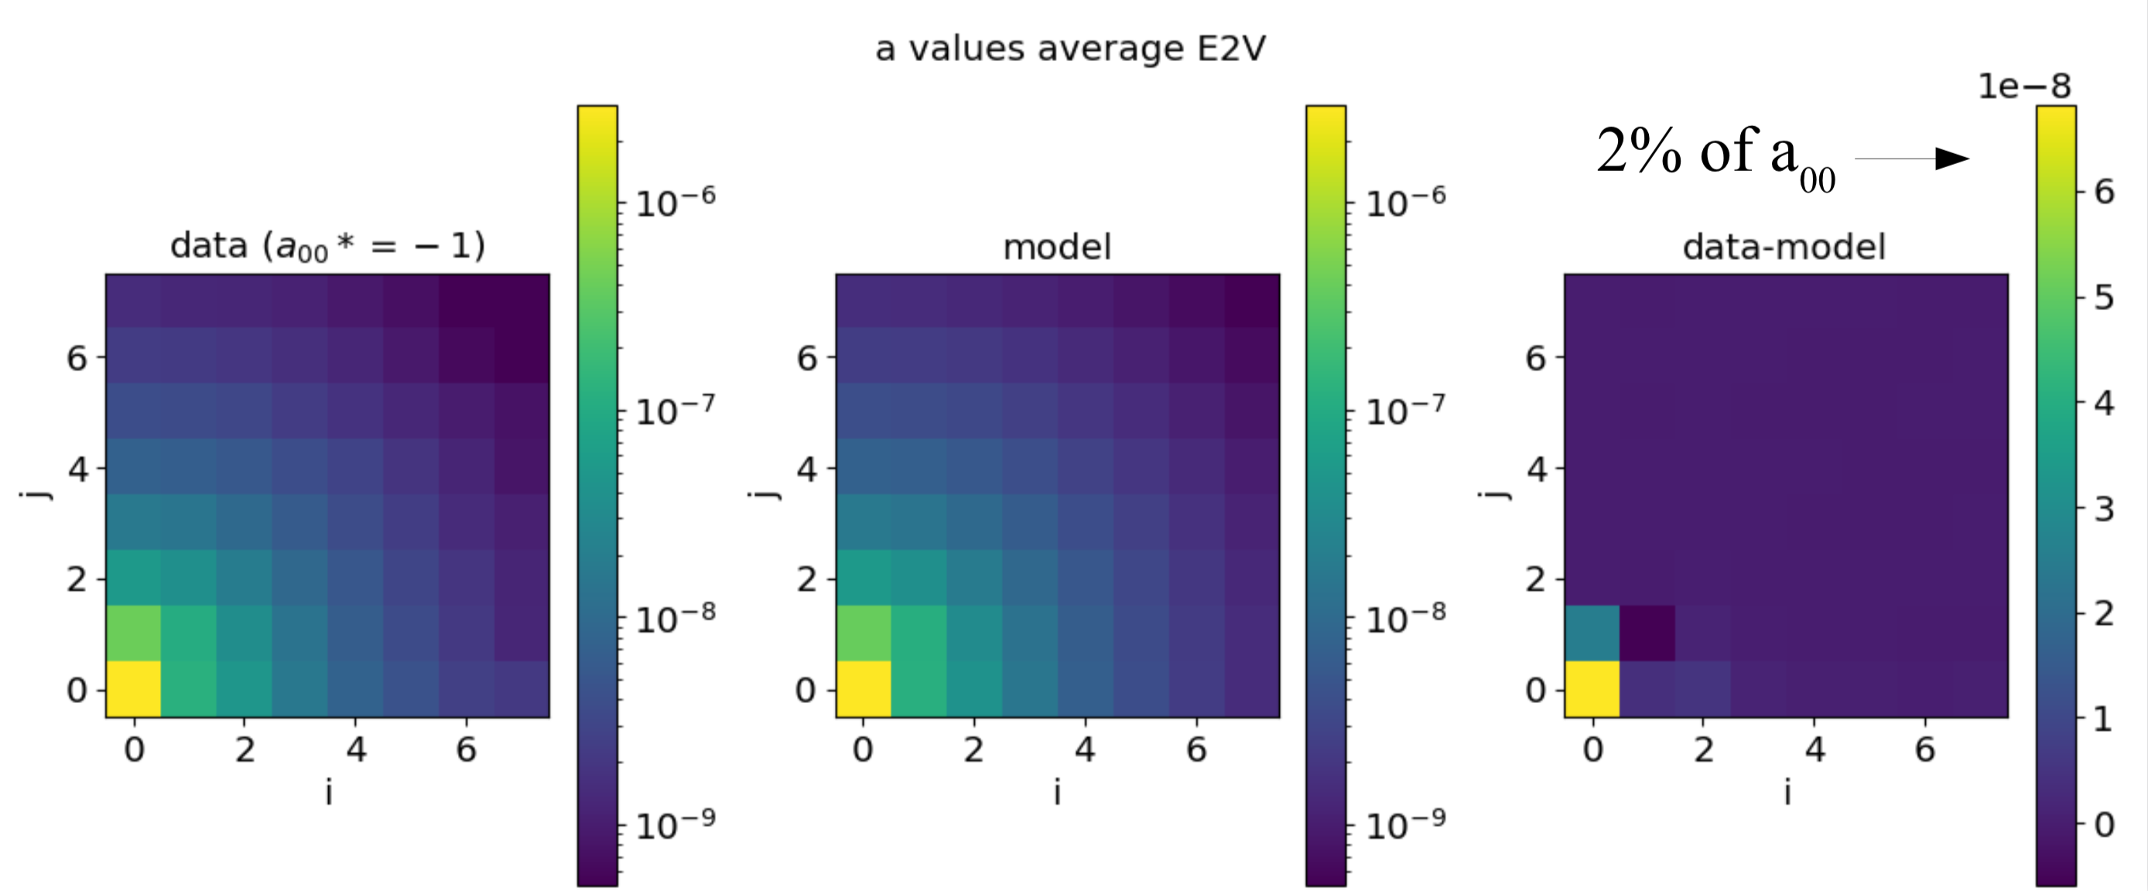
Brighter-fatter
Fit from PTC data for whole focal plane (Pierre Astier CVT slides)

Slide 26
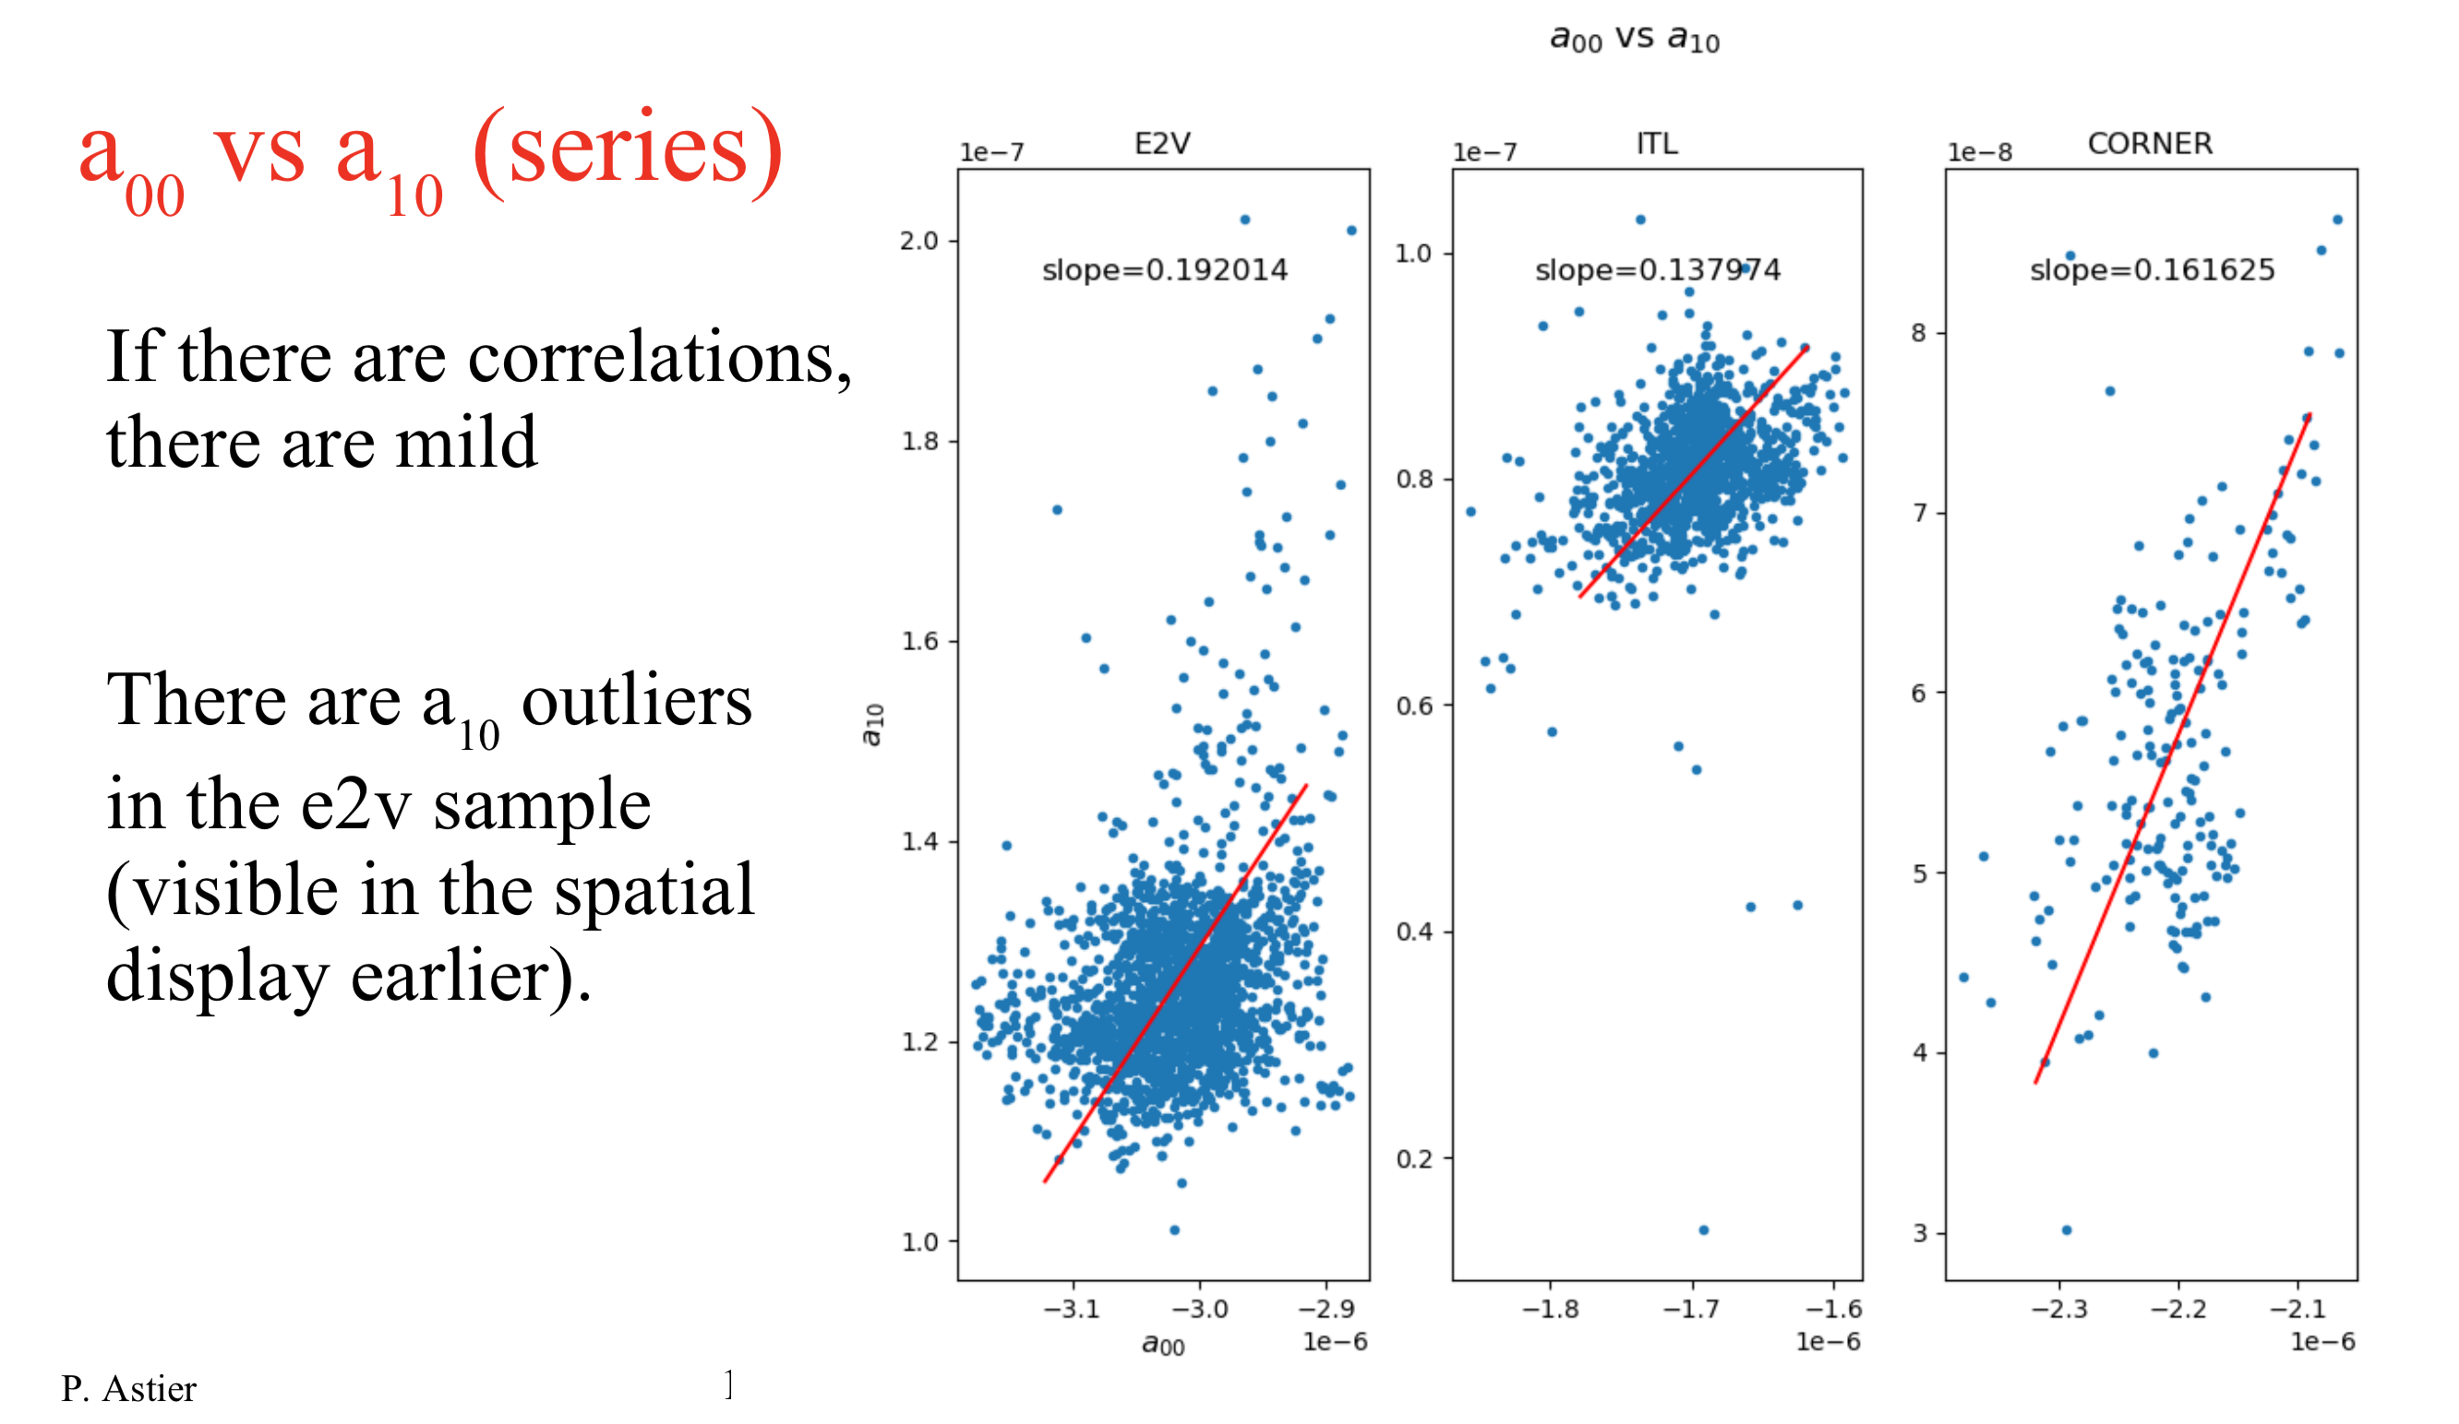
Brighter-fatter
Statistics on coefficients: serial direction

Slide 27
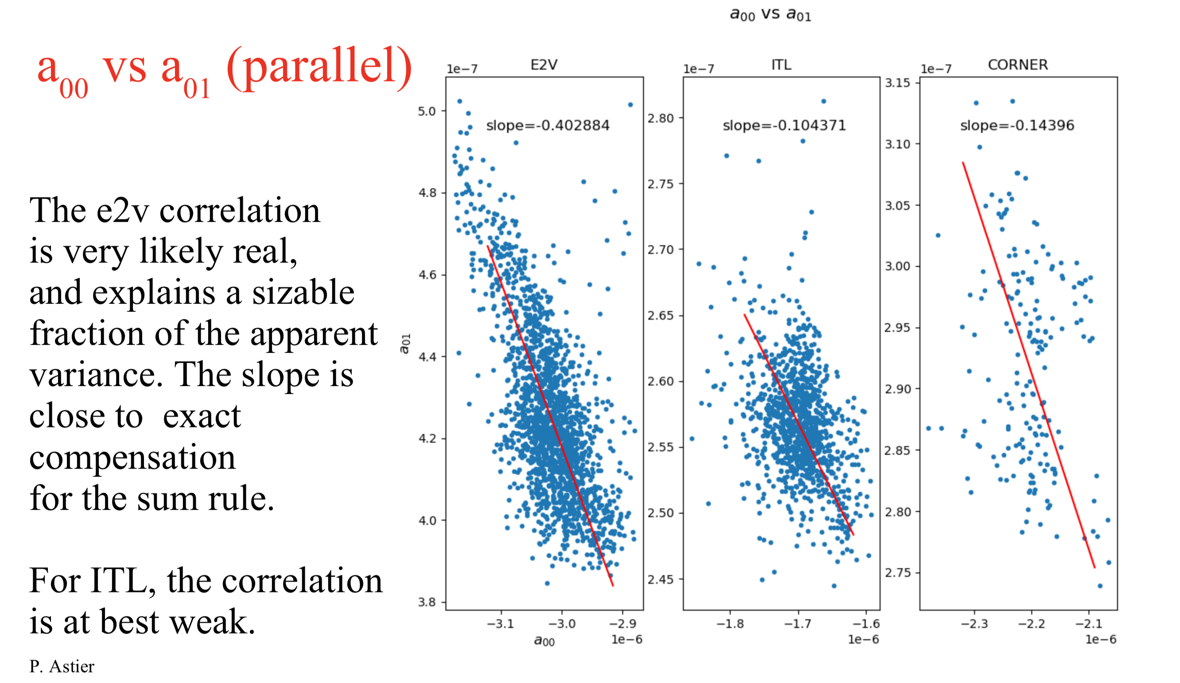
Brighter-fatter
Statistics on coefficients: parallel direction

Slide 28
Sensor anomalies: perspectives
Progress on many of the top concerns
More precision, more effects
Upcoming: last chance for testing run at SLAC, Narrow Beam CCOB
Raft testing available (TS8)
AuxTel available
ComCam: to be continued

Slide 30
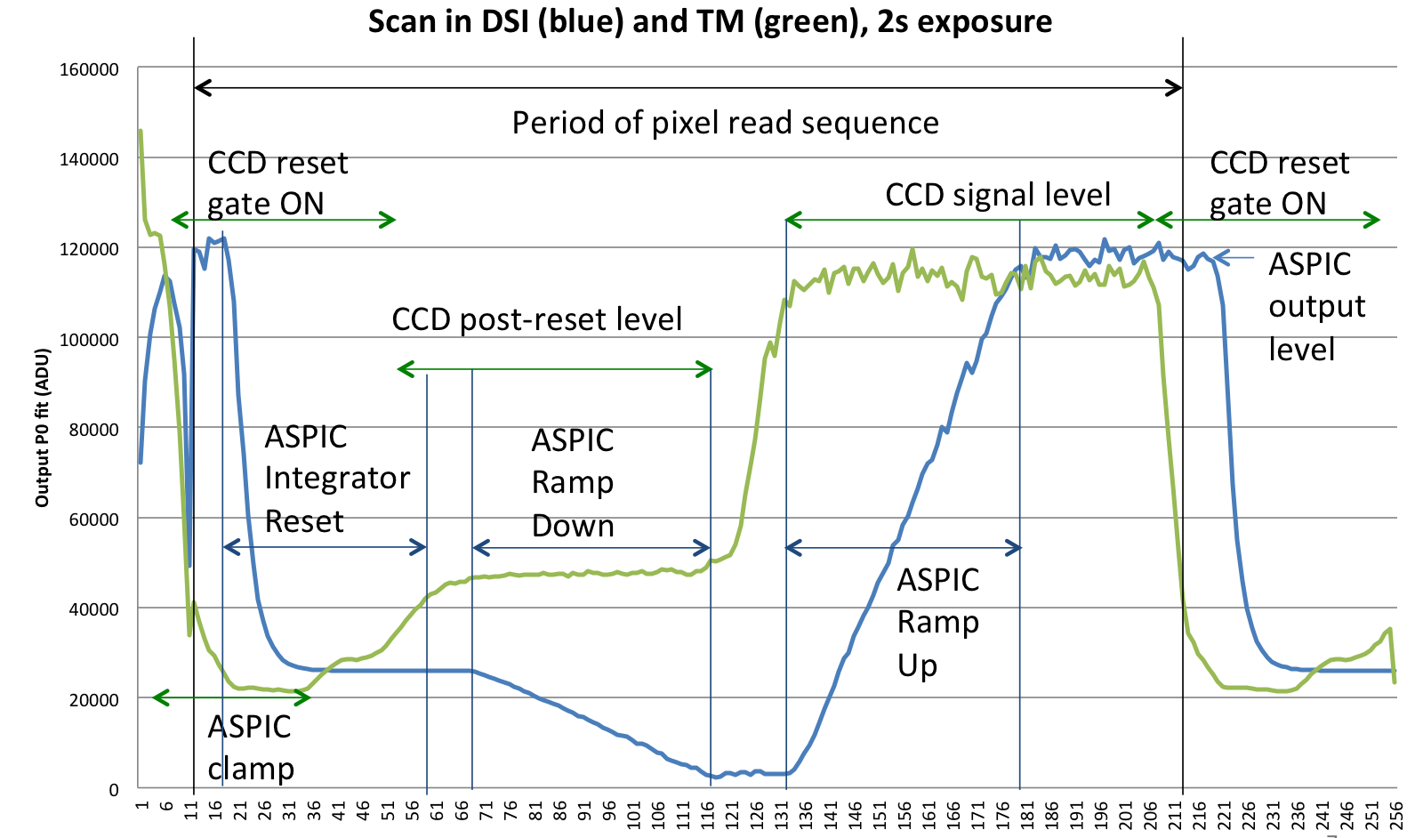
Pixel readout: time scan

Slide 31
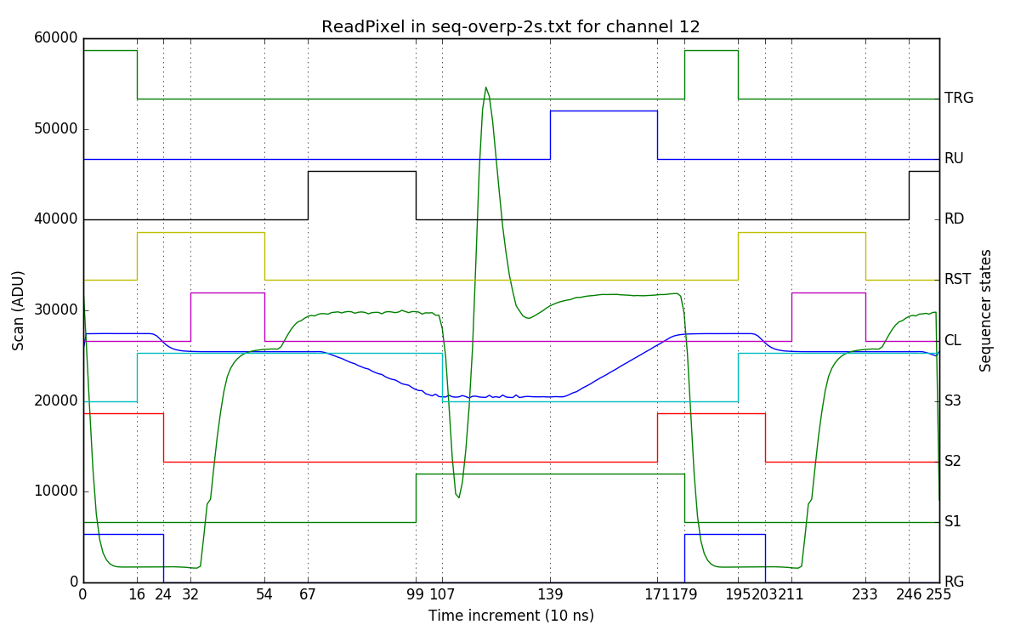
Sequencer clocks and readout
Raw OS
Integrated
ADC trigger
ASPIC signals
CCD serial clocks

