Slide 1
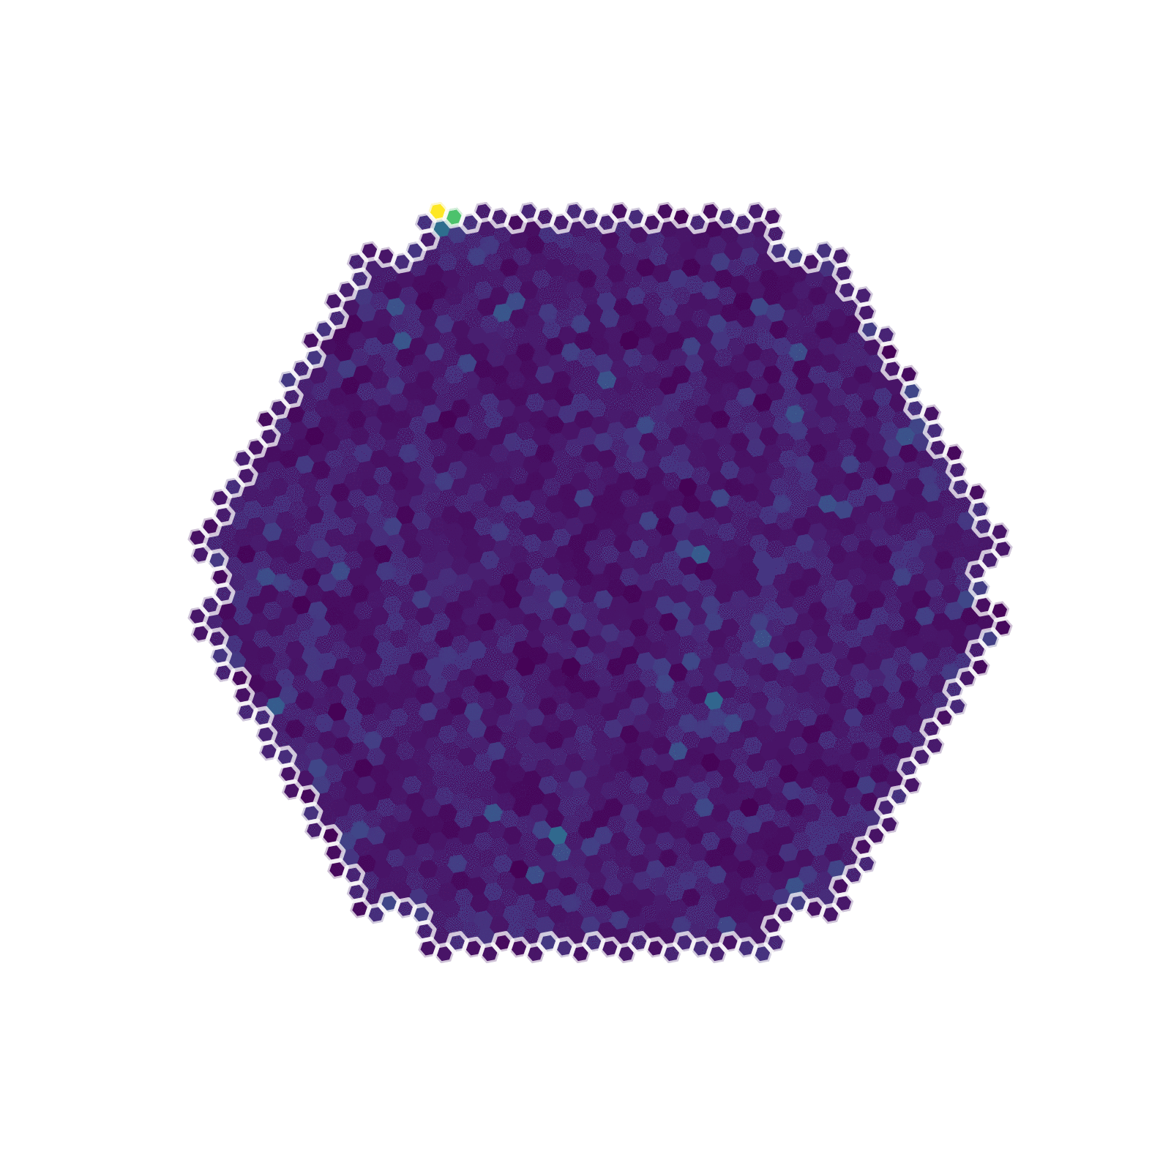
LST data analysis devs @LAPP
Thomas Vuillaume
Jeudi 8 décembre 2022

Slide 2
LST event reconstruction
gamma event
E = 0,189 TeV
Direction = (1,23; 6,22)rad

Slide 3
LST-1 data analysis workflow
DL1
MC test
DL2
MC test
IRFs
+
Sens plots
R1/DL0
MC
Random Forests Training
DL1
MC train
Real data
R0
Real data
DL1
DL3
Real data
DL2
R1 = calibrated waveform signal
DL1 = calibrated images and/or extracted parameters
DL2 = reconstructed events
DL3 = reconstructed photon list

Slide 4
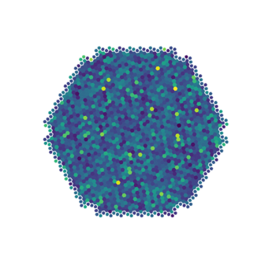
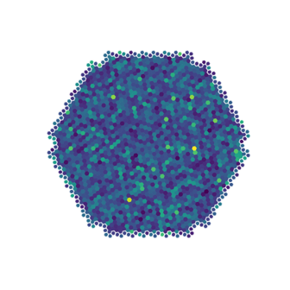
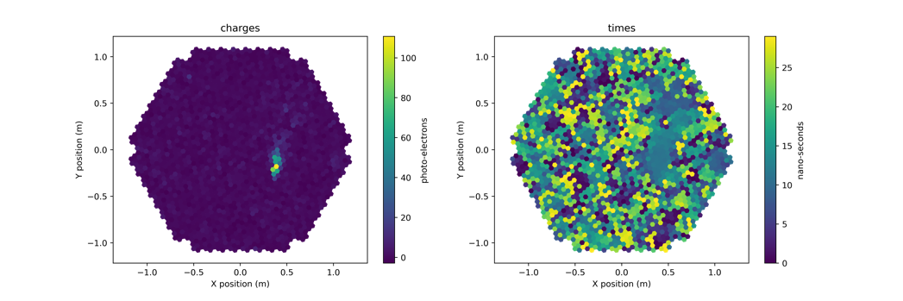
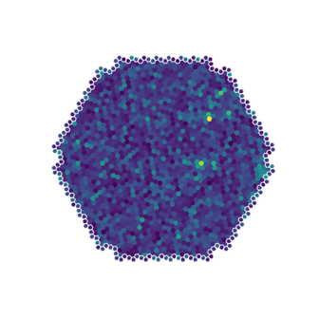
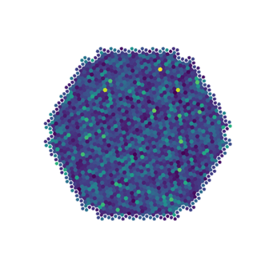
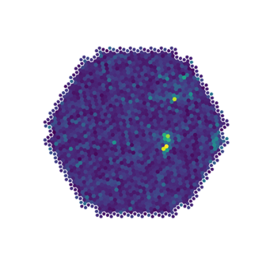
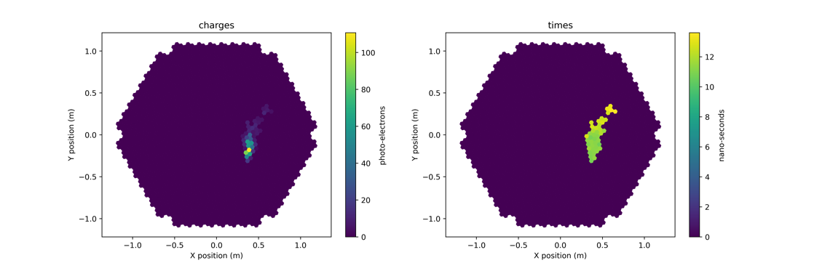
La reconstruction des évènements en 3 étapes
1. Calibration, Intégration
signal
time
2. Traitement du signal : Nettoyage du bruit, Extraction de paramètres d’image
3. Arbres de décisions + simulations Monte-Carlo
→ Paramètres physiques
Paramètres d’image
E = 0,189 TeV

Slide 5
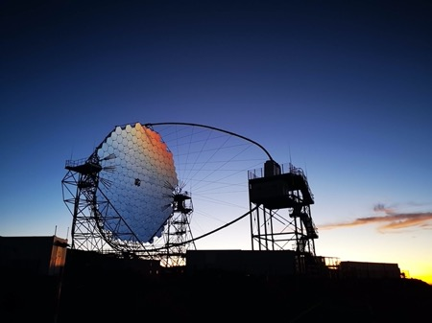
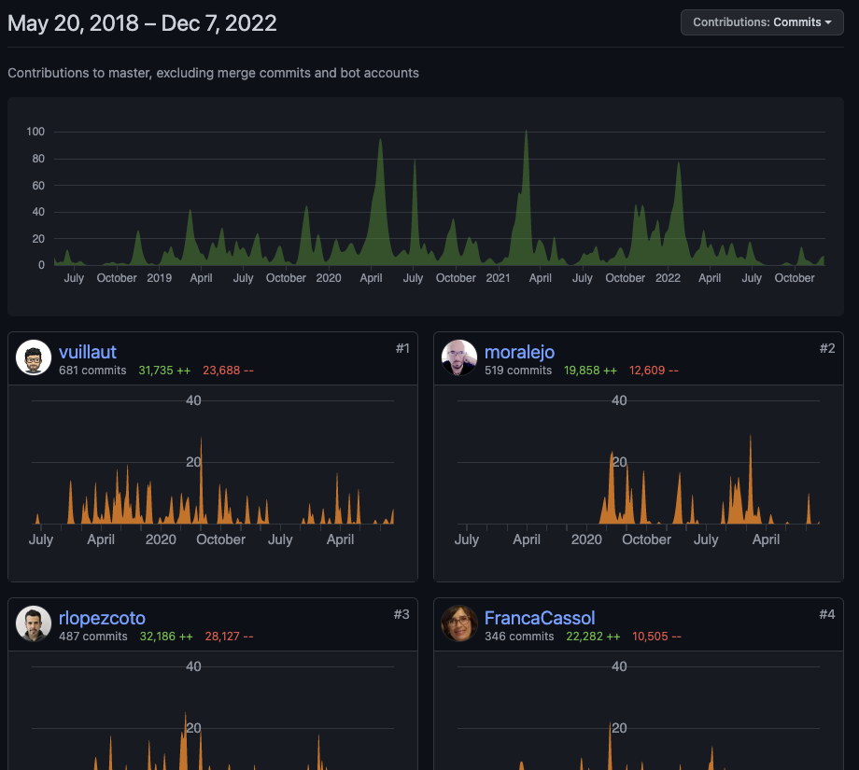
lstchain
Mainteneur et contributeur principal de lstchain. Now v0.9.11
Revue des contributions
https://github.com/cta-observatory/cta-lstchain/

Slide 6
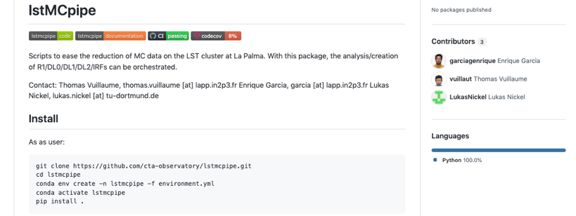
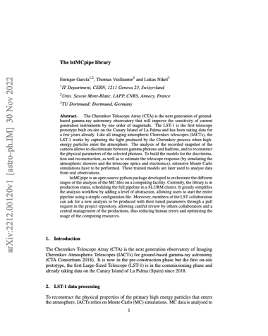
lstmcpipe
Python library, now v0.9.0
https://github.com/cta-observatory/lstmcpipe
https://cta-observatory.github.io/lstmcpipe
Manage the complete workflow (job orchestration) to analyse MC data on the cluster onsite
Simplifies greatly the life of LST analysers by training the random forests and producing the IRFs automatically
Users can request an analysis through GitHub pull requests
ADASS 2022 conference proceedings:
https://arxiv.org/abs/2212.00120
Enrique Garcia

Slide 7
lstmcpipe
DL1
MC test
DL2
MC test
IRFs
+
Sens plots
R1/DL0
MC
Random Forests Training
DL1
MC train
Real data
R0
Real data
DL1
DL3
Real data
DL2
R1 = calibrated waveform signal
DL1 = calibrated images and/or extracted parameters
DL2 = reconstructed events
DL3 = reconstructed photon list

Slide 8
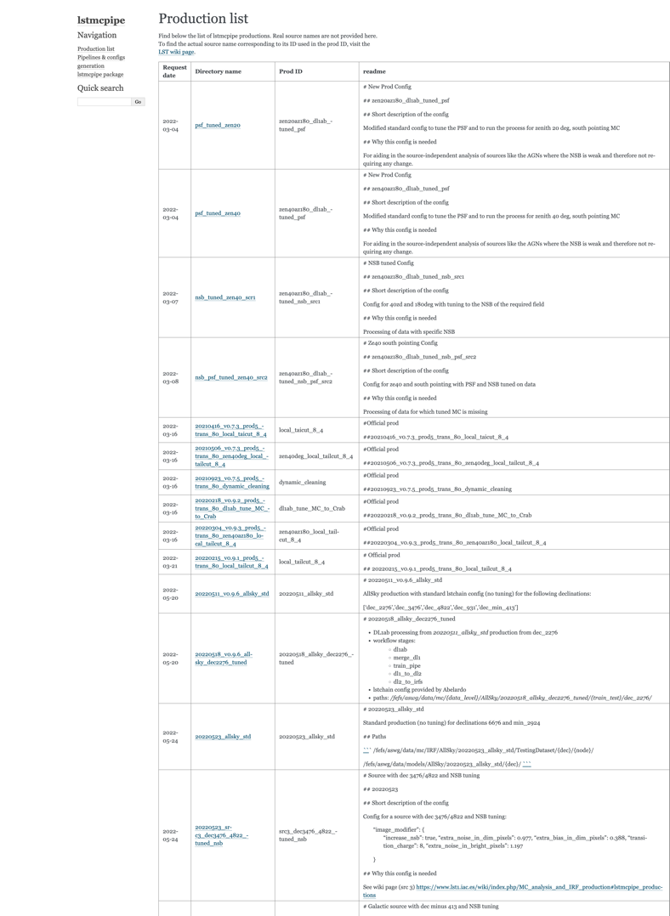
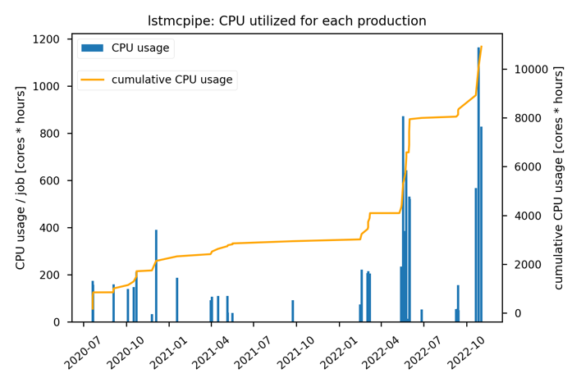
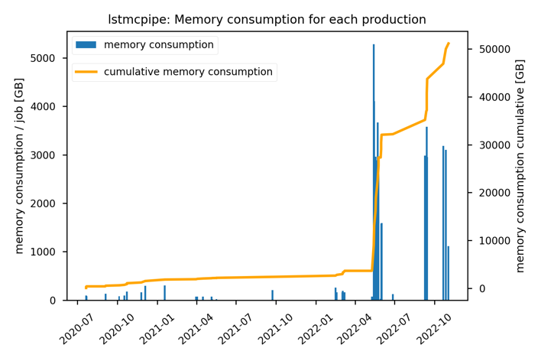
lstmcpipe

Slide 9
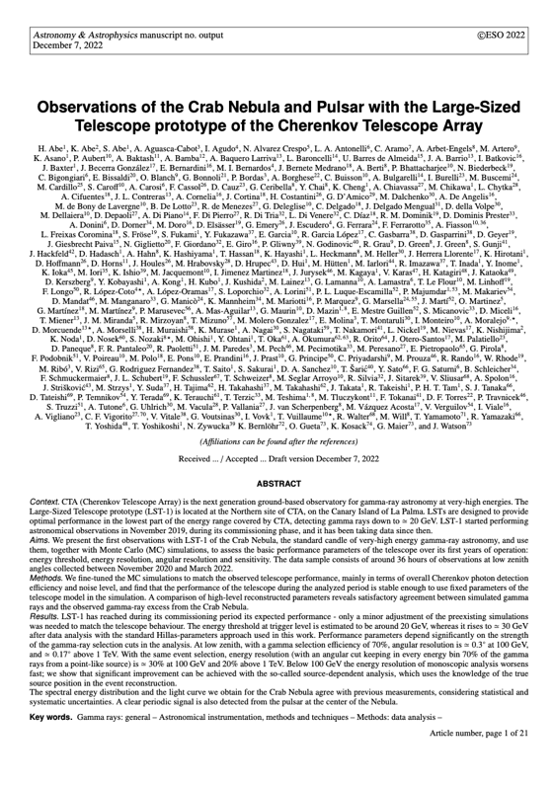
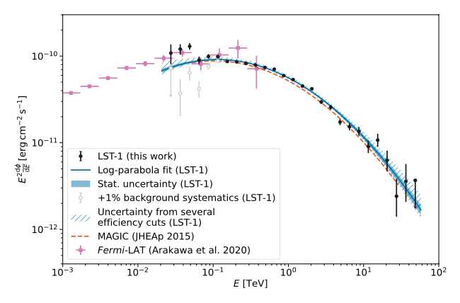
LST-1 performance paper
Corresponding author with Abelardo, Ruben, Seiya and Daniel
Has been reviewed – some changes required
To be published very soon 🤞

Slide 10

GammaLearn
1. Calibration, Intégration
signal
time
2. Traitement du signal : Nettoyage du bruit, Extraction de paramètres d’image
3. Arbres de décisions + simulations Monte-Carlo
→ Paramètres physiques
Paramètres d’image
E = 0,189 TeV

Slide 11
GammaLearn
1. Calibration, Intégration
signal
time
2. Traitement du signal : Nettoyage du bruit, Extraction de paramètres d’image
3. Arbres de décisions + simulations Monte-Carlo
→ Paramètres physiques
Paramètres d’image
E = 0,189 TeV

Slide 12
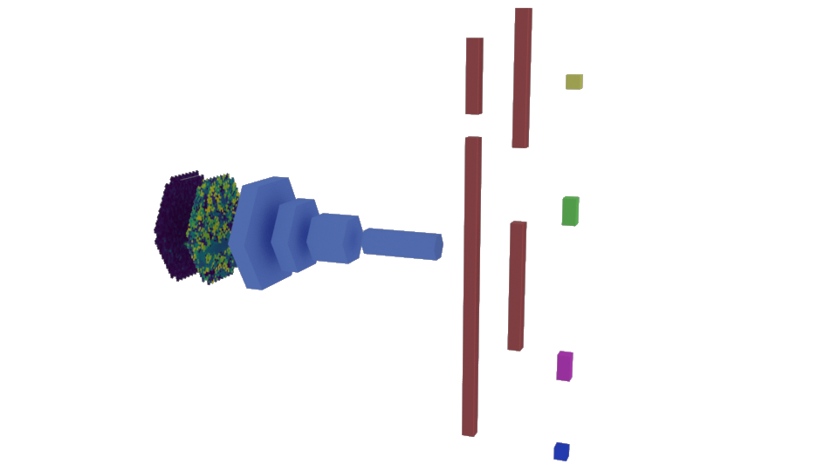

GammaLearn : γ−PhysNet
Full-event reconstruction from LST1 data
  A single network
  Gamma/proton discrimination
  Direction and energy reconstruction
Image charge + temporal info
Convolution block:
  ResNet-56 backbone
  Full pre-activation
  Indexed Convolutions
Energy
Global pool
Impact
flatten
Direction
Convolution block
Particle type
Multi-task block
Mikaël Jacquemont

Slide 13
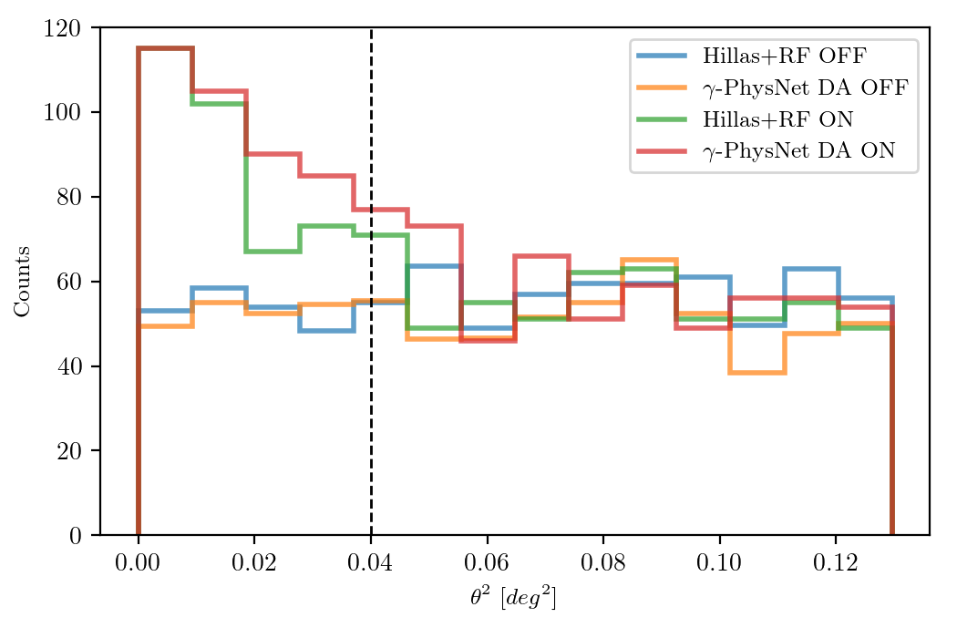
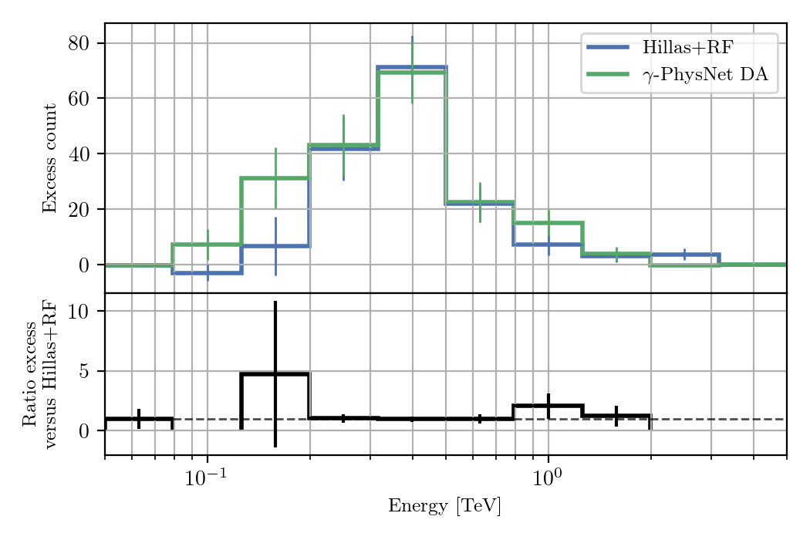
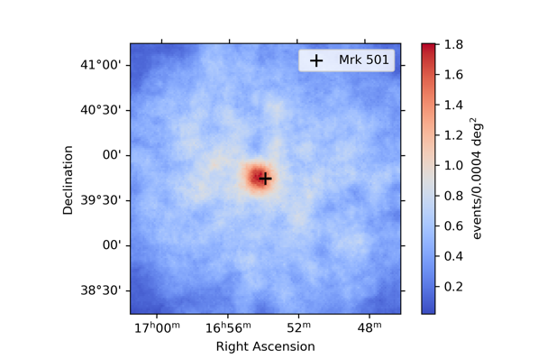
GammLearn Results on Mrk501 observations
 | Bkg | Excess | Significance
Hillas+RF | 238.3 | 148.7 | 7.6 𝜎
γ-PhysNet DA | 226.3 | 192.75 | 9.8 𝜎
T. Vuillaume et al,
ICRC 2021,
arXiv:2108.04130
+30%
Mikaël Jacquemont, Mathieu de Bony

Slide 14
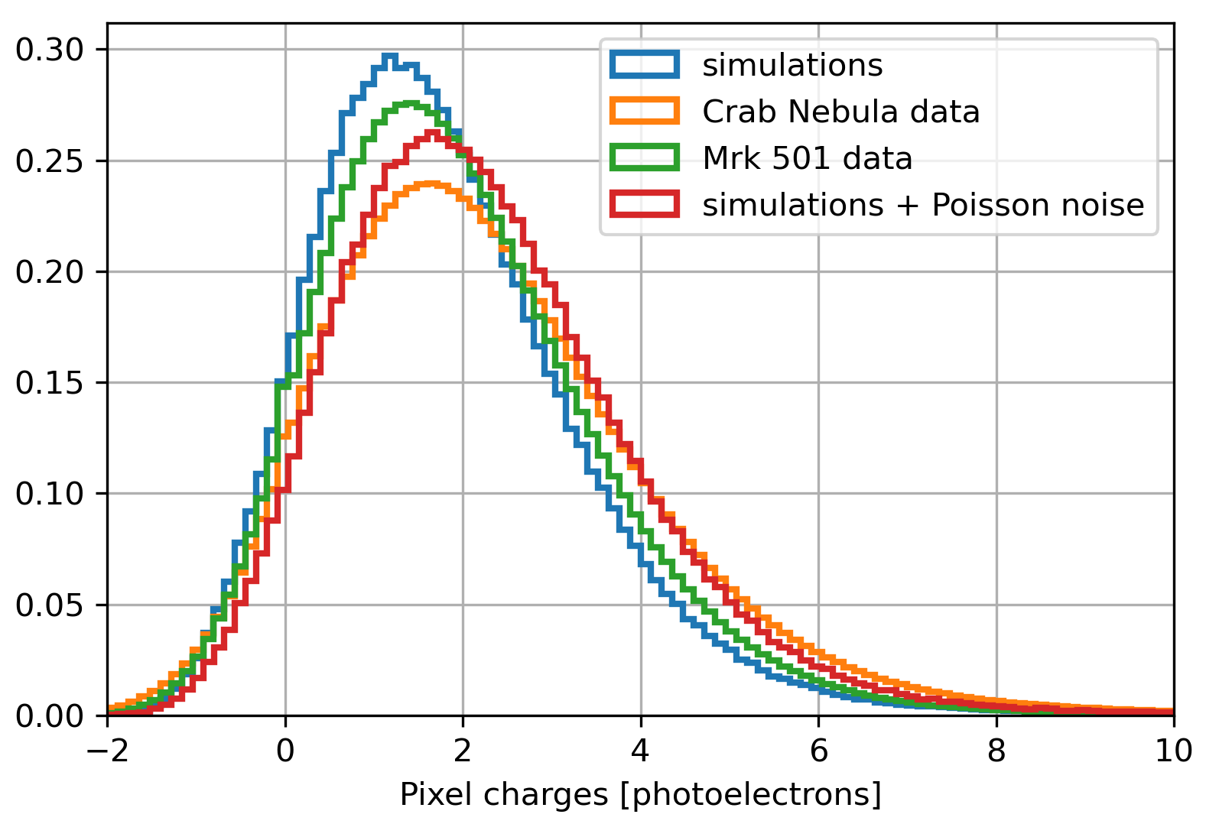

GammLearn Results on Crab observations
Matching NSB by adding Poisson noise to MC DL1 before re-training
Δ𝜆
M. Jacquemont et al, CBMI 2021,
doi: 10.1109/CBMI50038.2021.9461918.

Slide 15
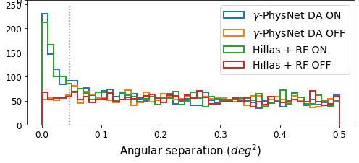
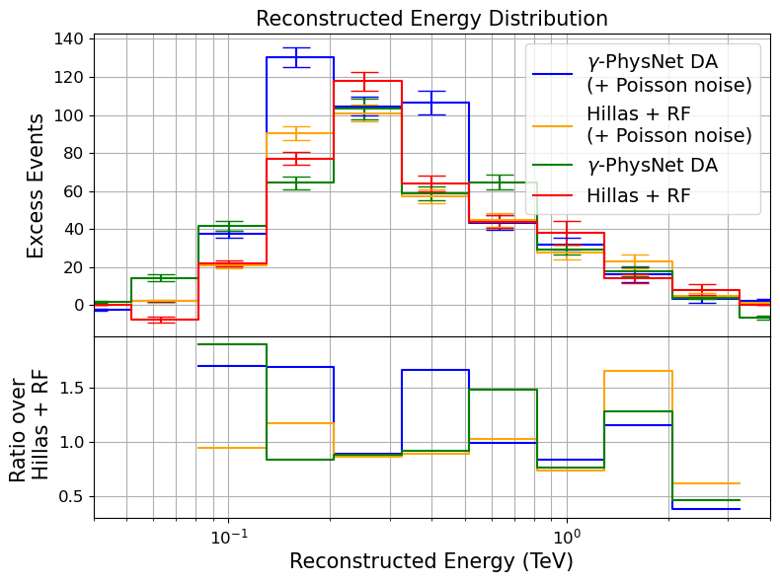
GammLearn Results on Crab observations
 | Bkg | Excess | Significance
Hillas+RF | 308 | 379 | 12.0 𝜎
Hillas + RF + noise | 305 | 376 | 11.9 𝜎
γ-PhysNet DA | 302 | 395 | 12.5 𝜎
γ-PhysNet DA + noise | 317 | 476 | 14.3 𝜎
+26%
M. Jacquemont et al, CBMI 2021,
doi: 10.1109/CBMI50038.2021.9461918.
Mikaël Jacquemont

Slide 16
Michaël Dell’aiera

Slide 17
Michaël Dell’aiera

Slide 18
Michaël Dell’aiera

Slide 19
Michaël Dell’aiera

Slide 20
Conclusion
Publication (&) plan for 2023:
Conference paper in Computer Science on domain adaptation with multitasking (applied to common datasets such as MNIST and cityscapes)
Conference and/or journal paper the application of the method to LST-1 data analysis
Journal paper on Transformers for CTA event reconstruction (if all goes well)
Brondon will help deploy in production at La Palma so LST analysers can use GammaLearn for data analysis
https://gammalearn.pages.in2p3.fr/pages/

