Slide 1
Arches LST

Slide 2
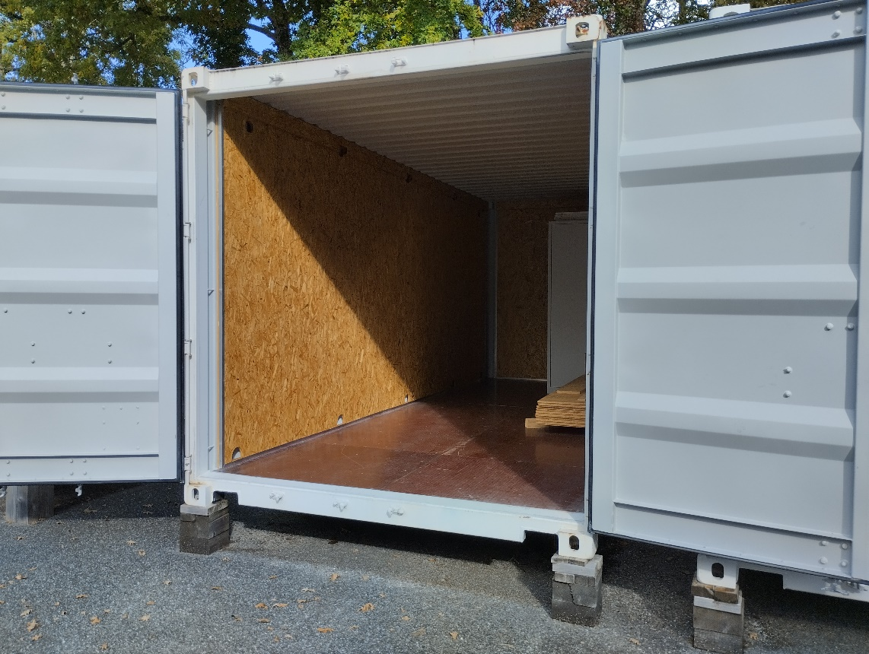
Les activités du groupe
Masse additionelles et palonnier
Production load pin
Pb tolerance load pin
Status prod LST 2 et suivant
Containeur outillage

Slide 3
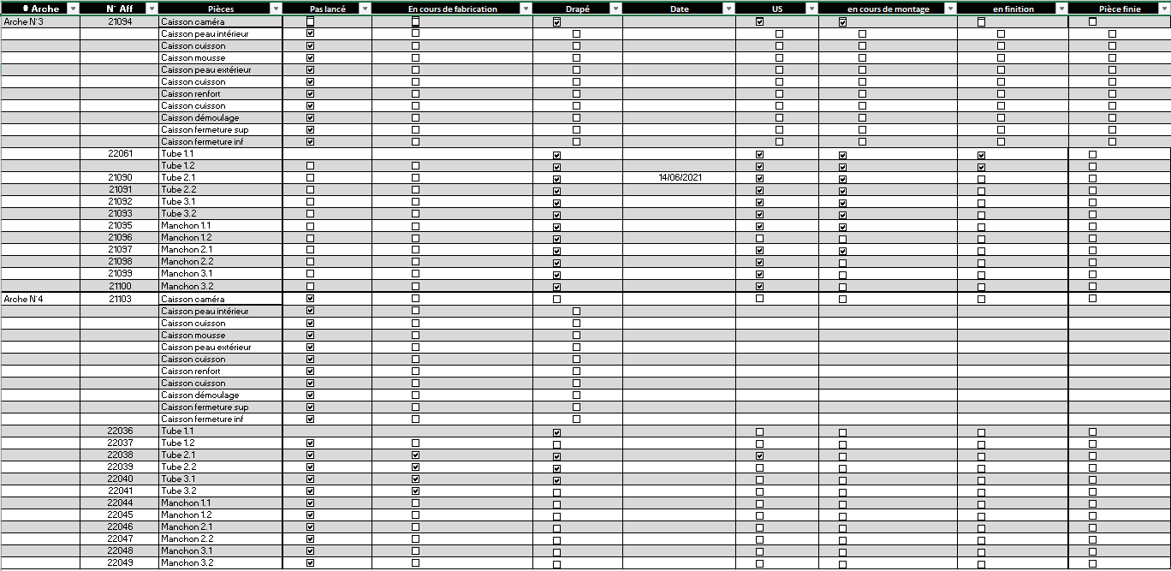
Production LST2-4
Production status :
LST 2 almost finished : currently performing rails implementation
All tubes for LST 3 cured, currently being post produced (assembly process)
Some tubes of LST 4 already cured

Slide 4
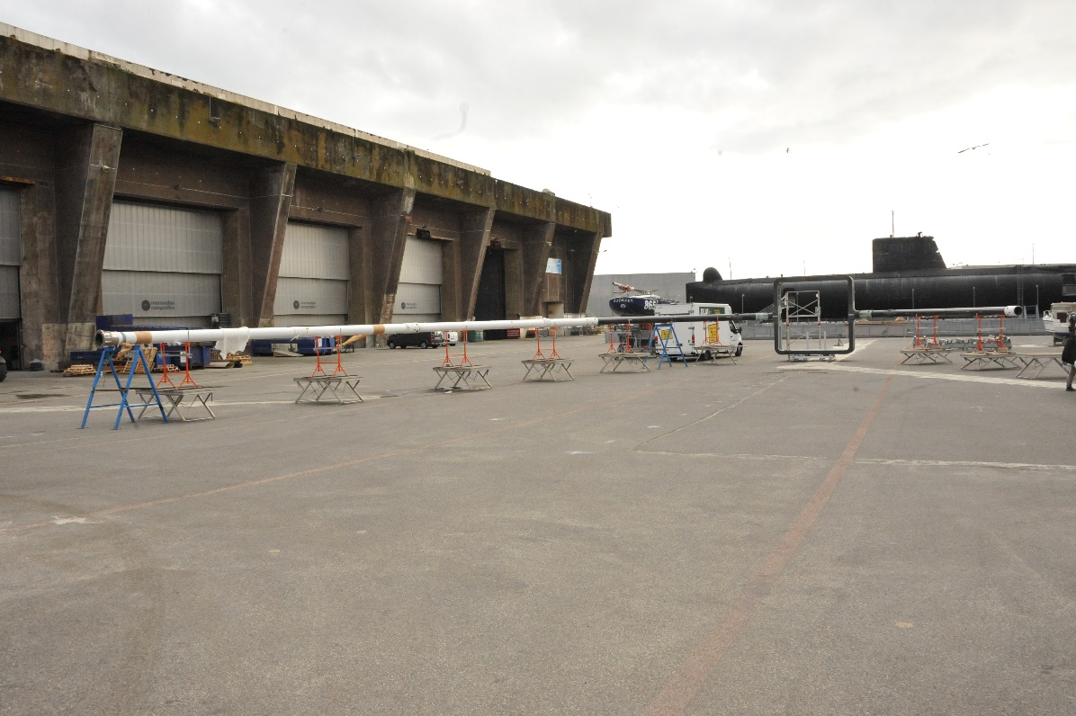
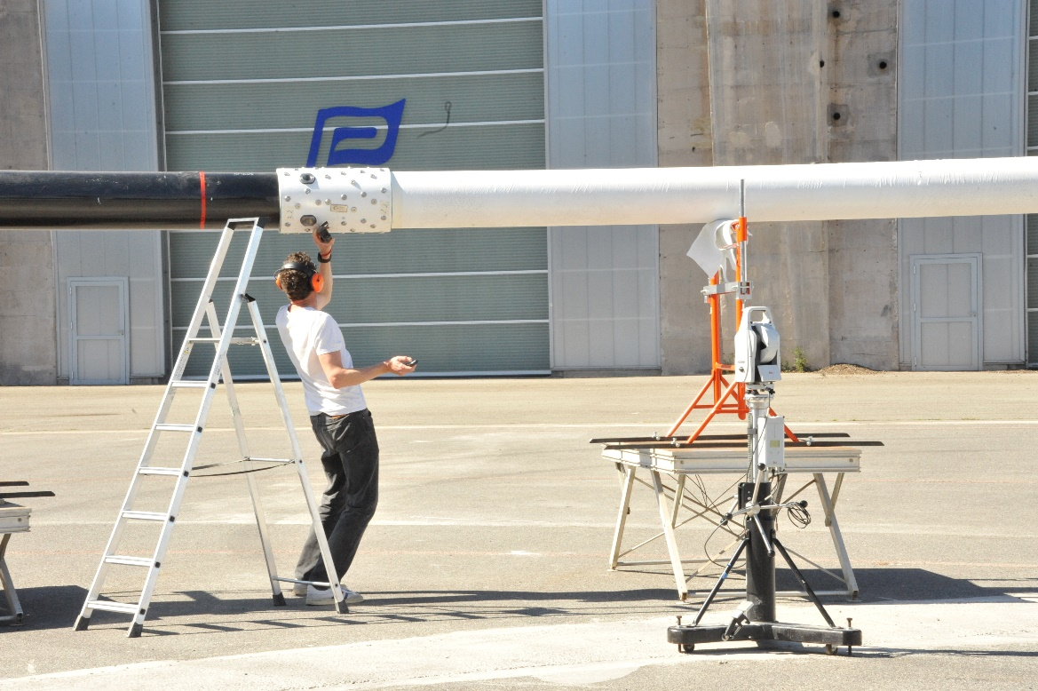
Montage a blanc LST2
LST 2 trial mounting & 3D checked passed in April 2022

Slide 5
Camera frame counterweight

Slide 6
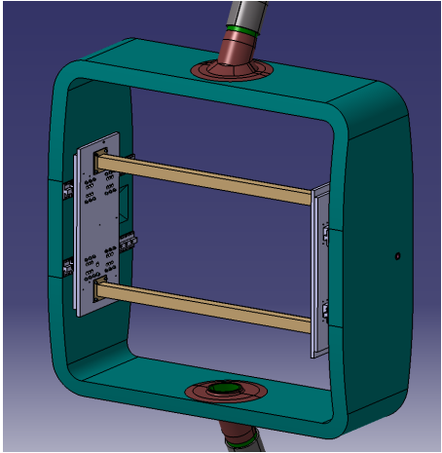
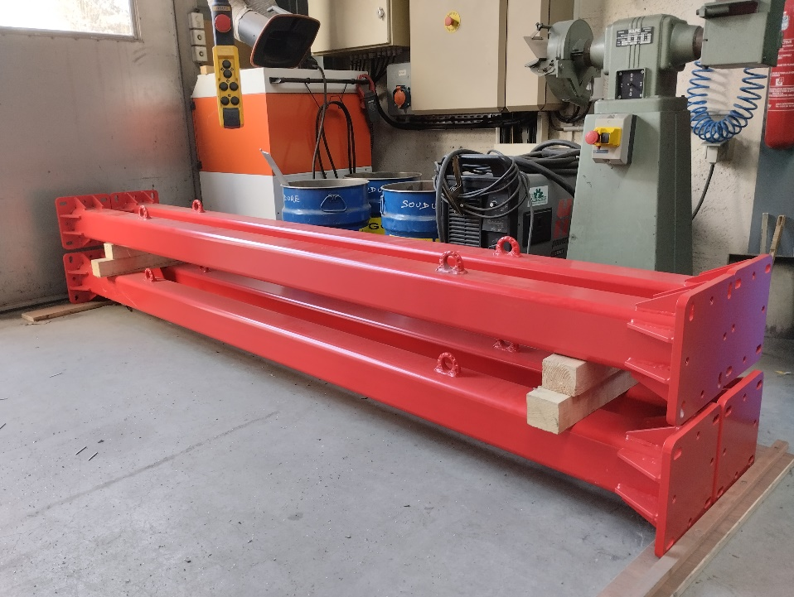
Camera frame counterweight

Slide 7
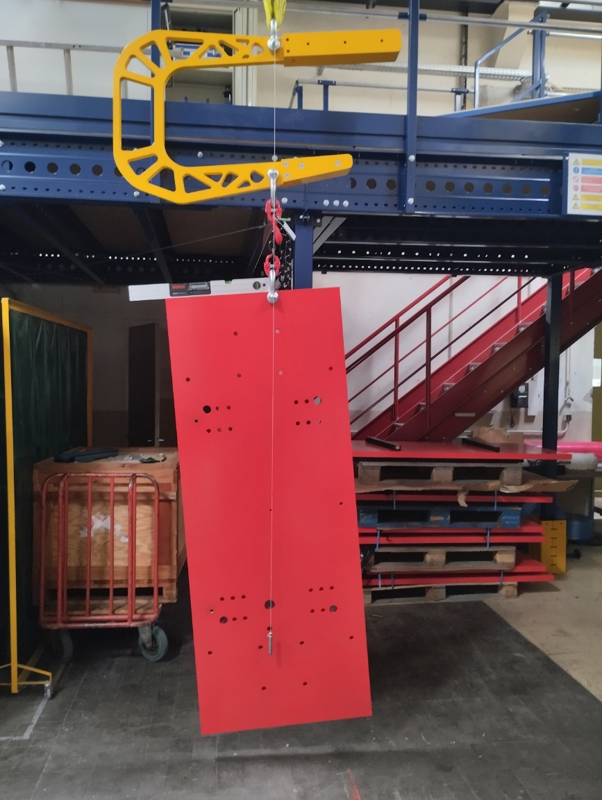
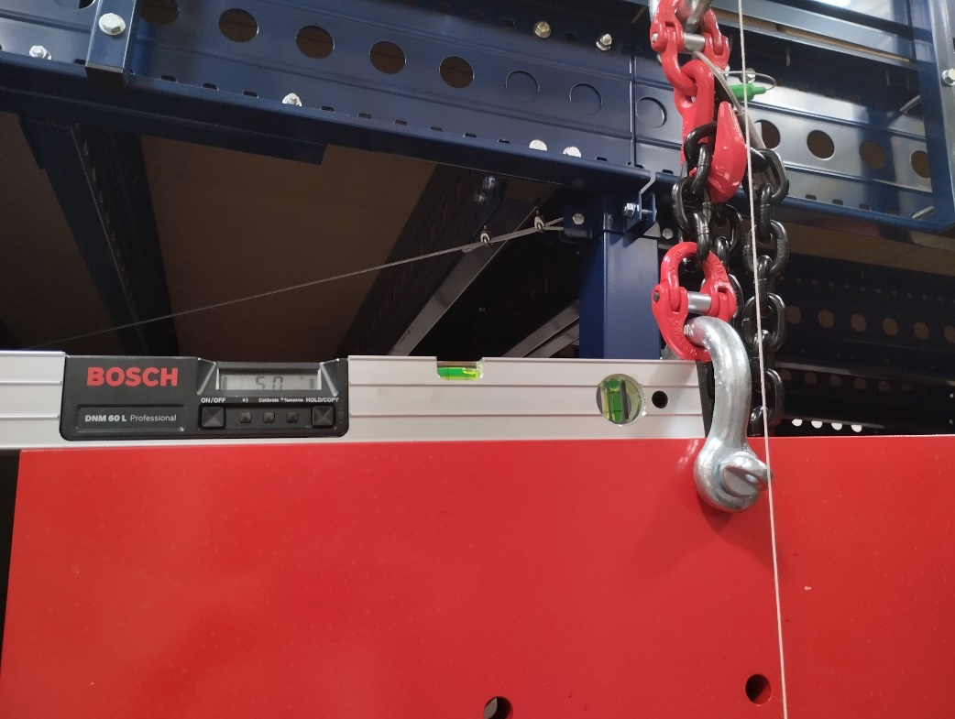
Camera frame counterweight
2 sets of 4 plates produced
One C shape spreader
Balanced as expected
4 spacing bars

Slide 8
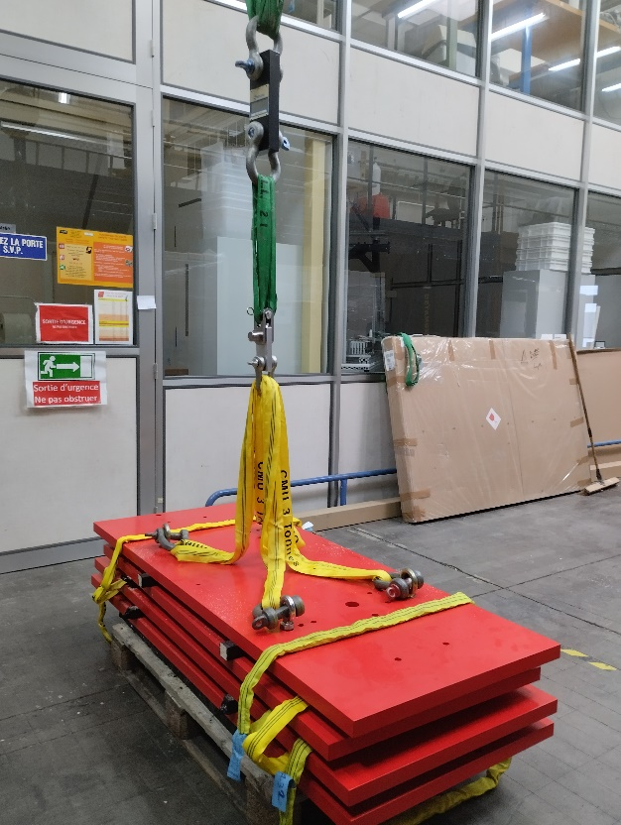
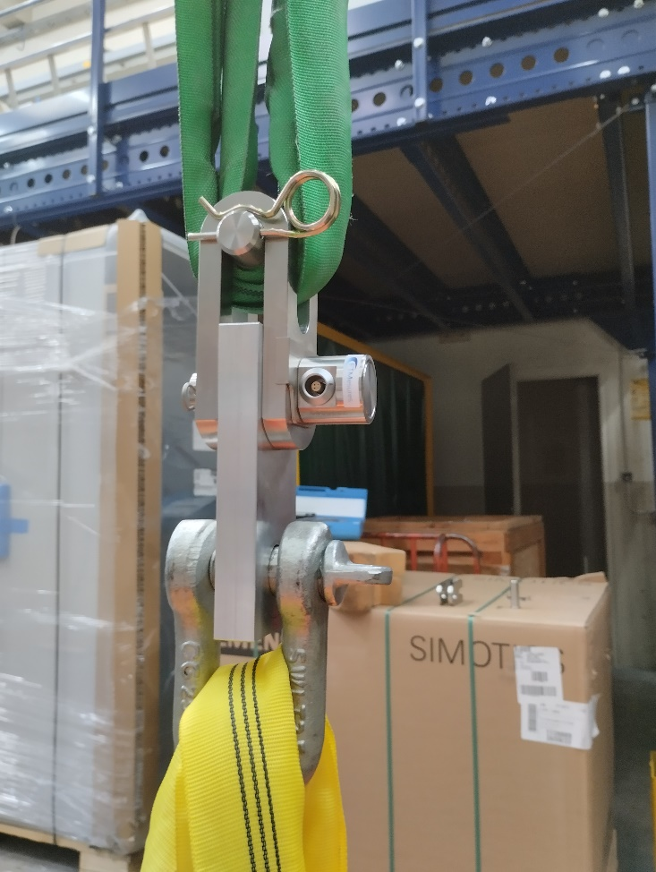
Load pin
Call for tender placed and goods delivered
78 Dynamometric axes for LST 2 to 4
2 +2 spare parts
Different supplier from LST 1
Delivery checks in progress

Slide 9
Training & Safety
We are going to refresh our training for :
Rope climbing activities
Cheery picker licence
Safety officer
If an intervention on LST 1 is still planned for this summer we will be ready to help :
We have ideas on how to release CF wire tensions to enable and perform needed work
Needs to be defined more precisely in collaboration with joseph and holger
Do we take the advantage of this operation to purchase and replace out of services load pins (need to be anticipated)

