Slide 1
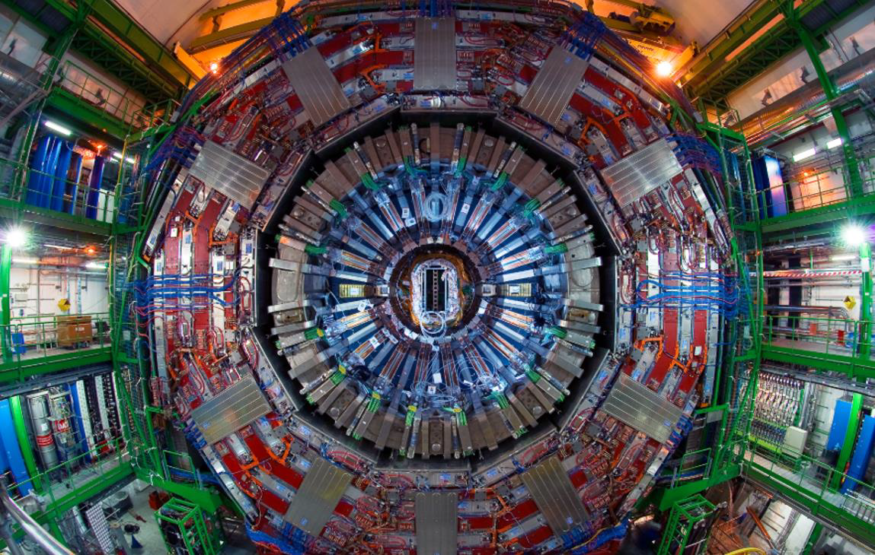




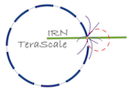
Search for a low-mass resonance in diphotons with CMS
Based on CMS-PAS-HIG-20-002
Suzanne GASCON-SHOTKIN
IP2I Lyon (IN2P3-CNRS)/Université Claude Bernard Lyon 1
on behalf of the CMS Collaboration
IRN Terascale@LPSC Grenoble (FR)
April 25, 2023

Slide 2

Outline
“Search for a standard model-like Higgs boson in the mass range between 70 and 110 GeV in the diphoton final state in proton-proton collisions at √s= 13 TeV” Full LHC Run 2 data!
CMS-PAS-HIG-20-002 http://cms-results.web.cern.ch/cms-results/public-results/preliminary-results/HIG-20-002/
Presented for the first time last month at EW
Motivation
Analysis strategy, event selection, changes wrt previous publication
Signal and background modeling
Results
Comparison with ATLAS results
First theoretical interpretations
Conclusions and perspectives
Acknowledgements
Credit: CMS Low-Mass H→γγ team
2

Slide 3
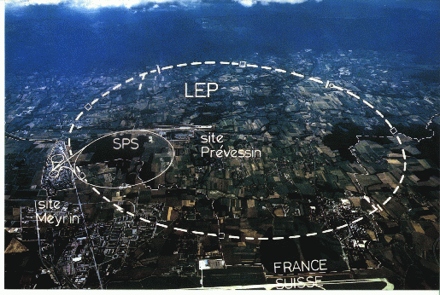
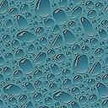
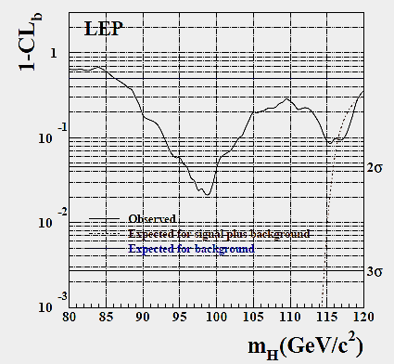
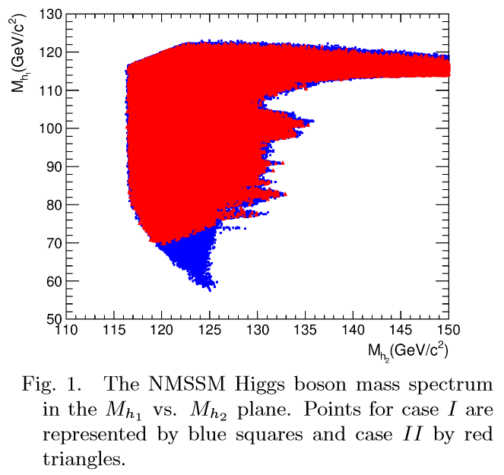
Motivation for low-mass diphoton searches
Final LEP SM Higgs boson search results: >2σ excess at mH= 98 GeV. Has contributed to sustained interest by both theorests and experimentalists in the possibility of additional low-mass (pseudo-) scalars
Much theoretical activity since then: Numerous BSM models allow a resonance with m<125 GeV coexisting with the Higgs boson discovered in 2012 GeV (generalized 2HDM, NMSSM, Higgs triplet….)
LEPHWG, Phys. Lett. B565:61-75,2003
J. Fan et al., Chinese Phys. C 38 073101
S. Gascon-Shotkin IRN Terascale@LPSCGrenoble Apr 25 2023

Slide 4
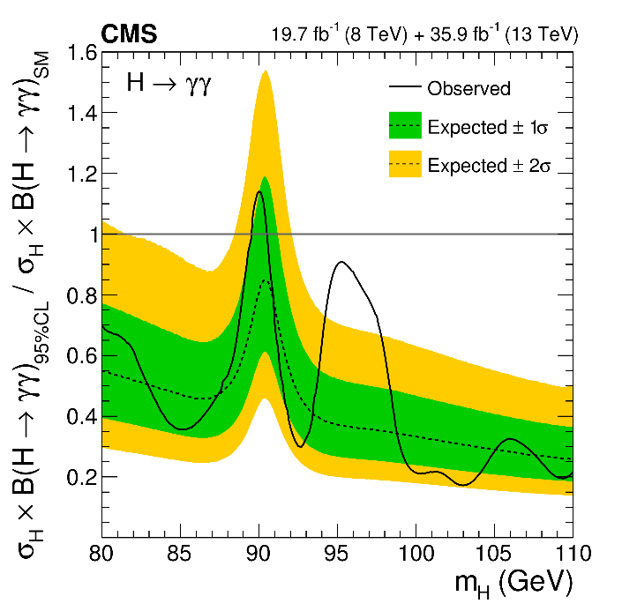
SM-like H→γγ (70 GeV<m_{H}<110 GeV)
CMS-PAS-HIG-20-002
  http://cms-results.web.cern.ch/cms-results/public-results/preliminary-results/HIG-20-002/
Search for narrow signal peak over smoothly-falling background (direct γγ , reducible γ + jet, jet+jet processes) except for relic Z→ee
Event reconstruction/selection, γ ID techniques (BDTs), signal and data-driven background modeling with discrete profiling method inherited from SM H→γγ analysis
Major changes wrt prior version (PLB 793 (2019) 320) (2012+2016 data):
  Kinematic event selection BDT (p_{T}/m_{γγ}, η , cos(φ₁−φ₂), both PhotonID BDT outputs, mass resolution wrt correct and incorrect vertices, vertex probability) reoptimized and events categorized for low-mass case
  Electron/relic Z→ee veto (based on pixel detector hits) reinforced with:
    Rejection of photon candidates also reconstructed as electrons
    Maximum value of ln (Σp_{T}²/GeV²)[tracks in chosen vertex] as function of p_{Tγγ}
  2017/18: Events with additional jets selected for class targeting VBF process
  2016: data reanalyzed with improved calibration
Major systematic uncertainties: per-photon energy resolution <20%, renormalization and factorization scales<14%, UE modeling <27%, PS<16%, JES corrections (VBF class) <16%.
PLB 793 (2019) 320

Slide 5
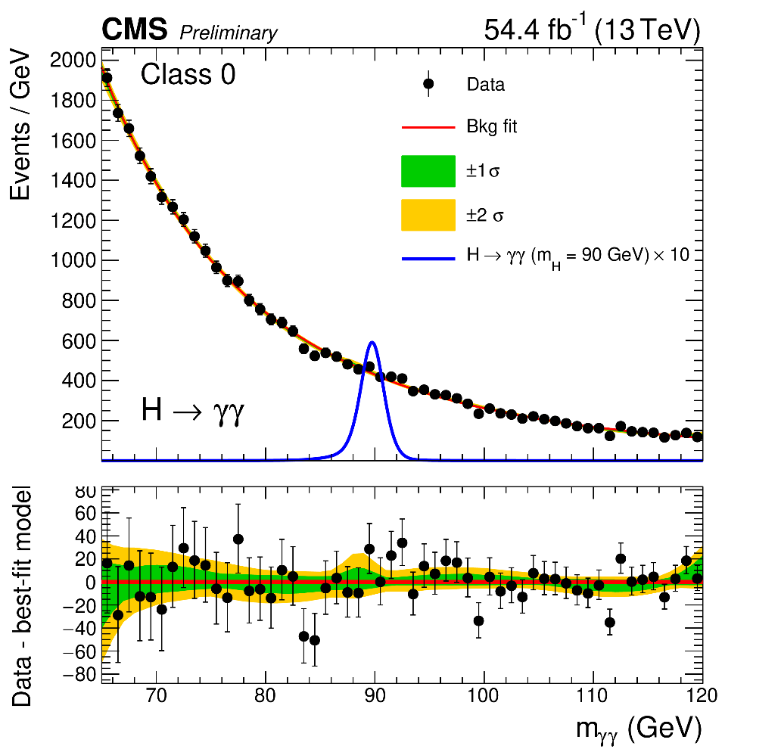
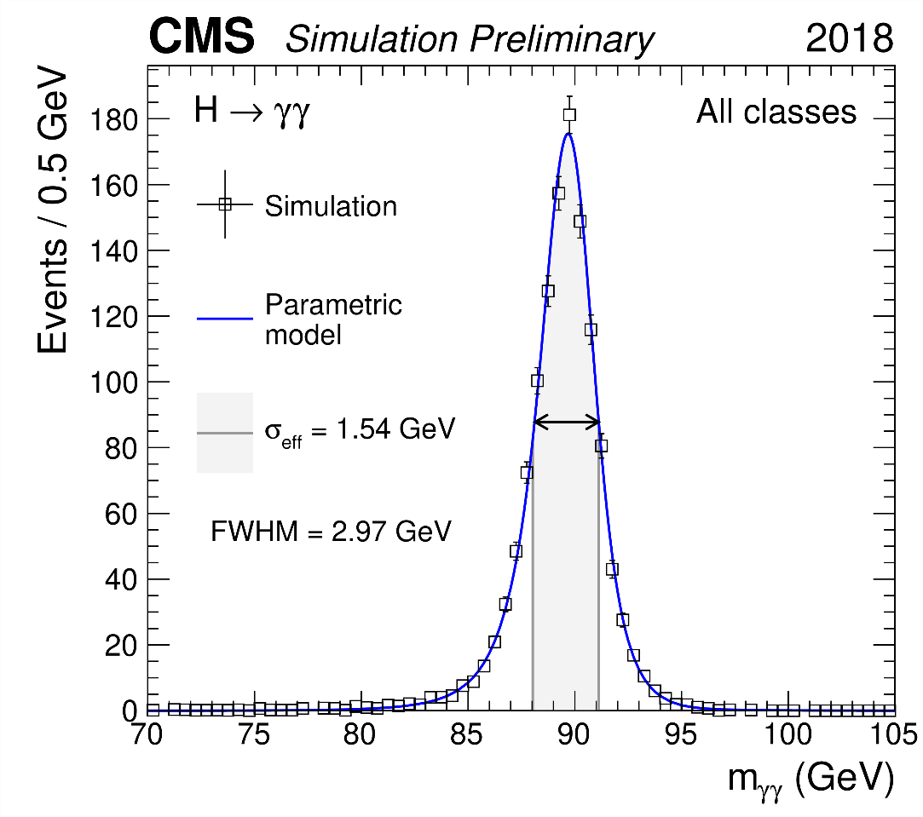
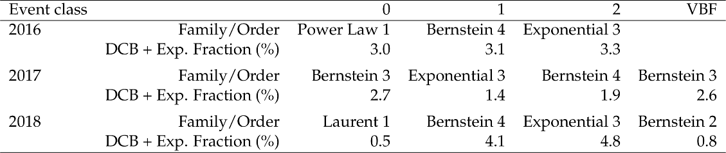
SM-like H→γγ (70 GeV<m_{H}<110 GeV)
CMS-PAS-HIG-20-002
  http://cms-results.web.cern.ch/cms-results/public-results/preliminary-results/HIG-20-002/
Signal modeling (sum of Gaussian functions): ggH, ttbarH, VBF, VH production processes present in SM proportions, ‘SM-like’ σ from LHC Higgs WG
Background model fit, stat.uncertainties only, 2018
Best-fit background functions w/DCB+exponential fractions
Background modeling (discrete profiling): Sums of continuous functions (different families/orders) with DCB+exponential (normalization floating)

Slide 6
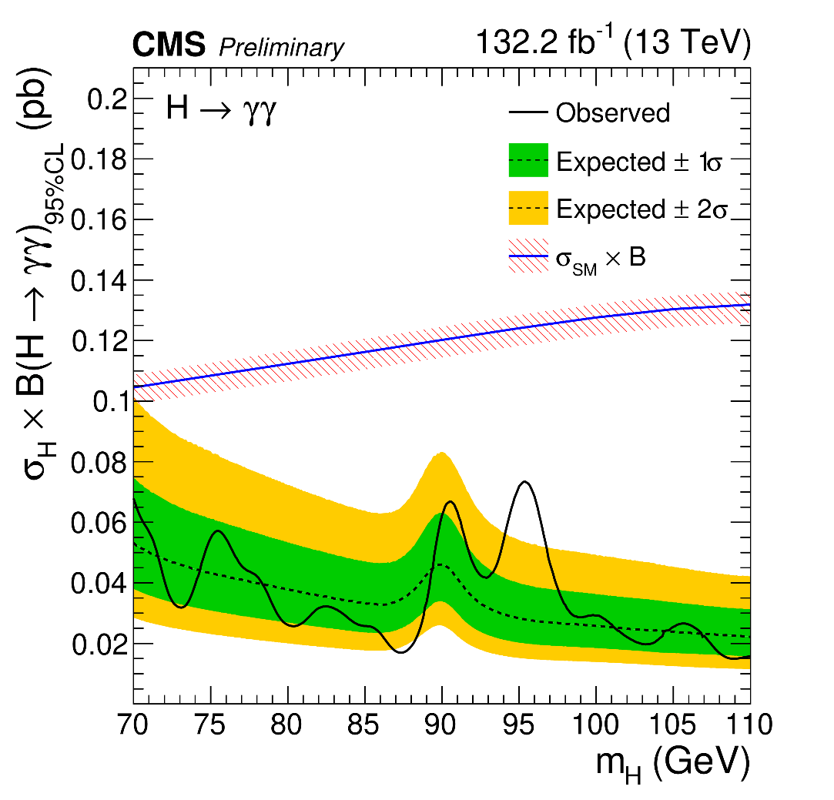
SM-like H→γγ (70 GeV<m_{H}<110 GeV)
CMS-PAS-HIG-20-002
  http://cms-results.web.cern.ch/cms-results/public-results/preliminary-results/HIG-20-002/
Observed and expected 95% CL UL on σ X B relative to SM-like expectation (production processes assumed in SM proportions)
Observed absolute 95% CL UL on σ X B between 15-73 fb

Slide 7
SM-like H→γγ (70 GeV<m_{H}<110 GeV)
CMS-PAS-HIG-20-002
  http://cms-results.web.cern.ch/cms-results/public-results/preliminary-results/HIG-20-002/
Observed local p-values for 2016, 2017, 2018 and combination
S/(S+B)-weighted m_{γγ} distribution with S+B fit for m_{H} =95.4 GeV
Modest excess with ~2.9σ local (1.3σ global) significance at m_{γγ}=95.4 GeV, more data needed to conclude!

Slide 8
SM-like H→γγ (70 GeV<m_{H}<110 GeV)
CMS-PAS-HIG-20-002
  http://cms-results.web.cern.ch/cms-results/public-results/preliminary-results/HIG-20-002/
Observed and expected 95% CL limits on σ X B by production process (integrated over all event classes)
100% production via gluon-induced processes (ggH, ttbarH in SM proportions)
100% production via fermion-induced processes (VBF, VH in SM proportions)
100% production via VBF
100% production via VH

Slide 9
SM-like H→γγ (70 GeV<m_{H}<110 GeV)
CMS-PAS-HIG-20-002
  http://cms-results.web.cern.ch/cms-results/public-results/preliminary-results/HIG-20-002/
‘Signal’ strengths μ fixing m_{H}=95.4 GeV
for the 11 event classes : χ² compatibility probability: 68%
for the 3 years χ² compatibility probability: 6%
First search for new diphoton resonances in this mass range with full LHC Run 2 data!

Slide 10
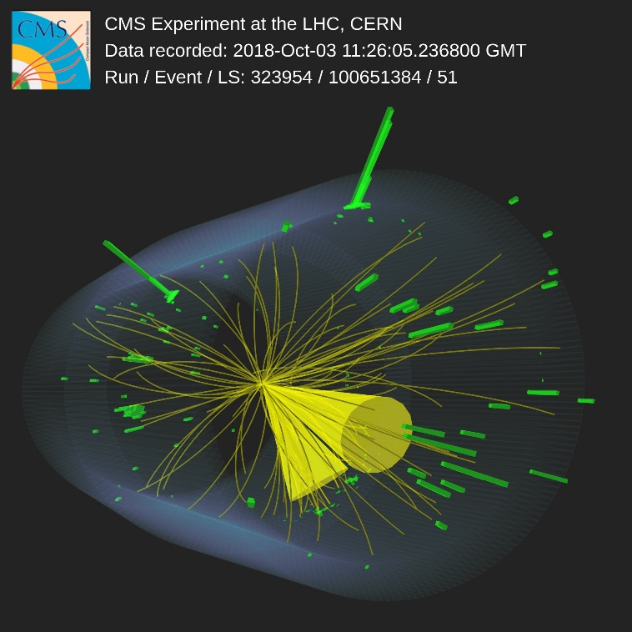
(credit event display: Tom McCauley)
Event recorded in 2018 selected by the analysis
2 photons and 2 jets

Slide 11
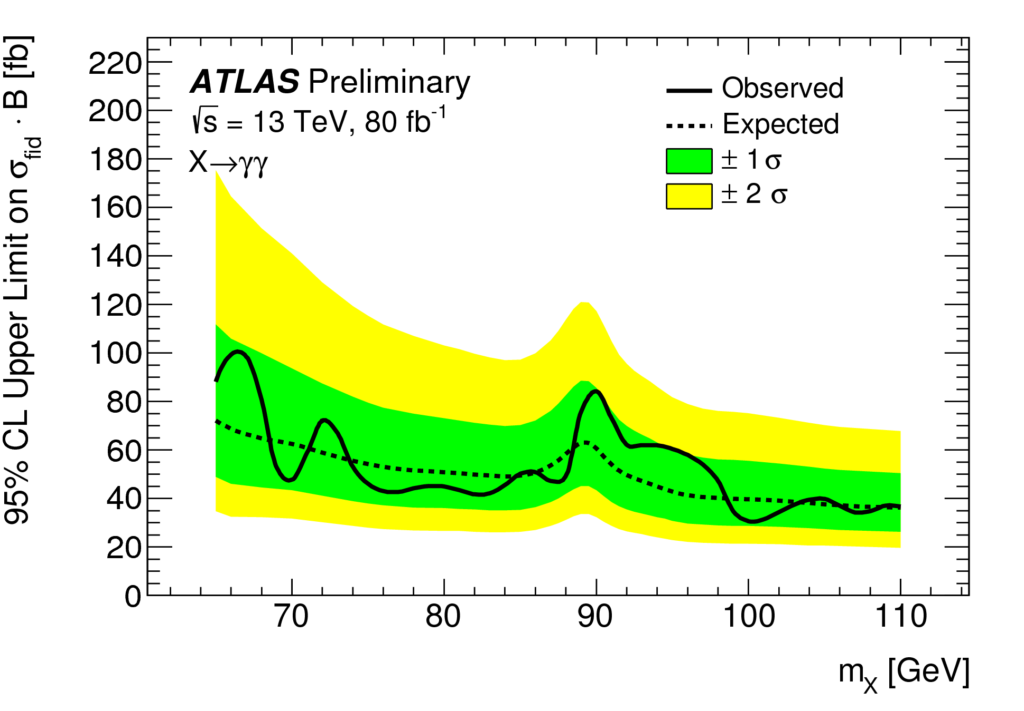
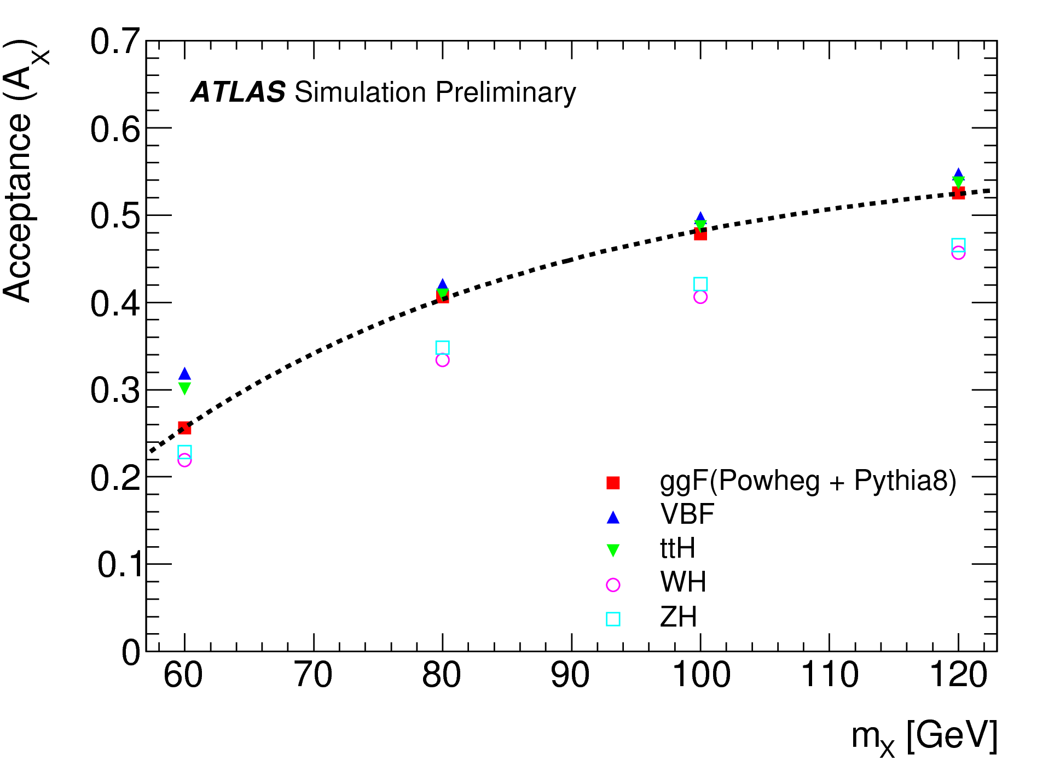
SM-like H→γγ (70 GeV<m_{H}<110 GeV)
CMS-PAS-HIG-20-002
  http://cms-results.web.cern.ch/cms-results/public-results/preliminary-results/HIG-20-002/
These results
Most recent ATLAS results: ATLAS-CONF-2018-025 (2016+2017)
Limit on fiducial σXB
Observed absolute 95% CL UL on total σ X B between 15-73 fb
Notes:
fix animations

Slide 12
SM-like H→γγ (70 GeV<m_{H}<110 GeV)
CMS-PAS-HIG-20-002
  http://cms-results.web.cern.ch/cms-results/public-results/preliminary-results/HIG-20-002/
First theoretical interpretation of these results: arXiv 2303.12018 (Biekoetter, Heinemeyer, Weiglein): 2HDM + complex singlet model (S2HDM) compatible with excesses at ~95 GeV for m_{γγ} (this analysis) and m_{bb} (LEP) for Types II and IV, also with m_{ττ} (CMS, arXiv:2208.02717, subm. JHEP) for Type IV (points in agreement with all experimental and theoretical bounds)
Model contains 3 CP-even (h₁, h₂, h₃), 1 CP-odd (A) neutral, 2 charged (H⁺⁻) and 1 DM (χ) scalars
Model types similar to those in 2HDM

Slide 13
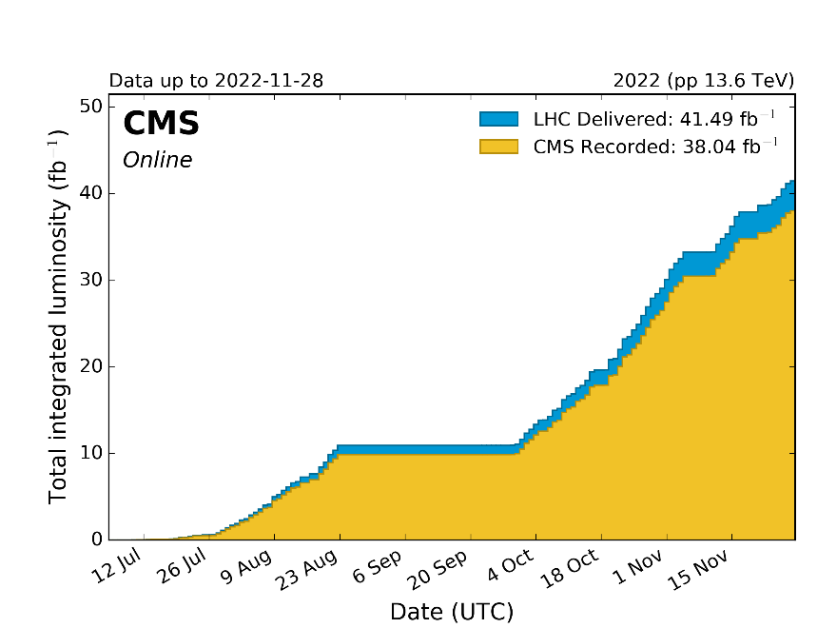
Conclusions and Perspectives
Presented new CMS search for additional low-mass SM-like H→γγ (70 GeV<mH<110 GeV) using full LHC Run 2 data: No evidence for the existence of extra Higgs bosons found so far
Modest excess at m_{γγ}=95.4 GeV with 2.9σ local (1.3σ global) significance.
First diphoton resonance search in this mass range with full LHC Run 2 data
More (Run 3) data is needed to conclude on the nature of this excess….and it’s on it’s way! (250fb⁻¹)
2022~2016
https://twiki.cern.ch/twiki/bin/view/CMSPublic/LumiPublicResults
13
https://hilumilhc.web.cern.ch/content/lhc-baseline

Slide 14
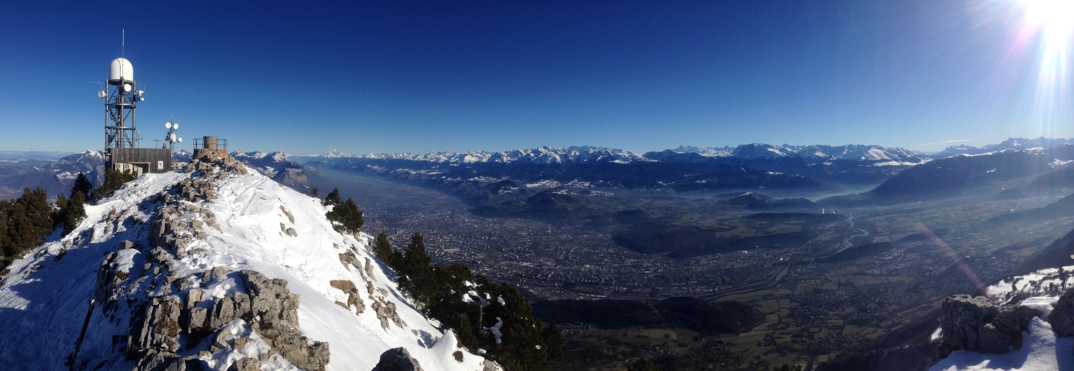
Acknowledgements
Th. Biekoetter, F. Canelli, A. DeWit, L. Finco, S. Heinemeyer, M. Lethuillier, H. Mei, M. Pierini, M. A. Shahzad, J. Steggemann, J. Tao, G. Weiglein…
Thanks to the Terascale@LPSC organization!

Slide 15
Backup

