Slide 1
KAGRA: Large Cryogenic Gravitational Wave Telescope
International Conference on the Physics of Two Infinities
Masaki Ando (Univ. of Tokyo)
On behalf of the KAGRA collaboration

Slide 2
GW-Related Presentations
* Mon, March 27
- Takahiro Tanaka: What can we learn from gravitational waves ?
- Patrice Verdier: The Einstein Telescope project
- Michael Page: Status of squeezing and quantum enhancement
for gravitational wave detection at NAOJ
* Tue, March 28
- Jonathan Gair: Machine learning for gravitational wave inference
- Kipp Cannon: LIGO-Virgo-KAGRA Observational Results and Outlook
* Wed, March 29
- Several presentations in the parallel session
* Thu, March 30
- Masaki Ando: KAGRA: Large Cryogenic Gravitational Wave Antenna
- Fabio Garufi: Advanced Virgo+ Status and Perspectives

Slide 3
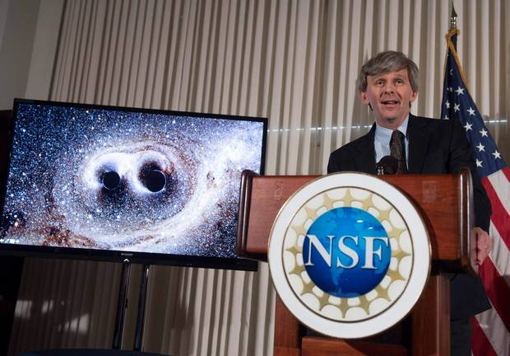
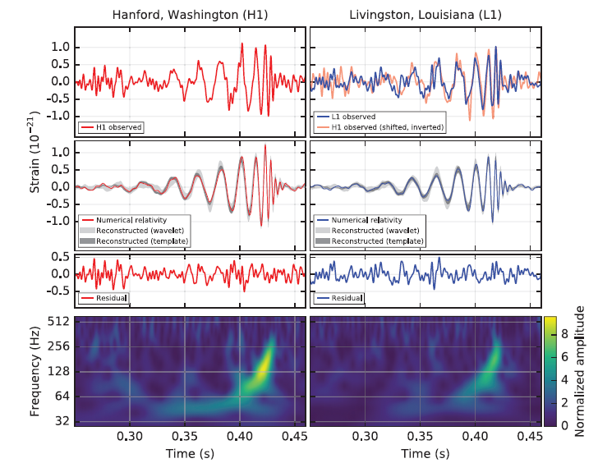
First Detection of GW
・On Feb. 11th, 2016, LIGO announced first detection
of gravitational wave. The signal was from inspiral
and merger of binary black hole at 410Mpc distance.
Opens a new field of ‘GW astronomy’.
Courtesy Caltech/MIT/LIGO Laboratory

Slide 4
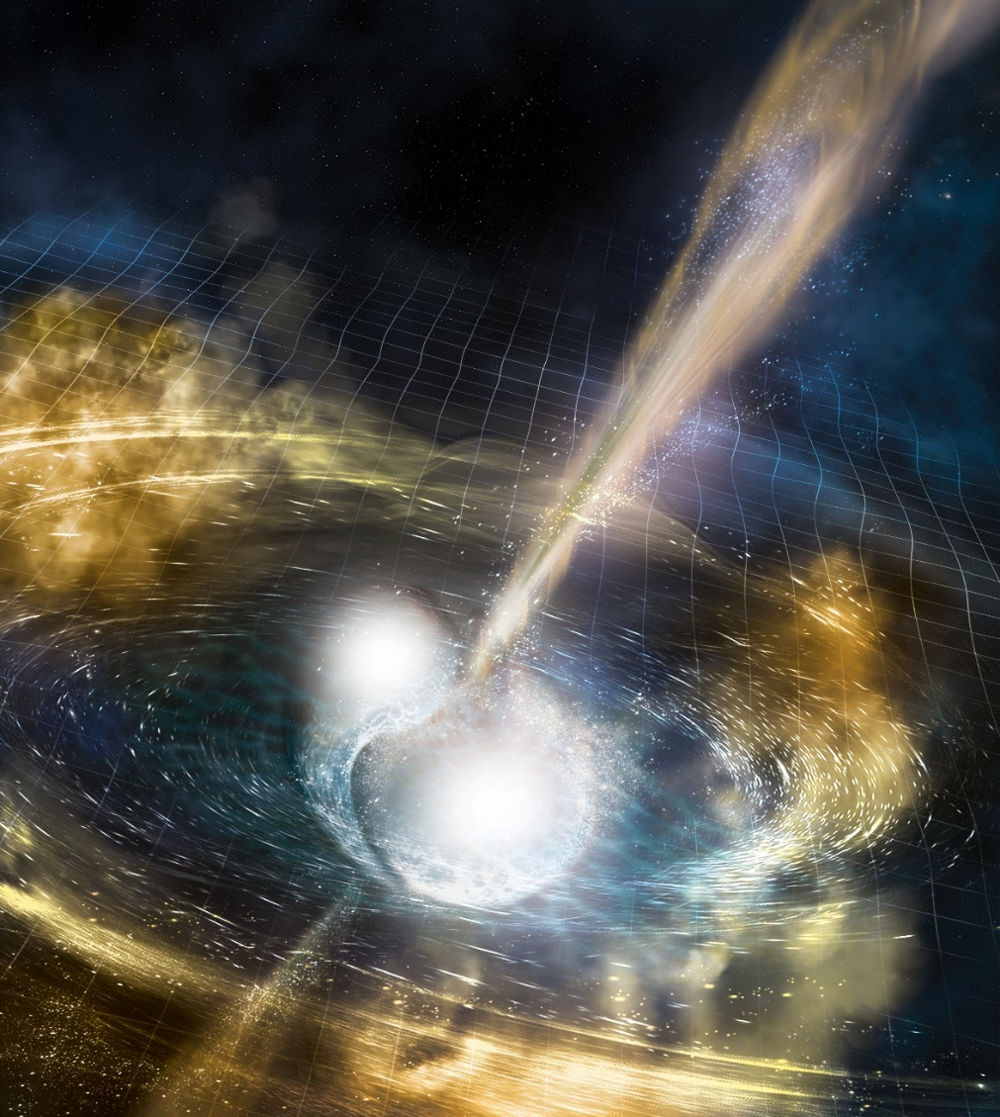
Merger of Binary Neutron Stars
・On Oct.16th, 2017,
LIGO-VIRGO collaboration
announced the first detection
of gravitational-wave signal
from merger of binary
neutron stars
・The signal was detected on
August 17th, 2017.
→ Named GW170817.
・Source Localization ~30deg²
Courtesy Caltech/MIT/LIGO Laboratory

Slide 5
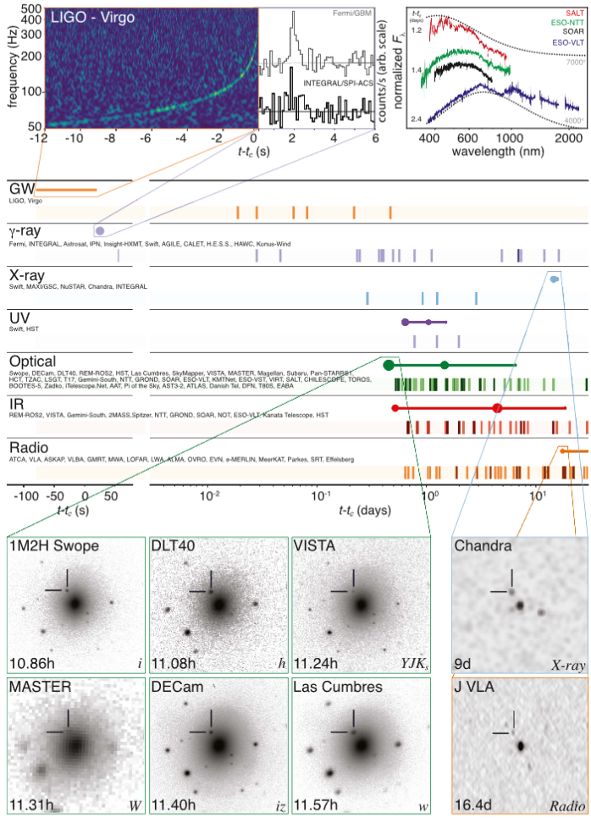
・EM counterpart was
observed for the first
time in GW170817.
・New knowledge
* Origin of SGRB.
* Origin of heavy elements
in the universe.
* EoS of neutron star
* Fundamental physics and
cosmology: speed of GW,
Hubble’s constant, ….
ApJL 848 L12 (2017)

Slide 6
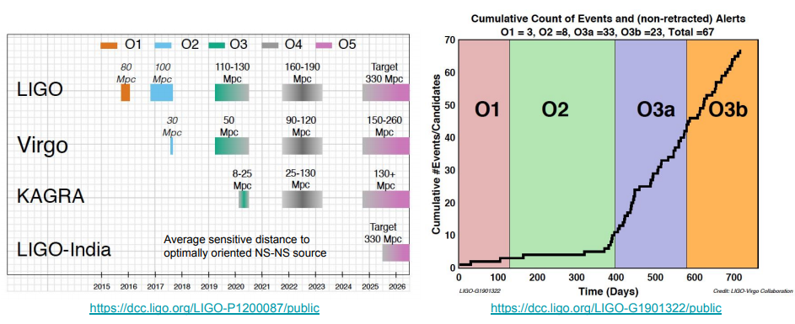
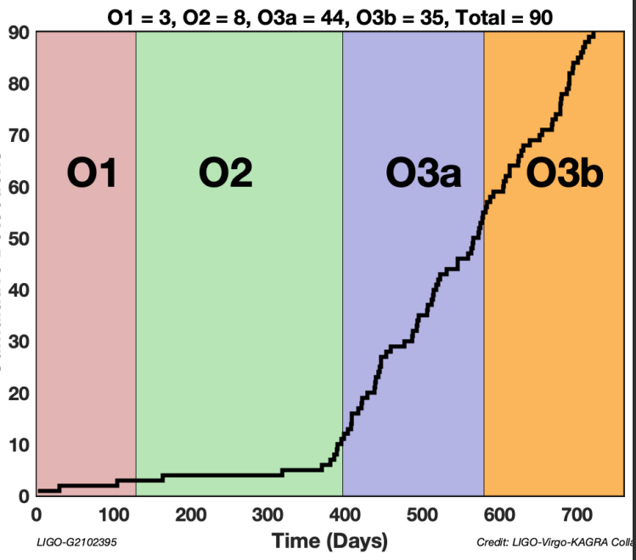
Observation Run and Detections
Being updated: O4 from March 2023
O5 is starting correspondingly later
[ LIGO G2001426-v2 (2020) ]

Slide 7
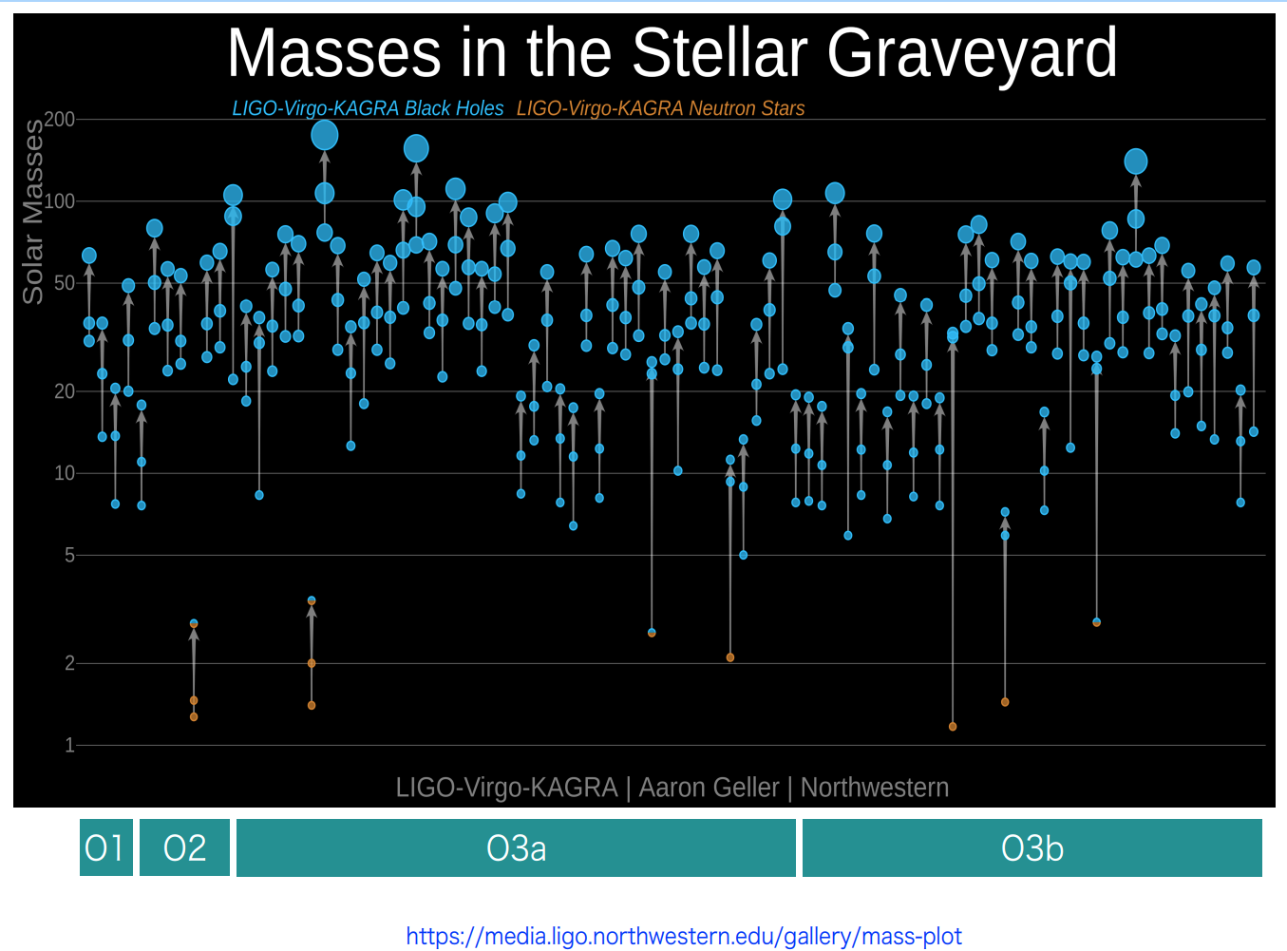
Detected Compact Binary Coalescences

Slide 8
After the First Detections ...
・The first GW (and EM counter part) detections
demonstrated new possibilities by GW astronomy,
and also showed new mysteries, such as the origin
of heavier mass BBHs, etc.
・Network of 2nd-gen. GW antennae (aLIGO, AdVIRGO,
KAGRA, LIGO-India) is being formed.
・Two ways after that for Astronomy and Cosmology:
- 3rd–gen. ground-based GW antennae (ET, CE).
- Space GW antennae (LISA, B-DECIGO, ASTROD,…).

Slide 9
Outline
・Overview of KAGRA
・Observation Runs
・Activities for O4
・Summary

Slide 10
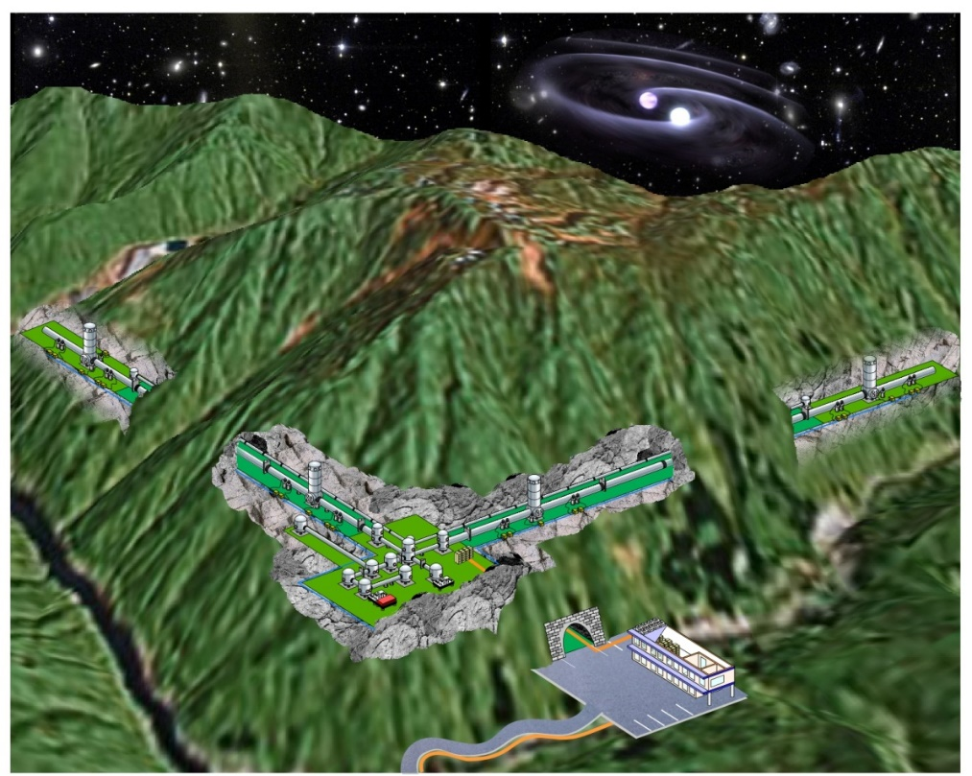
KAGRA (かぐら)
- Ground-based
GW antenna in Japan-
Artwork Image of KAGRA

Slide 11
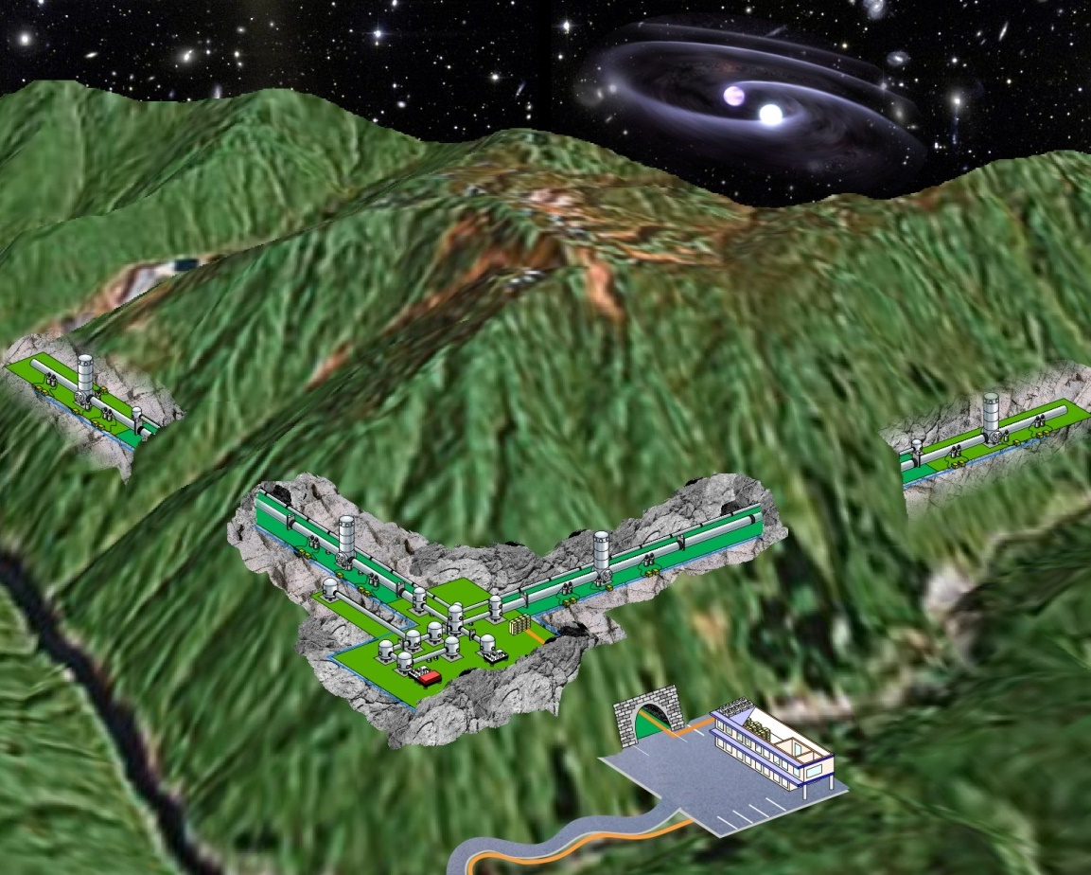
KAGRA
KAGRA (かぐら)
Large-scale Cryogenic Gravitational-wave Telescope
2nd generation GW detector in Japan
Large-scale Detector
Baseline length: 3km
High-power Interferometer
Cryogenic interferometer
Mirror temperature: 20K
Underground site
Kamioka site dedicated
L-shaped tunnel
Artwork Image of KAGRA

Slide 12

KAGRA Collaboration
KAGRA project is hosted by ICRR (Institute for Cosmic Ray Research, U. Tokyo) and co-hosted by NAOJ (National Astronomical Observatory of Japan) and KEK (High Energy Accelerator Research Organization)
KAGRA collaboration:
~508 members from
~157 Research groups
[as of Jan 25, 2023]

Slide 13
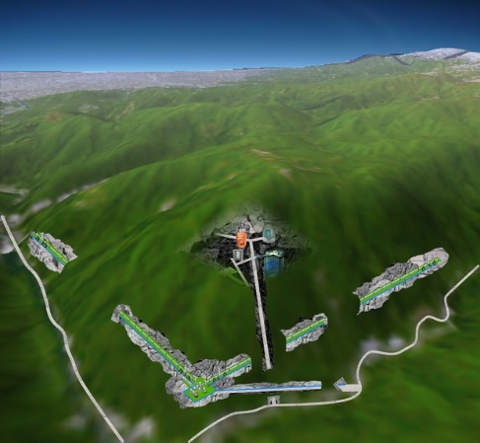
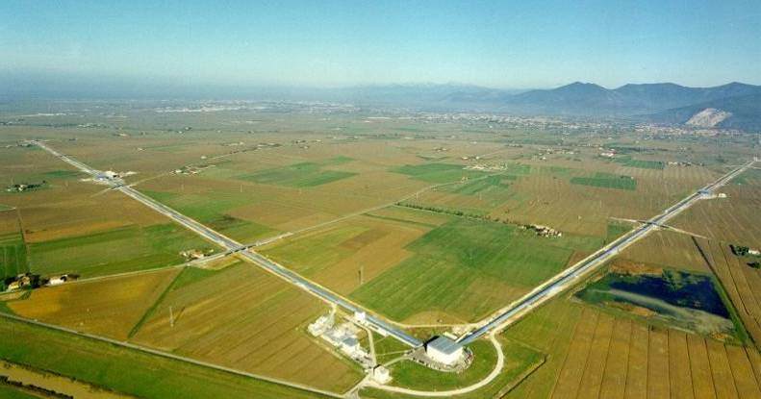

International GW Network
International network by 2nd–gen GW antennae.
→ GW astronomy (Detection, Parameter estimation, …)
aLIGO (USA)
4km x 2
KAGRA (JPN)
baseline 3km
GEO-HF (GER-UK)
baseline 600m
Adv.VIRGO (ITA-FRA)
baseline 3km
LIGO-India
project approved

Slide 14
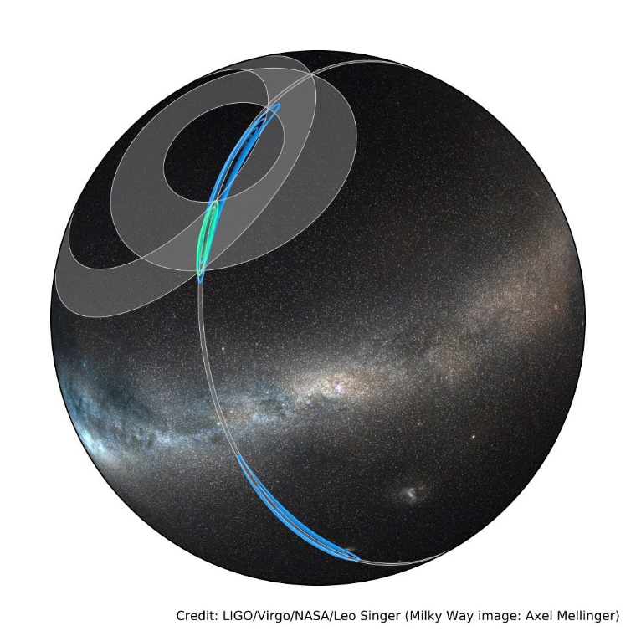
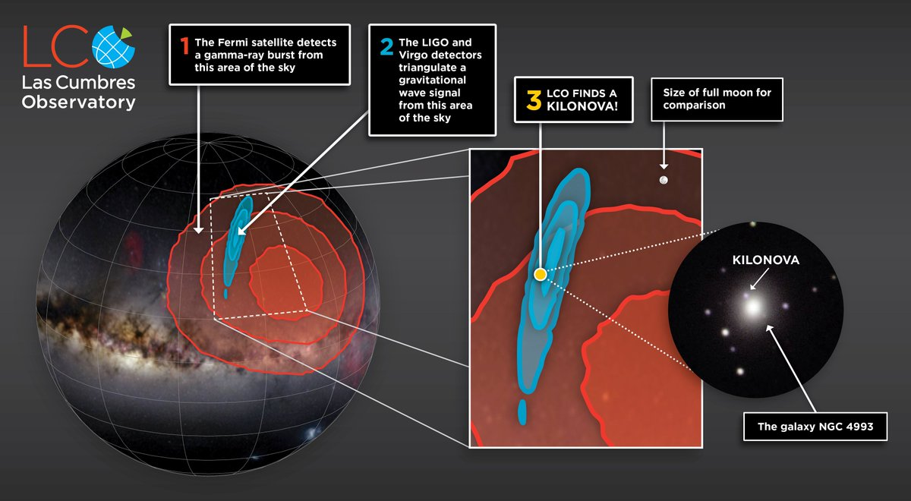
Importance of Sky Localization
・For GW astronomy, parameter estimation of the
source is important. In particular, sky localization is
critical for identification of EM counterpart.
・In GW170817, the sky position was localized with
~30deg² error by 2 LIGO + 1 VIRGO detectors.
~20 galaxies in this region.
Credit: LIGO/Virgo/NASA/Leo Singer
(Milky Way Image: Alex Mellinger)
Credit: Sarah Wilkinson / LCO
(Taken from https://youtu.be/wnwMhvdDcfI)

Slide 15
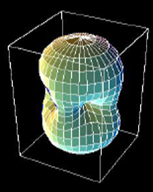
Antenna Pattern of GW Detector
Antenna Pattern
An Interferometric GW
antenna has …
* Good sky coverage
* Poor angular resolution
Difficult to determine the
source sky position
with single antenna.

Slide 16
International Network for Astronomy
Animation :
S. Kawamura (ICRR)
Multiple Detector
Identify the source
by the arrival-time difference
(and also signal strength)

Slide 17
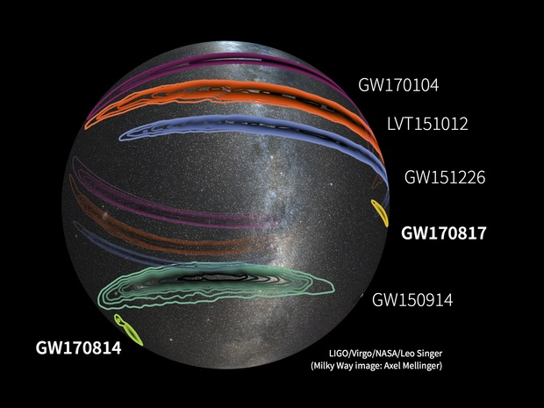
Source Localization
LIGO: 1200deg²
LIGO: 850deg²
LIGO-VIRGO: 30deg²
LIGO: 600deg²
LIGO-VIRGO: 60deg²

Slide 18
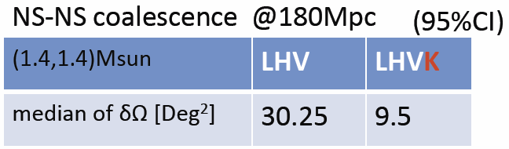

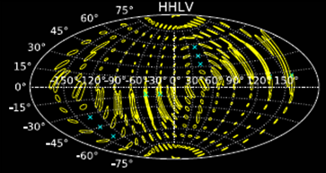
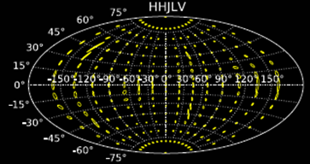
Sky Localization
H: LIGO-­‐Hanford
L: LIGO-­‐Livingston
V: Virgo,
K: KAGRA
I: LIGO-­Indea
From presentation by H. Tagoshi
J.Veitch+, PRD85, 104045 (2012)
Tagoshi+ (2014)
S.Fairhaurst
CQG 28(2011) 105021
Adding KAGRA to the network (aLIGO + adv. VIRGO)
→ Improvement of angular resolution by 3-4 times.

Slide 19
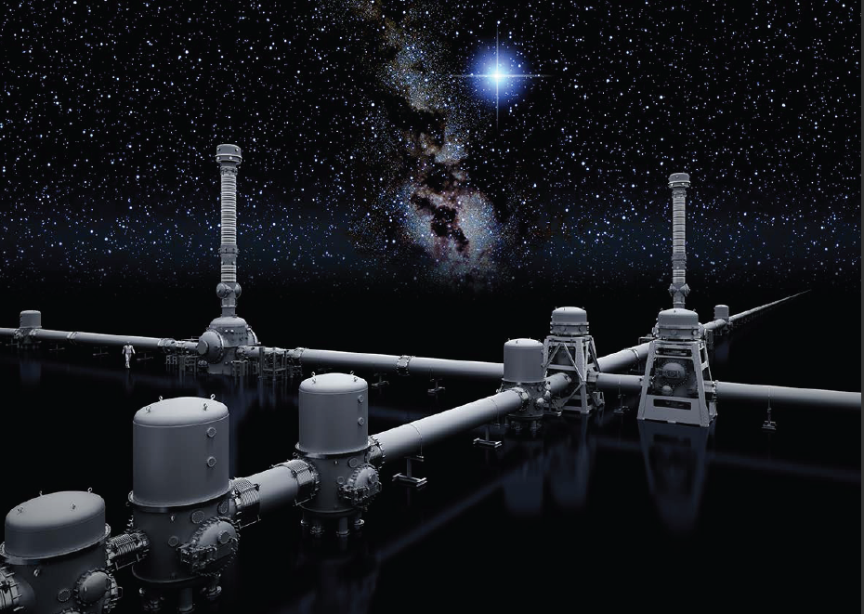
KAGRA GW Detector
・KAGRA as a 2.5-generation GW detector
Large-scale Detector
- Baseline : 3km
- Intra-cavity power ~400kW
Cryogenic interferometer
- Mirror temperature: 20K
Underground site :
- Underground site
at Kamioka, Gifu
* International GW network with LIGO/VIRGO
* Advanced technologies: cryogenic and underground

Slide 20
KAGRA Optical Design
Input/Output Optics
- Beam Cleaning and stab.
- Modulator, Isolator
- Fixed pre-mode cleaner
- Suspended mode cleaner
Length 26 m, Finesse 500
Main Interferometer
- 3 km arm cavities
- RSE with power recycling
DC readout scheme
- Cryogenic test masses
Sapphire, 20K
‘Type-A’ vibration isolator
Cryostat + Cryo-cooler
- Room-temp. Core optics
(BS, PRM, SEM, …)
ETM
- Output MC
- Photo detector
Y-arm cavity
ITM
Power
~180 W
Input
Bench
78 W
PRM
800 W
BS
ITM
ETM
Power ~380 kW
Laser
26-m MC
Power-recycling
Gain ~11
X-arm cavity
Length 3,000 m
Finesse 1,530
Laser Source
- Wavelength 1064 nm
- Output power 180 W
High-power MOPA
RSE: (Resonant
sideband Extraction)
Signal-band Gain ~15
Detuned RSE
(Variable tuning)
SEM

Slide 21
Sensitivity Comparison
KAGRA

Slide 22
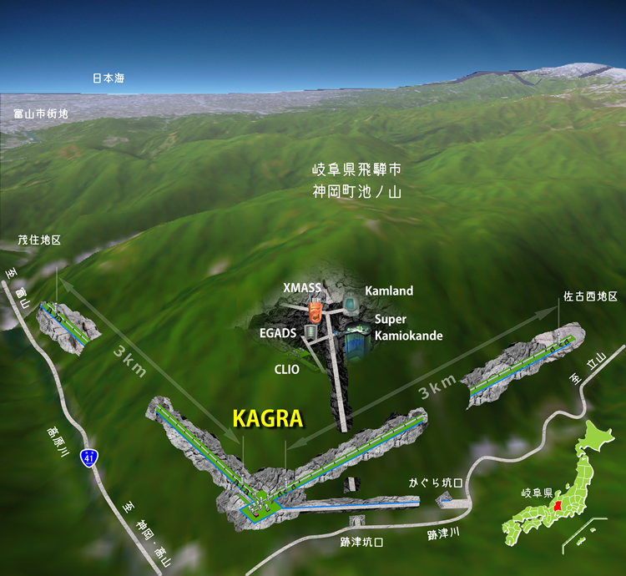
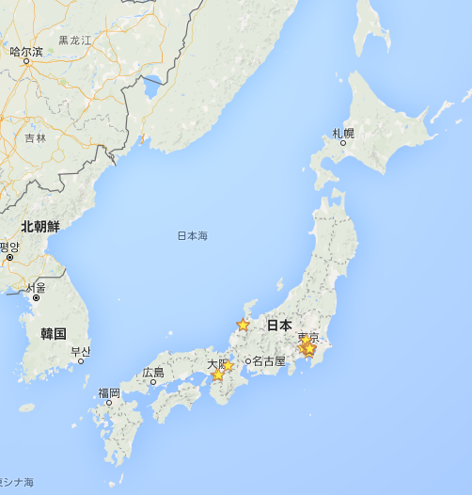
KAGRA Site
Underground site at Kamioka, Gifu prefecture
Facility of the Institute of Cosmic-Ray Research (ICRR), Univ. of Tokyo.
Underground Research Facility
Neutrino : SK, Kamland
Dark matter : XMASS
Gravitational Wave : CLIO, KAGRA
Geophysics : Strain meter
<1hour by car from Toyama
city or Toyama airport
Kamioka
Tokyo
Osaka
Map by Google

Slide 23
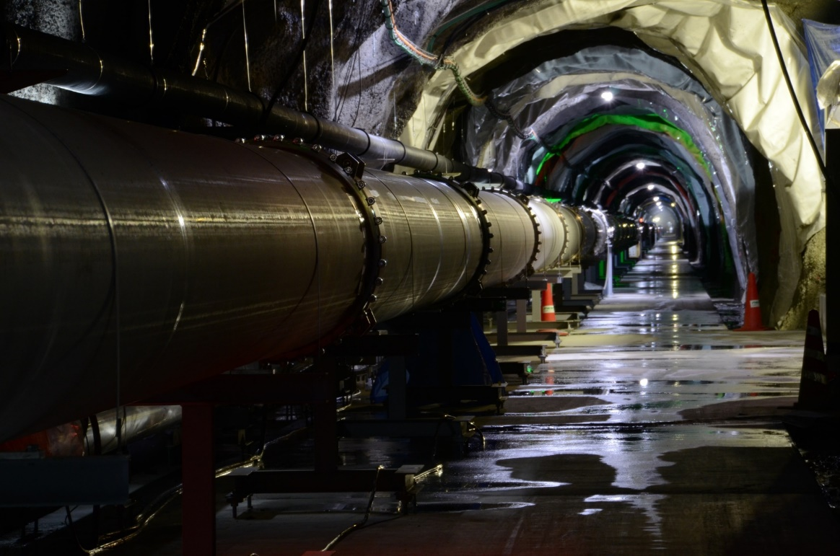
KAGRA Photo
3-km Tunnel and Beam Duct (Photo by S. Miyoki)

Slide 24
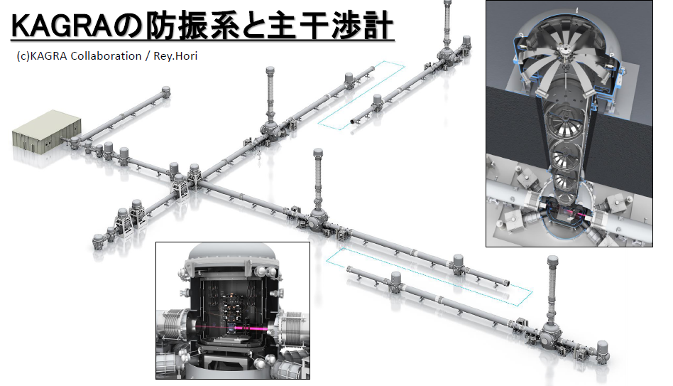
From presentation by Washimi

Slide 25
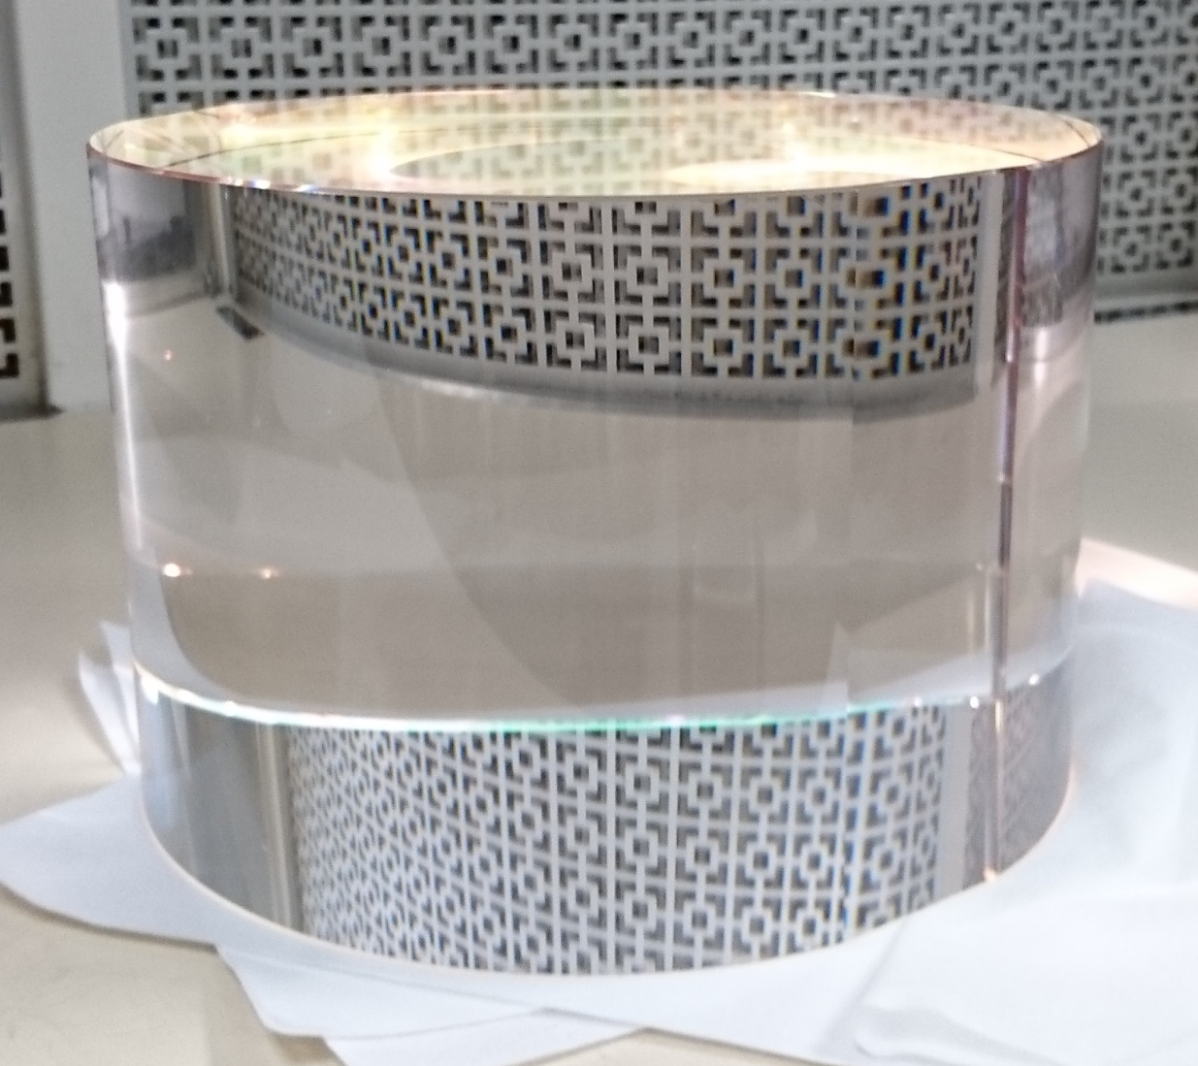
KAGRA Photos
Sapphire Mirror: Diameter 22cm, Thickness 15cm

Slide 26
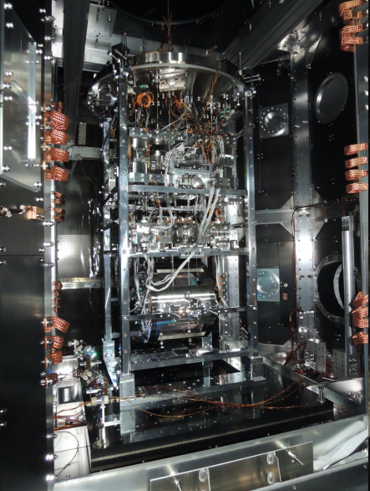
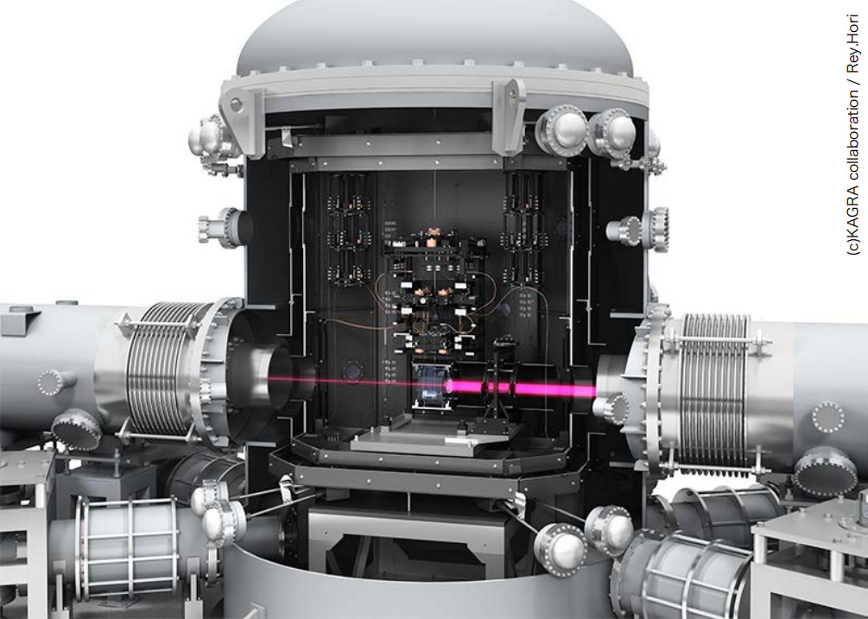
KAGRA Photo
Photo and CG model of cryogenic payload

Slide 27
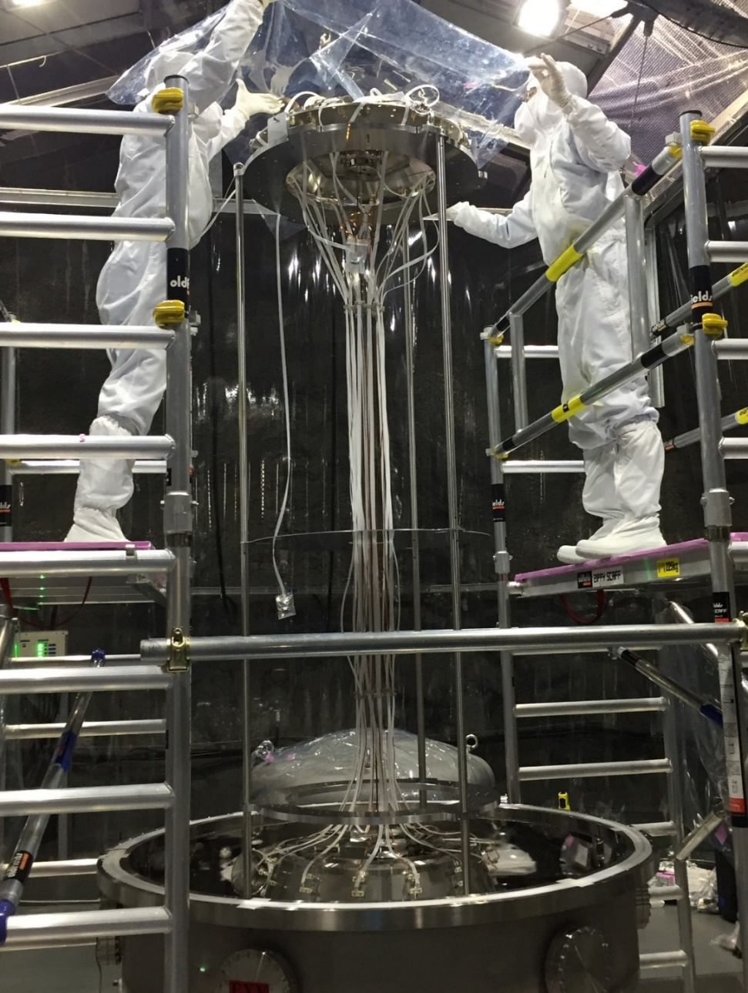
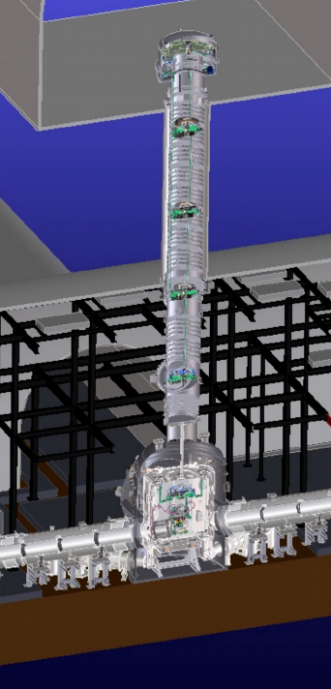
KAGRA Photos
Vibration Isolation

Slide 28
KAGRA Observation Runs

Slide 29
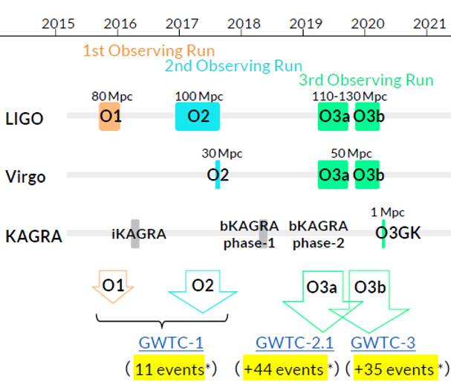
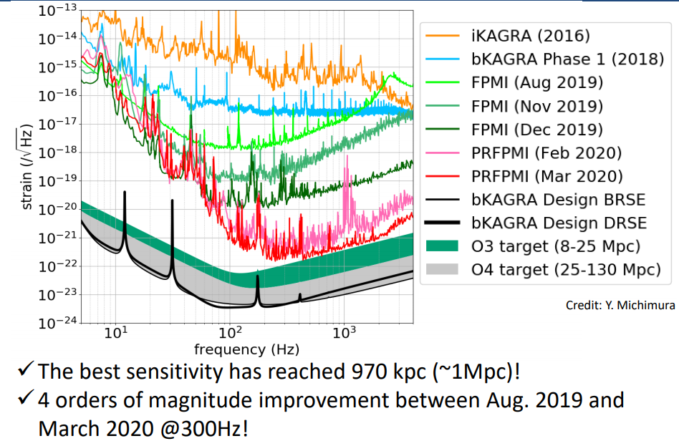
KAGRA Observation Run History
・~Mar 2016: iKAGRA (Room Temperature MI)
・~Mar 2018: bKAGRA phase-1 (Cryogenic MI)
・~ Apr 2019: bKAGRA phase-2 (Most items installed)
・May 2019 ~ April 2020: bKAGRA phase-3 to O3
PRFPMI configuration. Stable operation, Noise hunting.
BNS range sensitivity of ~1 Mpc (March 2020).
PTEP 2021, 05A101
Fig by Sawada

Slide 30
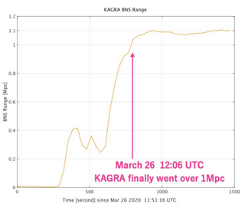
O3GK
From presentation by H. Takahashi (2021)
・Initial plan was to join the O3
with LIGO and VIRGO, once
KAGRA reached the ~1Mpc
sensitivity, based on MoA.
・KAGRA realized it in March 2020.
However, LIGO and VIRGO
stopped their operation due to
COOVID-19 situation.
・GEO600 at Germany and KAGRA
had a joint observation run
in April 2020 : O3GK
GEO600

Slide 31
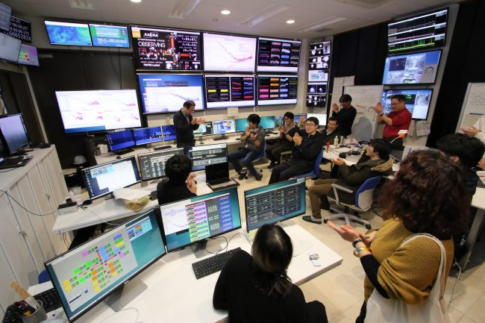
KAGRA Observation Run
・KAGRA started observation run in 2020
* KAGRA solo : 2 weeks (Feb. 25 – Mar. 10)
* O3GK : 2 weeks (Apr. 7 – Apr. 21)
* Science-mode duty factor 54%
* Typical binary range ~600 kpc (Best ~970 kpc)
From KAGRA web site (Feb 25, 2020)
From presentation by T.Kajita (May 27, 2020)
※ BNS range here: sky averaged range
PTEP 2021, 05A101

Slide 32
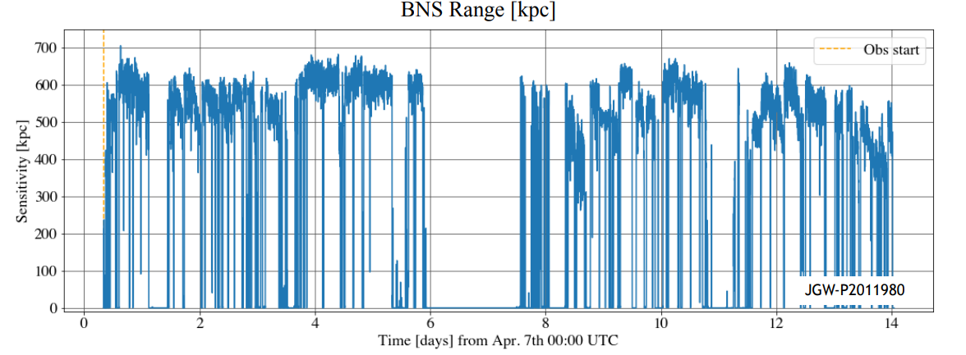
KAGRA Observation Run
・KAGRA started observation run in 2019
* KAGRA solo : 2 weeks (Feb. 25 – Mar. 10)
* O3GK : 2 weeks (Apr. 7 – Apr. 21)
From presentation at JPS meeting by T. Yamamoto (Sep 14-17, 2020)
※ BNS range here: sky averaged range

Slide 33
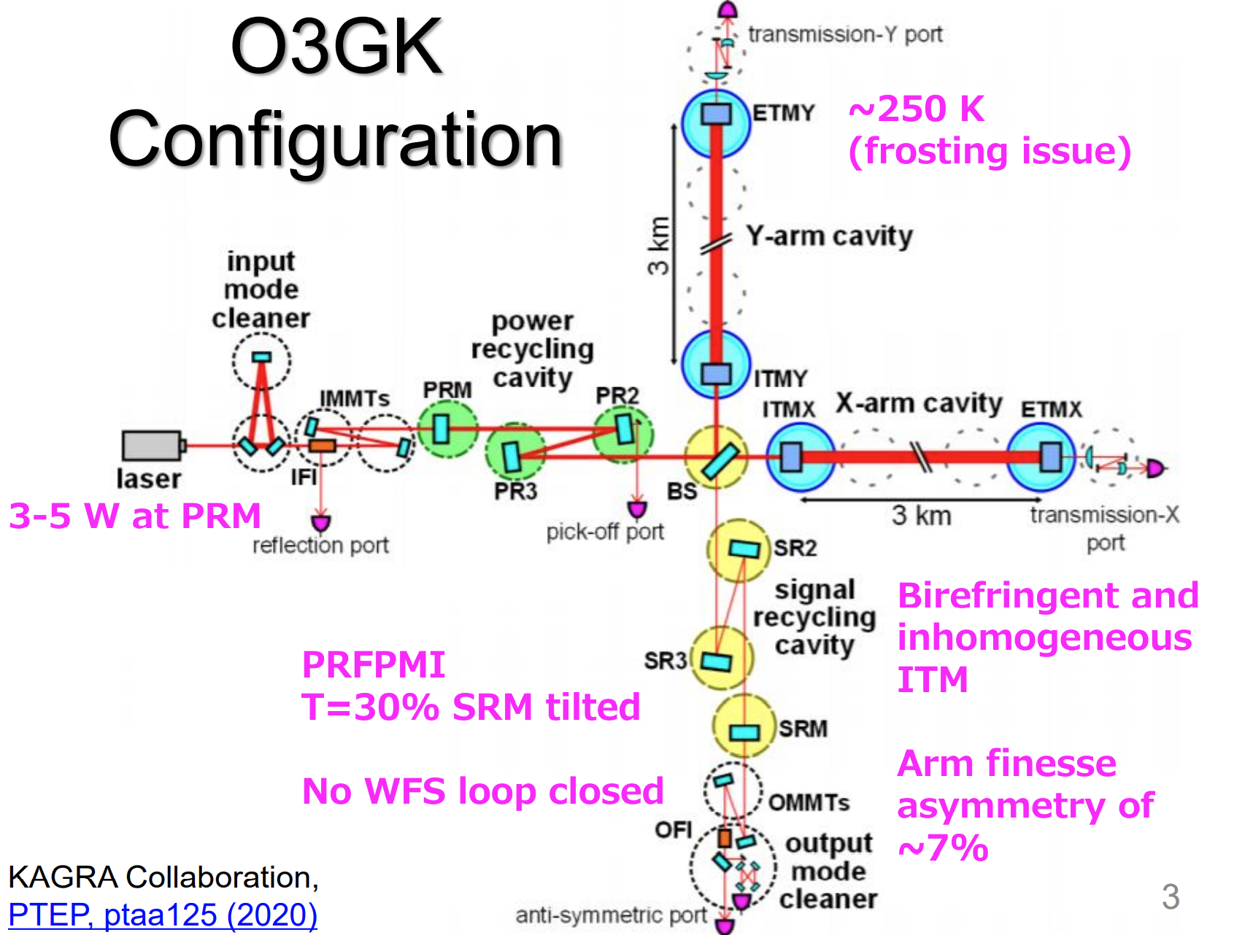
O3GK Interferometer Configuration
Figure: Y. Michimura (LVK Meeting March 2021)

Slide 34
KAGRA Sensitivity
PTEP 2021, 05A101

Slide 35
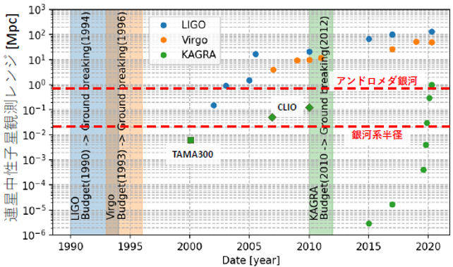
BNS Observable Range History
Fig. from Presentation by Washimi

Slide 36
Activities Toward O4

Slide 37
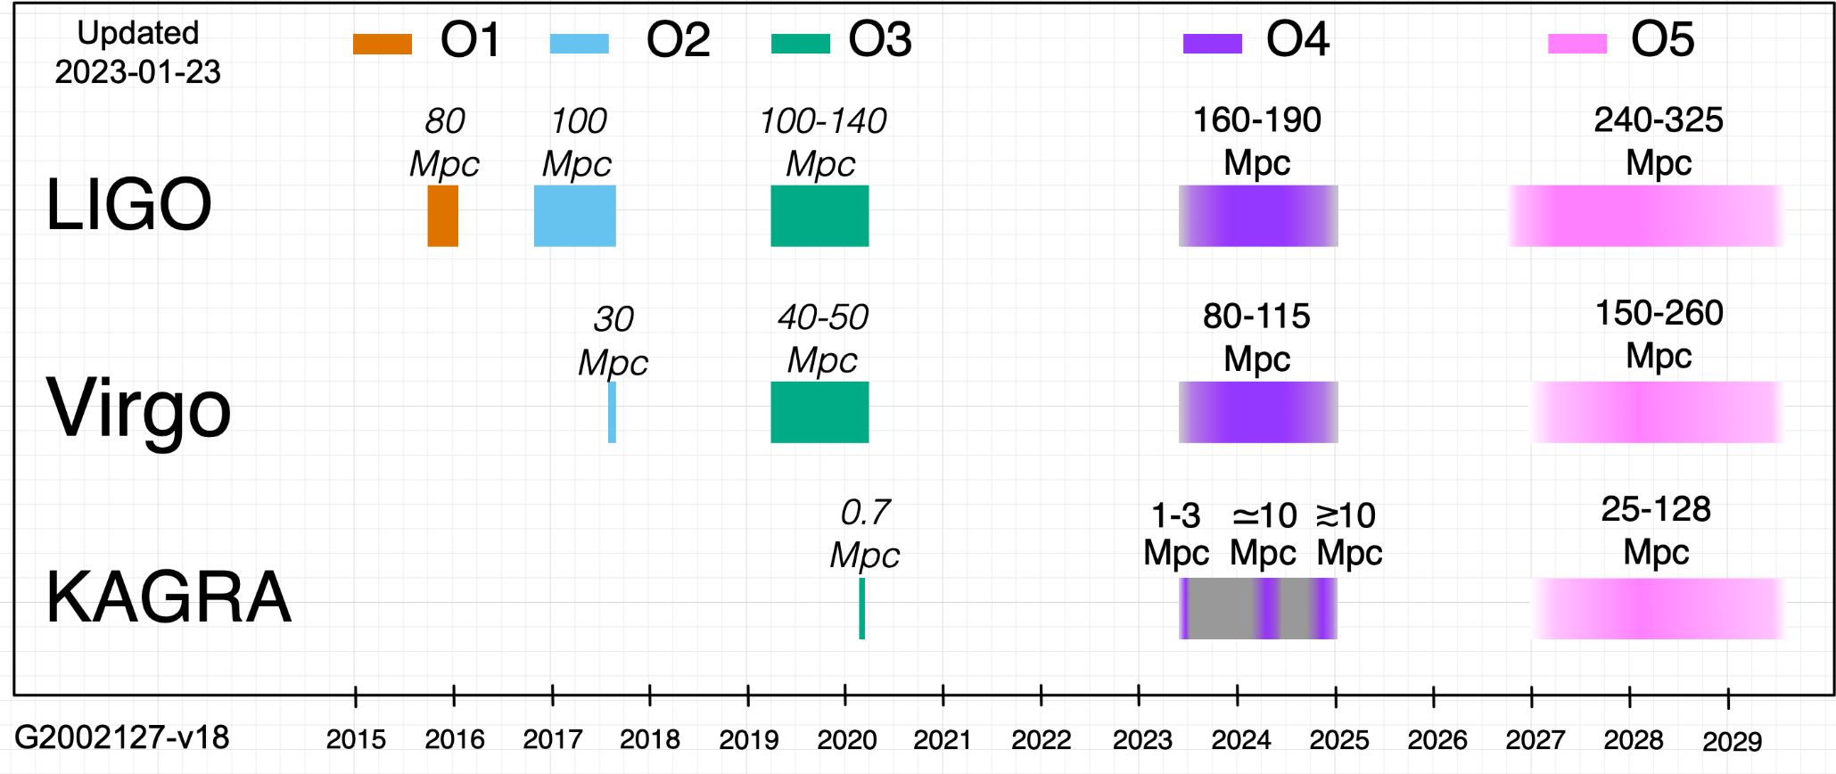
・KAGRA will join to O4 with improved sensitivity.
O3GK
Today
O4 start : 24 May 2023 in the current plan
(19 Jan 2023 announcement)
https://www.ligo.org/scientists/GWEMalerts.php

Slide 38
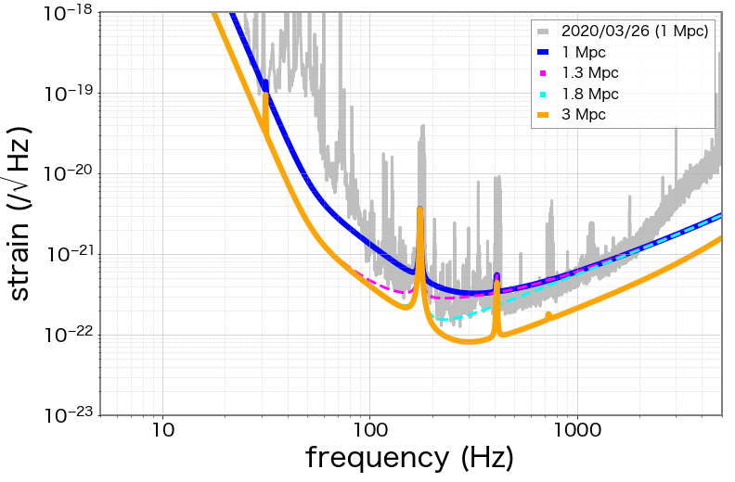
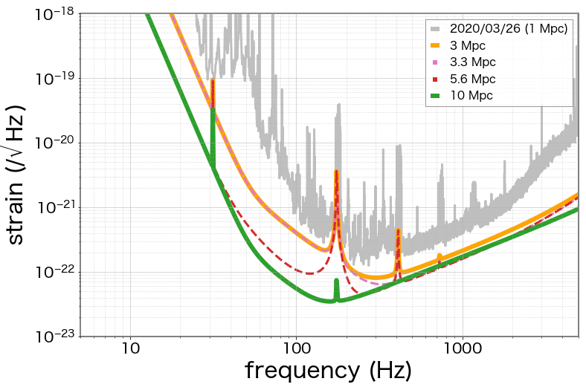
Expected Sensitivities
We aim to start O4 (O4a) with a sensitivity of 1-3 Mpc,
and achieve 3-10 Mpc at the end of O4 (O4b).
Fig. by Yuzurihara
O4a
O4b
KAGRA is planning to have an extended commissioning break between O4a and O4b.

Slide 39
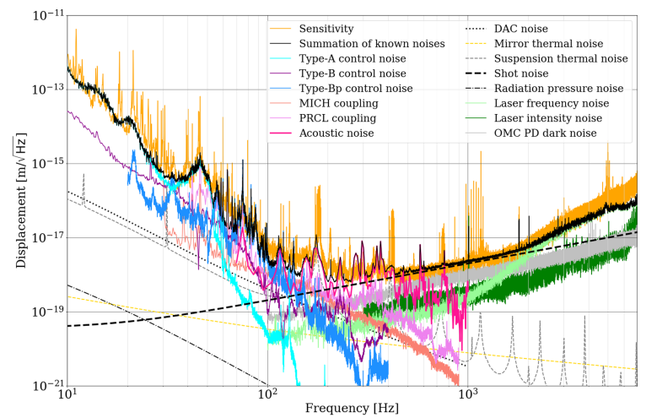
O3GK Noise Budget
PTEP 2022 [DOI: 10.1093/ptep/ptac093]
Test mass suspension
Control noises
Noise coupling from
auxiliary DoF
Laser freq. and
intensity noises
Acoustic noise
Coupling
Measured
sensitivity
Sum of identified
noise sources
Shot noise

Slide 40
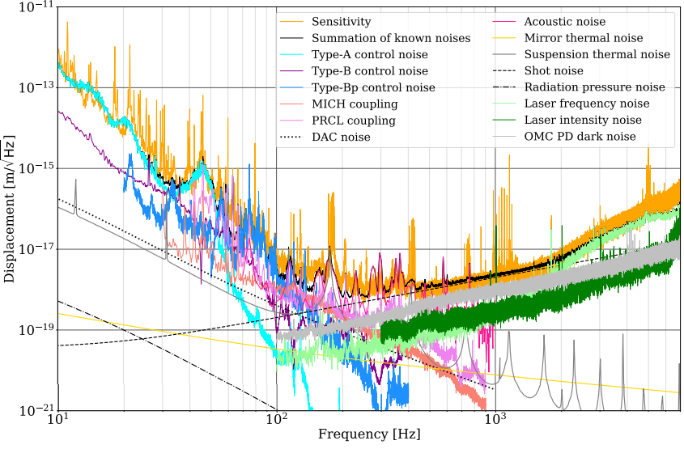
Sensitivity Improvement (1/4)
・Low Frequency (- 50 Hz):
- Type-A control noise: Type-A mitigation and Health Check.
- Optimization of control loops
PTEP 2022 [DOI: 10.1093/ptep/ptac093]

Slide 41
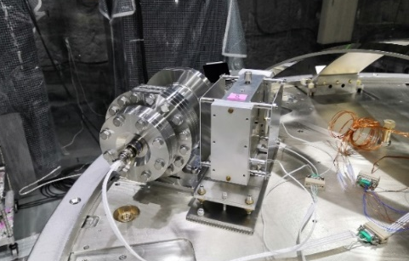
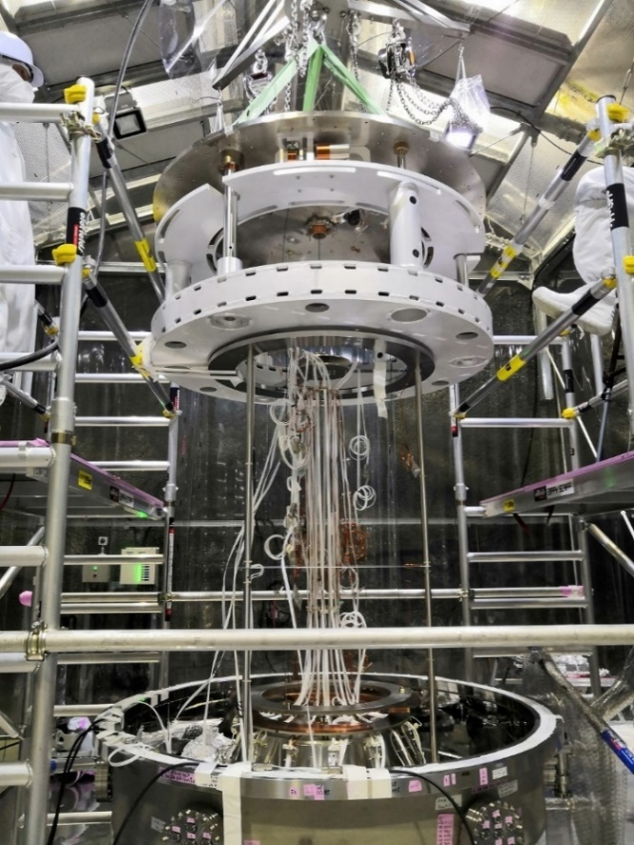
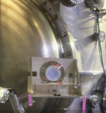
Type-A Mitigation and Improvement
・Re-installation of Type-A suspensions for mitigation of several
GAS filter stages.
・Installation of new aaccelerometer at top filter.
・Installation of optical levers for local damping of payload.
・Temperature control for GAS in Type-A/B/Bp.
R. Takahashi

Slide 42
Sensitivity Improvement (2/4)
・Mid Frequency (50 - 100Hz):
- Type-B/Bp control noise：Filter optimization
- Thermal noise：Cryogenic mirror and suspension.
PTEP 2022 [DOI: 10.1093/ptep/ptac093]

Slide 43
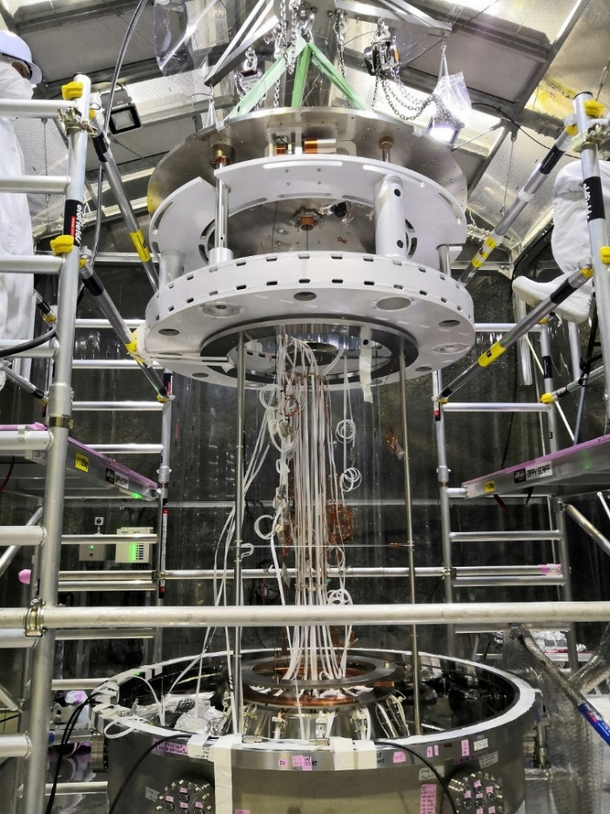

Type-B/Bp Improvement
・Identification of the Type-Bp (PR2/3) unstable performance.
PR2 was fixed. PR3 was improved but not fully fixed.
・Mitigation for Type-B (SRMs/BS).

Slide 44
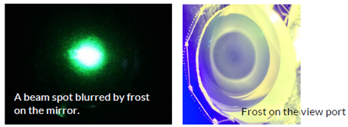
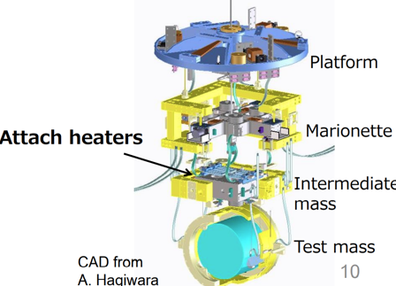
Improvement for Cryogenic Operation
・Mitigation of cryogenic payload: Stuck of a moving mass for the
rough alignment of mirrors at cryogenic temp. Newly designed
moving mass was installed.
・Frosting on Mirrors and cryostat viewport on the oplev. optical
pass. Heaters are attached to the intermediate mass stages
and viewports for defrosting. Test in IYC was successfully done.

Slide 45
Sensitivity Improvement (3/4)
・Mid Frequency (100Hz ~ 400 Hz):
- Acoustic noise due to stray-light coupling → Install Baffles.
- PRMI control noise → Filter optimization / tuning, Feedforward.
PTEP 2022 [DOI: 10.1093/ptep/ptac093]

Slide 46
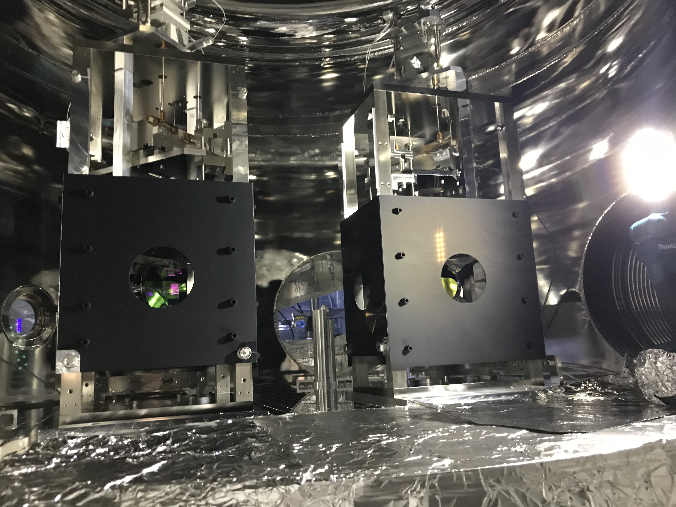
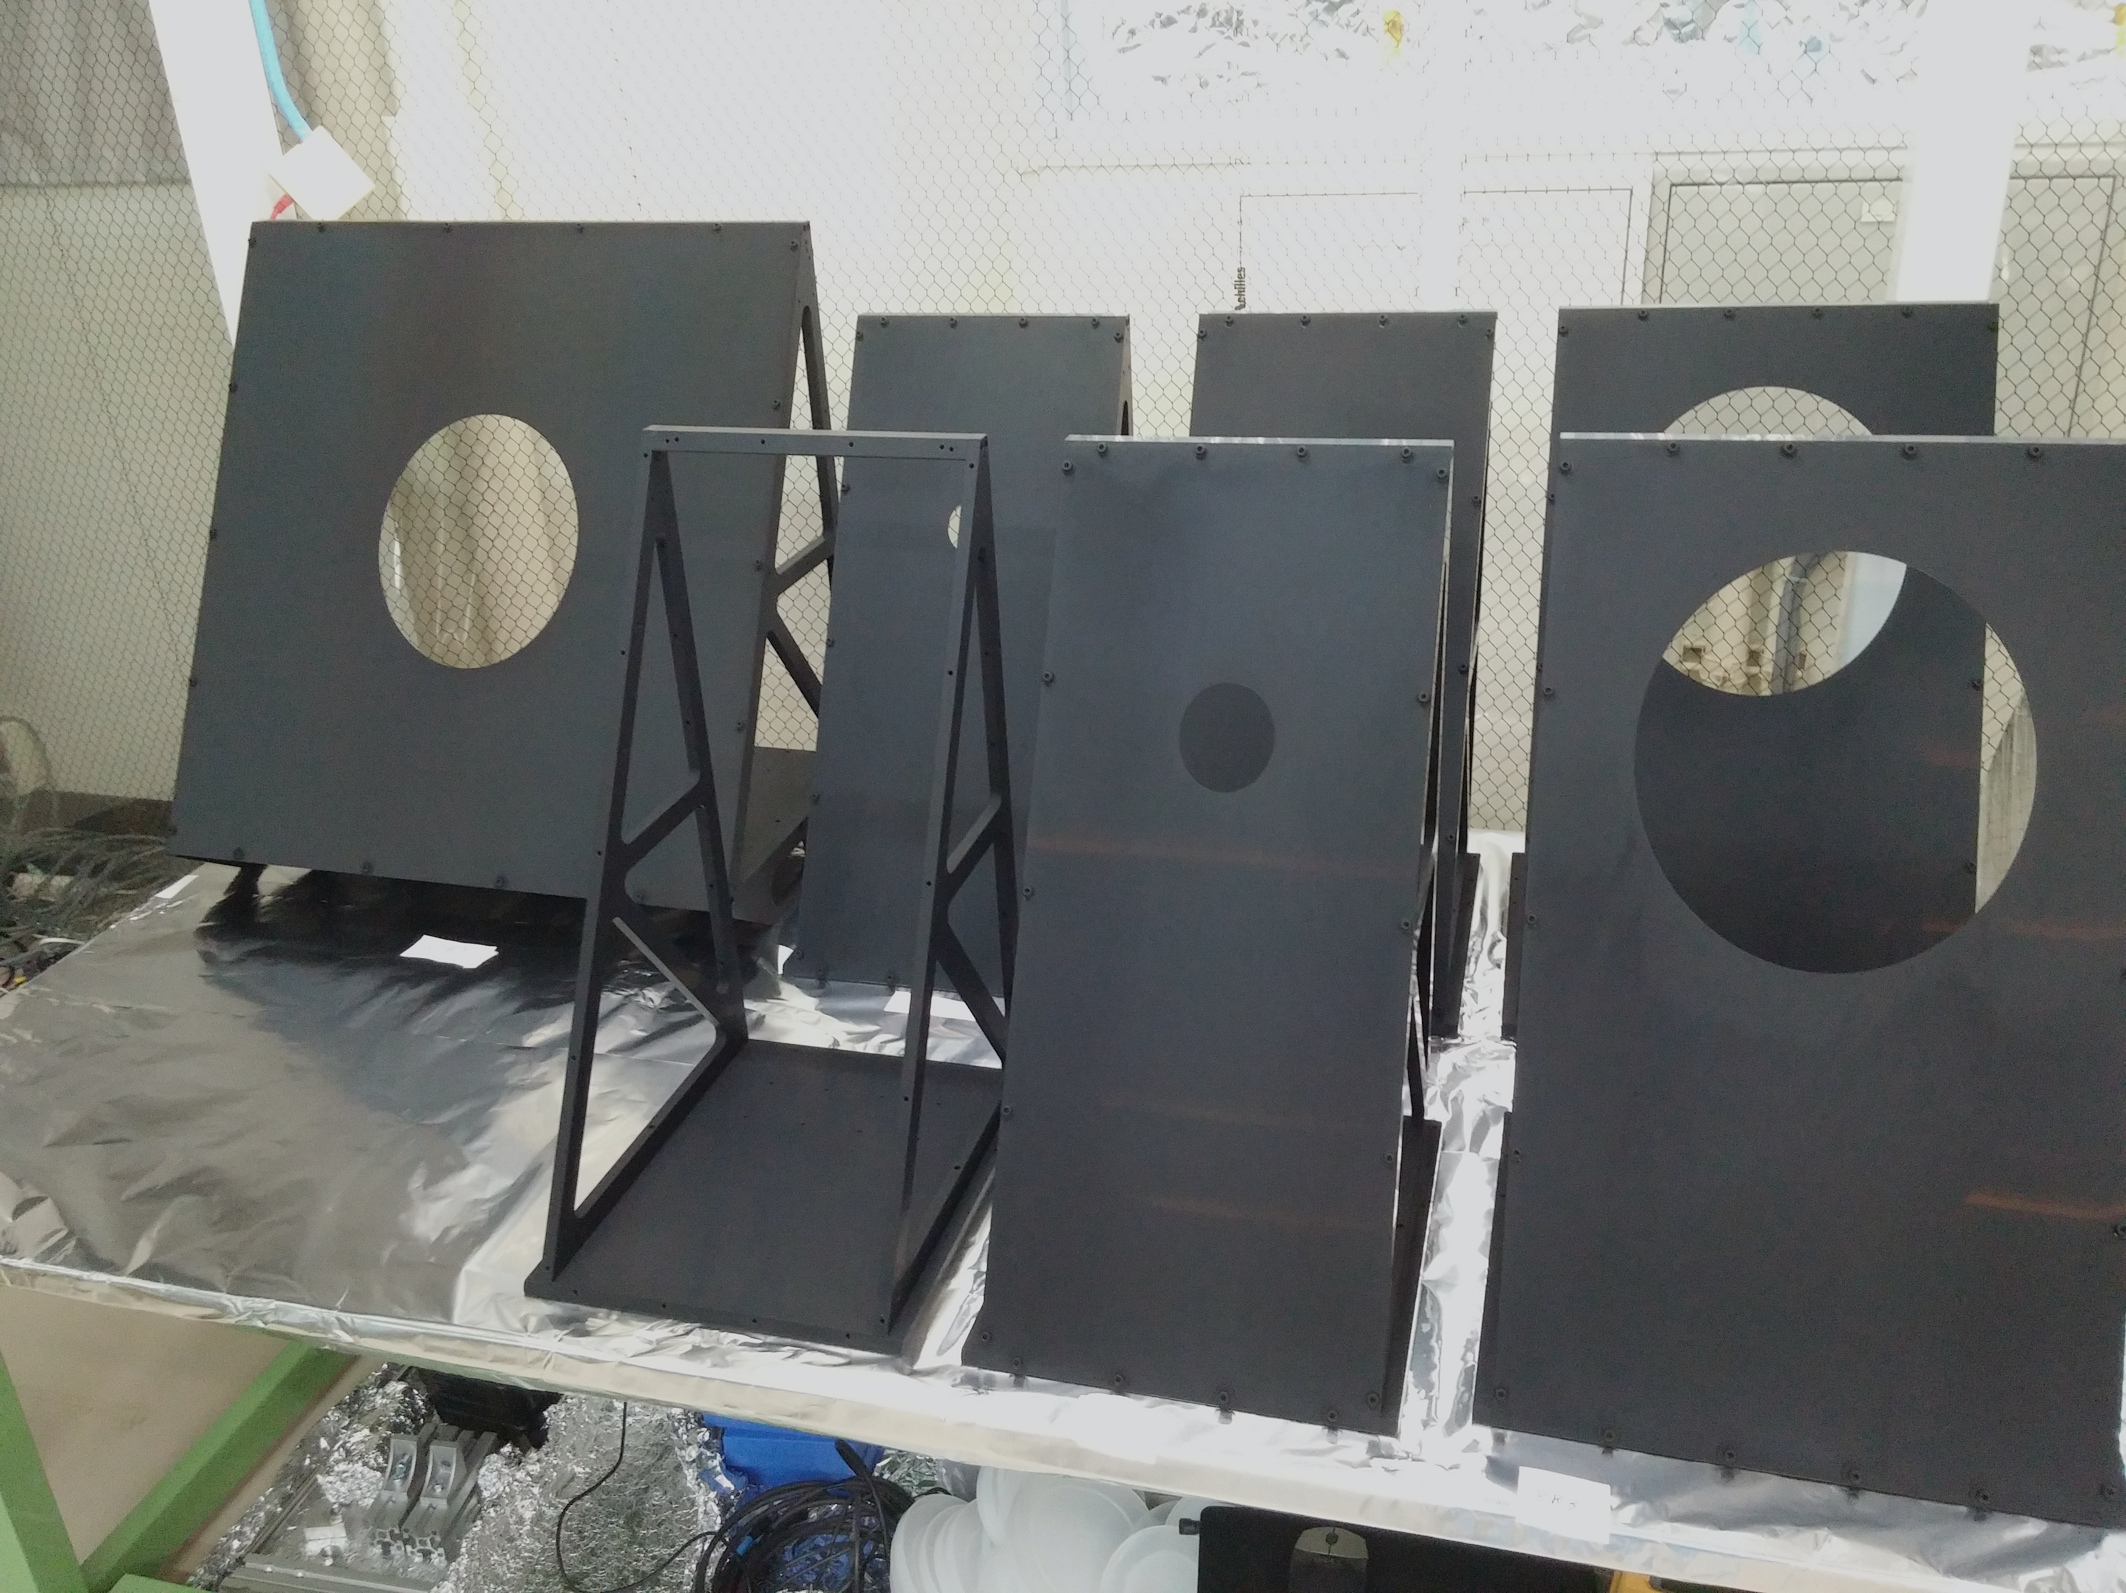
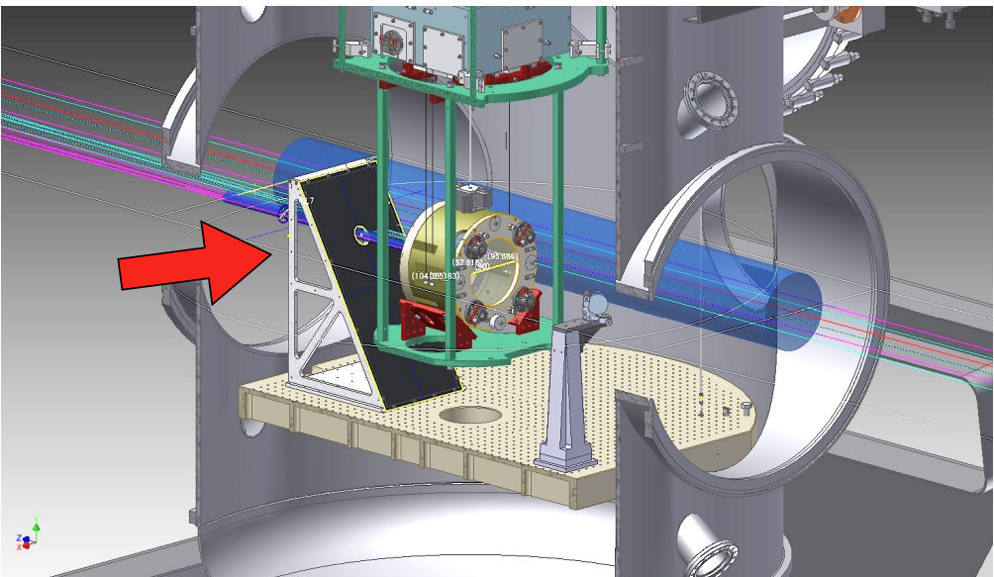
Stray-light Mitigation
・Mid-size baffles for stray-light reduction
- Installation of Baffles for IMC
suspensions was completed.
- Support frames for baffle for
Type-B/Bp suspensions are being
installed. PR2 baffle is installed.
T.Akutsu
IMC baffles
Mid-size baffles

Slide 47
Sensitivity Improvement (4/4)
・High Frequency (400 Hz - ):
- Shot Noise: 0% SRM, High-Power Laser, OMC/PD improvement
- Laser freq. and Int. noise: Reduction of noise and coupling
with better alignment (Control with wave-front sensors).
PTEP 2022 [DOI: 10.1093/ptep/ptac093]

Slide 48
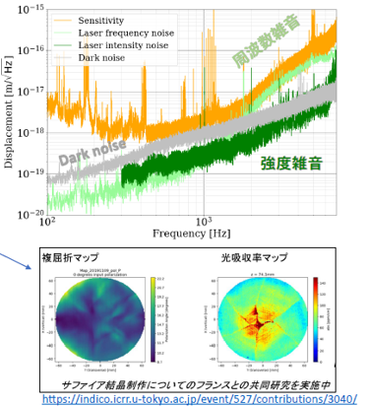

Shot noise and Laser noises
・Larger coupling from laser frequency and intensity
noise, probably due to birefringence of sapphire
test masses. Not an issue for O4 sensitivity.
・Higher-power laser source and
stabilization system.
・Improvement of photo detector.
Master Laser
NPRO
Power Amplifier
60W
Fig. taken from presentation at LVK meeting March 2023 by J. Yokoyama

Slide 49
Current Status
・Recovered full operation of the interferometer
- FPMI config.: Low-freq. noise improvement.
- PRFPMI: High-freq. noise improvement.
・Commissioning for stability and sensitivity.
・Preparation is ongoing to join O4a.
O4a start : May 24th, 2023 in the current plan.

Slide 50
Summary

Slide 51
Summary
・First direct detection of GW was achieved by LIGO
in 2015. ~90 events were detected so far by LIGO
and VIRGO.
・KAGRA in Japan has original feature of cryogenic
interferometer placed at underground site. It is
a 2.5-generation GW antenna.
・Joining KAGRA to the international network will
improve the source parameter estimation accuracy
and polarization separation. KAGRA will join O4
in 2023.

Slide 52
End

