Slide 1
SND@LHC
Scattering and Neutrino Detector at LHC
Kang Young Lee
GNU
On behalf of SND@LHC Collaboration
Physics of Two Infinities@Kyoto U. 2023.03.30

Slide 2
Outline
Introduction
SND@LHC
Analyses
Conclusion
- Forward Physics at the LHC
- Neutrinos at the LHC
- Timeline
- Detectors
- Physics Cases

Slide 3
Introduction

Slide 4
Forward Physics at the LHC
Central Region
Low rapidity, large p_{T}
t, H, heavy new particles
Forward Region
High rapidity, small p_{T}
hadrons, SM particles,
(if exist) light new particles
Expected :
10¹⁶ inelastic pp scattering events for LHC Run 3
10¹⁷ π⁰, 10¹⁶ η, 10¹⁵ D, 10¹³ B, … for each hemisphere
(13 TeV, 150 fb⁻¹ assumed)

Slide 5
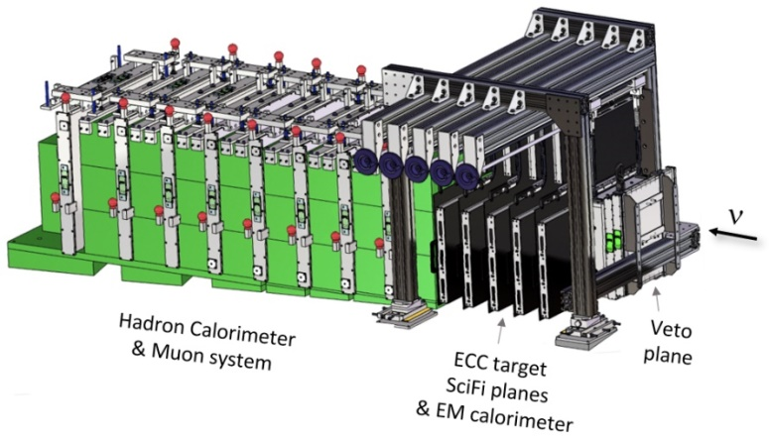
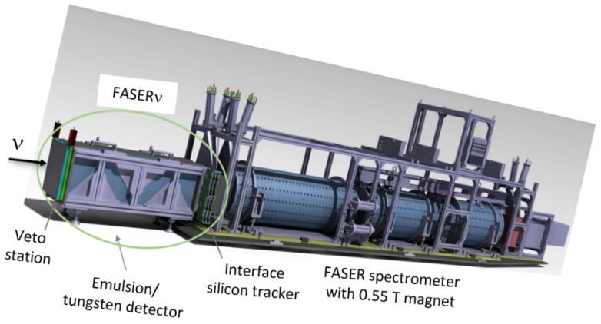
Forward Experiments at the LHC
LHCb : study of b-quark, IP8
LHCf : beam monitoring, IP1
TOTEM : QCD, IP5
SND@LHC
FASER & FASERν
𝜈, FIP
7.2 < η < 8.4
off-axis
Inada’s talk!
η > 8.8
on-axis

Slide 6
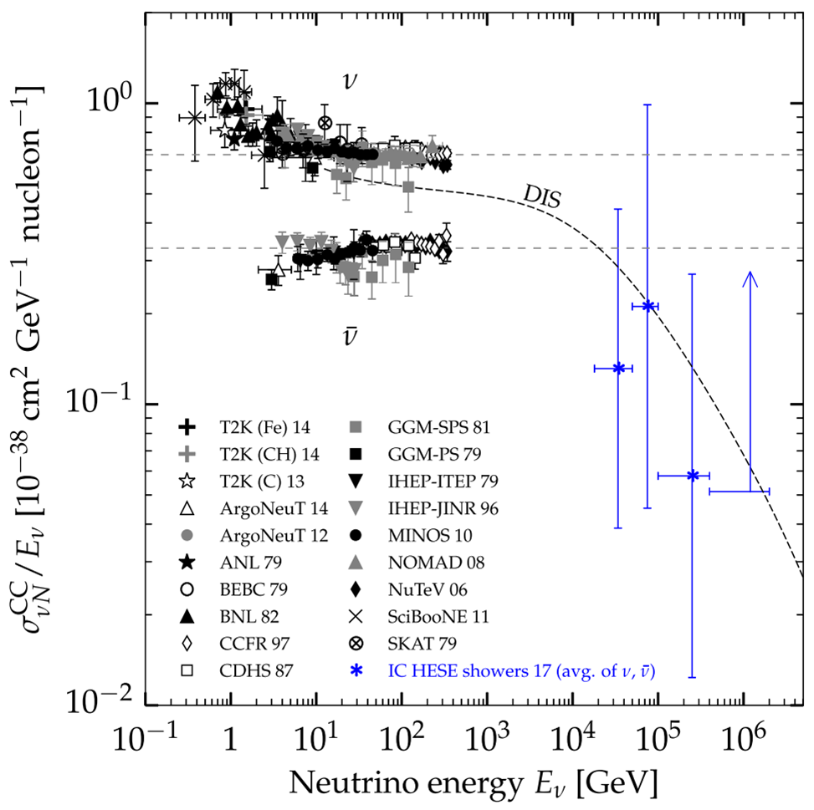
Neutrinos at the LHC
PRL 122 (2019) 041101
SND@LHC
The LHC neutrinos are interesting because…
First observation of the collider neutrinos
High energy neutrinos not explored region,
300 GeV ~ a few TeV
Large fluxes in the forward region
All the 3 flavour neutrinos can be observed.

Slide 7
SND@LHC

Slide 8
The SND@LHC
480 m away from the ATLAS interaction point (IP1)
Located in the TI18 tunnel, former positron transfer line to LEP
Shielded by 100 m rock
LHC magnet deflects charged particles
Neutrinos and (if exist) feebly interacting particles (FIPs) arrive at the detector

Slide 9
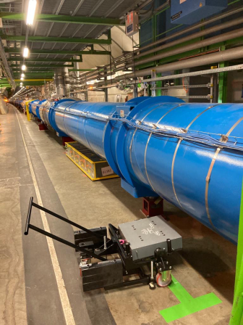
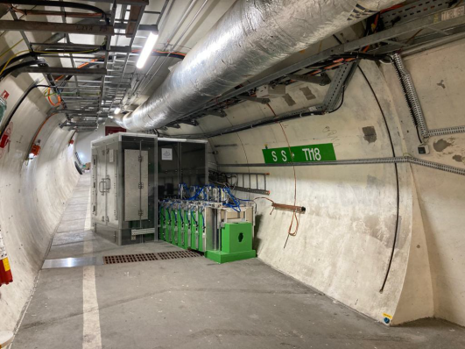
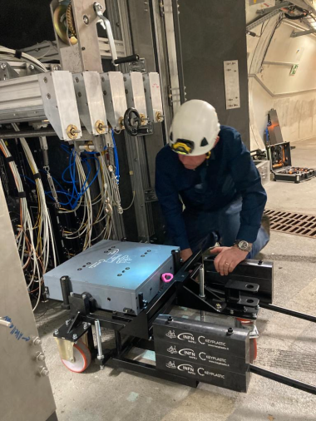
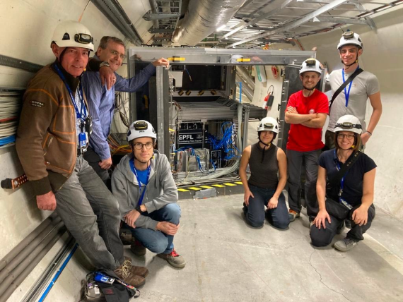
Timeline
Aug. 27th, 2020 Letter of Intent
Jan. 22nd, 2021 Technical Proposal
March, 2021 Approval by CERN RB
August, 2021 Infrastructure
Oct.13th, 2021 Detector construction completion
December, 2021 Detector installation in TI18
Apr. 7th, 2022 Installation of the first emulsion films
July, 5th, 2022 First 13.6 TeV collisions
July, 26th, 2022 Full target installation

Slide 10
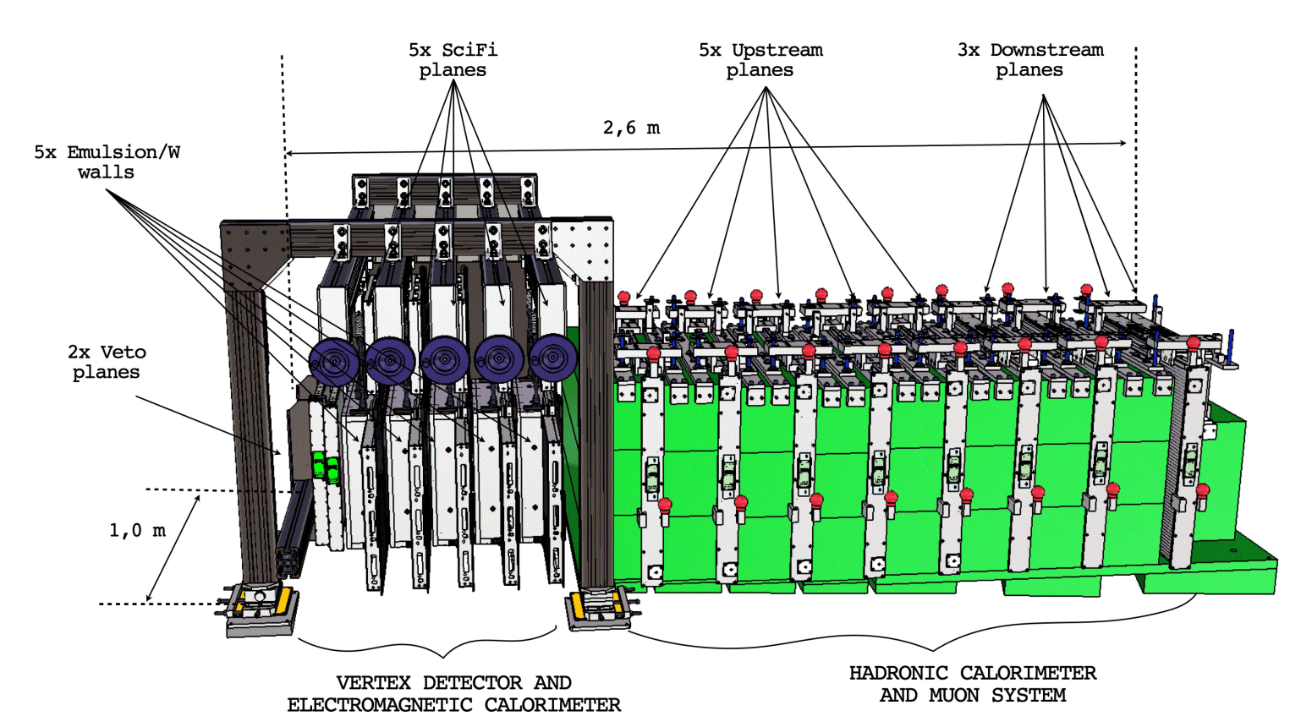
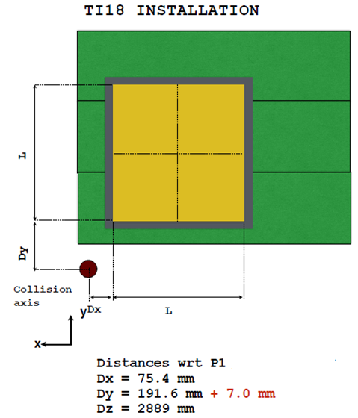
SND@LHC Detector
Hybrid detector
optimised for the identification of all three neutrino flavours and the FIPs
- Veto plane
- Vertex detector and EM calorimeter (~40 X₀ ) : ECC and SciFi
- Muon system and hadron calorimeter (~10 λ)
Detector paper
arXiv 2210.02784
to appear on JINST
SciFi
HCAL
Muon
ECC
Veto

Slide 11
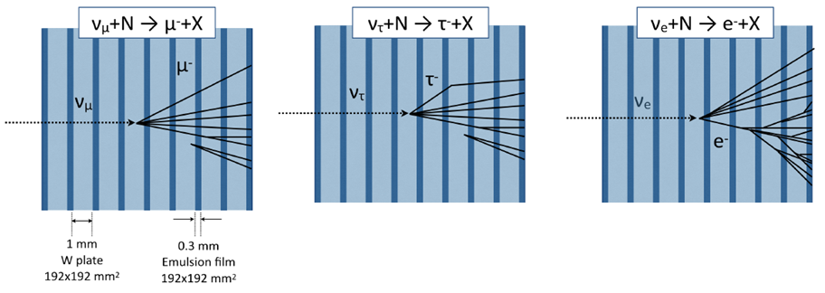
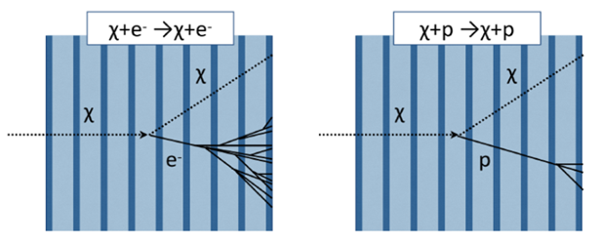
SND@LHC Detector
Identification of all three neutrino flavours and FIPs by event topologies in the ECC brick

Slide 12
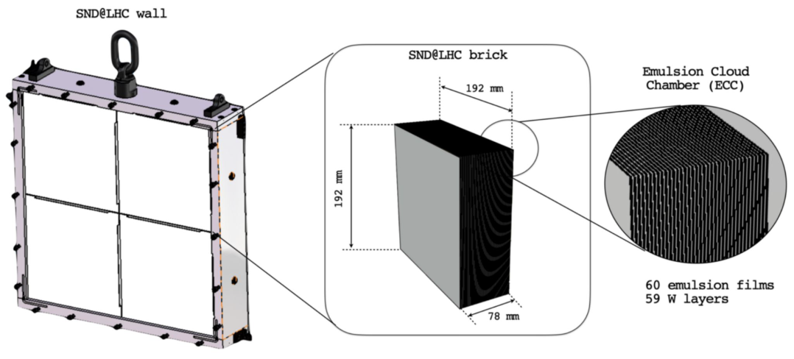
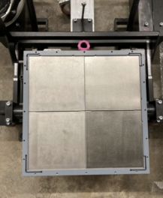
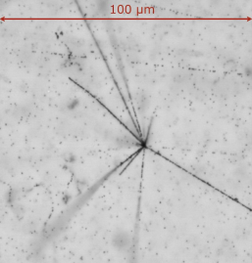
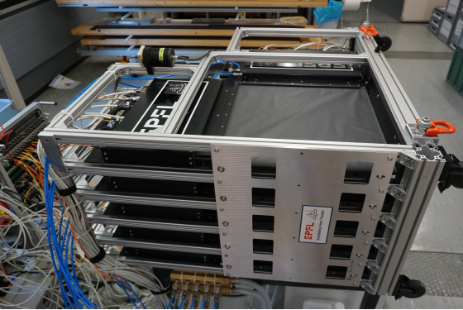
SND@LHC Detector
Emulsion target
Emulsion cloud chamber (ECC) brick consists of 60 emulsion films interleaved with 59 tungsten plates
Total tungsten mass 830 kg
5 walls x 4 bricks x 60 emulsion films
Replaced every 20 fb⁻¹
Sato’s talk!
SciFi detector
- Scintillating Fiber detectors interface emulsion detector with electronic detectors for position prediction and timing of outgoing particles.
- Electromagnetic calorimetry

Slide 13
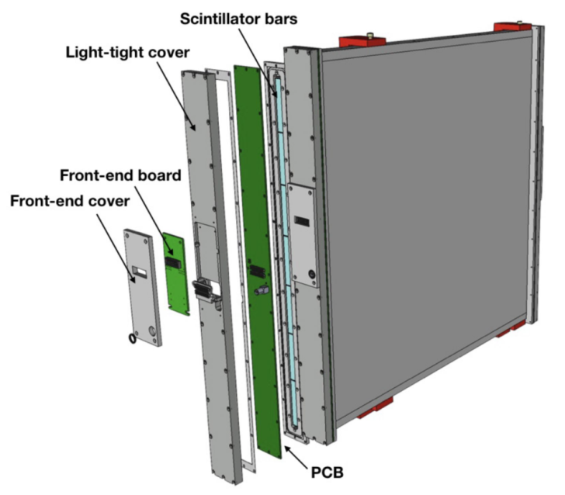
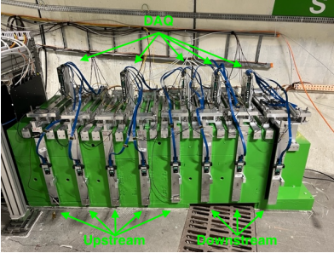
SND@LHC Detector
Veto system
- Tags incoming charged particles
- 2 planes with 7 scintillating bars
Hadronic calorimeter and muon system
- Upstream : 5 stations of Fe blocks with 10 Sci bars for hadronic calorimetry
- Downstream : 3 stations with 60 horizontal and 60 vertical Sci bars for muon tagging

Slide 14
Physics Cases
Measurement of the 𝜈 production cross section
Measurement of the forward charm production
Neutrino induced charm production
Lepton flavor universality test in neutrino interactions
Measurement of the NC/CC ratio
Direct search for FIP through their scattering

Slide 15
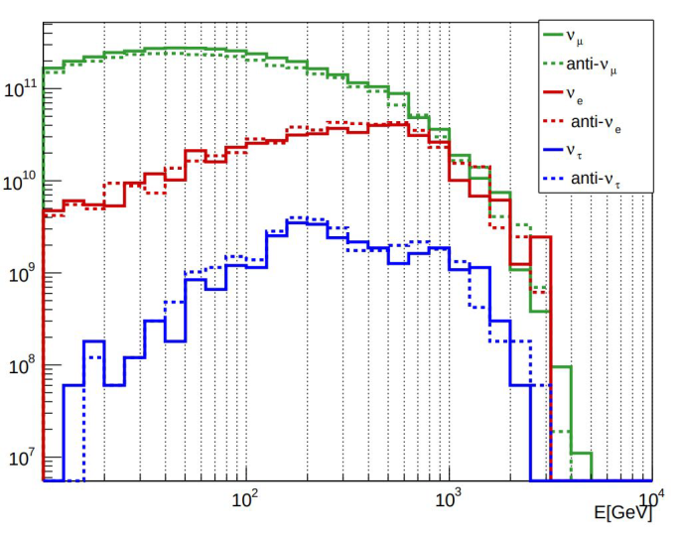
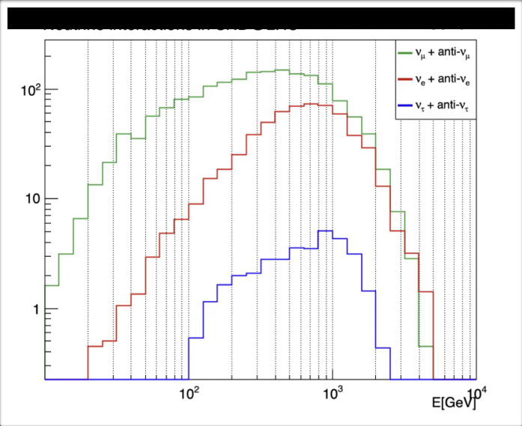
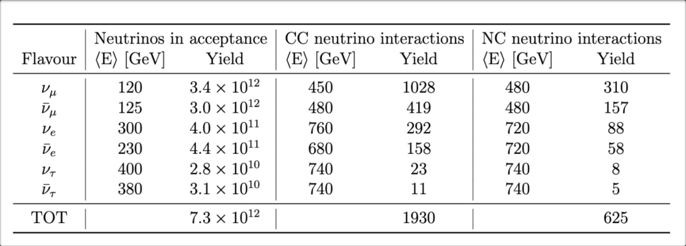
Physics Cases – Neutrino Production
Incoming Neutrinos to SND
Measurement of σ(pp → 𝜈 X)
Estimated from
290 fb⁻¹ in LHC Run 3
Angular acceptance 7.2 < η < 8.4
Neutrino interactions in SND

Slide 16
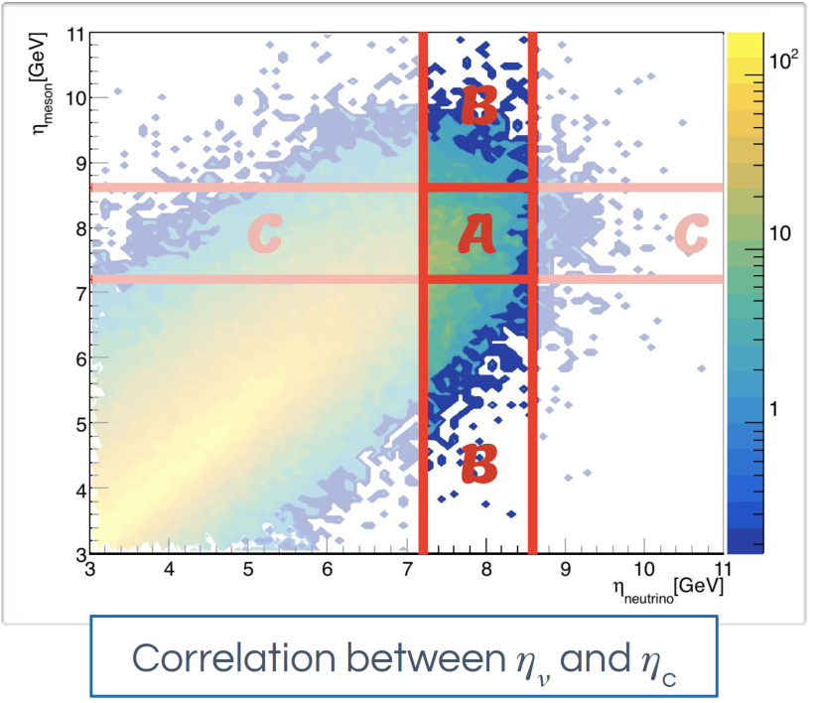
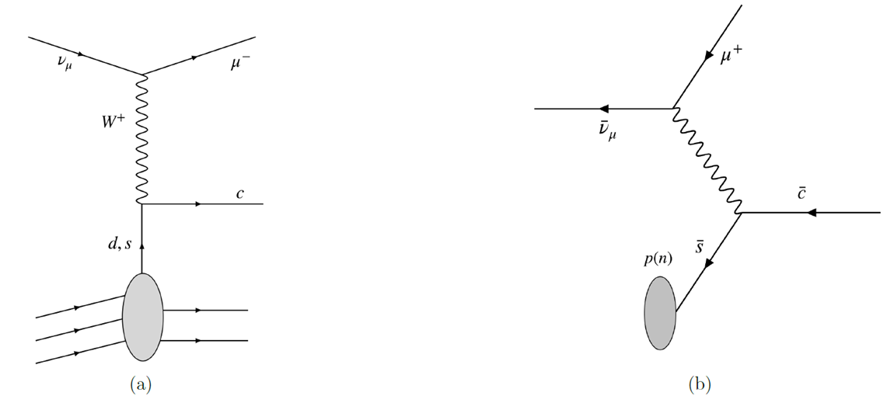
Physics Cases – Charm Physics
Neutrino production from charm decays
90% of 𝜈_{e} production is expected to be charm decays.
→ as a probe of charm production
→ impact on the gluon PDF at very small $x$
Charm production in neutrino
CC interactions
High energy neutrino can produce charm quark via DIS

Slide 17
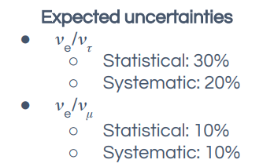
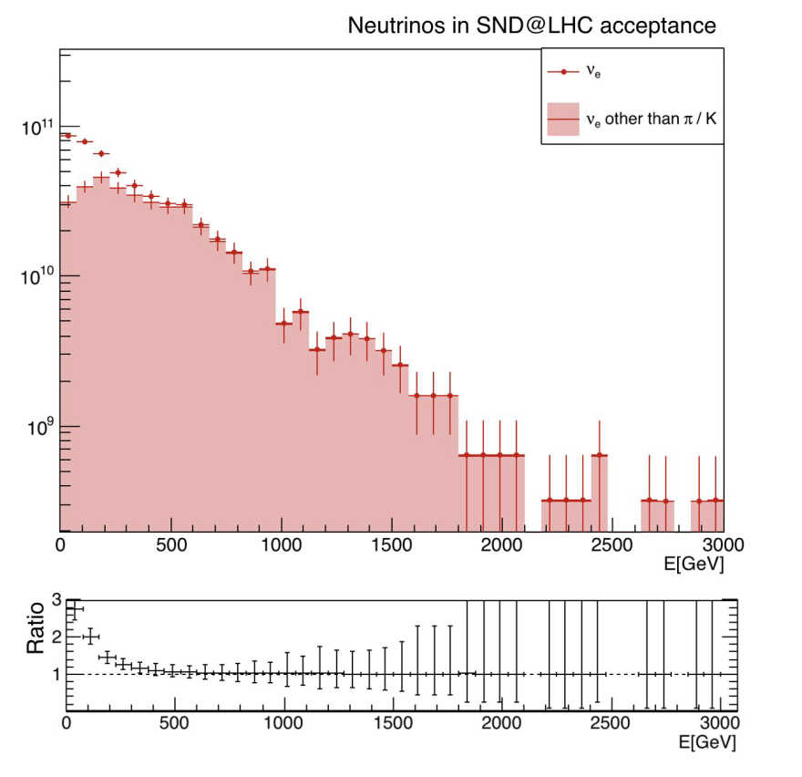
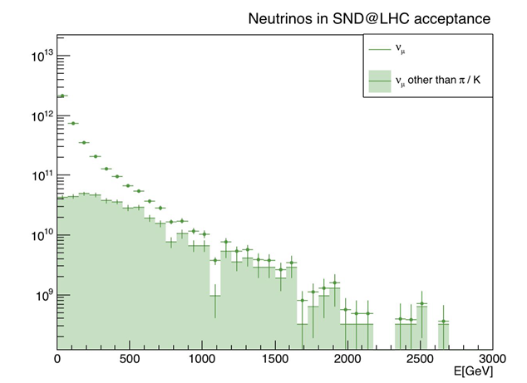
Physics Cases – Lepton Universality Test
All 3 flavors of neutrinos can be identified.
Unique opportunity to test lepton flavour universality with neutrinos
𝜈_{e} /𝜈_{τ} and 𝜈_{e} /𝜈_{µ} ratios

Slide 18
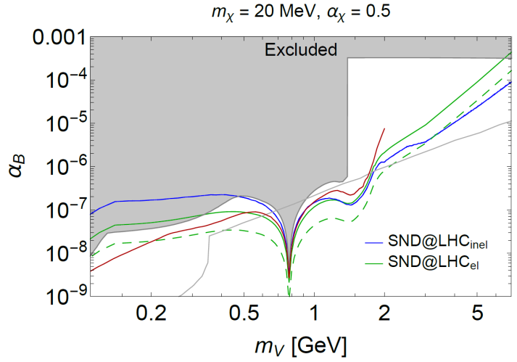
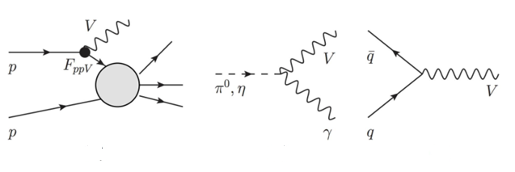
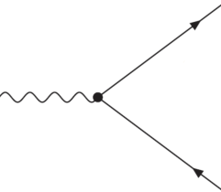
Physics Cases – FIP search
Direct search for FIP through scattering in the detector
e.g. leptophobic dark photon and light DM
JHEP 03 (2022) 006
Dark photon can be produced at IP1 through p bremsstrahlung, meson decays, Drell-Yann process etc..
Dark photon decays into LDM.
LDM scatterings in the detector
LDM decays in the detector

Slide 19
Analyses

Slide 20
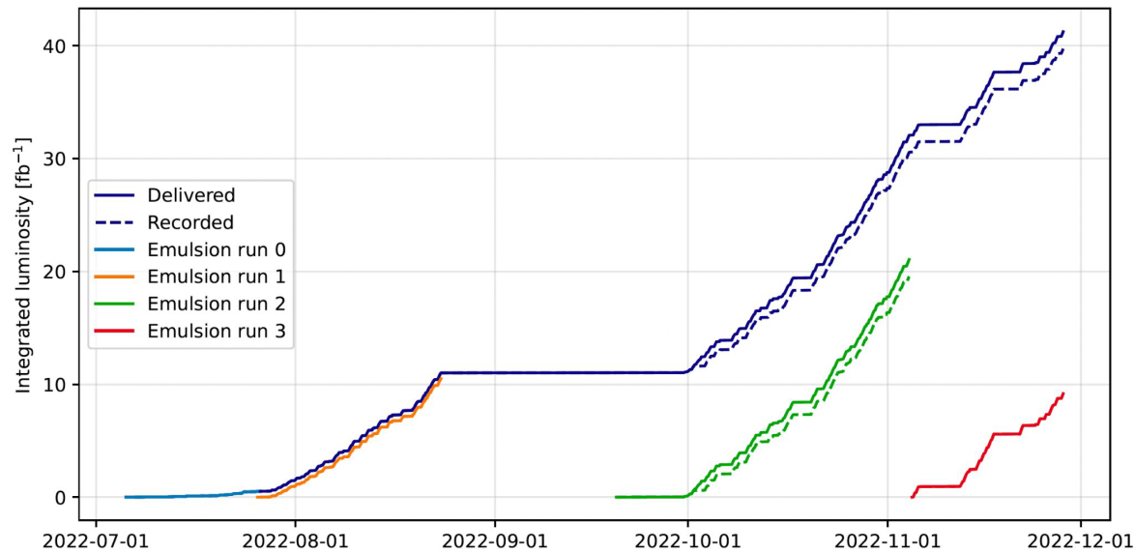
Data taking in 2022
Run3 in 2022
41.25 fb⁻¹ delivered
39.74 fb⁻¹ recorded (96%)

Slide 21
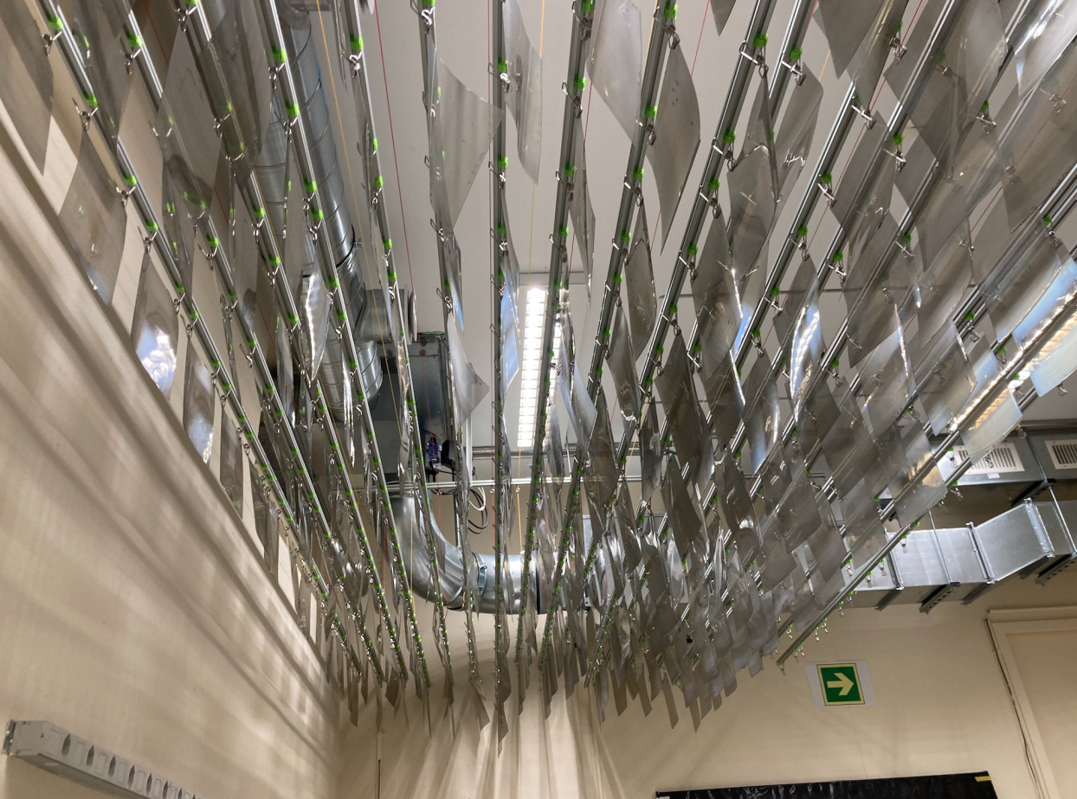
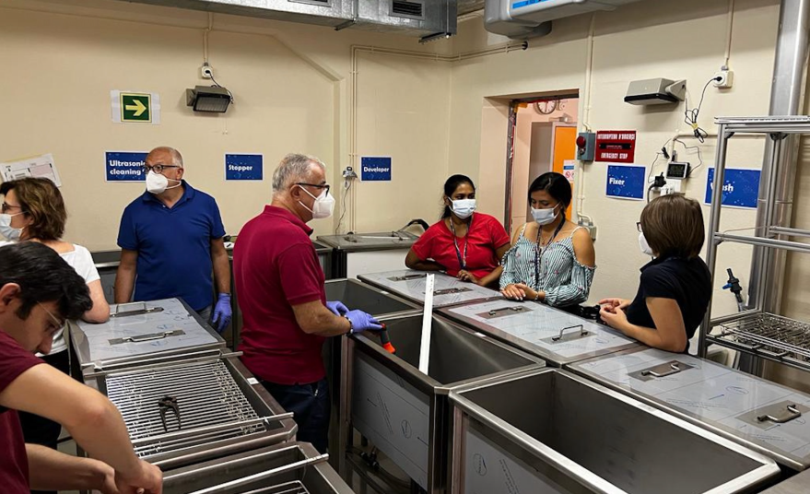
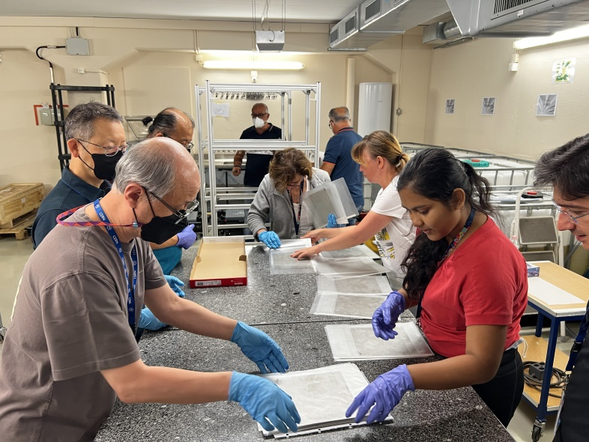
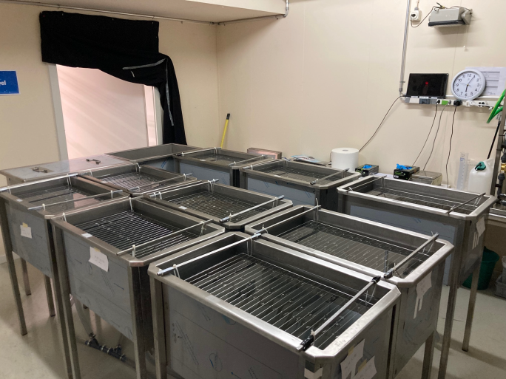
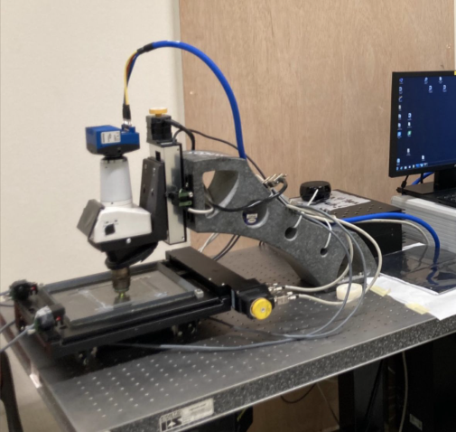
Emulsion Development & Scanning
- 16 walls assembled
- 3522 emulsion films installed (130 m²)
- 2370 emulsion films developed (86 m²)
- 2320 good quality films (85 m²), 98%
- 3500 L disposed chemical solutions

Slide 22
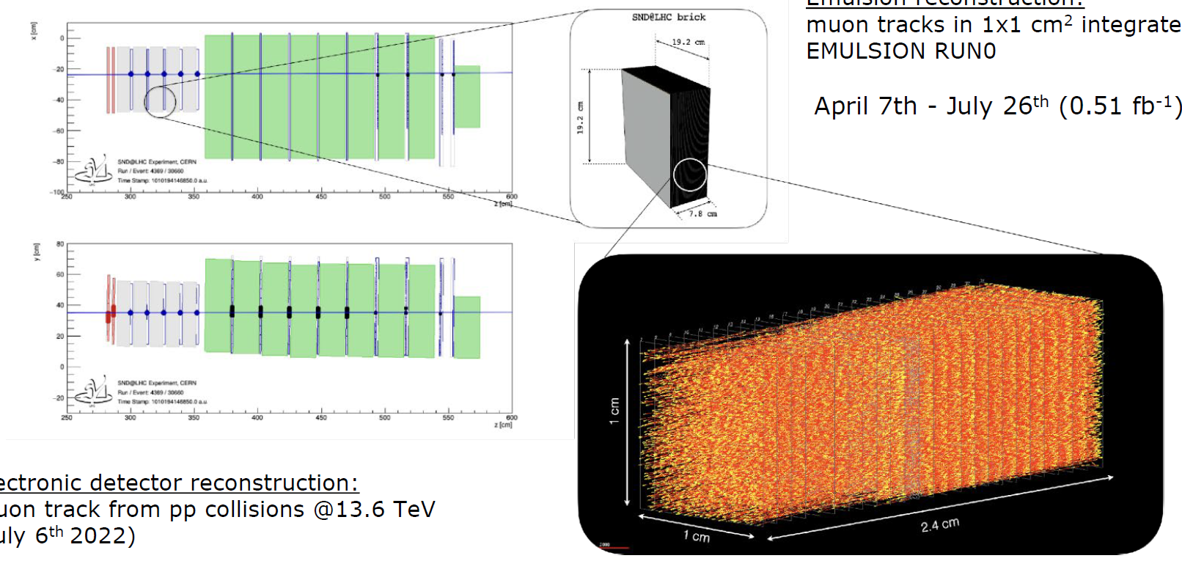
Muon Track Reconstruction
Emulsion Reconstruction
Muon tracks in 1x1cm²
Integrated in Run 0 of
0.51 fb⁻¹ (07/04-26/07)
Electronic Detector Reconstruction
Muon track from pp collisions
at 13.6 TeV (06/07/2022)

Slide 23
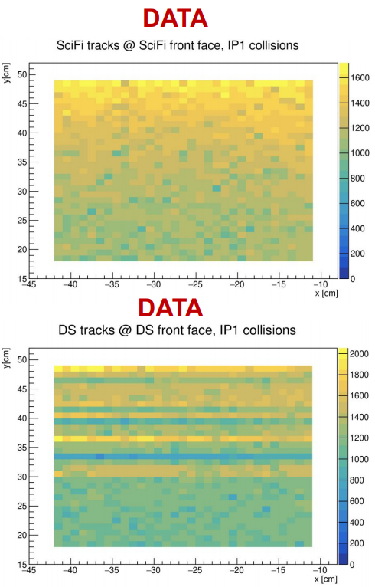
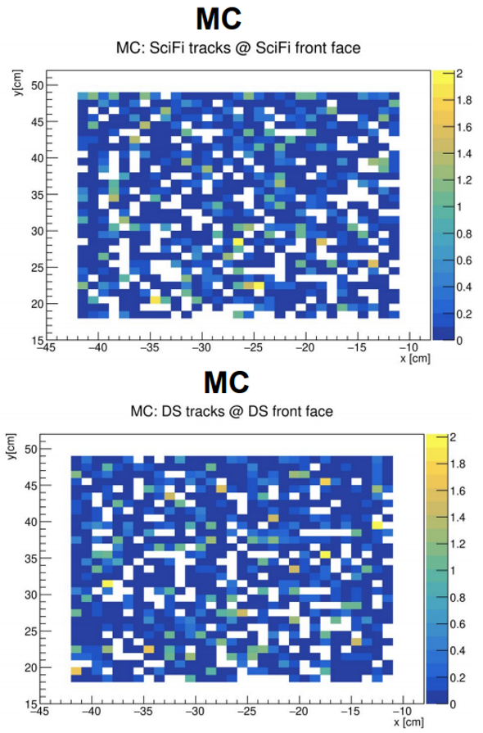
Data/MC Comparison
Measured muon
track rate in SciFi
(31x31 cm²):
(1.60±0.01_{stat})x10⁴
fb/cm²
Expected muon
track rate in SciFi
(31x31 cm²):
(1.57±0.10_{stat})x10⁴
fb/cm²
Measured muon
track rate in Muon
system (31x31 cm²):
(1.67±0.01_{stat})x10⁴
fb/cm²
Expected muon
track rate in Muon
system (31x31 cm²):
(1.59±0.10_{stat})x10⁴
fb/cm²
Muon flux from FLUKA
F. Cerutti, M.S. Gilarte
CERN-SY/STI

Slide 24
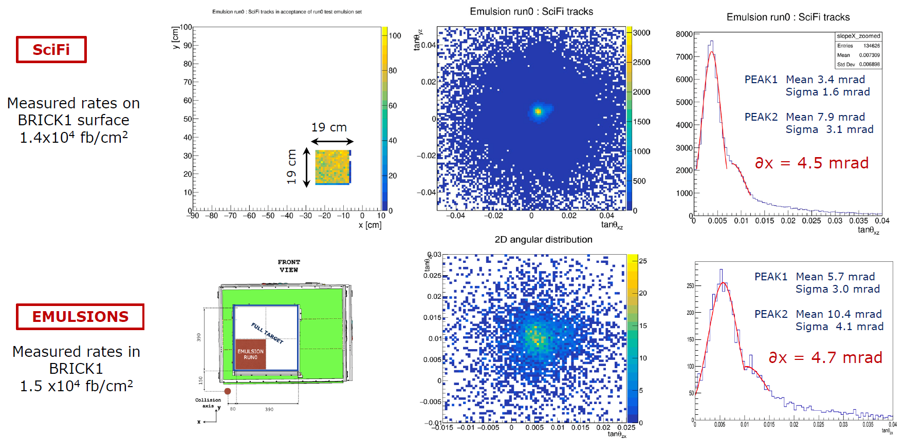
SciFi/Emulsion Comparison

Slide 25
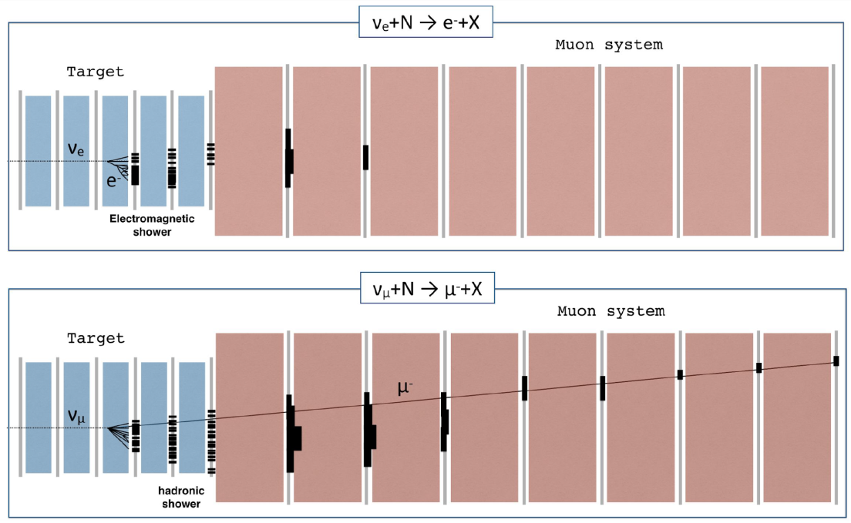
Neutrino Identification Strategy
First Stage
Identify the neutrino candidates in electronic detector data
Tag muons in the muon system
Measure electronic and hadronic energies in calorimeters
Second Stage
Identify the neutrino candidates in emulsion data
Tag electromagnetic showers
Match events to electronic detector data
Identify neutrinos of all flavours!

Slide 26
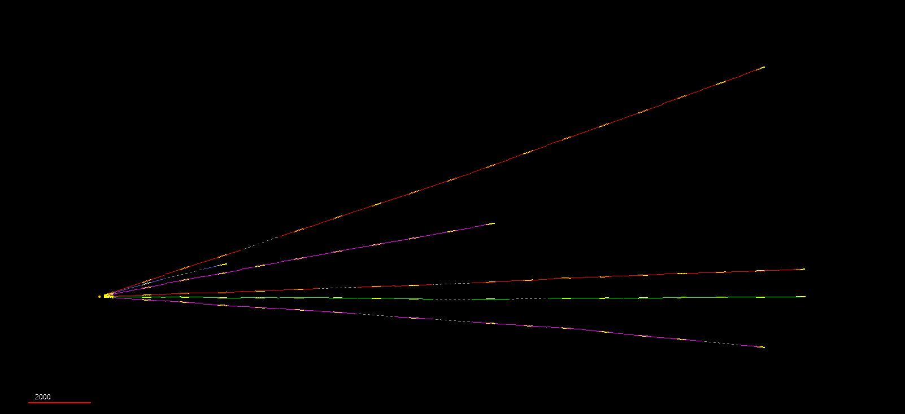
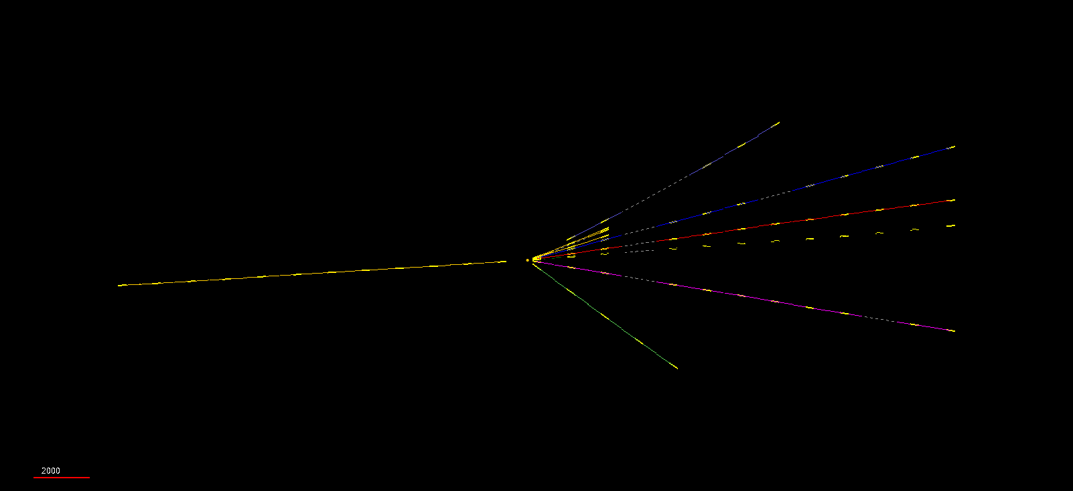
Vertex Reconstruction in Emulsion
Neutral particle interaction
Charged particle interaction

Slide 27
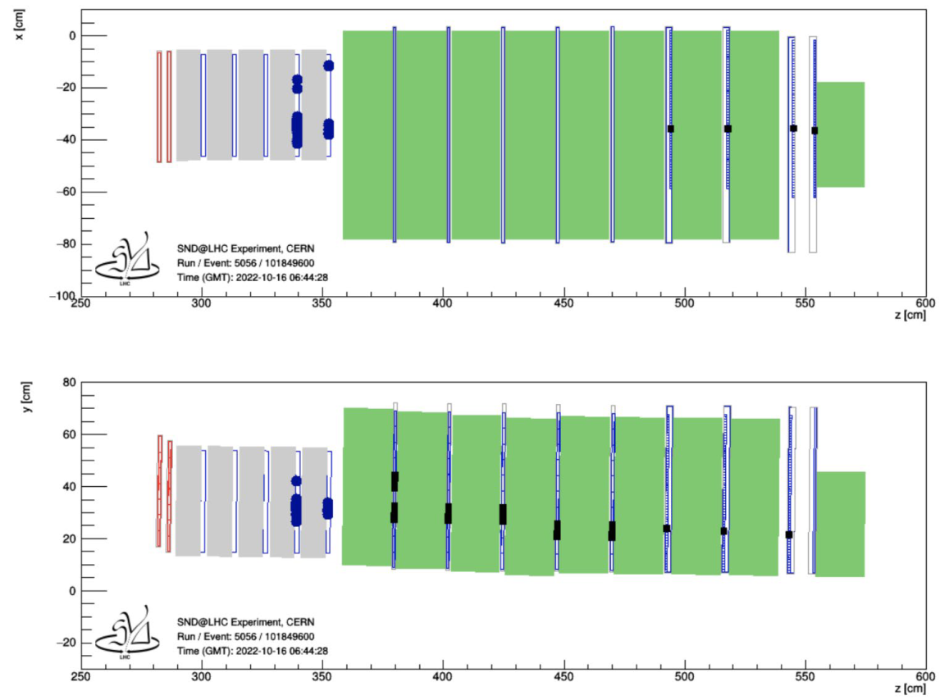
Neutrino Identification with Electronic Detectors
Neutrino selection criteria for electronic detectors
▶ Fiducial volume cuts
- Require an event from a neutral vertex, located in the 3rd or 4th wall
- Select fiducial cross-sectional area to reject entering backgrounds
▶ Neutrino ID cuts
- Require large EM activity in SciFi and hadronic activity in the HCAL
- Require timing for event produced upstream
- Muon reconstructed and isolated in the muon system
Top View
Side View

Slide 28
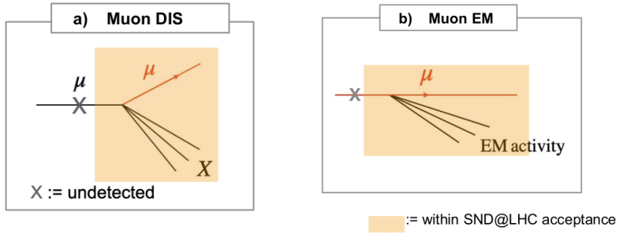
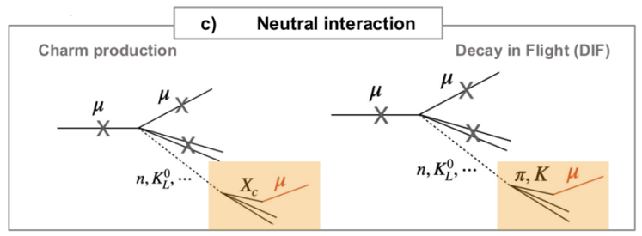
Background Estimation
Muon induced DIS and EM backgrounds
Number of undetected muons entering the target
$$\sim {10}^{−2}$$
SND@LHC PRELIMINARY
Muon induced neutral interaction backgrounds
$$\sim 0.2$$
Systematic uncertainty study is ongoing.

Slide 29
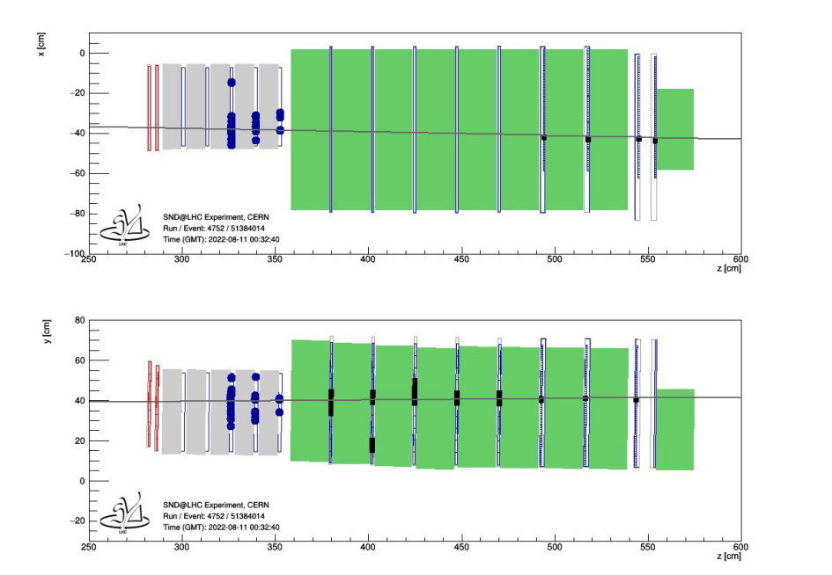
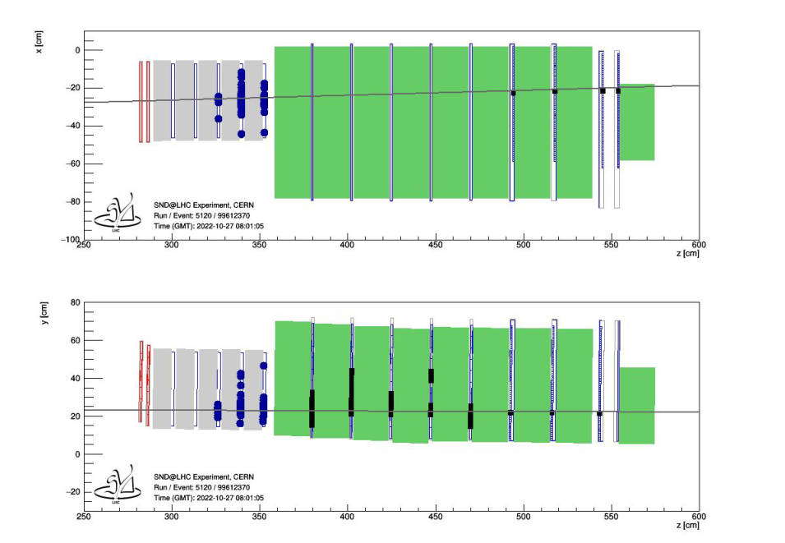
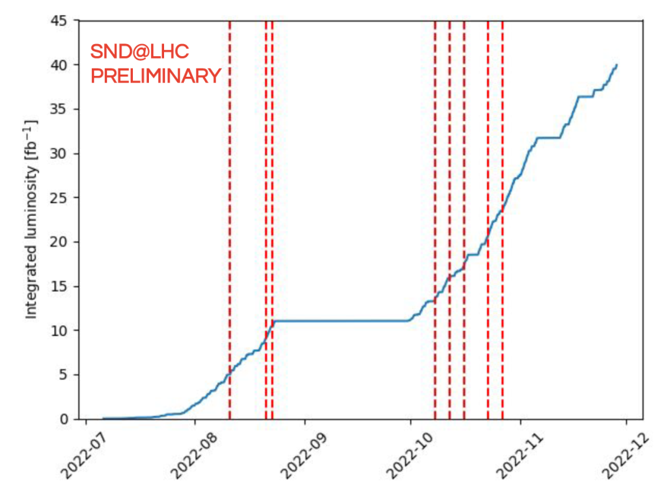
Observed Neutrino Candidates
Top View
Top View
Side View
Side View
Aug 11th
Oct 27th
8 𝜈_{µ} CC candidates observed
(5 expected)
0.2 background yields estimated

Slide 30
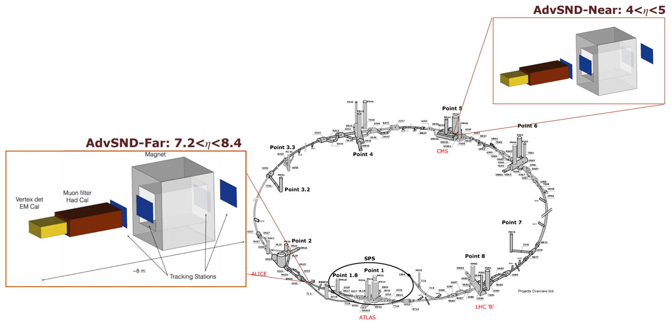
Beyond Run 3
Advanced SND@LHC
- Future project at HL-LHC era
Upgrade of SND@LHC during LS 4
Extension of the physics case
New technologies and detector layout
Two detectors:
AdvSND-Far (7.2 < η < 8.4)
Possible location: Forward Physics Facility
AdvSND-Near (4 < η < 5)
Possible locations: Existing caverns close to IP

Slide 31
Conclusion
SND@LHC starts running to perform measurements of 𝜈 and search for FIP in the forward region of the LHC.
SND@LHC collected 39 fb⁻¹ data at the LHC Run 3.
Measurement of muon flux with emulsions and electronic detectors shows good agreements with MC calculation.
8 𝜈_{µ} CC candidates are identified with the electronic detectors while the estimated backgrounds are 0.2. Systematic uncertainty is under evaluation to expect significance ~5σ.
Emulsion scanning & analysis is ongoing. Stay tuned!

Slide 32
Thank you!

