Slide 1
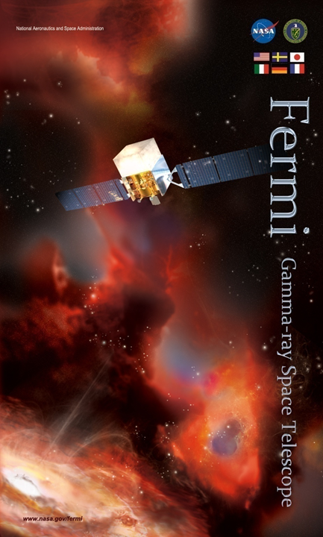
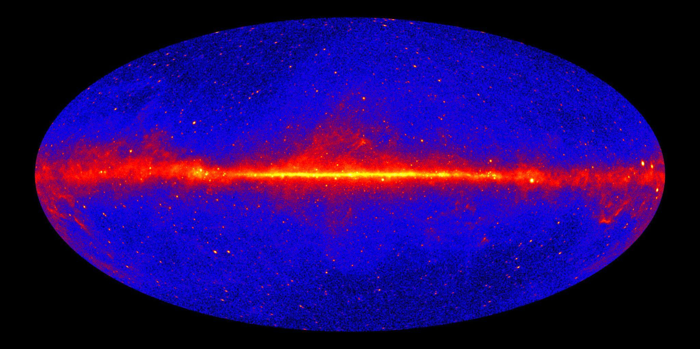
Recent Results of Fermi:
Its Role in the Era of Multimessenger/Multiwavelength Astrophysics
T. Mizuno (Hiroshima Univ.) on behalf of the Fermi-LAT Collaboration
@Kyoto Symposium (Physics of the Two Infinities),
2023 Mar. 27
Notes:
(Self introduction)
Recent results of Fermi
Crucial role in MM and MW

Slide 2
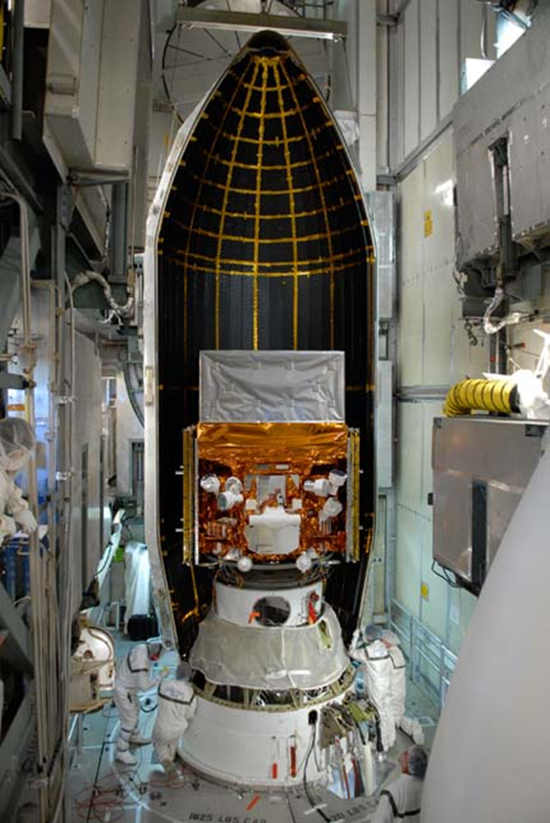
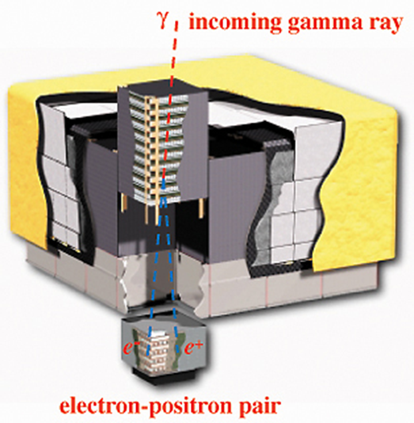
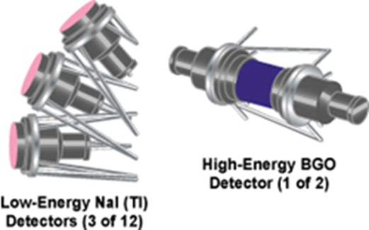
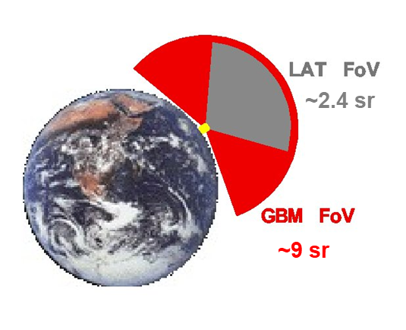
Fermi Mission
Fermi Gamma-ray Space Telescope:
International space mission, launched in 2008
LAT+GBM (TM is a LAT member)
LAT (Large Area Telescope)
20 MeV to > 300 GeV
Field of view (FOV): 2.4 sr
Gamma-ray sky survey (imaging & spectroscopy)
occasionally autonomous repoint request (ARR) triggered by GBM
(Atwood+09 for details)
GBM (Gamma-ray Burst Monitor)
8 keV to 30 MeV
FOV: 9 sr
Monitoring transient sources (spectroscopy)
Notes:
Fermi mission (instruments)
LAT+GBM (TM is a member of LAT collaboration)
LAT: pair-conversion type, gamma-ray sky survey
GBM (our best friend): scintillator, continuously monitor transient
LAT occasionally performs ARR triggered by GBM

Slide 3
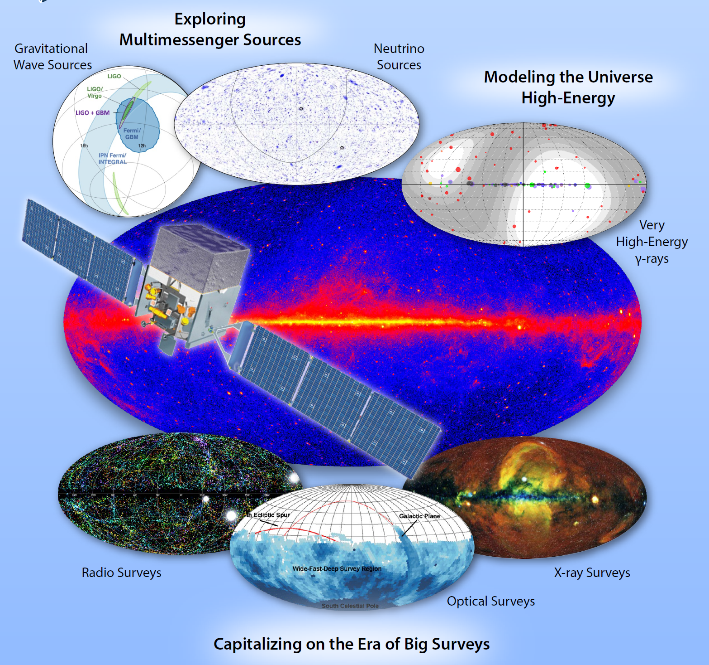
Role of Fermi in Today’s Astrophysics
NASA Astrophysics Advisory Committee panel report says
“Fermi provides unique access to the gamma-ray portion of the electromagnetic spectrum and the largest simultaneous filed-of-view of any space telescope. Its data give us a time-domain view of the entire gamma-ray sky and are a crucial asset for gravitational-wave and multi-messenger astrophysics”
Fermi plays a key role in today’s astrophysics by providing
Crucial data for multimessenger (MM) astrophysics
Useful catalogs of various source classes
Crucial data for multiwavelength (MW) astrophysics
(2022 NASA senior review proposal)
(see also Hadasch’s talk (Day1) and Tibaldo’s talk (Day 2))
Notes:
Role of Fermi
Response to NASA senior review proposal
My interpretation
Hereafter examples, starting with MM (MW also in Daniela’s and Luigi’s talks)

Slide 4
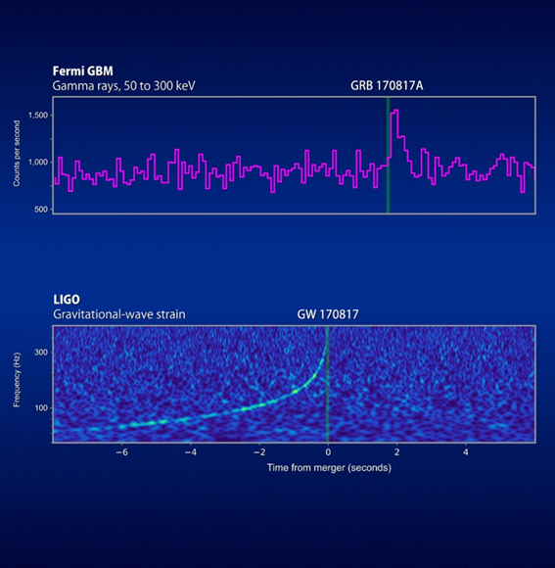
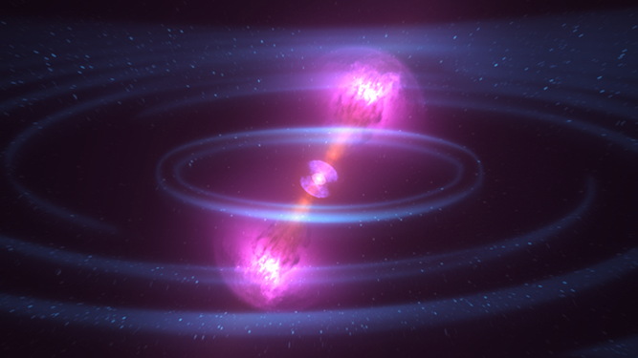
MM Astrophysics (1): GW170817
GW170817 (neutron star (NS) merger) = GRB 170817A (short gamma-ray burst; sGRB)
Positional & temporal association
Fermi GBM & LIGO
Credits: NASA's Goddard Space Flight Center/CI Lab
https://fermi.gsfc.nasa.gov/fermi10/fridays/01122018.html
Notes:
1st example of MM (GW170817)
NS merger; Fermi established it = sGRB
(Positional and) temporal association; Figure

Slide 5
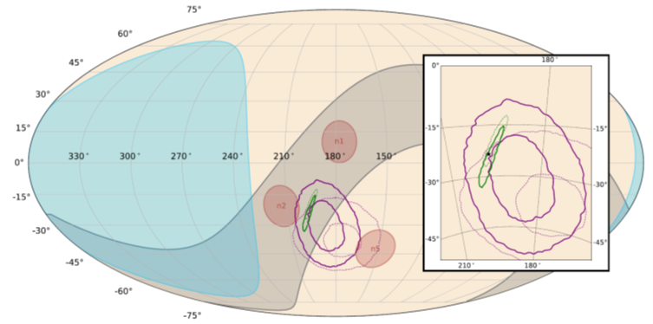
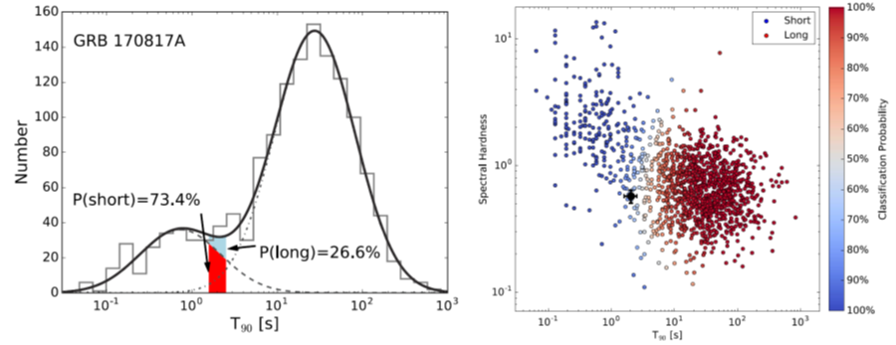
MM Astrophysics (1): GW170817 (Cont’d)
GW170817 (NS merger) = sGRB
T₉₀ ~2.0 s
E_{peak} ~200 keV
(probability to be a short-hard class ~70%)
localization
GBM & LIGO/Virgo
duration (T₉₀) T₉₀ vs. spectral hardness
(Goldstein+17)
LAT was off at t₀ due to South Atlantic Anomaly (Ajello+18)
~5% of GBM-sGRBs were detected by LAT (within FOV or ARR); next GW/GBM events in O4 are anticipated
Notes:
How we (GBM) established NS merger = sGRB (in more detail)
Positional association
T90 ~ 2s (short w/ >70%)
Epeak ~ 200keV (short-hard w/ ~70%)
LAT was off; next event in O4 anticipated

Slide 6
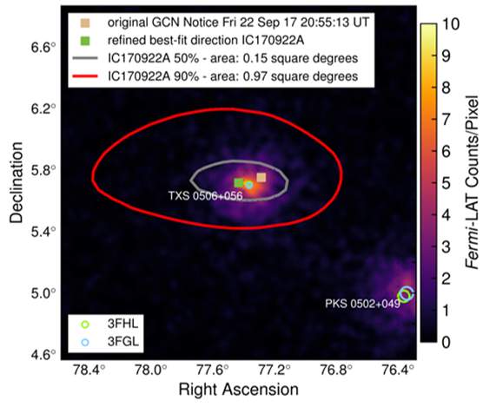
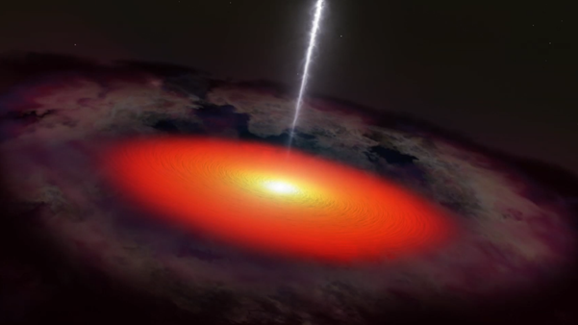
MM Astrophysics (2): IceCube-170922A
IceCube-170922A (high energy (HE) ν events) from TXS 0506+056 (blazar)
Positional & temporal association
E_{ν} ~ 290 TeV
(Analysis led by Y. Tanaka@Hiroshima;Atel#10791)
Fermi-LAT
Credit: NASA’s Goddard Space Flight Center
(Aasten+18)
9 yrs
1.5 months
Notes:
2nd example of MM (IceCube-170922A)
HE n event (~300 TeV)
LAT found it came from a blazar (positional and temporal)

Slide 7
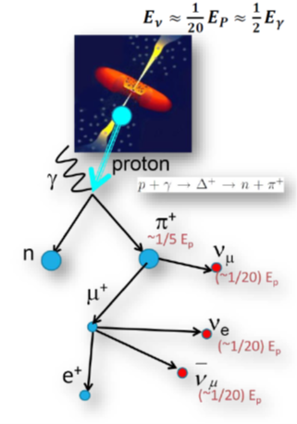
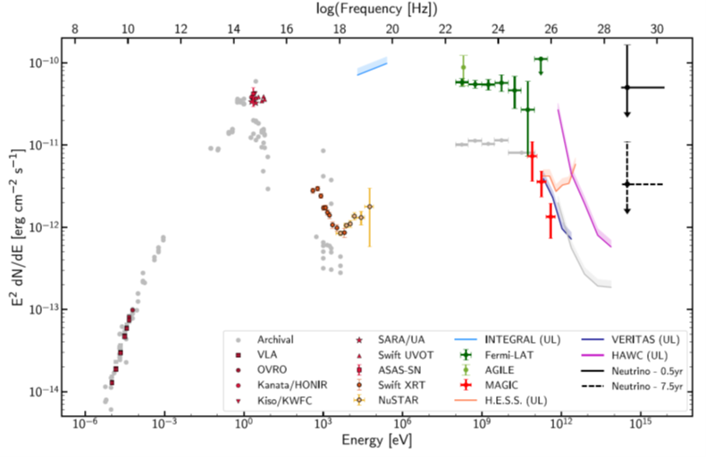
MM Astrophysics (2): IceCube-170922A (Cont’d)
HE ν events; cosmic-ray (CR) p+γ interaction (E_{ν} ~ 290 TeV, E_{p} ~ 3 PeV)
MW data shows rather typical (leptonic) blazar spectrum; difficult to draw a direct connection w/ neutrino flux, stimulating theoretical works
(e.g., Ansoldi+18, Keivani+18)
Fermi-LAT
(Aasten+18)
Notes:
Nature of the event
HE n -> CR-p (left figure)
MW data (right); leptonic (sync, IC)
(Interestingly) difficult; stimulates theoretical work

Slide 8
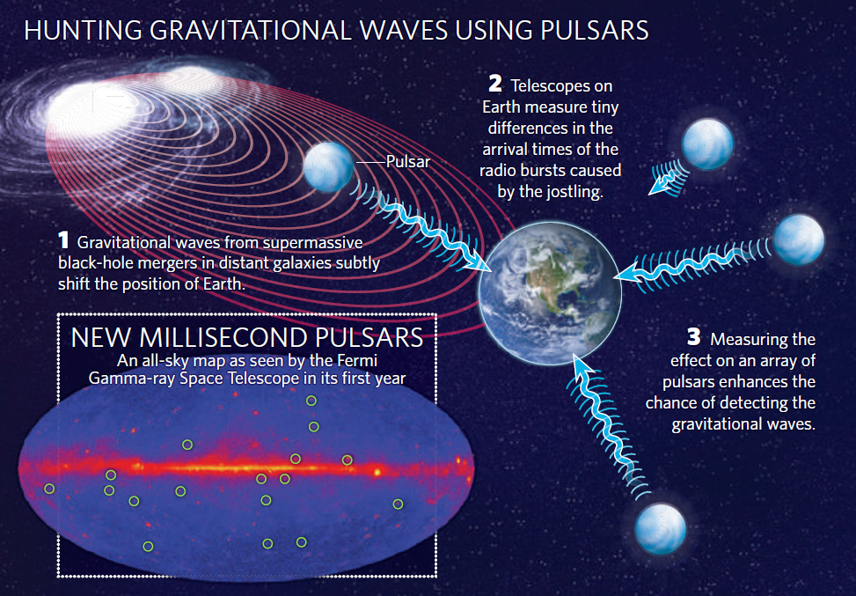
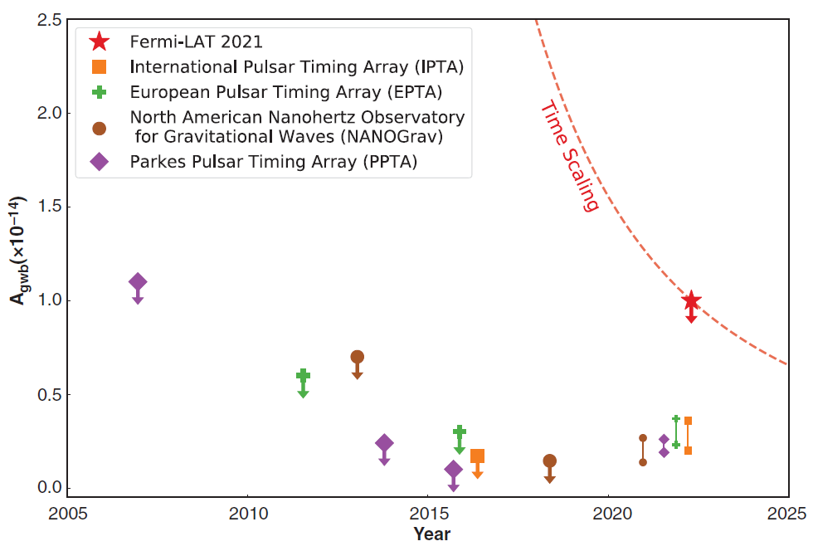
MM Astrophysics (3): Pulsars and GW
Coalescing binary supermassive black holes in merging galaxies fill the universe with long GWs (@nanohertz) => pulsar timing array (PTA) in radio
Gamma-ray is independent to and complementary with radio PTAs; free from effects of ionized interstellar medium (dispersion measure)
12.5 yrs data & 35 millisec. pulsars (MSPs); results already 30% as good as radio PTAs
(Ajello+22)
(Nature, 2010)
Notes:
3rd example of MM (PSR & GW)
Binary SMBH; long GW@nanoheltz
GW(BG) affects arrival time of signal; PTA
Radio PTA; (amplitude) A<0.3x10^-14 or possible detection, but controversial (suffer from effects of ionized ISM)
Gamma-ray; free from such effects, A<1x10^-14
# more massive and frequent => larger A (strain)

Slide 9
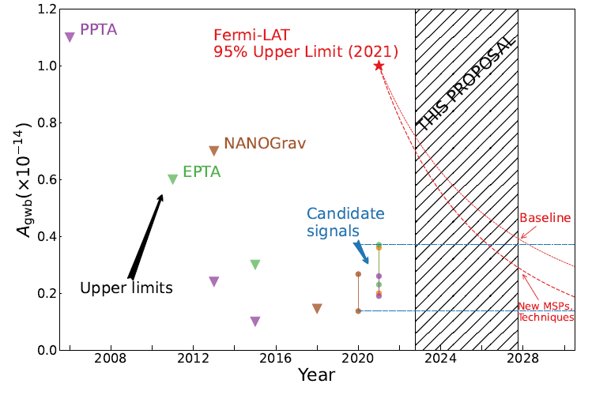
MM Astrophysics (3): Pulsars and GW (Cont’d)
Gamma-ray is independent to and complementary with radio PTAs; free from effects of ionized interstellar medium
12.5 yrs data & 35 MSPs; results already 30% as good as radio PTAs
The LAT constraints improve as t^{-13/6}
Over the next ~5 yrs Fermi-LAT will confirm or refute the candidate signal from radio PTAs
(Ajello+22)
(2022 NASA senior review proposal)
Notes:
Prospect in the near future
Already 30% as good ad radio
Improves faster than t^2; will confirm/refute possible signal. stay tuned
# Fermi-LAT continuously discovers MSPs

Slide 10
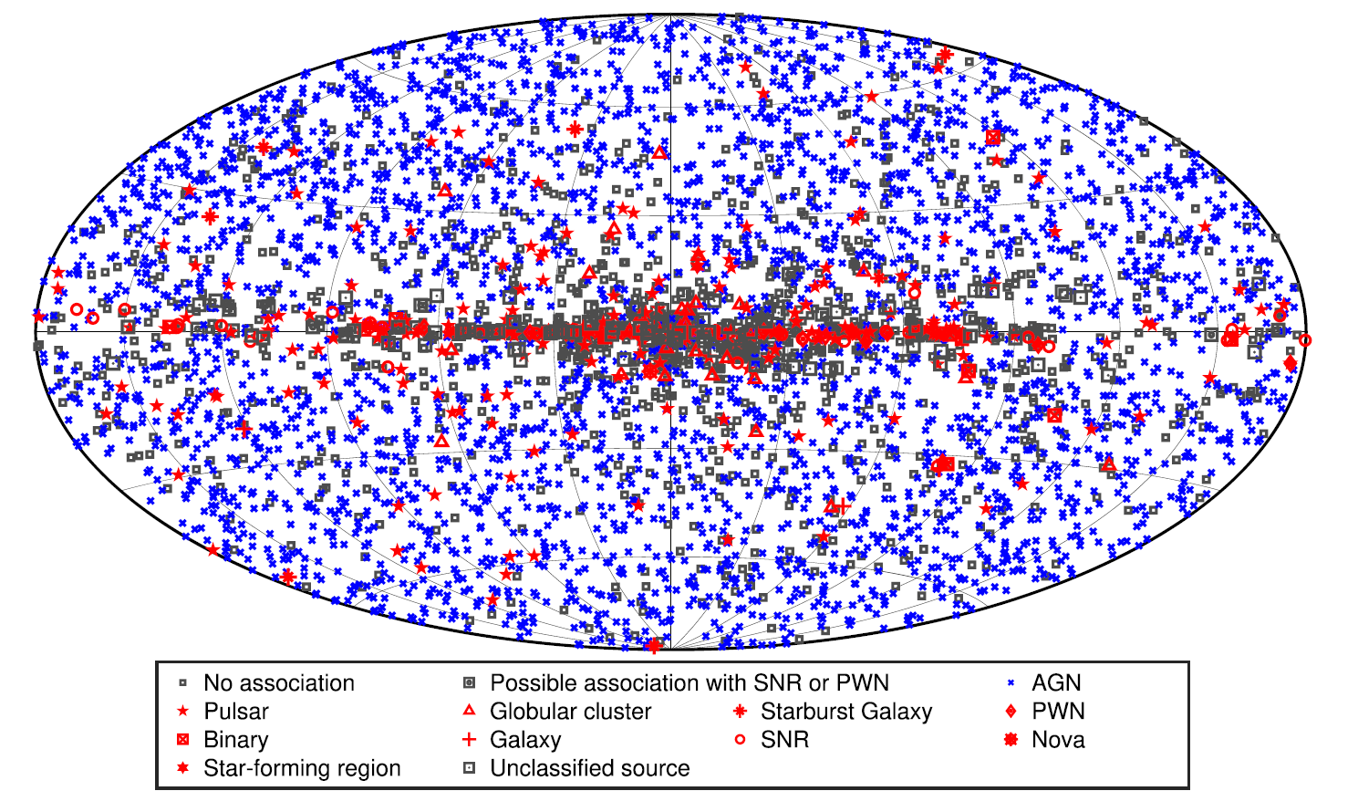
Useful Catalog and Resources
Fourth Fermi-LAT Source Catalog: Fermi-LAT Collaboration 2020, ApJS 247, 33
Main catalog that contains >6000 γ-ray sources
Light Curve Repository: https://fermi.gsfc.nasa.gov/ssc/data/access/lat/LightCurveRepository
Useful web-based service that provides automated time-series analysis
First Fermi-LAT Long-term Transient Source Catalog; Fermi-LAT Collaboration 2021, ApJS 256, 14
First Fermi-LAT Solar Flare Catalog; Fermi-LAT Collaboration 2021, ApJS 252, 13
Second Fermi-LAT Flaring Source Catalog; Fermi-LAT Collaboration 2017, ApJ 846, 34
Fourth Fermi-LAT AGN Catalog; Fermi-LAT Collaboration 2022, ApJS 263, 24
Second Fermi-LAT GRB Catalog; Fermi-LAT Collaboration 2019, ApJ 878, 32
Third Fermi-LAT Hard Source Catalog; Fermi-LAT Collaboration 2017, ApJS 232, 18
First Fermi-LAT Supernova Remnant Catalog; Fermi-LAT Collaboration 2016, ApJS 224, 8
Second Fermi-LAT Pulsar Catalog, Fermi-LAT Collaboration 2013,ApJS 208, 17
(Fermi-LAT Collab. 20)
(LC generated by LCR)
10 s
Notes:
We provide useful catalogs/resources
4th source catalog; main catalog w/ >6000 sources
LCR allows automated time-series analysis
and others
Variable sources; Long term transient catalog, Solar flare catalog, flaring source catalog
Stable sources; AGN catalog, GRB catalog, Hard source catalog
Galactic sources; SNR catalog, PSR catalog

Slide 11
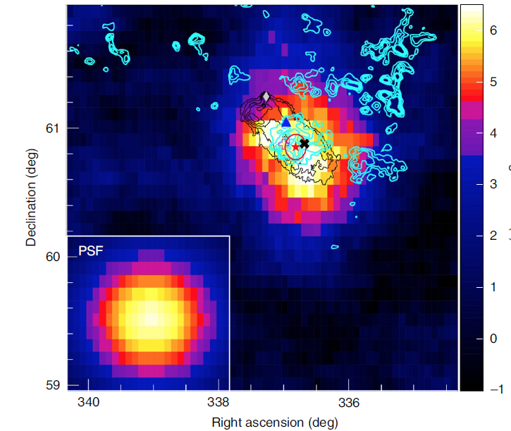
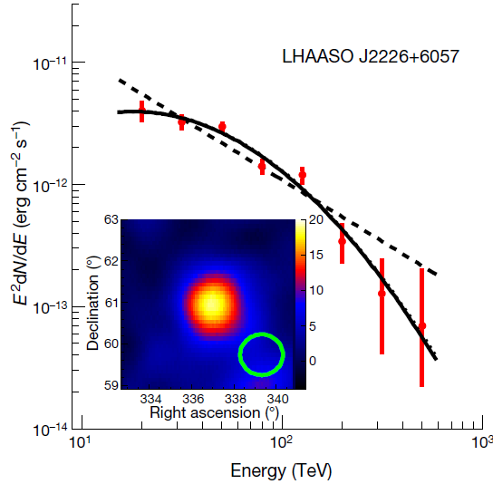
MW Astrophysics (1): SNR G106.3+2.7
Supernova remnants (SNRs) are believed to be the main source of Galactic CRs up to knee (~3 PeV)
Tibet ASγ discovered γ-rays above 100 TeV toward G106.3+2.7, with position deviates from pulsar but close to molecular cloud (“PeVatron”)
LHAASO reported E_{max} = 0.57 PeV
GeV data is crucial to investigate the source nature, but contamination from nearby pulsar (PSR) is severe (Xin+19)
(Amenomori+21, Cao+21)
10 s
Notes:
(Move to next topic; MW)
1st example of MW; SNR G106.3+2.7 (PeVatron)
SNR = origin of Galactic CRs
G106.7; promising PeVatron candidate (Tibet ASgamma, LHAASO)
PSR contamination severe in GeV
# PSR at diamond, contour shows MC, red star/circle by Tibet

Slide 12
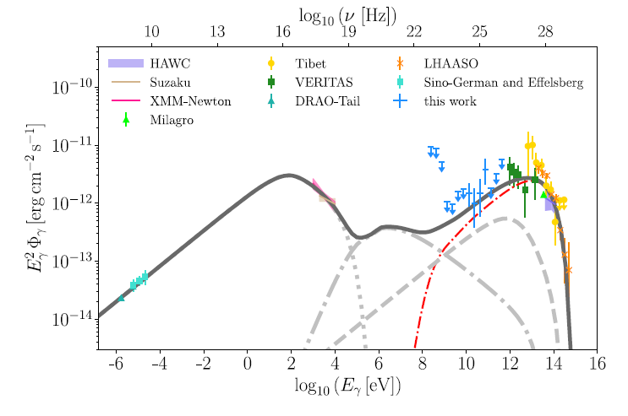
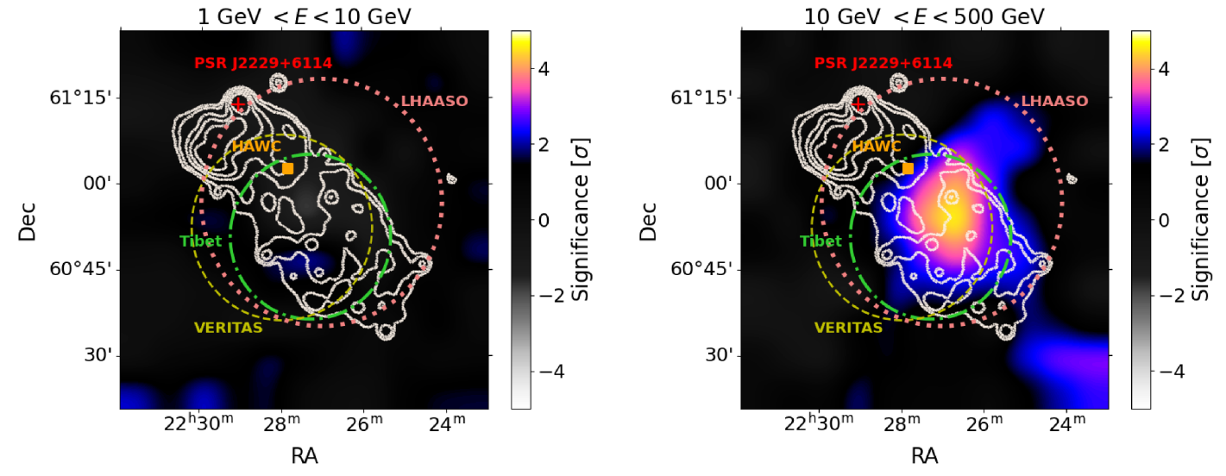
MW Astrophysics (1): SNR G106.3+2.7 (Cont’d)
Dedicated analysis by Fang+22 by removing >95% PSR contamination w/ phase-cut
No emission btw. 1-10 GeV, significant emission above 10 GeV from the SNR
GeV-TeV spectrum too hard to explain by single electron population (α_{e}=2.4 by radio and X-ray). Instead, e+p scenario well explain the MW spectrum, firmly establishing the source to be PeVatron
(Fang+22)
hadronic
leptonic
α_{p}=1.7, E_{p,max}=0.8 PeV, B~10 uG
W_{p}=3.3x10⁴⁸ erg, W_{e}=5.3x10⁴⁷ erg
(plausible for CR acceleration by SNR)
10 s
Notes:
Nature of the source (w/ new Fermi analysis)
No emission (<10 GeV), emission from SNR (>10 GeV)
GeV-TeV spectrum too hard for leptonic; e+p well explain MW spectrum
Physical parameters (plausible)

Slide 13
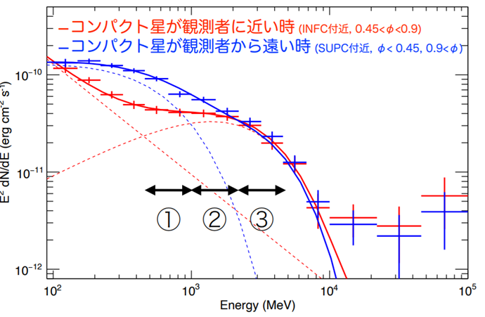
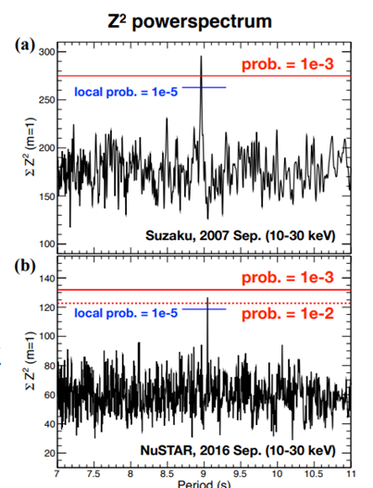
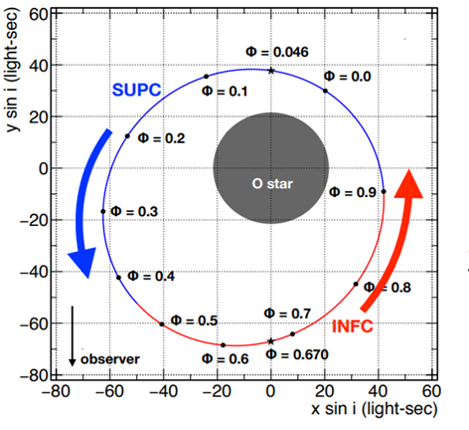
MW Astrophysics (2): LS 5039
Famous gamma-ray binary, whose GeV flux anti-correlates to X-ray/TeV
Compact star unknown, acceleration and emission mechanism unsettled
New Fermi data revealed two components in GeV (stable in HE)
Suzaku and NuSTAR revealed a sign of pulsation of P~9 s
(Yoneda+20
Yoneda, TM+21)
Suzaku (2007)
T=8.96+/-0.01
NuSTAR (2016)
T=9.05+/-0.01
10 s
Notes:
2nd example; LS 5039 (gamma-ray binary)
Orbital modulation in GeV; compact star, etc. unsettled
New Fermi data; two component (stable in HE)
X-ray data; pulsation (w/ spin down)

Slide 14
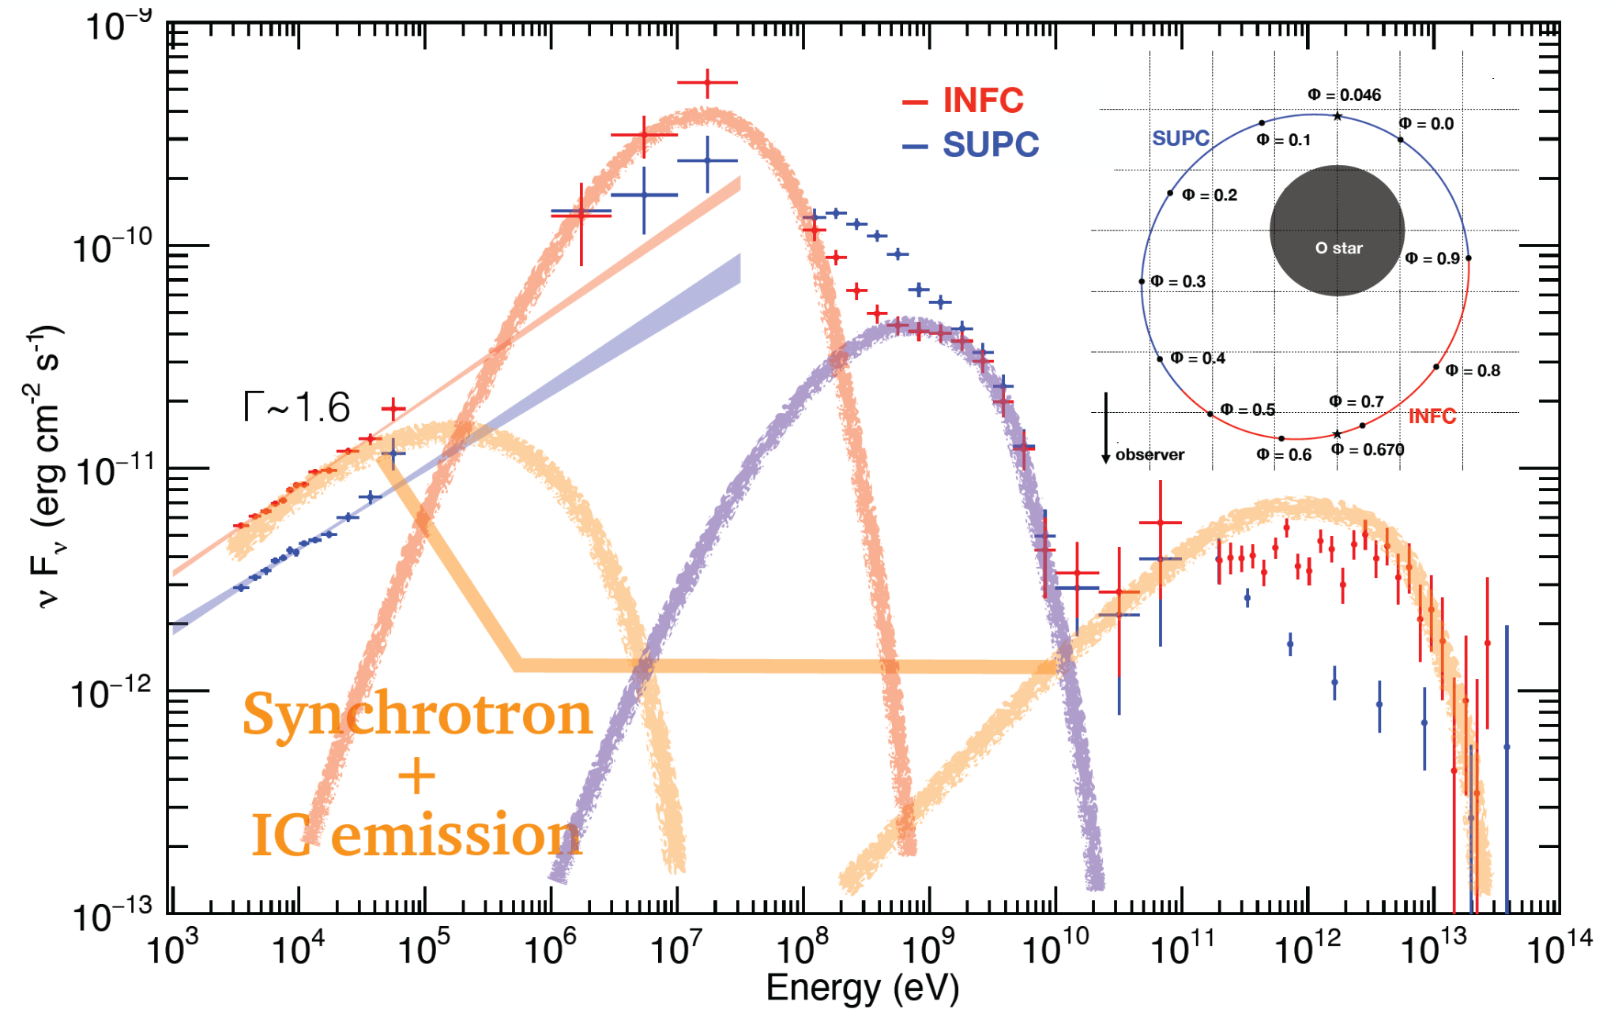
MW Astrophysics (2): LS 5039 (Cont’d)
Two component in GeV (at least 4 components in SED)
A sign of pulsation of P~9s
NS binary, but spin down luminosity is too small to explain L_{bol} (particularly MeV/GeV)
Magnetic reconnection in Magnetar + O star suggested
New hypothesis : Magnetar found in a binary system for the first time
(Yoneda+20
Yoneda, TM+21)
Suzaku (2007)
T=8.96+/-0.01
NuSTAR (2016)
T=9.05+/-0.01
10 s
Notes:
Nature of the source
Two components in GeV (stable in HE); at least 4 in SED
X-ray pulsation => NS, Edot<Lbol (MeV/GeV too bright)
B~10^15G suggested; B-reconnection in magnetosphere due to stellar wind is viable energy source
Possible model; sync+IC for X-ray/TeV, B-reconnection induced radiation for (hard&bright) MeV/GeV
If true, magnetar in binary for the first time
# P=9s, Pdot=3x10^-10, Edot=1x10^34 erg/s, Lbol=10^36 erg/s (stellar wind X, accretion X), B~10^15G
# Magnetar; typically 2-10s
# model; X (bow shock, sync.), MeV (B-reconnection, sync.), Stable GeV (B-reconnection, curvature radiation), TeV (B-reconnection->outflow, IC)

Slide 15
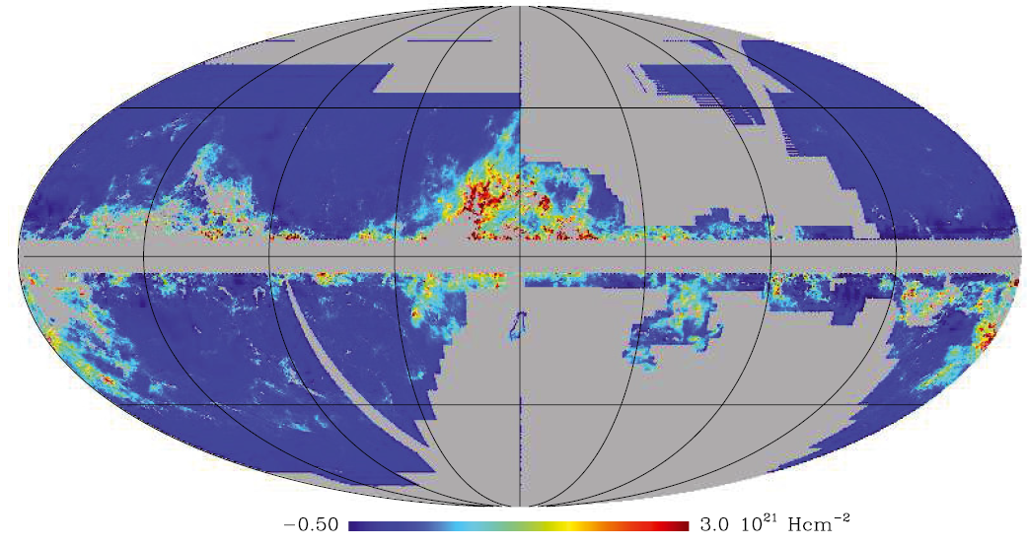
MW Astrophysics (3): Diffuse 𝛾-rays to study ISM gas and CRs
Diffuse 𝛾-ray is produced by interaction of CRs and interstellar medium (ISM), telling us gas and CRs in the interstellar space
(Simplest) Way: Use HI and CO lines to trace HI and H₂ gas, then use 𝛾-ray to obtain I_{CR} (∝I_{𝛾}/N_{H})
Issue: Significant amount of gas not properly traced by HI/CO lines
(e.g., Grenier+05, Planck Collab. 2011)
Dust and 𝛾-ray have been used to trace “dark gas”, but they cannot distinguish gas phases (presumably optically thick HI and CO-dark H₂)
Dark gas map
(Planck Collab. 2011)
Notes:
3rd example; diffuse gamma-ray
(All-sky image) Diffuse gamma probes ISM gas and CRs
Issue: dark gas
Dust/gamma cannot distinguish gas phases (uncertainty)

Slide 16
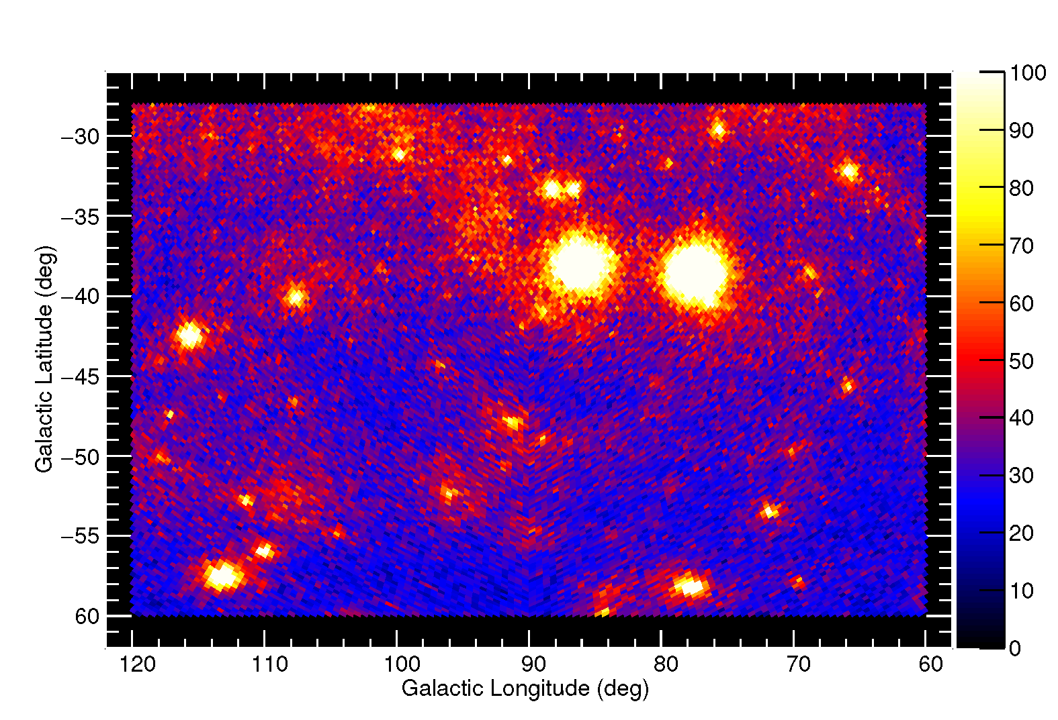
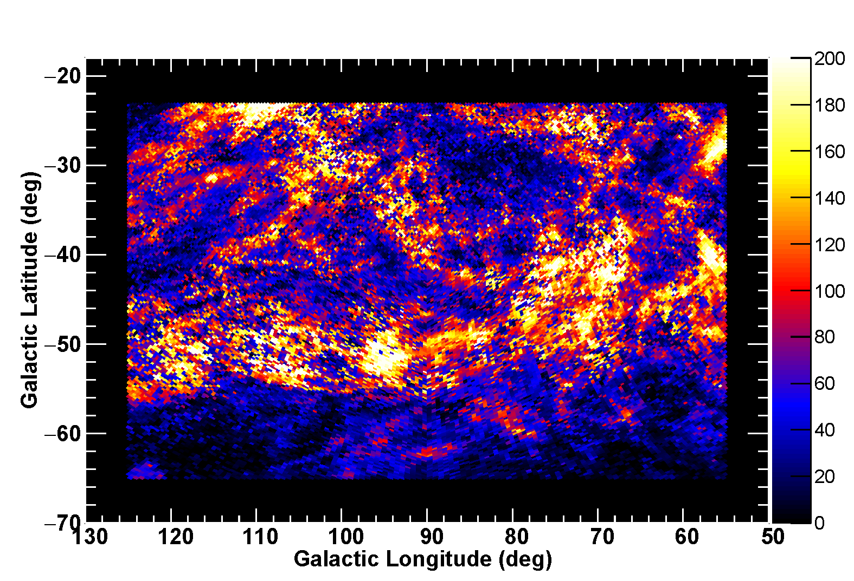
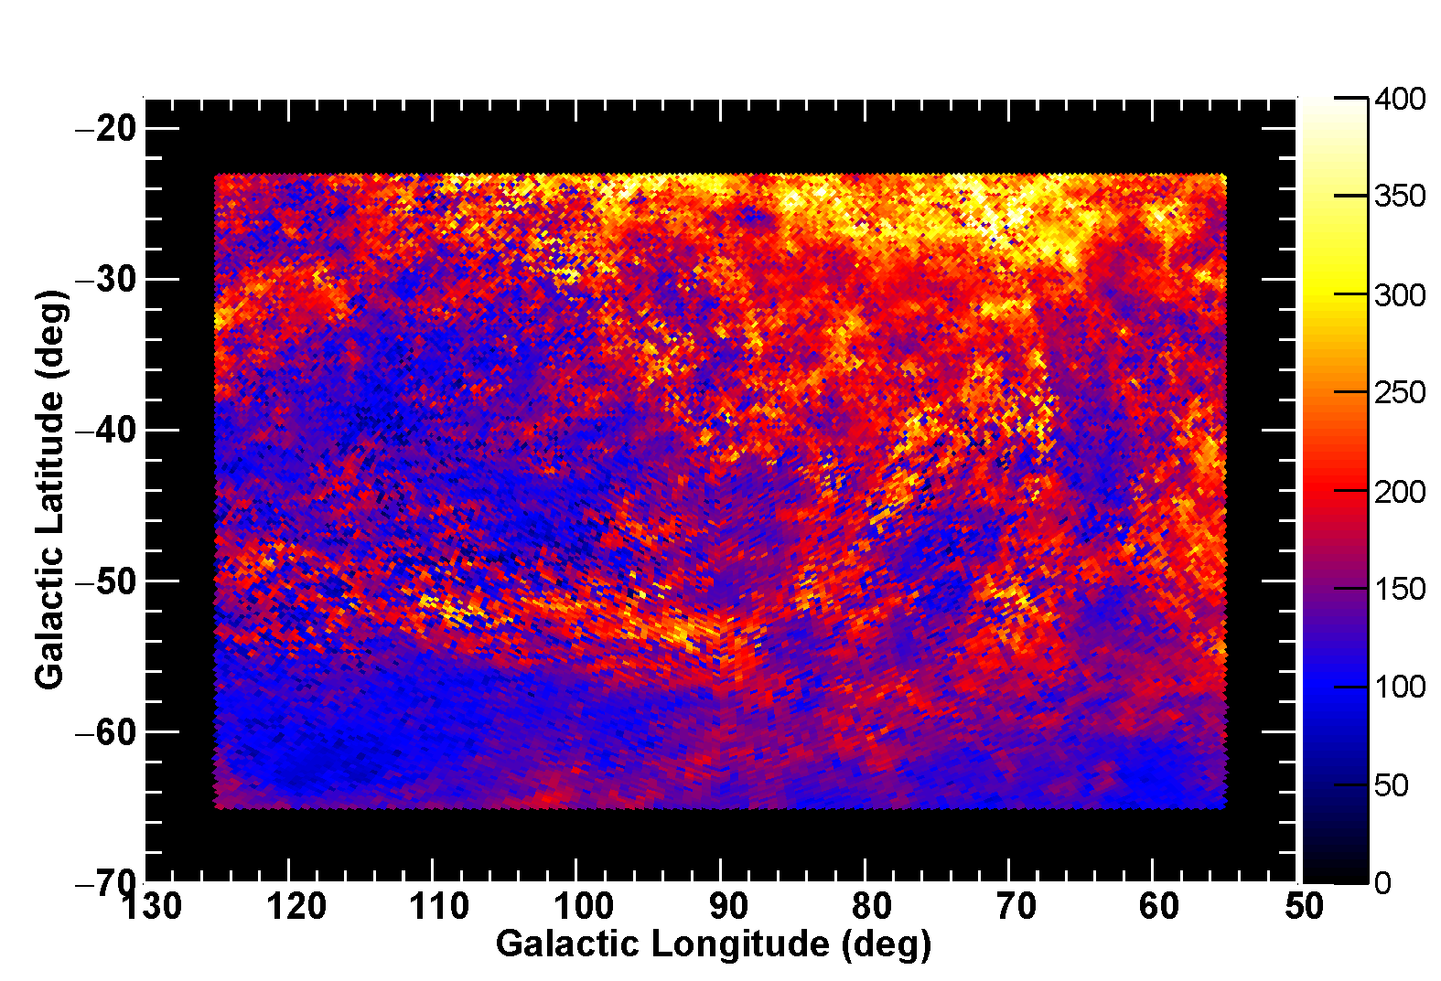
MW Astrophysics (3): MBM 53-55 Clouds and Pegasus loop
Dust and 𝛾-ray cannot distinguish phases of “dark gas”, preventing accurate measure of gas and CRs
Dust & HI correlation revealed that narrow-line HI gas is associated with dark gas and broad-line HI gas with optically thin HI (Kalberla+20)
(3C454.3’s contamination reduced; LCR)
Count map
Mizuno+22 applied HI-line-profile based analysis (for the first time) to 𝛾-ray data of MBM 53-55 clouds and Pegasus loop
MBM 53-55
W_{HI} (of narrow-HI)
W_{HI} (of broad-HI)
Pegasus loop
(Mizuno+22)
Notes:
How we can accurately measure gas & CRs?
Possible solution by using HI line profile (Kalberla+20)
We applied HI-line-profile based analysis to gamma-ray of MBM clouds & P.L.
Contamination of bright AGN reduced
narrow-HI (ISM structure), broad-HI (different distribution)

Slide 17
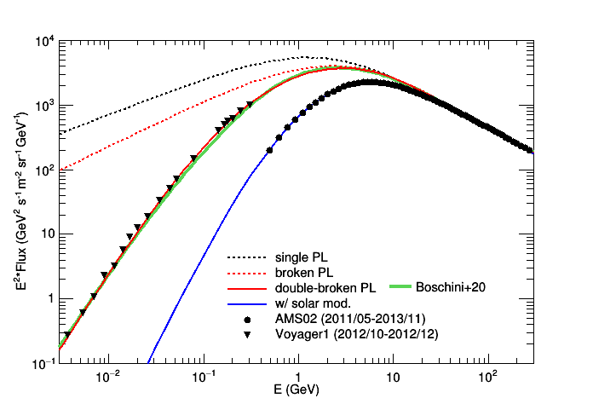
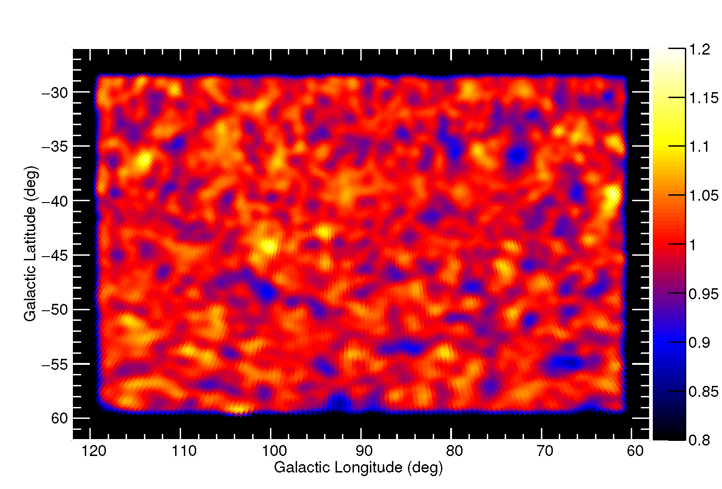
MW Astrophysics (3): MBM 53-55 Clouds and Pegasus loop (Cont’d)
We applied HI-line-profile based analysis (w/ aid by dust emission)
Succeeded in distinguishing gas phases and reproducing 𝛾-ray data
Also modelled interstellar CR spectrum (by PL of momentum w/ breaks) using 𝛾-ray data + CR data (AMS02, Voyager)
proton spectrum
covered by LAT
Count map (0.1-73 GeV)
Data/model (w/ final model)
Voyager
AMS02
R_{br1}~7 GV (agrees with a break in B/C ratio); independent proof of a break in interstellar D (diffusion coefficient)
Pegasus loop
(Mizuno+22)
Notes:
Results of the analysis
Succeed in distinguishing gas phases and modeling gamma-ray data
(Details in backup; Narrow-HI = thick HI, Residual = CO-dark H2)
Also interstellar CRs, break at ~7GeV (break of D)

Slide 18
Summary
Fermi is an international space mission, surveying GeV gamma-ray sky (LAT) and monitoring keV/MeV gamma-ray sky (GBM). It plays a key role in today’s astrophysics
MM: GW event (GW170817) counterpart, HE ν event (IC-170922A) counterpart, GW background@nanoheltz, etc.
Useful catalogs/resources: Source catalog, Light curve repository, etc.
MW: PeVatron (synergy w/ TeV), New class of gamma-ray binary (w/ X-ray), Interstellar medium and CRs (w/ radio), etc.
Thank you for your attention
(More examples in Hadasch’s talk (Day1) and Tibaldo’s talk (Day 2))
Notes:
Summary
Fermi plays a key role in several aspects
Crucial data for MM (each event/topic)
Providing useful catalogs/resources
Crucial data MW (each topic and synergy); Also in Daniela’s and Luigi’s talks

Slide 19
References (Also see p.17)
Atwood et al. 2009, ApJ 687, 1071
Goldstein et al. 2017, ApJL 848, 14
Ajello et al. 2018, ApJ 861, 85
Aasten et al. 2018, Science 361, 146
Ansoldi et al. 2018, ApJL 863, 10; Keivani et al. 2018, ApJ 864, 84
Ajello et al. 2022, Science 376, 521
Buson et al. 2022, ApJL 933, 43
Xin et al. 2019, ApJ 885, 106; Amenomori et al. 2021, Nature Astronomy 5, 460, Cao et al. 2021, Nature 594, 33
Fang et al. 2022, PRL 129, 071101
Yoneda et al. 2021, ApJ 917, 90
Grenier et al. 2005, Science 307, 1292; Planck Collab. 2011, A&A 536, 24
Kalberla et al. 2020, A&A 639, 26
Mizuno et al. 2022, ApJ 935, 97

Slide 20
Backup Slide

Slide 21
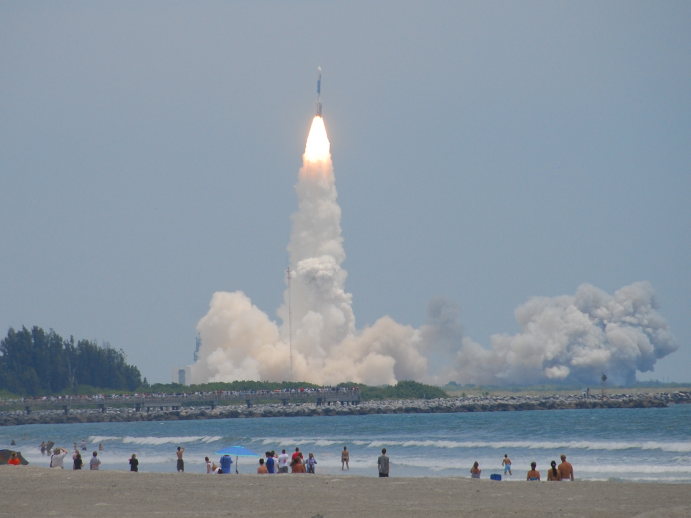
Fermi Mission (Cont’d)
International space mission, launched in 2008
Low-earth circular orbit, 565 km altitude
Operated for > 14 yrs, with no significant degradation of scientific performance
Observation modes of LAT
Primary mode = sky survey
Scan entire sky every 3 hrs
Autonomous Repoint Request (ARR)
Pointed observation following detection of bright hard-spectrum gamma-ray burst
Target of Opportunity
1 d to few weeks in duration for flaring sources
Launched in 2008 June from
Cape Canaveral Air Station@Florida
Fermi-LAT Collaboration
NASA/DOE & ~400 scientific members
(Japanese consortium contributes to both data analysis and operation; see backup)
Notes:
Fermi mission (operation)
TM: member of LAT collaboration
3 modes of LAT
(GBM continuously monitor the transients)

Slide 22
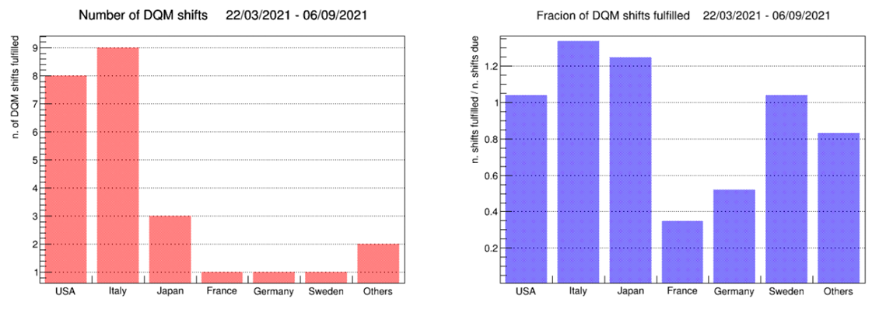
DQM (Data Quality Monitoring)
Monitor quality of instruments and data of Fermi-LAT
1 shift = 1 week. All work can be done via Web browser by reviewing 15 runs each day
Shifter checks monitor plots (light curves and hit maps) of each run. He/she flags the run as good (if everything is OK) or makes a report (if a possible issue is identified)
Important contribution to assure the quality of data (distributed to community). Japanese group takes 4-5 shifts every year. (22 shifts in FY2016-2020)

Slide 23
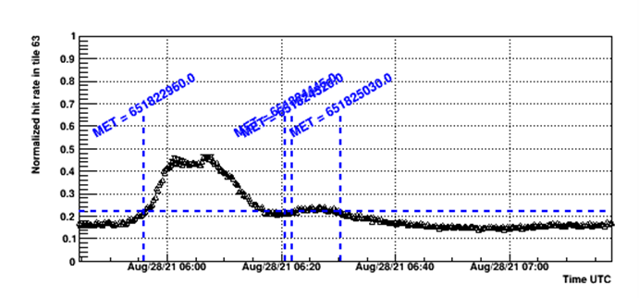
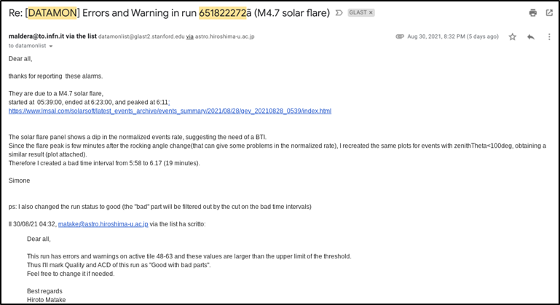
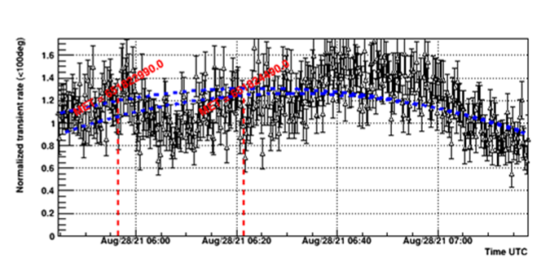
DQM (Cont’d)
Shifter checks monitor plots and makes a report if a possible issue is identified
Important contribution to assure the quality of data
In this example, shifter (student in Japan) identified a drop of rate associated with solar flare, and GTI is defined

Slide 24
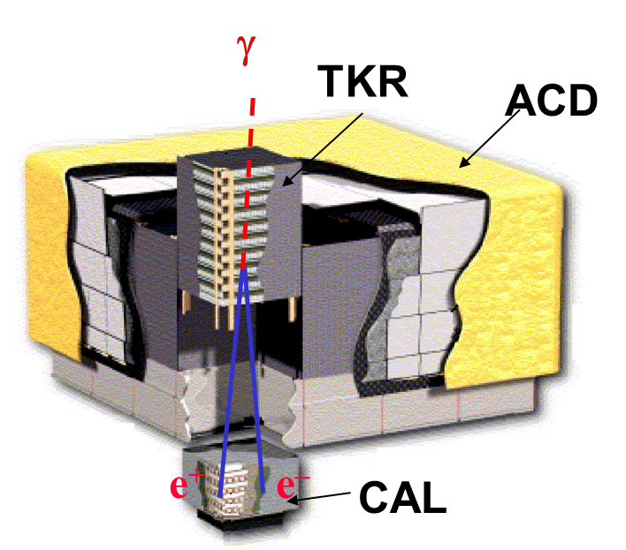
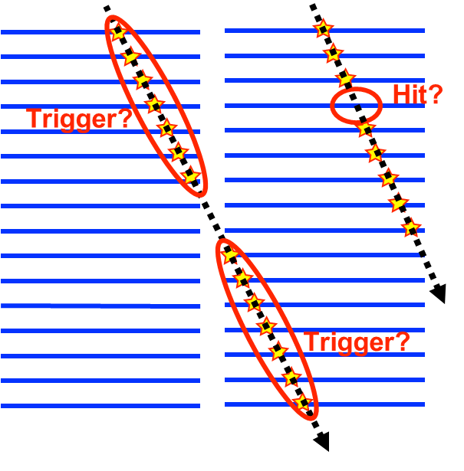
Tracker Monitoring: Efficiencies
Fermi-LAT consists of three subsystems, Tracker (direction measurement), CAL (energy meas.) and ACD (background rejection)
Experts monitor the instrument to assure stable performance. Nagoya group is responsible for TKR and monitors efficiencies and noise occupancies

Slide 25
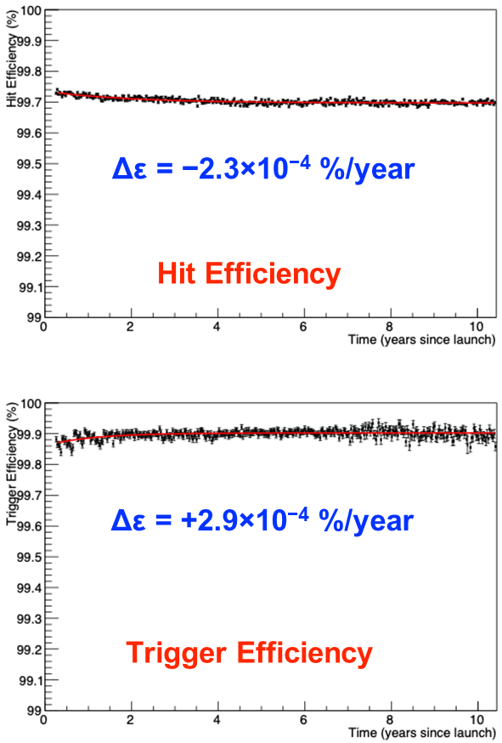
Tracker Monitoring: Efficiencies (Cont’d)
Experts monitor the instrument to assure stable performance (Nagoya group is responsible for TKR)
Hit & Trigger efficiencies have been stable over 10 yr

Slide 26
4th Fermi-LAT Source Catalog (4FGL)
(Fermi-LAT provides useful catalogs/resources of various types)
4FGL-DR3 contains 6659 γ-ray sources
(Fermi-LAT Collab. 20)
Useful when writing a proposal, paper of your source
Includes new γ-ray source classes (non-AGN galaxies, globular clusters, high-mass binaries, novae)
Some source classes are more populated than expected (MSPs, radio quiet pulsars, high-z AGNs)
~30% of sources unassociated
-6 -4 -2 0 2 4 (秒)
10 s
Notes:
(Next topic; useful catalogs/resources)
1st example of catalogs/resources (source catalog)
Summary plot (source class)
Useful for proposal/paper
Scientifically interesting (new g-ray source classes, sources more populated, unassociated sources)
# DR3 = Data Release 3 (incremental update)

Slide 27
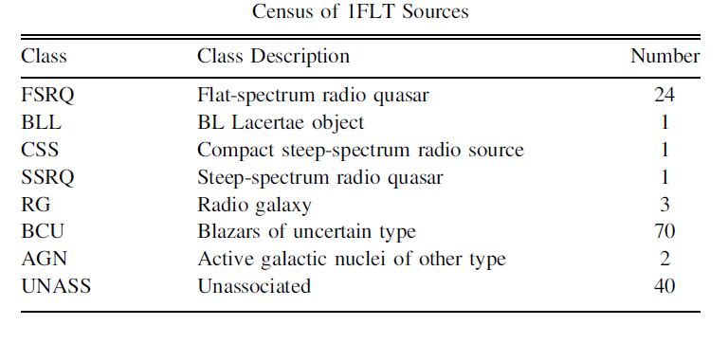
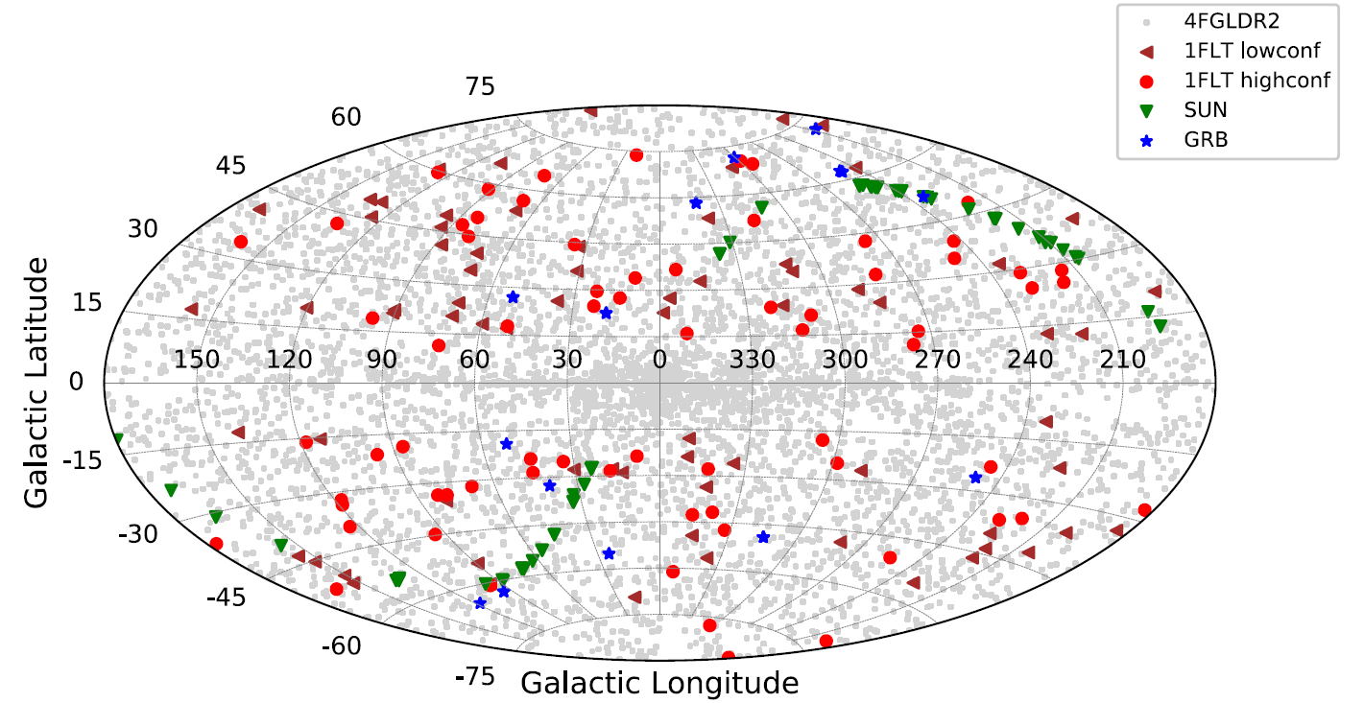
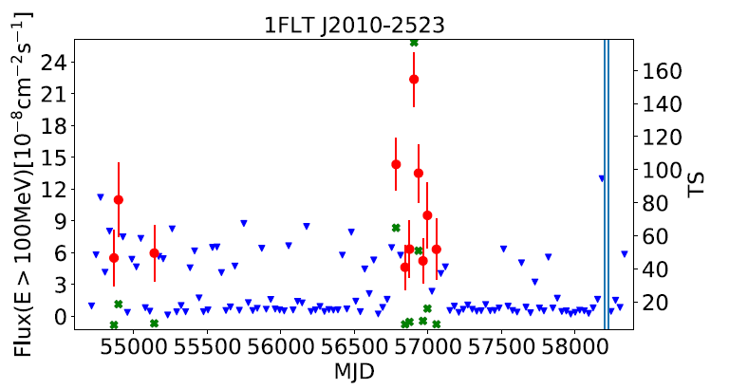
Long-term Transient Sources Catalog (1FLT)
(Fermi-LAT provides useful catalogs/resources of various types)
1FLT lists 142 new transient in monthly timescale, not in 4FGL
~100 are confidently associated with AGNs
(Fermi-LAT Collab. 21)
10 s
Notes:
2nd example (long-term transient catalog)
Transient search in monthly timescale (Figure; detected as in red points)
Summary plot (~140; mostly in high latitude)
~100; AGNs (Table)
# blue: 2sigma UL (TS<4); red: flux w/ error bar; green: TS

Slide 28
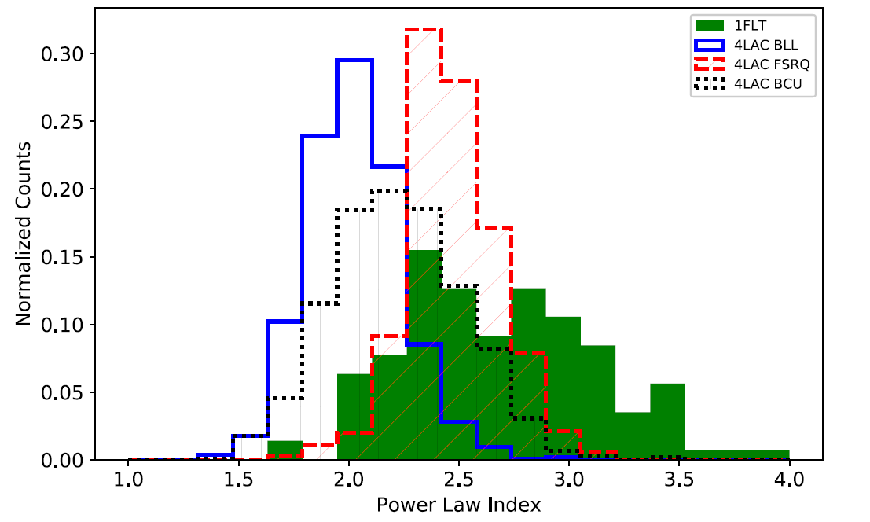
Long-term Transient Sources Catalog (1FLT) (Cont’d)
(Fermi-LAT provides useful catalogs/resources of various types)
1FLT lists 142 new transient in monthly timescale, not in 4FGL
~100 are confidently associated with AGNs
(Fermi-LAT Collab. 21)
(LAC; LAT AGN Catalog)
More FSRQ found; BL Lacs less variable, FSRQ’s activity mainly seen in flaring events
Spectrum softer than 4LAC; soft sources less distinguishable over long integration
-6 -4 -2 0 2 4 (秒)
10 s
Notes:
Scientific information (in gamma-ray)
More FSRQs found (Table)
Spectral index distribution (Figure); softer than sources in LAC
(If interested in soft sources, FLT would be a primary resource)

Slide 29
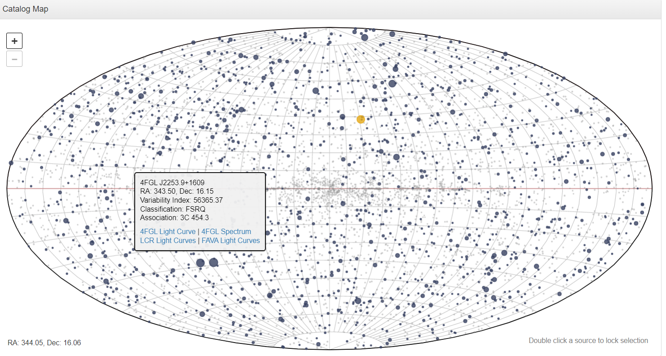
Fermi Light Curve Repository (LCR)
(Fermi-LAT provides useful catalogs/resources of various types)
Fermi LCR provides an automated time-series analysis
Provides LCs (resolutions of 3 day, 1 week and 1 month) for many 4FGL sources
Energy flux and photon flux
LCs derived from Maximum likelihood analysis
(you may also use LCR to find good-time-interval for reducing contamination to your source)
-6 -4 -2 0 2 4 (秒)
10 s
Notes:
3rd example (light curve repository)
Automated analysis (input; position or name)
Outputs: basic source information (example), LC (example)
Also useful for non-variable source analysis (will show example later)

Slide 30
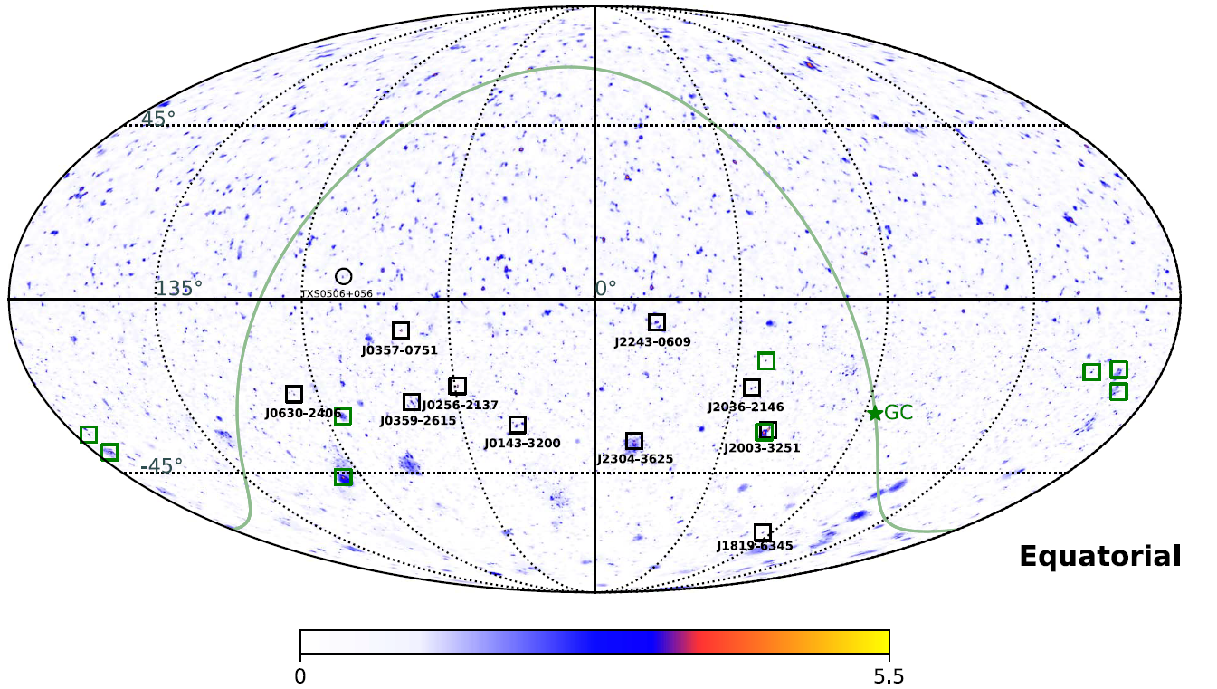
MM Astrophysics (4): neutrino - gamma ray connection
Association of neutrino with flaring blazar TXS 0506+056 sparked interest to identify further counterparts
No other counterpart has been identified unambiguously (positional & temporal)
Simultaneous observations ongoing to expand the populations (e.g., possible association ob IC211208A with gamma-ray flare of PKS 0735+17)
10 IceCube hotspots located in the southern sky are likely originated from blazars in 5BZCat (well-defined sample of blazars)
Only 1 out of 10 was reported as gamma-ray emitter in 2nd LAT AGN (active galactic nucleus) catalog, suggesting different emission sites for neutrino and gamma
(Buson+22)
Notes:
4th example of MM (n-g connection)
No other counterpart but ongoing effort
+ Correlation with a blazar catalog (Buson+22)
(Interestingly) weak connection with gamma

Slide 31
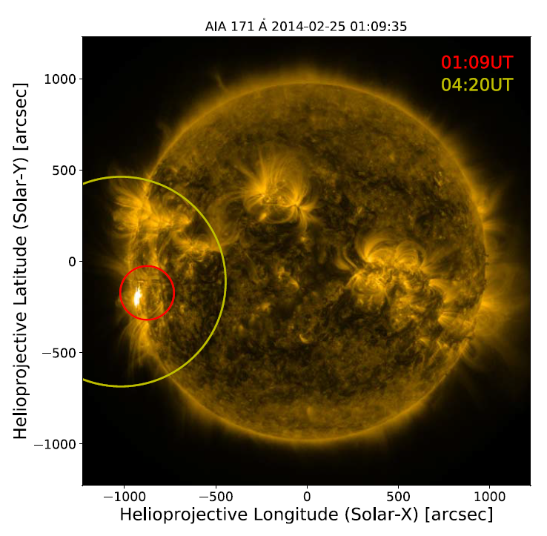
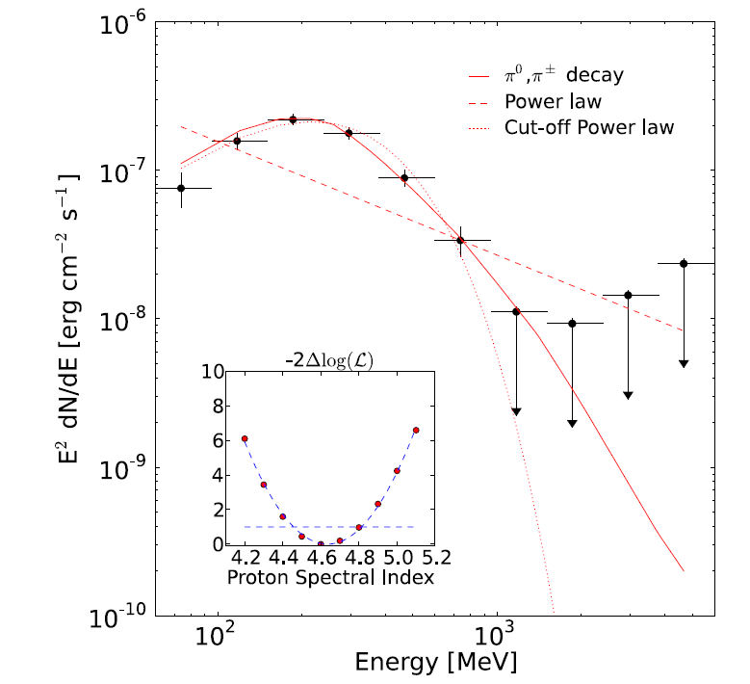
First Solar Flare Catalog
(Fermi-LAT provides useful catalogs/resources of various types)
Fermi-LAT detected 45 solar flares (FLSF; E>60 MeV)
3 from behind the limb
All but three flares are associated with coronal mass ejection
Emission due to decay of pions produced by >300 MeV protons
(Fermi-LAT Collab. 21)
10 s
Notes:
4th example (solar flare catalog)
45 solar flares
3 BTLs (example); accelerated in CME environment behind the limb, landed on the front side of the sun
Spectrum (example); not PL but curved spectrum (decay of pi0)
# STEREO-A/B have different phases (of earth’s orbit)

Slide 32
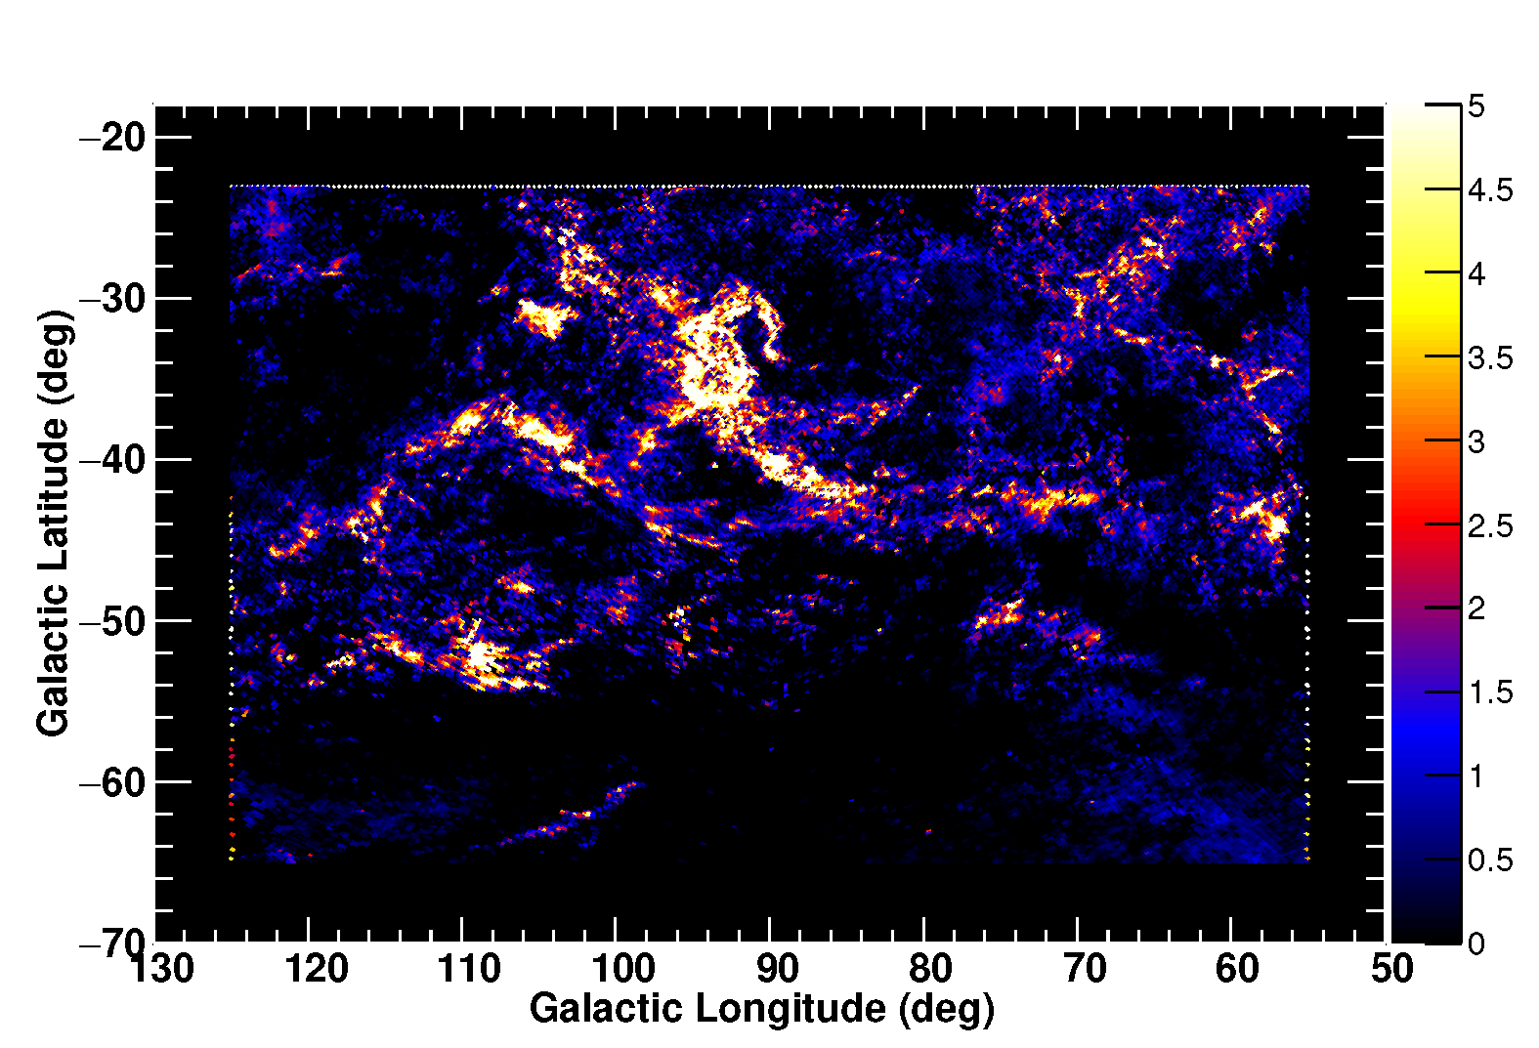
MW Astrophysics (3): MBM 53-55 Clouds and Pegasus loop (Cont’d)
We applied HI-line-profile based analysis
𝛾-ray/W_{HI} is higher in narrow HI, establishing it to be thick HI
Residual remains, very likely CO-dark H₂ (modeled using dust emission)
Also modelled interstellar CR spectrum (by PL of momentum w/ two breaks) using 𝛾-ray data + CR data (AMS02, Voyager)
Count map (0.1-73 GeV)
Data/model (w/ final model)
W_{HI} (of narrow-HI)
Residual gas template (dust Radiance)
Pegasus loop
(Mizuno+22)
Notes:
Results of the analysis
Narrow-HI = thick HI
Residual = CO-dark H2; succeed in modeling
Also interstellar CRs, break at ~7GeV

