Slide 1
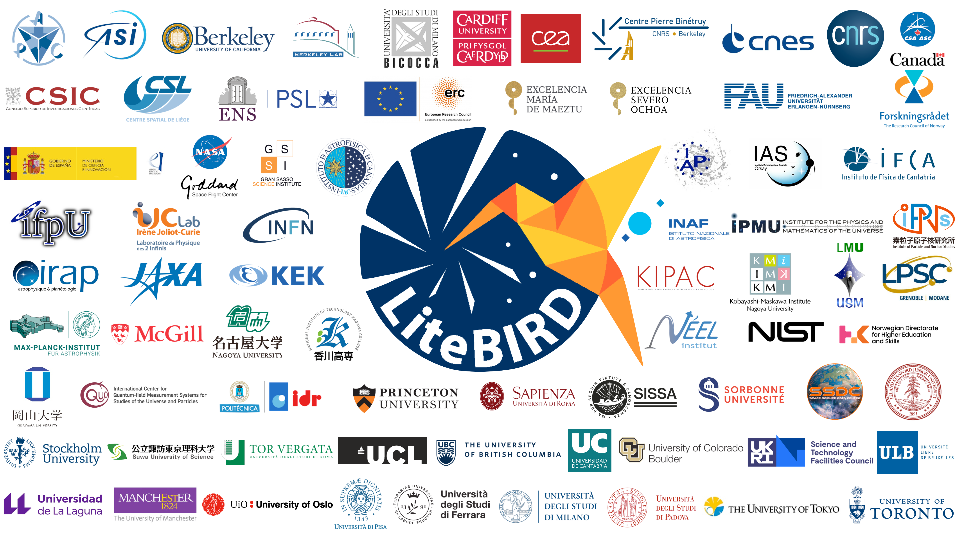

Slide 2
The LiteBIRD space mission
Clement (クレメン) Leloup (レル),
on behalf of the LiteBIRD collaboration
2023/03/30
International Conference on the Physics of the Two Infinities – Kyoto 2023
0
Notes:
Hello everyone, my name is Clement Leloup (クレメン レル)
I recently arrived as a postdoc at IPMU and I will now give you an overview of the LiteBIRD project.
Before I begin, I would like to thank the organizing committee for inviting me to give this talk.

Slide 3
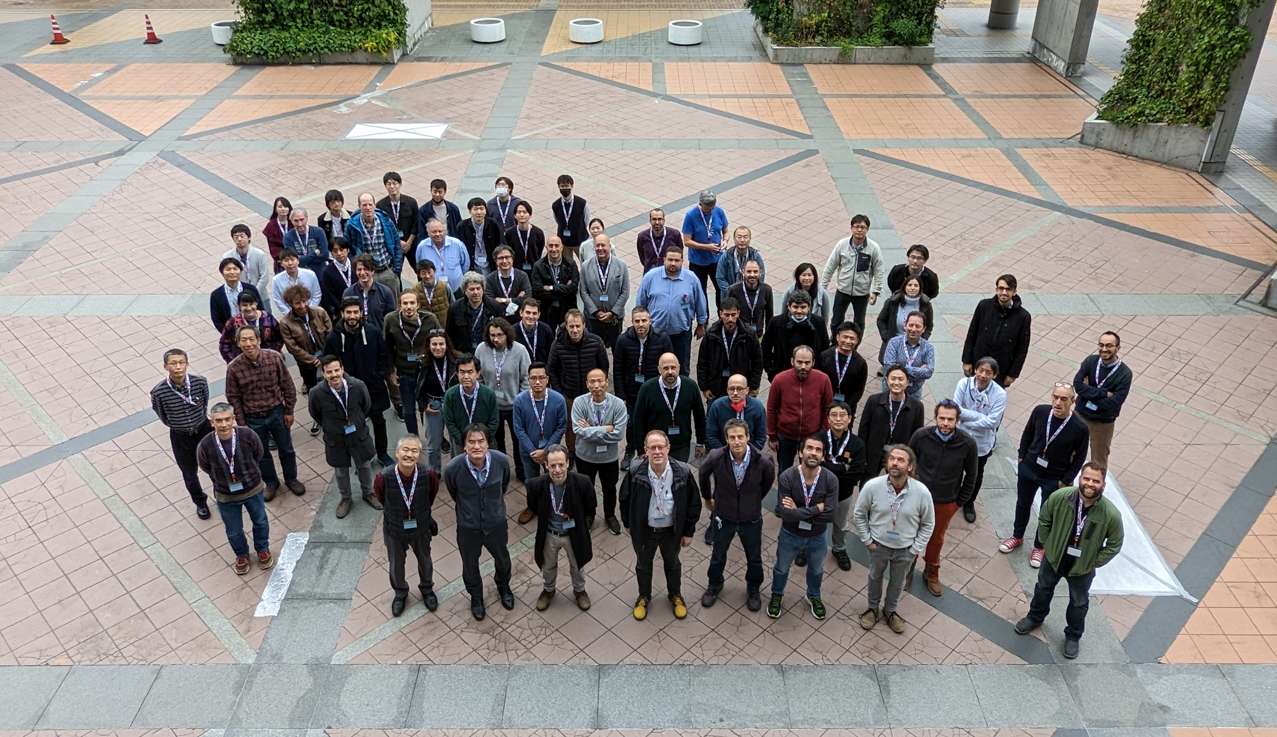
LiteBIRD Joint Study Group
Over 300 researchers from Japan, North America and Europe
Team experience in CMB experiments, X-ray satellites and other large projects (ALMA, HEP experiments, …)
LiteBIRD Global F2F meeting
December 5-8, 2022 in Okayama
2023/03/30
International Conference on the Physics of the Two Infinities – Kyoto 2023
1
Notes:
I will start by talking about the most valuable resource of any scientific collaboration: its people.
LiteBIRD is an international collaboration of more than 300 researchers from Japan, North America (US and Canada) and Europe (all these countries).
And here you can see the picture that was taken at our last F2F that happened in Okayama last December after 3 years of Covid restrictions.
So, what is this project all these great people are working on ?

Slide 4
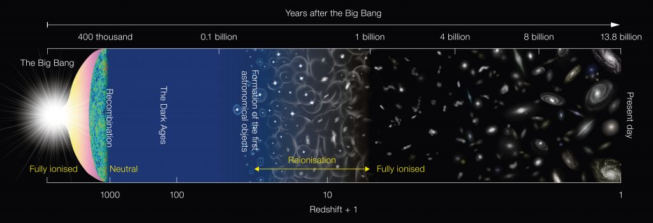
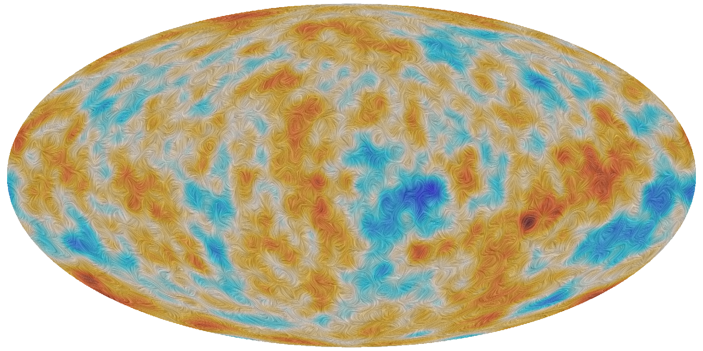
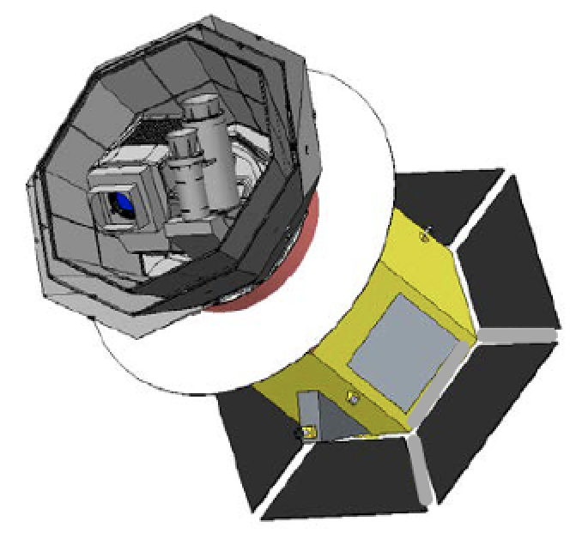
LiteBIRD overview
Lite (Light) satellite for the study of B-mode polarization and Inflation from cosmic background Radiation Detection
JAXA’s L-class mission selected in May 2019
Expected launch in late 2029 with JAXA’s H3 rocket
All-sky 3-year survey, from Sun-Earth Lagrangian point L2
Large frequency coverage (34–448 GHz in 15 bands) at 70–18 arcmin angular resolution for precision measurements of the CMB B-modes
Final combined sensitivity: 2.2 μK·arcmin
📖 Hazumi+ SPIE 2020
Credits NAOJ
Date
1/N
Conference
2
2023/03/30
International Conference on the Physics of the Two Infinities – Kyoto 2023
Notes:
LiteBIRD, or the Lite satellite for the study of B-mode polarization and Inflation from cosmic background Radiation Detection (not very inspired when coming up with this acronym).
It is a satellite aiming at observing the CMB B modes of polarization.
It has been selected by the Japanese space agency as a future Large class mission, to be launched by the end of the decade using the new JAXA H3 rocket. LiteBIRD is designed to probe CMB polarization with unprecedented sensitivity over a wide range of frequencies, at the largest possible scales.
I am pretty sure you have already seen this figure many times as the standard cosmological scenario is now well established.

Slide 5
LiteBIRD overview
Lite (Light) satellite for the study of B-mode polarization and Inflation from cosmic background Radiation Detection
JAXA’s L-class mission selected in May 2019
Expected launch in late 2029 with JAXA’s H3 rocket
All-sky 3-year survey, from Sun-Earth Lagrangian point L2
Large frequency coverage (34–448 GHz in 15 bands) at 70–18 arcmin angular resolution for precision measurements of the CMB B-modes
Final combined sensitivity: 2.2 μK·arcmin
📖 Hazumi+ SPIE 2020
Credits NAOJ
Date
1/N
Conference
2
2023/03/30
International Conference on the Physics of the Two Infinities – Kyoto 2023
Notes:
However, we still don’t know for sure what happened in the very early Universe just after the Big-Bang, and that’s what we want to investigate with the LiteBIRD mission. In order to probe this period, CMB is a tool of choice as has been proven by many previous CMB experiments.

Slide 6
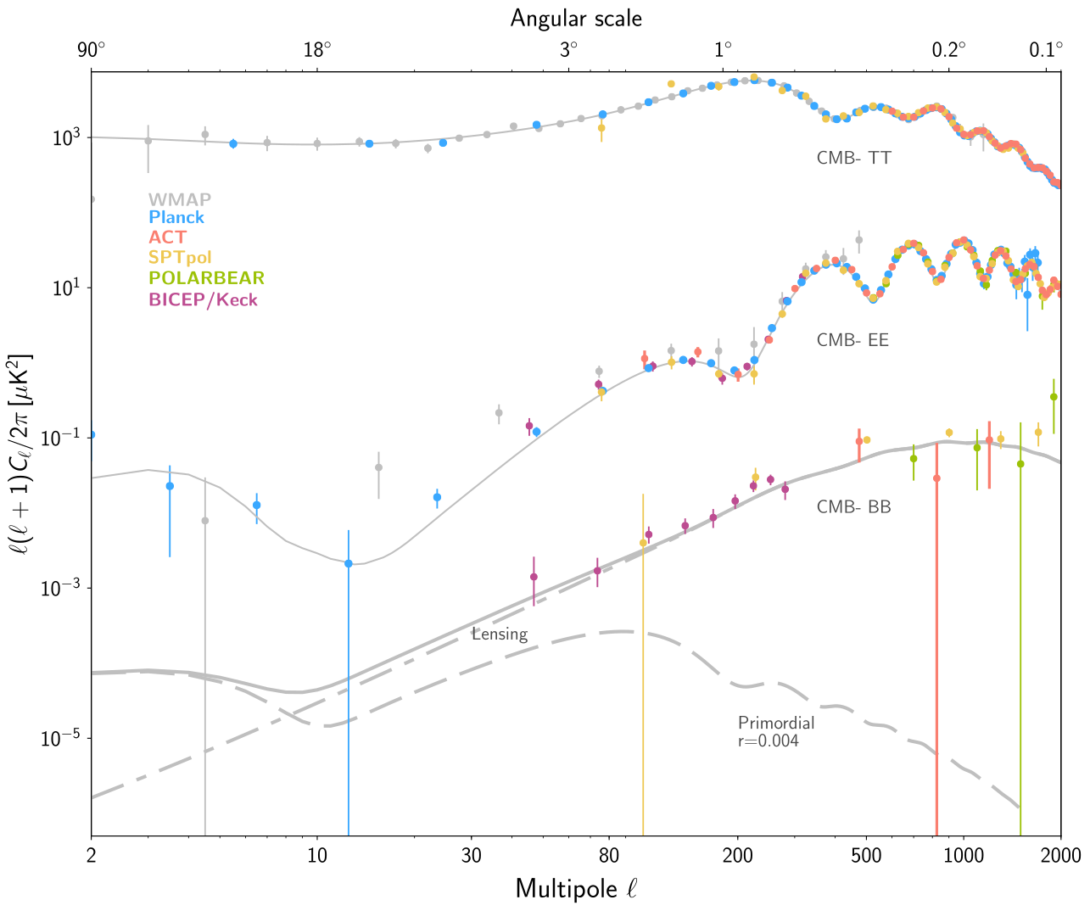
Main scientific objectives
CMB temperature and small scales polarization well known
Search for the B-mode signal as a probe of cosmic inflation in the CMB polarization
The inflationary (i.e. primordial) B-mode power is
proportional to the tensor-to-scalar ratio, r
Current best constraint: r < 0.032 (95% C.L.)
(📖 Tristram et al. 2021, combining BK18 and Planck PR4)
Planck
WMAP
ACT
SPTpol
POLARBEAR
BICEP2/Keck
Date
1/N
Conference
3
2023/03/30
International Conference on the Physics of the Two Infinities – Kyoto 2023
Notes:
The properties of CMB anisotropies in intensity and small-scale E modes of polarization have been measured with high precision.
Now the new observational frontier for CMB is the detection of B modes as a probe of cosmic inflation and large-scale E modes of polarization, which would have a transformative impact on our understanding of the early Universe.
The primordial contribution to B modes from inflation is proportional to the tensor-to-scalar ratio r, whose current best upper limit is r < 0.032 from a combination of data from Planck and BICEP.

Slide 7
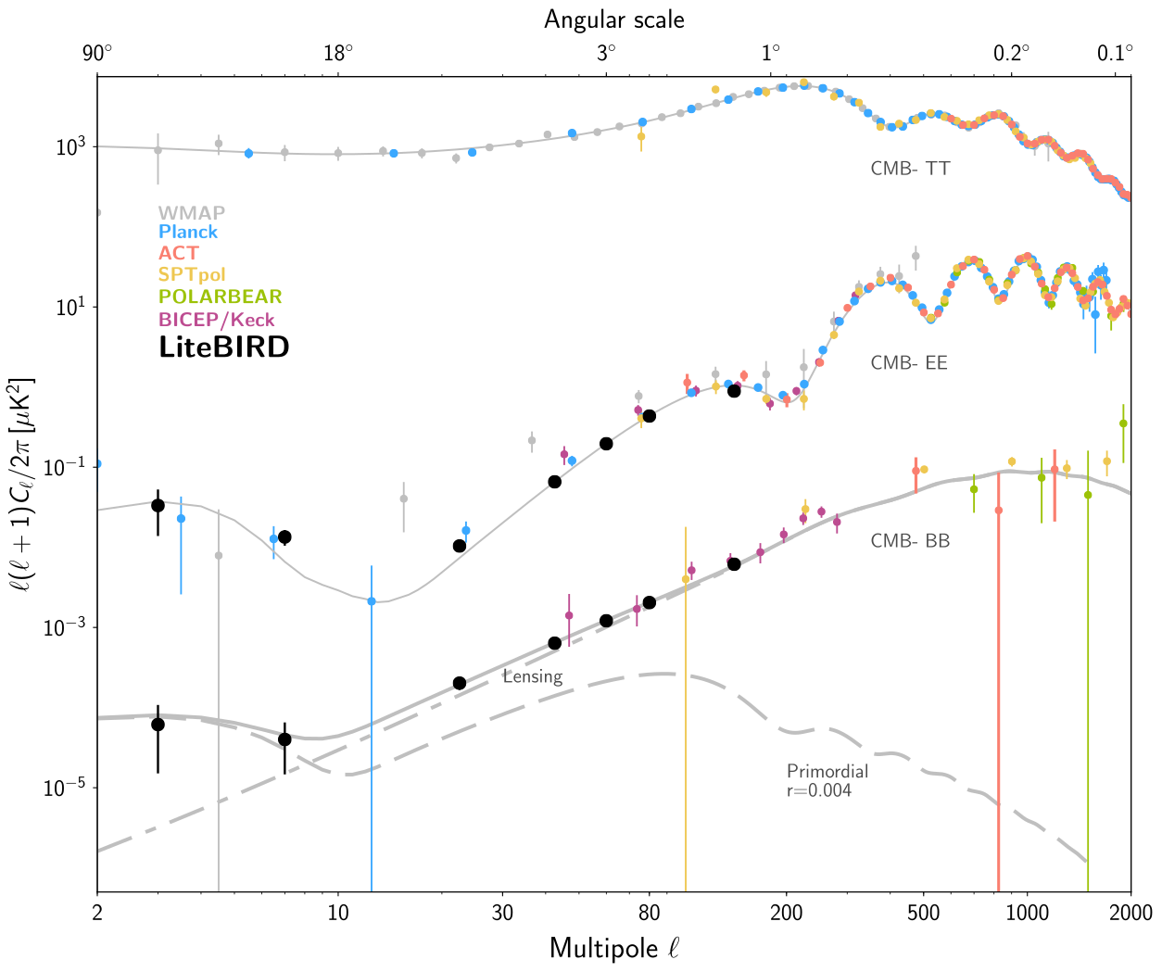
Main scientific objectives
CMB temperature and small scales polarization well known
Search for the B-mode signal as a probe of cosmic inflation in the CMB polarization
The inflationary (i.e. primordial) B-mode power is
proportional to the tensor-to-scalar ratio, r
Current best constraint: r < 0.032 (95% C.L.)
(📖 Tristram et al. 2021, combining BK18 and Planck PR4)
LiteBIRD will have a sensitivity on r improved by ~50
Scientific target without external data:
For r = 0, total uncertainty of 𝛿r < 0.001
For r = 0.01, 5-𝜎 detection of the reionization
(2 < ℓ < 10) and recombination (11 < ℓ < 200) peaks independently
Huge discovery impact (evidence for inflation, knowledge of its energy scale, …)
Planck
WMAP
ACT
SPTpol
POLARBEAR
BICEP2/Keck
LiteBIRD
Date
1/N
Conference
3
2023/03/30
International Conference on the Physics of the Two Infinities – Kyoto 2023
Notes:
With the contribution of observations from LiteBIRD, both of large-scale E modes and B modes, the sensitivity on r is expected to be improved by a factor ~50. Indeed, the scientific target for LiteBIRD is to reach a total uncertainty of 10^-3 assuming true r=0, and an independent sensitivity from reionization and recombination scales of 5-sigma each assuming true r=0.01.
These characteristics alone bring a huge potential for discovery and they drive the instrumental specifications.

Slide 8
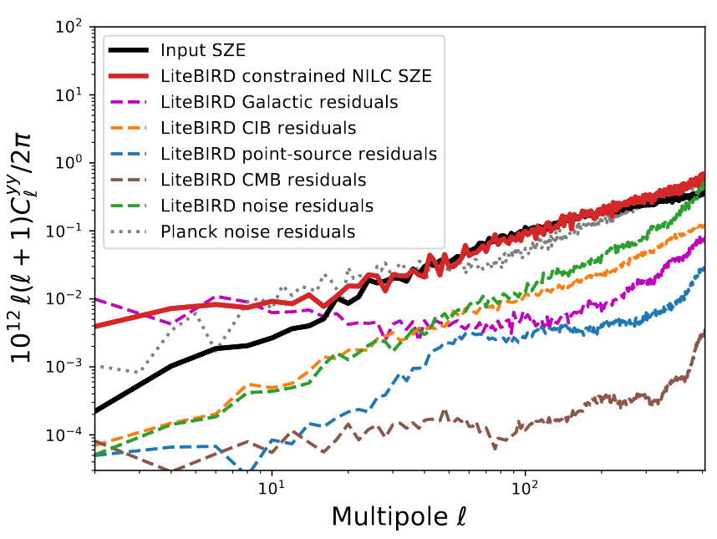
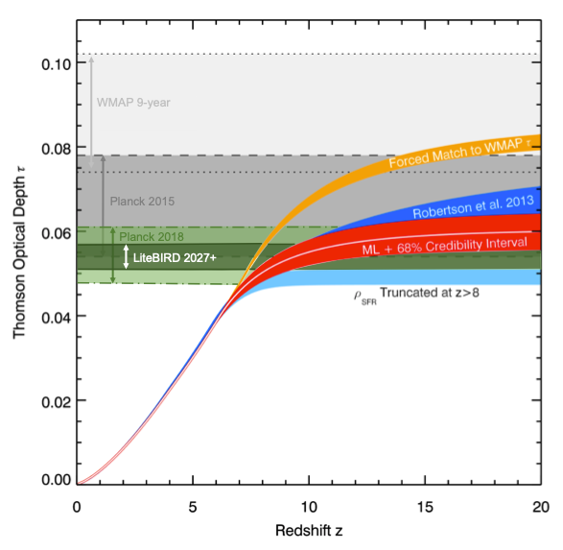
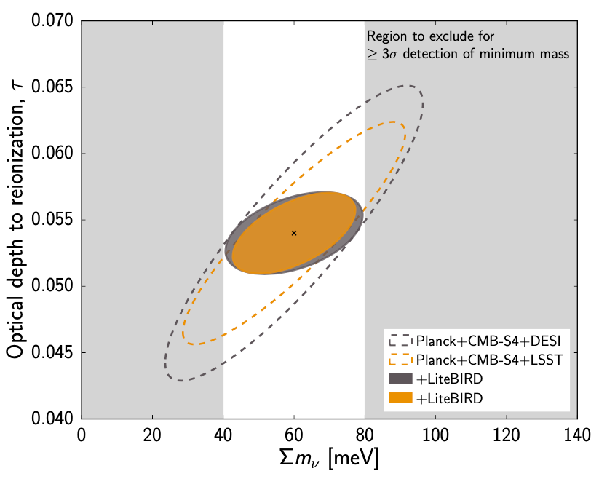
Other scientific outcomes
The mission general specifications are driven by the required sensitivity on r
By achieving this sensitivity, we will be able to explore other important scientific topics, such as:
Characterize the B-mode power spectrum (e.g. scale-invariance, non-Gaussianity, …)
Measure E modes at large scales:
Reionization (improve 𝜎(𝜏) by a factor of 3)
Neutrino mass (𝜎(∑m𝜈) = 15 meV)
Constraints on cosmic birefringence
SZ effect (thermal, diffuse, relativistic corrections)
Elucidate anomalies in the CMB maps
Constraints on Primordial Magnetic Fields
Galactic science
Characterizing the foreground SED
Large-scale Galactic magnetic field
Models of dust polarization
_{📖 adapted from Robertson+2015}
_{📖 adapted from Calabrese+2017}
📖 Hazumi+ PTEP 2022
Date
1/N
Conference
4
2023/03/30
International Conference on the Physics of the Two Infinities – Kyoto 2023
Notes:
In addition to these, the highly accurate observations of CMB polarization allow us to explore other scientific topics.
For instance, the detection of large-scale E modes makes possible the best measurement of the optical depth at reionization tau possible from CMB observations.
From the combination with observations at smaller scales (e.g. from CMB-S4, Planck, or LSS experiments), this can lead to a reduction of the uncertainty on the sum of neutrino masses from cosmology currently limited by its correlation with tau.
The high precision of LiteBIRD measurements will also lead to improved tracing of galaxy clusters at large scales using the SZ effect.
Another important improvement is on the characterization of foreground components, which can bring a lot of precious information for galactic science. Let’s discuss now the characteristics of the instruments and of the mission that will make these observations possible.

Slide 9
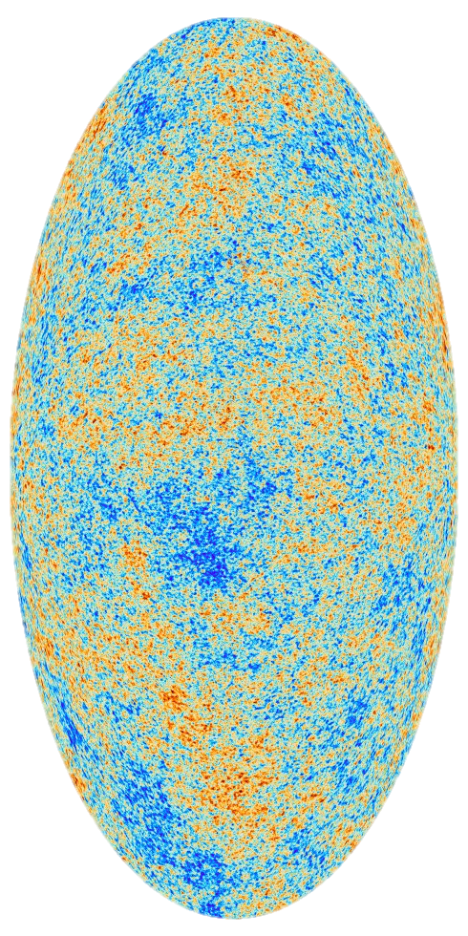
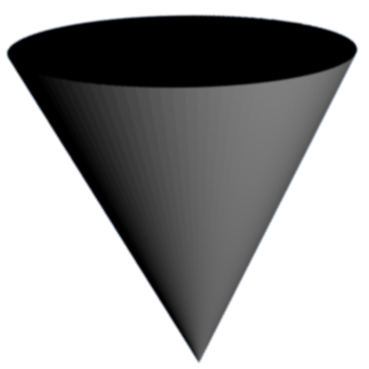
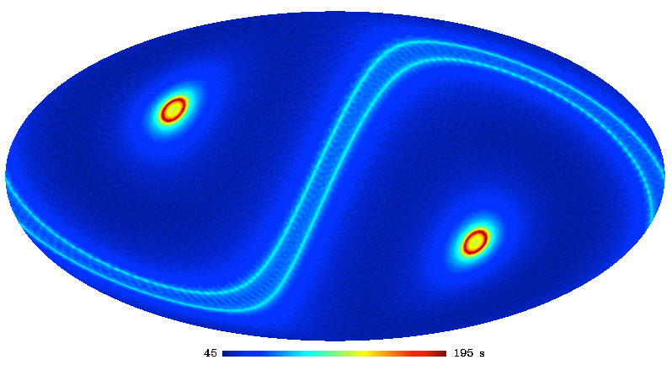
Scanning strategy
Boresight
Spin axis
(period 20 min.)
3-year survey, Sun-Earth L2 Lissajous orbit
Precession angle: 𝛼 = 45°
Spin angle: 𝛽 = 50°
𝛽
Sun
𝛼
CMB
FoV
Nhit map for a
3-year survey
(Galactic projection)
Precession (anti-Sun) axis
(precession period, ~3.2 h)
Date
1/N
Conference
5
2023/03/30
International Conference on the Physics of the Two Infinities – Kyoto 2023
Notes:
First of all, the LiteBIRD satellite will follow a Lissajous orbit around the L2 point of the Sun-Earth system, where it will stay for 3 years.
LiteBIRD’s scanning strategy combines a rotation around the Sun-Earth axis as well as a rotation of the telescopes around the axis of the satellite, looking in opposite directions.
This convoluted scanning strategy is optimized to allow the observation of a given point of the sky from as many angles as possible to reduce systematic effects, resulting in the following hit map in galactic coordinates.

Slide 10
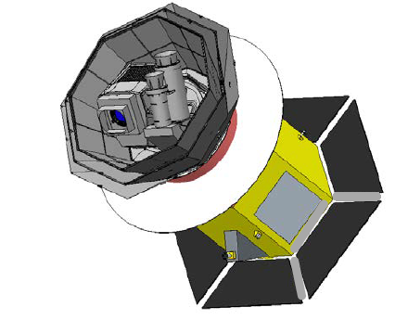
Satellite overview
3 telescopes to provide the 34-448 GHz range
LFT (low frequency telescope)
MFT (middle frequency telescope)
HFT (high frequency telescope)
Multi-chroic transition-edge sensor (TES) bolometer arrays cooled to 100 mK
Polarization modulation unit (PMU) in each telescope with rotating half-wave plate (HWP) → 1/f noise and systematics reduction
Optics cooled to 5 K
Payload module
LFT
HFT
MFT
V-grooves
(for radiative cooling)
Bus system
(or service module, SVM)
4.4 m
Solar shield
Mass: 2.6 t
Power: 3.0 kW
Data: 17.9 Gb/day
Star tracker
Solar panels
Date
1/N
Conference
6
2023/03/30
International Conference on the Physics of the Two Infinities – Kyoto 2023
Notes:
If we zoom in on the satellite itself, we can see the three telescopes that will provide the wide frequency coverage of LiteBIRD: the LFT, the MFT and the HFT. Each of them include a polarization modulation unit, or PMU, with a rotating half-wave plate to reduce 1/f noise and various systematic effects, capitalizing on the experience of previous ground experiments.
Let’s continue to zoom in on the subsystems.

Slide 11
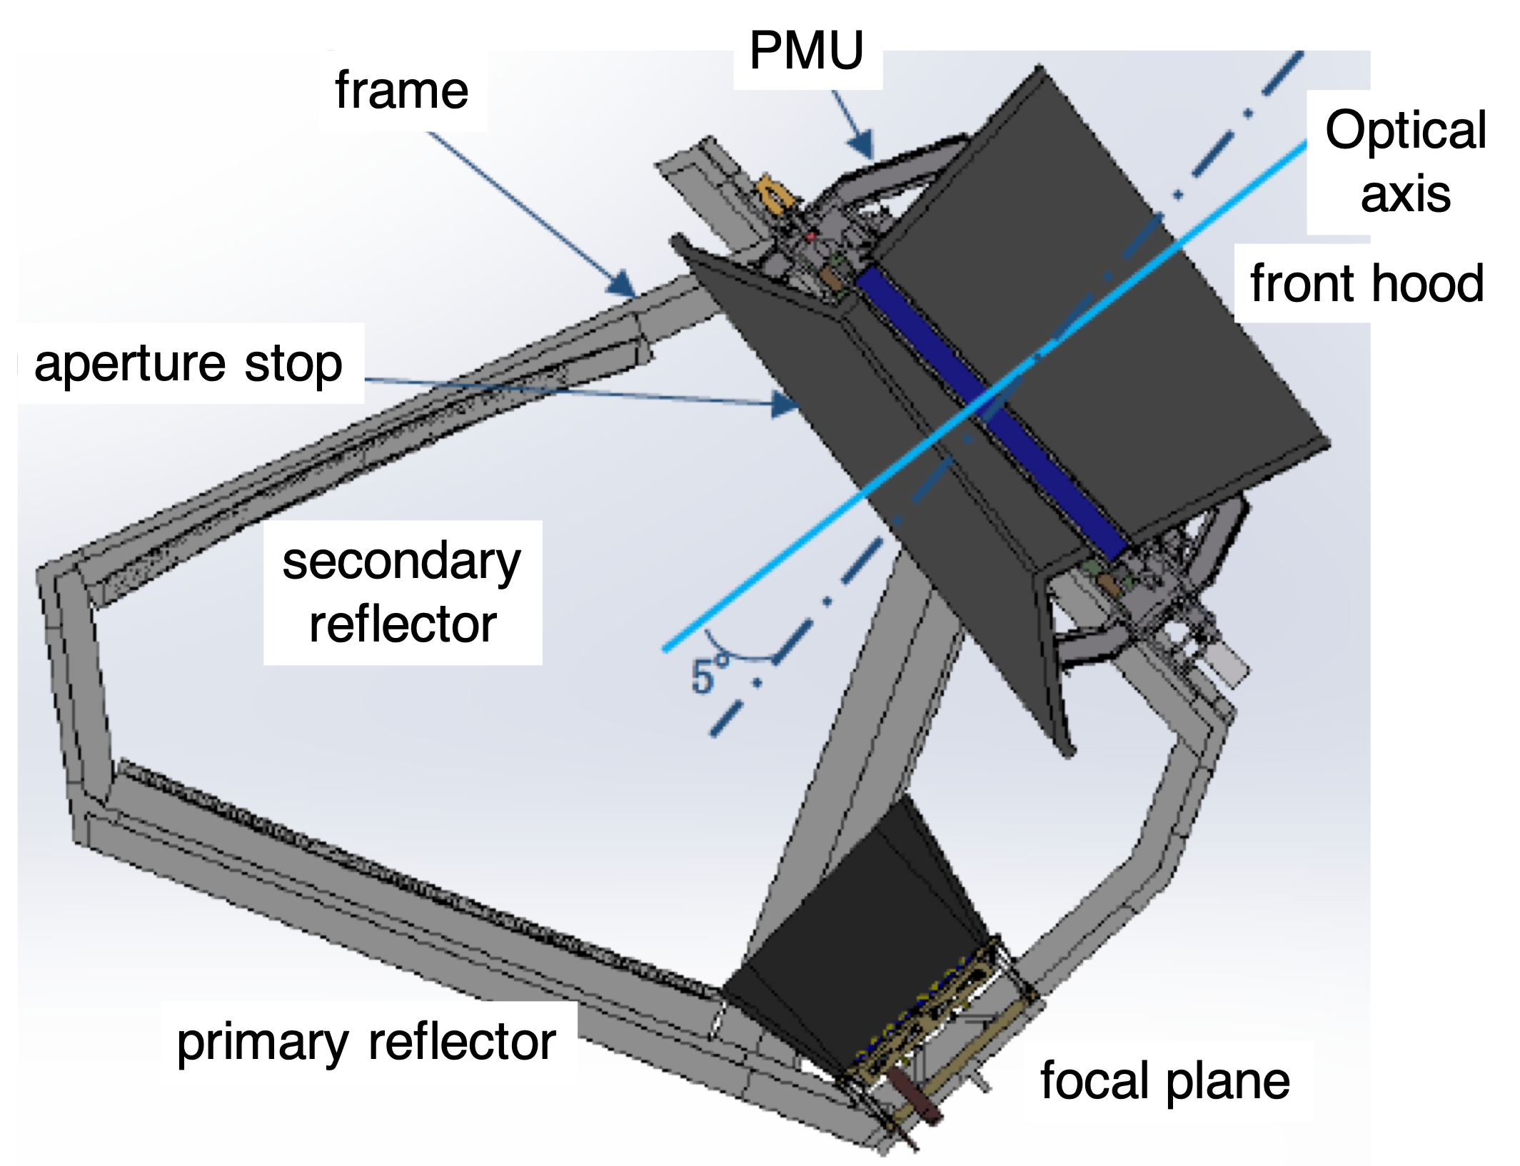
Low Frequency Telescope
📖 Sekimoto+ SPIE 2020
PMU
Frame
Optical axis
Polarization Modulation Unit (PMU) as the first sky-side optical element
Crossed-Dragone design
Mirrors and aperture stop at 5 K
Made of aluminium
Field of view: 18° x 9°
Weight < 200 kg
Front hood
Aperture stop
(5K)
Secondary reflector (5K)
5°
 | LFT
ν (GHz) | 34-161
Ap. diameter (mm) | 400
Ang. res. (arcmin) | 70-24
Primary reflector (5K)
Focal plane
Date
1/N
Conference
7
2023/03/30
International Conference on the Physics of the Two Infinities – Kyoto 2023
Notes:
The LFT follows a crossed-dragone design.
The light coming through the aperture first encounters the HWP before being reflected by the primary mirror, then by the secondary mirror before crossing the incident beam (hence “crossed”-dragone) to reach the focal plane.
It will observe at frequencies ranging from 34GHz to 161GHz.

Slide 12
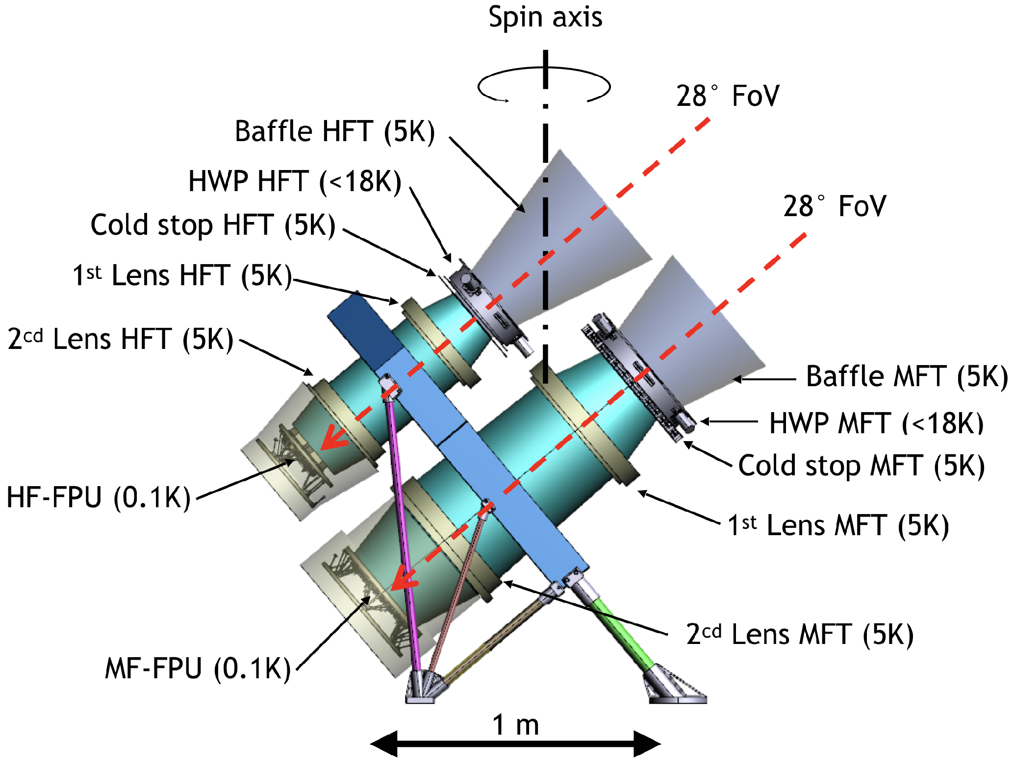
Middle-High Frequency Telescopes
📖 Montier+ SPIE 2020
Refractive optics
Each telescope has PMU with a HWP
Optics at 5 K
Field of view: 28°
Simple and inspired from ground experiments
Compact (mass & volume)
Simplified design for filtering scheme
PP lenses + ARC
Weight 180 kg
Spin axis
📖 Lamagna+ SPIE 2020
28° FoV
Baffle HFT (5K)
HWP HFT (<18K)
Cold stop HFT (5K)
28° FoV
1st lens HFT (5K)
2nd lens HFT (5K)
Baffle MFT (5K)
HWP MFT (<18K)
Cold stop MFT (5K)
HF-FPU (0.1K)
1st lens MFT (5K)
 | MFT | HFT
ν (GHz) | 77-224 | 166-448
Ap. diameter (mm) | 300 | 200
Ang. res. (arcmin) | 38-28 | 29-18
2nd lens MFT (5K)
MF-FPU (0.1K)
Date
1/N
Conference
8
2023/03/30
International Conference on the Physics of the Two Infinities – Kyoto 2023
Notes:
On the other hand, the MFT and HFT, which are mounted on the same structure to form the MHFT subsystem, have a refractive optical system instead of a reflective one. Here again the HWP is the first optical element on the path of light.
Then, there are two lenses and finally the focal planes.

Slide 13
Polarization Modulation Unit
Rotating a birefringent plate to modulate polarization
The first sky-side optical element
📖 Sakurai+2020
📖 Komatsu+2020
HWP birefringent axis
📖 Toda+2020
📖 Columbro+2020
📖 Sugiyama+2020
Polarization angle
LFT PMU BBM at Kavli IPMU:
Input light
Output light
1/f noise
Unpolarized signal
Modulated polarized signal
Demodulated signal
Power spectrum
Rotation test of superconducting magnetic bearing system in the 4K cryostat
Stable rotation at cryogenic temperature (< 10 K)
Frequency
Date
1/N
Conference
9
2023/03/30
International Conference on the Physics of the Two Infinities – Kyoto 2023
Notes:
As I emphasized earlier, the PMU and its half wave plate are critical elements of the optical system.
I will discuss it now because the PMU for the LFT is developed at IPMU, and from my contract I must mention it every time I make a presentation in public.
The HWP, by rotating, acts as a modulator of the incident polarized signal, making it possible to distinguish it from polarized instrumental noise and also reducing other systematic effects.
The rotation of the HWP must be very stable to avoid any systematic effects from the HWP, and monitored with high precision, which are both handled by the PMU system.

Slide 14
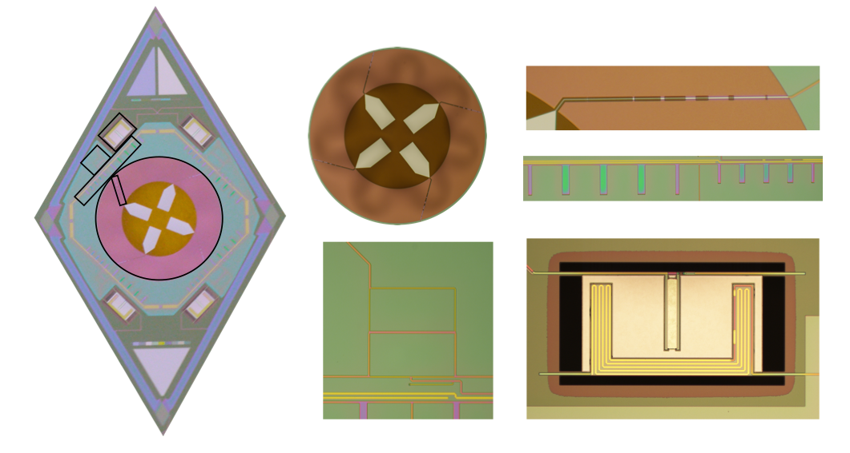
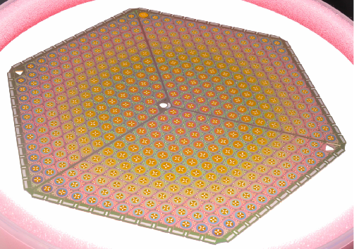
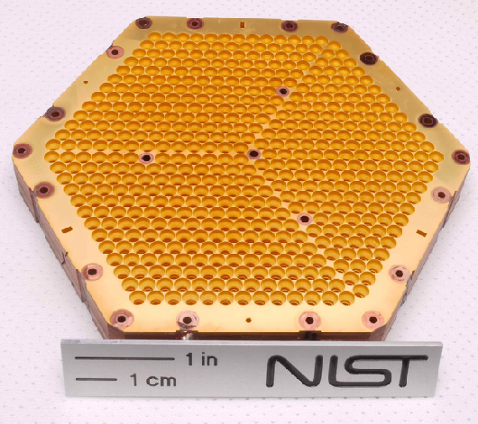
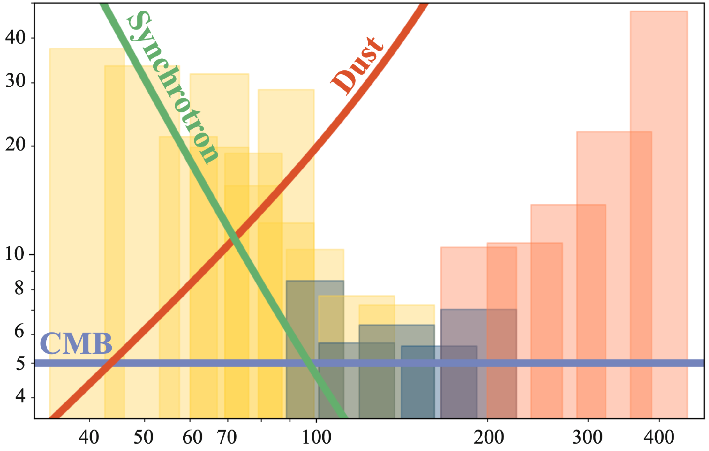
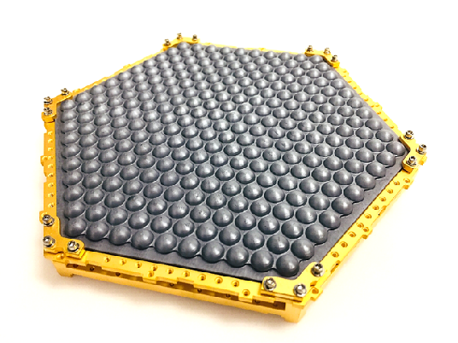
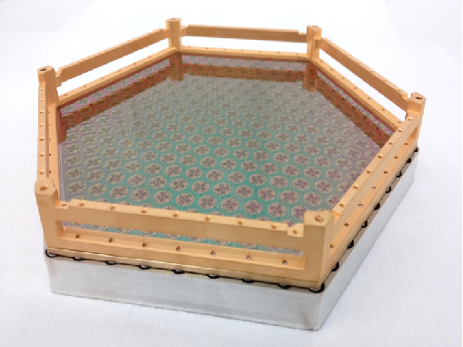
Sensitivities
420 mm
320 mm
📖 Hazumi+ SPIE 2020
190 mm
LFT
MFT
HFT
Horn coupled detectors
Platelets
Lensed coupled detectors
Lenslets
Sensitivity [µK•arcmin]
Number of sensors: 4508
15 bands including overlap between instruments
Lensed coupled detectors for LFT and MFT
Horn coupled detectors for HFT
Projected polarization sensitivities for the 3-year survey
Best of 4.3 μK·arcmin @ 119 GHz (Hazumi+ 2020)
Combined sensitivity to primordial CMB anisotropies: 2.2 μK·arcmin
Frequency [GHz]
Date
1/N
Conference
10
2023/03/30
International Conference on the Physics of the Two Infinities – Kyoto 2023
Notes:
Now to the last element of the optical system: the focal planes are populated with a total of 4508 Transition Edge Sensors.
Based on existing technologies, it was decided to use lensed coupled detectors for the LFT and MFT and horned coupled detectors for the HFT.
As mentioned before, one of the main challenges for the observation of CMB B modes is the effect of foreground. In order to clean foregrounds as efficiently as possible, LiteBIRD will use 15 frequency bands, 22 in total if we count the overlapping bands, completely covering the frequency range without any gap from 34GHz to 448GHz.

Slide 15
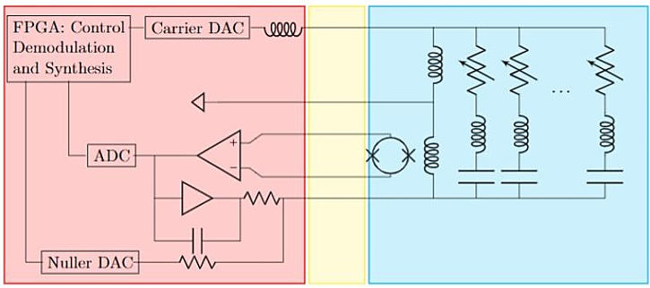
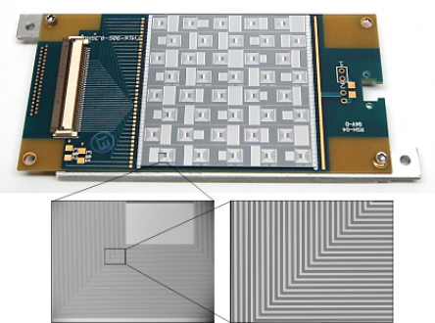
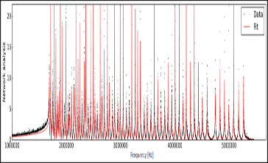
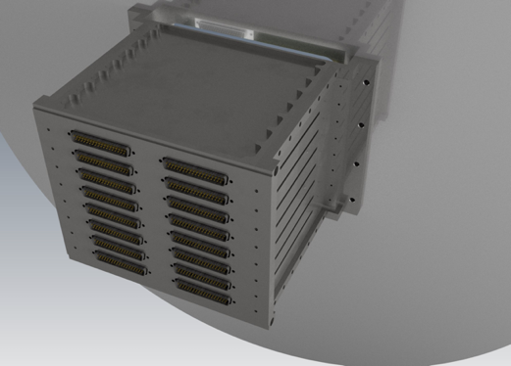
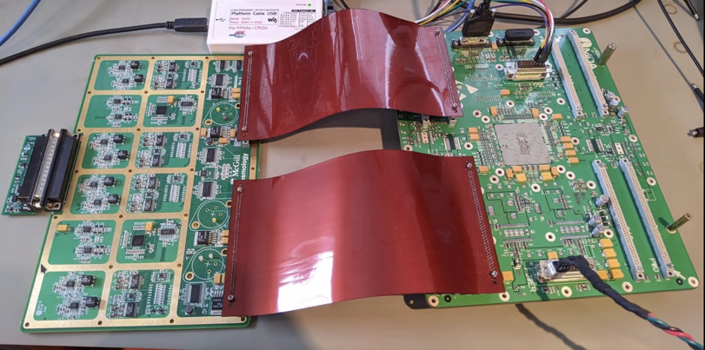
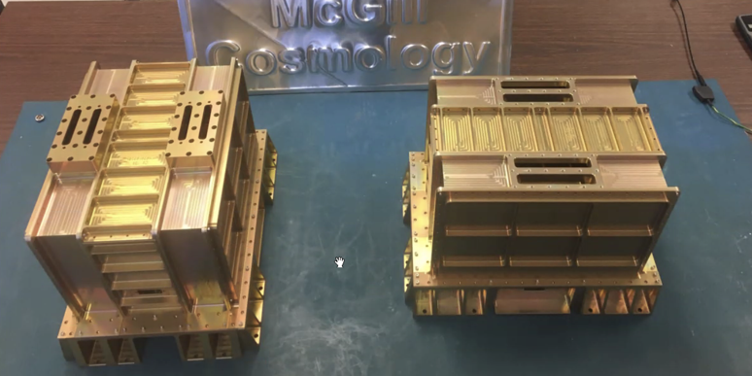
Readout system
Frequency multiplexing readout technology to readout multiple TES with less components
Assign unique frequency channel to TES sensors via superconducting resonators
Low noise SQUID amplifier and FPGA controller readout the signal
Saves mass, volume, power consumption and cost
Inspired from ground based CMB experiments
SQUID controller
board
SQUID controller assembly
Digitizer assembly
Signal Processing Unit
Digitizer assembly
Date
1/N
Conference
11
2023/03/30
International Conference on the Physics of the Two Infinities – Kyoto 2023
Notes:
Of course, the focal plane detectors need to be read.
(The readout system makes use of frequency multiplexing to read the large number of detectors in an efficient way, assigning a single frequency to each detector. This architecture is based on systems used in ground experiments.)

Slide 16
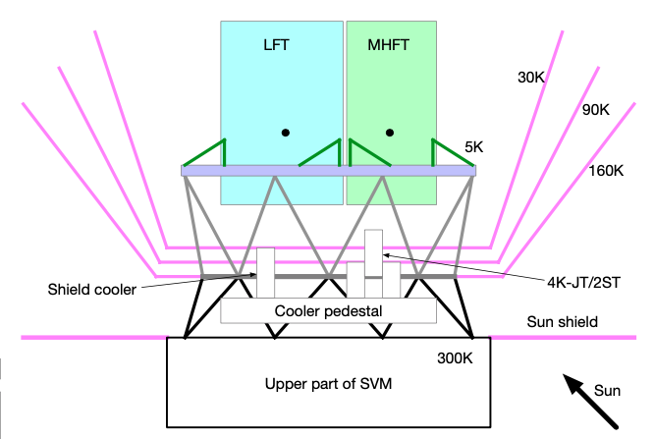
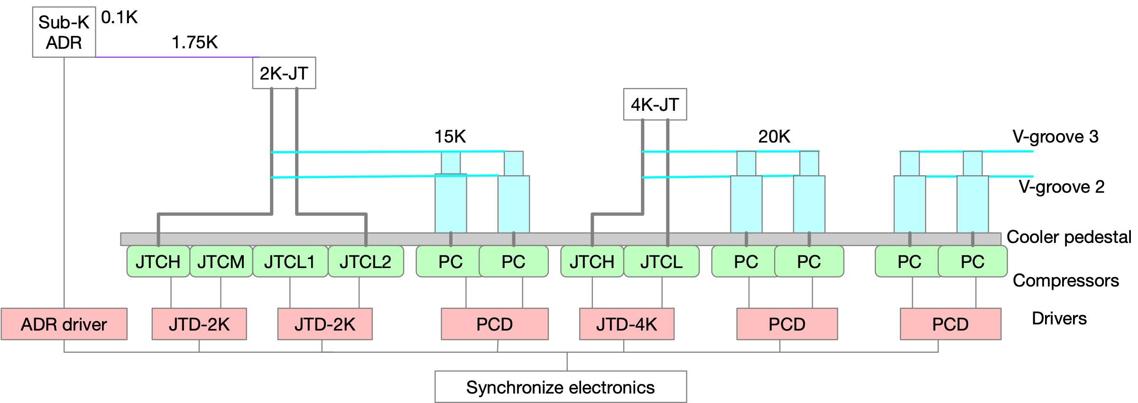
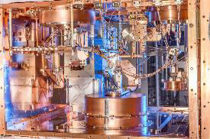
Cryogenic system
V-grooves
LFT
MHFT
30K
90K
5K
160K
Shield cooler
4K-JT/2ST
Cooler pedestal
Sun shield
Upper part of SVM
Sun
Continuous cooling at 100 mK
High stability on telescopes at all stages
Date
1/N
Conference
12
2023/03/30
International Conference on the Physics of the Two Infinities – Kyoto 2023
Notes:
And cooled.
But I don’t have time to elaborate on this.
(The cooling system needs to bring the focal plane from ambient temperature ~300K to 5K in the telescopes and 100mK on the focal planes. Most of the cooling is done passively through radiative cooling by the V-grooves up to 15K. The active cooling system that brings the instrument to cryogenic temperature has already been tested successfully for the HITOMI, and then the XRISM satellite.)
Using this instrument, some data analysis challenges still remain to be tackled to achieve the scientific goals of LiteBIRD.

Slide 17
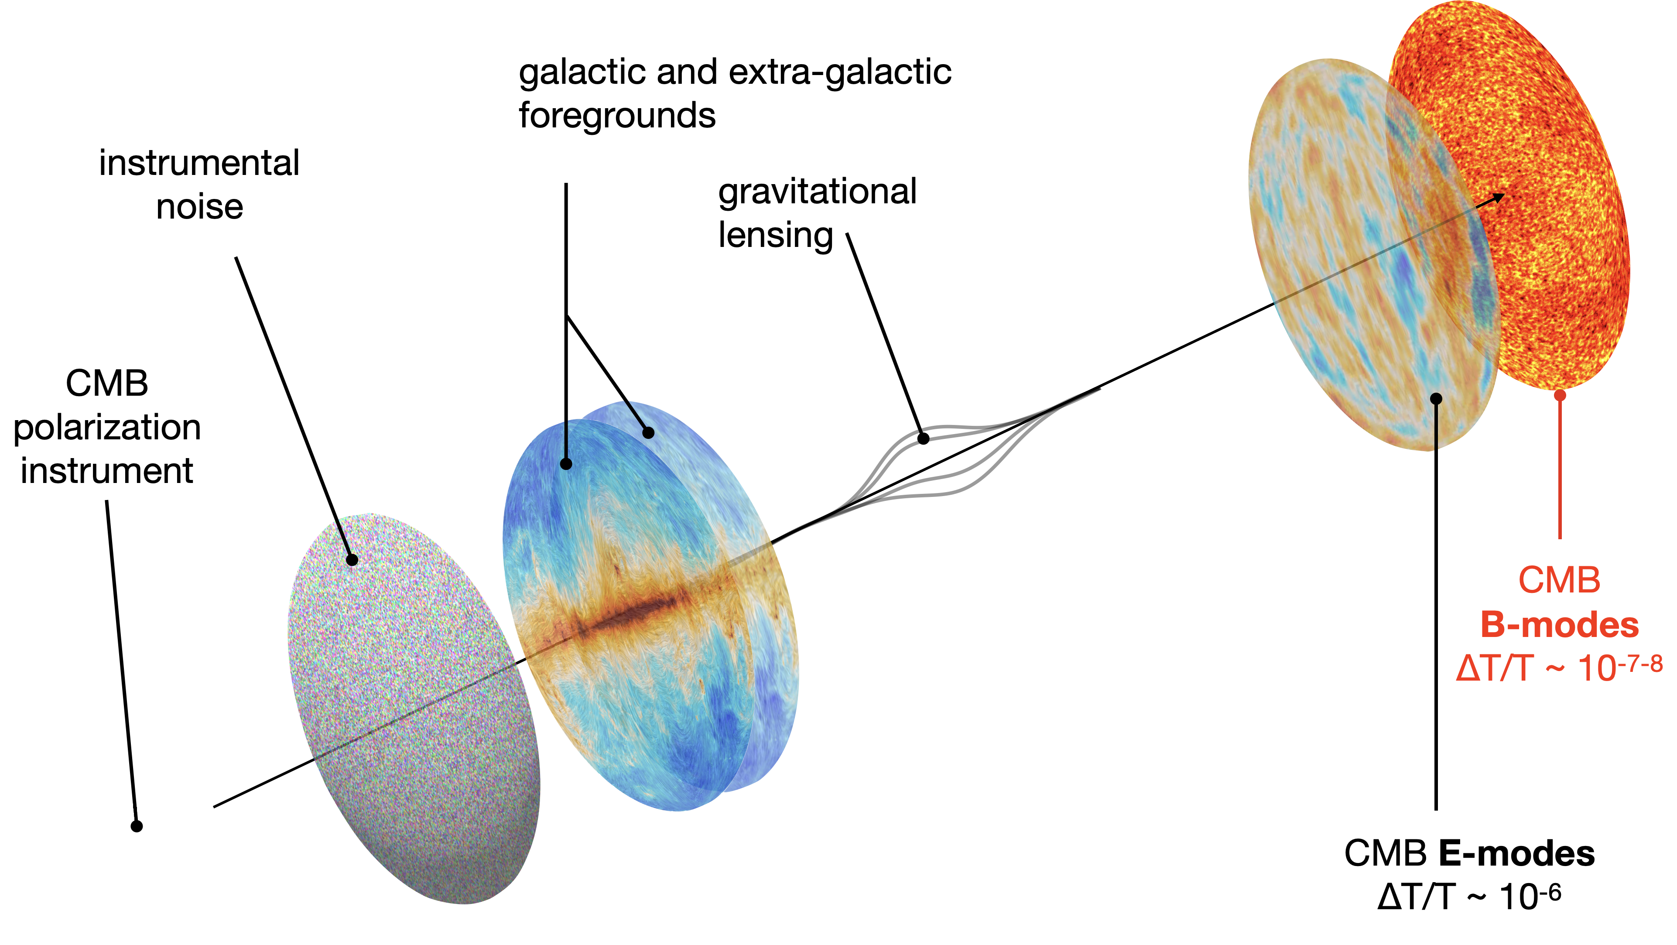
CMB observations
Credits Josquin Errard
Date
1/N
Conference
13
2023/03/30
International Conference on the Physics of the Two Infinities – Kyoto 2023
Notes:
Indeed, the primordial B-mode signal is hidden among other sources of microwave polarized radiation, such as lensing of E-modes, Galactic foreground emissions and instrumental effects.

Slide 18
CMB observations
Sensitivity [µK•arcmin]
Credits Josquin Errard
Frequency [GHz]
Date
1/N
Conference
13
2023/03/30
International Conference on the Physics of the Two Infinities – Kyoto 2023
Notes:
Focusing first on foreground components, here I flash again their spectral evolution, we need to combine the observations in all the frequency channels to clean the foreground and reconstruct CMB in a process called component separation.

Slide 19
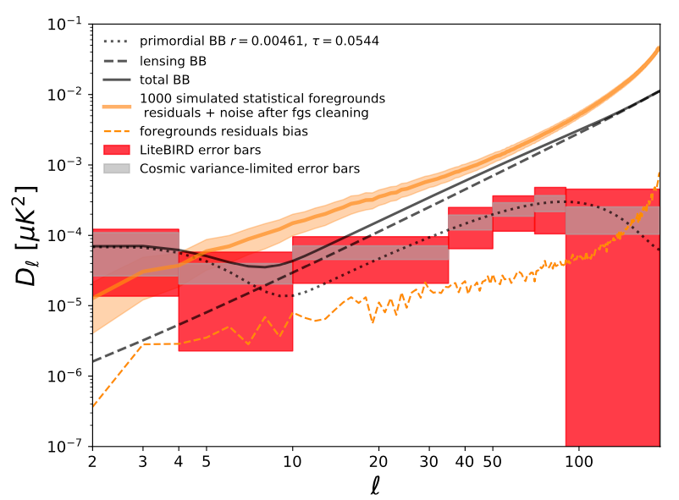
Foreground cleaning
Foreground modeling
Impact of foregrounds residual
Synchrotron: curved spectrum (AME is absorbed in the curvature)
Dust: modified blackbody
"Adaptive multiresolution technique" (extension of xForecast), to account for spatial variability. 12 x (Nside)² patches with galactic latitude dependent Nside :
 | Galactic latitude | HFT
 | Low | Medium | High
β_{d} | 64 | 64 | 64
T_{d} | 8 | 4 | 0
β_{s} | 4 | 2 | 2
📖 Hazumi+ PTEP 2022
Date
1/N
Conference
14
2023/03/30
International Conference on the Physics of the Two Infinities – Kyoto 2023
Notes:
In our forecasts, we assume the foreground emissions to be made of spatially variable synchrotron emissions from accelerated charged particles following a power law and of spatially variable thermal emissions from grains of dust in the interstellar medium following a modified black body law.
In order to match the spatial variability, we use a sophisticated method of parametric component separation where the parameters vary across the sky.
In this setting, we are able to reach the uncertainties illustrated by the red boxes for a Starobinsky inflation with r~0.004.
The gray boxes represent the cosmic variance uncertainty.

Slide 20
Systematic effects
Systematic error formalism
Systematic errors originate from combination of:
Imperfect knowledge of foregrounds
Miscorrection of instrumental or environmental effects
Bias on r
Date
1/N
Conference
15
2023/03/30
International Conference on the Physics of the Two Infinities – Kyoto 2023
Notes:
In addition to foreground emissions, we have to deal with systematic effects, and make sure that these are low enough to reach the scientific goals.
Systematic effects originate from the improper knowledge of the foreground components as well as from the miscorrection of instrumental effects.
And these two sources are highly interacting with each other. In particular, we have to take into account the step of component separation when we study systematic effects.

Slide 21
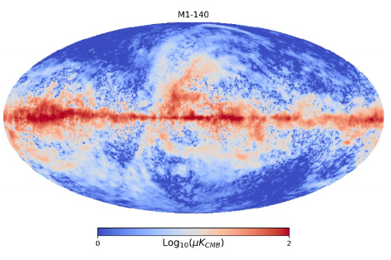
Systematic effects
Systematic error formalism
Systematic errors originate from combination of:
Imperfect knowledge of foregrounds
Miscorrection of instrumental or environmental effects
Bias on r
Date
1/N
Conference
15
2023/03/30
International Conference on the Physics of the Two Infinities – Kyoto 2023
Notes:
In order to illustrate the procedure of evaluating a systematic effect, I will discuss the particular case of beam far side-lobes that I have personally led.
To explain briefly where this effect comes from, let’s assume the telescope points in a direction of low foreground contamination.

Slide 22
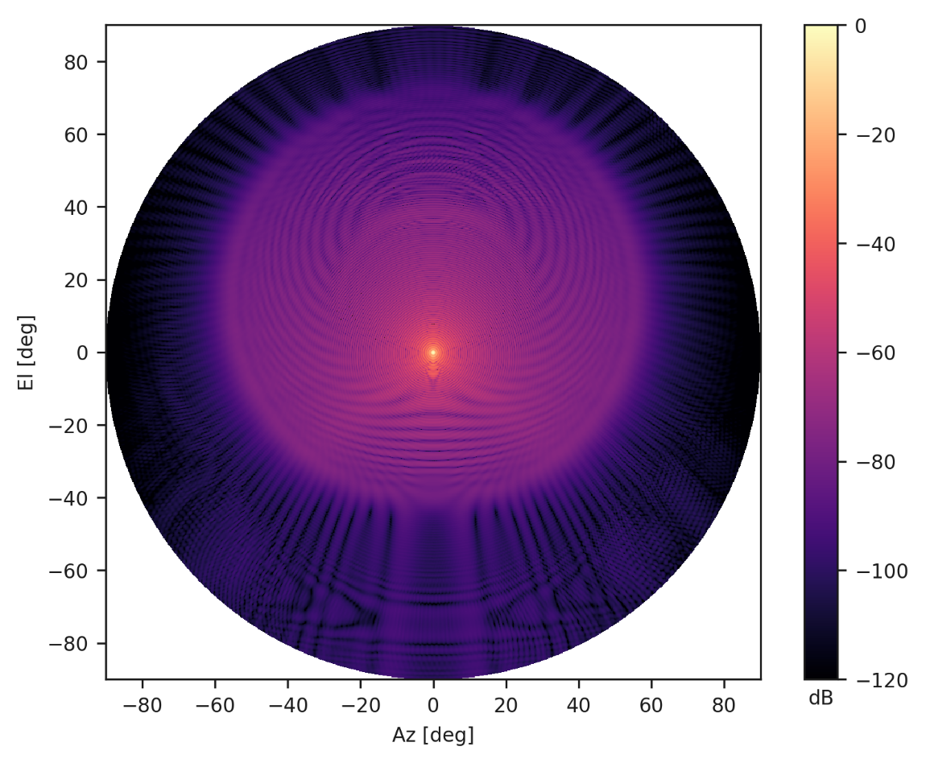
Systematic effects
Systematic error formalism
Systematic errors originate from combination of:
Imperfect knowledge of foregrounds
Miscorrection of instrumental or environmental effects
Bias on r
Date
1/N
Conference
15
2023/03/30
International Conference on the Physics of the Two Infinities – Kyoto 2023
Notes:
Because the optical system is not perfect, it will collect light from other directions with a kernel which is mostly gaussian, leading to a potential contamination from the galactic plane.
The knowledge of the structure of the beam at large angles, the so-called far side-lobes region, is therefore important.

Slide 23
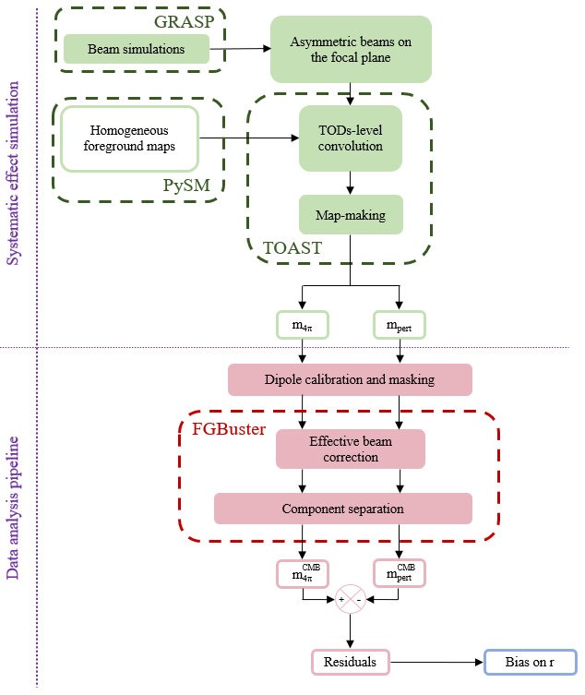
Beam far side-lobes
📖 Leloup et al. in prep
Date
1/N
Conference
16
2023/03/30
International Conference on the Physics of the Two Infinities – Kyoto 2023
Notes:
Here is a summary of the different steps in our analysis of beam side-lobes systematic effects.
I won’t enter into the details, but the general structure is the same for all systematic effects.

Slide 24
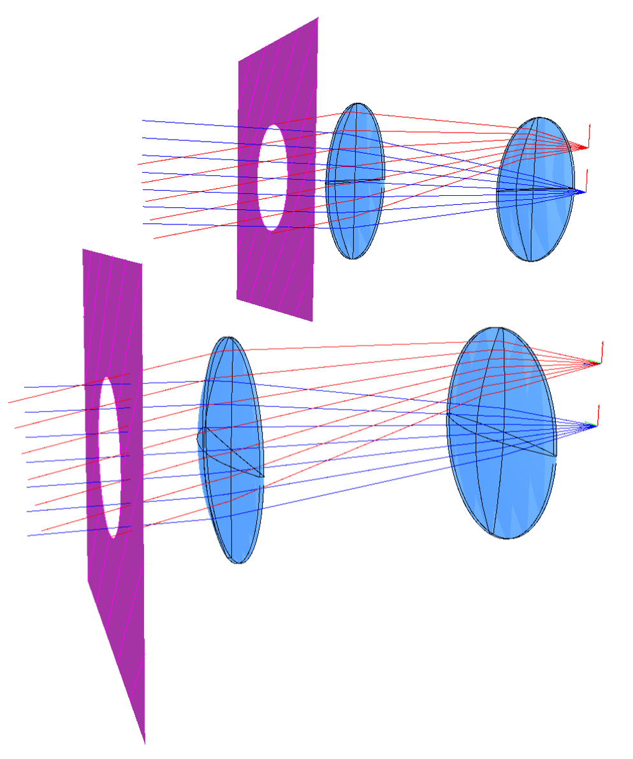
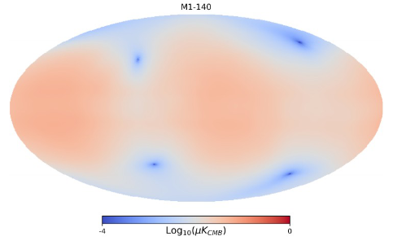
Beam far side-lobes
📖 Leloup et al. in prep
Simulation of the optical system response
Maps convolved by 4π beam and side-lobes
Date
1/N
Conference
16
2023/03/30
International Conference on the Physics of the Two Infinities – Kyoto 2023
Notes:
First we have to simulate the systematic effect.
In our case this corresponds to producing simulated maps of the beam response, and use these to simulate beam convolved observed maps including simulations of the focal plane, the scanning strategy, etc.

Slide 25
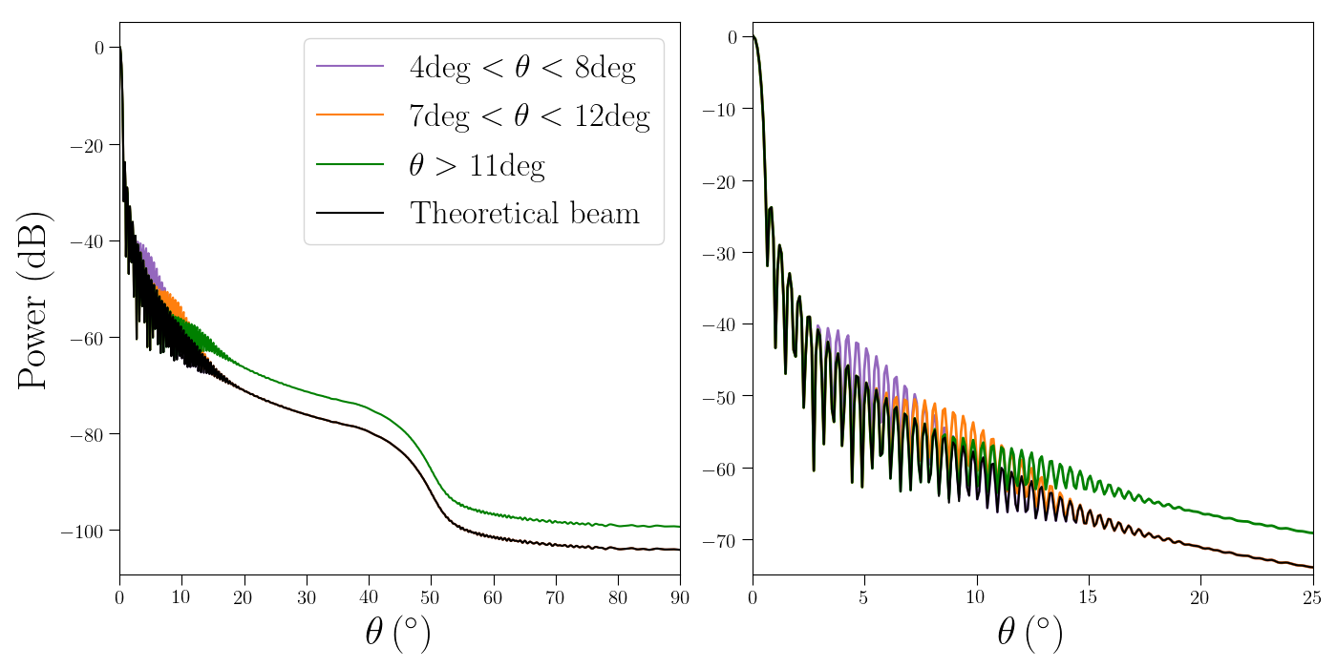
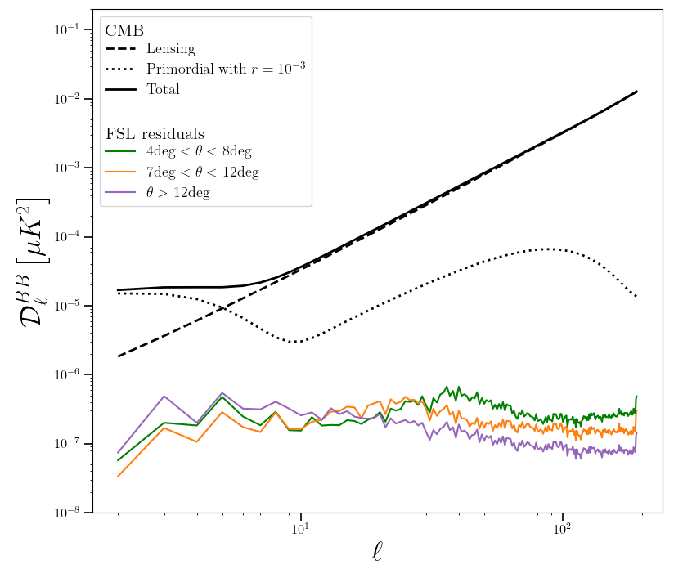
Beam far side-lobes
📖 Leloup et al. in prep
Perturbation of the beam as calibration error
Residuals from beam miscalibration
Date
1/N
Conference
16
2023/03/30
International Conference on the Physics of the Two Infinities – Kyoto 2023
Notes:
Then, we have to run the data analysis pipeline on these simulations up to the cosmological result, because the figure of merit is the impact on r.
In our case, we combine the previously simulated maps to produce simulations that include a perturbed beam that acts as a source of systematic error.
By running the analysis pipeline, we get power spectra of residuals for this effect.

Slide 26
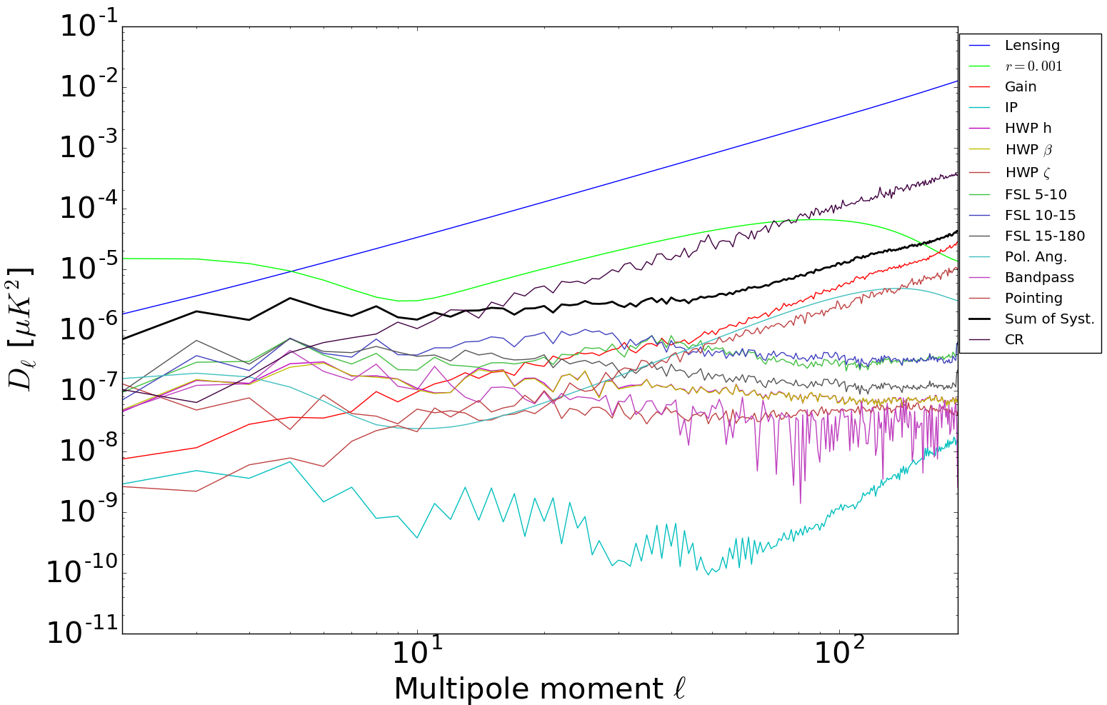
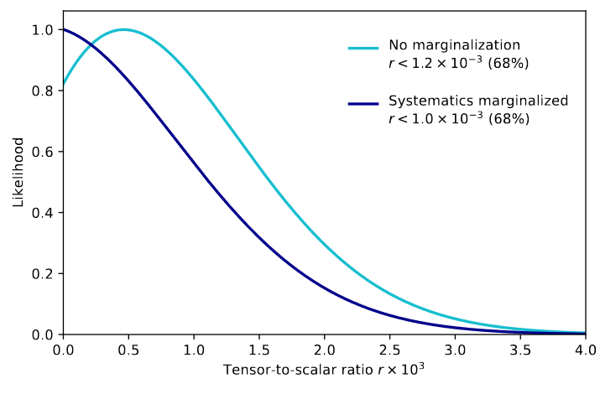
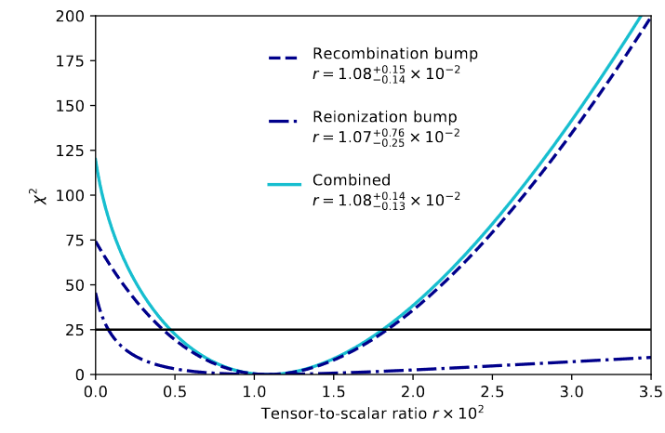
Forecast on constraints
Combined constraint on r from reionization and recombination bumps assuming r=0
Independent constraint on r from reionization and recombination bumps assuming r=0.01
📖 Hazumi+ PTEP 2022
Date
1/N
Conference
17
2023/03/30
International Conference on the Physics of the Two Infinities – Kyoto 2023
Notes:
We do this for every source of systematic error we can think of to get their corresponding residuals.
Finally, we combine the estimation of instrumental systematics as well as uncertainties from foreground removal to compute the expected posterior for r.
Here we see that, looking at the dark blue curve, the expected total uncertainty assuming r=0 is below 10^-3, while the reionization and recombination scale are enough to reach a 5-sigma detection if r=0.01.
Actually, that last point is very important because it means that we can have a multi-scale measurement of r, which is basically only accessible to a space mission.

Slide 27
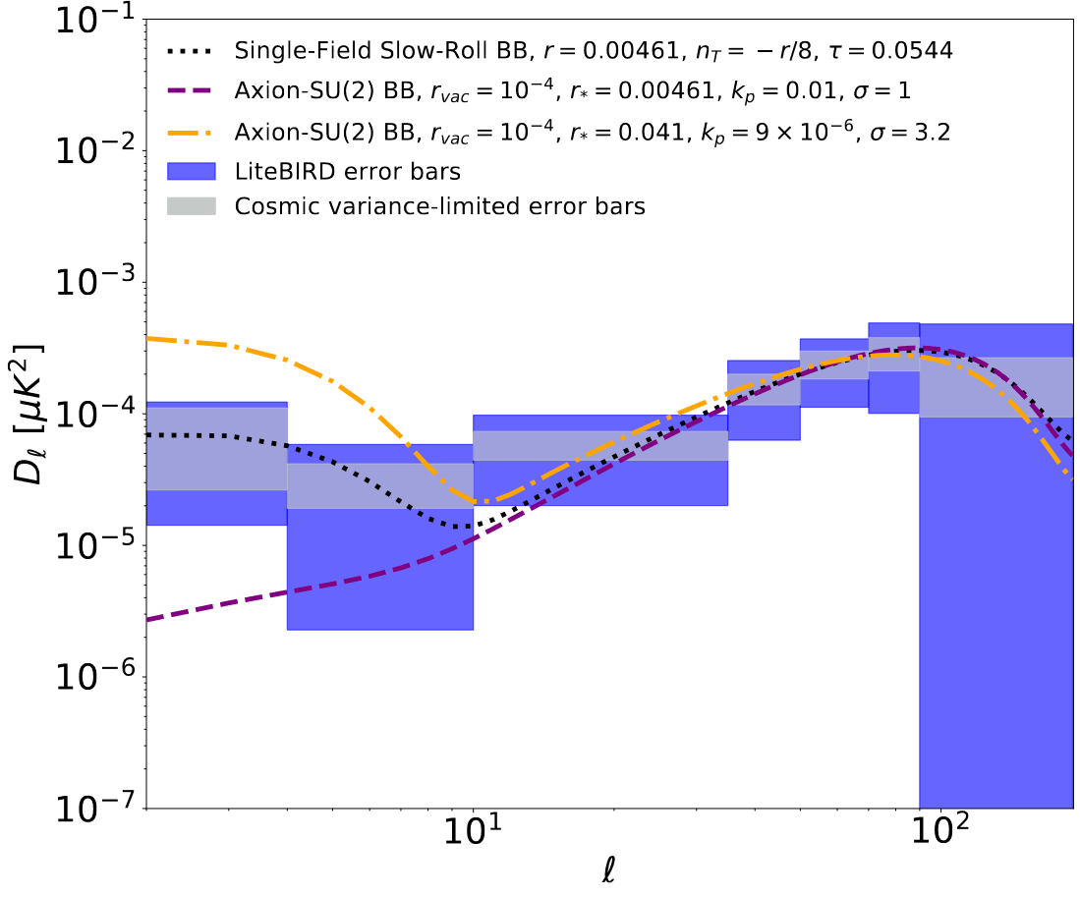
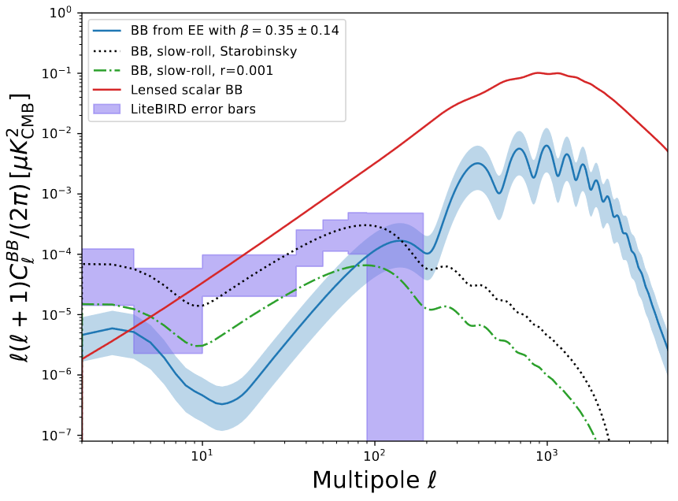
Science forecast beyond r
By going to space, LiteBIRD will be able to constrain B modes at multiple scales
Single scale measurement of r is not enough to understand the source of B modes, inflation or something else
📖 Hazumi+ PTEP 2022
Parity-violation during inflation
Cosmic birefringence
Primordial magnetic fields
Date
1/N
Conference
18
2023/03/30
International Conference on the Physics of the Two Infinities – Kyoto 2023
Notes:
To illustrate the importance of a multi-scale measurement of the power spectrum amplitude, i.e. of the shape of the power spectrum, here are some examples of inflation scenarios where the amplitude at the recombination scale are the same but the amplitude at the reionization scale is different.
On the other hand, other sources of large scale B modes can originate from non-inflation scenarios, such as cosmic birefringence or primordial magnetic fields, though with a different typical shape.
Actually, because it is very important to capitalize on multiple scales, there has been a recent effort between the CMB-S4 and LiteBIRD collaborations to prepare a joint work that would make use of the complementary strength of CMB-S4 at small scales and of LiteBIRD at large scales.

Slide 28
Summary
LiteBIRD is a future JAXA L-class mission that will be launched at the end of the decade
Its main scientific target is the detection of CMB B modes
Given its high sensitivity δr < 0.001 for r=0, it has a huge discovery impact or will be able to put tight constraints on inflation scenarios
Many other potential scientific output from the measurement of CMB polarization
To achieve this sensitivity with a full sky survey:
3 telescopes with a wide frequency coverage
More than 4000 TES detectors
Need for sophisticated foreground cleaning methods
Exquisite control of systematic effects is required
Date
1/N
Conference
19
2023/03/30
International Conference on the Physics of the Two Infinities – Kyoto 2023
Notes:
And this is a summary of my presentation. I will stop here, thank you.

