Slide 1

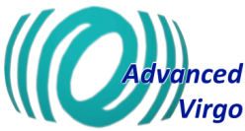
Advanced Virgo+ status and perspectives
VIR-0231A-23
Fabio Garufi (INFN-NA and UNINA)
On behalf of the Virgo collaboration

Slide 2








The Virgo Collaboration
There are currently more than 820 Members in the Virgo Collaboration, representing 138 Institutions in 15 different countries (as for Jan 2023); 9 of them are in the Steering Committee
Questa foto di Autore sconosciuto è concesso in licenza da CC BY-SA

Slide 3
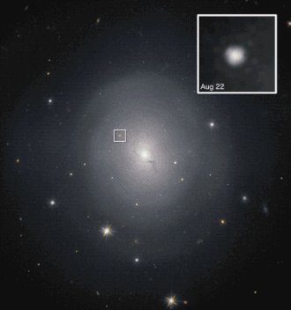
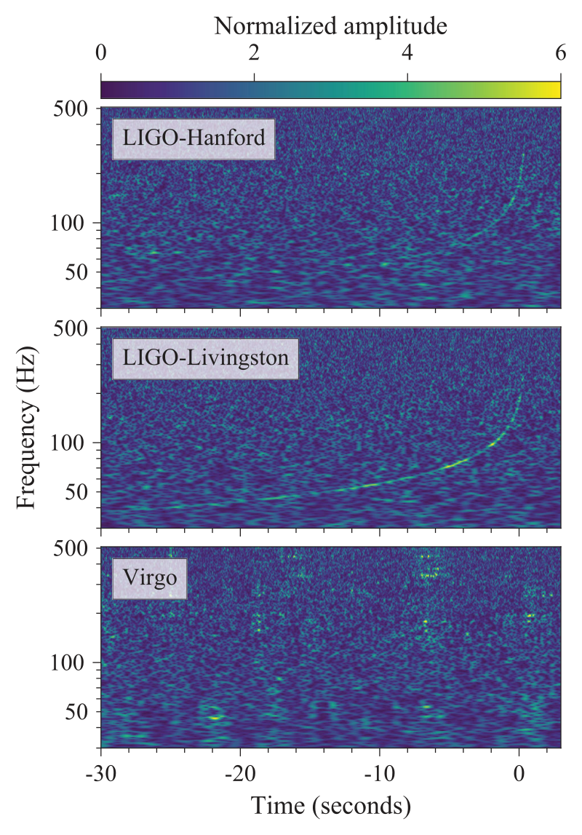
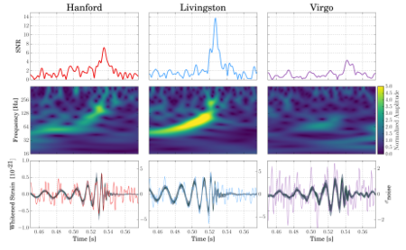
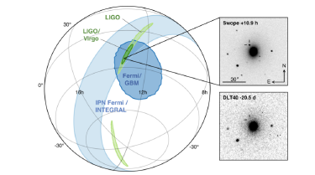
Previous observation runs
Adv Virgo and O3 run
Jan. 15, 2001 : brightest NS-BH merger
O3 ended on March 2020
Several exceptional events
NS-BH coalescences
  GW191219_163120 : extremely unequal mass components: 31M☉ + 1.2 M☉, and the lightest NS ever observed
  GW200115_042309: the brightest BH-NS coalescence detected up to now 6 M☉ + 1.4 M☉
BH-BH coalescences with IMBH
  GW190521_030229: 85 M☉ + 66 M☉ -> 142 M☉
  GW200220_061928: 87 M☉ + 61 M☉ -> 148 M☉
May 21, 2019: BH-BH merger to IMBH
Aug. 14, 2017:first triple detection
Sept. 14, 2015 first GW observation
August 17, 2017: first neutron-star merger detected
Aug. 1. 2017 Virgo joins the network

Slide 4
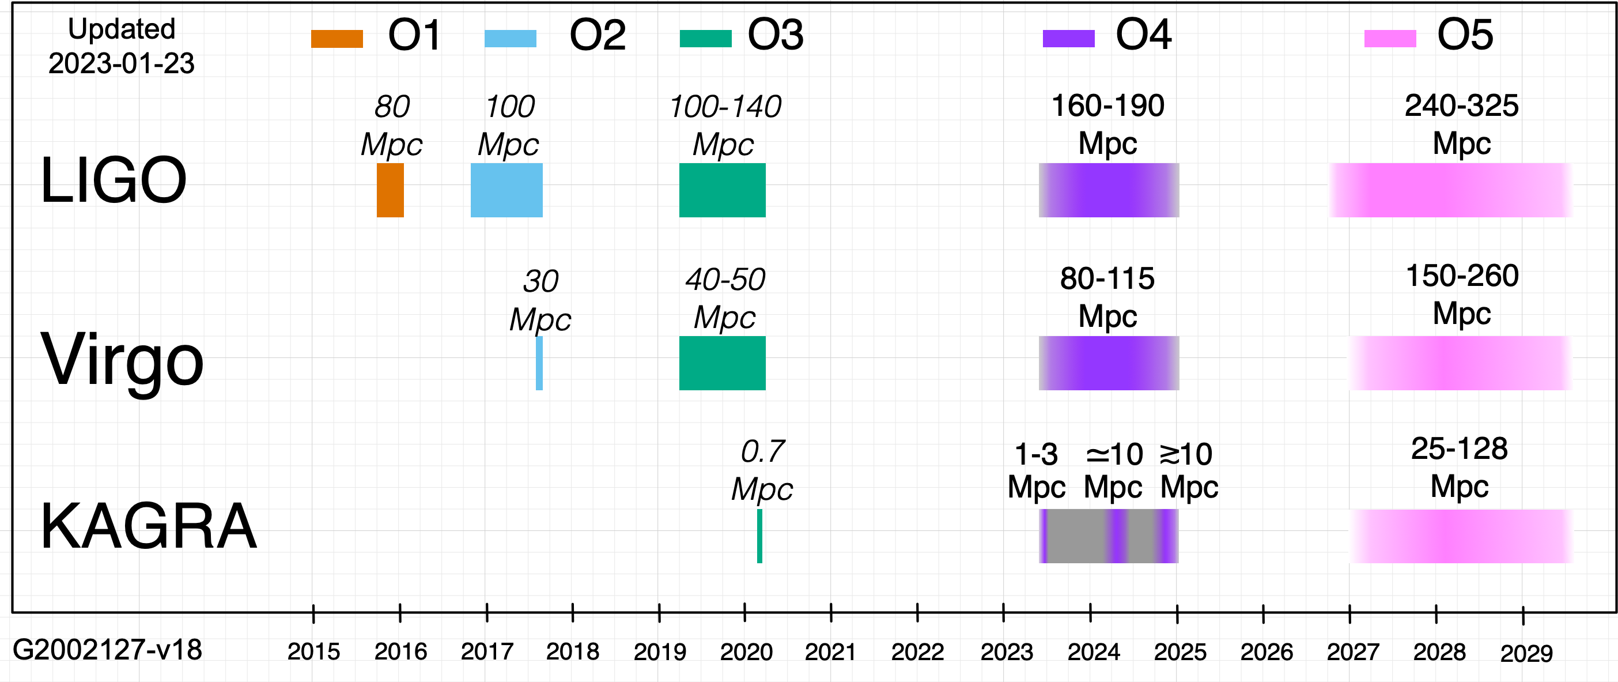
Observing runs: passed and planned timeline
O4 duration: 18 months (instead of 12 months)
Planned starting date of O4: May 24, 2023 (preceded by a 1-month engineering run)
Change motivated by upgrade plans for O5: sensitivity improvement for O5 comes primarily from lower noise mirror coatings, still in development not expected before the original O4 end date.
Additional observing time will increase the scientific output of O4, while the coating development is being finalized.

Slide 5
AdvVirgo towards O4
The interferometer has undergone to a series of upgrades since the end of O3 to enhance sensitivity
  Before O4 Phase I upgrades 2021-23
  Between O4 and O5 Phase II upgrades 2025-26 – lowering thermal noise (more invasive)
Phase I

Slide 6
Improvements in phase I
Higher power Laser amplifier
Signal recycling mirror on the anti-symmetric port.
Frequency dependent squeezing to beat Shot noise at high freqs and radiation pressure at low freqs.
Green light auxiliary laser to pre-align and control the signal recycling cavity; Scattered light mitigation
New Input mode Cleaner payload with an instrumented baffle to monitor and cut stray light.
New high finesse output mode cleaner and new read-out photodiodes.
High vacuum upgrades and reduction of environmental noise.
Deployment of accelerometer arrays for Newtonian Noise characterization
4
5
4
1
3
2
6

Slide 7
BNS range: the distance at which the signal from a 1.4+1.4 solar masses binary merger has a SNR of 8.
Estimated sensitivity
Single recycled interferometer
Dual recycled interferometer

Slide 8
Higher input power
The increase of input power (from 25W to the present 33W, however less than the 40 W design power) improves the shot noise, but it leads to:
  Higher radiation pressure effects (affecting the control of the detector)
  Stronger thermal effects (affecting both the control and the optical performance of the detector)

Slide 9
Signal recycling mirror
The Signal recycling mirror at the dark port, enhances the detector sensitivity.
It realizes a new cavity to be controlled both in angular and longitudinal degrees of freedom
Also the lock acquisition procedure has to be re-designed to take into account the locking of this new coupled cavity.
The implementation of the signal recycling technique requires auxiliary green lasers to control the 3 km arm cavities independently of the rest of the interferometer

Slide 10
Auxilary laser and new locking procedure
The lock acquisition has been implemented, based on the LIGO design by adding auxiliary green beams to control the arm cavities in an independent way with respect to the central area
This allows to add a common offset to the arms, bringing the main laser source out of resonance, avoiding main IR laser power build-up in the cavities
After the central area d.o.f. (MICH) are controlled, the offset on the common mode is reduced gradually, so that thermal effects due to power increase can be controlled near the lock point
The first lock at the final working point, described above, with an input power of 33W has been achieved in December 2021, but the lock showed strong instabilities and unexpected modifications in the detector response.
Simulations showed a possible link with power induced optical aberrations
Similar effects were observed in LIGO but with lower impact on the locking.

Slide 11
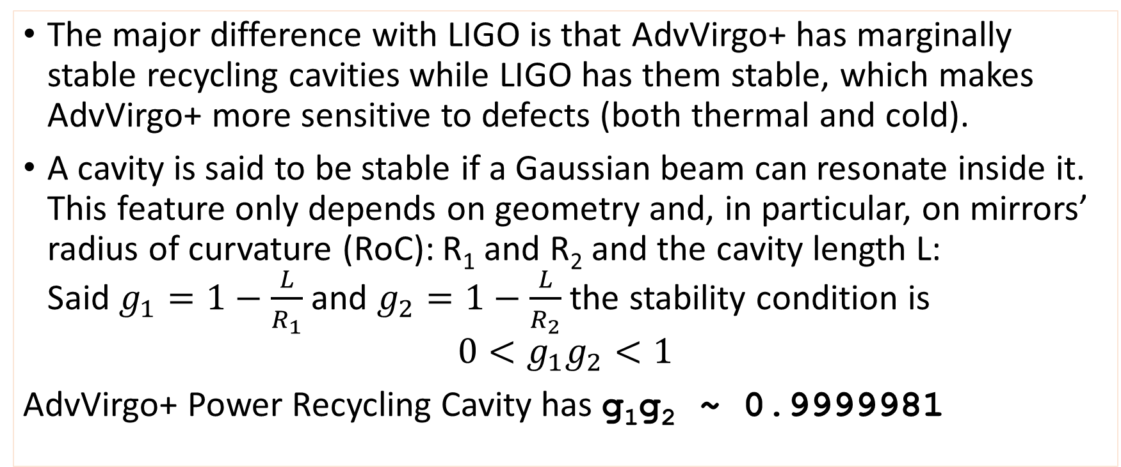
Cavities instabilities
The major difference with LIGO is that AdvVirgo+ has marginally stable recycling cavities while LIGO has them stable, which makes AdvVirgo+ more sensitive to defects (both thermal and cold).
A cavity is said to be stable if a Gaussian beam can resonate inside it. This feature only depends on geometry and, in particular, on mirrors’ radius of curvature (RoC): R₁ and R₂ and the cavity length L:
Said $g_{1}=1−\frac{L}{R_{1}}$ and $g_{2}=1−\frac{L}{R_{2}}$ the stability condition is
$$0<g_{1}g_{2}<1$$
AdvVirgo+ Power Recycling Cavity has g₁g₂ ~ 0.9999981

Slide 12
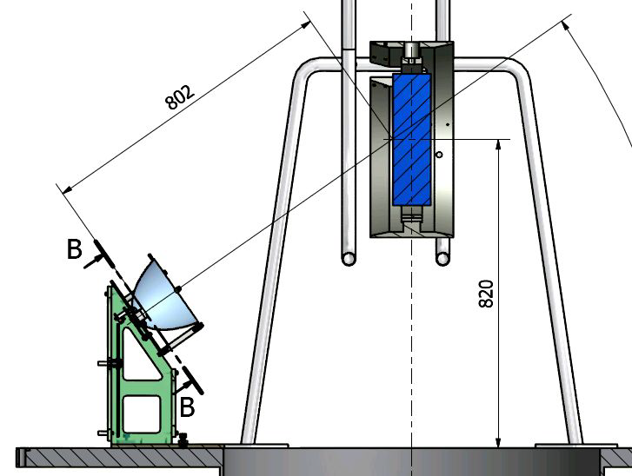
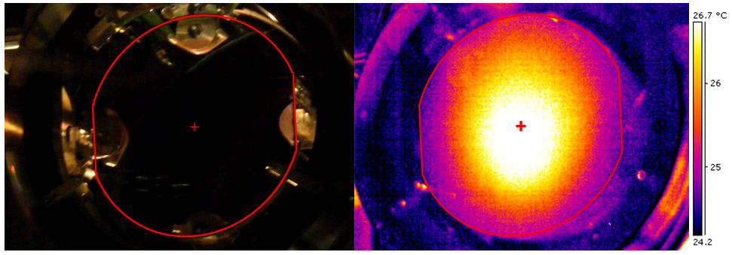
Thermal Compensation System
To compensate thermal effects on the mirrors’ RoC, a thermal compensation system has been installed since O2, based on CO₂ lasers and ring heaters around mirrors.
The main problem is that the Power Recycling mirror has a pre-tuned RoC, to be compliant with the 125W design input power, which makes the cavity unstable for 33W
an additional actuator has been installed to retune the PR RoC and stabilize the recycling cavity – “CHRoCC” (Central Heating Radius of Curvature Correction )
The situation improved but the lock is still unstable.

Slide 13
Frequency dependent squeezing
The injection of frequency dependent squeezed light, allows to reduce shot noise at high frequencies and radiation pressure noise at low frequencies.
The squeezed light source by AEI is the same used for frequency independent squeezing during O3
High-throughput Faraday isolators and beam optics suspended under vacuum for stray-light mitigation
A 300m long high finesse filter cavity has been built for squeezing ellipse rotation below 50 Hz
See Y. Zhao presentation

Slide 14
Quantum noise: radiation pressure and Shot noise

Slide 15
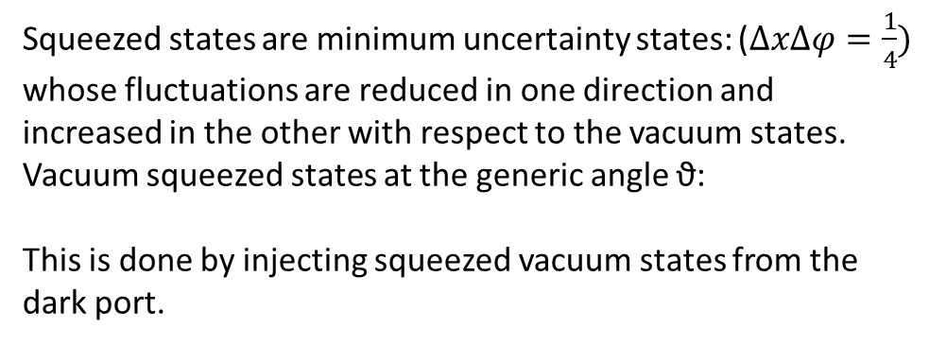
Squeezing to reduce quantum noise
Squeezed states are minimum uncertainty states: ($∆x∆φ=\frac{1}{4})$ whose fluctuations are reduced in one direction and increased in the other with respect to the vacuum states.
Vacuum squeezed states at the generic angle ϑ:
This is done by injecting squeezed vacuum states from the dark port.

Slide 16
Instrumented Baffles
Although passive baffles served their purpose, absorbing 99.5% of the Stray Light (SL), there was no real control or monitoring of where the SL went.
Virgo main arms do not have active sensors in the vicinity of the test masses to assist in the pre-alignment of the interferometer
In April 2021, a first instrumented baffle was installed before the suspended end mirror of the input mode cleaner (IMC) cavity.
  Replacement of the existing baffle by one equipped with photosensors, keeping its weight and mass distribution as close as possible to the original
76 photosensors behind the absorbing plate
Sensors mounted on large PCB
SL passes through 12° conical holes in the plate to avoid back-reflection
Data transmission via wi-fi

Slide 17
West Input payload incident
To prepare the installation of the point absorbers mitigation system, the vacuum chambers of the four cavities mirror were vented on 14/11/22
Fused silica fibers of West Input mirror broke during venting
Problem already experienced six times in 2015-2016 (+ 2 during tests)
  For this reason O2 run (2017) was done with metal wires suspensions
  Understood as due to small particles hitting the fibers
    More likely during venting/pumping
  Solved by installing protections around fibers and changing pumping/venting layout
    No fibers break since monolithic suspension re-installation in 2018
    2 full venting and 4 low-pressure venting done since then

Slide 18
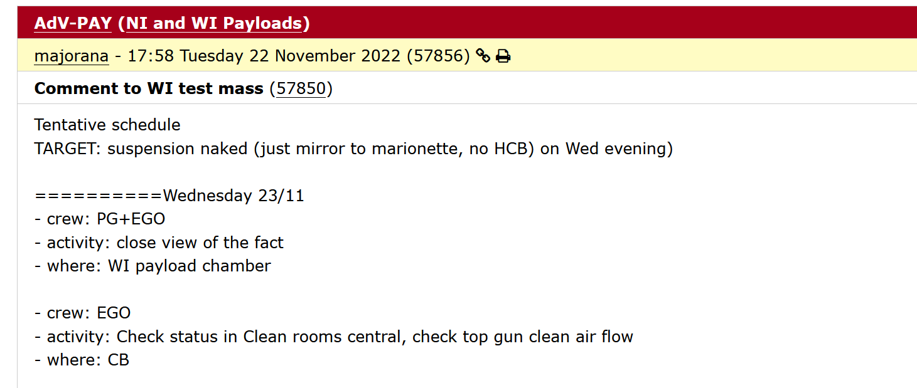
Recovery from payload incident

Slide 19
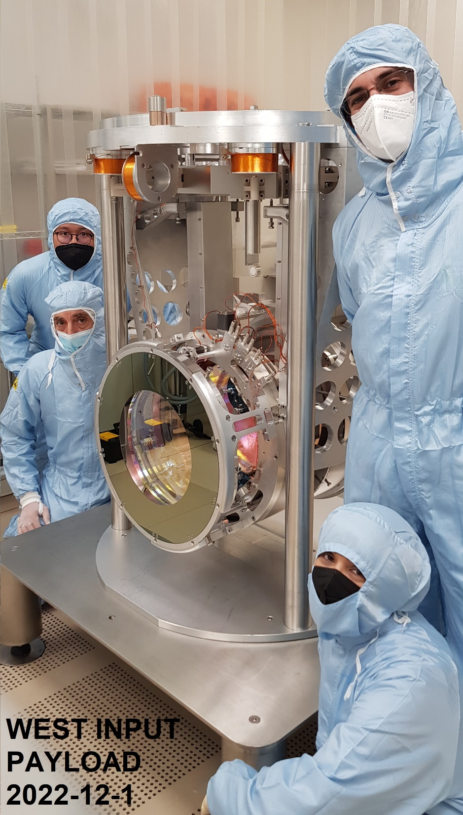
Recovery from payload incident
Work done
  Payload dismounted, repaired and reinstalled in less than 2 weeks
  Additional protection against potential dust particles prepared and installed before the payload reinstallation
  Vacuum chamber pumped down and valve opened on December 11th
Other installations done during the shut down
  Change of output mode-cleaner
  Installation of addition EOM to create new sidebands for SR mirror control
  Viewports for point absorbers mitigation
  Installation of repaired fiber amplifier

Slide 20
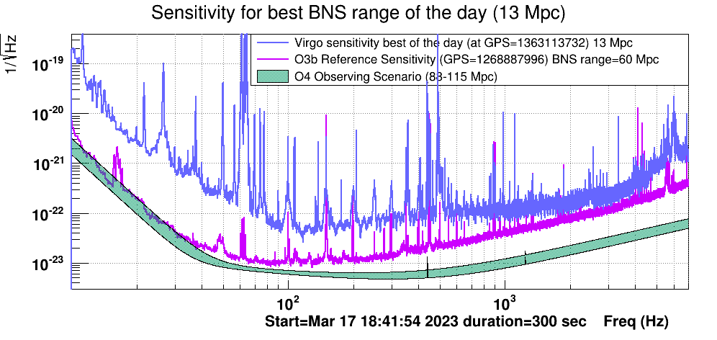
First sensitivity curves
Stable and robust interferometer control
  Routine night running
  2-days eng. run in early Nov.
Important features understood
  Role of HOM in SR cavity
Noise hunting started
First sensitivity curve measured in november
  Limited by defective OMC (~90% losses)
A 2 weeks commissioning break was planned to replace the OMC Started on Nov 14
Additional actions performed
  Installation of ZnSe windows for point absorbers mitigation
  PSL/INJ installations
From November to March, sensitivity (reach) passed from 4.8 to 13 Mpc, still progressing, despite the lowering of input power (see later).
NOT PUBLIC

Slide 21
Problems with input power and locking
It appears that we were suffering from an excess of power on the dark fringe due to the signal recycling cavity degeneracy (i.e. High Order Modes co-resonating with the carrier in the cavity)
  Discovered last October
Effects of high power on dark fringe
  Difficulties in the operation of the detection system
  Larger sensitivity to common mode noise
  Risk with scattered light
Moreover, we had to deal with a non negligible offset on the signal recycling cavity length control due to an optical offset in the corresponding Pound-Drever-Hall (PDH) signal

Slide 22
Cavities degeneracy problems
Several problems with degenerate recycling cavities were discovered during the commissioning of AdV+ Phase I
  Optical offsets
  Large contrast defect
  Simulations still on going, but very likely also the squeezing will suffer from the SRC degeneracy
It is too complicated to correct the defects above with the thermal compensation system (even after its upgrade with the two CHRoCC’s )

Slide 23
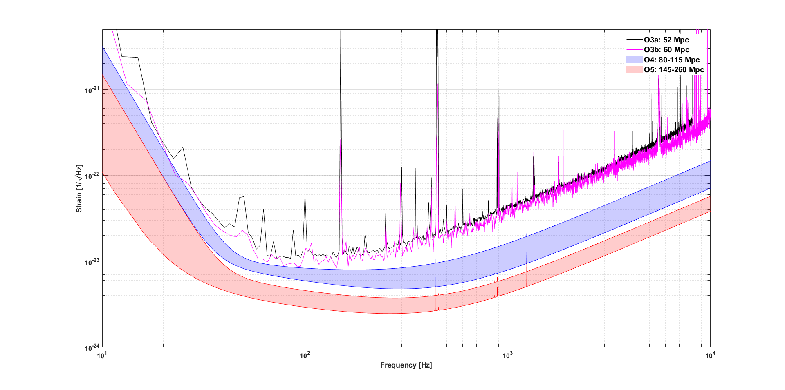
New goal with decreased power
Despite the use of the thermal compensation system, it was appearing more and more evident that we have problem in progressing in the commissioning of the interferometer with 33 W input power.
Given the effort already put in these activities and the approaching of the run, the only available option was to reduce the power injected into the interferometer back to 25
  The foreseen sensitivity curve of dual recycled ITF @25W is still compatible with the upper limit of blue band
  In parallel there is a study ongoing to evaluate the possibility of using detuned signal recycling cavity, but no plan is available at present.
VIR-1153A-22

Slide 24
Decisions to be taken (as at March 2023)
Make a test decreasing the power to 25 W
  Same intra-cavity power of O3 (~100 kW)
Main arguments
  Design sensitivity
  Control with the O3 intra-cavity power already done in the past
To be studied @ 25 W
  SRCL offset
  Power on dark fringe
A good lesson for the future
  Need to rethink some parts of AdV+ Phase II
  An important input for VirgoNEXT (1.5 MW in the cavity …)

Slide 25
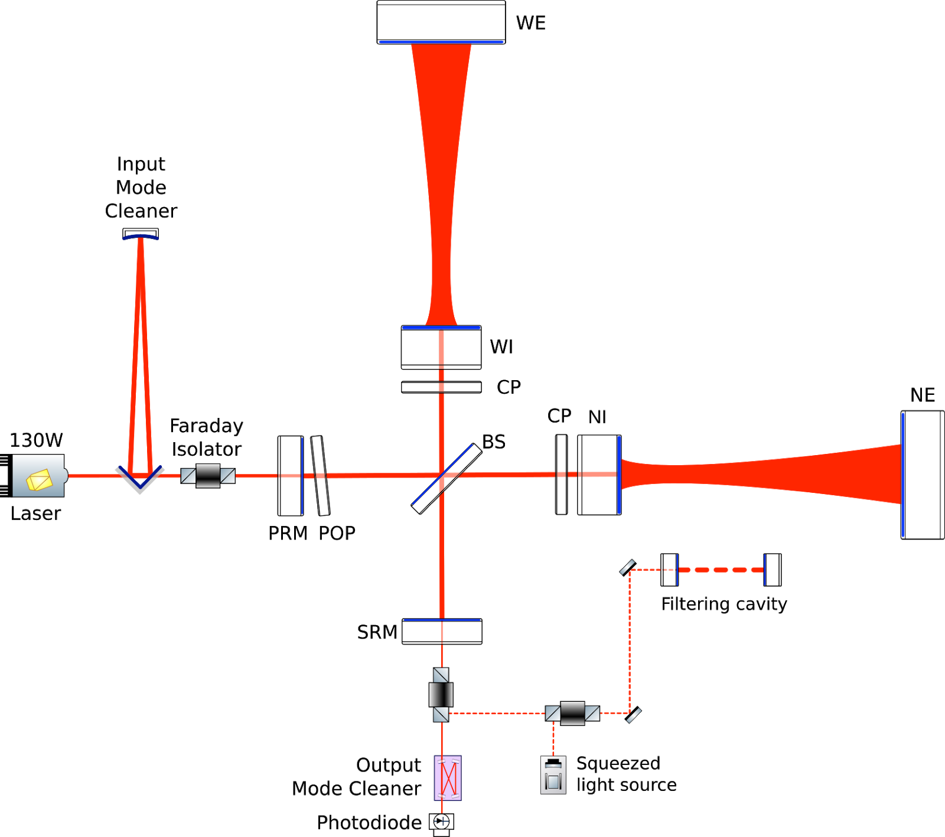
Phase II improvements
Phase II

Slide 26
Phase II improvements
Larger and heavier mirrors
New suspensions
Larger beams
New coatings
Several noises to beat:
  Thermal noise (coating + suspension)
  Radiation pressure fluctuation
  Residual laser Noise
  Stray light in the cavities
  Seismic and Newtonian noise
All the core optics (but the Beam Splitter) must be replaced to adapt to new beam geometry
All the telescopes will be modified
Higher power to Pre-stabilized laser: 40W => 80W

Slide 27
Pre Stabilized Laser (PSL)
PSL upgrade
  Upgrade present Fiber Laser to higher power
  Replace present Slave laser + Fiber Amplifier (NEOVAN) with new Fiber Laser
  Goal: two high power fiber lasers on the same table (redundancy)

Slide 28

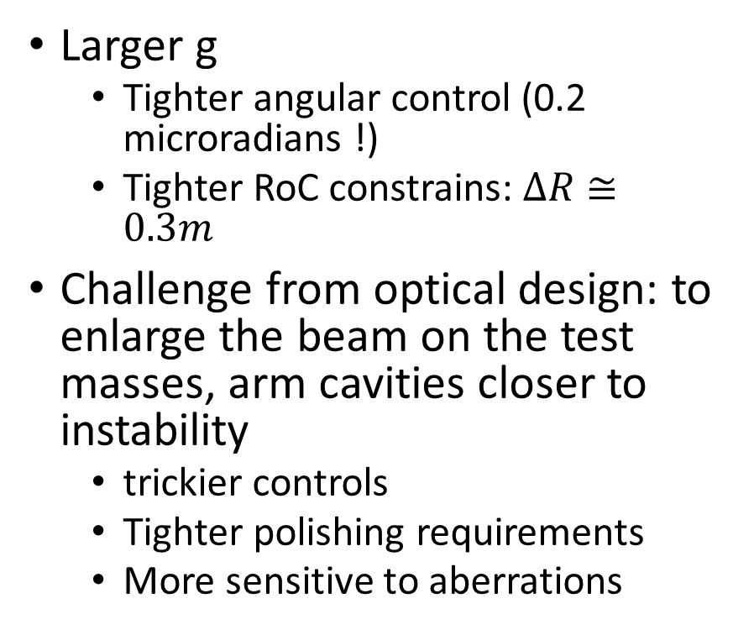
Cavities geometry
Larger g
  Tighter angular control (0.2 microradians !)
  Tighter RoC constrains: $∆R≅0.3m$
Challenge from optical design: to enlarge the beam on the test masses, arm cavities closer to instability
  trickier controls
  Tighter polishing requirements
  More sensitive to aberrations

Slide 29
Enhanced TCS
Ring-heaters for fine tuning of RoCs
CO2 heaters
Hartman wave-front sensing (HWS)
Phase cameras
New cameras for HWS
Upgraded HWS telescopes for end mirrors
Mode-cleaners for CO2 beams
DC CO2 laser beam shapers via deformable mirror
More remote controls
More phase cameras

Slide 30
Large mirrors
Substrates acquired and received at Laboratoire Materiaux Avancés (LMA) – Lyon
Polishing started Dec. 2021
Delivery of polished substrate foreseen for next summer
Several upgrades at LMA to prepare the realization of the large mirrors and the development of new coatings (Total investment 1.8 M€)
LIGO and Virgo agreed to pursue together the development of TiO₂:GeO₂/SiO₂ coatings at LMA
Joint LIGO-Virgo working group – G. Vajente (LIGO), C. Michel (Virgo)

Slide 31
Large beams => Large Test Mass
Design update and tests dedicated to SuperAttenuator (P. Chessa, INFN-Pisa)
PAYLOAD (Firenze-Urbino, Perugia, Roma, EGO)
  Design at present, successful, base
  Fiber production Machine suitable for 105 kg mirror fibers
  Anchoring fibers to marionette and test mass (new methods ?)
  Handling of large masses loads (overall payload+actuation cage 0.5Ton)

Slide 32
Superattenuator for large masses
A set of new thicker maraging blades is now being characterized to check compliance with Phase II design and to validate a new simulation tool.
A quantitative characterization is ongoing. First evidences arise about a significant increase of the carried load.
The Filter 7 prototype will be fully assembled after blade tests and crossbar LVDT calibration and installation.
We need a new dummy load. Design is ready, waiting for an offer.

Slide 33
Large masses => Larger, heavier Payload
Goal: suspend 100 kg mirrors
Large Payload for Large End Mirrors
  Design done
  Prototype built
  Including fused silica fibers ∅640 mm suspending O(100) kg dummy mirror
• Marionette 182 kg
• Mirror 104 kg

Slide 34
Large Payloads plans (at Jan ‘23)
Activities in clean room (until March 2023)
Transfer Function tests (ongoing)
Full reassembling from scratch of at the site, using the new set of ears HCB on new flats
performed with FARO articulated arm (10-20 um accuracy)
Mechanical design crosschecks also meant to the integration final TCS and SLC components
Order commitments (to be completed in the next 4-5 months)
first semester of 2023 to the construction (firms)
second semester 2023 + buffer up to Feb-March 2024 assembling at the site
Readiness to install at the end of O4 (April 2024)
The installation is coordinated with many other upgrades (SuperAttenuators and oter payloads, available only after O4)
Each installation takes an overall time of 1.5-2 months

Slide 35
O5 Finally
AdV+ Phase II
  Mirror construction progressing
  Shift of O5 start => More time given for the coating development
  New planning
  Ready to start construction of laser and payloads
  Installation to start promptly at the beginning of 2025 as soon as O4 ends.

Slide 36
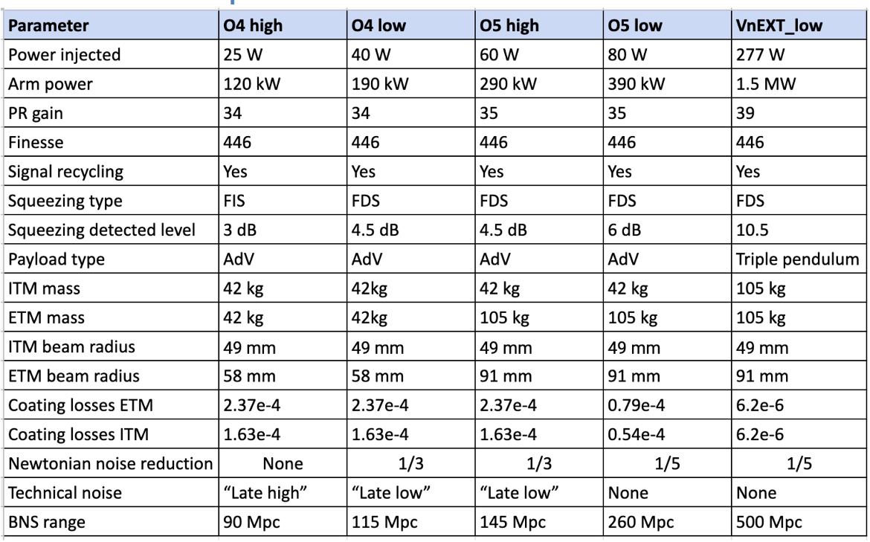




What next? VirgonEXT
adding an intermediate mass between the mirror and the marionette
After the O5 observing run:
Statement from EGO council:
  “The EGO Council asks also the Virgo Collaboration to prepare a plan for Virgo_nEXT, with the aim of continuing EGO activity until at least the beginning of Einstein Telescope and with the purpose to maximise the synergy between Virgo_nEXT oriented R&Ds and ET R&Ds”
Design team Coordinator elected: Viviana Fafone
Need for stable cavities in Virgo_nEXT requested in a long note

Slide 37
Proposed VnEXT layout
Same size and bulk material as O5, new material for coatings
Increase the injected power into the interferometer
Upgrades needed to TCS to correct mirrors’ deformations
Stable recycling cavities
Input and end test masses, should be suspended through an additional stage
Marionette cable made
of silica or a similar material
Reduction of optical losses.
Reduction of phase noise of the squeezing field.
Increase of the lock precision of the filter cavity and optimization of its controls.
OMC design might evolve to an empty cavity to reach lower losses and scattering

Slide 38
Expected sensitivity
The purple band shows the range of sensitivities achievable by VnEXT
The dotted curve in the purple band shows the best sensitivity achievable by VnEXT with improved amorphous coatings.
VIR-0497D-22

Slide 39
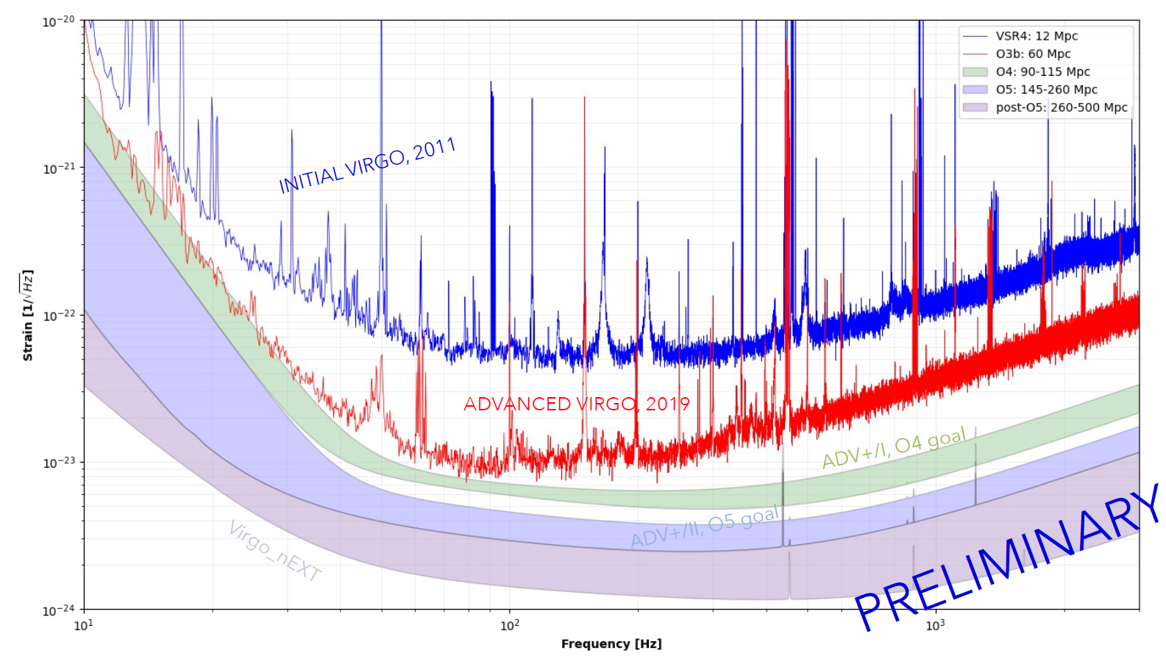
Expected sensitivity (Spare slide)
VIR-0218A-23

