Slide 1
Concluding remarks for the International Conference on the Physics of the two Infinities: everything was said and shown in a beautiful way.
Michel Spiro, President IUPAP
Kyoto March 27-30, 2023

Slide 2
Man is suspended between two abysses of Nothing and the Infinite. Pascal Pensées, 72 1670 (Enlightenment Century)
The Uroboros:
Serpent eating its own tail

Slide 3
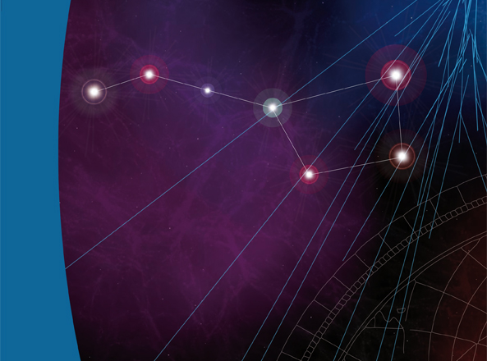
ΛCDM Cosmology
Standard Model Particle Physics
Physics of the Two Infinities
> 100 detectors (running
or in construction)
>10 000 scientists + ?AIs
Cutting edge technology
and instrumentation
High Energy Multimessenger Astronomy
Neutrino Sector
Particle Physics

Slide 4
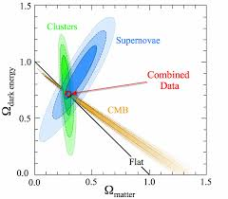
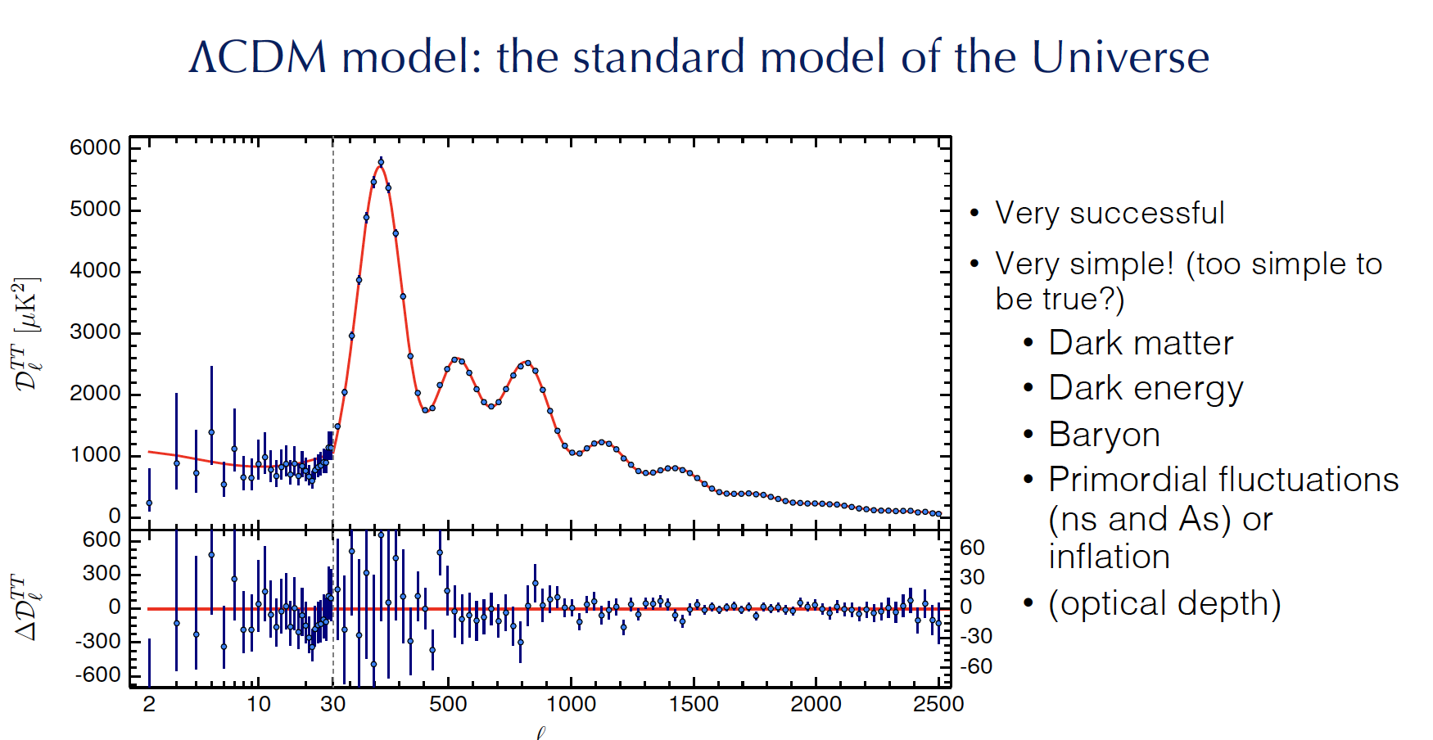
The universe is an infinite sphere, the centre of which is everywhere, the circumference nowhere. Pascal Pensées ΛCDM
Successes
Tests of General Relativity (atomic clocks and cold trapped atoms are entering the game at laboratory scale)
Account for the history of the universe
from inflation to structures in the Universe
Concordance: CMB, BAO, SN, clustering
Entering the era of precision measurements

Slide 5
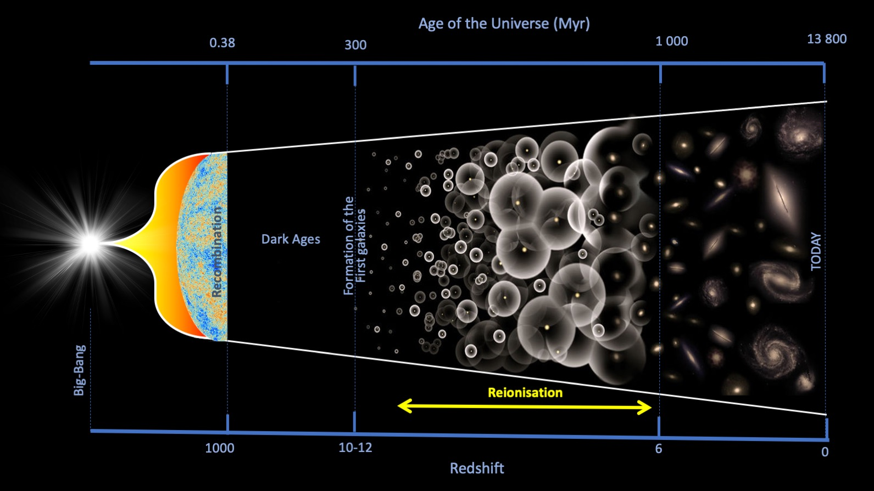
The universe is an infinite sphere, the centre of which is everywhere, the circumference nowhere. Pascal Pensées ΛCDM
Mysteries
Tensions (H0, σ8, …)
Star and galaxy formation era to be explored
Black holes in the Universe
Antimatter disappearance (looking forward to the antimatter gravitational mass measurement at CERN and to CP violation in the neutrino sector or in the quark sector plus enlarged Standard Model theory)
Dark matter (evidence from BBN, CMB, BAO, rotation curve and virial theorem, structure formation…Search for new particles Beyond Standard Model)
Origin of Λ? Dark (vacuum?) energy (SNIa, CMB, structure): connected to quantum vacuum properties or to a scalar field or to fine tuning…?
Cosmic
Dawn
Cosmic
dawn

Slide 6
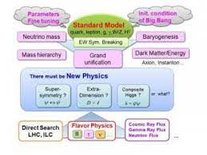
Perhaps he will think that here is the smallest point in nature. I will let him see therein a new abyss. I will paint for him not only the visible universe, but all that he can conceive of nature’s immensity in the womb of this abridged atom. Pascal Pensées 72 Standard model of particle physics
Successes
Elegant theory
Account for all HEP measurements so far
Discovery of the Higgs Boson, the first
elementary scalar particle

Slide 7
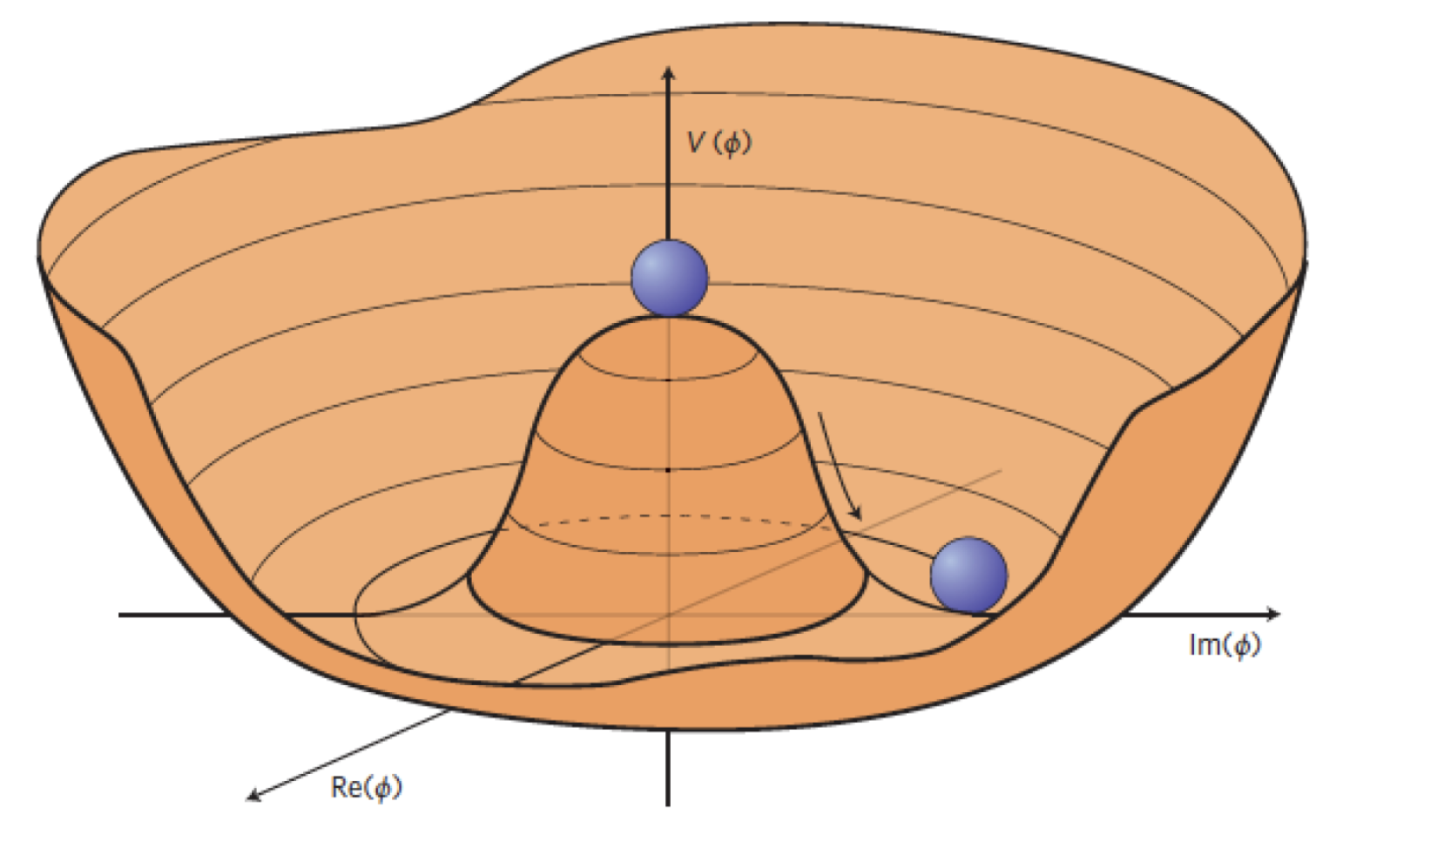
Perhaps he will think that here is the smallest point in nature. I will let him see therein a new abyss. I will for him not only the visible universe, but all that he can conceive of nature’s immensity in the womb of this abridged atom. Pascal Pensées 72 Standard model of particle physics
Mysteries: Physics beyond the standard model
Why three families, huge differences between the masses
Hierarchy (GUT and EW scales) and fine tuning ( supersymmetry (dark matter?))
Needs for new particles (DM?), for physics beyond the Standard Model and a new scale in energy beyond the Standard Model (precision measurements in decays, electroweak measurements.. Search for proton decay, GUT?…)
Is the Higgs sector fully understood? Could the Higgs be an inflaton? Shape of the Higgs potential? Could baryogenesis arise at the EW phase transition?
Is neutrino sector, the first sector beyond the standard model?

Slide 8
Alice in Wonderland, Lewis Carroll Neutrino sector
Successes
- Discovery of neutrino oscillations
- First measurements of Δm2 and mixing angles
- Good limits on absolute masses (still an issue with hierarchy of masses)
- Better understanding of the role of neutrinos in stars, BBN, cosmology and particle phsics

Slide 9
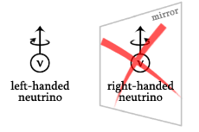
Through the Looking-Glass, Lewis Carroll Neutrino sector
Through the Looking-Glass, Lewis Carroll Neutrino sector
Mysteries
- Majorana or Dirac (longstanding issue)
- The hierarchy and the exact values of the masses and the consequences in cosmology and astrophysics (interplay between Cosmologt and particle physics)
- Neutrino CP violation (δ_{CP}) , precise mixing matrix and leptogenesis
- Neutrino inferred High Energy Scales (Seesaw and leptogenesis)? Are they related to the GUT scale?
- Are there sterile neutrinos?

Slide 10
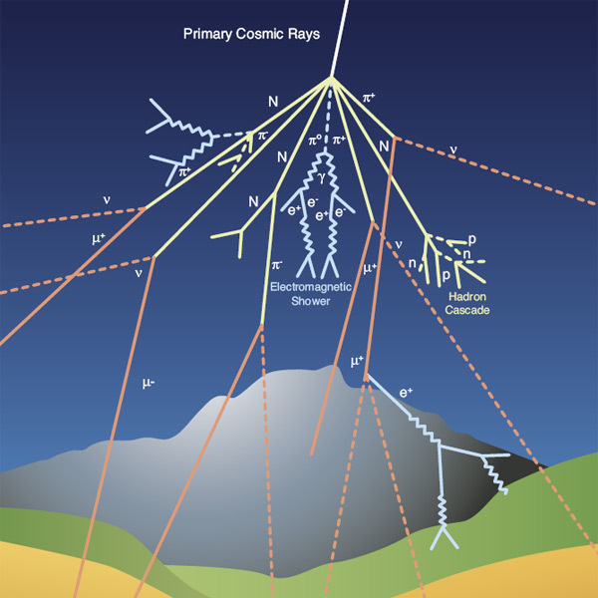
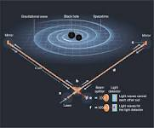
Neither Number, nor Measure, nor Time, in as much as they are only aids for the imagination, can be infinite but the finite follows from the infinite. Spinoza Letter to Meyer on infinity 1663 Extreme events in the Universe: Multimessenger astronomy
High Energy Multi messenger astronomy
Charged cosmic rays (GZK, ?)..)
Gamma rays (SN, Pulsars, AGN, BH, ?)
Neutrino astronomy (Solar, SN, cosmic ν, GZK, ?)
Gravitational waves (BH, NS, SN, ?…)

Slide 11
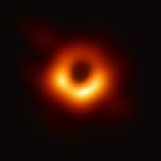
Neither Number, nor Measure, nor Time, in as much as they are only aids for the imagination, can be infinite but the finite follows from the infinite. Spinoza Letter to Meyer on infinity 1663 Extreme events in the Universe: Multimessenger astronomy
Black Holes and jets
Mass range from few to 10⁹ solar masses
Primordial or built up with time or both. Could they constitute dark matter?
Black holes seem to play a key role in structure formation and
are a laboratory for quantum gravity
Supernovae, hypernovae, gamma ray bursts and neutron stars
Multi messenger observations,
Mechanisms and Origin of elements
Equation of state
Acceleration mechanisms, access to the highest energy
Jets, background light in the universe
Physics beyond the Standard Model possible reach

Slide 12
We burn with desire to find solid ground and an ultimate sure foundation whereon to build a tower reaching to the Infinite. But our whole groundwork cracks, and the earth opens to abysses. Pascal Pensées 72. Key investigations for the uroboros (two infinities)
Poof (smoking gun) and study of the inflation phase (almost at reach)
Polarization of CMB (B modes)
Higgs sector, an asset to understand inflation?
Stochastic gravitational waves
Is there a grand unification scale between the elecroweak and Planck scale which could account for GUT, neutrino masses, baryo and leptogenesis and inflation?
Quantum Gravity we desperately need a theory
Unexpected?

Slide 13
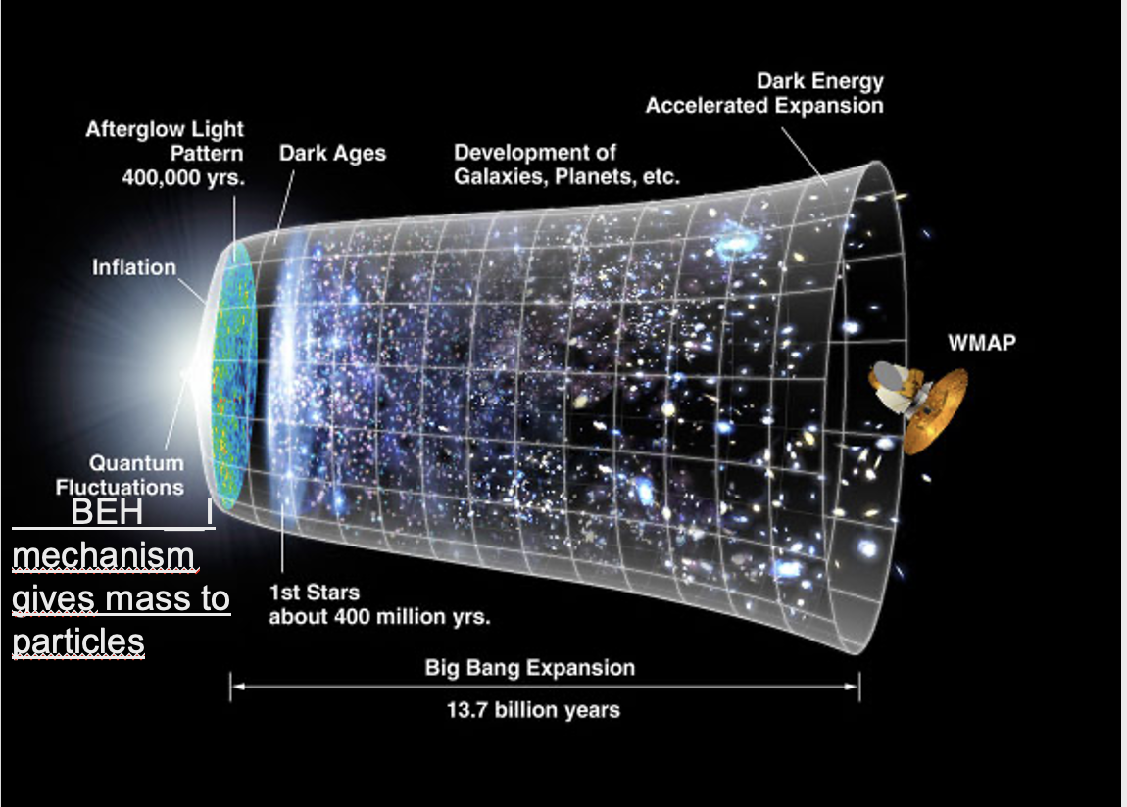
There is as much difference between nothingness and empty space, as between empty space and the material body; and thus empty space holds the medium between matter and nothingness. Pascal Letter 1647 Key investigations for the uroboros: in other words
Quantum Vacuum (is the Universe born from
vacuum quantum fluctuations? Role of the Higgs boson?)
Proton decay and neutrino sector
(is there any relation?)
Black Holes (Many questions associated to them.
Are they key to understanding Quantum Gravity,
Galaxy formation 10⁶ to 10⁹ M₀, Dark Matter 10 to 100 M₀…)

Slide 14
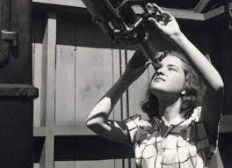
Black holes as dark matter?
Most events seen by LIGO/VIRGO are coalescence of few tens of solar masses black holes (excellent laboratory to test General Relativity)! Could these black holes be the dark matter in the universe?
Very recently the EROS collaboration, combining its data with MACHO, has recently shown that the dark matter in the halo of our galaxy cannot be made of compact objects of masses between 10⁻⁶ and 10³ solar masses
This is based on observations of millions of stars in the LMC, looking (for 10 years) at the occurrence of alignments between us, a dark compact object in the halo of our galaxy and a star in the LMC.
Thèse 2021: Tristan Blaineau, directeur de thèse: Marc Moniez

Slide 15
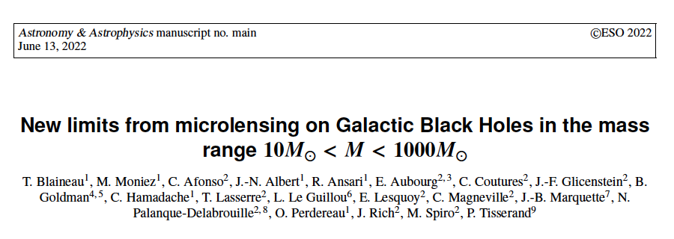

Slide 16
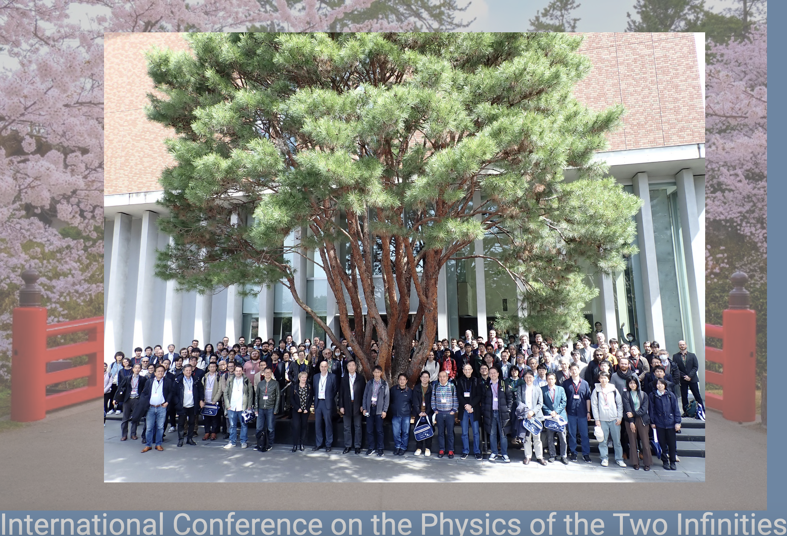
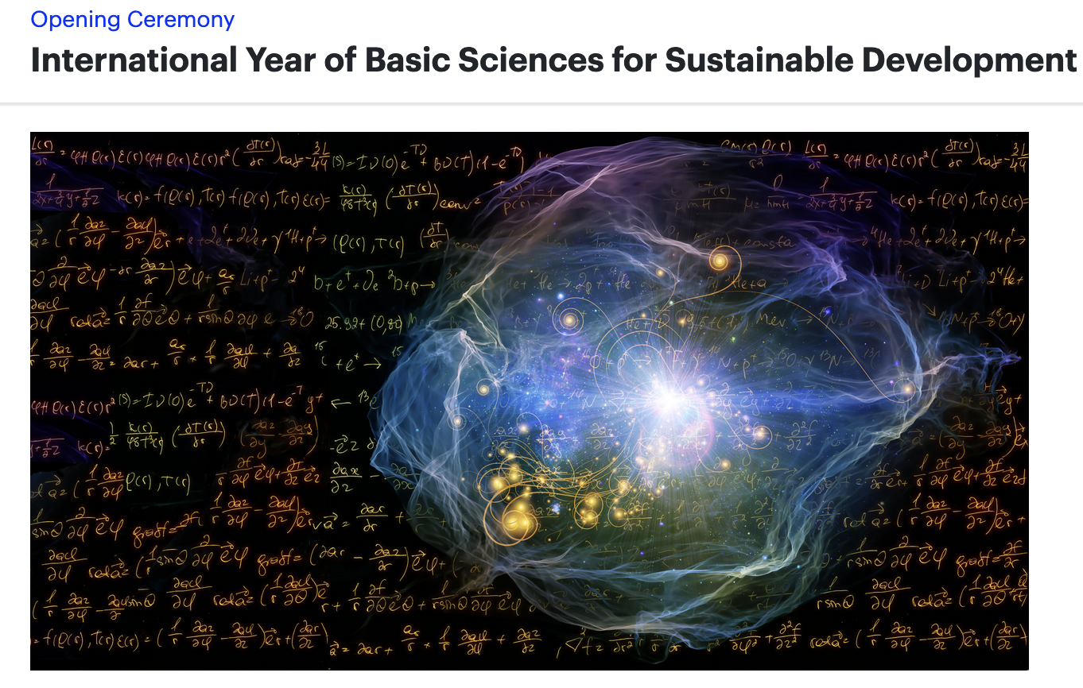
Physics of the two infinities are curiosity and inquiry driven. They re-enchant our world and contribute to make it worth to be sustainable. Physics of the two infinities
This is a great subject, a lively field, a bold community
(>100 expts, > ten thousands people)
It was a great conference, a great place and a great attendance
It resonates with philosophy
This conference will be part of IYBSSD 2022/2023
Basic Sciences explore the soul of the Universe

Slide 18
Thanks to Michel Gonin, Takaaki Kajita and Tsuyoshi Nakaya for having organized this conference.

