Slide 1
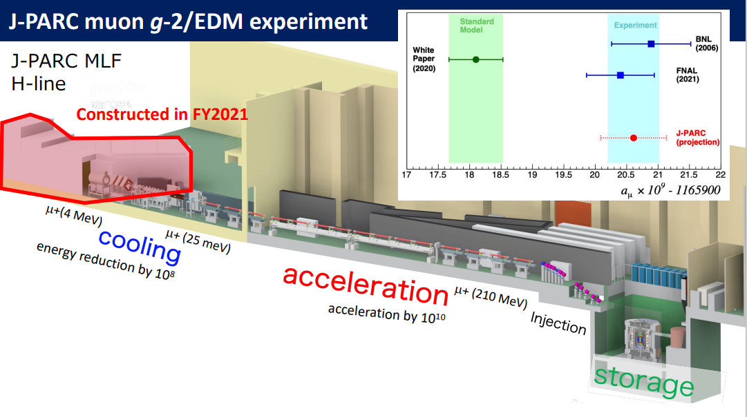

Status of
Physics motivation
Experimental method & three features
Current status of J-PARC muon g-2/EDM experiment
  3-D spiral injection and demonstration experiment
Schedule and summary
H.Iinuma (Ibaraki Univ.)
on behalf of the J-PARC muon g-2/EDM collaboration
@kyoto 2023

Slide 2
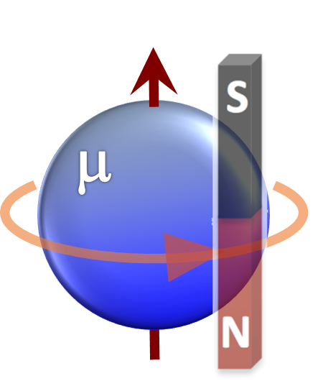
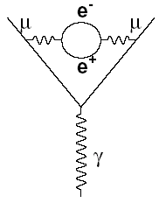
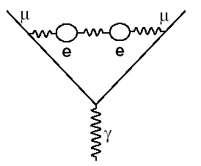
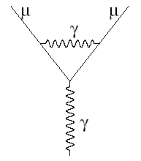
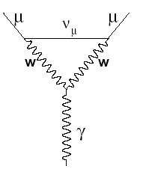
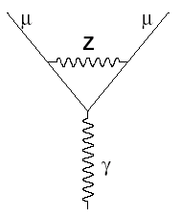
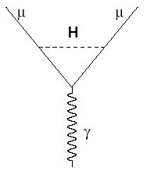
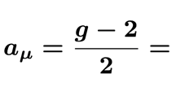
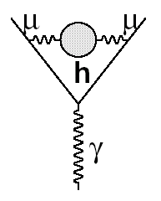
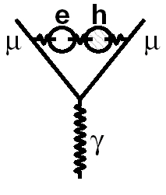
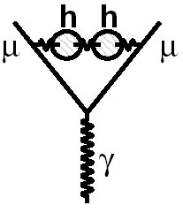
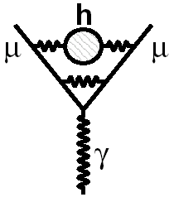
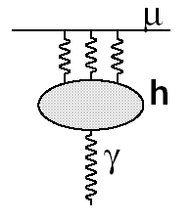

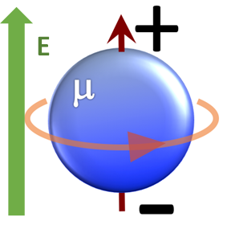
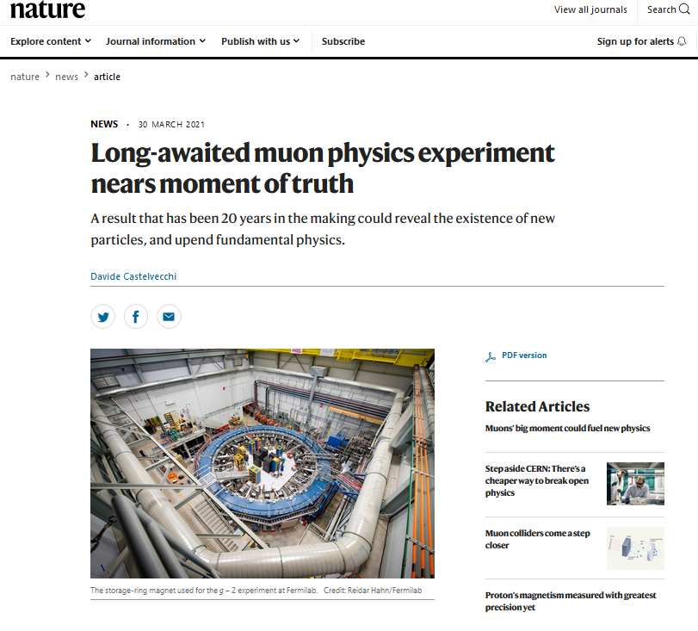
1.Physics motivation:
Muon spin presession tells what？
Anomalous magnetic moment
+?
Exp.
The.
Differ by 4.2 standard deviation
Electric Dipole Moment
https://www.nature.com/articles/d41586-021-00833-2
Direct evidence of new physics
2019年
2021 March
The SM ～ 2 x 10⁻³⁸ e･cm
Upper limit (E821) < 1.9 x 10⁻¹⁹ e･cm (90% CL)
米国
BNL E821, FNAL E989 (20年後)
FNAL E989’s first result consistent with BNL E821 (20 years ago)
Different view by independent experimental method does help to judge these questions.

Slide 3
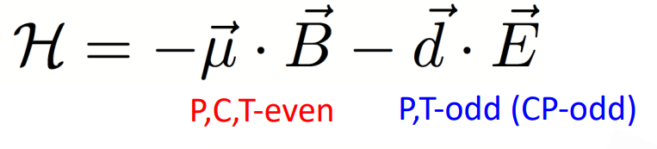
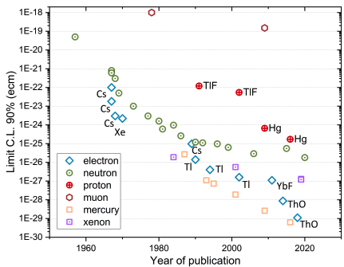
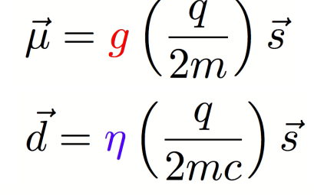
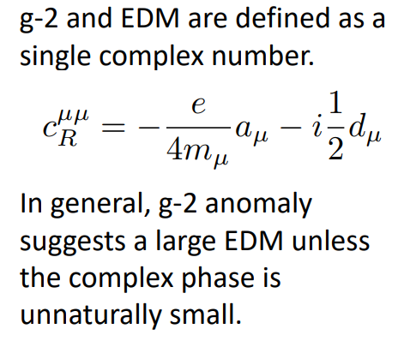
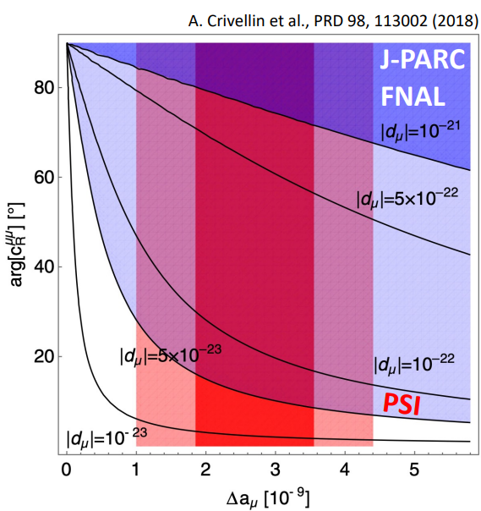
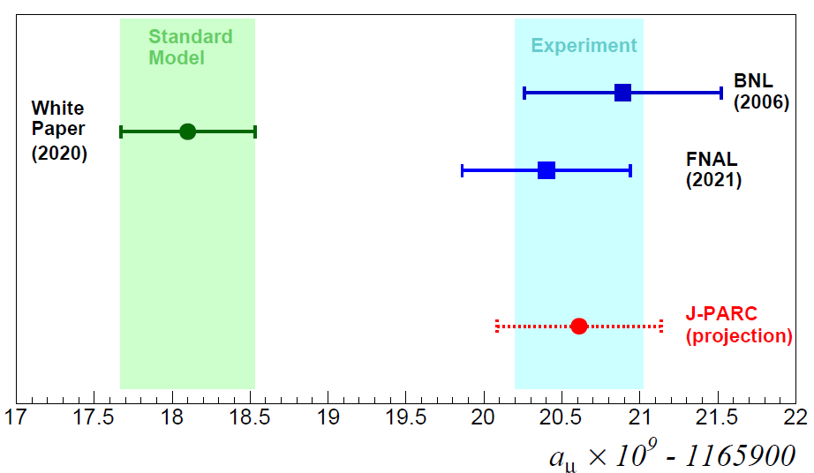
1.EDM($d_{μ}$) vs. $a_{μ}$ (model independent relation)
Muon
Muon

Slide 4
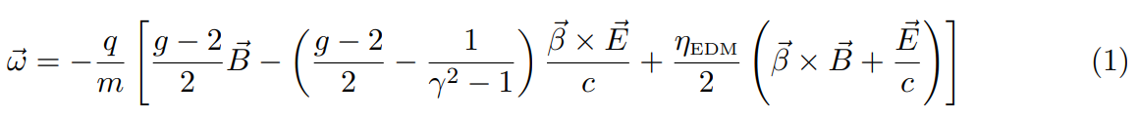
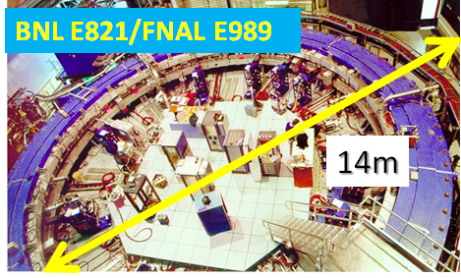
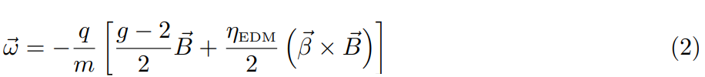
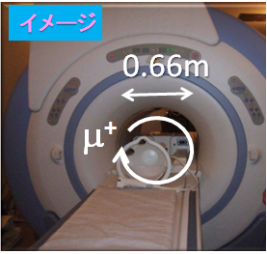
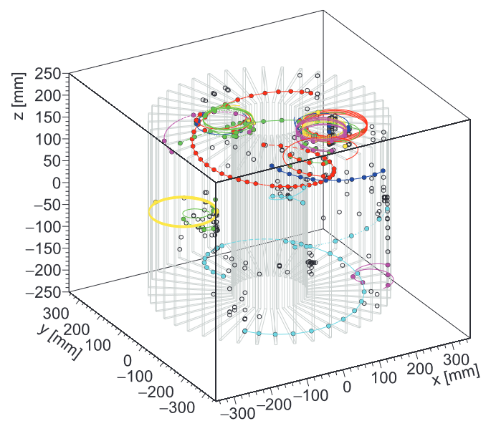
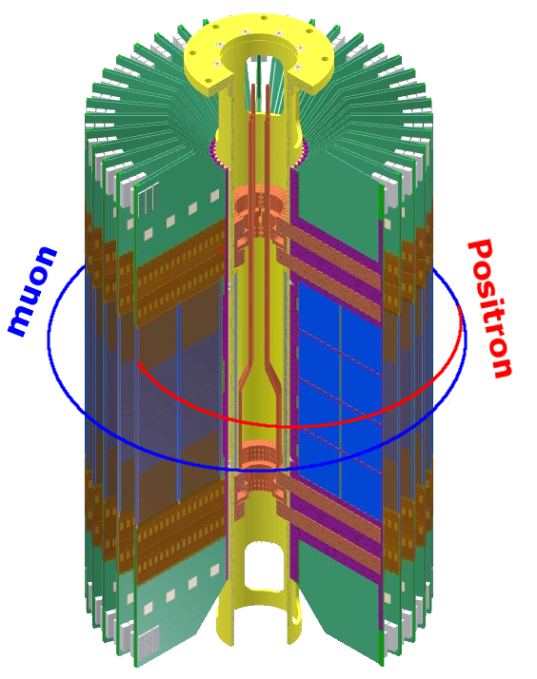
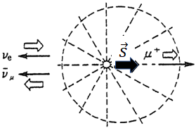

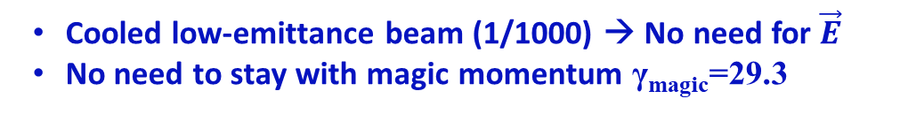




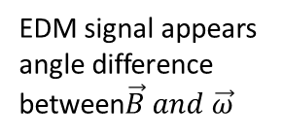


Experimental method & 3 features of new experiment ：
$\vec{E}=0$・$γ_{magic}$・sub-meter ring
B=1.45[T]
γmagic=29.3
Cooled low-emittance beam (1/1000) → No need for $\vec{E}$
No need to stay with magic momentum γ_{magic}=29.3
Storage beam in compact orbit diameter =0.66m (1/20)
Very precise control of stored beam
Good injection efficiency (>80%)
$$\vec{B}$$
$\vec{ω}={\vec{ω}}_{s}−$ ${\vec{ω}}_{c}$
EDM signal appears angle difference between$\vec{B} and \vec{ω}$
${\vec{ω}}_{s}$:spin motion
B=3[T]
γ=3
${\vec{ω}}_{c}$:cyclotron motion
Cyclotron orbit diameter 0.66m
Measure g-2 and EDM at a time, with the same setup but independently!
$$\vec{s}$$
$$\vec{β}$$
Spin vector
Beam momentum

Slide 5
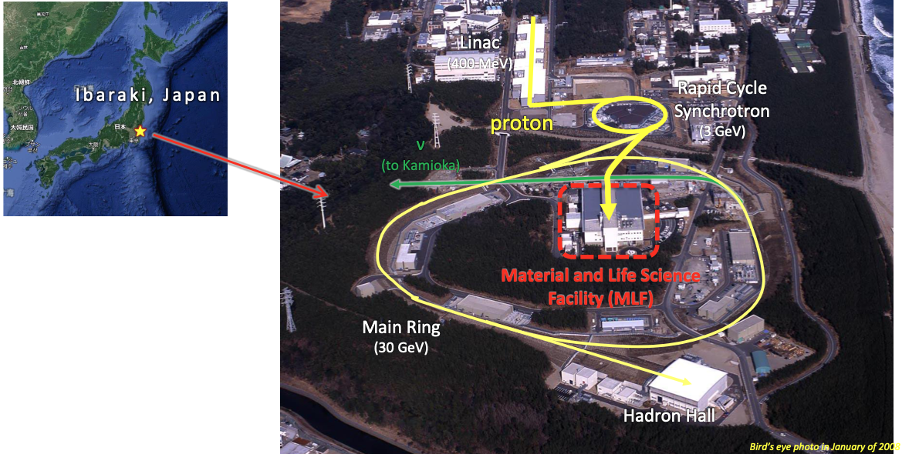
J-PARC MLF
Muon g-2/EDM
I live in Tokai-village, 15minuts from J-PARC by car
COMET
Next speaker

Slide 6
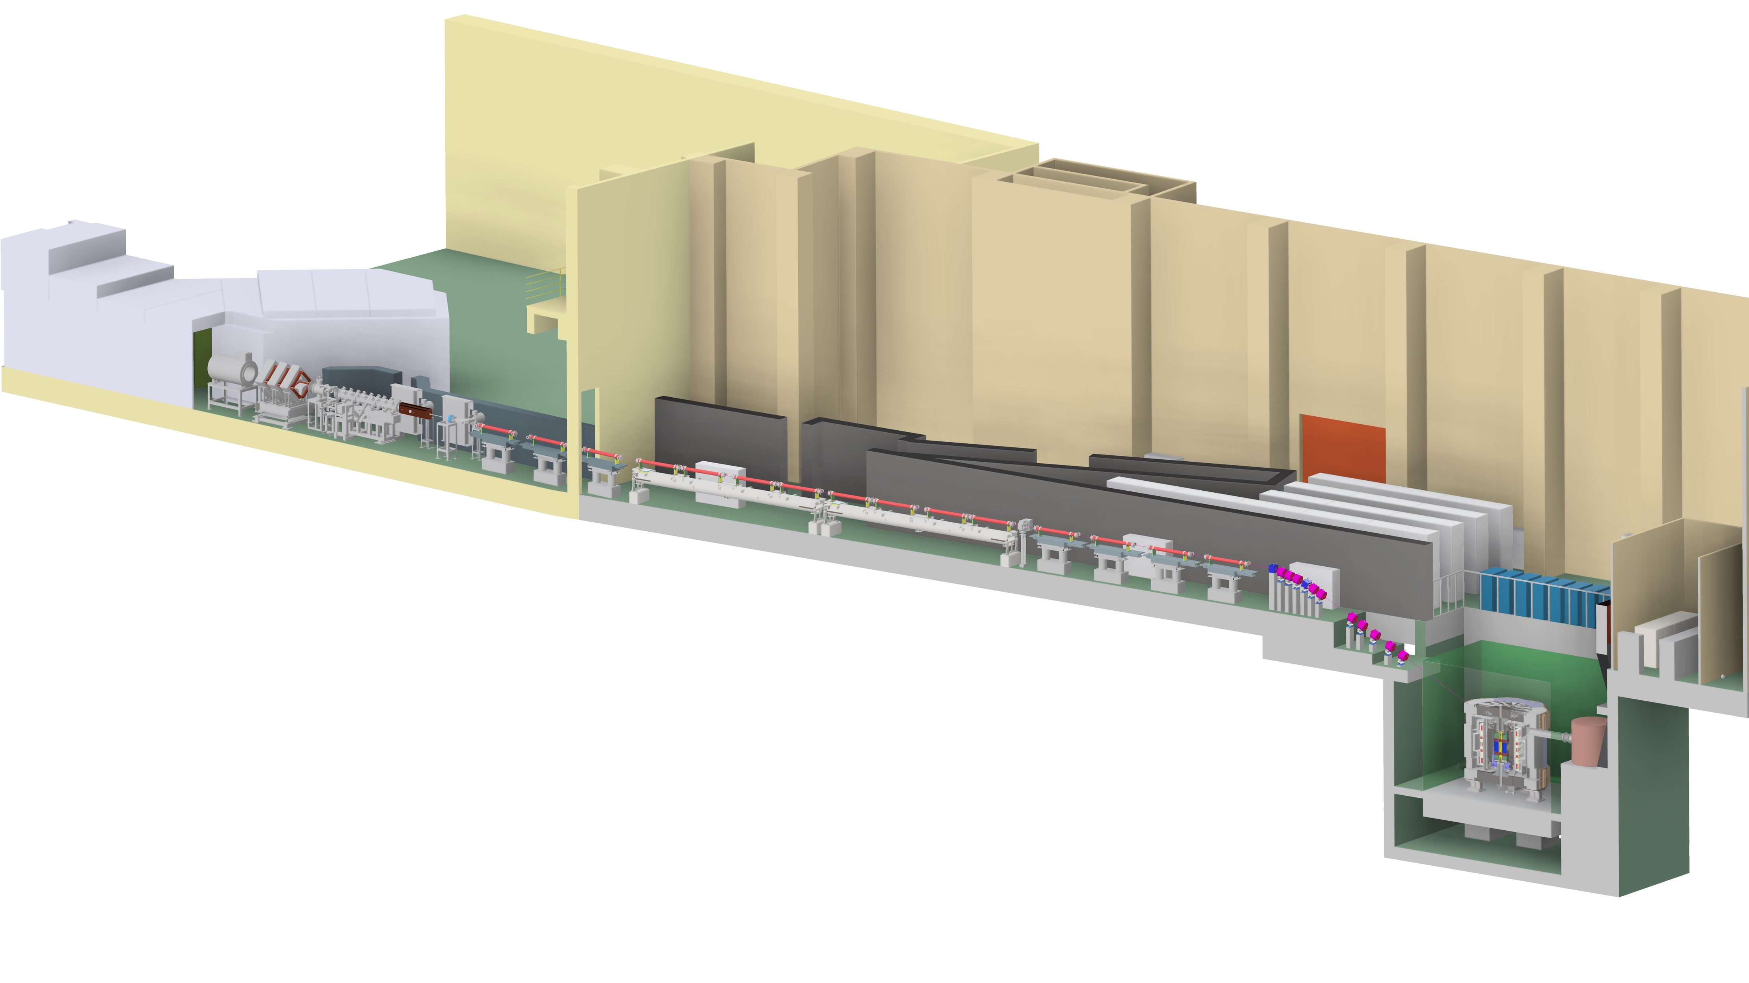
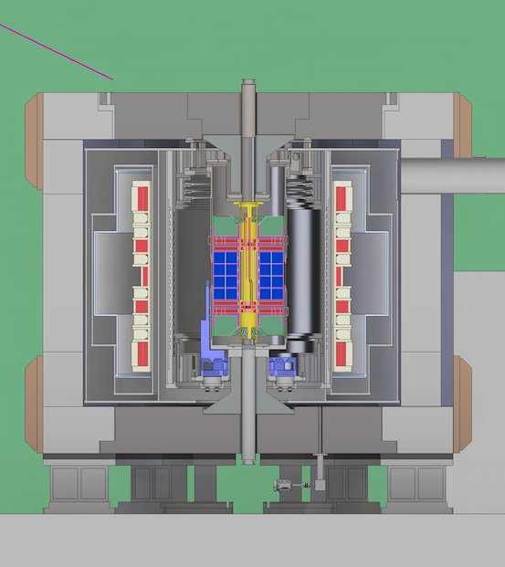

3. Current status of J-PARC muon g-2/EDM experiment
This experiment consists of six subsystems.
All of them are important to realize
this experiment.
Surface muon beam
Muon acceleration
Muon cooling
Muon cooling and re-acceleration
  J-PARC MLF Muon H-Line
Super high precision uniformity $\vec{B}$
  Apply medical MRI technology for our super conducting storage magnet
Muon beam Injection and storage in the super adjusted magnetic field
  3-D spiral injection
Measure spin precession${\vec{ω}}_{a},{\vec{ω}}_{EDM}$
  Minimize systematic uncertainty
Injection
Storage magnet
Zoom
Positron detector

Slide 7
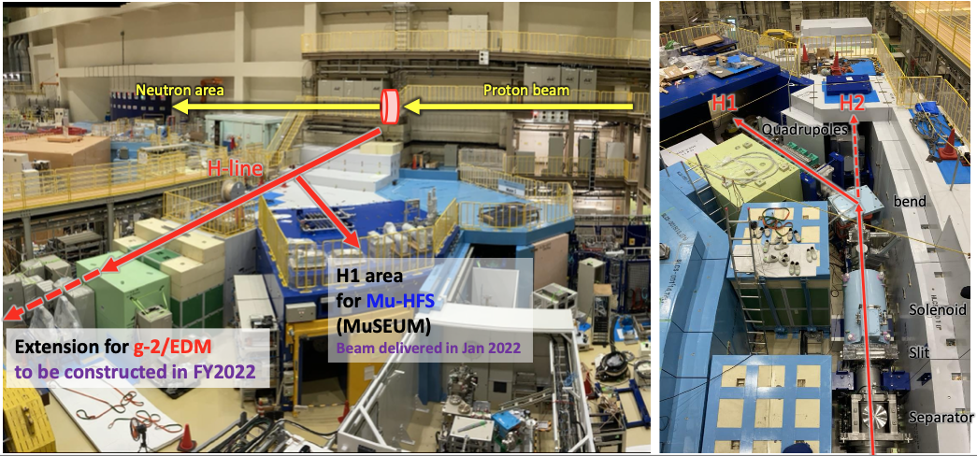
Surface μ⁺ beam
MLF H2 beam line.
  Surface μ⁺ beam: 4MeV, 10⁸ μ+/s with 25Hz rep
  Beam line extension inside the (existing) MLF bldg. in this fiscal year.
  Construction of extension bldg. is also ready.

Slide 8
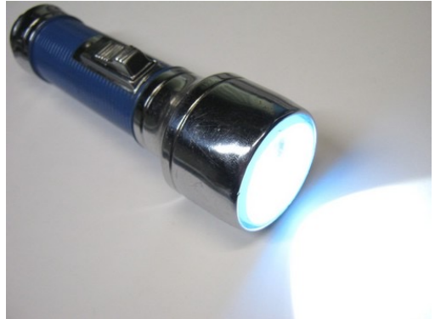
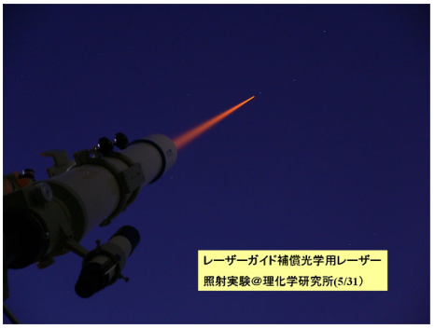
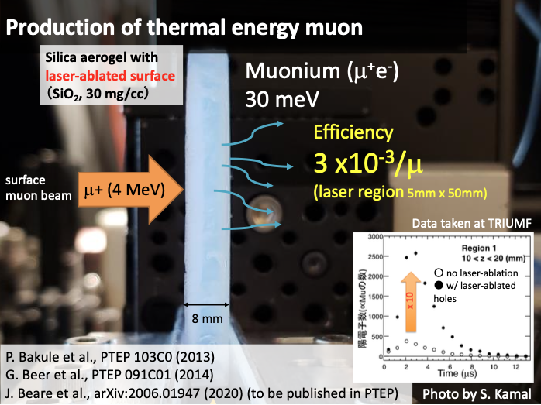
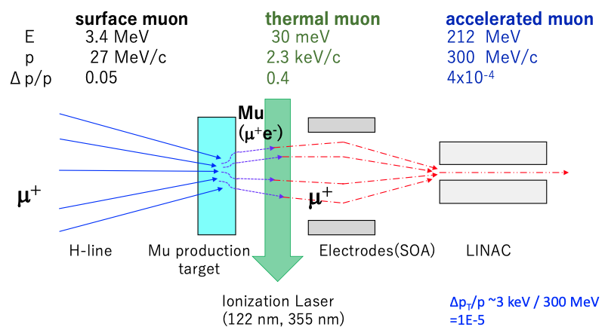
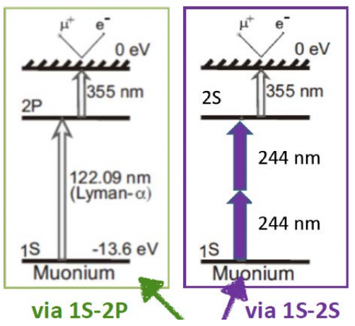
Muon cooling
Low emittance muon beam by reacceleration of thermal muon.
  Silica aerogel target : Surface muons stopped, and thermal muoniums emitted.
  Laser ablated aerogel to increase the efficiency.
Thermal muonium ionization by laser.
  Two scheme under consideration.
  1S-2P excitation by 122nm
  or 1S-2S excitation by 244nm

Slide 9
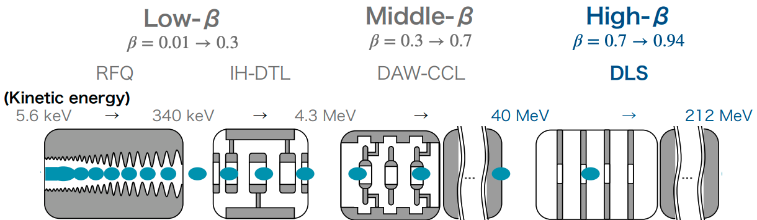
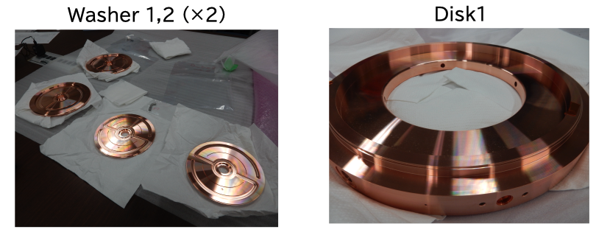
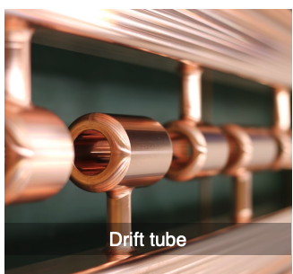
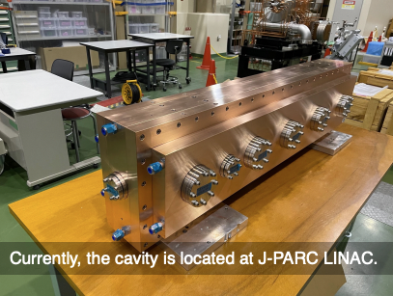
Muon acceleration
Muon reacceleration to 300MeV/c by muon LINAC.
  Series of 4 types of cavities depending on the muon β of each stage.
Acceleration test
with thermal μ
planned in 2023
Fabrication
completed
1st tank
under fabrication
Prototype fabrication
in JFY2022

Slide 10
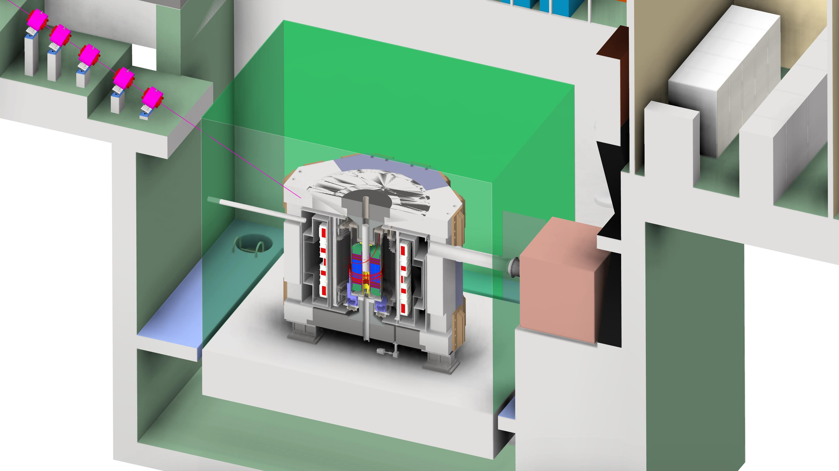
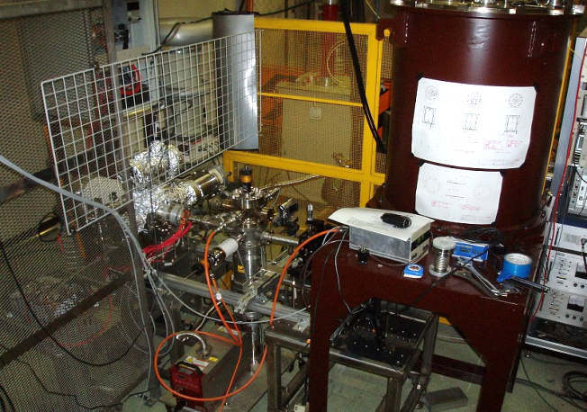
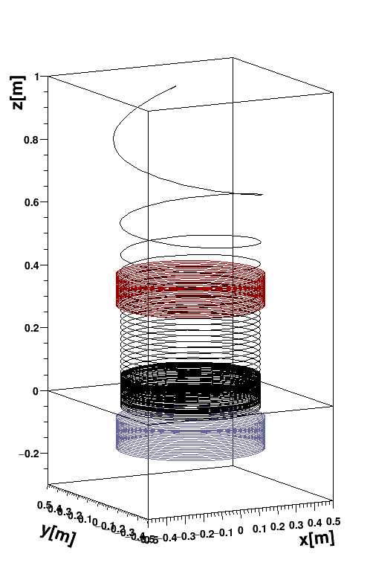
Beam injection and storage
Demonstration experiment @ KEK

Slide 11
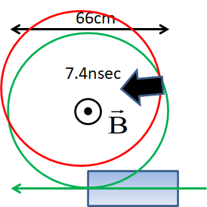
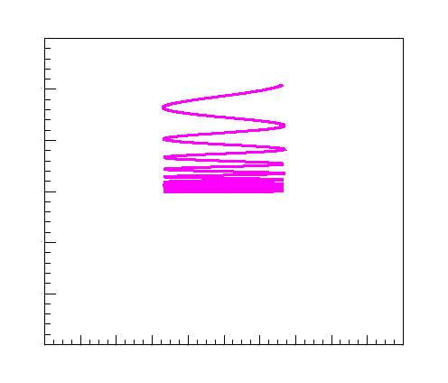





Kicker & Weak focus are important for 3-D spiral injection
11
Technical difficulties for compact 2-D injection:
3T is too high to cancel fringe field by inflector,
Required kick angle is too fast and big.
NIM.A 832 (2016) 51-62.
https://doi.org/10.1016/j.nima.2016.05.126
Utilize fringe field
Radial field B_{R} deflects beam direction and changes θ
B_{R}
θ
μ beam
$$z\left(t\right)=z_{0}sin\left(ωt\right)$$
$$ω^{2}=\frac{qcβB_{0}}{mρ}n$$
Vertical Harmonic motion in fiducial volume
Main solenoid coil
Z=0 plane
w
Kicker
w
Beauties：
Smooth connection between injection and storage sections
A unit of magnet does work for this method and decrease sources of error field
New idea and unprecedented scheme!
We need to demonstrate feasibility!
Radial field

Slide 12




Demonstration feasibility of 3-D spiral injection
80keV Electron beam (β=0.5), instead of muon, is adjusted “X-Y coupling”, injected into ϕ0.24m orbit.
Cyclotoron period is only 5nsec.
電子銃
DC 100kV
Learn how to control beam of “X-Y coupling”
Reflect studies on original experiment
Wakate B:2011～2013
Kiban-B:2014～2018
Kiban-Ａ2019～2022
Electron Gun
Electric
Deflector
Steering Coils
Collimator
Quad’s
Steering Coils
Bending
magnet1
2 m
Top view of wide-angle camera
12

Slide 13






Preliminary result of “stored” beam of 3-D spiral injection
13
DC beam with kicker coil
Injected beam (100ns width) is kicked and then we detected “stored signal” for few μs
Prompt signal from
injected beam
SciFi (above storage region)
Upper monitor
Very preliminary
PMT signal (mV)
Delayed signal from
stored electron
SciFi (storage region)
SciFi (below storage region)
Prompt signal from
injected beam
Lower monitor
Kicker
current (A)
Kicker current
Time from TRG (us)
https://www.ocha.ac.jp/danjo/op/ytp/20230221_yuasa.html
https://www2.kek.jp/kokusai/AIL/TYL/index.html

Slide 14






Super precisely adjusted $\vec{B}$
14
Design work of superconducting magnet for muon storage is ongoing applying medical MRI technology
Test bench with superconducting magnet (dedicate for Mu HFS)
April, 2015
<500ppb
[1] M. Abe, K. Shibata, “Consideration on Current and Coil Block Placements with Good Homogeneity for MRI Magnets using Truncated SVD”, IEEE Trans. Magn., vol. 49, no. 6, pp. 2873-2880, June. 2013.
[2]阿部充志 他、特許第４９０２７８７号、「MRI装置用磁場調整」、
平成24年１月13日登録、日本国特許庁
14

Slide 15



Positron Detector
Silicon detector for momentum measurement of decay positrons.
  Silicon strip sensor: Hamamatsu S13804, 190um pitch.
  High hit rate capability (6 tracks/ns) and stability over rate changes (1.4 MHz ~ 10 kHz)
  High efficiency for positron in the analysis window (p=200-270 MeV/c).
φ: 66 cm
Number of detected positron (p: 200-275 MeV)
Up-down asymmetry of detected positron

Slide 16



Positron detector is in production
Major components are in or completed the mass-productions.
Assembly procedure is under R&D.
Quarter-vane: submodule of detector
FPGA
board
FPC
silicon strip sensor
ASIC

Slide 17

Schedule
Physics data taking expected from JFY 2028.

Slide 18



Expected sensitivity
Total efficiency of muon
will be $1.3 × {10}^{−5}$.
Muon g-2
Statistical uncertainty: 450 ppb (2 years of data taking)
  Uncertainty comparable to BNL can be reached
Systematic uncertainty: less than 70 ppb.
Muon EDM
Statistical uncertainty: $1.5 × {10}^{−21} e∙cm$
Systematic uncertainty: $0.4 × {10}^{−21} e∙cm$
  mainly from detector mis-alignment

Slide 19



Summary
Muon g-2/EDM experiment at J-PARC aims to measure muon g-2/EDM by utilizing
  Low emittance muon beam stored by weak focusing magnetic field.→No need $\vec{E}$ focus
  Compact storage magnet with low momentum muon.→ No “magic” momentum
This will be an independent measurement from BNL/FNAL at different systematics.
All subsystem of this experiment are getting ready for realization.
  Some of them are already in “construction phase”.
Expected data taking from JFY 2028.
After 2 years of data taking,
  muon g-2 measurement at 450ppb(stat.) : comparable to BNL.
  muon EDM sensitivity at $1.5 × {10}^{−21} e∙cm$(stat.): 2 orders of magnitude improvement.
Many technical challenges we are facing,
but expecting new results from J-PARC!
The 25th collaboration meeting at Ibaraki University
2022December

Slide 21



Sensor alignment
Precise alignment between detector and B-field
is essential for muon EDM measurement.
  If rotated each other, “g-2 component” of spin
  precession comes into “EDM component”.
Goal of sensor alignment: 1um precision.
  Assembly procedure under development.
    sensor alignment jig under test
    sensor position/shape measurement by coordinate measuring machine.
  Precision of ~ 2um already achieved (near to the goal).
spin precession
by g-2
spin precession
by EDM
Sensor alignment jig
Glued position of each sensor (1st,2nd,3rd,4th)
Deviation from ideal (gray) position
sensor hold by vacuum chuck
Vertical shift/ tilt
Horizontal shift/ tilt
1 um

Slide 22


