Slide 1
Nuclear Emulsion in neutrino precise measurements.
Osamu Sato Nagoya University
For
B02 group in Grant-in-Aid for Scientific Research
on Innovation Areas
“Exploration of Particle Physics and Cosmology with Neutrinos”.

Slide 2
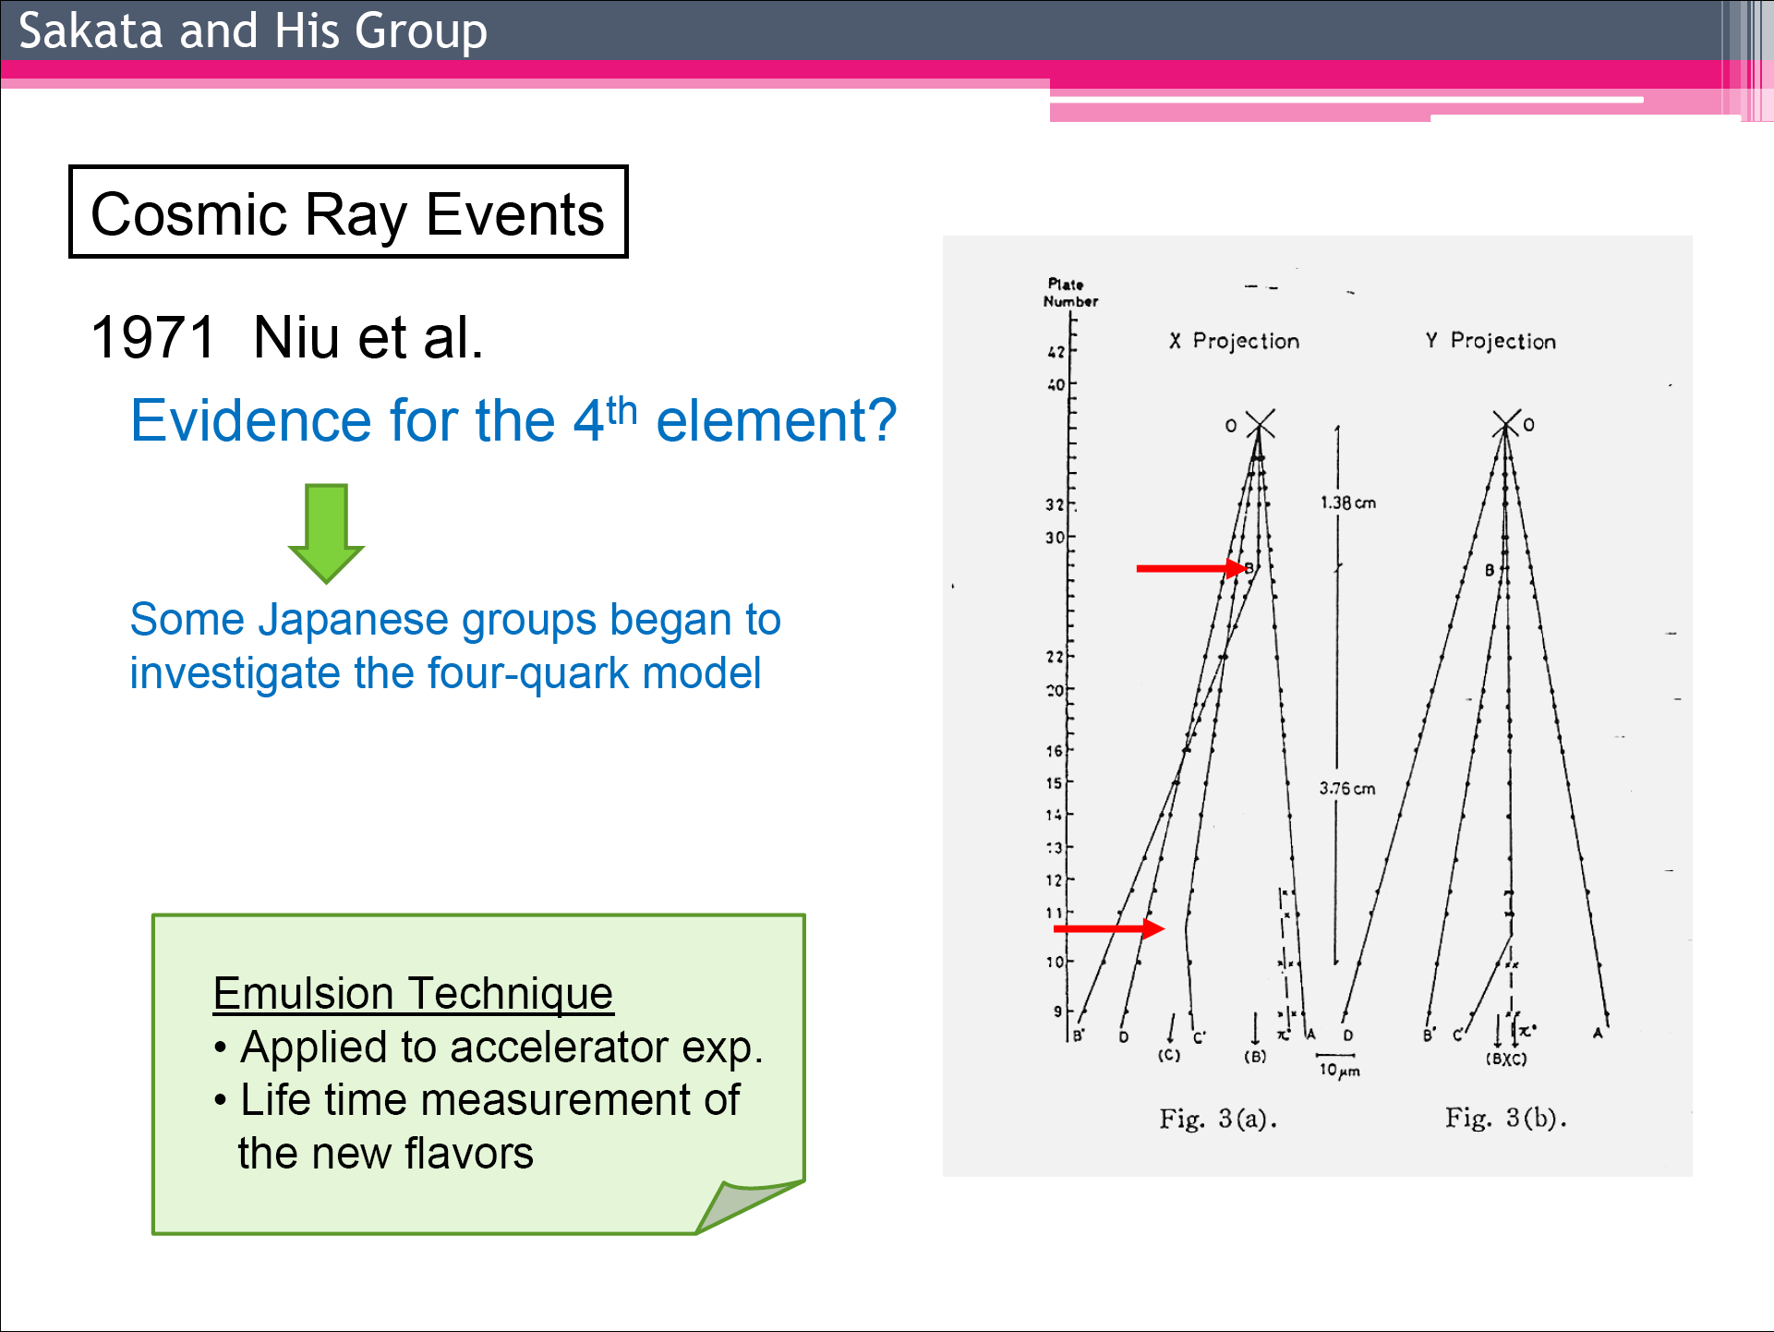
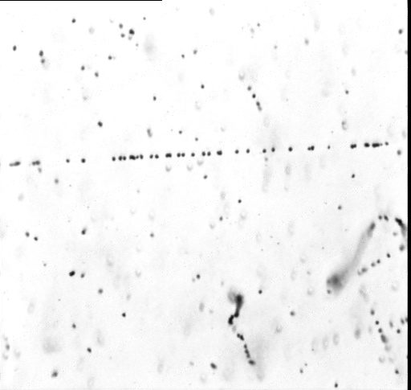
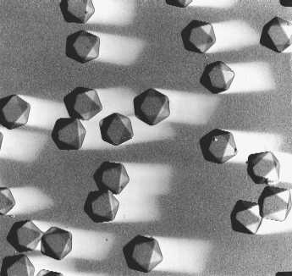

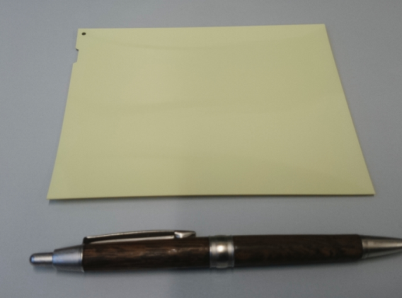
Nuclear Emulsion detector:
3D tracking device with 50 nm precision
10 GeV/c π
beam
Sensitivity 36 grains/100 μm
Charm particle (X particle) was detected by emulsion first.
20 μm
Camera
KOBAYASHI Makoto: Nobel Prize Lecture
Object lens
Emulsion film
Emulsion layer (44 μm)
Cross-sectional view
Plastic base (200 μm)
200 nm
Emulsion layer (44 μm)
AgBr crystal 10¹⁴ crystals in a film

Slide 3
Automatic Track recognizing microscope
Emulsion detector contributed to elementary particle physics.
While there was a big problem.
The readout of tracks was time consuming by human eye.
Majority of people gave up and use electronic detector.
Nagoya university pioneered the automatic tracking microscope from 1970 .
Continuous improvements, tack readout speed increased 100 times / 10 years.
The automatic track recognizing
microscope change the story.
Now experiments
with emulsion detector
become comparable scale
with other experiments.
Speed in cm²/h
1000m²/Year
4500
3m²
10000
100 Times faster by every 10 years
1000
100
72
10
1
1
0.1
0.082
0.01
0.003
0.001
TS(TTL)
NTS(CPLD)
UTS(FPGA)
SUTS(FPGA)
HTS(GPU)
HTSⅡ
1983 1994 1998 2006ｰ 2015～ 2022

Slide 4
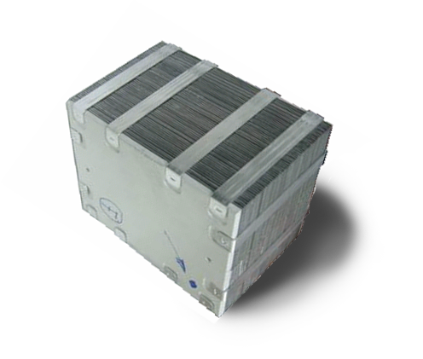
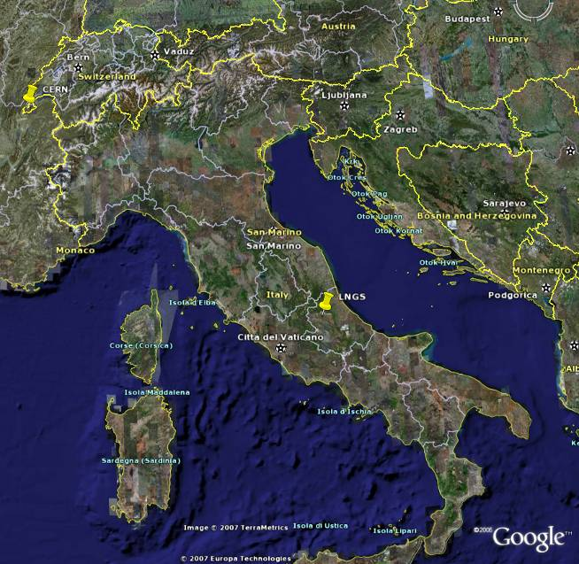
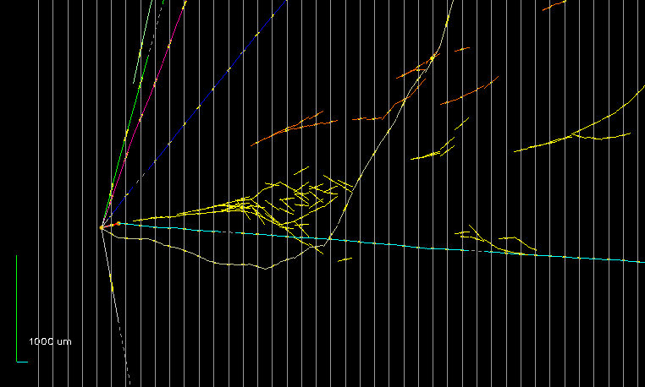
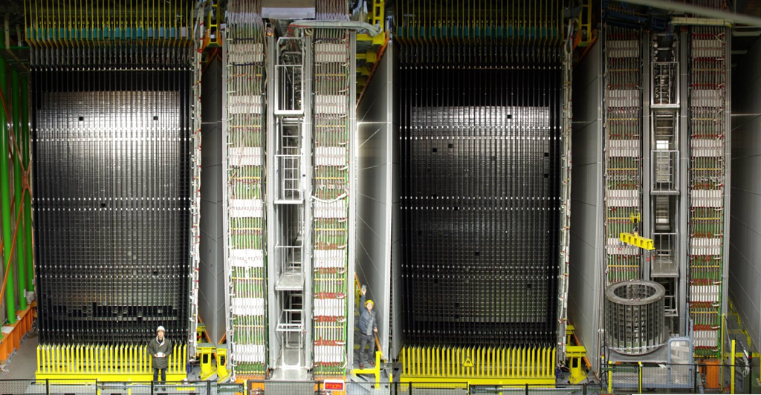
OPERA νμ◊ντ
OPERA Full detector 1250 tons 15000 ECC
τ
ν_{τ}
鉛
ECC
56 pb+ 57films
12.5 x 10 x7cm3 8kg
1mm
Emulsion
2008-2012
Pot = 17.96 10¹⁹
First ν_{τ} event in OPERA NEUTRINO2010
15万個のＥＣＣ 1250 トン
1300トンがニュートリノを待ち構える
Phys.Lett. B691 (2010) 138-145
7
730㎞
νμ−>ντ?
1
5
3
γ2
γ1
< Eν > ( GeV ) 17
(ν_{e} + ν_{e}) / ν_{μ} 0.89, 0.06 %
ν_{μ} / ν_{μ} 2.1 %
ν_{τ} prompt Negligible
2
8 daughter
6
τ⁻→ρ⁻ ν_{τ}
ρ⁻→π⁰ π⁻
π⁰ → γ γ
4
ECC 57 films 56 Pb
Notes:
4

Slide 5
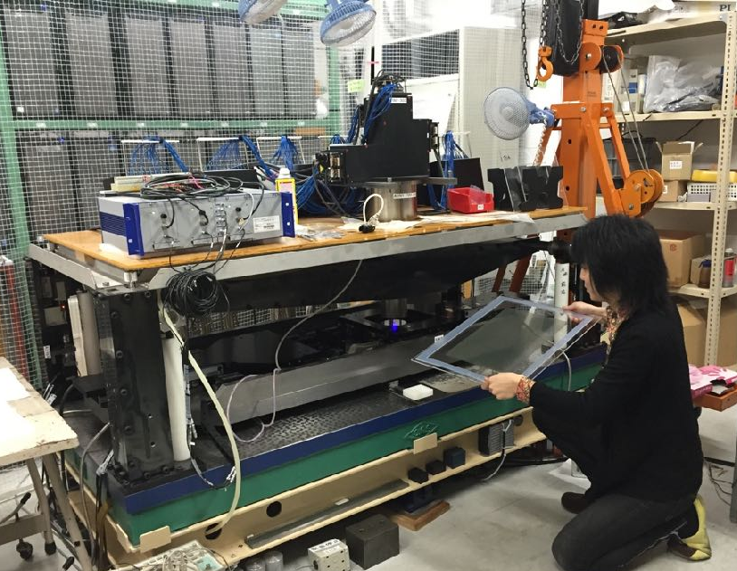
Evolution of Emulsion Scanning Speed
and Decline of Photographic Film Industry
Peak in 2000
Current system “HTS”
5000 cm²/h
1st event of
νμ→ντ
in OPERA
(total 10 events)
Discovery
of ντ
in DONUT
Emulsion scanning speed (cm²/h)
Global demand for color film* (relative)
Crisis for
future emulsion
experiments !!
1/10
in 10 years
→New system “HTS-Ⅱ” (developing)
will be 25000 cm²/h (x5 faster)
*data from FUJIFILM
We started the development and supply
of Nuclear Emulsion itself in our laboratory (2010–)

Slide 6
Subject other than track readout
A giant supplier of emulsion, FUJI Film reduced its production. (Digital camera era.)
Then Preparation of Enough emulsion films is subject to promote projects.
Our survival plan
Developing / constructing New Emulsion Production Facility in NAGOYA university.
Scale of a total nuclear emulsion area of several 100 m2 or 1000 m2.
First experiments we supplied or will supply soon the Emulsion films.
DsTau (NA65 CERN SPS), Study for tau neutrino flux. supplied for 2021(22) run
FASERν (LHC), Study of High Energy neutrino from the LHC. supplied for 2022 run
SND@LHC (LHC) , Study of High Energy neutrino from the LHC. supplied for 2022 run and
GRAINE Precise measurement of cosmic gamma rays supplied for 2023-Spring
Balloon flights in 2023 (NOW)
NINJA (J-PARC), Study of sub-GeV GeV neutrino interactions to be supplied 2023 run
Scan Pyramids Muon radiography for Pyramid Considered
Observation from multiple observation site for targets

Slide 7
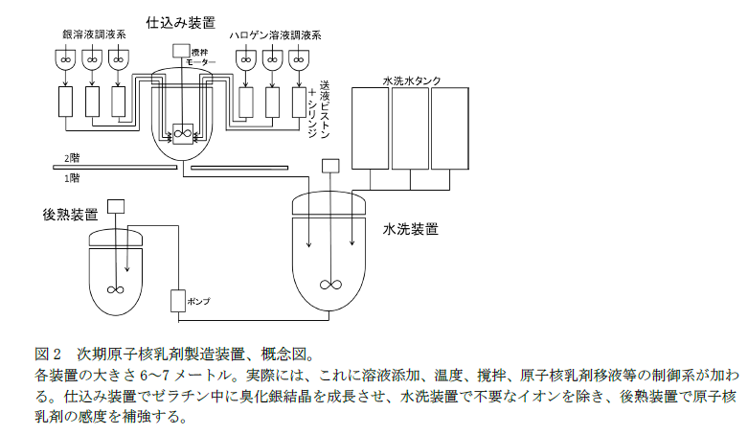
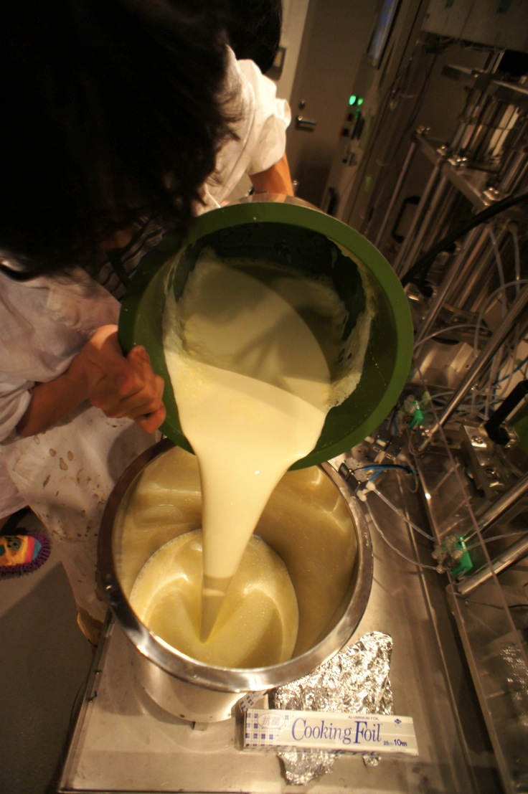

Install of 10 times large-scale
Gel Production Machine(3rd machine)
We
automatize
preparation,
liquid transfer,
washing, …etc
3rd
1st
2nd
4ℓ
12ℓ
120ℓ
New Machine enables the stable & long-term mass-production.

Slide 8
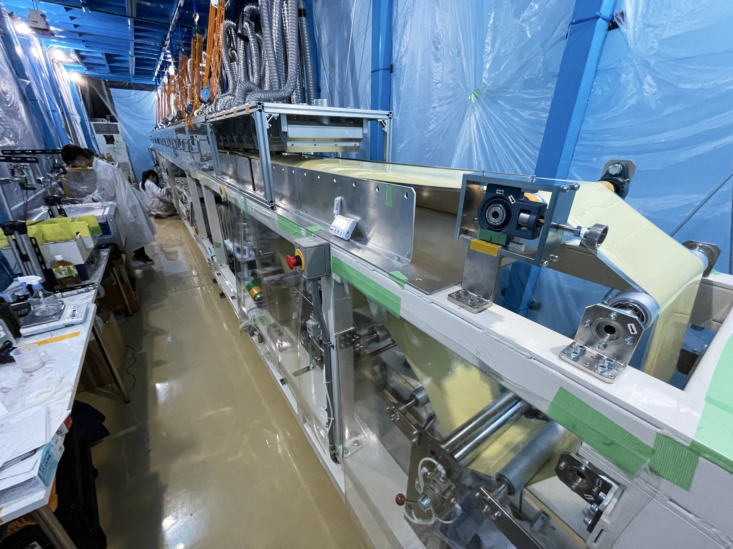
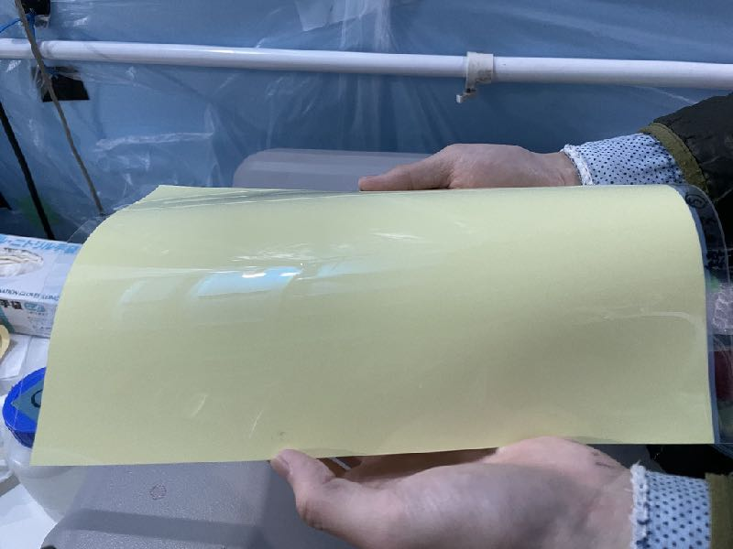
2019 Oct.– Start installation
2021 May.-
Roll-to-roll emulsion film coating facility
started practical operation
(Real production in the dark)
Drying
Coating
Winding
Melting
achieved production speed
of ~8 m²/day
Double-sided emulsion film
after two processes

Slide 9
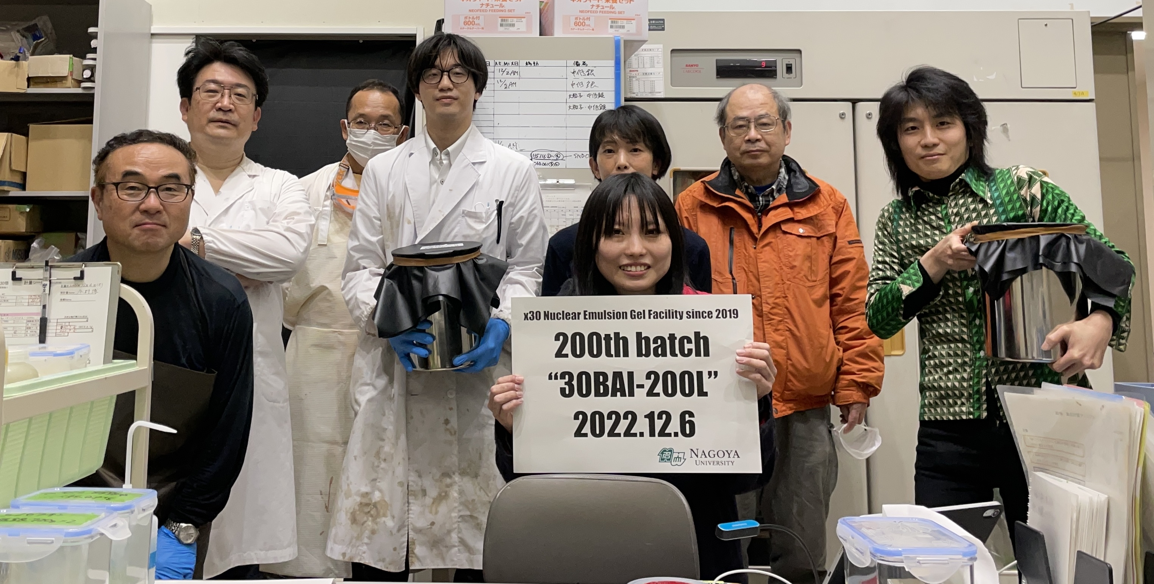
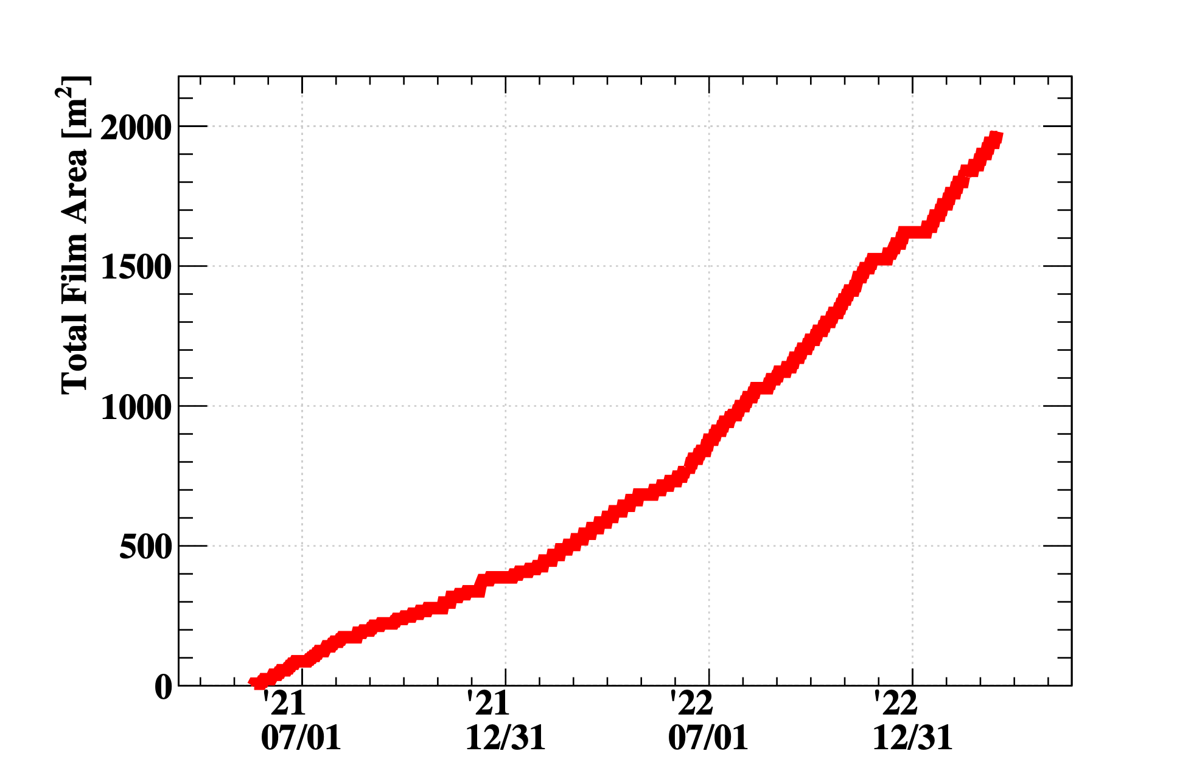
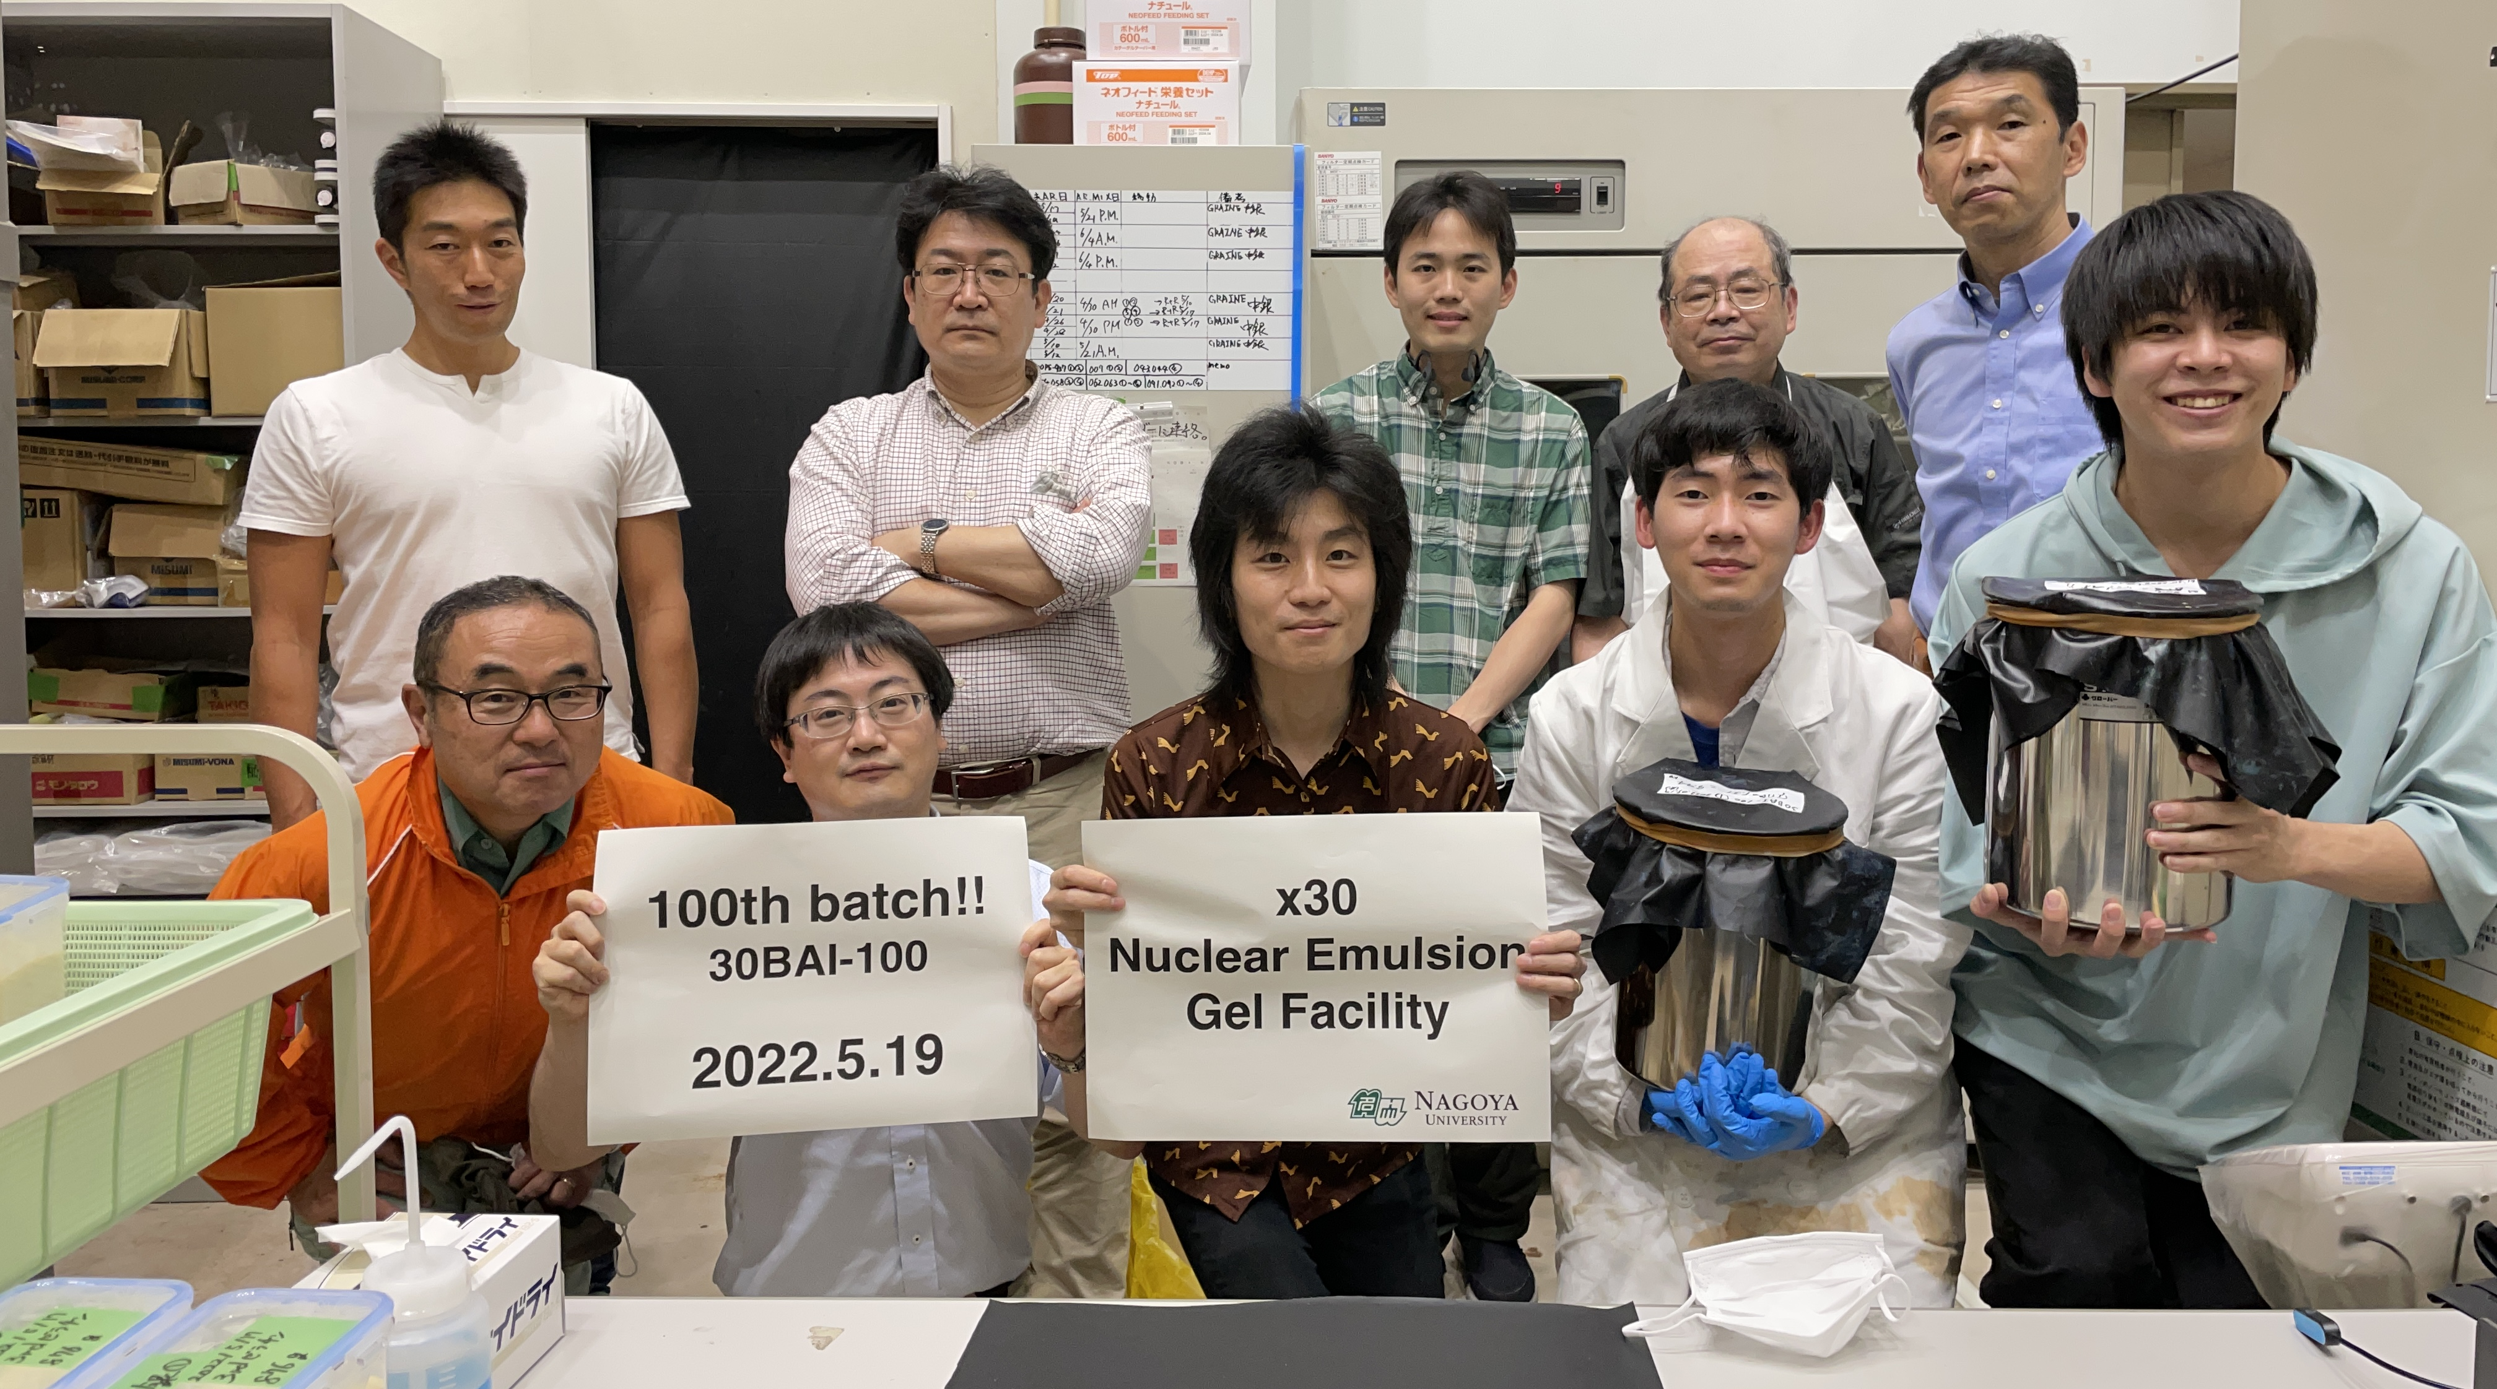
Result of
Mass Production
in the new facility
200th batch
1 batch ~2Bottle(8m2)
~125m²/month
(=1500m²/year)
Photo at 100th batch
2021/05
Start mass production
2021/07
2022/01
2022/07
2023/01
20230326

Slide 10
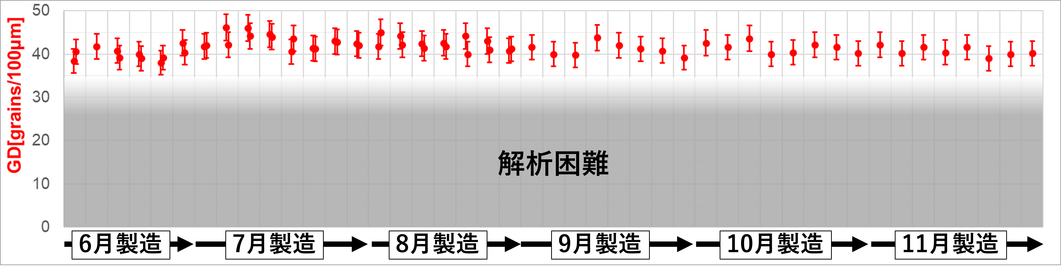
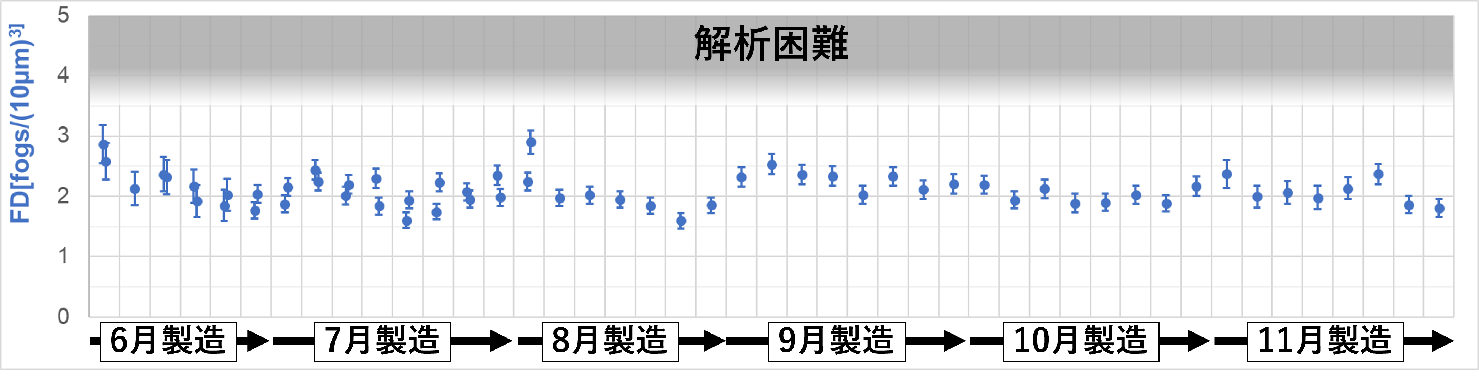
Performance of Films
Master thesis 2022(Usuda)
Signal: Grain Density
High is good
10 GeV/c π
beam
Sensitivity 36 grains/100 μm
NOISE: Fog Density
Low is good
20 μm
Stable quality of Grain Density and Fog Density at long production

Slide 11

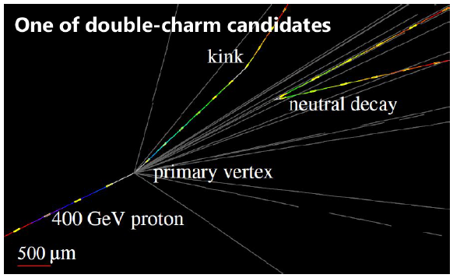
DsTau(CERN NA65)
DsTau web site
https://na65.web.cern.ch/
Physics Target
  Precise understanding of ντ production flux
    Measurement of differential (X_{F}, Pt) production cross section of Ds
  Reduction of tau neutrino nucleon cross section uncertainty 50% → 10%
    Update of tau neutrino cross section given by DONUT by new knowledge on tau neutrino flux.
    Inputs for future tau neutrino projects : SHiP ν_{τ}
  Byproduct study
    Charm production： forward production, 、 intrinsic charm ?
    Charm hadron’s interaction cross section measurement.
Tau neutrino production study principle
  Double kink decay topology + partner cham.
Physics run 2021-2023
Small kink angle(7mrad)
D_{s} → τ kink decay
D_{s}
ν_{τ}
Proton beam
X
τ
D⁺
ν_{τ}
X'
~5 mm
11
Notes:
1 mrad = 0.057 deg

Slide 12
FASER and SND@LHC

Slide 13

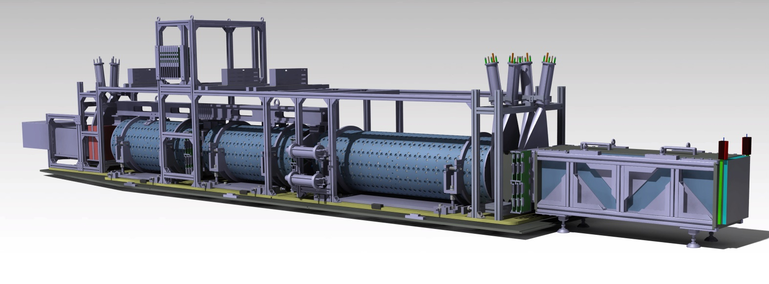
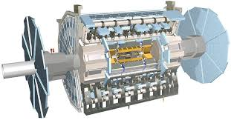
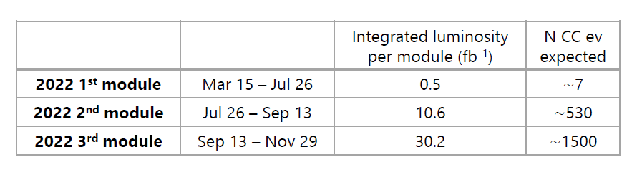

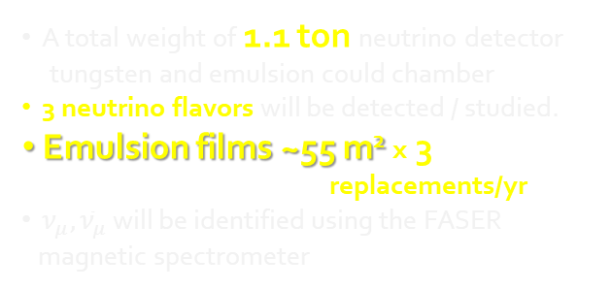

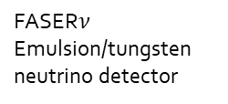

FASERν (ForwArd Search ExpeRiment):
neutrinos study in the currently unexplored TeV energy region
LHC Run 3 (2022-2025)
FASER spectrometer
FASER$ν$
Emulsion/tungsten
neutrino detector
480m from IP
Charged particles
Neutrino
beam
The main FASER detector was successfully installed in March 2021.
Interface tracker
LHC magnets
Veto
First electron neutrino
Candidate in FASER2022
A total weight of 1.1 ton neutrino detector
tungsten and emulsion could chamber
3 neutrino flavors will be detected / studied.
Emulsion films ~55 m² x 3
replacements/yr
$ν_{μ}, {\overline{ν}}_{μ}$ will be identified using the FASER
magnetic spectrometer
$$ν_{e}$$
$$e$$
$$ν_{μ}$$
$$μ$$
$$τ$$
$$ν_{τ}$$
Emulsion film
(precision tracker)
1 mm tungsten plate
(neutrino target)

Slide 14
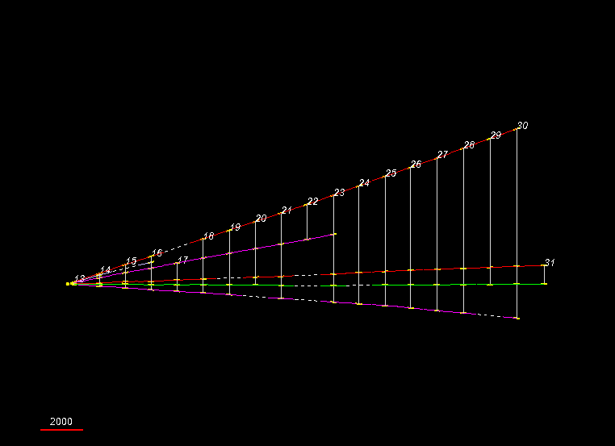
A neutral vertex in ECC
5 ECC walls 830kg, 44m2 emulsion total surface.
3 or 4 times replacements /yr. 4 times changes in 2022

Slide 15
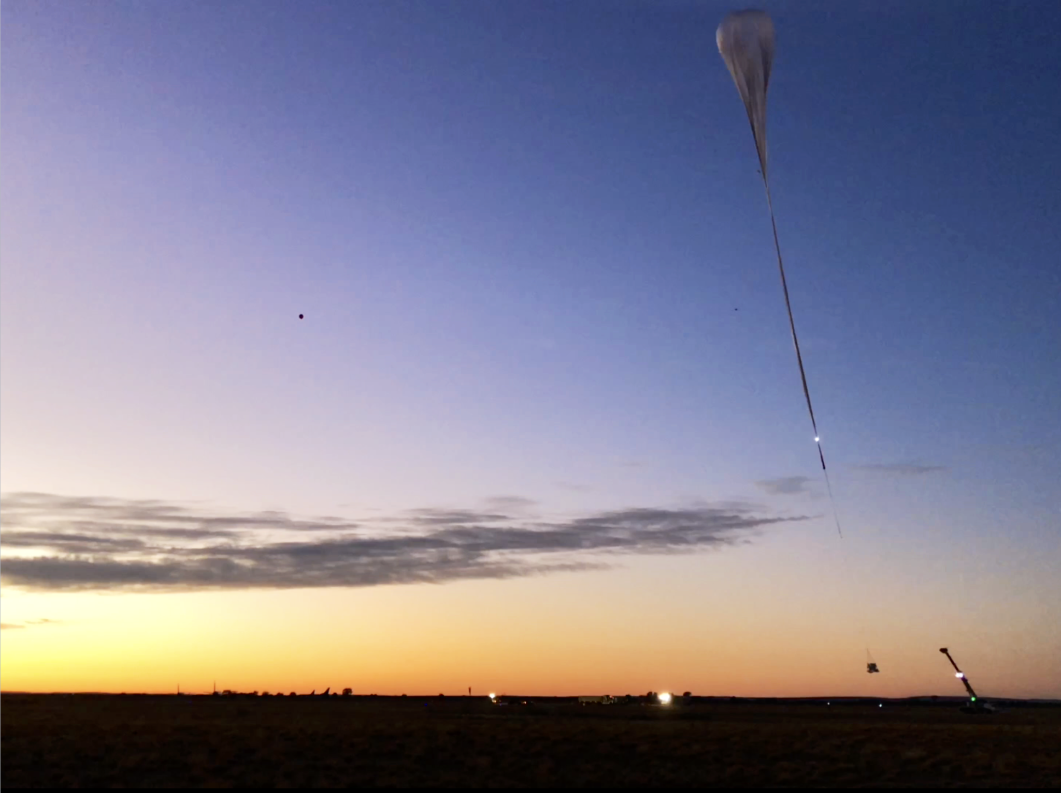
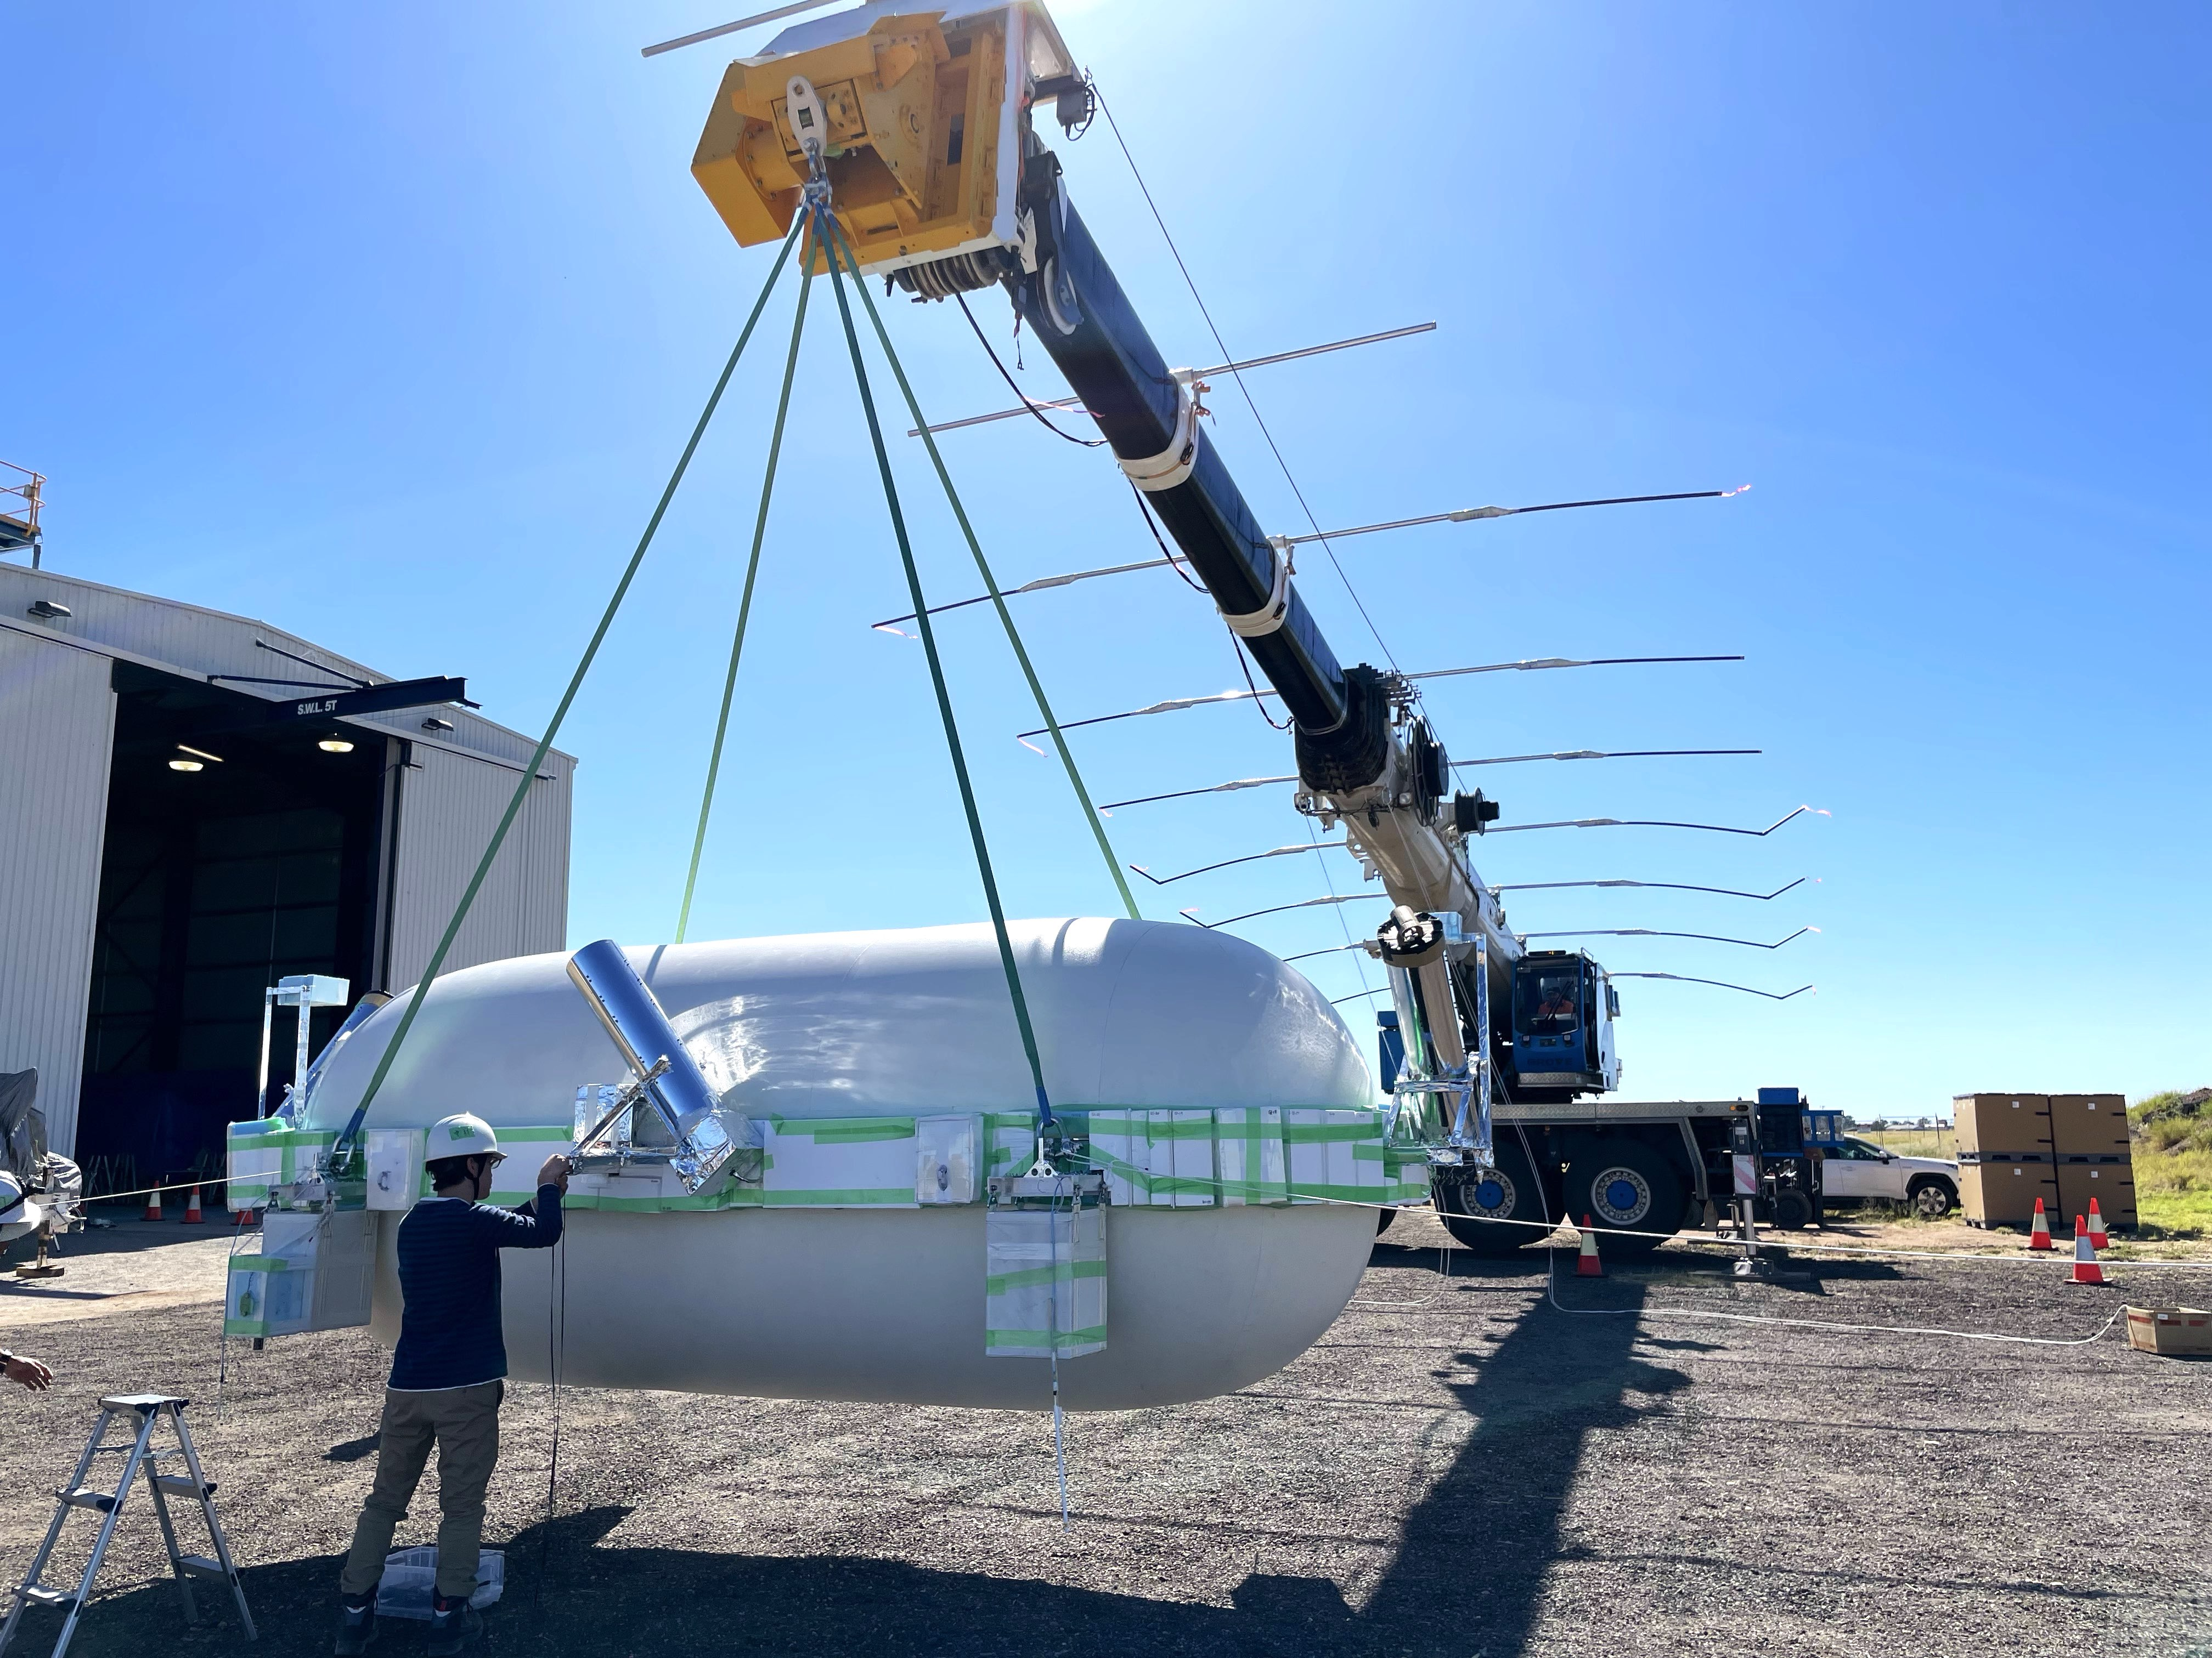
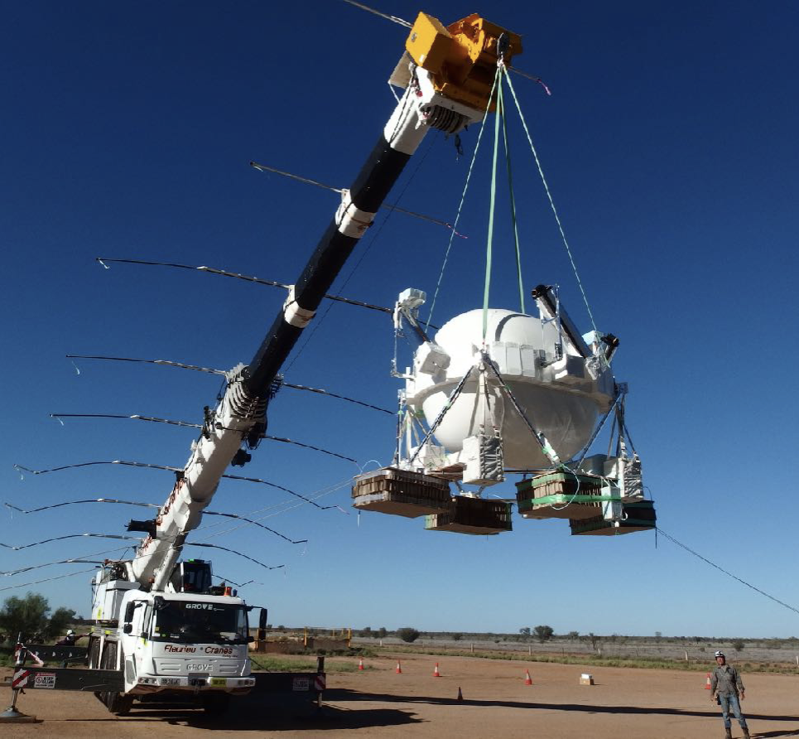
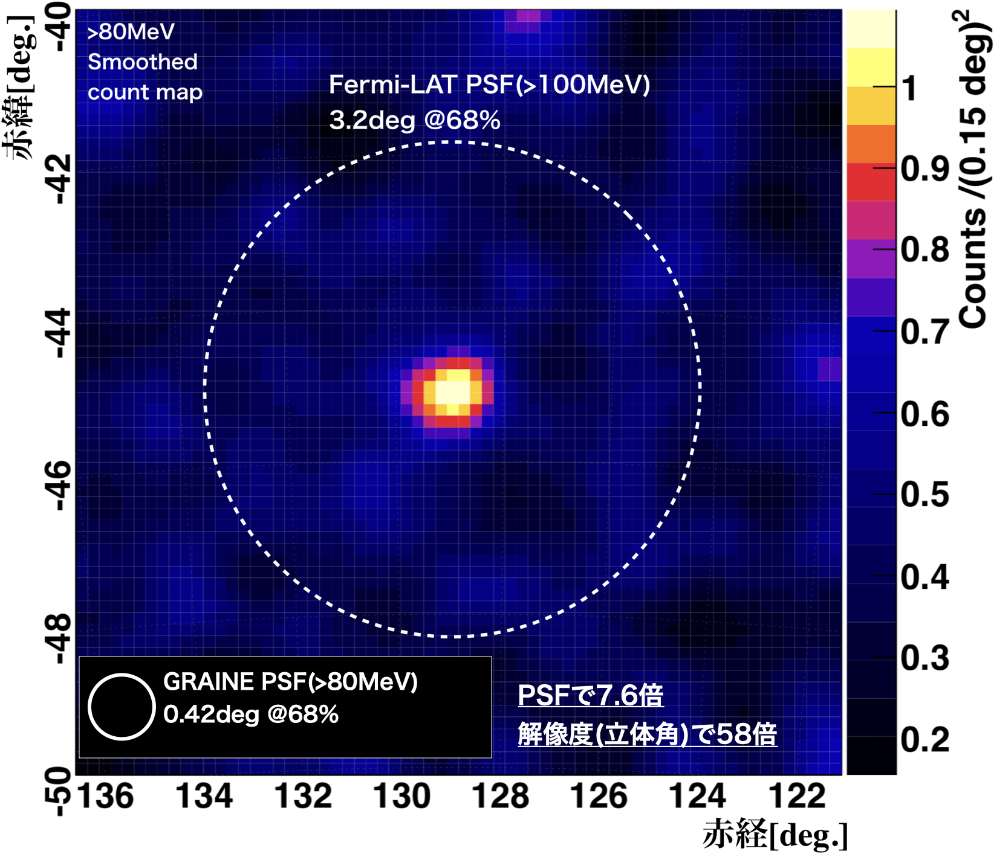
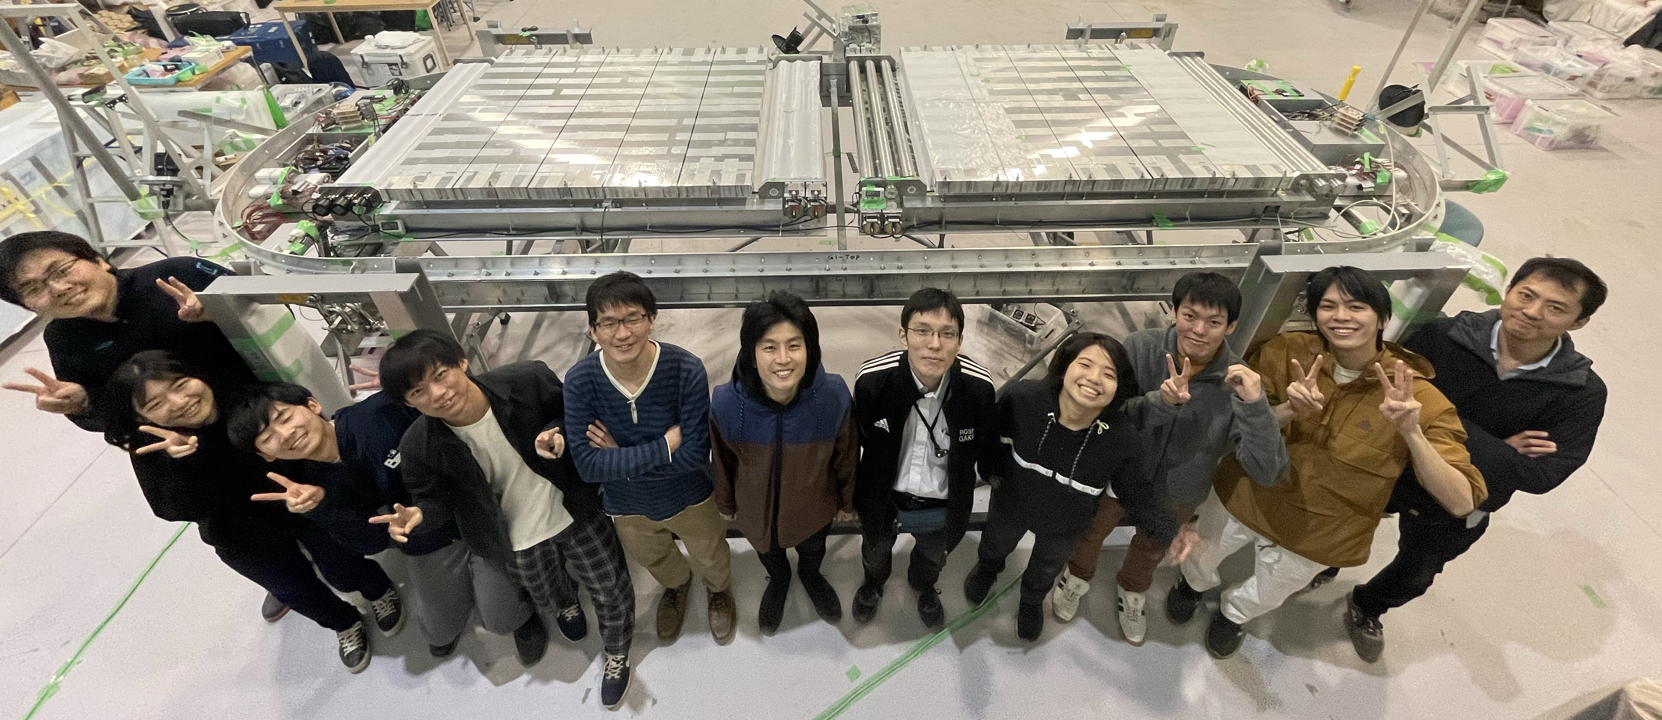
GRAINE Project
Cosmic γ-ray Observation in sub-GeV/GeV
using Balloon-borne Nuclear Emulsion Telescope
Dedicated talk
by S. Aoki
16:30- Today
GRAINE2018 Demonstrated
Detection of Vela pulsar
Highest Imaging (0.5°,>80MeV)
GRAINE2023 Starts
Scientific Observation
with Large-scale Telescope
≒GRAINE2018
x 6.5
  – High-res imaging of Vela in GeV region
  – Obs. of Gal. center
  – Survey for transient sources
Scientific
Balloon Launch
provided by
ISAS/JAXA
Almost Ready for launching !
Total surface of emulsion :250m²

Slide 16

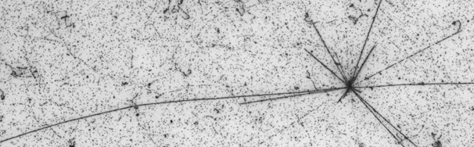
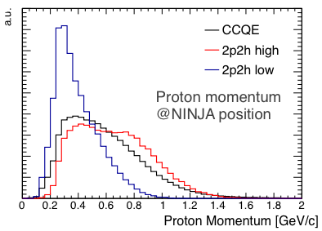
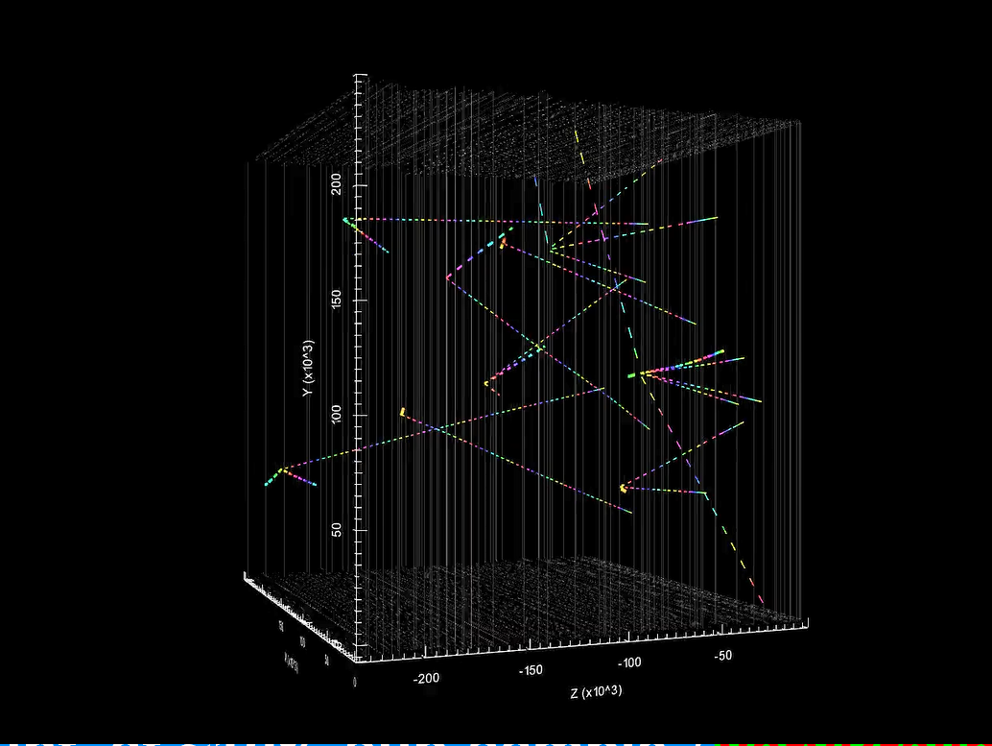
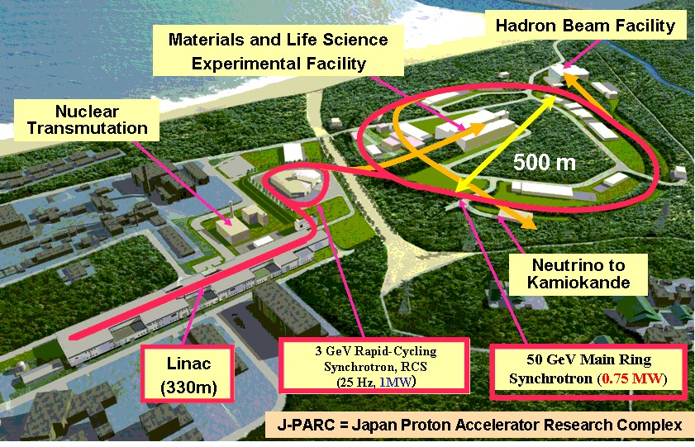

Neutrino Interaction research with Nuclear emulsion and J-PARC Accelerator
Precise measurement of neutrino-nucleus cross-sections in Sub-Multi GeV
Electron neutrino cross-section measurement
Sterile neutrino search
Plenary talk today (17:45-)
Proton momentum
Nuclear Emulsion
Difficult to study
10μｍ
Current detectors
A neutrino interaction in emulsion @J-PARC
Neutrino-water interactions

Slide 17

Summary of B02 Emulsion amount for
GRAINE
Installation / Beam exposure Year | NINJA Total Emulsion surface(m2) | DsTau Total Emulsion surface (m2) | FASERnu Total Emulsion surface (m2) | SND Total Emulsion surface (m2) | GRAINE Total Emulsion surface(m2)
2018 | 10 | 49 | 30 | 0 | 42
2019 | 120 | 0 | 0 | 0 | 0
2020 | 25 | 0 | 0 | 0 | 0
2021 | 0 | 110 | 0 | 0 | 0
2022 | 0 | 110 | 130 | 140 | 0
2023 | 250 | 200 | 180 | 176 | 250（500）
2024 | 400 |  | 180 | 176
2025 | 600 |  | 180 | 176
B02
Emulsion
B02 constructed a new emulsion production facility at Nagoya university.
Started supplying emulsions to REAL projects and producing physics results now !
Together with production, polishing emulsion quality and production process improvement is continued in order to increase the production power and reduce man power ..

Slide 18
Summary
Emulsion readout / analysis is not bottleneck now.
Giant supplier of emulsion, like FUJI, reducing production.
We decided to install large scale emulsion production facility in
Nagoya University and target production speed of several 100 m2 to 1000 m2.
Construction started 2019 and became good shape in 2020 and continue producing emulsion films through the years.
The coated and cut emulsion films supplied from 2021 for (DsTau) and 2022 for (DsTau, FASER, SND@LHC) and ready for (GRAINE) observation.
Currently producing gels for NINJA and DsTau, FASER, SND@LHC fotr2023 run.
Total supplied emulsion film (total surface)
2021 110 (DsTau)m2
2022 110(DsTau)+ 130(FASER) + 140(SND)m2
The supplied amount of emulsion is nearly reached to original plan.
Now it start producing preliminary but good physics results.
We continue producing emulsion films for next experiments ..

Slide 19
backups

Slide 20
Use of NAGOYA Emulsions
γ
Next-generation
scanning speed
10000
μ
Gamma-ray Telescope
Muon Radiography
1000
R&D
Dark Matter
Search
Use of Film [m²/Year]
100
NINJA
ENPHATIC
ν
10
DsTau
1
FASERν
SND/SHiP
2010
2014
2019
2023
1st machine
(x1 scale)
2nd machine
(x3 scale)
3rd machine
(x30 scale)
& Coating machine
2010- Install & development started
2013- Supplied self-controlled films to real experiments.
2014- New projects launched. Successfully achieved good results.
2019- All projects plan to expand the scale of experiment

Slide 21
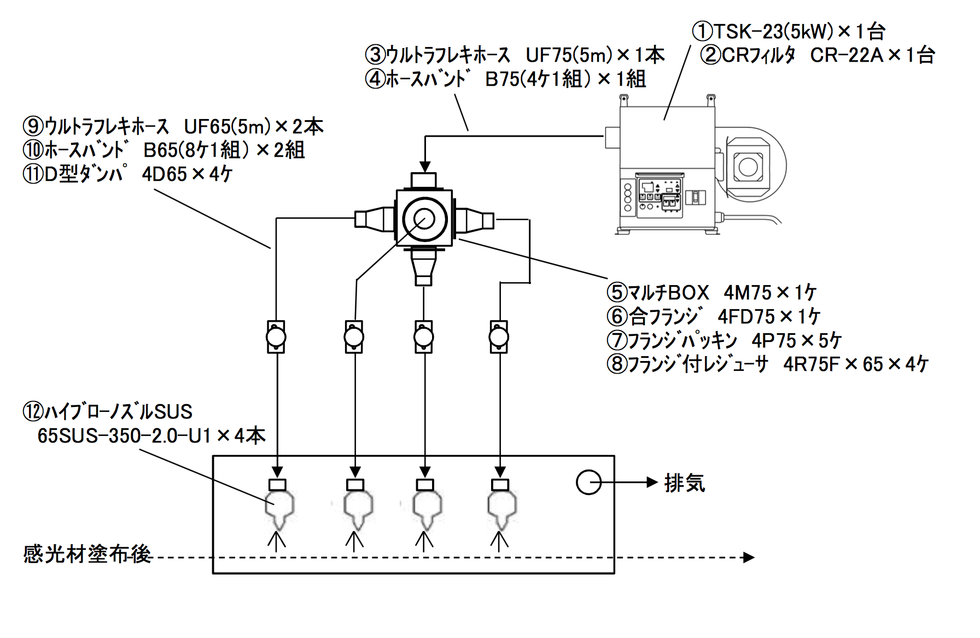
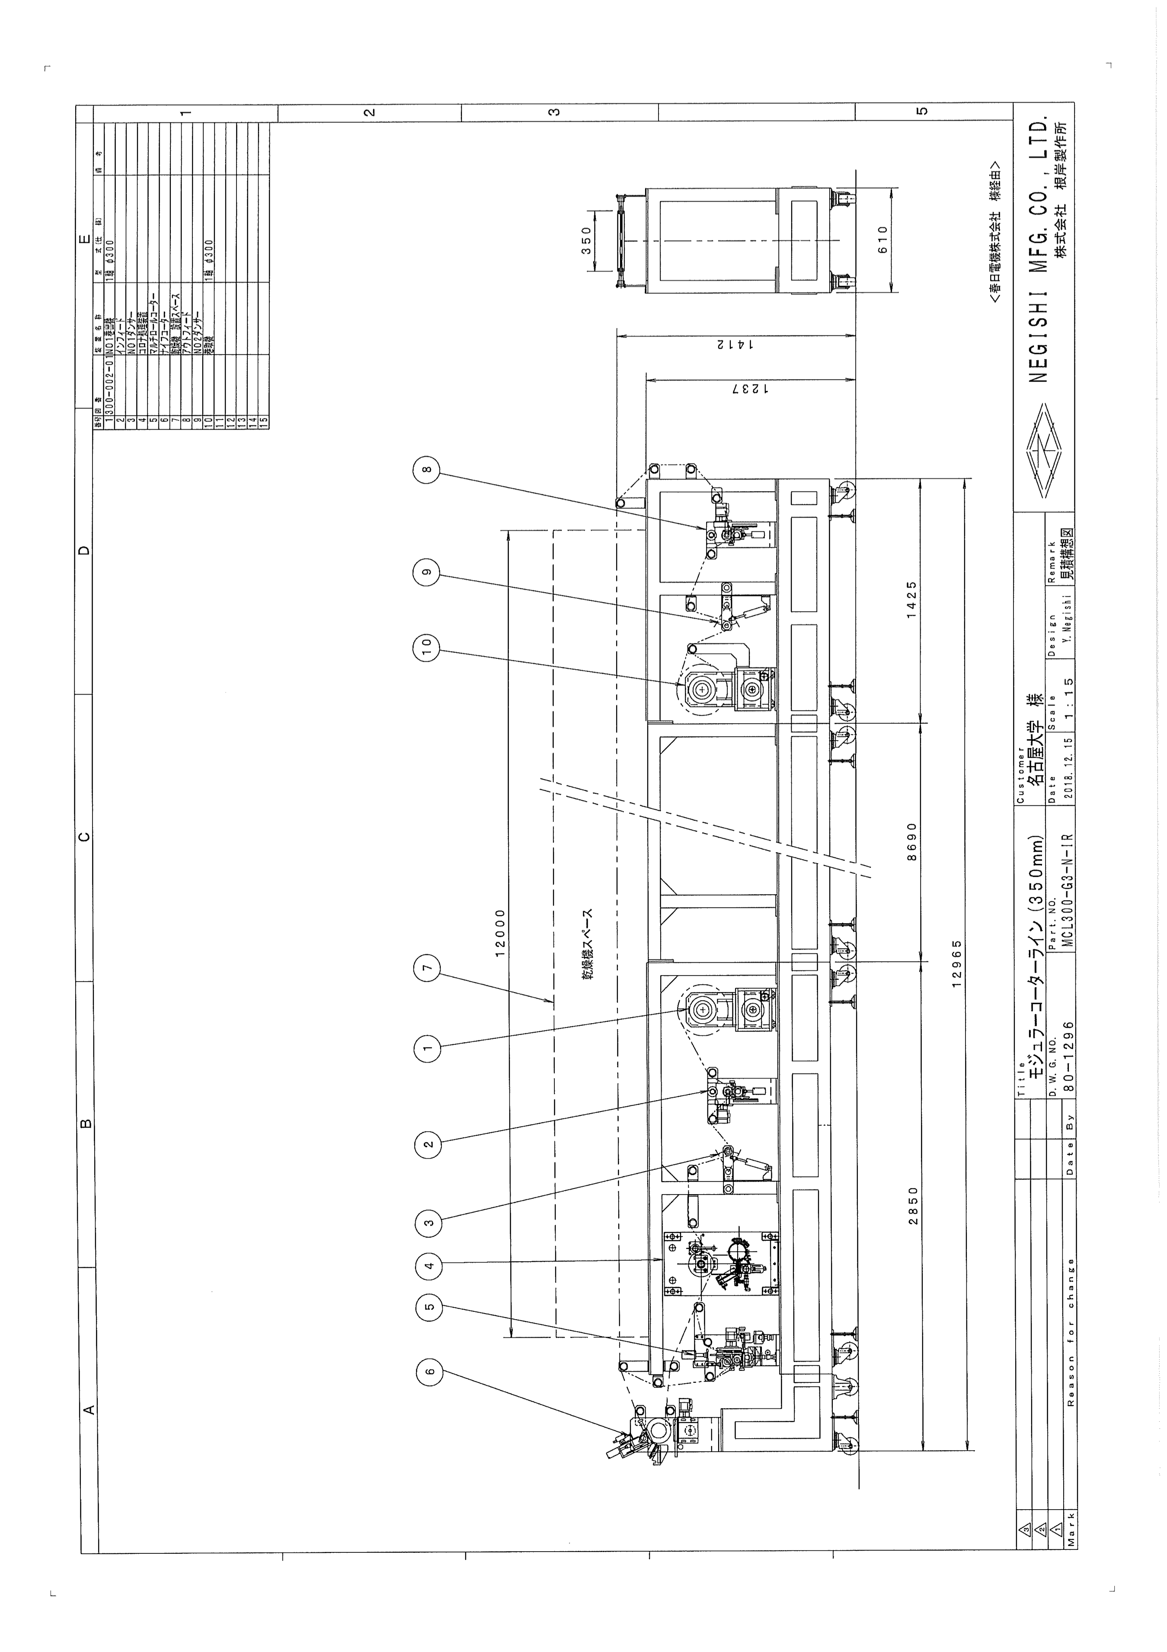

Emulsion Coating facility
“Roll-to-Roll
Coater”
乾燥10m
乾燥
乾燥
13 m
> 1000 m²/y is possible by this facility!!

Slide 22
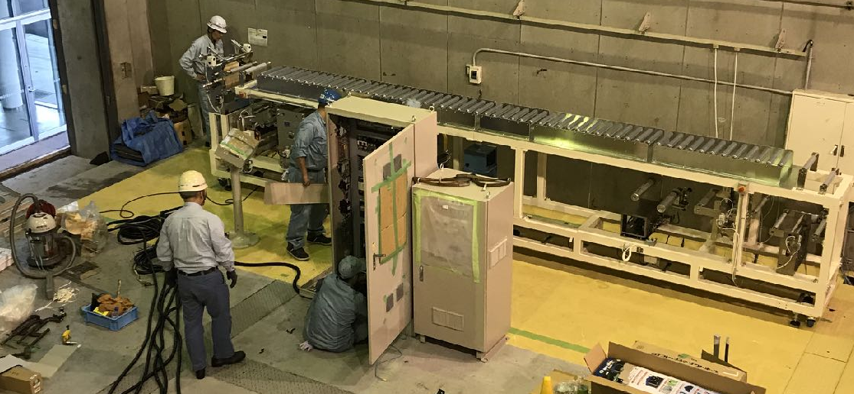
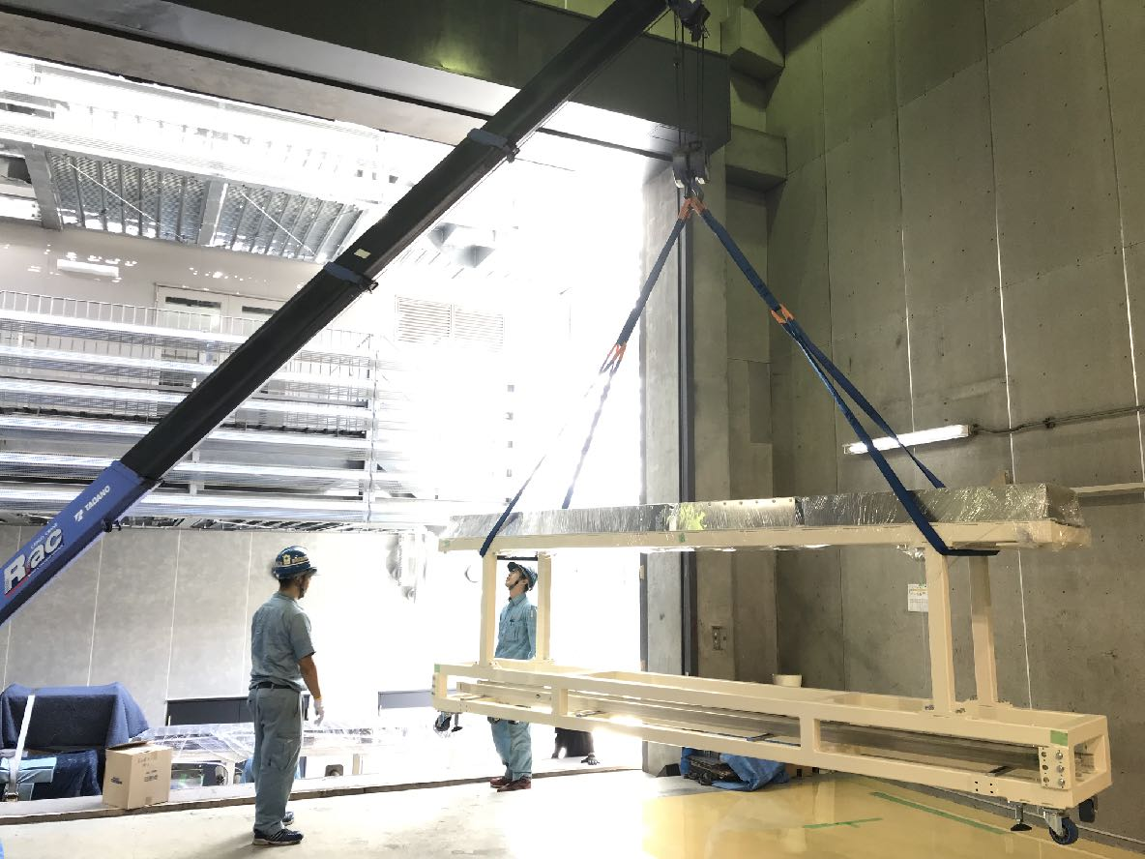
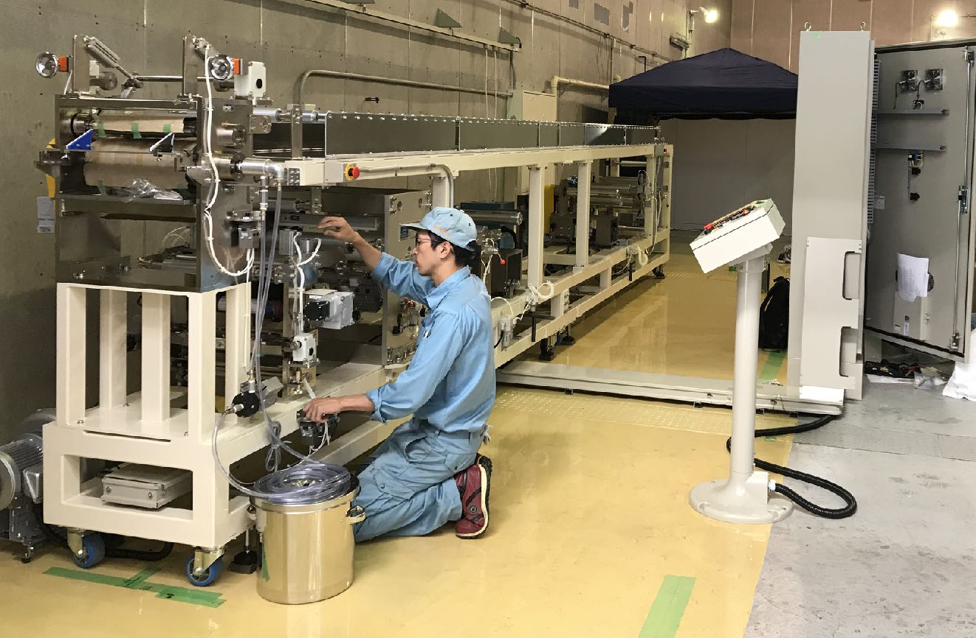
Installation of Roll-to-Roll
Coater
2019 Oct.– Start installation

Slide 23
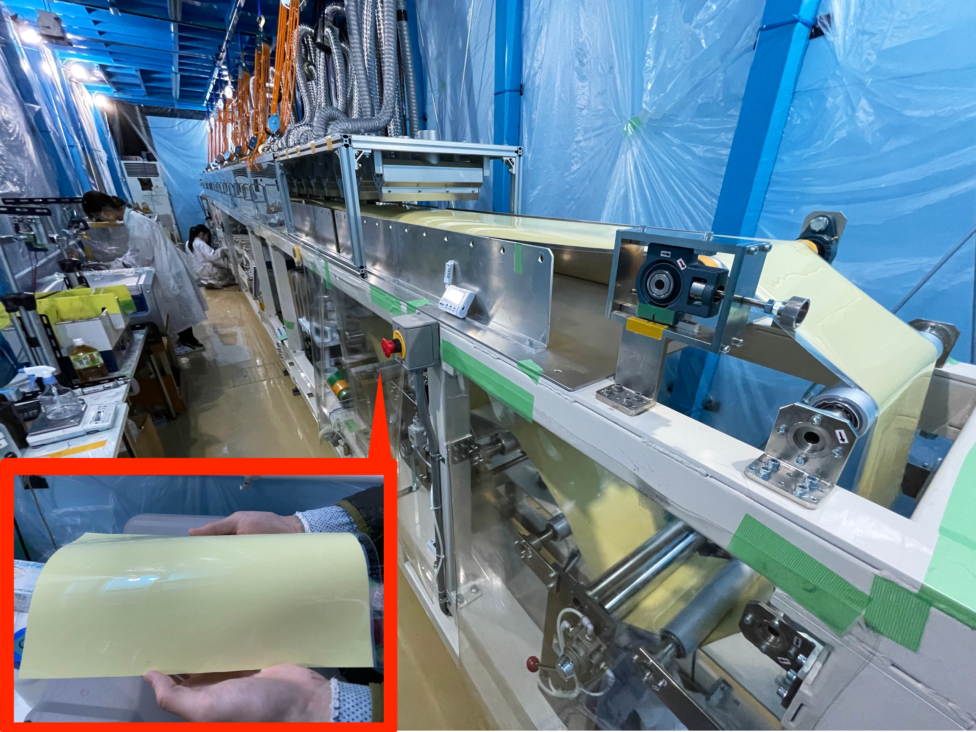
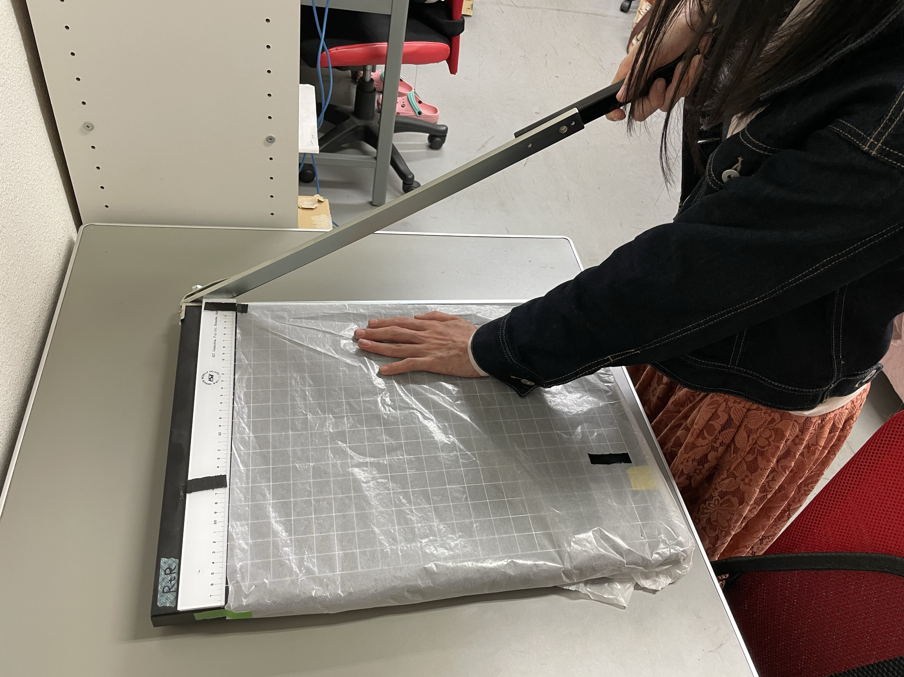
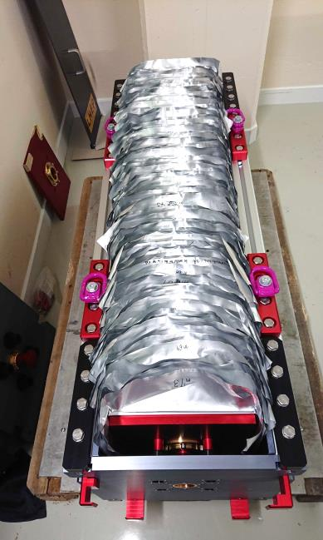
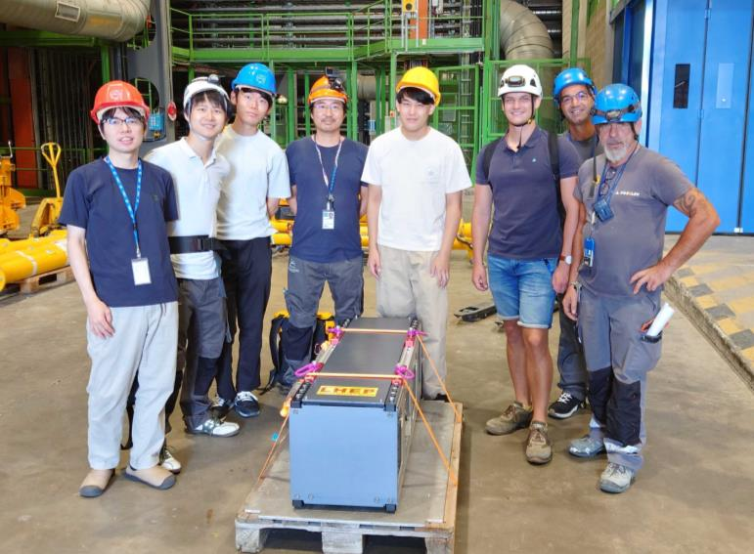
Film Production for
FASER-nu 2022 run
Gel Production
Gel-to-Film (coating & drying)
Cutting into Sheet (250 x 300 mm²)
Provided 150 m²
Emulsion Film in total.
✓Installation in Mar.
✓Installation in Jul.
✓Installation in Sep.
Resetting process
(humidity control)
Shipping to CERN

Slide 24
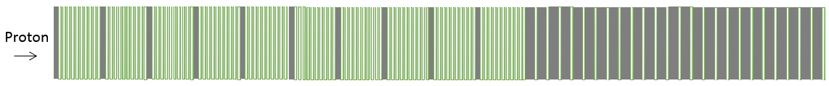


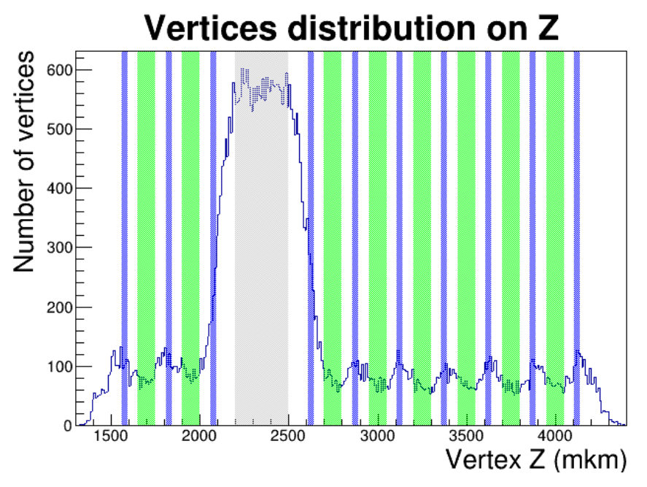

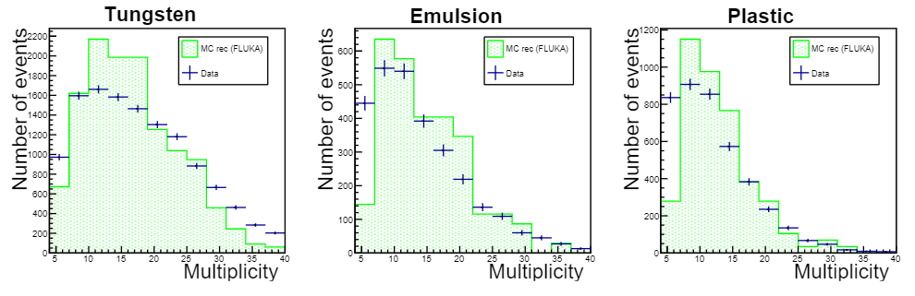
The detector structure (~400 modules)
2.3x10⁸ Proton-tungsten interactions （4.6x10⁹ POT）
DsTau paper:
10.1007/JHEP01(2020)033
400GeV/c
Proton beam
10 Units
(A total of 100 nuclear emulsion films )
Another 2 units for momentum evaluation
(25 films）
Detecting about 1000 Ds → τ →X decays
Emulsion PLASTIC
Target
Decay Volume & Tracking detector
Ds
ν_{τ}
X
Proton beam
10⁵/cm²
τ
tungsten
emulsion
ν_{τ}
Tungsten
plastic
D⁺
X'
Plastic plate (200 μm)
Nuclear emulsion film (320 μm)
Tungsten plate(0.5 mm)
Notes:
役割を説明
target, decay volume

Slide 25
Interaction at tungsten
Some distribution comparison Data/MC
IP Multiplicity Space angle
IP (um) Multiplicity (本) angle (rad)
It looks EPOS MC reproduce real data well.

Slide 26
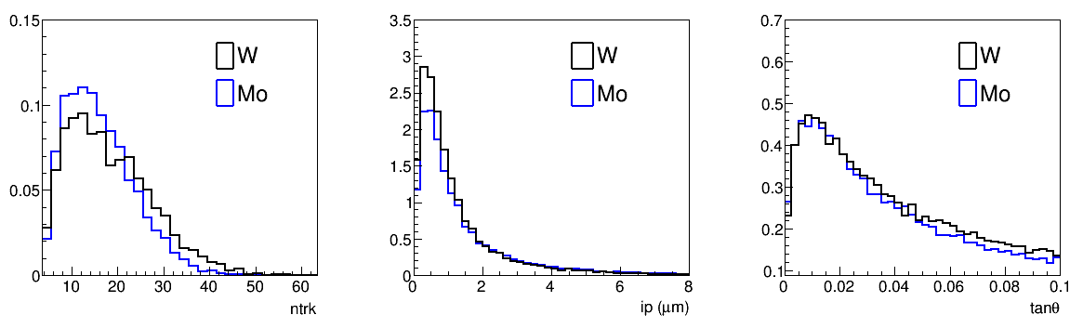
Molybdenum target from 2021 run
The neutrino source , the beam dump of DONuT experiment was tungsten target .
On the other hand, future experiment SHIP will use molybdenum alloy together with tungsten for beam dump.
In 2018 pilot run, we exposed proton only modules with tungsten(0.5mm thick) modules.
From 2021run, also molybdenum (1.0㎜ thick）modules.
A subsample data of molybdenum interactions shows following features.
Charged track multiplicity of proton interaction is less than tungsten target case.
Angle distribution of secondary particle is nearly same with tungsten target case.
IP is bit larger but it is expected by thickness difference of target plate.
Charged track Multiplicity IP to 1ry vertex Angle distribution of 2ry trk

Slide 27
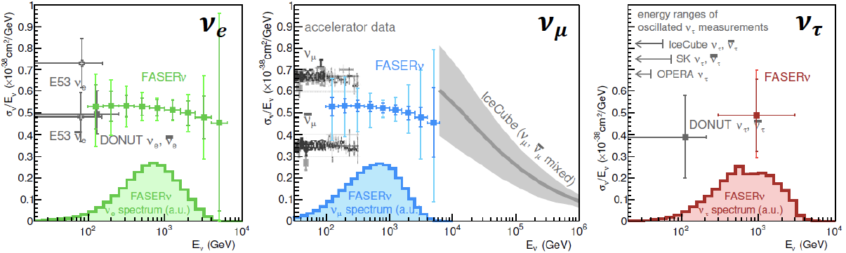
FASERν (ForwArd Search ExpeRiment): neutrinos study at un-explored energy region
LHC tunnel
p-p collision at ATLAS
Charged particles
Neutrinos (and new particles)
FASER
Neutral hadrons
LHC magnets
100 m of rock
Service tunnel
480 m
Notes:
Here, I propose a novel approach to make use of this intense neutrino beam.
Let’s follow what happens after proton collision in ATLAS. A bunch of forward mesons are created and some of them decay into neutrinos. Charged particles are deflected by the LHC magnets. Neutral hadrons stop in the rock. Finally only neutrinos can go further.
What a coincidence, there is a disused service tunnel and a space is available. Let’s put a neutrino detector, LHCnu. Although this is not designed as a neutrino beamline, this setup functions as a neutrino beamline. In this way, I can exploit neutrino beam from the LHC with a negligible cost for infrastructure. This is a big advantage of LHCnu, because if you want to build a dedicated neutrino beamline, it would cost minimum 100 million euro.
In fact, the use of this location was first proposed for the dark photon search by the FASER Collaboration, including myself. LHCnu will be a part of the FASER activity.

Slide 28
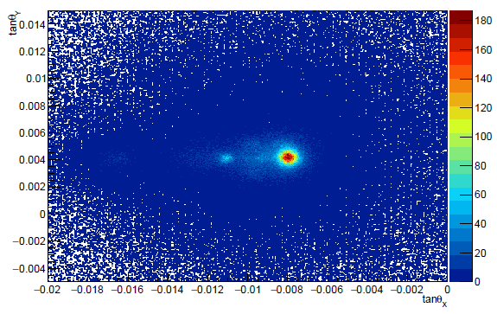
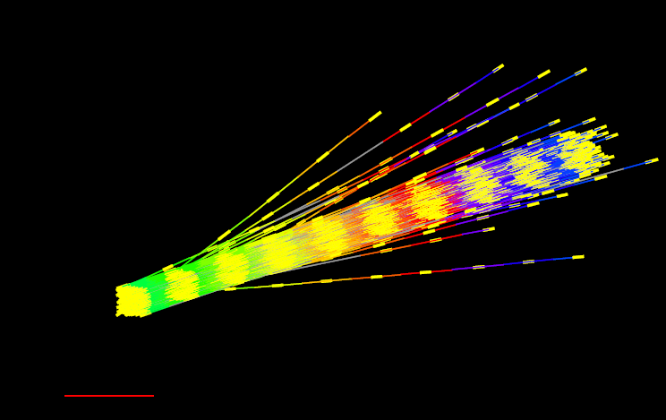







Basic measurements :
Angular Scatter Plot (2nd module)
20 mrad
2022 2nd module (10.6 fb⁻¹)
1000 $μ$m
 | track density (/cm²/fb⁻¹) (within 10 mrad from the peak)
2022 1st module (0.5 fb⁻¹) | 1.2$×$10⁴
2022 2nd module (10.6 fb⁻¹) | 1.3$×$10⁴
Position resolution
$σ∼$0.4 mrad
$σ∼$0.4 mrad
$σ=$0.19 $μ$m

Slide 29





Observation of $ν_{μ}$ CC interactions by FASER spectrometer
Track q/p distribution

Slide 30

Ettore Zaffaroni slide at Moriond2023

Slide 32




GRAINE2018
Balloon
Experiment
Balloon Flight in AUS
0.4m² telescope
Flight duration ~17h
JAXA Balloon Program
✓ World’s Highest imaging
0.51deg 68%radius (>80MeV)
✓ Detection of Vela pulsar (7.4σ)

