Slide 1
Fast birefringence measurement and compensation using a pair of identical liquid crystals.
Shalika Singh, Marc Eisenmann, Matteo Leonardi

Slide 2
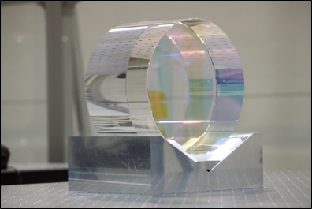
KAGRA’s Test Mass
23 kg
22 cm diameter
15 cm thickness
KAGRA cryogenic temperature
Thermal Noise when Temperature
KAGRA Sapphire
High Mechanical QF and thermal conductivity
But
Birefringent sensitivity

Slide 3
Birefringence
Polarization - oscillation of E
k - Laser propagation
S polarization - perpendicular
P polarization - parallel
Polarization Rotation
Polarization Retardation
Sapphire
S
or
or
or
k
P
Same Phase
Phase delay
Azimuth($Ψ$)
Polarization Rotator
Ellipticity (Δn)
Polarization Retarder
Sapphire

Slide 4
Existing Measurement Methods in KAGRA
Polarimetry
Motorized HWP Variable polarization rotator
Rotation and Retardance At least two measurement
Credit: Correlation between Birefringence and absorption mapping in large size sapphire substrates for gravitational wave interferometry, Simon Zeidler et all 2023 (under review)
Pout ≠ Pin
Pout = Pin
S pol
$$Ψ$$
P pol
Pin
Sample
Pout = 0W
Pout ≠ 0W
HWP
PBS

Slide 5
Existing Measurement Methods in KAGRA
Soleil-Babinet Compensator (SBC)
Motorized HWP Variable polarization rotator
Translation SBC Variable polarization retarder
Direct Measurement
Credit: M Tokunari et al 2006 J. Phys.: Conf. Ser. 32 432
Birefringent Crystal of varying thickness, R $∝x_{c}$
$$xc$$
P pol
Pin
Sample
Pout ≠ 0W
Pout = 0W
HWP
Polarizer

Slide 6
Disadvantages
Mechanical control (step motor)
4 Test Mass + spare (but more are tested)
Polarimetry | 6s per point
Compensation | 30s per point
Mass (kg) | Radius Increase | Birefringence measurement duration (polarimetry)
23 (present KAGRA) | 1 (Present 11 cm) | 1-2 weeks
40 | 1.2 | 1.4-2.8 weeks
200 | 2.1 | 4.4-8.8 weeks

Slide 7
Liquid Crystal (LC)
Polarization retarder
Electronically controlled Fast (LCD have 60-360 Hz refresh rate)
Cheap
Requires low voltage (V_{MAX} = 25 V)
Incident Laser
LC Molecules
Glass Substrate
Transparent conductive layer
LC Alignment layer
0<V_{RMS}<V_{MAX}
LC cell spacer
Polarization changed

Slide 8
LC and Controlled Retardance
Polarization retarder Apply voltage
Polarization rotator rotate LC axis
45 °
Azimuth($Ψ$)
LC1
LC2
Rotation [rad]
Retardation [rad]
Polarization state coverage
Rotation [rad]
LC1 Voltage [au]
LC1 Voltage [au]
LC2 Voltage [au]
LC2 Voltage [au]
Rotation [rad]

Slide 9
Setup
Electronically tunable fast measurement
Act on LC₂ linear polarimeter
Act on both LC₁ and LC₂ Compensation
Measurement time will go down from weeks to hours (0.3s per point)
Pout = 0W
Pout ≠ 0W
LC1
LC2
Pin
P pol
Sample
Polarizer

Slide 10
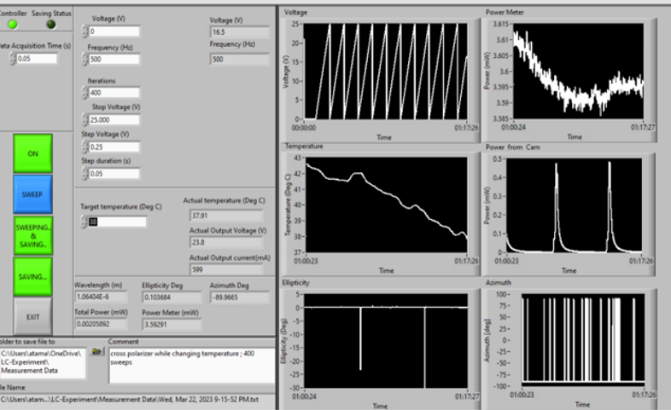
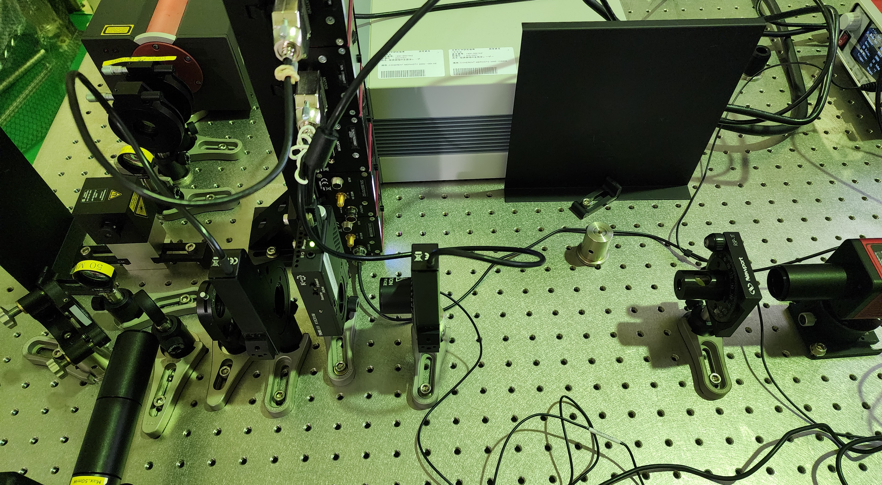
LC calibration setup
Voltage
Main Power
LabVIEW
LASER-1064 nm
Power Ppol
Temperature
QWP & HWP
Ellipticity
Azimuth
FI
PD
QWP & HWP
LC
Polarizer
PD
Switching speed= 95.8ms / 1.81ms @ 25.6°C
Op. Temperature = -20 °C to 45 °C

Slide 11
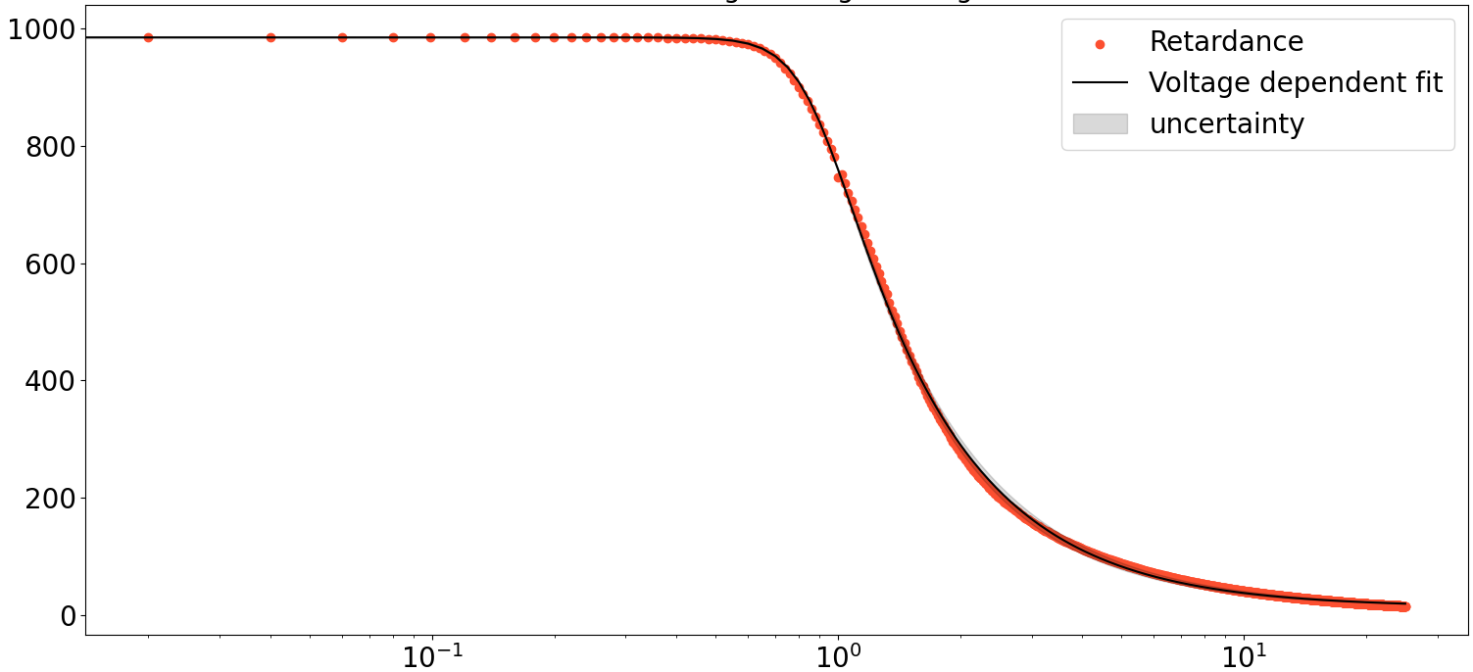
Calibration
Measured retardation at 25 °C 987 nm to 14 nm
Estimated uncertainty : ~6E-9 like Polarimetry and SBC
Max Δn
Retardation [nm]
Min Δn
Voltage [V]

Slide 12
Upcoming & Conclusion
What’s next?
Finalize calibration
Measure known birefringence sample
Measure 2D polarization of KAGRA test mass
Conclusion
Faster (0.3 s per point)
Cheaper (compared to other electronically controlled optics)
Similar uncertainty in retardance

Slide 13
Birefringence in KAGRA

Slide 14
Effect of temperature on sensitivity

Slide 15
How do we get our calibration curve

