Slide 1
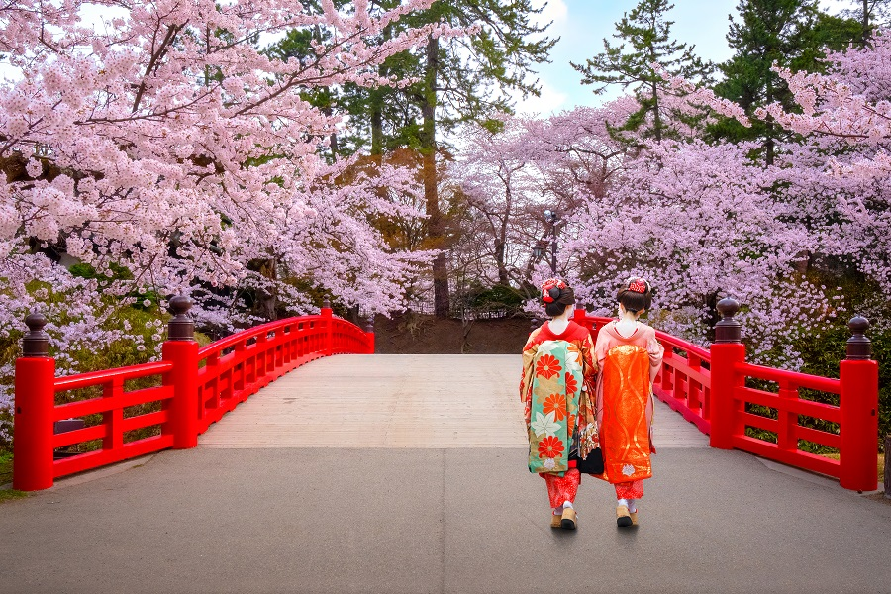
1
20
On the Hubble constant tension in the Supernovae Ia Pantheon sample
Biagio De Simone (University of Salerno & INFN)
Visiting
29th March 2023, International Conference on the Physics of the Two Infinities, Kyoto University

Slide 2
Outline of the talk
2
Introduction on modern cosmology
The Hubble constant tension
The binning approach to the Hubble tension
On the Hubble constant tension in the SNe Ia Pantheon sample
Summary of the results
The importance of Gamma-ray Bursts as high-redshift probes
Discussion and conclusions

Slide 3
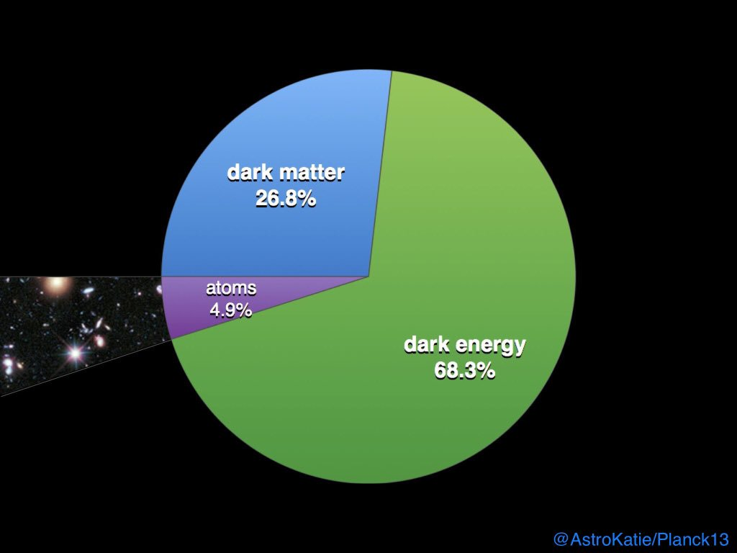
3
An introduction to modern cosmology
The most accredited model for describing the universe structure and evolution is the ΛCDM model
ΛCDM: «COLD DARK MATTER» (CDM, NOT DIRECTLY VISIBLE) AND THE «COSMOLOGICAL CONSTANT» (Λ)
$Ω_{0m}$ = TOTAL MATTER DENSITY (DARK MATTER + BARYONS) OF THE UNIVERSE
$Λ$ = THE ENERGY OF VOID, RESPONSIBLE FOR THE EXPANSION OF THE UNIVERSE
$w$ = PARAMETER OF THE EQUATION OF STATE FOR THE UNIVERSE ($w=−1$ IN THE ΛCDM MODEL)
$H_{0}$ = HUBBLE CONSTANT, DESCRIBES THE UNIVERSE EXPANSION RATE IN THE ΛCDM MODEL
$Ω_{0m}$
$Λ$
VISIBLE
UNIVERSE

Slide 4
4
The Hubble constant and its tension
$$H_{0}≝\frac{R′(t_{0})}{R(t_{0})}$$
$${v=H}_{0}∙D$$
, $R\left(t_{0}\right)=$ SCALE FACTOR COMPUTED IN THE PRESENT ($t_{0}$)
HUBBLE’S LAW
$H_{0}$ TENSION
discrepancy in more than 4σ between the local value of $H_{0}$ (Supernovae Ia and Cepheids) and the value of $H_{0}$ from the Cosmic Microwave Background (CMB)
M. G. Dainotti, et al., 2021, ApJ, 912, 150

Slide 5
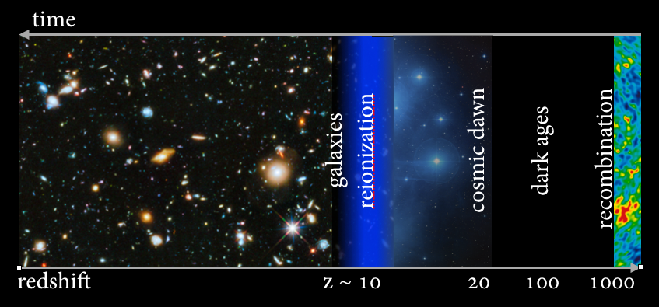
Investigating the Hubble constant tension
5
We divide the Pantheon sample (1048 SNe Ia with $0<z<2.26$, Scolnic et al. 2018)
in 3 and 4 bins ordered in redshift + 1 Baryon Acoustic Oscillations
EACH $H_{0}$ IS ESTIMATED IN ONE BIN THROUGH A MCMC APPROACH
WE FIT THE GIVEN VALUES OF $H_{0}$
$$g\left(z\right)=\frac{{\tilde{H}}_{0}}{{(1+z)}^{α}}$$
$α=$ evolution parameter
$${\tilde{H}}_{0}=H_{0}(z=0)$$

Slide 6
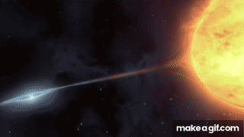
6
Why SNe Ia?
Why these particular SNe Ia are among the best standard candles?
EXPLOSION OF A WHITE DWARF IN A BINARY
SYSTEM
INCREASING OF MASS UNTIL THE CHANDRASEKHAR LIMIT IS REACHED [$M\sim 1,4 M_{\text{☉}}$ (SOLAR MASSES)] AND THE STAR EXPLODES
IMPORTANT FEATURE: GIVEN THE CHANDRASEKHAR LIMIT, THE BRIGHTNESS OF SNe Ia IS ALMOST THE SAME

Slide 7
7
Results for ΛCDM model (3, 4 bins)
The $w_{0}w_{a}$CDM model results are compatible with the ΛCDM ones
(omitted for brevity)
M. G. Dainotti, et al., 2021, ApJ, 912, 150

Slide 8
8
Results for ΛCDM model (3, 4 bins)
M. G. Dainotti, et al., 2021, ApJ, 912, 150
Extrapolating $H_{0}$ at the redshift of the Last Scattering Surface ($z=1100$) we obtained a value of $H_{0}$ compatible in 1 $σ$ with the $H_{0}$ CMB measurement.

Slide 9
9
The correction to the luminosity distance
M. G. Dainotti, et al., 2021, ApJ, 912, 150
At redshift $z≅10$ the correction to the luminosity distance becomes in the order of $0.5∗{10}^{29}cm$

Slide 10
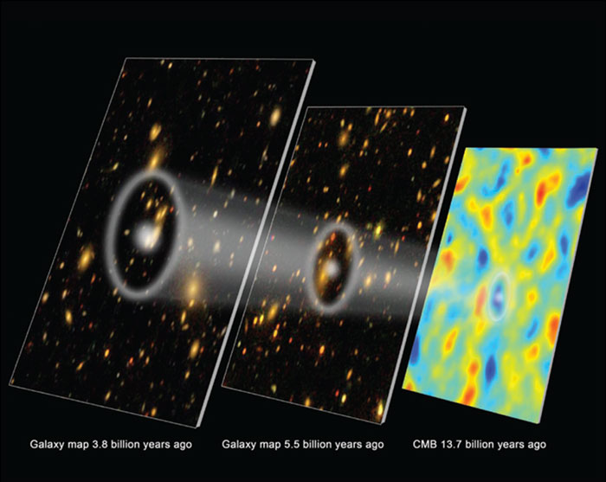
10
Baryon Acoustic Oscillations
A «TUG OF WAR» DURING THE RECOMBINATION, GRAVITY VS. HEAT PRESSURE OF MATTER:
A SERIES OF «BUBBLES» WAS CREATED ($0≤z_{obs}^{BAOs}≤3$)
THE BAOs CONTRIBUTION:
M.G. Dainotti, et al., 2022, Galaxies, 10, 1, 24
$$χ^{2}=χ_{SNe}^{2}+χ_{BAOs}^{2}$$
TOTAL CHI-SQUARE TEST:
Notes:
AGGIUNGERE CMB

Slide 11
11
$H_{0}\left(z\right)$ fitting (3 bins $Λ$𝐶𝐷𝑀) + BAOs
Varying $H_{0}$ and $Ω_{0m}$
M.G. Dainotti, et al., 2022, Galaxies, 10, 1, 24
M.G. Dainotti, et al., 2022, Galaxies, 10, 1, 24

Slide 12
12
$H_{0}\left(z\right)$ fitting (3 bins $w_{0}w_{a}$𝐶𝐷𝑀) + BAOs
Varying $H_{0}$ and $w_{a}$
M.G. Dainotti, et al., 2022, Galaxies, 10, 1, 24
M.G. Dainotti, et al., 2022, Galaxies, 10, 1, 24

Slide 13
13
Testing the Hu-Sawicki model
Testing the Hu & Sawicki (2007) model with $n=1$
In the case of $F_{R0}={−10}^{−7}$
(value of the field at the present time)
Despite adopting this modified gravity model, such a decreasing trend is still visible
M.G. Dainotti, et al., 2022, Galaxies, 10, 1, 24

Slide 14
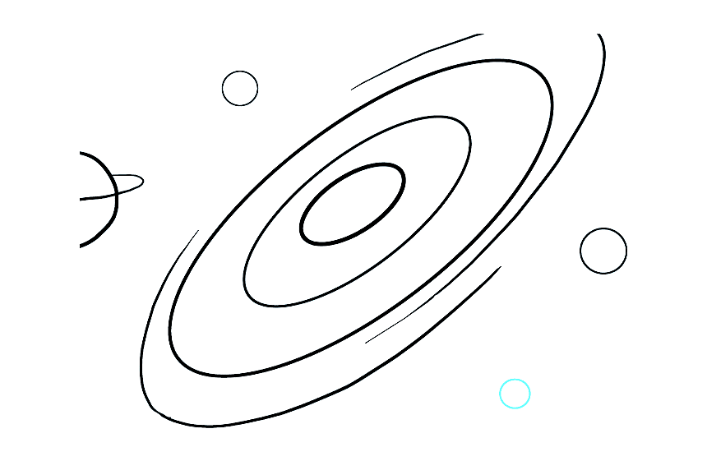
A world-wide collaboration
for a universe-wide tension
14
M.G. Dainotti , B. De Simone, T. Schiavone, G. Montani, E. Rinaldi, G. Lambiase, M. Bogdan, and S. Ugale

Slide 15
15
Discussion of the results
SNe Ia ANALYSIS: POSSIBLE ASTROPHYSICAL EFFECTS
POSSIBLE EVOLUTIONARY EFFECTS ON THE OBSERVABLES LIKE COLOR, STRETCH AND MASS CORRECTION OR STATISTICAL FLUCTUATIONS OR EVEN HIDDEN BIASES
IN ANOTHER PAPER, NICOLAS ET AL. 2021, IT IS SHOWN THAT THE STRETCH FACTOR ($x_{1}$) SHOWS AN EVOLUTIONARY TREND WITH REDSHIFT AND THIS MAY EXPLAIN OUR OBSERVED TREND.
FUTURE WORK: INVESTIGATE THE HUBBLE CONSTANT TENSION IN THE PANTHEON+ SAMPLE
Asymmetric distribution
N. Nicolas, et al., 2021, A&A, 649, A74

Slide 16
16
Discussion of the results
SNe Ia ANALYSIS: POSSIBLE THEORETICAL MODELING
THIS RESULTS CAN BE EXPLAINED THANKS TO DIFFERENT THEORETICAL FRAMEWORKS
IF NOT DUE TO ASTROPHYSICAL BIASES OR SELECTION EFFECTS
MODIFIED GRAVITY SCENARIO, $G=G\left(z\right)$ -> IN MODIFIED THEORIES THERE IS A VARIATION OF THE G CONSTANT (ex. $f(R)$ THEORIES, HU-SAWICKI MODEL)
> THE HU-SAWICKI MODEL WITH VARYING $Ω_{0m}$ HAS BEEN ANALYZED BUT THE HUBBLE CONSTANT DECREASING TREND WAS PROVEN TO HOLD ANYWAY
THIS «G» MAY NOT BE A CONSTANT, AFTER ALL...
$F=\frac{Gm_{1}m_{2}}{d^{2}}$

Slide 17
How can we possibly solve the tension?
17
Excellent candidates:
Gamma-ray Bursts
Using probes in
$$2.26<z<1100$$
Which probes?
Quasars, standard sirens, Tip of Red Giant Branch method, Megamasers, lensed quasars and lensed SNe, but also…

Slide 18
18
A data catalog to perform GRB population studies, morphology, models and properties classification
42101 data points collected!
529 lightcurves gathered
We are working on for
On-the-fly conversion from fitted flux to luminosity
Ability to download magnitude and flux data files in uniform format
Automatic plots with the embedded fitting, both Bayesian (MCMC) and $χ^{2}$ for LCs and spectra
Web scraper for automatizing data collection (ongoing)
Packaging for release to the scientific community
Contact us at: bdesimone@unisa.it
maria.dainotti@nao.ac.jp
M. G. Dainotti, The RATIR Collaboration, R. Fathima, D. Levine, B. De Simone Y. Niino, Oates, Cenko et al., 2022 (supported by Exploratory Reseach Grant)

Slide 19
19
Summary and conclusions
THE HUBBLE CONSTANT TENSION IS STILL AN OPEN PROBLEM. SNe Ia ALONE ARE NOT ENOUGH
THE ROLE OF GRBs IS CRUCIAL. CORRELATIONS ARE PROMISING TOOLS FOR STANDARDIZING GRBs AND FOR TESTING COSMOLOGICAL MODELS
THE MOST COMPLETE OPTICAL CATALOG OF GRBs WITH REDSHIFT AIMS TO PROVIDE SCIENTIFIC COMMUNITY A RELIABLE DATA SET FOR ESTIMATING COSMOLOGICAL PARAMETERS (YOU ARE WELCOME TO CONTRIBUTE!)
STANDARDIZED CANDLES (SNe Ia) + STANDARDIZABLE CANDLES (GRBs) + OTHER PROBES = CAST MORE LIGHT ON THE OPEN COSMOLOGICAL PROBLEMS

Slide 20
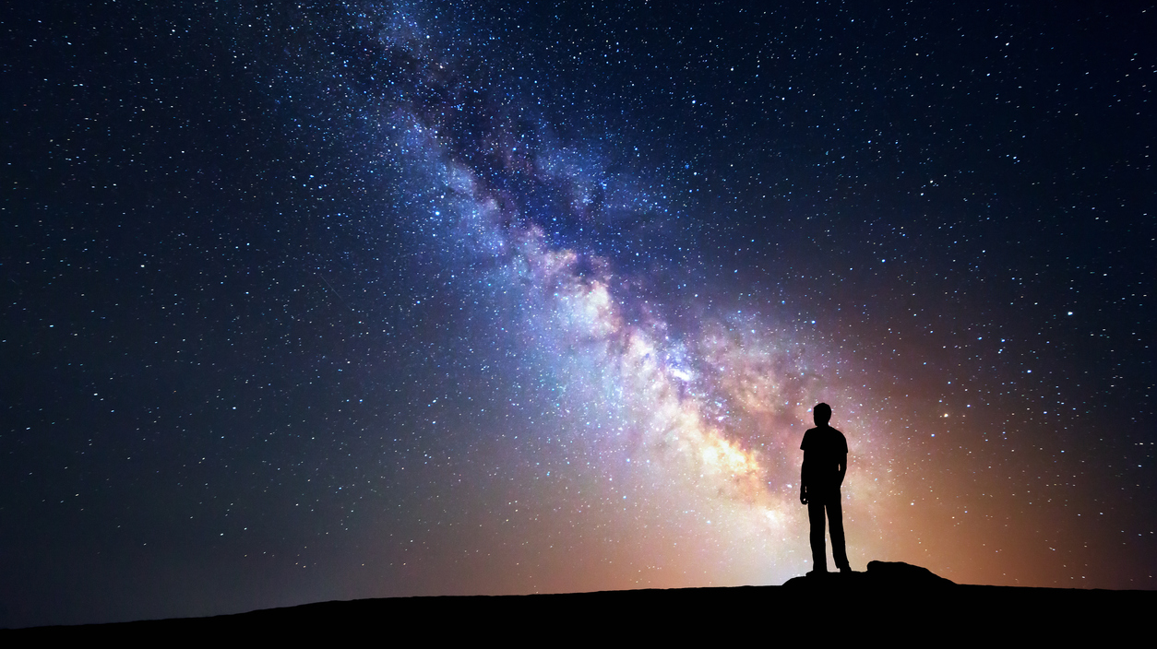
Thank you for your attention!
20
If you want to join us:
maria.dainotti@nao.ac.jp
bdesimone@unisa.it
Any comments or questions?

Slide 21
B1
Theory vs. Data
A $χ^{2}$ TEST IS PERFORMED FOR EACH BIN IN ORDER TO FIND THE BEST VALUE FOR $H_{0}$
Fiducial abs. mag.
Host-mass corr.
Color
Bias corr.
App. magnitude
Stretch
$$μ_{th}^{(SN)}\left(z,H_{0},…\right)=5∗\log_{10}\left( \frac{d_{L}\left(z.H_{0},…\right)}{10pc} \right)+25$$
$$μ_{obs}^{(SN)}=m_{B}−M+αx_{1}−βc+ΔM+ΔB$$
With the covariance matrix $C^{−1}$
$$χ^{2}=\sum_{i}{\frac{{(μ_{obs}^{i}−μ_{th}^{i})}^{2}}{{ε_{μobs}^{i}}^{2}}}$$
$$χ_{SNe}^{2}={Δμ}^{T}C^{−1}Δμ$$
$$Δμ=μ_{obs}^{(SN)}−μ_{th}^{(SN)}$$
M. G. Dainotti, et al., 2021, ApJ, 912, 150

Slide 22
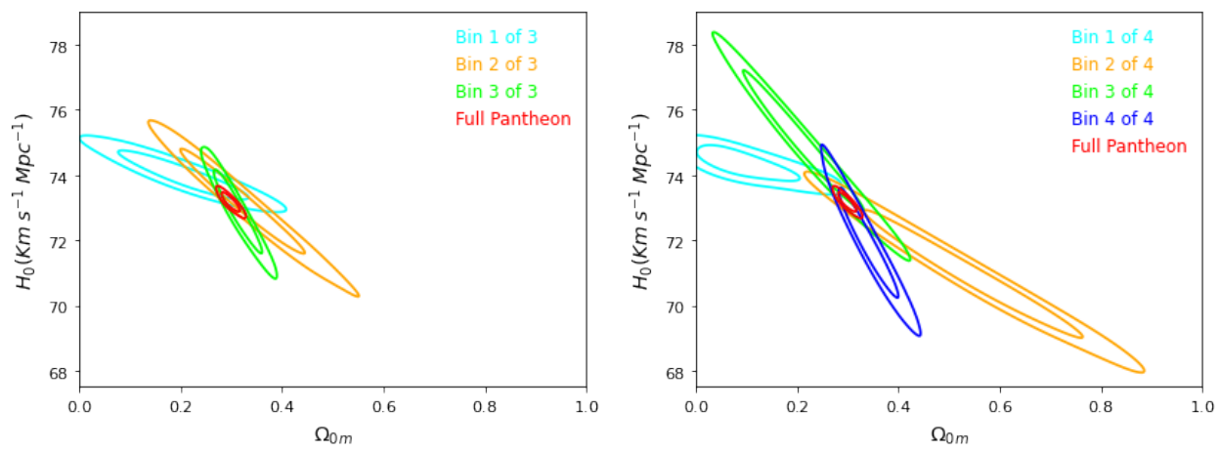
B2
Criteria for the bins selection
(ΛCDM model)
M. G. Dainotti, et al., 2021, ApJ, 912, 150
3 bins -> the best choice (closed contours and 1-sigma compatibility with total Pantheon)
4 bins -> comparison with Kazantzidis & Perivolaropoulos (2020a)
20, 40 bins -> to test the independence of the results on the binning choice

Slide 23
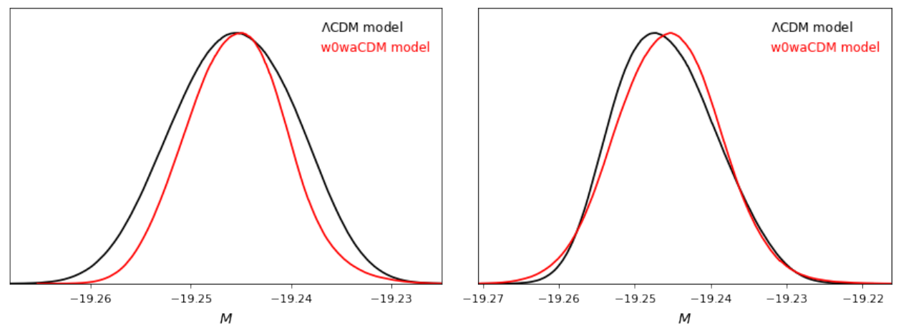
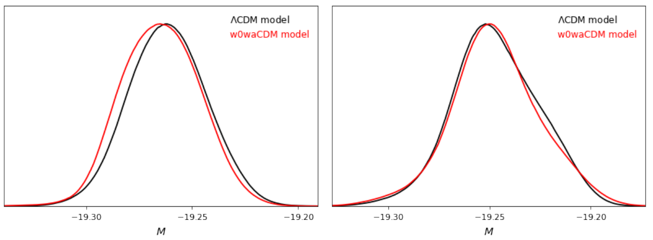
B3
Calibration of the fiducial value for $M$
$M$, the SN Ia fiducial absolute magnitude, is degenerate with $H_{0}$
We calibrated the first bin in every division assuming
$H_{0}=73.5 km/s/Mpc$
M. G. Dainotti, et al., 2021, ApJ, 912, 150

