Slide 1
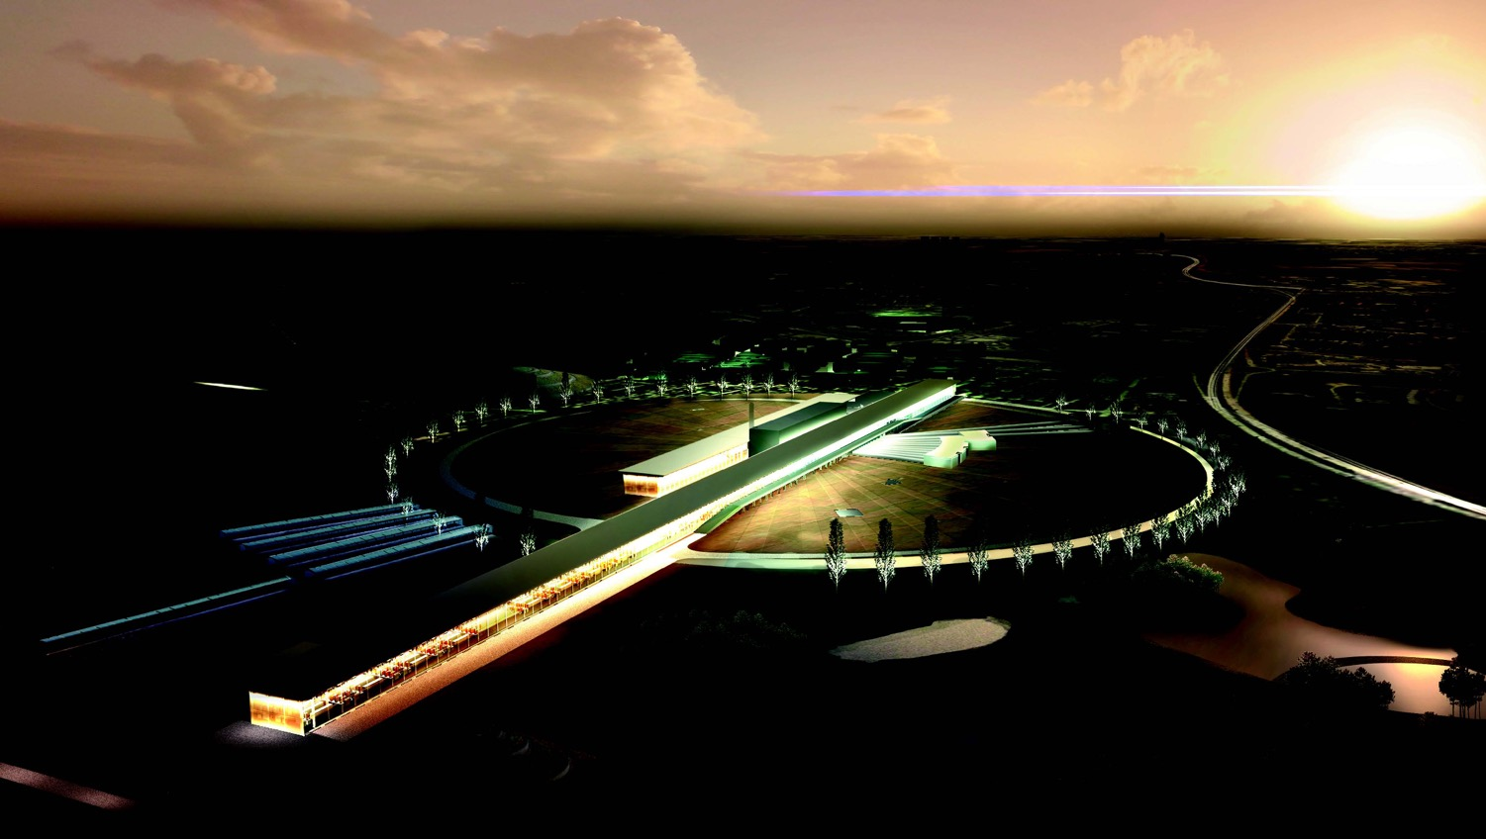


The European Spallation Source neutrino Super Beam project
Marcos Dracos
IPHC-Strasbourg

Slide 2
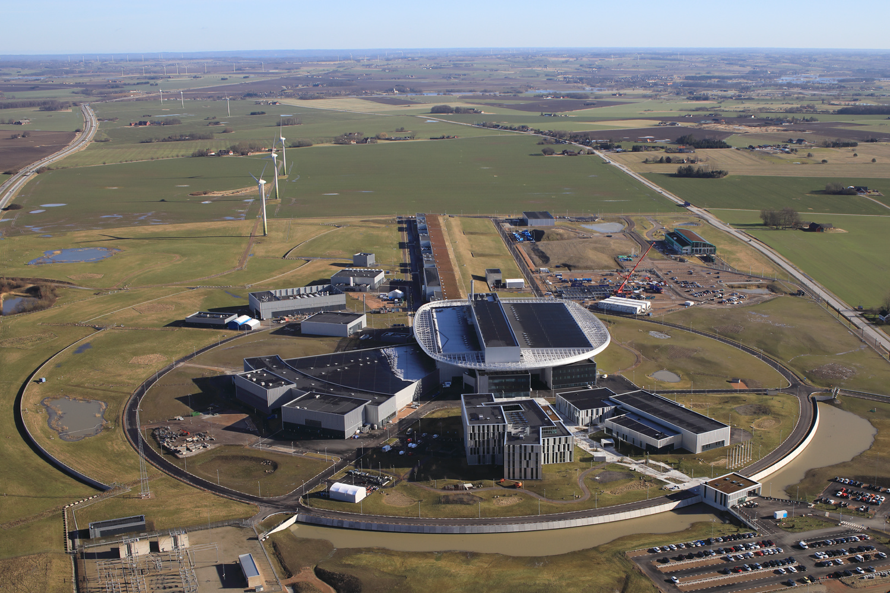

European Spallation Source
Neutron facility
linac
Central Utility
Building
Exp. Hall
E01
Target
Monolith
under construction phase
(~2 B€ facility)

Slide 3
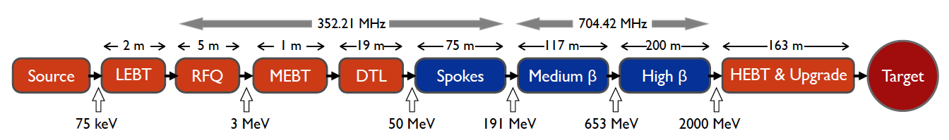
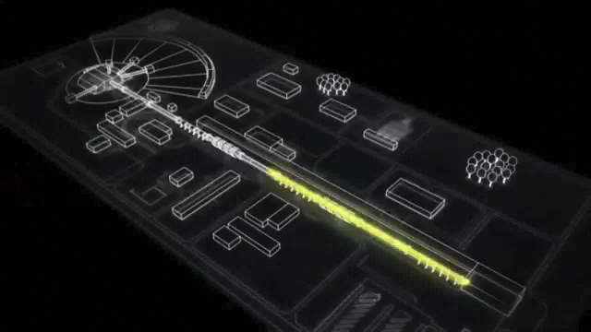
ESS proton linac
empty space for energy upgrades
The ESS will be a copious source of spallation neutrons.
5 MW average beam power.
125 MW peak power.
14 Hz repetition rate (2.86 ms pulse duration, 10¹⁵ protons).
Duty cycle 4%.
2.0 GeV protons
  up to 3.5 GeV with linac upgrades
>2.7x10²³ p.o.t/year.
8
x10¹⁴
ESS 5 MW
2015 design
7
λ = 1.5 Å
6
5
Brightness (n/cm²/s/sr/Å)
4
3
ESS 5 MW
2012 design (TDR)
Linac ready by 2025 (protons on the target)
2
UK TS2
32 kW
SNS
1-2 MW
JPARC
0.3-1 MW
1
UK TS1
128 kW
ILL 57 MW
0
time (ms)
1
2
3
4

Slide 4
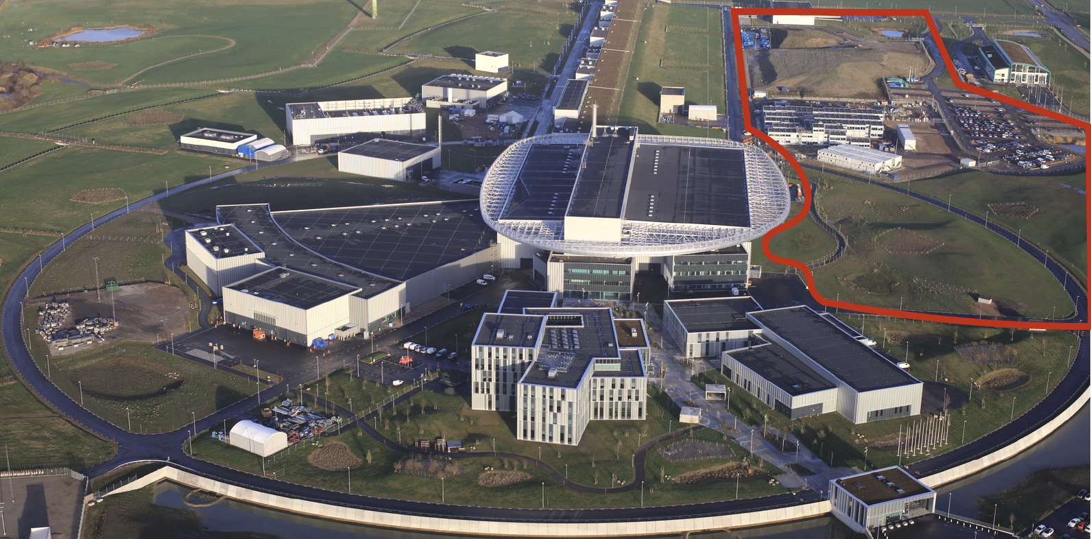
European Spallation Source as Neutrino Facility
(2nd oscillation maximum)
ν

Slide 5
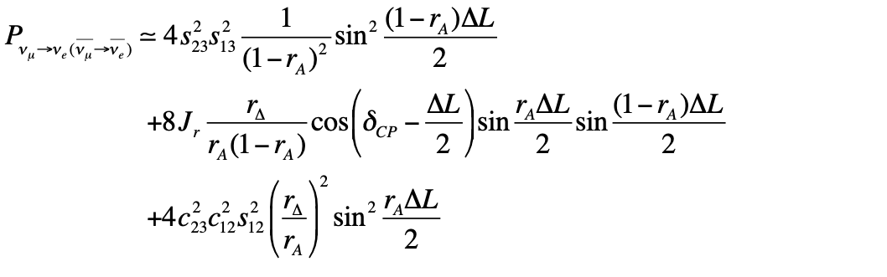
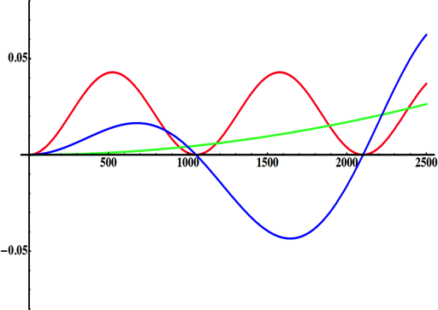
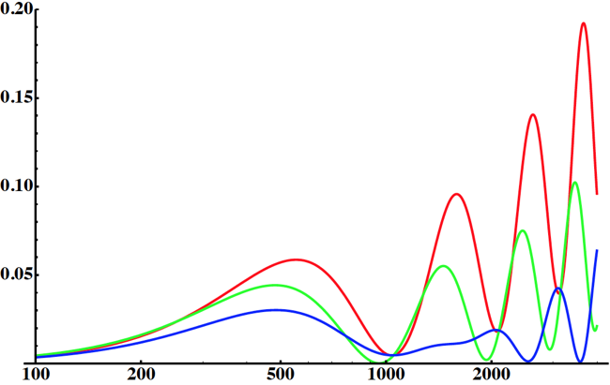
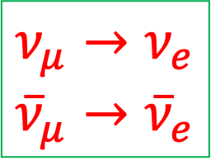
Neutrino Oscillation probability
"atmospheric"
$$ν_{μ}→ν_{e}$$
$${\overline{ν}}_{μ}→{\overline{ν}}_{e}$$
"interference"
"solar"
(arXiv:1110.4583)
1st osc. max.
2nd oscillation maximum
atmospheric
δ_{CP}=-90
δ_{CP}=0
δ_{CP}=+90
P(ν_{μ}→ν_{e})
solar
L/E
θ₁₃=8.8º
("large" θ₁₃)
CP interference
θ₁₃=8.8º
2nd osc. max.
L/E
1st oscillation max.: A=0.3sinδ_{CP}
2nd oscillation max.: A=0.75sinδ_{CP}
more sensitivity at 2nd oscillation max.
(arXiv:1310.5992, arXiv:0710.0554)

Slide 6
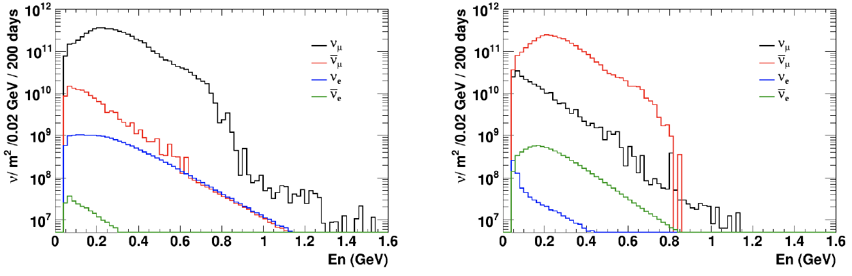
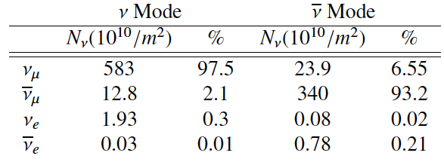
Having access to a powerful proton beam…
What can we do with:
5 MW power
2 GeV energy
14 Hz repetition rate
10¹⁵ protons/pulse
>2.7x10²³ protons/year
conventional neutrino (super) beam
proton beam
decay tunnel
p
hadrons
physics
π
ν
⨂B
target
hadronic collector
(focusing)
Detector
"neutrino mode"
"anti-neutrino mode"
almost pure ν_{μ} beam
small ν_{e} contamination which could be used to measure ν_{e} cross-sections in a near detector
at 100 km from the target, per year (in absence of oscillations)

Slide 7
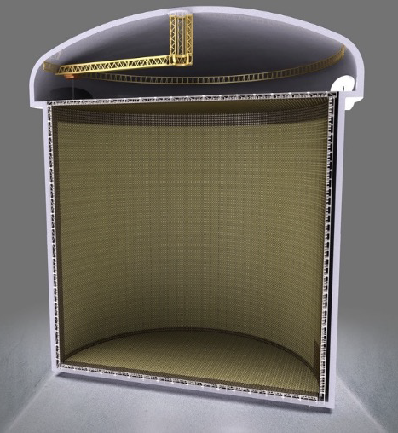
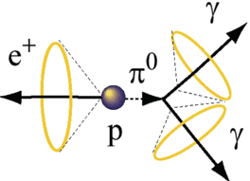
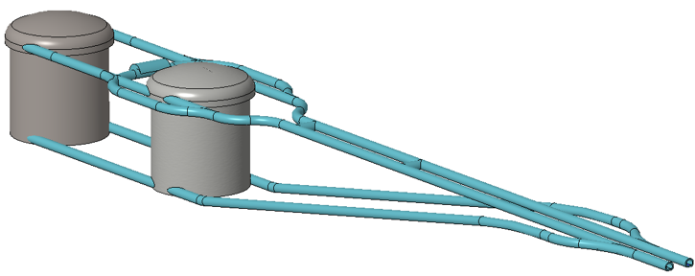
Can we go to the 2nd oscillation maximum using our proton beam?
Yes, if we place our far detector at 350- 550 km from the neutrino source.
Megaton Water Cherenkov detector
Neutrino Oscillations
Proton decay
Astroparticles
Understand the gravitational collapsing: galactic SN ν
  Supernovae "relics"
Solar Neutrinos
Atmospheric Neutrinos
75 m
75 m
2x
500 kt fiducial volume (~20xSuperK)
Readout: ~20” PMTs
30% optical coverage

Slide 8
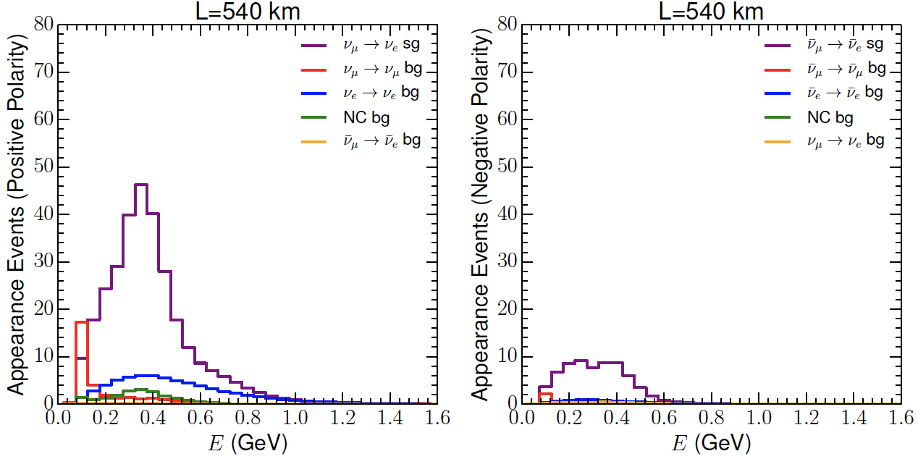
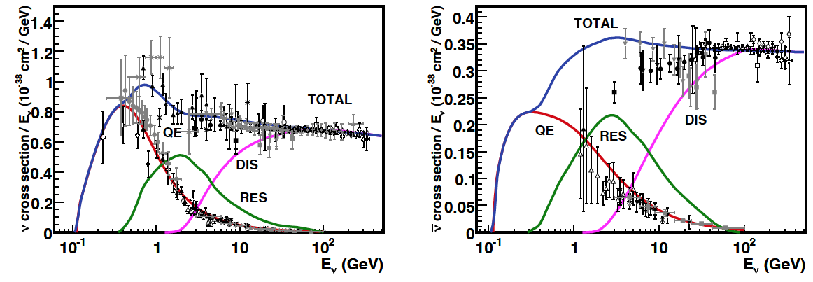
Neutrinos in the far detector
540 km (2.5 GeV), 10 years
neutrinos
anti-neutrinos
δ_{CP}=0
5 years
5 years
below ν_{τ} production, almost only QE events, not suffering too much by π⁰ background

Slide 9
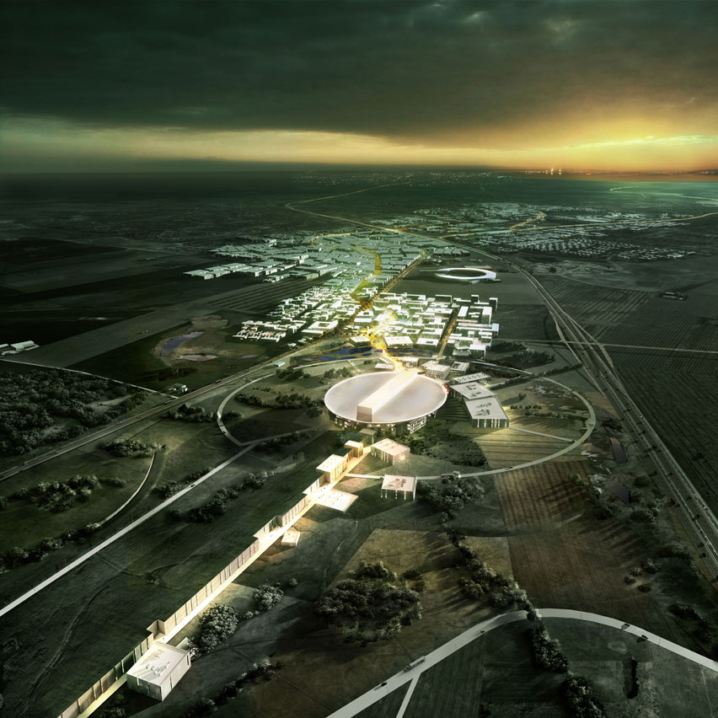
ESS modifications to produce a neutrino Super Beam
European Spallation Source Linac

Slide 10
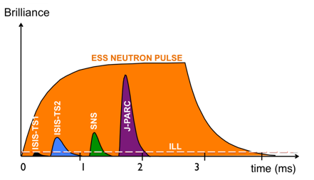
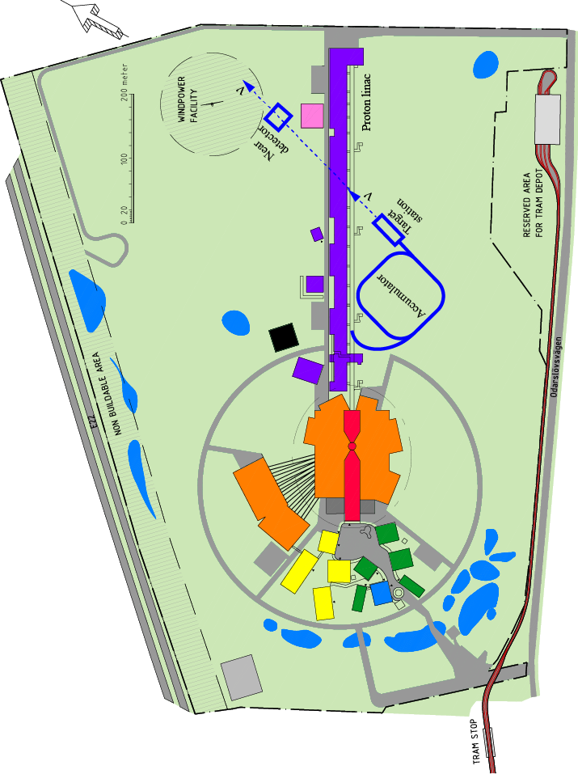
How to add a neutrino facility?
The neutron program must not be affected and if possible synergetic modifications.
Linac modifications: double the rate (14 Hz → 28 Hz), from 4% duty cycle to 8%.
Accumulator (C~400 m) needed to compress to few μs the 2.86 ms proton pulses, affordable by the magnetic horn (350 kA, power consumption, Joule effect)
  H⁻ source (instead of protons),
  space charge problems to be solved.
~300 MeV neutrinos.
Target station.
Underground detector.
Short pulses (~μs) will also allow DAR and coherent scattering experiments (as those proposed for SNS) using the neutron target.

Slide 11
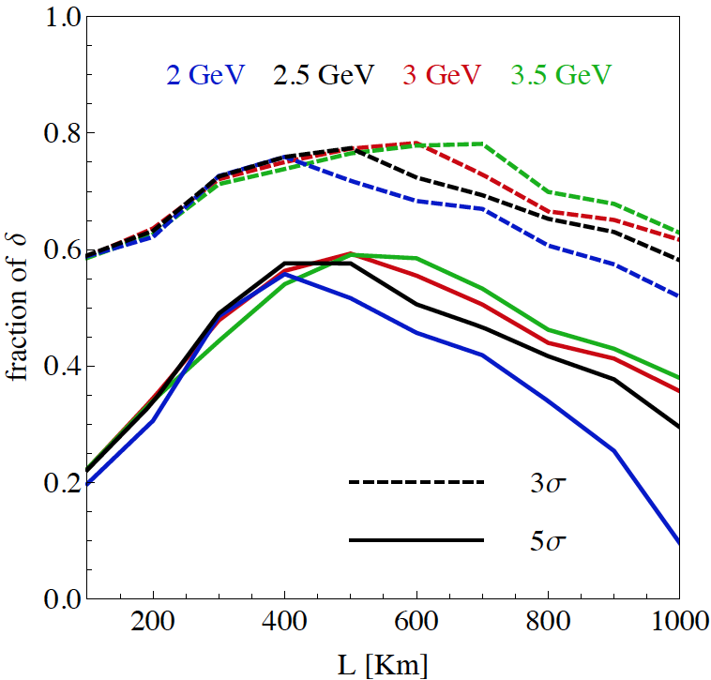
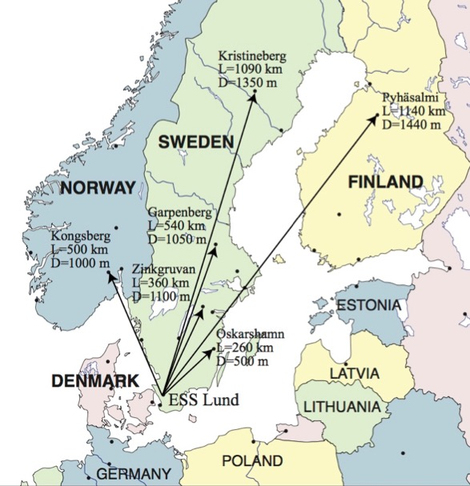
Which baseline?
CPV (Nucl. Phys. B 885 (2014) 127)
Garpenberg
1st osc. max.
Zinkgruvan
~60% δ_{CP} coverage at 5 σ C.L.
>75% δ_{CP} coverage at 3 σ C.L.
systematic errors: 5%/10% (signal/backg.)
Candidate active mines

Slide 12

ESSνSB at the European level
A H2020 EU Design Study (Call INFRADEV-01-2017)
Title of Proposal: Discovery and measurement of leptonic CP violation using an intensive neutrino Super Beam generated with the exceptionally powerful ESS linear accelerator
Duration: 4 years
Total cost: 4.7 M€
Requested budget: 3 M€
15 participating institutes from
11 European countries including CERN and ESS
6 Work Packages
started in 2018 and ended in 2022
ESSνSB
BENE (2004-2008)
ISS (2005-2007)
EUROν (2008-2012)
LAGUNA (2008-2010)
LAGUNA-LBNO (2010-2014)
COST Action CA15139 (2015-2019)

Slide 13
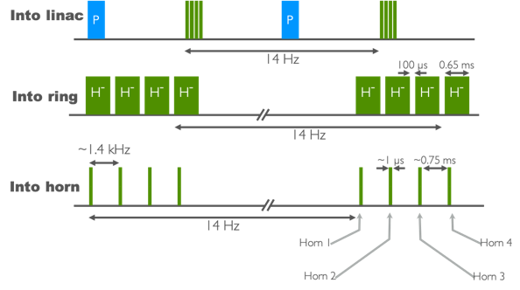
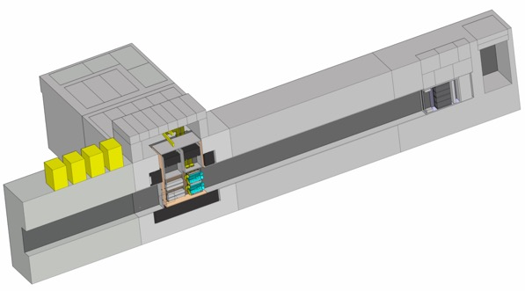
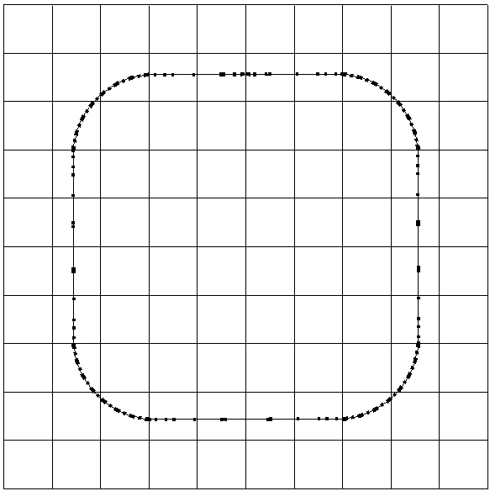
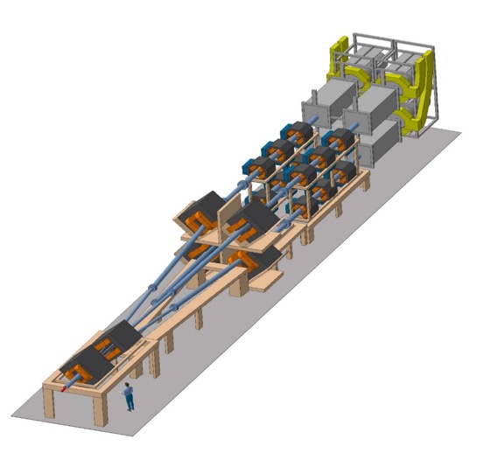
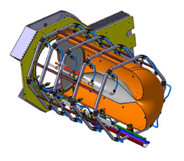
ESS modifications and operation
H⁻ source
time operation option
accumulator lattice
injection
neutrino beam
horn power supply
RF
beam dump
decay tunnel (50 m)
proton beam
target/horn x4
extraction
collimation
Switchyard

Slide 14
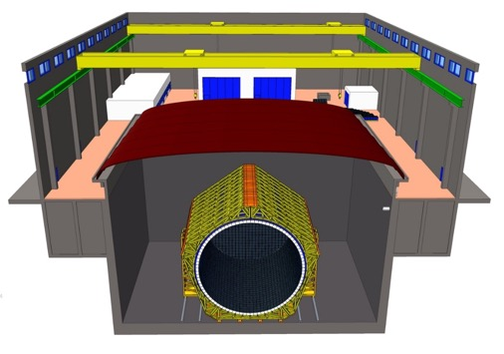
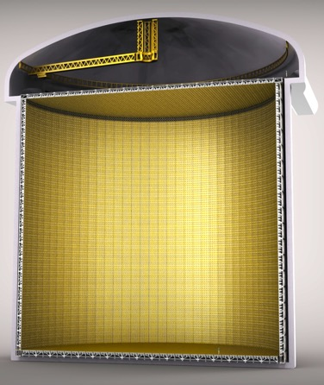
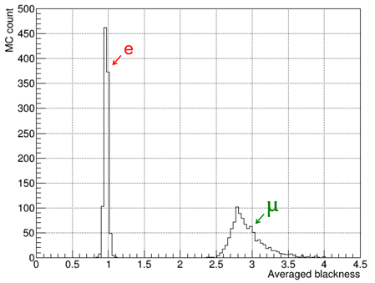
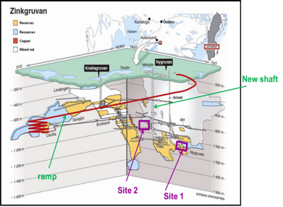
Detectors
Near detector
electron-muon separation
75 m
75 m
astroparticle physics program with the Far Detector

Slide 15

After many Optimisations
New Magriation Matrices for the far detector
Genetic Algorithm for Target Station optimisation
WC detector
ν_{e} reconstruction efficiency
(using T2K-like reconstruction algorithm)
horn optimisation
"new"
"old"

Slide 16
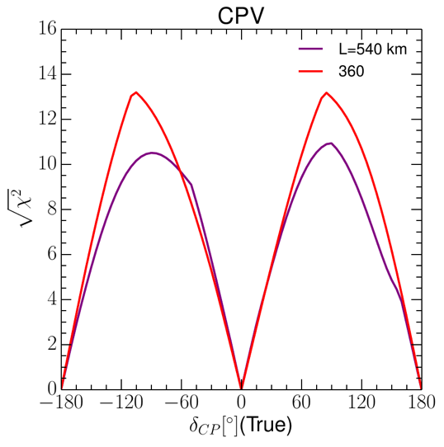
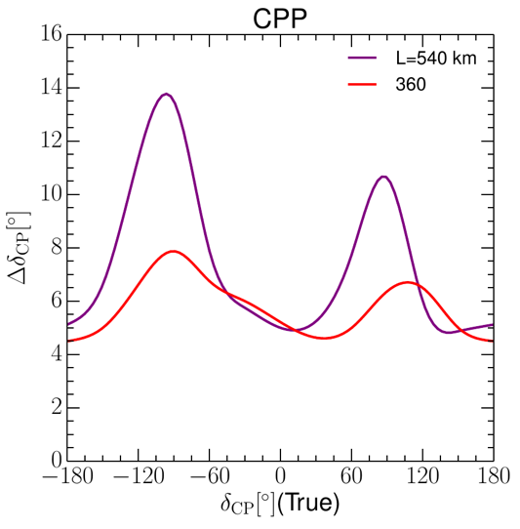
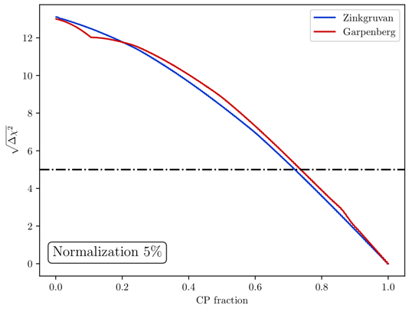
Final results
Precision measurement
Δδ_{CP}<8° for all values
>72% after 10 years
equivalent to Neutrino Factory

Slide 17
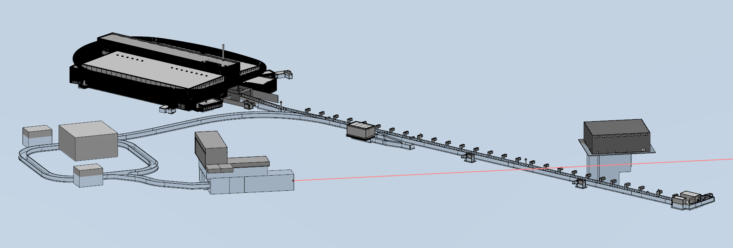
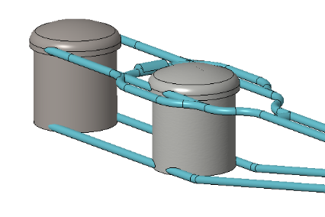

Final ESSνSB facility configuration
near detector
accumulator
target station
https://arxiv.org/abs/2206.01208
far detector
European Physical Journal Spec. Top. 231, 3779–3955 (2022). https://doi.org/10.1140/epjs/s11734-022-00664-w
Conceptual Design Report

Slide 18
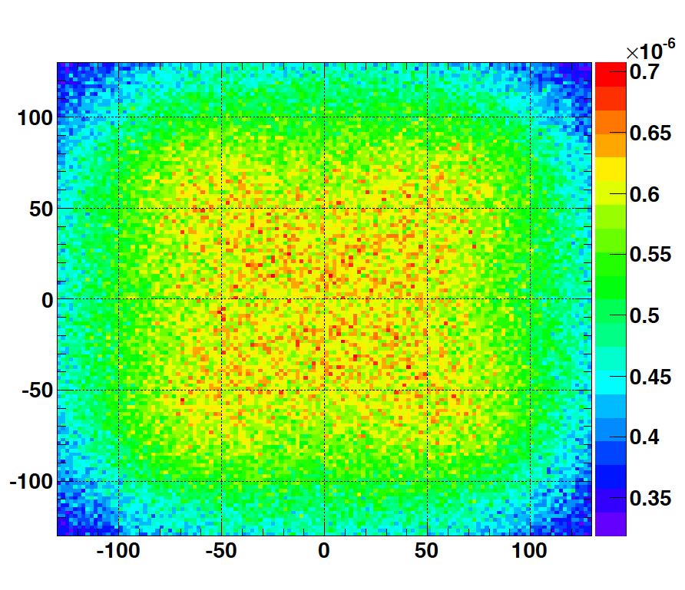
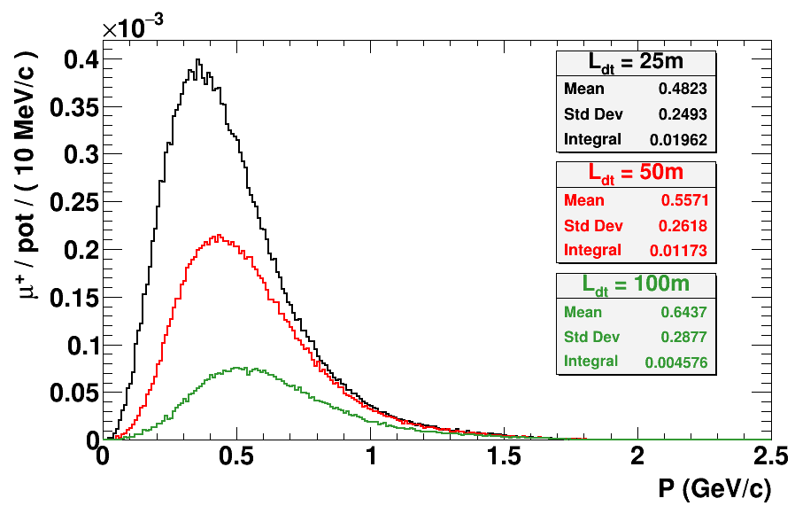
Muons at the level of the beam dump
2.7x10²³ p.o.t/year
y (cm)
muons at the level of the beam dump
(per proton)
more than 4x10²⁰ μ/year from ESS compared to 10¹⁴ μ used by all experiments up to now (10¹⁸ μ for COMET in the future).
4.2x10²⁰ μ/year
(16.3x10²⁰ for 4 m²)
x (cm)
10⁻³
4.1x10²⁰ μ/year
muons/proton
input beam for future 6D μ cooling experiments,
low energy nuSTORM,
Neutrino Factory,
Muon Collider.
<E_{μ}>~0.5 GeV
<L_{μ}>~3 km

Slide 19
ESSνSB and (R&D) synergies
ν_{μ} + ‾ν_{e}
ν_{μ} or ‾ν_{μ}
ν_{e} + ‾ν_{μ}
Super Beam
nuSTORM
ESSνSB
+Decay At Rest and Coherent scat.
(with short pulses)
2.7x10²³ p.o.t/year
Neutrino Factory
Muon Collider
ESSμSB

Slide 20
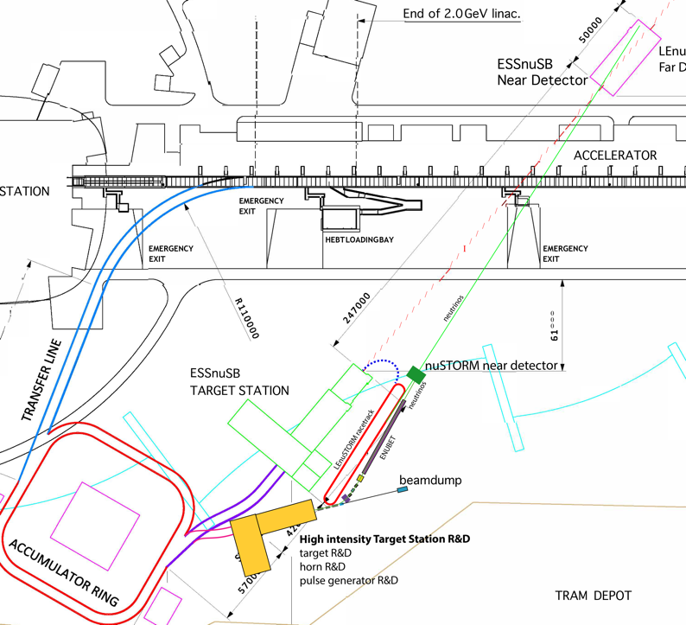
New proposed studies
(mainly cross-section measurements)
Design of a racetrack storage ring for low energy muons produced with a beam from the ESS linac.
Design a transfer system from the initial collection and extraction of pions behind the target station, up to the injection point.
Design a transfer line from the ESSνSB ring-to-switchyard transfer line to the nuSTORM target.
Design an injection scheme for the racetrack storage ring
Design a Monitored Neutrino Beam (low energy ENUBET)
Optimize the performance of the ESSνSB accelerator complex
using 1/4 of 5MW
Cross-section measurements with:
Low Energy nuSTORM: π⟶ μ ⟶ e+ν_{μ}+ν_{e}
Low Energy ENUBET: π ⟶ μ+ν_{μ}
Excellent supporting letter from the ESS director

Slide 21
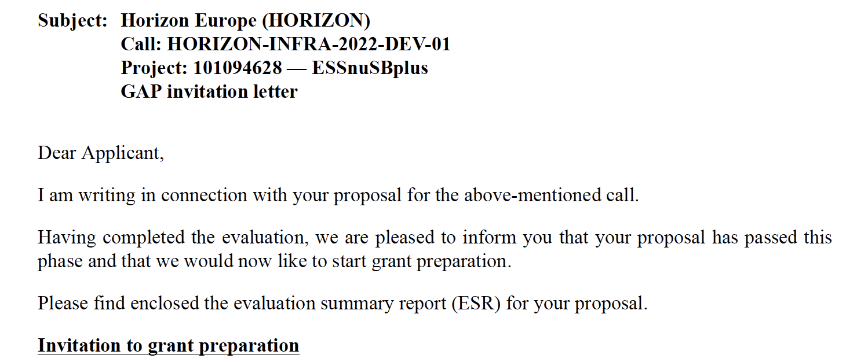

ESSνSB+
Research and Innovation actions
Innovation actions
Design Study
HORIZON-INFRA-2022-DEV-01
Title of Proposal: Study of the use of the ESS facility to accurately measure the neutrino cross-sections for ESSνSB leptonic CP violation measurements and to perform sterile neutrino searches and astroparticle physics.
Acronym of Proposal: ESSνSB+
July 2022
3 M€
4 years

Slide 22
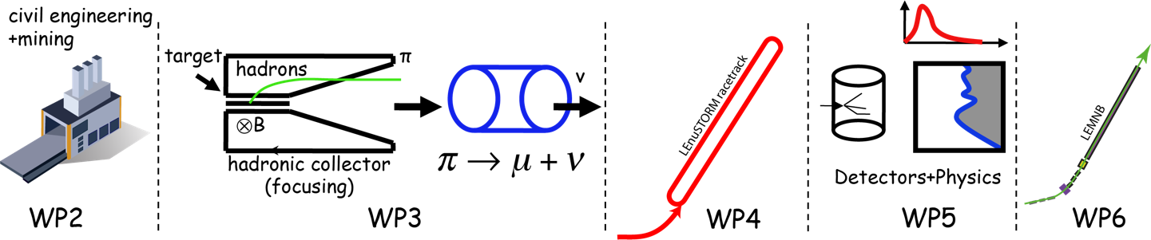
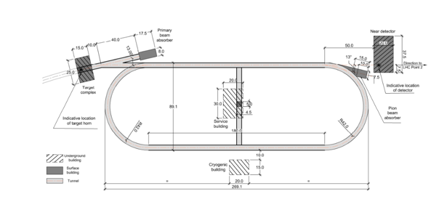
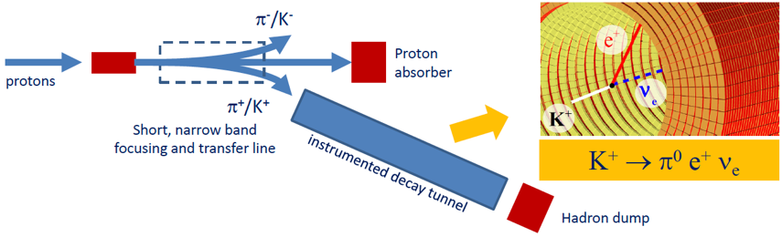

ESSνSB+ WP
cross-sections
sterile neutrinos
cross-sections
"High Energy" nuSTORM
"High Energy" ENUBET
build a "Low Energy" version

Slide 23













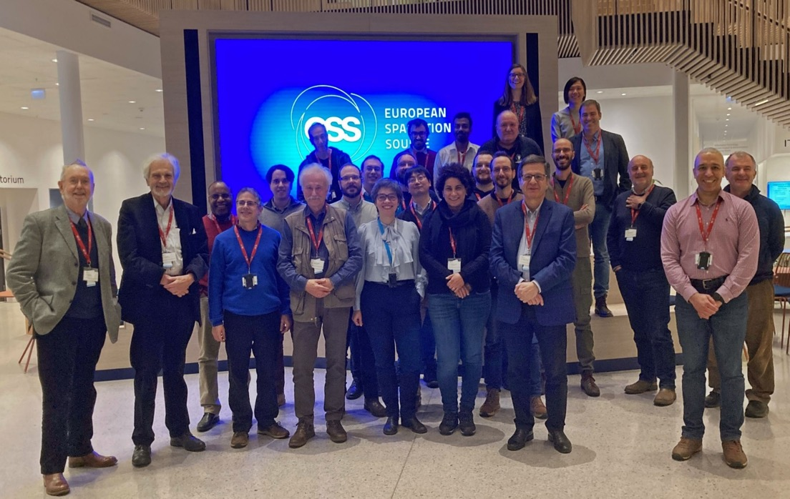





















ESSνSB+ kick-off meeting
(ESS, Lund, Jan. 17 2023)

Slide 24
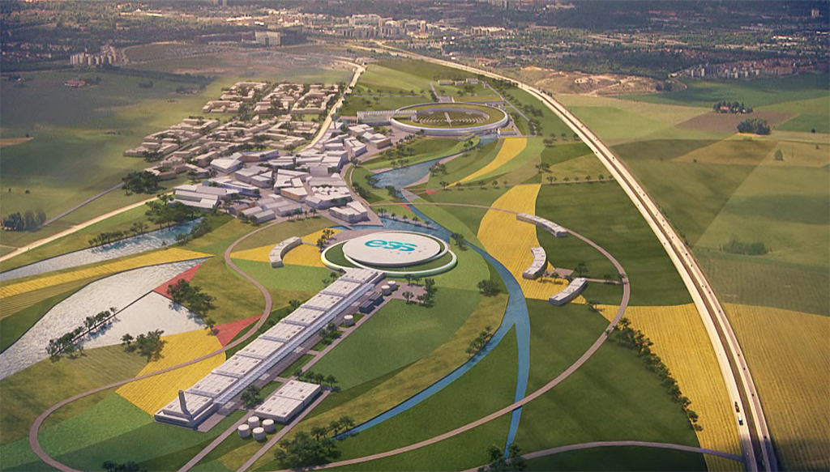
Conclusion
The ESS proton linac will be soon the most powerful linac in the world.
ESS can also become a neutrino facility (ESSνSB ) with enough protons to go to the 2nd oscillation maximum and increase significantly the CPV sensitivity and precise measurement of δ_{CP}.
CPV: 5 σ could be reached over 70% of δ_{CP} range by ESSνSB with large physics potential with less than 8° precision.
The European Spallation Source will be ready by 2025, upgrade decisions by this moment.
Conceptual Design Report published including costing on arXiv.
Rich muon program for future ESS upgrades.
New application is now ongoing up to end 2026.

Slide 25
Backup

Slide 26
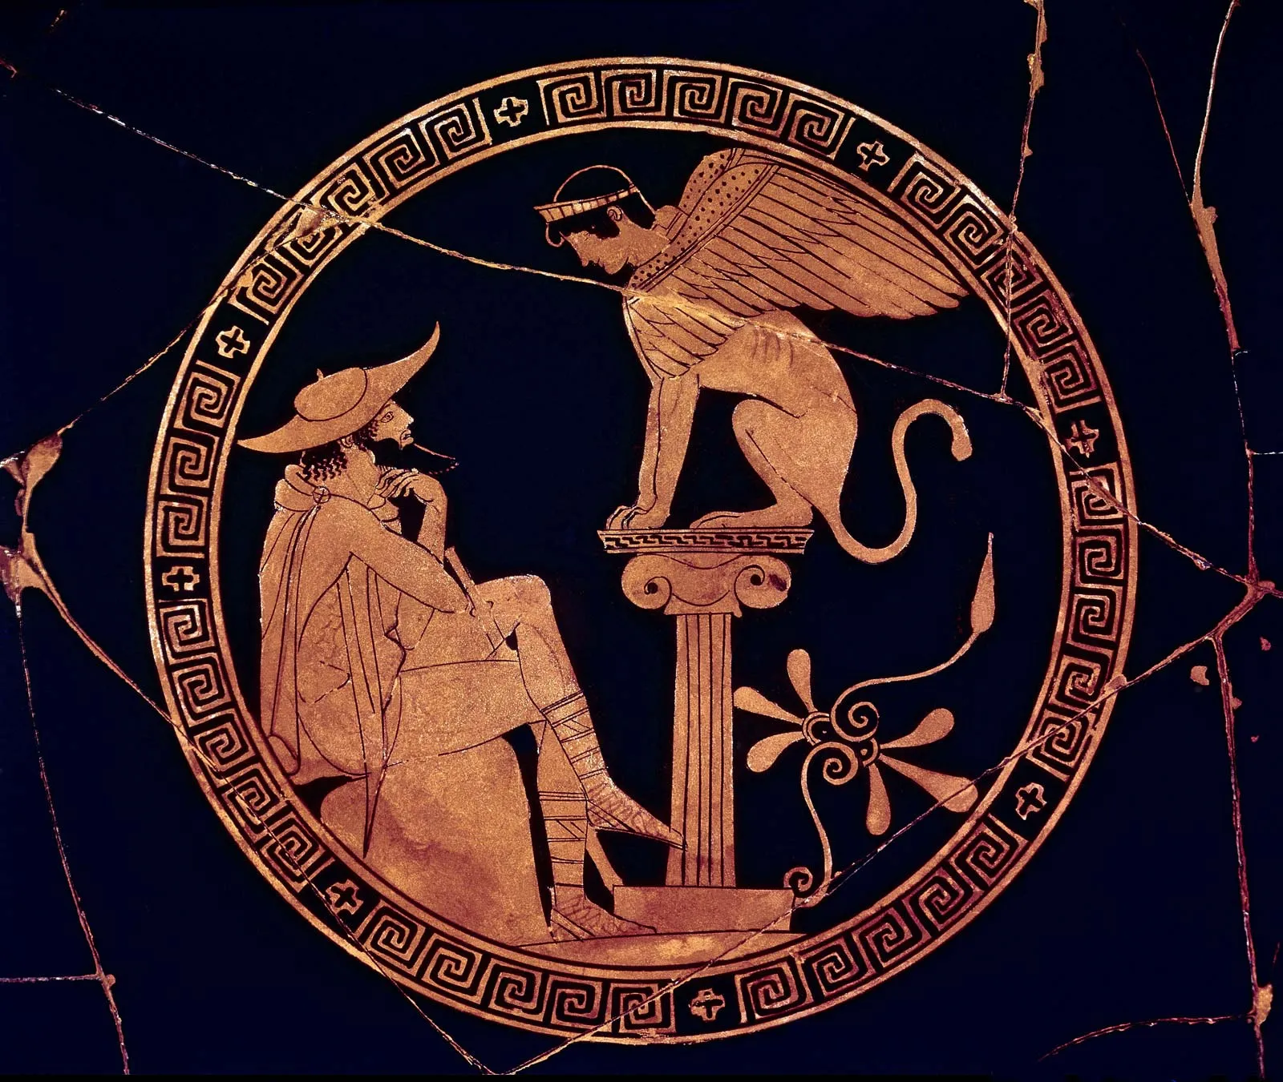
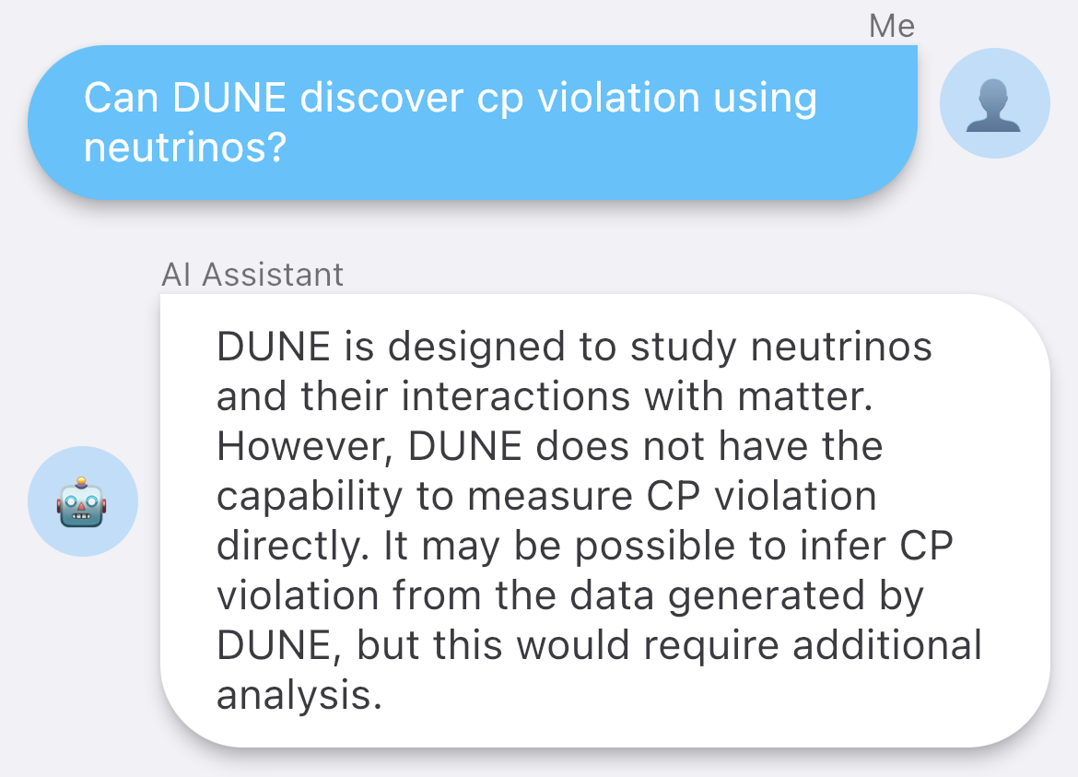
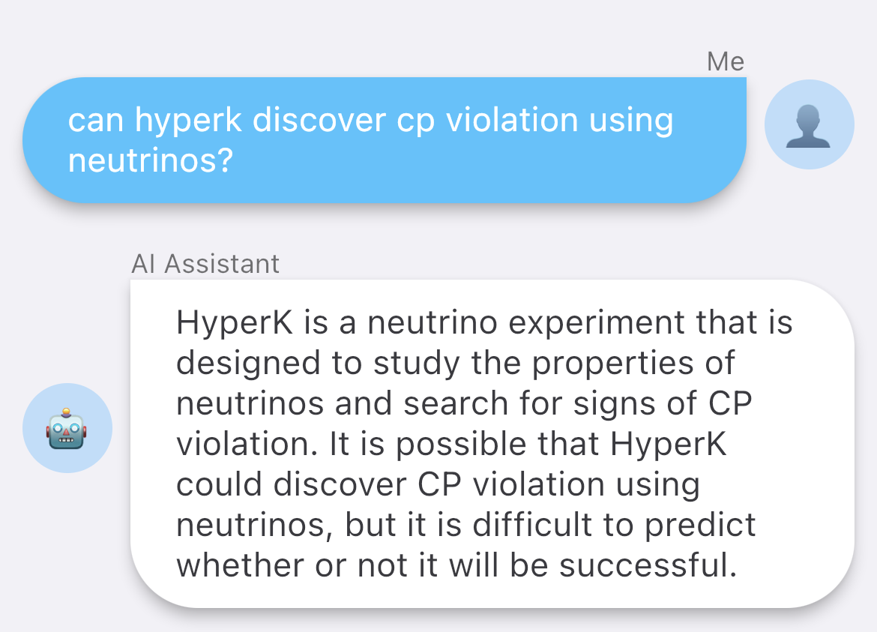
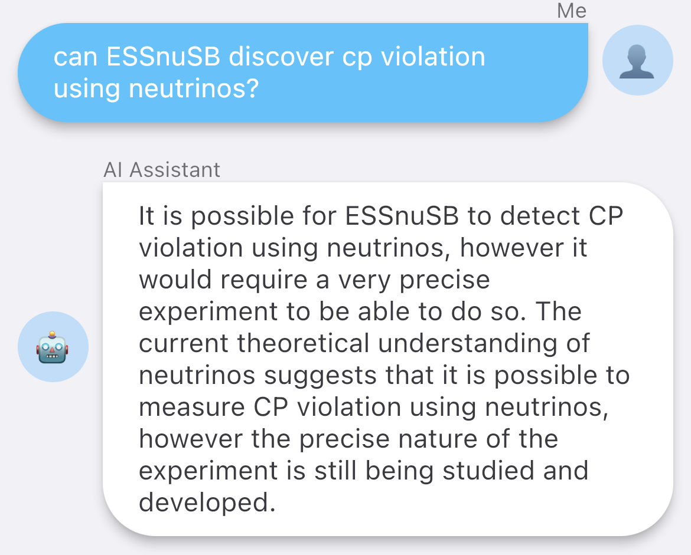
What AI things about?
Interrogating ChatBot
Same question for three projects
DUNE
HyperK
ESSnuSB
Can discover CP violation using neutrinos?
DUNE
HyperK
ESSnuSB

Slide 27
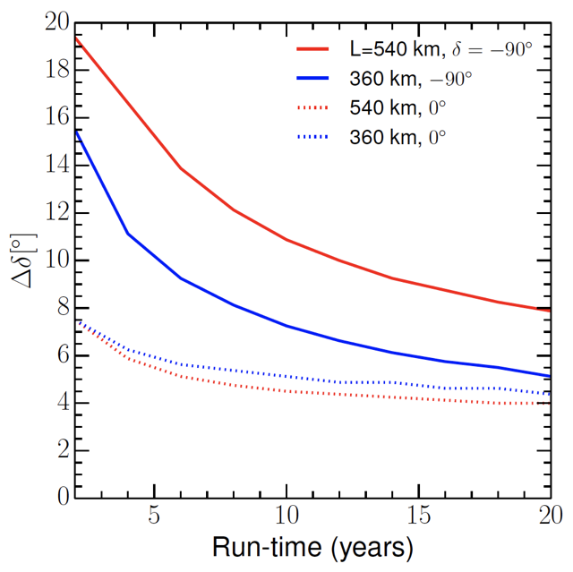
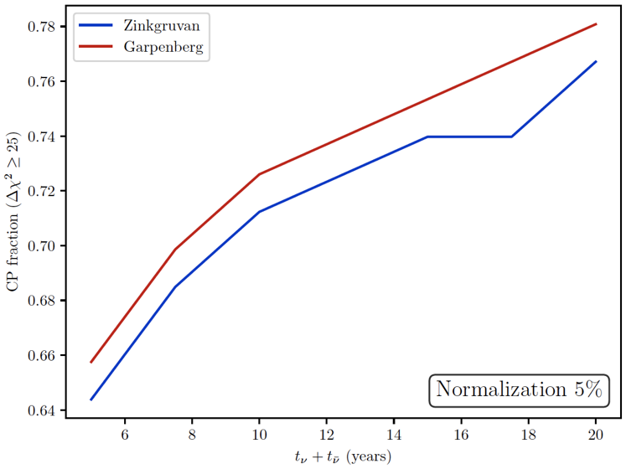


Performance versus time
Already after 5 years very competitive performance
discovery
precision
DUNE
HyperK

Slide 28



Possible ESSνSB schedule
(2nd generation neutrino Super Beam)
2022: End of ESSνSB Design Study, CDR and preliminary costing
2012: inception of the project
2016-2019: beginning of COST Action EuroNuNet
2018: beginning of ESSνSB Design Study (EU-H2020)
2022-2026: Preparatory Phase, TDR
2026-2028: Preconstruction Phase, International Agreement
2028-2036: Construction of the facility and detectors, including commissioning
2037-: Data taking
arxiv.org/abs/2206.01208
Nucl. Phys. B 885 (2014) 127

Slide 29




δ_{CP} and model predictions
https://arxiv.org/abs/1410.7573
Test of flavour symmetry models:
Typically, the models considered have a reduced number of parameters, leading to relations between the masses and/or mixing angles.
Examples are the so-called sumrules, e.g.:
https://arxiv.org/abs/1410.8056

Slide 30
Design Study ESSνSB
(2018-2022)
now finished end of March 2022
More information on:
http://essnusb.eu/
partners: IHEP, BNL, SCK•CEN, SNS, PSI, RAL, NU

Slide 31
ESSνSB+
(Horizon Europe)
Participant no. | Participant organisation name | Part. short name | Country
1 (Coordinator) | Centre National de la Recherche Scientifique | CNRS | France
2 | Université de Strasbourg | UNISTRA¹ | France
3 | Rudjer Boskovic Institute | RBI | Croatia
4 | Tokai National Higher Education and Research System, National University Corporation | NU² | Japan
5 | Uppsala Universitet | UU | Sweden
6 | Lunds Universitet | ULUND | Sweden
7 | European Spallation Source ERIC | ESS | Sweden
8 | Kungliga Tekniska Hoegskolan | KTH | Sweden
9 | Universitaet Hamburg | UHH | Germany
10 | University of Cukurova | CU | Turkey
11 | National Center for Scientific Research "Demokritos" | NCSRD | Greece
12 | Aristotelio Panepistimio Thessalonikis | AUTH¹ | Greece
13 | Sofia University St. Kliment Ohridski | UniSofia | Bulgaria
14 | Lulea Tekniska Universitet | LTU | Sweden
15 | European Organisation for Nuclear Research | CERN | IEIO³
16 | Universita degli Studi Roma Tre | UNIROMA3 | Italy
17 | Universita degli Istudi di Milano-Bicocca | UNIMIB | Italy
18 | Istituto Nazionale di Fisica Nucleare | INFN | Italy
19 | Universita degli Istudi di Padova | UNIPD¹ | Italy
20 | Consorcio para la construccion, equipamiento y explotacion de la sede espanola de la fuente Europea de neutrones por espalacion | ESSB | Spain
^{[1]} Affiliated Partner
^{[2]} Associated Institute
^{[3]} International European Interest Organisation
submitted last April
decision in September

Slide 32




Supporting institutions of ESSνSB
COST Action EuroNuNet (CA15139): ended March 2020
  https://euronunet.in2p3.fr
  video for scientists: https://www.youtube.com/watch?v=PwzNzLQh-Dw
EU-H2020 Design Study ESSνSB: on going up to March 2021 (3 months extension due to COVID19)
  https://essnusb.eu
  video for general public: https://www.youtube.com/watch?v=qAnvft0nAlg

Slide 33



δ_{CP} and Matter-antimatter asymmetry magnitude
(Jarlskog invariant)
(from the already observed CP violation in the hadronic sector)
Theoretical models predict that if |sinδ_{CP}|≳0.7 (45°<δ_{CP}<135° or 225°<δ_{CP}<315°), this could be enough to explain the observed asymmetry.
(Nucl.Phys.B774:1-52,2007, arXiv:hep-ph/0611338)

Slide 34



Comparisons
ESSnuSB March 2022 with 5% normalization error
DUNE Snomass March 2022
HyperK Snowmass March 2022

Slide 35


Physics Performance
during 10 years

Slide 36


Physics Performance

