Slide 1
Engineering Department Mandate and Structure

Slide 2
The Engineering Department
Mandate and activities
Project Phases
Structure
Working with other WP’s within INFRA- Dev
Tools

Slide 3
The Engineering Department
The Engineering Department (EN) is mandated for the design, engineering, procurement, installation, commissioning, operation, maintenance and eventually dismantling of:
The special systems (e.g. vacuum, cryogenics, survey) associated with the gravitational wave detector;
The technical infrastructure systems needed to operate the interferometer (e.g. civil engineering, cooling, ventilation, electricity).
The requirements, parameters and the layout of the interferometer are set by the ET collaboration in charge of the GW observatory.

Slide 4
The Engineering Department
The activity of the Engineering Department is in the following fields:
The technical infrastructure: civil engineering, cooling, ventilation, electricity, transport, handling, access and alarms;
The technical systems associated with the gravitational wave detector: vacuum, cryogenics and survey;
Technical Coordination in close collaboration with the Project Office;
Giving technical support to the ET Collaboration.

Slide 5
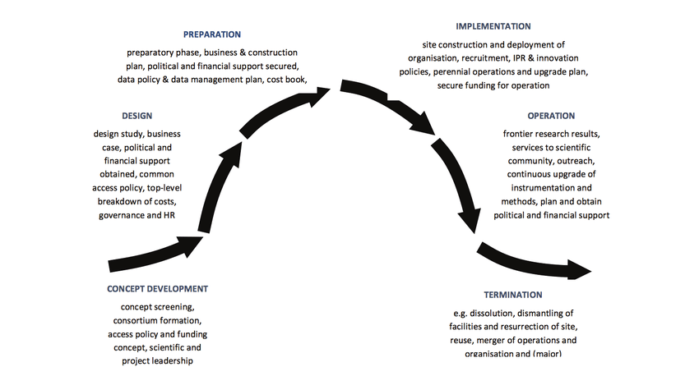
The Engineering Department Phases
Preparatory phase (sept 2026): will need support from ET Collaboration → TDR and Cost
Preliminary Design Phase
Need a holistic view of ET
Final Design Phase
Implementation phase
Civil
Technical Infrastructures
GW Detector
Operation
ED needs to adapt to every phase

Slide 6
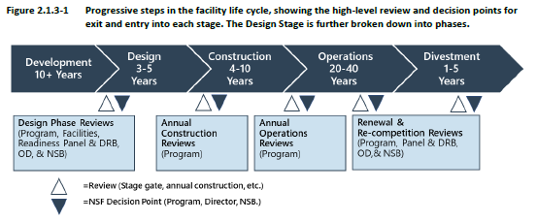
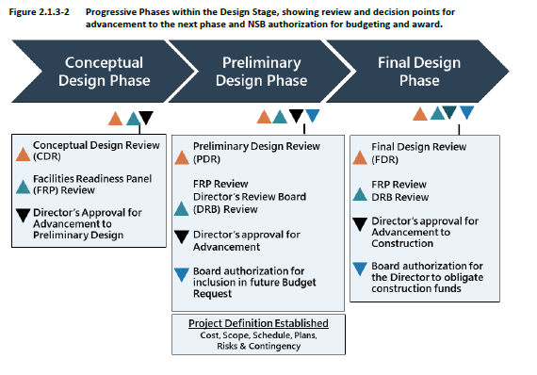
Life Cycle Stages (nsf21107.pdf)

Slide 7
The Engineering Department Structure
The organization of the Engineering Department will be based on work packages following the WBS to ensure the benefits of a systematic approach → Systems Engineering
Vertical team structure functions with focus on the specific goals. Preferred for growing or scaling the teams.
Engineering Design Processes and Tools used for Infrastructure and GW Detectors are expected to be different.
Integration: that the system can be built together and that it will work

Slide 8
The Engineering Department Structure
Engineering Department
Project Office
Safety
Procurement
………….
Civil Engineering
Technical Infrastructure
Risk and Integration
GW Detectors

Slide 9
Civil Engineering
Maria Marcella
Site
Underground
Surface
Layout
Tunnels
Offices and laboratories
Geology
Caverns
Technical Buildings
Environment and Landscape
Shafts
Roads
Access

Slide 10
Technical Infrastructure
Ventilation
Electricity
Cooling
Transport and Handling
Access and Alarms

Slide 11
Risk and Integration

Slide 12
GW Detectors
Suspensions
Vacuum
Cryogenics
Optics
Interferometer
……….
HF Suspensions
Beampipe vacuum
ET cryostats
LF Suspensions
Other vacuum systems
LF Cryotrap

Slide 13
The Engineering Department Tools
Consensus on a CAD system with online Product Lifecycle Management (PLM) system: on premise or in the Cloud?
Workflows: approval processes, change management, ….
Re-use of Items and Commercial parts
Managed Bill of Materials
Document management
Various options like Teamcenter (on premise, Teamcenter X (Cloud), Enovia, ………

Slide 14
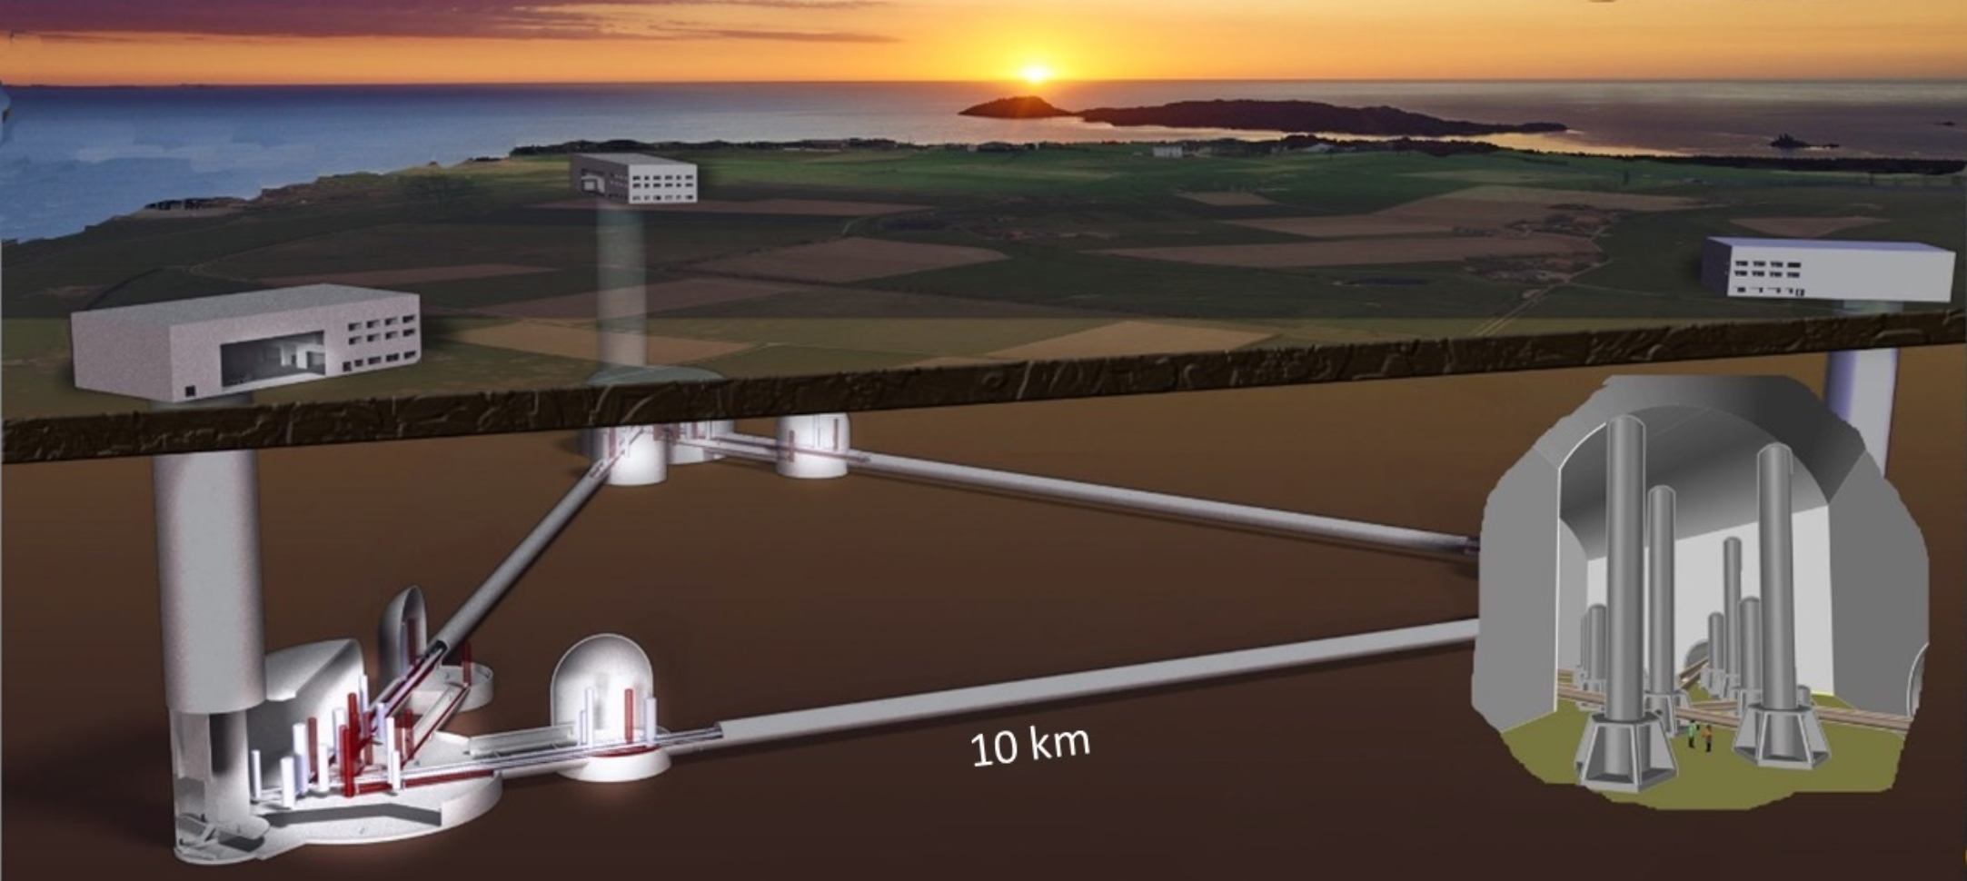
Outline
The site
The layout and the variants
The geology and the variants
The environment and the landscape
The underground setting
The tunnels
The caverns
The shafts
The accesses and the recesses
The surface works
Offices and laboratory
Technical buildings
Access roads
Draft 20221018

Slide 15
Task of the Work Packages
The goal is the definition of alternative TDR’s for the underground and surface civil infrastructures
Site characterization specification and service plant requirements constitute an inputs for the following Tasks, however interactions with scientists is needed.
Task 1: Science and technology requirements
Task 2: Civil Engineering Studies for the Underground Works
Task 3: Civil Engineering Studies for the Surface Works
Task 4: Environmental impacts and landscape engineering
Task 5: Civils vs industrial engineering (performance and noise reduction strategy)
Task 6: Support to the implementation phase

Slide 16
Site characterization vs civil engineering
Aimed at ensuring detector performance and at gathering requirements for civil engineering design
Geological conditions to identify structures, faults, lithology, fractures, alteration, short- and long-term water ingress, etc. to estimate risks of geological hazards i.e. tunnel stability, ground water lowering, subsidence, karst, earthquakes.
Hydrogeological conditions to understand the groundwater regime to evaluate potential water inflow into tunnels, shafts and larger cavities during construction phase and define mitigation actions during exploitation phase, Water-drainage systems are a significant source of infrastructure noise affecting the GW detector.
Draft 2022101u8
Geotechnical conditions to understand and forecast the behaviour of hosting rock mass and the variability of the relevant infrastructure parameters as a function of rock types, weathering level, parting, lateral and vertical anisotropy, etc. Also to identify the levels of the primary radioactive elements and their radioactive decay products that lead to human exposure during the works and the lifetime of ET

Slide 17
Task1: Science and technology requirements
Convey and express relevant scientific requirements into civil engineering constraints, condition and qualification
Assessing CE technical choices based on:
Excavation volume (i.e., tunnel length and diameter)
Site underground conditions and related uncertainties
Ground behaviour
Excavation method
Tunnel depth
Support requirements
Final lining design
Water ingress and tunnel drainage system
Environmental aspects
Labour cost
Health and safety regulations
Market competition
Contract type
Cost of bidding
Draft 20221018
The variants
Layout (L or △)
Site (Sardinia or EMR)

Slide 18
WP2: Civil Engineering Studies for the Underground Works
Geotechnical settings and modelling
Structural engineering modelling (metal constructions)
Safety is under project office!
BIM and digital twin
Water drainage systems
Draft 20221018

Slide 19
WP3: Civil Engineering Studies for the Surface Works
Design of research buildings, guesthouses, technical facilities, exit portals, access roads
Transportation and logistics
Integration and connectivity between surface and subsurface
Draft 20221018

Slide 20
WP5: Environmental impacts and landscape engineering
Excavation waste removal strategy
Protected areas and reserves
Territorial issues
Mitigation actions
….
Draft 20221018

Slide 21
WP6: Civils vs industrial engineering
ET performance and noise reduction strategy
Overall dimension requirements for scientific installation (cryogenic plant, vacuum pumps, etc.)
Structural needs for positioning of technical/service installations (water pumps, air ventilations, electric power, etc
Configuration of network of connections (cabling, ducts, buffer zones, etc.)
Integration Studies for the pipes, the ducts and the cables
Integration Studies for the Gravitational Detector
Draft 20221018

Slide 22
Task 6: Support to the implementation phase
Draft 2
02210
18
The bidding and the procurement process
The construction work
Site supervision
Safety

