Slide 1

Time Synchronization Scheme for the Hyper-Kamiokande experiment
IN2P3-IRFU-INFN
25/10/2022

Slide 2
Context
LPNHE, CEA and INFN have joined forces to design a full time distribution scheme that has been submitted to the international collaboration in April 2022. The group will be in charge of its construction, commissioning and maintenance.
The proposal envisions to provide a system that fulfills the needs of the HK far detector. Possible synergies could be found with the time generation system at JPARC, the Intermediate Water Cherenkov detector and the future ND280 upgrades (when integrated in HK).
To conceive this proposal, an intense and fruitful R&D campaign has been carried out. The designed time distribution system meets all the far detector requirements.
This program takes advantage of the experience that group members have acquired in designing similar systems for other experiments and of a very fruitful collaboration with the SYRTE lab (Observatoire de Paris) responsible for the French UTC implementation.

Slide 3
HK Clock Distribution Scheme
Cavern
/
/
2
Time data and UTC (ethernet)
DAQ
network
WR
Network
Slow control
WR switch
WR switch
FE
PPS/10MHz
Commands and data
2nd distribution stage
…
10MHz, PPS & Data
Time Ref/
fanout
125MHz &
data
PPS/125MHz
1st distribution stage
FE
GNSS
GNSS
5MHz
Clk and data
(redounded link)
5MHz
Slow
control
…
Time/
Freq comp.
Atomic Clock
Sync commands
125MHz &
data
FE
Calibration
/
10
2nd distribution stage
…
5MHz
WR
Network
FE
WR switch
WR switch
Clk and data
(redounded link)
Time Ref/
fanout
PPS/10MHz
10MHz, PPS & Data
1st distribution stage
GNSS
Atomic Clock
GNSS
5MHz
PPS/125MHz
Redundancy

Slide 4
HK Clock Distribution Scheme
Cavern
/
/
2
Time data and UTC (ethernet)
DAQ
network
WR
Network
Slow control
WR switch
WR switch
FE
PPS/10MHz
Commands and data
CEA
2nd distribution stage
…
10MHz, PPS & Data
Time Ref/
fanout
125MHz &
data
PPS/125MHz
1st distribution stage
FE
GNSS
GNSS
5MHz
Clk and data
(redounded link)
LPNHE
INFN
5MHz
Slow
control
…
LPNHE
Time/
Freq comp.
Atomic Clock
Sync commands
125MHz &
data
FE
Calibration
/
10
2nd distribution stage
…
5MHz
WR
Network
FE
WR switch
WR switch
Clk and data
(redounded link)
Time Ref/
fanout
PPS/10MHz
10MHz, PPS & Data
1st distribution stage
GNSS
Atomic Clock
GNSS
5MHz
PPS/125MHz
Redundancy

Slide 5
The Clock Generation & UTC Conceptual Scheme
The local time is generated (by a precise atomic clock) in the form of 5MHz (HK local time).
The time reference point custom board receives this frequency, generates a local PPS and distributes them to the GNSSs and the first distribution stage. It has extra ports to compare the main and spare base cadence.
The first distribution stage produces the clock which is sent via the second stage to the FE.
The events will be tagged with the HK local time and converted in UTC by the DAQ. A correction algorithm will be applied to compensate the atomic clock drift.

Slide 6
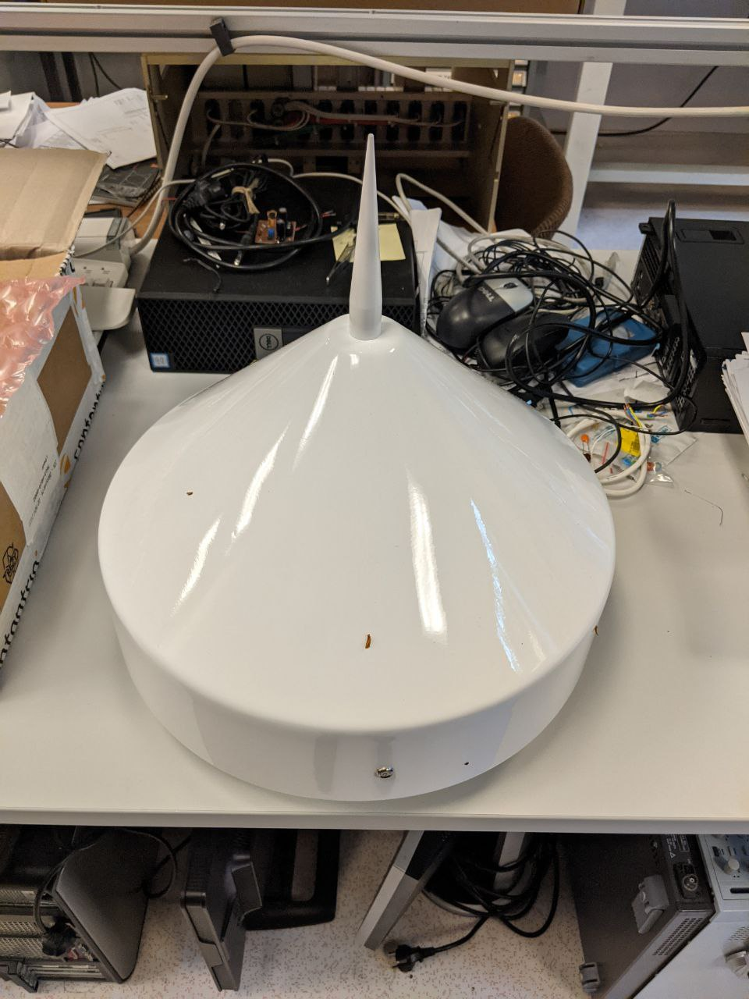
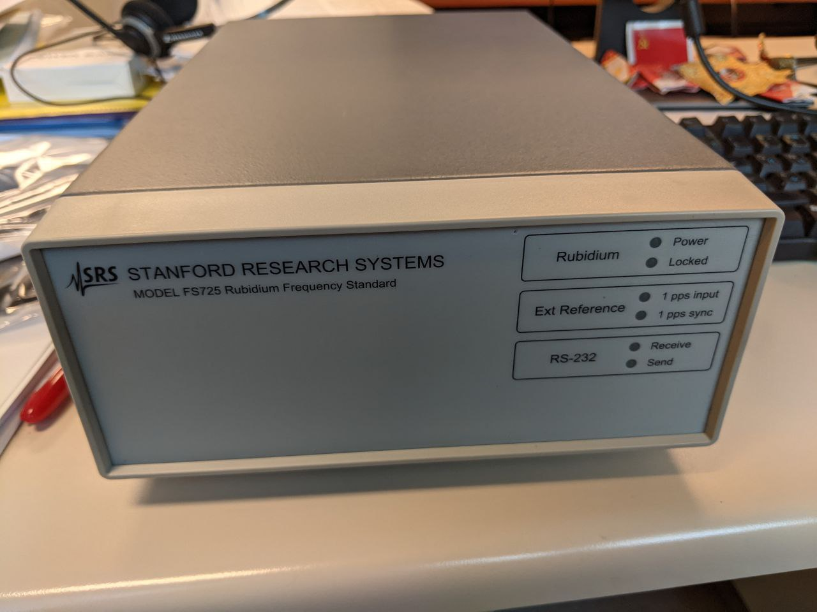
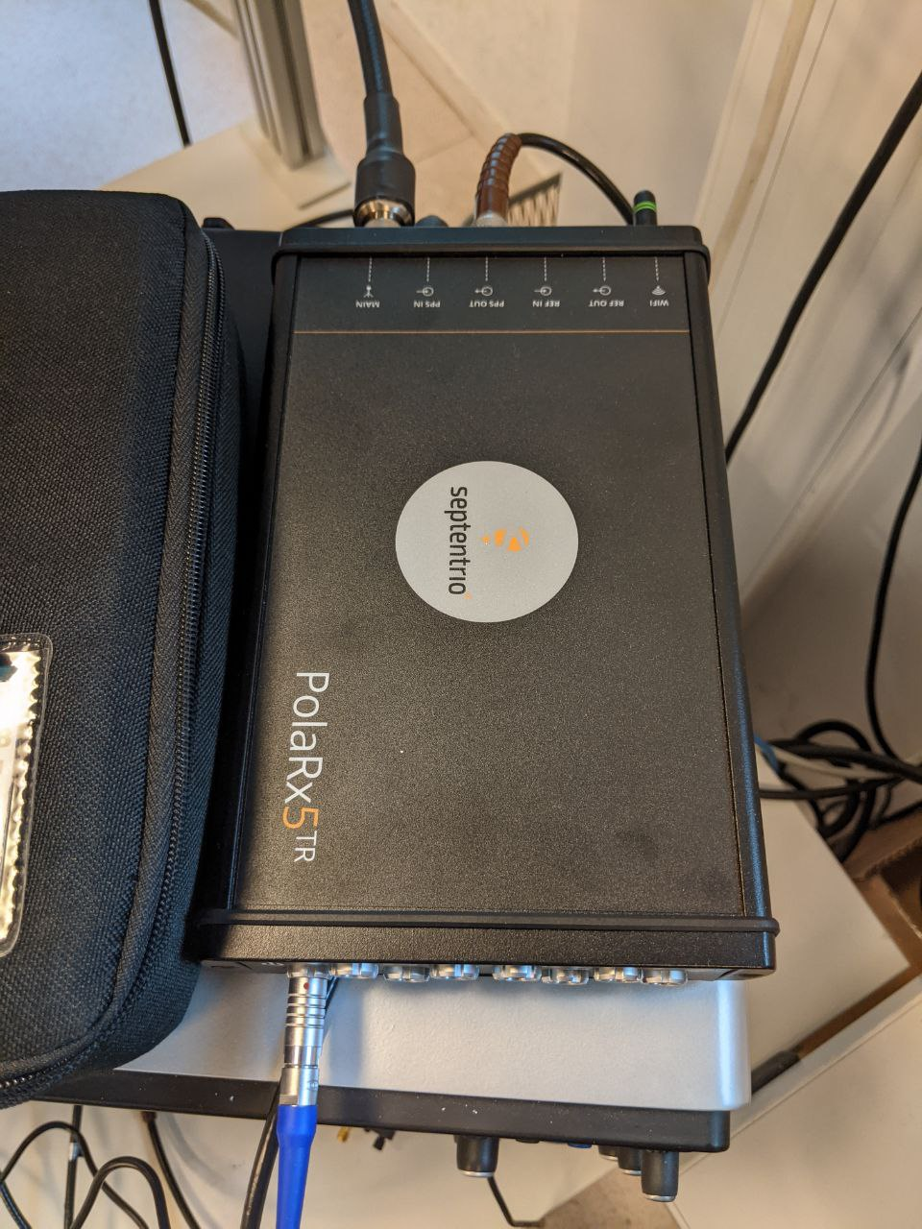
Time Base and UTC Characterization
All the main chain components have been purchased and an extensive test campaign has been performed to precisely characterize the proposed scheme
At LPNHE we have:
2 SRS SF725 Rubidium atomic clocks
2 Septentrio PolaRx5TR receivers + antennas
2 clock and Frequency counter Keysight 53220
1 PH1008 Passive Hydrogen Maser Atomic clock
We have also a copy of the UTC(OP) PPS and 10MHz clock sent via white Rabbit link from the SYRTE laboratory (where it is produced). This is very important time reference for comparative analysis.
Work performed by M. Guigue, L. Mellet and V. Voisin

Slide 7
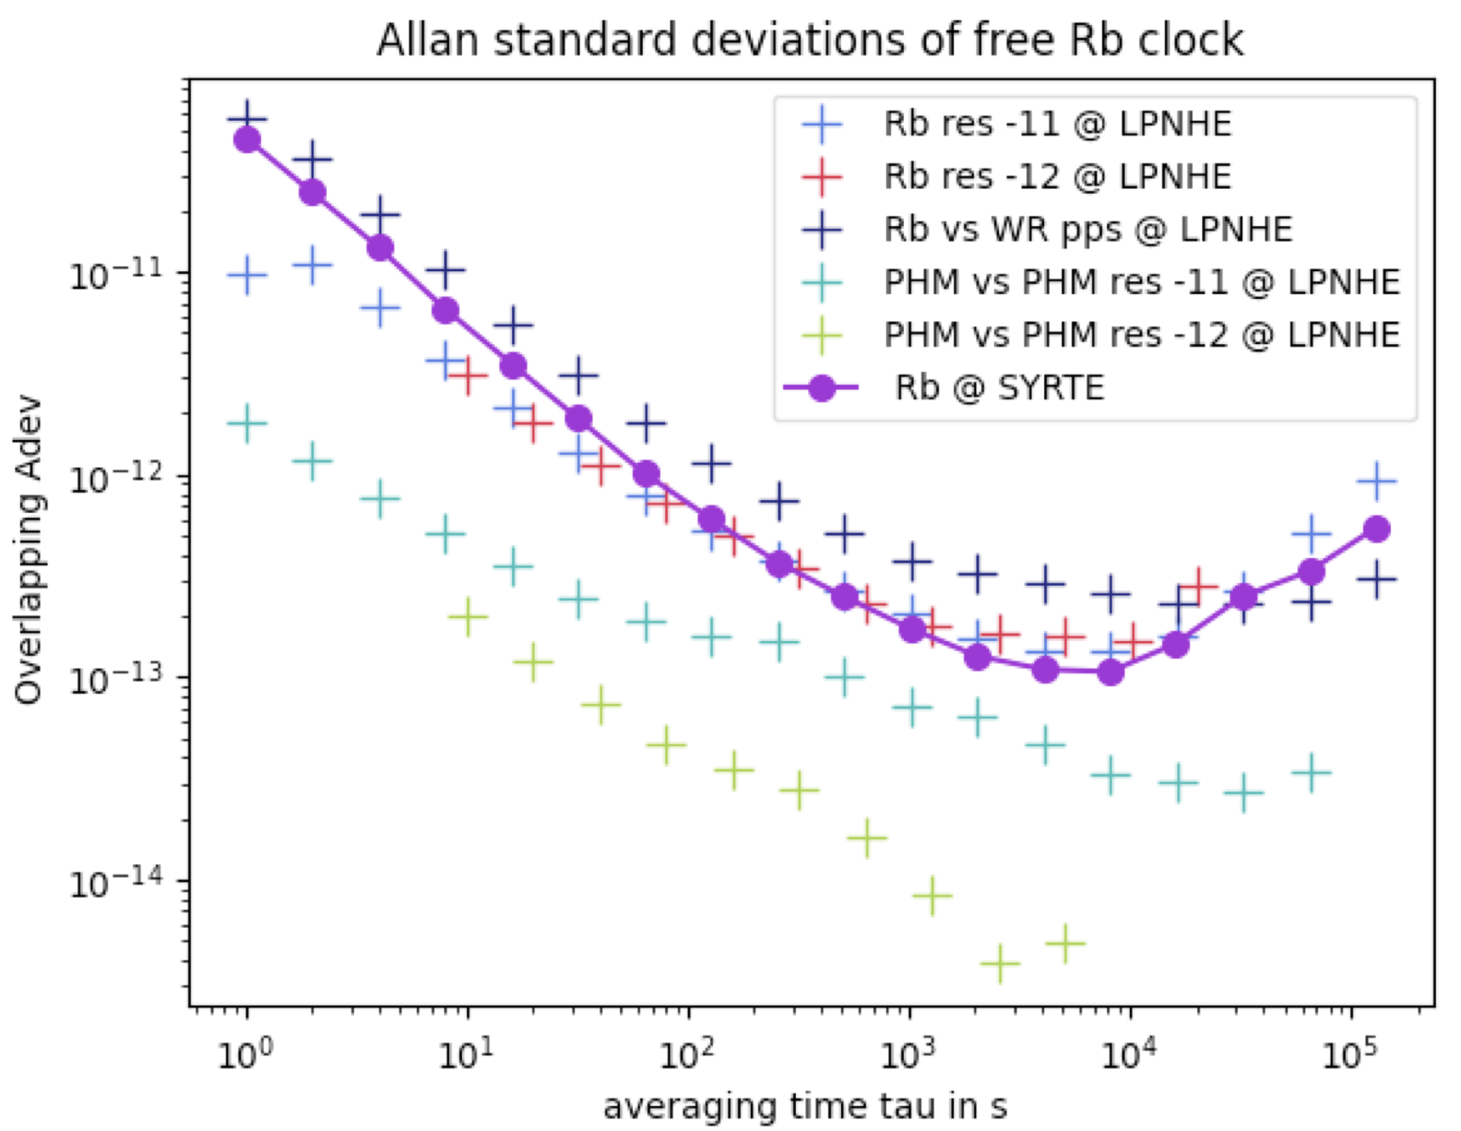
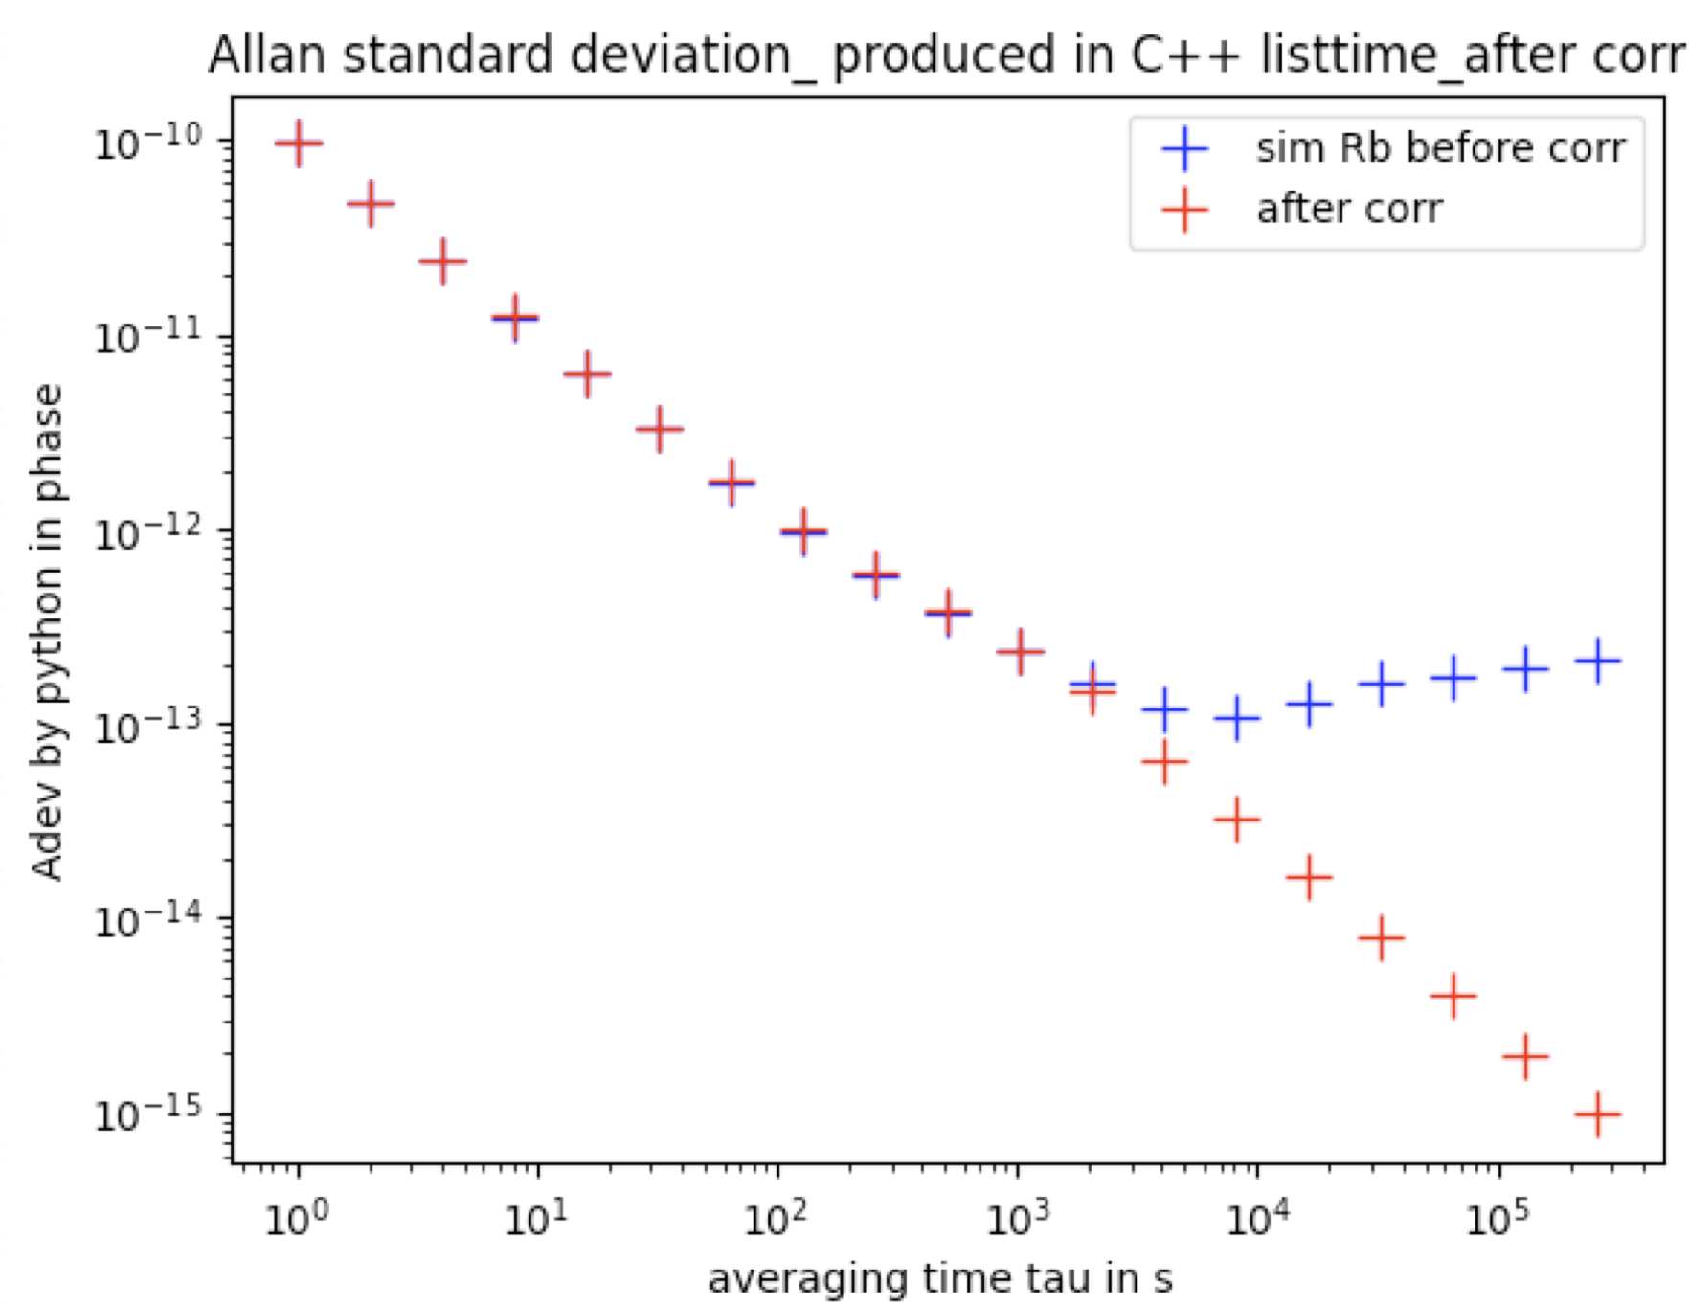
Time Base and UTC Characterization Results and correction studies
Measured performances of the atomic
clocks and GNSS receivers
Simulated stability of the local time base after
UTC conversion and correction
The work on the correction algorithm is progressing and we are planning to test it on real data in the next 6 months.
Tests at HK and JPARC site are under discussion. We hope to perform them by March 2023.
The local time base to UTC and JPARC site expected uncertainty is about 10 ns (100 ns required).
More detail in the L. Mellet talk https://hkdbweb.in2p3.fr/doc/meetingfiles/A00004681/Clockstudies_HKpremeeting.pdf
Work performed by M. Guigue, L. Mellet and V. Voisin

Slide 8
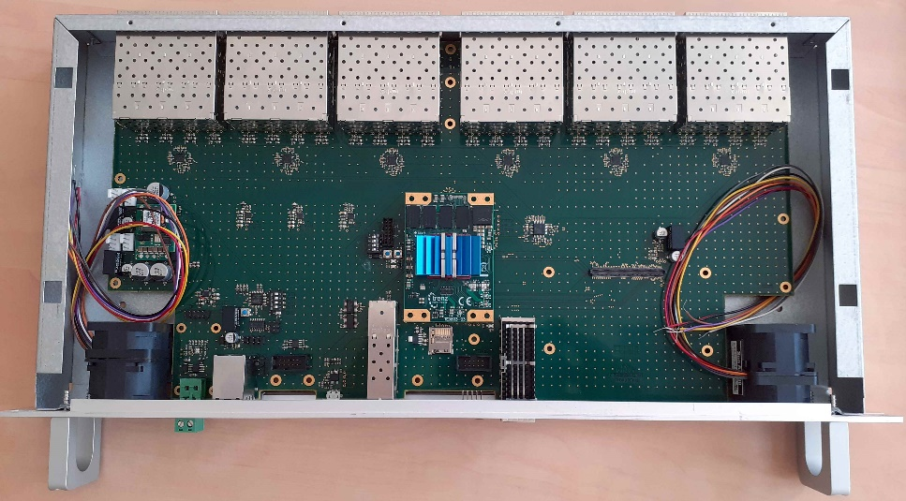
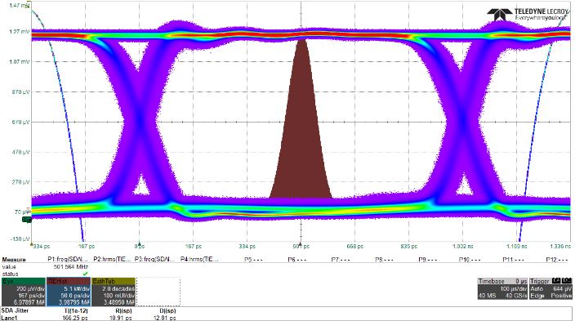


First Clock Distribution Stage Board Demonstrator
  Principles
  Generic board for R&D on clock distribution based on Trenz SoC with Xilinx UltraScale+ FPGA
  Command interpreter on SoC (bare metal, Linux in final system) + Gbit Ethernet link to control PC
  Mezzanine card interfaces to external reference master clock
  Optical out – 1 Gbps data mode
  Rj = 11 ps and Dj < 13 ps
  Current results
  48 TX ports tested in pure clock distribution mode, modulated clock mode and classical serial data transmission. Runs up to 1 Gpbs and shows low jitter Rj typ. ~10 ps Dj typ. <20 ps
  Stability of input to output latency at level of 10 ps after board power cycling, and comparable stability of relative phase alignment between different optical outputs
  48 RX ports tested for 125 MHz clock feed back reception. Logic based on DDMTD technique being implemented to measure stability of distributed clock via round-trip latency monitoring
Work performed by CEA-IRFU D. Calvet and E. Molina

Slide 9
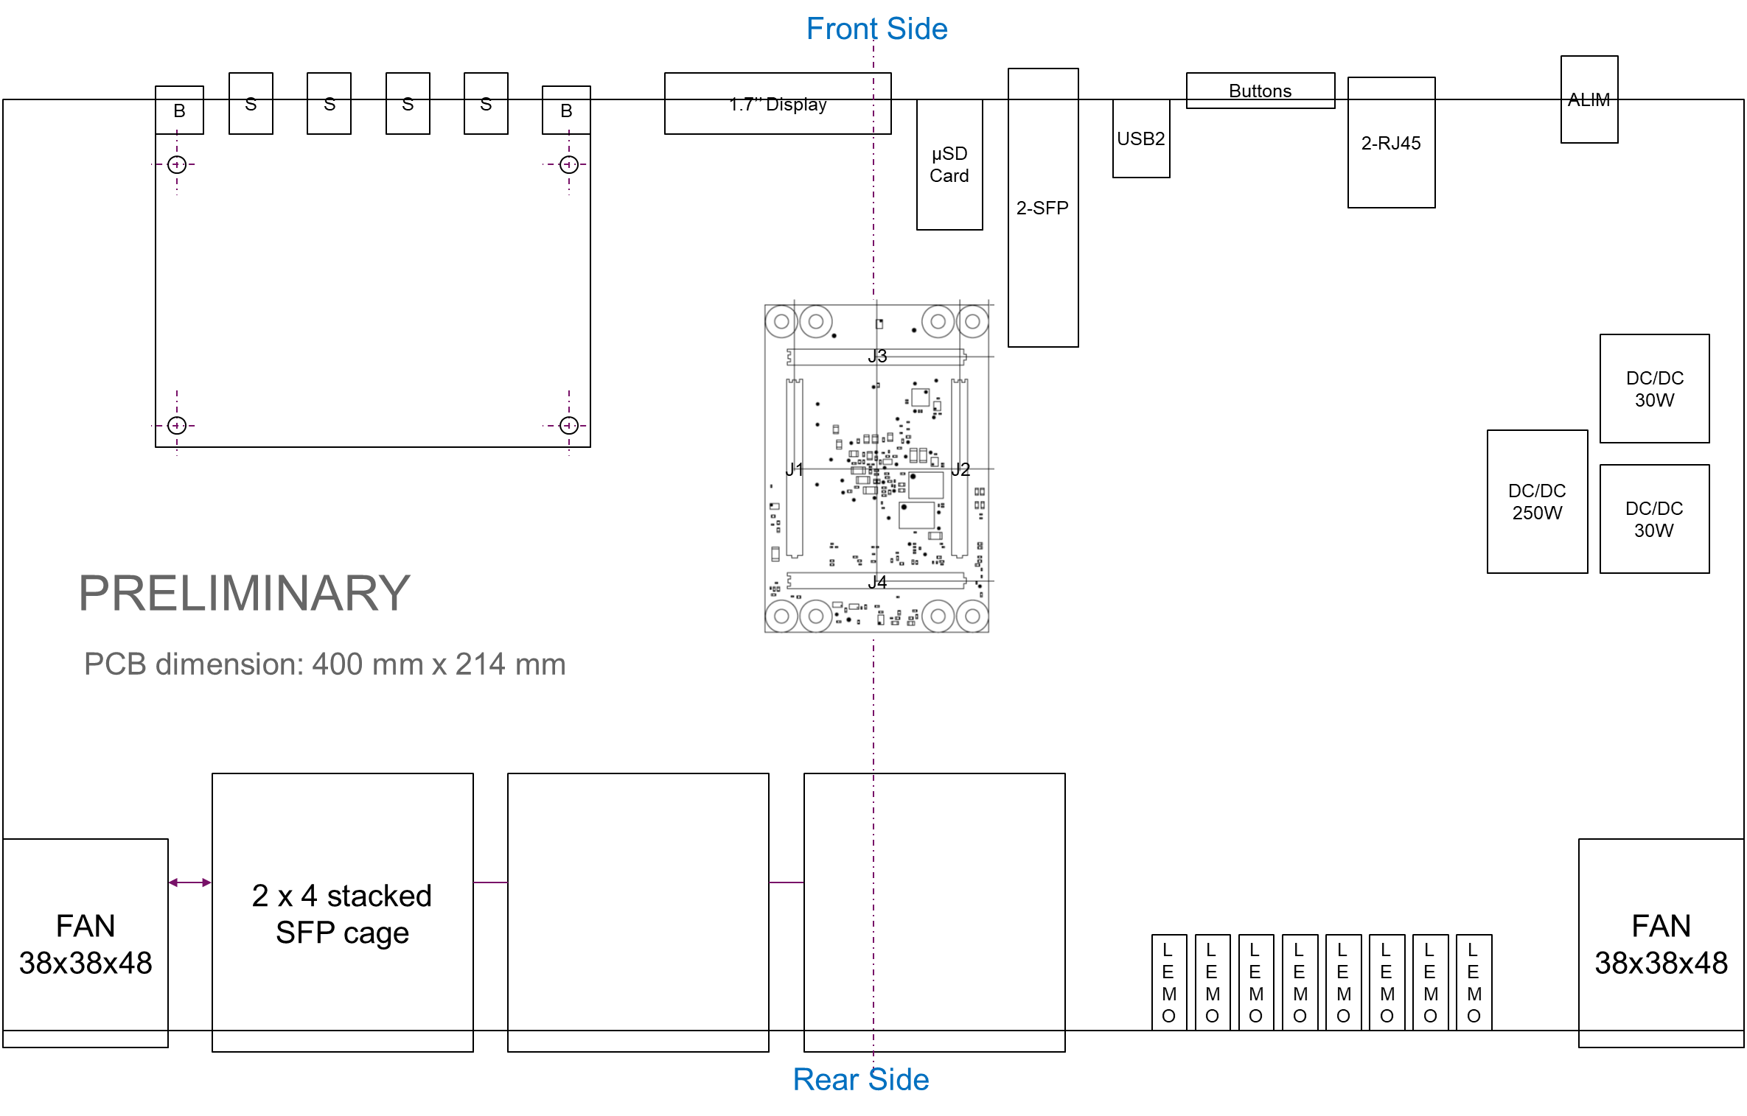
First Clock Distribution Stage Board Next Steps
  48-port demonstrator – exploitation
  Continue firmware/software functionality developments and device characterization
  Incorporate clock mezzanine card – production suffered delays; board now expected mid-nov
  Validate specific blocks and various concepts as much as possible
  1st stage clock distributor prototype – in design
  Same concept architecture as 48-port prototype and re-use of many of its validated parts.
  Lower density of 24-ports allowable by the use of passive optical splitter in the TX direction and because only a small fraction of 2nd stage distributors will have a return optical link to the 1st stage
Work performed by CEA-IRFU D. Calvet and E. Molina

Slide 10
Second Clock Distribution Stage Board Concept
The board receives the clock from the first stage and transmits the it to the time distribution endpoint in the front-end embedded into data via optical fiber.
The main element is an FPGA with embedded processors mounted on Trenz module TE0808.
It runs a custom firmware and software working under a Linux OS (Debian).
Work performed by LPNHE (s. russo and E. Pierre)

Slide 11
Second Clock Distribution Stage Board
Tests and Next Steps
Jitter measured at the
Endpoint = 2.4ps
Clock and data distribution have been tested with EVBs and already available boards. The jitter at the endpoint has been measured at 2.4 ps (requirement 100 ps) after a PLL jitter cleaner.
The firmware and software development continues on EVB and it will be ported on the first prototype as it arrives. The porting time will be very short due to the high compatibility of the two systems.
Tests will be then performed against the DPB prototypes already in our possession (thanks to C. Toledo and M. Ziembicki)
To absorb long delay on procurement a tender for the final production mezzanine purchase has been done. The process will be finalized by mid November.
Work performed by LPNHE and INFN (s. russo and F. Ameli)

Slide 12
Time Distribution Endpoint
The time distribution endpoint will be embedded in the Data Processing Board.
We support the DPB development providing firmware/hardware IPs and components.
A full chain composed from the second distribution stage, the DPB and digitizer will be installed at CERN as soon as a suitable space will be available (negotiations started).
To absorb long delay on procurement a tender for the final production SFP transceivers purchase has been done. The process will be finalized by mid November.
Work performed by LPNHE and INFN (s. russo and F. Ameli)

Slide 13
Time Distribution Schedule
The work is on schedule. The production is expected to be concluded in time for the assembly and commissioning in Japan

Slide 14
Summary
A great synergy and collaboration has been established between IN2P3, CEA, INFN.
The full time distribution scheme has been designed.
Test and characterization campaigns on different subsystems have been carried out.
First prototypes have been designed and are ready/fabricated now.
The system will be tested together with the DPB and digitizer soon

Slide 16
Clock Generation & UTC - Connections
The local time is generated (by a precise atomic clock) in the form of 5MHz in synch to each other (HK local time).
The time reference point custom board receives the frequency, generate a local PPS and distributes them to the GNSSs and the first distribution stage. It has extra ports to compare the main and spare base cadence.
GNSSs use the input cadence to sync the outputs and have a reference frequency more stable than the internal oscillator

Slide 17
Clock Generation & UTC - Connections
2 GNSSs receivers (connected to the same antenna) get information from the satellites and measure the time distance between the local PPS and UTC.
The result of this measure is sent to DAQ and used to transform the local tag to UTC
The DAQ monitors the status of the GNSSs and select which one to use

Slide 18
Clock Generation & UTC - Redundancy
The full chain (atomic clock, GNSSs (x2), and first distribution stage) is replicated for redundancy
Having a total of 4 GNSS receivers will allow the DAQ to identify if one is malfunctioning . Extra different brands receivers will be also used.
The time distance between the 2 chains will be constantly measured and the result sent to DAQ. This info will be used in case of switch from one chain to the other

Slide 19
Clock Generation & UTC - Reliability
Scheduled interventions on components will be performed to reduce the risk of failures
A third atomic clock will be available at far detector site and periodically turned on. It will serve as cold spare used if the main or the hot spare needs maintenance
All the atomic clocks will be measured against the so-called travelling station every 3 / 4 years.
The GNSS receivers will be changed before the end of life.
The maintenance cost needs to be included in the budget request

Slide 20
Septentrio PolaRx5TR calibration
Our receiver (RINEX name: LPN1) was calibrated against one at Observatoire de Paris (OP73) in turn calibrated against a travelling station from Bureau International de Poids et de Mesures (BIPM, responsible of defining UTC). OP73 is then a so-called level 1 receiver and LPN1 has been calibrated as a level 2.
The receiver internal delays were measured for both GPS and Galileo constellations.
The combined uncertainty of the LPN1 station hardware delays calibration is 4 ns. This is the conventional uncertainty applied after a “direct calibration” in the TAI system.

Slide 21
Septentrio PolaRx5TR calibration
The two tables correspond to GPS (P1 and P2 codes) and Galileo (E1 and E2a) codes.
The values will be configured in the receiver and a correction will be applied to the UTC time. Mixing the two constellations' data will be done to provide the UTC time.

Slide 22
Time Base and UTC Characterization
The work on the time base characterization continues and an extensive test campaign is ongoing (thanks mainly to Lucille Mellet, Vincent Voisin and Mathieu Guige).
Most of the results are summarized here:
https://indico-sk.icrr.u-tokyo.ac.jp/event/7332/contributions/22011/attachments/20557/26254/LPNHE_timingsystem_R%26D.pdf
I give just a quick recap:

Slide 23
Kind of Test Performed
We basically perform 2 kind of tests:
Local time base characterization. Test our proposed concept on real hardware
Time transfer via common view: a method to measure two local time bases using the GNSS data. This method is implemented using the files published regularly by UTC(k) labs (Syrte in our case).

Slide 24
Local Time Base Characterization
For this test we use 1Rb clock sending 1 PPS and 10 MHz clock to the Spetentrio receiver. Thanks to the time transfer algorithm, we can estimate the drift of our local time base with respect to GNSS time (only GPS in this case)
PPS
Rb clk
GNSS
10 MHz
CGGTTS
CGGTTS file with time distance
Between local time and GPS time

Slide 25
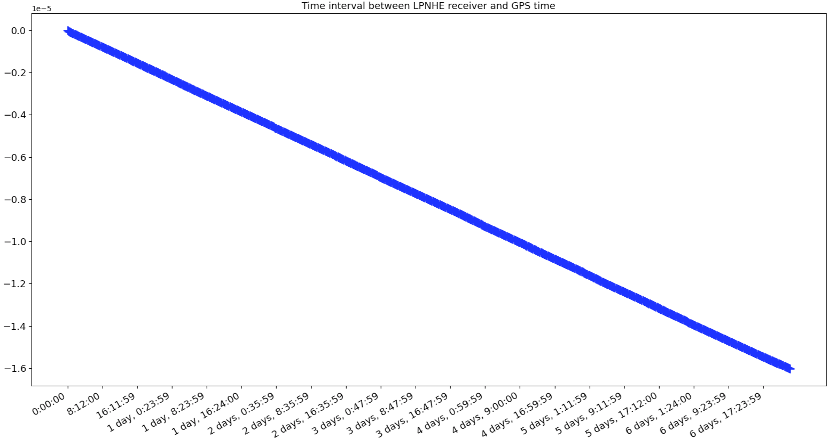
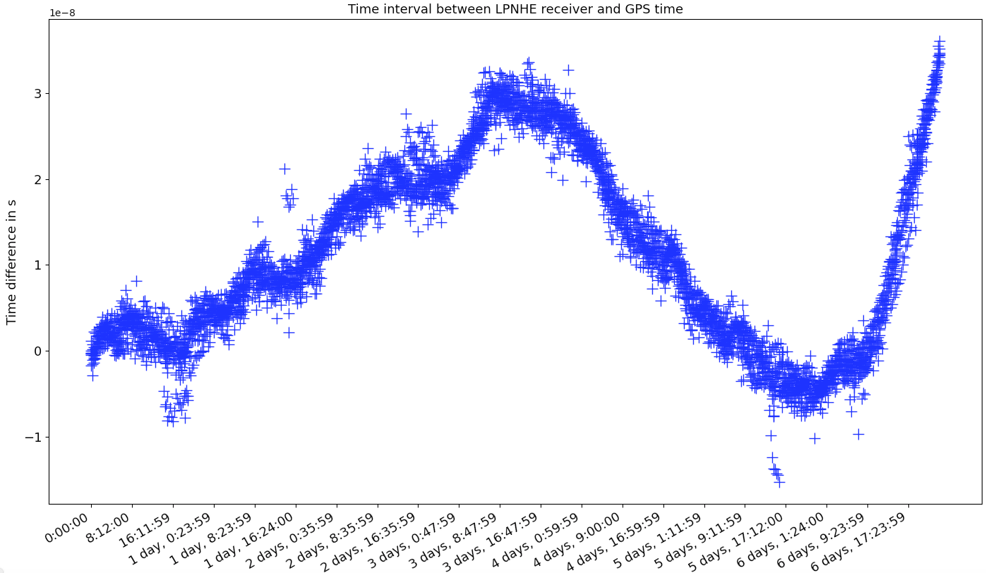
Local Time Base Characterization
The “raw” plot (left), as produced from the receiver, shows a liner drift, as expected for the Rb clock. Once removed we can see that the clock “noise”.
(from Lucille’s talk cited before)

Slide 26
What Do We Do With It?
Extracting the drift from the left plot will allow us to precisely correlate the local time base (used to time tag the events) to GNSS time. Once done we can calculate the uncertainty on it (right plot). In this case is about 4 ns over 6 days (random walk).
(from Lucille’s talk cited before)

Slide 27

How Accurate Is This Method?
Freq/Time cnt
WR switch
PPS
PPS
Rb clk
GNSS
10 MHz
PPS
10 MHz
WR switch
UTC(OP)
Time distance between
local Rb and UTC(OP)
PPS 10 MHz
GNSS
CGGTTS
CGGTTS file with time distance
Between local time and GPS time
CGGTTS
SYRTE
To evaluate our drift estimation method, we have done the following measure:
- We have created a CGGTTS form the GNSS steered by Rb clock (as before).
Then we have used the time transfer technique to measure the time distance between our Rb clock to SYRTE UTC(OP) via common view method.
Finally, we have compared this time distance with the one measured via the counter.
Vincent Voisin work

Slide 28
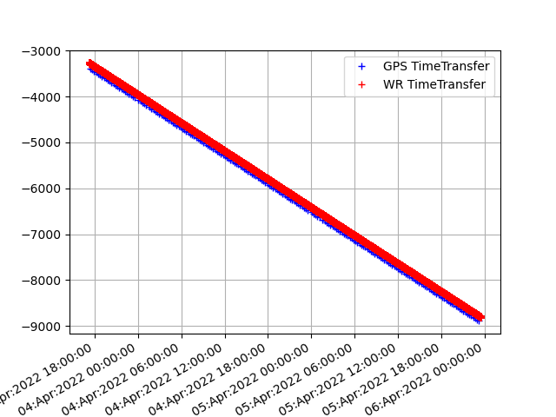
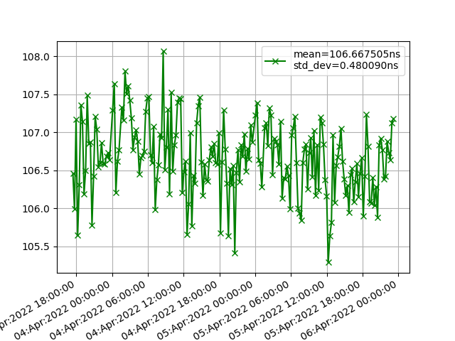
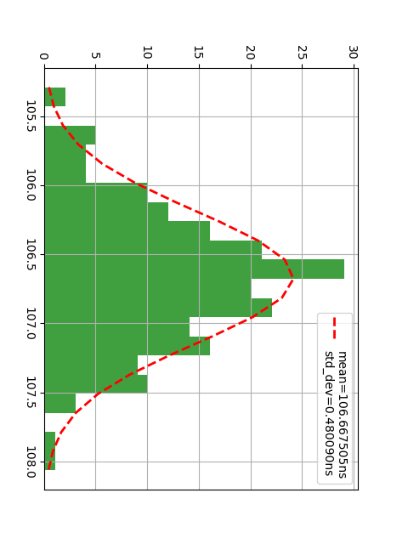
How Accurate Is This Method?
Time distance between local Rb and UTC(OP): Common view vs White Rabbit
Local time base/ UTC(OP)
Via common mode (blue)
Local time base/ UTC(OP)
Via white rabbit (red)
(same slope as before)
Common view method/WR method difference
+/- 3 ns max
Histogram of the difference
Sigma = 0.48 ns
3 days of data. X axis: local time Y axis: ns
Vincent Voisin work

