Slide 1
Hyper-Kamiokande
experiment
ILANCE, LLR, LPNHE, OMEGA

Slide 2
IN2P3 physicists and engineers
ILANCE: M. Gonin, G. Pronost (postdoc)
LLR: A.Afiri, M. Buizza-Avanzini, O. Drapier, F. Gastaldi, M. Louzir, T. Mueller, J. Nanni, P. Paganini, B. Quilain, A. Beauchene (PhD student)
LPNHE: A. Blondel, J. Dumarchez, C. Giganti, M. Guigue, M. Martini, B. Popov, S. Russo, V. Voisin, M. Zito, W. Saenz (postdoc ANR), L. Mellet (PhD student), C. Dalmazzone (PhD student) + one more ANR postdoc starting from 2023
OMEGA: S. Callier, P. Dinaucourt, S. Conforti, F. Dulucq, L. Raux, C. de la Taille
APC: C.Volpe (theoretician)
Natural continuation of our participation in the Japanese neutrino program (T2K and SK)
In close collaboration with CEA-IRFU colleagues

Slide 3
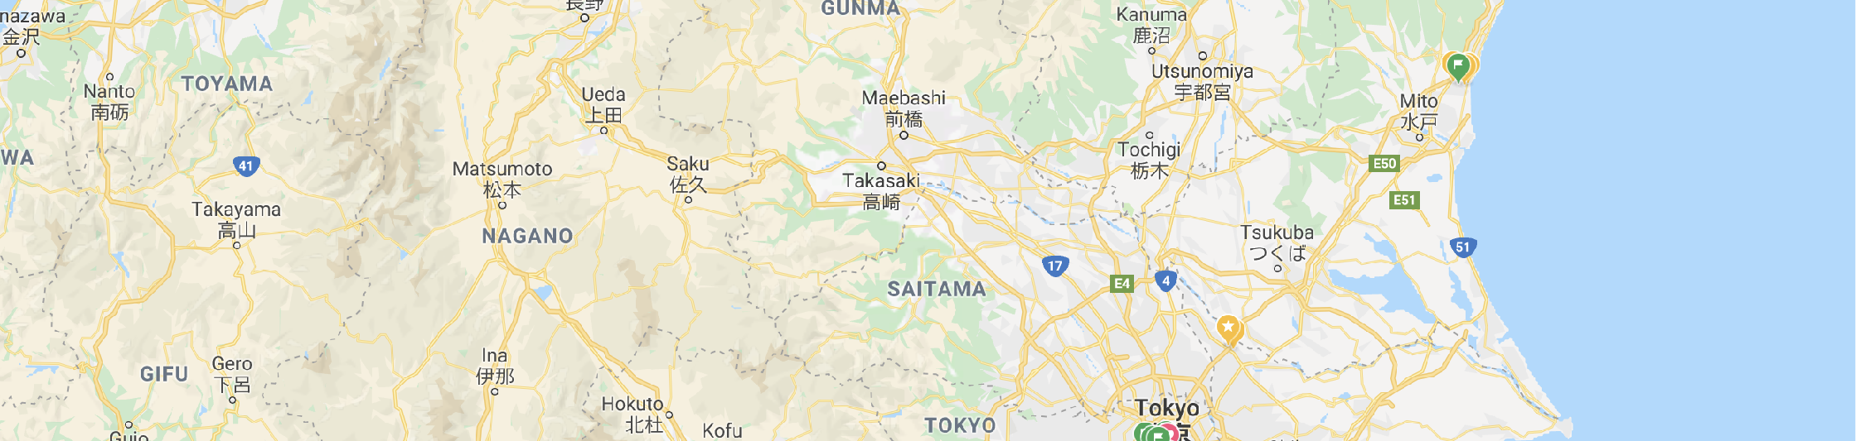

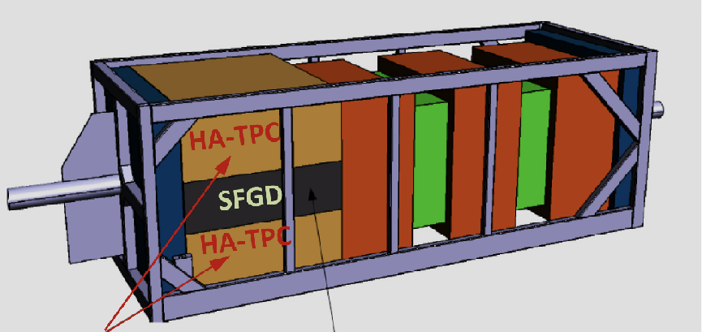
Hyper-Kamiokande in Japan
295 km @ 2.5° Off Axis
Third generation Water Cherenkov detector in Japan
Based on the experience from T2K and Super-Kamiokande
295 km and 2.5° off-axis w.r.t. existing neutrino beam from J-PARC
Existing near detector ND280 currently being upgraded for T2K-II
Vast non-accelerator scientific program

Slide 4
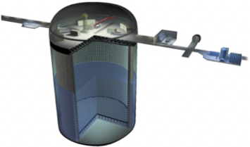



Hyper-Kamiokande vs Super-Kamiokande
Super Kamiokande
Hyper Kamiokande
60 m
40 m
40 m
74 m
 | Super Kamiokande | Hyper Kamiokande
Site | Mozumi-yama | Tochibora-yama
Number of ID 20’’ PMTs | 11 129 | >20,000
Photo-coverage | 40 % | >20%
Single-photon efficiency/PMT | ~12% | ~24%
Dark rate/PMT | ~4 kHz | ~4kHz
Time resolution of 1 photon | ~3 ns | ~1.1 ns
Total/fiducial mass (kton) | 50 / 22.5 | 260 / 187
Fiducial volume x8:
→ non-beam ν physics
Beam neutrino
event rate x 20:
→ beam ν physics
Start operations in 2027 with 240 kt.MW and an assumed runtime 10⁷ s per year

Slide 5

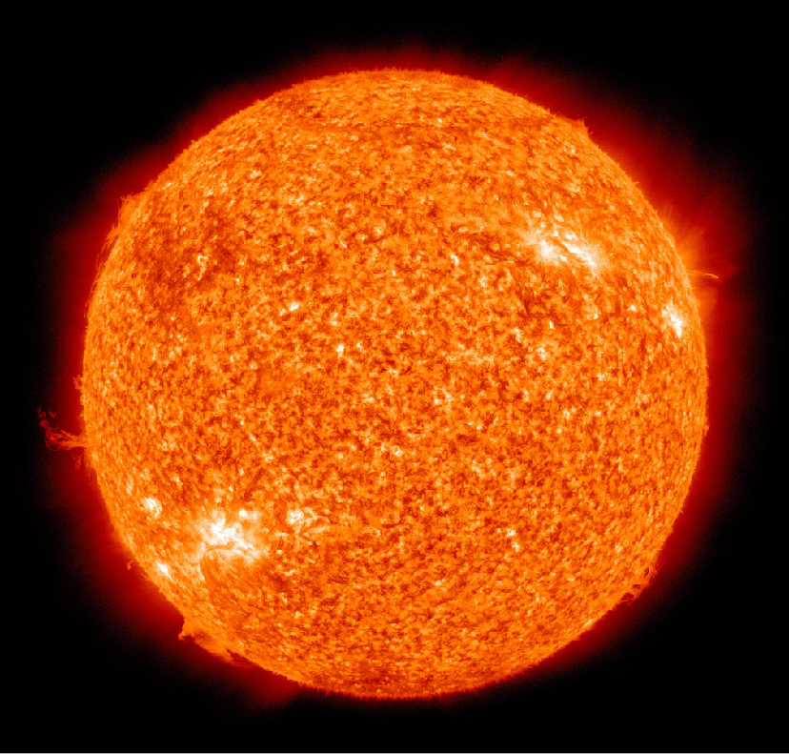


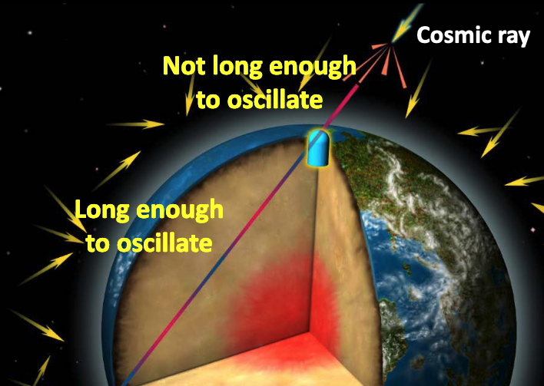


















Hyper-Kamiokande physics program
Solar neutrinos
Rare events
Probe Grand Unified Theories via p-decay or n-n oscillation
ν _{e}
ν _{e} ν_{e}
ν_{μ} ν_{μ}
Atmospheric neutrinos
MSW effect
Non-standard interactions
Observe CP violation for leptons at 5σ
Precise measurement of δ_{CP}
High sensitivity to ν mass ordering
Supernovae neutrinos
ν _{e}
J-PARC accelerator neutrinos
ν _{e} ν_{e}
ν_{μ} ν_{μ}
Transient SNν : constrain SN profile models
Relic SNν : constrain cosmic star formation

Slide 6



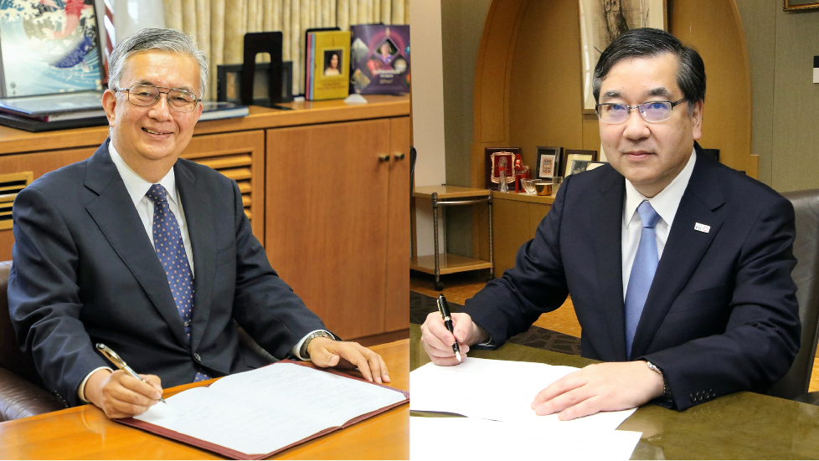











Experiment approval: key dates
Number of collaborators
Conclusions of 2018 SC : “Le projet n’est pas actuellement approuvé au Japon et il n’y a pas suffisamment d’informations quant à l’organisation du projet pour envisager et discuter des participations directes à HK.”
KEK
UoT
May 2020:
Signature of MOU
Aug. 2019:
MEXT approval
of HK project
Feb. 2020:
HK budget
approved
May 2021:
Groundbreaking ceremony
2018
2019
2020
2021
Oct. 2018:
IN2P3 CS discussing HK
Jan. 2021:
CEA CS approved HK
Oct. 2019:
LPNHE CS
approved HK
March 2021:
LLR CS
approved HK
Oct. 2021:
IN2P3 CS
discussing HK

Slide 7
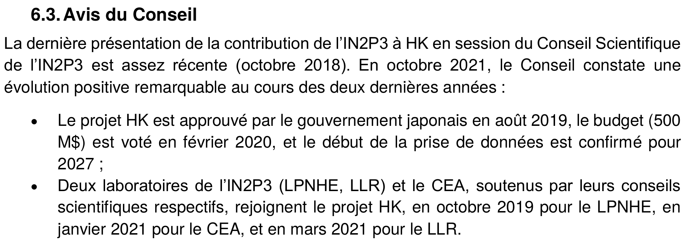
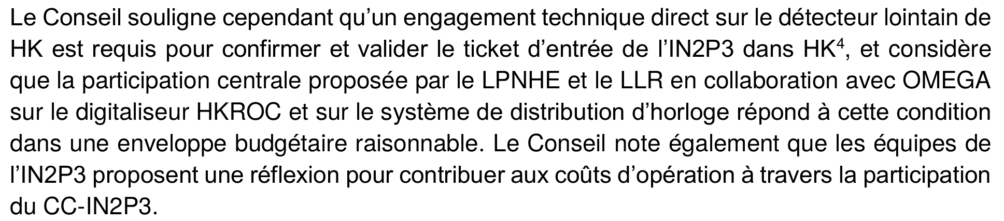
Conclusions of the 2021 SC
...
RD4HK initiated in 2022
(Benjamin’s talk)

Slide 8
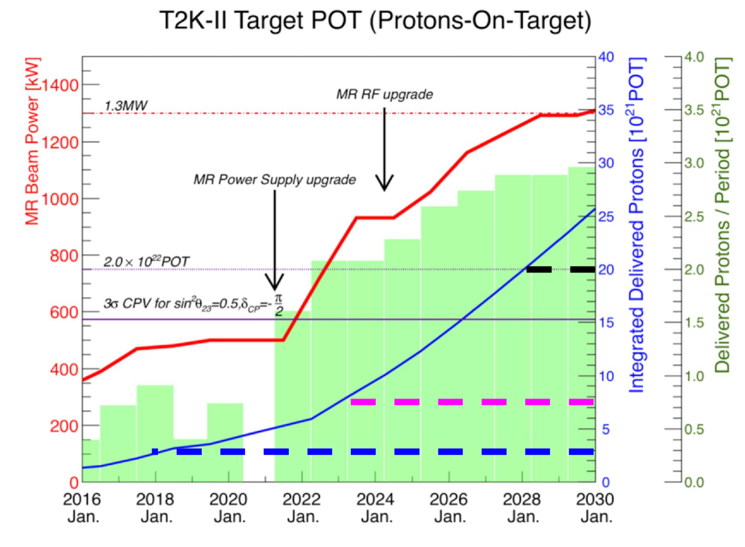
Tokai to HK: heritage from T2K
Accelerator upgrade
Power increase (500kW --> 1.3 MW)
x2.7 more stats per s (wrt T2K-I)
ν / ν flux uncertainty < 5% thanks to
NA61/SHINE hadroproduction measurements
T2K
T2K-II
T2HK

Slide 9

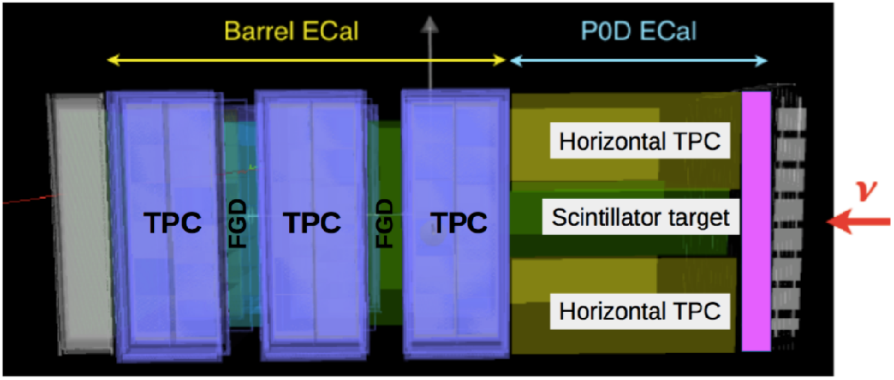

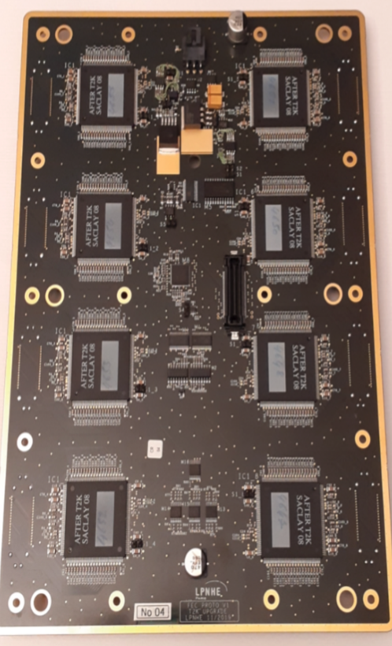
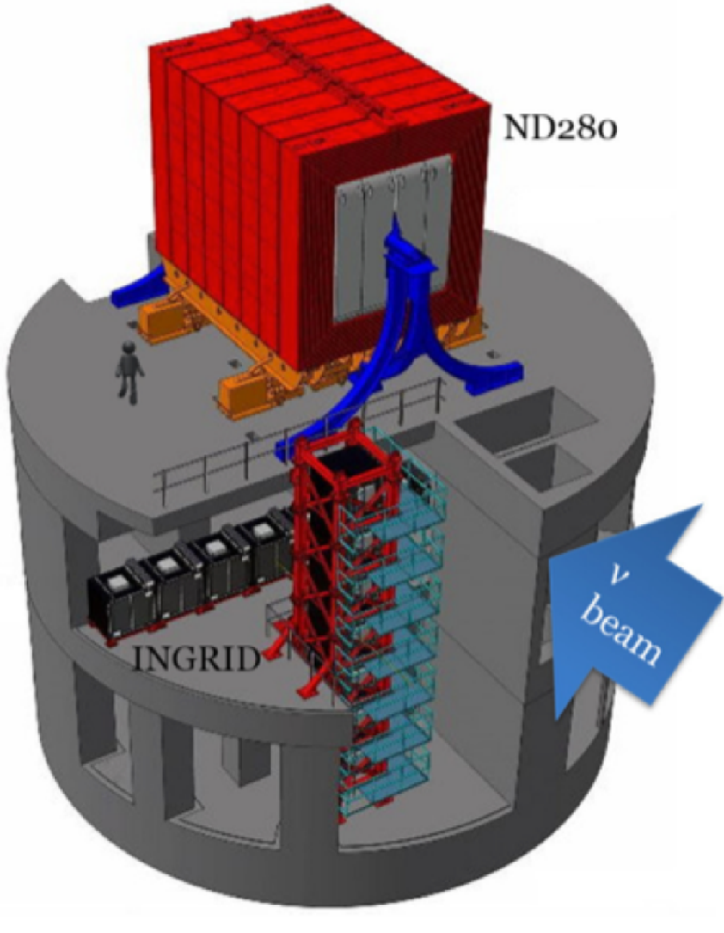

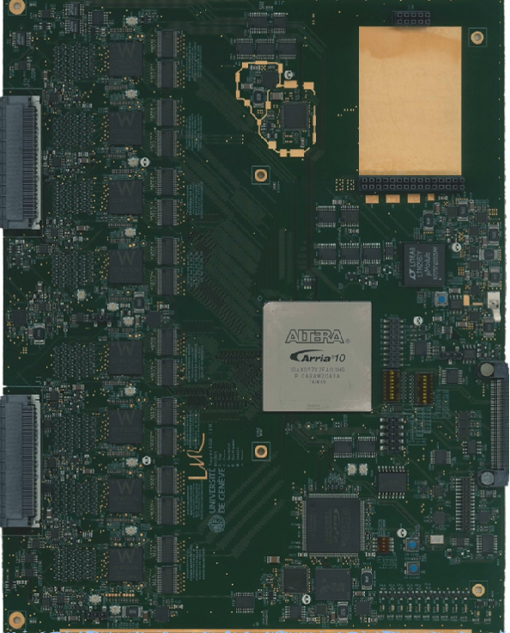
Tokai to HK: heritage from T2K
Accelerator upgrade
Power increase (500kW --> 1.3 MW)
x2.7 more stats per s (wrt T2K-I)
ν / ν flux uncertainty < 5% thanks to
NA61/SHINE hadroproduction measurements
Magnetized near detector @280 m (ND280)
Used for T2K Oscillation Analysis for >10 years
Being upgraded now for T2K-II
(crucial contributions and strong support from IN2P3)
Systematics uncertainties under control from Day-1 of HK
FEC for HA-TPC readout
FEB for SuperFGD readout

Slide 10
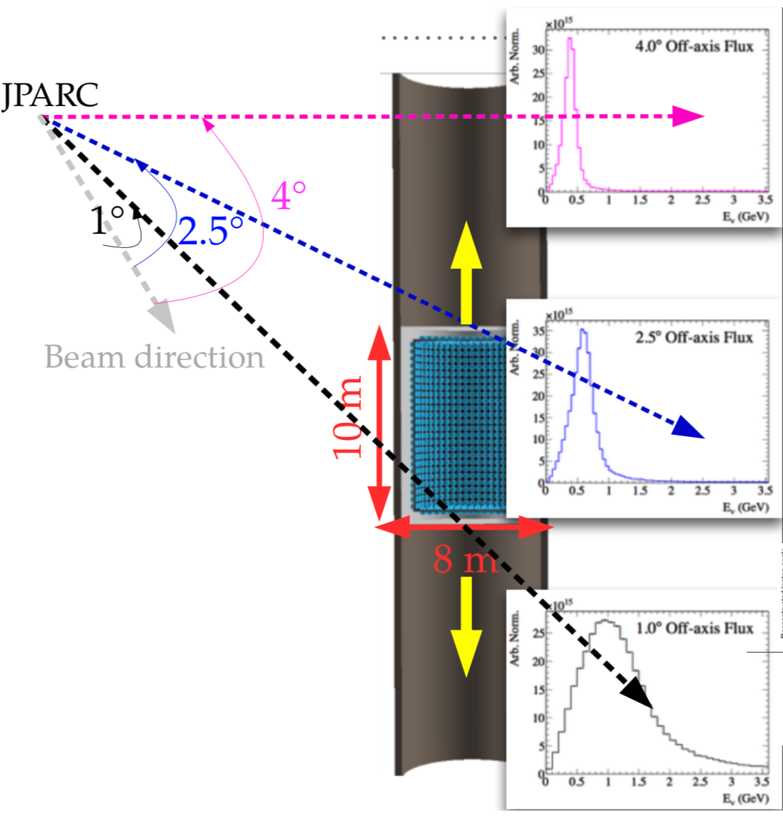
Tokai to HK: what will be new
Accelerator upgrade
Power increase (500kW 1.3 MW)
x2.7 more stats per s (wrt T2K-I)
ν / ν flux uncertainty < 5% thanks to
NA61/SHINE hadroproduction measurements
Magnetized near detector @280 m (ND280)
Used for T2K Oscillation Analysis for >10 y
Being upgraded now for T2K-II
(crucial contributions and strong support from IN2P3)
Systematics uncertainties under control
from day 1 of HK
Intermediate Water Cherenkov Detector (IWCD/E61)
Measure ν interactions on Water
High stats. sample of ν_{e} interactions
Needed to reach final HK goal for systematics uncertainties
(if IWCD is delayed, ND280 will be the only near detector on day 1 of HK)
NEW

Slide 11


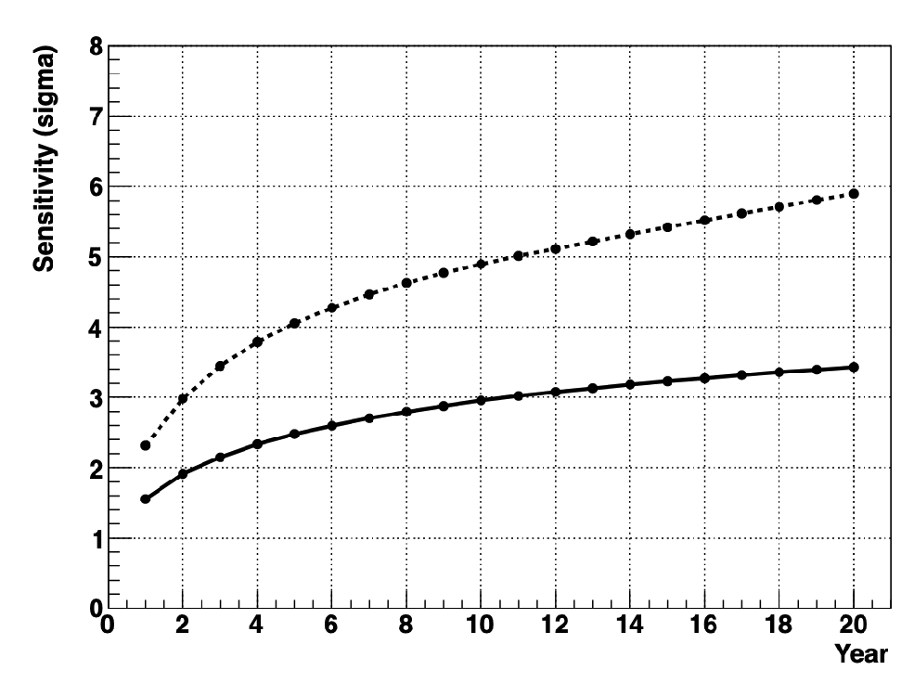
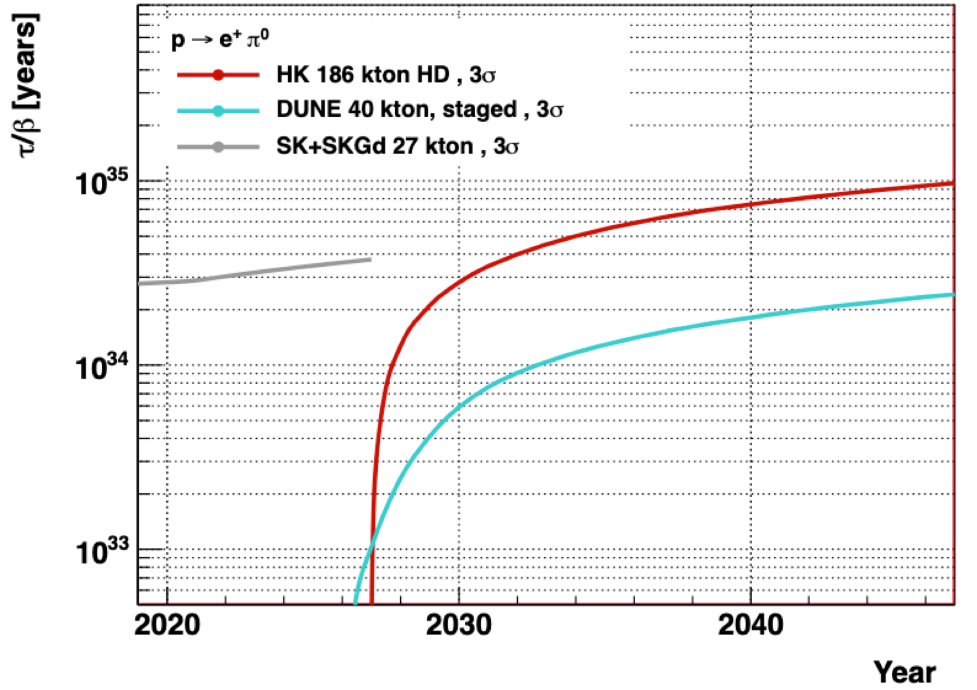



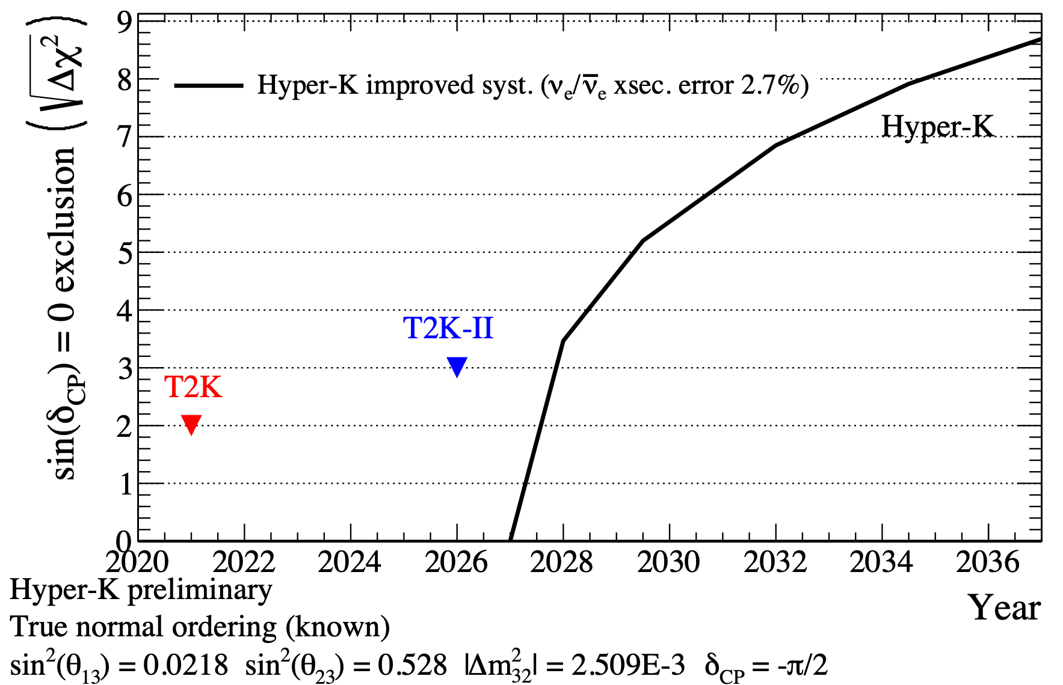



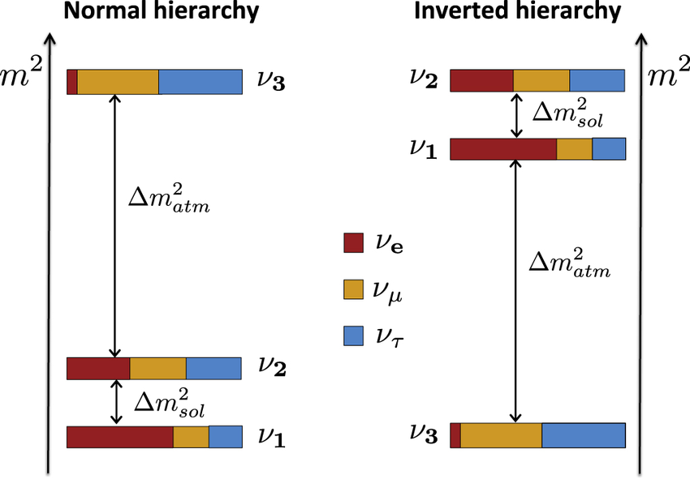


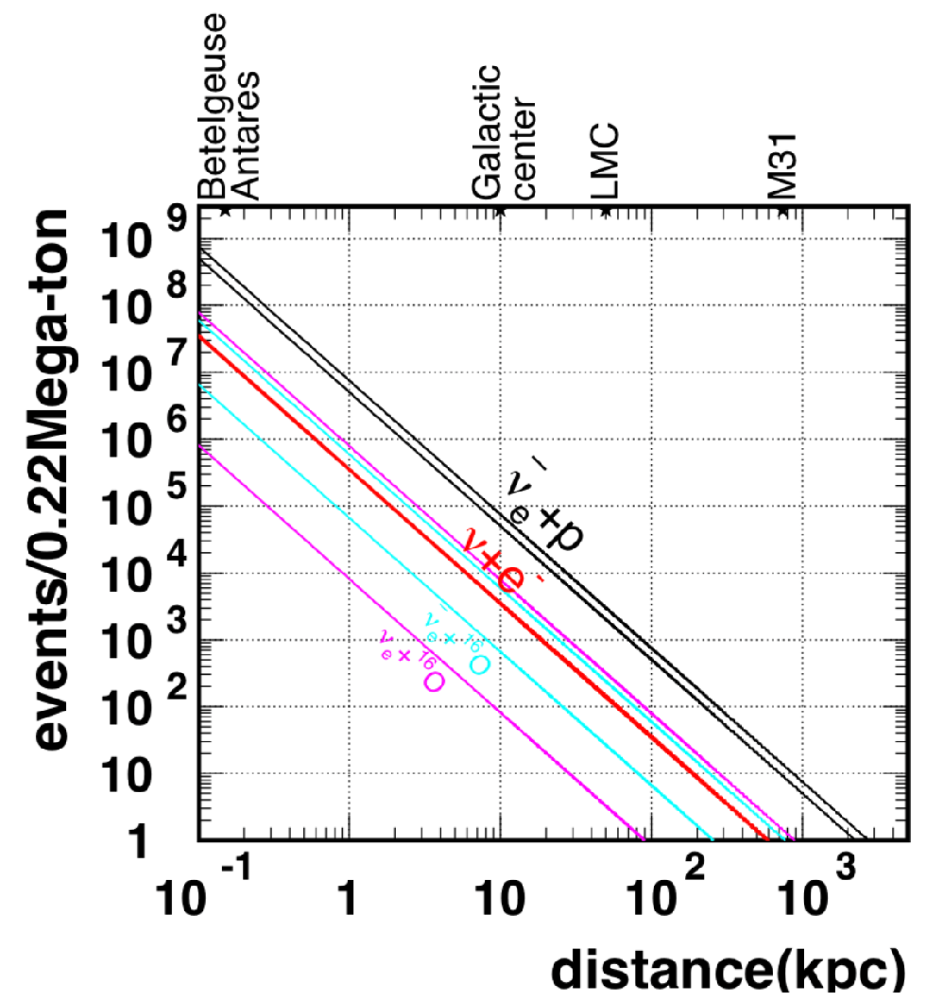
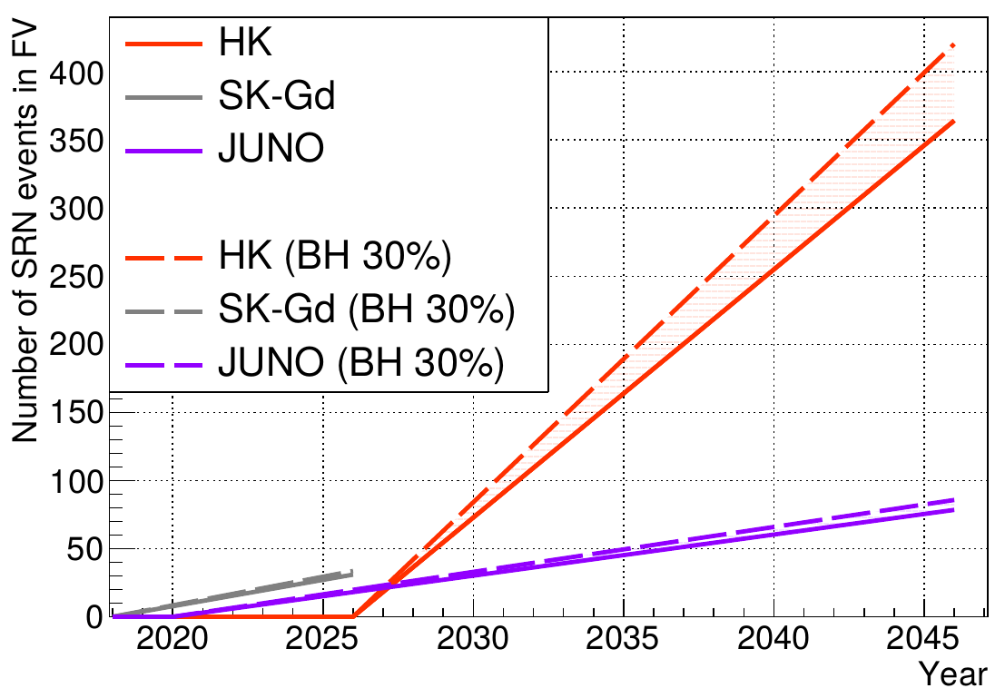

Hyper-Kamiokande Physics
Solar physics
Rear events
Neutrino oscillations
CP violation
Solar upturn
Proton decay
Supernovae modeling and Early Universe
mass ordering
Supernovae
DSNB

Slide 12
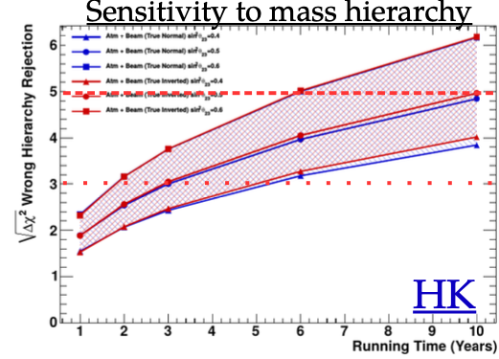
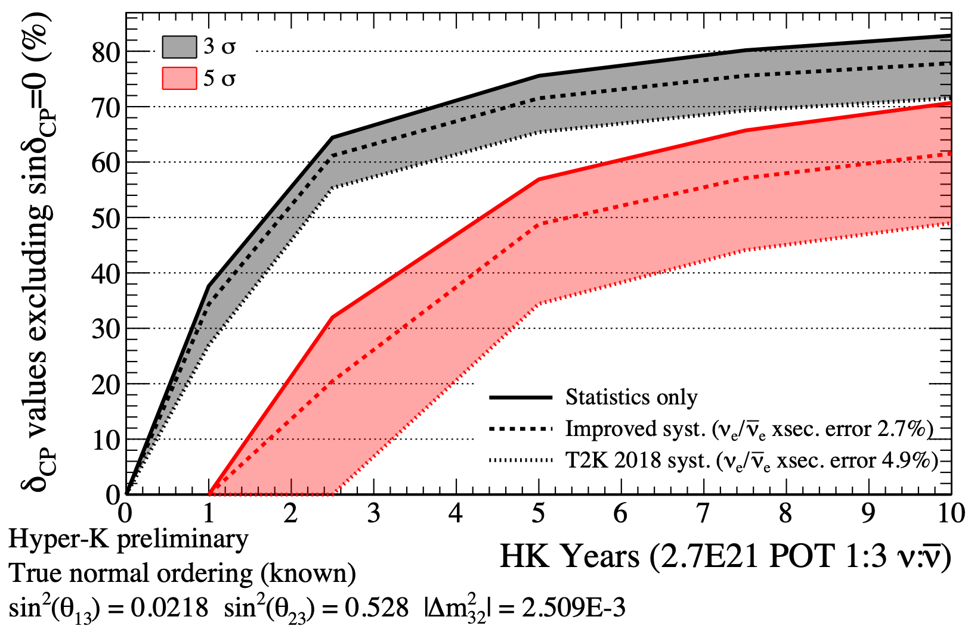


Fast CP-violation discovery
Known mass ordering (KM3NET)
5σ in 2 years
3σ (T2K-II)
in 6 months
 |  |  | 50 % | 70 %
Hyper Kamiokande | 0.5 y | 2 y | 5 y | 5 y
DUNE (staged*) | 4 y | 8 y | 10 y | 13 y
$δ_{CP}={−π}/2$
$Allδ_{CP}$
If δ_{CP}=-π/2, CP violation discovered before any other LBL-ν experiment
Fastest experiment to survey possible δ_{CP} values
$3σ$
$5σ$
$5σ$
$3σ$
* 2 modules@1.2 MW y1; 3 modules y2;
4 modules y4; @2.4 MW y7
DUNE CDR arXiv:2002.03005
IUPAP Neutrino panel report

Slide 13
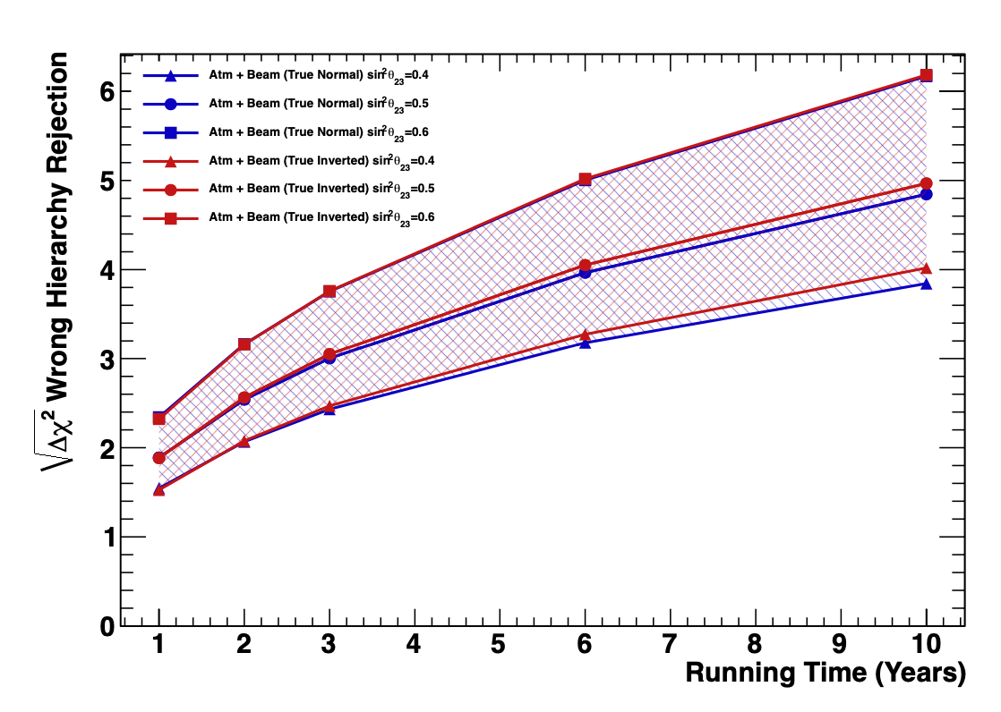
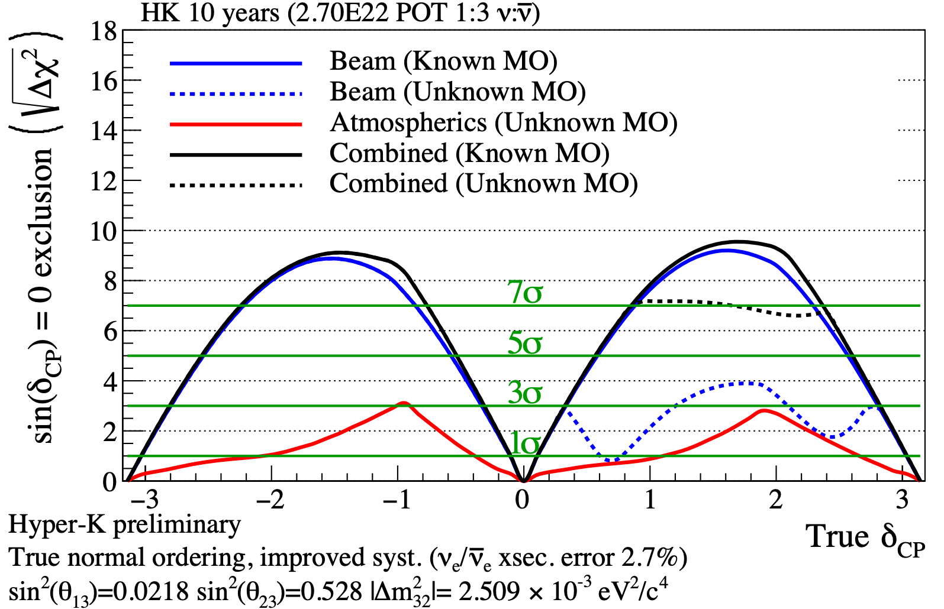



Mass ordering sensitivity with atmospherics
If not discovered by T2K/SK, NOvA, ORCA or JUNO before 2027, HK can determine MO after 6-10 years via atmospheric ν
Sensitivity to CPV is little affected if we add atmospheric ν
→ MO prior knowledge not really required to explore δ_{CP}

Slide 14
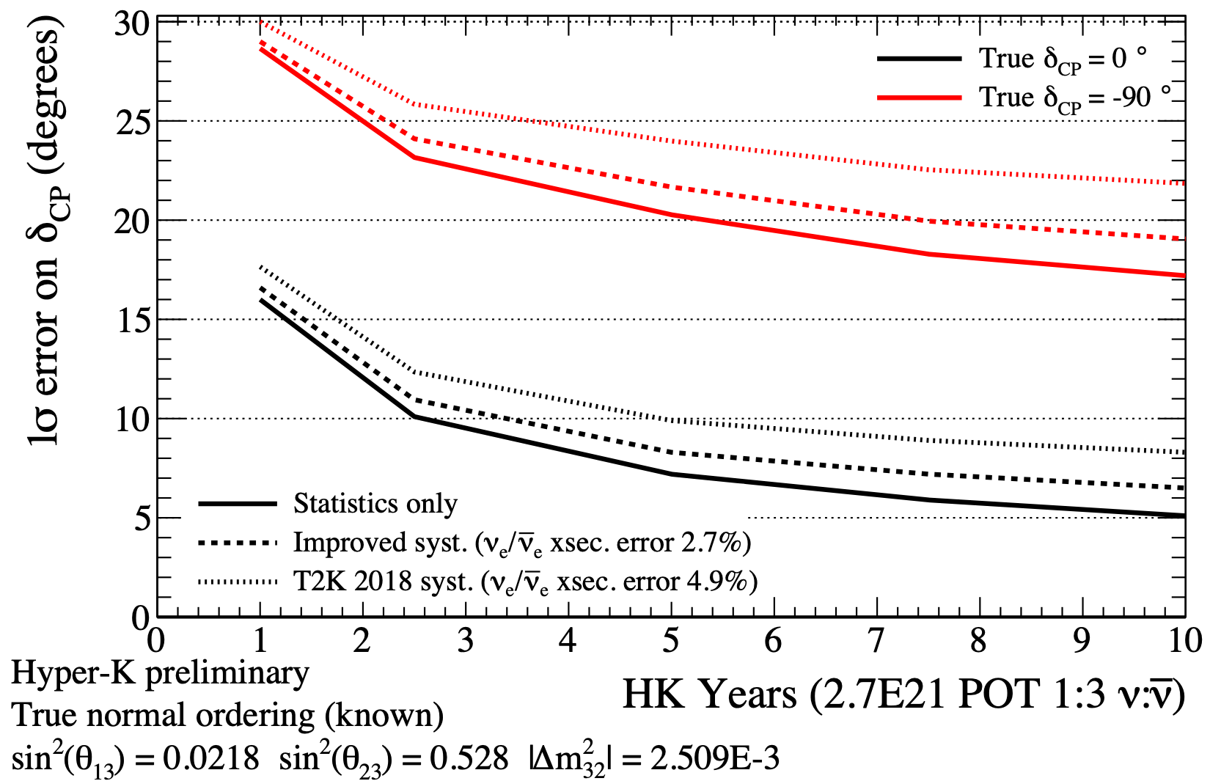
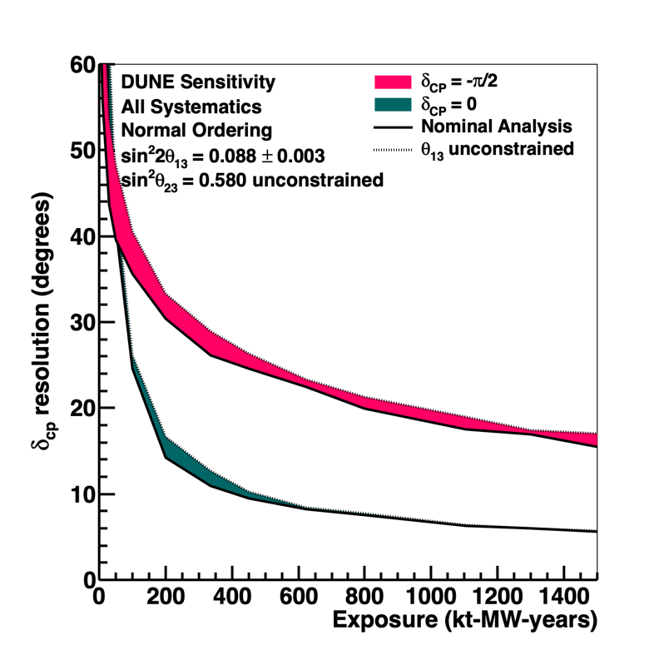
δ_{CP} measurement resolution
 | 30° | 20° | 15° | 10°
Hyper Kamiokande | 1 y | 7 y | 1 y | 3 y
DUNE | 5 y | 12 y | 5 y | 8 y
$δ_{CP}={−π}/2$
$δ_{CP}=0$
Precision = sensitivity to matter-antimatter models
→ HK will quickly reach precision on δ_{CP} of 30°(15°) for δ_{CP} =-π/2 (0)
For the ultimate precision on δ_{CP} it will be important to further
reduce systematics uncertainties w.r.t. T2K (ND280 Upgrade + IWCD)
DUNE CDR arXiv:2002.03005

Slide 15
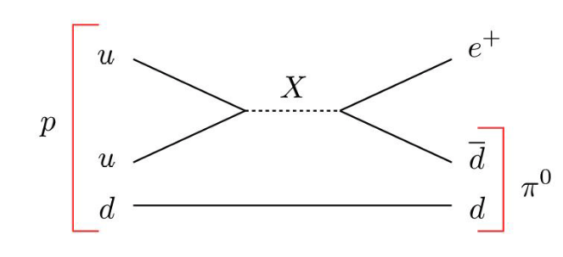
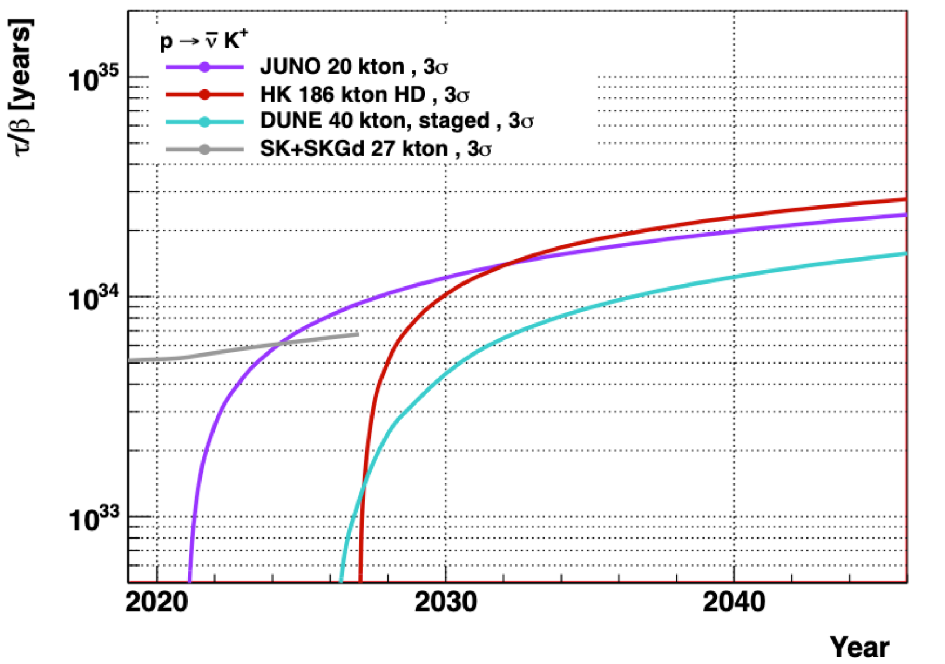
Proton decay
Motivated by Grand-Unification Theories
HK will have the best limit on p → e⁺π⁰ for bound protons
→ about 1 order of magnitude better than current limits
Thanks to its huge mass, HK will also have leading sensitivity to channels with invisible particles (p → ν K⁺)
HK is sensitive to free proton decay
Phys. Lett. B 233 (1-2) 178-182
$τ/B>{10}^{35}y$
$τ/B>3×{10}^{34}y$
JUNO: J. Phys. G 43 (2016) 030401 (arXiv:1507.05613)
DUNE: FERMILAB-PUB-20-025-ND (arXiv:2002.03005)

Slide 16
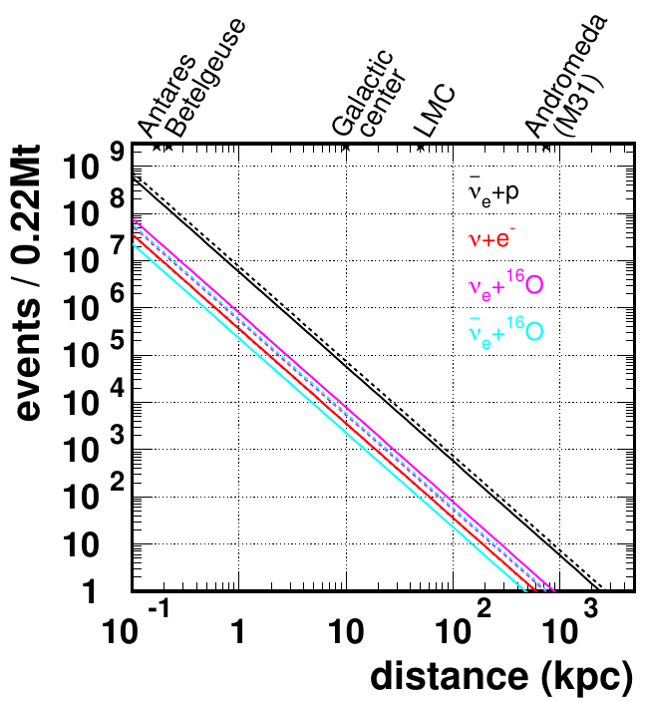
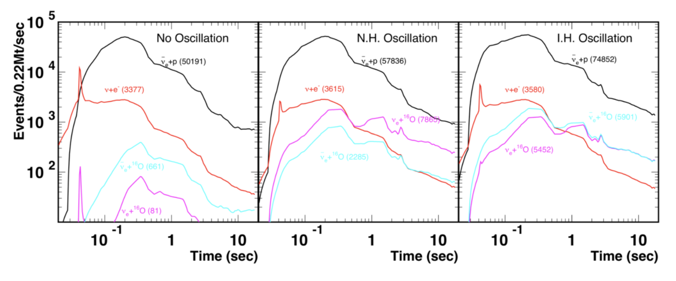
Astrophysical neutrinos
Supernova neutrinos
Increase by ~10 in stat sensitivity w.r.t. SK
SN1987A type ~2500 events
Galactic center: ~50000+ events
Direction (1°@10kpc) → triangulation
Time profile: collapse models
SN ν expected every 3 years in HK!
(if HK is sensitive up to 4 Mpc)
Gravitational waves sources
Nearby (10Mpc) neutron star mergers
→Unique multi-messengers observatory
arXiv:2101.05269

Slide 17
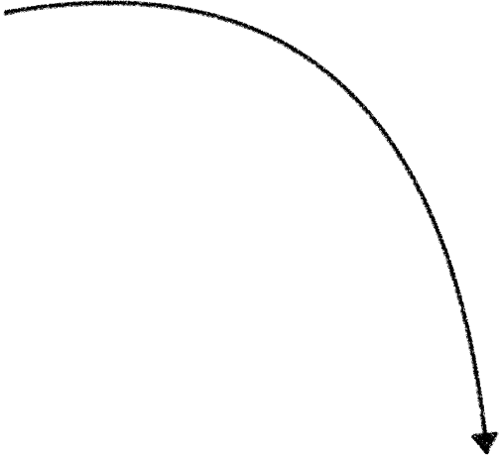


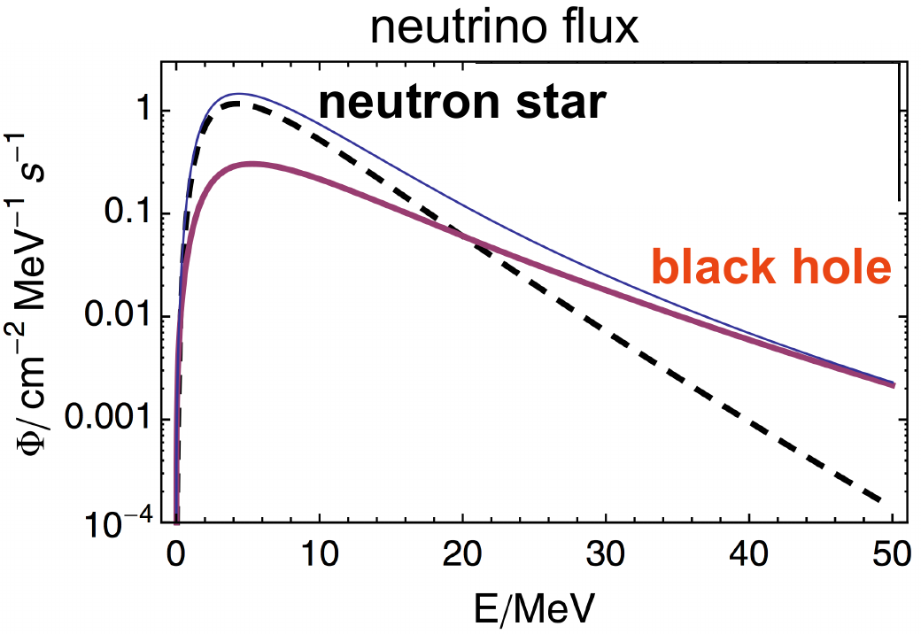
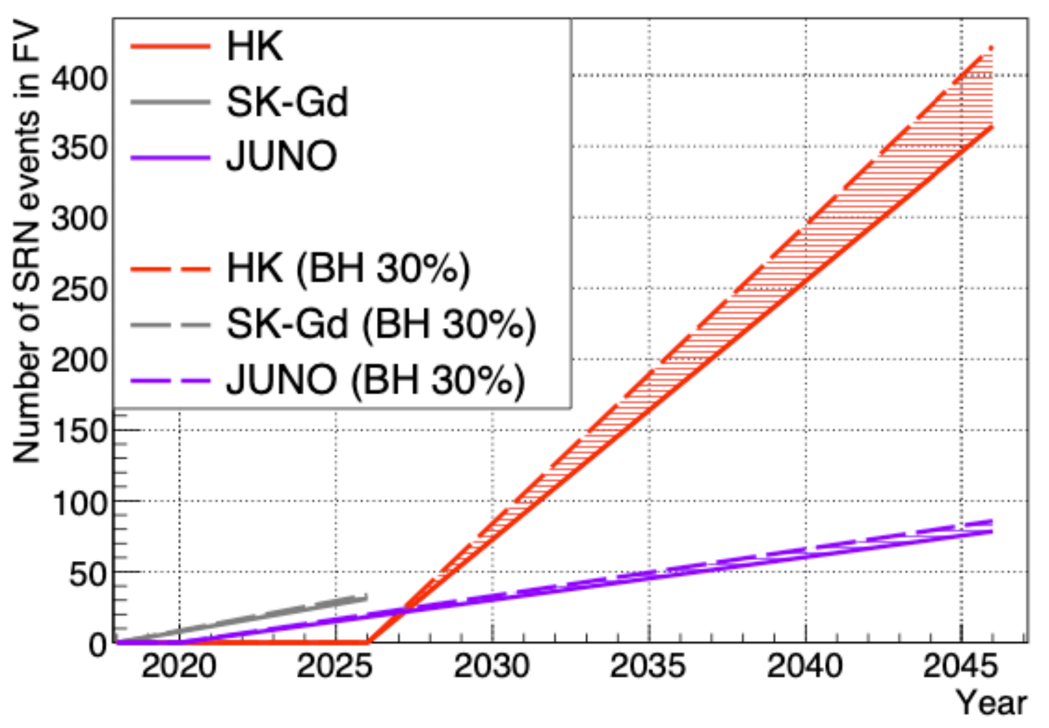
SN-relic neutrinos (DSNB) in HK
SN-relic neutrinos (SNRν) offer new constraints on cosmic star history
→ Could be first detected by SK-Gd
→ The spectrum will be determined by HK
Impact of redshift: low energy ↔ probe older stars
Sensitivity to neutron star vs black hole formation

Slide 18



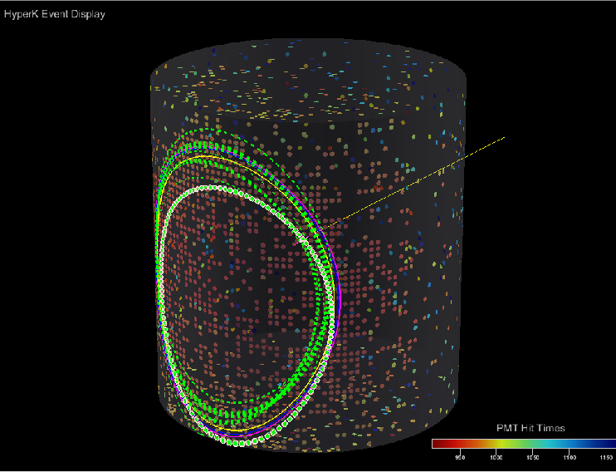
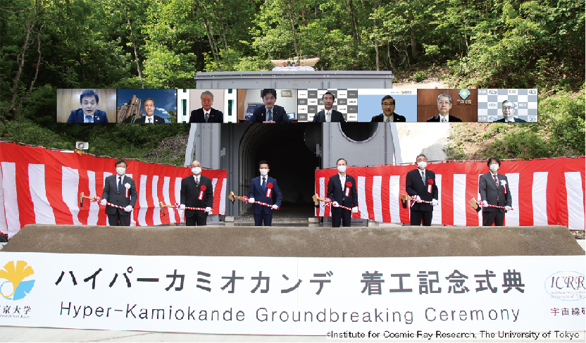





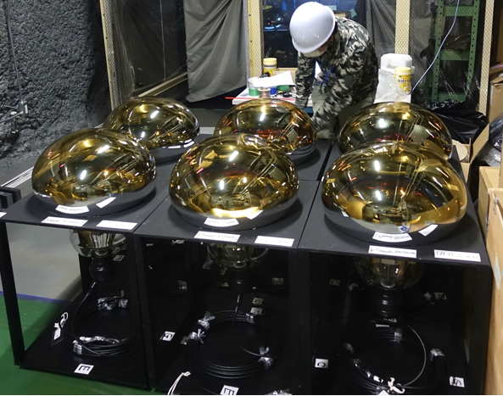

HK schedule
May 28 2021
First light in 2027
2020
2021
2022
2023
2024
2025
2026
2027
2028
Geo survey
Tunnel constr.
Cavern excavation
Tank constr.
PMT install.
Commis.
Operations
PMT production
Water
filling
Electronics R&D
Electronics production
Electronics installation
Strong engagement of Japan: ~500 M$ for construction
Expected from other countries: ~100 M$
International contributions are nearly formalized
(proposed IN2P3 contributions presented by Benjamin) Canada, Spain, UK already committed for 10-20 M€ each for the far detector construction
First 2000 PMT
March 2021

Slide 19

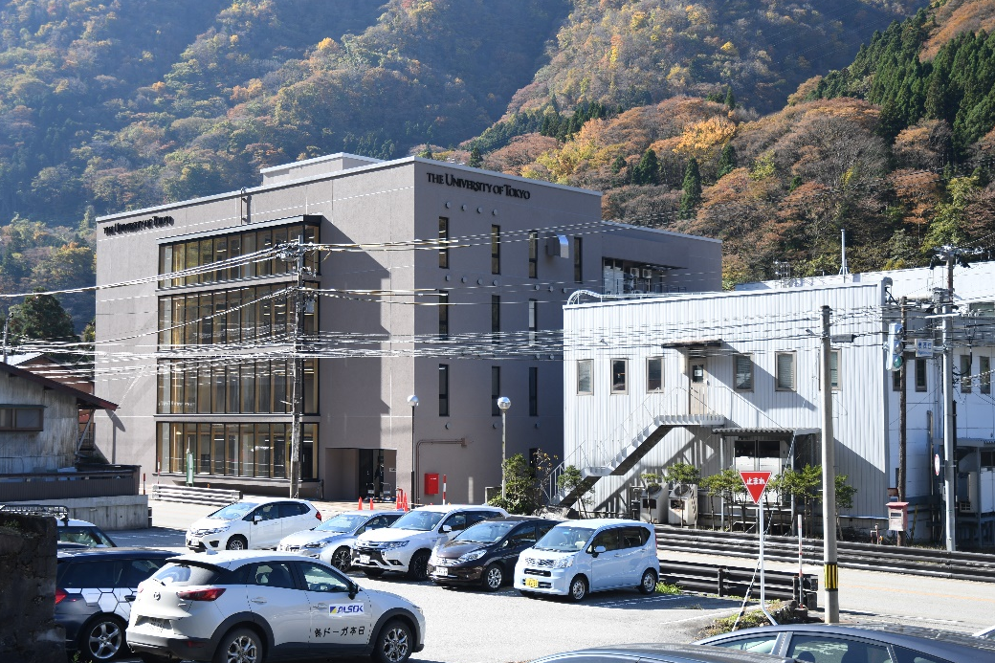

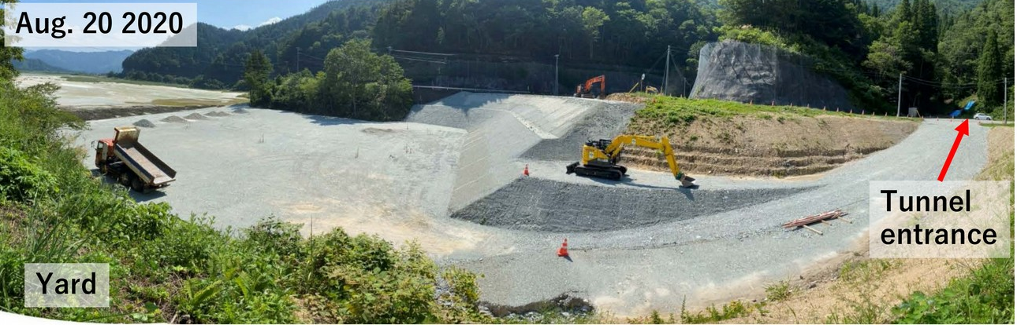

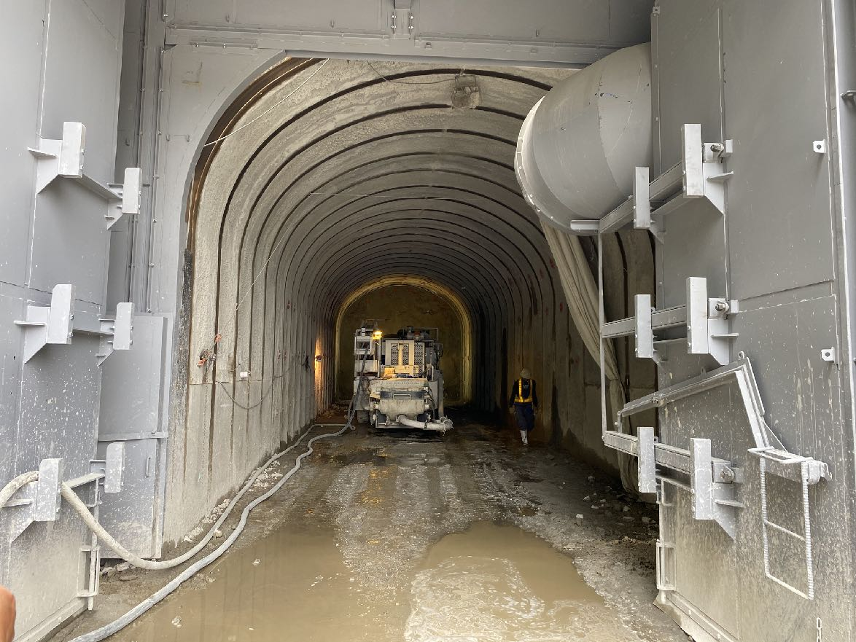




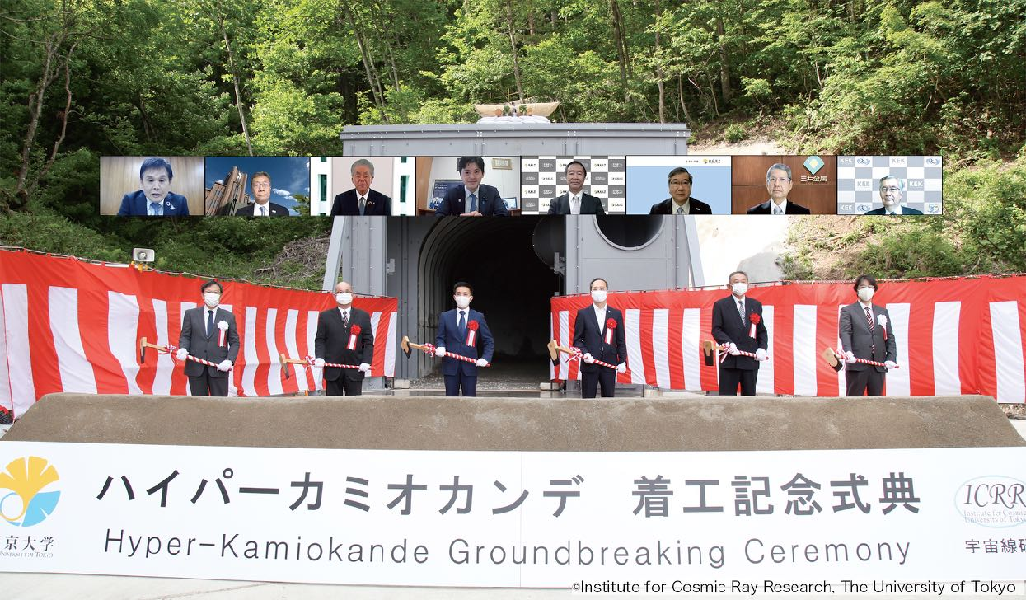

Construction is on schedule
Entrance yard finished (Aug. 2020)
New main building finished
(Spring 2022)
Survey completed
Excavation on-going
New main building
Everything on track!
Groundbreaking ceremony
(May 2021)
Tunnel entrance (June 2021)

Slide 20
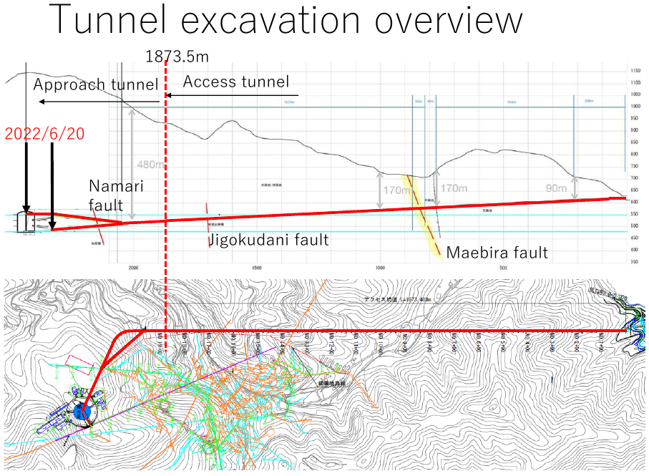
Recent progress: access tunnel excavation
The dome center was reached on 24th of June 2022!

Slide 21
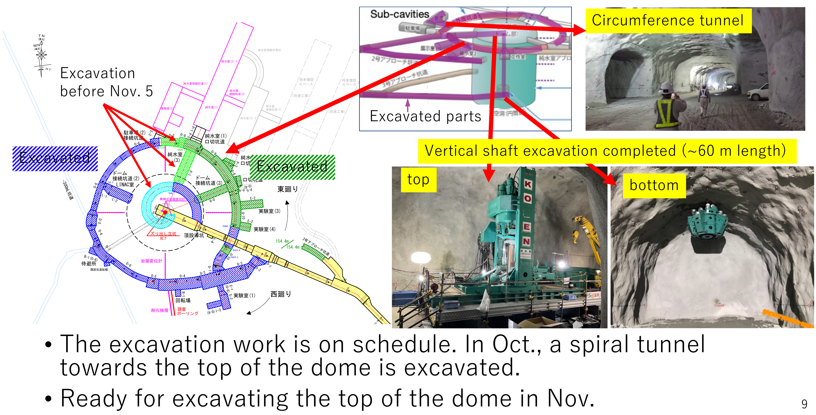
Recent progress: cavern excavation
Vertical shaft excavation completed on schedule!

Slide 22




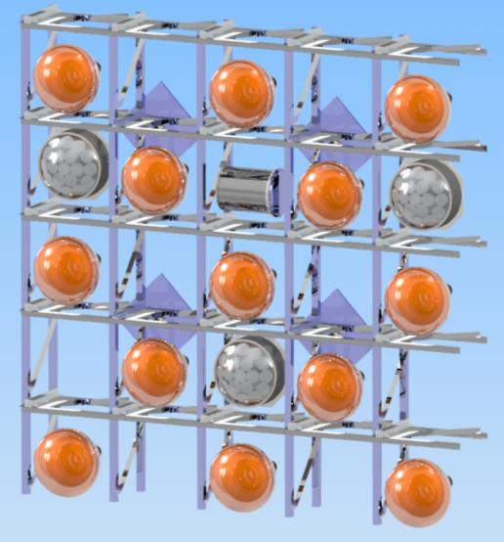
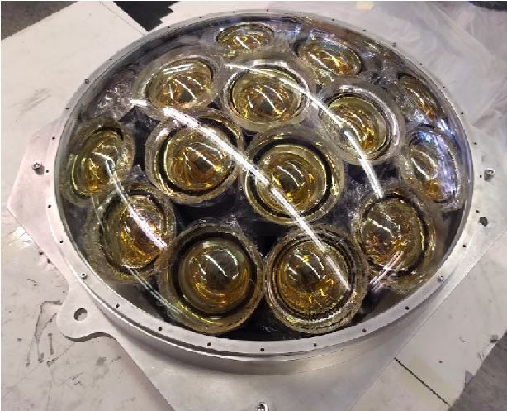


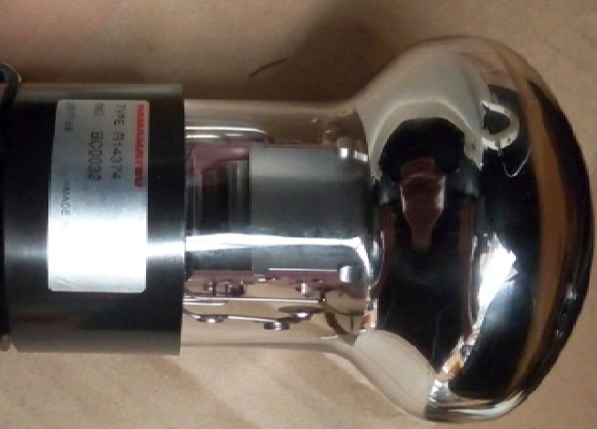


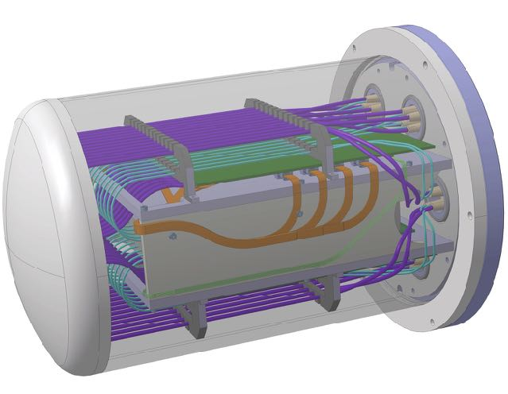
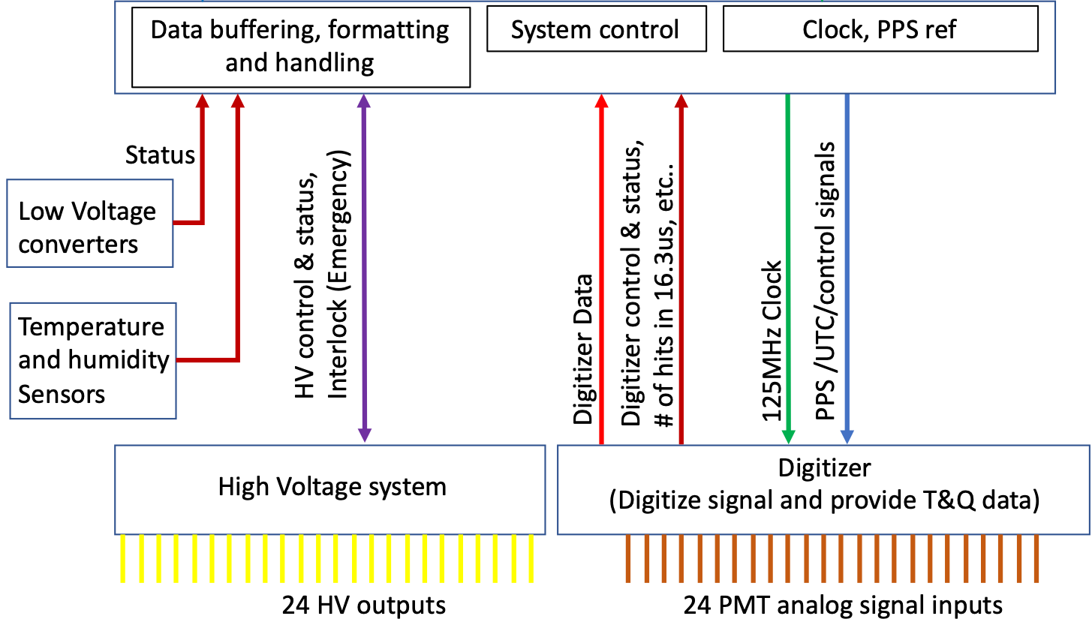
20” PMTs, mPMTs and readout
multi-PMT
20” Box&Line PMT
19 x 3” PMT
Underwater electronics
Inner detector composed of
20k+ 20” PMTs (Hamamatsu R12860)
~1k mPMTs (19 3” R12199-02 PMTs)
Better signal-to-noise ratio, directionality, timing
Size of detector requires an in-water electronics
Underwater
NEW

Slide 23
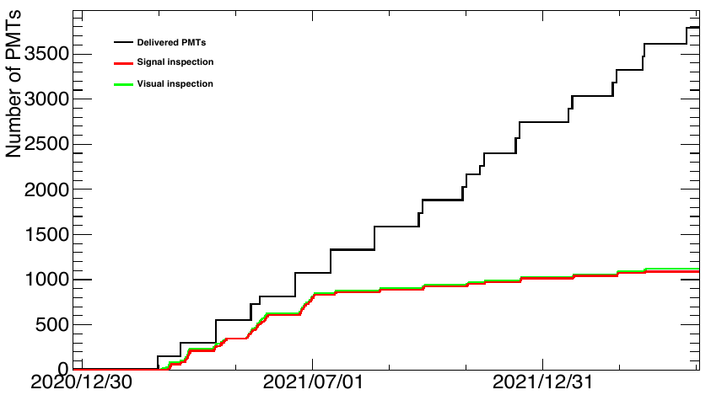
Recent progress: 20’’ PMT production
> 3700 20’’ PMTs already produced (at the beginning
the signal and visual inspection was done for almost all PMTs).
Since July 2021 the inspection rate is 10%.

Slide 24
Intermediate conclusions
Hyper-Kamiokande has a vast and rich physics program including:
Precision study of ν oscillations (fast CP-violation discovery, δ_{CP} measurement, etc)
Rare events observatory (e.g. proton decay)
Multi-messenger astrophysics
→ Impressive and quick discovery potential!
Construction started and on schedule → Operation will start in 2027
Natural continuation of our involvement in Japanese ν program (T2K/T2K-II and SK)
Upgraded ND280 will be used as the HK near detector starting from day 1
Unique program of world-leading measurements and discoveries up to ~2040

Slide 25
Backup slides

Slide 26
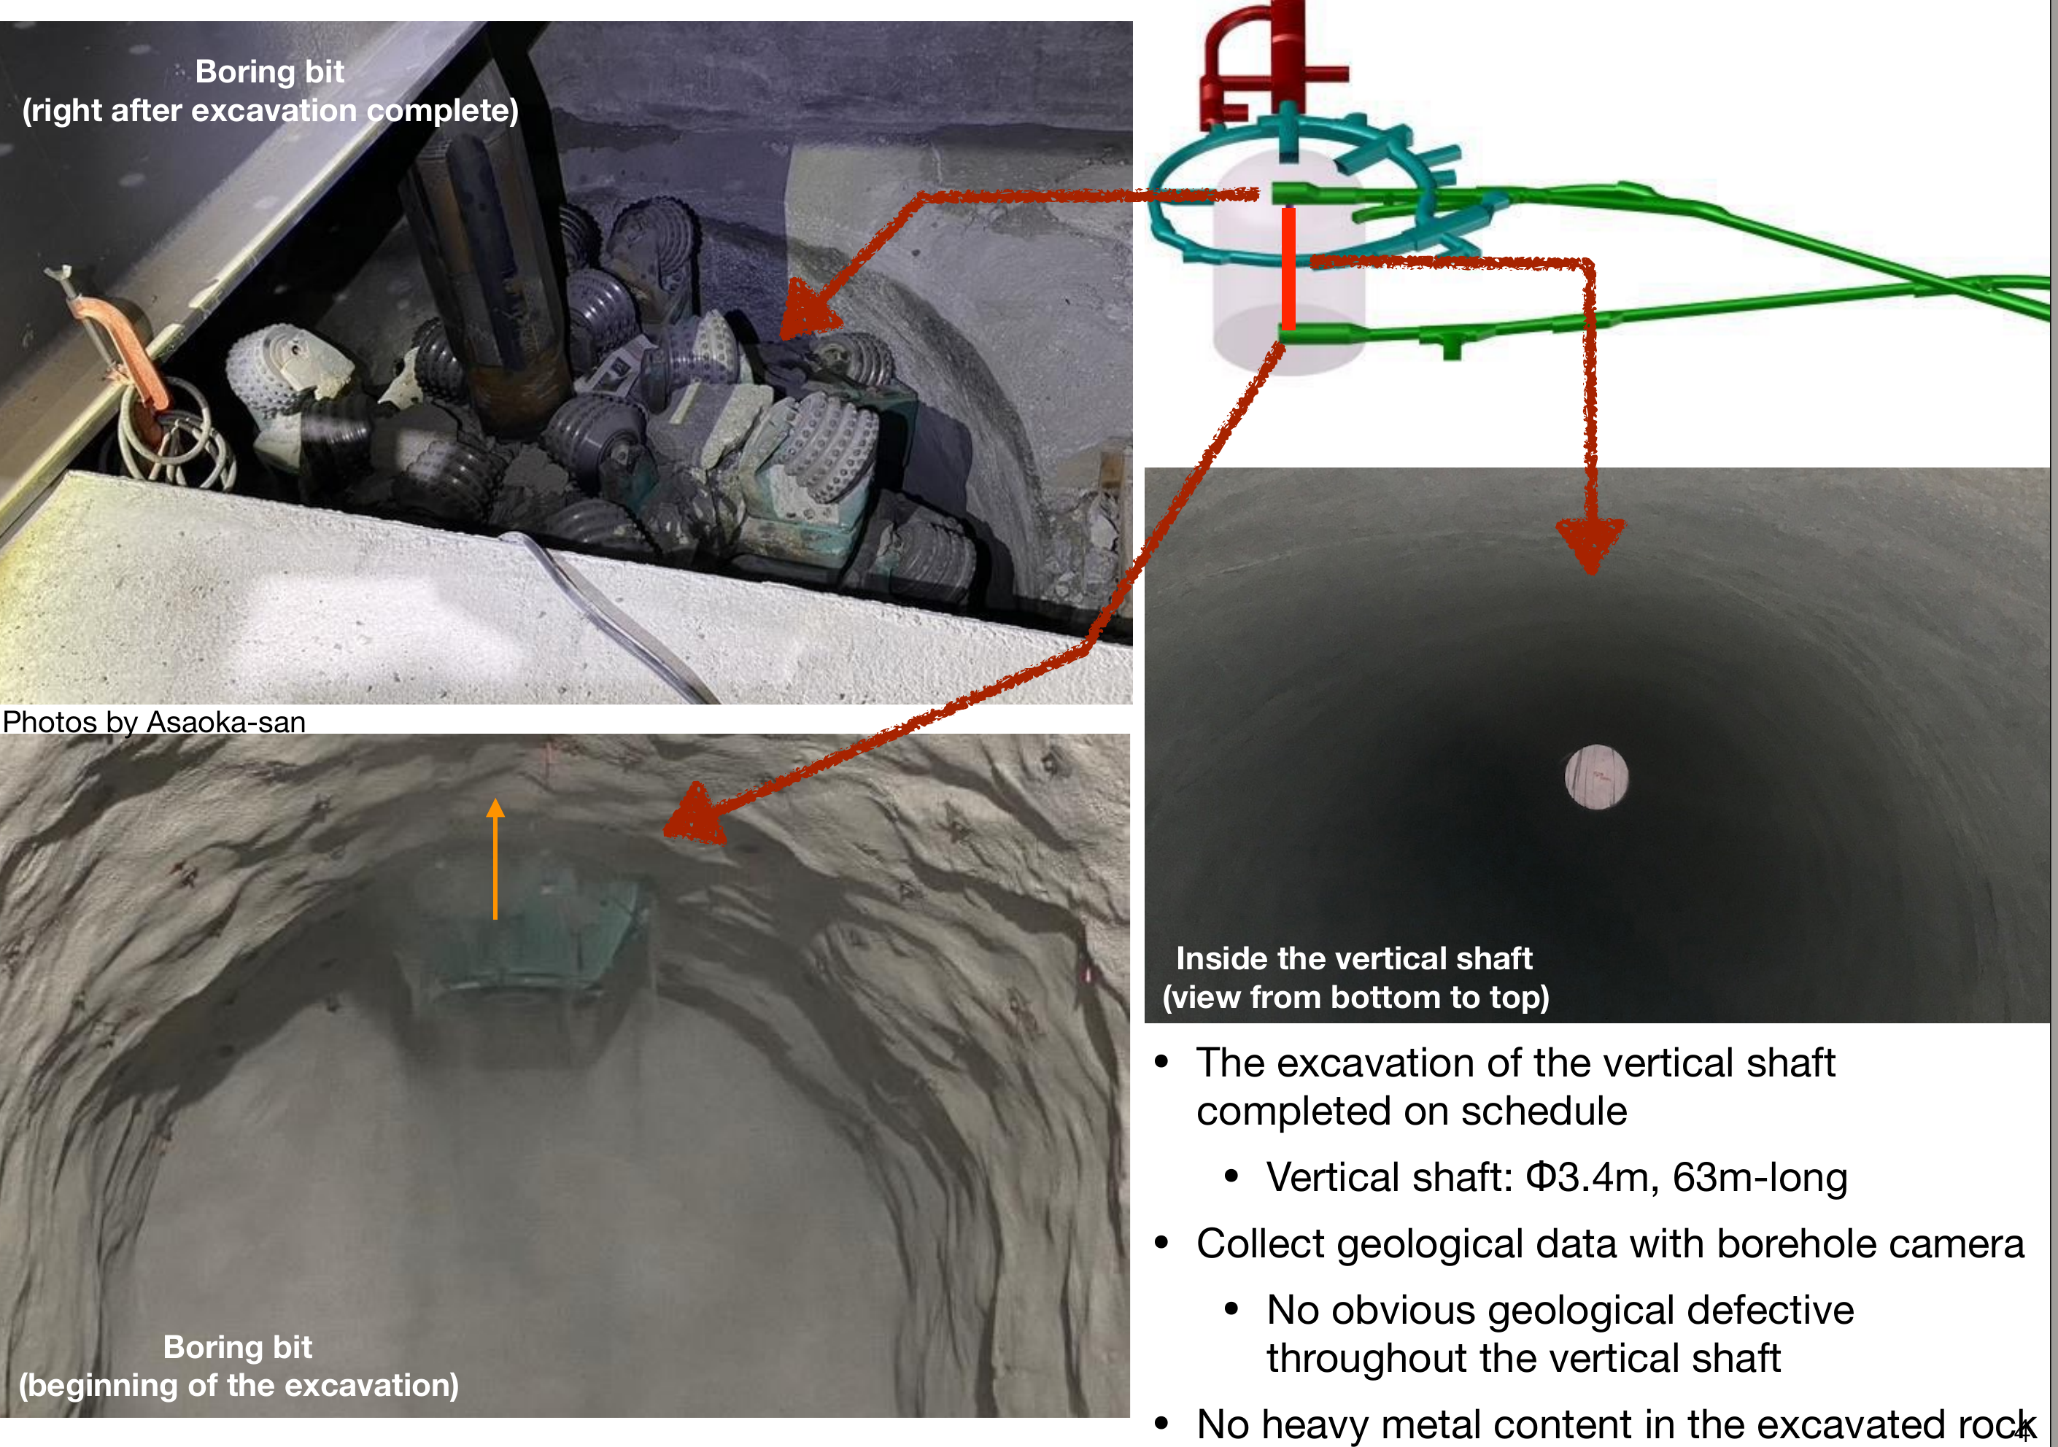
Recent progress: cavern excavation
Vertical shaft excavation completed on schedule!

Slide 27
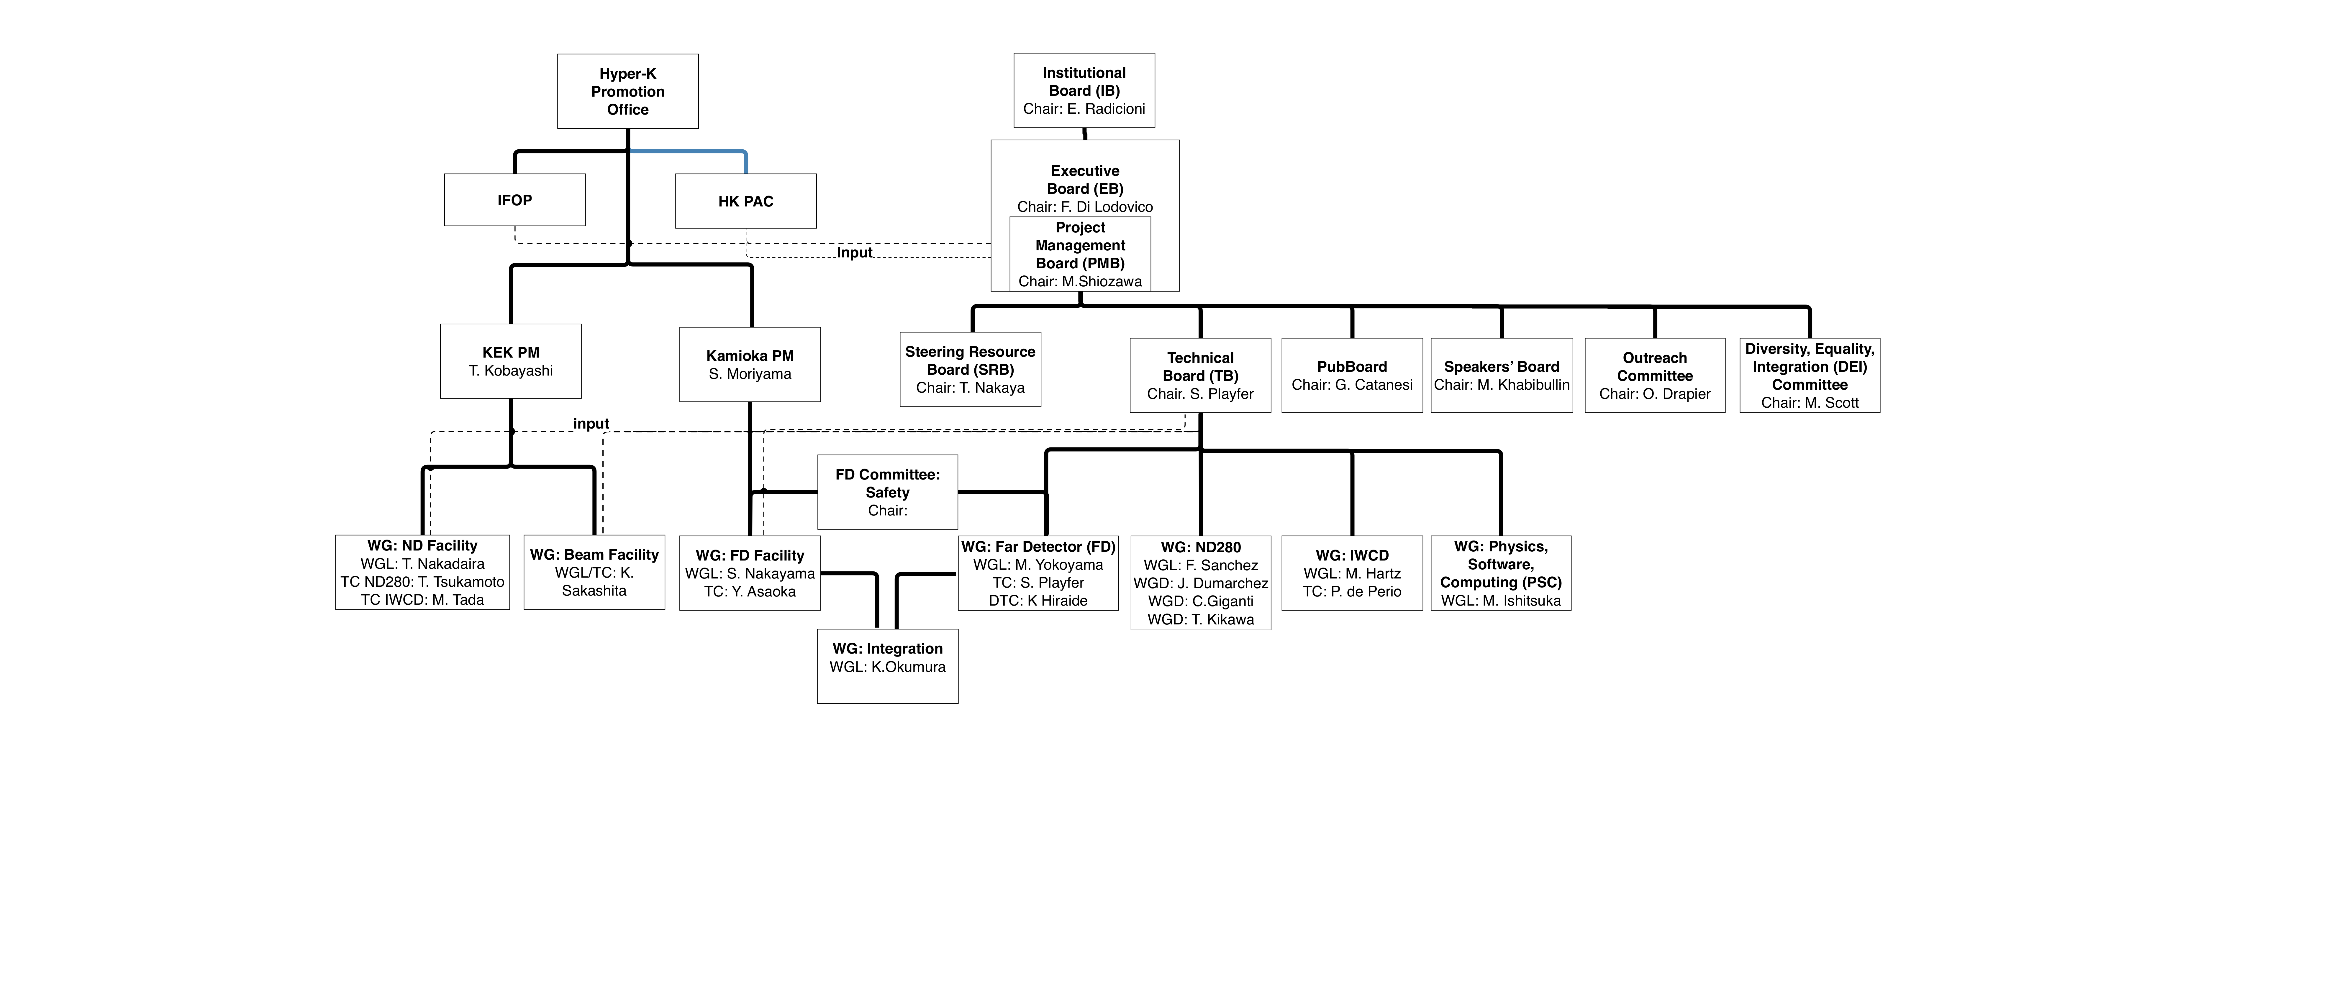

HK organizational chart
See next slide

Slide 28

Far detector Working Groups

Slide 29

IN2P3-CEA technical contributions to HK
295 km @ 2.5° Off Axis
ND280 Upgrade and maintenance
- Super-FGD electronics
- High-Angle TPCs electronics & readout
Construction of HK far detector
- Front-end electronics & timing system
International computing effort
- CC-IN2P3 as T1 for HK

Slide 30
SWOT
Strengths:
Well-known exceptional Water Cherenkov technology
Use of existing neutrino beam and near detector complex built for T2K, thus saving large amount of money for the long-baseline program and reducing systematics uncertainties from the first day of the experiment.
Construction budget for Hyper-Kamiokande have been allocated by Japanese government in 2019 with a budget profile that will allow to start the experiment in 2027.
Leading roles of French groups and acquired expertise in the ongoing T2K experiment
Opportunities:
Fast measurement of CP violation, before any other experiments.
Huge target mass, making HK the most sensitive observatory for rare events in the MeV–GeV energy region.
IN2P3 groups can build on their long standing expertise in the T2K experiment to propose strong contributions in Hyper-Kamiokande. There are still many possibilities to contribute, e.g. electronics of the outer detector, further ND280-upgrade, IWCD.
Deployment of a similar timing system for the near and intermediate detectors without any additional R&D.
Weaknesses:
Small groups at LLR and LPNHE. Mitigated by the large overlap in terms of physics case, technologies and tools between T2K, SK and HK.
Hyper-Kamiokande is an IN2P3 R&D project since 2022, but not yet an IN2P3 master project, undermining our visibility within the collaboration.
Risks:
Approval by CS-IN2P3 and allocation of IN2P3 funding is needed to capitalize on the R&D on the digitizer to make a strong contribution to the HK detector in addition to the timing system and computing.
Since the HKROC digitizer was not selected as the primary option for the HK inner detector, there is still an uncertainty about the outcomes of this contribution.

Slide 31

Financial resources
External and internal investments:
- 70k€ for R&D towards HK (Sorbonne Université)
- 400k€ (X) + 90k€ (IN2P3) for R&D on HKROC
- 300k€ (ANR) + 150 k€ (IN2P3) for R&D on time generation and clock distribution
Significant efforts to acquire externals fundings before asking for IN2P3 investments

Slide 32
Conclusions and outlook
Hyper-Kamiokande has a vast and rich physics program including:
Precision study of ν oscillations (fast CP-violation discovery, δ_{CP} measurement, etc…)
Rare events observatory (e.g. proton decay)
Multi-messenger astrophysics
→ Impressive and quick discovery potential!
Construction started and on schedule → Operation will start in 2027
Natural continuation of our involvement in Japanese ν program (T2K/T2K-II and SK)
Upgraded ND280 will be used as the HK near detector starting from day 1
Unique program of world-leading measurements and discoveries up to ~2040
Identified contributions on electronics (RD4HK during 2022) and computing
Used funding from external sources (Sorbonne University, Ecole Polytechnique, ANR)
Technological decisions taken in September 2022
→ approval by CS-IN2P3 & recognition of HK as IN2P3 master project are needed for full-scale participation in the HK experiment

Slide 33
Time Distribution costs estimations
 | Total number of PMTs | PMT per FE | Total number of FE (Time distribution nodes) | Number of nodes per distributor | Number of distributors | Distributor cost per unit | Total distributor's cost
Outer detector | 13 300 | 72 | 185 | 16 | 12 | 3 000 | 36 000
Inner detector | 20 000 | 24 | 833 | 16 | 53 | 3 000 | 159 000
MultiPMT | 2 000 | 12 | 167 | 16 | 11 | 3 000 | 33 000
Second stage
distribution
Total distributor's cost | 228 000
Atomic Clock cost | 54 000
GNSS recevier | 13 000
Antenna + cable | 4 000
Clock multiplication board | 2 000
Total clock ref cost | 73 000
Redundant system | 73 000
Grand total clock reference | 146 000
Slow Control switch | 2 000
Total cost | 376 000
Contigency | 20%
Gran total | 451 200
Time generation estimated cost: 145 k€ (LPNHE)
Time distribution (first and second stages) estimated cost: 250 k€ (LPNHE +CEA)
Time distribution endpoint cost: 80 k€ (INFN)
Total = ~480 Keuros

Slide 34

Computing efforts in Hyper Kamiokande
Tier model similar to CERN’s
Resources and data management using DIRAC
Software containerized and shared via CVMFS
System similar in other IN2P3 exp. (Belle-II, CTA, LSST…)
obvious synergies
First 10 years of operations:
25 PB (data + MC — mostly Far Detector)
880 MCPU.hours
(minimal with one copy of each file)

Slide 35

Proposed Contribution: CC-IN2P3 as T1 site
CC-IN2P3 Tier1 for LHC (WLCG)
infrastructure, expertise available
Low-rate data stored on tapes
Disk and CPU for productions
Database management
Two proposed scenarii:
1. ND280 data storage
2. Near and Far detectors data storage
First step: CC-IN2P3 as T1 site for T2K
integration of CC as grid site into GridPP
disk allocation and data transfer
First production for HK at CC-IN2P3 completed

Slide 36


Contribution to HK Far Detector electronics
France would develop and produce the whole PMT read-out chain (w/o DAQ)
clock generation and distribution
time and charge digitization
Clock generation and UTC
Time distribution
53
53
16
Underwater
833
24
Time distribution endpoint

Slide 37

HKROC: new chip and readout
HK requirements
fulfilled
Chip and readout board for PMT inspired by HGCROC chip
1. Large dynamic range: 3 gains / ch.→ up to 2500 pC
2. Excellent charge & time resolution: (<200 ps)
3. TSMC CMOS 130nm etching
4. Reduced dead-time (<50 ns): SAR ADC sampling waveform at 40 MHz
R&D funded by X (400 k€)
HKROC delivered in Nov 2021
First tests in December 2021
Synergy OMEGA/LLR/IRFU
Use in future WC detectors!

Slide 38

Competitors and time constraints
Two other competitors : Japan QTC (SK chip) & Italian discrete solution
HK internal review Apr-June 2022 selection of digitizer solution
Selection criteria:
Performances
Group expertise
Official engagement
on fundings in
June 2022
First tests results
Internal
review
Now

Slide 39

Time Generation & UTC
Cavern under
the Mt. Ikeno
Computing/
Monitoring system
Time data and UTC
To TDM
GNSS (x2)
PPS
Local time/GNSS
PPS comparator
Control
10 MHz and PPS
Clock conditioning Board
125 MHz and PPS
To TDM
Atomic Clock (x2)
Local time
PPS comparator
Septentrio PolaRx5 satellites detection
10 MHz
Creation of reliable Universal Time for global synchronization and stable 125 MHz frequency for front-end digitizers
Strong collaboration between LPNHE and SYRTE (Observatoire de Paris)
Calibration of clocks and GNSS antennas
Creation of a dedicated lab to study clocks and GNSS at LPNHE
Long-term studies and comparison using atomic clocks, antennas and PPS-SYRTE
R&D program supported by SU Emergence and ANR “Bertha”

Slide 40




Clock distribution
Strong collaboration between LPNHE/INFN/IRFU
Baseline proposal of time distributor modules (TDM) was finalized
Clock and Data Recovery (CDR) technology implemented using ser-des
“Tree-like” structure
Board design shared btw CEA & LPNHE
Main distributor (53 ports)
Second distributors (16 ports)
Slow control and asynchronous signals distribution
FE board development in collaboration with HKROC’s
Other competitor: SK-based clock distribution system
selection of the solution in June 2022
Official engagement on fundings for approval
Clock generation and UTC
Designed at IRFU
Adapted by INFN/LPNHE
Time distribution
53
53
16
Underwater
833
24
Time distribution endpoint

Slide 41

Upcoming milestones
Technological decision for HKROC and clocks
R&D almost complete
HK internal review beginning of 2022 technological decision June 2022
MOU signature in 2022

Slide 42


HK LBL- oscillations measurements
Data taking plan: 1.3 MW 6 cycles/year 10 years ( )
mode
~2740 events for
mode
~1624 events for
Appearance measurements: increased by 2 orders of magnitude (75:15 for T2K-I Nature)
Higher statistics measurements of the oscillation parameters

Slide 43





HK OA samples

Slide 44


sensitivity

Slide 45

Proton decay
HK CDR arXiv:1805.04163

Slide 46
Sensitivity to other oscillation parameters

Slide 47
Degeneracy - MO

Slide 48



Solar neutrinos: upturn
Matter effect in the Sun dominant at high energy
transition in probability around a few MeV
Displacement towards lower energy could be explained by
Statistical fluctuation ?
Light sterile neutrino ?
Non Standard Interaction in the dense Sun ?
Measurement accessible using mPMTs (lower energy threshold)

Slide 49


mPMT impact on physics
Preliminary
Preliminary
Vertex resolution improved w/ mPMT for dWall ≤ 8m → FV expansion
mPMT allows to explore < 5 MeV region.

Slide 50
Digitizer costs
1.9 M€ for ID to be shared btw IN2P3 and CEA
0.7 M€ for OD to be shared btw IN2P3, CEA and UK

Slide 51
Collaboration Organigram

Slide 52

Electronics organization for ID B&L

Slide 53





Hyper-Kamiokande schedule
May 28 2021
First light in 2027
March 2021

Slide 54








May 28 2021
HK schedule
First light in 2027
May 28 2021
Mid 2023:
HKROC and
time distrib.
production
April-July 2022:
Internal review
Start electronics
installation
2020
2021
2022
2023
2024
2025
2026
2027
2028
Geo survey
Tunnel constr.
Cavern excavation
Tank constr.
PMT install.
Commis.
Operations
PMT production
Water
filling
Electronics R&D
Electronics production
Electronics installation
First 2000 PMT March 2021

Slide 55


Tunnel construction
August 2021

Slide 56

Computing timeline

Slide 57





Rb atomic clock
SRS FS7025
@LPNHE
Microwaves oven
@ 6.8347 GHz
Rb-87 lamp
Rb-87 cell
Rb-87 filter
Photosensor
Physics Today 60, 11, 33 (2007)
Allan standard deviation: paper
Comparison with time reference at SYRTE performances studies
Test using more stable clocks e.g. Passive Hydrogen Maser (PHM1008)
Strontium optical atomic clock @SYRTE

Slide 58



GNSS antenna and receiver
Receive signals from various satellites e.g. Galileo
Produce 1 PPS using received signals
Synchronization with UTC (after calibration & correction)
Septentrio PolaRx5
@LPNHE

Slide 59
Tests at Jussieu and SYRTE
Dedicated tests and performances at SYRTE
Clock and GNSS calibration
Creation of a dedicated lab to study clocks and GNSS at LPNHE
Room for long-term tests (5th floor, Tower 13)
Time transfer (White Rabbit) between Syrte-Obs.Paris and Jussieu
PPS with UTC(OP) available in lab soon
Installation of GNSS antenna on the Jussieu roof (Tower 13)
Long-term studies and comparison using
atomic clocks and PPS-Syrte
First implementation of GNSS signals corrections
Build prototypes for HK
R&D towards HK and other IN2P3 projects
LPNHE
Tower 13

