Slide 1

Proof of the principle experiment of Machine Learning based online Characterization and Optimisation of a high intensity LAser pulse (ML-COLA)
Viacheslav Kubytskyi, Moana Pittman
Laboratoire de Physique des 2 infinis Irène Joliot-Curie – IJCLab
P2IO 1 December 2022

Slide 2
Outline
CPA technology
STC problems in the context of PALLAS
Measurements with multispectral camera
Next steps

Slide 3
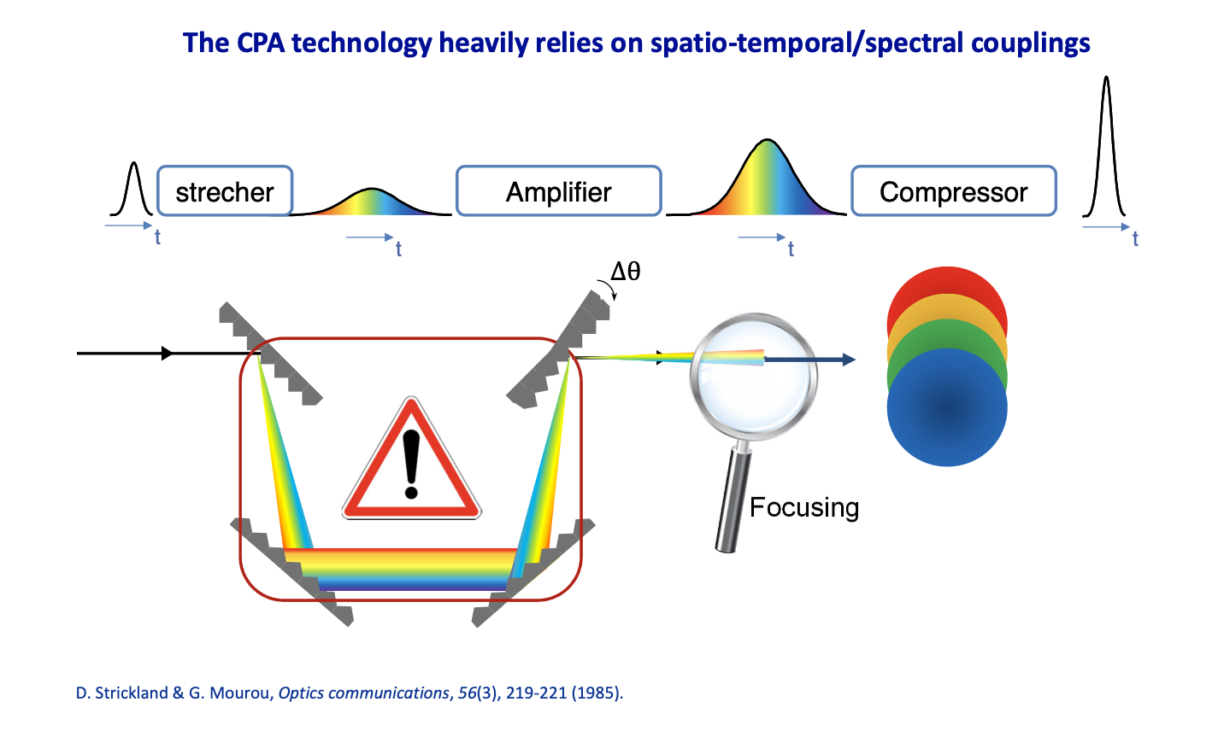
CPA technology
Need to focus all spectral components of the pulse into very small temporal and spatial dimensions.
Requires: high level expert, advanced diagnostics and many adjustment iterations.
Source: Fabien Quere. Methods for characterisation of high-power femtosecond lasers

Slide 4
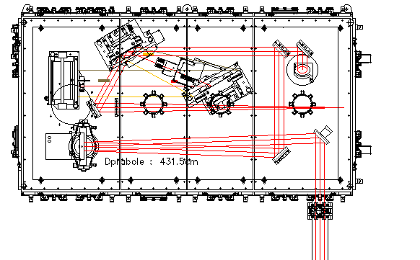
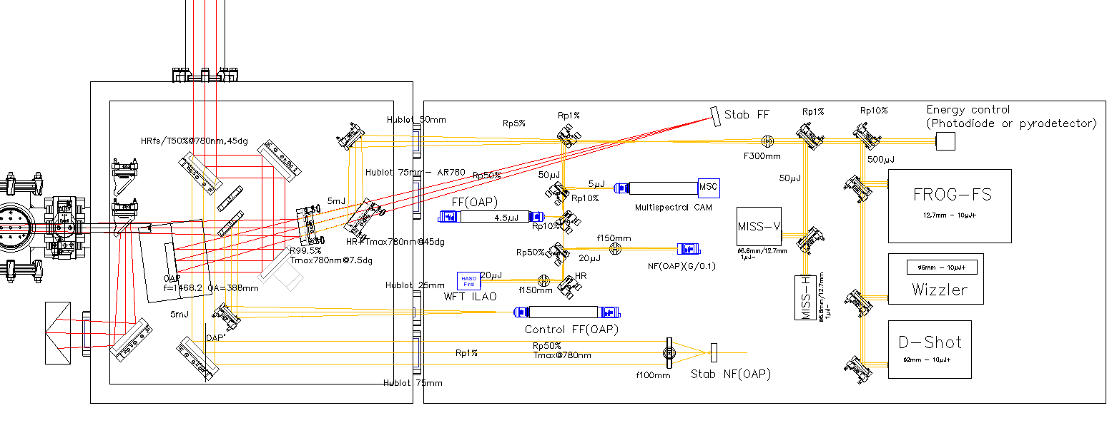
High energy pulse compressor
Laser control and beam quality in a context of laser plasma experiment PALLAS
Laser control. Real time & integrated
Plasma cell
Diagnostics and transport
Ultrashort laser pulse needs to be broad spectra.
Chromatic optical elements misalignment leads to residual cromaticity.
UHI CPA LASERIX
  40TW 1.6J / 40fs @ 10Hz
Important: Short bunch focusing, intensity at focus.
Notes:
Complete spatial, spectral , temporal(Frog) in real time
MISS 2-spatioo specteral 2d inferommetry
Measure longitudinally , transversally and combine.

Slide 5
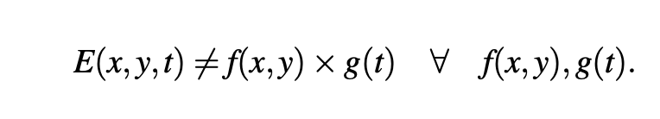
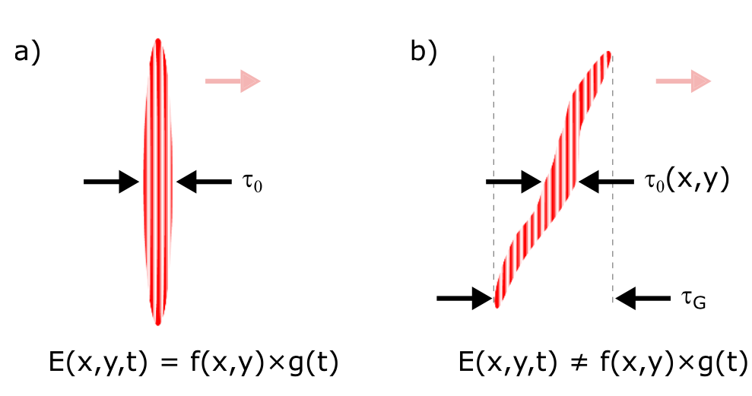
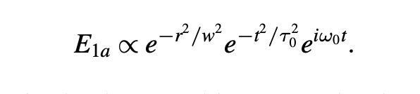
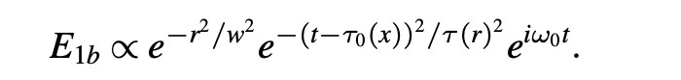
What is STC?
One example of STC: pulse-front tilt
When it is important:
Intensity at the focus is the most critical parameter of a laser pulse.
Misalignment of compressor gratings can lead to STCs such as PFT.
J. Opt. 22 (2020) 103501 (33pp) https://doi.org/10.1088/2040-8986/abad08
Spatio-temporal characterization of ultrashort laser beams: a tutorial
Spencer W Jolly, Olivier Gobert and Fabien Qu ́er ́e
Notes:
Measure “length” locally

Slide 6
Principal idea of the project
Laser beam quality, compressor alignment GOOD or BAD?
ML learns automatically, from image details and additional diagnostics.
Decompose imperfections and perform necessary corrections
Automatization

Slide 7
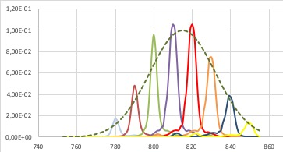
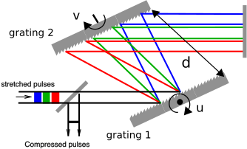
Is it possible to measure?
With scan-based technique like Termites/Insight.
Very precise, but slow.
Reconstruction algorithms.
In ML-COLA we proposed to use multispectral camera coupled with ML methods in order to perform snapshot measurements for laser characterization.
Spatio-spectral intensity & Spatio-spectral phase

Slide 8
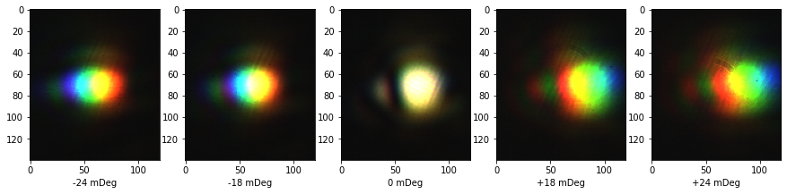
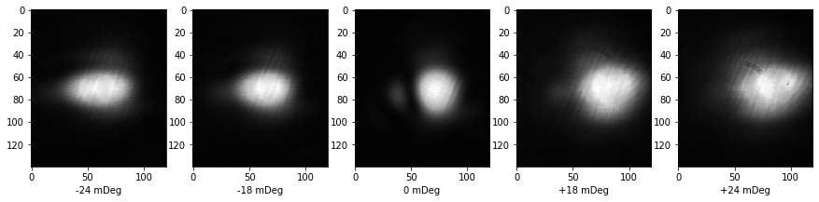
Measurements with multispectral camera
-0.42 mRad
-0.31 mRad
0 mRad
0.31 mRad
0.42 mRad

Slide 9
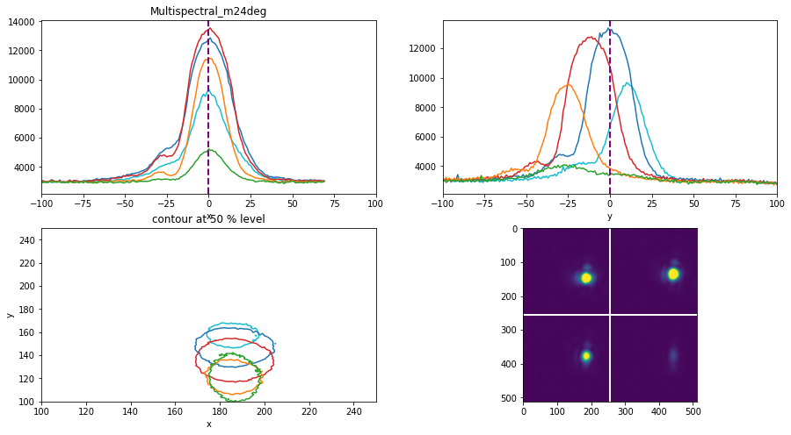
Channel by channel.
Notes:
Clearly see misalignments follow spectrum.

Slide 10
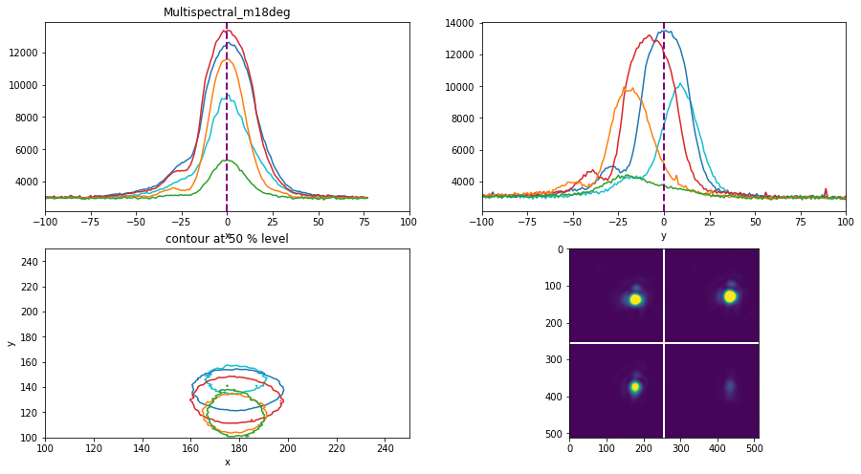

Slide 11


Slide 12


Slide 13
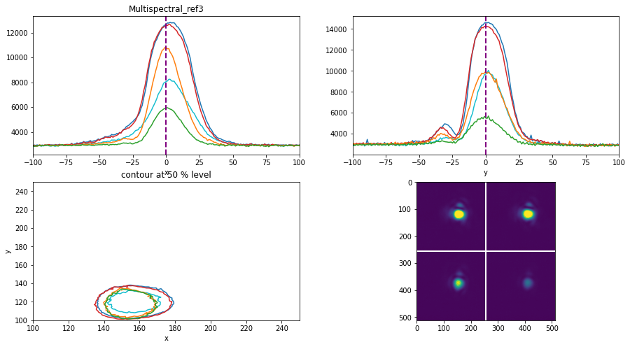

Slide 14
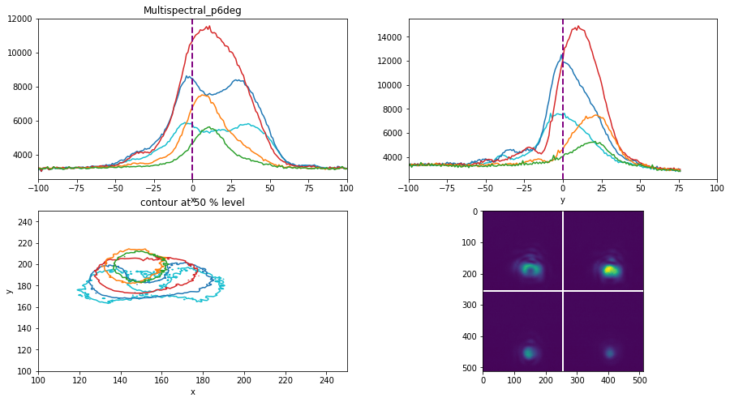

Slide 15
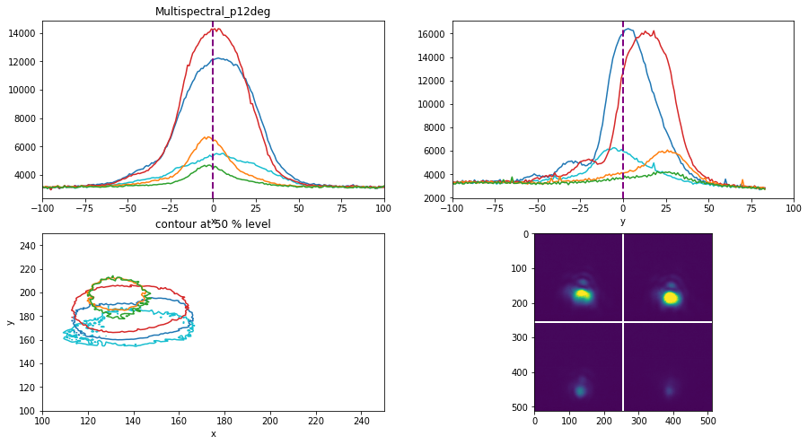

Slide 16
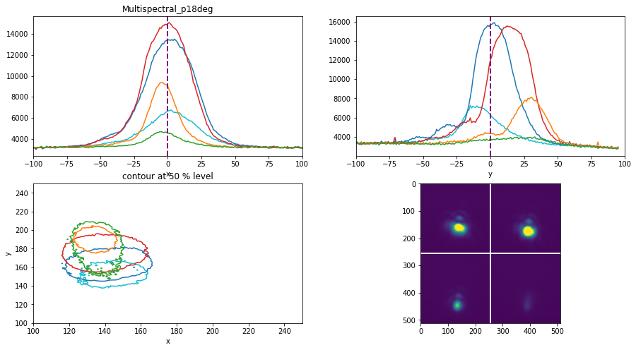

Slide 17


Slide 18
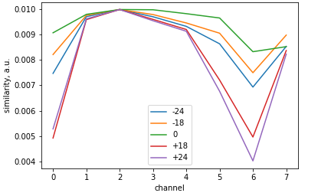
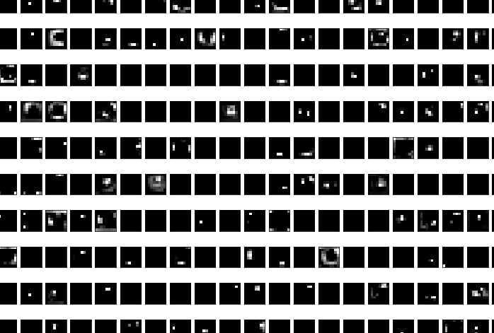
Similarity between channels.
Feature extraction with VGG16
Pretrained model
classification
adapted to 8 channels inputs

Slide 19
Optimisation and ML tasks.
DATASET:
Amplitude and phase data: images from multispectral camera and INSIGHT/termite measurements
Compressor and principal laser parameters: (u, v, d), adaptive mirror configuration, timings, temporal length, energy, pointing stability etc.
Categorical labels assigned by the laser expert
Structural similarity
Autoencoders
Feature extraction
Measurements dataset for training. Data taking of labelled data.
Robust bounded optimizer
Transfer learning, domain adaptation
Notes:
We want ML learns automatically, form image details. GOOD or BAD alignment?

Slide 20
Timeline and next steps
Camera delivery : December 2021.
Setup, tests and several measurements. Automatization.
PhD student Gueladio Kane
2023: data + ML
Equipment to buy: achromatic objective optics, motorization,
special Notch filter, PC for automatization and ML.

Slide 21
Summary
Key idea: Snapshot measurement combined/reinforced with ML techniques.
Outcomes:
Unique diagnostics of ultrashort high intensity laser
Online control and shot to shot stability.
Laser characterization for PALLAS.

Slide 22
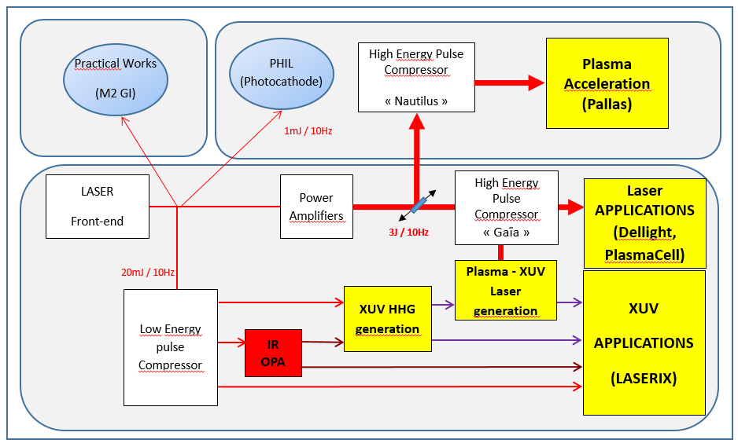
LASERIX platform at IJCLab
Equipements : UHI CPA Laser
  40TW 1.6J / 40fs @ 10Hz (37J @ 0.1Hz démontrés en 2007) ^{(*)}
    → matériels disponibles et « gros » potentiel d’upgrade
  Base Amplitude Laser « customisé » (flexibilité & performances)
  Contrôle Commande développé avec Amplitude Laser, évolutif
Activités Scientifiques / Techniques
  R&D sources intenses (laser, XUV) et diagnostics spécifiques
  TP lasers intenses (M2-GI-PLATO, Polytech)
  Applications : Physiques des Plasmas, matériaux, irradiation, expériences résolues en temps (régions XUV - NIR), façonnage de faisceaux XUV, Physique non-linéaire, QED (Dellight) et… accélération par laser : PALLAS
Temps faisceau
  PALLAS 50% (20 semaines)
  Autres 50% (20 semaines)
  Maintenances (7 semaines)
  Arrêt : Août (5 semaines)
^{(*)} F. Ple et al., "Design and demonstration of a high-energy booster amplifier for a high-repetition rate petawatt class laser system," Opt. Lett. 32, 238-240 (2007)
Notes:
Main characteristics: CPA, energy
Beam lines, experiments (Q, PALLAS)
Nautilus, compression gratings - STC

