Slide 1
SLDO IV curves
Impact of the precision parameter of the multimeter used for electrical QC
Paul Chabrillat
ATLAS ITk
07/11/2022

Slide 2
Test procedure
I – Setting parameters and monitoring
II – Studying the impact of precision

Slide 3
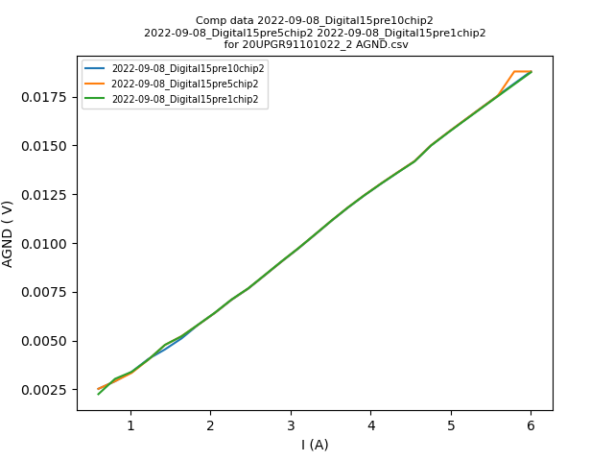
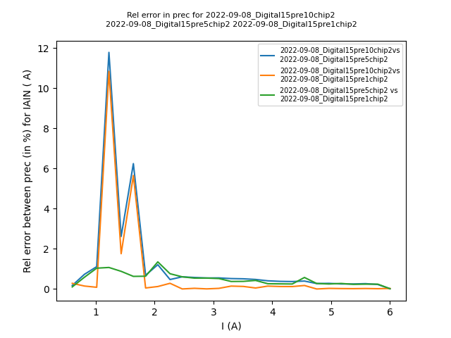
Comparing Precision

Slide 4
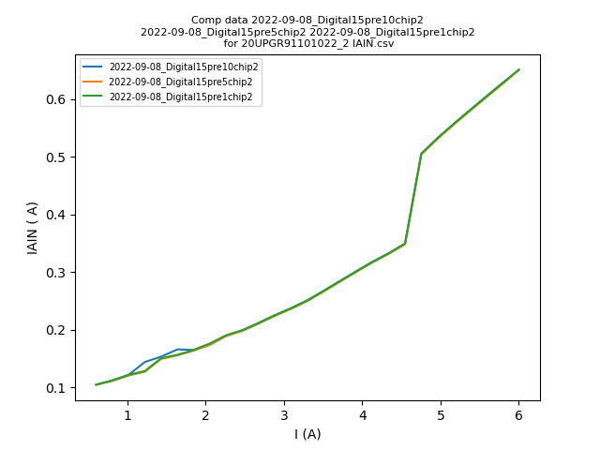
Comparing Precision

Slide 5
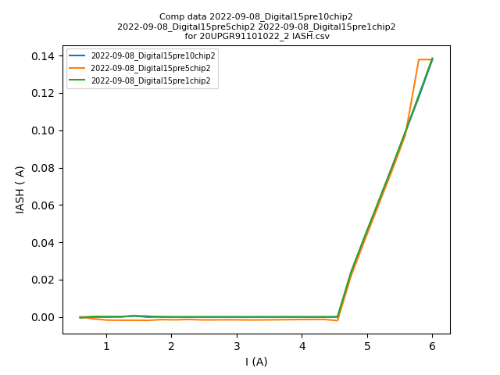
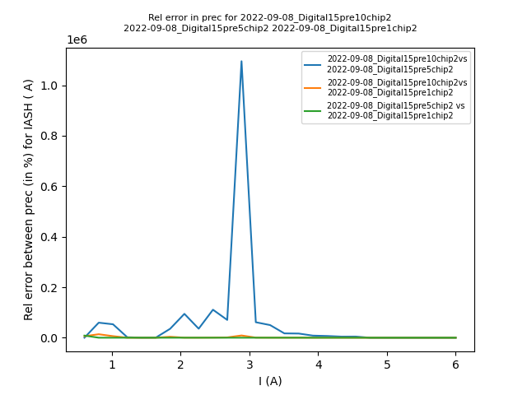
Comparing Precision

Slide 6
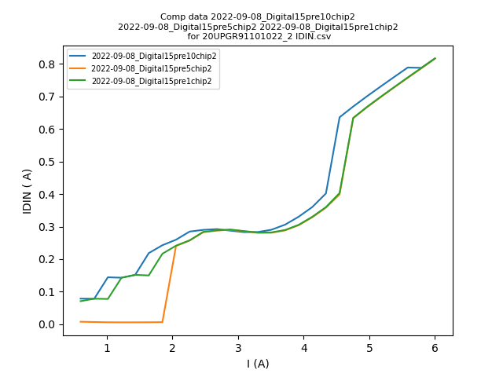
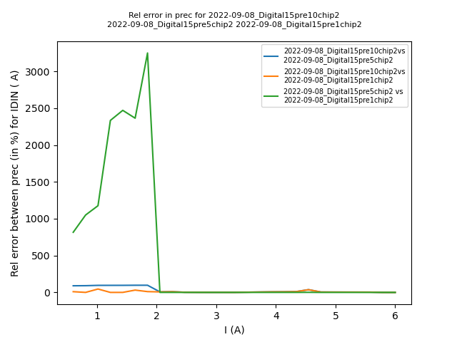
Comparing Precision

Slide 7
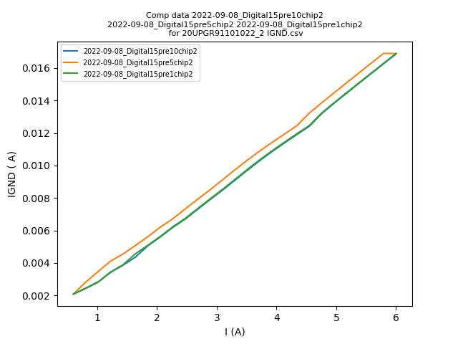
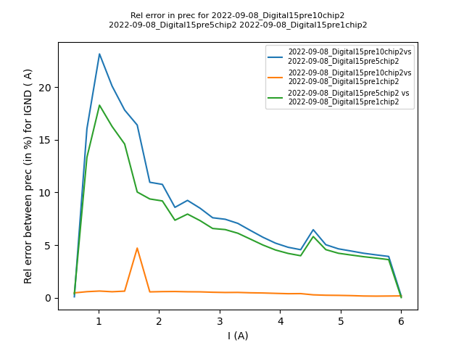
Comparing Precision

Slide 8
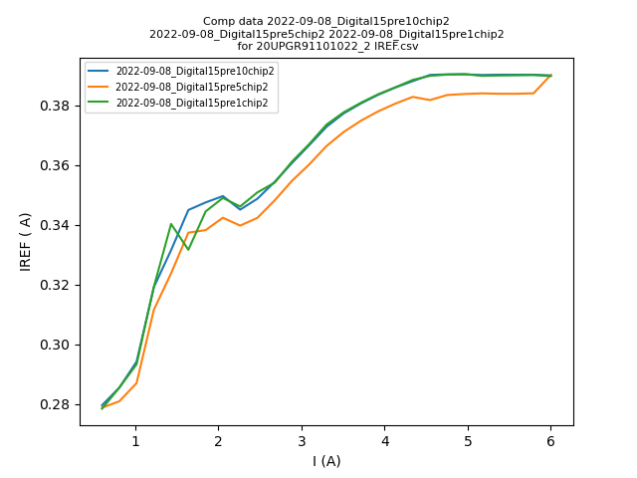
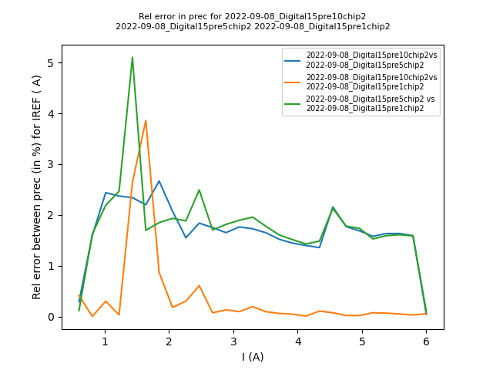
Comparing Precision

Slide 9
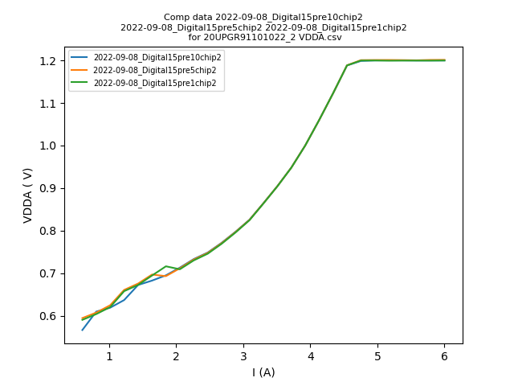
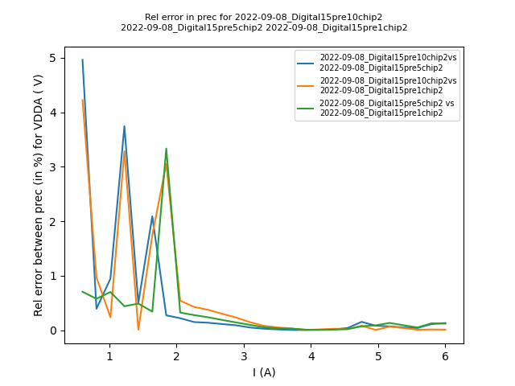
Comparing Precision

Slide 10
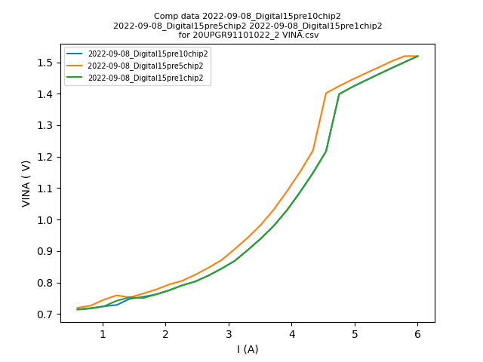
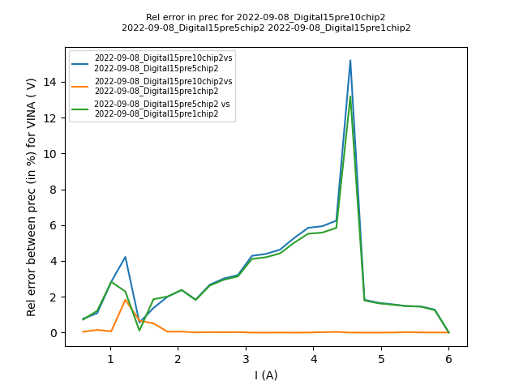
Comparing Precision

Slide 11
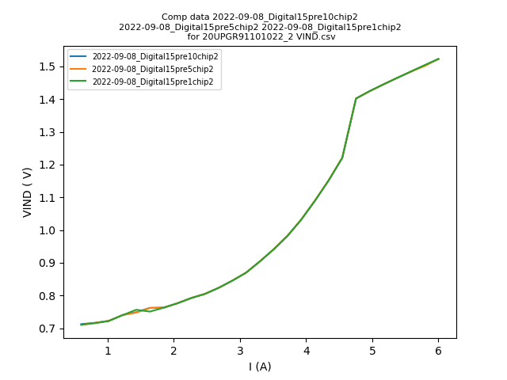
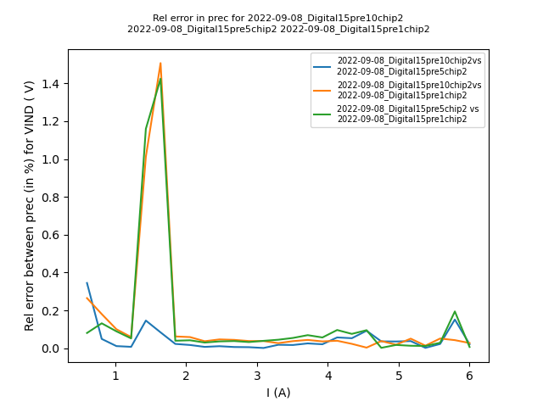
Comparing Precision

Slide 12
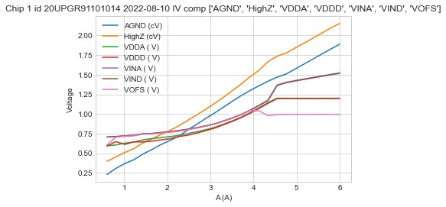
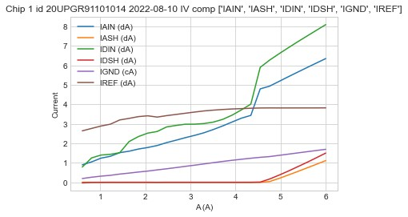
Parameters

Slide 13

Conclusion
No impact of precision on almost every parameter in the operation region

