Slide 1
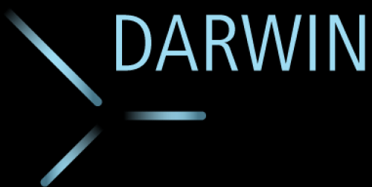
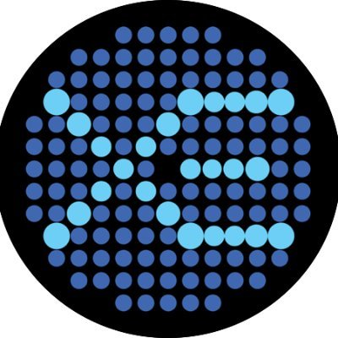
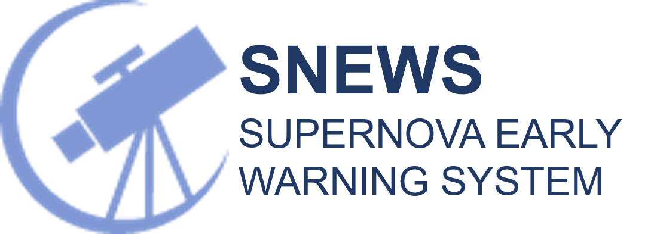
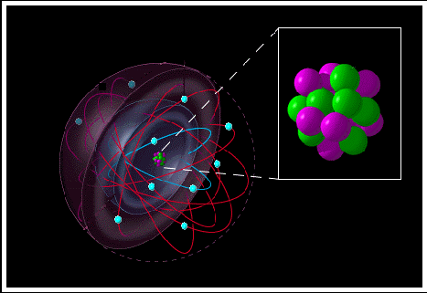
Hunting Supernova neutrinos with
Dark Matter Detectors
Melih Kara
kara@kit.edu
WIMPS, neutrons &
Neutrinos scatter of off
The nucleus
Photons & electrons scatter off
of atomic electrons
Adapted from
The Time Machine Project © Cetin Bal
Melih Kara kara@kit.edu 2nd DMLab Meeting Hamburg, 12-13 December 2022

Slide 2
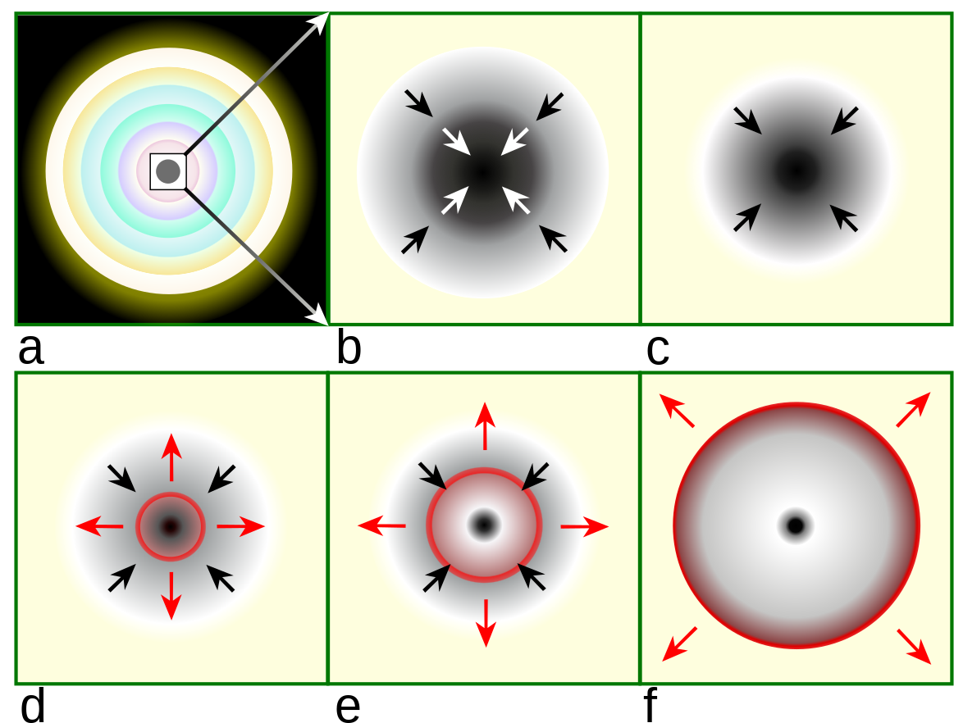
Supernova Neutrino Emission
Multimessenger Signal
Neutrinos,
Gravitational Waves,
Electromagnetic Signal
Massive Star
Core collapse
Mass infall, nu traps
https://en.wikipedia.org/wiki/Type_II_supernova
Outward shock
forms
Neutrinos
escape
Shock breakout
Neutrinos starts emitting hours to days before the shock breakout, providing an early warning
First ever multimessenger signal using EM, gravitational waves and neutrino observatories. – Dark Matter Detectors can also help!
While existing neutrino observatories probe individual neutrino flavors,
dark matter detectors are flavor blind.
The interaction channel is Coherent-Elastic Neutrino Nucleus Scattering
Differential CEvNS rates
1
Melih Kara kara@kit.edu 2nd DMLab Meeting Hamburg, 12-13 December 2022

Slide 3
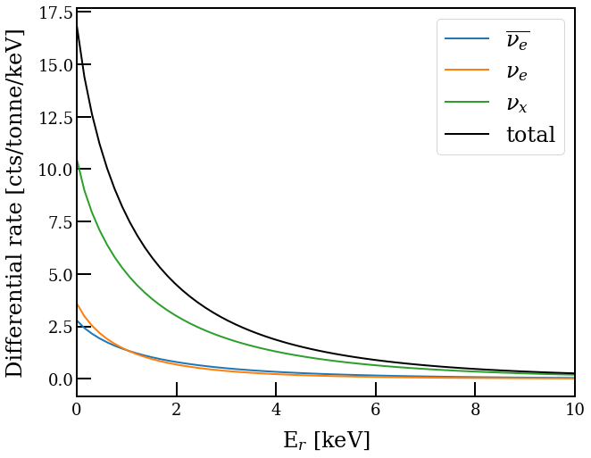
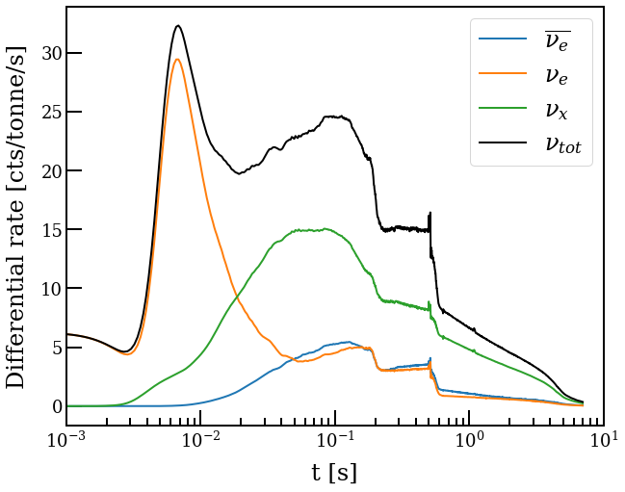
Supernova Interaction Rates
Neutrino flux -> Model dependent, snewpy
Atomic cross-section with Xenon Nucleus
We then use these Recoil Spectra and time distributions to simulate detector signal.
y-pos
x-pos
2
Melih Kara kara@kit.edu 2nd DMLab Meeting Hamburg, 12-13 December 2022

Slide 4
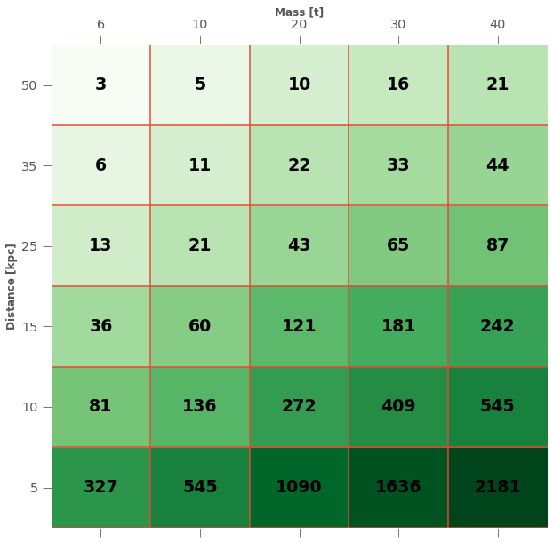
Scaling of the expected counts
Mass [tons]
Scaling by the distance
and by the target mass
XENONnT size
LXe TPC’s
Distance [kpc]
DARWIN size DM detectors are expected to be comparable with neutrino observatories
3
Melih Kara kara@kit.edu 2nd DMLab Meeting Hamburg, 12-13 December 2022

Slide 5
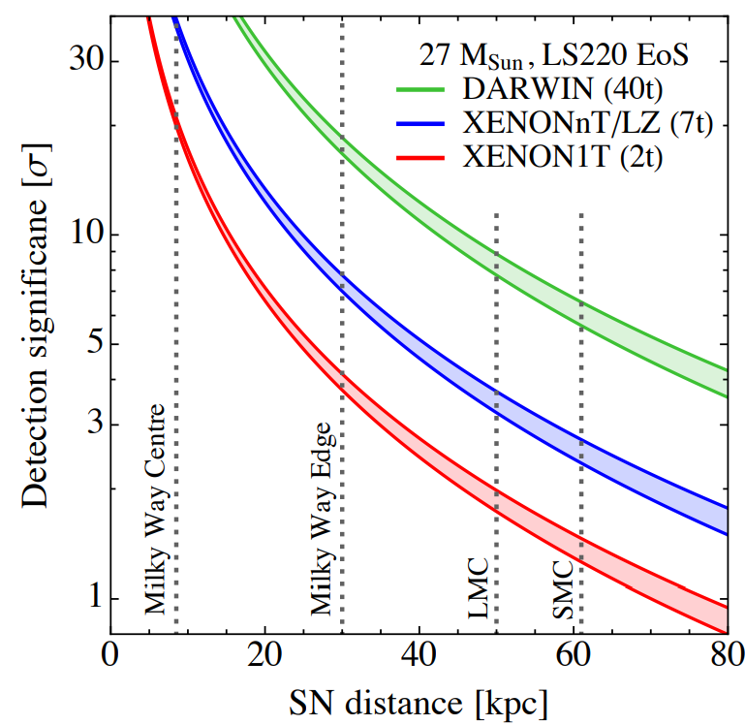
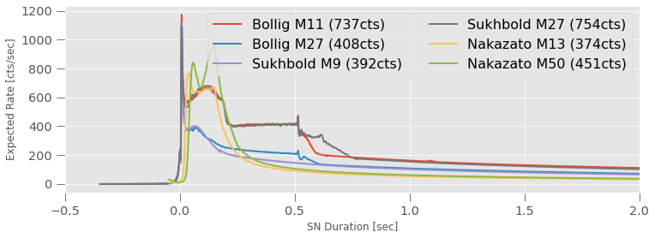
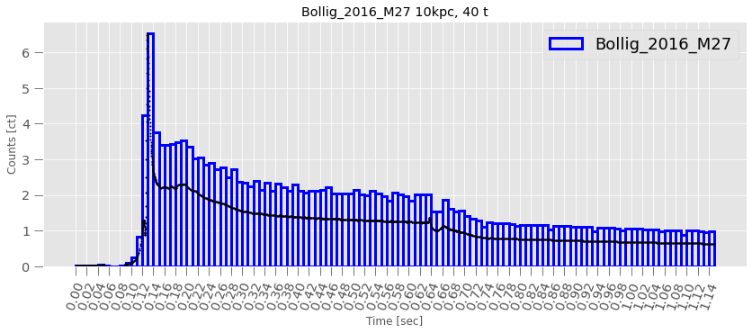
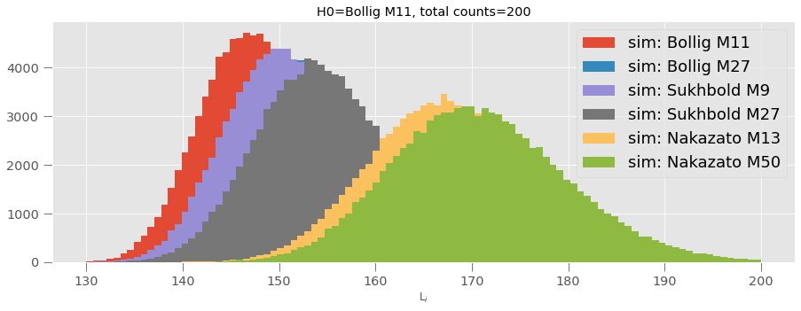
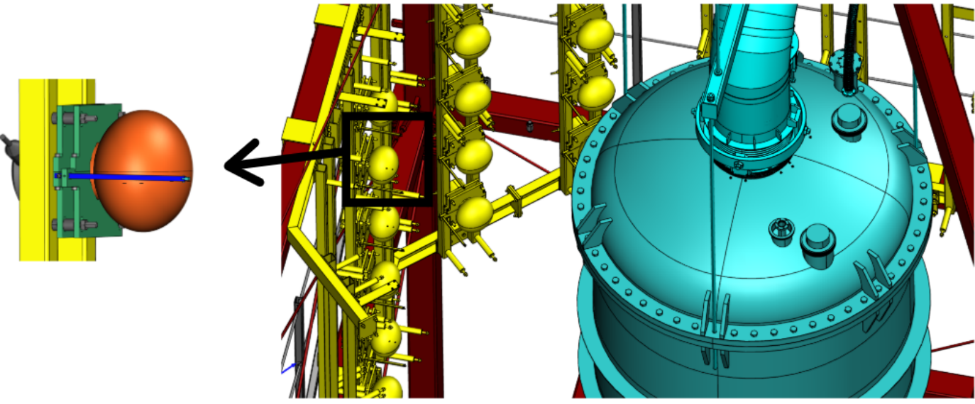
Ongoing studies
Currently, we are studying the sensitivities of XENONnT and DARWIN to neutrinos from a possible supernova
https://arxiv.org/abs/1606.09243v2
y-pos
x-pos
PRELIMINARY
4
Melih Kara kara@kit.edu 2nd DMLab Meeting Hamburg, 12-13 December 2022

Slide 6
Ongoing studies
Currently, we are studying the sensitivities of XENONnT and DARWIN to neutrinos from a possible supernova
https://arxiv.org/abs/1606.09243v2
Improving the study on 2016 Lang et al paper,
We study the sensitivity of detection as a function of supernova distance for existing and future dark matter detectors using more realistic signal simulations and wider range of supernova models.
y-pos
x-pos
PRELIMINARY
5
Melih Kara kara@kit.edu 2nd DMLab Meeting Hamburg, 12-13 December 2022

Slide 7
Ongoing studies
Currently, we are studying the sensitivities of XENONnT and DARWIN to neutrinos from a possible supernova
https://arxiv.org/abs/1606.09243v2
y-pos
x-pos
PRELIMINARY
6
Melih Kara kara@kit.edu 2nd DMLab Meeting Hamburg, 12-13 December 2022

Slide 8
Ongoing studies
Currently, we are studying the sensitivities of XENONnT and DARWIN to neutrinos from a possible supernova
https://arxiv.org/abs/1606.09243v2
Online Monitoring in XENONnT
In XENONnT, we utilize a triggerless DAQ which allows us to access the data shortly after it is taken.
y-pos
Possible supernova signal
x-pos
By injecting simulations from various models in XENONnT’s existing science runs
We optimize our trigger threshold at different distances as a function of false alarm rate over signal detection.
In the example above, setting a threshold at 3 sigma
Our trigger doesn’t generate a false alarm and it detects two models at 10kpc, while it misses one.
PRELIMINARY
After cuts
7
Melih Kara kara@kit.edu 2nd DMLab Meeting Hamburg, 12-13 December 2022

Slide 9
Ongoing studies
Currently, we are studying the sensitivities of XENONnT and DARWIN to neutrinos from a possible supernova
https://arxiv.org/abs/1606.09243v2
y-pos
x-pos
PRELIMINARY
8
Melih Kara kara@kit.edu 2nd DMLab Meeting Hamburg, 12-13 December 2022

Slide 10
Ongoing studies
Currently, we are studying the sensitivities of XENONnT and DARWIN to neutrinos from a possible supernova
Model discrimination power studies.
We are investigating ways to discriminate between different physics-driven supernova models.
Current approach is to use binned maximum log-likelihood methods, in the near future we are planning on investigating unbinned analysis.
https://arxiv.org/abs/1606.09243v2
https://arxiv.org/abs/1606.09243v2
y-pos
y-pos
x-pos
x-pos
PRELIMINARY
credit: Paul Kuhwald
9
Melih Kara kara@kit.edu 2nd DMLab Meeting Hamburg, 12-13 December 2022

Slide 11
Ongoing studies
Currently, we are studying the sensitivities of XENONnT and DARWIN to neutrinos from a possible supernova
https://arxiv.org/abs/1606.09243v2
y-pos
x-pos
PRELIMINARY
10
Melih Kara kara@kit.edu 2nd DMLab Meeting Hamburg, 12-13 December 2022

Slide 12
Ongoing studies
Currently, we are studying the sensitivities of XENONnT and DARWIN to neutrinos from a possible supernova
We also have a muon and neutron veto surrounding our TPC.
Together containing ~700 tons water allowing for the detection of Supernova signal
by detecting the Cherenkov radiation following the Inverse Beta Decay (IBD)
Combined study is expected to
increase our sensitivity
and help with event selection
Led by
L.D. Garcia
LPNHE (Paris)
https://arxiv.org/abs/1606.09243v2
y-pos
x-pos
PRELIMINARY
11
Melih Kara kara@kit.edu 2nd DMLab Meeting Hamburg, 12-13 December 2022

Slide 13
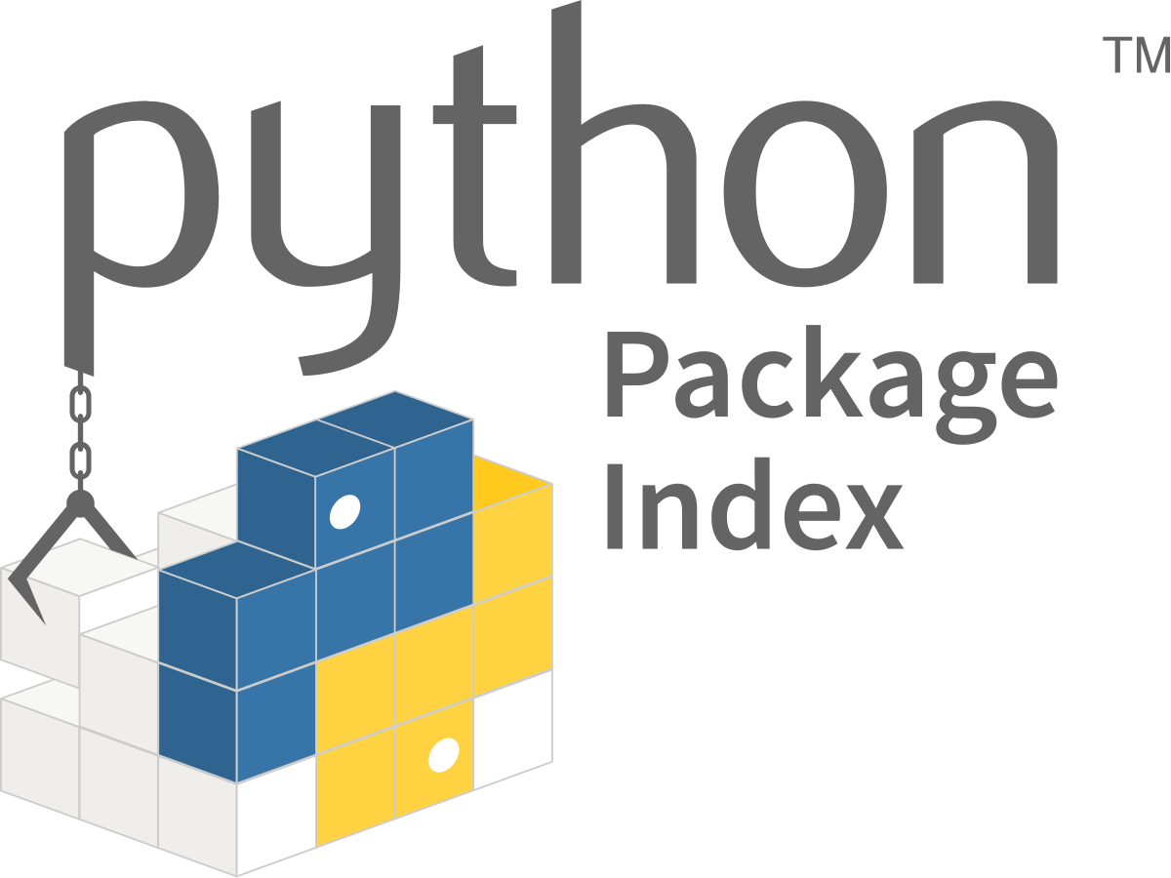
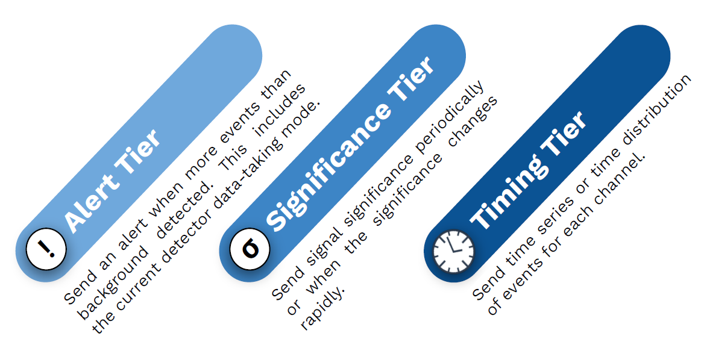
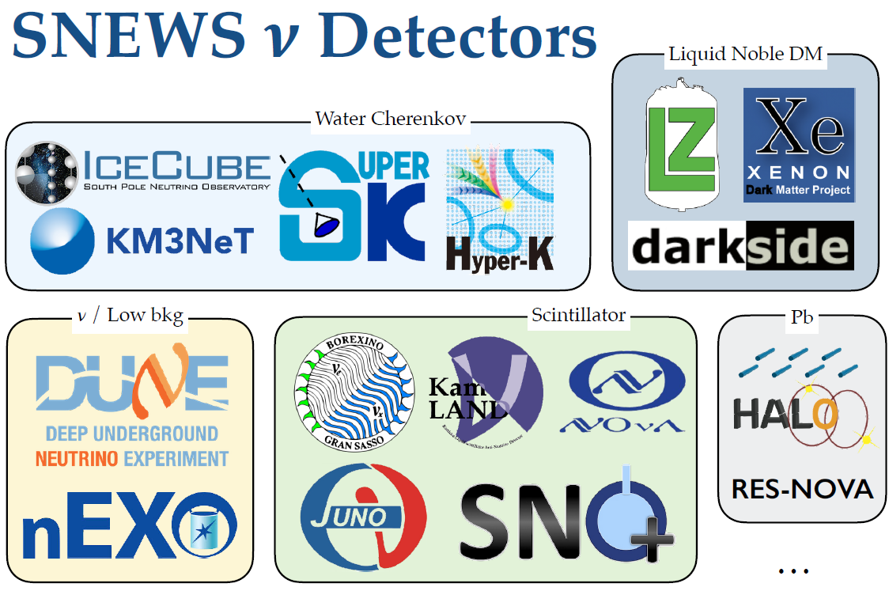
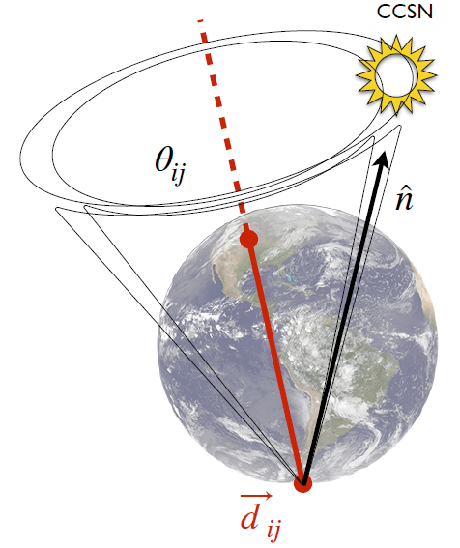
Connection to SNEWS
snews_pt
snews_cs
PRE-SUPERNOVA
FOLLOW-UP
12
Melih Kara kara@kit.edu 2nd DMLab Meeting Hamburg, 12-13 December 2022

Slide 14
Connection to SNEWS
snews_pt
snews_cs
PRE-SUPERNOVA
FOLLOW-UP
13
Melih Kara kara@kit.edu 2nd DMLab Meeting Hamburg, 12-13 December 2022

Slide 15
Connection to SNEWS
snews_pt
snews_cs
PRE-SUPERNOVA
FOLLOW-UP
14
Melih Kara kara@kit.edu 2nd DMLab Meeting Hamburg, 12-13 December 2022

Slide 16
Connection to SNEWS
snews_pt
snews_cs
PRE-SUPERNOVA
FOLLOW-UP
14
Melih Kara kara@kit.edu 2nd DMLab Meeting Hamburg, 12-13 December 2022

Slide 17
Connection to SNEWS
snews_pt
snews_cs
PRE-SUPERNOVA
FOLLOW-UP
14
Melih Kara kara@kit.edu 2nd DMLab Meeting Hamburg, 12-13 December 2022

Slide 18
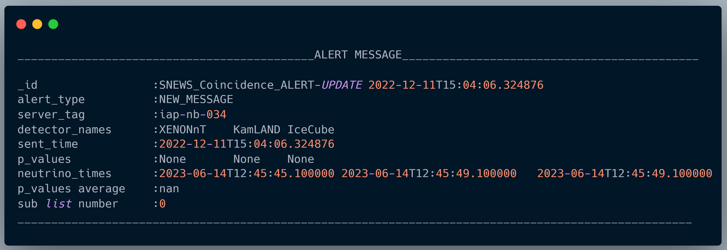
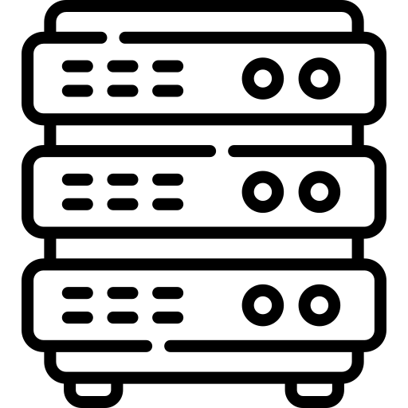
Connection to SNEWS
KIT Server
Purdue Server
Oxford Server
Coincidence Search
Alert messages are published through Kafka stream
simultaneously Slack and e-mail alerts are issued to members and subscribers
15
Melih Kara kara@kit.edu 2nd DMLab Meeting Hamburg, 12-13 December 2022

Slide 19
Summary
Neutrinos
Dark Matter detectors can detect SN neutrinos via CEvNS
Hundreds of different SN models in snewpy are under study
Realistic detector simulations are made
Sensitivities of current and future (DARWIN) DM observatories are being investigated in detail.
Inspecting ways to probe physics from detected signal
Integrating XENONnT to Supernova Early Warning System
DARWIN is expected to be ambitious player in the supernova search
Differential CEvNS rates
x-pos
16
Melih Kara kara@kit.edu 2nd DMLab Meeting Hamburg, 12-13 December 2022

Slide 20
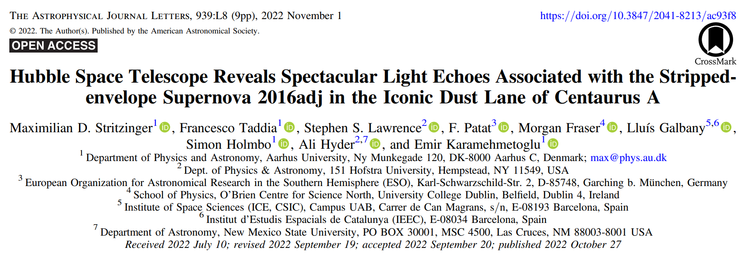
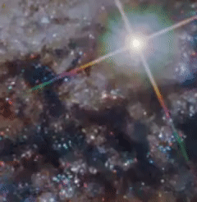
Thanks For Listening
Maximilian D. Stritzinger et al 2022 ApJL 939 L8
Melih Kara kara@kit.edu 2nd DMLab Meeting Hamburg, 12-13 December 2022

Slide 21
Melih Kara kara@kit.edu 2nd DMLab Meeting Hamburg, 12-13 December 2022

