Slide 1
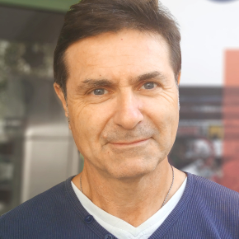
Target - ion source workshop GANIL – 6th-8th of September
Scientific Organizing Committee:
Maud Baylac - IN2P3
Rodolphe Clédassou - IN2P3
Rémi Cornat - IN2P3
Pierre Delahaye - GANIL - chair
Gilles de France - GANIL
Marcella Grasso - IN2P3
Sébastien Incerti - IN2P3
Arnaud Lucotte - IN2P3
Christelle Stodel - GANIL
Thomas Thuillier – LPSC
Local Organizing Committee:
Mickaël Dubois – chair
Marie – Laure Abavent – administrative support
Following
Prospectives
https://prospectives2020.in2p3.fr/
mission Spiro - future of GANIL
https://indico.in2p3.fr/event/20534/
Skills assessment within the institute
Presentations at workshop are available here:
https://indico.in2p3.fr/event/28990/

Slide 2
Workshop content
4 sessions, half a day each
Physics objectives (targets, sources, ISOL target ion sources)
GANIL and reaccelerated beams
Low energy beams at S3 and DESIR
Future of GANIL – ISOL beams (low energy and reaccelerated)
Newgain (S3 N=Z, Superheavies, and MNT in dedicated cave)
Medical applications with SPIRAL 2 and Arronax
Targets (convener C. Stodel)
Target laboratories (GANIL, GSI, JRC Geel)
Targetry for accelerators and medical applications with high power beams (LISOR, MEGAPIE, MYRRHA, ARRONAX, REPARE)
Cryogenic targets (CHyMENE)
Sources (convener T. Thuillier)
Operation of sources at GANIL and GSI, metallic beams R&D
Superconducting source for Newgain and experience from FRIB
Charge breeder experience from ANL (EBIS + ECRIS)
ISOL Target ion sources (convener P. Delahaye)
R&D on target and ion source materials, including UCx and other targets
R&D on sources (Laser ion source, FEBIAD, Nier Bernas)
Operational and R&D experience from ISOLDE
Some associated questions
Target lab at GANIL for conventional targets
Skill transfer for actinides from JRC Geel?
What strategy for enriched isotopes
Recycling of material worthwhile?
Rnd table 1
How to increase the attractivity of accelerator physics and its connections with universities?
What model for GANIL operation?
What place for an EBIS/ECRIS charge breeder in the future of GANIL?
Rnd table 2
How urgent is a laser ion source at SPIRAL 1, vs what does it imply?
Strategy of SPIRAL 1 beam R&D to be communicated to & via GUEC
Laser ion source consolidation needed at ALTO
Rnd table 3
Report being written by Mickael Dubois

