Slide 1
Colloque GANIL 2023
Marcella Grasso
Scientific Director in charge of Nuclear Physics and Applications, IN2P3

Slide 2
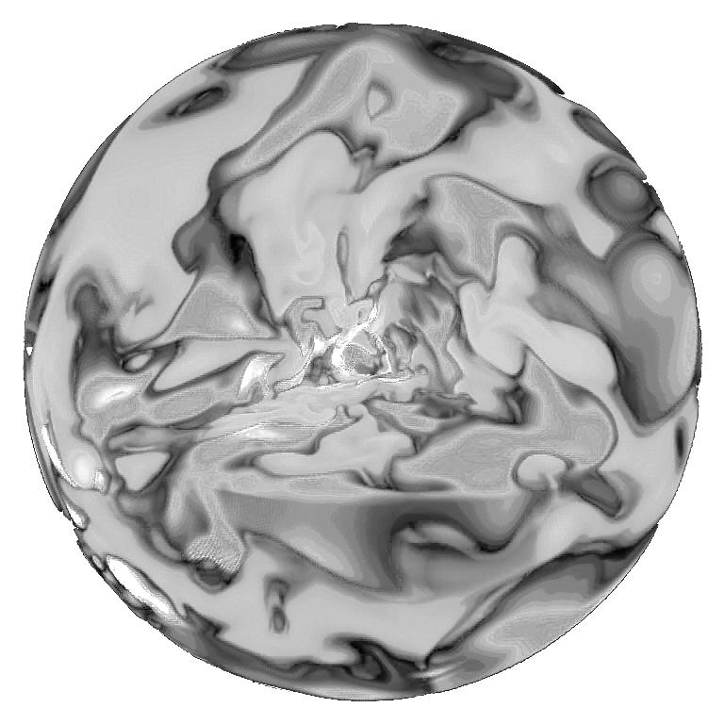
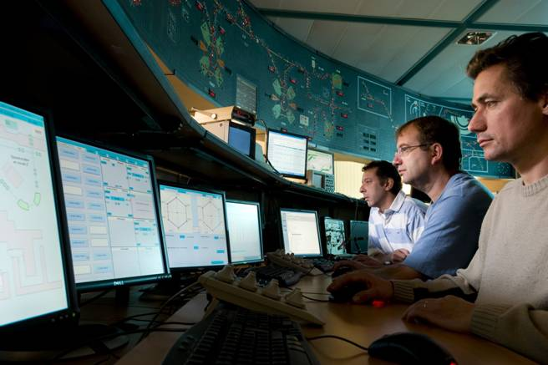
IN2P3: a national institute
al
MISSION: COORDINATING RESEARCH IN THE FIELDS OF NUCLEAR, PARTICLE and ASTROPARTICLE PHYSICS
EXPLORES
the physics of the two infinities: from elementary particles to cosmology
COORDINATES
research programs,
projects and
international
collaborations
RUNS and OVERSEES
LINKS WITH SOCIETY
DEVELOPS
research laboratories in connection with universities and
other finding agencies
technologies, applications
of societal interest
expertise,
teaching, training
PROVIDES

Slide 3
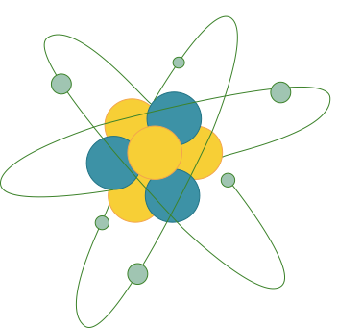
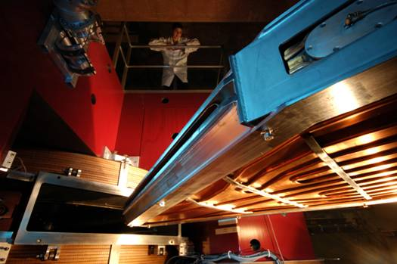
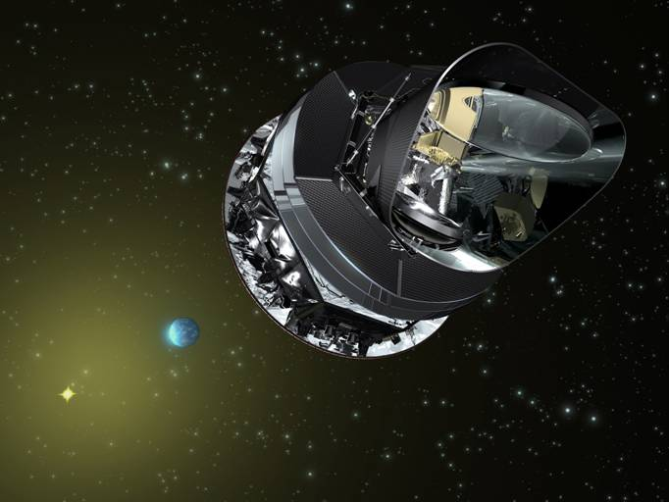
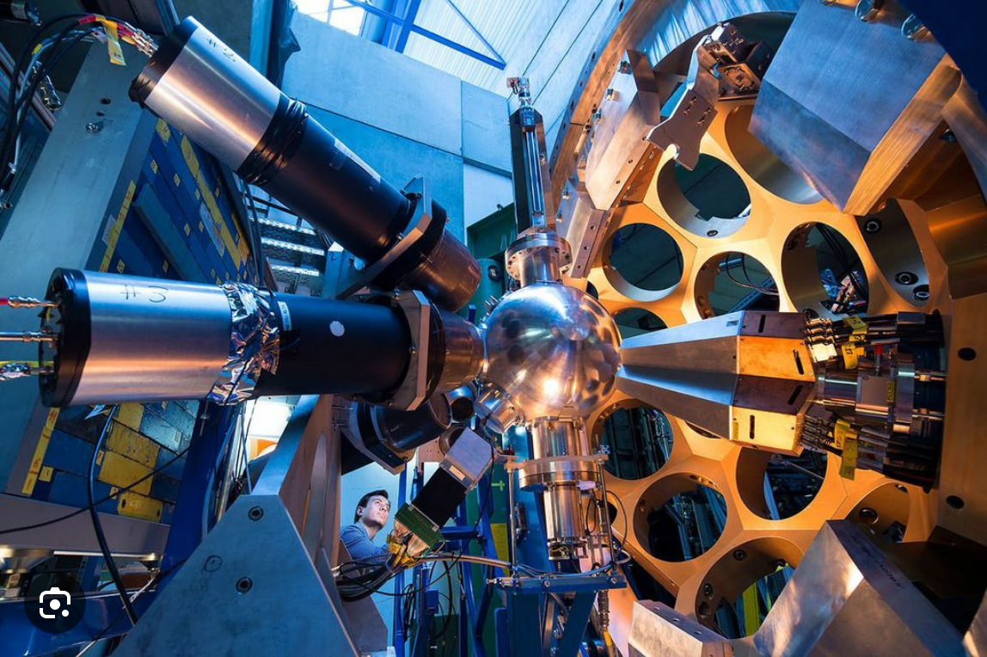
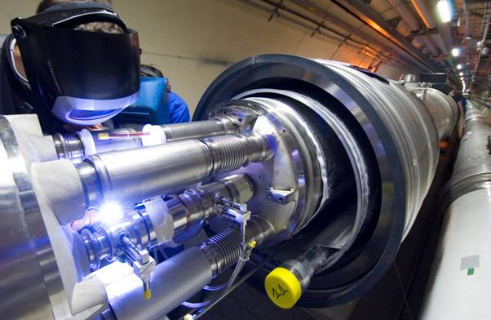
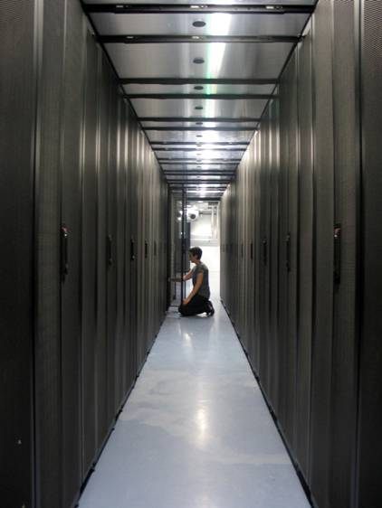
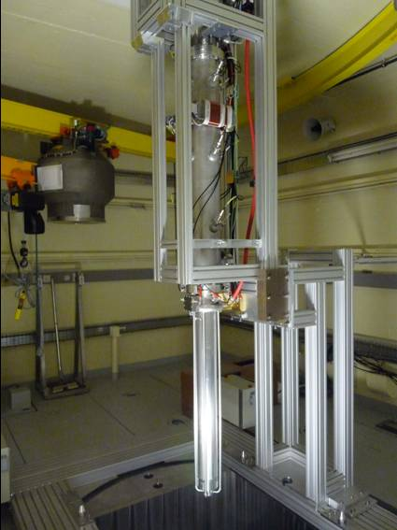
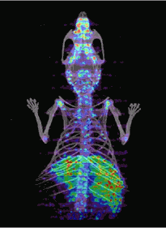
Research Areas
Astroparticle physics and Cosmology
Universe composition and evolution
Nuclear physics
Nuclei and nuclear matter, nuclear energy and medical applications
Particles & hadronic physics
Matter’s most elementary constituents
Computing & Data
Data Science and Computing
Accelerators & Technology
R&D
25 laboratories and national platforms
1000 scientists,
1500 engineers, technicians and administrative staff
300 post-doc
400 PhD students

Slide 4
About 300 physicists and 300 engineers and technicians, in 13 IN2P3 laboratories (nuclear physics, nuclear astrophysics, nucleon structure, activities on nuclear energy, environment and techniques for medical applications)
Health and environment:
- Nuclear techniques for medical applications (radioisotopes for medical applications, dosimetry, hadrontherapy)
-Radioisotopes in the environment (nuclear waste treatment and natural radioactivity)
Nuclear energy
(nuclear data, MSR, sub-critical reactors, scenarios for nuclear energy, studies of materials under extreme conditions)
Nuclear structure, reactions and nuclear astrophysics
Structure of the nucleon
New: activities on double beta decay. So far, within the perimeter of the Scientific Director in charge of Astroparticle Physics and Cosmology
Several networks and international collaborations: for example, EUROLABS (transnational access), ARIEL (transnational access to neutron facilities), ISOLDE collaboration, FAIR members, …
September 1st 2023, start date International Research Laboratory with FRIB

Slide 5
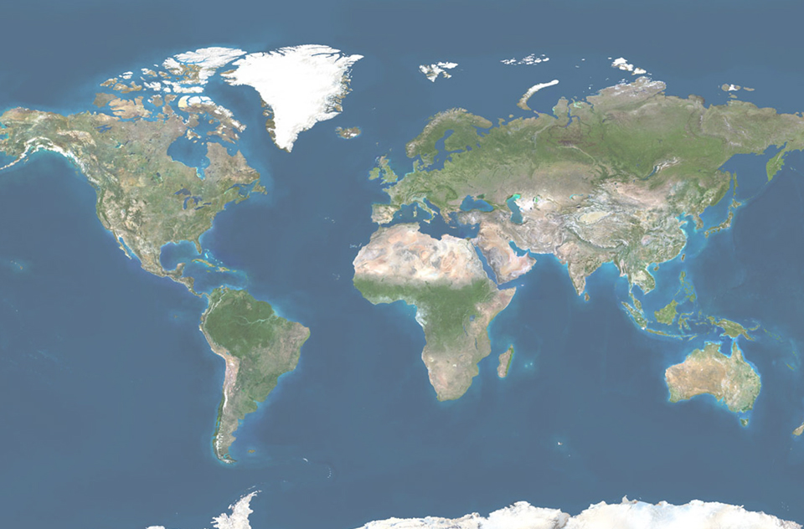
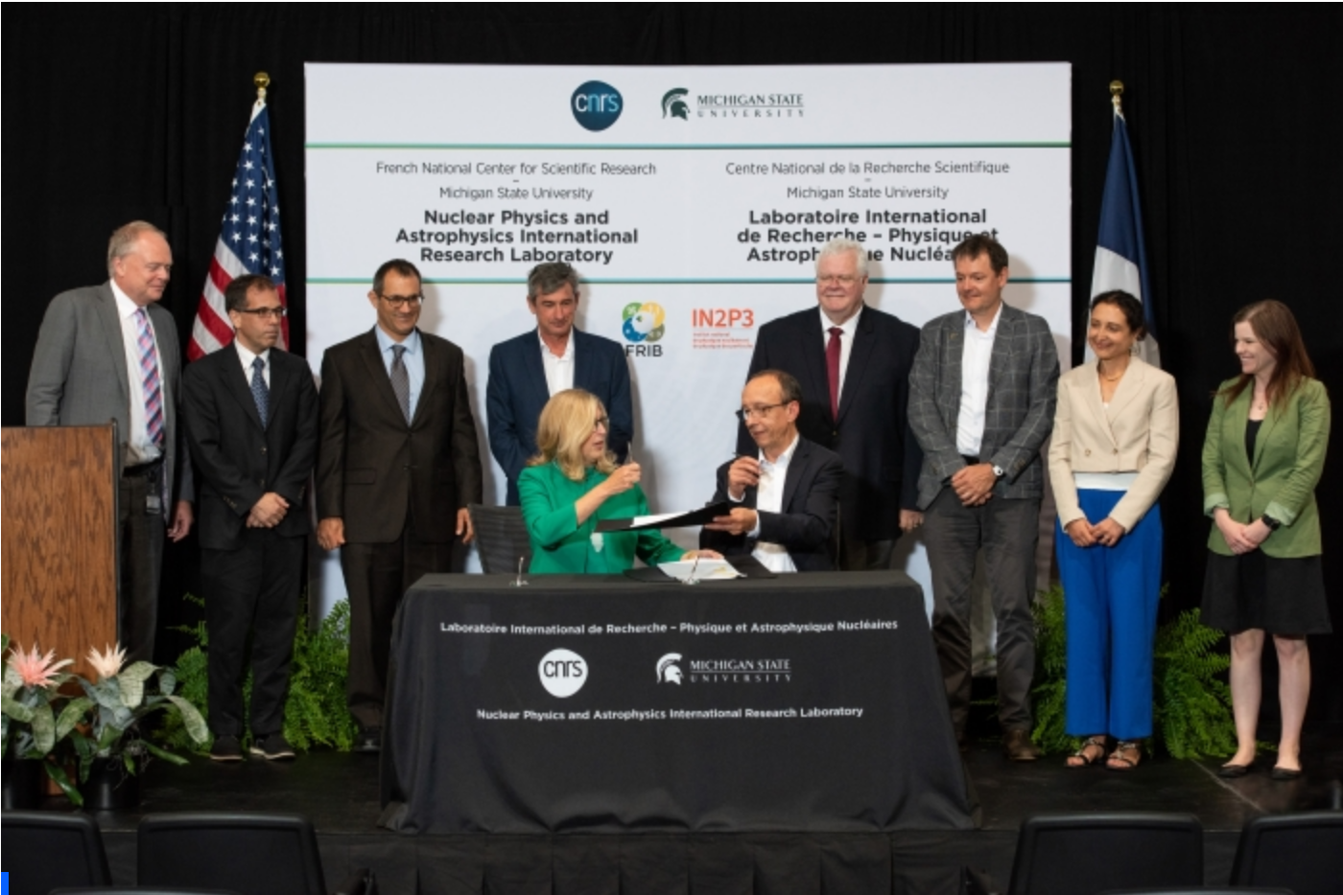
International Research Laboratory NPA with Michigan State University
NPA
(CNRS-MSU)
NPA (Nuclear Physics and Nuclear Astrophysics), September 2023
Inauguration Ceremony on July 18, 2023
5

Slide 6
Recent ‘Prospective’ exercise at IN2P3
December 2022: document with the French roadmap for Nuclear, Particle and Astroparticle physics, and associated technical developments and applications
Science and projects at GANIL in the next decade and beyond

Slide 7
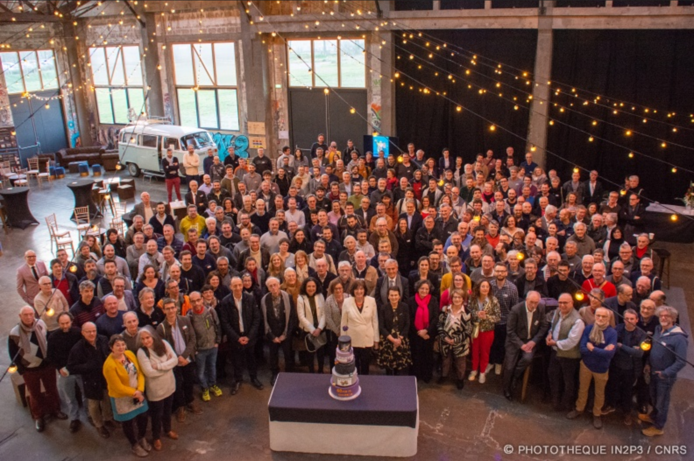
GANIL
Science with the cyclotrons
SPIRAL2 : before 2030 and after 2030

Slide 8
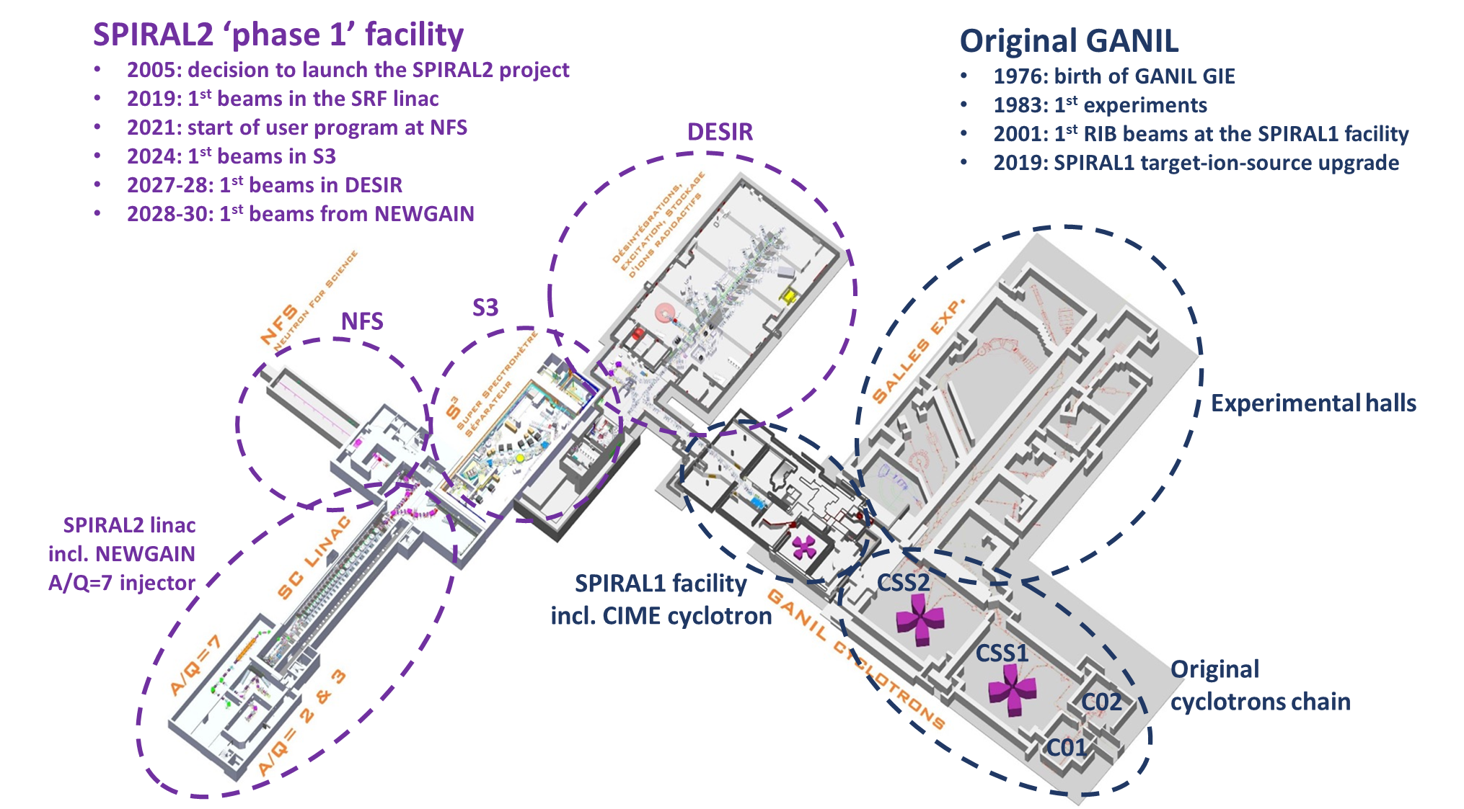
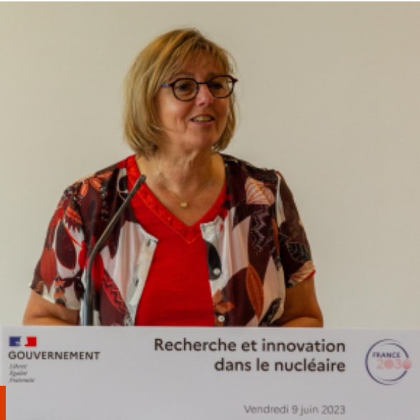
Before 2030
Neutrons for Science (NFS) started to work in 2021 (first exp). Neutrons produced from protons and deuterons accelerated from the LINAC: mainly fission, but also low-energy excitations, …
Commissioning of the Super
Separator Spectrometer (S3) planned in 2025: nuclei with very low cross sections, such as superheavy elements or neutron deficient nuclei close to the limit of stability
DESIR in 2027-2028
unique opportunities in terms of selection of exotic nuclei and/or beam purity.
masses, laser spectroscopy, beta-decay spectroscopy, … building construction starts in 2023.
First stone ceremony on November 10, 2023
June 9 2023. Minister of Higher Education and Research at GANIL
NEWGAIN, Injector 2: A/Q =3-7 Increasing beam intensities of heavy (A > 40) and very heavy (Xe, Pb, U) nuclei
Recently commissioned LINAC
Refurbishment of the cyclotrons – by the end of the decade

Slide 9
Beyond 2030
International expert committee, chaired by Michel Spiro: vision for the future of GANIL (report provided to CNRS and CEA in December 2021)
Strategy to be defined based on different recommendations and options suggested by the expert committee: new building for production of neutron-rich exotic nuclei, production of radioisotopes, new reacceleration system -> from Coulomb barrier up to 100 MeV/nucleon, ….
On this basis, GANIL direction asked Hanna Franberg and Stéphane Grevy to prepare a document where a few possible scenarios are identified, with:
-the description of the physics cases associated with each step
-a budget estimation

Slide 10
Thank you for your attention

