Slide 1
Fusion and competitive fission modes in the cold synthesis of superheavy nuclei
Autor Autor
A. Augustyn, T. Cap, and M. Kowal

Slide 2
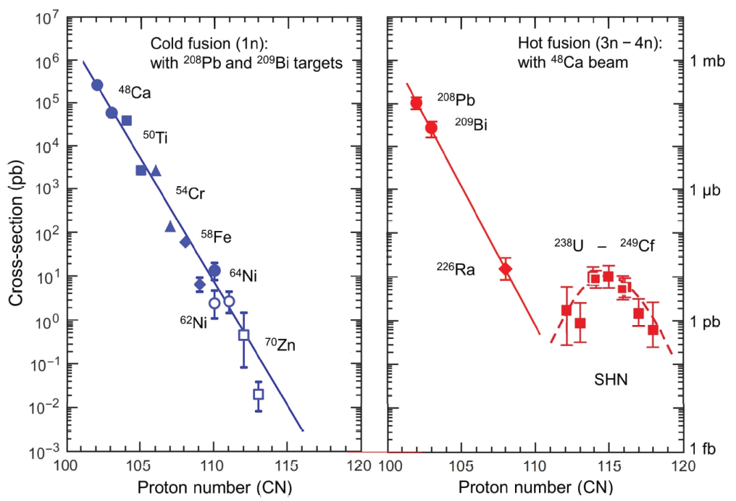
Motivation
The fusion probability P_{fus} for the production of superheavy nuclei is difficult to determine, both theoretically and experimentally.
A way to calculate P_{fus} would be very helpful in the search for the new elements 119 and 120.
We wanted to use the micro-macro model with the inclusion of rotational energy and a random walk method on potential energy surfaces (PES) to calculate the probability of fusion for three cold fusion reactions (⁴⁸Ca+ ²⁰⁸Pb, ⁵⁰Ti+²⁰⁸Pb and ⁵⁴Cr+²⁰⁸Pb) and compare results with available experimental data.
Sigurd Hofmann, Sergey N. Dmitriev, Claes Fahlander, Jacklyn M. Gates, James B. Roberto and Hideyuki Sakai
Report of the 2017 Joint Working Group of IUPAC and IUPAP, Pure Appl. Chem. 2020; 92(9): 1387–1446

Slide 3
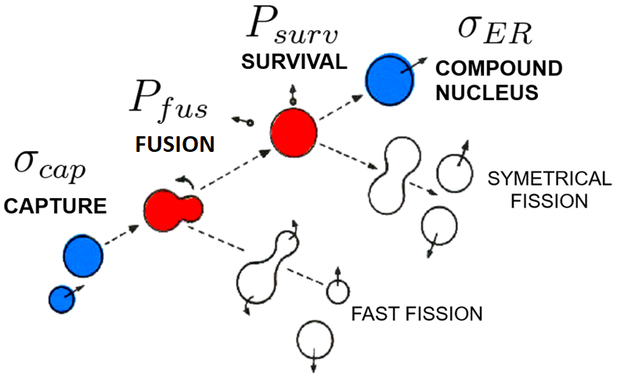
Synthesis of SHN can be described
as a 3 step process:
Not measured directly,
difficult to calculate
Well established theory
and formulas
Monte Carlo Statistical model
Psurv << 1
Measured in experiments, can be calculated using various models
Random Walk
Diffused barrier formula
masses, fission barriers, deformations from Warsaw
Micro-Macro model

Slide 4
Warsaw macro-micro model with rotational energy
liquid drop with a Yukawa-plus-exponential model,
normalized with respect to the spherical shape
Strutinsky shell correction with deformed Woods-Saxon single-paricle potential, pairing energy from Bardeen-Cooper-Schrieffer (BCS) theory
Allows to obtain the binding energy for a set isotope of given nuclear shape β and angular momentum l.
rigid body approximation,
moment of inertia for given β

Slide 5
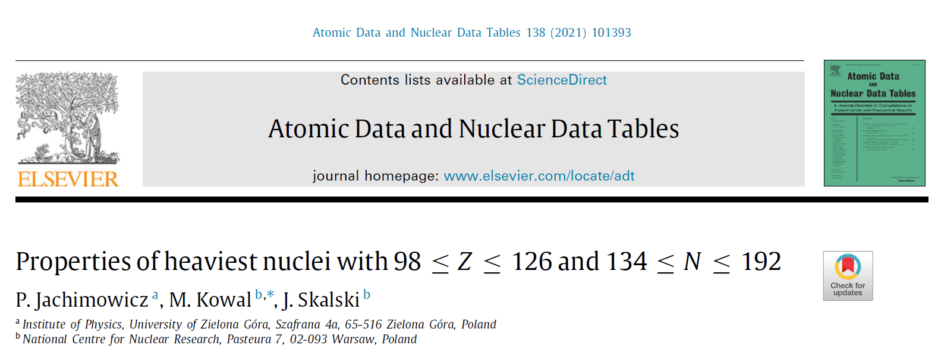
Ground-state and saddle-point shapes and masses for 1305 heavy and superheavy nuclei
including odd-A and odd–odd systems. Static fission barrier heights, one- and two-nucleon separation energies,
and Qα values.
Microscopic–macroscopic method with the deformed Woods–Saxon single-particle potential and
the Yukawa-plus-exponential macroscopic energy taken as the smooth part.
Ground-state shapes and energies are found by the minimization over seven axially-symmetric deformations.
A search for saddle-points was performed by using the "imaginary water flow" method in three consecutive stages,
using five- (for nonaxial shapes) and seven-dimensional (for reflection-asymmetric shapes) deformation spaces.
Good agreement with the experimental data for actinides.

Slide 6
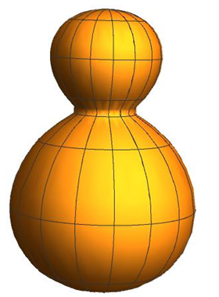
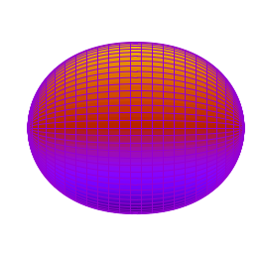
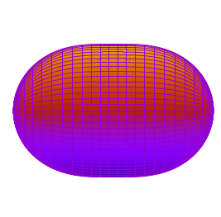
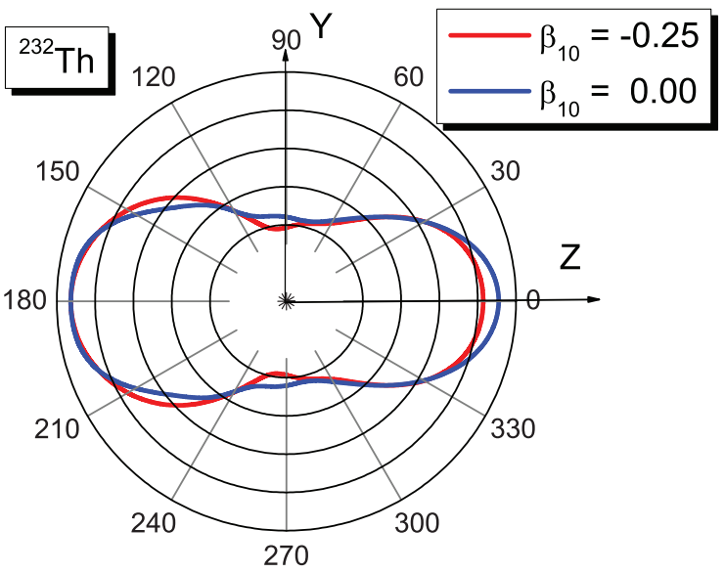
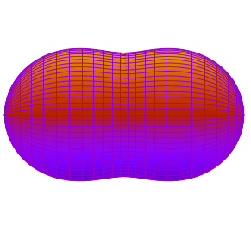
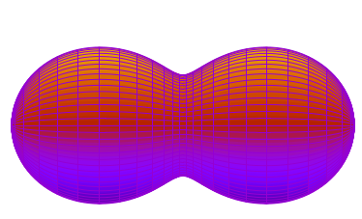
Shape parametrization
Z
$$β_{10}=+0.93$$
$$β_{20}=+1.65$$
$$θ$$
$$β_{30}=+0.00$$
An expansion of the nuclear radius R(θ, φ) onto spherical harmonics Y_{λμ}(θ, φ) is used:
For now, shapes in random walk method are limited to axially symmetrical (μ = 0) and depend only on β₁₀, β₂₀, β₃₀ and β₄₀.
R
$$β_{40}=−0.25$$
Y
X
Compound
nucleus
Fission saddle point
Scission point
symmetrical fission
P. Jachimowicz, M. Kowal, and J. Skalski,
Phys. Rev. C 87, 044308 (2013)
2nd minimum

Slide 7
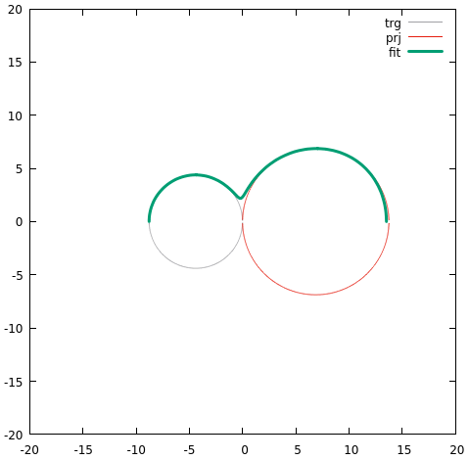
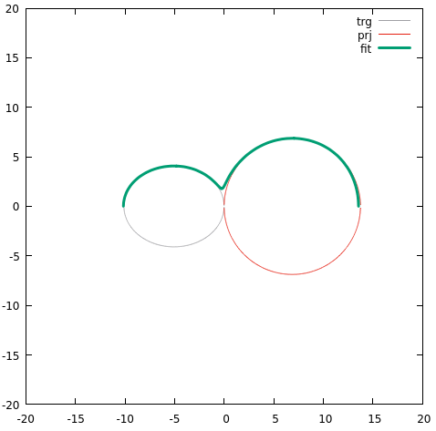
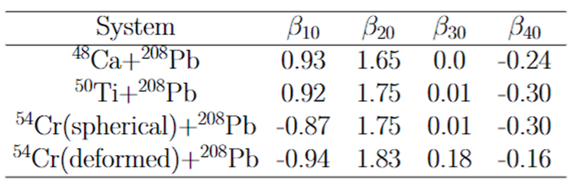
Starting point parametrization
After overcoming the entrance channel barrier, the projectile and the target are assumed to be in a touching configuration.
The spherical harmonic parametrization is fitted, with the origin situated in the neck, giving the β parameters for the starting point configuration.
The shapes are asymmetrical, but β₃₀ is near to 0, thanks to the inclusion of β₁₀.
⁵⁴Cr
²⁰⁸Pb
⁵⁴Cr
²⁰⁸Pb

Slide 8
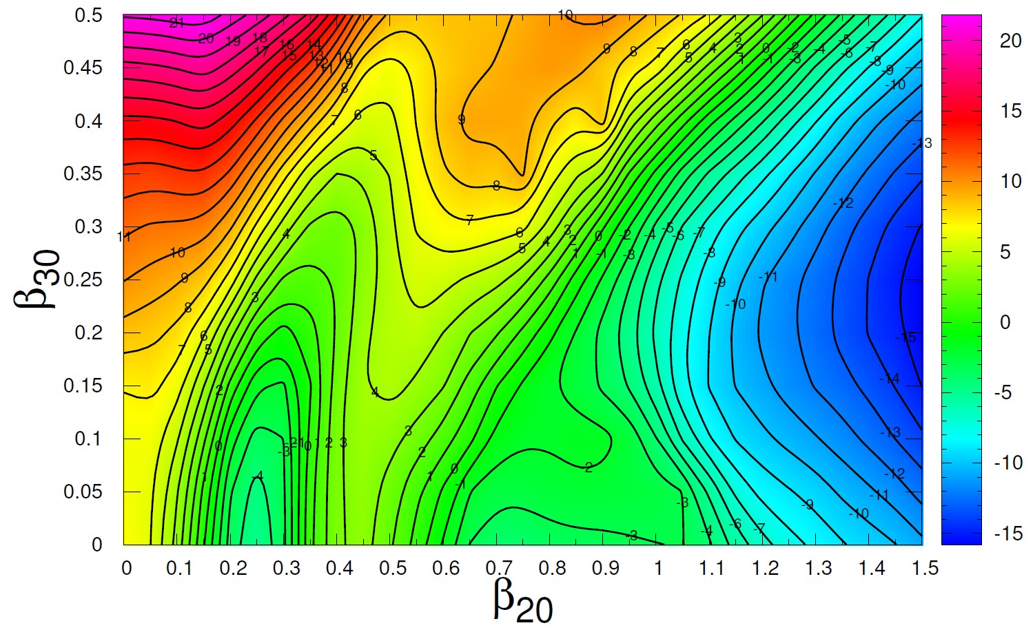
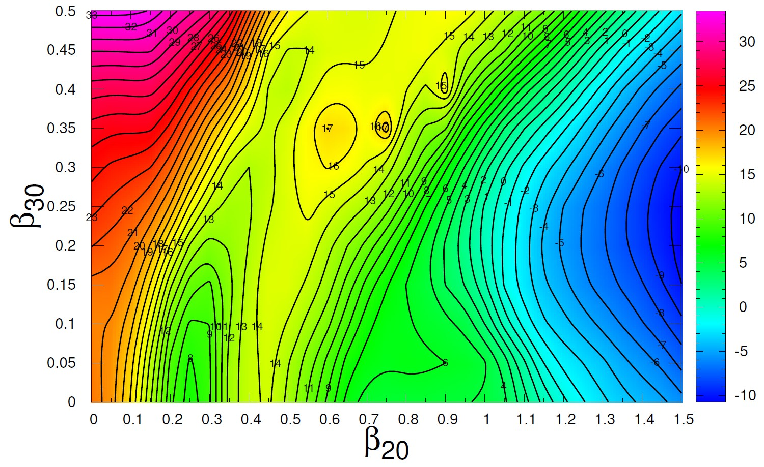
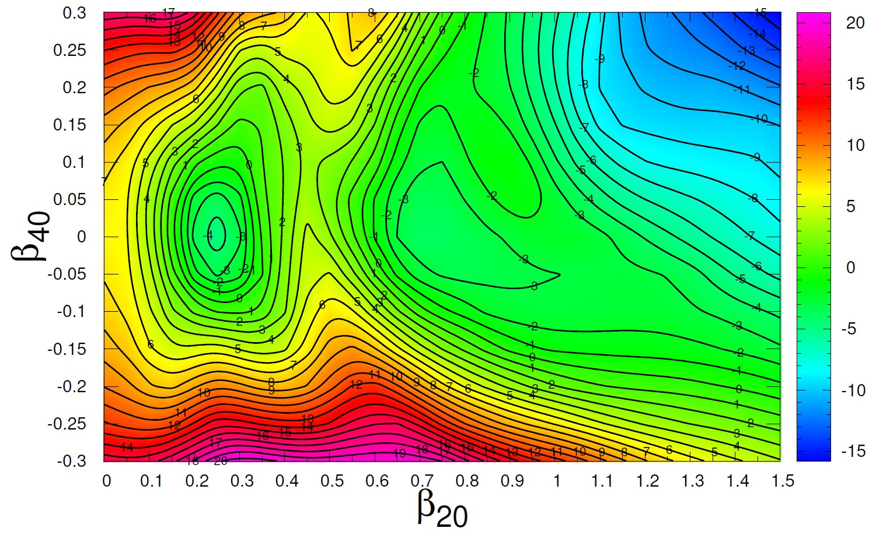
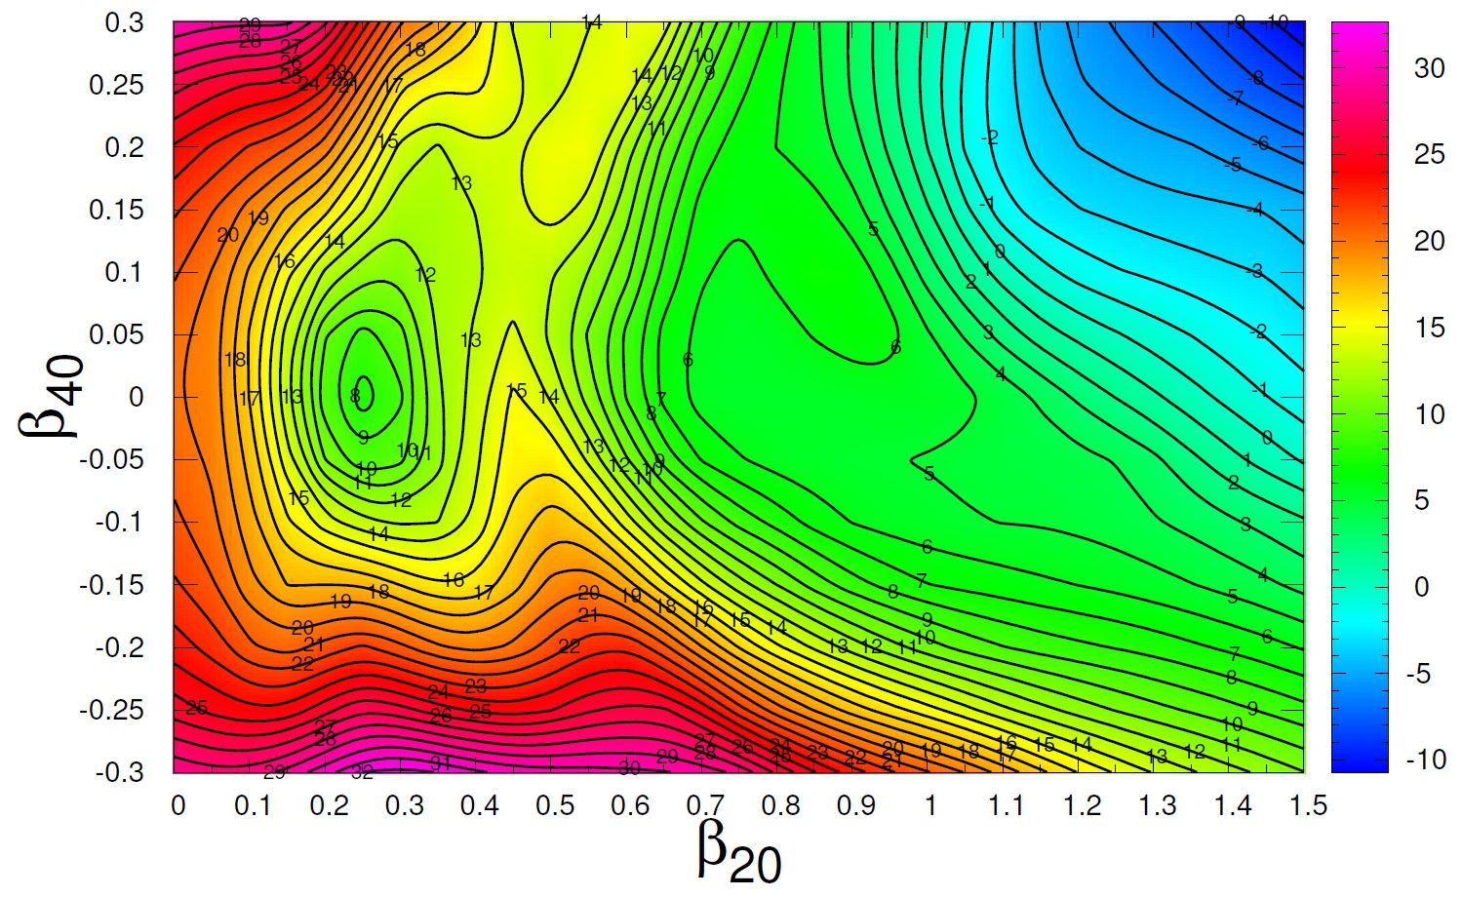
Potential energy surfaces
asymmetry
⁴⁸Ca+ ²⁰⁸Pb
l = 0
⁴⁸Ca+ ²⁰⁸Pb
l = 60
elongation
neck parameter

Slide 9
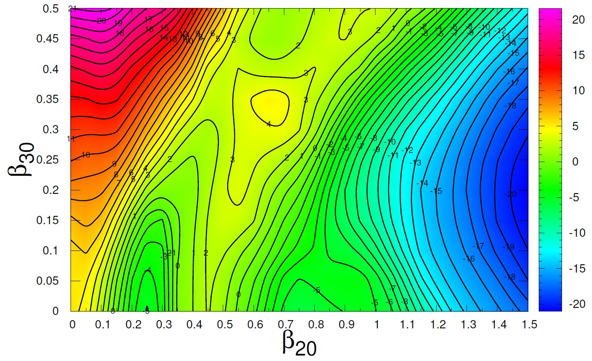
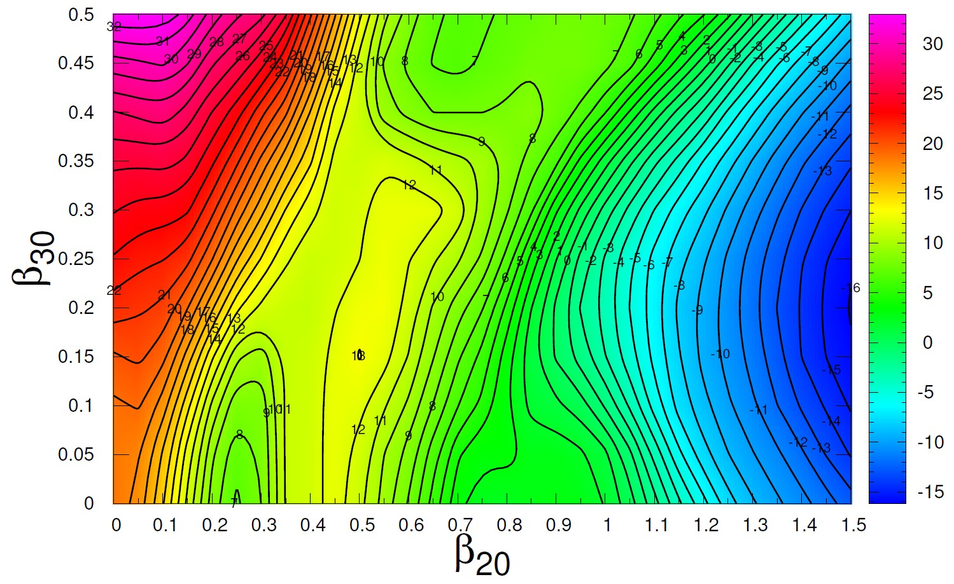
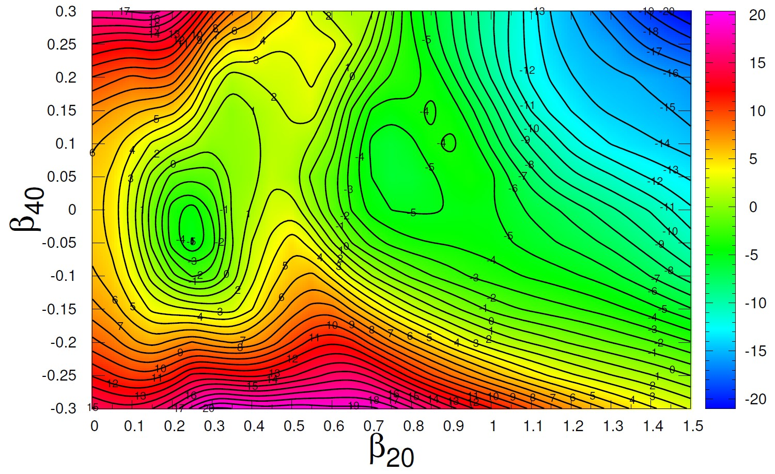
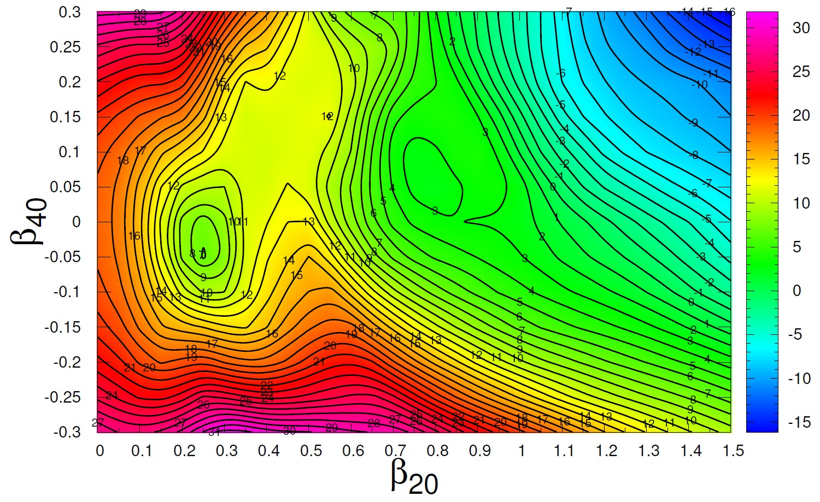
Potential energy surfaces
asymmetry
⁵⁴Cr+ ²⁰⁸Pb
l = 0
⁵⁴Cr+ ²⁰⁸Pb
l = 60
elongation
neck parameter

Slide 10
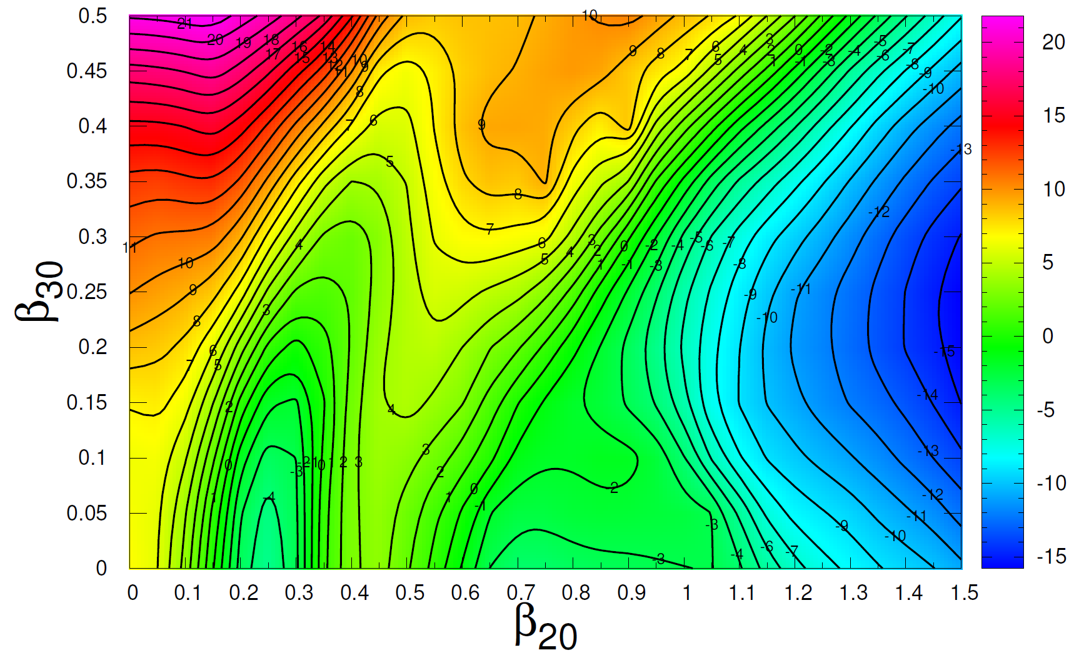
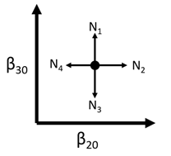
Random walk method
The probability of transitioning from one shape to another is determined by the number of available energy levels (Fermi gas model) for a given shape β.
a – constant density parameter
Only one β parameter changes at a time, by a step of 0.05, giving 8 possible directions of movement.
Fusion: β₂₀ <= 0.3, β₃₀ <= 0.2, β₄₀ <= 0.2 → compound nucleus.
Fission: when the thickness of the neck connecting the fission fragments is less than 4.0 fm.
⁴⁸Ca+ ²⁰⁸Pb
l = 0

Slide 11
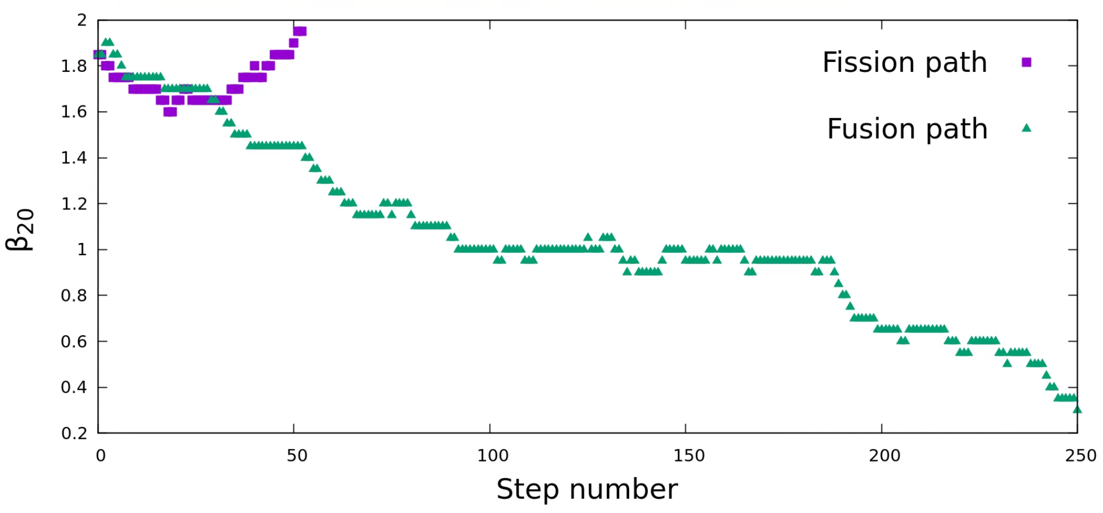
Example of a paths
⁵⁴Cr+ ²⁰⁸Pb
E* = 50 MeV, l = 40

Slide 12
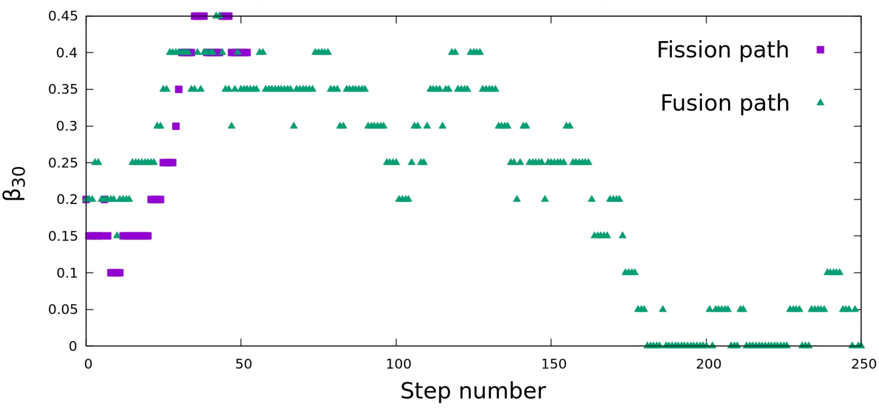
Example of a paths
⁵⁴Cr+ ²⁰⁸Pb
E* = 50 MeV, l = 40

Slide 13
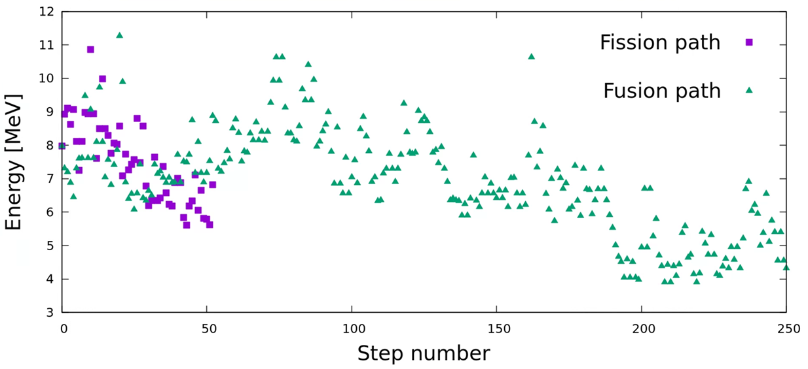
Example of a paths
⁵⁴Cr+ ²⁰⁸Pb
E* = 50 MeV, l = 40

Slide 14
Random walk method
Calculations were done for excitation energies from 20 to 70 MeV with 1 MeV step. 10000 paths were calculated for a given energy and l-value from 0 to l_{max}. P_{fus}(l) is given as a ratio of the number of paths that lead to fusion to the total number of paths.
P_{fus}(E_{c.m.}) = $\frac{\sum_{l=0}^{lmax}{\left(2l+1\right)P_{fus}\left(l\right)}}{{(2l_{max}+1)}^{2}}$ fusion probability averaged over $l$

Slide 15
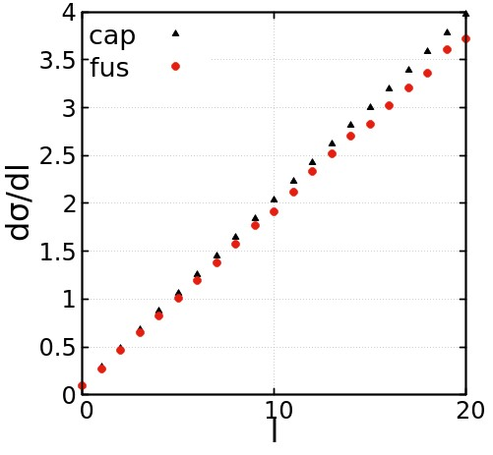
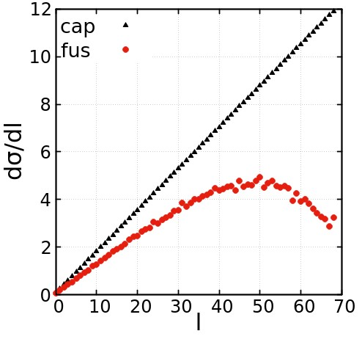
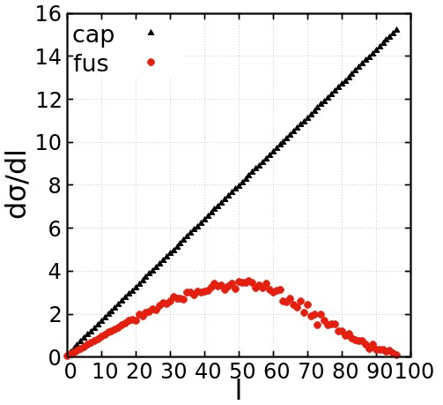
Spin distrubiton for capture and fusion
Capture cross section calculated from diffused barrier formula
Fusion cross section from the random walk method
Distributions of $\frac{dσcap}{dl} \left(black\right) and \frac{dσfus}{dl} (red)$ for ⁴⁸Ca+ ²⁰⁸Pb
E* = 20 MeV
E* = 40 MeV
E* = 60 MeV

Slide 16
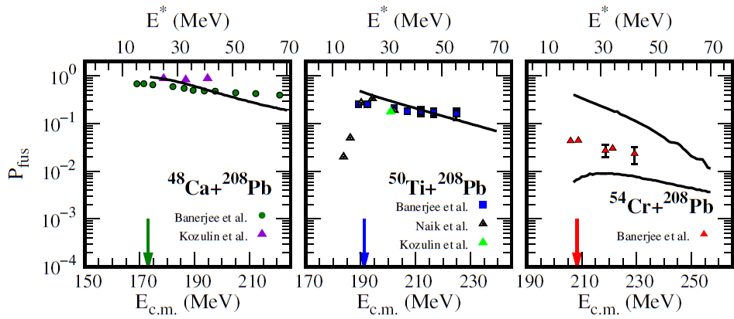
Fusion probability from the random walk
P_{fus}(E_{c.m.}) = $\frac{\sum_{l=0}^{lmax}{\left(2l+1\right)P_{fus}\left(l\right)}}{{(2l_{max}+1)}^{2}}$ fusion probability averaged over $l$
spherical ⁵⁴Cr
deformed ⁵⁴Cr

Slide 17
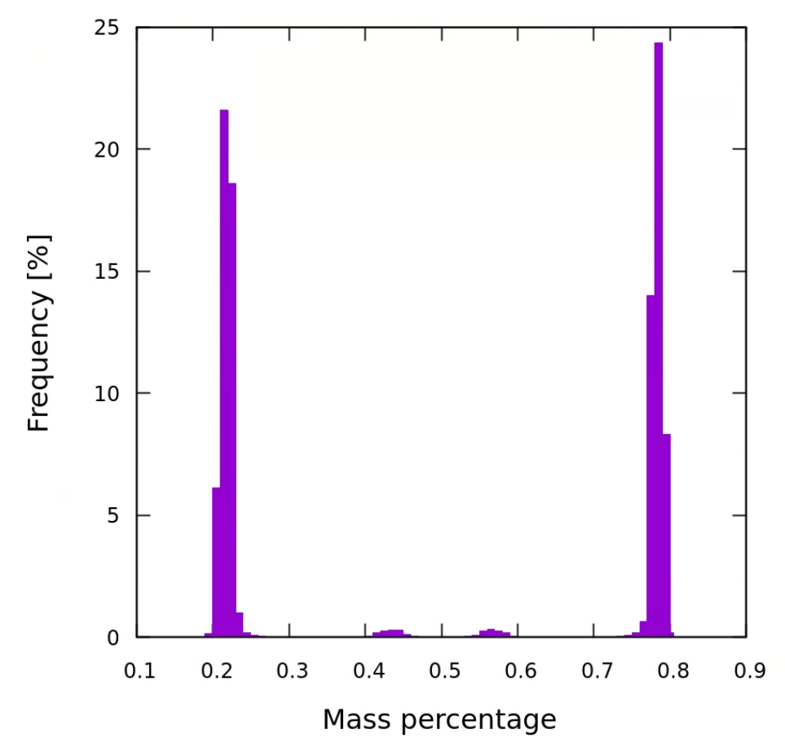
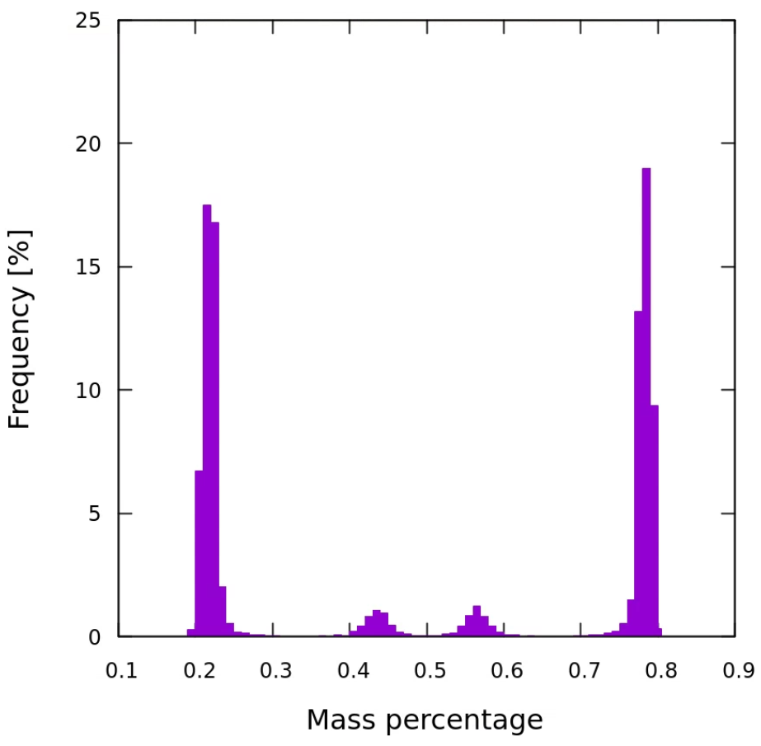
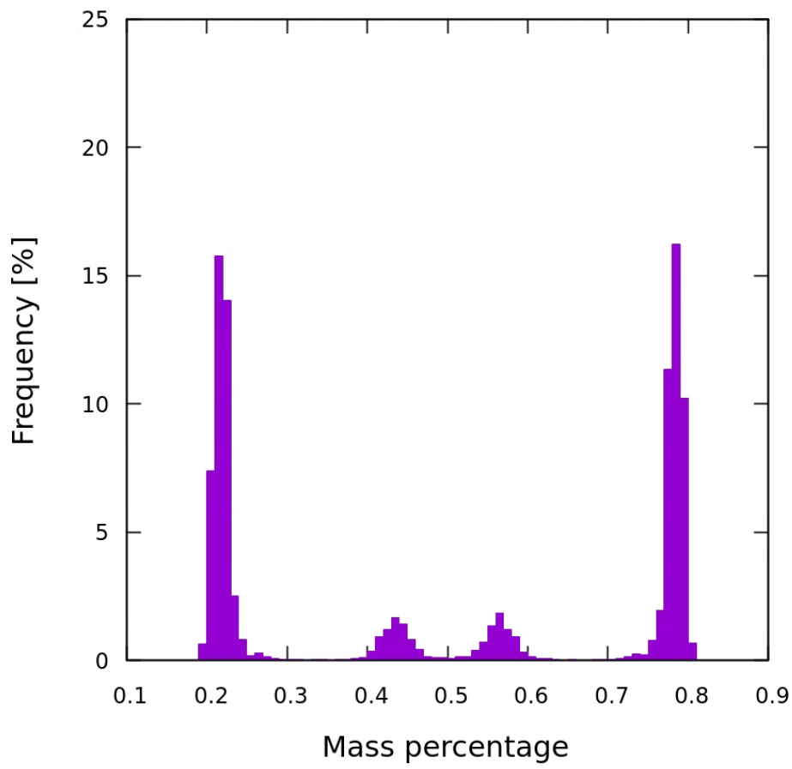
Mass distribution of fission fragments
The final fission shapes can be divided, and their volumes compared, giving the mass distribution of fission fragments, for each E* and l.
⁵⁴Cr+ ²⁰⁸Pb
E* = 30 MeV, l = 20
⁵⁴Cr+ ²⁰⁸Pb
E* = 50 MeV, l = 40
⁵⁴Cr+ ²⁰⁸Pb
E* = 70 MeV, l = 70

Slide 18
Next steps
Expand to 8 β dimensions.
Determine optimal step size for each β parameter.
Expand to non-axially symmetric shapes and incorporate multiple possible starting points depending on the orientation of the target and the projectile.
Introduce a density parameter beyond Fermi gas model.
Incorporate shell-correction damping.
Calculate P_{fus} for other cold fusion reactions.
Calculate P_{fus} for hot fusion reactions, both already performed and planned experiments.

Slide 19
Thank you for your attention!

Slide 20
BONUS SLIDES

Slide 21
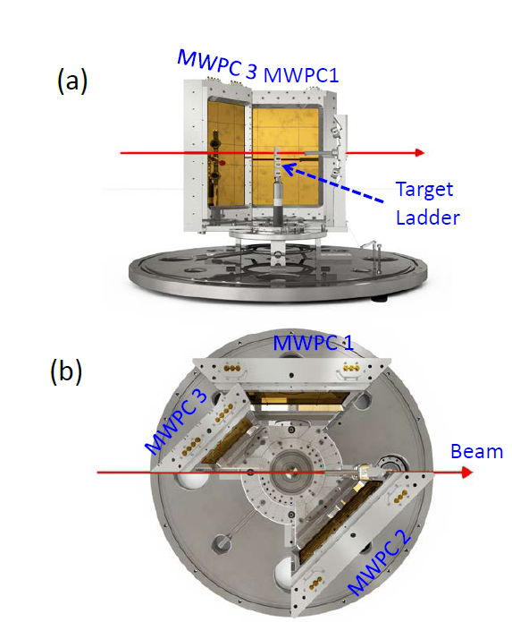
Mechanisms Suppressing Superheavy Element
Yields in Cold Fusion Reactions
Banerjee et al., PRL 122, 232503 (2019)
measured in the experiment

Slide 22
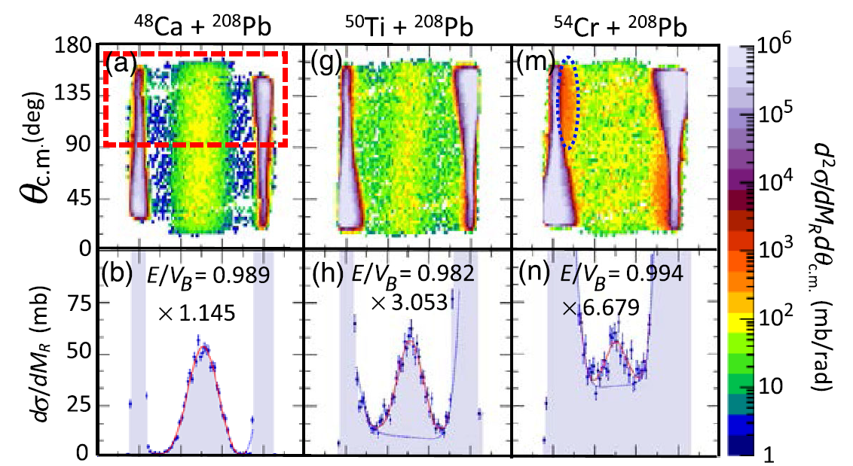
Mechanisms Suppressing Superheavy Element
Yields in Cold Fusion Reactions
Banerjee et al., PRL 122, 232503 (2019)
Pfus can be experimentally estimated:
Psym = $\frac{\text{Fusion}\text{−}\text{Fission} \text{cross} \text{section}}{\text{C}\text{apture} \text{cross} \text{section}}$
Fusion-Fission
cross section
(symmetrical fission)
Fast Fission
cross section
Mass ratio,
symmetric
split: M_{R} = 0.5

Slide 23
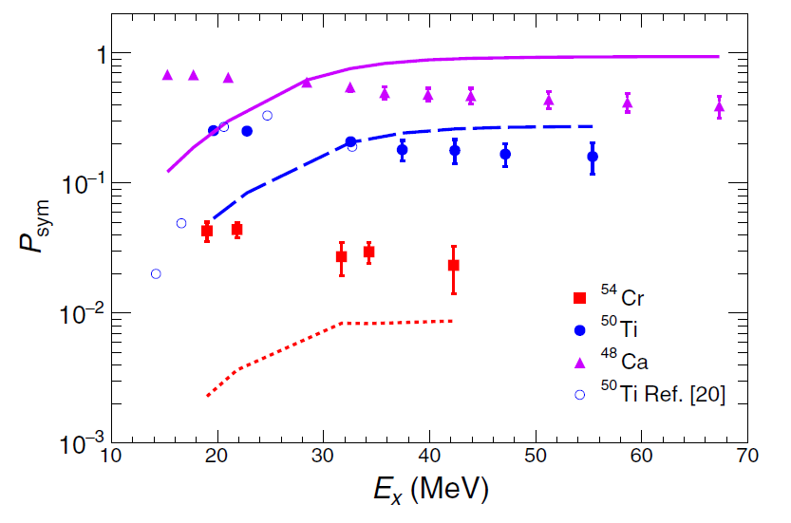
Banerjee et al., PRL 122, 232503 (2019)
Reactions:
⁴⁸Ca + ²⁰⁸Pb → ²⁵⁶No*
⁵⁰Ti + ²⁰⁸Pb → ²⁵⁸Rf*
⁵⁴Cr + ²⁰⁸Pb → ²⁶²Sg*
Difusion model calculations by
V. Zagrebaev and W. Greiner
PRC 78, 034610 (2008).
The experimental trends
are different than the model predictions for all 3 reactions.
The conclusion was that diffusion
is not the main mechanism responsible for the synthesis
of SHN.
Questions:
Can the diffusion approach (FBD) describe the experimental results?
What is the fusion mechanism?
Upper limit for
fusion probability
Excitation energy

Slide 24
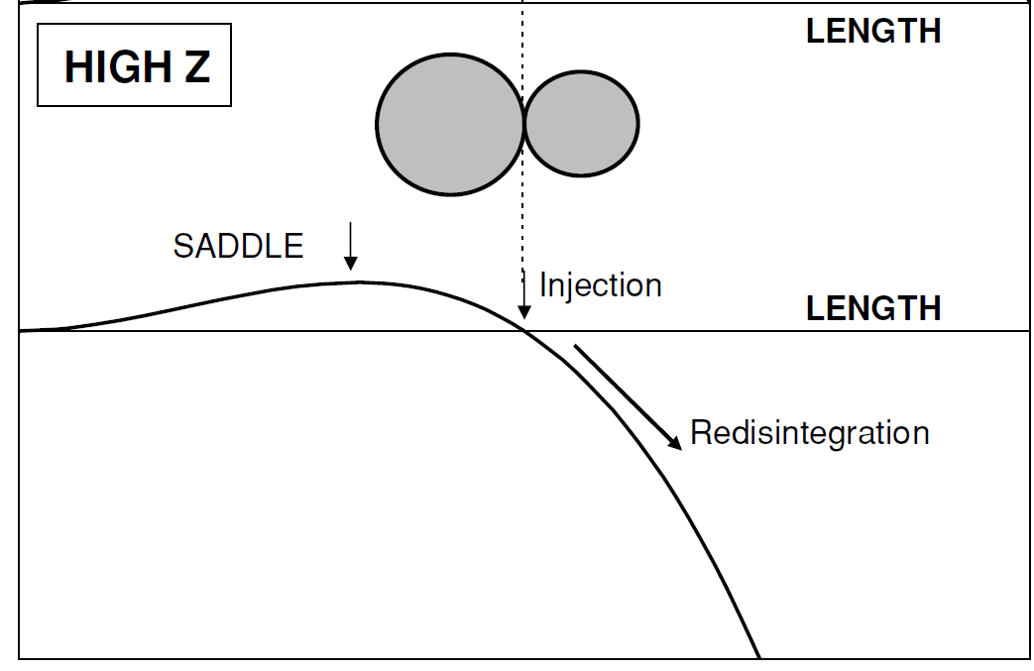
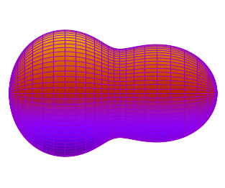
In the FBD model, we use
1D motion approximation
The system must overcome an internal barrier H to fuse.
Pfus is calculated by solving
1D Smoluchowski Diffusion Equation
Deformation energy
H (barrier)
$P_{fus}\left(l\right)= \frac{1}{2}\left(1 −erf\sqrt{\frac{H\left(l\right)}{T}}\right)$ when $L_{inj }≥L_{saddle}$
CN
H($l$) – the function of angular momentum
and bombarding energy
T – the temperature depends on available energy
L is the effective elongation (along the fusion path)

Slide 25
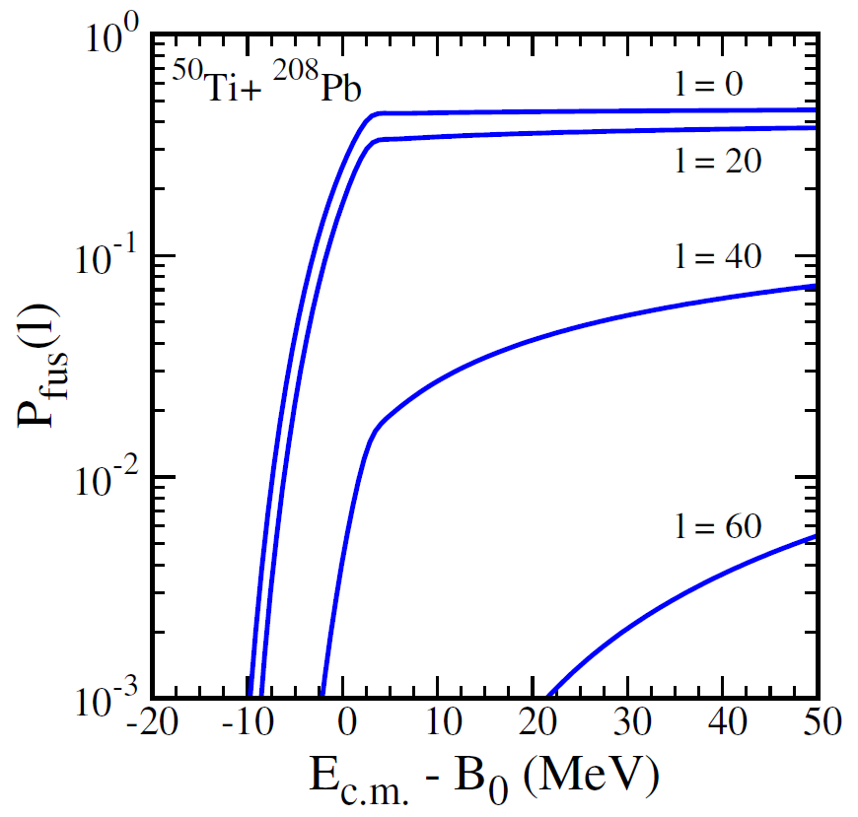
$l$ = 0
Central collision
Impact
Parameter
Peripheral
collisions
Higer partial waves $l$
=
Higher rotational energy
=
Higher barrier H($l$)
=
Lower Pfus($l$)
Energy relative to the entrance
channel barrier B₀
B₀ = 191.3 MeV
E*(E_{c.m.} = B0) = 21.7 MeV

Slide 26
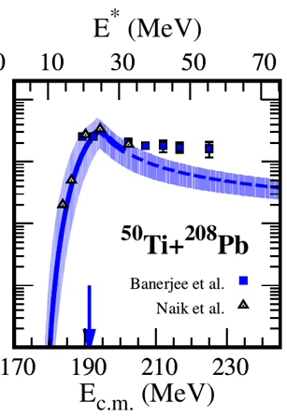
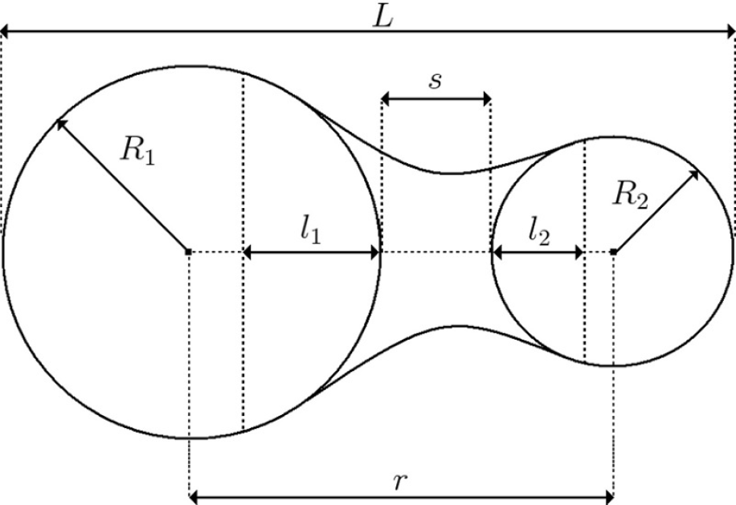
Fusion probability averaged over $l$
P_{fus}(E_{c.m.}) = $\frac{\sum_{l=0}^{lmax}{\left(2l+1\right)P_{fus}\left(l\right)}}{{(2l_{max}+1)}^{2}}$
Tangent configuration of projectile and target
(s_{injection} = 0 fm)
The Pfus saturation above B0 results from suppression of the contributions from higher partial waves and can be linked to the critical angular momentum.
Below B0, the Pfus growth comes from the reduction
in the height of the internal barrier opposing fusion.
s_{injection} > 0 fm
The difference between rotational energies in the fusion saddle and
the contact (sticking) configuration
plays a major role in CN formation
at energies above B0.
B0 - entrance channel barrier (Coulomb+Nuclear potential)

Slide 27
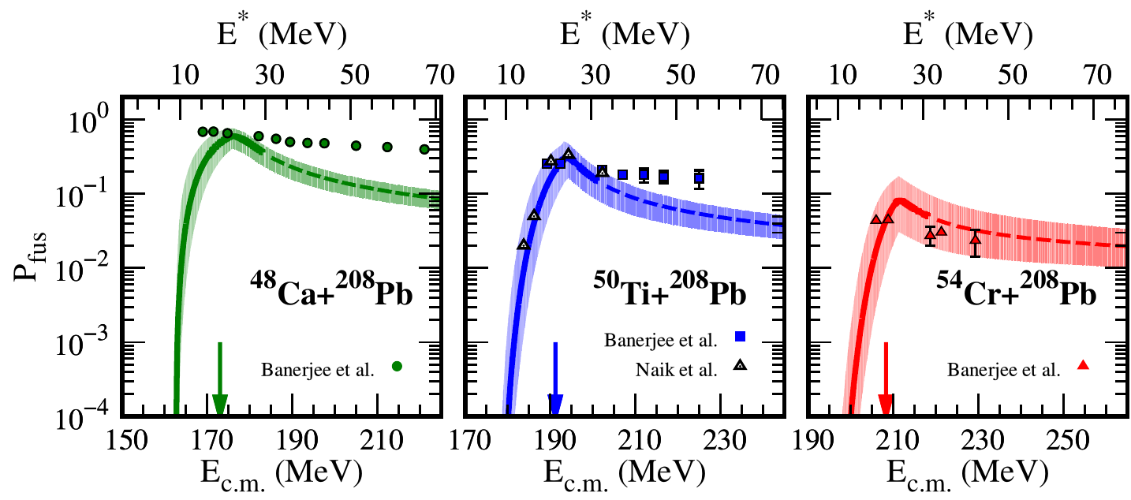
Fusion probability from FbD model
T. Cap, M. Kowal, and K. Siwek-Wilczyńska, Phys. Rev. C 105, L051601 (2022)

