Slide 1
Isthmus connecting mainland and island of stability of superheavy nuclei
Michał Kowal, NCBJ

Slide 2
Plan:
Intro
New elements incorporated into Production of SHN probability modeling;
new tables of nuclear properties (barriers and masses),
density of states depending on energy and deformation.
Results & Predictions
Conclusions and perspectives
Colloque GANIL 2023 (25-29 septembre 2023)

Slide 3
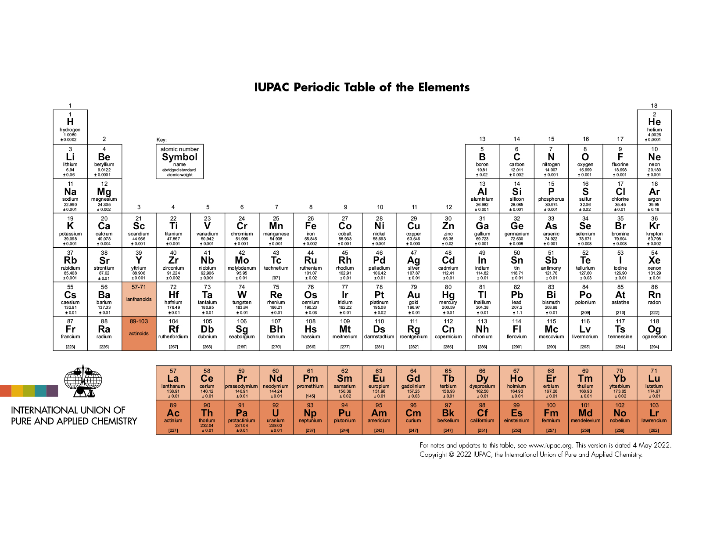

Slide 4
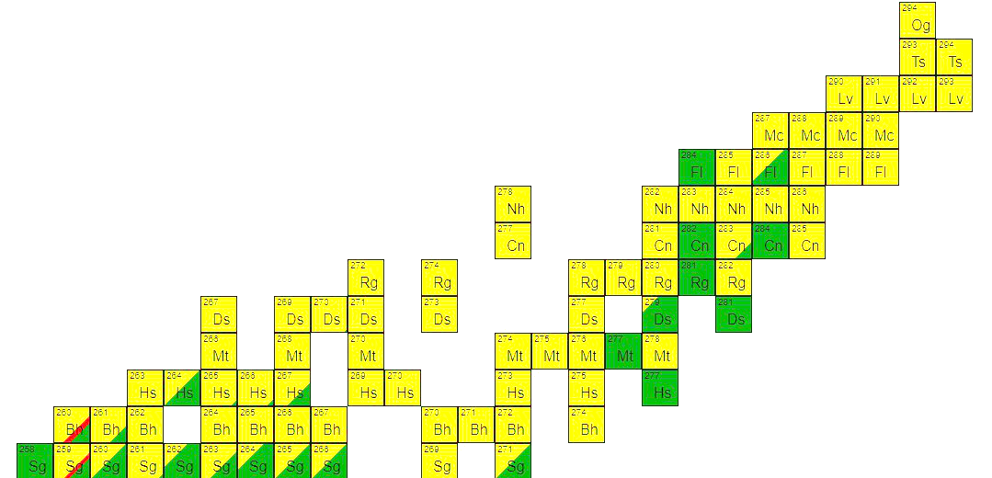
Attempts of going beyond the reactions Act. + ⁴⁸Ca by using heavier projectiles like ⁵⁰Ti, ⁵⁴Cr, ⁵⁸Fe, and ⁶⁴Ni gave no results so far.
BUT
All heavier actinides with Z>98 live to short that one could perform target with them.
There is no link between cold & hot scenarios.
To produce more & more heavier nuclei the mass and charge of projectile should be increased but it pulls an increase of the Coulomb repulsion what drastically reduces the cross sections.
Not all superheavy (SH) isotopes
Z < 118 have been produced yet.
Produced nuclei lies belong to the far “island of stability” of superheavy elements.

Slide 5
The task is to identify optimal projectile-target combinations and predict the ideal entrance channel bombarding energy, maximizing production cross sections in specific exit channels.

Slide 6
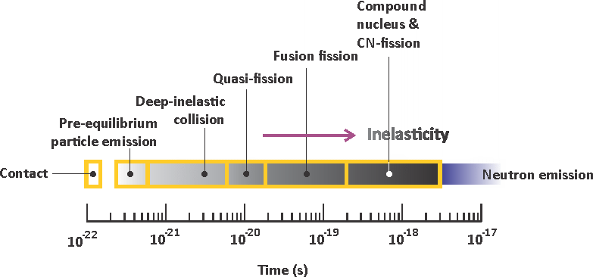
Fig from Valeri Zagrebaev
Fig from Jurij Oganiesian

Slide 7
Basic assumptions:
After the capture stage, the internal mass asymmetrical conditional saddle point - the fusion barrier - must be overcome by the system.
The stochastic nature of the fusion process is accompanied by dissipation of energy and angular momentum.
All nucleons are transformed from projectile to the target by a diffusion process.
Fusion - By - Diffusion - Smoluchowski equation
W. J. Świątecki, K. Siwek-Wilczyńska, and J. Wilczyński, Phys. Rev. C 71, 014602 (2005).
Di - Nuclear - System - master equation
G.G. Adamian, N.V. Antonenko, Eur. Phys. J. A (2022).

Slide 8
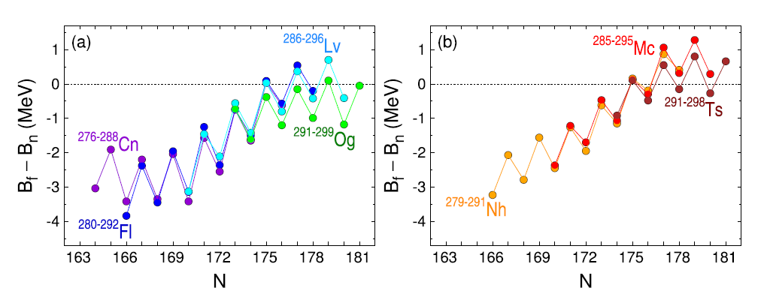
U>Bn>Bf>T

Slide 9
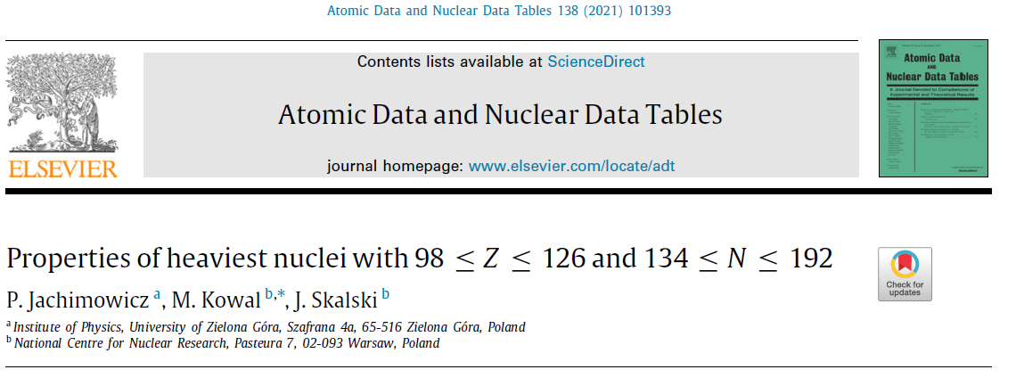
application of ADNT2021 tables to estimate the chances of producing new elements
Microscopic-macroscopic method
R(θ,ϕ)$=$c$R_{0}\left\{1+\sum_{λ=1}^{∞}{\sum_{μ=−λ}^{+λ}{β_{λμ}Y_{λμ}\text{(}\text{θ}\text{,}\text{ϕ}\text{)}}}\right\}$
I. Muntian, Z. Patyk and A. Sobiczewski, Acta Phys. Pol. B 32, 691 (2001).
H. J. Krappe, J. R. Nix and A. J. Sierk, Phys. Rev. C20, 992 (1979).
S. Cwiok, J. Dudek, W. Nazarewicz, J. Skalski and T. Werner, Comput. Phys. Commun. 46, 379 (1987).

Slide 10
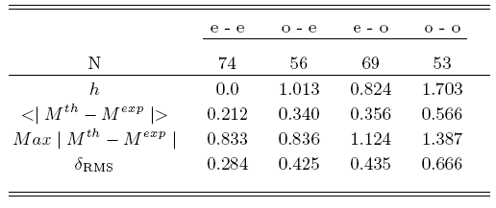
SH masses (g.s.) for 1305 nuclei (including odd & odd-odd systems)
Seven dimensional minimization is performed using the gradient method
For odd system, additionally the minimization over configurations at every step of the gradient procedure has been done.
P. Jachimowicz, M. Kowal, and J. Skalski, Phys. Rev. C 89, 024304 (2014).
A fit to exp. masses Z>82, N>126 (number of nuclei: 252)
For odd and odd-odd systems there are 3 additional parameters – macroscopic energy shifts (they have no effect on Q alpha and fission barriers)

Slide 11
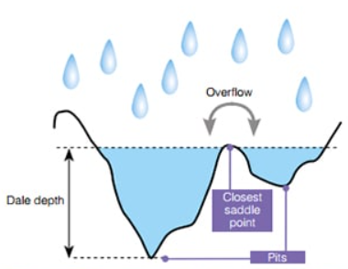
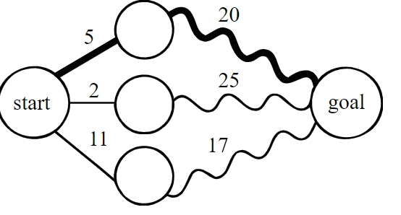
Search for Saddles
How to represent many-dimensional landscapes?
(Any n-dimensional landscape with n ≥ 3 is difficult to visualize. For a long time, two-dimensional energy maps serving the search for fission saddles were obtained by minimizing over the remaining, i.e. over the other n − 2, shape coordinates. This was an obvious and easiest choice, especially in the selfconsistent studies, which are based on the minimization with constraints. )
How to search for saddles?
(Saddles on the energy landscape are neither minima nor maxima, therefore a proper method of search for them is required, different from the minimization)
Mathematical Art
by Henry Segerman
IWF
DPM

Slide 12
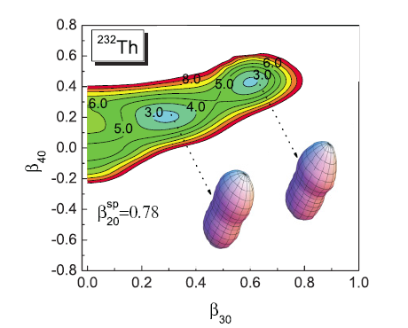
Search for Saddles
Which deformation/constrain parameters to use? (An arbitrary shape of a drop requires infinite number of coordinates)
How many deformations/consrains are sufficient? (At present, the practical restrictions by available computation resources confine one to 5 - 6 coordinates when performing calculations for many nuclei)
Fragment of the energy surface for 232Th projected on the (β30,β40) plane by fixing β20 = 0.78 and minimizing over β50,β60,β70,β80; the minima correspond to shapes lying slightly beyond the second saddle
Adiabatic fission barriers in superheavy nucleiP Jachimowicz, M Kowal, J Skalski
Physical Review C 95 (1), 014303 (2017)

Slide 13
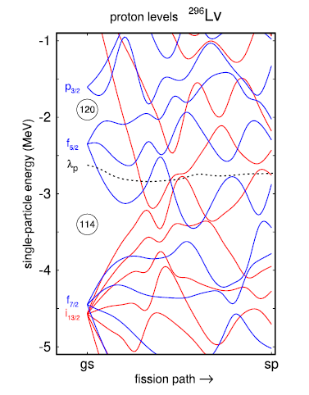
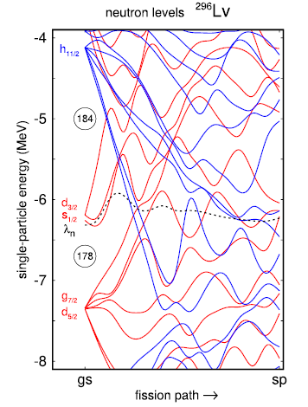
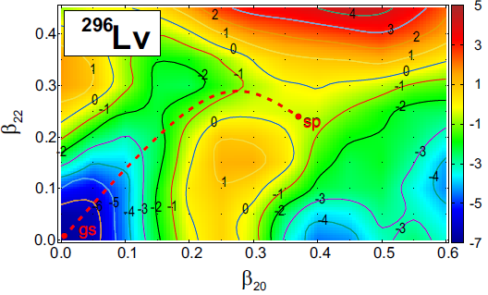

Slide 14
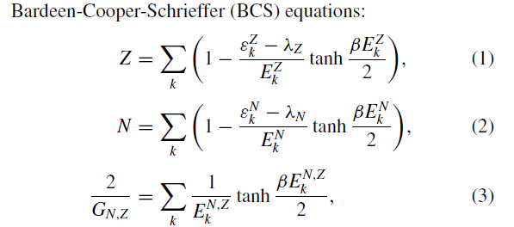
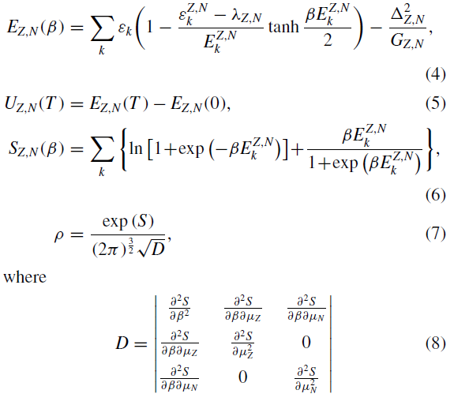
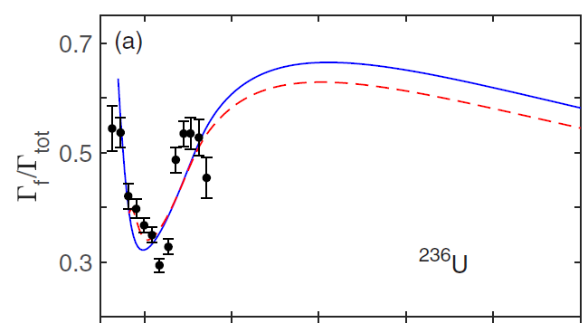

Slide 15
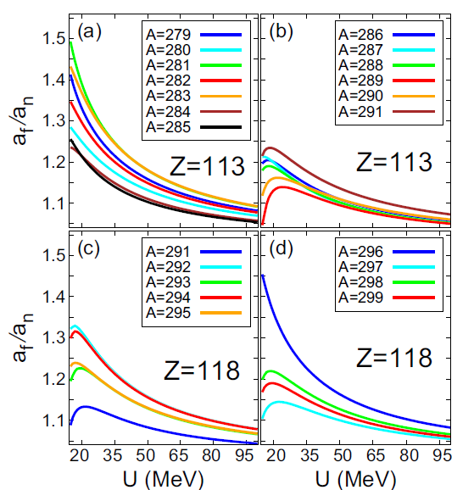
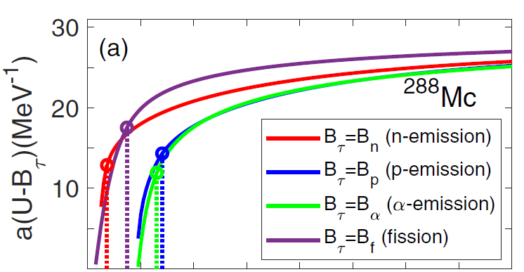

Slide 16
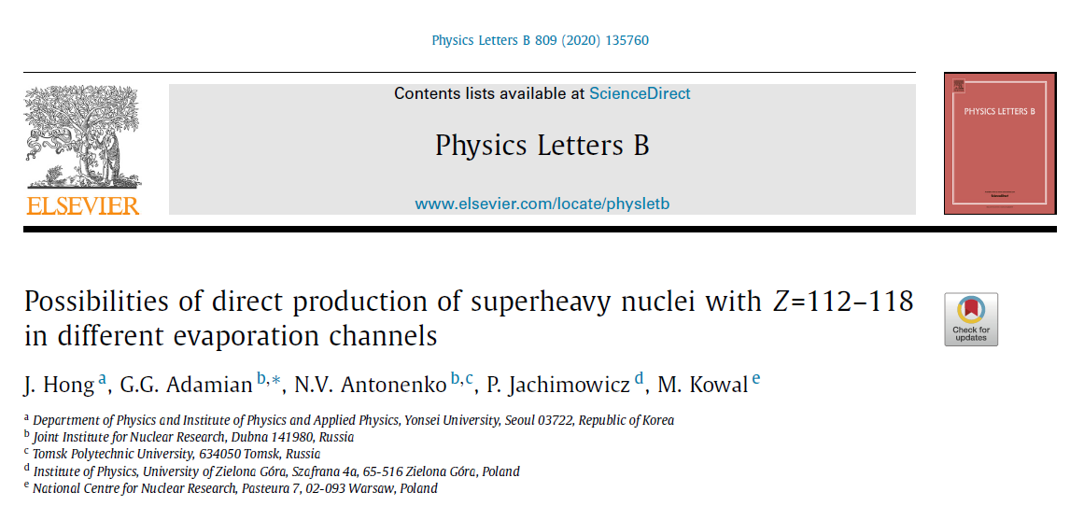
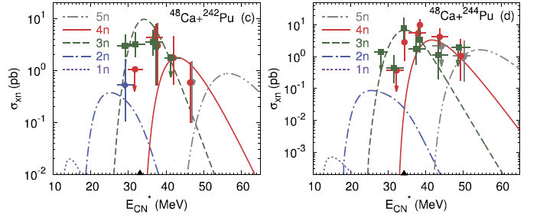

Slide 17
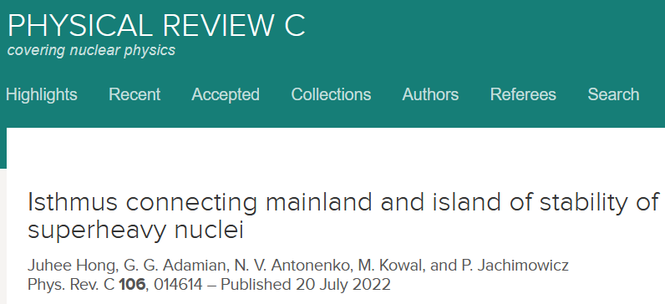
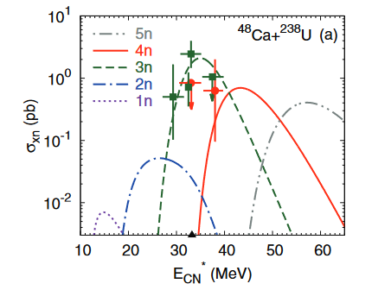
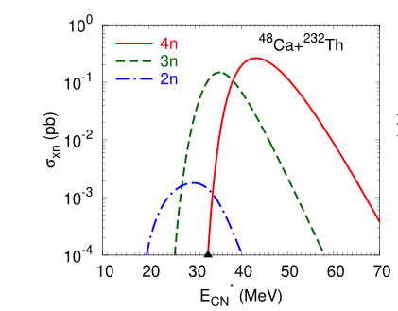
For the 48 Ca + 232 Th → 277 Ds +3n reaction, we predict a maximum cross section σ3n ≈ 0.1 pb, which is smaller than the experimental production cross sections σ4n = 16 pb (E ∗ CN = 40.6 MeV in the 48 Ca + 226 Ra → 270 Hs +4n reaction and σ3n ≈ 3, 10, 3 pb in the reactions 48 Ca + 238 U → 283 Cn +3n, 48 Ca + 242,244 Pu → 287,289 Fl +3n, 48 Ca + 245,248 Cm → 290,293 Lv +3n.
The nucleus with Z = 110 seems to be the boundary nucleus between the mainland (where the last nucleus is Hs) and the island (archipelago) of stability of superheavy nuclei. In other words, the Ds nucleus is located at the isthmus connecting the island of stability and the mainland from the side of a relatively neutron-rich nuclei
Tthe dependence of the production cross section on the atomic number Z from Hs to Lv has a minimum in the Ds nucleus. Consequently, experimental observation of this minimum of the production cross section will indirectly indicate the existence of an archipelago of stability of superheavy nuclei.

Slide 18
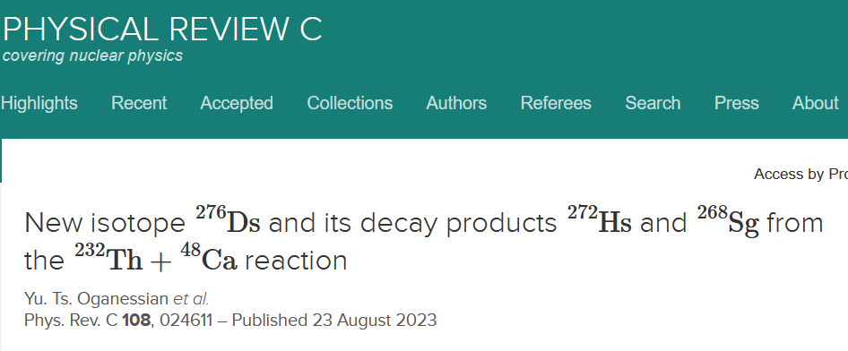
EXP
TH

Slide 19
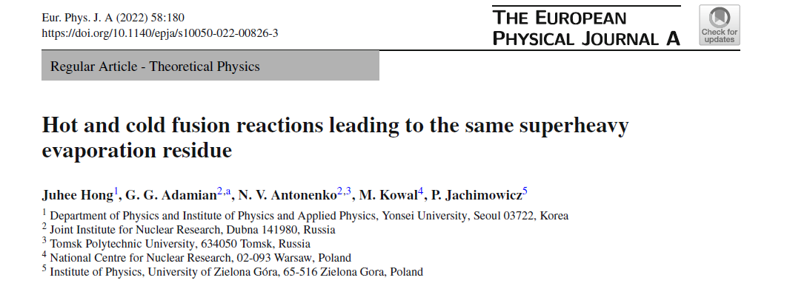
Excitation functions are predicted for the Production of isotopes of a superheavy nucleus with charge numer Z = 112 in the (2 − 5)n-evaporation channels of the complete fusion reactions 48Ca+233,235U for future experiments. The calculated production cross section of the 277Cn isotope in the hot fusion reaction 48Ca+233U is compared with the experimental one in the cold fusion reaction 70Zn+208Pb. The strong correlation between the fusion probability and asymmetry in the entrance reaction channel is revealed. The possibility of filling the gap between the isotopes of superheavy nuclei with Z = 112 produced in cold and hot Fusion reactions is indicated.

Slide 20
70Zn+208Pb
48Ca +233U
276
Ds
48Ca +232Th (0.1 pb)

Slide 21
