Slide 1
Developments of the HRS, GPIB and PIPERADE devices for the DESIR facility
Mathieu Flayol from LP2i Bordeaux
flayol@cenbg.in2p3.fr
Outline:
HRS
GPIB
PIPERADE
  Buffer gas cooling technique
  ToF-ICR
  PI-ICR
Colloque ganil 2023

Slide 2
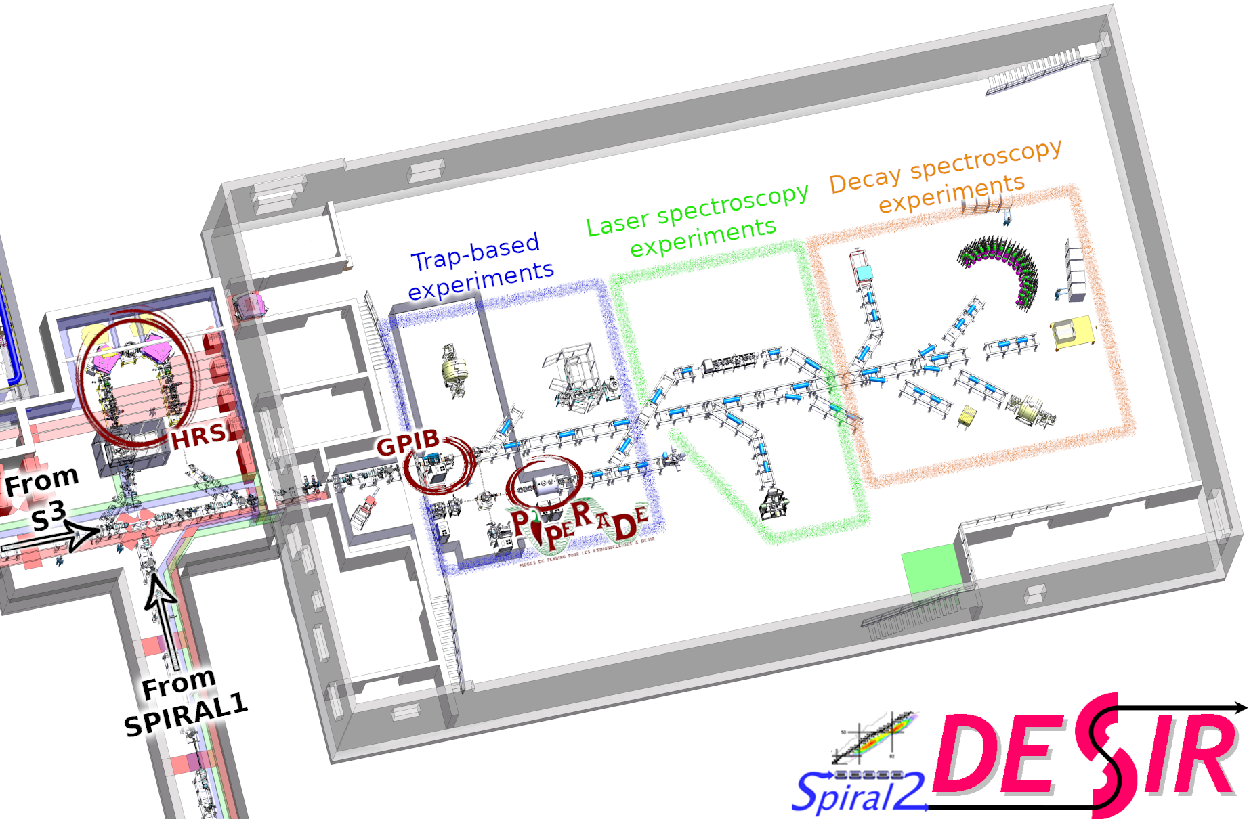
$$M({}_{Z}^{A}{X)=Nm_{n}+Zm_{p}+BE}$$
High-precision mass measurement
Good optical quality and bunch
isobars
Isobars and isomers
experiments in DESIR
Other experiments in DESIR
HRS
GPIB
prepares
PIPERADE
purifies
purifies
Laser spectroscopy
Decay spectroscopy
Trap experiments
Really sensitive to contamination

Slide 3
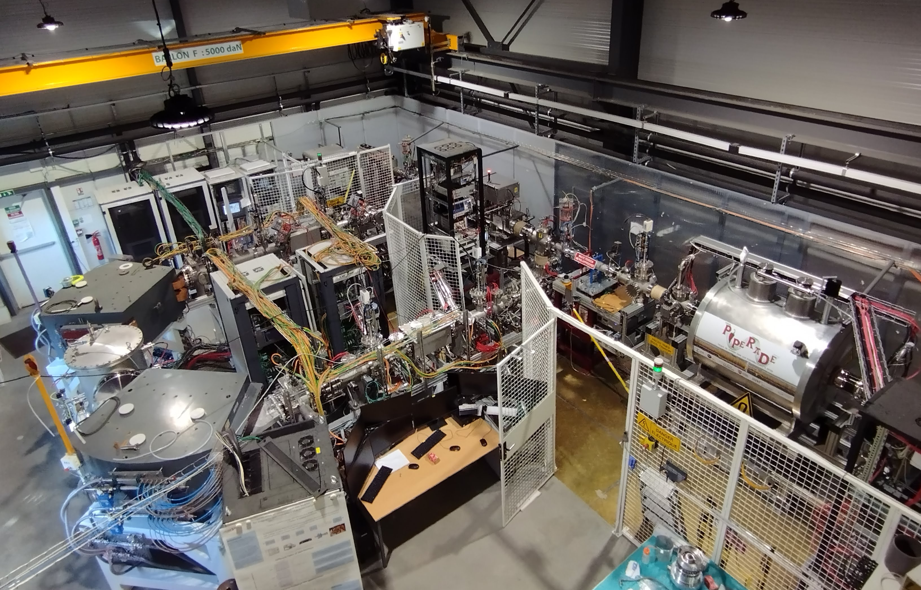
HRS
3

Slide 4

3-keV line
3

Slide 5

3

Slide 6
HRS
3

Slide 7
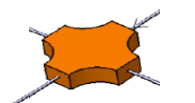
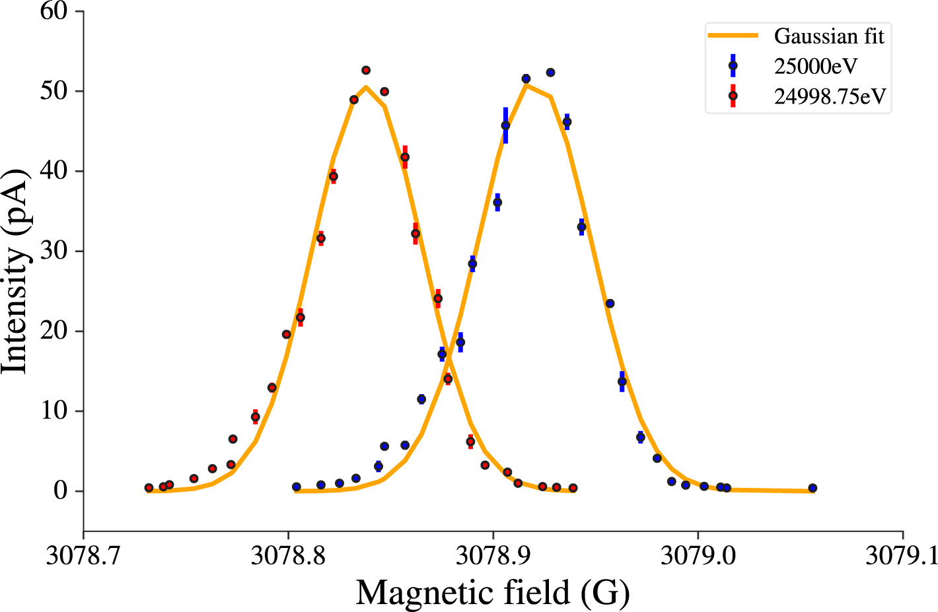

High Resolution Separator
Objective : M/ΔM >20 000
Resolving power of 23400 reached !
Finalise the hexapolar/octupolar corrections to minimize aberrations
Development of a new technique to simulate contaminated beam (tunable IOI/Contamination ratio and mass difference)
J. Michaud et al. NIM B 541 (2023) 161-164
J. Michaud et al. NIM B 541 (2023) 243-245
$$\frac{M}{ΔM}=\frac{E}{ΔE}$$

Slide 8
HRS
5

Slide 9
3-keV line
5

Slide 10
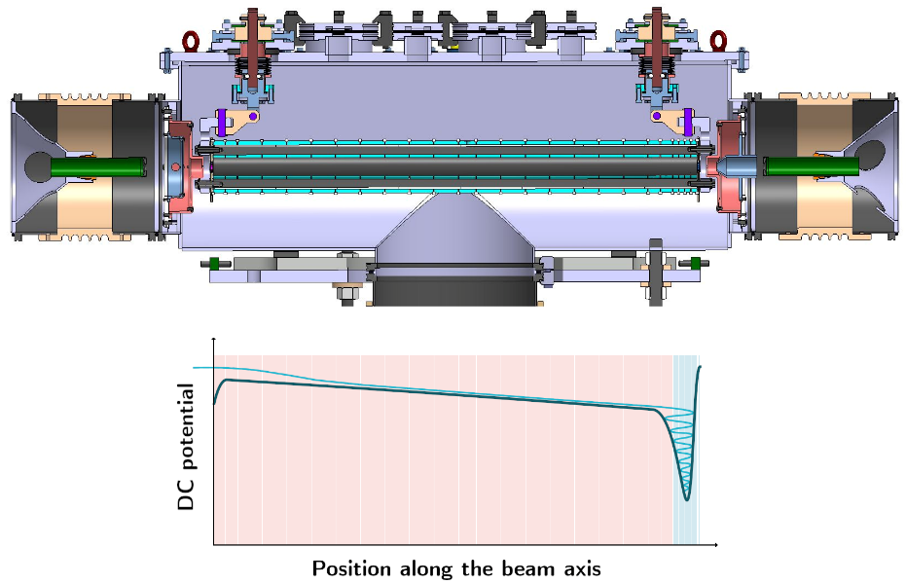
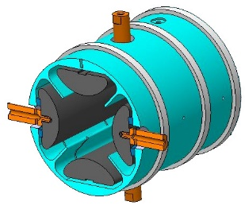
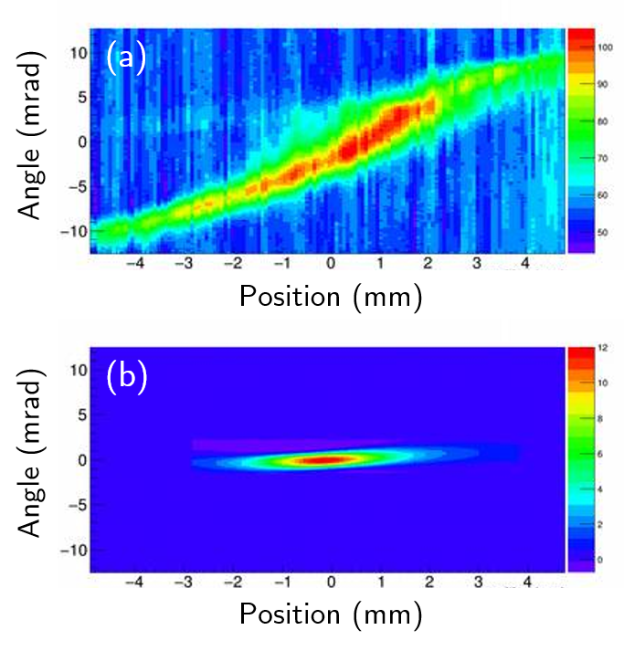


Objective: beam cooling (transverse emittance < 3 π.mm.mrad at 60 keV) beam bunching (longitudinal emittance < 10 eV.us)
M. Gerbaux et al, NIM A 1046 (2023) 167631
Characterisation in continuous mode
  Emittance reduction from 20 to 3 π.mm.mrad
  Transmitting power of the order of 70-80%,
  >90% if long optimisation
$$∼ 20π.mm.mrad$$
3$π.mm.mrad$

Slide 11
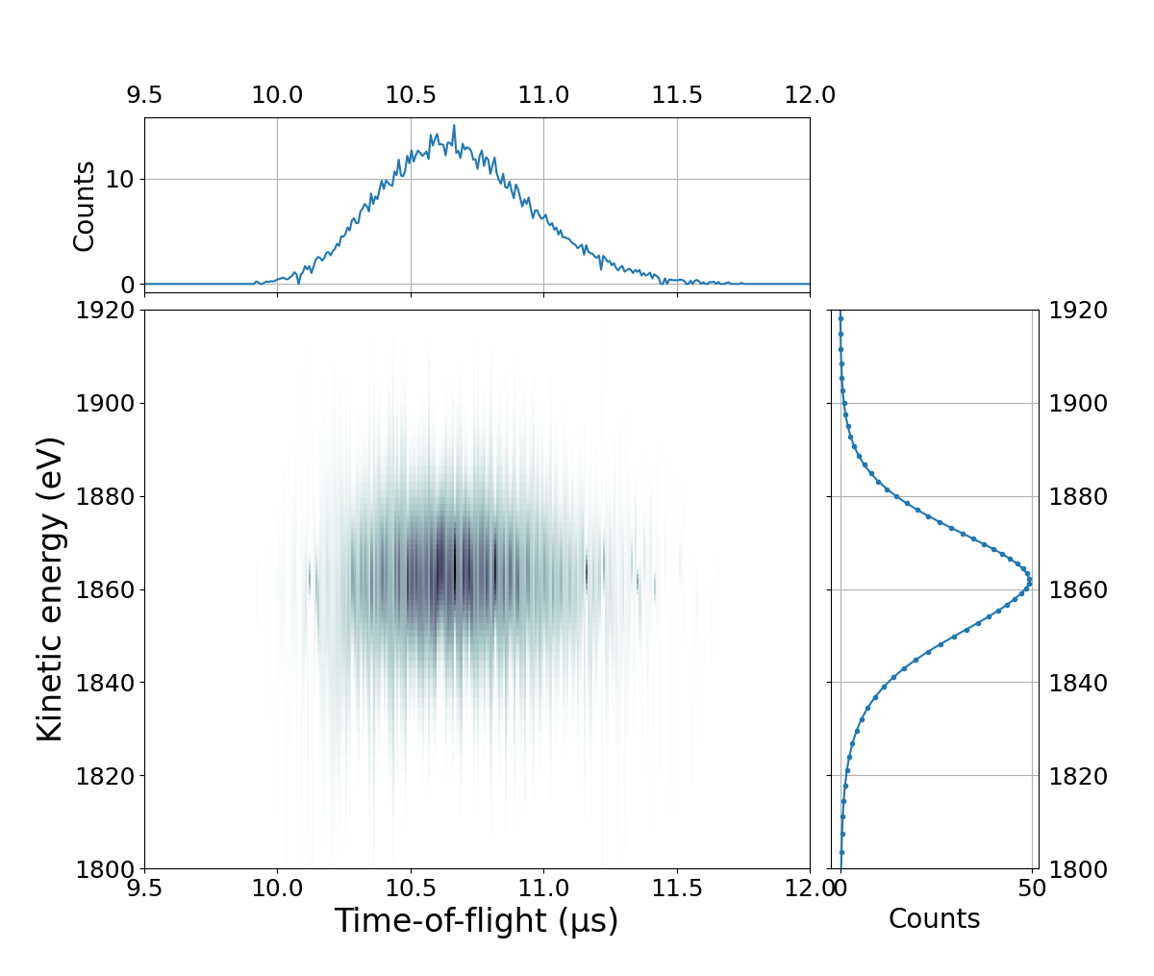
Objective: beam cooling (transverse emittance < 3 π.mm.mrad at 60 keV) beam bunching (longitudinal emittance < 10 eV.us)
First tests in bunch mode (PostDoc A. Husson 3 years)
  Good transmission efficiency but not measured in a precise and reliable way (diagnostic studies is needed)
  Time of flight dispersion down to a few 100 ns at 3 keV
  Measurement of the energy dispersion <10 eV but limited by the detection devices
M. Gerbaux et al, NIM A 1046 (2023) 167631

Slide 12
3-keV line
8

Slide 13
8

Slide 14
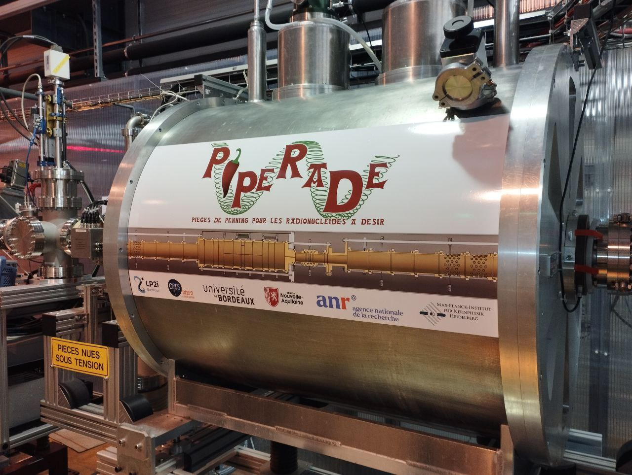
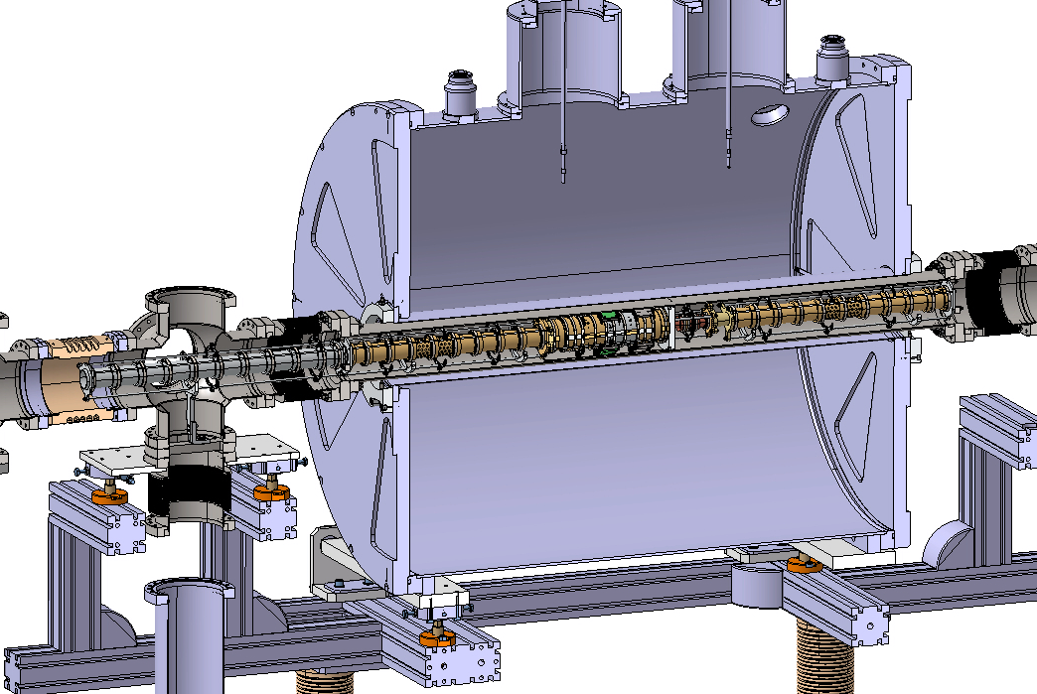

PIPERADE = 2 cylindrical traps inside a 7 T magnet
From
GPIB
Towards
detector
Entrance electrodes
Injection electrodes
1st trap
2nd trap
Extraction electrodes
Exit electrodes
Diaphragm

Slide 15
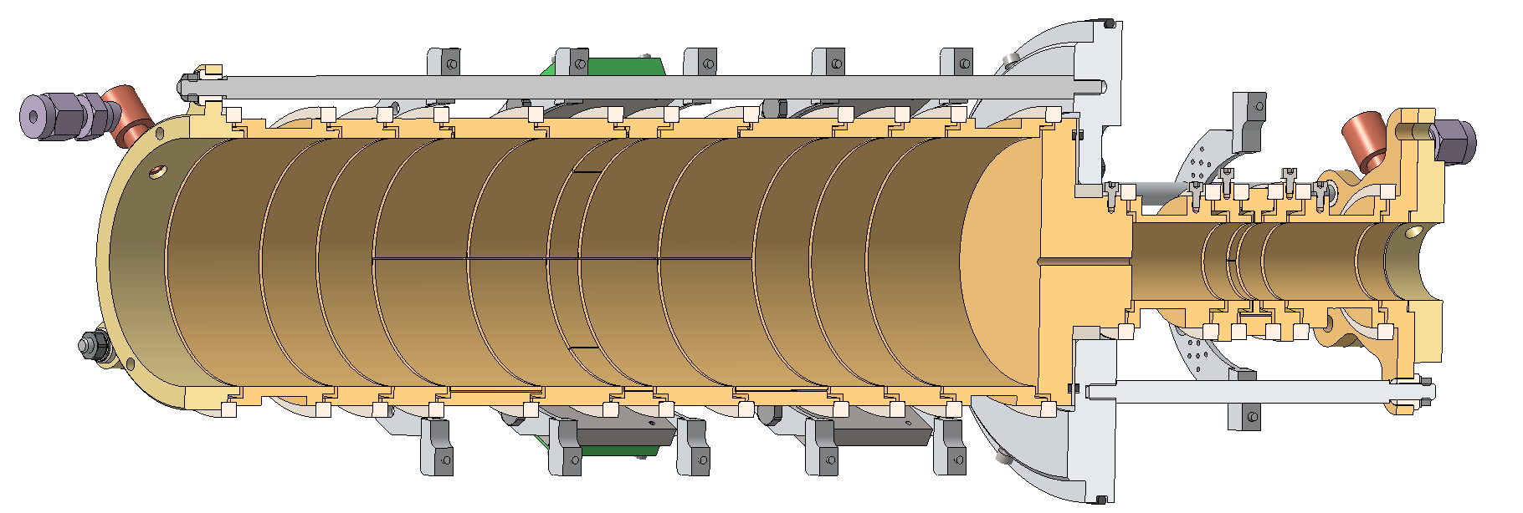
Double Penning trap of PIPERADE
B
Measurement Trap
(High-resolution purification and high-precision mass measurement)
Purification Trap
y

Slide 16
Double Penning trap of PIPERADE
B
Measurement Trap
(High-resolution purification and high-precision mass measurement)
Purification Trap
Ring electrode
y

Slide 17
Double Penning trap of PIPERADE
B
Measurement Trap
(High-resolution purification and high-precision mass measurement)
Purification Trap
Ring electrode
Diaphragm
y

Slide 18
Double Penning trap of PIPERADE
Final MCP
B
Measurement Trap
(High-resolution purification and high-precision mass measurement)
Purification Trap
Ring electrode
Diaphragm
y

Slide 19
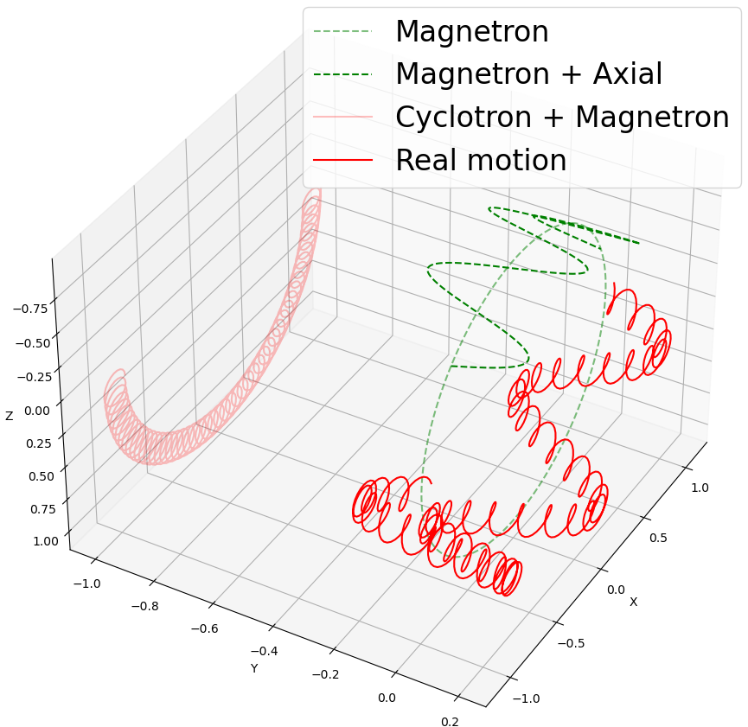
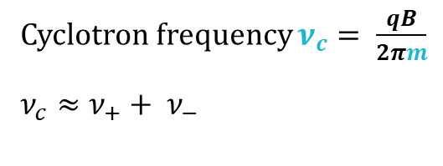
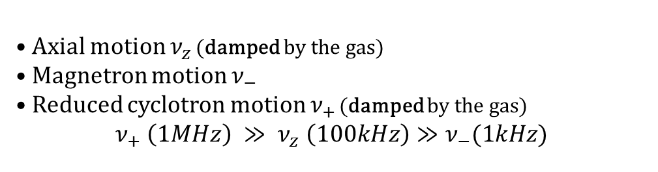
3 eigen motions
• Axial motion $ν_{z}$ (damped by the gas)
• Magnetron motion $ν_{−}$
• Reduced cyclotron motion $ν_{+}$ (damped by the gas)
$$ν_{+} \left(1MHz\right) ≫ ν_{z} \left(100kHz\right)≫ν_{−}(1kHz)$$
Reacting to:
RF excitations:
  Dipolar (Increase or decrease the amplitude)
  Quadrupolar (Convert one into another)
Gas pressure
Cyclotron frequency $ν_{c}= \frac{qB}{2πm}$
$$ν_{c}≈ν_{+}+ ν_{−}$$

Slide 20
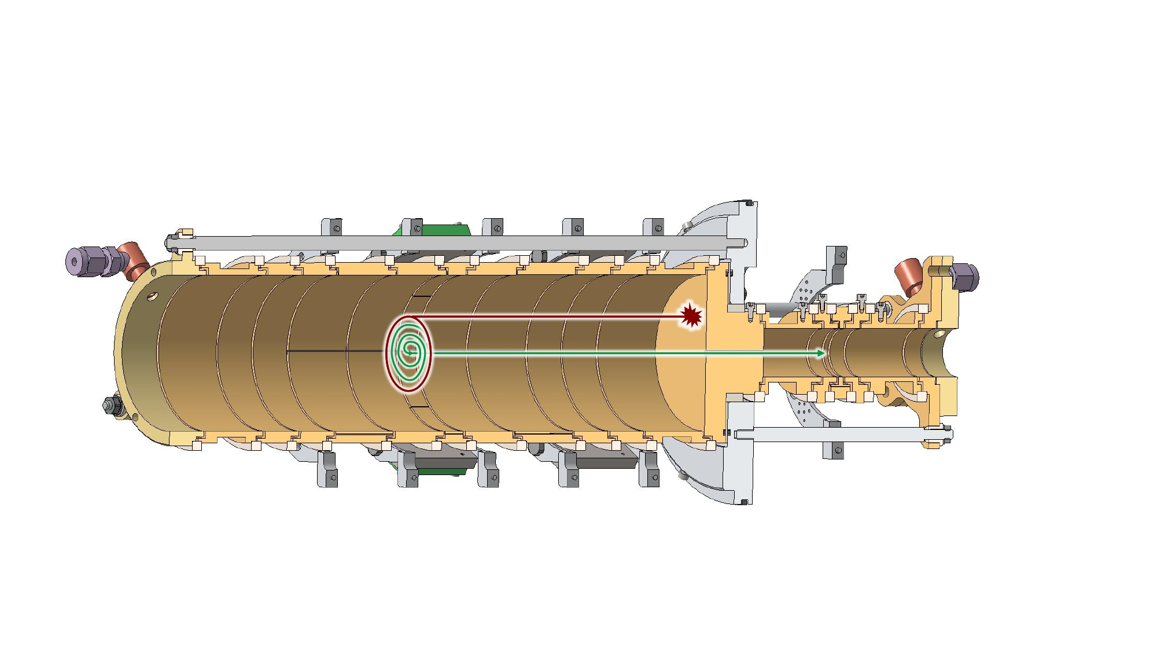
Buffer Gas Cooling
Implemented on PIPERADE with a resolving power of 10⁵

Slide 21
Buffer Gas Cooling Technique
Waiting time
Dipolar excitation
x
Trap center
x
Quadripolar excitation
Diaphragm

Slide 22
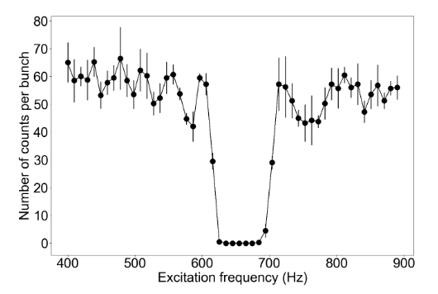
Magnetron decentering
Decentered
Centered
Centered
x
x
x
x
x
Dipolar excitation frequency’s scan
(increase the magnetron motion’s radius when at the correct frequency)
Legend :
x
Trap center
Diaphragm
Ion Bunch
P. Ascher, et al. NIM A 1019 (2021) 165857

Slide 23
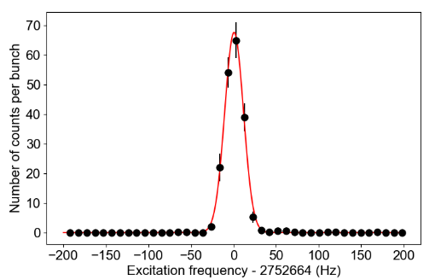


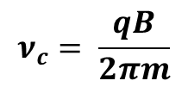
Buffer gas cooling technique
Recentered
x
x
$$ν_{c}= \frac{qB}{2πm}$$
Quadrupolar excitation frequency’s scan
(magnetron motion’s conversion into cyclotron motion when at the right frequency)
$$39K^{+}$$
Resolving power: $\frac{ν_{c}}{Δν_{c}}∝ \frac{m}{Δm}≈{10}^{5}$
Decentered
P. Ascher, et al. NIM A 1019 (2021) 165857
x

Slide 24
Time of Flight Ion Cyclotron Resonance
Give radial energy to the ions (dipolar + quadrupolar)
Then convert it to axial energy (freeing the ions)
Therefore ToF is shorter at the resonance

Slide 25

Time of Flight Ion Cyclotron Resonance
Give radial energy to the ions (dipolar + quadrupolar)
Then convert it to axial energy (freeing the ions)
Therefore ToF is shorter at the resonance
$$\vec{F}=\vec{µ}.\vec{∇}\vec{B}$$

Slide 26
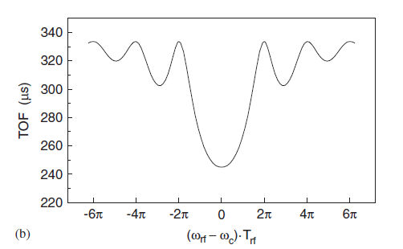
Time of Flight Ion Cyclotron Resonance
Give radial energy to the ions (dipolar + quadrupolar)
Then convert it to axial energy (freeing the ions)
Therefore ToF is shorter at the resonance
$$\vec{F}=\vec{µ}.\vec{∇}\vec{B}$$
Ideal ToF ICR
M. Koenig, et al. IJMS 31 (1995) 95

Slide 27
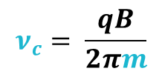
Time of Flight Ion Cyclotron Resonance
Give radial energy to the ions (dipolar + quadrupolar)
Then convert it to axial energy (freeing the ions)
Therefore ToF is shorter at the resonance
$$\vec{F}=\vec{µ}.\vec{∇}\vec{B}$$
Ideal ToF ICR
M. Koenig, et al. IJMS 31 (1995) 95
$$ν_{c}= \frac{qB}{2πm}$$

Slide 28
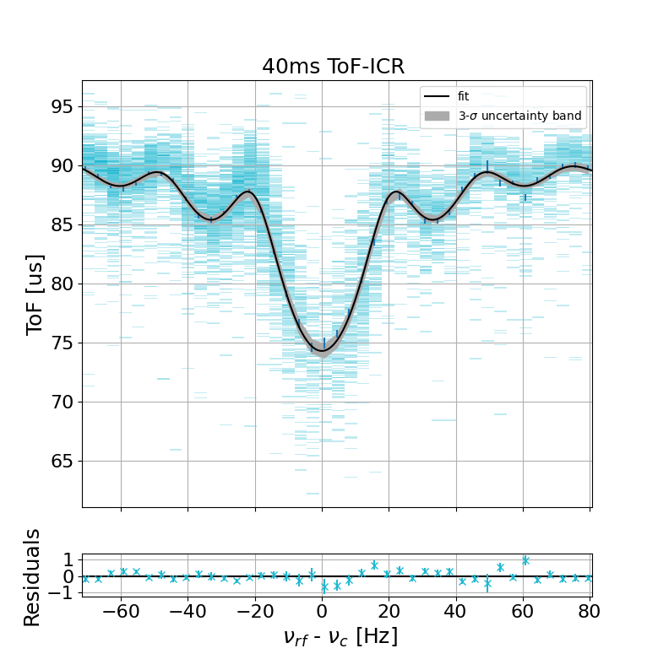

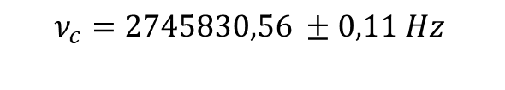



Example of ToF ICR at PIPERADE
$$Excitation Time of 40 ms$$
$$ν_{c}=2745830,56 ±0,11 Hz$$
$$ν_{c}= \frac{qB}{2πm}$$
$${}_{}^{39}{K^{+}}$$
Done using the new program
Dinko Atanasov & Mathieu Flayol

Slide 29
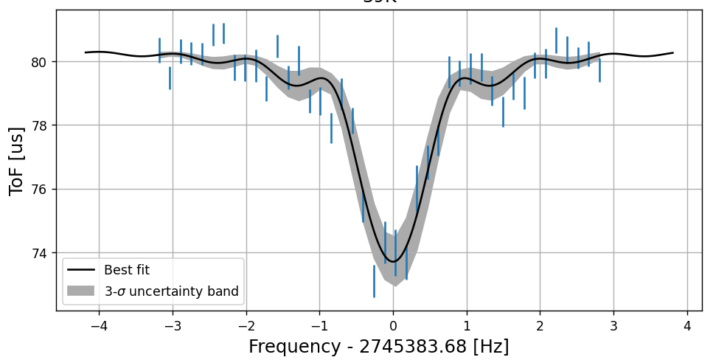
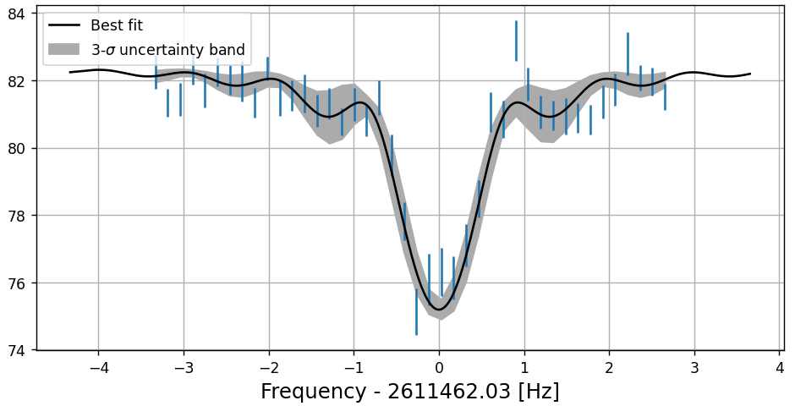
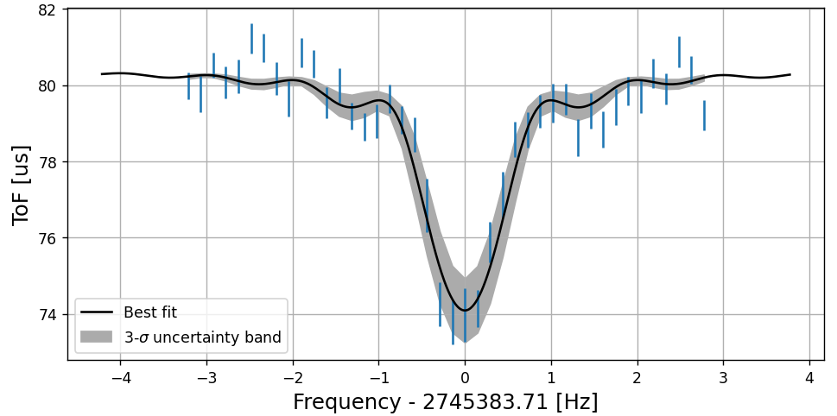
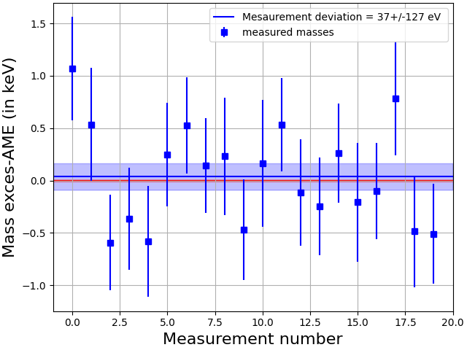




1s ToF-ICR mass measurement ⁴¹K
$${}_{}^{39}{K^{+}}$$
$${}_{}^{41}{K^{+}}$$
$${}_{}^{39}{K^{+}}$$
+1
Measured with a well known reference (³⁹K)
$$ν_{c}= \frac{qB}{2πm}$$

Slide 30
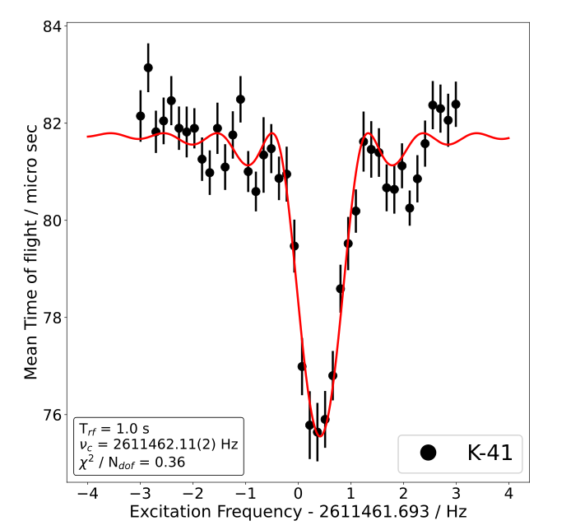

1s ToF-ICR mass measurement ⁴¹K
Precision : $\frac{δm}{m}≈{3∗10}^{−9}$
Study of the systematic uncertainty is ongoing

Slide 31
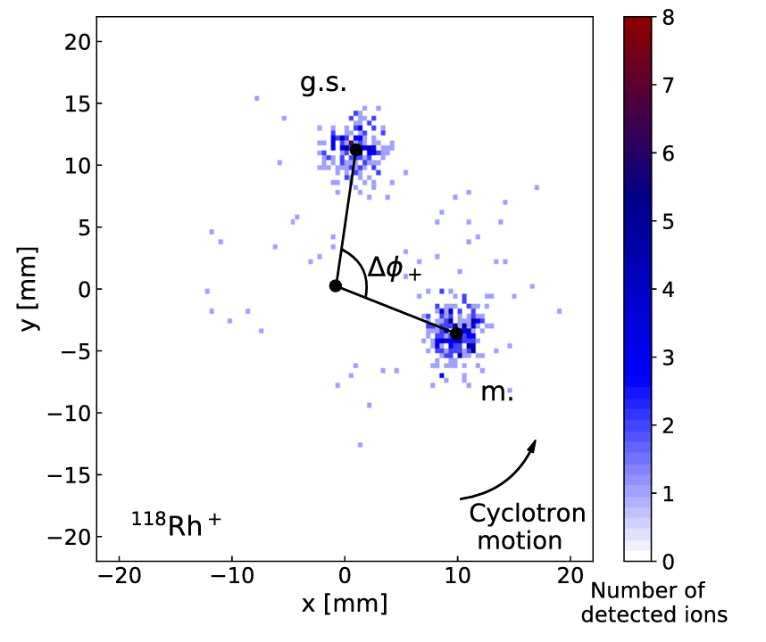
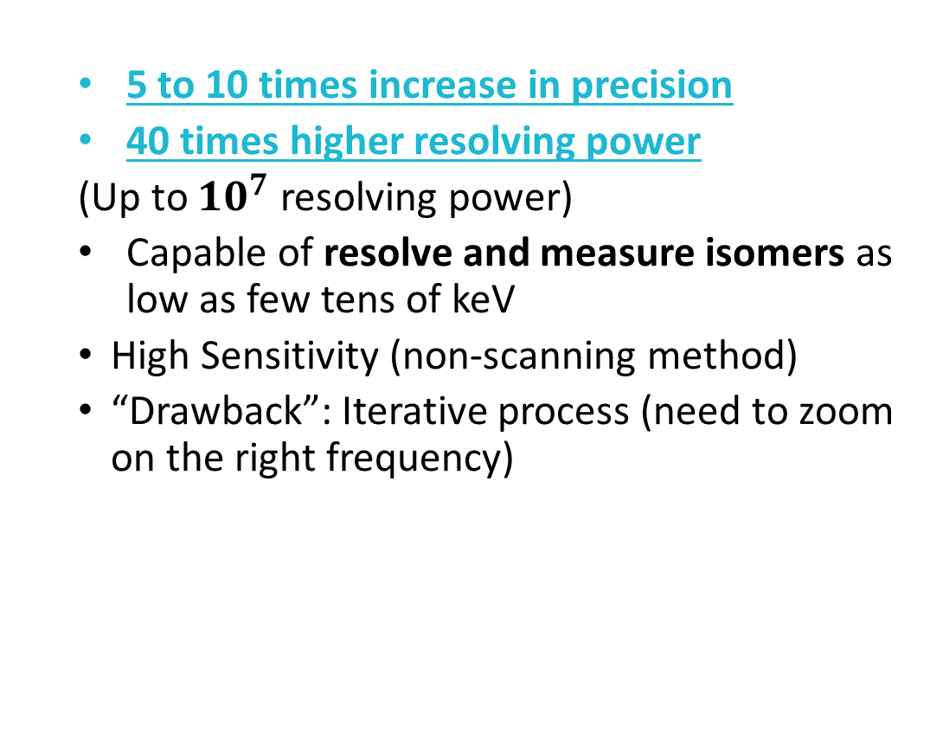

Phase-Imaging Ion-Cyclotron-Resonance technique
Developped at SHIPTRAP
Projected phases measurement
  5 to 10 times increase in precision
  40 times higher resolving power
  (Up to $10^{7}$ resolving power)
  Capable of resolve and measure isomers as low as few tens of keV
  High Sensitivity (non-scanning method)
  “Drawback”: Iterative process (need to zoom on the right frequency)
compared to ToF-ICR
M. Hukkanen et al. Phys. Rev. C 107 (2023) 014306

Slide 32
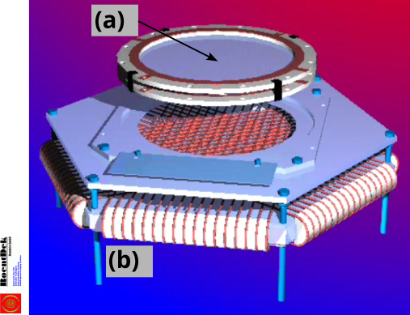
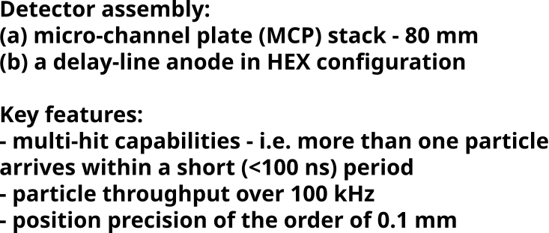
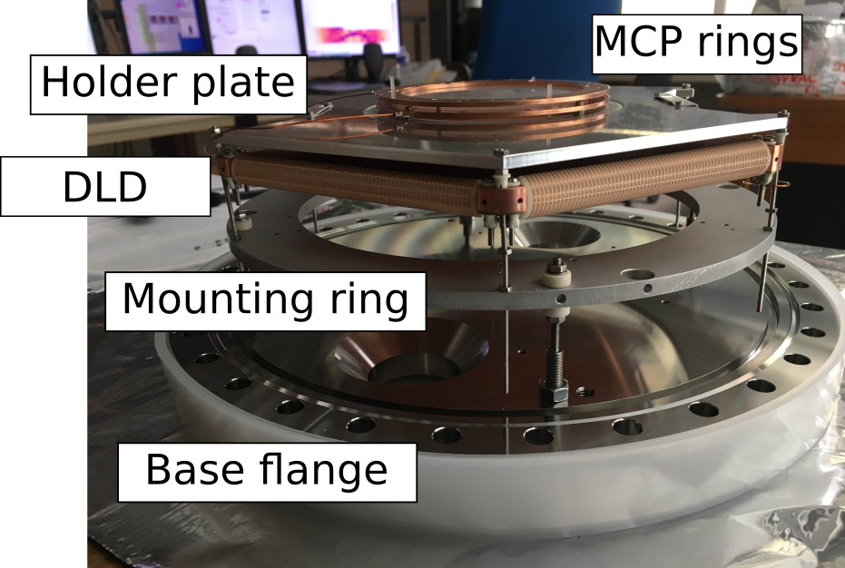
Hexagonal delay-line micro-channel-plate
MCP rings
Holder plate
DLD
Mounting ring
O. Jagutzki et al. IEEE Trans. Nuc. Sci. 49 (2002) 5
Base flange 250 mm

Slide 33
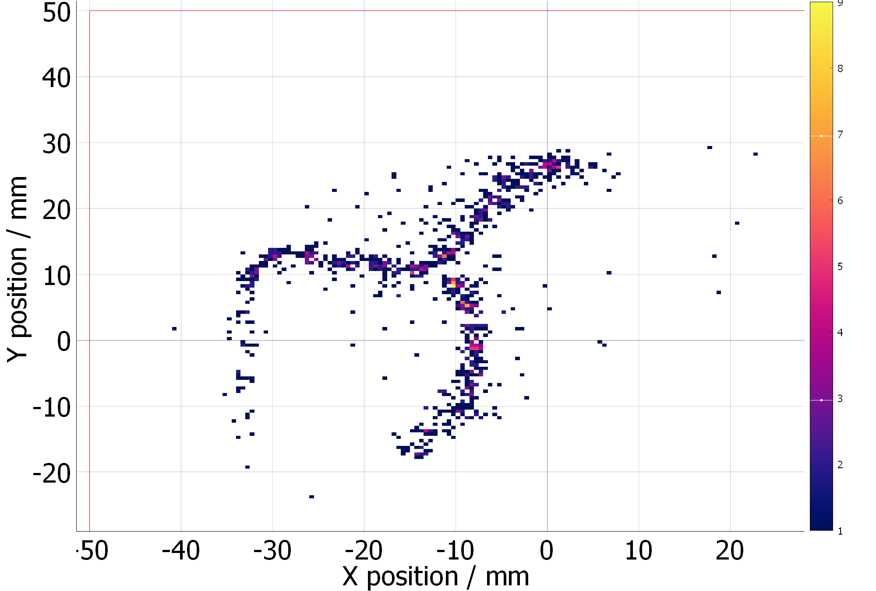
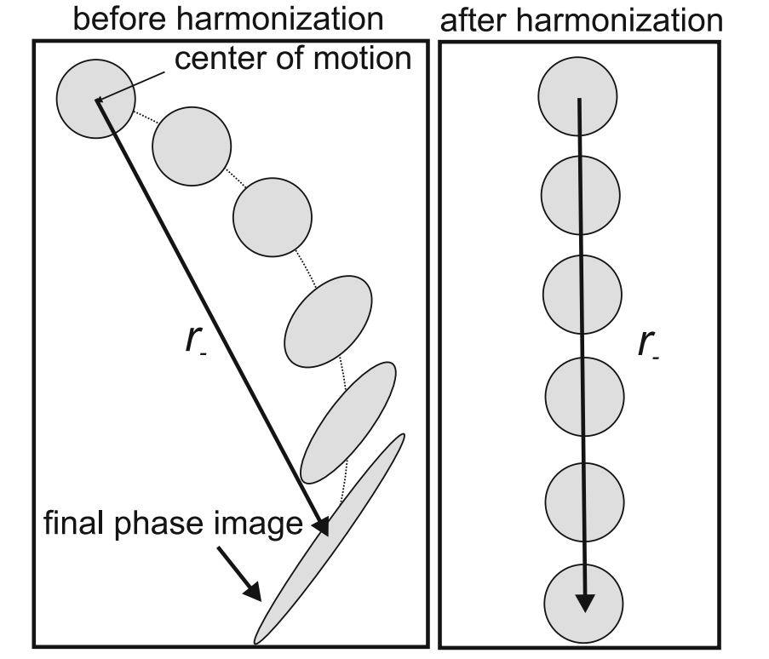
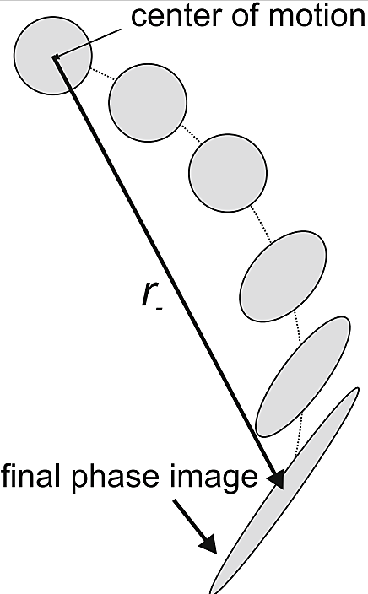

Magnetron amplitude scan for 3 magnetron phases
$${{}_{}^{85}{Rb}}^{+}$$
Eliseev, S et al. Appl. Phys. B 114 (2014) 107–128

Slide 34
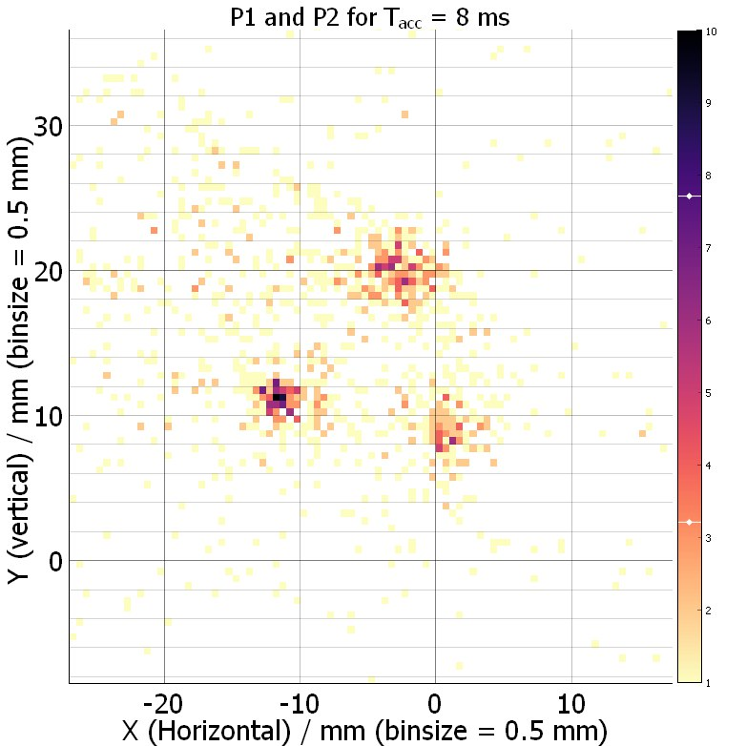
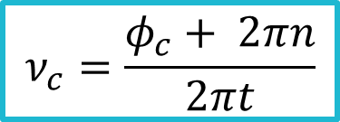

First PI-ICR at PIPERADE
Magnetron
$$ν_{c}=\frac{φ_{c}+ 2πn}{2πt}$$
$$Φ_{c}$$
Centre
Cyclotron réduit
Z

Slide 35
Conclusion
HRS
HRS
Hexapolar/Octupolar corrections to minimize aberrations
Resolving power of 23400 reached !
P. Alfaurt, A. Balana, B. Blank, L. Daudin, B. Lachacinski, J. Michaud, L. Serani

Slide 36
Conclusion
Continuous mode characterised
Works routinely in bunch mode
Technical developments ongoing in order to do the bunch mode characterisation
P. Alfaurt, P. Ascher, L. Daudin, M. Gerbaux, S. Grévy, A. Husson, B. Lachacinski, S. Perard

Slide 37
Conclusion
ToF-ICR reached precision of 10⁻⁸ – 10⁻⁹
Space-charge effect studies
Do a first mass measurement with PI-ICR
Systematic studies
P. Alfaurt, P. Ascher, D. Atanasov, L. Daudin, M. Flayol, M. Gerbaux, S. Grévy, M. Hukkanen, A. Husson, B. Lachacinski, Y. Langlois, S. Perard and A. de Roubin

Slide 38
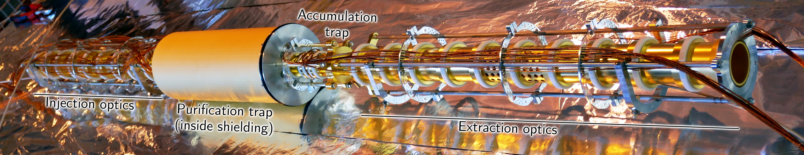





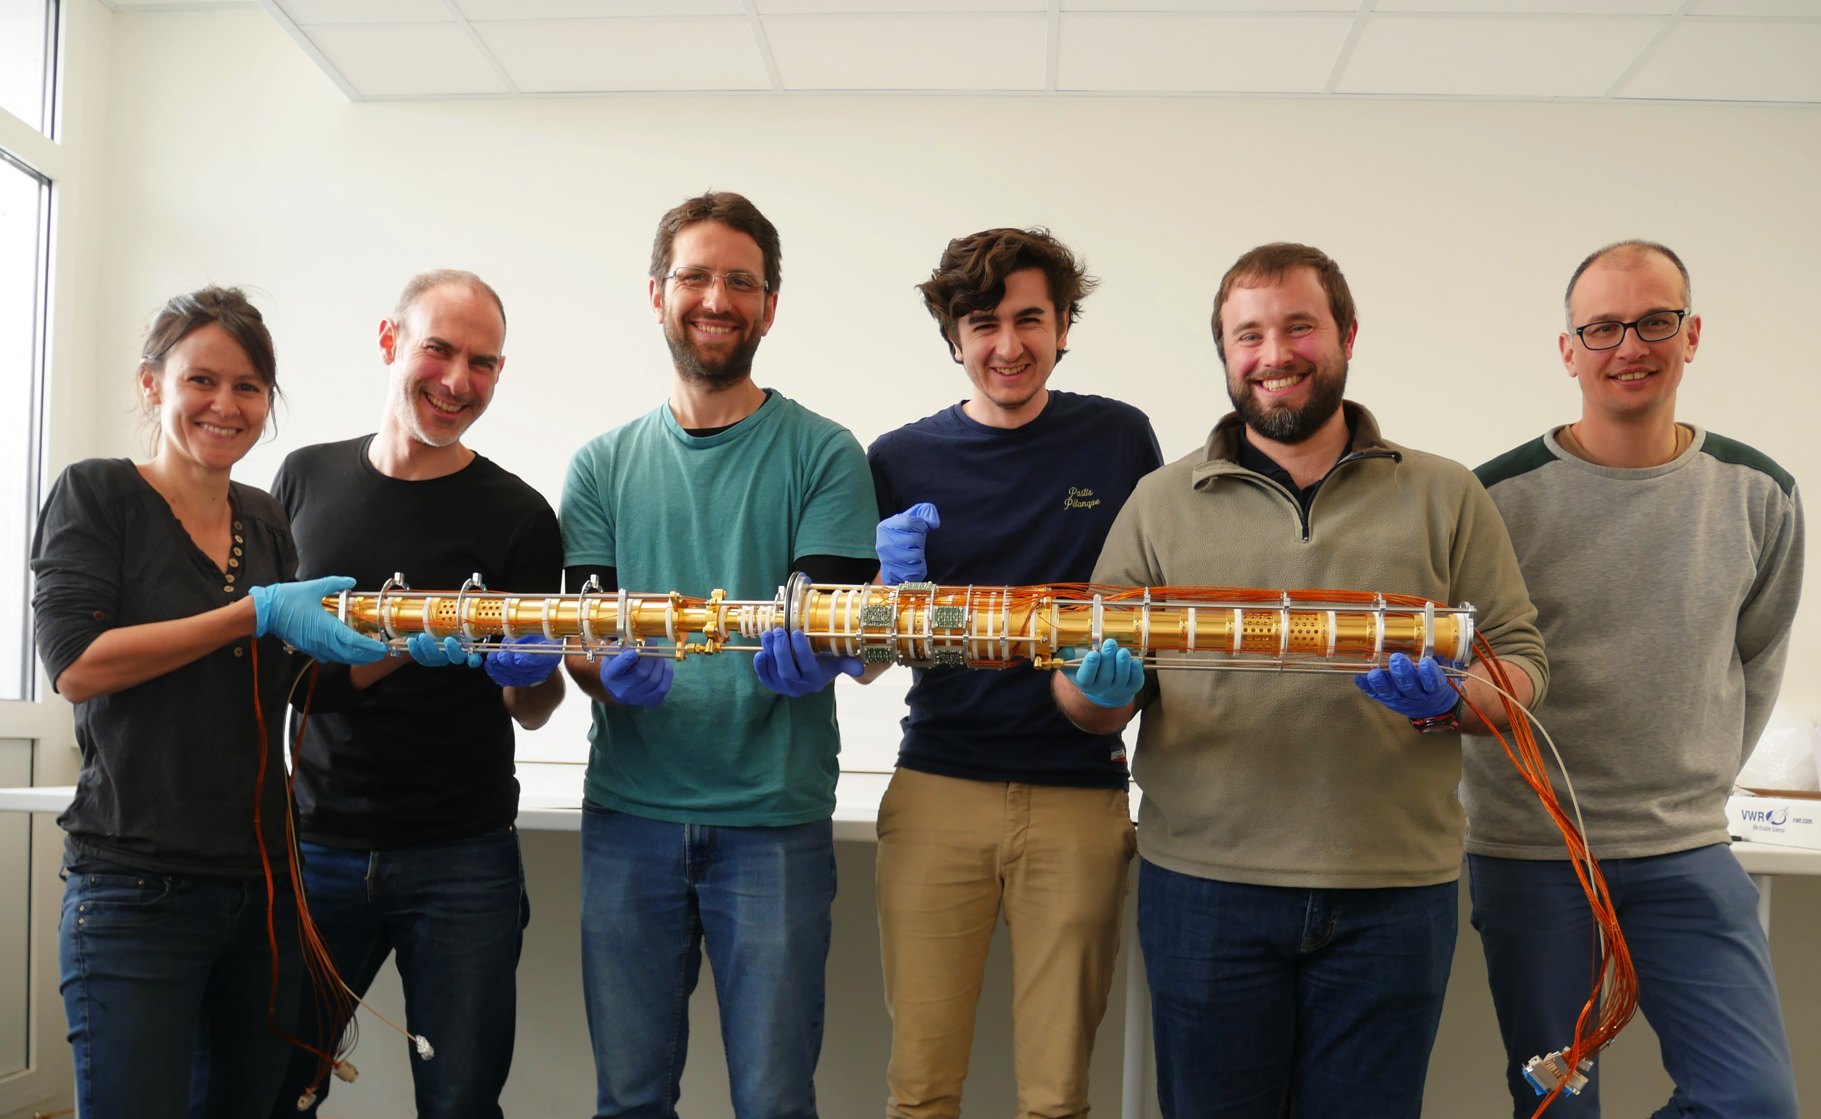



Thank you!
P. Alfaurt, P. Ascher, D. Atanasov, A. Balana, B. Blank, L. Daudin, M. Flayol, M. Gerbaux, S. Grévy, M. Hukkanen, A. Husson,
B. Lachacinski, Y. Langlois, J. Michaud,
S. Perard, A. de Roubin and L. Serani
ANR-2011-BS04-020-02
ANR-11-EQPX-0012

Slide 39
Injection in the traps
E_{p}
0V
-80V
-85V
MCP
Purification trap
Measurement trap
y

Slide 40
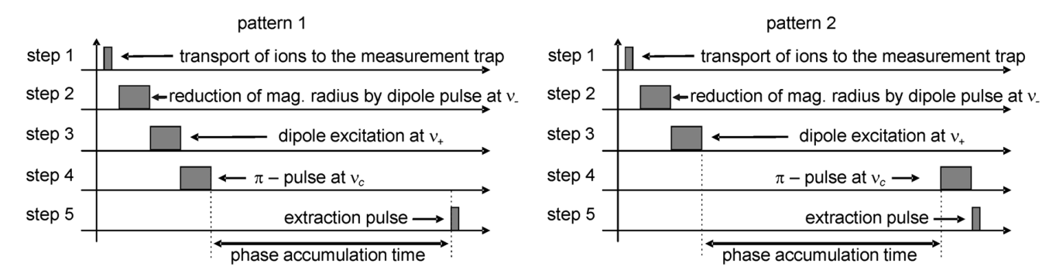
Eliseev, S et al. Appl. Phys. B 114 (2014) 107–128

Slide 41
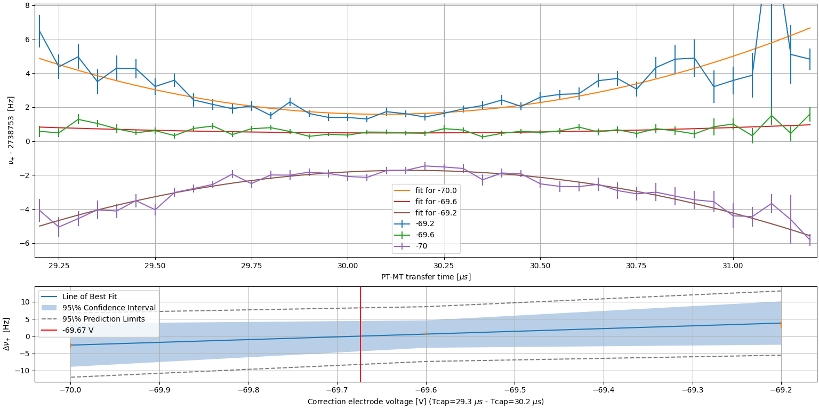
      Investigation of E field anharmonicities started

Slide 42
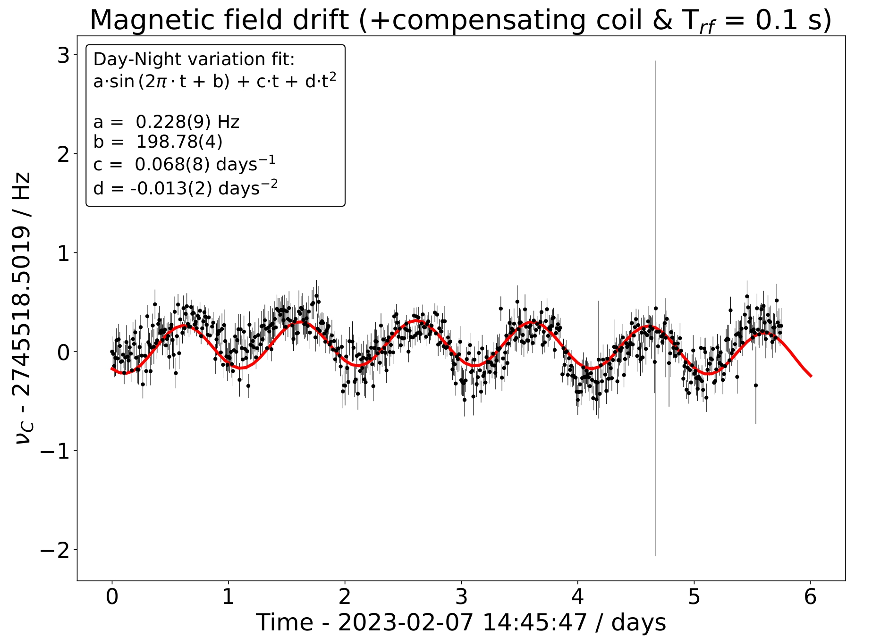
Drift of the magnetic field has been studied

Slide 43
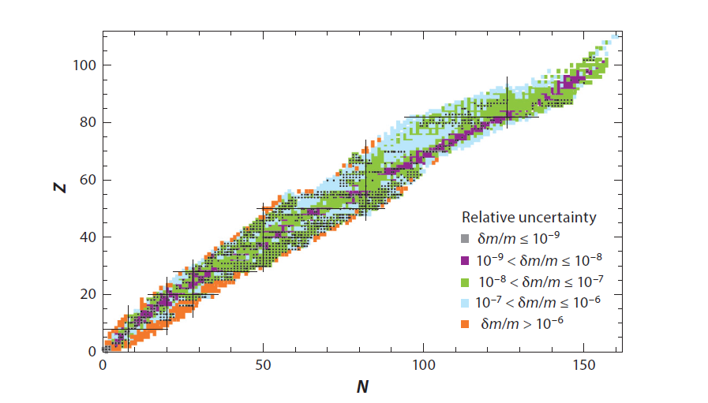
Penning trap in the mass measurement world
Penning-Trap Mass Measurements in Atomic and Nuclear Physics
Jens Dilling, Klaus Blaum, Maxime Brodeur, Sergey Eliseev
Annual Review of Nuclear and Particle Science 2018 68:1, 45-74

