Slide 1





Observation of a correlated free four-neutron system and future perspectives
Colloque GANIL 2023
Soustons, France
Duer, M., et al. Nature 606, 678–682 (2022)
+++ Accepted RIBF proposal, SAMURAI74
Kenjiro Miki & Meytal Duer
Stefanos Paschalis

Slide 2

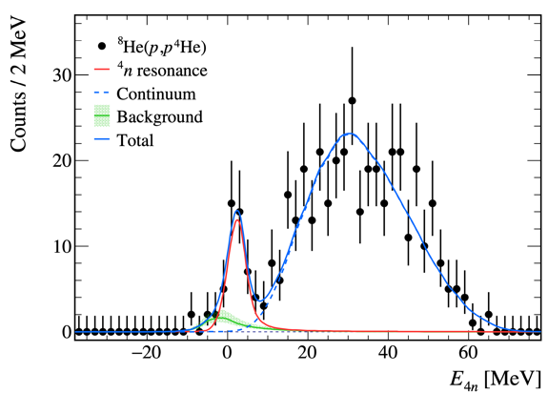
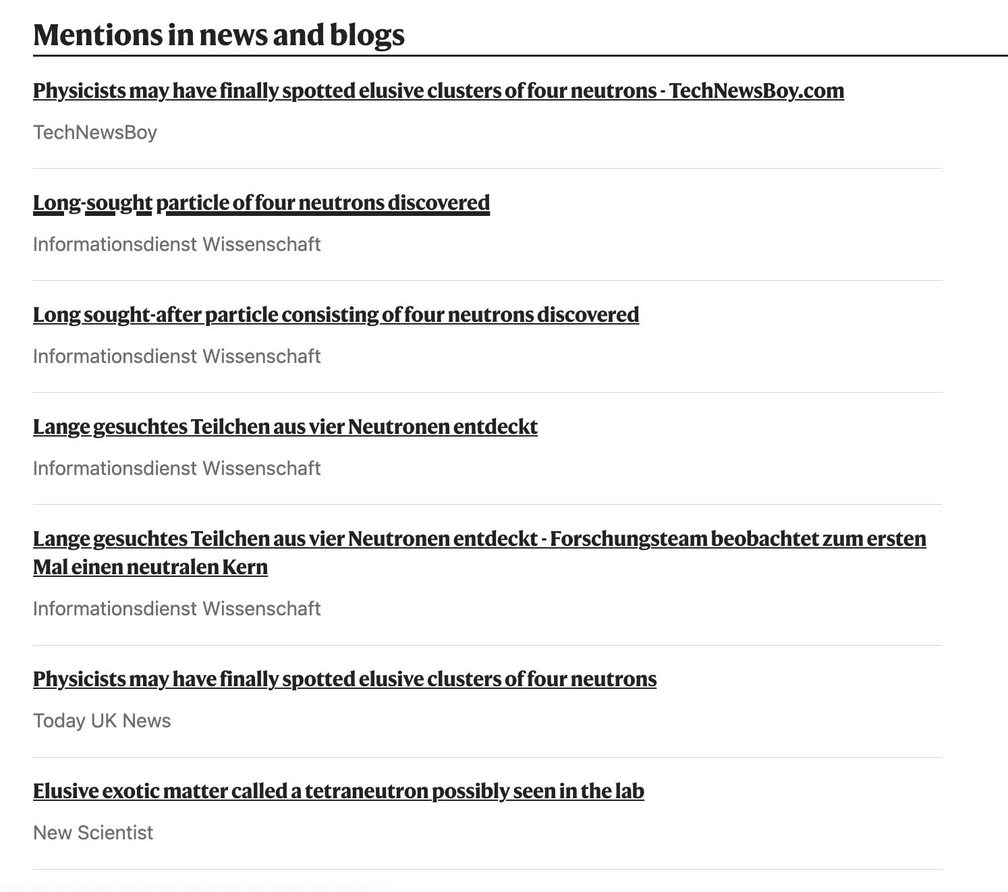
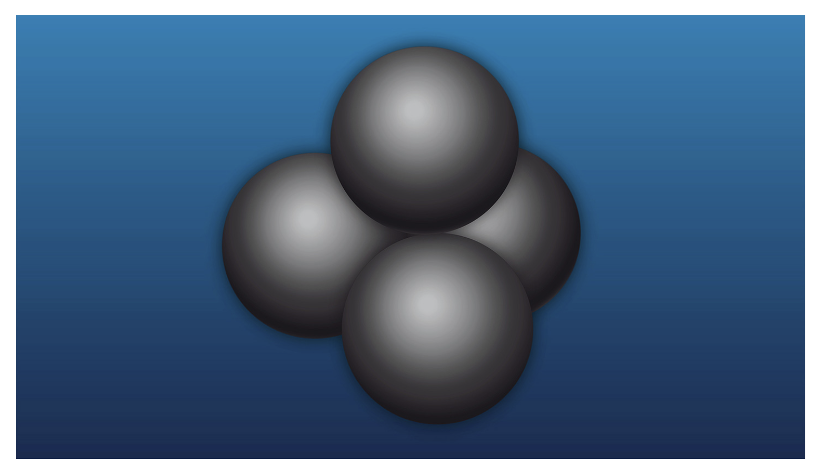

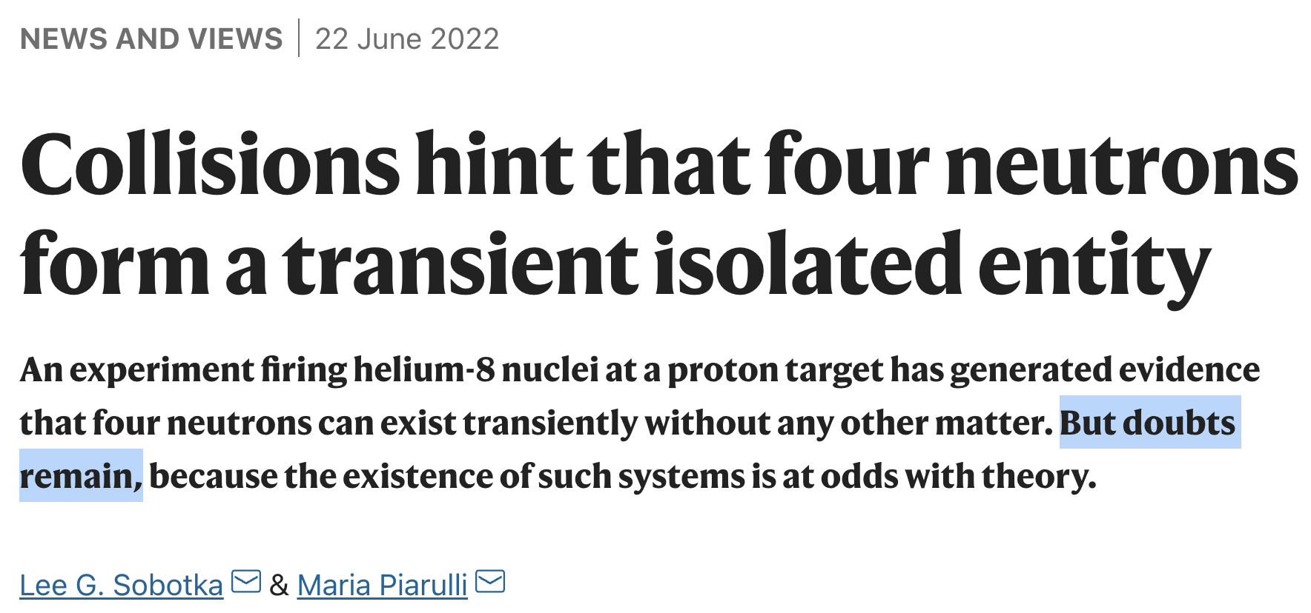
Observation of a correlated free four-neutron system
Duer, M., et al. Nature 606, 678–682 (2022)

Slide 3
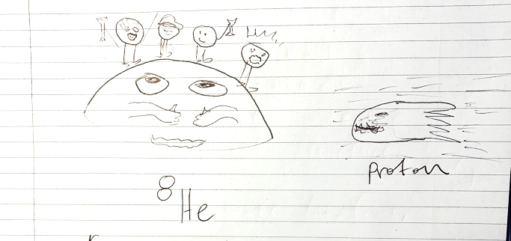
Observation of a correlated free four-neutron system
Duer, M., et al. Nature 606, 678–682 (2022)
Head of Media Relations | The University of York
Thanks for the summary; it is quite a tricky one for a lay person to grasp…..
….. what they might be able to tell us about the 'Big Bang', so can your findings contribute to that conversation for example?

Slide 4
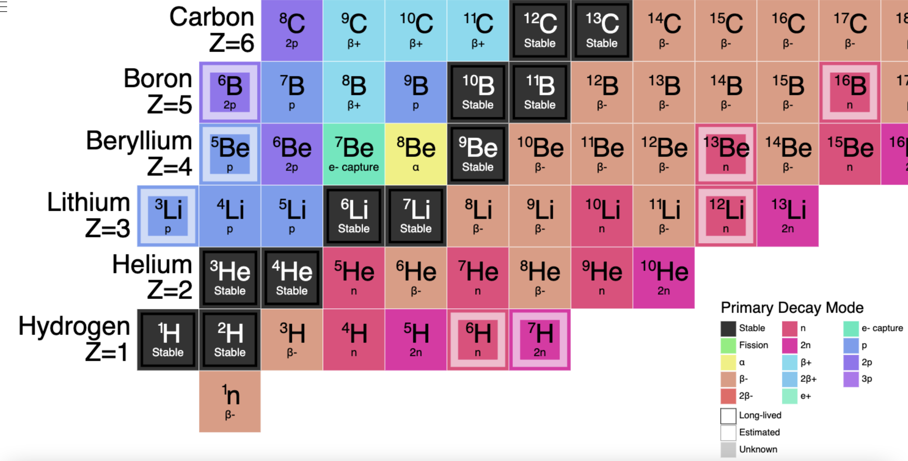
Nuclear landscape
Light nuclei
4n?

Slide 5
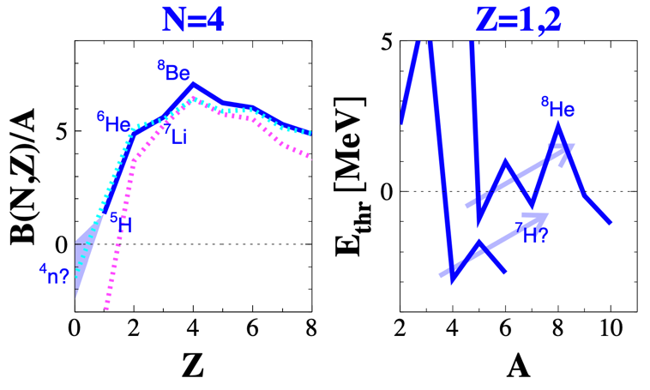
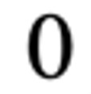
Nuclear landscape
Light nuclei
N = 4
Figures by
F.M. Marques
4n?

Slide 6
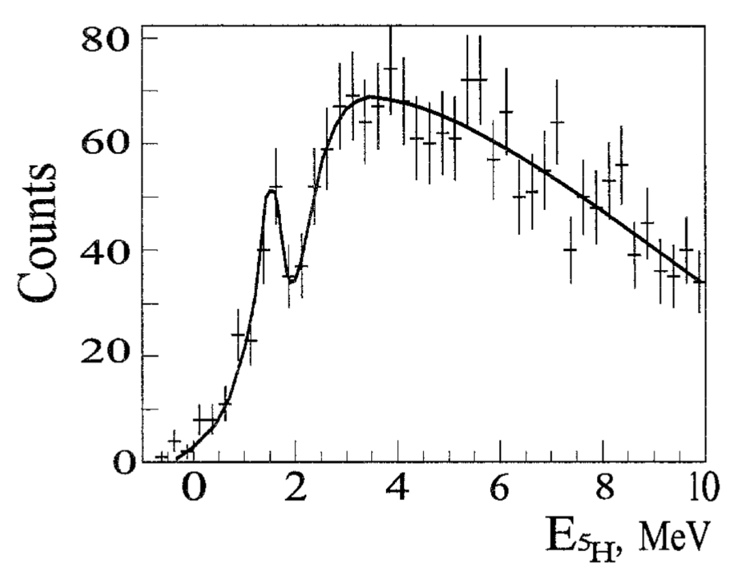
Nuclear landscape
Light nuclei
⁵H
XI. Sidorchuk et al.
Nuclear Physics A719 (2003) 229c
4n?

Slide 7
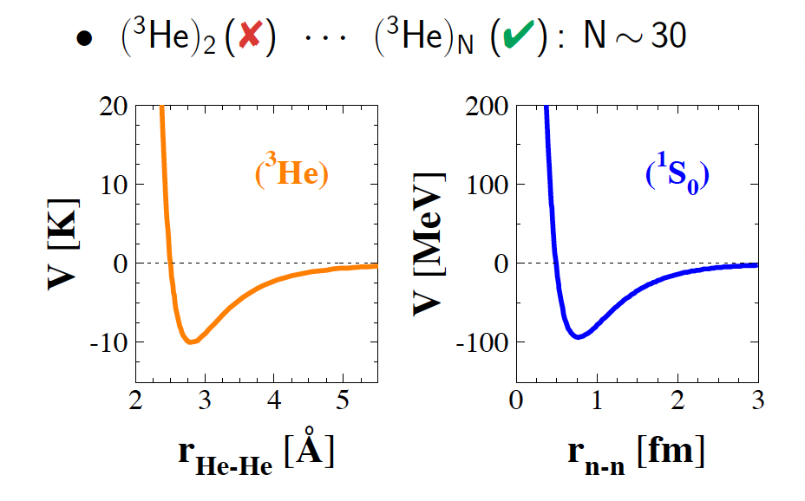
Nuclear Forces
is known to be just unbound by only about 100 keV
Two-nucleon Systems:
T_{z}=-1
T_{z}=0
T_{z}=+1
R. Guardiola, PRL 84, 1144 (2000)
Spin^{π} =0⁺
T=1
Di-proton
Di-neutron
T=0
Spin^{π} =1⁺
Deuteron ground state
few-body fermionic systems
T = 3/2 component of 3N forces
coupling to the continuum
proton-proton proton-neutron neutron-neutron

Slide 8
A 60-year quest
of multi-neutron systems

Slide 9
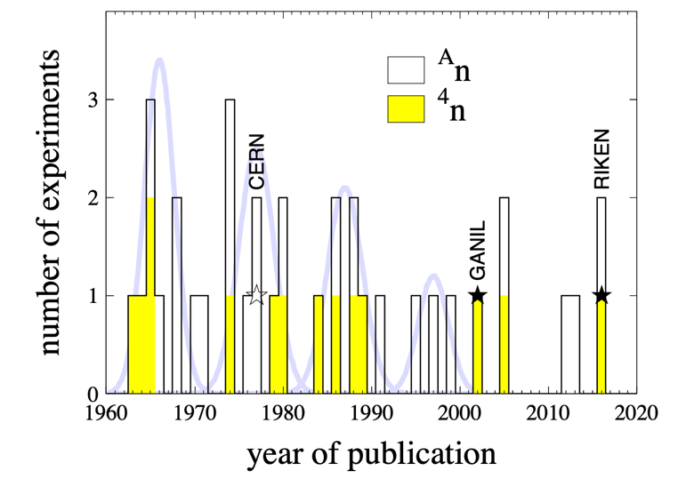
A 60-year quest
Experimental work – throughout the decades
For a recent, comprehensive review see:
EPJ A 57, 105 (2021)
36+ experiments searching for
multi-neutrons!!

Slide 10
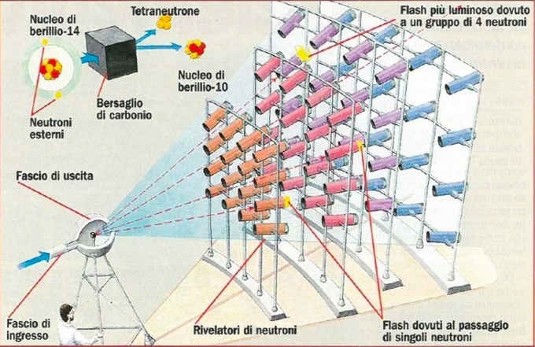
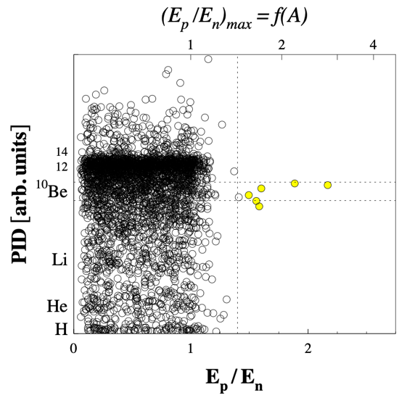
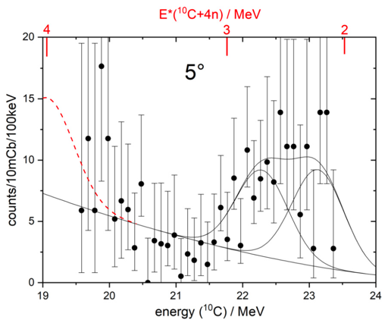
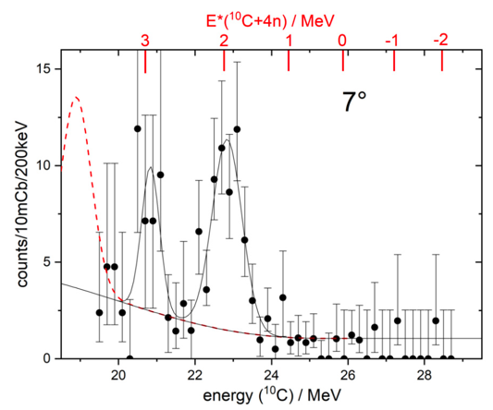
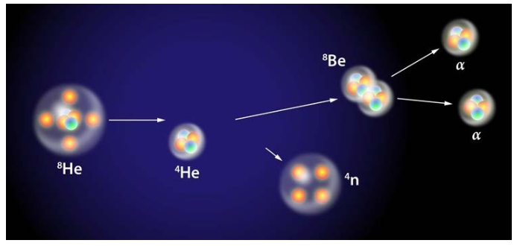
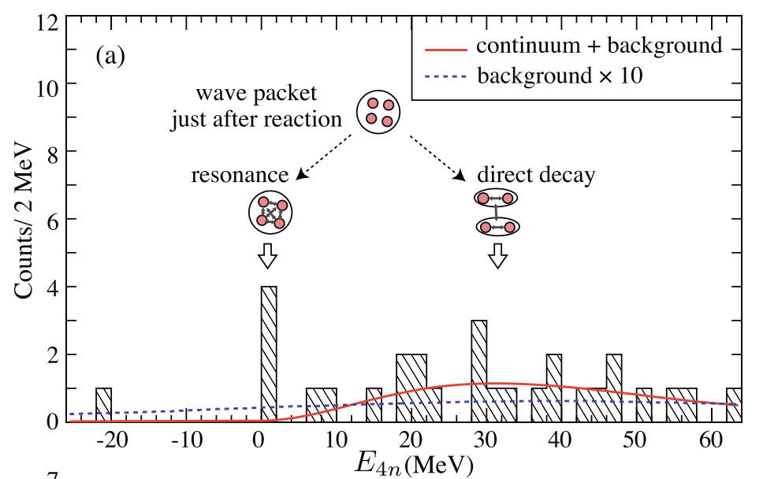
A 60-year quest
Experimental work
Thomas Faestermann et al., PLB 824 (2022) 136799
GANIL – 2002
C (¹⁴Be, ¹⁰Be) 4n
Multi-nucleon transfer
TUM – 2022
⁷Li(⁷Li,¹⁰C) ⁴n
6 events consistent with bound 4n or a low-energy resonance (E(4n) < 2 MeV)
  4n resonance E(4n) = 2.93 MeV, Γ < 0.24 MeV
  or
  4n bound by 0.42(16) MeV & ¹⁰C in 1st excited state
F.M. Marques et al., PRC 65, 044006 (2002) and arXiv:nucl-ex/0504009
RIKEN – SHARAQ/RIBF – 2016
⁴He (⁸He, ⁸Be) ⁴n
Double charge exchange reaction
K. Kisamori et al., PRL 116, 052501 (2016)
4 events consistent with 4n resonance:
E(4n) = 0.8 ± 1.3 MeV, Γ < 2.6 MeV
K. Kisamori et al., PRL 116, 052501 (2016)

Slide 11
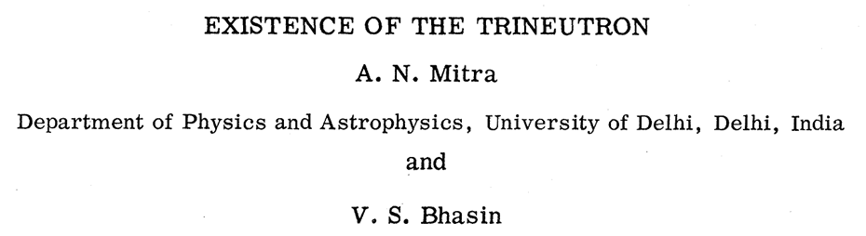
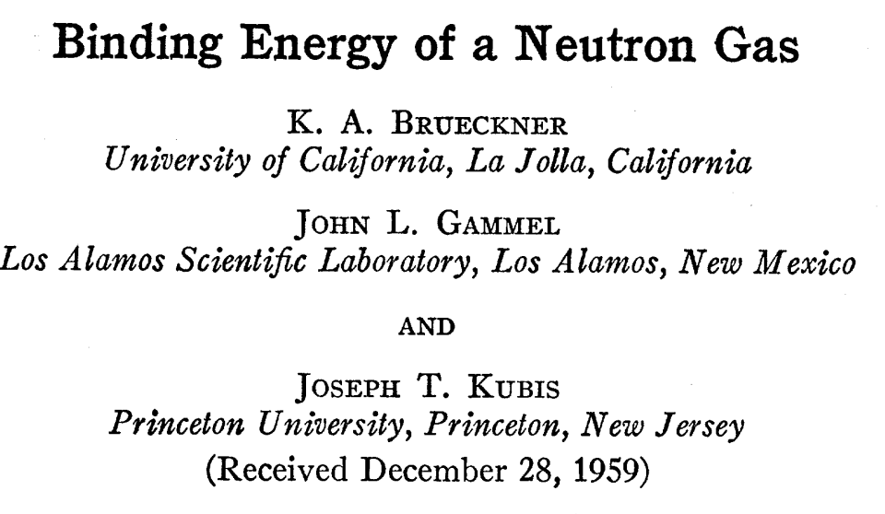
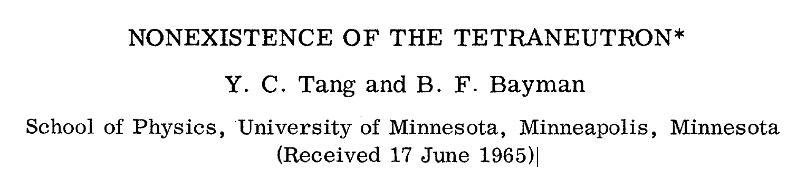
A 60-year quest
Theoretical calculations
(1965)
We conclude that a neutron gas is not bound at any density….
Here again, we find that there is neither a bound nor a resonant 4n system.

Slide 12
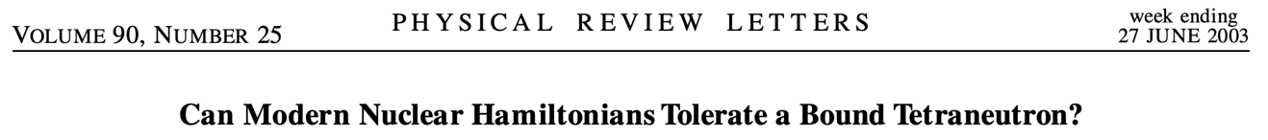
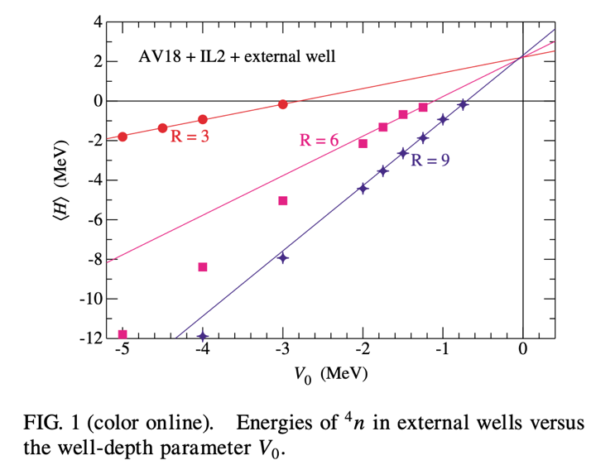

A 60-year quest
Theoretical calculations
Regarding a bound ⁴n:
“… our current very successful understanding of nuclear forces would have to be severely modified in ways that, at least to me, are not at all obvious.”
Regarding a ⁴n resonance state:
“This suggests that there might be a ⁴n resonance near 2 MeV, but since the GFMC calculation with no external well shows no indication of stabilizing at that energy, the resonance, if it exists at all, must be very broad. In any case, the AV18/IL2 model does not produce a bound ⁴n.”
AV18/IL2

Slide 13
A 60-year quest
Theoretical calculations, resonance or not?
(3n) Lazauskas, PRC 71 (2005) 044004 : 3NF
(4n) Lazauskas, PRC 72 (2005) 034003 : 4NF
(3,4n) Hiyama, PRC 93 (2016) 044004 : 3NF(T =3/2)
No, 3n/4n
Shirokov, PRL 117 (2016) 182502
Gandolfi, PRL 118 (2017) 232501
Fossez, PRL 119 (2017) 032501
Li, PRC 100 (2019) 054313
Yes, 3n/4n
Deltuva, PRL 123 (2019) 069201
Deltuva, PRC 100 (2019) 044002
Ishikawa, PRC 102 (2020) 034002
No, 3n/4n
non-resonant low-energy enhancement of the density of states in the four-neutron spectrum.
Deltuva, PLB 782 (2018) 238
Higgins, PRL 125 (2020) 052501
Lazauskas, PRL 130 (2022) 102501
non-resonant dineutron-dineutron correlations
“The differences among them must rather be found in the methods used to solve the few-nucleon problem and/or in the way they access the few-neutron continuum”: Eur. Phys. J. A (2021) 57:105

Slide 14
Latest Experimental work
SAMURAI at RIBF/RIKEN
“Observation of a correlated free four-neutron system”
Duer, M., et al. Nature 606, 678–682 (2022)

Slide 15
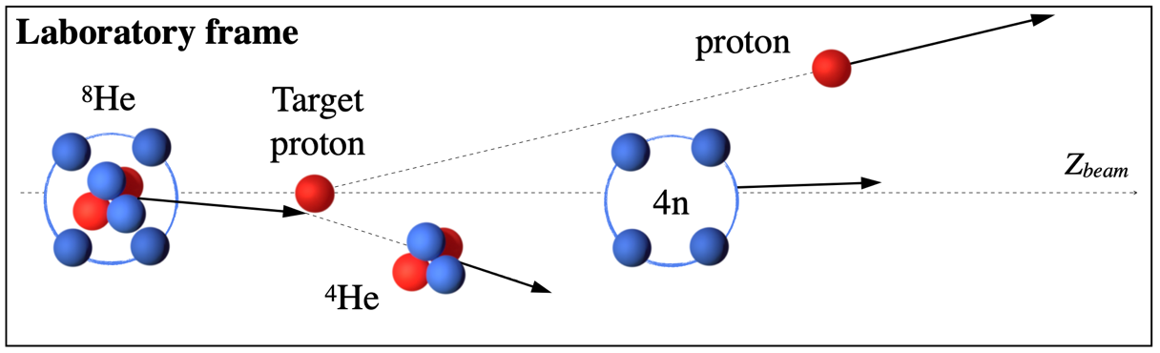
Method
⁸He(p,pα)⁴n Quasi-Elastic knockout reaction at large momentum transfer
Reconstruct the energy of the missing mass of the ⁴n system through the precise measurement of the charge particles involved in the reaction (p, α).
Basic principle: Don’t touch the neutrons !
Quasi-elastic scattering of α in ⁸He

Slide 16
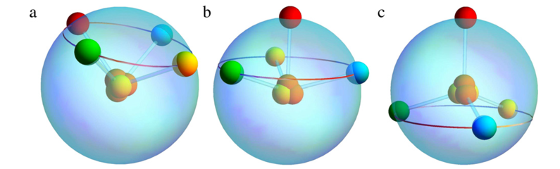
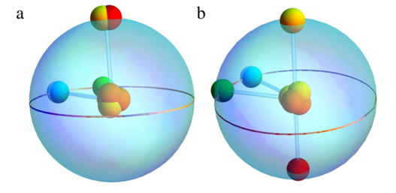
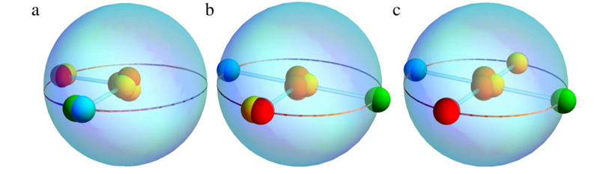
Method
⁸He(p,pα)⁴n Quasi-Elastic knockout reaction at large momentum transfer
⁸He a good starting point to populate a 4n system. Highest possible A/Z=4.
Well-formed α cluster. Large overlap < ⁸He | α ⊗ 4n >
Indeed, large alpha SF reported by L.V. Chulkov et al., NPA 759, 43 (2005)
Tetrahedral configurations
Great circle configurations
P. Mei, P. Van Isacker , Annals of Physics 327 (2012) 1182–1201

Slide 17
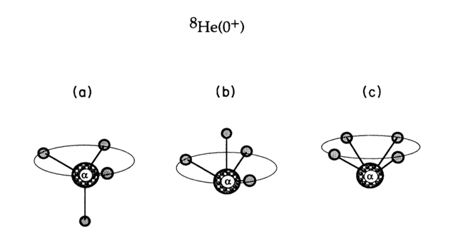
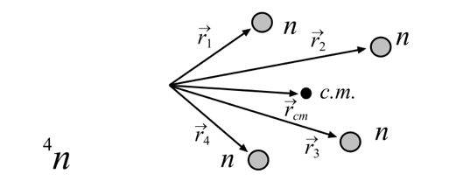
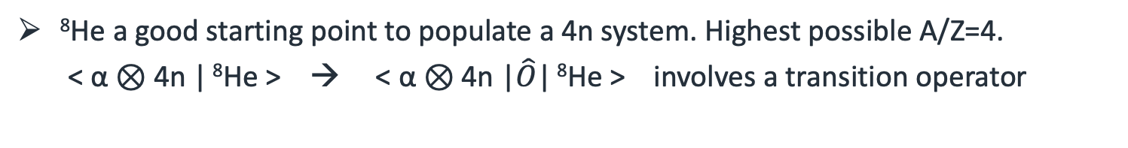
Method
⁸He(p,pα)⁴n Quasi-Elastic knockout reaction at large momentum transfer
⁸He a good starting point to populate a 4n system. Highest possible A/Z=4.
< α ⊗ 4n | ⁸He > → < α ⊗ 4n |$\hat{O}$| ⁸He > involves a transition operator
⁸He W.F. in the COSMA model
initial structure
reaction mechanism, and
final-state interaction (FSI)
Two of the three most probable configurations
found in ⁸He can be associated with a ⁴n system.
The probability for each of them is approx. 30%.
M.V. Zhukov, PRC 50, R1 (1994)
“Sudden removal of the α-particle from ⁸He”
The exact case of interest is studied within the COSMA model.
L.V. Grigorenko et al., EPJA 19, 187 (2004)

Slide 18
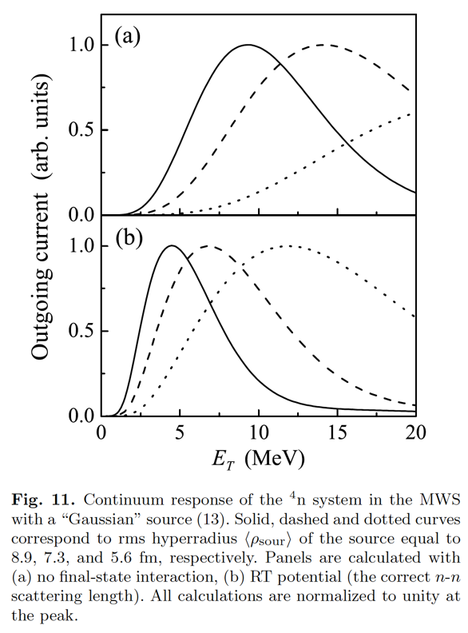
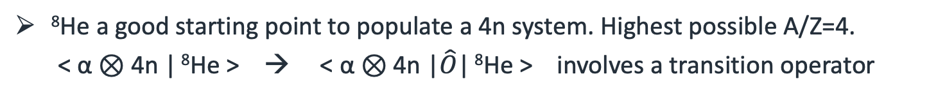
Method
⁸He(p,pα)⁴n Quasi-Elastic knockout reaction at large momentum transfer
⁸He a good starting point to populate a 4n system. Highest possible A/Z=4.
< α ⊗ 4n | ⁸He > → < α ⊗ 4n |$\hat{O}$| ⁸He > involves a transition operator
⁸He W.F. in the COSMA model
initial structure
reaction mechanism, and
final-state interaction (FSI)
Two of the three most probable configurations
found in ⁸He can be associated with a ⁴n system.
The probability for each of them is approx. 30%.
M.V. Zhukov, PRC 50, R1 (1994)
“Sudden removal of the α-particle from ⁸He”
The exact case of interest is studied within the COSMA model.
L.V. Grigorenko et al., EPJA 19, 187 (2004)

Slide 19
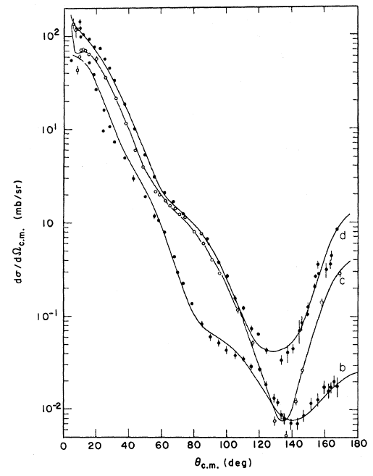
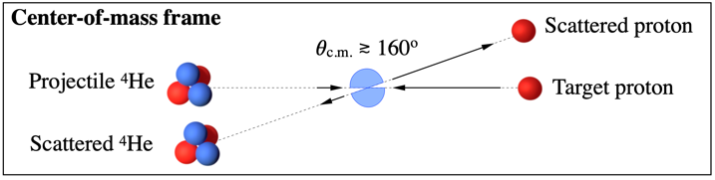

Method
⁸He(p,pα)⁴n Quasi-Elastic knockout reaction at large momentum transfer
(p, α) elastic scattering data is well known.
Quasi-elastic scattering of α in ⁸He
(p, α) elastic scattering
PRC12, 251 (1975)
85 MeV
d-sigma/d-Omega
100 MeV
156 MeV
Theta C.M.

Slide 20

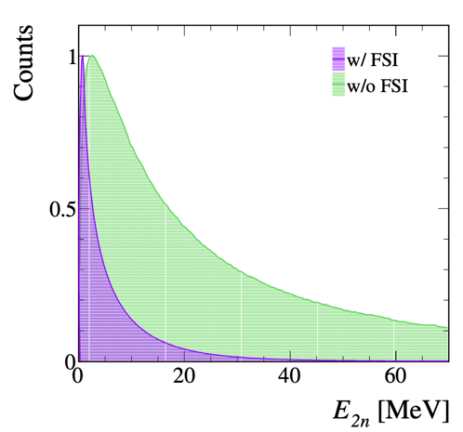
Method
⁸He(p,pα)⁴n Quasi-Elastic knockout reaction at large momentum transfer
Helium beams allow for a “control case” to be employed ⁶He(p,pα)²n !!
⁶He
2
Theory:
Göbel, M. et al., “Neutron-neutron scattering length from the ⁶He(p, pα)nn reaction”
PRC 104, 024001 (2021).

Slide 21
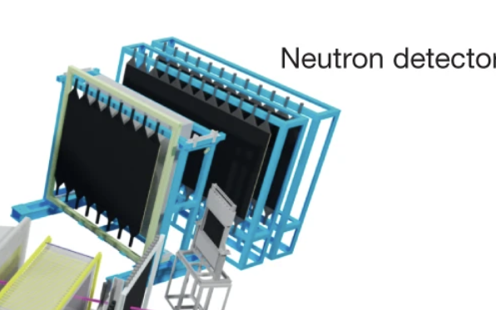
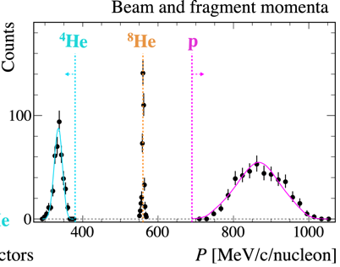

Experimental setup
SAMURAI at RIBF/RIKEN
400 + 120 scintillator bars
2x10⁵ pps ⁸He
7.5 Tm
2.1 Tm
3.2 Tm

Slide 22
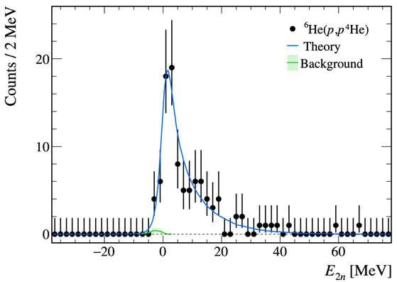

Results:
Missing-mass spectra
Control reaction - ⁶He(p,pα)²n
two-neutron system
Theory:
Göbel, M. et al., “Neutron-neutron scattering length from the ⁶He(p, pα)nn reaction”
PRC 104, 024001 (2021).
Göbel, M. et al.,
PRC 104, 024001 (2021)
Confirming the expected low-energy structure for of di-neutron
“Observation of a correlated free four-neutron system”
Duer, M., et al. Nature 606, 678–682 (2022)

Slide 23
Results:
Missing-mass spectra
Control reaction - ⁶He(p,pα)²n
two-neutron system
⁸He(p,pα)⁴n
four-neutron system
Confirming the expected low-energy structure for of di-neutron
A near-threshold resonance-like structure:
E_{r} = 2.37 ± 0.38(stat.) ± 0.44(sys.) MeV
Γ = 1.75 ± 0.22(stat.) ± 0.30(sys.) MeV
“Observation of a correlated free four-neutron system”
Duer, M., et al. Nature 606, 678–682 (2022)

Slide 24
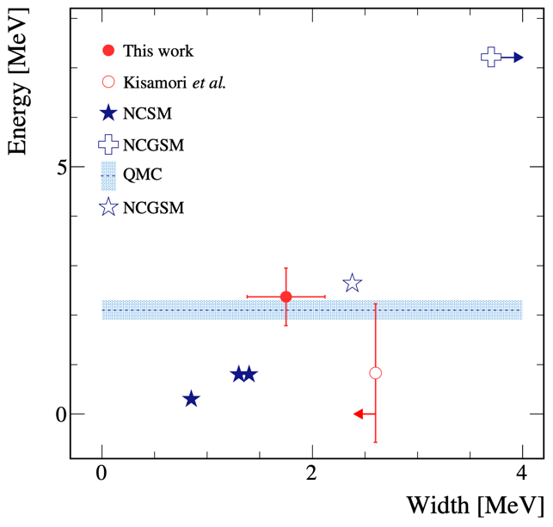
Comparison of experimental results with theory predictions
No-Core Shell Model (NCSM)
PRL 117, 182502 (2016)
No-Core Gamow Shell Model (NCGSM)
PRC 100, 054313 (2019)
PRL 119, 032501 (2017)
(where the blue arrow indicates that the width is predicted to be larger than 3.7 MeV)
Quantum Monte Carlo (QMC)
PRL 118, 232501 (2017)
E_{r} = 2.37 ± 0.38(stat.) ± 0.44(sys.) MeV
Γ = 1.75 ± 0.22(stat.) ± 0.30(sys.) MeV
Duer, M., et al. Nature 606, 678–682 (2022)
Notes:
No-Core Shell Model (NCSM)
Shirokov, A. M. et al. Prediction for a Four-Neutron Resonance. PRL 117, 182502 (2016)
No-Core Gamow Shell Model (NCGSM)
Li, J. G., Michel, N., Hu, B. S., Zuo, W. & Xu, F. R.
Abinitio no-core Gamow shell-model calculations of
multi-neutron systems.
PRC 100, 054313 (2019)
Fossez, K., Rotureau, J., Michel, N. & Płoszajczak, M.
Can Tetraneturon be a Narrow Resonance?
PRL 119, 032501 (2017)
where the blue arrow indicates that the width is predicted to be larger than 3.7 MeV
QMC:
Gandolfi, S., Hammer, H.-W., Klos, P., Lynn, J. E. & Schwenk, A.
Is a Trineutron Resonance Lower in Energy than a Tetraneutron Resonance? Phys. Rev. Lett. 118, 232501 (2017).

Slide 25
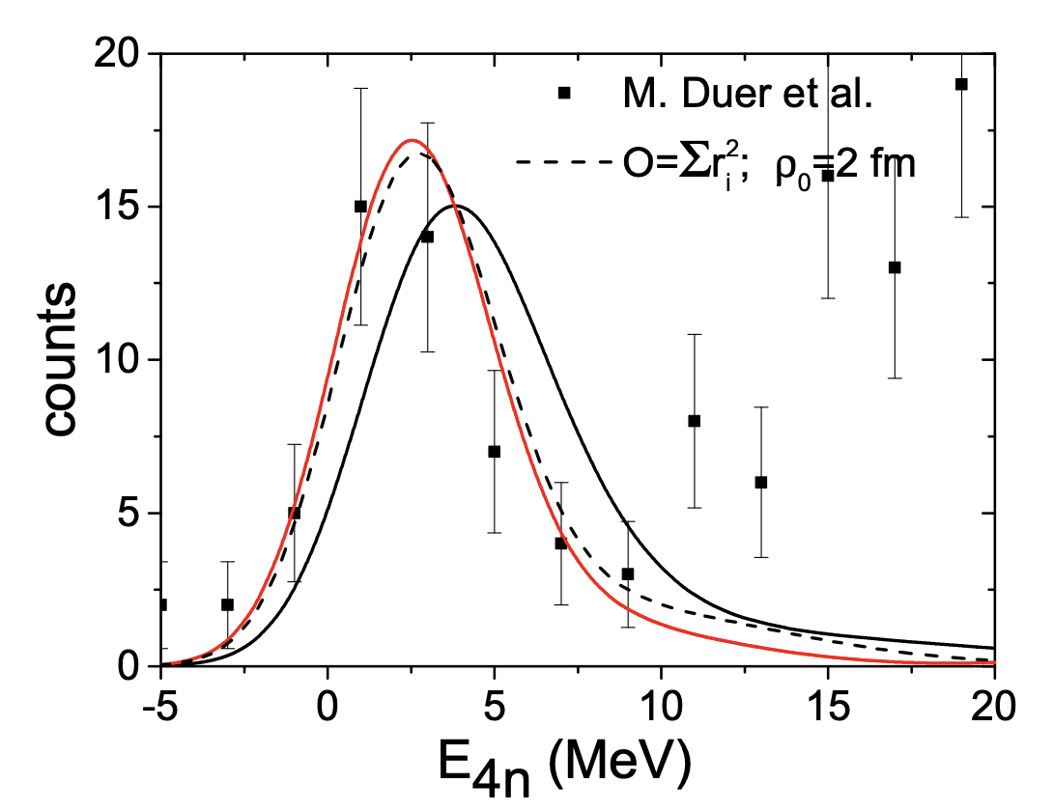
“Low Energy Structures in Nuclear Reactions with 4n in the Final State”
Lazauskas, PRL 130 (2023) 102501
“We show that these experimental results find a natural explanation in terms of the dineutron correlations in the final state, if the four neutrons are weakly bound in the initial projectile, forming a broad wave function.”
strong sensitivity of the response function to the neutrons’ initial distribution inside ⁸He
Dependency on how we populate & how we measure four neutrons
Requires two-dineutron correlations
as well as the presence of pre-existing two-dineutron clusters in the initial ⁸He state
Measuring the relative momentum amongst the neutrons should help resolve this
→ New experiment

Slide 26
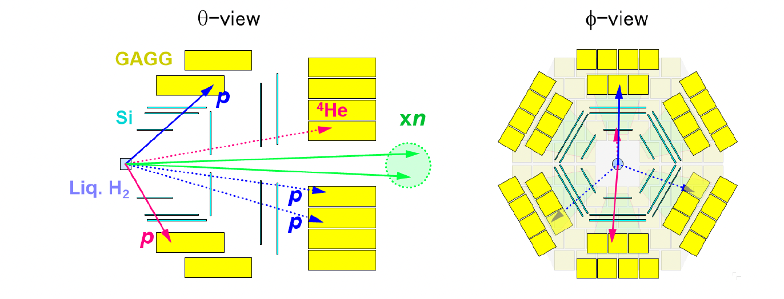
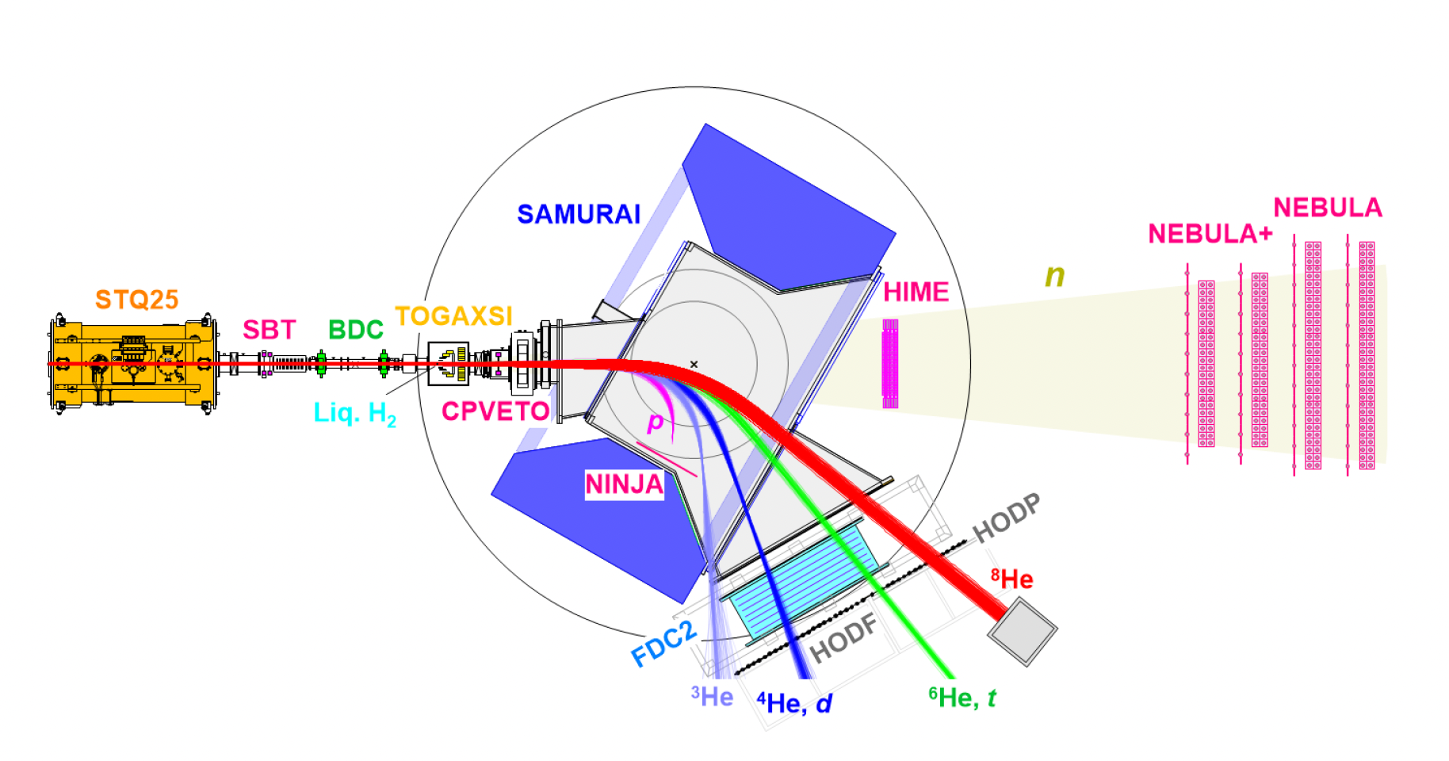
Accepted RIBF proposal SAMURAI74
(Kenjiro Miki & Meytal Duer)
⁸He(p, pα)4n
⁶He(p, 3p)4n and ⁸He(p, 3p)6n
complementary reactions & 4n in coincidence for direct relative momentum measurement
d-sigma/d-Omega
TOGAXSI
Theta C.M.
HIME
HIME
NEBULA
NEBULA+
4n detection Eff. ~ 0.9%

Slide 27
Accepted GANIL proposal
The tetra-neutron Isobaric Analog State in ⁴H
(Augusto Macchiavelli & Marlène Assié)
LISE beam line
- CATS multiwire proportional chambers
- MUGAST array covering from 5 to 30 degrees
- Additional MUST2 detector at 0 degree
Populate the IAS of the n⁴ in ⁴H via the ⁶He(p,³He)⁴H reaction
ΔT =0,1 changes are allowed
Selective ³He + p (from ⁴H decay) trigger due to isospin selection rules

Slide 28
Summary and Conclusions
experimental observation of a four-neutron resonance-like structure near threshold.
⁸He beam and a quasi-elastic (p,pa) reaction at large momentum transfer in inverse kinematics enabled access to the ⁴n system in a recoil-less way.
The finely tuned experimental apparatus (SAMURAI setup) and the high intensity radioactive beams provided by RIBF enabled a high-resolution measurement yielding a low-energy peak with a statistical significance well beyond the 5σ level.
Next generation experiments approved - where four neutron system is accessed in different ways and where all four neutrons are detected in coincidence.
elaborate nuclear theories accounting fully for the effect of the continuum and modelling the exact nuclear reaction are essential to understand the observed low-energy peak.

Slide 29
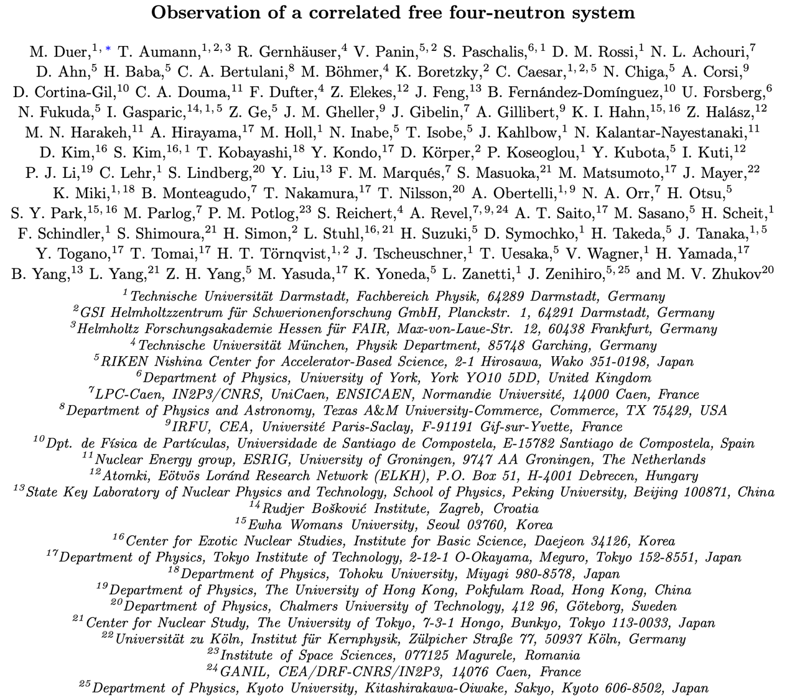
Thank you !!

Slide 30
Backup slides

Slide 31
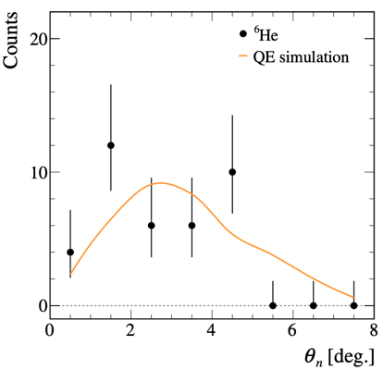
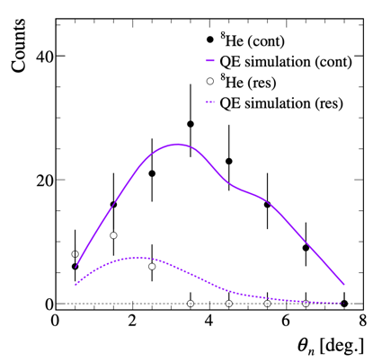
Neutron detection
Events with one neutron in coincidence are
consistent with expected distributions
⁶He(p,pα)²n
⁸He(p,pα)⁴n
Duer, M., et al. Nature 606, 678–682 (2022)

Slide 32
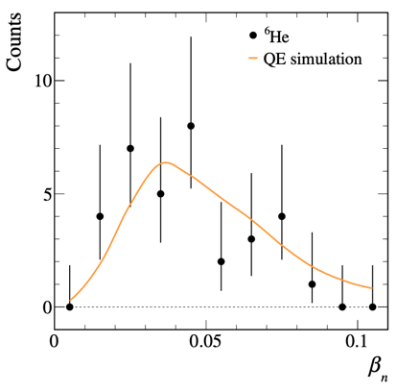
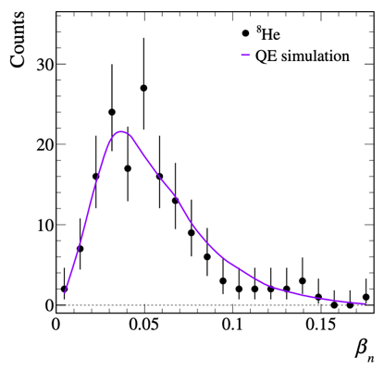
Neutron detection
Events with one detected neutron are
consistent with expected distributions
⁶He(p,pα)²n
⁸He(p,pα)⁴n
Duer, M., et al. Nature 606, 678–682 (2022)

Slide 33
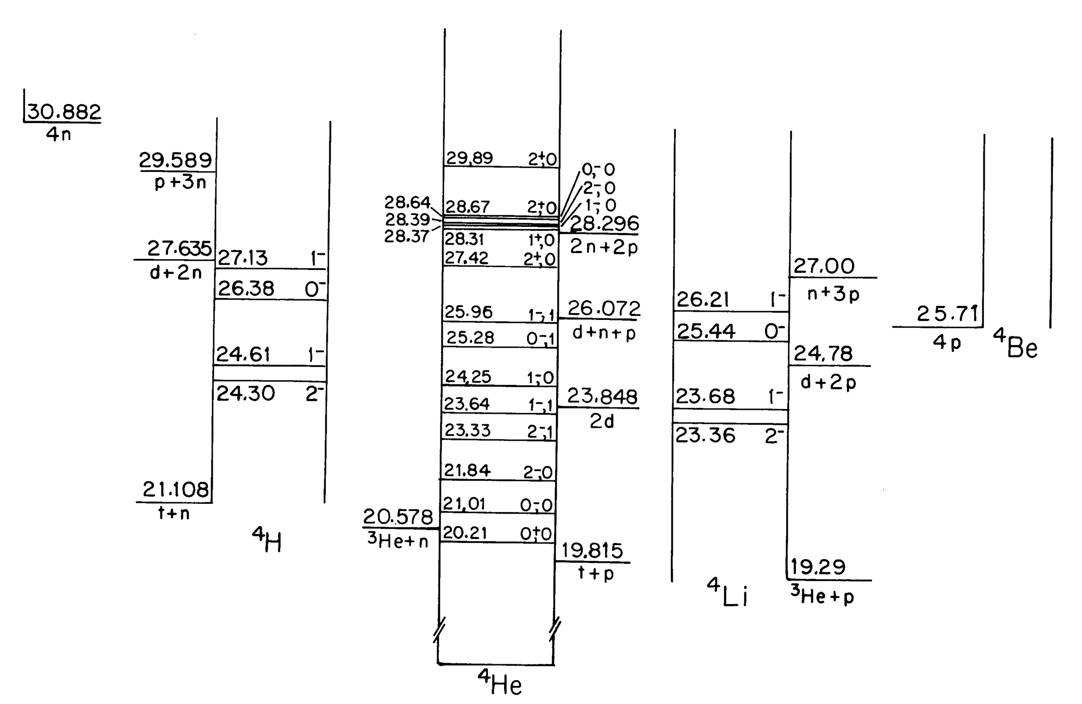
A=4 Isobaric Analog States - IAS

Slide 34
Nuclear Forces
is known to be just unbound by only about 100 keV
Two-nucleon Systems:
T_{z}=-1
T_{z}=0
T_{z}=+1
R. Guardiola, PRL 84, 1144 (2000)
Spin^{π} =0⁺
T=1
Di-proton
Di-neutron
T=0
Spin^{π} =1⁺
Deuteron ground state
proton-proton proton-neutron neutron-neutron
few-body fermionic systems
T = 3/2 component of three-nucleon forces
coupling to the continuum
Notes:
Direct scattering experiments between two neutrons are impossible to perform due to the lack of a stable neutron target. The scattering length, ann, in the 1S0 singlet state is large and negative, indicating no bound di-neutron system.

Slide 35
Low Energy Structures in Nuclear Reactions with 4n in the Final State
Lazauskas, PRL 130 (2022) 102501
“complement the analysis of the ⁸He(p, p⁴He)4n reaction, by addressing shortcomings of the COSMA model in three essential ways”:
implementing a realistic description of the 8He valence neutron distribution,
implementing a rigorous dynamics for the four-neutron break-up, and
considering the interaction between valence neutrons in full extent and retaining consistency between the multineutron Hamiltonians before and after the α-particle removal.
We show that
these experimental results find a natural explanation in
terms of the dineutron correlations in the final state, if the
four neutrons are weakly bound in the initial projectile,
forming a broad wave function.
“Low energy structures in nuclear reactions with 4n in the final state”
? Dependency on:
how we produce it &
how we measure it
strong sensitivity of the response function to the neutrons’ initial distribution inside ⁸He

Slide 36
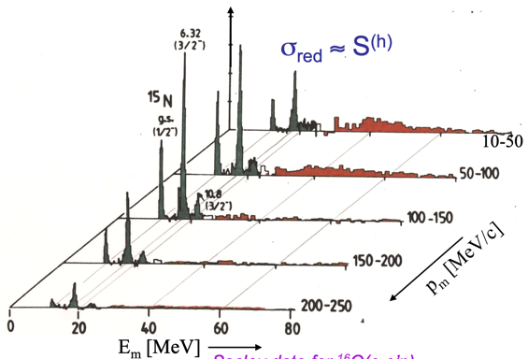
Method
⁸He(p,pα)⁴n Quasi-Elastic knockout reaction at large momentum transfer
Large momentum transfer minimizes final state interactions between the 4n and the (p, α).
Quasi-elastic scattering of α in ⁸He
Spectral function:
distribution of mom. (p_{m}) and energies (E_{m})
Minimizing FSI at larger mom. transfer: ¹⁶O (e,e’p)
J. Mougey, Nucl. Phys. A335 (1980) 35.

Slide 37
Acknowledgements
DFG, German Research Foundation Project-ID 279384907 - SFB 1245
the GSI-TU Darmstadt cooperation agreement,
by the UK STFC under contract numbers ST/P003885/1 and 9
ST/L005727/1 and the University of
York Pump Priming Fund,
BMBF projects No. 05P15RDFN1, 05P15WOFNA, and 05P15WOCIA, by
Project FAIR- RO-04/DEMAND - IFA,
by JSPS KAKENHI Grant No. JP16H02177, JP16H02179, and JP18H05404„
by the Spanish Research grant PGC2018-099746-B-C21, and by the
Swedish Research Council, project grant 2011-5324 and 2017-03839.
IBS grant funded by the Korea government grant No. IBS-R031-D1.
acknowledges partial support by the US DOE grant No. DE-FG02- 08ER41533.
HIC for FAIR and Croatian Science Foundation under projects No. 1257 and 7194. Z. E., Z. H.,
by NKFIH grants No. 114454, 128947 and GINOP-2.3.3-15-2016-00034

Slide 38
Structure of ⁸He
COSM + Gamow
alpha + 4n, like with COSM, but using Gamow basis, continuum coupling etc..
Shows enhanced probability to find the four neutrons at the same side
Two-body neutron density plots
G. Papadimitriou, private communication
…(COSM + Gamow) is a pure structure method. It is not the decay of 4 neutrons from ⁸He. We need appropriate many-body scattering boundary conditions for this. However, there is indeed a correlation, but we cannot say if there is a preformataion amplitude before decay. The calculations for this plot is from phenomenological COSM + Gamow basis model using a central interaction (Minnesota). Calculations for the 4n with Robert is from ab-initio using realistic interactions…
Relevant to G. Papadimitriou et al., PRC 84, 051304(R) (2011), and his PhD Thesis

Slide 39

Overlap of the ⁴n wavefunction with that of the residual 4n system emerging from ⁸He
The ⁸He WF has been considered within the COSMA model:
a simple five-body cluster orbital shell model approximation
initial structure
reaction mechanism, and
final-state interaction (FSI)
Two of the three most probable configurations
found in ⁸He can be associated with a ⁴n system.
The probability for each of them is approx. 30%.
M.V. Zhukov, PRC 50, R1 (1994)
“Sudden removal of the α-particle from ⁸He”
The exact case of interest is studied within the COSMA model.
L.V. Grigorenko et al., EPJA 19, 187 (2004)

Slide 40
Overlap of the ⁴n wavefunction with that of the residual 4n system emerging from ⁸He
The ⁸He WF has been considered within the COSMA model:
a simple five-body cluster orbital shell model approximation
initial structure
reaction mechanism, and
final-state interaction (FSI)
Transformation of ⁸He WF into the 4-n c.m. system with proper anti-symmetrization indeed has a significant l = 0 component as the expected for the ⁴n ground-state configuration.
Two of the three most probable configurations
found in ⁸He can be associated with a ⁴n system.
The probability for each of them is approx. 30%.
M.V. Zhukov, PRC 50, R1 (1994)

Slide 41
Overlap of the ⁴n wavefunction with that of the residual 4n system emerging from ⁸He
source function : overlap between the ⁸He and α-particle wave functions. The source function results from a representation of the wave function in the internal variables of the four-neutron system (hyperradius of 4n, angles and hyperangles of 4n), and apha-4n relative motion and a proper transformation of the ⁸He wave function to the valence-neutron c.m. coordinates.
initial structure
reaction mechanism, and
final-state interaction (FSI)
“Sudden removal of the α-particle from ⁸He”
The exact case of interest is studied within the COSMA model.
L.V. Grigorenko et al., EPJA 19, 187 (2004)

Slide 42
Prelim. ab-initio calculations to estimate the width and energy of the ⁴n system
This slide had been prepared for the
NP1406-SAMURAI19 PAC meeting
Extrapolation of bound state methods
  no information about the width
  very similar real energy with JISP16 and with AV18+IL7 (S. C. Pieper, PRL90, 252501 (2003))
NC-GSM with JISP16
  Wood–Saxon basis for s_{1/2}, p_{3/2}, p_{1/2}
  truncated HO basis for higher ang. mom.
NCSM + J-matrix with JISP16
  calculate phase shifts corresponding to a 4-body decay
  extract pole position in complex plane
Material by: P. Maris, A.I. Mazur, I.A. Mazur, G. Papadimitriou, R. Roth, A.M. Shirokov, J.P. Vary

Slide 43
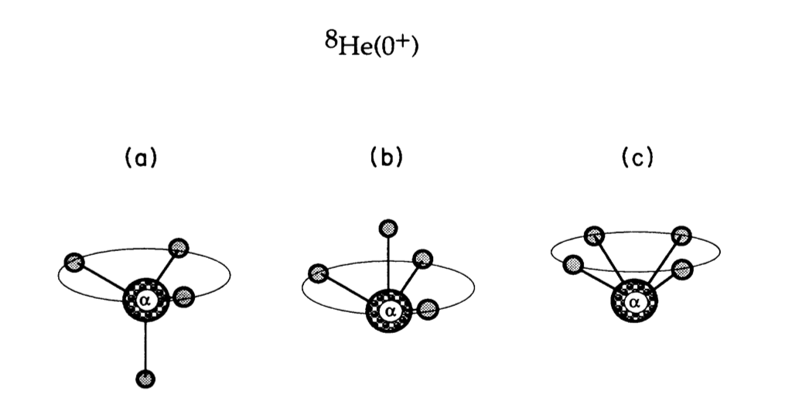
Structure of ⁸He
five-body Hamiltonian in the Hartree-Fock-Bogoliubov approximation.
The ⁸He WF has been considered within the COSMA,
a simple five-body cluster orbital shell model approximation
Critisism:
… where the authors constructed the ground state
wave function by assuming that the four neutrons occupy the 1p_{3/2} state in a harmonic oscillator potential. However, this model is too simplistic, since it completely neglects the pairing correlation and the continuum couplings….
........pairing leads to strong dineutron structure in ⁸He
Two of the three most probable configurations
found in ⁸He can be associated with a ⁴n system.
The probability for each of them is approx. 30%.
M.V. Zhukov, PRC 50, R1 (1994)
K. Hagino, N. Takahashi, and H Sagawa
PRC 77, 054317 (2008)

Slide 44
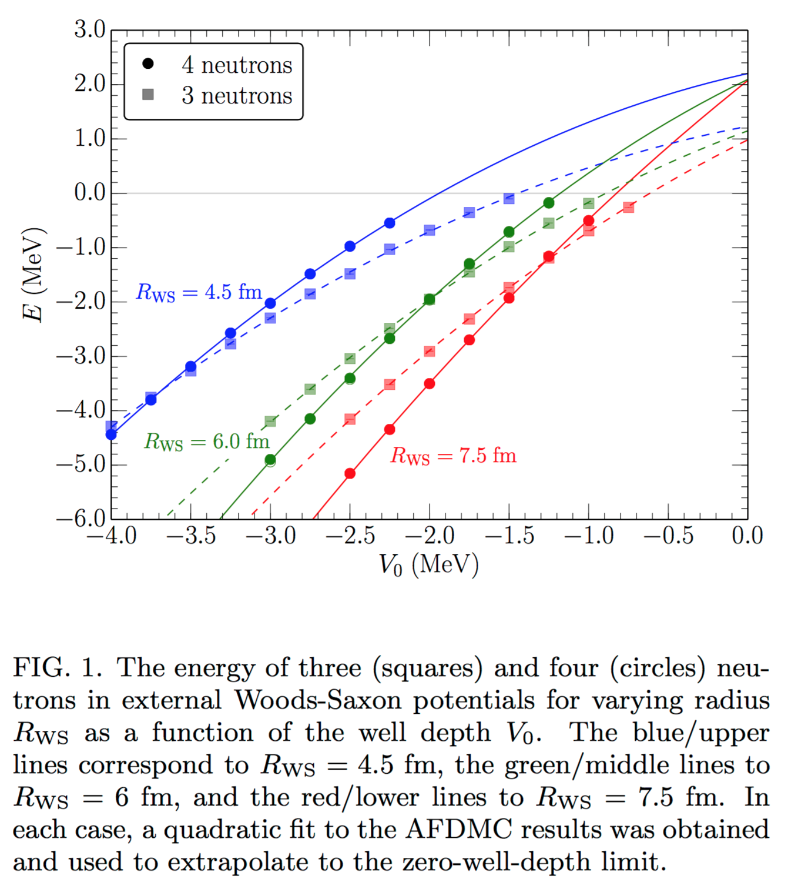
recent theoretical studies
Is a trineutron resonance lower
in energy than a tetraneutron resonance?
Prediction for a Four-Neutron Resonance
A. M. Shirokov et al., PRL 117, 182502 (2016)
S. Gandolfi et al.,
arXiv:1612.01502v1 [nucl-th] 5 Dec 2016
“The respective 4n resonance at E_{r} = 0.844 MeV and width Γ = 1.378 MeV appears consistent with what is expected from directly inspecting the 4n phase shifts and what is predicted to be seen experimentally.”
NCSM + J-matrix with JISP16
Possibility of generating a 4-neutron resonance with a T = 3/2 isospin 3-neutron force
E. Hiyama et al., PRC 93, 044004 (2016)
“In conclusion, we were not able to validate the recent observation of a 4n signal as related to the existence of resonant 4n states.”
Quantum Monte Carlo with
N²LO chiral EFT

Slide 45


Slide 46

N = 4
https://people.physics.anu.edu.au/~ecs103/chart/

Slide 47


Slide 48

Very light nuclei
Systematics – SEMF
If one naively uses best fitted parameters from
the entire nuclear chart:
  a_{V} =15.5MeV
  a_{S} =16.8MeV
  a_{C} =0.72MeV
  a_{asym} =23.0MeV and
  δ = ±11 A^{-1/2} MeV or 0
B/A = - 15 MeV
Figures by F.M. Marques

Slide 49
Nuclear landscape
Light nuclei
N = 4
The system made of two neutrons, the di-neutron, is known to be unbound by only about 100 keV.
2n?

Slide 50
NN interaction
Delicate balance
Nature of the interactrion is such that deuteron is bound in T=0 channel and
Then resonance for the nn
Could 3-body give rise to enhanced stability…
T=3/2
Paper by Ben Bayman
Then proceed with experimental history, some theory prediction
Cabonelli

Slide 51

Nuclear Forces
Two-nucleon Systems
Deuteron excited
resonant state
Di-proton
Di-neutron
Spin/parity =0⁺
Deuteron ground state
Spin/parity =1⁺
proton-proton proton-neutron neutron-neutron
Notes:
Direct scattering experiments between two neutrons are impossible to perform due to the lack of a stable neutron target. The scattering length, ann, in the 1S0 singlet state is large and negative, indicating no bound di-neutron system.

Slide 52
A 60-year quest
Experimental work – GANIL – 2002
C (¹⁴Be, ¹⁰Be) 4n
¹⁴Be breakup on a carbon target
The 6 events are consistent with bound ⁴n or a low-energy resonance (E<2 MeV)
F.M. Marques et al., PRC 65, 044006 (2002) and arXiv:nucl-ex/0504009.

Slide 53
A 60-year quest
Experimental work – RIKEN – SHARAQ/RIBF – 2016
⁴He (⁸He, ⁸Be) ⁴n
Double charge exchange reaction
4 events in the region 0 - 2MeV consistent with the formation of a tetraneutron resonance at E(4n) = 0.8 ± 1.3 MeV, Γ < 2.6 MeV
K. Kisamori et al., PRL 116, 052501 (2016)

Slide 54
A 60-year quest
Experimental work – TUM – 2022
“Indications for a bound tetraneutron”
⁷Li(⁷Li,¹⁰C) ⁴n
Multi-nucleon transfer
Two possible explanations:
  a ⁴n state unbound by 2.93 MeV and an extraordinarily small width (Γ < 0.24 MeV)
  the ¹⁰C is in the first excited state and the 4n has a bound state with a binding energy of BE=+0.42(16) MeV
Thomas Faestermann et al., PLB 824 (2022) 136799

Slide 55


Experimental setup
SAMURAI at RIBF/RIKEN
Precise vertex reconstruction
incoming ⁸He beam from BigRIPS
Si tracker: TU Munich & SAMURAI
⁴He
alphas
p
Liq. H₂ (5 cm)
fast protons
⁸He
100 um thick SSDs
100 um pitch
Readout by the APV ASIC
neutrons

Slide 56



Experimental setup
SAMURAI at RIBF/RIKEN
Reaction vertex reconstruction
Precise vertex reconstruction
<0.2 mm
Si tracker: TU Munich & SAMURAI
⁴He
p
Liq. H₂ (5 cm)
100 um thick SSDs
100 um pitch
Readout by the APV ASIC
MINOS LH₂ target

Slide 57

Observation of a correlated free four-neutron system
Duer, M., et al. Nature 606, 678–682 (2022)
Dad, my TikTok videos have way more views than this
Oh, we have two talks for something that does not exist!
GRC 2023 participants

