Slide 1
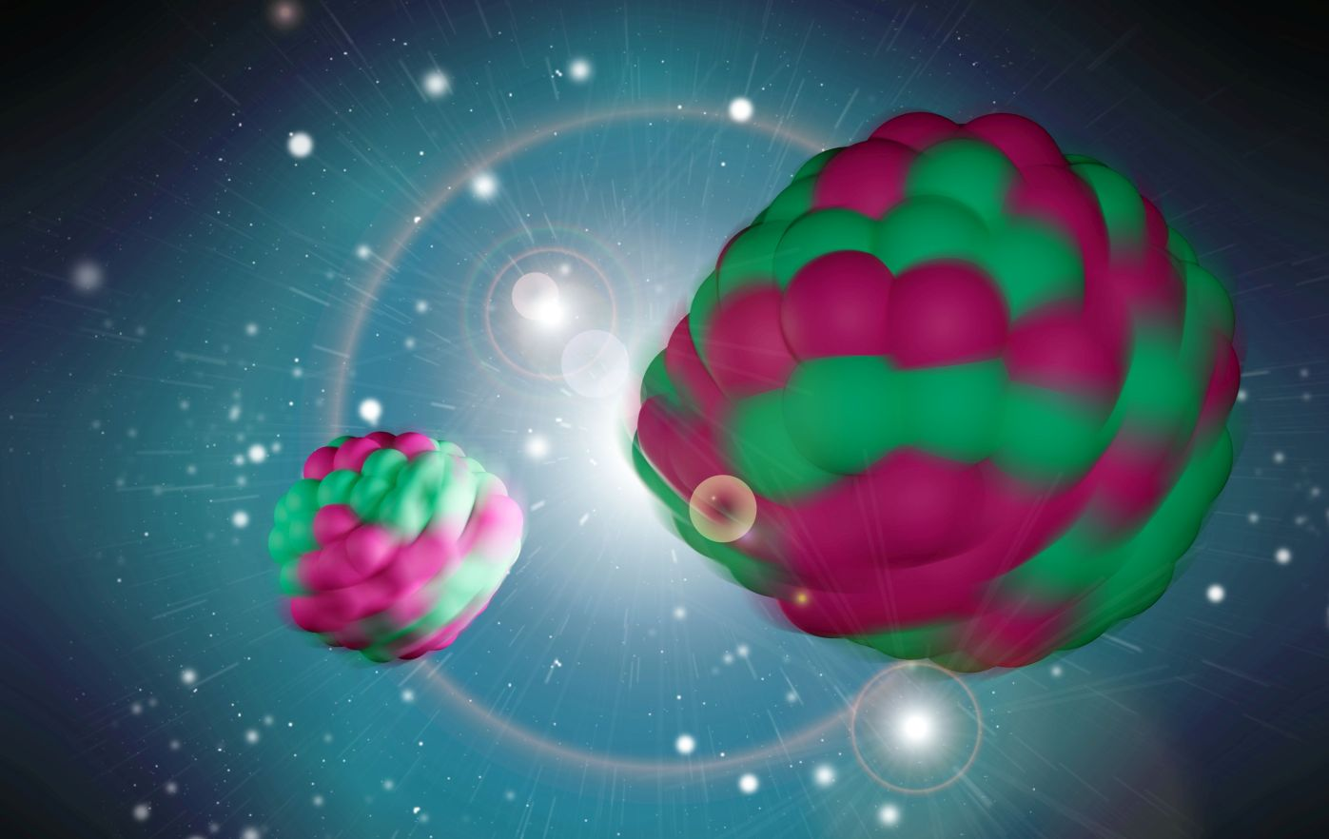
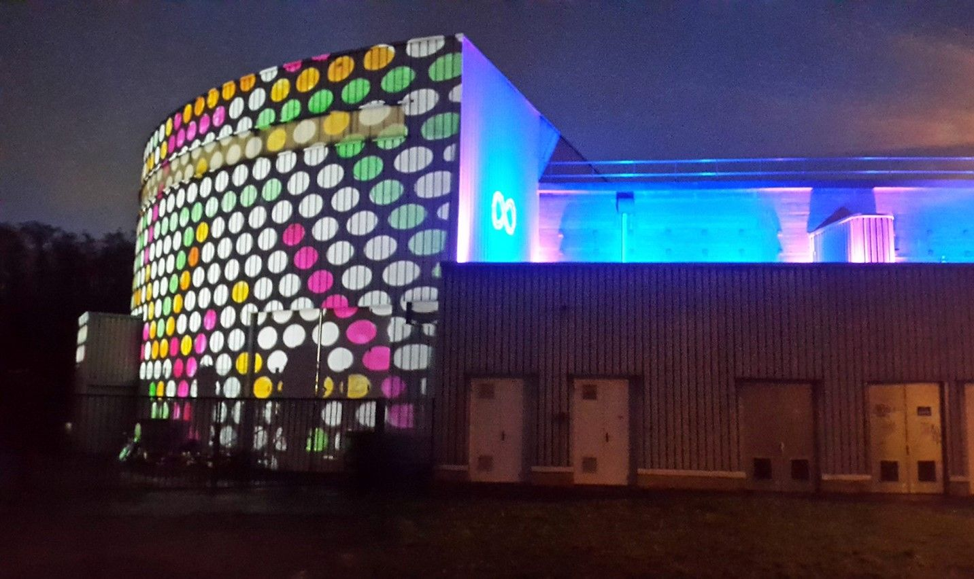
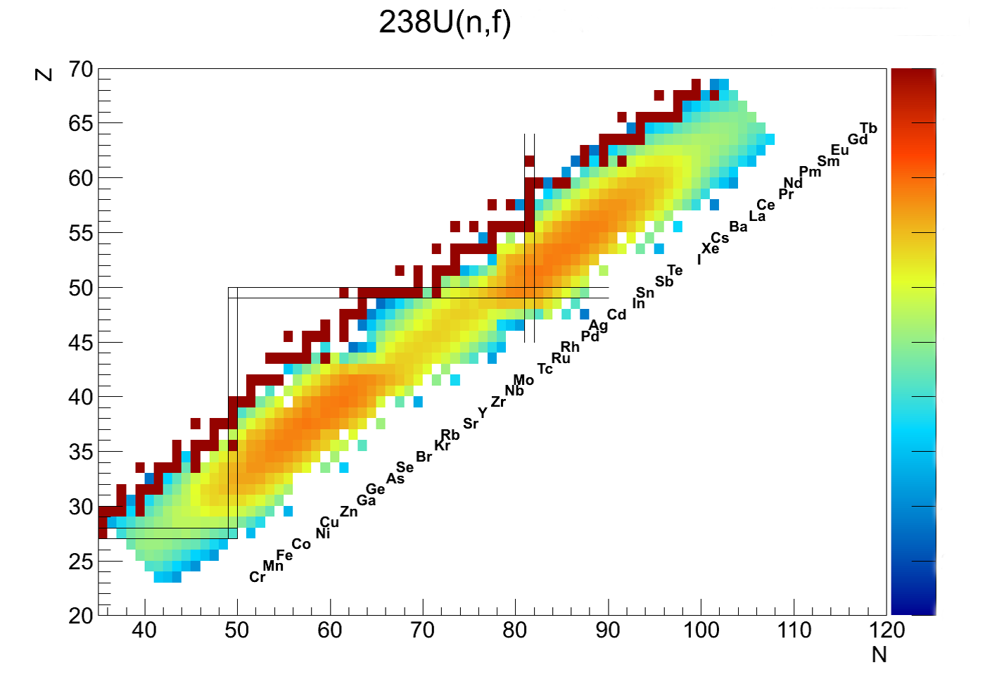
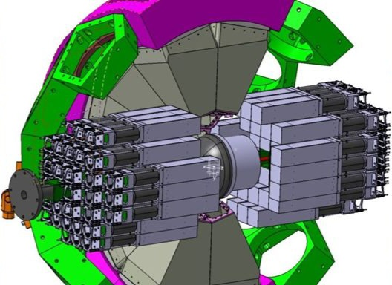


Gamma ray spectroscopy of nuclear fission at ALTO and NFS
J.N. Wilson, IJC Lab, Orsay
Oslo Workshop 10/05/22
C. Hiver, G. Pasqualato
G. Charles, I. Matea, J. Ljungvall,
A. Lopez-Martens, K. Hauschild,
M. Lebois, K. Stoyachev
+ the nu-Ball2, FATIMA, PARIS +
Warsaw DSSD collaborations
J.N. Wilson, IJC Lab
Image: L. Petizon
The ALTO facility of IJC Lab

Slide 2
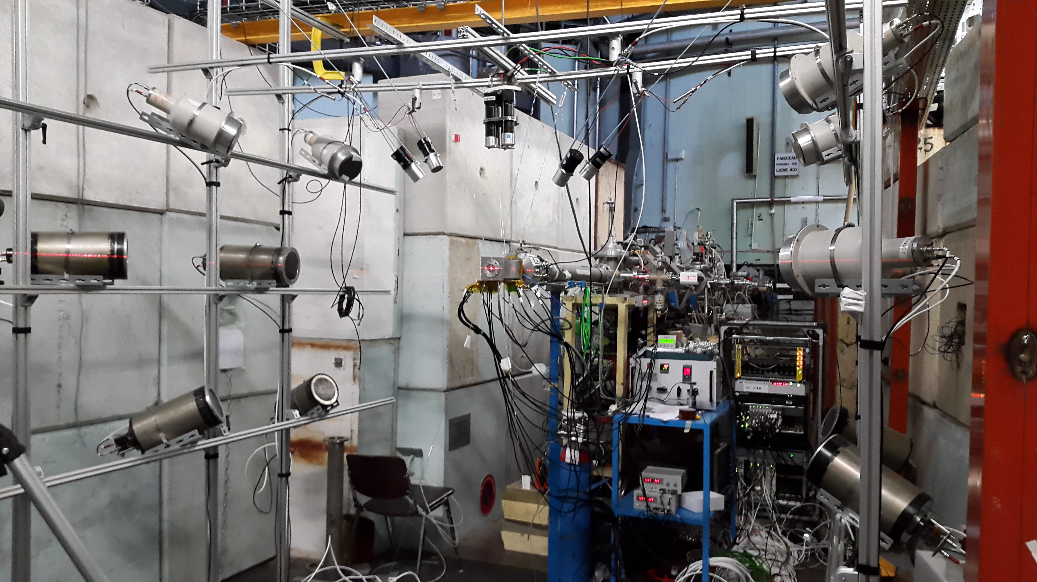
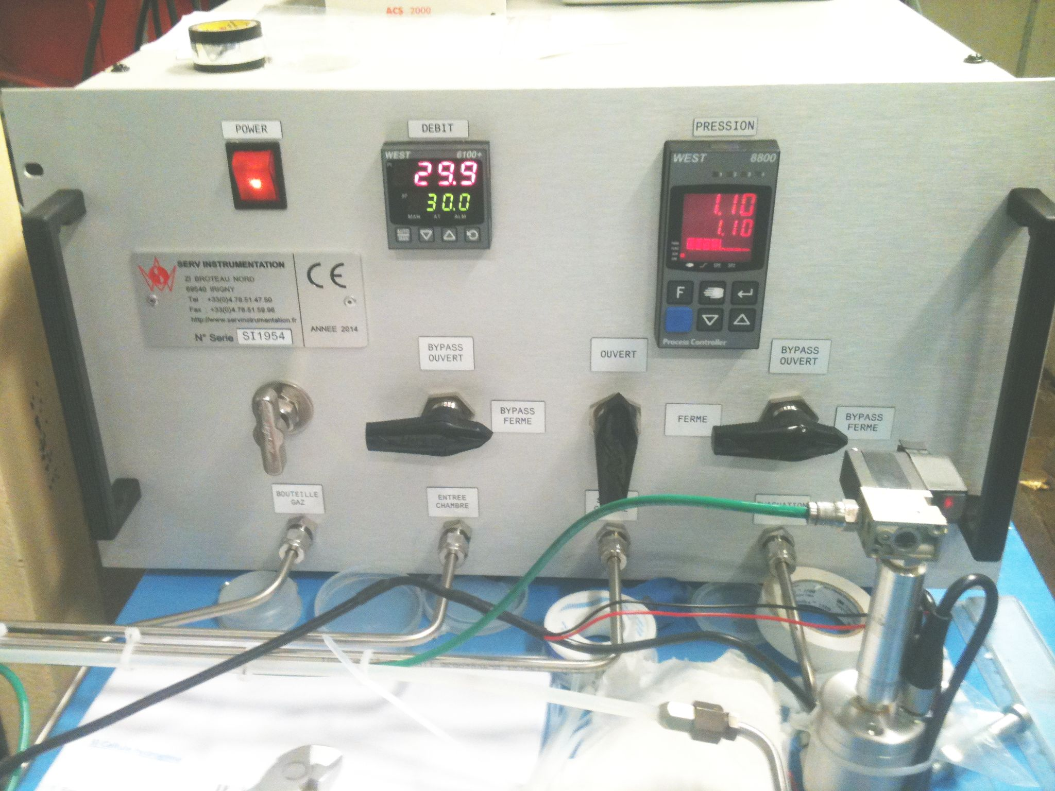
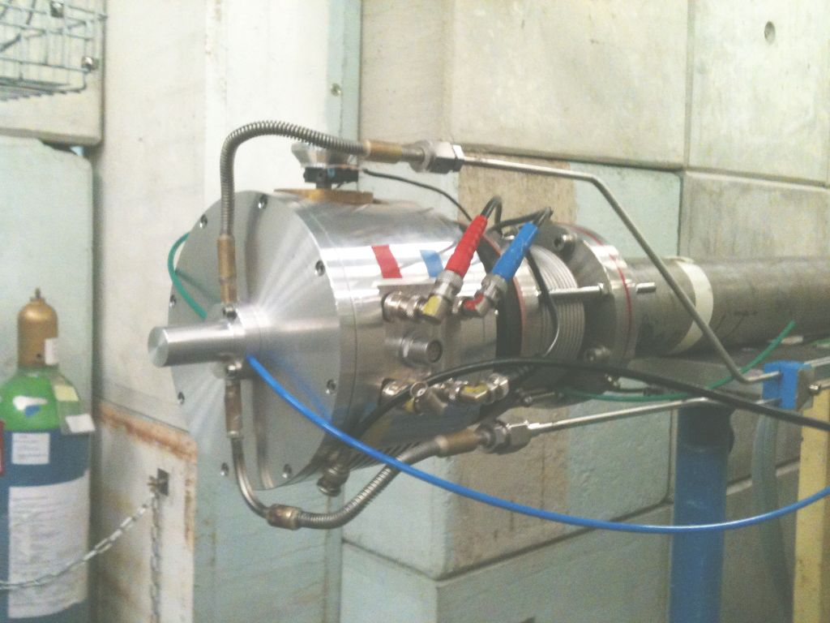
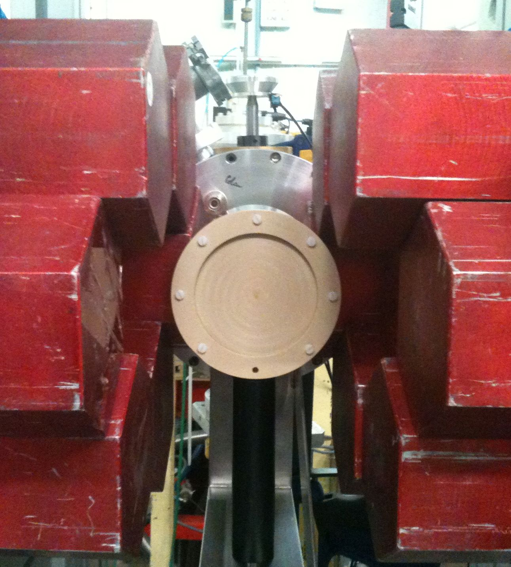
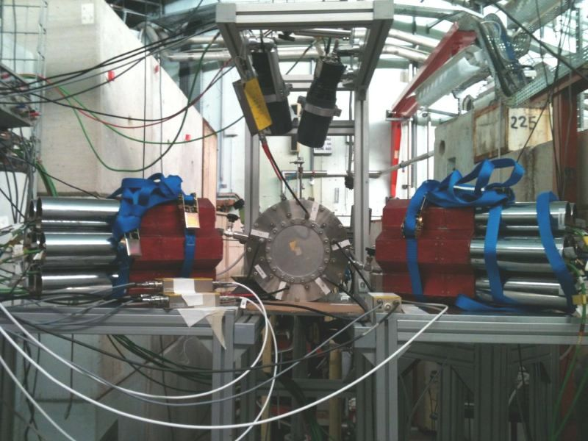
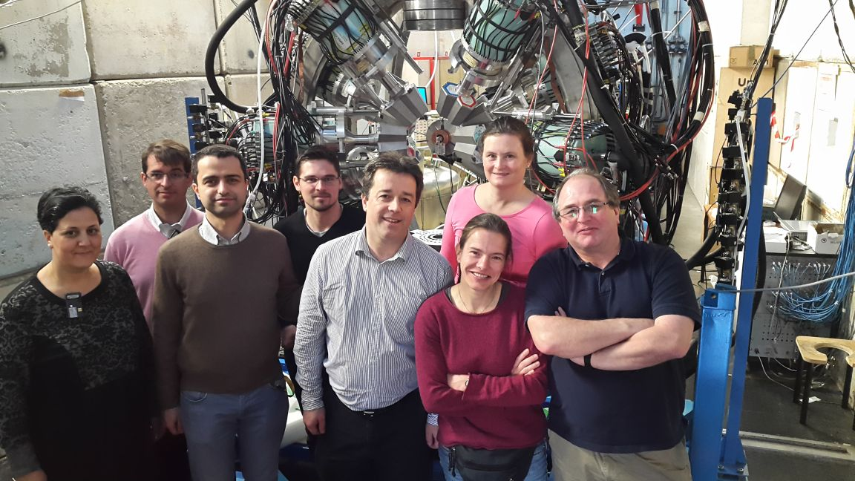
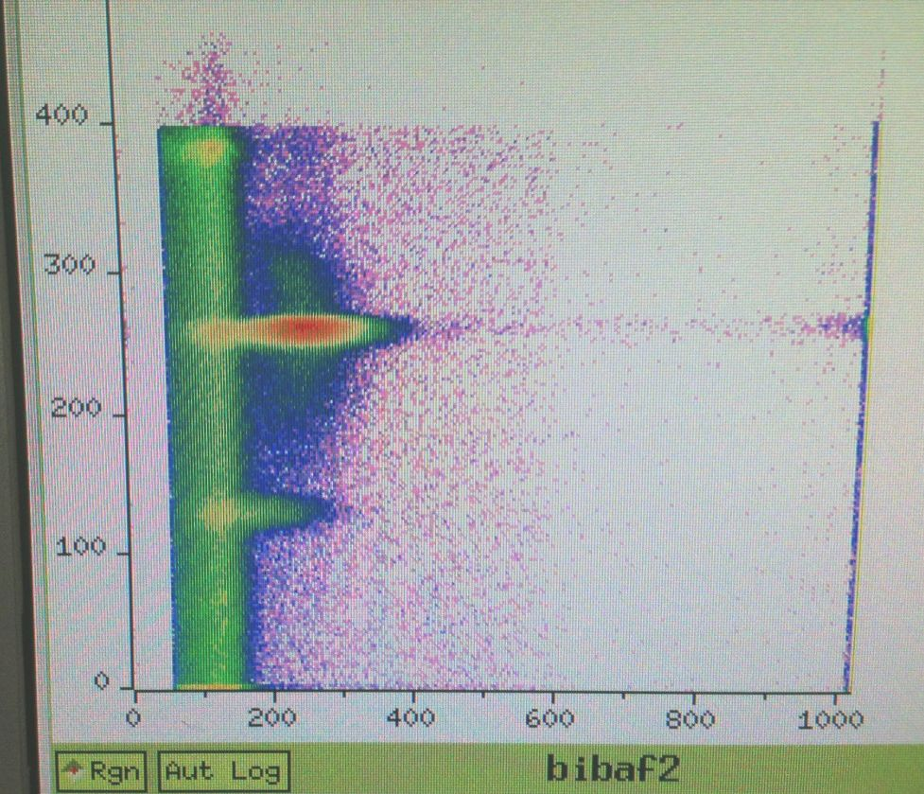
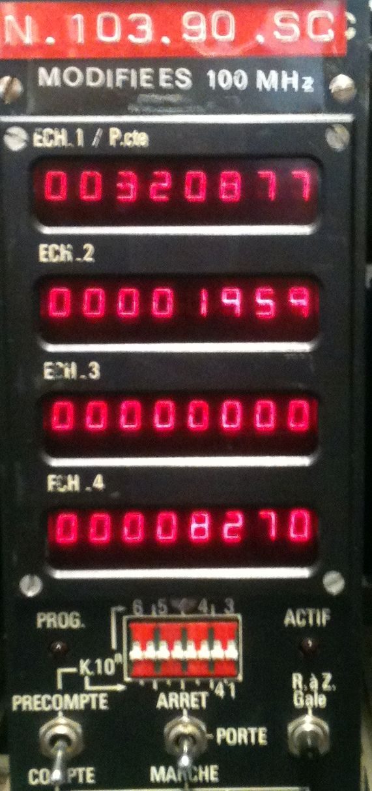
10 years of LICORNE@ALTO
Study of prompt emission in fission
Fast neutron tomography
Dark matter TPC tests
(33 publications, 8 Ph.D theses since 2013)

Slide 3
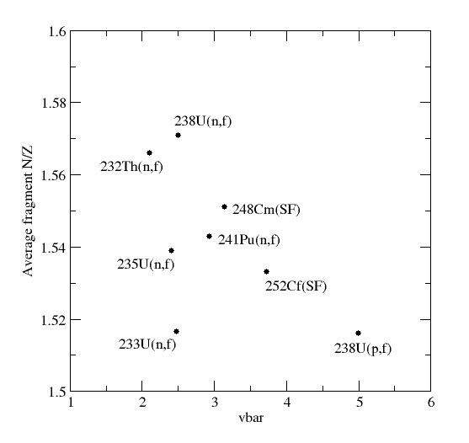

Why do spectroscopy of neutron induced fission?
The most neutron rich production mechanisms available ²³²Th(n,f) and ²³⁸U(n,f)
Fragments stop in 1-2ps in dense actinide material
Hence high resolution gamma ray spectroscopy in direct kinematics is possible
v/c = 0 gives the ultra-high resolving power of Ge intrinsic resolution
$R\text{∝}$ $\frac{1}{{(ΔE)}^{3}}$
But all fragments produced together
Exoticity
Too hot!
Complementary technique to inverse kinematics

Slide 4
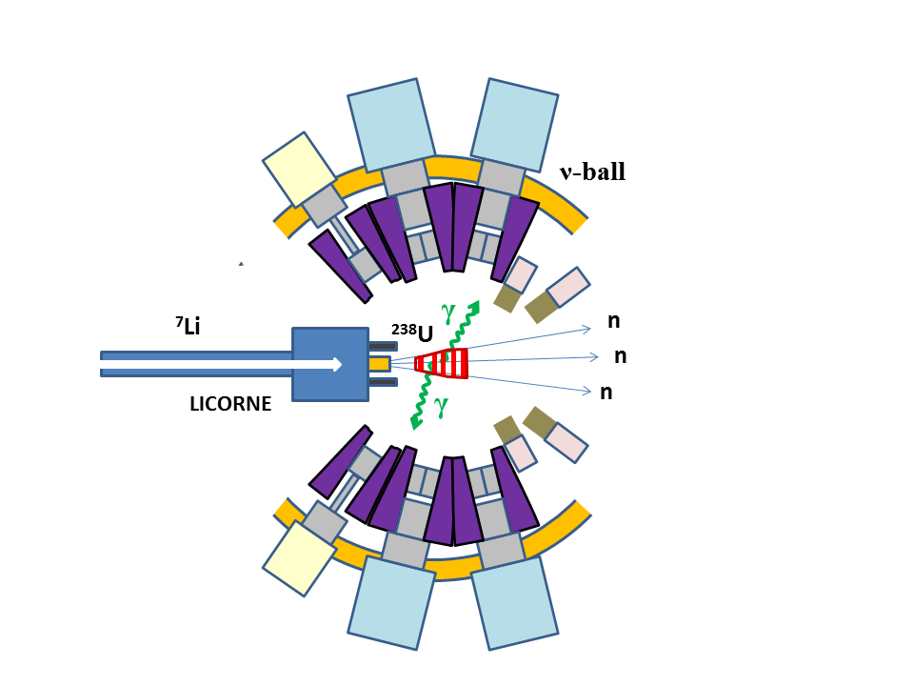
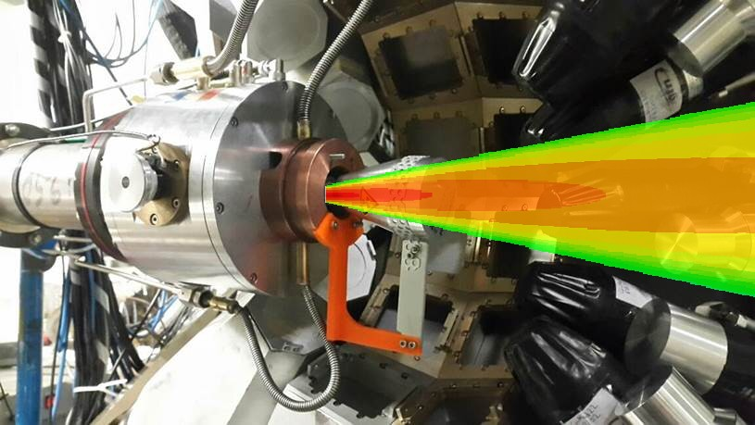
LICORNE/ν-ball coupling principle
LICORNE: The unique inverse kinematics neutron source of the ALTO facility
Primary beam (400ns – pulsed)
2 x 10¹¹ /s
Samples
Secondary beam
2 x 10⁷ /s
Gas target
up to 10⁵ fissions/s
⁷Li (16 MeV)
H₂
1.5 MeV neutrons
²³⁸U
²³²Th
~100 g
200 nA
3 x 10²⁰ atoms/cm²

Slide 5
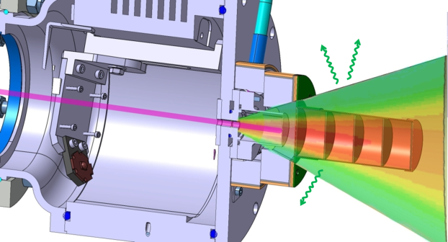
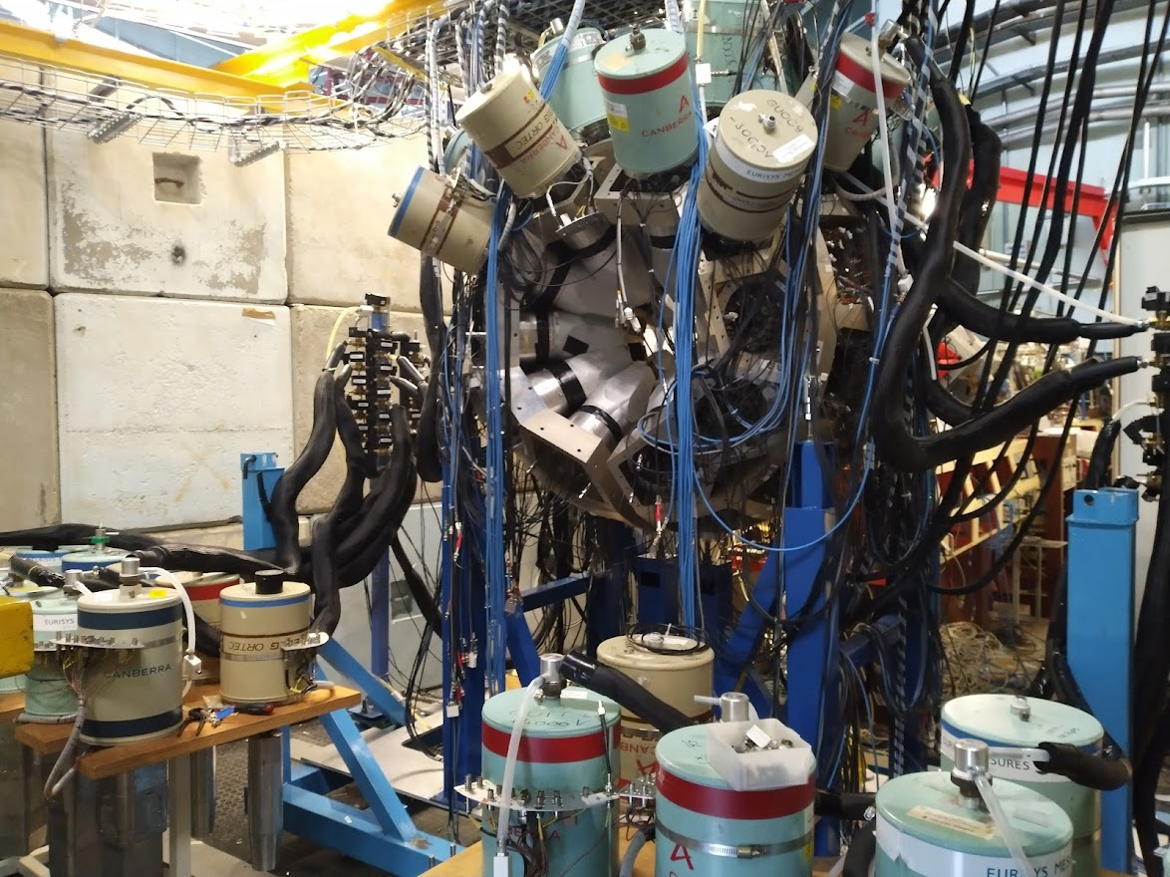
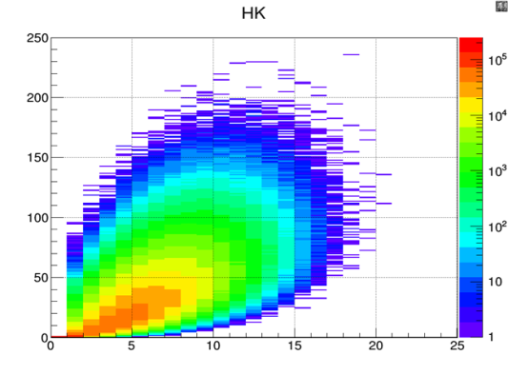
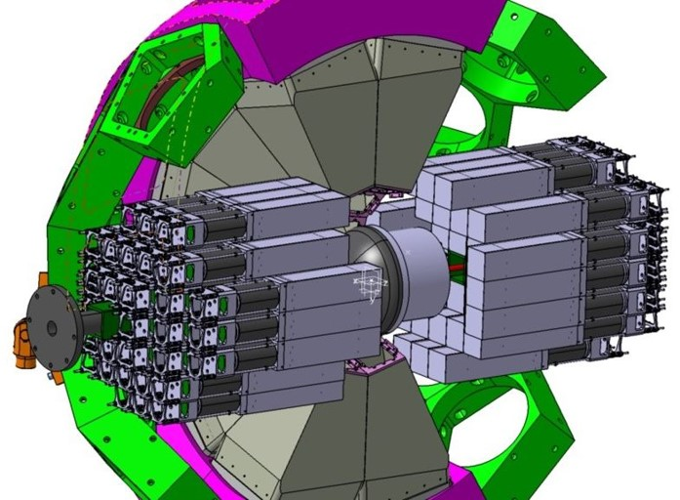
The nu-Ball2: Hybrid γ-ray spectrometer at ALTO
Study of: nuclear fission, neutron rich isotopes, lifetimes/nuclear moments
Innovations
Hybrid Spectrometer (Ge/BGO/LaBr3/PARIS)
high resolution, high efficiency
Different geometries and couplings
Calorimetry for reaction studies/selection
Fully digital, 200 channels, including BGO
Modes Triggered or Triggerlesss
15 approved experiments. 2900 hours beam time
march 2022 – june 2023
nu-Ball2 under construction 03/03/22
Coupled Devices
TFGIC (European Commission, JRC Geel)
DSSD silicon detectors (HIL Warsaw)
LICORNE neutron source (ALTO)
CORSET FF detector (Dubna)
OUPS plunger (IJC Lab)
OPSA charged particle detctor (IJC Lab)
Gamma detectors
28 Clover Ge’s(GammapoolEU consortium)
15 Coaxial Ge’s (UK/France loan pool)
36 FATIMA LaBr3 (FATIMA collaboration)
72 PARIS phoswich (PARIS collaboration)

Slide 6
Spectroscopy of fission for Nuclear Structure studies with nu-Ball1/LICORNE
Prompt and delayed spectroscopy of the neutron-rich ⁹⁴Kr and observation of a new isomer
R-B. Gerst et al. Phys. Rev. C 102, 064323 (2020)
Spectroscopy and Lifetime Measurements in ^{134,136,138}Te Isotopes and Implications for the Nuclear Structure beyond N = 82, G. Hafner, R. Lozeva, et al. Phys. Rev. C103 034317 (2021)
First lifetime investigations of N>82 iodine isotopes, ^{135,137,139}I: The quest for collectivity
G. Häfner et al. Phys. Rev. C 104, 014316 (2021)
Study of N = 50 gap evolution around Z = 32: new structure information for ⁸²Ge D.Thisse, M.Lebois, D.Verney, et al., Eur.Phys.J. A 59, 153 (2023)
Gamma-ray spectroscopy of fission fragments with state-of-the-art techniques
S. Leoni, C. Michelagnoli, J. N. Wilson, La Rivista del Nuovo Cimento (2022) 45:461–547
See talk of Damien Thisse, Thursday

Slide 7
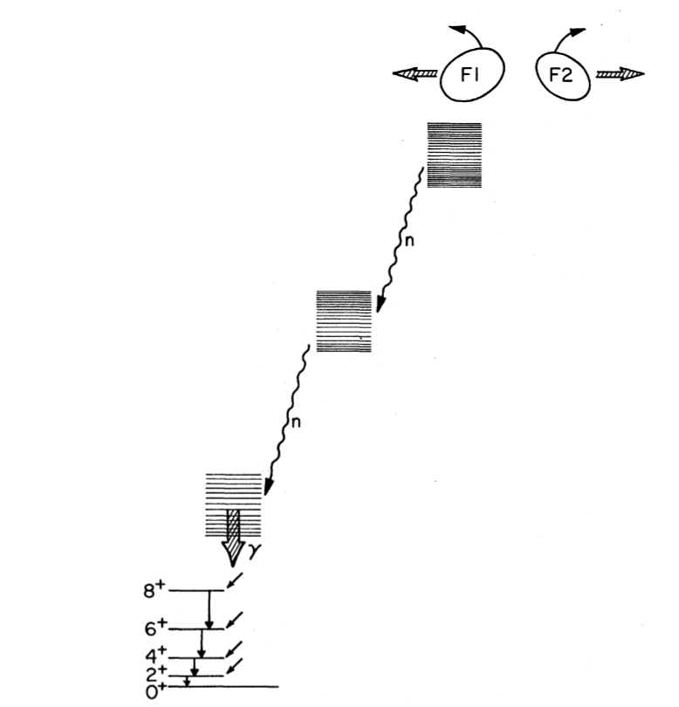
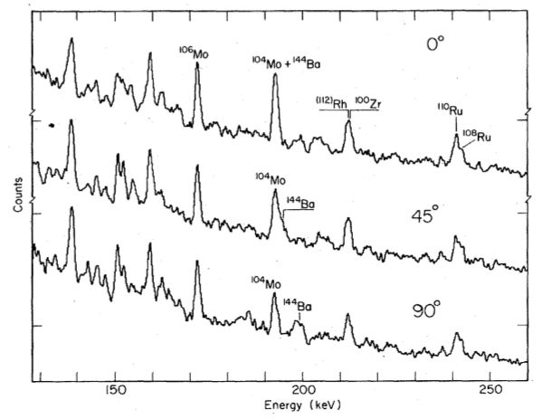
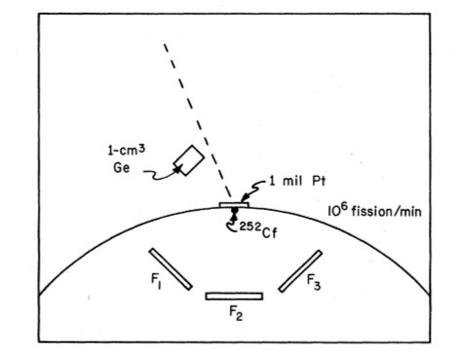


Fission fragments emerge spinning!
Gamma-ray spectra
J.B. Wilhelmy et al.
Phys. Rev. C 5 2041 (1972)
Experimental setup
Conclusions
Average spin is 7 $±$ 2 hbar
Angular momentum must be oriented in a plane perpendicular to the fission axis
²⁵²Cf(SF) (g.s. 0+)

Slide 8
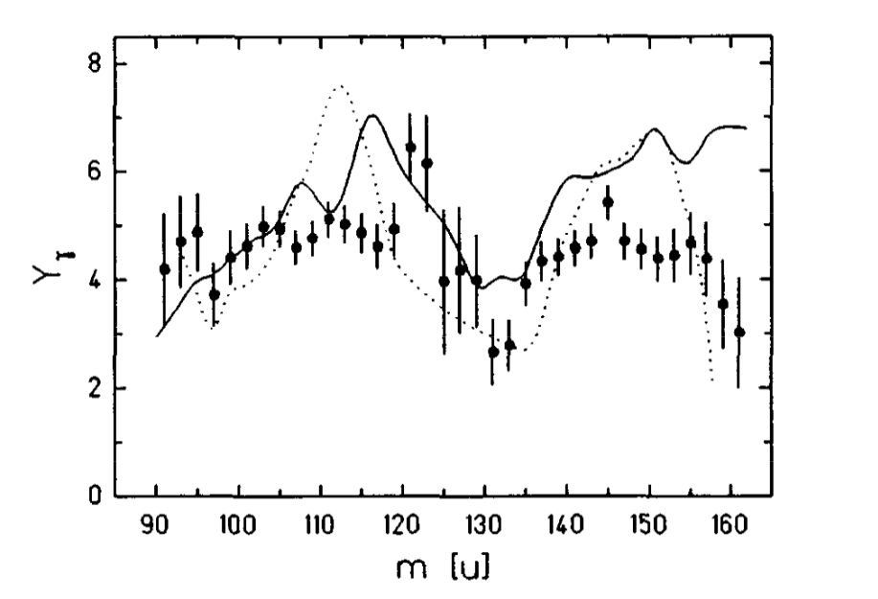
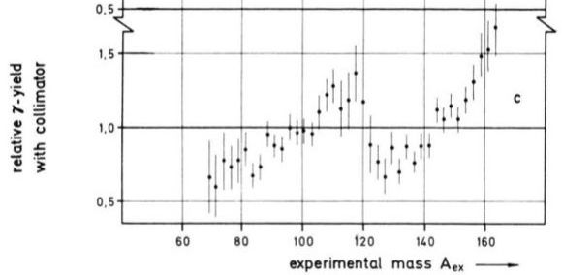
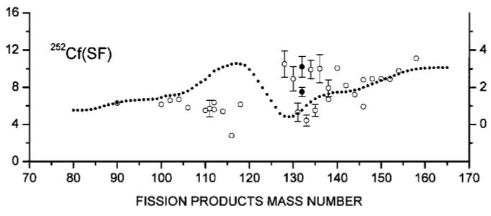



How does spin vary with the mass of the fragment?
P. Armbruster et al. Zeitschrift für Naturforschung A26, 512 (1971)
P. Glassel et al. Nuc. Phys. A502 315 (1989)
Physical collimation
Isomeric yield ratios
H. Naik et al. Phys. Rev. C71 014304 (2005)
Relativistic headlight effect
Y_{m}
Y_{m}
m
m

Slide 9
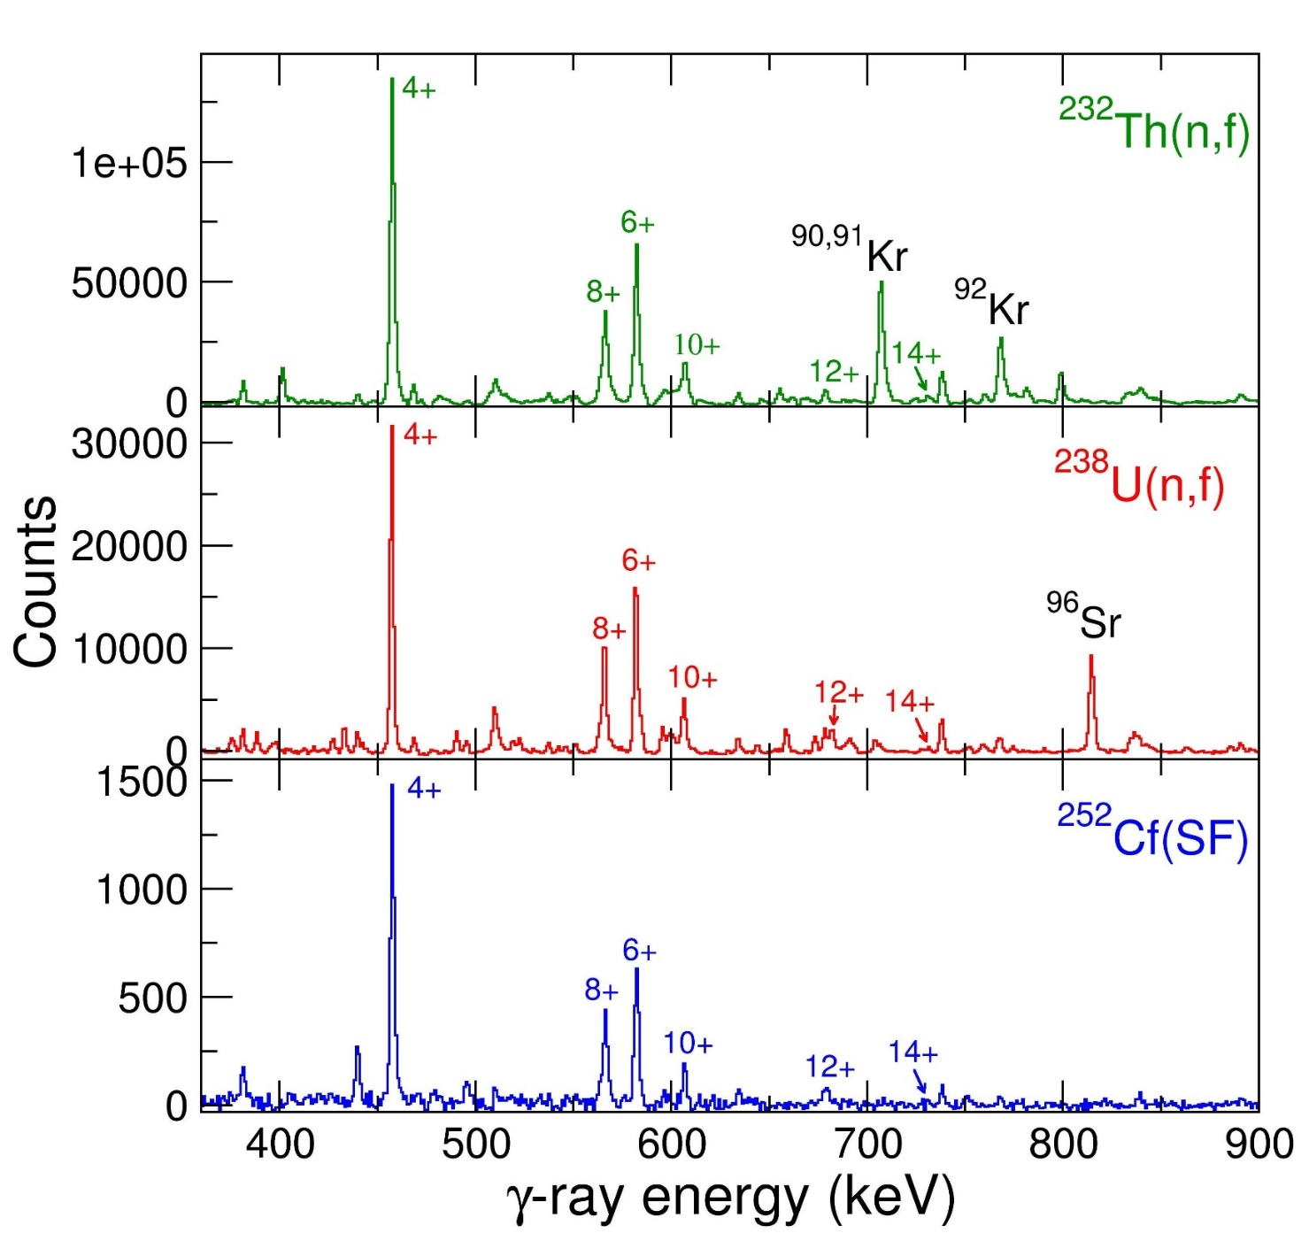
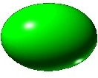
nu-Ball1 results: Gates on the 2⁺ → 0⁺ transition in ¹⁴⁰Xe
Study of 3 different systems with the same device
Prompt decay only
Separation of prompt fission decay and beta feeding is essential
¹⁴⁰Xe
⁹⁰Kr
(separation with pulsed neutron beam)
¹⁴⁰Xe shows invariant intensity pattern
Does the partner nucleus not matter?
¹⁴⁰Xe
⁹⁶Ru
(With ionisation chamber tagging one
Fragment in flight and stopping the other)
¹⁴⁰Xe
¹¹⁰Ru

Slide 10
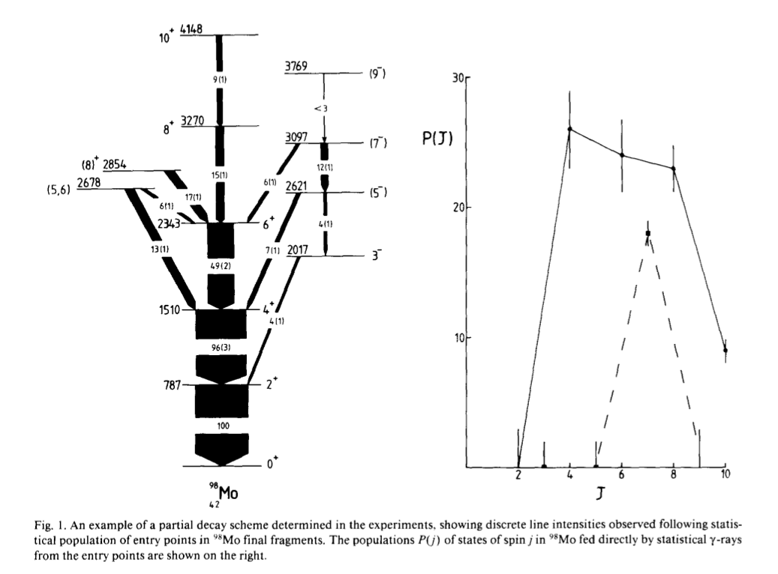
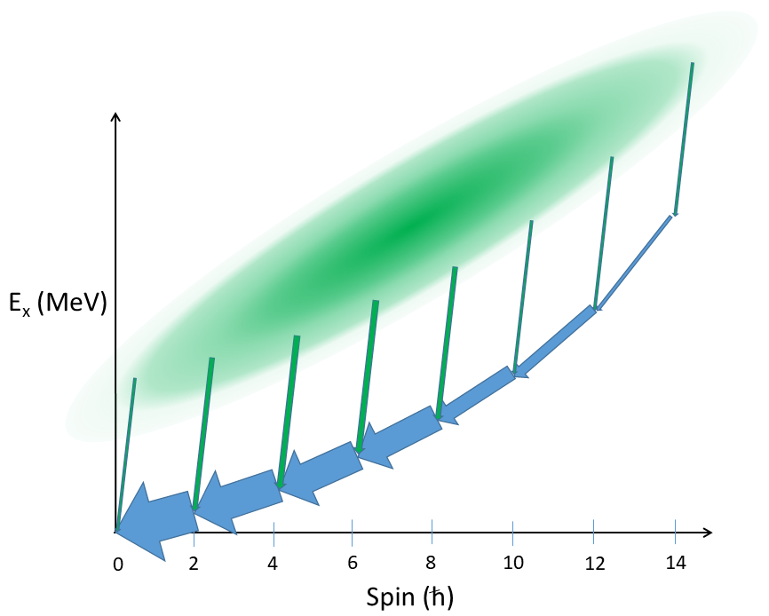
The Manchester Spin Method (MSM)
.
Y. Abdelrahman et al. Phys. Lett. B 199 4 504 (1987)
Calculation of nucleus average spin <I> from intensity balances across all observed discrete levels
S₁₄
S₁₂
S₁₀
S₈
S₆
S₄
S₀
S₂

Slide 11
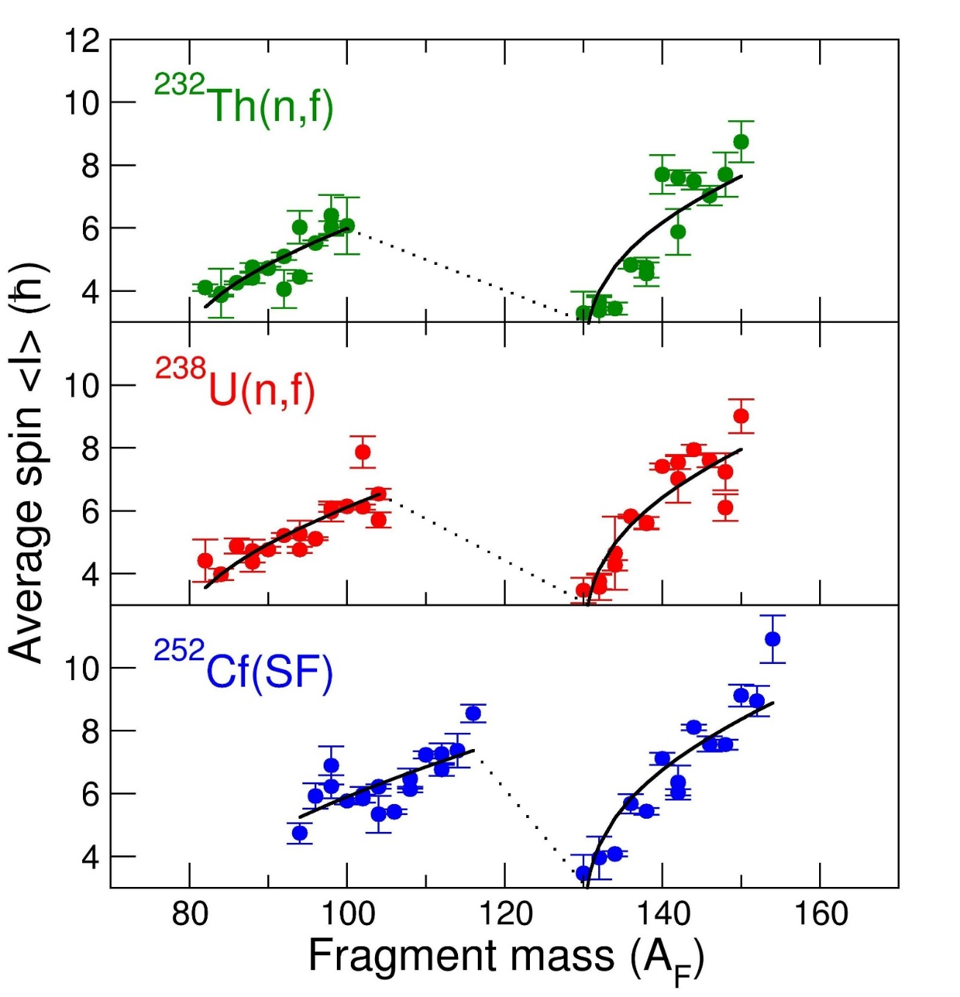
RESULTS: Average spin <I> vs fragment mass (A)
30 even-even nuclei measured for each system
Definitive universal saw-tooth pattern
Slope and curvature. Heavy peak has higher spins
Universial sawtooth fitted with result derived from statistical theory
Remarks
No notable dependence of <I> on the partner nucleus. Only dependence on its own mass
e.g.
¹⁴⁰Xe + ⁹⁰Kr
¹⁴⁰Xe + ⁹⁶Sr
¹⁴⁰Xe + ¹¹²Ru
Each nucleus doesn’t care who it emerged with!
25% difference in mass
Spin and vbar sawtooths are linked and driven by the energy partition in fission
Certain partners have large asymmetries in <I>
e.g. ¹⁵⁰Ce has double the <I> of ⁸⁶Se
Highly asymmetric distribution
J.N. Wilson et al. Nature 590 566 (2021)

Slide 12
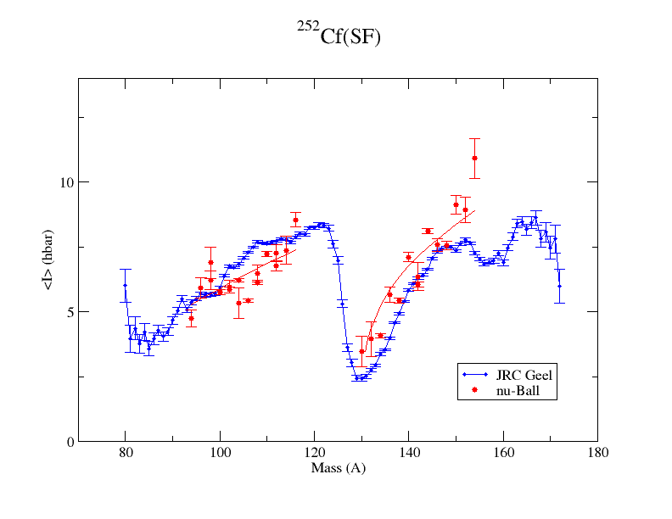
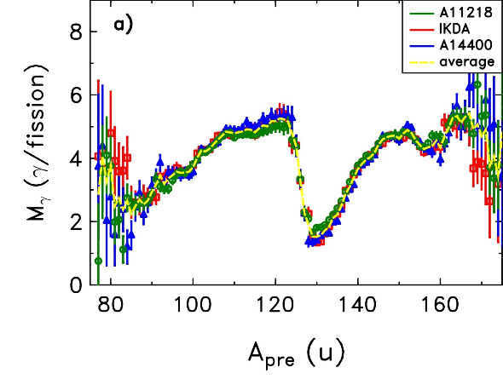
Independent sawtooth behaviour confirmation
²⁵²Cf
JRC-Geel data
Normalization: Literature value of 1.6 hbar per emitted gamma
M. Travar et al. Phys. Lett. B 817 136293 (2021)

Slide 13
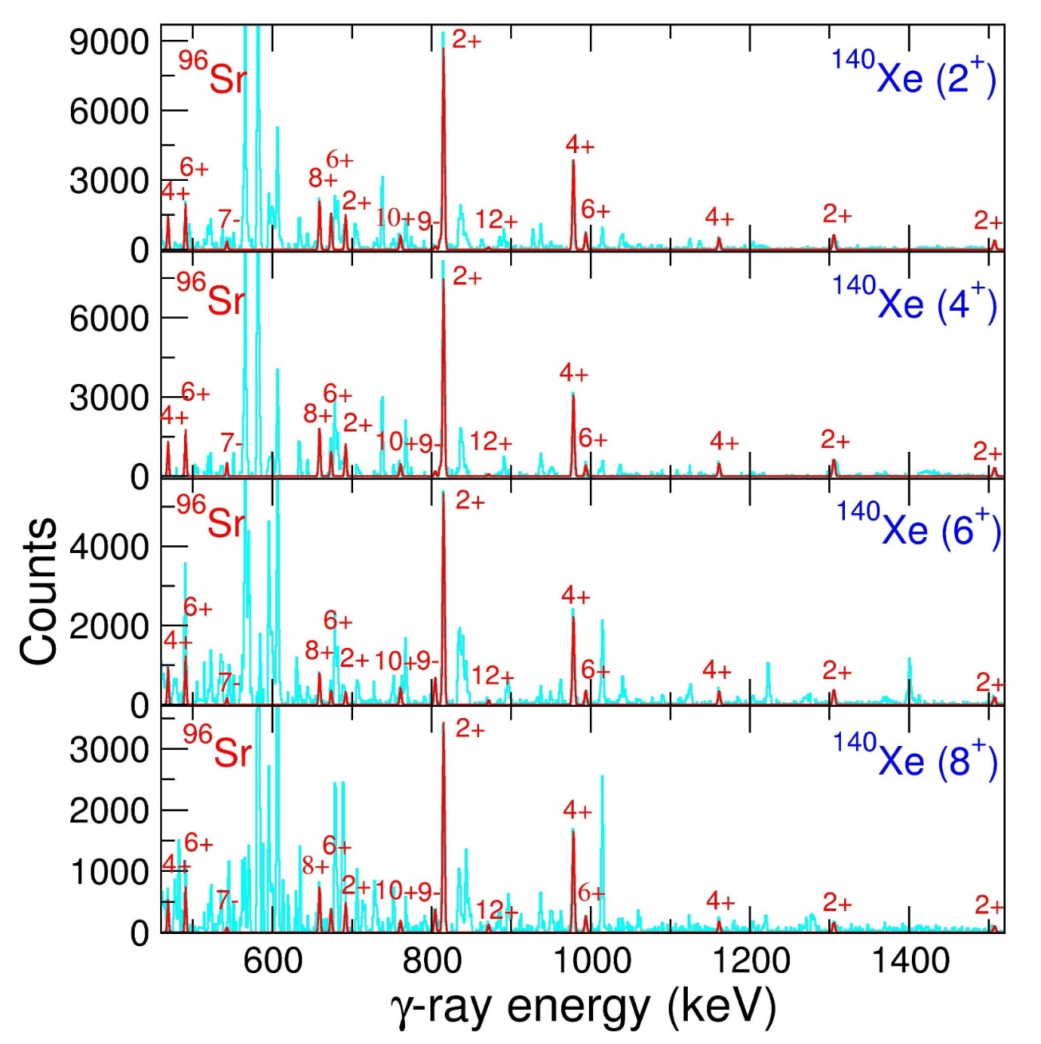
⁹⁶Sr partner γ’s with increasing ¹⁴⁰Xe spin conditions
Increasing spin demanded in ¹⁴⁰Xe
No change in ⁹⁶Sr partern gamma ray intensity pattern!

Slide 14
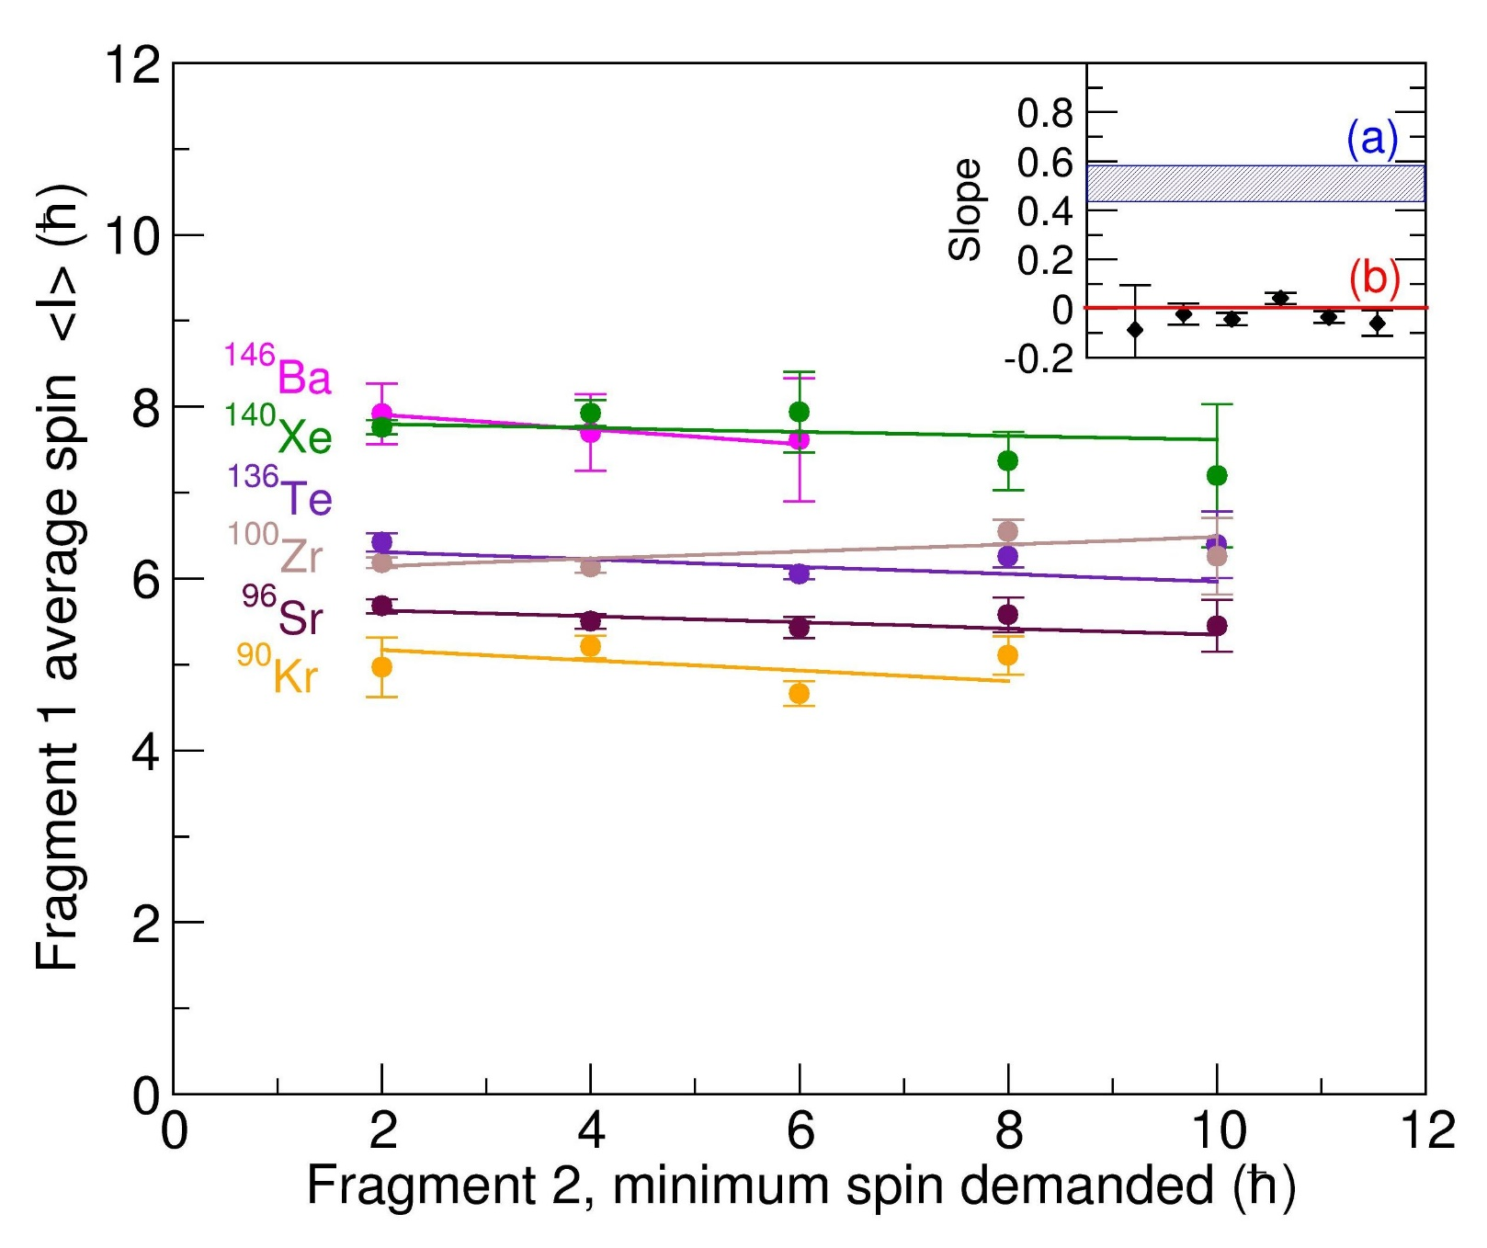
Correlation between fission fragment spin magnitudes
J.N. Wilson et al. Nature 590 566 (2021)

Slide 15


Correlation between fission fragment spin magnitudes
Correlated spins (Pre-scission)
Uncorrelated spins
${\vec{S}}_{1}+{\vec{S}}_{2}+{\vec{S}}_{o}=0$
J.N. Wilson et al. Nature 590 566 (2021)

Slide 16
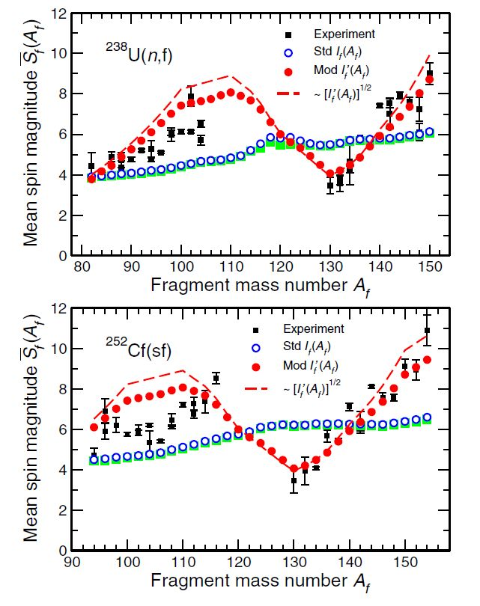
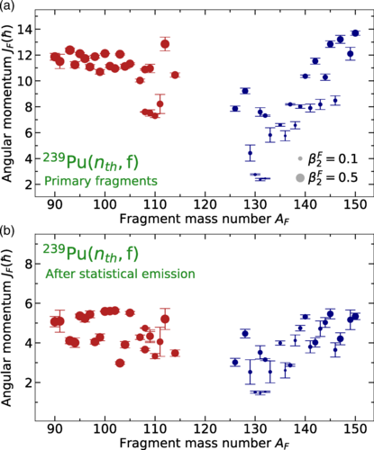
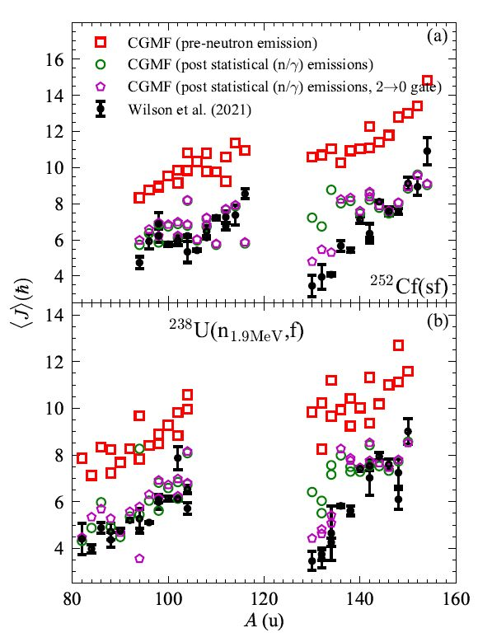
Subsequent theoretical works
P. Marevic et al. (Livermore)
Phys. Rev. C104, L021601 (2021)
Microscopic DFT
I. Stetcu et al. (Los Alamos)
Phys. Rev. Lett. 127, 222502 (2021)
CGMF, Monte-Carlo Hauser Feshbach
J. Randrup and R. Vogt, (Berkeley)
Phys. Rev. Lett.127, 062502(2021)
FREYA, Monte-Carlo de-excitation code

Slide 17
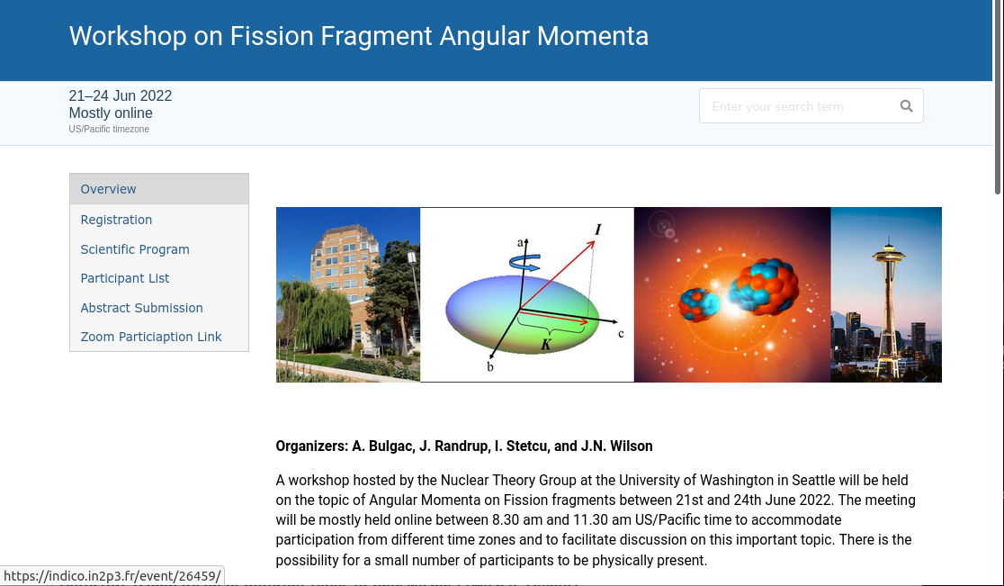

Slide 18
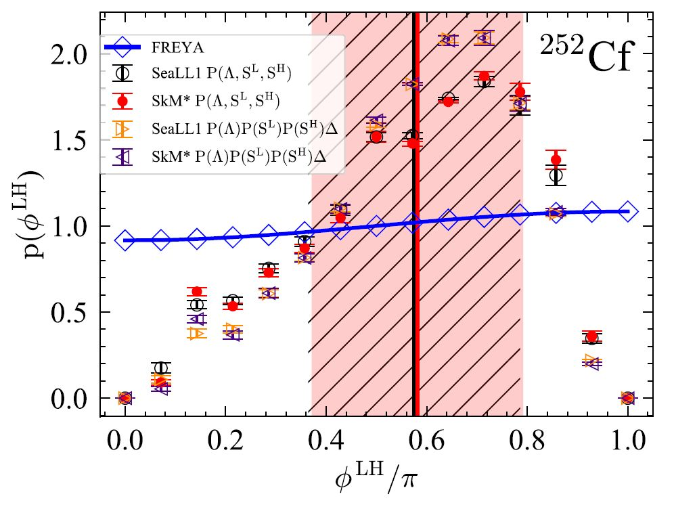
Correlation between the fragment spin directions?
TDDFT, A. Bulgac, I. Abdurrahman, K. Godbey, and I. Stetcu, Phys. Rev. Lett. 128, 022501 (2022)
J. Randrup and R. Vogt, Phys. Rev. Lett.127, 062502(2021)
I_{L}
I_{H}
E_{L,ex}
E_{H,ex}
Theoretical predictions strongly disagree
However, directional correlations can be determined by experiment!
L
Image courtesy of S. Aberg

Slide 19
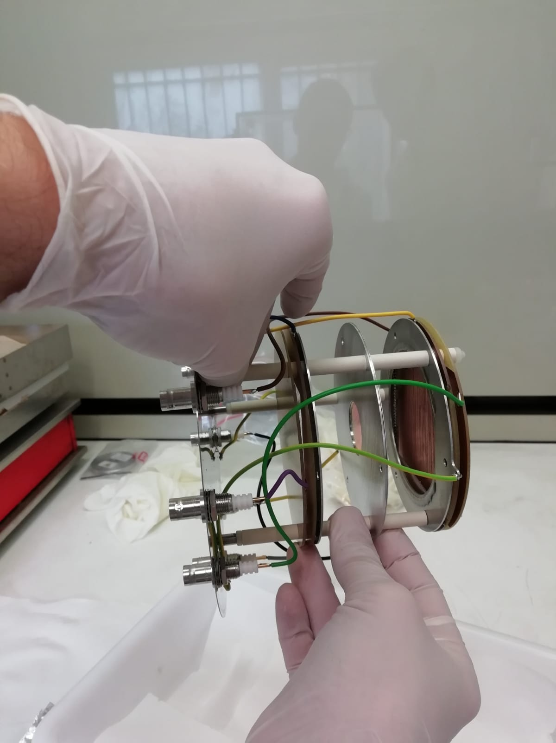
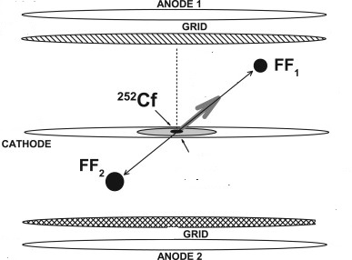

ν-ball2 + 4π ²⁵²Cf source + Segmented Ionisation chamber
FROZEN project
M. Lebois
θ
A. Göök et al.
JRC-Geel
n
γ
Simultaneous event-by-event measurement of:
Prompt/delayed fission gamma rays and neutron(s) (via TOF)
Fragment Kinetic Energies, Fragment A/Z and partner A/Z
Fission axis direction and all directional correlations
Prompt/Delayed gamma sum energy and multiplicity
Measurment of correlations between multiple fission observables are key to obtaining interesting new results (in our opinion)
Analysis is ongoing

Slide 21
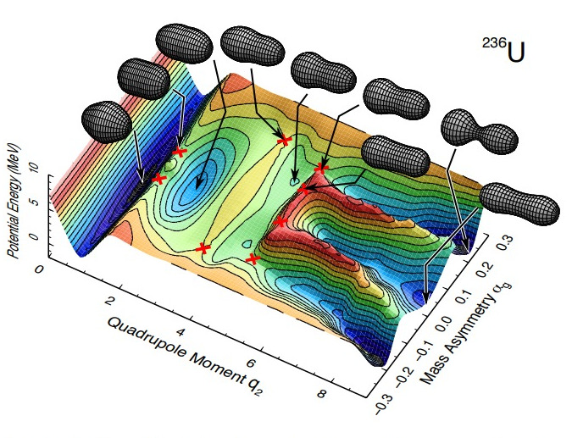
What determines mass/charge partition in fission?
To better constrain theory and the pathway(s) to fission through the complex potential energy landscape requires measurements of fragment yields as a function of A,Z, E* and J of fissioning systems.
T. Ichikawa et al. Phys. Rev. C 86, 024610 (2012)

Slide 22


Gamma decay of fission shape isomers – Corentin Hiver Ph.D thesis
Poster
Ep
a
Axis ratio 2:1
a = 1
b = 2
Class II states
b
Class I states
$$0_{II}^{+}$$
Meta-stable state
$$0_{I}^{+}$$
Deformation β
1:1
1,3:1
2:1

Slide 23
Most isomers decay by delayed fission
Ep
Spontaneous fission lifetimes (ns to ms) are several orders of magnitude lower than the G.S.
Class II states
Class I states
$$0_{II}^{+}$$
Meta-stable state
Delayed Fission
$$0_{I}^{+}$$
Deformation β

Slide 24

Competing gamma back decay
Ep
Class II states
Class I states
$$0_{II}^{+}$$
Meta-stable state
Gamma-back decay
Delayed Fission
$$0_{I}^{+}$$
Deformation β

Slide 25
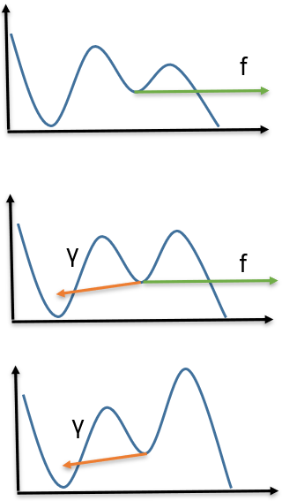
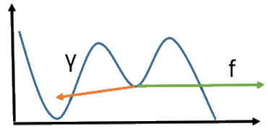
Searching for gamma back decays
Delayed fission
Competition fission/γ
Delayed γ decay
Terra incognita

Slide 26
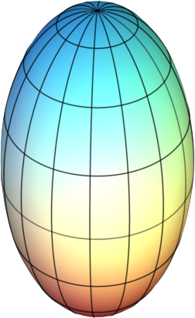
High-K shape isomers and their survivability in superheavy nuclei
High-K shape isomers, present in the secondary PES minimum of actinides, may be a key to understanding the existence of long-lived K isomers in superheavies,
in particular, beyond Z=118.
118
long lived K isomers?
114
We can only explore possible k-isomers through gamma spectroscopy of low-Z actinides
110
106
superheavies
102
98
actinides
with shape isomers
energy
fission from
high-K shape isomer
94
K
92
fission from
shape isomer
deformation

Slide 27
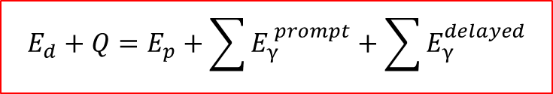

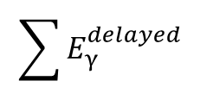

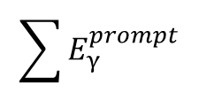
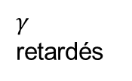
Selection of the rare back decay events through calorimetry
Ep
$$E_{d}+Q=E_{p}+\sum{E_{γ}^{ prompt}}+\sum{E_{γ}^{delayed}}$$
^{236*}U
²³⁵U + d
^{237*}Np
p
Fission
$$E_{p}$$
Isomer
$$\sum{E_{γ}^{prompt}}$$
^{236f}U
$$\sum{E_{γ}^{delayed}}$$
$γ$ retardés
^{236*}U
Deformation $β$

Slide 28
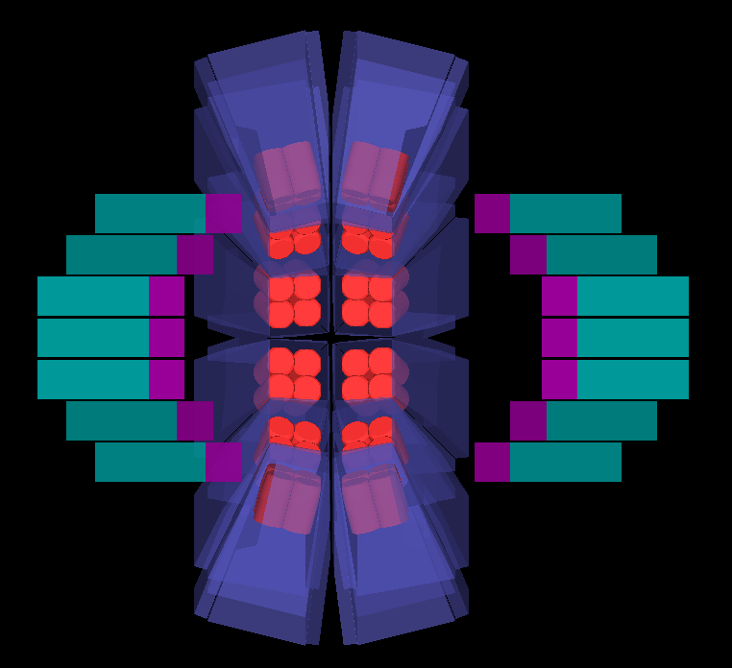



Experimental setup: Data analysis ongoing
$$γ$$
$$γ$$
p
$$γ$$
DSSD

Slide 29


Predicted fission shape isomers in the light actinides
S. J.-P. Delaroche, M. Girod, H. Goutte, J. Libert., Nuclear Physics A 771 103–168 (2006)
P. Jachimowicz, M. Kowal and J. Skalski, Phys. Rev. C 85, 034305 (2012)
B. Nerlo-Pomorska, K. Pomorski, J. Bartel, and C. Schmitt, Eur. Phys. J. A 53:67 (2017)
A second nu-ball2 experiment was performed in May 2023 to search for exclusive isomer gamma decay in ^{232,233}Th

Slide 30



Gamma ray spectroscopy of fast neutron-induced fission with EXOGAM at NFS
NFS
- NFS
- LICORNE
Determine incident neutron energy through TOF (~10 bins)
Neutron flux
10m from source
Neutron energy (MeV)
EXOGAM
Proposal submitted september 2023 to perform ²³²Th(n,f) at NFS:
60 collaborators, 21 institutions, 8 countries
Requires 8µA, 880 kHz primary beam and EXOGAM@10m with 8.3g thorium target

Slide 31

Nuclei accessible via gamma spectroscopy in direct kinematics

Slide 32

LICORNE/NFS comparaison for ²³²Th(n,f)

Slide 33

Evolution of fission yields with incident neutron energy
Detailed study of the ingrowth of the symmetric fission mode with incident energy. Evolution of A/Z distributions.
Yield measurements through determination of the total intensity of discrete gamma rays which feed the first excited states (even-even nuclei). Absolute yields have currently 20-30% accuracy.
Benchmark gamma coincidence intensities with 252Cf data to improve absolute accuracy.

Slide 34
Open questions on angular momentum effects we hope to address
How does the spin sawtooth pattern change with increasing excitation energy as the symmetric fission mode begins to dominate?
Is the intrinsic angular momentum generation mechanism for the symmetric fission mode the same as for the asymmetric?
Does some pre-scission spin feed through to the final fragments or does it go into the relative motion (orbital angular momentum)?
What happens to the correlation between partner fragment spins when there is a significant source of pre-scission angular momentum?

Slide 35














The ν-Ball collaboration
IJC Lab, CEA DAM
Subatech, CENBG, IPHC,
GANIL, LPC Caen
University of Surrey, NPL
University of Manchester
IFJ-PAN Krakow
University of Warsaw
University of Novi Sad
Riken
TU Darmstadt
IFK- Koln
University of Milano
INFN Legnaro
JRC-Geel
Leuven
University of Madrid
IFIC Valencia
University of Sofia
University of Oslo
ELI-NP, Bucharest
35

Slide 36






The ν-Ball2 campaign: March 2023 – June 2023

Slide 37



ν-Ball2/FATIMA – ps lifetimes in neutron rich fragments
24 Clover Ge + BGO
20 FATIMA LaBr3 in close packed configuration
238U(n,f) @ 2 MeV
Thanks to S. Pascu
Flagship experiment N-SI-120 completed
Fast-timing lifetime measurements in neutron rich fission fragments
3 weeks of beam time
Pulsed neutron beam from LICORNE (400 ns)
2.3 x 10¹⁰ events
Improvement over nu-Ball1
Significantly reduced backgrounds
× 6.5 more events
× 8 more Ge-Ge coincidences
× 50 more LaBr3-LaBr3-Ge coincidences
(June to October 2022)
University of Surrey
TU Darmstadt
University of Cologne
University Madrid
University of Warsaw
(> 70 International users)

Slide 38



ν-Ball2 Construction and commissioning phase
January – March 2022

Slide 39




nu-Ball2 successful coupling with PARIS + Warsaw DSSD
Thanks to A. Maj
P. Napiorkowski, K. Hadynska-Klek
Record number of FASTER digital electronics channels
(> 300). Triggerless.
5 synchronised crates

Slide 40
Fission yield measurements using gamma-gamma coincidences
γ
γ
Ge
Ge
Measure the total intensity of gammas feeding the 1st excited state
Initially performed for SF sources (²⁵²Cf, ²⁴⁸Cm ,etc.)
Difficulty of summing all the gamma intensity feeding the first excited state, especially for odd nuclei. Hence confined for the moment to even-even fragments.
Cannot measure direct ground state feeding
First excited state side-feeding must be determined from partner gating
Corrections needed for:
- missing intensity due to isomeric states
- beta decay feeding of fragments (fission tag, pulsed beam)
Limited precision (20-30%)
?
Ground State

Slide 41
Unexpected asymmetric fission mode in ²¹⁵Fr*
¹⁹⁷Au(¹⁸O,f) → ²¹⁵Fr* @ 61 MeV
First nu-Ball2 experimental results
K. Miernik et al. submitted to PRC (2023)
Fragment yields derived from γ-ray coincidence intensities in many even-even nuclei
Z=54 (14%)

Slide 42



Slide 43



Spectroscopy and lifetime measurements in ^{134,136,138}Te isotopes and implications for the nuclear structure beyond N = 82
theory
Newly measured
lifetimes
experiment
Evolution of collectivity beyond N=82
Extention of data on B(E2) tr. rates
Assymetric behaviour wr. N=82
SM theory over-estimates experiment
Slowed-down collectivity beyond N=82
G. Häfner, R. Lozeva, et al., Phys. Rev. C 103, 034317 (2021)
G. Häfner, R. Lozeva et al., Phys. Rev. C 104, 014316 (2021)

Slide 44

Fission fragment decay
Primary fragment entry
distribution
Secondary fragment entry
distribution
<M_{γ}> (one fragment) ~ 3.5 - 4
<ν> (one fragment) ~ 1 - 2

Slide 45


Fragment decay scheme examples
¹³⁴Te
¹⁴⁰Xe

Slide 46


2D gamma-gamma coincidence analysis
1D spectrum
D.C. Radford, ESCL8R and LEVIT8R: software for interactive graphical analysis of HPGe coincidence data sets. Nucl. Instrum. Meth. Phys. Res. A 361, 297−305 (1995)

Slide 47

The Manchester Spin Method (MSM)
Corrections necessary for
Isomeric decays (long time gates)
2+ feeding (partner gating)
0+ feeding (extrapolation)
Statistical transitions (small model dependency)
Neutron emission (small model dependency)
Advantages
Measure cumulative intensity flow: discrete gamma decays between states at or near yrast
Redundancy of the intensity information
Allows reconstruction of missing intensity for unresolvable transitions
Robustness and insensitivity to imperfections
Potential systematic errors
Trigger condition (triggerless data important)
Missing weak gamma ray branches
Incorrect spin assignments
Incorrect level schemes (e.g. ⁹⁰Kr/⁹¹Kr)
Drawbacks
Complex analysis involving 50-100 fragment decay schemes
Complex statistical error analysis
Very hard work!
Statistical error analysis
Covariance of side-feedings (S_{i},S_{j})
Sensitivity/Accuracy of the method
0.3ħ−0.6ħ from information incompleteness study
0.4ħ−1.0ħ from non-statistical variation about the trend line

Slide 48

Gamma ray spectroscopy of nuclear fission

Slide 49
Theoretical explanations
Rasmussen (1969) Bending. Di-nuclear system. Thermal excitations.
Moretto (1989) Bending, Wriggling, Twisting, Tilting. Semi-classical theory. Thermal excitations.
Misicu (1999) Bending, Coupled oscillators. Quantum fluctuations.
Shneidman (2002) Bending. Di-nuclear system. Quantum fluctuations.
Gönnenwein (2007) Bending, Wriggling. Quantum fluctuations.
Hoffman (1964) Coulomb forces.
Mikhailov (1999) Orientation pumping, coupled deformed fragments. Equal spins.
Bonneau (2007) Coupled deformed fragments. Quantum fluctuations and thermal excitations.
Bertsch (2019) Microscopic theory: Energy density functionals (Gogny D1S).
Pre
Scission
Theories
Post Scission
Theories

Slide 50
Fission fragment decay
Primary fragment entry
distribution
Secondary fragment entry
distribution
<M_{γ}> (one fragment) ~ 3.5 - 4
<ν> (one fragment) ~ 1 - 2

Slide 51
nu-Ball2 campaign experiments at ALTO
(April 2022 – June 2023)
Coulex
58Fe – G. Pasqualato
60Ni – K. Hadynska-Klek
40Ca – P. Napiorkowski
Structure
44Ti, 42Ca – M. Matejska-Minda
Lifetimes (RDM)
60Zn – M.L. Cortes
GDR
80Sr links residues to CN shape – M. Ciemala
Neutron induced fission
238U(n,f) – S. Pascu
Heavy ion induced fission
197Au(18O,f) – K. Miernik/A. Korgul
178W(12C,f) – K. Miernik/A. Korgul
Light ion induced fission (fission isomers)
235U(d,f), 232Th(d,f) – C. Hiver/J. N. Wilson
Spontaneous fission
252Cf(SF) – M. Lebois/S. Oberstedt
12 experiments completed
> 300Tb of data collected!

Slide 52


Gamma ray spectroscopy of fission fragments with state-of-the art techniques
S. Leoni, C. Michelagnoli, J.N. Wilson
La Rivista del Nuovo Cimento 45, p461–547 (2022)
Nuclear structure (neutron rich isotopes)
Single particle levels, residual interactions around shell closures (¹³²Sn, ⁷⁸Ni, N=50)
Evolution of nuclear shapes: onset of deformation
shape-coexistence phenomena (e.g N=60)
Triaxiality
Higher-order of deformation: octupole shapes
isomer spectroscopy
Nuclear astrophysics: nuclei in the r-process path
Fission isomers
ν-Ball1 results
^{135,137,139}I
^{134,136,138}Te
⁹⁴Kr
⁸²Ge
Fission mechanism/fission theory
Gamma rays as a probe of the fission mechanism
Angular momentum in fission
Correlation of fragment observables
Energy applications
Fission yield data
Gamma-ray heating effects in reactors
Inelastic neutron scattering on actinides

