Slide 1













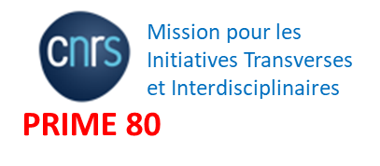





Design of innovative diamond detectors for beam monitoring in highly radiative environment for applications in nuclear and medical physics
ML Gallin-Martel*, A. André, Y. Arnoud, A. Bes, JL Bouly, J. Collot, D. Dauvergne, R. Delorme,
F. Di Franco, P. Everaere, L. Gallin-Martel, O. Guillaudin, C. Hoarau, F. Lafont, A. Lacoste, E. Lagorio, C. Léonhart, J. Livingstone
S. Marcatili, M. Marton, R. Molle, JF Muraz, N. Ponchant, F. Rarbi, M. Reynaud, O. Rossetto, J. Waquet, M. Yamouni
M. Evin, A. Guertin, F. Haddad, C. Koumeir,
V. Métivier, R. Molle, Q. Mouchard, F. Poirier, N. Servagent
P. Barberet, J. Jouve, S. Sorieul
Ph. Laniece, AM Leite, Y. Zhu
JF Adam, R. Serduc, S. Keshmiri
F. Vianna Legros
L. Abbassi, T. Crozes, F. Donatini, E. Gheeraert, J. F. Motte, J. Pernot
J. Bousquet, E. Corne, J. Letellier, D. Nusimovici.
F. Lafont, TN. Tran – Thi
J. Herault, JP. Hofverberg, D. Maneval, R. Trimaud
*mlgallin@lpsc.in2p3.fr

Slide 2

Context
Development of new generations of ion accelerators:
  Nuclear applications: the production of radical species for radiolysis applications
  Medical applications: hadrontherapy, flash therapies and X-ray or synchrotron radiation therapy
  very precise monitoring of the beam with rapid counting in a highly radiative environment.
The intrinsic qualities of diamond:
  speed, low leakage current, excellent SNR, resistance to radiation
  ⇒ an excellent candidate to meet such monitoring requirements over a wide dynamic range from a fraction of pA (single particle) up to µA.

Slide 3
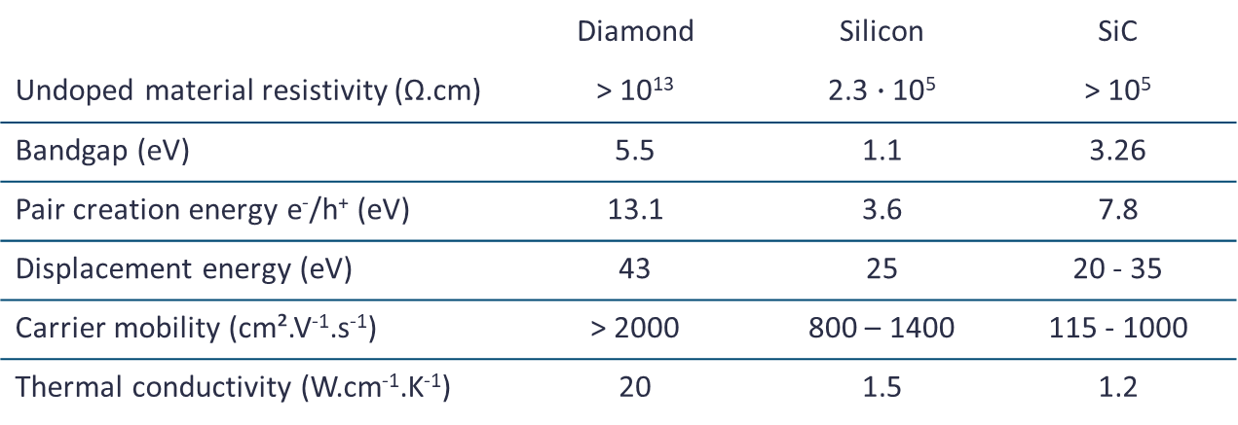
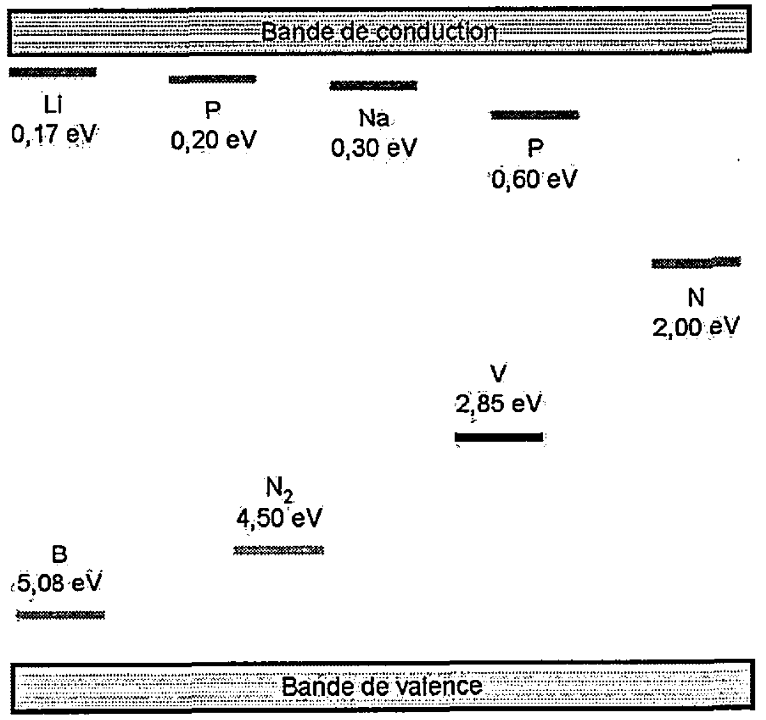


Diamond a wide band gap semiconductor
Diamond Assets :
Intrinsic radiation hardness
Fast signal risetime enables timing precision of a few tens of ps
Low noise
Issues :
Cost
Availability of large area
Energy levels of defects in diamond
Simplify scheme of trapping (1), re-emission (1’), recombination (2) and generation (3) phenomena
N. Tranchant, PhD Thesis, 2008, INSA Rennes.
M. Pomorski, PhD Thesis, 2008, Goethe University Frankfurt.

Slide 4
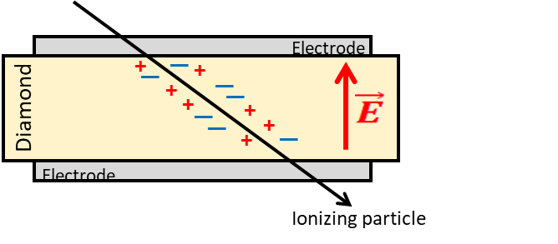
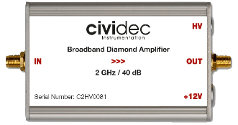
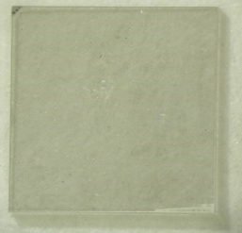

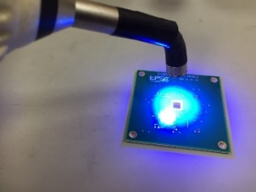
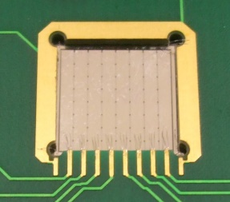
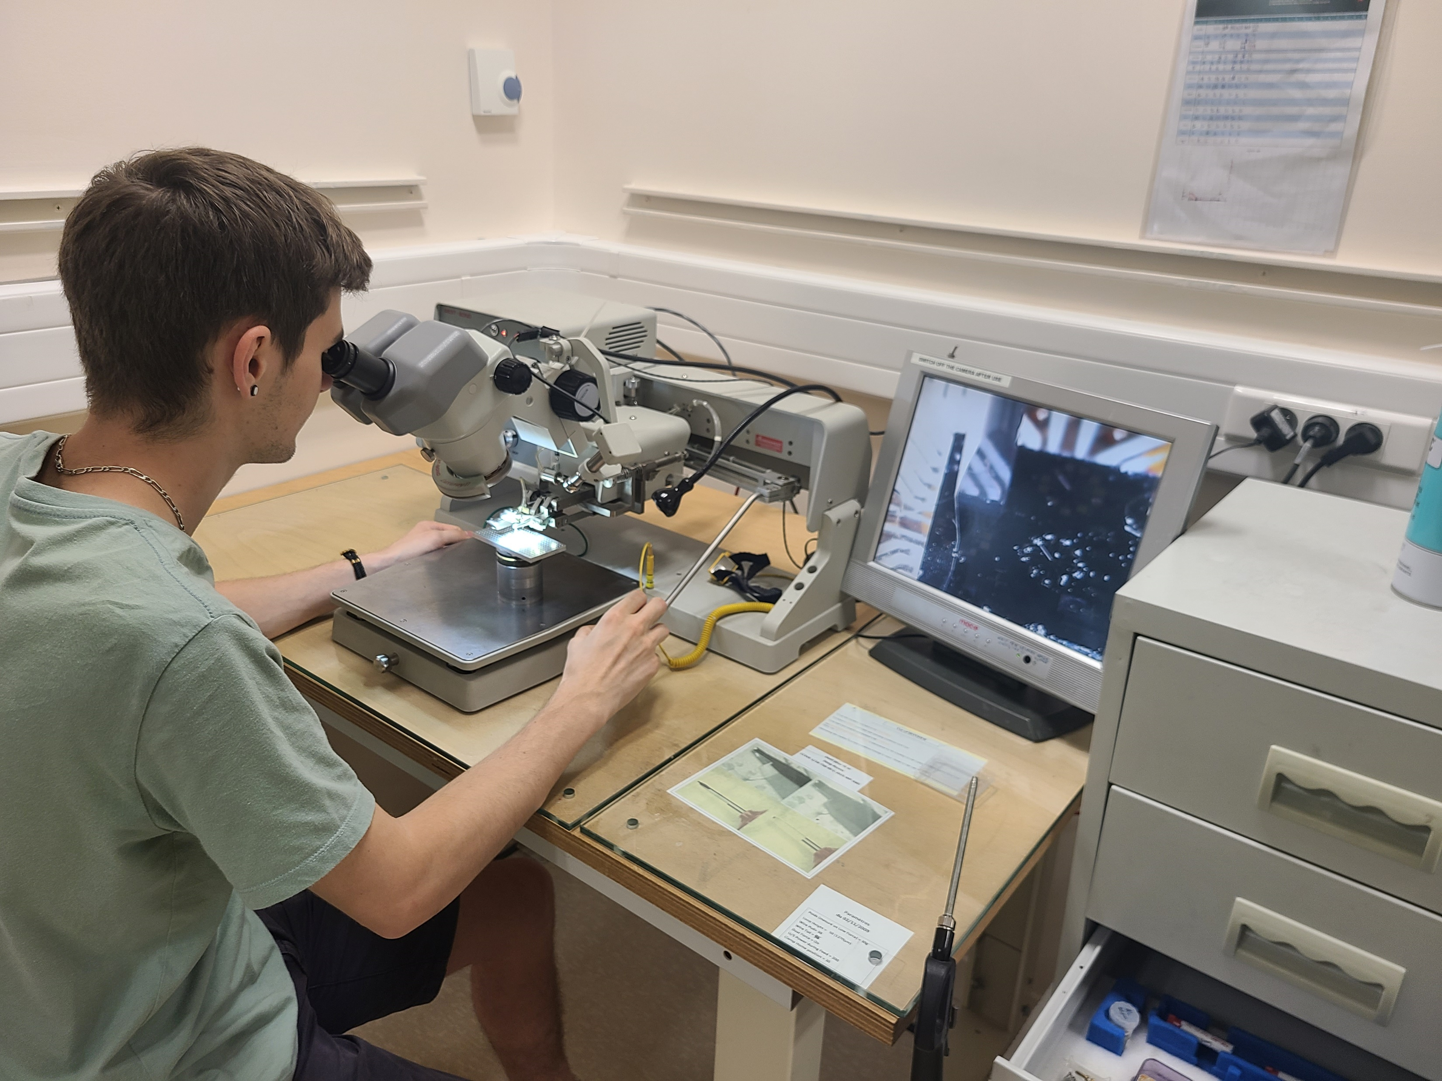
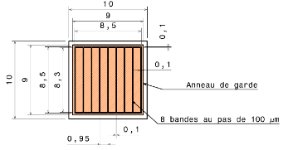
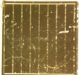
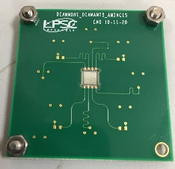
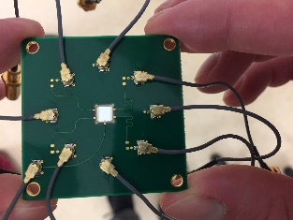
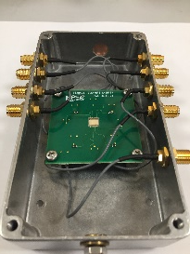
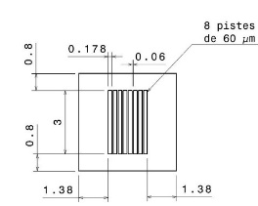
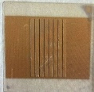
Diamond as beam monitors
Solid state ionization chamber
Read-out electronics
Fast current preamplifier
Charge preamplifier
QDC
HT
Diamond metallisation
Detector assembly
Band Width: 2 GHz
Gain: 40 dB
Impedance: 50 Ω
Dynamic range: ~ +/- 1 V
Power Supply: 12 V / 100 mA

Slide 5
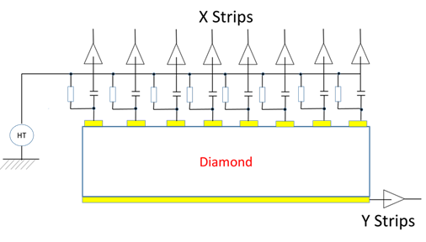
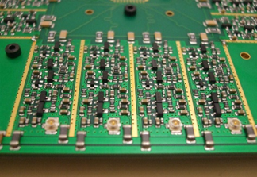
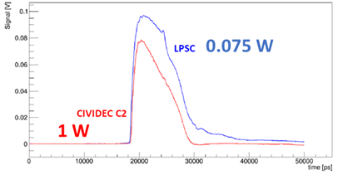
Diamond as beam monitors
Solid state ionization chamber
Read-out electronics
Fast current preamplifier
Charge preamplifier
QDC
HT
Read out electronics @ LPSC
Diamond metallisation
Detector assembly
Discret
C. Hoarau et al 2021 JINST 16 T04005
https://doi.org/10.1088/1748-0221/16/04/T04005

Slide 6
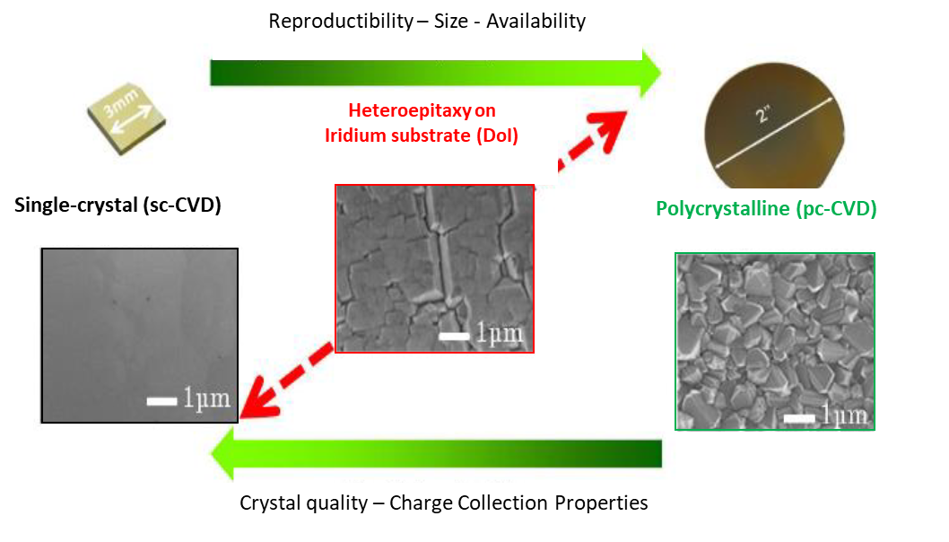
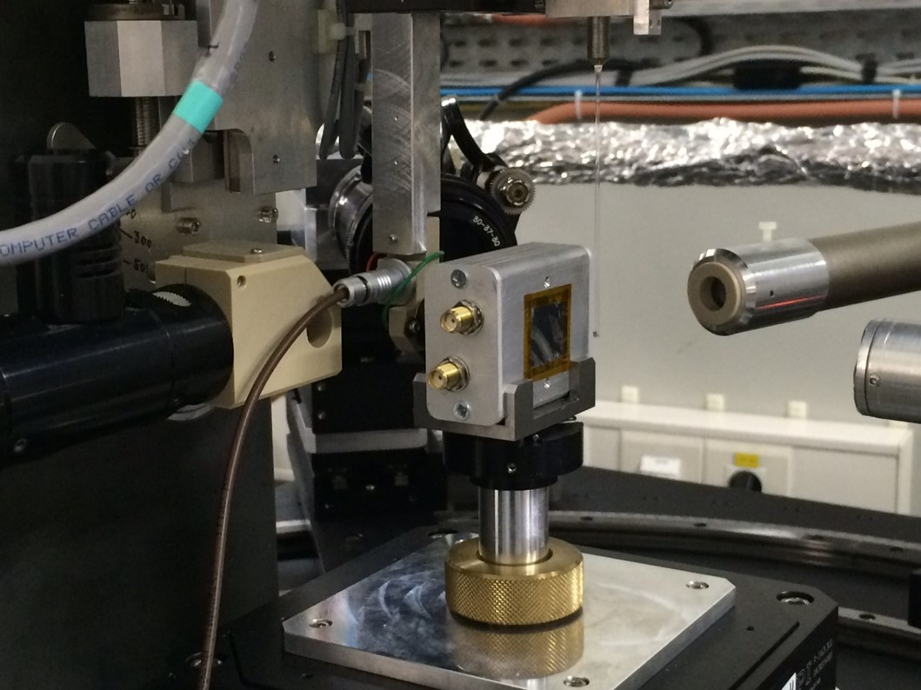
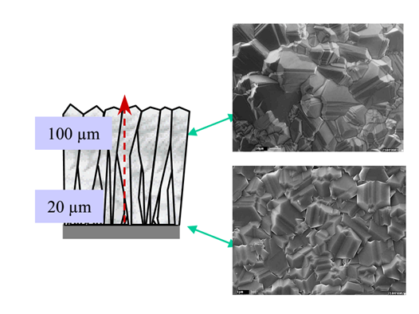
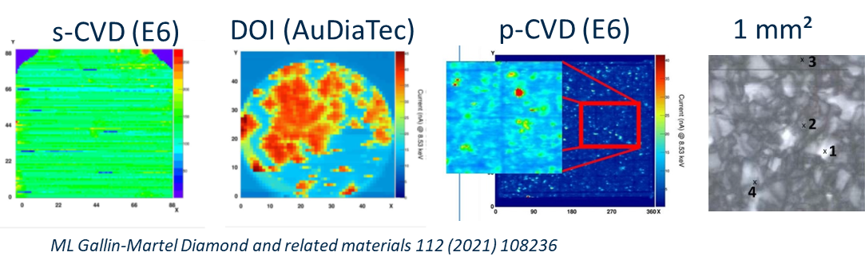
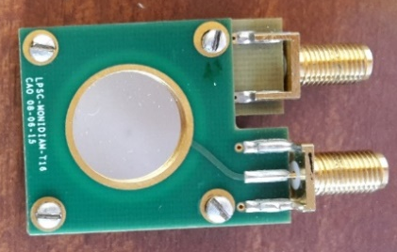
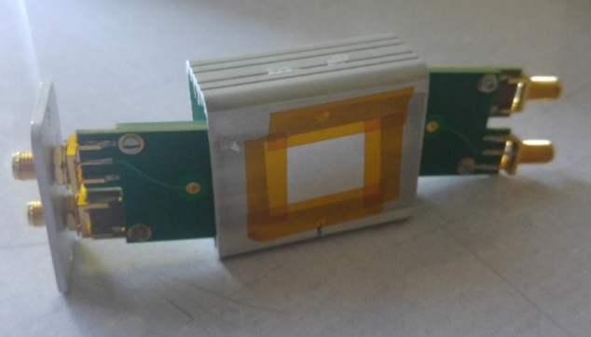
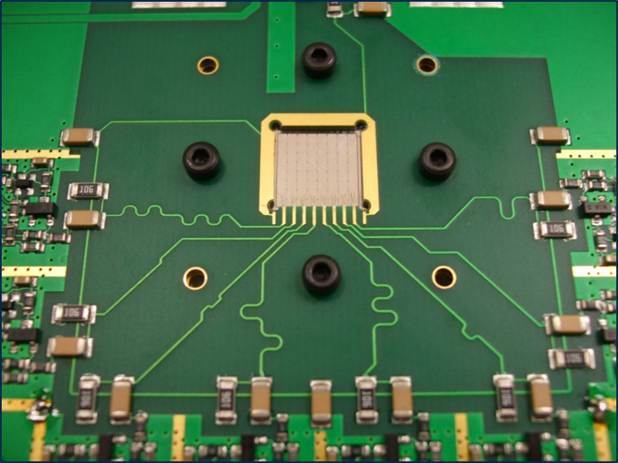
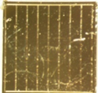
Diamond detector for beam monitoring: sCVD? pCVD? DOI?
N. Vaissiere PhD thesis https://tel.archives-ouvertes.fr/tel-01022652
XBIC = X rays Beam Induced Current
@ ESRF (France) : Photons 8.5 keV
=> 2D « current maps » with CVD diamonds
https://doi.org/10.1016/j.diamond.2020.108236

Slide 7
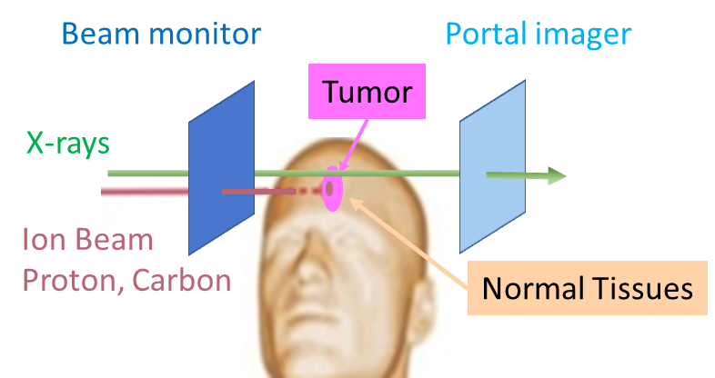
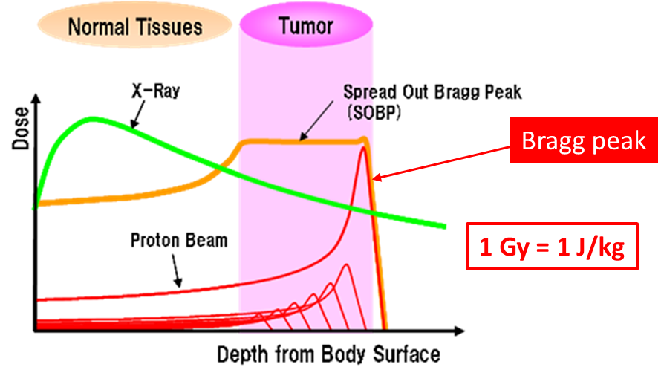
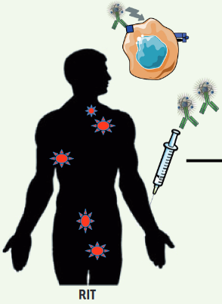
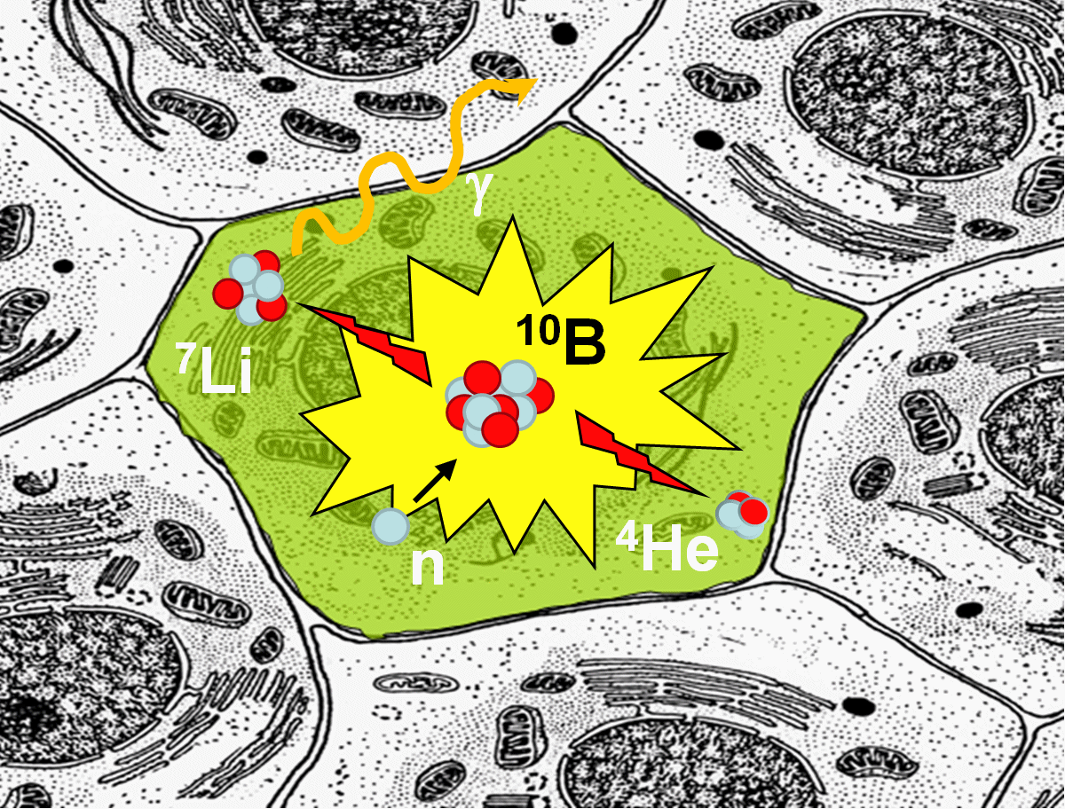
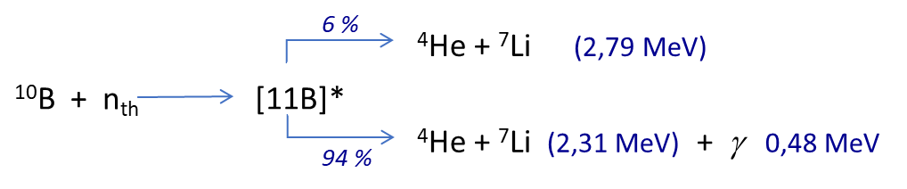
Beam monitors for on-line control of radiotherapies in cancer treatment
X-rays vs hadrontherapy
Flash therapy vs conventionnal => high doses in a very short time
Conventional X-rays
or hadrontherapy → Gy/mn
Flash therapies → 100 Gy/s
Short pulses to be monitored at high beam intensity !
High particle couting rate capabilities to be demonstrated
Bunch or train of bunches time stamps
Vectorized Internal Radiotherapy and Boron Neutron Capture Therapy (BNCT)
Radionuclides α : 223Ra, 225Ac, 212/213Bi, 211At…
Energy α : 5 – 9 MeV
Objectives: improved dose predictions and biological effects for targeted radiotherapy
monitor low-energy ion beams for radiobiology experiments

Slide 8
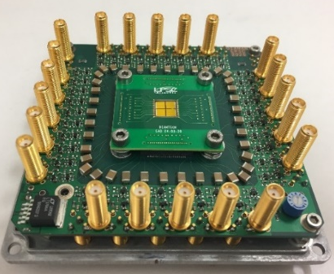
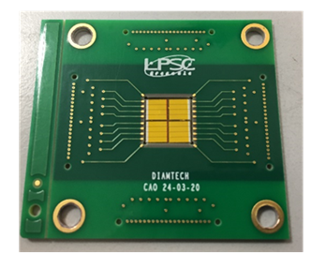
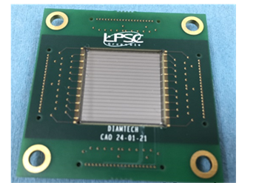
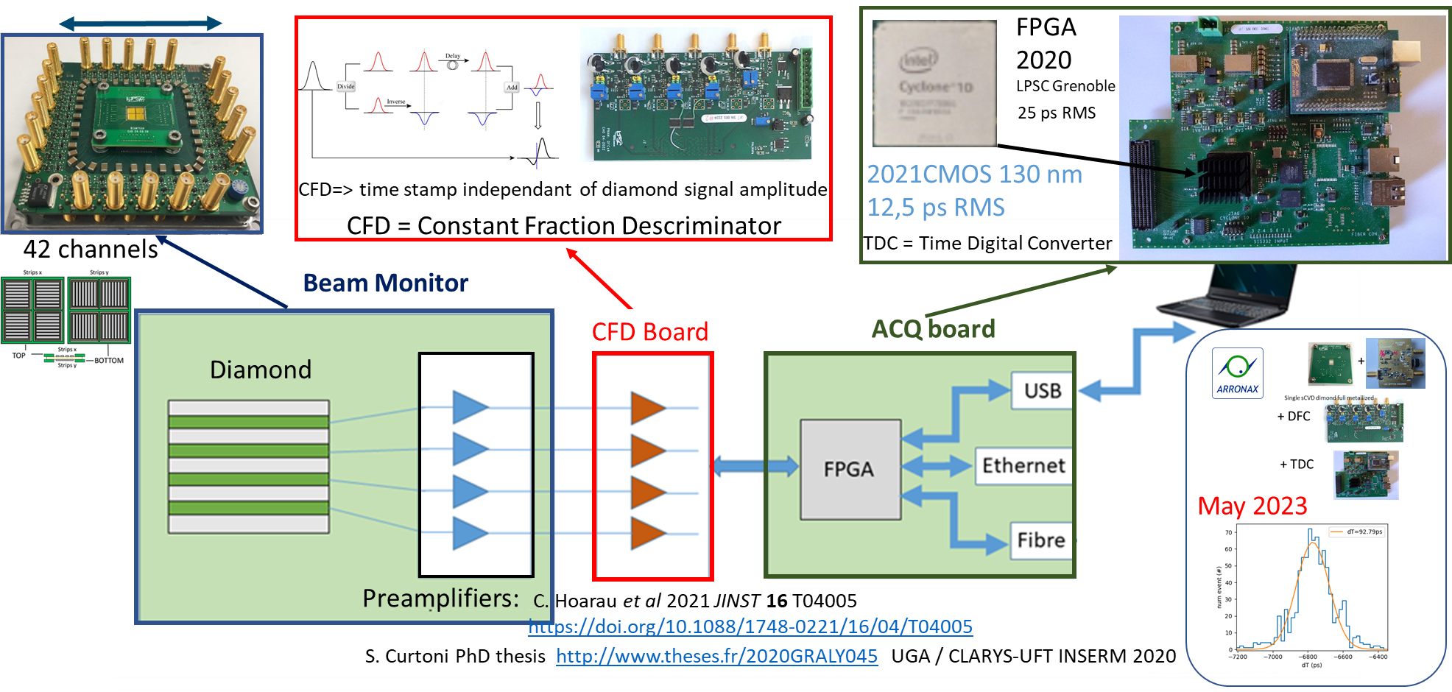
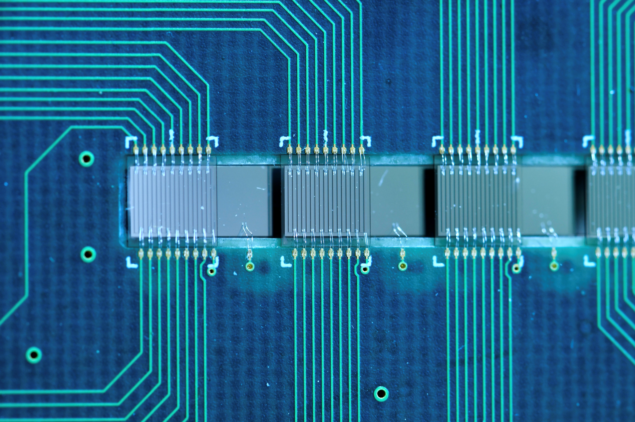
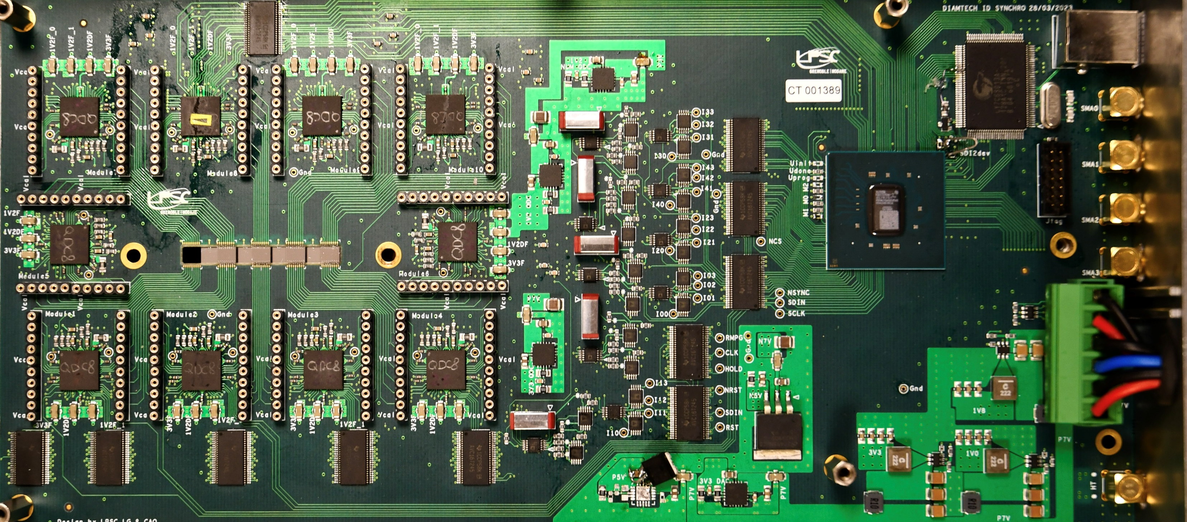
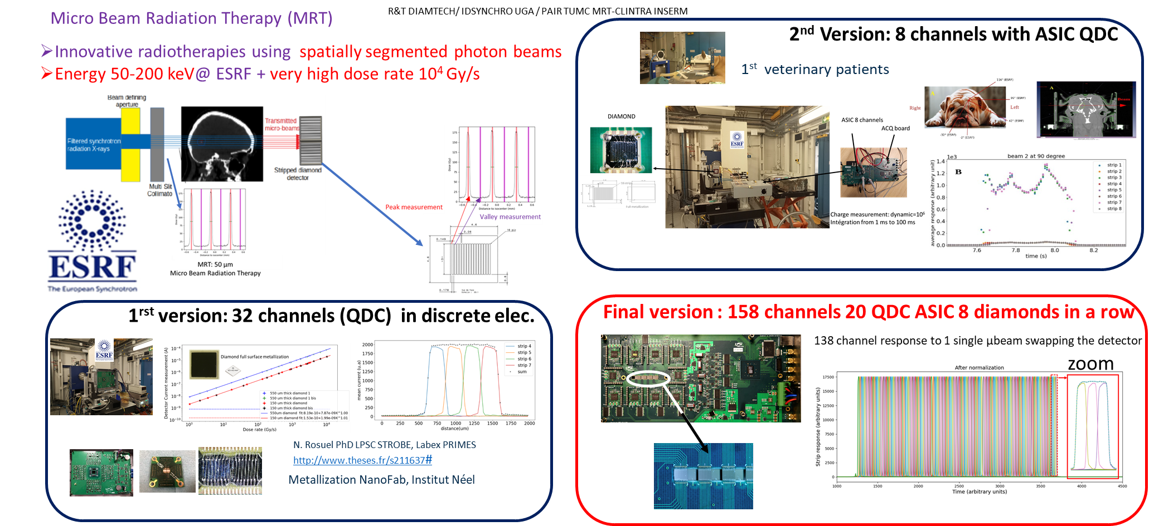
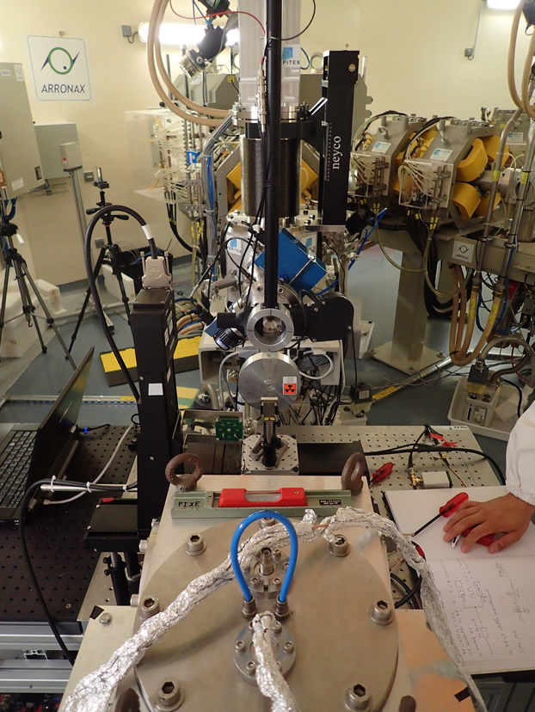
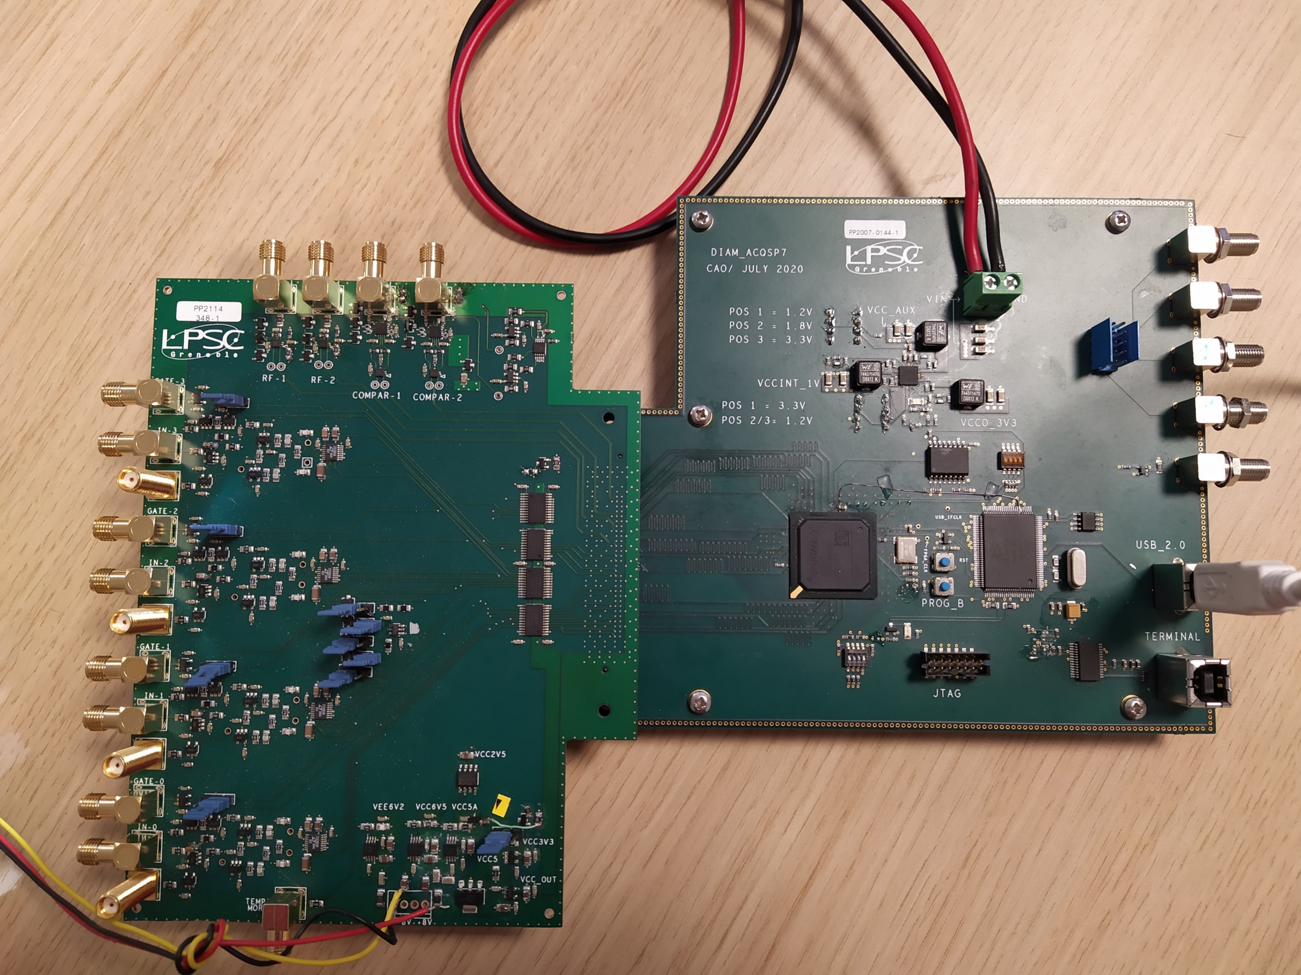
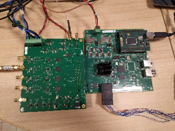

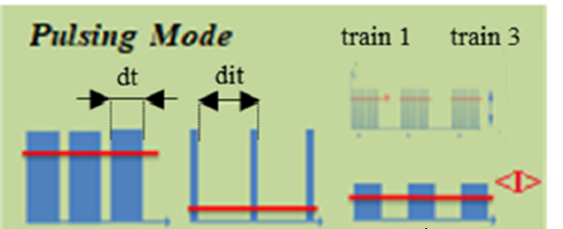
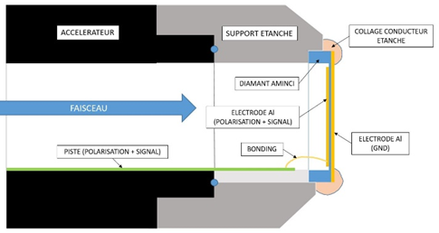
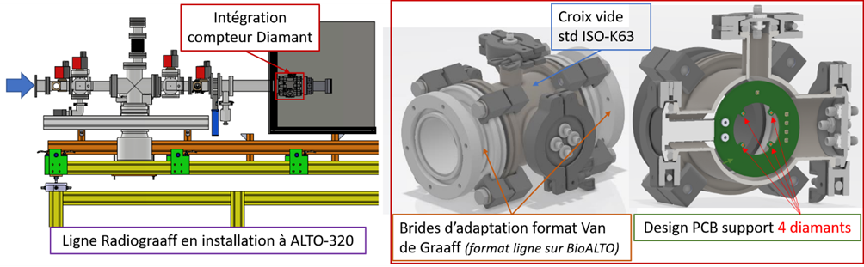
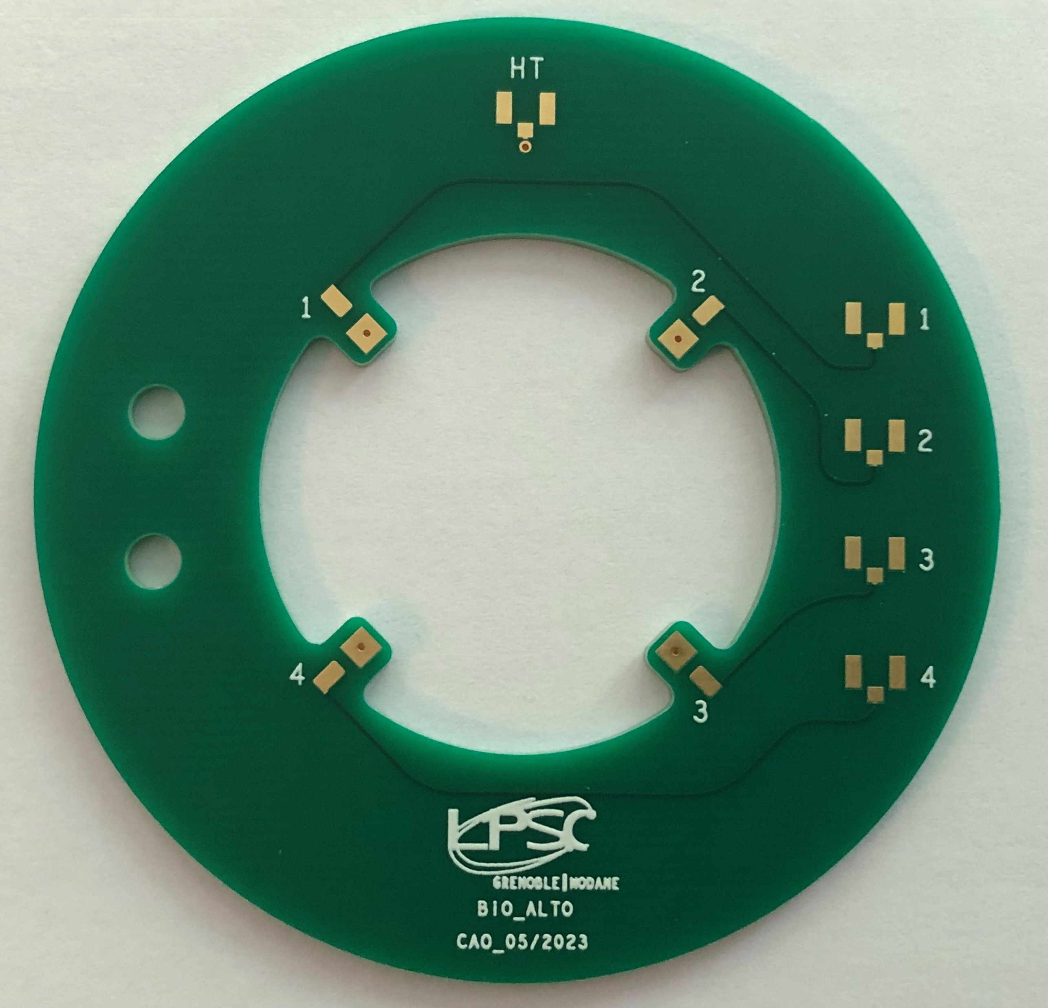
DIAMOND – Beam monitoring @IN2P3 and for medical application : various specification lists!
‘
40 preamps + DFC + TDC 4 diamond sCVD in mosaic or 1 pCVD
Proton beam monitoring in hadrontherapy (CAL)
Coll. Clarys UFT / Coll. TIARA / Coll. ClaRyS - LaBeX PRIMES (P. Everaere PhD thesis)
Single particle
XY spatial resolution ~1 mm
Time resolution ~100 ps
Micro-Xrays beam monitoring application to Microbeam Radiation Therapy (ESRF)
R&T DIAMTECH / IDSYNCHRO / PAIR TUMC - Coll. LPSC – STROBE (INSERM) (N. Rosuel PhD thesis)
Current integration (dynamic=10⁶)
Integration from 10 ms up to 100 ms
138 QDC channels : 20 ASIC + 8 Diamonds in 1 row
Pulsed proton beam monitoring – application to Flash Therapy (ARRONAX)
R&T DIAMTECH / ANR – DIAMMONI Coll. LPSC SUBATECH ARRONAX (R. Molle PhD thesis)
Current integration (dynamic=10⁵)
Train Counting => Time stamps ~3 ns
Bunch Counting
QDC : Train counting
1 sCVD / 1 pCVD diamond
DIAMMONI
Fast preamp + 500 MHz ADC : Bunch counting
Micro - ion beam monitoring (LP2I Bordeaux/AIFIRA - IRSN/ MIRCOM)
Coll. LPSC Institut Néel-Grenoble LP2I-Bordeaux IRSN (C. Léonhart PhD thesis)
To be crossed by protons with energy up to 4 MeV, alpha particles up 6 MeV and B, C, O, … ions up to 8 - 10 MeV.
Diamond deep etching => diamond menbrane of ~1 µm (Institut Néel)
Integration on the µ beam line = extraction window
DéFI DiaMs
Monitoring low energy ion beam (ALTO)
Coll. LPSC IP2I Lyon IJC lab via PICTURE (MP Diamant & BioALTO)
Counter with 4 diamonds (2x2x0.1mm³) placed in the halo of the beam for irradiation monitoring and beam alignment.

Slide 9
DIAMOND – Beam monitoring @IN2P3 and for medical application : various specification lists!
‘
40 preamps + DFC + TDC 4 diamond sCVD in mosaic or 1 pCVD
Proton beam monitoring in hadrontherapy (CAL)
Coll. Clarys UFT / Coll. TIARA / Coll. ClaRyS - LaBeX PRIMES (P. Everaere PhD thesis)
Single particle
XY spatial resolution ~1 mm
Time resolution ~100 ps
Micro-Xrays beam monitoring application to Microbeam Radiation Therapy (ESRF)
R&T DIAMTECH / IDSYNCHRO / PAIR TUMC - Coll. LPSC – STROBE (INSERM) (N. Rosuel PhD thesis)
Current integration (dynamic=10⁶)
Integration from 10 ms up to 100 ms
138 QDC channels : 20 ASIC + 8 Diamonds in 1 row
Pulsed proton beam monitoring – application to Flash Therapy (ARRONAX)
R&T DIAMTECH / ANR – DIAMMONI Coll. LPSC SUBATECH ARRONAX (R. Molle PhD thesis)
Current integration (dynamic=10⁵)
Train Counting => Time stamps ~3 ns
Bunch Counting
QDC : Train counting
1 sCVD / 1 pCVD diamond
DIAMMONI
Fast preamp + 500 MHz ADC : Bunch counting
Micro - ion beam monitoring (LP2I Bordeaux/AIFIRA - IRSN/ MIRCOM)
Coll. LPSC Institut Néel-Grenoble LP2I-Bordeaux IRSN (C. Léonhart PhD thesis)
To be crossed by protons with energy up to 4 MeV, alpha particles up 6 MeV and B, C, O, … ions up to 8 - 10 MeV.
Diamond deep etching => diamond menbrane of ~1 µm (Institut Néel)
Integration on the µ beam line = extraction window
DéFI DiaMs
Monitoring low energy ion beam (ALTO)
Coll. LPSC IP2I Lyon IJC lab via PICTURE (MP Diamant & BioALTO)
Counter with 4 diamonds (2x2x0.1mm³) placed in the halo of the beam for irradiation monitoring and beam alignment.

Slide 10

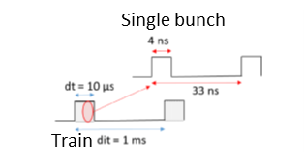
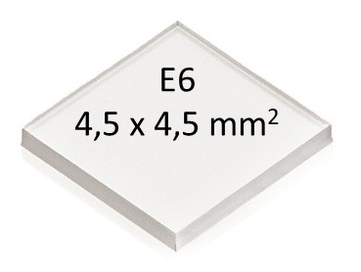
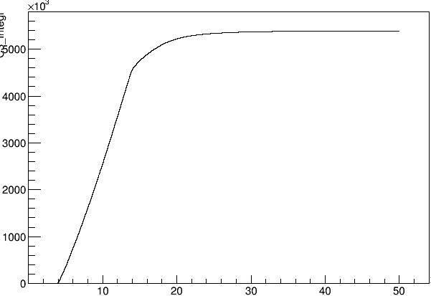
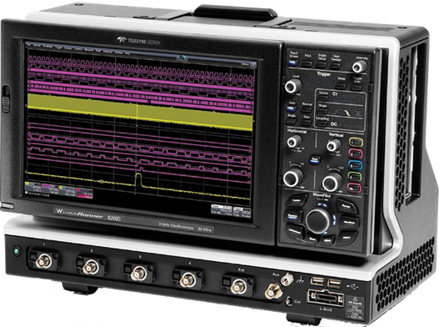




Diamond beam monitor for high proton beam intensities : train couting and time stamps towards « proton FLASH therapies »
Train Counting Mode
ANR - DIAMMONI
Train integral = DSO post analysis
Beam intensity up to 300 nA measured on diamond
Volts-seconds
DSO Lecroy
2 GHz; 10 or 20 GS/s
68 MeV Proton beam
I = 10nA, dt = 10µs, dit = 1s
Time ( µs)
Train integral = on line measurement with LPSC QDC
QDC board
developped @ LPSC
Train - Diamond signal
A.U
FE elec.
+ DAQ
validation
Tension(en V)
Amplitude (V)
DAQ
developped @ LPSC
Temps (µs)
Time ( µs)
Time ( µs)

Slide 11



Diamond beam monitor : the challenge of a linear response on a wide dynamic with ion beams
Study of linearity as a function of beam intensity: sCVD versus pCVD
R. Molle, PhD Thesis LPSC ARRONAX SUBATECH, ANR DIAMMONI
sCVD / pCVD
Charge in a 50 µs-train (µC)
Diamond
sCVD: Linear response from 1 Gy/s up to 10² kGy/s
pCVD: Linear response from 1 Gy/s up to 4 10² kGy/s
~300 Gy/s
for monitoring proton beams in FLASH conditions
with typical dose rate : ~ 300 Gy/s
Each point = ACQ on a single train to avoid any influence of the fluence

Slide 12







High proton flux : diamond signal analysis and simulation towards a better understanding of charge collection mechanism
sCVD and pCVD diamond signals for different beam intensities in ARRONAX
Y. Arnoud simulation of a gas ionization chamber
sCVD
pCVD
3,8 µA
3,8 µA
Amplitude (au)
Amplitude (au)
0,03 µA
Beam intensity
Time (µs)
0,03 µA
Time (µs)
Beam intensity
X µA = beam intensity measured on diamond
PyDiam simulation package in Python 3 (R. Molle PhD thesis, ANR DIAMMONI)
DIAMMONI needs to be
Thin: 50 µm
Biased > 1V/µm (= « normal » bias): 200 V = 4 V/µm
500 µm diamond thick

Slide 13


High fluences : what’s the limit for diamond continuous exposure in a ion beam?
ANR - DIAMMONI
Objectives of the “aging” experimental set-up:
each area corresponds to a beam intensity (= flux = 𝜑)
Irradiation of each zone until obtaining an identical cumulative fluence (=𝜙) between the zones at the end of the experiment
Before
irradiation
sCVD 550µm E6
XBIC mapping at ESRF
Targeting objective

Slide 14











High fluences : diamond aging studies with 68 MeV alpha particles
ANR - DIAMMONI
This diamond was irradiated with 68-MeV alpha particles at ARRONAX with a fluence of approximately 10¹⁵ ions/cm²
The current scales are in relation to the X-beam intensities in the two experiments (before vs after irradiation)
=> The main observation is that the XBIC is close to the leakage current in the irradiated areas which means that the charges are no longer collected.
Before annealing
After
annealing
F. Laffont, TN , Tran – Thi XBIC setup BM05 ESRF
Photoluminescence spectra
sCVD 500µm E6
Simplify scheme of trapping (1), re-emission (1’), recombination (2) and generation (3) phenomena
F. Lafont et al. Article submitted to Diamond and Related Material 2023
The diamond is colored in green typical of GR1 type defects
XBIC mapping at ESRF
After annealing
(1000 °C for 6 hours)
Diamond has recovered
No irradiation-related structural defects are visible => the vacancies created by the irradiation are too far from one another to induce a significant deformation of the crystalline mesh.
From simple calculations, we estimated the displacements per atom to be of the order of few p.p.m
XBIC mapping at ESRF
Before irradiation
Binocular observation
Black traces of irradiation on the PCB
XBIC mapping at ESRF
After irradiation
In blue the areas of less effective charge collection
Before annealing
After
annealing
To understand the origin of this degradation, Bragg diffraction imaging was performed.
N. Tranchant, PhD Thesis, 2008, INSA Rennes.
M. Pomorski, PhD Thesis, 2008, Goethe University Frankfurt.

Slide 15




High fluences : diamond aging studies with 68 MeV alpha particles
Impact of flux on Charge Collection Efficiency (CCE)
R. Molle PhD thesis ANR DIAMMONI
Normalized charge collection per alpha particle
68-MeV alpha particles
ACQ : every ~3 mn between two consecutive points
unusable
Charge collected per alpha (%)
dt = 50µs
dit : variable => <I> = cste
Duration : ~30 mn for each A to E point
E
D
C
With increasing flux, charge collection decreases.
The fluence creates damage in the detector.
It results in the creation of traps that disrupt the collection of charges.
A
Fluence (alpha/cm²)
Proton therapy:
~10¹⁰ protons/cm²/treatment
~20 patient/day
~10¹³ proton/cm²/year
Ion beam monitoring:
It has been shown that
pCVD diamond are
more radiation tolerant than sCVD
Available with larger surfaces:
4 in mosaïc => 16 cm² to be covered
Simplify scheme of trapping (1), re-emission (1’), recombination (2) and generation (3) phenomena
CCE drops faster with fluence at higher flux.
10¹³ alphas/cm²/s = 0.1 alpha/nm²/s: interplay between vacancy creation and stable electronic defects (charge carrier traps)?
Why not measure on the halo ?
N. Tranchant, PhD Thesis, 2008, INSA Rennes.
M. Pomorski, PhD Thesis, 2008, Goethe University Frankfurt.

Slide 16
Conclusion
The development are in connection with collaborations established at IN2P3, CNRS (INP), CAL, IRSN and ESRF
It has been done in the context of interdisciplinary research IN2P3 - INP skills exchanges take place between
  characterization: sources (labs) + accelerator beams @ IN2P3 AIFIRA / GIP - ARRONAX, XBIC @ ESRF
  Instrumentation (IN2P3 labs, Institut Néel, etc.)
Diamond beam monitors + FE electronics and DAQ have been developed
  Various specifications (time resolution, continuous or pulsed beams, single particle counting up to 10⁶ particle in a bunch)
  Diamond beam monitoring satisfies the FLASH therapy condition (linear response in the range 1 to 4 10⁵ Gy/s with X-rays and proton beams)
  => the proposed detection systems will bring significant added value to the transfer of high dose rate flash radiotherapy to clinical trials
Simulation + aging studies are on going for a better understanding of the signal formation and the impact of very high fluences on charge collection

Slide 17














Fission Fragment (FF) detection with diamond detector
Lohengrin experiment at ILL
Diamond
detector
FF
Energy resolution
Time resolution
sCVD diamond for fission fragment detection @ LOHENGRIN
σ/µ = 1.6%
FF A=98, E=90 MeV
ML Gallin-Martel et al, Front. Phys., 20 September 2021
Characterization of Diamond and Silicon Carbide Detectors With Fission Fragments
https://doi.org/10.3389/fphy.2021.732730
σ/µ = 1.5%
σ=9.5 ps
FF A=86, E=86 MeV
FF A=98, E=100 MeV
Monolithic diamond ∆E-E telescope
1rst prototype
FF
∆E
E
A. Portier PhD thesis, LPSC – Néel, Université Grenoble Alpes, March 2023, https://www.theses.fr/2023GRALY026

Slide 18

THANKS FOR YOUR ATTENTION !
©
Diamond Jokes Quotes

