Slide 1


Results from the PARIS array at the Nuball1 and Nuball2 campaigns in IJCLab
Michał Ciemała
IFJ PAN Kraków
Colloque GANIL, 2023, Soustons

Slide 2
Presentation plan
PARIS project – short information
PARIS coupled to Nuball1
PARIS coupled to Nuball2
Summary

Slide 3
PARIS project – short information

Slide 4
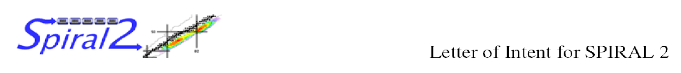
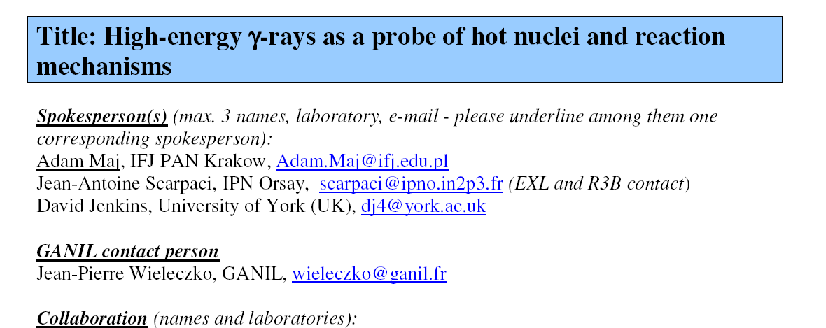
PARIS project
4-5-6th October, 2005 „Future prospects for high resolution gamma spectroscopy at GANIL”
Convenors : Bob Wadsworth and Wolfram Korten
WG „Collective modes in continuum” – convenors: Silvia Leoni and Adam Maj;
M. Kmiecik: talk on possible Jacobi shapes in exotic nuclei
GANIL
SAC open session
October 19th, 2006

Slide 5
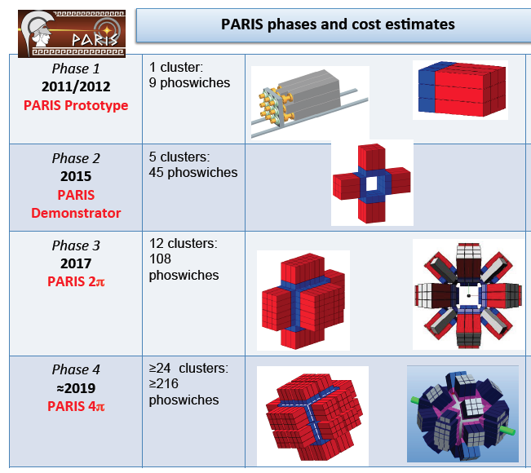
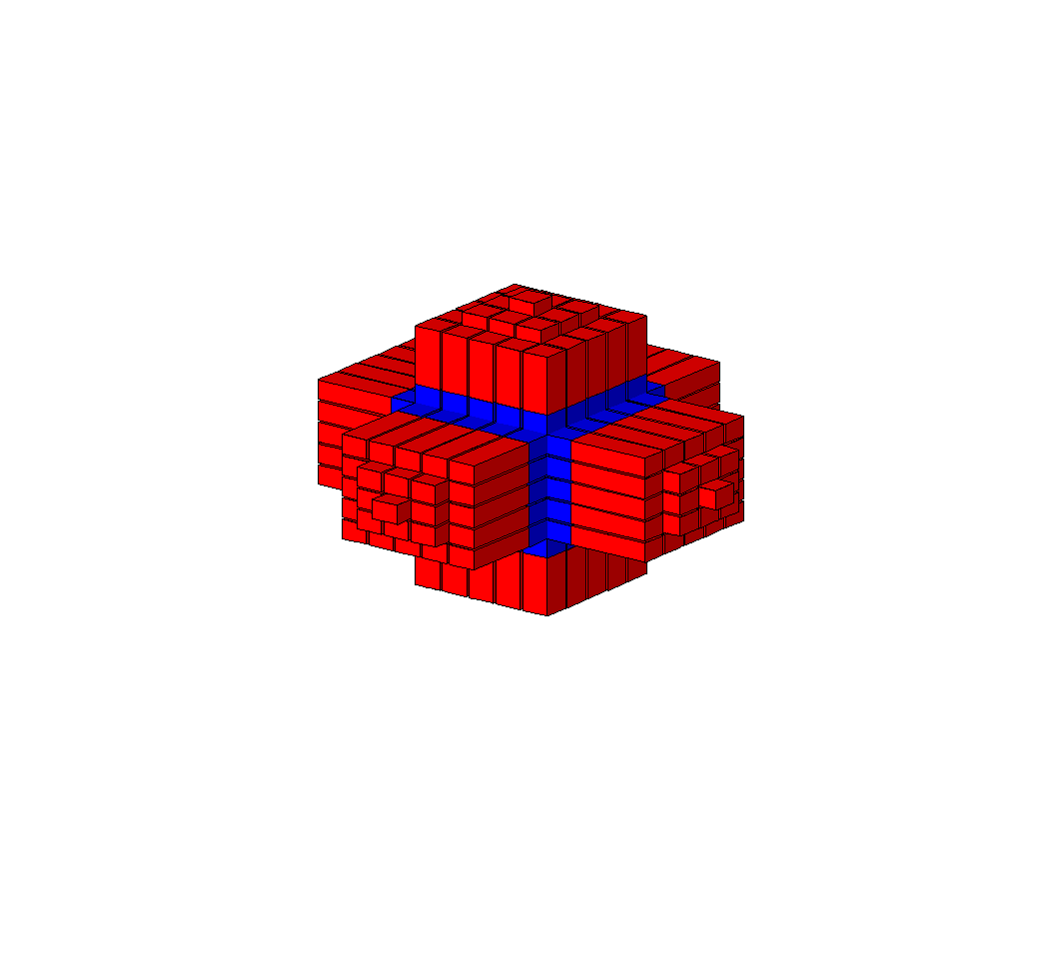
Photon Array for studies with Radioactive Ion and Stable Beam - PARIS
PARIS is made of clusters:
Cluster = 9 phoswiches of LaBr₃:NaI or CeBr₃:NaI
Digital electronic basing on V1730 digitizer, which can be coupled to NUMEXO2 boards. Also other electronic used, by example FASTER digitizers (NFS exp. and @IJCLab)
PARIS cluster
8 clusters
72 phoswiches
2021
2025?
Goal of the new MoU
4π mini-cube
(150 phoswiches)
2025?
Today we have ~ 10 clusters (90 detectors)
after2025
after2025

Slide 6

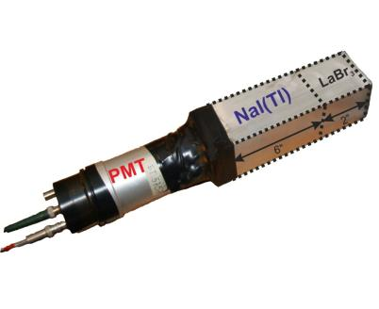
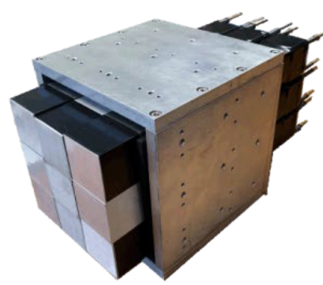
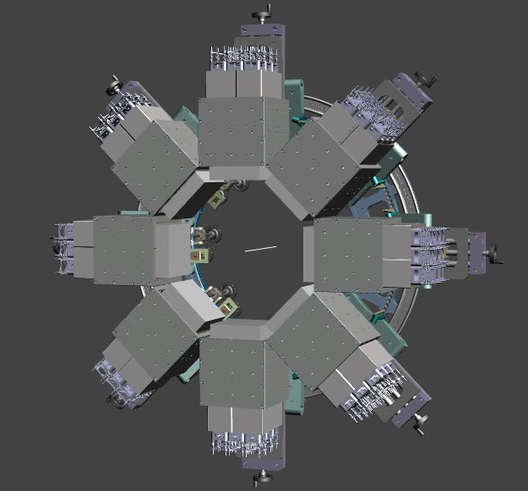
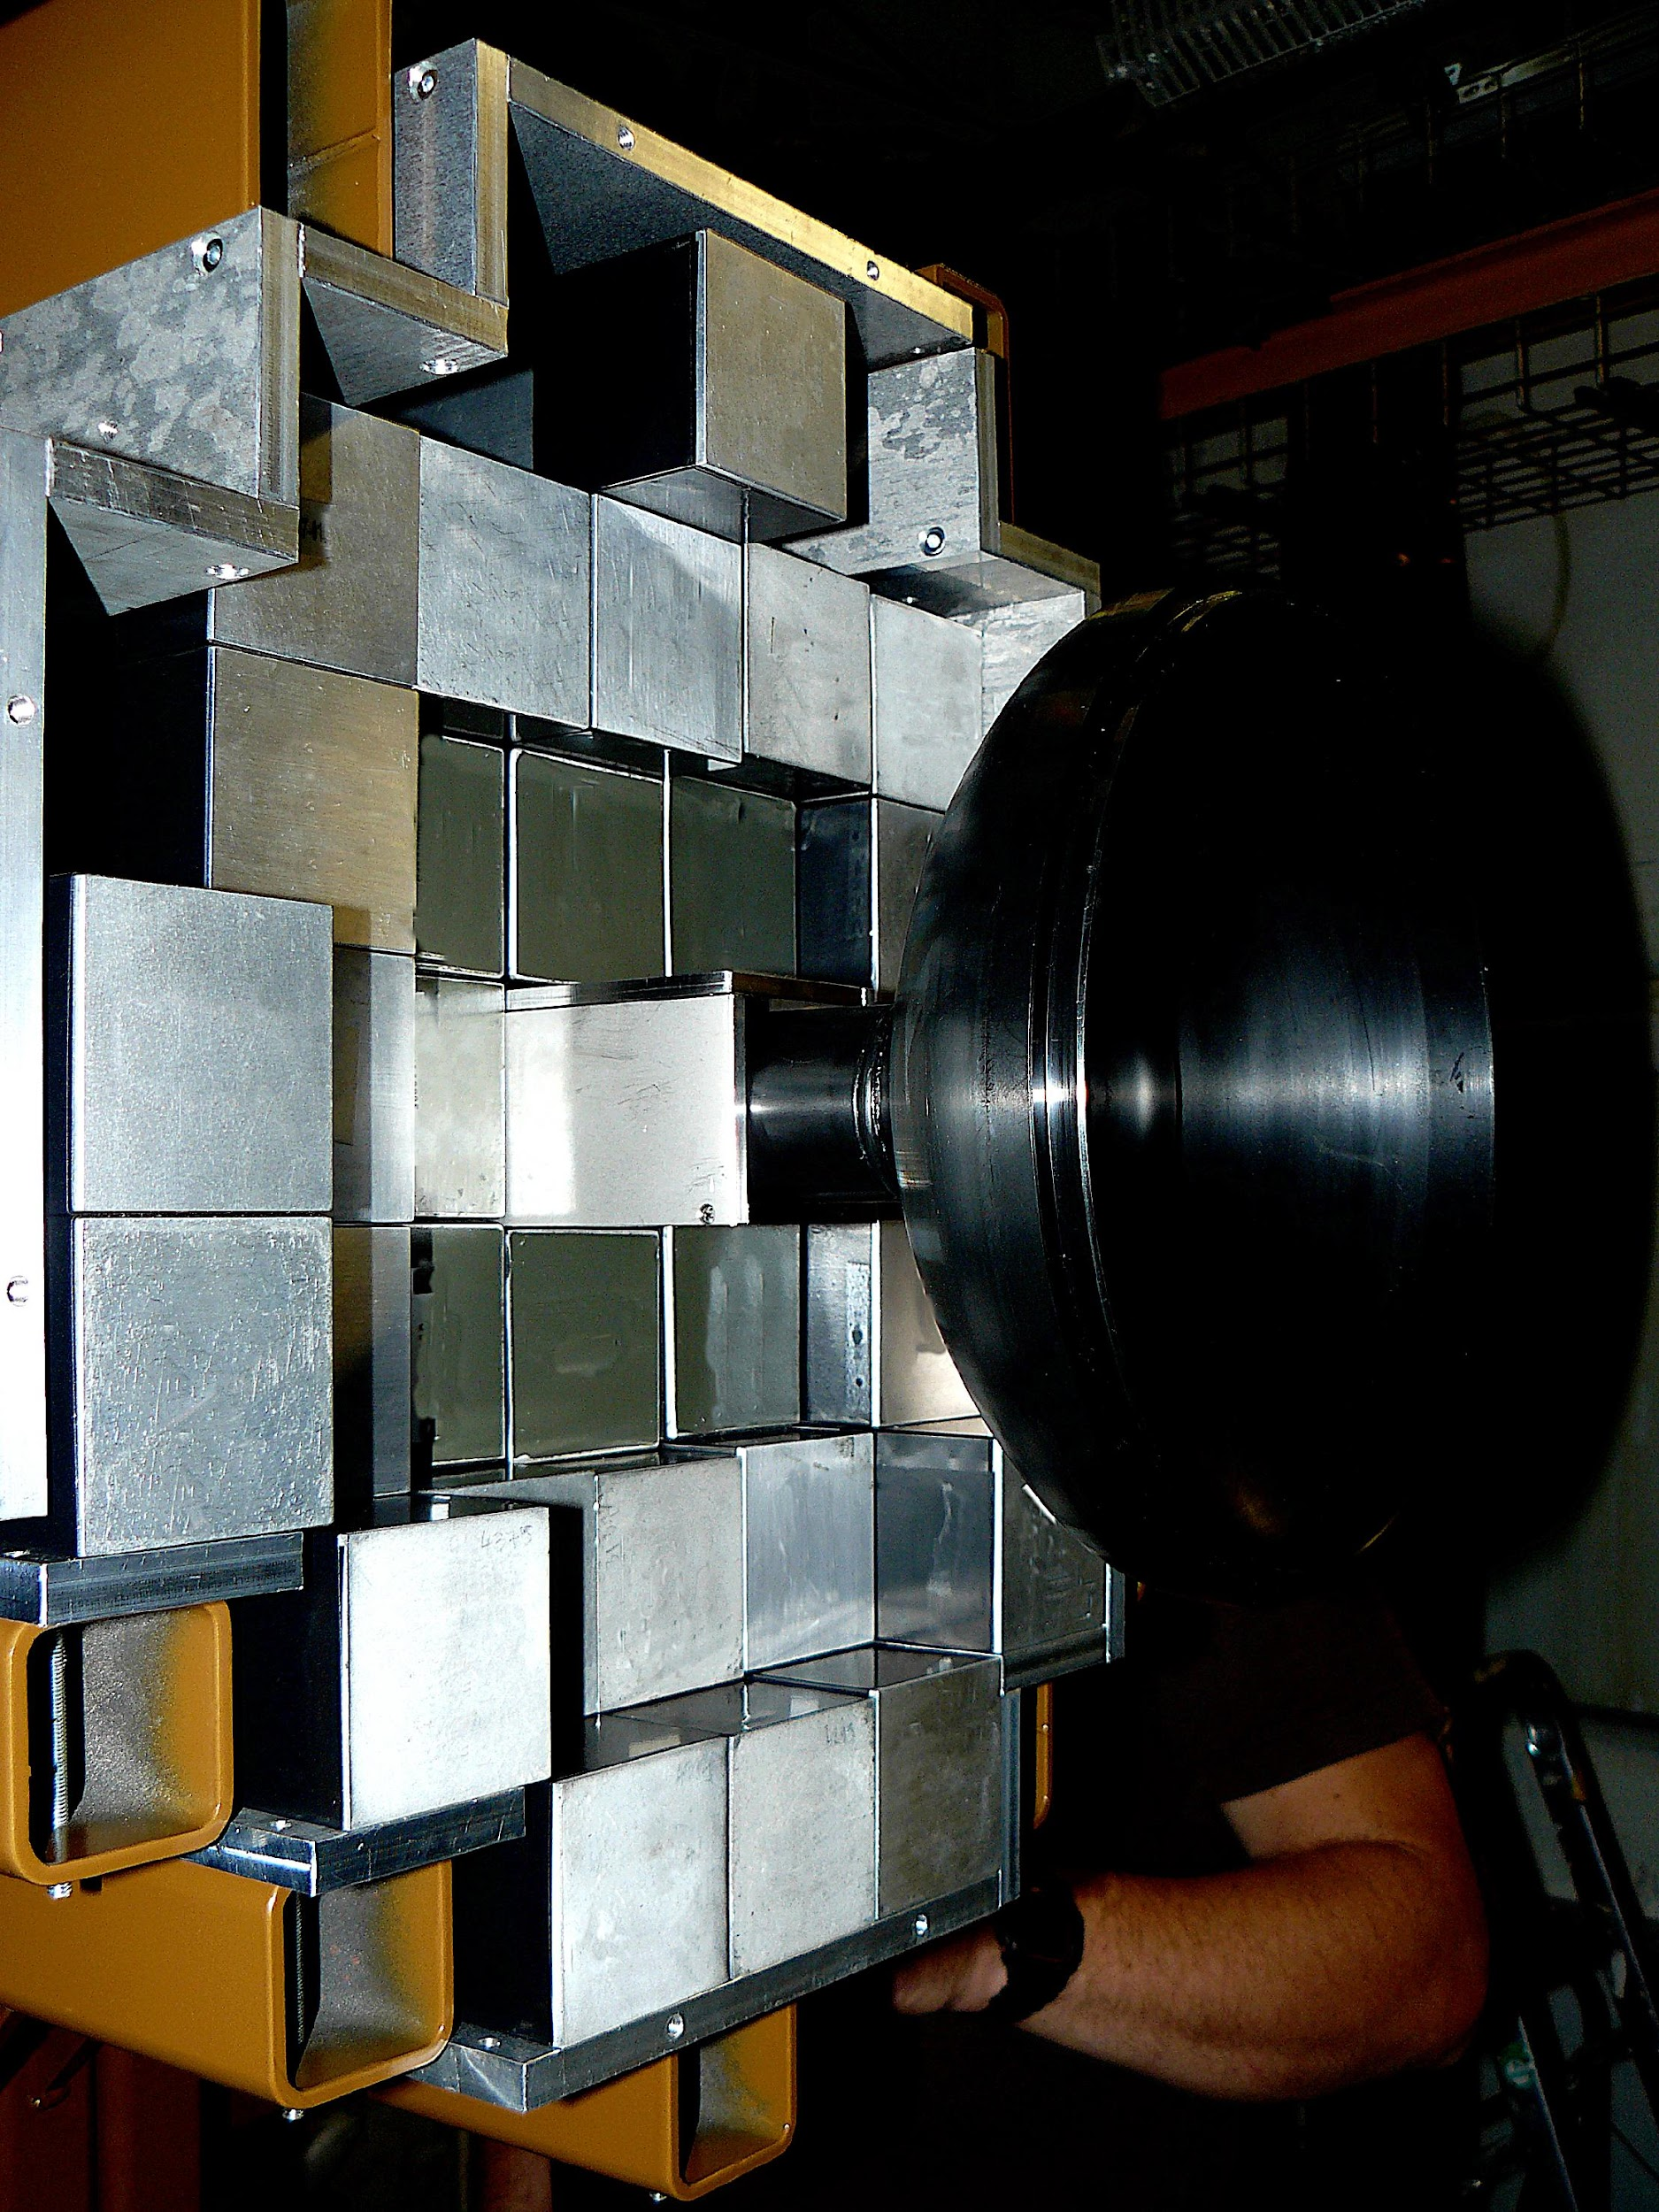
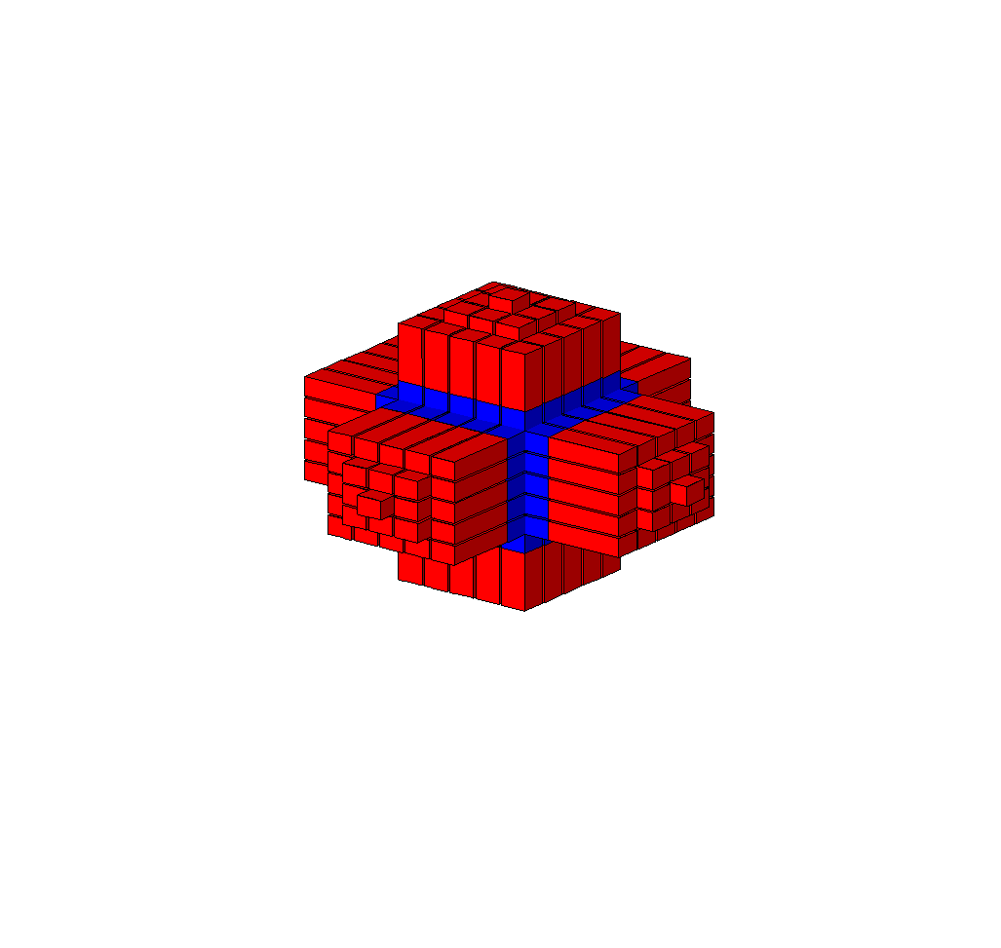
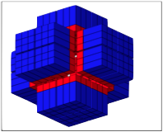
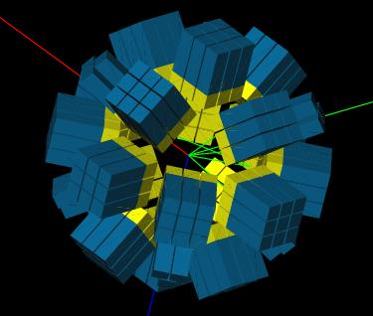
PARIS design
PARIS is made of rectangular phoswiches (LaBr₃/CeBr₃+NaI)
arranged in clusters
(9 phoswiches each) - this allows cubic, wall or semi-spherical geometry

Slide 7
PARIS organization
10 PARTNERS:
IN2P3 (France), COPIN (Poland), GANIL/SPIRAL2 (France), TIFR/BARC/VECC (India), IFIN HH (Romania),
INFN (Italy), UK, Turkey, GSI/FAIR Darmstadt
PARIS Steering Committee
Angela Bracco (INFN, Italy)
Wilton Catford (UK)
Oliver Dorvaux (IN2P3, France)
Sefa Ertuerk (Turkey)
Bogdan Fornal (COPIN, Poland) - Vice-Chair
Juergen Gerl (GSI/FAIR, Germany)
Marek Lewitowicz (GANIL, France) - Chair
Vandana Nanal (India)
Mihai Stanoiu (Romania)
PARIS Project Manager
Adam Maj (Krakow)
Working Groups and their Coordinators
Piotr Bednarczyk (Krakow) - Online user interface integration
Sergio Brambilla (Milano) - Electronic and DAQ integration
Michał Ciemała (Krakow) - Physics event generators, off-line data analysis and data management
Oliver Dorvaux (Strasbourg) - Detectors
Iolanda Matea (Orsay) - Mechanical integrations
Oliver Stezowski (Lyon) - Simulations and characterization
PARIS Collaboration Council (21 institutions)
F. Camera (INFN and U. Milano) - chair and PARIS spokesman
C. Bhattacharya (VECC Kolkata), W. Catford (U. Surrey), M. Cinausero (LNL Legnaro), S. Courtin (IPHC Strasbourg),
Zs. Dombradi (ATOMKI Debrecen), C. Ducoin (IPN Lyon), S. Ertuerk (U. Nigde), N. Gelli (U. Florence), J. Gerl (GSI),
A.K. Gourishetty (IIT Roorkee), D. Jenkins (U. York), M. Kmiecik (IFJ PAN Krakow),
B. Kumar Nayak (BARC Mumbai), M. Labiche (STFC Daresbury), V. Nanal (TIFR Mumbai), P. Napiorkowski (HIL Warsaw), M. Ploszajczak (GANIL), M. Stanoiu (IFIN-HH Bucharest), J. Wilson (IPN Orsay)

Slide 8
PARIS detectors in experiments
So far PARIS was used in a number of experiments performed at
GANIL 2017:
@VAMOS,AGATA: Lifetime measurements of excited states in neutron-rich C and O isotopes : a stringent test of the three body forces, S. Leoni, B. Fornal, M. Cieamła et al.
b) GANIL 2022:
@VAMOS: Insight into fission from the gamma probe: Going beyond current status with PARIS@VAMOS, Ch. Schmitt, A. Lemassson, M. Cieamła et al., talk on Wednesday by Christelle Schmitt
@LISE: Study of deformed and spherical 2⁺ states via Coulomb excitation and first time measurement of PDR in ³⁴Si, R. Lica, S. Calinescu, O. Sorlin, et al.
Study of Proton/Neutron contribution along Silicium isotopic chain, S. Grévy, R. Thomas, O. Sorlin, et al.
@NFS:Nuclear structure studies using neutron inelastic scattering reactions, example of the pygmy resonance in ¹⁴⁰Ce, M. Vandebrouck, I. Matea et al., previous talk by Marine Vandebrouck

Slide 9
PARIS detectors in experiments
So far PARIS was used in a number of experiments performed
b) 3 exp at CCB in IFJ PAN Krakow (2 clusters + 4 Large LaBr3 + KRATTA + DSSSD) 2016-2021
next talk by Maria Kmiecik
c) 13 exp at IPN / IJCLab Orsay (1-8 clusters, standalone and with nuBall and nuBall2, BEDO, Corset, …) (2016-2023)
Plans for PARIS campaigns:
June 2023 - end of 2024: 2 clusters in Mumbai
October 2023 – 2024: 3 clusters in Krakow
from January 2025 - possible PARIS-AGATA campaign at LNL Legnaro
after 2026: possible new campaign at GANIL

Slide 10
PARIS coupled to Nuball1

Slide 11
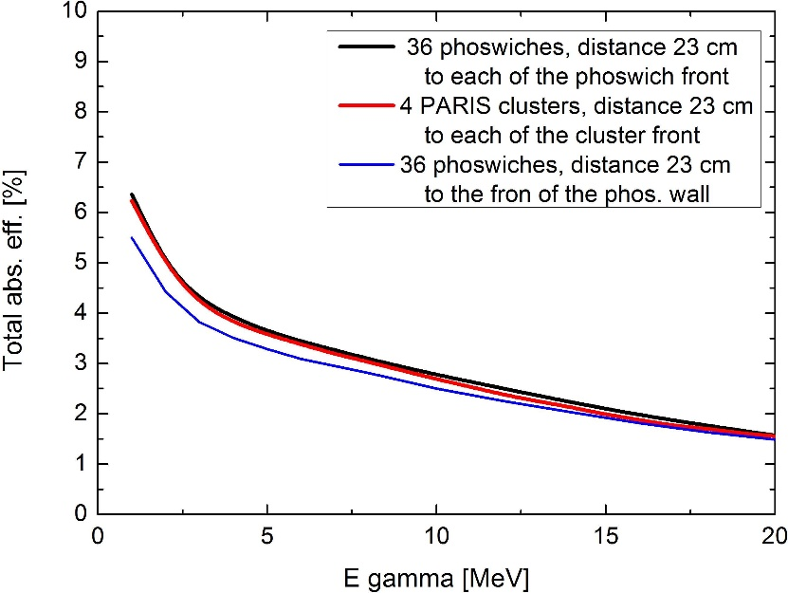
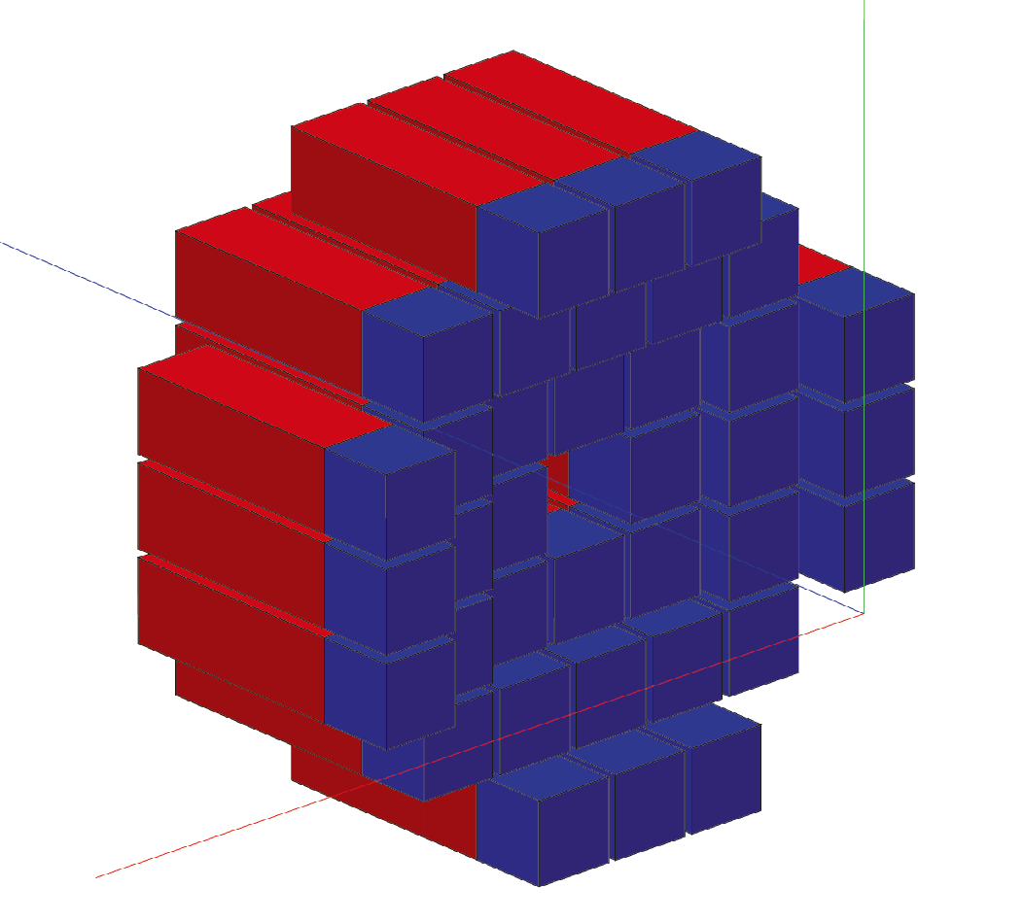
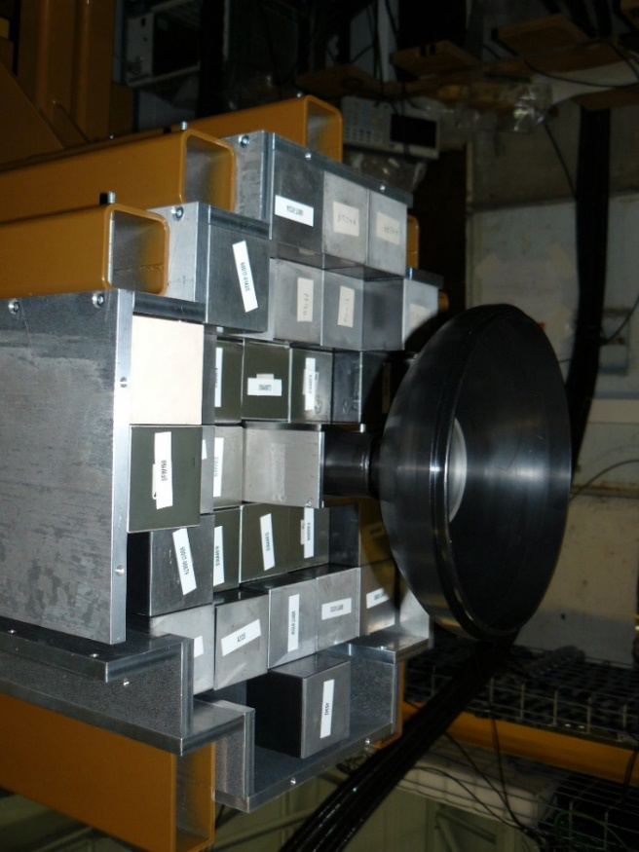

PARIS configuration in IPN/IJCLab experiment (Nuball1 + PARIS)
33 PARIS detectors („wall” configuration
at backward angles at 23 cm):
11 CeBr₃:NaI phoswiches,
22 LaBr₃:NaI phoswiches.
efficiency
Good energy resolution for low and high energy
γ-rays ~ 35 keV @ 1.332 MeV
Excellent Time resolution (below ~ 1 ns)
Large efficiency for high energy γ-rays

Slide 12
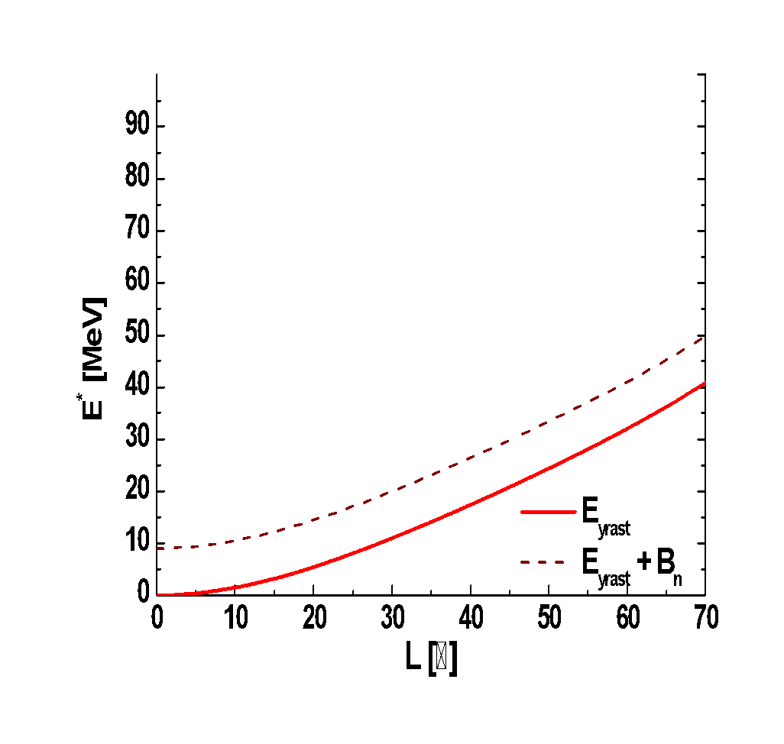

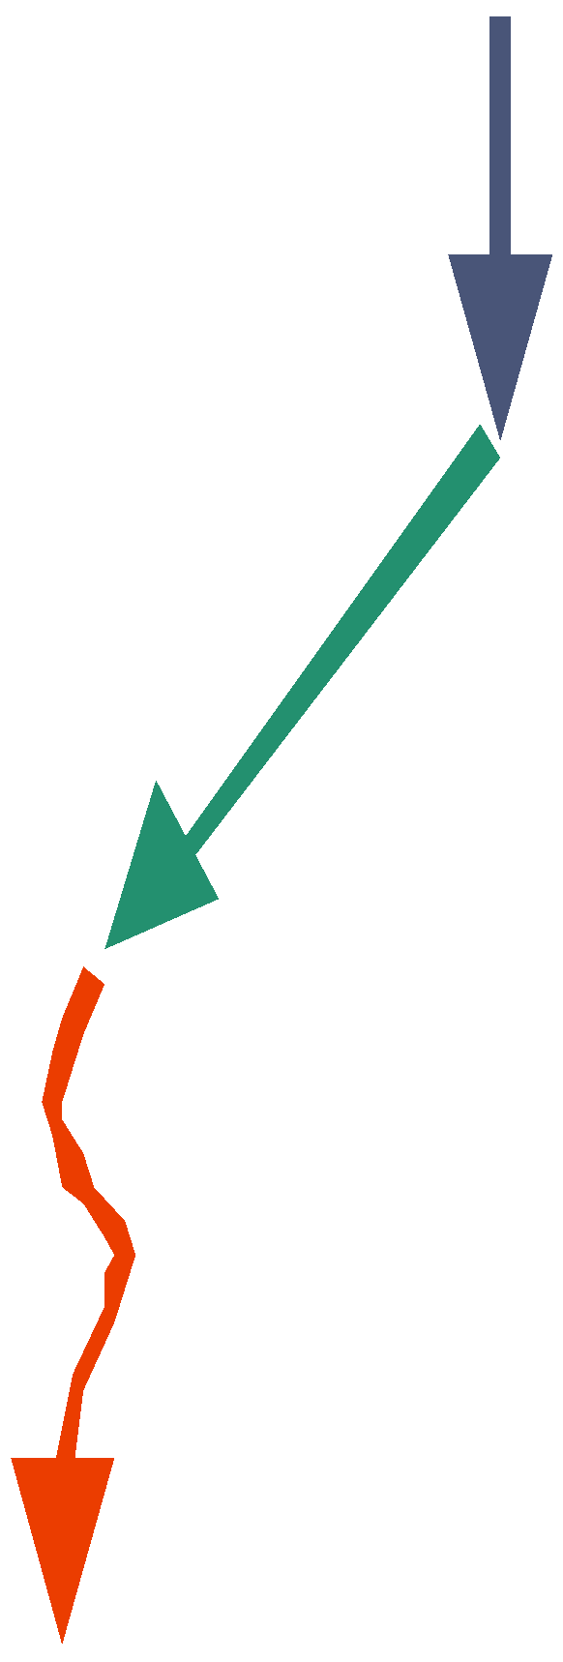






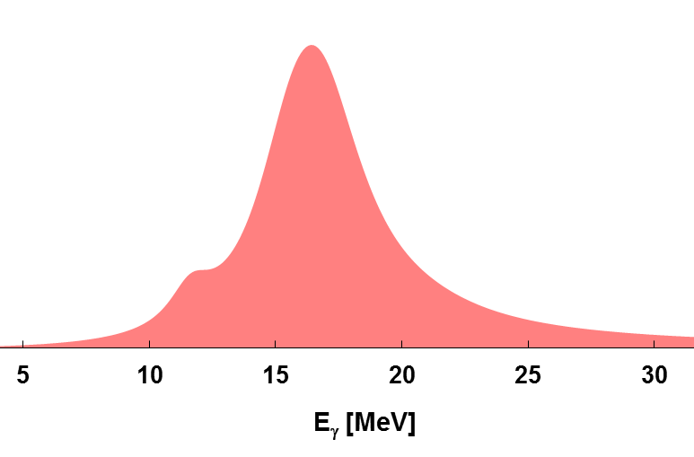
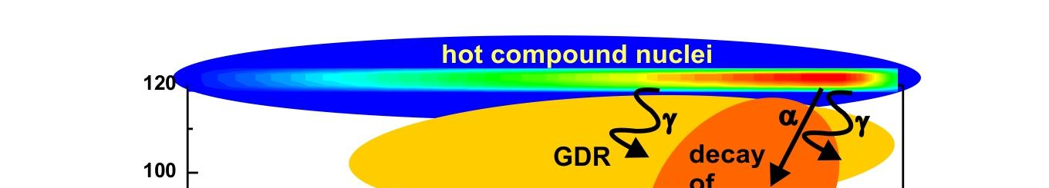
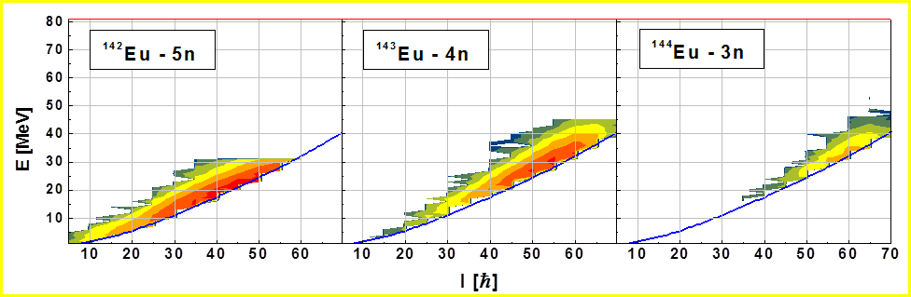



“Feeding of low-energy structures of different deformations by the GDR decay: the nuBall array coupled to PARIS”
Link between deformation of hot compound nucleus and deformation of cold evaporation residue by the measurement of GDR decay of compound nucleus
GDR γ
n
GDR high energy gamma rays
- hot nucleus shape
low energy transitions
- deformation
of excited residue
n
α
n
GDR γ
Excitation energy [MeV]
n
n
Angular momentum [h]
Choosing the particular decay path
by coincidence measurement of high and low-energy γ rays

Slide 13

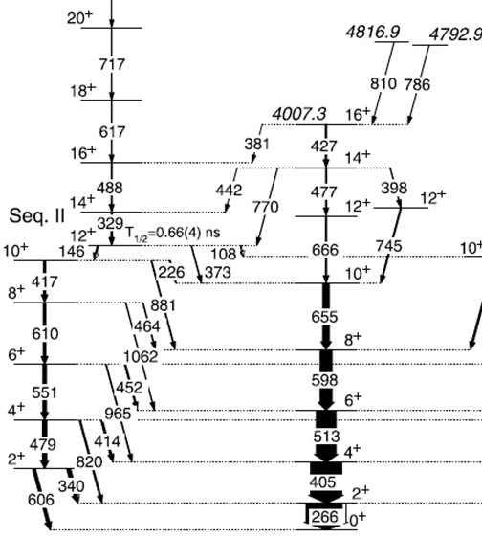
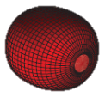
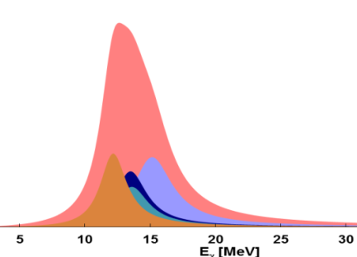
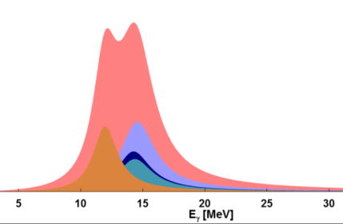
The ¹⁹²Pt* decay to ¹⁸⁸Pt residue
High-energy γ rays from ¹⁹²Pt* CN decay in 4n channel
in coincidence with low-energy transitions in ¹⁸⁸Pt
β =0.18 and γ=−6°
near prolate
How the deformation changes along the decay path?
β=0.16 and γ=−40°
triaxial
GDR strength functions for CN decaying to particular states of ¹⁸⁸Pt
Gate on transitions
S. Mukhopadhyay et al., Phys. Lett. B 739, 462 (2014)

Slide 14
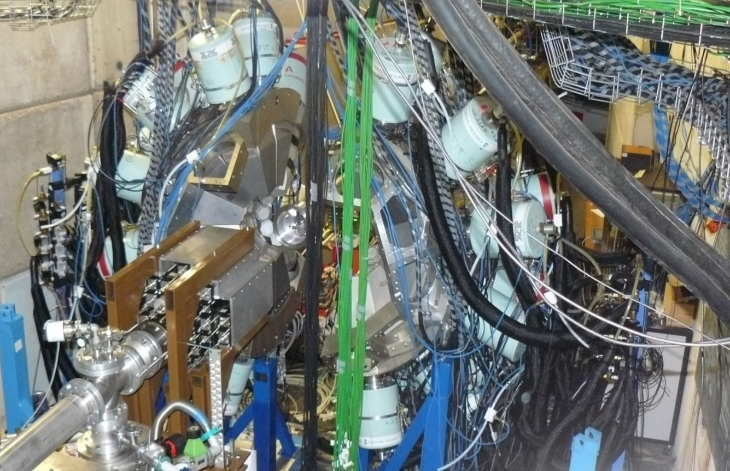
The nuBall + PARIS experiment at IPN / IJCLab
ν-ball array: 33 Clovers +10 Coaxial HPGe
coupled to 33 PARIS detectors:
11 CeBr₃:NaI phoswiches,
22 LaBr₃:NaI phoswiches.
Triggerless DAQ by FASTER digitizer
¹⁸O + ¹⁷⁴Yb → ¹⁹²Pt
Beam energy: 90 MeV
E* = 59 MeV
T = 1.5 MeV
L_{max} = 38 ħ
Target thickness: 1.5 mg/cm²
AmBe+Ni
used for high energy callibration (up to 9 MeV)
ν-ball
PARIS

Slide 15
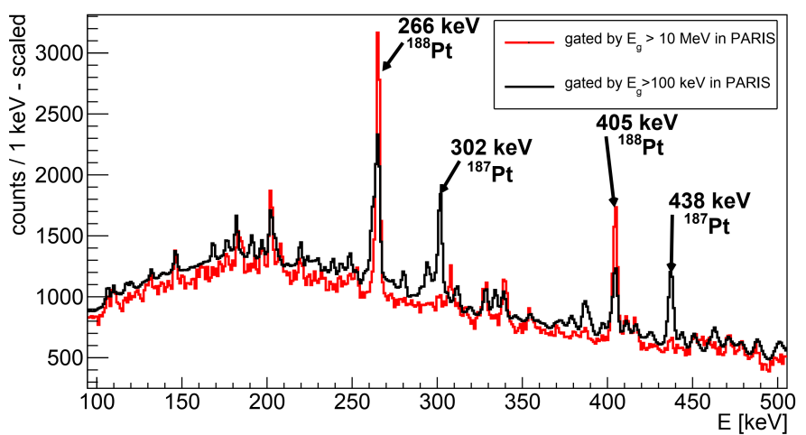
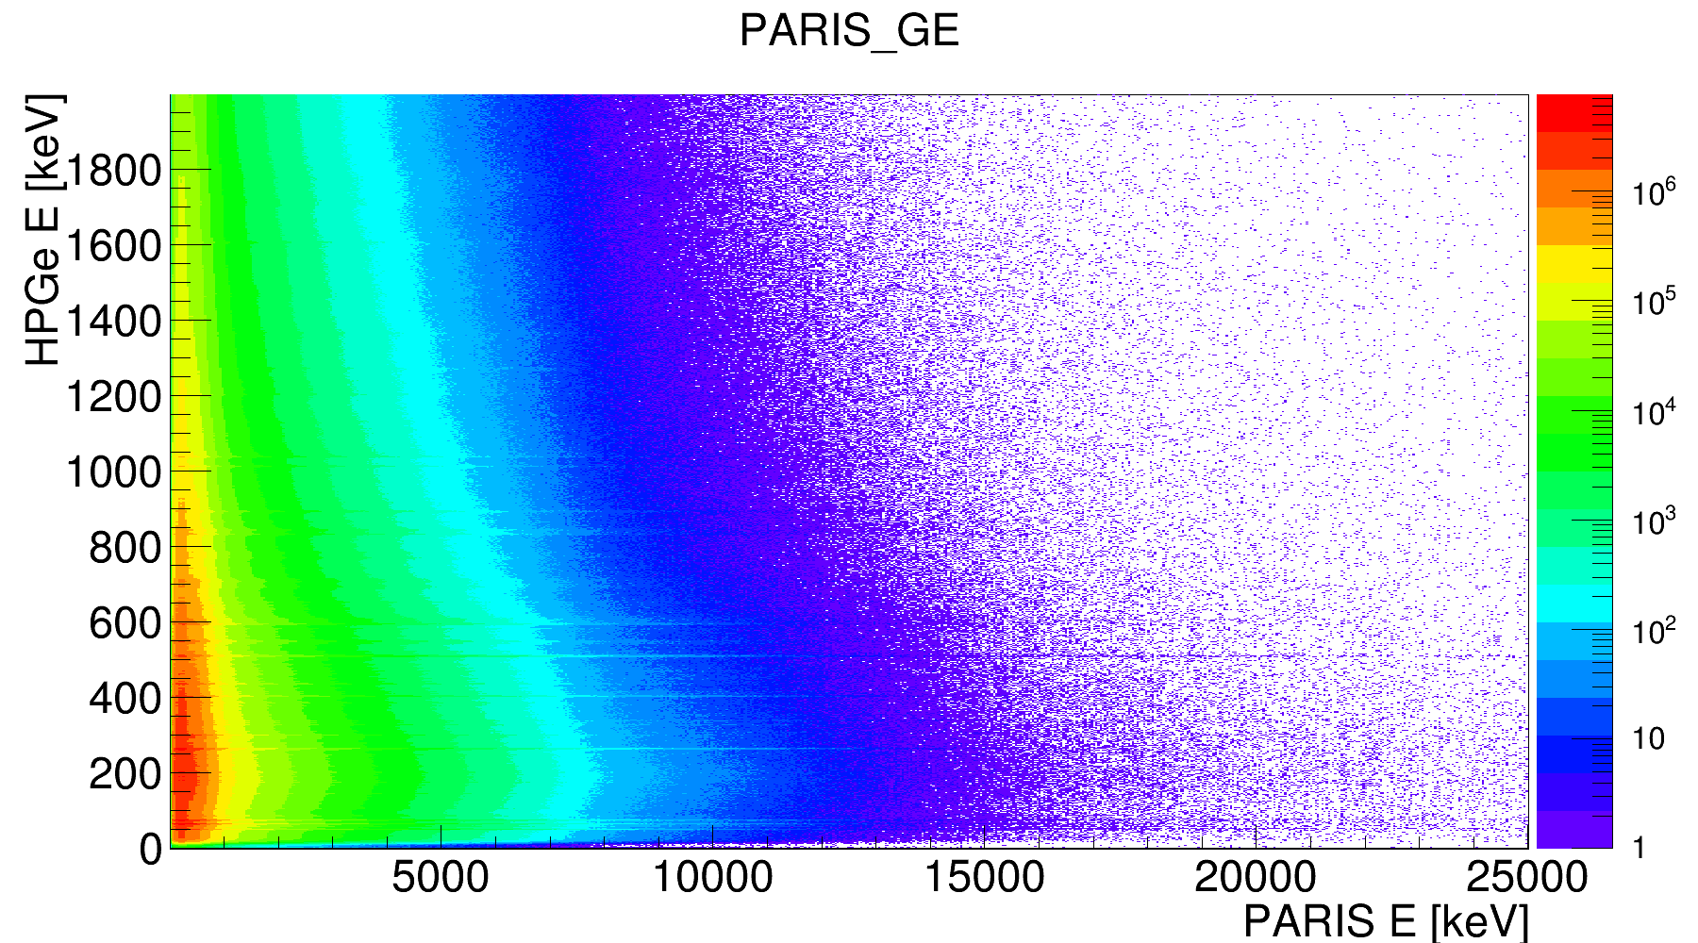
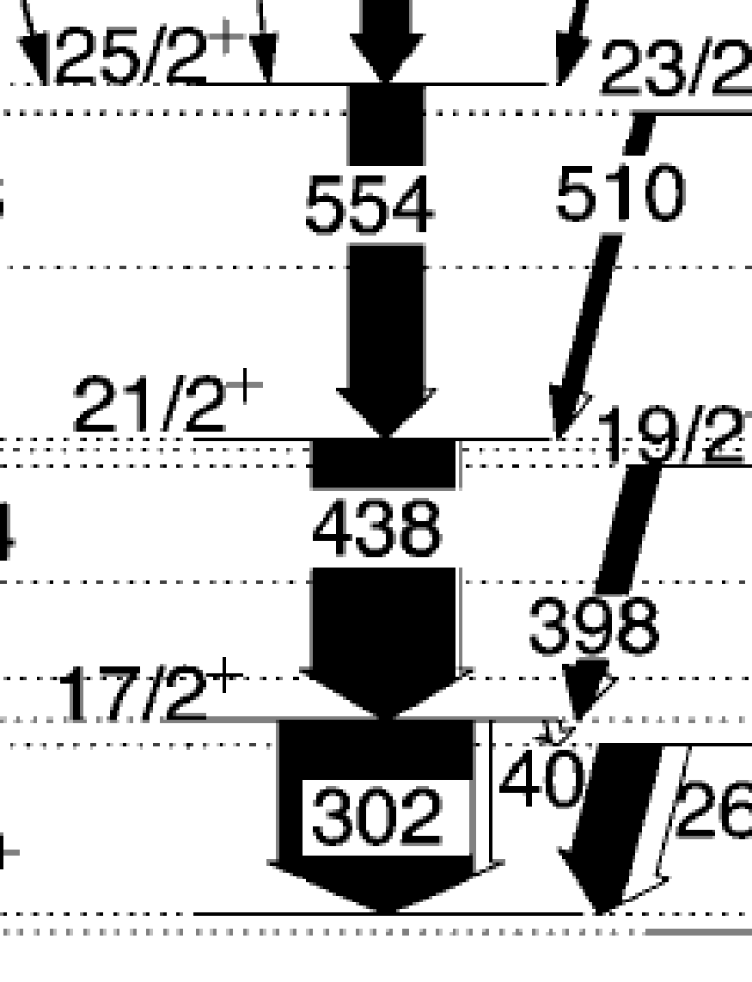
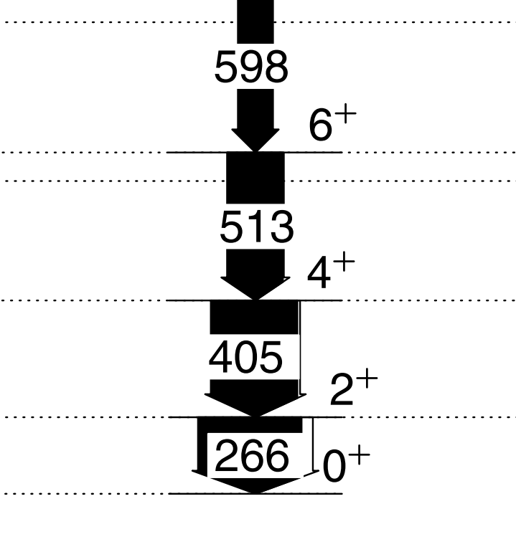
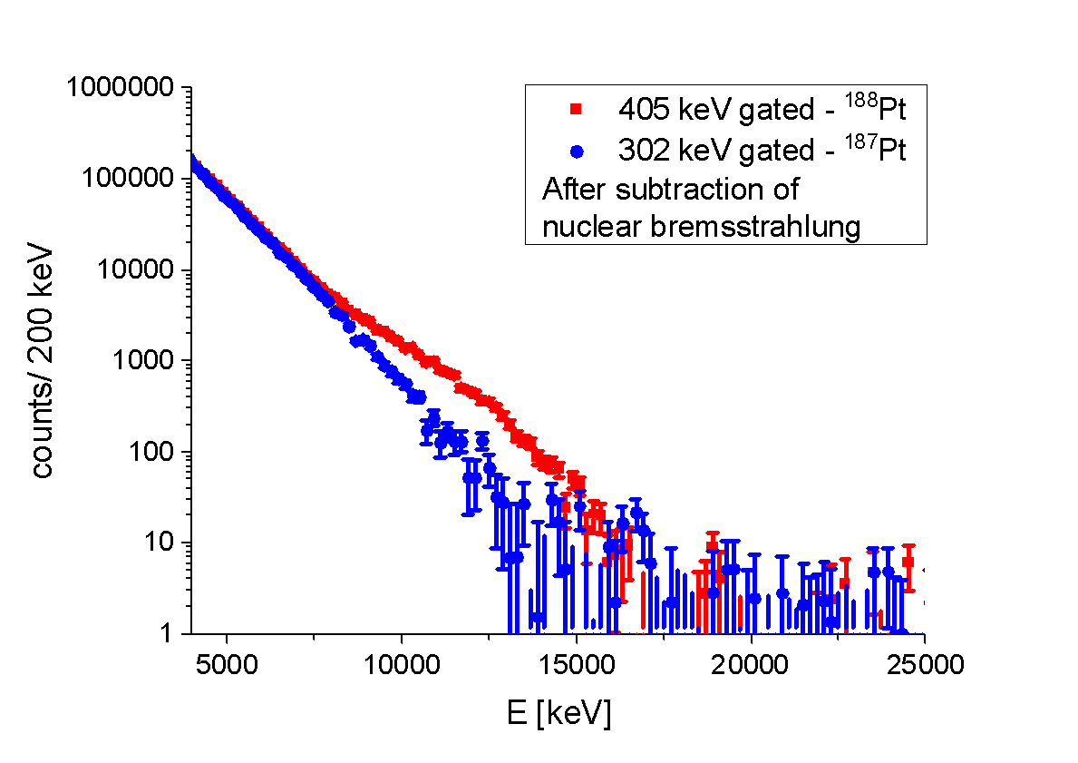
γ – γ HPGe vs PARIS
405 keV
302 keV
90 MeV ¹⁸O + ¹⁷⁴Yb → ¹⁹²Pt
¹⁸⁷Pt
¹⁸⁸Pt

Slide 16
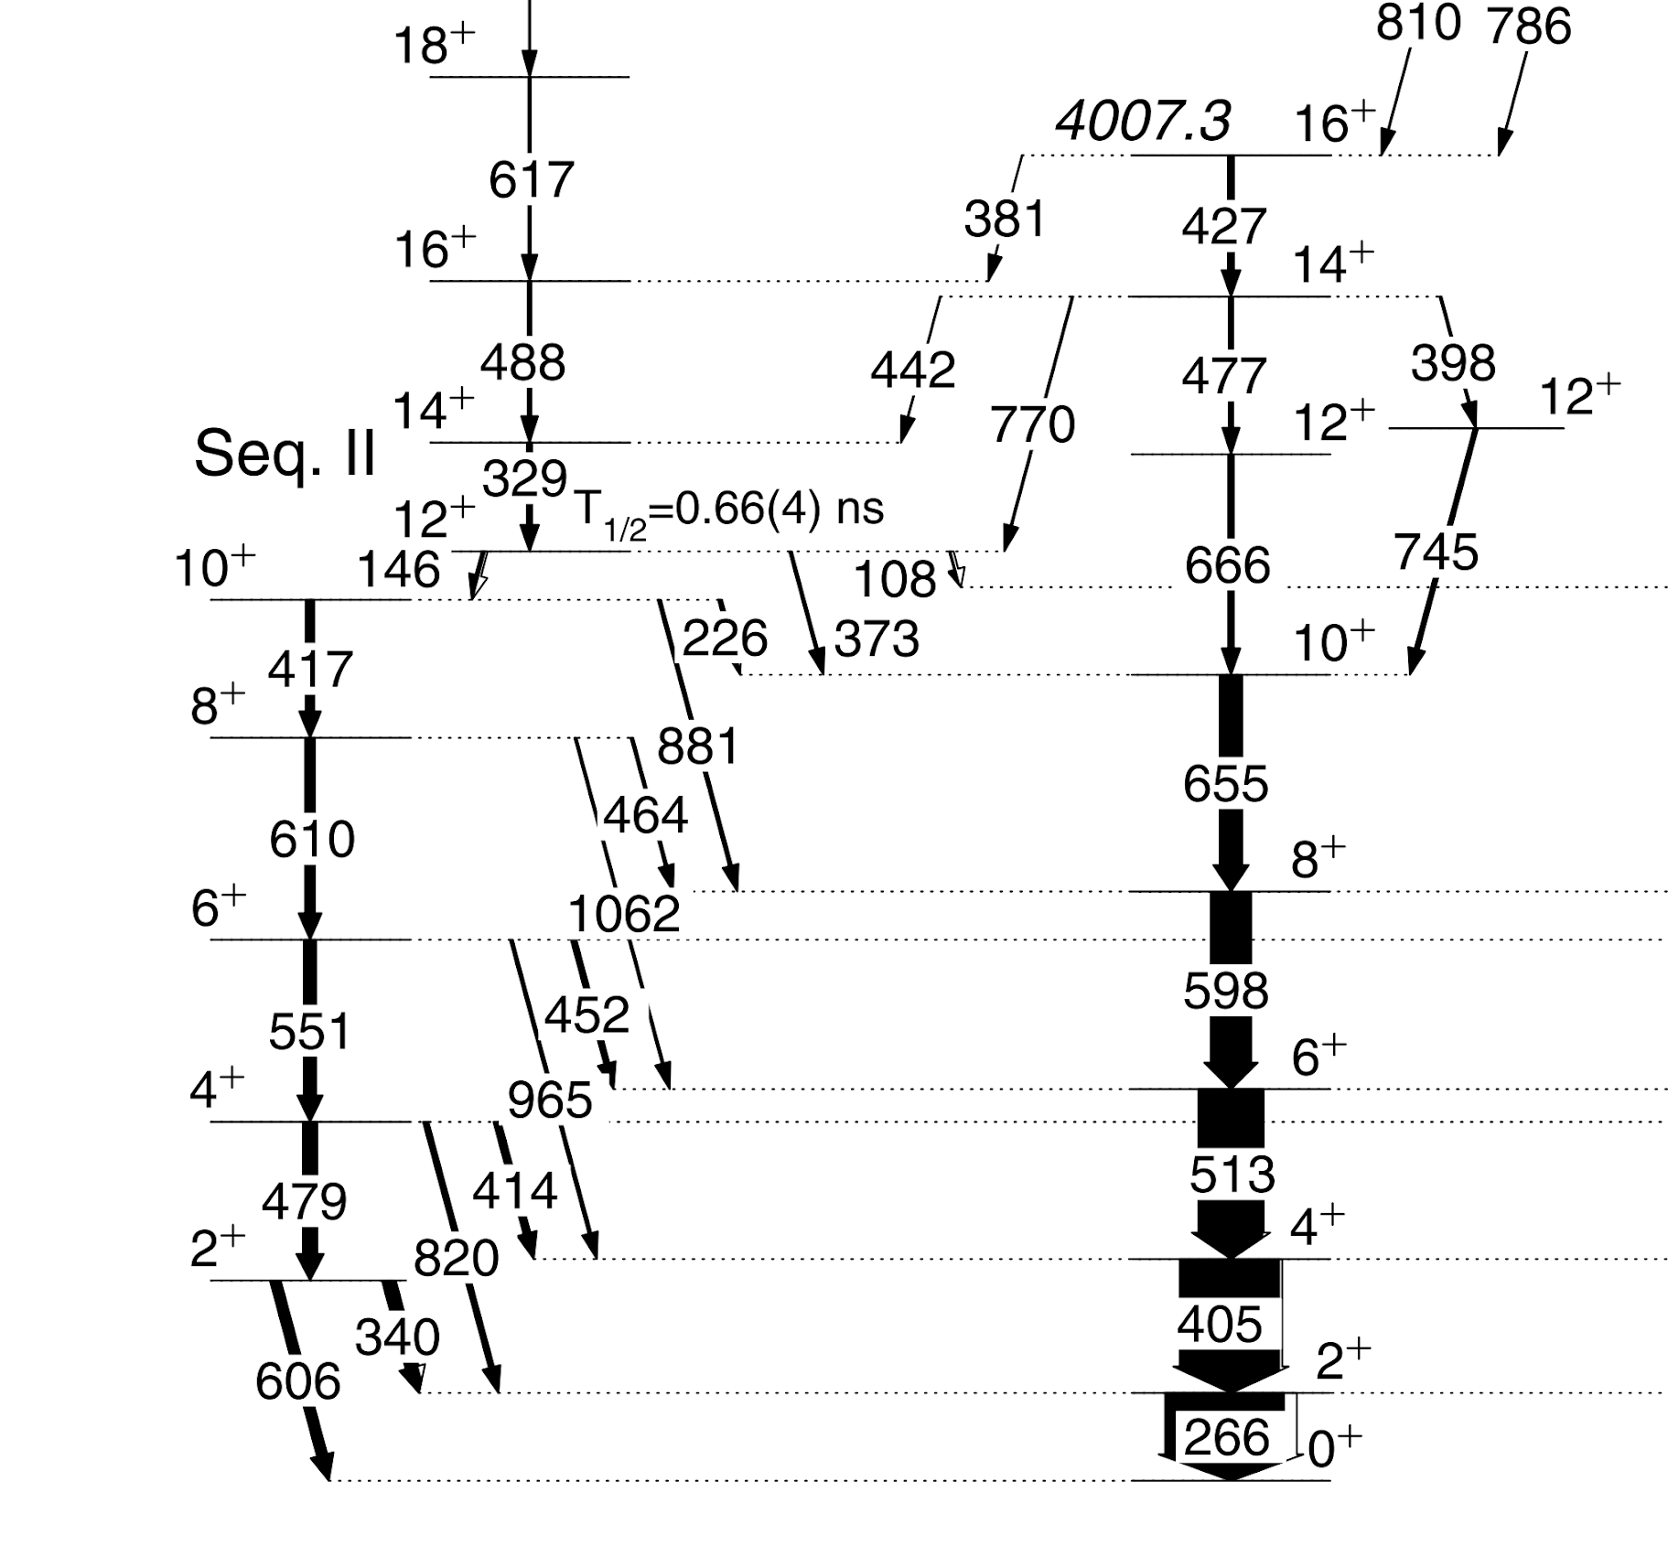
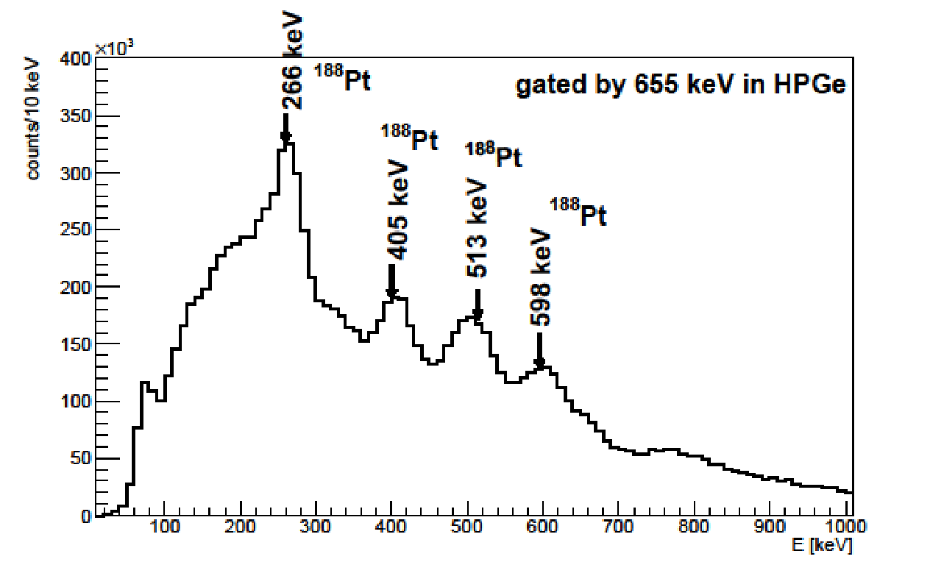
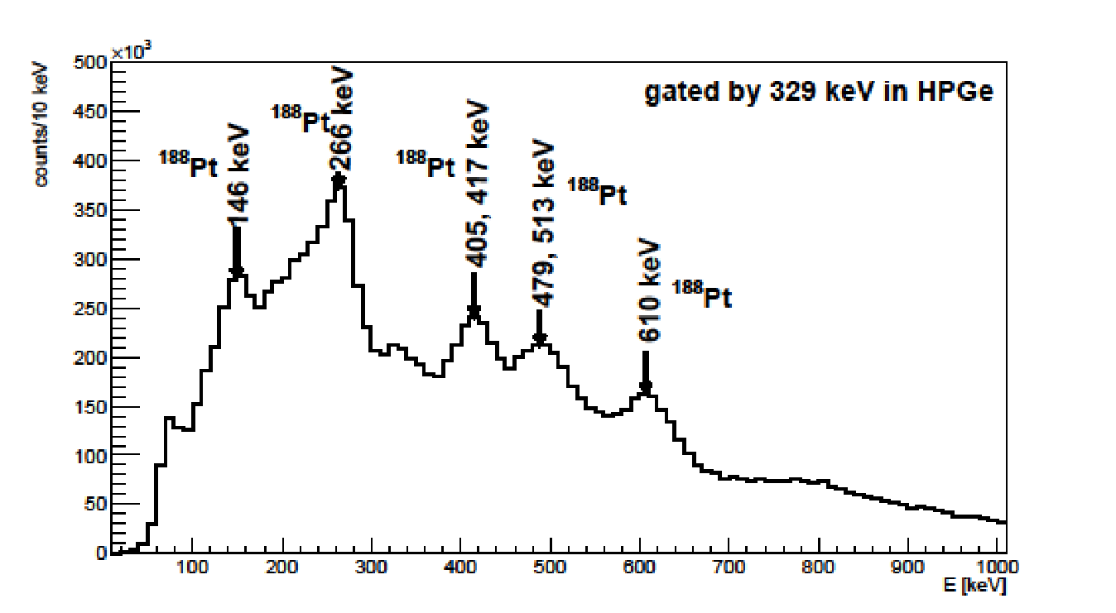
selection prolate / triaxial band
¹⁸⁸Pt
655 keV
329 keV
PARIS low energy spectra

Slide 17
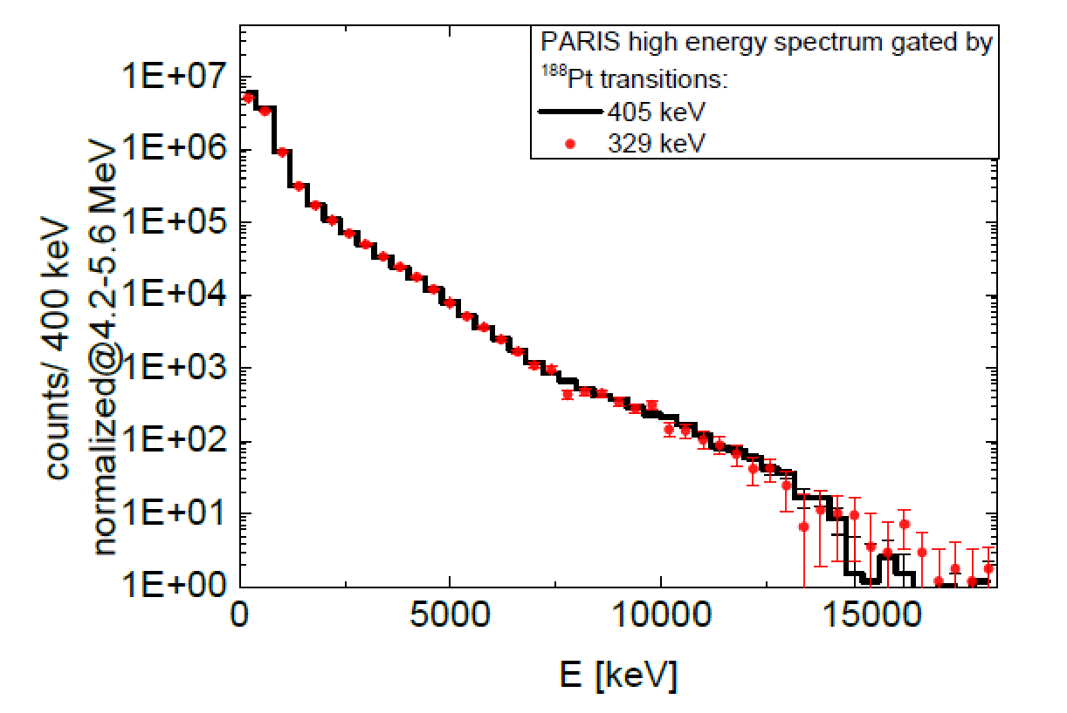
high-energy γ rays
¹⁸⁸Pt
GDR spectra from the CN decay to various residual states – very similar
PARIS high energy spectra

Slide 18
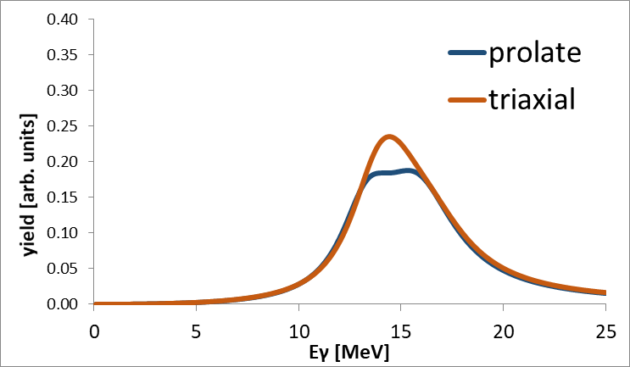
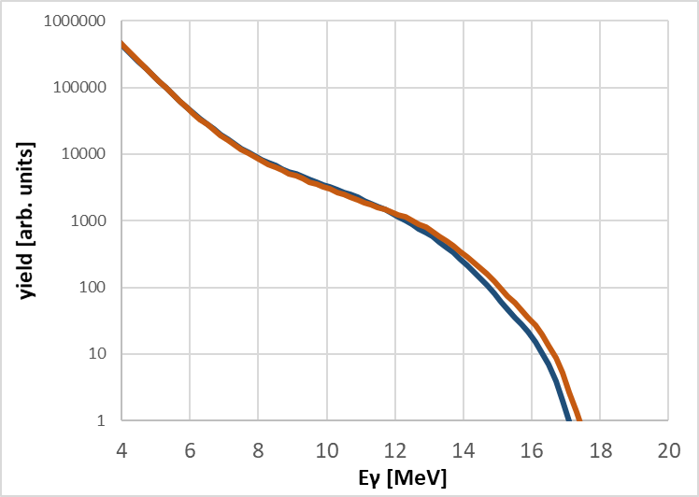
Analysis – Statistical model – GEMINI++
The GEMINI++ Monte Carlo statistical code by R.J. Charity, Phys. Rev. C82, 014610 (2010)
with added GDR Decay M. Ciemała et al. Acta Phys. Pol. B44, 611 (2013)
Used in the analysis by example in: M. Ciemala et al. Phys. Rev. C91, 054313 (2015)
β=0.16 and γ=−40°
triaxial
β =0.18 and γ=−6°
near prolate

Slide 19
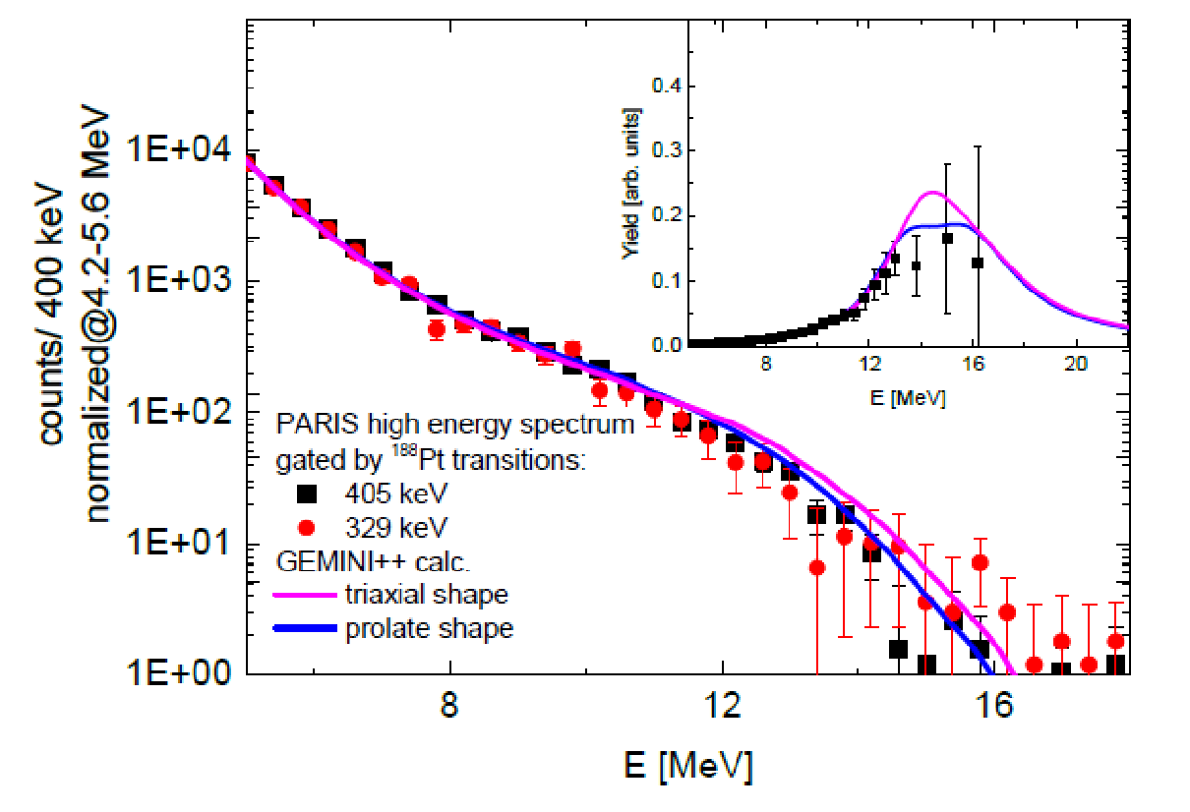
Comparison to statistical model
Better agreement to experimental data is seen for the calculations assuming prolate-like shape
of the nucleus.
Suggestion that either:
the assignment of the triaxial deformation for 12+ isomer is wrong
or
the nucleus does not preserve the shape during the decay.
M. Ciemała et al., Acta Phys. Pol B Proc. Suppl. 16, 4-A3 (2023)

Slide 20
PARIS coupled to Nuball2

Slide 21

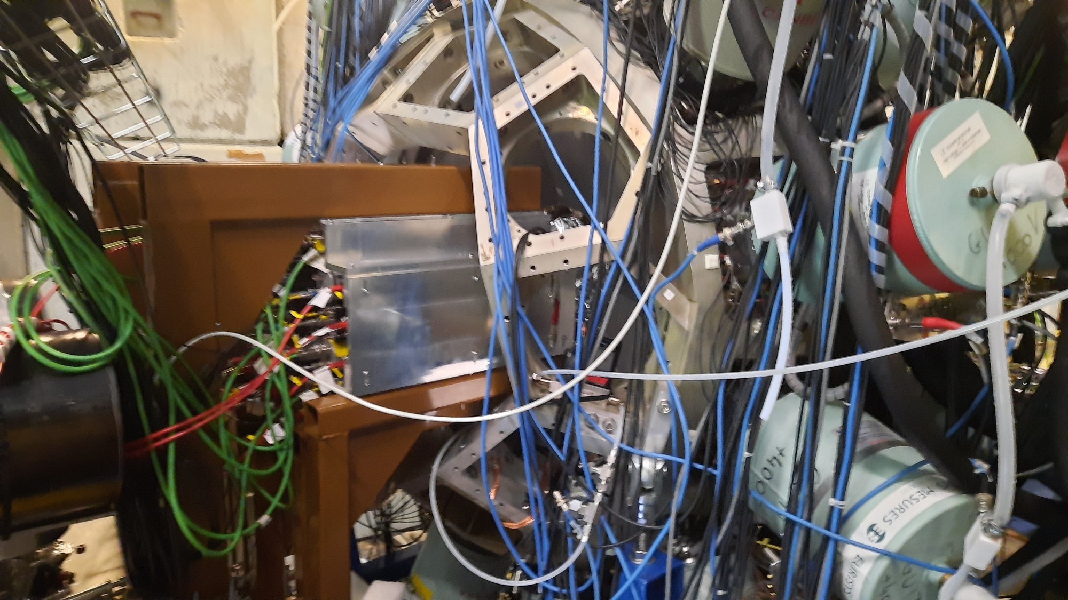
The PARIS + NuBall2 experiments
from November 2022 to June 2023

Slide 22
PARIS + NuBall2 experiments
2022 List of experiments:
N-SI-122, November 2022: M. Ciemała et al. “Links between ⁸⁰Sr compound nucleus’ shape and its residue’s deformation studied with the GDR”
2023 List of experiments:
N-SI-129, January 2023: J. Wilson et al. “Detailed spectroscopy of fission isomers in Uranium isotopes”
N-SI-131, January 2023: G. Pasqualato et al., “Evidence for enhanced collectivity in ⁵⁸Fe examined through Coulomb excitation”
N-SI-85, March/April 2023: P.J. Napiorkowski et al., „Coulomb excitation of super-deformed band in ⁴⁰Ca”
N-SI-125, March 2023: M. Lebois et al., “Neutron-gamma de-excitation of fission fragments level lifetimes in exotic neutron-rich nuclei “
N-SI-136, May 2023: J. Wilson et al. “Search for the fission shape isomer in ²³²Th”
N-SI-128, June 2023: M. Matejska-Minda et al. „Investigation of high spin structures in ⁴⁴Ti and ⁴²Ca via discrete and continuum gamma spectroscopy”
N-SI-137, June 2023: K. Hadyńska-Klęk et al, “- Emergence of the collectivity near magic nuclei: Coulomb excitation of ⁶²Ni”

Slide 23

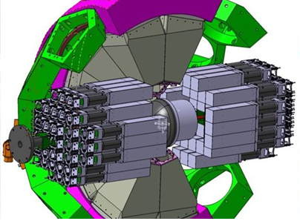
N-SI-122: Links between ⁸⁰Sr compound nucleus’ shape and its residue’s deformation studied with the GDR using Nu-Ball2+PARIS
Spokesperson: M.C.
Study:
links between deformation of hot compound nucleus ⁸⁰Sr and different deformation of the final state of the ⁷⁶Kr residues;
population of states of different deformation fed by high-energy γ–rays from GDR decay.
By measurement of high-energy gamma rays from the GDR decay in hot ⁸⁰Sr compound nucleus by PARIS array (in wall geometry) in coincidence with discrete gamma transitions in ⁷⁶Kr evaporation residue by nu-Ball2 array.
PARIS@Nu-Ball
PARIS@Nu-Ball2

Slide 24
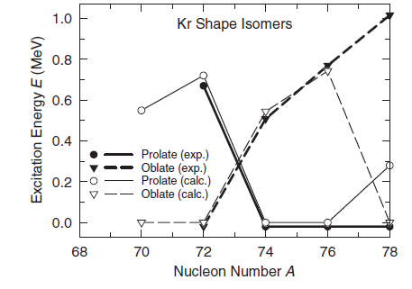
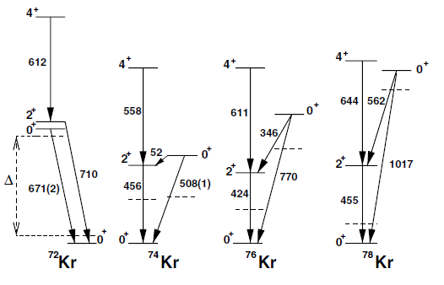


Shape coexistence ⁷²⁻⁷⁸Kr
P. Möller et al., Phys. Rev. Lett. 103, 212501 (2009)
E. Bouchez et al., Phys. Rev. Lett. 90, 082502 (2003)
oblate
11 ps
oblate
oblate
61 ps
prolate
38 ns
18.8 ns
β=0.3-0.4
oblate
prolate
prolate
prolate

Slide 25
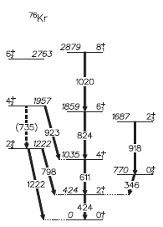
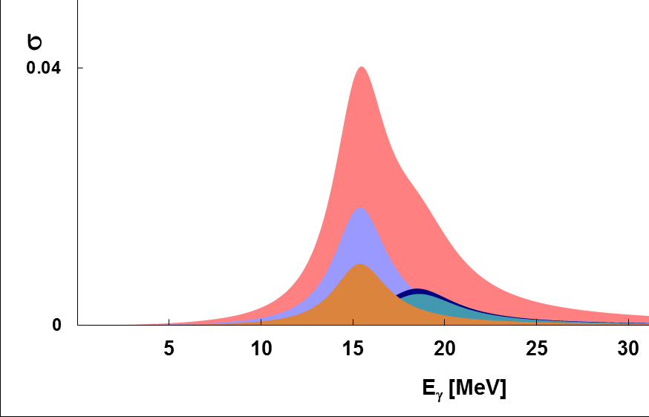
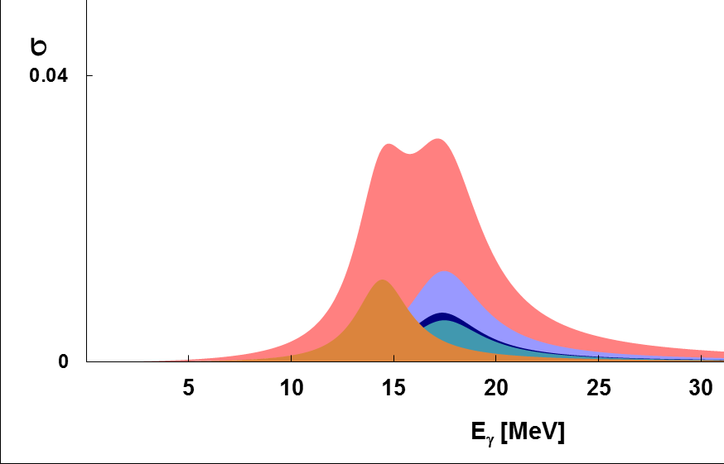
The GDR excited in ⁸⁰Sr CN
High-energy gamma rays from the GDR decay in hot ⁸⁰Sr compound nucleus
measured in coincidence with discrete gamma transitions in ⁷⁶Kr evaporation residue
GDR line-shapes
E. Clement et al., Phys. Rev. C 75, 054313 (2007)
⁷⁶Kr
oblate
prolate
result: GDR strength → nuclear shape

Slide 26
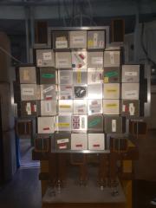
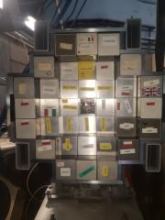
The PARIS + NuBall2 experiment
Performed
Nov 2022
Reaction:
Setup:
nu-Ball2 array: Ge detectors around 90 degrees,
~4.5% efficiency at 1MeV
2 × 36 PARIS phoswiches
3% (at 23 cm) efficiency for 15 MeV gamma rays
Measurement:
high-energy gamma rays from the GDR Decay
in hot ⁸⁰Sr compound nucleus
by PARIS array (in wall geometry)
discrete gamma transitions
in ⁷⁶Kr evaporation residue by nu-Ball2 array,
Event-by-event FOLD – (PARIS and nu-Ball2)
¹⁶O @ 95 MeV on ⁶⁴Zn → ⁸⁰Sr* → ⁷⁶Kr

Slide 27
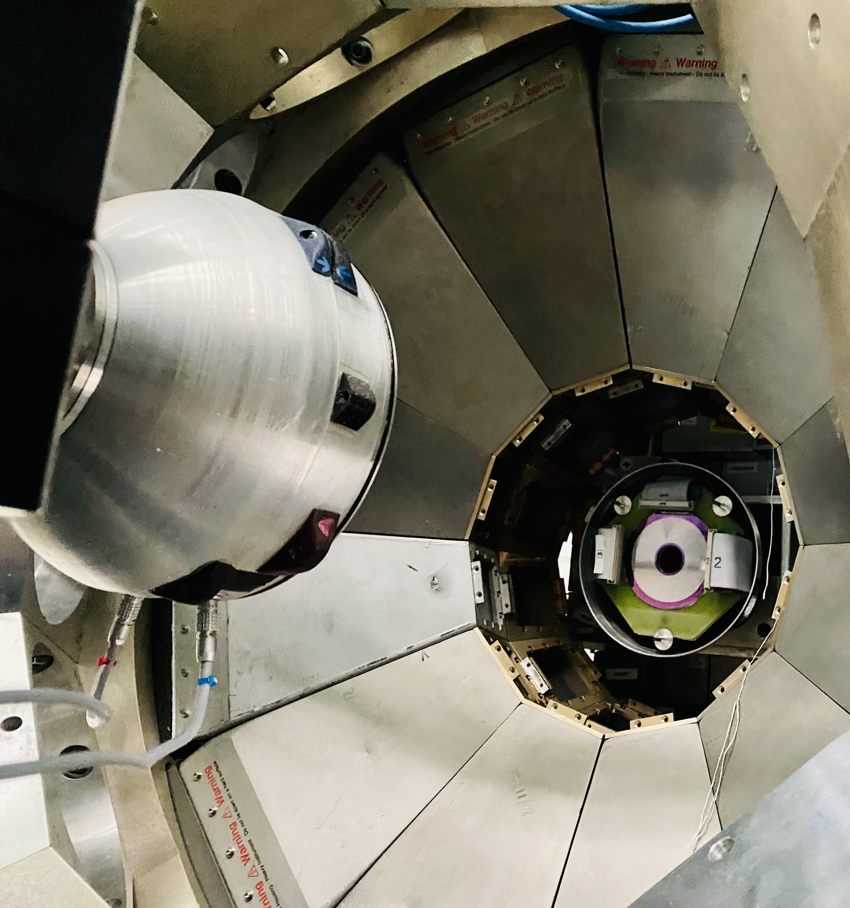
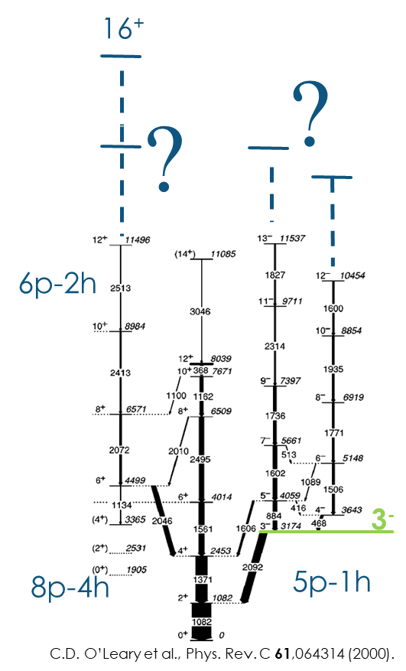
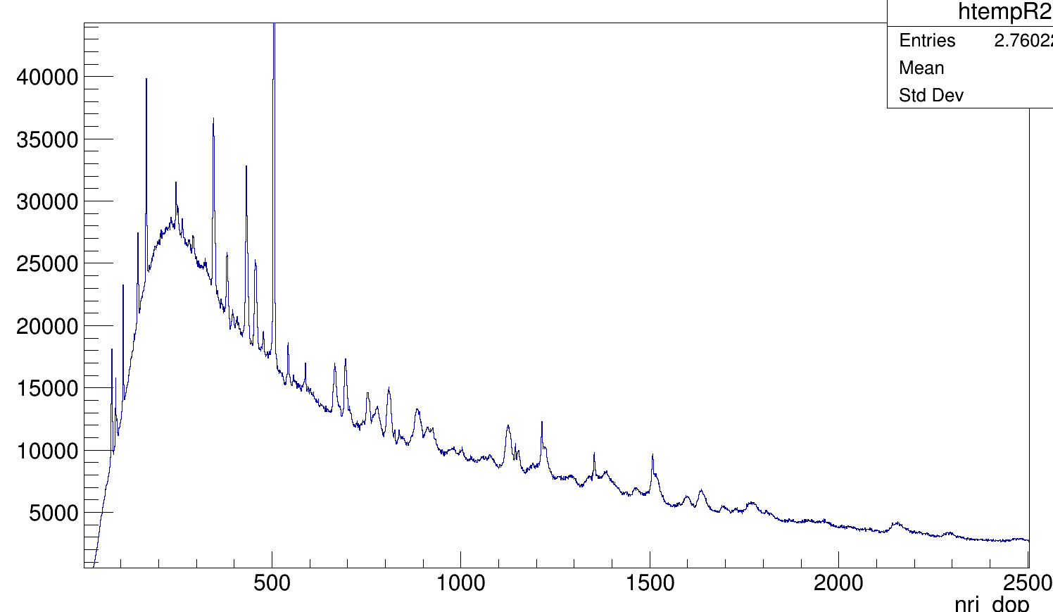
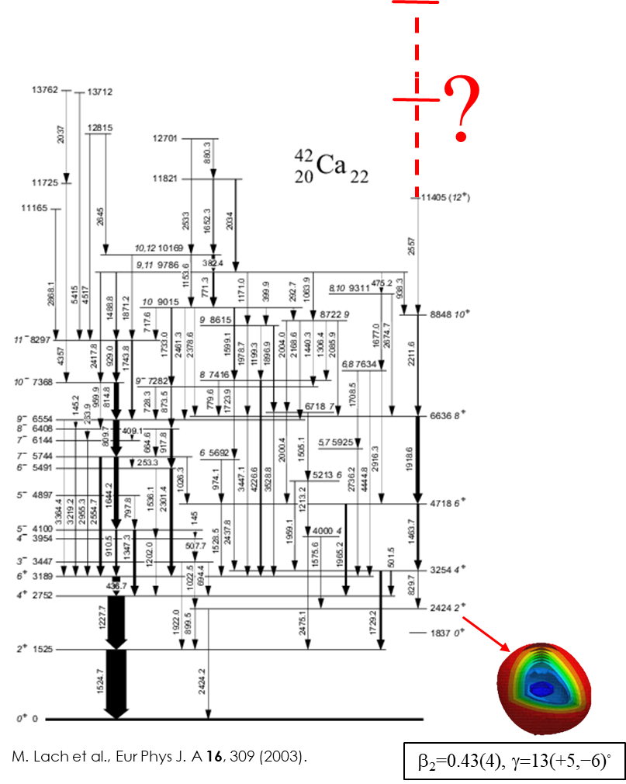

N-SI-128: Investigation of high spin structures in ⁴⁴Ti and ⁴²Ca
via discrete and continuum gamma spectroscopy
using Nu-Ball2+PARIS+Warsaw DSSD
Spokesperson: Magdalena Matejska-Minda
Performed
June 2023
The aim of the measurement:
Re-examine at high spins ⁴²Ca and ⁴⁴Ti, in order to extend the known and unknown structures up to or beyond the terminating states.
Investigating discrete and high energy gamma rays – link between deformed states (resonances) in a hot CN and yrast SD in a cold ER by coincident measurement of continuum and discrete gamma-rays.

Slide 28
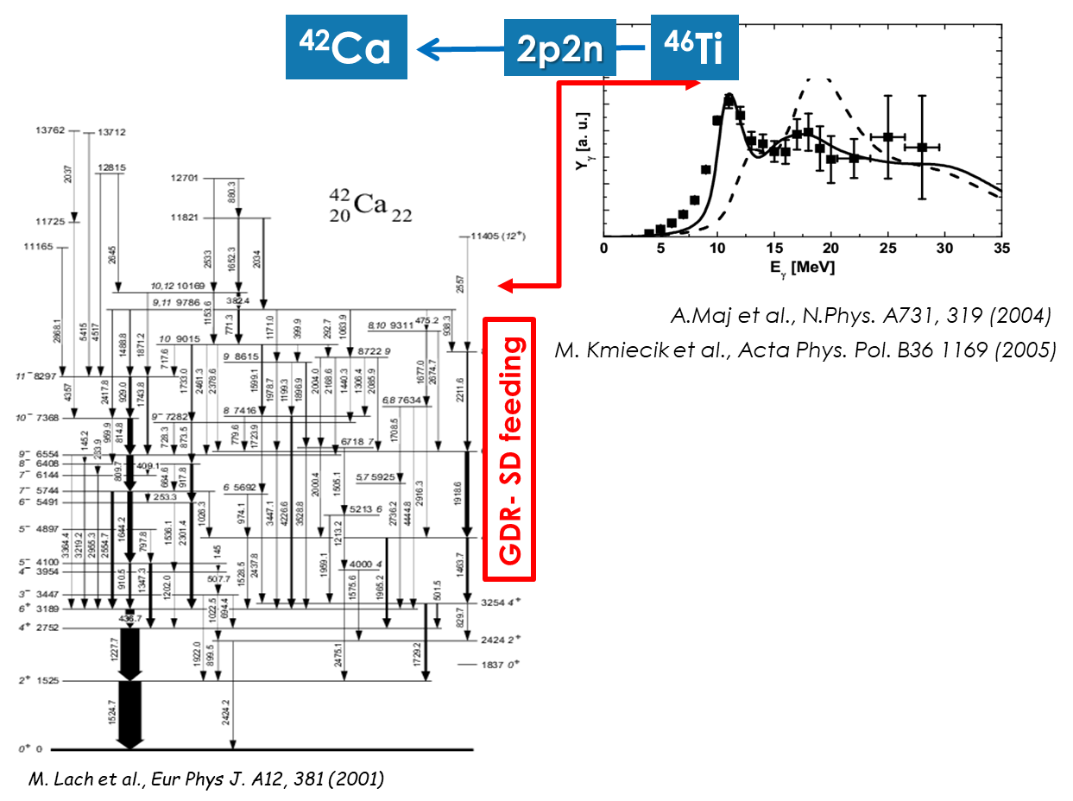
N-SI-128: Investigation of high spin structures in ⁴⁴Ti and ⁴²Ca
via discrete and continuum gamma spectroscopy
using Nu-Ball2+PARIS+Warsaw DSSD
Survival of large deformation of ⁴⁶Ti
The low energy GDR component ~10MeV seems to feed preferentially the highly-deformed band in ⁴²Ca
This suggest that very deformed shape of hot CN persist in the entire evaporation process
Investigating discrete and high energy gamma rays – link between deformed states (resonances) in a hot CN and yrast SD in a cold ER

Slide 29
Summary
Travelling detector PARIS was coupled to Nuball1 (one experiment), and for longer campaign with Nuball2 eight experiments all at IJCLab.
The PARIS + nuBall experiment aiming to measure γ-decay of GDR from hot CN (¹⁹²Pt) in coincidence with discrete transitions from residues (¹⁸⁸Pt).
Both data sets: of GDR measured in coincidence with residues characterized by near prolate and triaxial show very similar behavior. Data analyzed using statistical model GEMINI++ code show better agreement for the calculations assuming prolate-like shape of the nucleus. This might suggest either that shape of the nucleus is not always preserved during the decay, or wrong experimental assignment of the tri axial deformation of the 12+ isomer.
During Nuball2+PARIS campaign two related experiments were conducted. Study of shape evolution from hot ⁸⁰Sr compound nucleus to states of various deformation in ⁷⁶Kr evaporation residue and investigation of high spin structures in ⁴⁴Ti and ⁴²Ca via discrete and continuum gamma spectroscopy. Both providing datasets collected with more efficient experimental setup nuBall2+PARIS (with 72 PARIS detectors).

Slide 30
Acknowledgements
A. Maj, M. Kmiecik, B. Fornal, P. Bednarczyk, N. Cieplicka-Oryńczak, I. Dedes,
Ł.W. Iskra, M. Matejska-Minda, K. Mazurek, B. Wasilewska, M. Ziębliński; IFJ PAN, Krakow, Poland;
J. Wilson, I. Matea, M. Lebois, C. Hiver, G. Pasqualato; IJCLab Orsay, France;
F.C.L. Crespi, A. Bracco, F. Camera, S. Leoni, B. Million, O. Wieland, S. Brambilla; INFN Milano and Milano University, Italy;
P.J. Napiorkowski, K. Hadyńska-Klęk, M. Kicińska-Habior; Warsaw University, Poland;
O. Stezowski; IP2I Lyon, France;
M. Lewitowicz; GANIL, France;
O. Dorvaux, Ch. Schmitt, J. Dudek, S. Kihel; IPHC Strasbourg, France;
D. Jenkins; University of York, UK;
W. Catford; University of Surrey, UK;
M. Stanoiu, S. Calinescu, C. Petrone, F. Rotaru; IFIN-HH, Bucharest, Romania;
S. Erturk; Nigde University, Turkey;
J. Gerl; GSI Darmstadt, Germany;
I. Mazumdar, V. Nanal; TIFR Mumbai, India;
The Nuabll1/Nuabll2 and PARIS collaboration
Partial financial support by EURO-LABS, COPIGAL, COPIN-In2P3 and EURO-LABS is acknowledged.

Slide 31

¹⁸⁸Pt possible transitions for gating
¹⁸⁸Pt not possible transitions for gating
Also 488 keV from Seq IV
Good candidates
Mixed ¹⁸⁷Pt and ¹⁸⁸Pt
Clean ¹⁸⁸Pt

